Slide 1
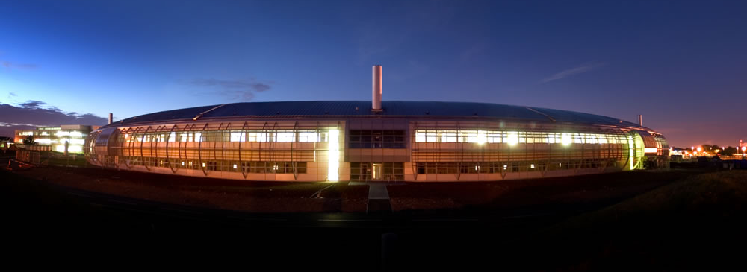
Status of the Diamond Light Source
BENI SINGH
On behalf of the Diamond Team
ESLS-XXIV Workshop
MAX-IV Lund, Sweden
28-30th November 2016

Slide 2
Talk Outline
Introduction to Diamond
Operations update
  Statistics
Two New normal conducting cavities
  LMBF
Plan for upgrades of existing IDs
DDBA commissioning
Missing Sextupole Optics
Progress with Diamond-II
Conclusions
B. Singh
ESLS XXIV, MAX-IV, (Nov 2016)

Slide 3
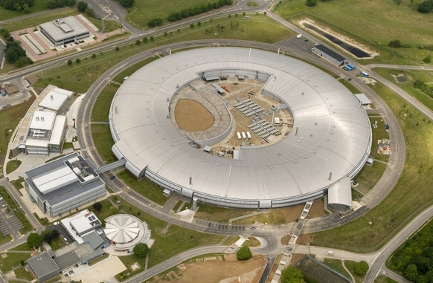
Diamond Light Source
Diamond Light Source
Diamond is the UK’s national synchrotron radiation facility
Located at Rutherford Appleton Laboratory, Oxfordshire
Construction began March 2003
Commissioning 2005 - 2006
Start of user operations Jan 2007
Lattice | DBA
Structure | 24 cell
Symmetry | 6 (broken by mini-beta cells, I21 optics and DDBA cell)
Straights | 18 × 5m / 6 × 8m
Energy | 3 GeV
Circumference | 561.571 m
H / V Tunes | 28.184 / 13.284
H / V Chromaticity | 2.0 / 2.0
H / V Emittance | 2.72 nm.rad / 8 pm.rad
Energy spread | 0.096 %
Current | 300 mA
Lifetime | >7h
B. Singh
ESLS XXIV, MAX-IV, (Nov 2016)

Slide 4
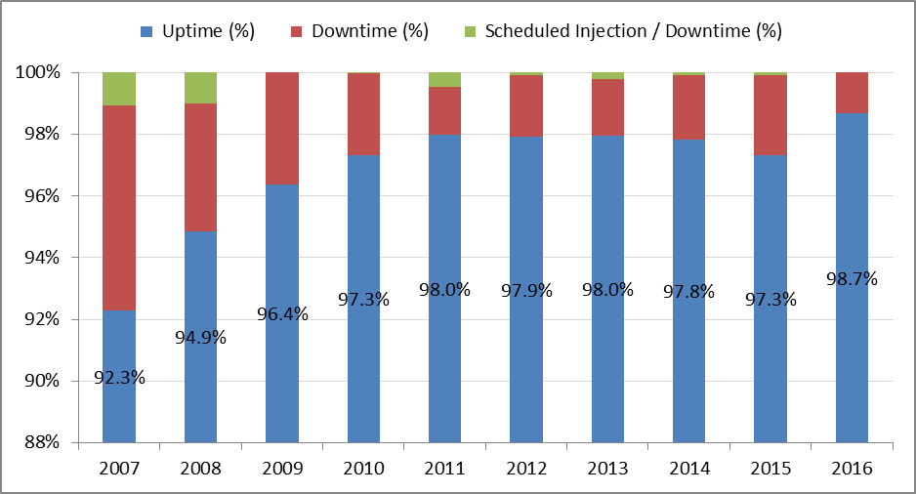
Operations Update
*
*
Allocated hours adjusted after cavity swap.
Data up to Run#4 2016
Courtesy C Bailey
B Singh
ESLS XXIV, MAX-IV, (Nov 2016)

Slide 5
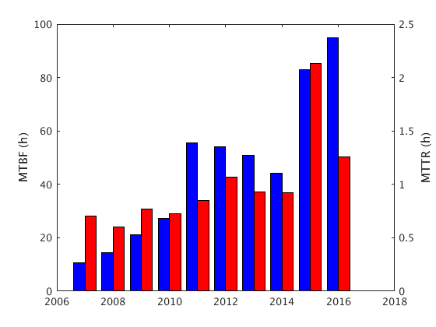
Operations Update
Currently above target >72h MTBF
Currently above target >72h MTBF (meantime between failures)
MTTR ---- meantime to recover
Courtesy C Bailey
B Singh
ESLS XXIV, MAX-IV, (Nov 2016)

Slide 6
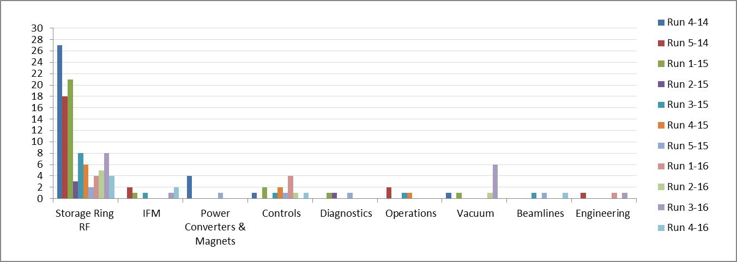
Operations Update
NUMBER OF TRIPS
Vacuum faults increase due to I12 SCW in run 3-16
Courtesy C Bailey
B Singh
ESLS XXIV, MAX-IV, (Nov 2016)

Slide 7
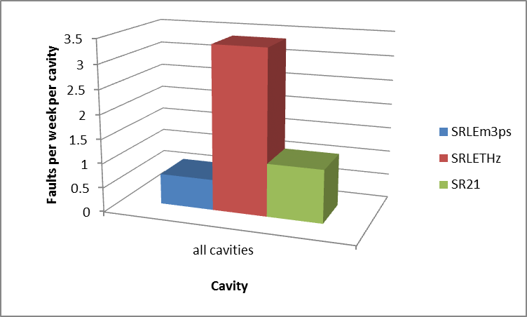
Fast Vacuum Trips
Low alpha operation requires high cavity voltage: generally 1.7MV per cavity
Usually one or two weeks low alpha operation per year
Compare two low alpha modes with normal optics operating at the same voltage
SRLEm3ps
  Stable short bunch low α
  3.4MV(two cavities), 3.5ps
SRLETHz
  Bursting short bunch low α
  3.4MV (two cavities) , 3.5ps
SR21
  Normal operation at high V
  1.7MV(single cavity), 16ps
Bunch structure strongly influences trip rate
B Singh
ESLS XXIV, MAX-IV, (Nov 2016)

Slide 8
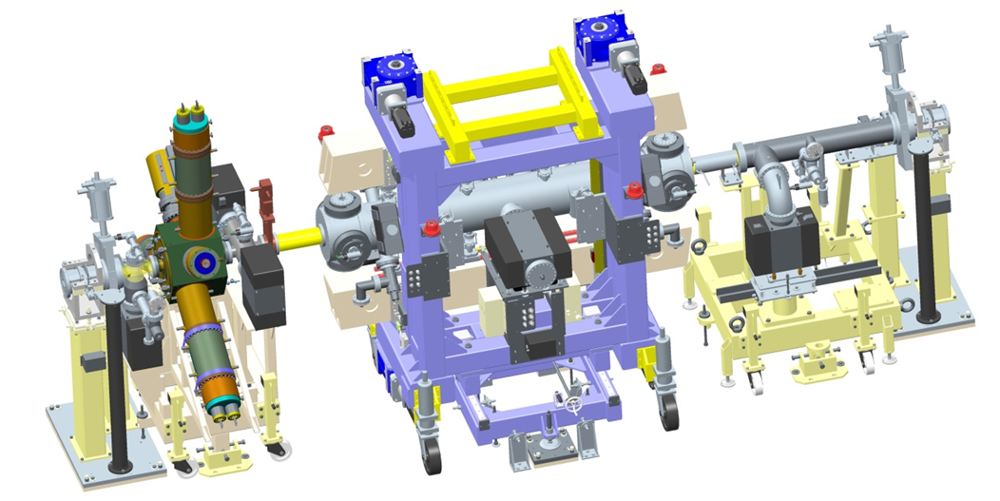
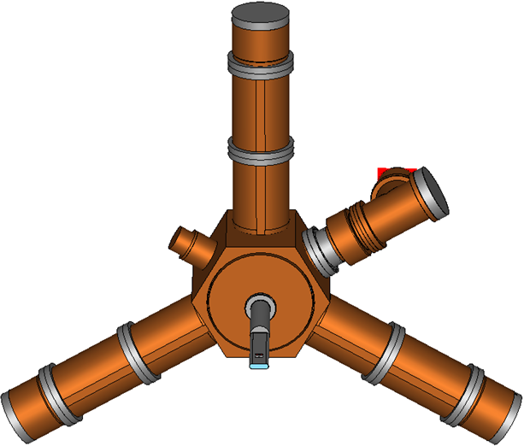
Two New Normal Conducting Cavities
Two cavities have been ordered from RI for delivery in early 2017 and planned to install same year (June?)
Will be located upstream of IDs in straights immediately before and after RF straight
Prefer not to be close to the superconducting cavities because of risk of contamination of SC cavities by gas evolved from warm NC cavities
Courtesy C Christou
B Singh
ESLS XXIV, MAX-IV, (Nov 2016)

Slide 9
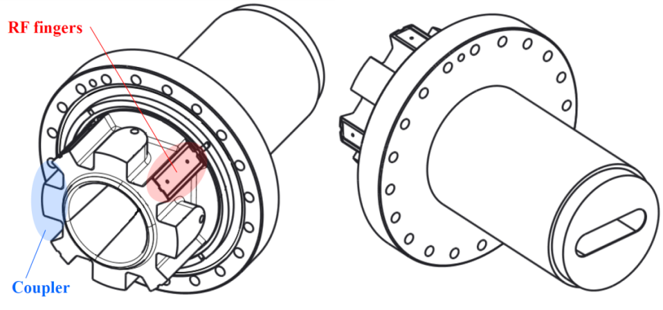
Advantages and disadvatages of NC
Power and voltage requirements on four cavities are modest
  1.0MV, 150kW on superconducting cavities
  0.3MV, 100kW on normal conducting cavities
Superconducting cavity trip rate increases rapidly with operating voltage
  Reducing voltage reduces risk of cavity trip
  Need to accommodate any combination of “safe” voltages of superconducting cavities
    1.1MV, 1.2MV, 1.4MV, 0.8MV
Possible Disadvantages
  HOM ---- longitudinal instabilities and to be cured by LMBF
  Plan to install LMBF in 2017.
Courtesy C Christou
B Singh
ESLS XXIV, MAX-IV, (Nov 2016)

Slide 10
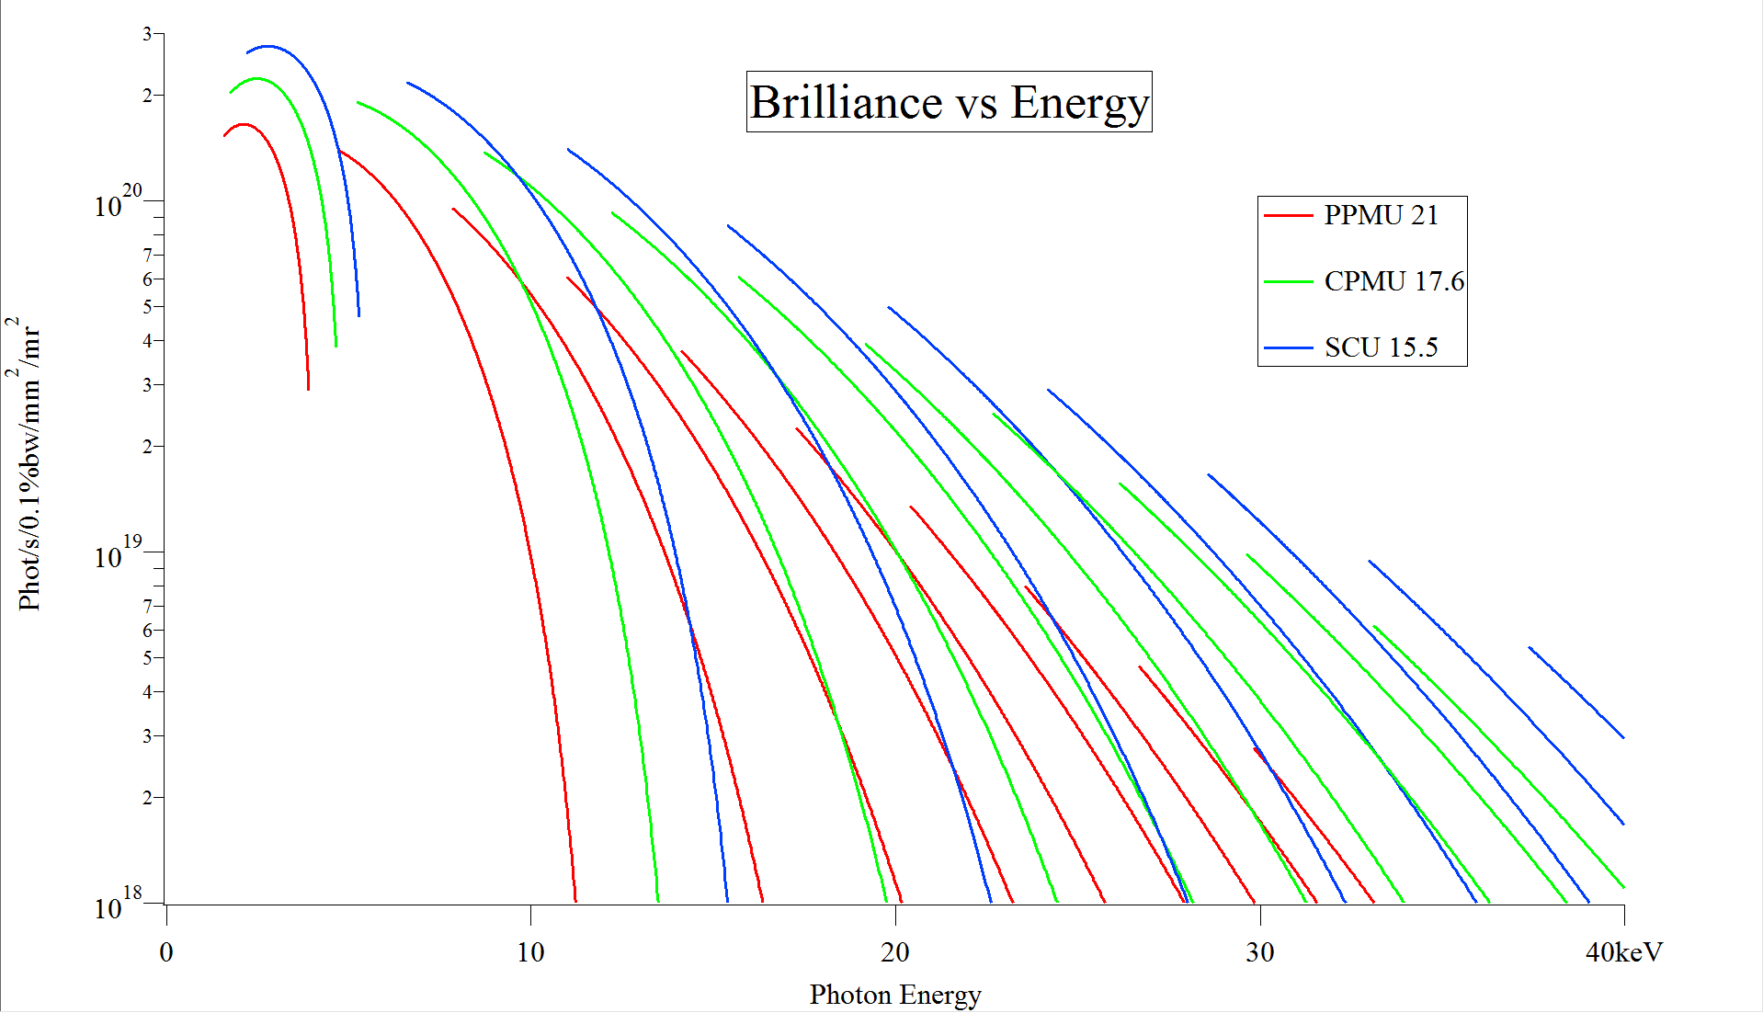
Current plans for upgrades of existing IDs
  Both technologies of CPMU and SCU are under development and will replace some of the existing IDs due to significant brightness gain over PPMU’s at higher photon energies
  2 x CPMU’s being designed – will use PrNdFeB at 77K. Install Nov. 2017 and Mar. 2018
  1 x CPMU planned for Nov. 2018 (TBC)
  1 x SCU Aug. 2018 (TBC)
Courtesy S Milward
Beni Singh
ESLS XXIV, MAX-IV (Nov 2015)

Slide 11
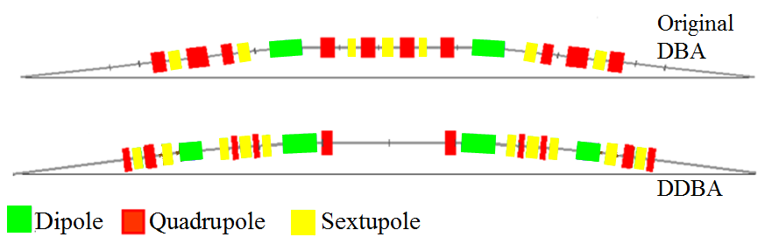
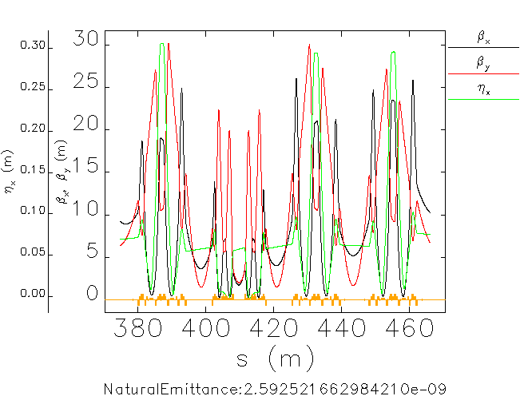
DDBA Design
existing DBA cell
BM beamline
DDBA cell
modified DDBA cell
Insertion Device
ID beamline
Introduces an additional straight section (VMX beamline 0.7 m ex-vac -> 2.0 m in-vac)
Lots of R&D required (magnet design challenging, vacuum with small apertures, engineering integration, etc.)
DDBA cell
Additional straight
Courtesy R. Bartolini
Beni Singh
ESLS XXIV, MAX-IV, (Nov 2015)

Slide 12
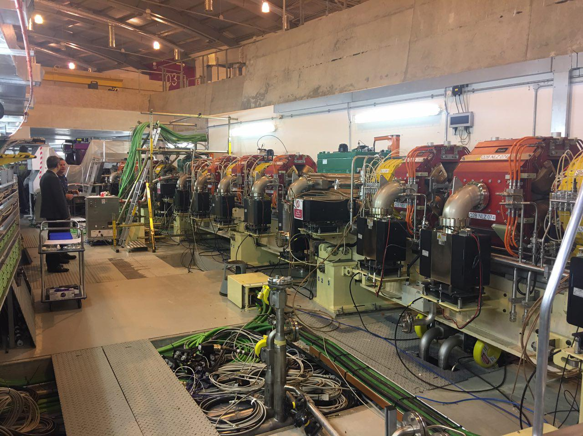
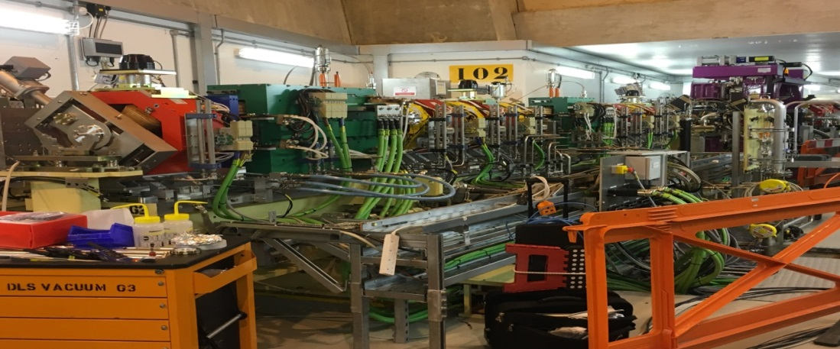
DDBA Removal and Installation
Removal of old DBA cell and installations of new DDBA cells was completed during 8 week of shutdown starting from 7th oct, 2016 after #run4
Commissioning started on 17 Nov. 2016
Process of removal of old DBA cell
One of two new installed DBA cell
Courtesy R. Bartolini
Beni Singh
ESLS XXIV, MAX-IV, (Nov 2015)

Slide 13
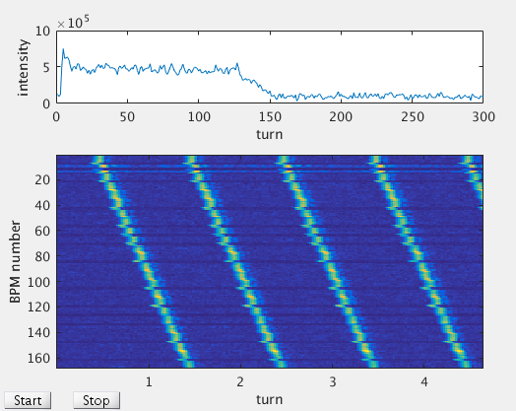
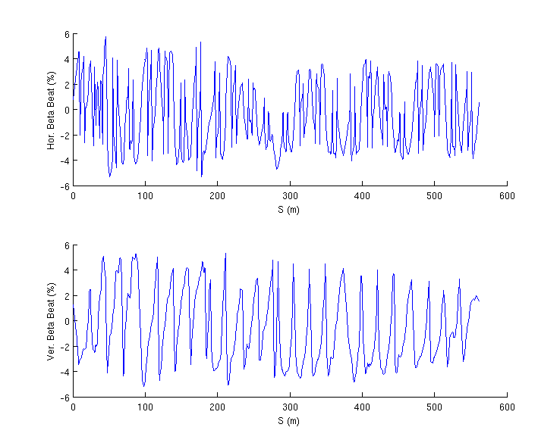
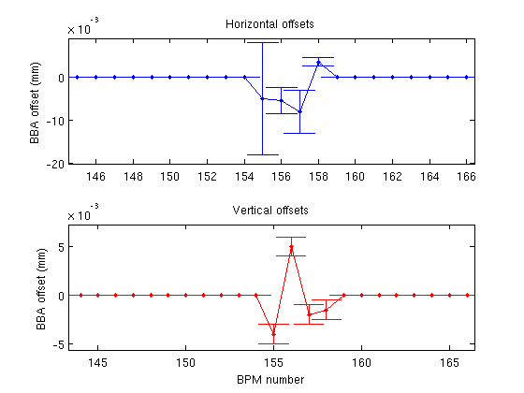
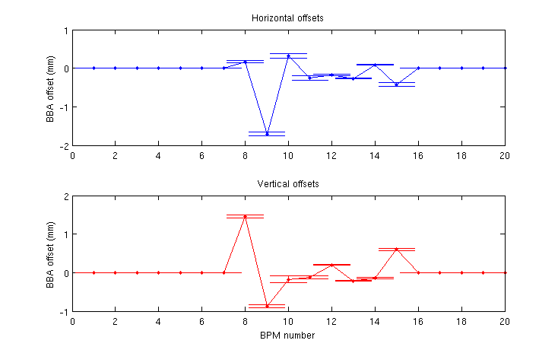
DDBA Commissioning
Started with on-axis injection burtfile created before DDBA installation
Set DDBA magnets to calculated set points from calibration
Observed more than four turns as beam injected first (RF off)
More than 100 turns after tweaking DDBA cell correctors and beam survives to next injection with RF On
Orbit errors x/y =±5mm/±1mm
Set kickers to values of off-axis injection
Accumulation just by tweaking little bit tunes but with poor injection (<10%)
BBA at 10mA
Orbit corrected to zero
LOCO --- optics set with beta-beat ~6%
On-axis injection
beta-beat (LOCO)
Final BBA
First BBA
Beni Singh
ESLS XXIV, MAX-IV, (Nov 2015)

Slide 14
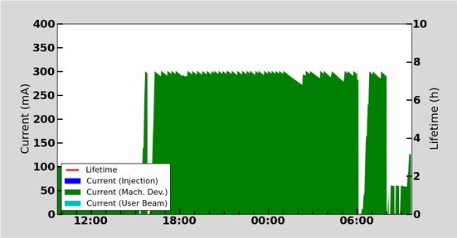
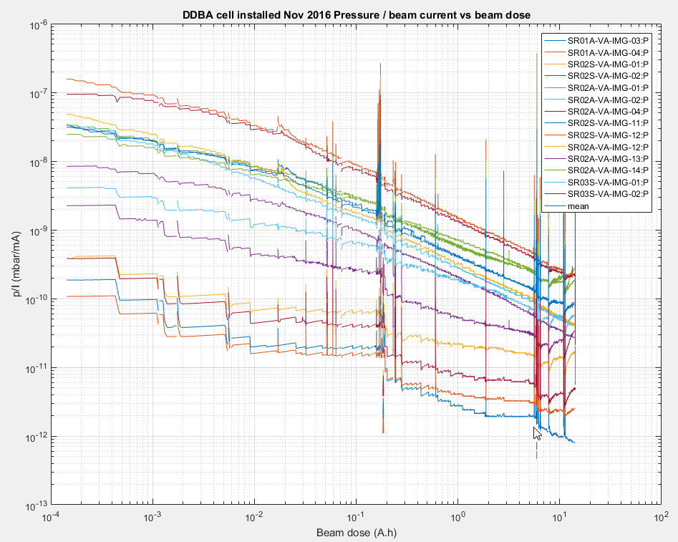
DDBA Commissioning
300mA stored current reached (normal operation)
Vacuum conditioning on going at 300mA (user mode)
All software such FOFB, SOFB,TMBF , vertical emittance control, coupling etc are working well
Vacuum conditioning over night
Status of vacuum conditioning of cell-2
Beni Singh
ESLS XXIV, MAX-IV, (Nov 2015)

Slide 15
DDBA status and future work
Operation at 300mA over night with wigglers off and IDs open
FF tables and trims of IDs are working well
Effect of IDs on injection efficiency and lifetime to be assessed
Tune scan for lifetime and inj. eff to be done with wigglers on and IDs closed to
minimum gaps
Further optimization of lifetime and inj. eff to be done using online MOGA etc.
Beni Singh
ESLS XXIV, MAX-IV, (Nov 2015)

Slide 16
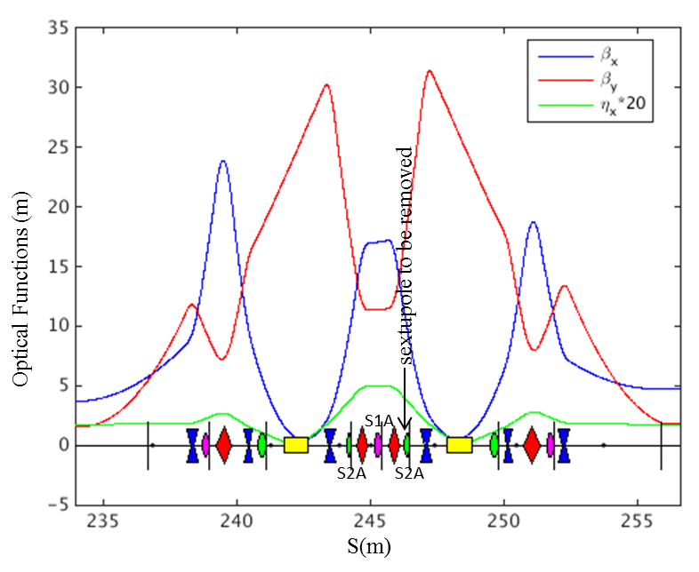
Missing Sextupole Optics for DIAD beamline
Radiation from multipole wiggler and operational by second half of 2018
Downward chromatic sextupole S2A of CELL-11 to be removed and multipole wiggler installed
Change in chromaticity are to be compensated using local S2A (mirror) and local/global S1A
Finding new solutions to nonlinear dynamics which restores DA on/off momentum (lifetime & injection efficiency) using MOGA
Proposed Chromatic sextupole S2A of cell-11 to be removed
Effects of MPW116 (B₀=1.4T, N=6, , λ=116mm and L=0.7m)
Case | Emittance ε_{x} (nm.rad) | Energy spread (σ_{E}/E) | Effective Emittance (nm.rad)
MPW116 | 2.69 | 9.586.10⁻⁴ | 4.08
Without MPW116 | 2.72 | 9.596.10⁻⁴ | 4.05
Beni Singh
ESLS XXIV, MAX-IV, (Nov 2015)

Slide 17
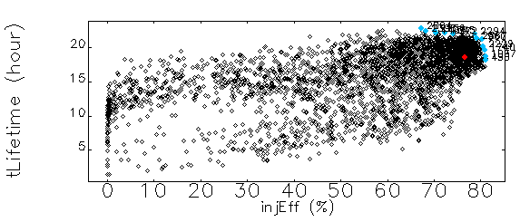
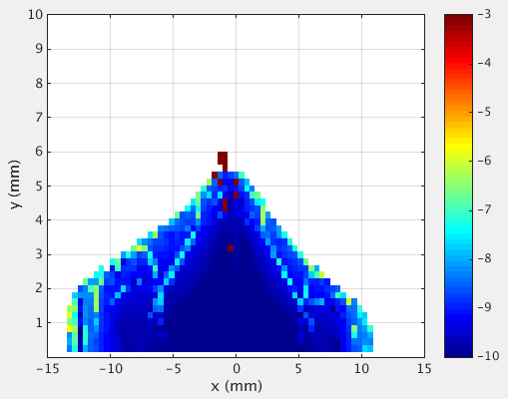
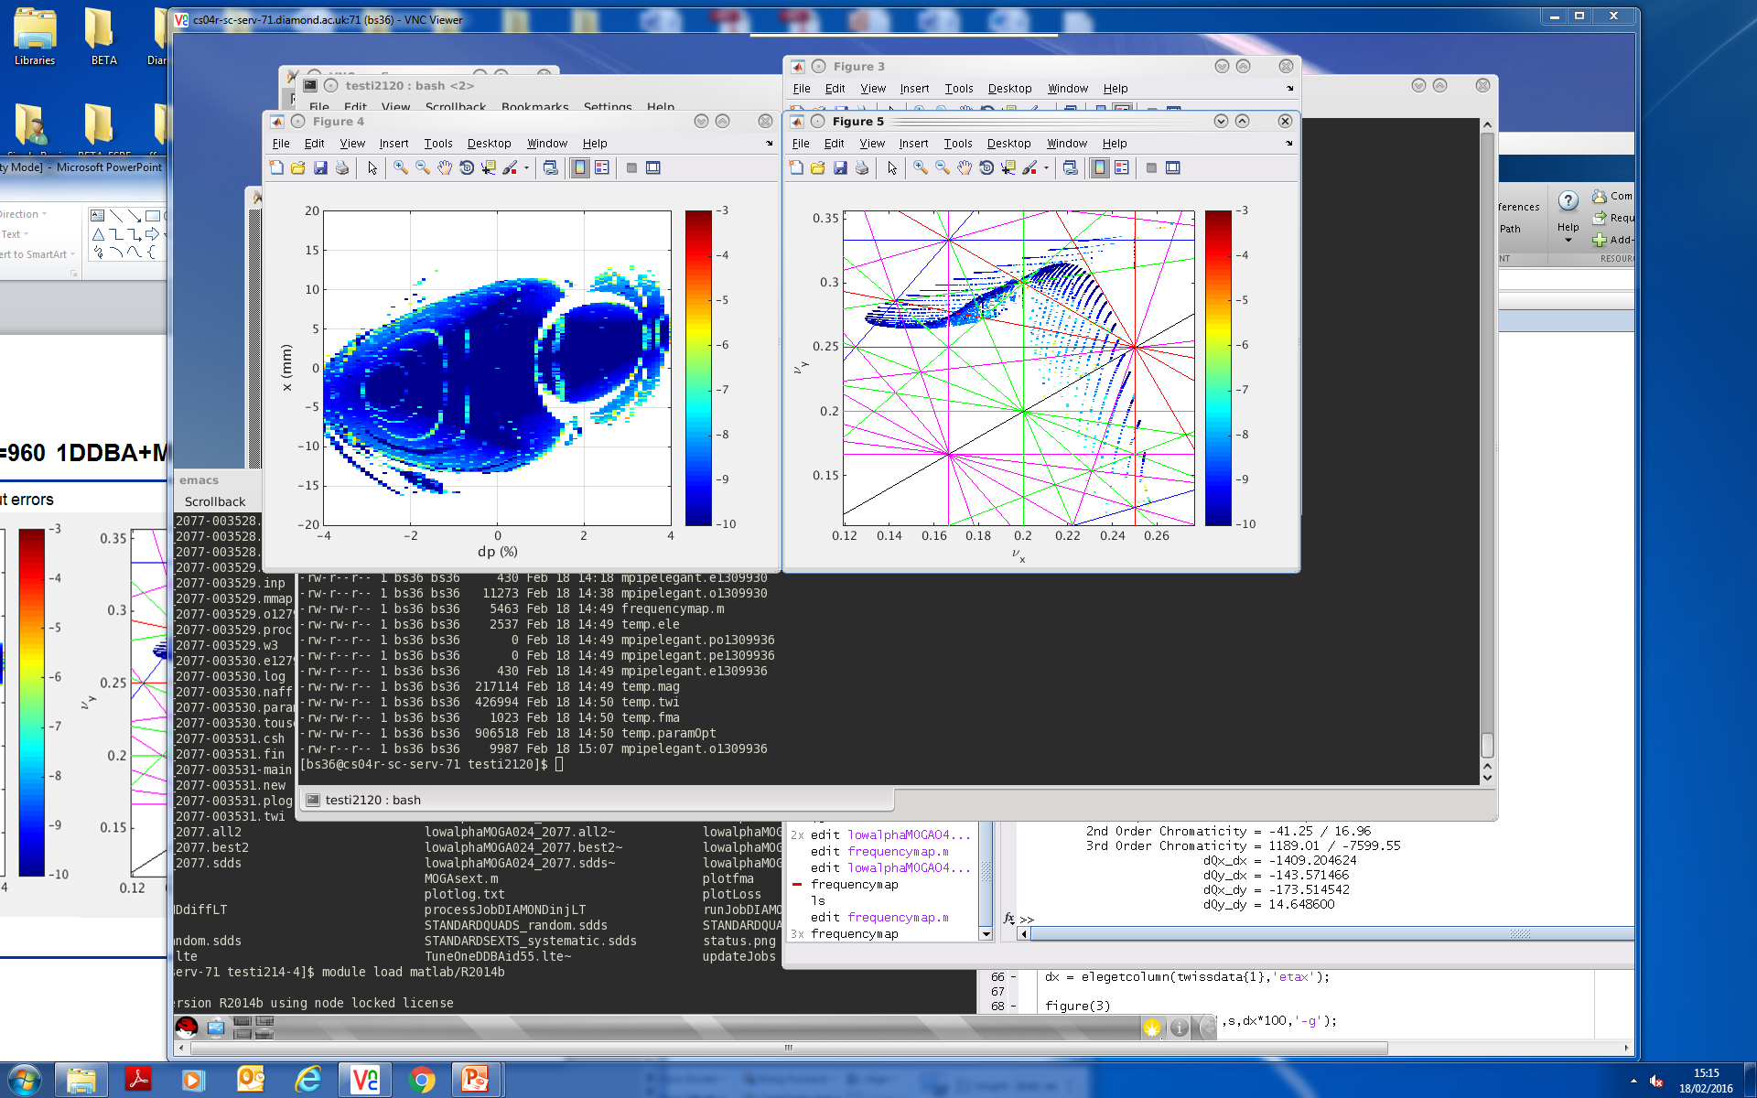
MOGA Simulations
MOGA RunID which produced best result is chosen as final solution.
Lifetime =21h , Inj. Eff. =80.3%
This solution used to simulate lifetime and inj. eff. with all errors including displacement and multipolar.
Injection at 8.3mm at injection point
MOGA Evolution
Case | Lifetime (h) | Inj.Eff. (%)
DDBA+missing sextupole | 18.8±1.7 | 82.4±4.5
DDBA only | 19.7±0.8 | 89.3±4.0
x-DA vs δp/p
DA for δp/p =0
Table: Touschek Lifetime, 3000 Turns, 900 Bunches, σ_{l}=5.34mm, V=2.6MV and Inj. Eff. for 1500 Turns and 8.3mm injection oscillations at injection point considering all displacement and multipolar errors for 50 seeds and coupling k=0.3%.
Beni Singh
ESLS XXIV, MAX-IV,(Nov 2015)

Slide 18
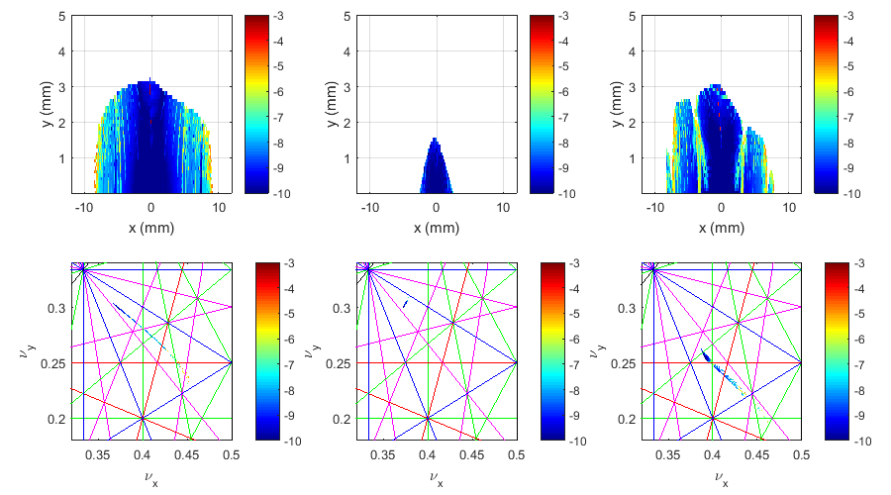
Low Alpha Mode in Missing Sextupole
Indications are that a workable lattice could be developed
Constraints:
α₁ = -1×10⁻⁵
α₂ = 0
For ideal lattice:
lifetime: 21.0 h => 20.8 h
Injection efficiency: 28.0 % => 14.5%
Assessment of error sensitivity yet to be made
Major issue is requirement for S2A[11,3]
  Required strength > 50 m⁻³
  Outside range of existing magnet/power supply capabilities
Work in progress …
DDBA only
DDBA+missing sextupole
Local chromaticity correction
DDBA+missing sextupole
MOGA optimisation
Courtesy I Martin
Beni Singh
ESLS XXIV, MAX-IV,(Nov 2015)

Slide 19
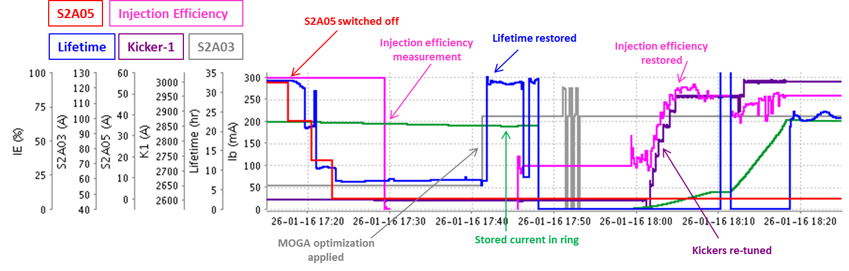
Machine Tests
Measured chromaticity=1.2/1.1 when local S2A =120A
Machine tests for the concept of missing sextupole in cell-11 in presently operational lattice (I21). A significant reduction in lifetime is observed once S2A05 (S2A[11,5]) is switched off, which restores once the MOGA optimized sextupoles are applied. The injection efficiency, once the current of kicker magnets is increased, is also restored.
Beni Singh
ESLS XXIV, MAX-IV,(Nov 2015)

Slide 20
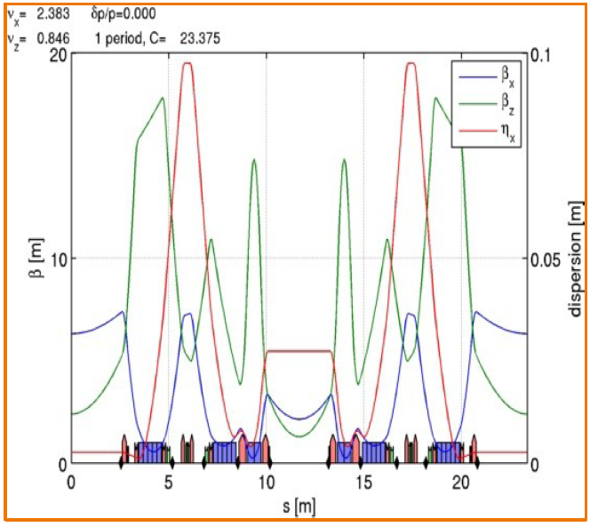
Modified 6BA Lattice ---100/140pm
Initial studies on modified 6BA design proved difficult (a simple scaling of TBA doubling the number of cells did not work)
Collaboration with ESRF: Use the ESRF cell concept (7BA with longitudinal gradient dipoles) – removing the mid dipole to make it a 6BA with a straight at the centre
This design is promising!
First analysis shows it is as good as the 4BA
Longitudinal gradient dipoles + strong gradient dipole (up to 1.4 T 40 T/m)
~3 m mid-straight section
~2mm bunch length
work in progress!
Courtesy R Bartolini

Slide 21
First Look at Engineering Integration
Initial consideration on layout, engineering integration, girders,
beamline layout, etc.
Beni Singh
ESLS XXIV, MAX-IV,(Nov 2015)
Courtesy R Bartolini

Slide 22
Conclusions
DDBA upgrade was the biggest change to the Diamond storage ring since it was commissioned in 2006 and has been successfully commissioned. No major issues noted so far.
Further Diamond-I upgrades
  Missing sextupole optics for DIAD beamline to be operational in second half of 2018
Work on Diamond-II is progressing
Thanks
Beni Singh
ESLS XXIV, MAX-IV, (Nov 2015)

