Slide 1
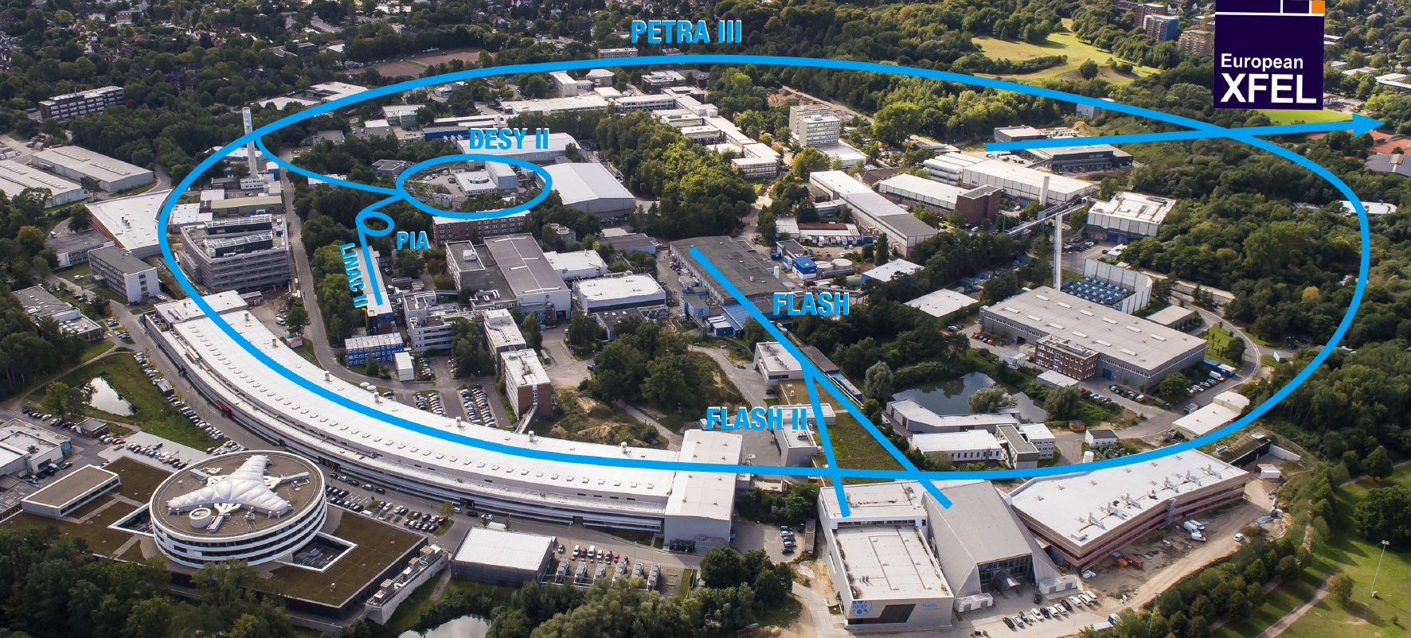
PETRA III, Status and Upgrade
M. Bieler,
for the PETRA III Team
ESLS XXIV, Lund, 30.11.2016

Slide 2
Content
PETRA III Overview
PETRA User Operation 2016
Plans for 2017
PETRA IV

Slide 3
PETRA III Overview
2.3 km circumference
6 GeV electrons
20 damping wigglers
14 (+10) undulator beamlines
1 nm rad x 10 pm rad
100 mA
TopUp operation, 1% beam current variation

Slide 4
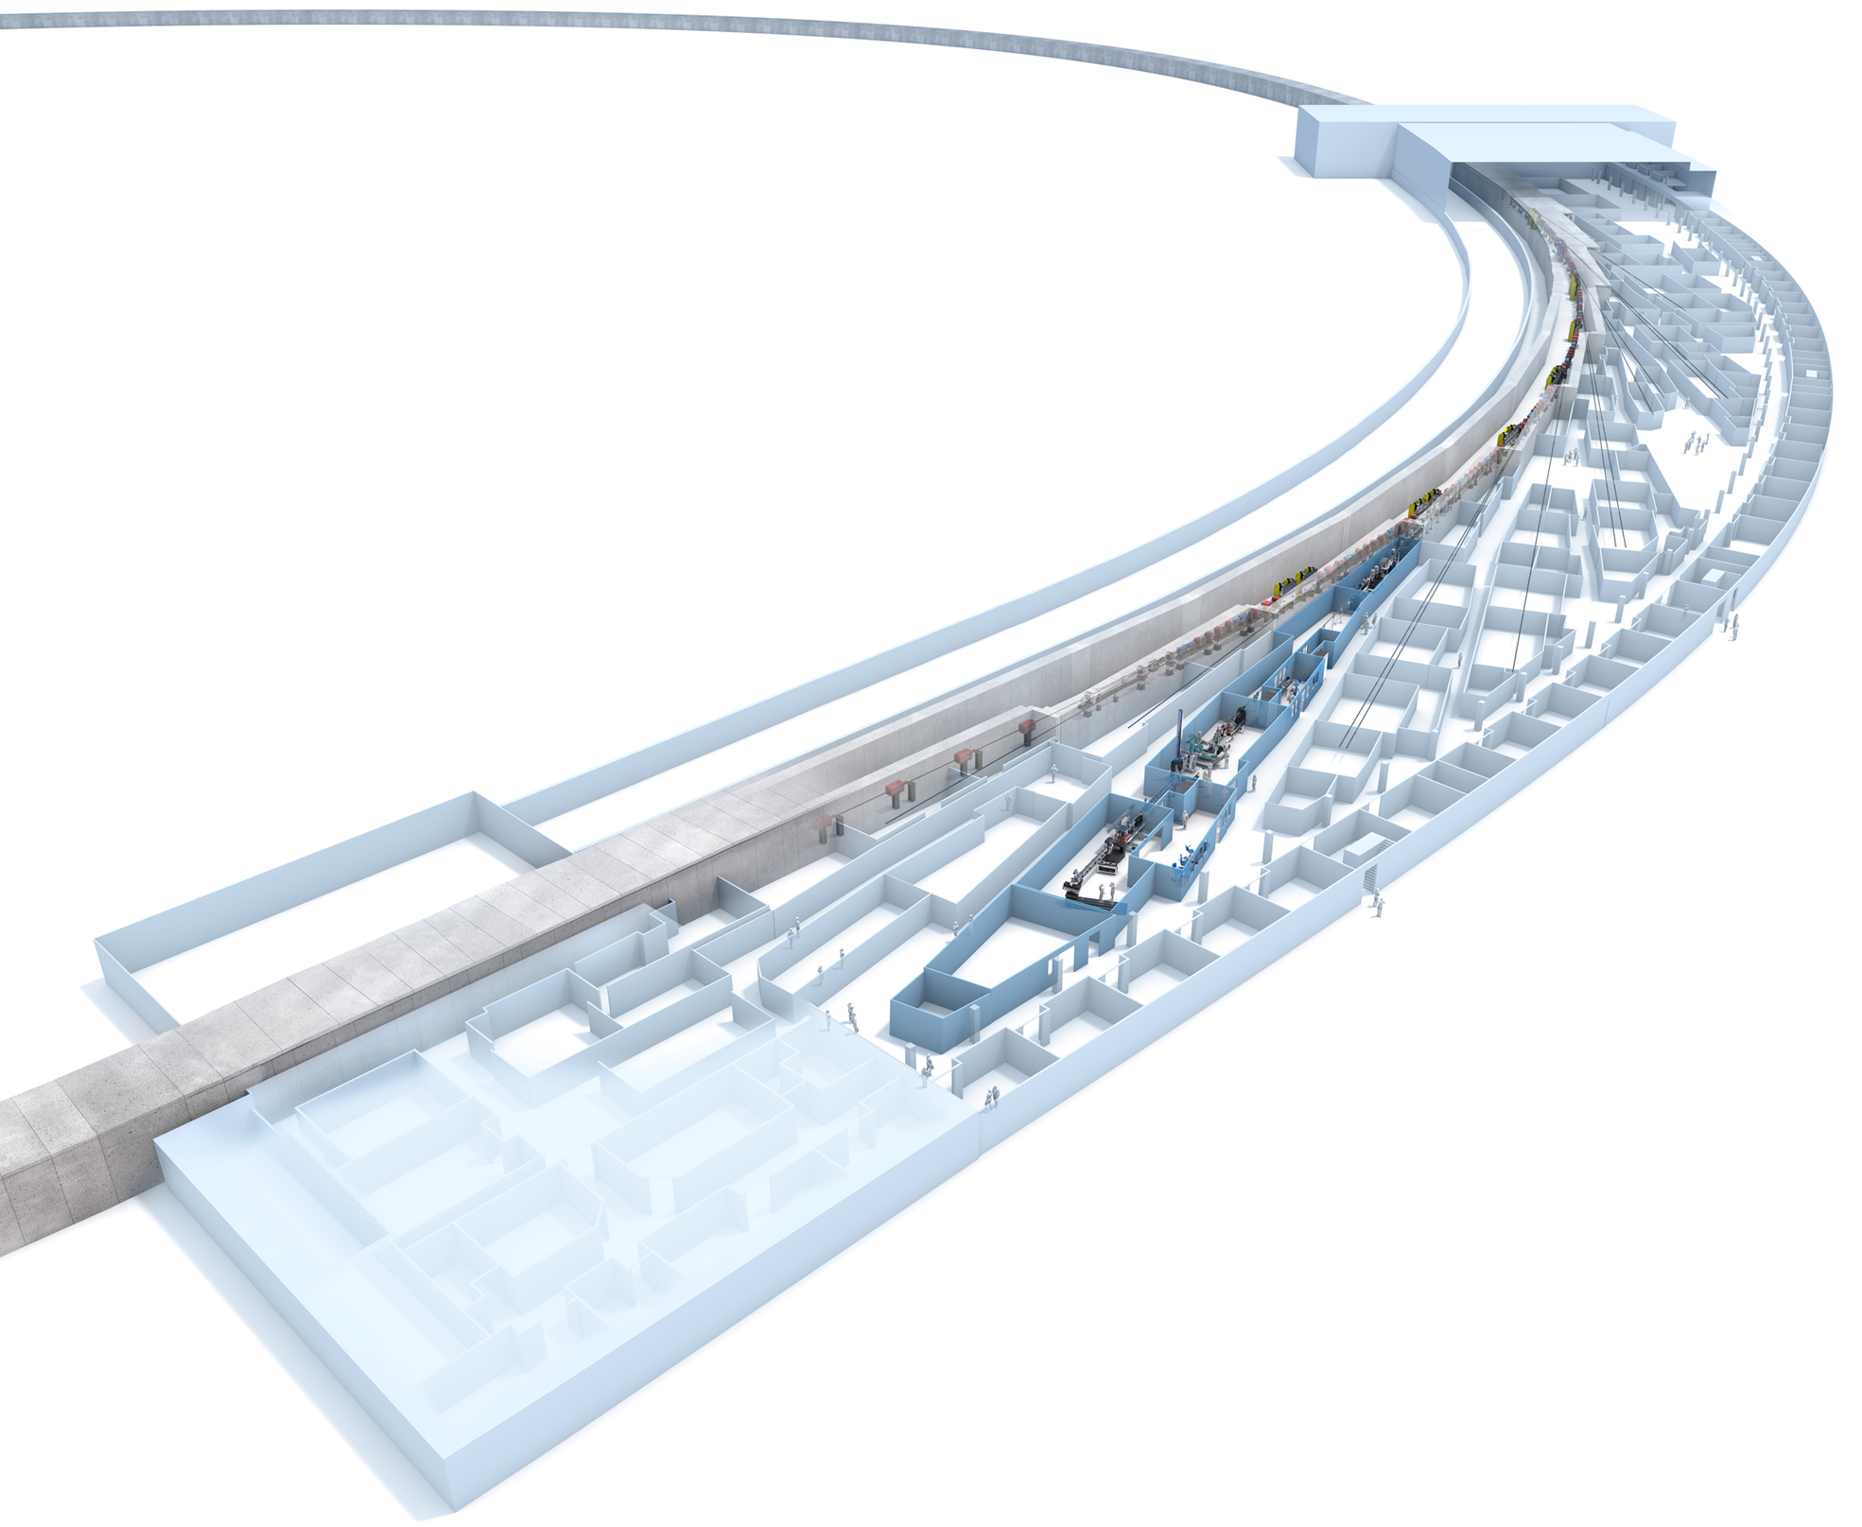
PETRA III Overview
Max von Laue Hall:
1/8 of the circumference of PETRA III
8 double bend acromat cells
14 undulator beamlines:
2 m Undulators: 11
5 m Undulators: 3 (2+1)
5 m Apple Undulator: 1

Slide 5
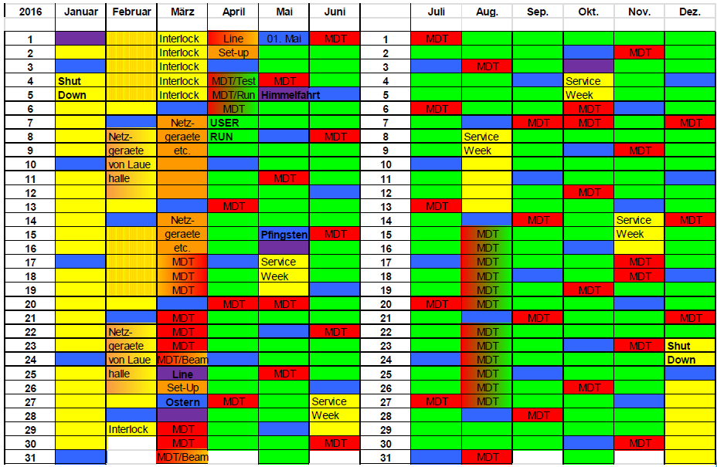
User Operation 2016
 | Service Week
 | Sunday (User Run)
 | Userrun
MDT | Machine Development
External Users from April 7 to Dec. 22.

Slide 6
User Operation 2016
User Run 2016
(as of Nov. 28th)
Scheduled time: 3881 h
48 % Timing Mode (40 or 60 Bunches)
Availability 95.9 %
5 bunch patterns:
Timing Mode
40 bunches, 192 ns
60 bunches, 128 ns
Continous Mode
240 bunches, 32 ns
480 bunches, 16 ns
960 bunches, 8 ns
23%
34%
29%
14%
0%

Slide 7
User Operation 2016
Continuous Mode, 960 Bunches:
960 bunches
8 ns
100 mA
100 µA per bunch
15 h lifetime
Timing Mode, 40 Bunches:
40 bunches
192 ns
100 mA
2.5 mA per bunch
1.5 h lifetime
Problems in Timing Mode:
HOMs in cavities
Radiation damage
Spurious bunches

Slide 8
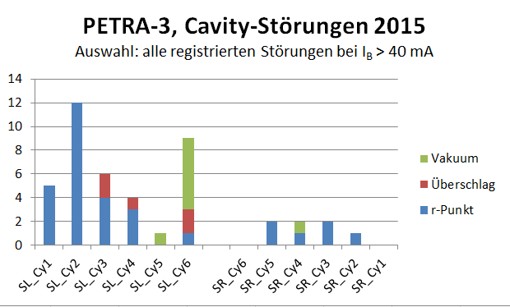
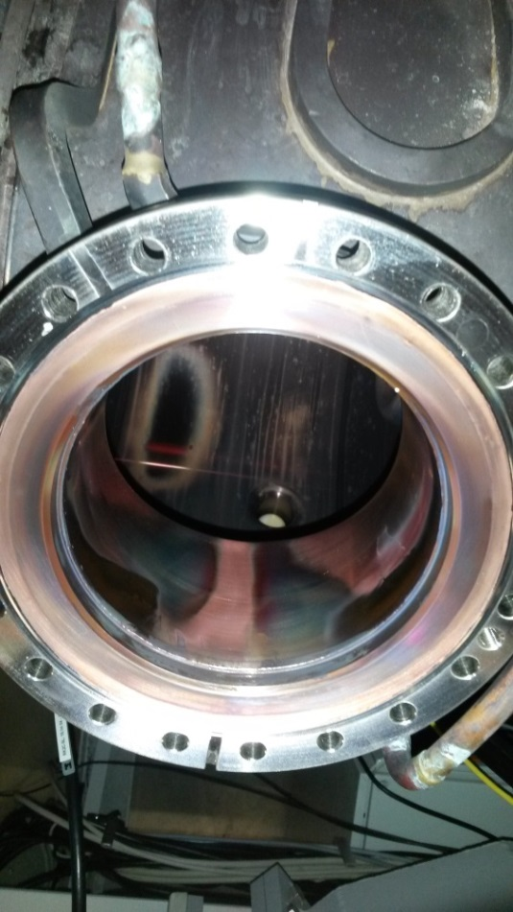
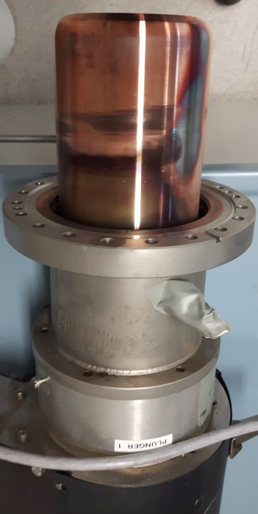
User Operation 2016
Timing Mode, 40 Bunches:
HOMs in cavities.
Main source of RF trips 2015: Reflected power.
Main contribution from cavity 2 SL.
2016:
Plungers at cavity 2 SL exchanged in August, cavity 2 SL back in operation, no more problems.
Reflected power trips mainly occur in timing mode.
March 2016:
Strong vacuum event.
Cavity 2 SL detuned, decoupled from the RF waveguide.
Since then operation with 11 of 12 cavities.

Slide 9
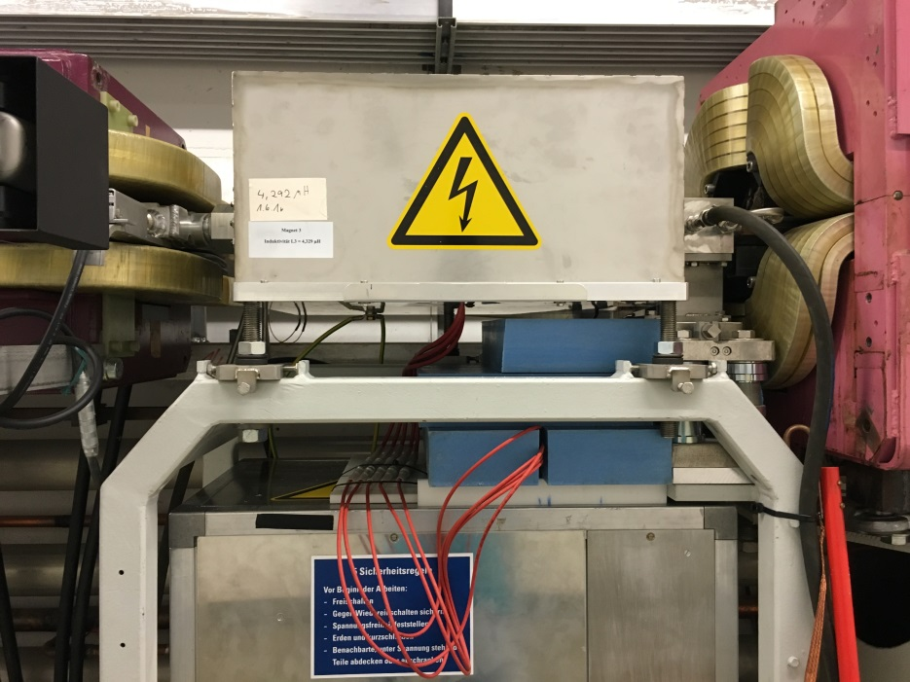
User Operation 2016
Timing Mode, 40 Bunches:
Radiation damage.
Beam life time 1.5 h,
compared to 15 h with 960 bunches.
2016:
Additional shielding against neutrons introduced, no more problems.
Radiation levels 10 times higher.
Radiation damage increases.
Single event upsets in electronics:
Spontaneous firing of an injection kicker, only in 40 bunch mode.
Beam pipe
Kicker magnet
Kicker pulser

Slide 10
User Operation 2016
Timing Mode, 40 Bunches:
Spurious bunches.
Bunch separation 192 ns.
Typical pump – probe time delays: 150 ns
The multibunch feedback is used to resonantly excite the spurious bunches > 2 ns and clear them.
Spurious bunches at the level of 10⁻⁸ disturb the measurements.
Main bunch
Spurious bunches
at -8, 2, 8 ns
Main bunch +/- 2 ns gated out
by the experiments

Slide 11
Availability 2016
95,7 %
Studies,
Testruns
weekly average
goal
yearly average

Slide 12
Availability 2016

Slide 13
Availability 2016
Definition:
Availability =
This rather unique ‘warmup time’
(recommended by MAC in Nov. 2011) reduced the availability in 2016 from 97% to 95.7%
delivered beam time
scheduled beam time
Definition:
Fault: Every beam loss of more than 25%, plus 1 hour (or 1 downtime)

Slide 14
MTBF 2016
Definition:
Mean Time between Failures =
delivered beam time
number of faults
41:00 h

Slide 15
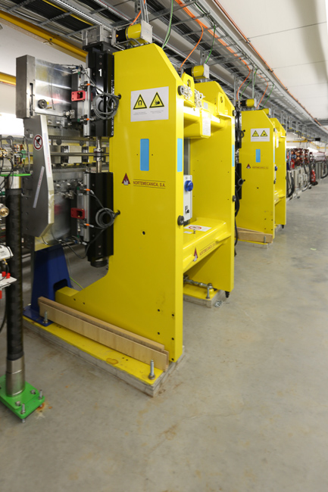
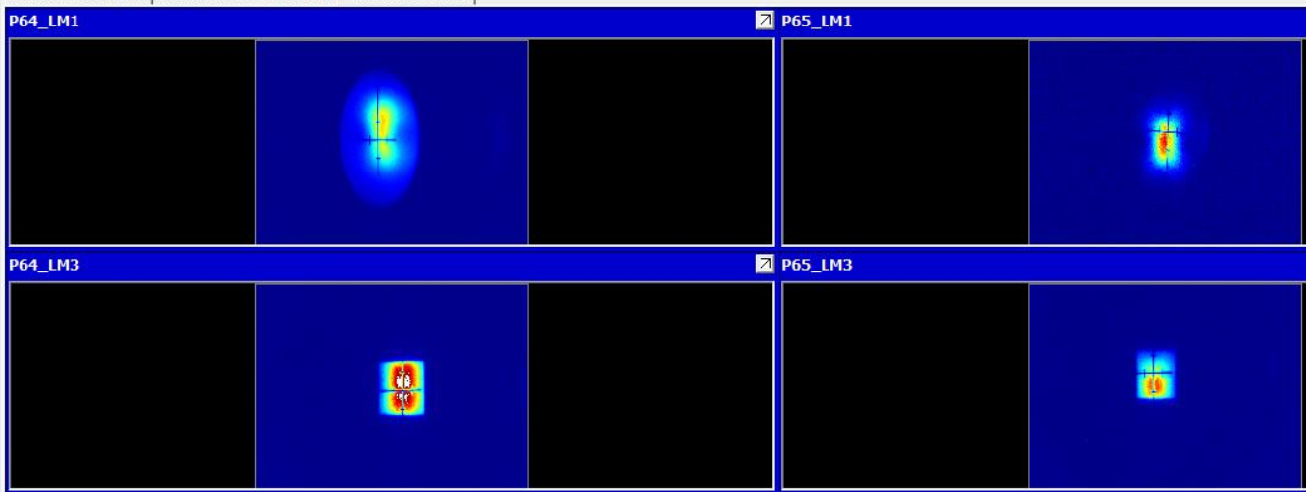
Status of Extension Beamlines
2 extension beamlines are
operational: PU64, PU65

Slide 16
Plans for 2017
2017 | Januar | Februar | März | April | Mai | Juni |  | Juli | Aug. | Sep. | Okt. | Nov. | Dez.
1 |  | g j | m p | Test Run | . | . | 1 | . | u w | . |  | MDT | .
2 | a b | g j | m r | Test Run | . | . | 2 | . | u w | . | . | . | .
3 | a b | g j | m r | Test Run | MDT | . | 3 | . | r | . | . | . | .
4 | a b | g | m r | Test Run | . | . | 4 | . | r | . | MDT | . TdoT ? | .
5 | a b |  |  | MDT | . | . | 5 | . | r | . | . | . | .
6 | a b | g j h | A | Test Run | . | . | 6 | s |  | MDT | . | Service | MDT
7 | a b | g j h | A | Test Run | . | MDT | 7 | s | A | . | . | Week | .
8 |  | g j h | A | Test Run | . | . | 8 | s | A | . | . |  | .
9 | c b d f | g j h | A | Test Run | . | . | 9 |  | A | . | . |  | .
10 | c b d f | g j h | A | . | MDT | . | 10 | s t | A | . | . |  | .
11 | c b d f | g j h | A | . | . | . | 11 | s t | A | . | MDT | TdoT ? | .
12 | c b d f |  |  | MDT | . | . | 12 | s t | A | . | . |  | .
13 | c b d f | k | A | . | . | . | 13 | s t |  | MDT | . | . | MDT
14 | c b d f | k | A | . | . | MDT | 14 | s t | Test Run | . | . | . | .
15 |  | k | A | . | Service | . | 15 | s t | Test Run | . | . | MDT | .
16 | c b d f | k | A | . | Week | . | 16 |  | Test Run | . | . | . | .
17 | c b d f | k | A | . | & Ausweich- | . | 17 | s u | . | . | . | . | .
18 | c b d f | k | A | . | termin | . | 18 | s u | . | . | MDT | . | .
19 | c b d f |  |  | . | Interlock | . | 19 | s u | . | . | . | . | .
20 | c b d f | m p | A B | MDT | P22 & 23 | . | 20 | s u | . | MDT | . | . | MDT
21 | c b d f | m p | A B | . |  | MDT | 21 | s u | . | . | . | . | .
22 |  | m p | A B | . | . | . | 22 | s u | . | . | . | MDT | .
23 | e f b a | m p | A B | . | . | . | 23 |  | MDT | . | . | . | Shutdown
24 | e f b a | m p | A B | . | MDT | . | 24 | u w | . | . | . | . | Shutdown
25 | e f b a | m h p | A B | . | . | . | 25 | u w | . | Service | MDT | . | Shutdown
26 | e f b a |  | Test Run | MDT | . | . | 26 | u w | . | Week | . | . | Shutdown
27 | e f b a | m h p | C B | . | . | . | 27 | u w | . |  | . | . | Shutdown
28 | e f b a | m h p | C B | . | . | MDT | 28 | u w | . |  | . | . | Shutdown
29 |  |  | MDT | . | . | . | 29 | u w | . |  | . | MDT | Shutdown
30 | g j |  | C B | . | . | . | 30 |  | MDT |  | . | . | Shutdown
31 | g j |  | C B |  | MDT |  | 31 |  | . |  | . |  | Shutdown
Shutdowns in Jan/Febr and July/Aug

Slide 17
Plans for Winter 2016/2017
Exchange of one undulator at PU1
Modification of straight section east:
Room for 3 insertion devices for PU21
Installation of front end for PU21 in the tunnel, no hole in the wall
Installation of new undulators PU22-24
Installation of personal interlock for hutches of PU22-24
Realignment of section east, connection between PXE and old tunnel

Slide 18
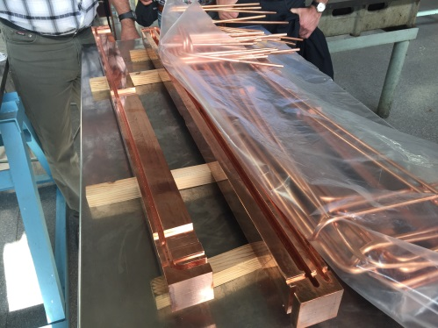
Plans for Summer 2017
Exchange of last absorber in damping wiggler section north (PU61)
Installation of front end for PU61 in the tunnel, including a power absorber,
no hole in the wall
Completion of beamline PU21, including the hole in the wall
Installation of personal interlock for hutches of PU21

Slide 19
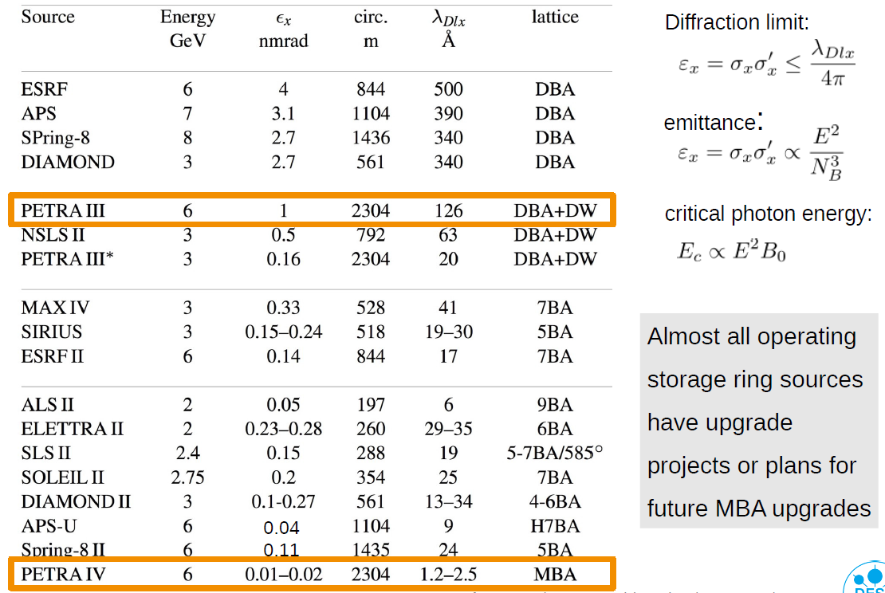
PETRA IV, Motivation

Slide 20
PETRA IV, Parameter Range

Slide 21
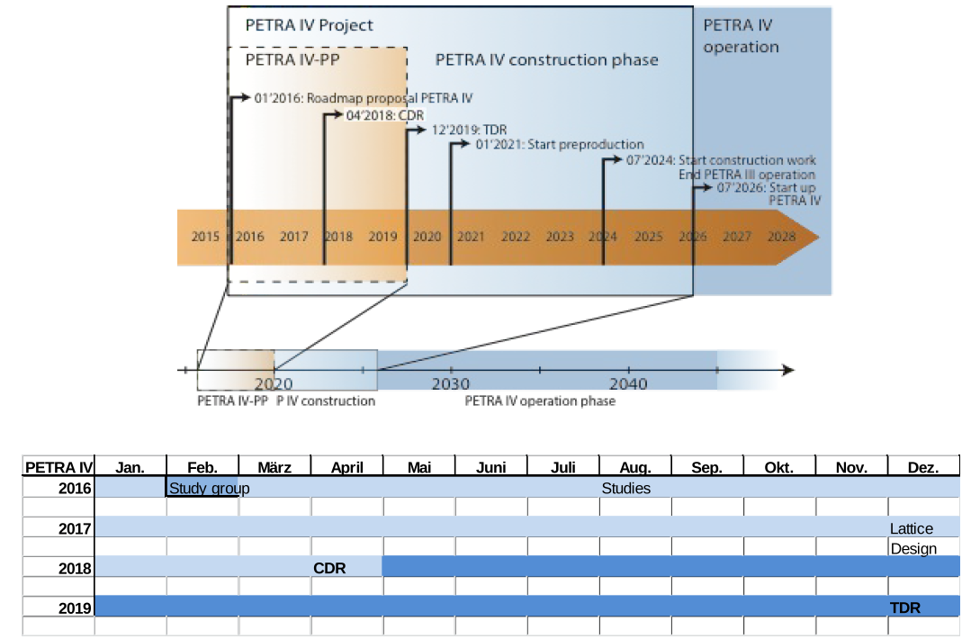
PETRA IV, Timeline

Slide 22
PETRA IV: Design Strategy
On axis injection with existing injectors
New lattice for the synchrotron
additional booster ring, or linac?
Scaling of the ESRF cell
Phase space exchange solution (double twist in 4D-phase)
Magnet design: quads, combined function magnets and dipoles with longitudinal gradient
girder design: alignment and installation concepts
fast kickers: on axis injection
vacuum design: small chambers
y <---> x
3 arc octants
y = hor., x = vert.
3 arc octants
injection section
undulator sections
x = hor., y = vert.
x <---> y
More details in the following workshop

Slide 23
Thank you for your attention!

