Slide 1
R&D Towards a UK X-FEL and CLARA Overview
Peter Williams
Daresbury Laboratory
29th November 2016
XXIV European Synchrotron Light Source Workshop, Lund

Slide 3
STFC FEL Strategic Review
Published by STFC, August 2016
Available at www.stfc.ac.uk/files/fel-report-2016/
“This strategic approach for developing a UK FEL focuses on two key objectives:
meeting the UK’s immediate XFEL needs using existing and near-future facilities;
preparing to meet the UK’s long-term needs by constructing an XFEL facility in this country.”
“In the long term, the UK’s capacity requirements will be best served by constructing a UK FEL facility with a specification designed to meet our needs.”
“The final decision on whether to build an XFEL in the UK (and to what specification) is unlikely to be taken before 2020…”
“The exact specifications of a UK facility will be developed over the next 4 years…”

Slide 4
STFC FEL Strategic Review
“One of the options is likely to be a SwissFEL-like design…”
“This would be a normal conducting XFEL operating at energies up to 10 keV, with a repetition rate of around 100 Hz.”
“It would also complement XFEL.EU and LCLS-II, which will remain essential for a small number of applications that demand a high repetition rate…”
“There are a number of key areas of technology which would underpin the development of a UK FEL facility, and capability in each of these needs to be further developed within the UK in order to enable UK science to take full advantage of FELs in pursuing frontier science.”
“The CLARA test facility at Daresbury Laboratory will address many of these areas directly (guns, RF structures, laser issues, single shot diagnostics, timing and synchronisation).”
“It is very difficult to develop state of the art accelerator technologies in isolation. It is only through bringing them together in a facility such as CLARA that they can be properly tested and proven.”

Slide 5
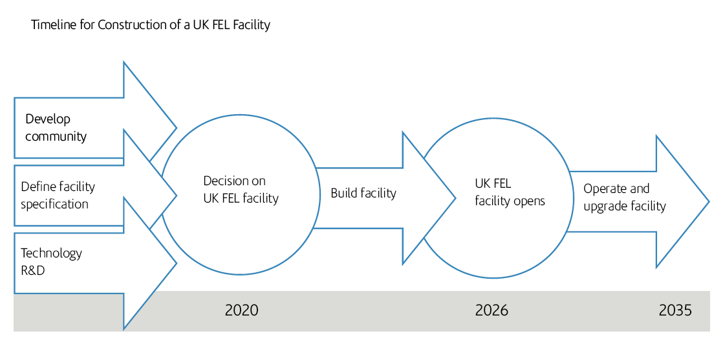
STFC FEL Timeline

Slide 6
UK X-FEL R&D Planning
The accelerator community has generated a draft UK FEL R&D programme in parallel with the generation of the strategy to develop the skills and technology required so that when we get the green light for the UK X-ray FEL facility we are ready to make swift, well informed, decisions on layout and have solutions to all major technical issues at hand
The plan has received input from, and will be implemented by, ASTeC, CI, DLS, & JAI
The six goals identified need to be ratified now that the STFC FEL strategy has been published
Over-arching the R&D programme is the detailed design, assembly, commissioning, development, and exploitation of the CLARA FEL Test Facility
A very important aspect of the overall programme will be strong connections to the potential FEL user community.

Slide 7
Six UK FEL R&D Goals
1. Gun Development
Optimised electron source demonstrated
Minimum emittance at low and high charge
High repetition rate (at least 100 Hz)
Photocathode material selection, optimisation, and demonstration
ASTeC, CI
2. RF Development
RF frequency options studied in detail
State of the art low level and high level RF control and stability demonstrated
RF structure design & optimisation
Economic optimisation of accelerating gradient
Multibunch operation considerations studied
ASTeC, CI, DLS

Slide 8
Six UK FEL R&D Goals
3. Electron Beam Transport Simulation and Optimization
Delivering appropriate quality electron bunches at the entrance to the FEL and transporting through the FEL
Start to end simulations from cathode to FEL, optimizing performance and stability
Understanding and mitigating (or potentially exploiting) collective effects such as space charge, wakefields, and CSR
Alignment and tuning strategies within the FEL
ASTeC, CI, DLS, JAI
4. FEL Output Simulation and Optimization
Critically examine potential FEL output performance enhancements over current generation of X-ray FELs with plan for experimental demonstrations on CLARA
Achieving the best FEL output stability shot to shot (intensity and wavelength).
Generation of flexible FEL output pulse structures (eg two colour, two pulse, …).
Generating ultra-short photon pulses (sub fs).
Generating transform limited FEL output (time-bandwidth product).
Other potential enhancements (higher peak power, generating useful high harmonics of fundamental, polarisation control, …)
ASTeC, CI

Slide 9
Six UK FEL R&D Goals
5. Electron & Photon Diagnostics
Bunch (slice) measurements at all charge levels
Transverse and longitudinal profiles (e.g. cSPR, …)
Diagnostics for precise beam position measurement, (e.g. cavity BPM)
Feedback systems (trajectory, optics, energy, charge, …)
FEL pulse wavelength, pulse length, profile, etc.
ASTeC, CI, JAI
6. Synchronisation
Achieving sub-10 fs synchronisation between the FEL output and an external laser:
Timing distribution and synchronisation of essential systems demonstrated.
Measuring synchronisation level between FEL output and external laser.
Measuring electron bunch arrival time at fs level.
Minimising electron bunch jitter through passive or active schemes.
ASTeC, CI

Slide 10
CLARA
CLARA is a purpose built dedicated flexible FEL Test Facility
CLARA is a scaled down version of an X-ray FEL containing all of the key technical components, where all lessons learnt can be directly applied to any future UK FEL.
The key objectives are:
To develop new methods for improving the quality of the light output from FELs
Prove new technologies
Develop the UK skill base
Lower the total cost of a UK FEL
Lower the risks associated with UK FEL.

Slide 11
International Perspective
CLARA is of great interest internationally
Any new technique we prove or technology we develop can be applied to new and existing FELs
There are very few such test facilities globally
CLARA has established formal links with SwissFEL (PSI, Switzerland), LCLS-II (SLAC, USA), CERN, INFN (Italy), and FERMI@Elettra (Italy).
Examples of these collaborations include:
Switzerland has provided ~£1m of equipment for CLARA in exchange for future beam time access, and support from STFC expertise in the design/delivery of various SwissFEL systems and FEL commissioning.
The US wants to use CLARA to develop new FEL concepts beyond the capability of their test facility.
CERN and FERMI@Elettra are developing novel accelerator technologies for more cost effective FELs and would like to prove this technology on CLARA (H2020 proposal).
INFN is leading an H2020 proposal to make use of CLARA for innovative accelerator developments.

Slide 12
Summary of operating modes
MODE | FLAT | ULTRASHORT | SHORT | LONG
Energy | 240 MeV | 240 MeV | 150—240 MeV | 150 – 240 MeV
Pulse Duration | 250fs flat region | 50 —35 fs FWHM | 585 fs FWHM | 1.875 ps FWHM
Charge | 250 pC | 25—50 pC | 250 pC | 250 pC
Peak Current | 400 A | 500 — 1500 A | 400 A | 125 A
Norm Emittance (mm-mrad) | 0.5 (Target) 1.0 (Max) | 1.0 (Target) 1.5 (Max) | 0.5 (Target) 1.0 (Max) | 0.5 (Target) 0.8 (Max)
RMS Energy Spread (keV) | 25 (Target) 100 (Max) | 100 (Target) 150 (Max) | 25 (Target) 120 (Max) | 25 (Target) 75 (Max)
Purpose | 800nm Seeding and Harmonic Generation | Single Spike SASE (+ mode-locked single spike SASE) | 100nm saturation Schemes only requiring spectral characterisation, Highest harmonic upconversion potential Shortest pulse durations in absolute terms. | 266nm schemes requiring long wavelength modulation of the pulse energy (Mode-Locking, Mode-Locked Afterburner, Slice + Taper).

Slide 13
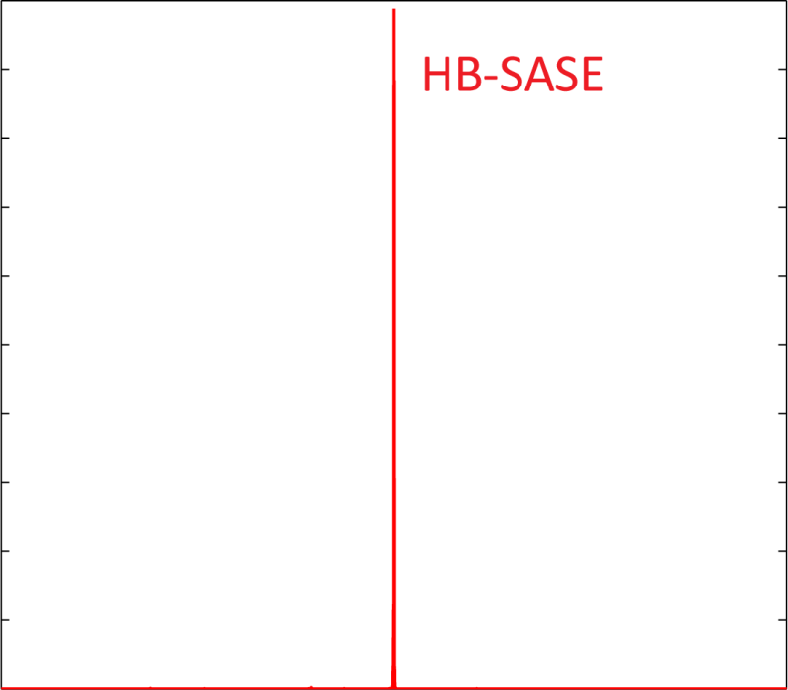
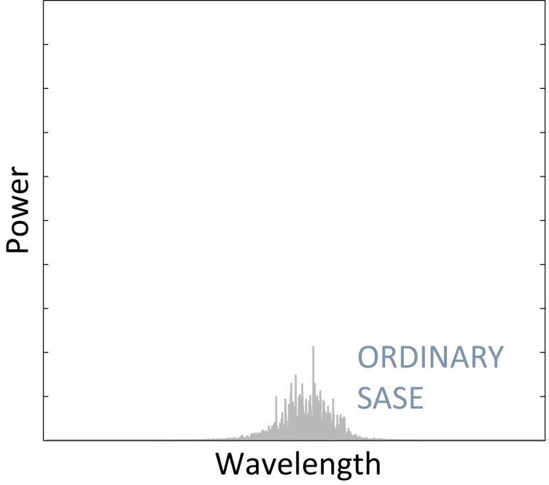
What will CLARA be able to do?
Example 1: Reducing the spread of wavelengths
Prove that a new idea called HB-SASE actually works
Could then build it in from the start of the UK FEL
Will work at any wavelength and any repetition rate, no fancy optics required!
NORMAL FEL
B.W.J. McNeil, N.R. Thompson & D.J. Dunning, PRL 110, 134802 (2013)

Slide 14
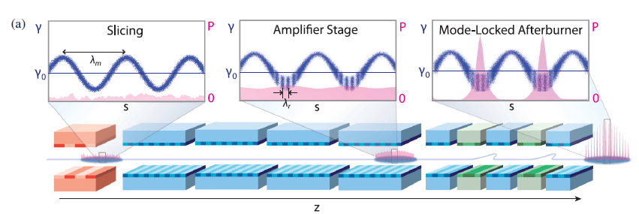
What will CLARA be able to do?
Example 2: Generate few cycle pulses
Prove that a new idea called Mode-locked afterburner actually works
Could then build it in from the start of the UK FEL
Able to probe ever faster processes (down to sub-attosecond)
D.J. Dunning, B.W.J. McNeil, & N.R. Thompson PRL 110, 104801 (2013)

Slide 15
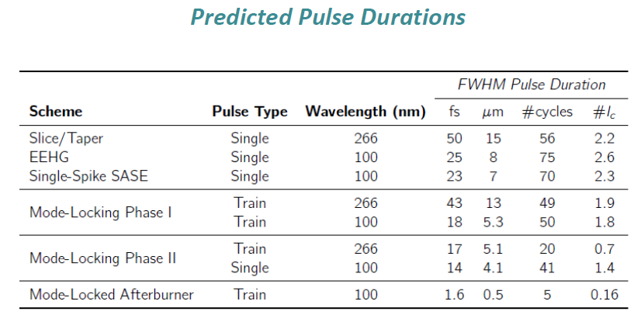
What will CLARA be able to do?
Example 2: Generate few cycle pulses
Prove that a new idea called Mode-locked afterburner actually works
Could then build it in from the start of the UK FEL
Able to probe ever faster processes (down to sub-attosecond)

Slide 16
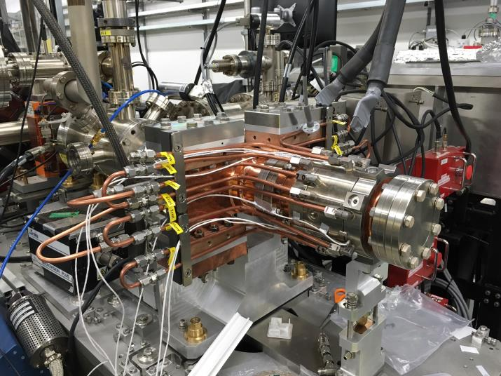
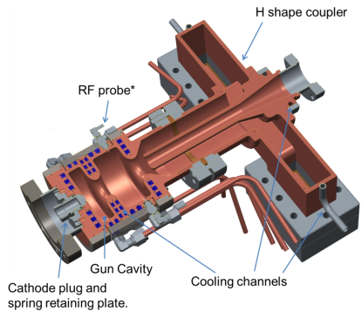
What will CLARA be able to do?
Example 3: Prove performance of 400 Hz Photoinjector
1.5 cell S-band gun with RF probe
Maximum gradient of 120 MV/m @100 Hz, or 100 MV/m @400 Hz
10kW cooling capacity
Vacuum load lock system for easy replacement of cathode
Now installed for beam characterization

Slide 17
CLARA Schematic & Project Phases
Phase 1, 50 MeV
Phase 2, 250 MeV
Phase 3, 100nm FEL

Slide 18
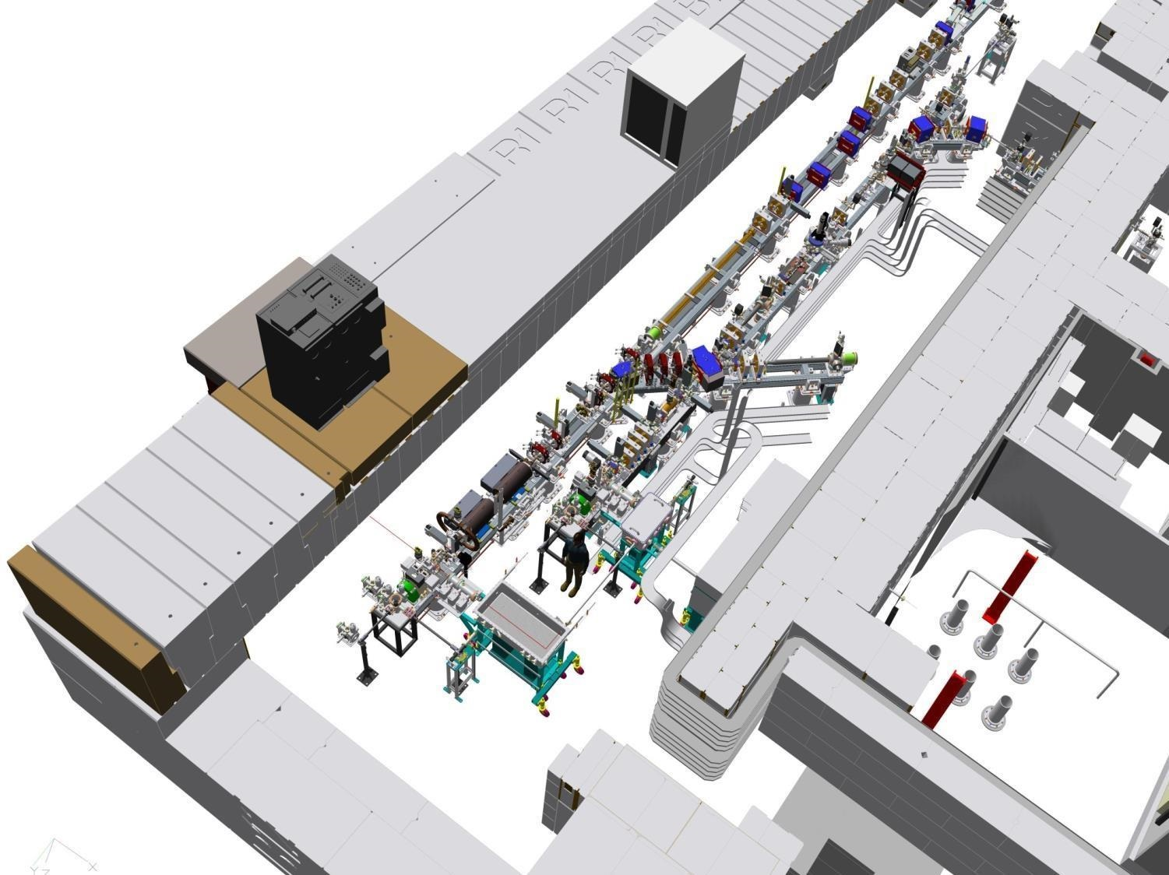
Variable Bunch Compressor (VBC)
CLARA Phase 1
Engineering Technology Centre
Laser Heater Stage
Accelerating Linac2 S-Band 70MeV
Dump
VELA
Collimator & YAG diagnostics
Accelerating Linac1 S-Band 45MeV
High Rep Rate Gun
CLARA
Photocathode loadlock
Engineering Technology Centre

Slide 19
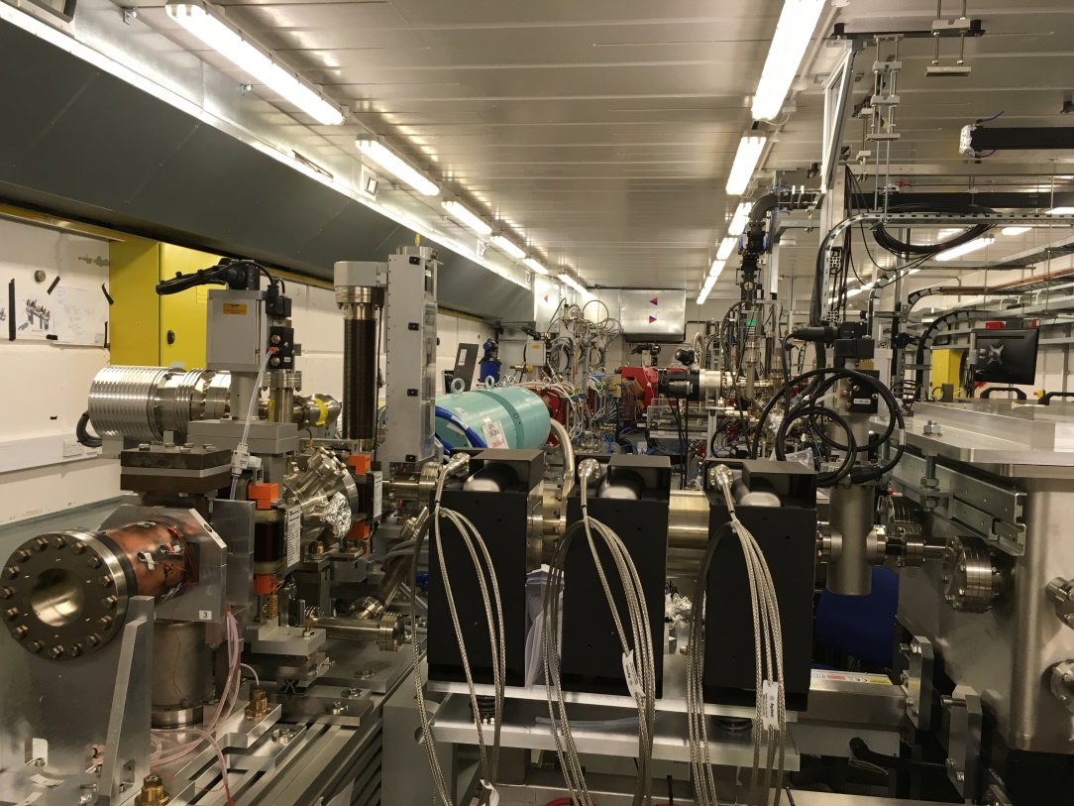
CLARA Phase 1

Slide 20
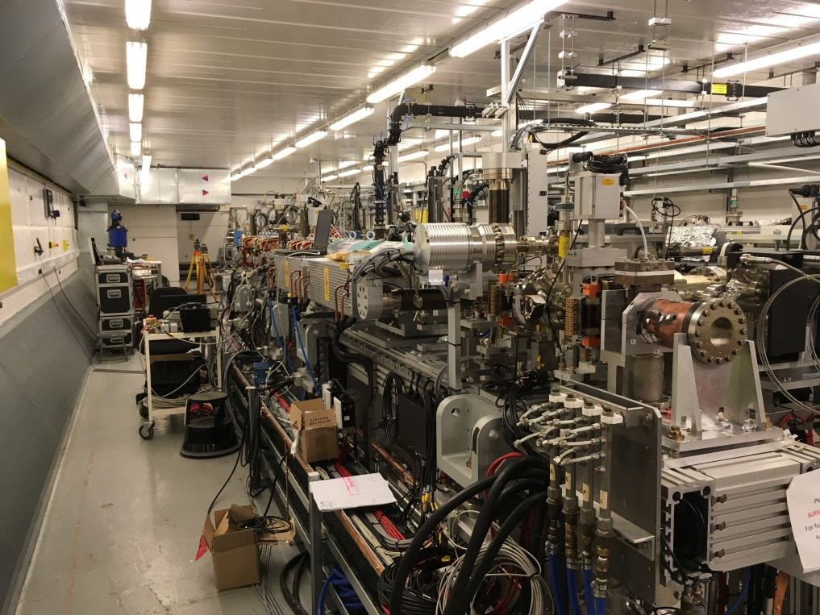
CLARA Phase 1

Slide 21
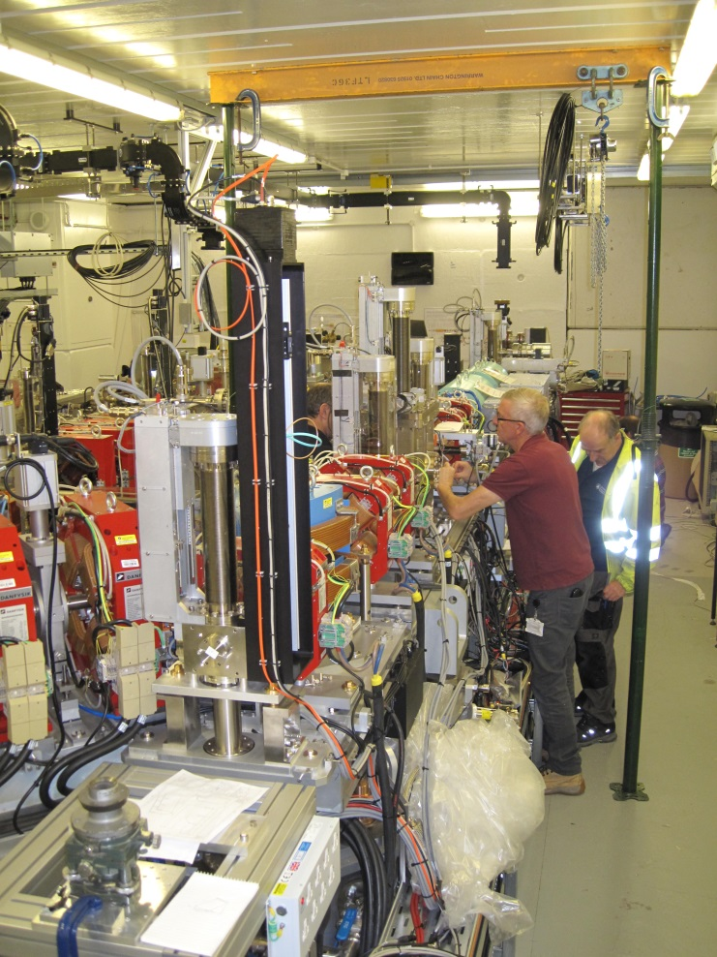
CLARA Phase 1

Slide 22
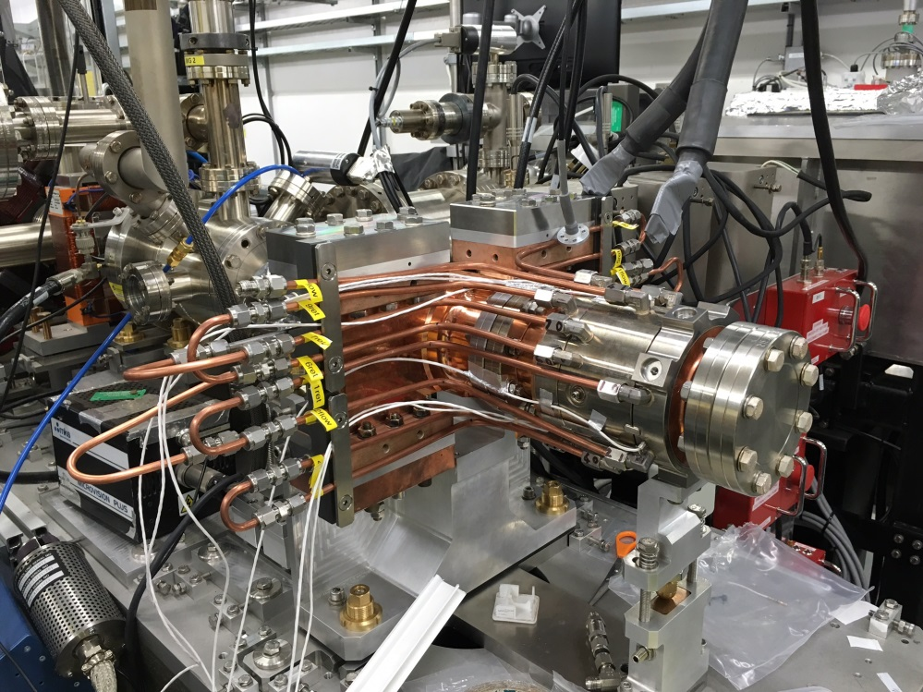
CLARA Phase 1

Slide 23
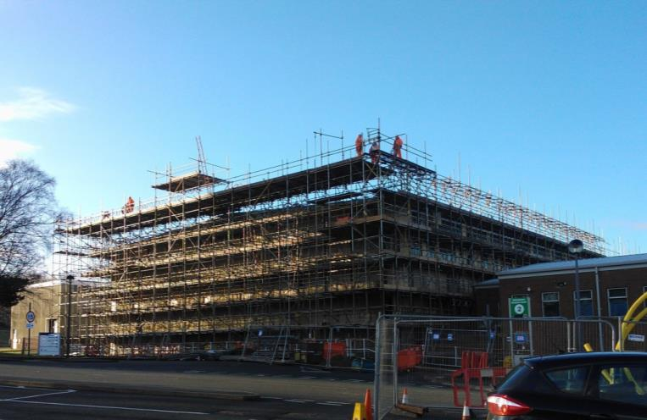
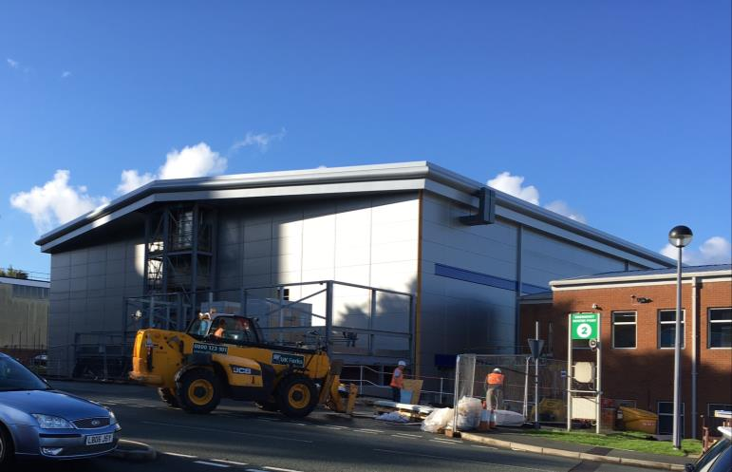
The Electron Hall
CLARA is housed within the Electron Hall (ex-SRS user area)
The Electron Hall was not fit for purpose so is being upgraded
Since we want to build a very stable FEL, we need the temperature of the facility to also be very stable
The temperature within the Electron Hall normally varied by at least 15 °C over the year
Refurbishment is reducing this to ±1 °C within the building volume
Within the shielded enclosure the specification is ±0.05 °C (23.0 ±0.03 °C already demonstrated!)
Building on track for completion ahead of schedule in 2016
February 2016
September 2016

Slide 24
CLARA Status
Phase 1, 50 MeV
Installation completion delayed by (very) late arrival of waveguide components for both guns and linac (does not impact end date of Phase 3)
Commissioning of both guns starts Jan 2017
Phase 2, 250 MeV
Procurement of equipment is ongoing (magnets, klystrons, modulators, pumps, valves, power supplies, etc) ~£8M committed/spent so far.
Concrete casting and roof beams Spring 2017. All shielding assembled Spring 2018.
Phase 3, 100nm FEL Test Facility
Detailed design stage.
Undulator tender documents being prepared now.

Slide 25
Summary
UK FEL strategy has been published
Need for UK FEL identified but no go ahead decision or detailed specification expected before 2020
Anticipated to be NCRF hard X-ray FEL at ~100Hz
UK FEL R&D Plan has been developed by ASTeC, CI, DLS, & JAI
Starts 1st April 2017 and runs for 4 years
CLARA
Phase 1 installation almost complete
Phase 2 procurement ongoing
Phase 3 detailed design in progress
Electron Hall refurbishment almost complete

Slide 26
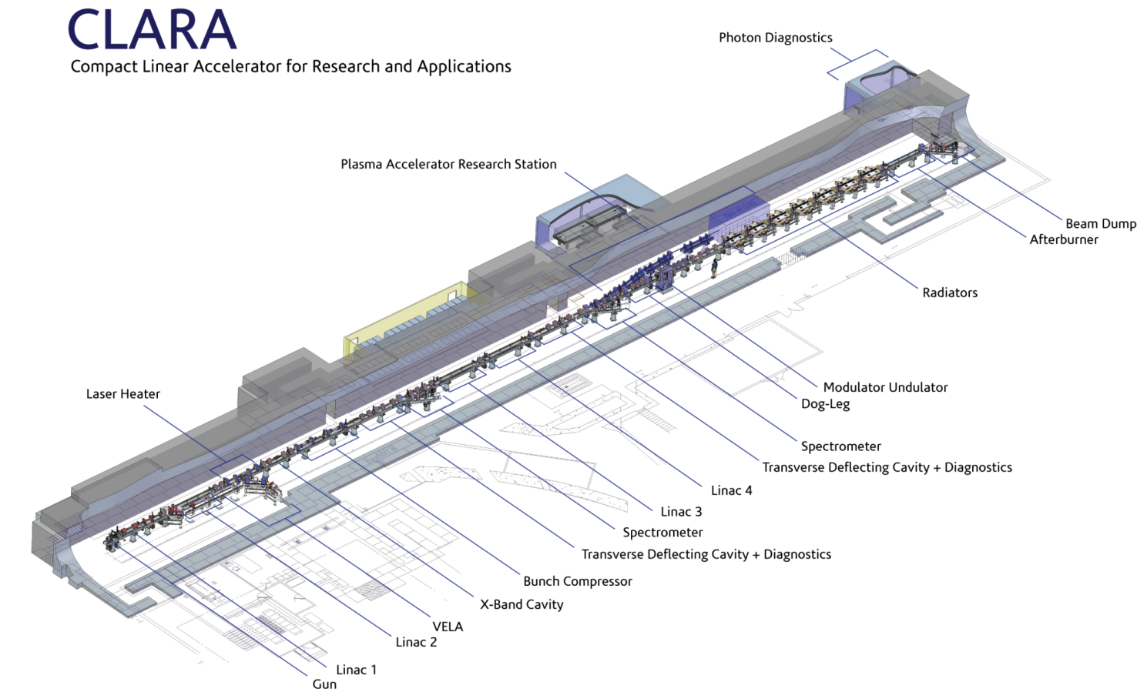
Thanks to everyone who is contributing to the CLARA project

