Slide 1
Status of the MAX IV Short Pulse Facility
Sara Thorin

Slide 2
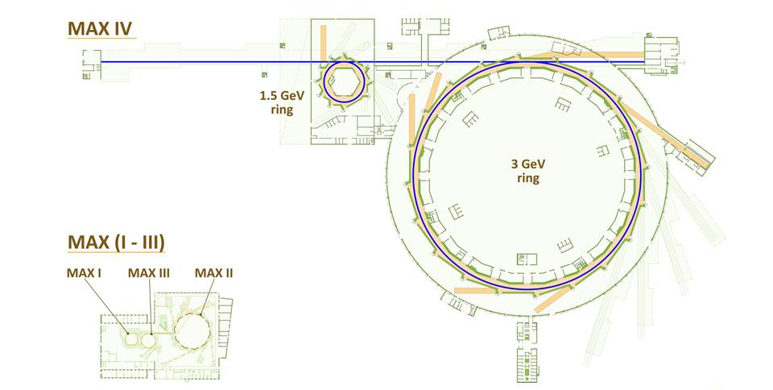
MAX IV
SPF
Linac
Notes:
Funded 2009
Inauguration summer 2016

Slide 3
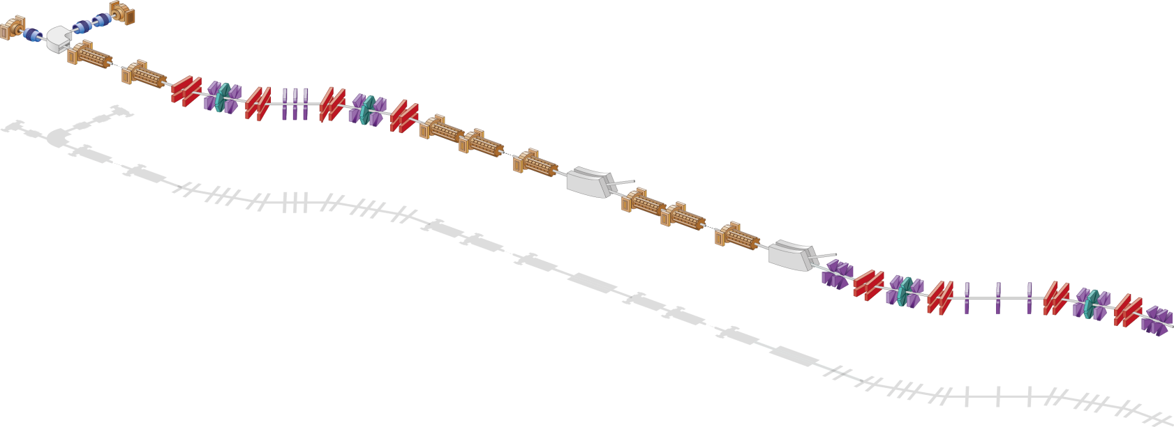
MAX IV linac overview
Thermionic RF gun
Photo cathode RF gun
Extraction
1.5 GeV
BC1 @ 260 MeV
Extraction
3 GeV
BC2 @ 3 GeV
SPF
Full energy injection and top up operation for the two storage rings
Energy | 1.5 GeV/ 3GeV
Injection frequency | 10 Hz
Charge | 0.6-1 nC/shot
Emittance | 10 mm mrad
Energy spread | <0.2%

Slide 4
MAX IV linac overview
Thermionic RF gun
Photo cathode RF gun
Extraction
1.5 GeV
BC1 @ 260 MeV
Extraction
3 GeV
BC2 @ 3 GeV
SPF
Full energy injection and top up operation for the two storage rings
High brightness driver for the Short Pulse Facility
Energy | 1.5 GeV/ 3GeV
Injection frequency | 10 Hz
Charge | 0.6-1 nC/shot
Emittance | 10 mm mrad
Energy spread | <0.2%
Energy | 3GeV
Injection frequency | 100 Hz
Charge | 100 pC
Bunch length | 100 fs
Emittance | 1 mm mrad
Energy spread | <0.4%

Slide 5
MAX IV linac overview
Thermionic RF gun
Photo cathode RF gun
Extraction
1.5 GeV
BC1 @ 260 MeV
Extraction
3 GeV
BC2 @ 3 GeV
SPF
Full energy injection and top up operation for the two storage rings
High brightness driver for the Short Pulse Facility
Energy | 1.5 GeV/ 3GeV
Injection frequency | 10 Hz
Charge | 0.6-1 nC/shot
Emittance | 10 mm mrad
Energy spread | <0.2%
Energy | 3GeV
Injection frequency | 100 Hz
Charge | 100 pC
Bunch length | 100 fs
Emittance | 1 mm mrad
Energy spread | <0.4%
Possible future Free Electron Laser

Slide 6
MAX IV Short Pulse Facility
Thermionic RF gun
Photo cathode RF gun
Extraction
1.5 GeV
BC1 @ 260 MeV
Extraction
3 GeV
BC2 @ 3 GeV
SPF
BC2 @ 3 GeV
U
FemtoMAX

Slide 7
MAX IV Short Pulse Facility
Thermionic RF gun
Photo cathode RF gun
Extraction
1.5 GeV
BC1 @ 260 MeV
Extraction
3 GeV
BC2 @ 3 GeV
SPF
Soft X-ray FEL beamline
Linac extention + hard X-ray FEL
Wakefield acceleration experiment
BC2 @ 3 GeV
U
FemtoMAX

Slide 8
MAX IV Short Pulse Facility
Thermionic RF gun
Photo cathode RF gun
Extraction
1.5 GeV
BC1 @ 260 MeV
Extraction
3 GeV
BC2 @ 3 GeV
SPF
Soft X-ray FEL beamline
Linac extention + hard X-ray FEL
Wakefield acceleration experiment
BC2 @ 3 GeV
U
FemtoMAX

Slide 9
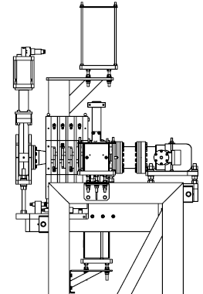
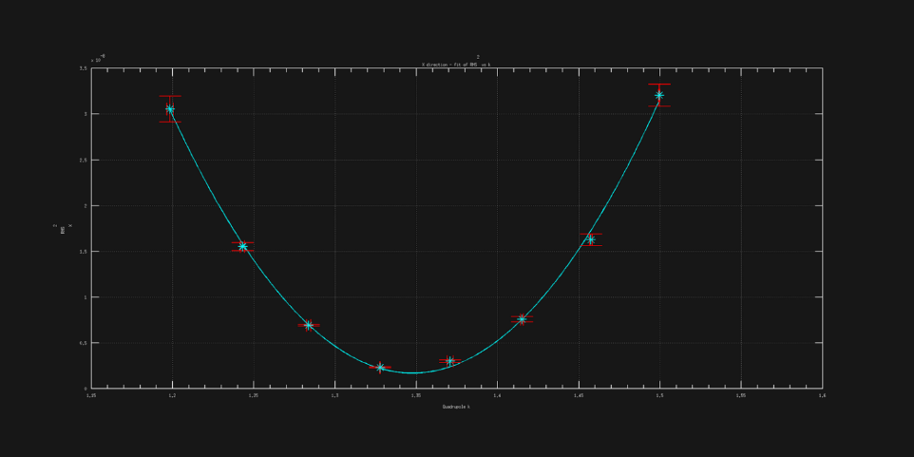
High brightness gun
1.6 cell UCLA-type RF gun
Copper cathode
10 Hz/100Hz
SLED
Ti-sapphire laser, 263 nm
Norm Emittance ~ 1.5 mm mrad @ 150 pC
To improve emittance:
Polish cathode
Longitudinal laser pulse shaping
Increase power in the gun

Slide 10
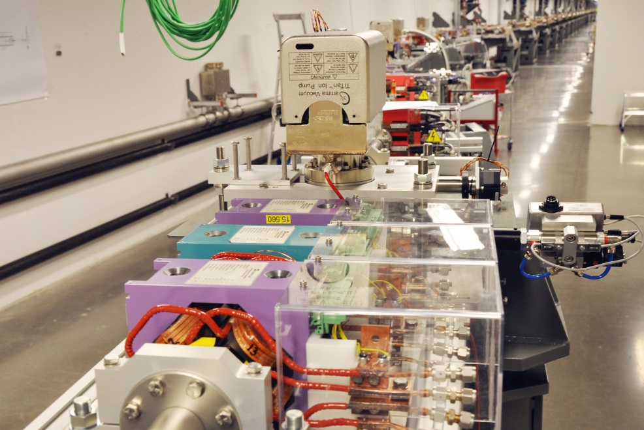
Bunch compressors – double achromats
4
BC1
quad
R56 > 0
T566 > 0
0
dipole
2
sext
E
E
Y[m]
-2
E_{mean}
2
4
6
X[m]
8
10
12
z
z
 | BC1 | BC2
R56 | 2.23 cm | 2.89 mm
T566 | 8.05 cm | 6.76µm

Slide 11
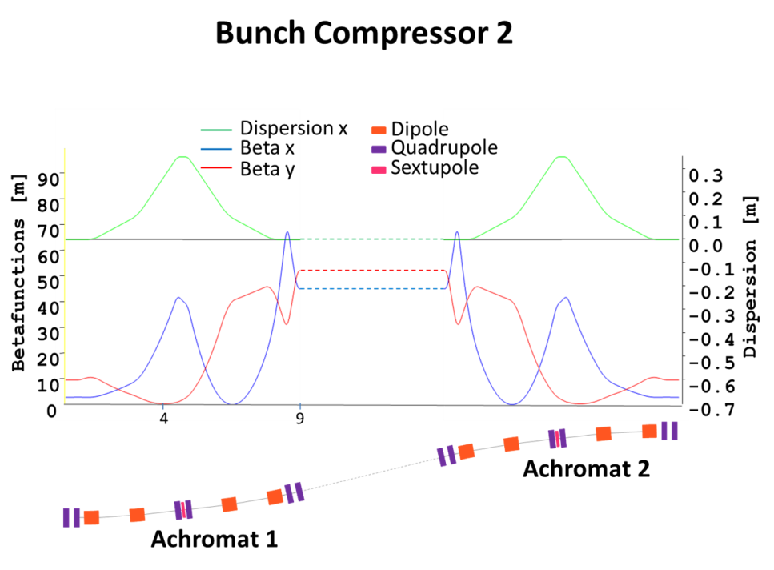
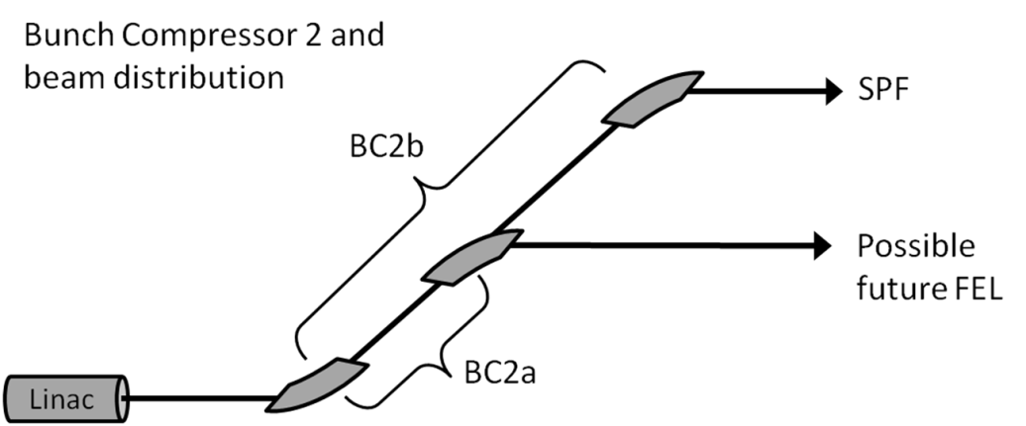
Bunch compressors
Why self linearising compression?
economy
reliability
simplicity
Why compression in double achromats?
positive R56 (fixed)
positive T566 for linearisation
“weak” sextupoles for tuning
symmetry → small energy depending matrix elements
beam spreader
4
BC1
quad
0
dipole
2
sext
Y[m]
-2
2
4
6
8
10
12
X[m]

Slide 12
Simulation results - SPF-pulse
Gun – 1st linac: ASTRA
Linac + compressors: ELEGANT
Charge | 100 pC
Δt fwhm | 100 fs
Peak current | 1.5 kA
Compression factor | 50
Slice εN | 0.42 mm mrad
Proj εN | 0.55 mm mrad
Emittance increase | 5 %
Slice ΔE/E | 0.035 %

Slide 13
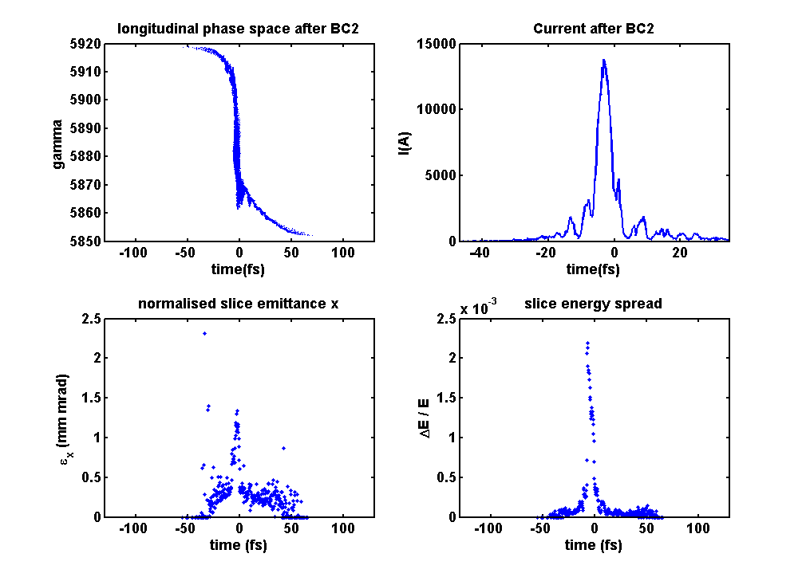
Simulation results - full compression
Gun – 1st linac: ASTRA
Linac + compressors: ELEGANT
Charge | 100 pC
Δt fwhm | 10 fs
Peak current | 14 kA
Compression factor | 500
Slice εN | 1.5 mm mrad
Proj εN | 2.4 mm mrad
Emittance increase (slice) | 375 %
Slice ΔE/E | 0.25 %

Slide 14
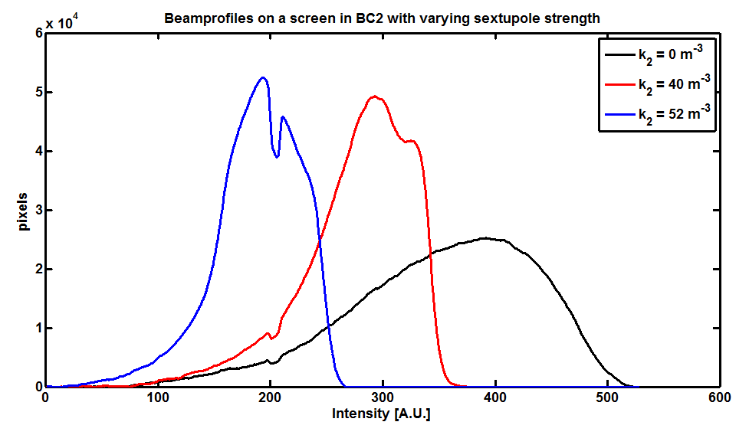
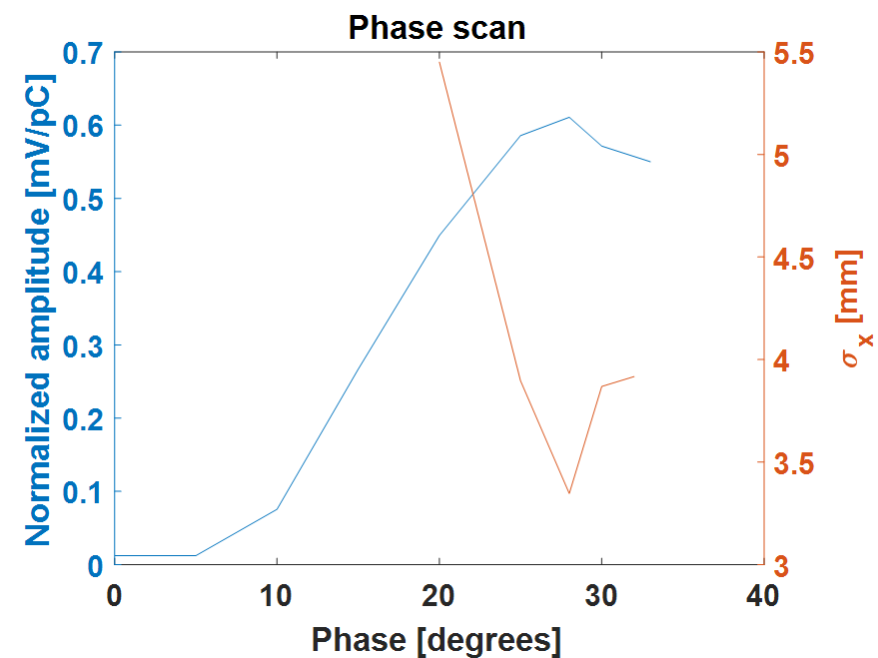
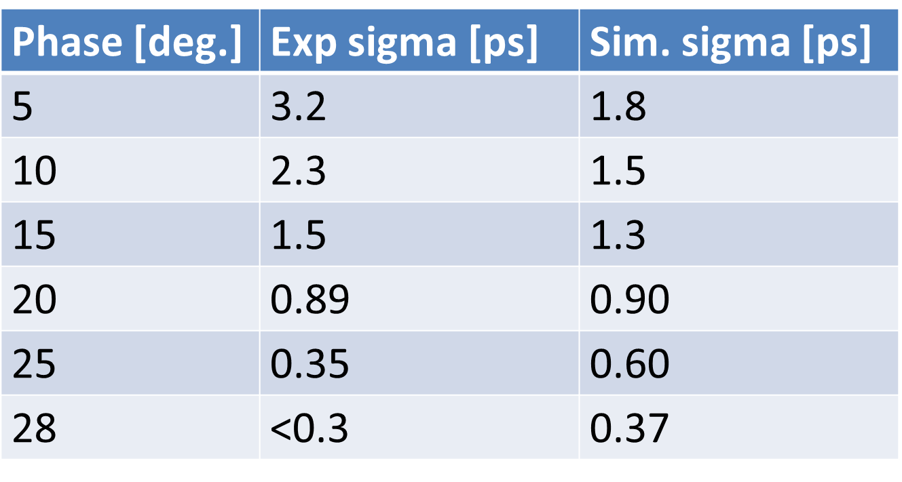
Bunch compression measurements
Sextupole influence on longitudinal bunch profile and bunch length
Horn antenna
Streak on BC2 screen

Slide 15
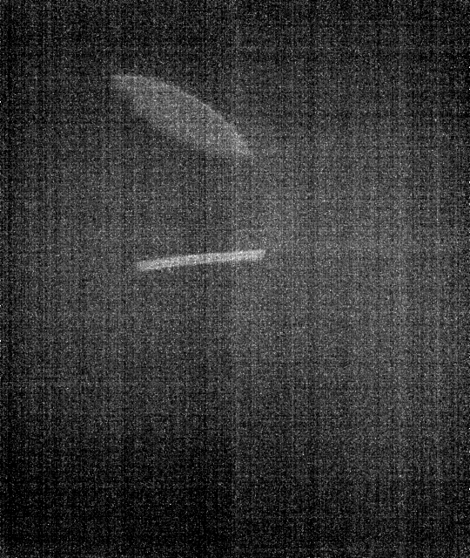
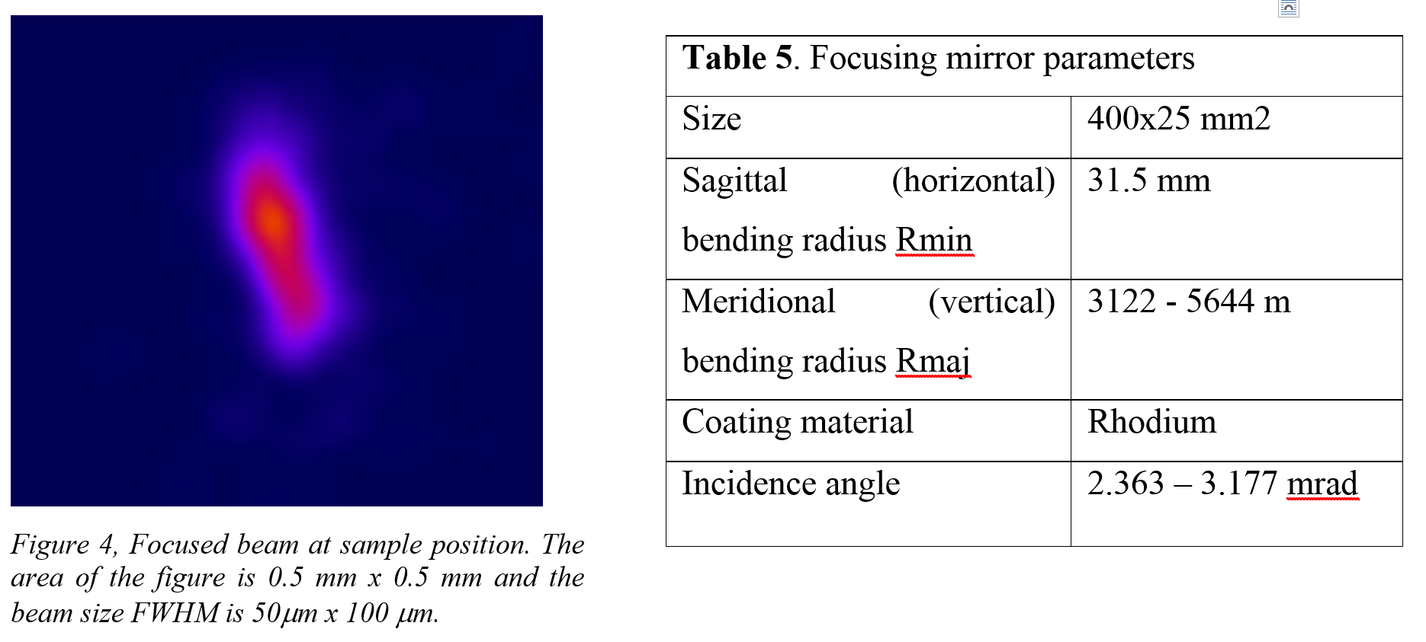
FemtoMAX beamline @ SPF
First test of the first X-bpm at FemtoMAX front end with ‘X-rays’, May 2015
Status – Focused beam on last screen
Monochromators aligned and commissioned for 2-5 keV
Focused beam at sample position. Beamsize is 50 μm x 100 μm

Slide 16
