Slide 1
CONSTRUCTION OF THE WIGGLER DEDICATED TO THE BALDER BEAMLINE OF MAXIV: FROM SOLEIL WIGGLER TO MAXIV WIGGLER
O. Marcouilléª, F. Marteauª,S. Tripathiª , A. Thiel^{b}, H.Tarawneh ^{b}, K. Tavakoliª, J. L. Marlatsª, A. Maryª, M. Valleauª, J. Vétéranª, L. Chapuisª, P. Berteaudª, T. El Ajjouriª, P. Brunelleª, C. Herbeauxª , N. Bechuª , A. Lestradeª, A. Nadjiª , M. E. Couprieª .
ªSynchrotron SOLEIL, L’Orme des Merisiers, 91 192 BP 34 Gif-sur-Yvette, France.
^{b}MAX IV Laboratory, Lund University, P.O. Box 118, SE-221 00 Lund, Sweden.
Olivier MARCOUILLE – ESLSXXIV - 28-30 Nov. 2016

Slide 2
OUTLINE
FEW WORDS ON THE SOLEIL WIGGLER
FROM SOLEIL WIGGLER TO MAXIV WIGGLER: USERS NEEDS AND TECHNICAL CHANGES
MAGNETIC PERFORMANCES
VACUUM LEVEL
CONCLUSIONS

Slide 3

WIGGLER AT SOLEIL: WSV50
Problematics
How to produce photons of 50 keV
on an intermediate energy Storage
Ring like SOLEIL (2,75 GeV – 500 mA
and limit the radiated power of a fixed
Length of ID?
50 keV
P<25 kW
Critical Energy
E_{c}[keV]=0.665 B[T].E²[GeV]
Pushing E_{c} up to 50 keV
BUT Increase of the power
OR….
Increasing the number of poles,
i.e. decrease the period length →
Decrease of the field (B~exp[-ag/λ₀])
→ OPTIMUM of the period Length
Out-vacuum technology
O. Chubar, NSLSII
Angular Flux
dF/dΩ=2.65 10¹⁶ E²[GeV] I[A] [E_{ph}/E_{c}]² K_{2/3}²[E_{ph}/2E_{c}] L_{w}[m]/λ₀
Radiated power
P[kW]=0.633 B²[T] E²[GeV] I[A] L_{w}[m]
Research of optimum
The radiated power is constant (25 kW)
Scan of the values of (B, L_{w})
Evaluation of the angular Flux dF/dΩ

Slide 4
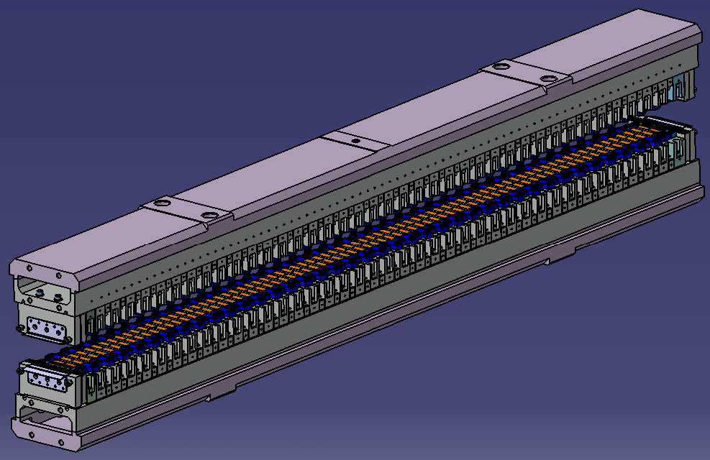
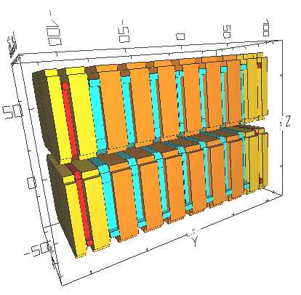
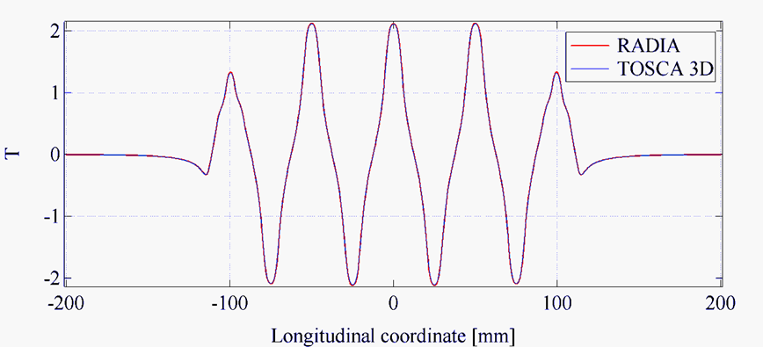
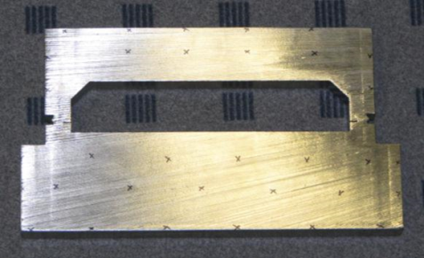
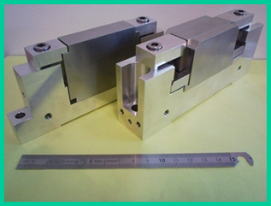
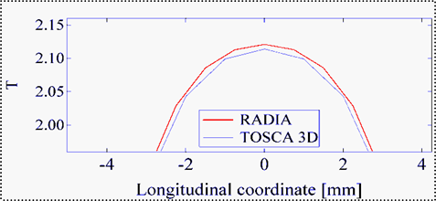
MAGNETIC DESIGN
OF WSV50
Technology | Hybrid in-vacuum
Magnets | NdFeB (Br=1.25T/Hc=1950 kA/m) from VAC
Poles | VdPer (Bs=2.35T)
Period length | 50 mm
Number of full periods | 38
Minimum gap | 5,5 mm
Max. magnetic field | 2.1 T
Radiation aperture | +/- 1.8 mrad
3 periods model
RADIA Sofware
GIRDERS
Stainless steel 316L
Hyperquench
Vibration
Heat treatment
→ Low µ (<1.01)
Cross-check

Slide 5
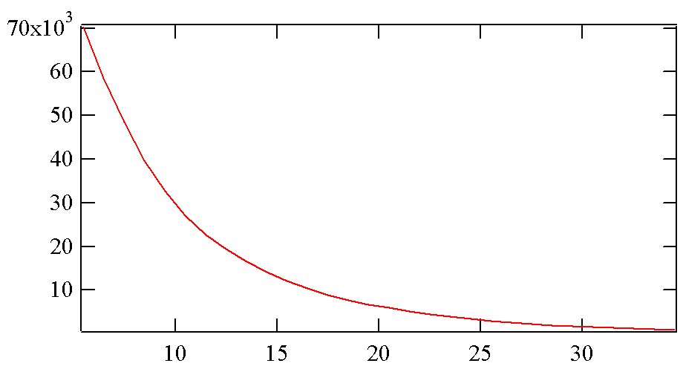
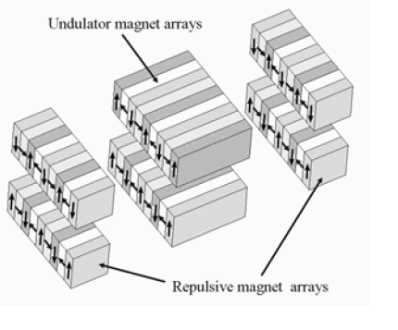
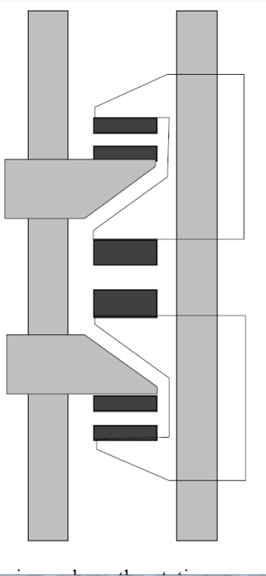
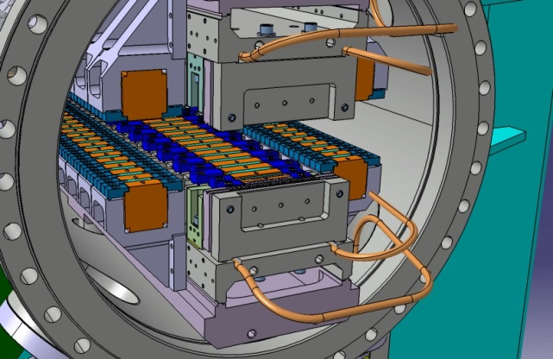
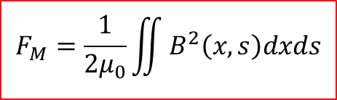
NEEDS AND CONSTRAINTS: MAGNETIC FORCES
$$F_{M}=\frac{1}{2μ_{0}}\iint{B^{2}\left(x,s\right)dxds}$$
Magnetic force [N]
Special toolings (magnet mounting)
Stiff girders and powerful motors
Reduce transverse pole size (WSV50)
Force Compensation system
  Magnets (Spring8, SLAC)
  Springs (SOLEIL)
5.5 mm
Magnetic gap [mm]
Repulsive
magnet
Magnet
arrays
Bizen et al., SPRing8
SOLEIL studies (hybrid structure)
Carr et al., SLAC

Slide 6
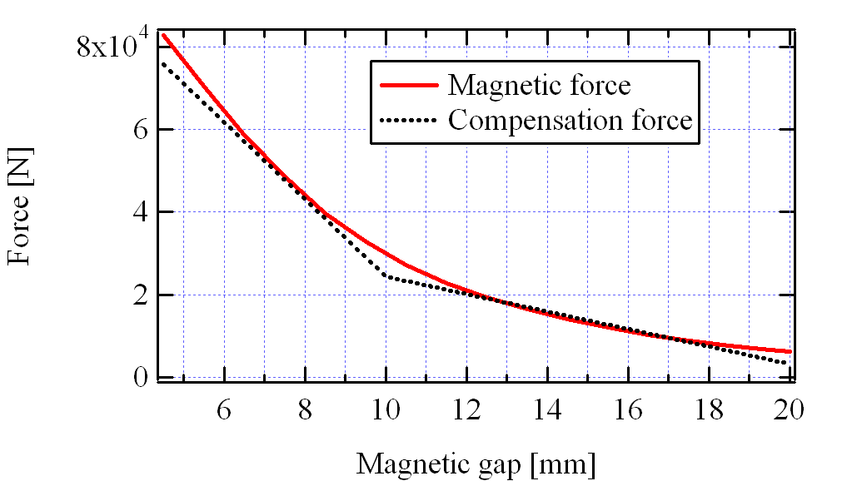
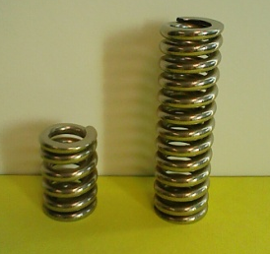
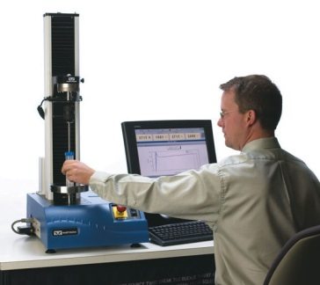
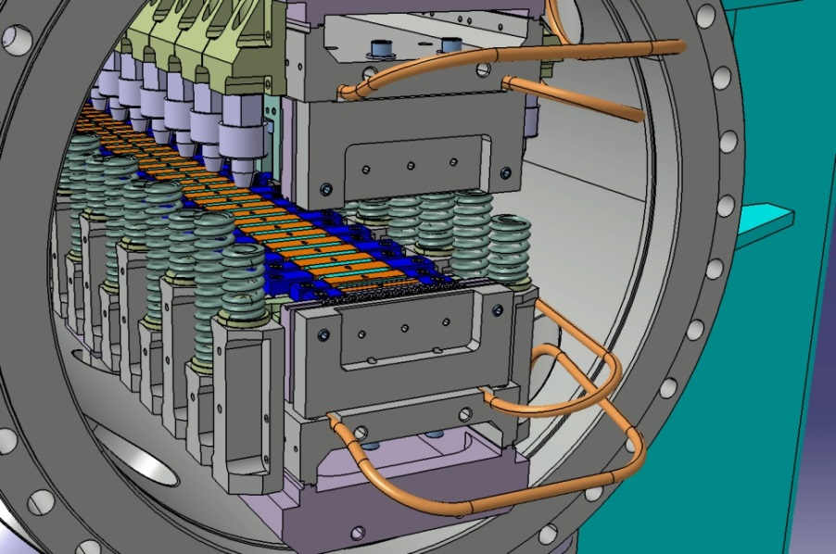
MAGNETIC FORCE COMPENSATION ON WSV50-SOLEIL
Type of spring | Cycle number | Time | Rigidity K [N/mm] | σ_{K} [N/mm]
Long | 1 | 170h | 61 | 0.2
Long | 190 | 2h | 62 | 0.3
Short | 1 | 170h | 163 | 0.3
Short | 500 | 5 s | 164 | 0.5
4,5 mm
Spring
Spring Shim
Spring Support

Slide 7
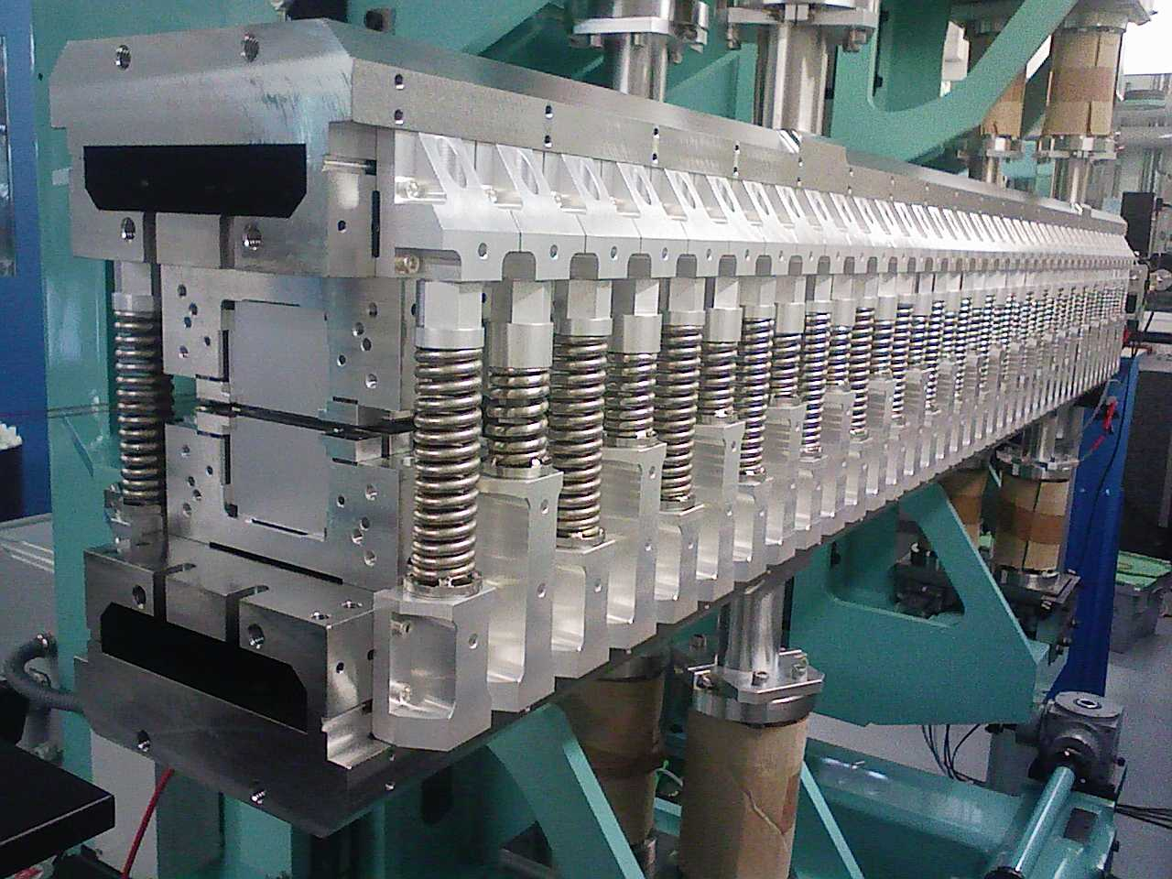
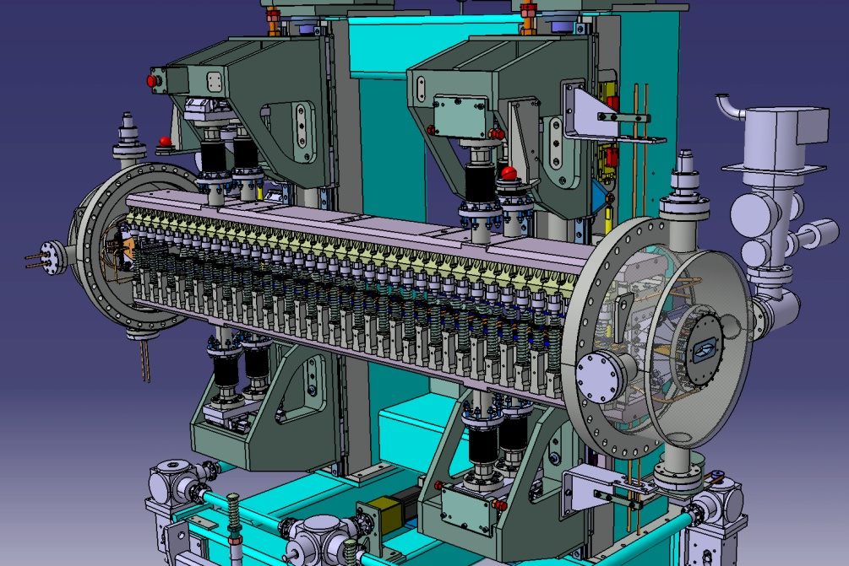
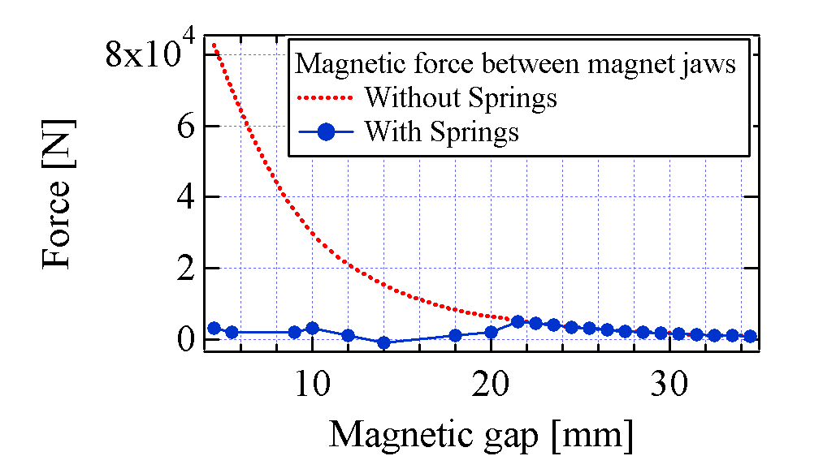
MAGNETIC FORCE COMPENSATION:
EFFECT AND CONTROL
Magnetic system and counter force system
Carriage, magnetic system and Vac. Chamber ends
4,5 mm

Slide 8
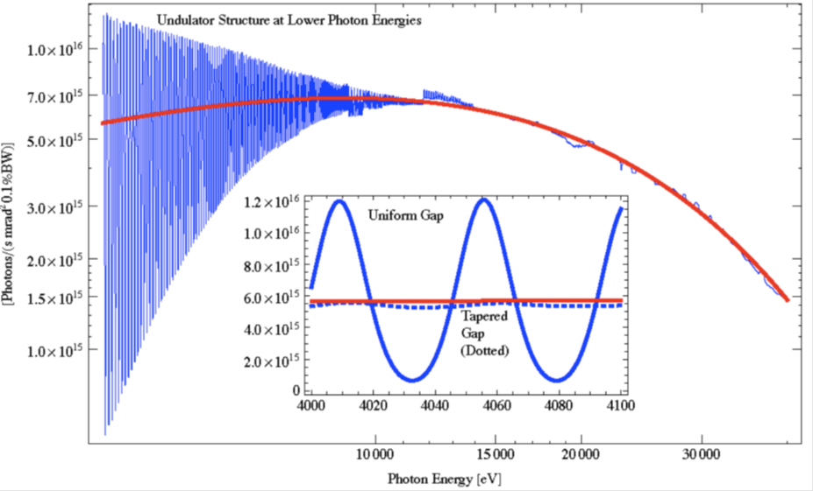
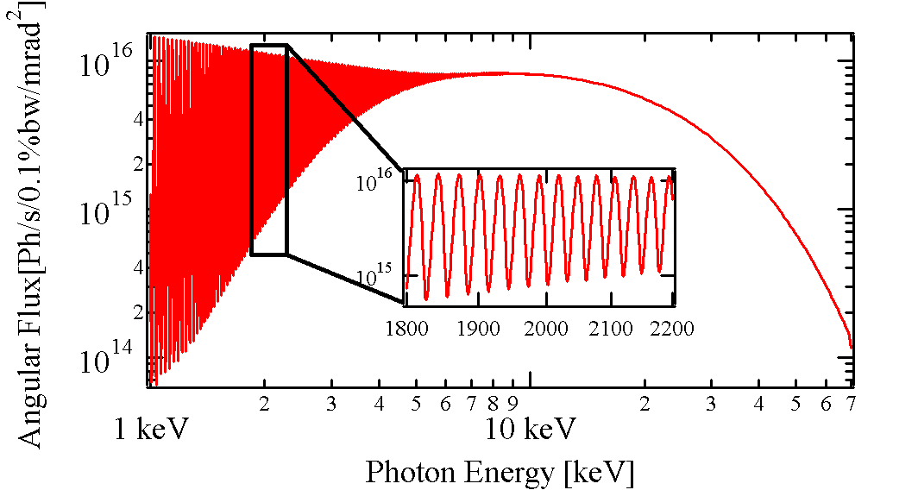
FROM WSV50-SOLEIL TO WSV50-MAXIV:
SPECTRAL NEEDS
MAXIV@3GeV (4 keV→40keV)
MAX: 3 GeV / 500 mA
Construction of a wiggler for the BALDER beamline of MAXIV
Energy range: 4 keV – 40 keV
Collaboration contract signed between SOLEIL and MAXIV in June 2012
Wiggler design inspired from the SOLEIL in-vacuum wiggler WSV50
K=11
SOLEIL@2,75 GeV (20 keV→50 keV)
K=9.8
MAXIV predictions
Aperiodicity (SCW34, CLS)
Tapering of girders (WSV50, MAXIV)
SOLEIL predictions

Slide 9
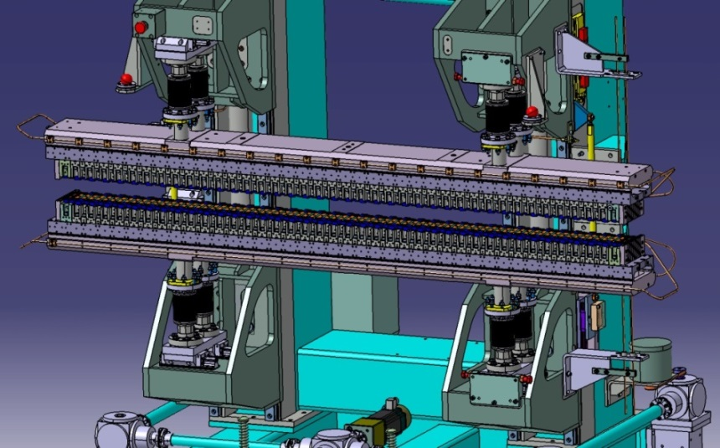
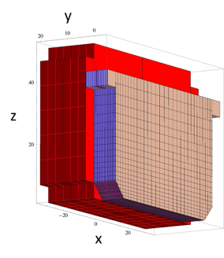
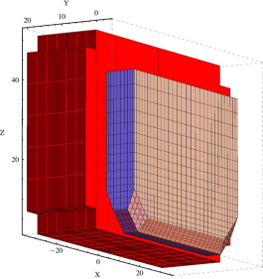
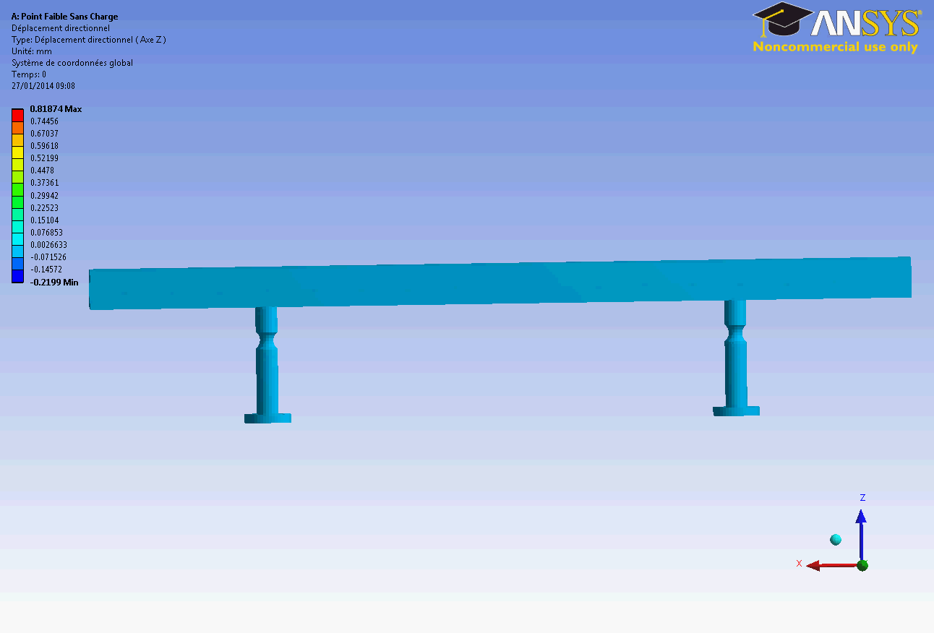
FROM WSV50-SOLEIL
TO WSV50-MAXIV:
MAJOR CHANGES
Girders and magnetic system
  Operational gap: downto 4.2 mm
  Tapering (2 mm) of girders to smooth the spectrum at low energy (4 keV)
  Pole geometry to increase the field and limit the risk of demagnetization during baking
Weak point
E. Wallen, MAXIV
Technology | Hybrid in-vacuum
Magnets | NdFeB (Br=1.21T/Hc=2250 kA/m) from NEOREM
Poles | VdPer (Bs=2.35T)
Period length | 50 mm
Number of full periods | 38
Minimum gap | 4.2 mm (taper: 2 mm)
Max. magnetic field | 2.42 T
Radiation aperture | +/- 1.87 mrad
Tapering of girders
K. Tavakoli, SOLEIL

Slide 10
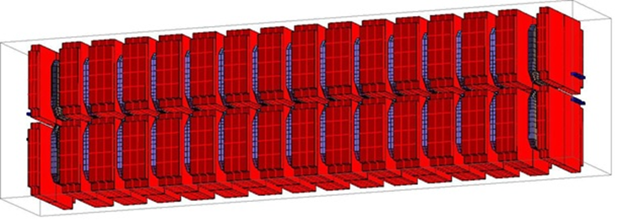
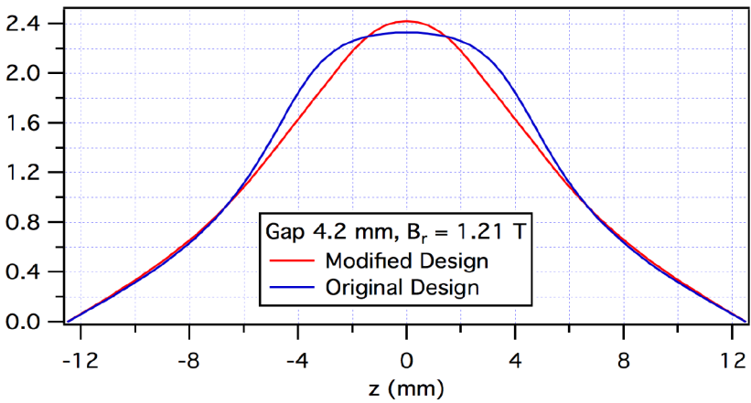
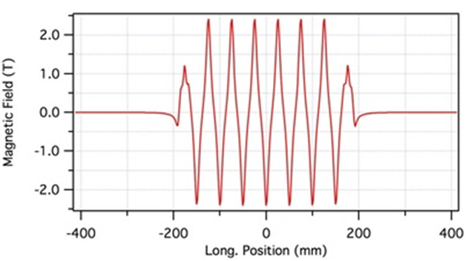
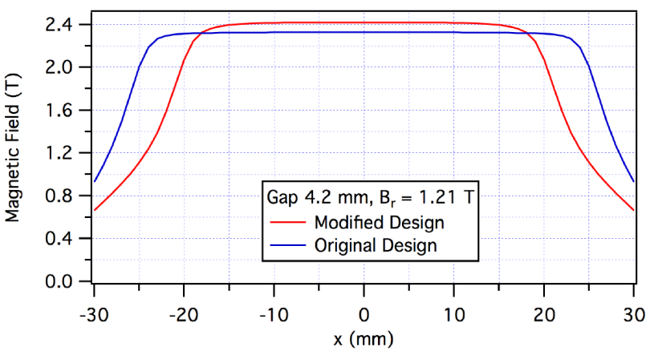
MAGNETIC DESIGN
6 periods model
RADIA Sofware
E. Wallen, MAXIV
SOLEIL
Design
Magnetic Field [T]
MAXIV Design
Good field region
MAXIV
Good field region
SOLEIL

Slide 11
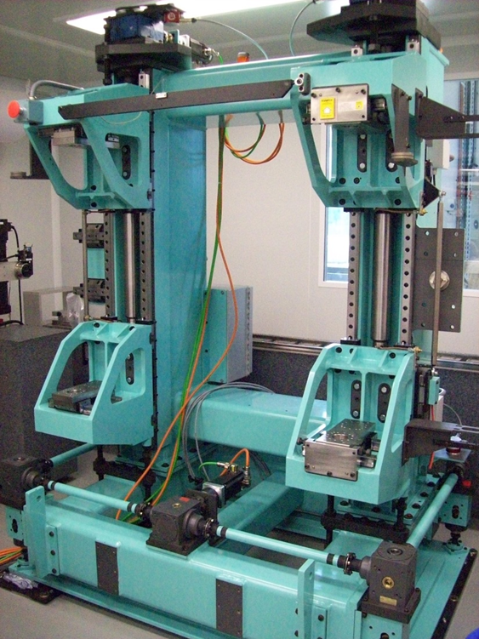
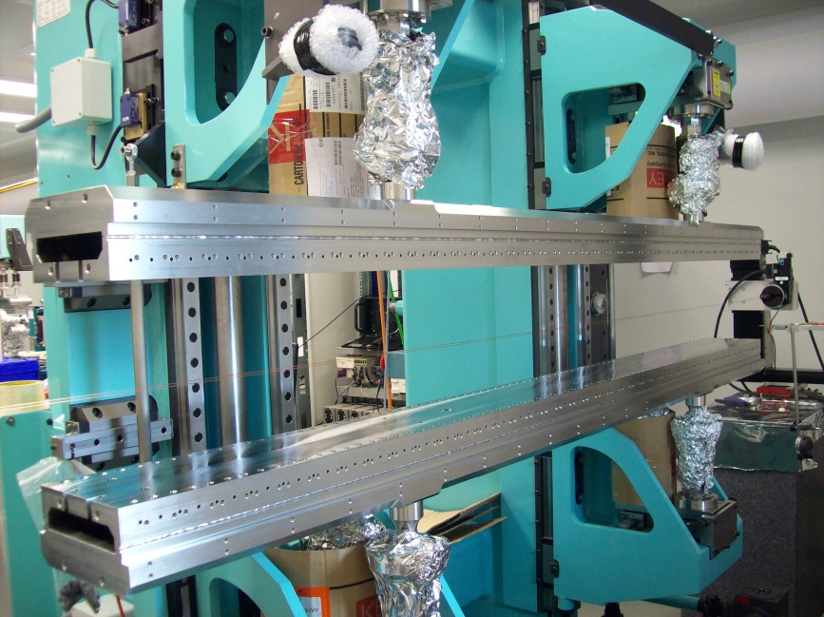

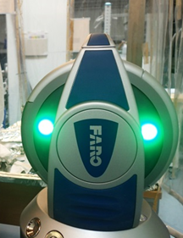
ASSEMBLING: PLANEITY CONTROL
3 motors carriage
Stainless steel girders
Target
Laser Tracker
NORTEMECANICA, Spain

Slide 12
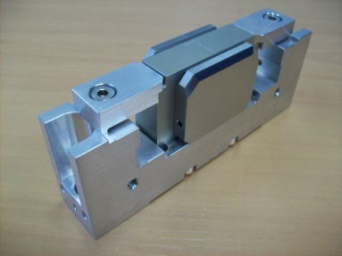
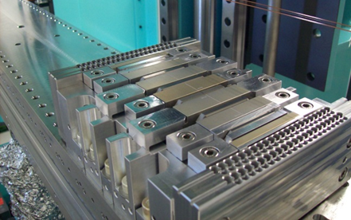
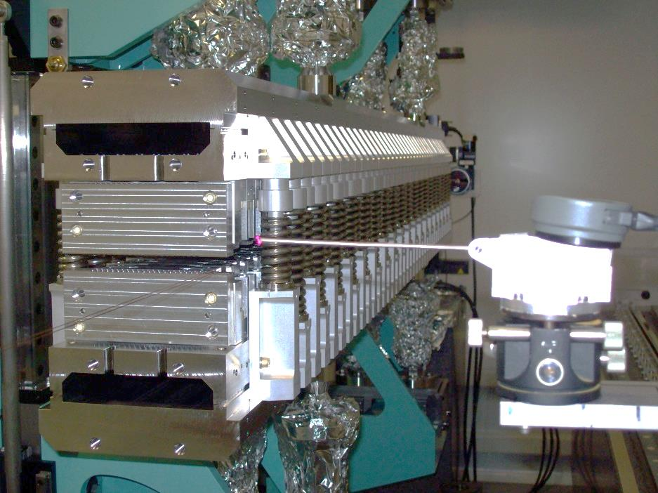
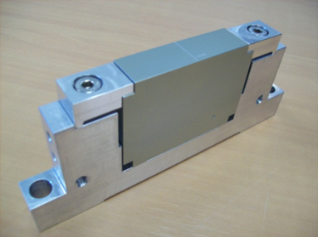
ASSEMBLING: PLANEITY CORRECTION
Amagnetic shims between girders and
Magnet/poles supports
Tuning of spring force with shims
Touch sensor to check: +/-0,03 mm

Slide 13
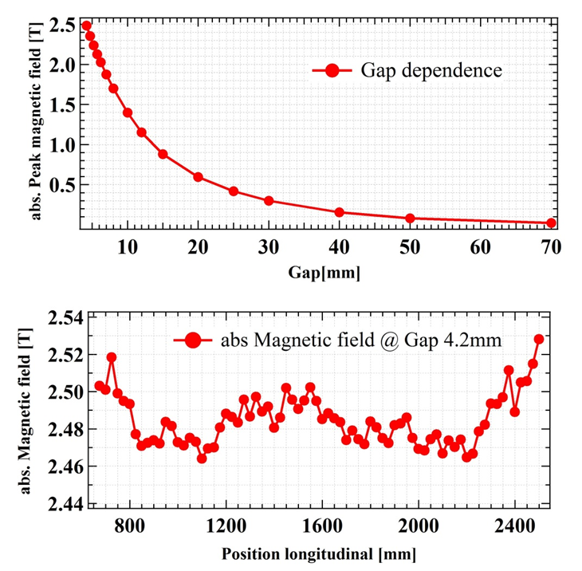
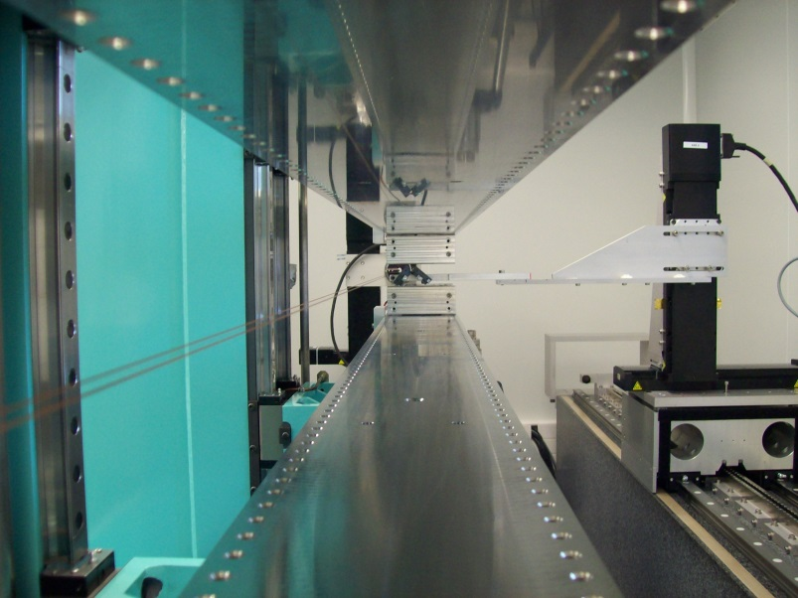
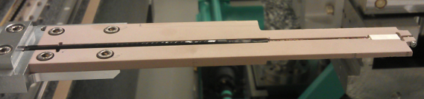
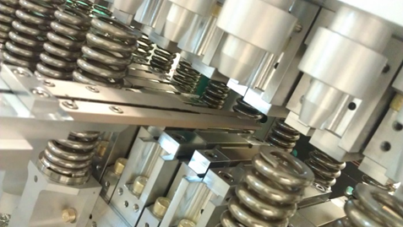
MAGNETIC PERFORMANCES: MAGNETIC FIELD
Group3
DANFYSIK
3 mm calibrated Hall probe
Mounted on a mobile carriage
Range: 0 - 3T
Accuracy: 5.10⁻⁶ T
Reproducibility:10⁻⁵ T

Slide 14
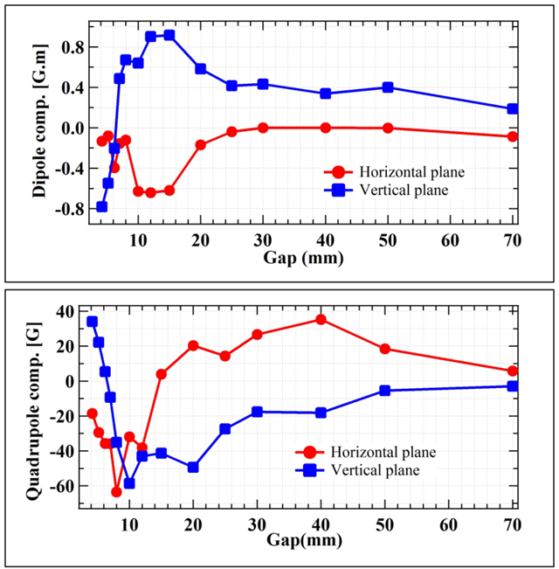
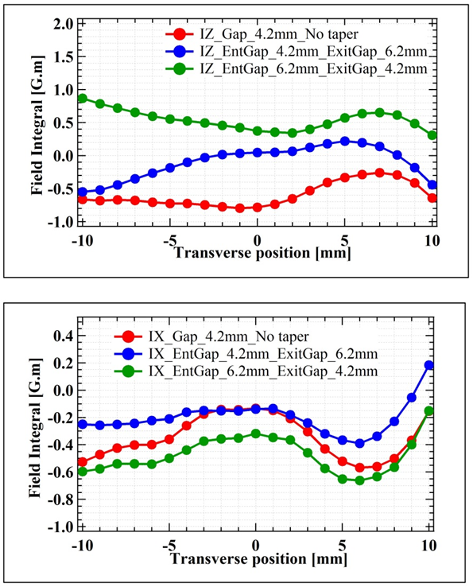
MAGNETIC PERFORMANCES: FIELD INTEGRALS
Integrated components vs Gap
Effect of taper on the field integrals
VERTICAL
Low quadrupolar components
Dipolar components corrected with trim coils
HORIZONTAL

Slide 15
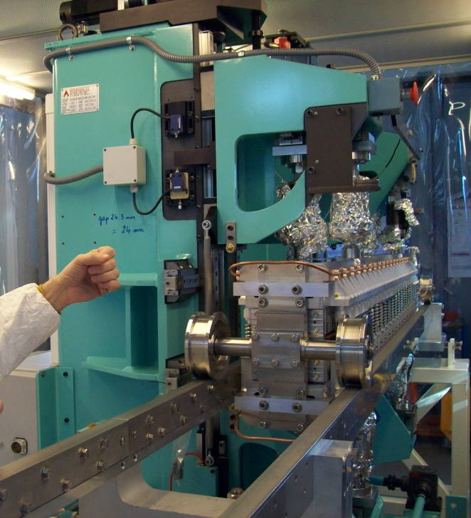
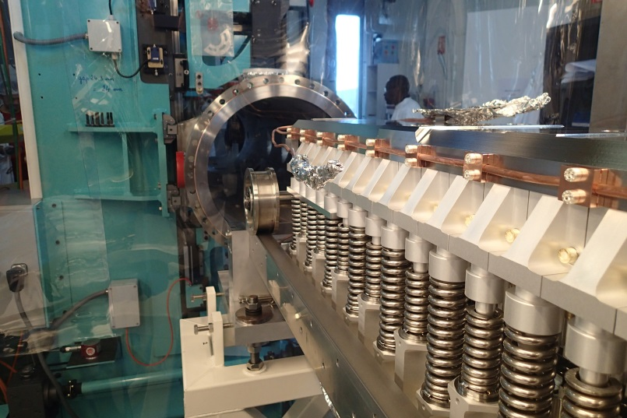
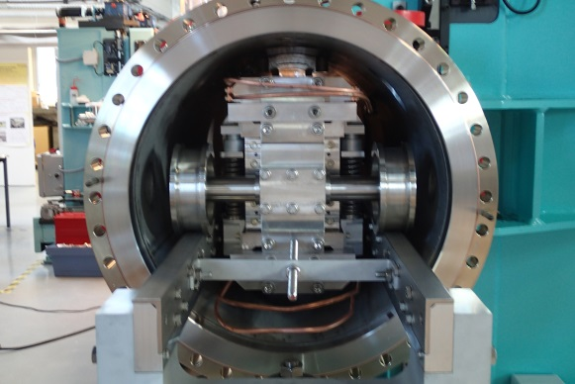
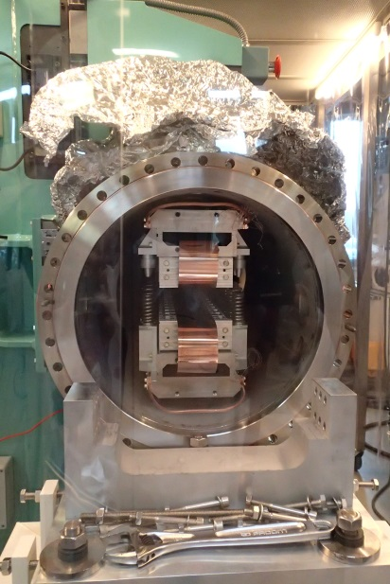
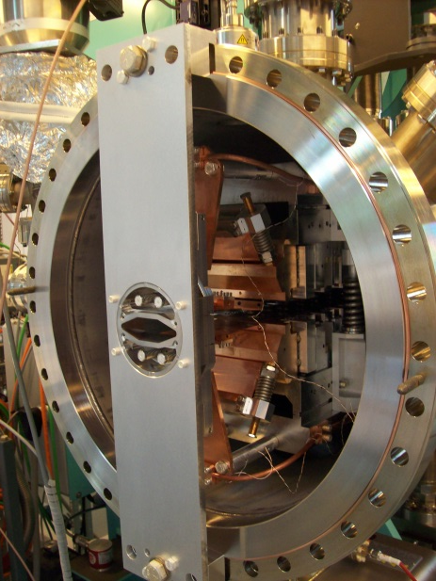
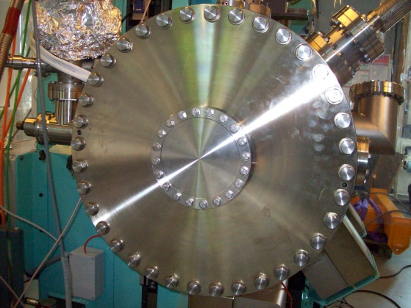
INSIDE VACUUM VESSEL ASSEMBLING
Inside de vacuum vessel
Vacuum vessel mounting
Magnetic system displacement
Copper foils
Extremity flange
Transition mounting

Slide 16
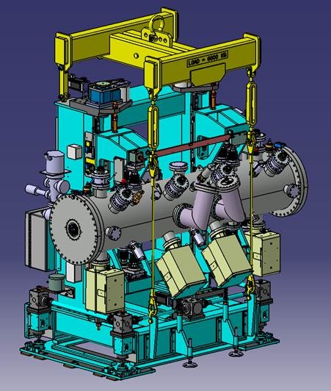
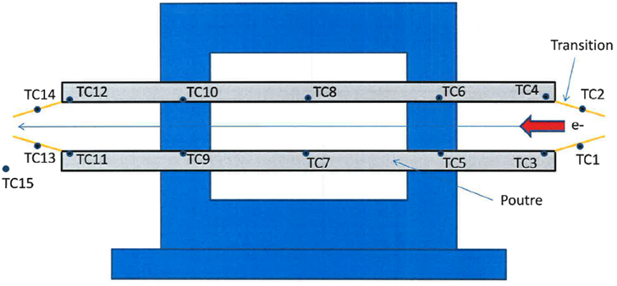
PUMPING AND INSTRUMENTATION
1 500 l/s ion pump
4 150 l/s ion pump
2 NEG Cartridges
2 PENNING GAUGES
15 THERMOCOUPLES

Slide 17
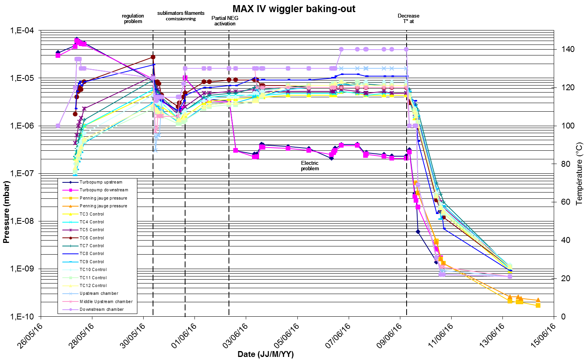
VACUUM TESTS AT SOLEIL
Baking
N. Bechu - SOLEIL

Slide 18




DELIVERY AND
INSTALLATION IN THE MAXIV TUNNEL
Lifting of 4,7 tons wiggler
Loading before departure to MAXIV
In-situ conditionning:
Gaseous Nitrogen
In the MAXIV tunnel
H.. Tarawneh - MAXIV

Slide 19


VACUUM TESTS
AT MAXIV
Baking
M. Grabski/H. Tarawneh - MAXIV
Baking

Slide 20
CONCLUSIONS
The Wiggler dedicated for the Balder Beam line is an upgrade version of the wiggler built for SOLEIL
The choice of the technology (PM) results from the need of compacity and zero running costs and maintenance
Major changes and adaptations:
  Functionnal needs
    Tapering of girders
    Operation at low gap
    Magnetic system: geometry of poles
  Specific constraints
    Carriage axis: higher than at SOLEIL
    Measurement bench:
      Adapt the measurement axis
      Measure downto 4 mm
  Control means
    Laser Tracker
    Touch sensor
Wiggler is within specifications in terms of magnetic field level, field integrals, vacuum pressure and is presently ready for commisioning at MAXIV storage ring

