Slide 1


Optimized lattice of the Very Large Acceptance compact Storage Ring
Karlsruhe Institute of Technology (KIT, Karlsruhe, Germany)
KIT-ISS ANKA ,Karlsruhe, Germany
A.Papash*, E.Bründermann, A.-S. Müller
Karlsruhe Institute of Technology,
Institute for Beam Physics and Technology,
76344, Eggenstein-Leopoldshafen, Germany
* alexander.papash@kit.edu

Slide 2
Abstract
Combination of a circular storage ring and a laser wake-field accelerator (LWFA) might be the basis for a new generation of compact light sources and advancing user facilities to different commercial applications including multi-user medical applications etc.
Meanwhile the post-LWFA beam is NOT directly suitable for storage and accumulation in conventional storage rings. The energy-spread of a post-LWFA beam well exceeds the momentum-spread of beams injected and stored in existing light sources. Ultra-short electron bunches after LWFA will be spread out in existing storage rings.
Storage rings with adapted features should be built. In order to build these new rings, feasibility studies are required. Experimental "proof–of-principles" of stable rotation of ultra-short (fs) bunches as well as storage of a wide-momentum spread beam in circular rings would be a solid ground for further R&D on LWFA facilities
Extensive studies of possible geometries and lattices of Very Large Acceptance compact Storage Ring (VLA-cSR) in the energy range from 50 to 500 MeV in progress Objective -- create a ring model suitable to store wide momentum spread (2÷3% rms) beam as well as ultra-short electron bunches in the fs range.
More than 40 versions of compact ring lattices based on DBA, DBA-FDF, TBA, 5BA cells, were analyzed so far

Slide 3
DBA-FDF lattice with relaxed settings, split elements and optimized
parameters was chosen as a basis for further detailed studies of VLA-cSR
Lattice Model compromises contradictory conditions like small circumference of the ring and small dispersion. DA is opened up to 15-20 mm to fit the wide momentum-spread beam
Chromaticity per unit cell is limited while the ≈“-I” condition is realized
The condition of mirror symmetry at the positions of the horizontal chromatic sextupoles is fulfilled
Local maxima of the horizontal beta-function and dispersion at positions of the main chromatic sextupoles help to limit the high sextupole strength
Phase advance per cell is adjusted to minimize the leading resonance-driving terms.
Harmonic sextupole and octupole families applied for non-linear studies, in particular to operate the ring at a negative compaction factor and to manipulate the bunch length and shape etc., providing the octupole strength will be limited.

Slide 4
CONTENT
VLA-cSR ring studies -- part of the ATHENA Project
Expected parameters of post LWFA beam
Formulation of a problem and experimental proof-of-principles
FLUTE as ring injector
Parameters and lattice of the VLA-cSR ring
Non-linear features of the ring
Phase compression
APPENDIX

Slide 5
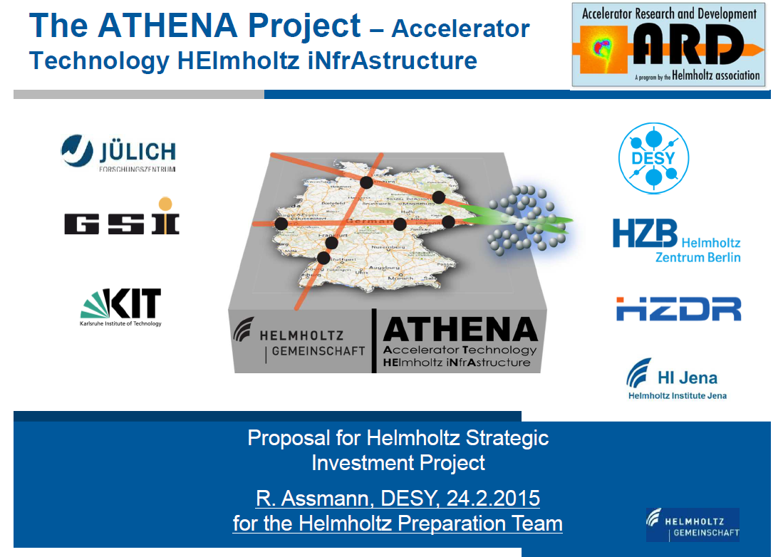

Slide 6
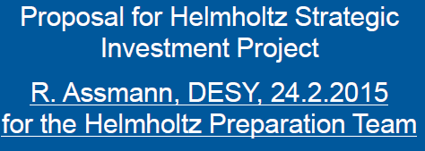
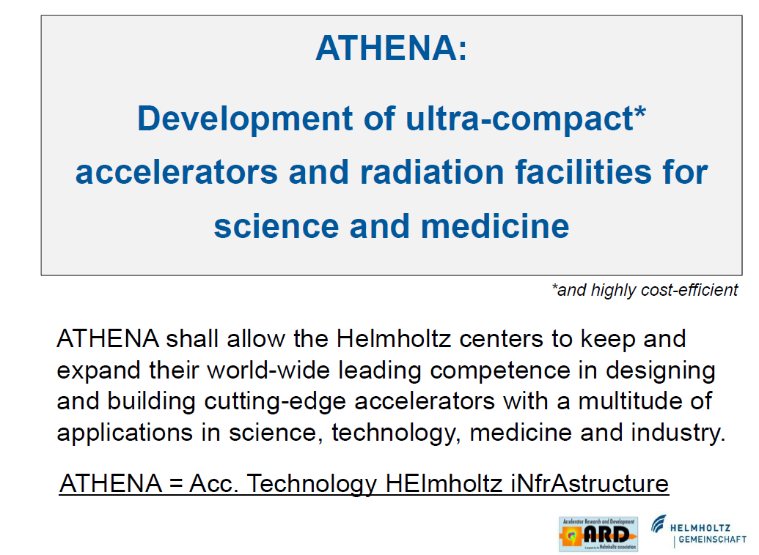

Slide 7
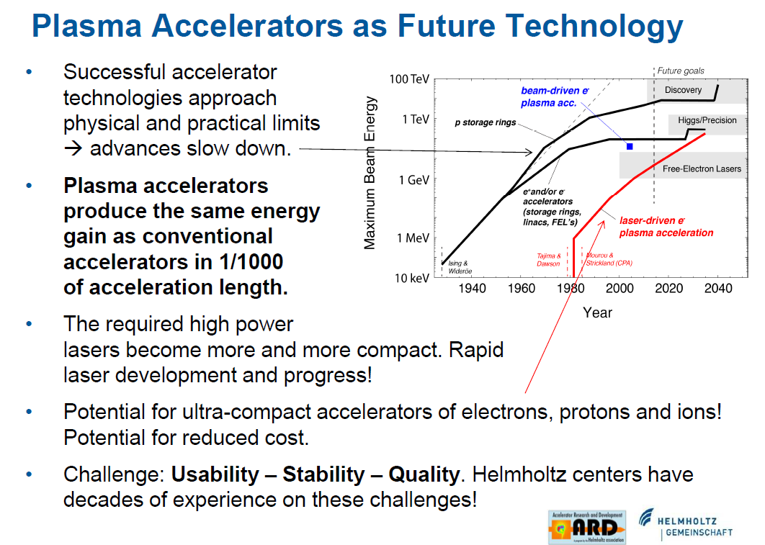

Slide 8
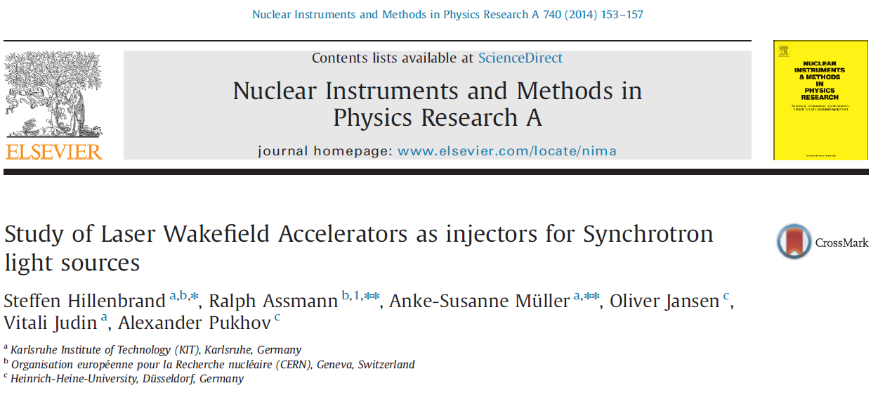
Combination of LWFA and Storage ring would allow to build new generation compact Light Sources and expand user facilities to different commercial applications including multi-user medical applications etc.

Slide 9
Is it possible to accept reasonable part of the
e-beam after LWFA for further storage, manipulation
and accumulation in a dedicated ring ?
expected parameters of electron beam generated
by Laser Wake-field accelerator

Slide 10

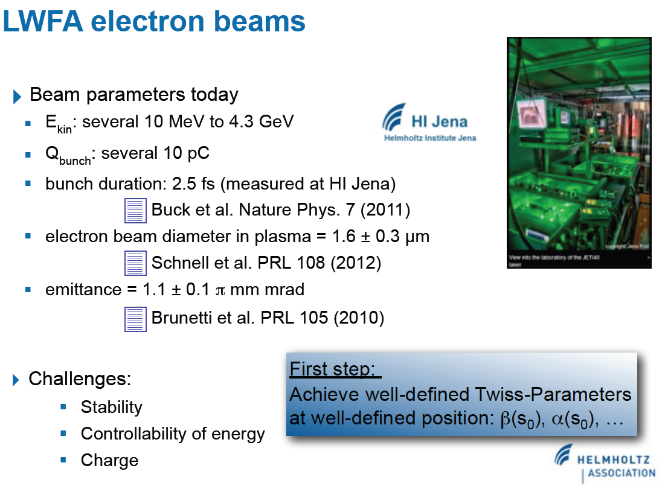

Slide 11
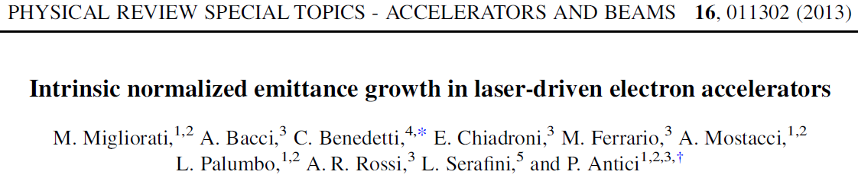
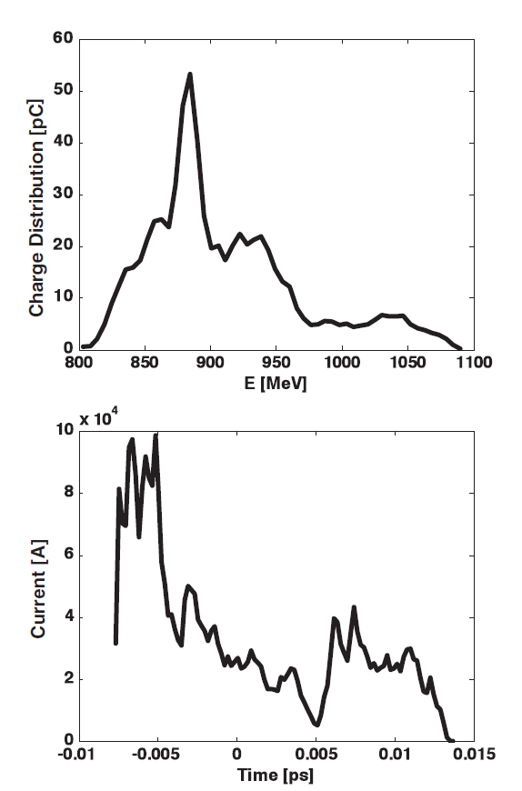
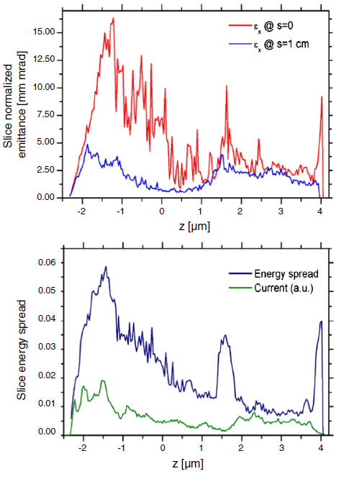
Energy spectrum
of post-LWFA beam
e-beam after
Laser Wake-Field
Accelerator
Full mess ?
NO comments ?
BUT !
Central core of
E-beam is clearly visible
Fig.1. Charge distribution vs energy (top)
and current vs time (bottom) of the
Initial electron distribution as obtained
with the PIC code ALADYN
Fig.3. Comparison of slice normalized emittance
at the interaction point after a 1 cm drift space
(top) and slice energy spread (bottom). The
number of slices in the longitudinla plane is 200.

Slide 12
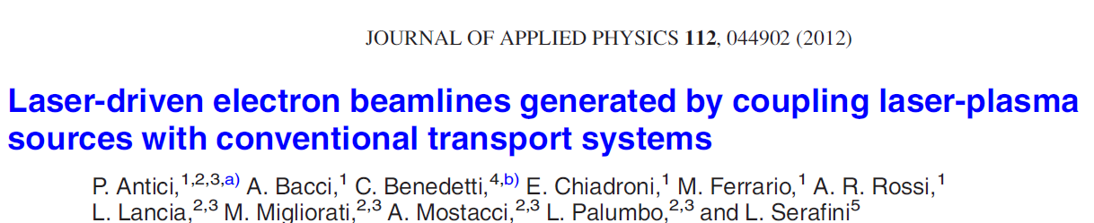
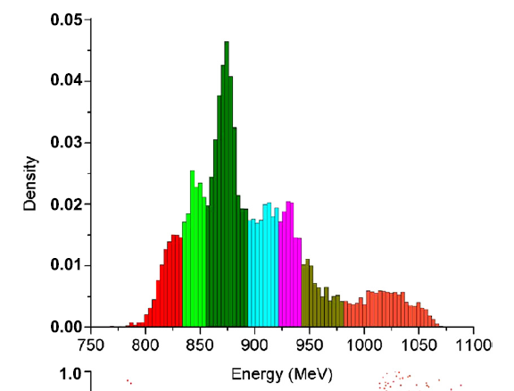
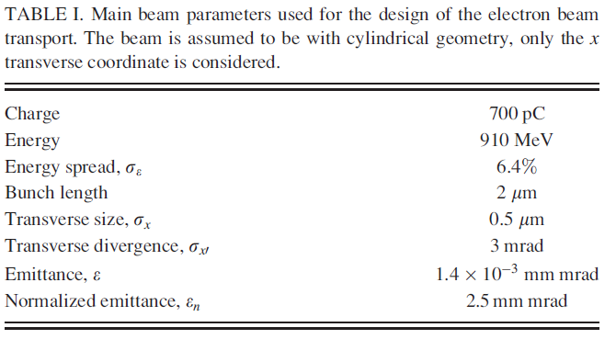
Energy distribution of the e-beam after LWFA is NOT a GAUSSIAN. Assuming Gaussian distribution of main peak (green slices) the energy spread of e-beam to be ACCEPTED by the LWFA ring is ΔΕ ≈ 25 MeV at Ecentral = 875 MeV.
Anticipated full width at half maximum of MAIN PEAK is
Single spike width FWHM ≈ 3%
σp ≈1.2%
Is it reasonable for further
accumulation and storage
in a dedicated ring ?
Fig. 3. Bunch spectrum. The ordinate in histogram
indicates the amount of particles normalized
to all particles.

Slide 13
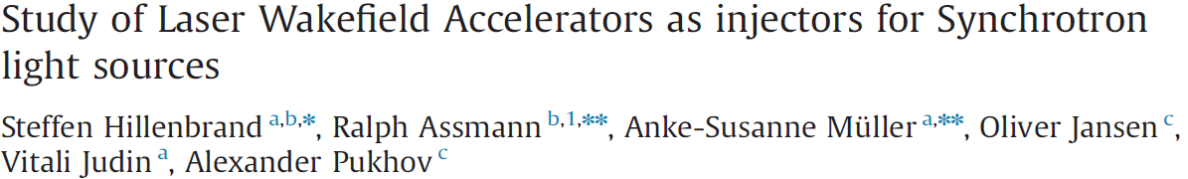
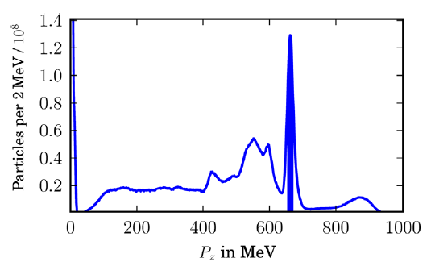
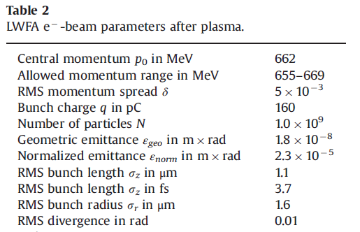
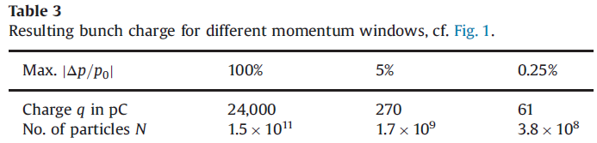
ΔE ≈ 14÷20 MeV
E = 662 MeV
Δp/p≈ 2÷3 %
FWHM ≤ 3 %
σp ≈1.3 %
assuming Gaussian
distribution of
main peak (single spike)
FWHM
Fig.1. Longitudinal momentum distribution of
LWFA generated electrons.

Slide 14
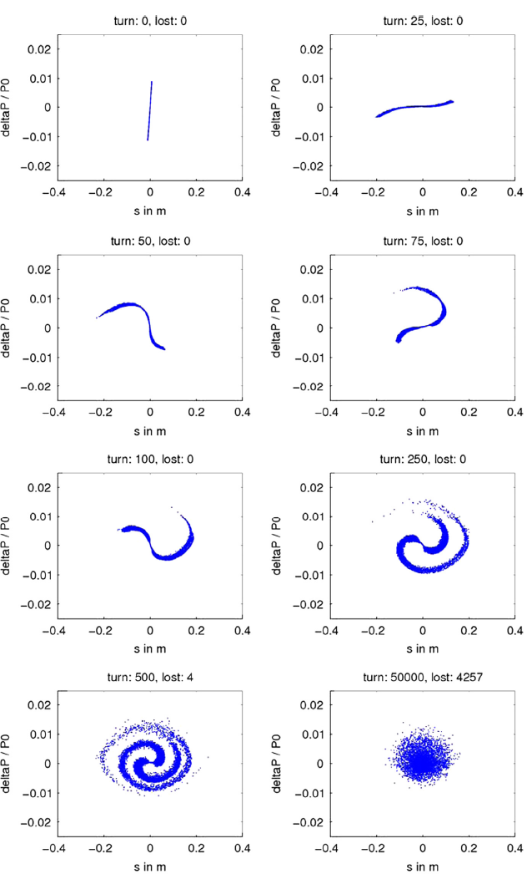
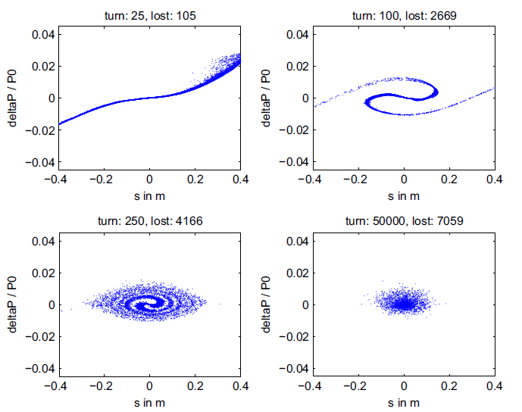
Some problems arise:
Evolution of longitudinal phase space after injection of post LWFA bunch (τ ≈ 10 fs) into the ANKA ring (top left to botom right) for a maximal initial energy deviation Δp= ±1%. Simulations were carried with N=10000 particles.
During circulation in the present generation light source ring ultra-short pulses injected after LWFA will be spread out inside RF Bucket and partly lost due to synchrotron motion filamentation (compaction factor) caused by large momentum spread of injected bunch
Evolution of longitudinal phase space of beam with momentum spread Δp= ±3% exceeding RF acceptance of the ring. Particles are lost by moving out of RF Bucket.

Slide 15
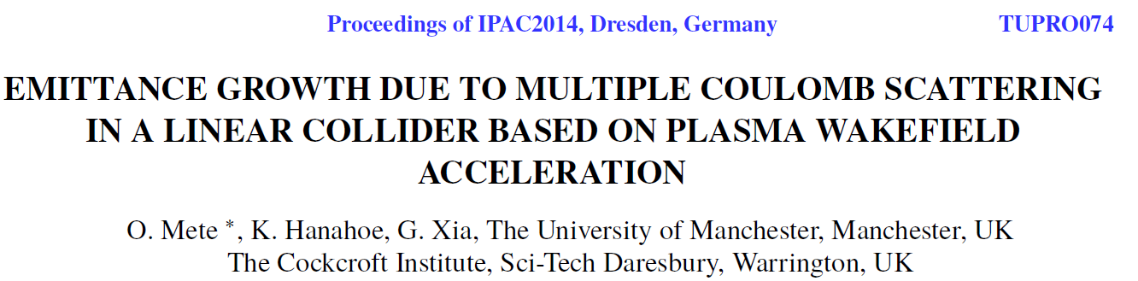
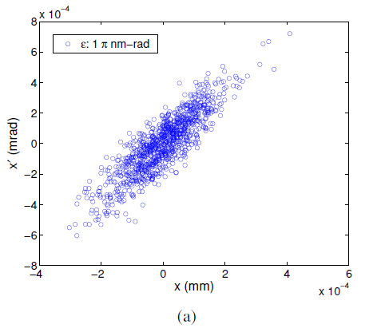
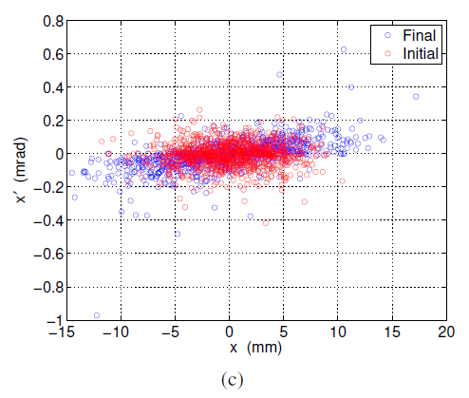
More problems may lead to emittance
growth and bunch broadening in the ring
Due to the expanding of electrons in the plasma “bubble” with large divergence σ_{x′} and large momentum spread σ_{E} of initial bunch extracted from electron plasma the effective normalized beam emittance ε_{norm} will grow significantly according to
ε²_{norm} = <γ>²⋅ (σ²_{E} ⋅σ²_{x} ⋅σ²_{x′} + ε²)
approximating beam divergence as σ_{x′} =σ_{x} ⋅s where s is distance from the laser target, the normalized emittance should grow with distance as square of product of momentum spread and distance from the target (σ_{E} ⋅s)²
ε²_{norm} ≈ <γ>²⋅ (σ²_{E} ⋅σ⁴_{x} ⋅s² + ε²)
Growth of normalized emittance should lead to increase of bunch length due to synchrotron-betatron coupling in dispersion sections of a ring. Laser driven e-gun could be immersed into a strong field solenoids with short focusing distance in order to limit effect of beam emittance growth.
At low energies (<100 MeV) multi-bunch instability and Intra-beam scattering would contribute to bunch length increasing
Evolution of phase space for electron beam travelling
through neutral Li gas sampled and compared at:
a) Initial phase space distribution,
c) 130-150 m as initial and final, respectively.

Slide 16
expected parameters of electron beam generated by Laser Wake-field accelerator
The pulse width of single spike electron bunch extracted from the Laser Wake Field Accelerator and
after bunch compression should be expected in a range of
σ_{τ} ∼ 1 to 10 fs
while energy spread of such ultra-short spike could be varied in a range of
σ_{E} ∼ 1% to 3%
The bunch charge of single spike might be in a range of
Q ≈ 20 ÷ 30 pC
and should not exceed
Q ≤ 200 pC
in order to fulfill conditions for a single spike.
The pulse duration of bunch with charge of Q ∼ 1 nC might reach
σ_{τ} ∼ 30 ÷ 100 fs
The laser spot footprint is less than 1 μm and initial beam spot might be expected as small as σ_{x,y} ∼ 1 μm
More realistic to expect that due to fast expansion of electrons in a plasma with large angular and momentum spread the beam size should be defined at expanded bubble surface where electrons leave dense plasma
σ_{x,y} ∼ 10 μm ( this number should be ckecked -?)
The beam divergence is rather high
σ_{x′,y′} ∼ 1 ÷ 3 mr.
Thus, emittance of electron spikes after LWFA (1 GeV) might be estimated as
ε_{x,y} ∼ 10 ÷ 30 nm⋅rad ( ε_{norm} ∼ 20 mm·mr )

Slide 17
Definition of a problem
beam after LWFA is NOT fitted for storage and accumulation in present generation rings
energy spread of post LWFA beam σ_{E} ∼ (1÷3)% exceeds momentum spread of beam injected and stored in existing light sources (σ_{E} ∼ 0.1%)
utlra short e-pulses after LWFA (σ_{τ} ∼ 10 fs) will be spread out in existing storage rings to σ_{rf} ∼ 1 ns due to RF filamentation process
LWFA beam will be destroyed if one would attempt to inject it into present generation light sources
Dedicated rings with new features are required
before to build LWFA facility one should study how is it possible to accept beam after LWFA
experimental "proof of principles" is required of stable rotation of ultra-short (∼fs)
bunches as well as wide-momentum spread beam in a circular rings would be a solid
ground for further R&D on LWFA facilities

Slide 18
Prototypes

Slide 19
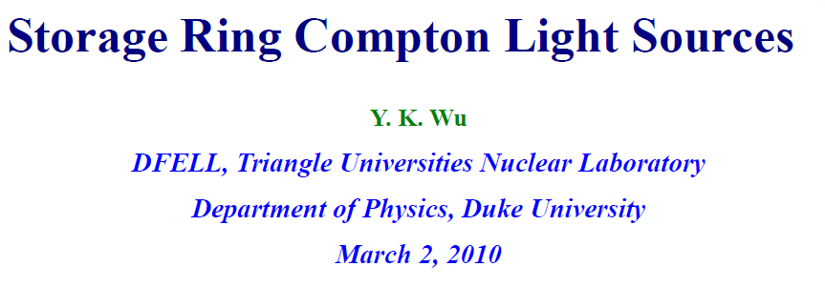
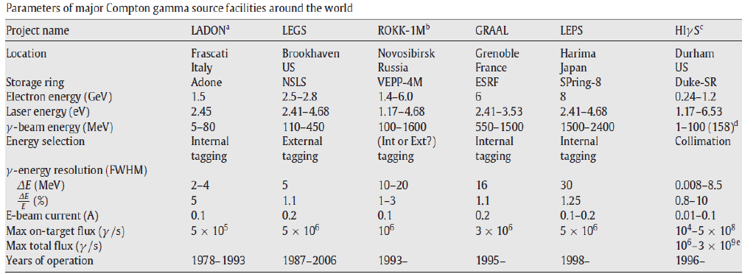
Prototypes

Slide 20
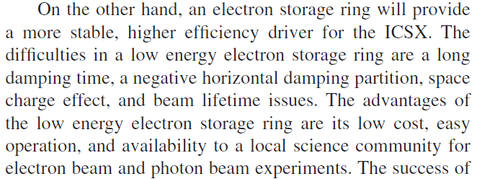

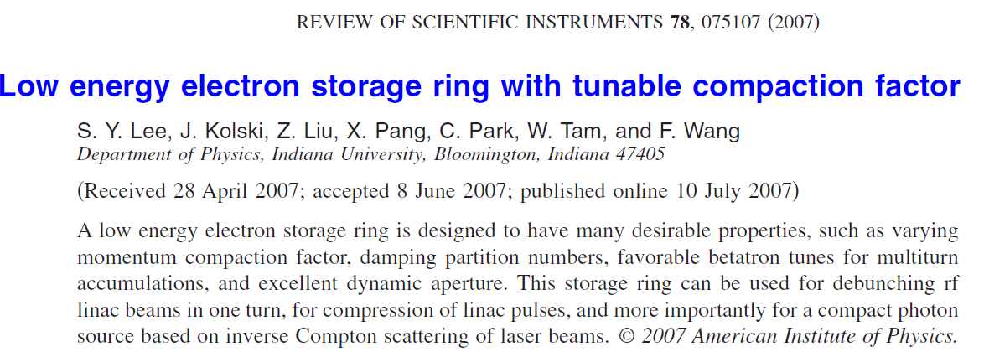
Prototypes
Compact Low energy electron storage rings for inverse Compton Scattering
D.E.Monston (MIT, USA) “Inverse Compton Scattering: A Small Revolution in X-Ray Sources and Applications“
Inverse Compton Scattering x-ray (ICSX) sources. LINAC -- driver for electron beam…
Energy of scattered γ quants
under head-on collision

Slide 21
Prototypes
ICSX Project ( Indiana University, USA )
20 – 100 MeV (up to 600 MeV) e-synchrotron. Ring circumference = 20 m
Four fold symmetry, Four 90° bending magnets, ρ=2 m (D=2.5 m) Four 3 m long straigth sections
Two sets of focusing damping wigglers -- three gradient rectangular dipoles each set (either four bends of chican type) located at opposite straights
Chican magnet system to interact e-beam with laser pulses for inverse Compton scattering
Tunable momentum compaction factor (−1..+0,58) by adjusting field strength of damping wigglers
Debunch RF LINAC beam bunches
Compress LINAC pulses by operation at α≈ 0 ( quasi-isochronous mode)
Energy spread of ICSX ring - combined effect of SR and CS
Electron loses significant part of energy due to stochastic nature of Compton scattering – strong excitaiton of syncrhotron oscillations -- large momentum spread δ > 1.5% (e –beam energy E = 50 MeV)
Large Dispersion of ICSX ring (D>2 m) would lead to SMALL geometric Momentum Acceptance
IBS (Touschek life time), vacuum conditions for low energy electrons require additional studies
Unfortunately, post LWFA beam with large momentum spread not fitted to the ICSX ring

Slide 22
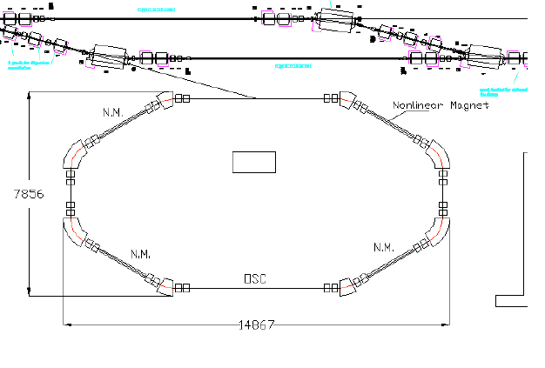
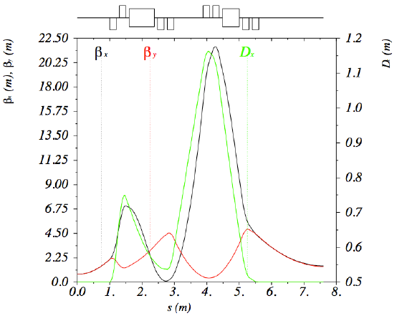
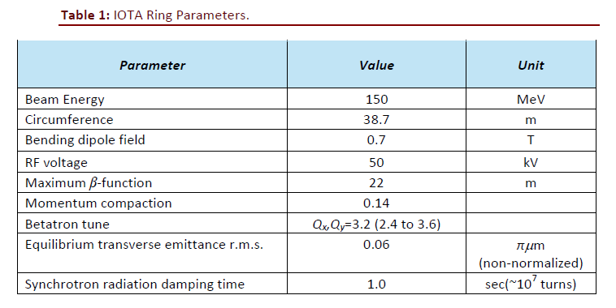
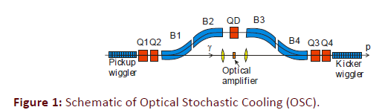
IOTA ring (ASTA proposals 2013)
Prototypes
IOTA ring layout
IOTA lattice
The IOTA ring is designed for the proof-of-principle experiment of the nonlinear integrable optics at the ASTA facility.
It is desirable to accommodate more experiments, such as the nonlinear focusing with electron beam lens and optical stochastic cooling. four 2 m nonlinear magnet insertions sections
Optical stochastic experiment at IOTA (2014)

Slide 23
FLUTE LINAC
as
injector of low energy
Electron beam

Slide 24
The VLA-cSR ring should provide possibility for EXPERIMENTS and TESTS with electron beam in a wide energy range from 50 to ∼500 MeV with objectives:
1) Ring operation with ULTRA SHORT PULSES
preserve pulse structure of ultra-short bunches with pulse width
σ_{τ} ≤ 30 fs
Charge of single spike could be in the range of
Q = 20 ÷ 200 pC
in order to fulfill conditions for a single spike injection after the LWFA while the
pulse duration of bunch with charge of Q ∼ 1 nC might reach
σ_{τ} ∼ 100 fs.
Ring operation with beam of large momentum spread
feasibility studies of a ring with large Momentum Acceptance
ΔP/P > ≈ 10 %
and reasonably large Dynamic Aperture to store the electrons after the LWFA with
emittance of about
ε_{x,y} ∼ 10 to 30 nm⋅rad (rms)
and momentum spread of
  σ_{E} ∼ ± 1 % (realistic value) up to ± 3 % (if possible et al)
  3) Is it feasible and realistic to COMBINE ring operation with beam of large
  momentum spread AND ultra short bunch width ???

Slide 25
At beam energy 50 MeV the SR dumping time is about τSR ≈ 20 s and one can consider processes associated with SR as SLOW ADIABATIC DAMPING with respect to betatron and synchrotron motion as well as to stochastic cooling processes in a dedicated test ring
Available energy range of the LWFA ring from 50 up to 500 MeV would allow to study injection, circulation and storage of ultra-short bunches as well as beam with large momentum spread after the FLUTE at low energies – without interfering with Synchrotron radiation damping.
Also one could investigate beam sirculation and storage after the laser wake-field accelerator at high energies up to 500 MeV.
e-beam Energy | SR Damping time in horizontal phase space plane | SR Damping time in vertical phase space plane | SR Damping time in longitudinal phase space (bunch length – energy spread)
50 MeV | 20 s | 19.6 s | 9.7 s
100 MeV | 2.5 s | 2.45 s | 1.2 s
200 MeV | 0.32 s | 0.31 s | 0.15 s
400 MeV | 39 ms | 38 ms | 19 ms
500 MeV | 20 ms | 19.7 ms | 9.7 ms

Slide 26
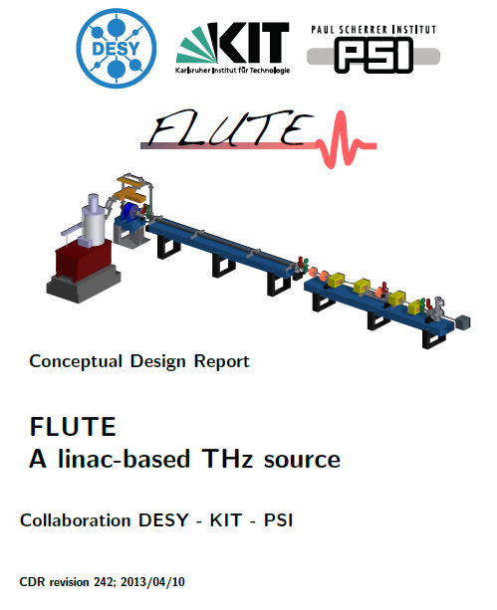
Why FLUTE as a test injector, why not a conventional Light Source facility ?
(1) First of all, FLUTE is a research test bench DEDICATED to R&D while user facilities are overbooked and can not be easily modified and even can NOT be modified et al in order to fulfil very specific requirements for post LWFA ring
(2) Beam parameters after FLUTE might be easily fitted
to those after the LWFA:
Parameters of FLUTE beam:
Beam energy 40 to 90 MeV
Bunch length (rms) from σ_{τ} = 5 fs (Q= 1 pC charge)
to σ_{τ} <100 fs (Q= 100 pC charge)
momentum spread (rms) σ_{E} ∼ 1%
repetition rate 10 Hz
FLUTE beam emittance ε_{x,y} < 10 nm⋅rad (rms)
Parameters of FLUTE beam are more reproducable and
stable than those from LWFA . Ideal for systematic R&D
(3) The SR dumping time is τSR ≈ 20÷40 s at E=50 MeV, i.e. SR
is SLOW ADIABATIC process with respect to betatron and
synchrotron oscillations as well as possible stochastic cooling
(4) With beam after FLUTE one could study short (∼fs) as well as
wide momentum spread (δ∼2%) bunches indepenent on SR
(5) Ring could operate in an energy range from 50 to 500 MeV
(6) Next step towards post LWFA facility would be an injection
of ∼500 MeV e-beam after the LWFA into the VLA-cSR ring

Slide 27
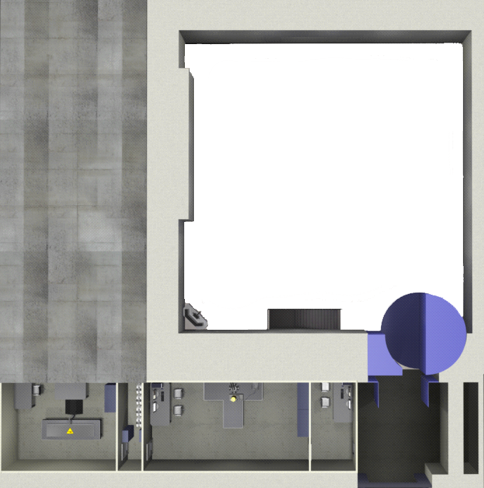
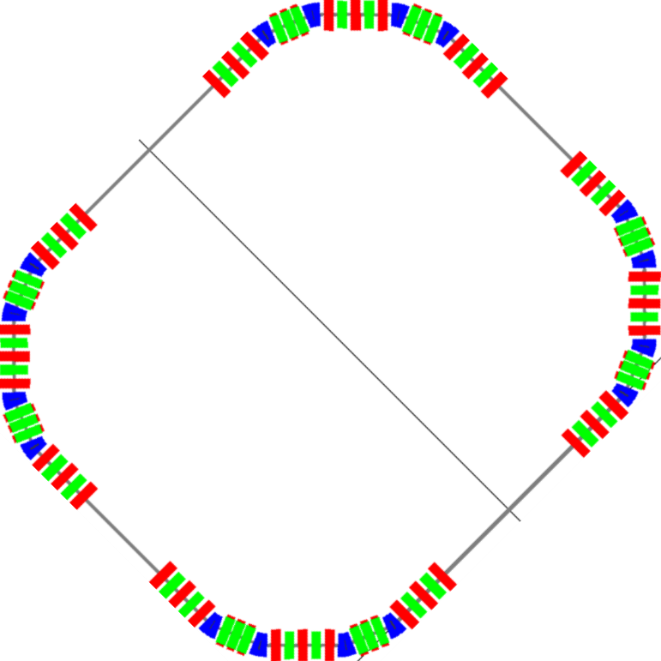
Layout of FLUTE and post-LWFA ring in the Bunker
Experimental Hall
Ring is fitted into the
FLUTE bunker and might be
located above the LINAC
at second level
(height 5 m)
Bunker
S =210 m²
Area =15 m × 14 m × h = 5 m
with radiation protection
diagonal ~21 m
COST saving project
NO additional radiation protection
NO additional costs for building and
moderate cost for engineering
Rooms around Bunker are available
to locate power supplies, electronics
and engineering equipment
Laser clean room
Experimental room
Control room
1

Slide 28
REASONS to use FLUTE as an injector for the low energy post LWFA test storage ring
At 50 MeV the SR damping time is ≈ 20 s and SR is SLOW ADIABATIC process with respect to betatron and synchrotron motion
Using FLUTE as an injector one can systematically study effects associated with circulation of large momentum spread beam as well as with rotation of ultra-short bunches without being affected by SR
Optic stochastic cooling processes might be studied in a dedicated low energy test ring
Using FLUTE as an injector one can simulate beam conditions after LWFA but more reproducable and stable than those from LWFA
Energy range from 50 MeV up to ∼500 MeV would allow to test low energy beam after FLUTE as well as beam after Laser Wake Field Accelerator
Cost saving project. Compact ring dimensions help to locate ring in existing Bunker vault where FLUTE is installed. Radiation protection, communications and other engineering equipment already provided either might be easily accommodated

Slide 29
VLA-cSR lattice with relaxed parameters
(ring geometry fitted to the FLUTE Bunker)

Slide 30
VLA_cSR ring lattice with relaxed parameters
”3Q_SPLIT_SHORT_5” lattice version fitted to the FLUTE Bunker 15 × 14 m
Parameters of „21_3,6,9“ lattice
are shown in brackets
SXT and OCT
are not shown
L=2 m
Elements are
not in scale
Circumference [m] 44.112 (41)
Horizontal Tune 5.8438 (11.31)
Vertical Tune 8.4605 (2.61)
Nat. hor. Chromaticity −16 (−27)
Nat. vert.Chromaticity −21 (−19)
Chr / Cell −4 / −5.2 (−6.8 / (−4.8)
MAX-IV Chroma (h/v) −50 / −44
MAX-IV CHR / Cell −2.5 / −2.2
NSLS-II CHR / Cell < |3|
ESRF-100 pm / Cell −3.6 / −2.7
Mom compact. 6.034E-03 (3.6E-03)
Hor.damp.partition Jx 1.397 (0.97)
Energy 50 MeV
Rad.energy/turn [MeV] 0.00
Natural Emittance [nm] 0.18 (0.1)
Appr.vert. Emittance [pm] 0.31
Natural energy spread 4.24E-05
Hor. damping time [s] 24 (20)
Vert. damping time [s] 34 (19)
Long. damping time [s] 21 (9)
Radiation Integrals:
I1 [m] 2.662E-01
I2 [1/m] 4.935E+00
I3 [1/m2] 3.876E+00
I4 [1/m] -1.96E+00
I5 [1/m] 3.389E-01
L = 3 m
Earlier version
„VLA_21_3,6,9“
13,204 m
Blue – bends
Red – quads
Green Sextupoles

Slide 31
Ring Lattice “3Q_SPLIT_SHORT_5”. C = 44.112 m
D=25 cm
Betatron tune
Qx=5.8438
Qy= 8.4605

Slide 32
Table 1. Parameters of VLA-cSR and MAX-IV rings

Slide 33
Table 1. Parameters of VLA-cSR and MAX-IV rings (cont.)

Slide 34
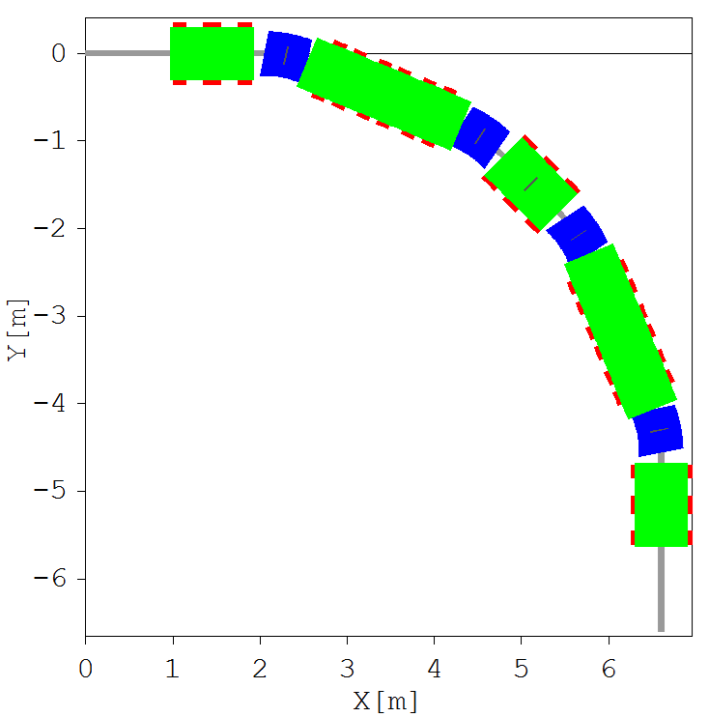
”3Q_SPLIT_SHORT_5” lattice version. One Cell. Length L=11.028 m
Parameters of
„21_3,6,9“ lattice
are shown in brackets
E=50 ÷ 500 MeV
B⋅R=0.167÷1,67 T⋅m
BENDS
TH = 22.5° (22.5°)
L=50 cm (30)
B = 0.13 ÷1,3 T (0.22-2,2)
R =1.273 m (0.764)
θ1=θ2=11.25° (0)
STR=−3.99 m-2 (0)
GRAD= −(0,67÷6,7) T/m
Quads eff. length
Q1,3 = 15 cm (15)
Q2,7,8 = 20 cm
Q4A-4B 15-15 cm
Q5A-5B 15-15 cm
Q6A-6B 15-15 cm
Quads strength
| Kq | < 16 m⁻² (30)
| G | < 3 ÷ 30 T/m
MAX-IV Kq < 4 m⁻²
Chromatic SXT
Integr. Strength Ks·L (m⁻²)
4A-4-4B= +2.2 / 2.2 / 2.2 (+33)
5A-5-5B= −11.3 / 11.3 / 11.3 (-35)
6A-6-6B = +2.1 / 2.1 / 2.1 (+34)
|Ks⋅L | < 11 m⁻² (40)
(MAX-IV S < 22 m⁻²)
SXT effective length
15-10-15 cm (15)
Lq=1 m
L/2=1 m
22.5°
Element dimensions
not in scale
Quads
strentgh (m⁻²)
Q1=−2.138 (−5.8)
Q2=+6.736 (+18.2)
Q3=−4.01 (−13.9)
Q4A=+11.7 (+28.7)
Q4B=+11.485
Q5A=−15.305 (−20)
Q5B=−16.435
Q6A=+11.65 (+28.9)
Q6B=+11.6 5
Q7=−2.437 (−12.1)
Q8=+8.460 (+26.2)
Q4A-4B Q5A-5B Q6A-6B
Q1 Q2 Q3
22.5°
Gradient Bends (blue)
Quads (red)
Chromatic SXT(green)
Combined function magnets (Q+S)
QUADS in dispersion sections
are splitted in doublets
Chromatic SXT are splitted in triplets
Central SXT of each triplet is flanked
between quads
S4A-S4-S4B S5A-S5-S5B S6A-S6-S6B
Q7 Q8 Q7
22.5°
Q6B-6A Q5B-5A Q4B-4A
S6A-S6-S6B S5A-S5-S5B S4A-S4-S4B
22.5°
Q3 Q2 Q1
„3Q_SHORT_5“ cell
All sextupoles
are shown
6,602 m

Slide 35
Lattice “3Q_SPLIT_SHORT_5”. half- cell
Chromaticity ξx= −16 ξy = −21
Betatron tune Qx=5.8438 Qy= 8.4605
Phase adv/cell μ_{x}=1.461⋅2π=2.922π
μ_{y}=2.1151⋅2π=4.2303π
Ph adv(half-cell) μ_{x}=0.7305⋅2π=1.461π (ν_{x} ≈ ¾)
μ_{y}=1.084⋅2π=2.1151π
D=25 cm
Δμ_{x}(S6B-S4A)=(0.64− 0.203)⋅2π=0.44⋅ 2π = 0.88 π ≈1π
Δμ_{x}(S6-S4)=(0.636− 0.208)⋅2π=0.43⋅ 2π = 0.86 π
Δμ_{x}(S6A-S4B)=(0.63− 0.21)⋅2π=0.42⋅ 2π = 0.84 π
Minimization of linear RDT
by proper choice of
betatron phase advance
and mirror symmetry
Second and third order
Chromaticity terms
are reduced
Split quads and sextupoles
applied to reduce
overfocusing
Horizontal and vertical betatron
functions are WELL separated
Q1 Q2 Q3 BM Q4A - Q4B Q5A-Q5B Q6A-Q6B BM Q7 Q8
S1 S11 S2 S21 S3 S41 S4A-S4-S4B S51 S5A-S5-S5B S61 S6A-S6-S6B S62 S7 S81 S8

Slide 36
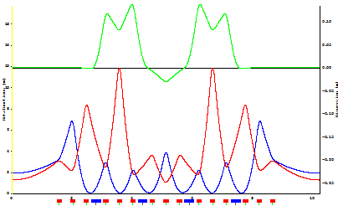
Lattice “3Q_SPLIT_SHORT_5” One cell
Betatron tune
Qx=5.8438
Qy= 8.4605
Phase adv/cell
μ_{x}=1.461⋅2π=2.922π
μ_{y}=2.1151⋅2π=4.2303π
D=25 cm
VLA _21_3,6,9
Mirror
symmetry
Q1 Q2 Q3 BM Q4A-4B Q5A-5B Q6A-6B BM Q7 Q8 Q7 BM Q4A-4B Q5A-5B Q6A-6B BM Q3 Q2 Q1

Slide 37
An envelope of wide momentum spread beam
Lattice “3Q_SPLIT_SHORT_5”. One cell
Post-LWFA beam with large momentum spread
ε_{y,}=10 nm·rad (rms)
Vertical envelope
ε_{y,}=10 nm·rad (rms)
ε_{x} =10 nm·rad (rms)
Required
MA > ±3%
σ_{p} =1% (rms)
ε_{x}=10 nm·rad (rms)
σ_{p} =2% (rms)
Required
MA > ±6%
σ_{p} =2% (rms)
Horizontal envelope
Dx = 24 cm
L, m
Beam envelope of a beam with
small momentum spread
Expected beam envelope at equilibrium
(damping time > 20 s)
IBS not included
ε_{y,}=10 nm·rad (rms)
σ_{p} =2% (rms)
ε_{x} =10 nm·rad (rms)
σ_{p} = 0.1% (rms)
σ_{p} ∼ 0.1%
Natural Emittance 0.18 nm
Appr.vert. Emittance 0.3 pm
Natural energy spread 4.2·10⁻⁵
Green – dispersion trajectory

Slide 38
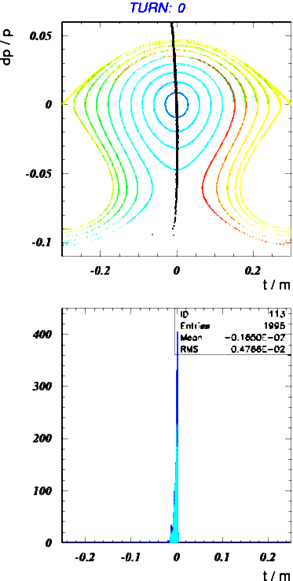
10 fs bunch rotation
in the VLA-cSR
(A.-S.Müuller)

Slide 40
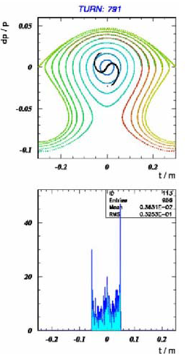

Slide 42
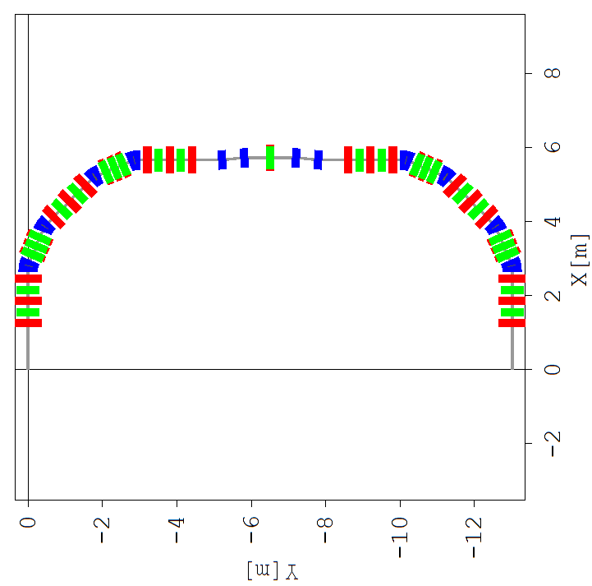
Layout of the LWFA ring + phase compressor of CHICAN type
Study in progres

Slide 43
Non-linear optics
VLA-cSR lattice
with relaxed parameters

Slide 44
Early versions of the VLA-cSR lattice suffer from non-linear distortion caused by strong over-focusing
It was necessary to relax strong settings of early versions (lattice „21.3,6,9“ as an example) and find compromises between lattice parameters
Quadrupole strength of „21_3,6,9“ lattice Kq>30 m⁻² i.e. ∼10 times MORE of MAX-IV quads (Kq < 4 m⁻²)...
Chromaticity/cell HIGH, dispersion SMALL D_{max}<12 cm and required SXT strength is HIGH (S⋅L≈40 m⁻² )
Dynamic aperture (on-momentum) is SMALL DAx≈−5..+7 mm NOT enough for stable circuation
Merit of the „3Q_PLIT_SHORT_5“ lattice
Ring dimensions are fitted to existing FLUTE Bunker while main parameters are improved
Radius of bending magnets is increased, gradient and edge focusing in vertical direction are applied
Quads are splitted in doublets QA-QB, distances between elements are increased
Quads strength reduced from 30 m⁻² to Kq<14 m⁻² (still few times higher those for MAX-IV)
The compensation of horizontal chromaticity is done by sets of splitted SXT triplets SXA–SX−SXB
Ring lattice is modelled to satisfy „−I“ condition for mirror symmetry non-interleaved sextupoles
Max of Dispersion is doubled D=25 cm, integrated SXT strengh reduced S·L<20 m-2 (MAX-IV S⋅L≈20 m⁻²)
Side effect – decreasing of Geometric Momentum Acceptance to MA≤ ±7% (60×30 mm chamber)

Slide 45
Merit of the “3Q_SPLIT_SHORT_5“ lattice
Chromatic SXT S4 and S6 are flanked between quads and located at position of D_{max} and β_{Xmax}
Phase advance between S4 and S6 is close to π and Symmetry conditions are applied
β_{x}(S6)=β_{x}(S4) α_{x}(S6)=−α_{x}(S4) D(S6)=D(S4) D′ (S6)=−D′ (S4) μ_{x}(S6−S4)≈π
S5 is positioned in the middle of dispersion section at MAX of vertical β_{y}(S5) and MIN β_{x}(S5)≈5 cm
Vertical SXT S5 has little influence on SXT non-linear terms in horizontal plane
Quads gradients relaxed to <25 T/m at 500 MeV (MAX-IV Q gradients are <40 T/m)
Half-cell betatron phase advance close to μ_{x}≈3.5 (ν_{x}≈1.75) and Resonance Driving Terms (Qx, 2Qx, 3Qx, Qx±2Qy) are reduced due to lattice symmetry and periodicity
Quadratic (ξ_{2x} ), Cubic (ξ_{3x}) CHROMA and ADTS are minimized by lattice geometry and harmonic SXT
Dynamic aperture ±5 mm of early lattice versions („21_3,6,9 “) is OPENED to -14..+18 mm (3Q_SPLIT_SHORT_5)
DA for off-momentum particles (δ≤±5%) is enough for stable circulation of wide momentum spread beam
Octupoles and decapoles should be added to VLA-cSR lattice to suppress ADTS, quadratic and cubic chromaticities etc. but its strengh must be limited in order to preserve stability of betatgron motion
Full suppresion of ADTS by octupoles leads to reduction of DA. Full suppression of second order chromaticity by octupoles leads to increase of ADTS and cubic chromaticity terms. As a result the MA is improved but DA is reduced

Slide 46
DYNAMIC APERTURE. Lattice “3Q_SPLIT_SHORT_5”
Chromatic SXT
3Q_SPLIT_SHORT_5
Chromatic SXT
3Q_SPLIT_SHORT_5
DAy = ±5 mm (±50 σ_{y})
axial injection
might be
possible
Off-
momentum
δ=+3%
ON-
momentum
Chamber
60 x 40 mm
DAx = −14…+18 mm (±100 σ_{x})
Ax ≈ 120 mm·mr
With errors
Ax ≈ 50 mm·mr
Ax (MAX-IV) < 10 mm·mr
SXT int. strength S⋅L
4A-4-4B=+2/+2/+2 m⁻²
5A-5-5B=-11/-11/-11 m⁻²
6A-6-6B=+2/+2/+2 m⁻²
Chromatic SXT
3Q_SPLIT_SHORT_5
DA. Lattice early versions
Chromatic SXT
ON-momentum
CHR+HRM SXT
+ OCT
ON-momentum
Off-momentum
δ=−3%
„21-9“
„21-3“
Chamber
60 x 40 mm
SXT int-str
S4⋅L=+33 m⁻²
S5⋅L=−35 m⁻²
S6⋅L=+34 m⁻²

Slide 47
Off-momentum dynamic aperture as function of energy deviation
Lattice “3Q_SPLIT_SHORT_5”
CHR SXT
Chromatic
Sextupoles
CHR+HRM SXT
3Q_SPLIT_SHORT_5
OFF-momentum
Acceptance
horizontal plane
MAx =−6%..+6%
3Q_SPLIT_SHORT_5
3Q_SPLIT_SHORT_5
Momentum Acceptance in
vertical plane is improved by
adjusting harmonic sextupoles
MAy = −8%..+8%
SXT int. strength S⋅L
4A-4-4B=+2/+2/+2 m⁻²
5A-5-5B=-11/-11/-11 m⁻²
6A-6-6B=+2/+2/+2 m⁻²
OFF-momentum
Acceptance
vertical plane
MAy= −4%..+5%
Chamber
60 x 40 mm
Chamber
60 x 40 mm
early versions of VLA-cSR lattice. strong settings of quads cause over-focusing and non-linear distortions
CHR
SXT
„21-3“
CHR+HRM
SXT+OCT
„21-9“
CHR+HRM
SXT+OCT
„21-9“
CHR SXT
S4⋅L=+33 m⁻²
S5⋅L=−35 m⁻²
S6⋅L=+34 m⁻²

Slide 48
Betatron tune diagram. Lattice “3Q_SPLIT_SHORT_5”
Chromatic
Sextupoles
Momentum deviation
δ = ±8%
Chromatic
+
Harmonic
Sextupoles
Momentum deviation
δ = ±4%
δp= +8%
δp= +4%
Chromatic and
Harmonic sextupoles
tuned to vanish first order
and minimize second
order chromaticity
δp= −8%
Chromatic sextupoles
adjusted to vanish first
order chromaticity
δp= −4%
Harmonic Sextupoles reduce tune spread
for same momentum offset in ∼3 times
By adjusting chromatic and harmonic sextupole families one can
compensate linear as well as second order chromaticity.
Tune deviation for off-momentum particles is reduced and momentum acceptance is improved

Slide 49
Lattice “3Q_SPLIT_SHORT_5”.
Betatron tune deviation for off-momentum particles
CHR+HRM-SXT+CHR-OCT
Chromatic and Harmonic Sextupoles as well as octupoles are applied
CHR+HRM-SXT+CHR-OCT
Tune diagram
Momentum spread
δ = ±10%
Betatron tune deviation is less than
δQ_{x,y} ≤0.03 for off-momentum particles
δ ≤ ± 10%
Chromatic and Harmonic Sextupoles as well as octupoles located in the dispersion sections of a ring compensate first and second order chromaticity. Octupoles to adjust ADTS are located in the achromatic sections of a ring and switched OFF
Integrated octupole strength is limited to K₃⋅L ≤ ±20 m⁻³ in order to
minimize high-order non-linear distortions and preserve dynamic aperture
CHR+HRM-SXT+CHR-OCT
CHR+HRM-SXT+CHR-OCT

Slide 50
At low energies Beam Life time is limited by scattering on residual gas
required pressure for VLA-cSR
P < 10E-11 torr

Slide 51
VLA-cSR lattice.
Outcome of Feasibiltiy studies
Extensive studies of possible geometry and lattice of the very large acceptance compact storage ring operating in the energy range 50 to 500 MeV have been provided
The main objective of feasibility studies was to create ring model suitable to store the beam after Laser Wake field accelerator with wide momentum spread (σ ∼ 1÷2%) as well as ultra-short electron bunches in a “∼fs” range
More than 40 models of compact ring lattice based on DBA, DBA-FDF, TBA, 5BA cells etc. have been composed, simulated, analyzed and merit of different configurations has been carefully studied
The DBA-FDF Lattice with relaxed settings and optimized parameters could be accepted as a basis for further Detailed Design studies of the Very Large Acceptance compact Storage Ring
Proposed VLA-cSR lattice model compromises contradictory conditions
-- Small circumference of the ring C ≤ 50 m
-- Small dispersion D< 15÷25 cm
-- Large Dynamic Aperture in the dispersion plane DAx > 15 mm
-- Large Acceptance in both planes Ax,y > 20 mm⋅mr
-- Wide Momentum Acceptance MA ∼ 5 ÷10%
-- Chromaticity / cell should be limited to |ξ/cell | < 5 (NSLS-II sets limits for SXT |ξ/cell | < 3 )
The “−I” condition is provided. The mirror symmetry at position of horizontal chromatic sextupoles is satisfied
Local maximums of horizontal beta-function and dispersion at position of main chromatic sextupoles help to restrict sextupole strength. Dynamic Aperture is opened significantly from DA= −5..+6 mm to DA= −15.. +20 mm
Phase advance per cell is adjusted to minimize leading Resonance Driving Terms including high order chromaticity terms. The dynamic aperture for ON- and OFF-momentum particles is enough to store wide energy spread beam
Harmonic sextupole and octupole families should be used for non-linear studies in particular to operate the ring at negative compaction factor, to manipulate with bunch length and shape etc. but OCT strength must be limited

Slide 52
Appendix

Slide 53
Amplitude dependent tune shift. Lattice “3Q_SPLIT_SHORT_5”.
Octupoles located in achromat section of a ring compensate ADTS
Tune diagram
ADTS tune shift
octupoles OFF
Tune diagram
ADTS tune shift is reduced by
Octupoles located in achromat
section of a ring
horizontal tune shift
(ε =30π mm⋅mr)
ε =30π mm⋅mr)
Vertical
tune shift
In order to suppress ADTS the integrated octupole strength is increased to K₃⋅L ≈ ±250 m⁻³
As a consequence the DA is shrunk in horizontal and vertical planes
ON-
momentum
Off-
momentum
δ=−5%
Off-
momentum
δ=+5%

Slide 54
Lattice ”3Q-SPLIT_SHORT_5”.
Chromaticity, dynamic aperture and momentum acceptance
C=44.11 m Ring footprint 2X × 2Y = 13.202 × 13.202 m (reference orbit) fitted to the FLUTE Bunker 14 × 15 m
Betatron tune Q_{x}= 5.8438 Q_{y}= 8.4605
Phase advance Δμ_{x,y}/cell μ_{x}=1.461⋅2π=2.922π μ_{y}=2.115⋅2π = 4.2302π
Ph.adv. Δμ_{x,y}/half-cell μ_{x}=0.7305⋅2π =1.461π (ν_{x} ≈ 3/4) μ_{y}=1.0576⋅2π = 2.1151π
Δμ_{x}(S6B-S4A)=(0.64− 0.203)⋅2π=0.44⋅ 2π = 0.88 π ≈1π
Δμ_{x}(S6-S4)=(0.636− 0.208)⋅2π=0.43⋅ 2π = 0.86 π
Δμ_{x}(S6A-S4B)=(0.63− 0.21)⋅2π=0.42⋅ 2π = 0.84 π
off-momentum tune shift ΔQ_{x,y}=ξ₁δ + ξ₂⋅δ² + ξ₃δ³+… | Natural Chromaticity 3Q_SPLIT_SHORT_5 | Chromatic sextupoles 3Q_SPLIT_SHORT-5 | CHR + HRM sextupoles 3Q_SPLIT_SHORT-5 | CHR+HRM SXT + OCT-ADTS HRM SXT minimize ξ_{2x,y}
Linear chrom hor/vert ξ₁ | ξ_{1x}= −16.6 ξ_{1y}=−20.9 | ξ_{1x} = +0.01 ξ_{1y} = +0.01 | ξ_{1x}= −0.03 ξ_{1y}=−0.05 | ξ_{1x}= −0.01 ξ_{1y}=−0.01
Quadr. Chr. h/v ξ₂ ₍∂β/∂δ, ∂D/∂δ) | ξ_{2x}= +309 ξ_{2y}= +94 | ξ_{2x} = + 14 ξ_{2y} = −98 | ξ_{2x}= +0.8 ξ_{2y}= −11.5 | ξ_{2x}= + 0.27 ξ_{2y}= −1.32
Cubic chroma hor/vert ξ₃ | ξ_{3x}= −31 107 ξ_{3y}= −3 162 | ξ_{3x}= −21 ξ_{3y}= +497 | ξ_{3x}= −3 ξ_{3y}= +84 | ξ_{3x}= +19 ξ_{3y}= +126
Off-momentum betatron tune shift | δQx≤0.1(δ = ±0.5%) δQy≤ 0.1(δ = ±0.5%) | δQx≤0.03(δ =±4%) δQy≤ 0.1(δ =±3%) | δQx≤0.02(δ=±8%) δQy≤ 0.1(δ=±8%) | δQx≤0.02(δ =±8%) δQy≤ 0.1(δ =±8%)
Dynam. Aperture 2a×2b=60×40 mm | DA_{X} =± 18 mm DA_{Y} =± 7.5 mm | DA_{X}=−14+18 mm DA_{Y} = ± 6 mm | DA_{X}=−8..+12 mm DA_{Y} = ± 6 mm | DA_{X} =−8..+10 mm DA_{Y} =± 6 mm
Moment. Accept. 2a×2b=60×40 mm | MA_{X}=−0.5%..+3% MA_{Y} =−0.5%..+2% | MA_{X} = −8%..+6% MA_{Y} =−4.5%..+6% | MA_{X}= −6%..+6% MA_{Y} =−8%..+9% | MA_{X} = −6%..+8% MA_{Y} =−7%..+8%

Slide 55
Lattice ”3Q-SPLIT_SHORT_5”.
Quads, sextupole and octupole settings
off-momentum tune shift ΔQ_{x,y}=ξ₁δ + ξ₂⋅δ² + ξ₃δ³+… | Natural Chromaticity 3Q_SPLIT_SHORT_5 | Chromatic sextupoles 3Q_SPLIT_ SHORT-5 | CHR + HRM sextupoles 3Q_SPLIT_SHORT-5 | CHR+HRM SXT + OCT-ADTS HRM SXT minimize ξ_{2x,y}
Sextupole Integrated Strength b₃⋅L_{S} (m⁻²) b₃=(1/BR)∂²B/∂R² L_{S} – SXT Length | SXT OFF QUADS Q1= −2.138 m⁻² Q2= +6.736 Q3= −4.01 Q4A=+11.7 Q4B=+11.485 Q5A= −15.305 Q5B=− 16.435 Q6A= +11.65 Q6B= +11.65 Q7= −2.437 Q8= +8.460 | S1= 0 S11=0 S2=0 S21=0 S3=0 S41= 0 S4A = +2.21 m⁻² S4 = +2.2 S4B = +2.2 S51 = 0 S5A = −11.25 S5 = −11.25 S5B = −11.25 S61= 0 S6A = +2.11 S6 = +2.11 S6B = +2.11 S62= 0 S7=0 S81=0 S8= 0 | S1= −1.613 S11=−0.881 S2=+0.914 S21=−1.083 S3= +2.293 S41= −17.022 S4A = +5.246 S4 = +2.659 S4B = +3.287 S51 = +4.621 S5A = −2.669 S5 = −10.127 S5B = −12.223 S61= −4.710 S6A = +6.786 S6 = +3.080 S6B = +2.241 S62= −2.125 S7= −1.139 S81=−1.547 S8= + 1.645 | S1=+4.939 OC1=−62 S11=+2.126 OC11=−36 S2 = −0.065 OC2=−39 S21=−5.518 OC21=−191 S3 = −1.813 OC3=+255 S41= −17.07 S4A = +5.273 S4 = +2.729 S4B = +3.249 S51 = +3.485 S5A = −3.116 S5 = −10.046 S5B = −12.033 S61= −4.232 S6A = +7.039 S6 = +3.136 S6B = +2.235 S62= −2.280 S7=+2.966 OC7=−133 S81=+0.238 OC81=−67 S8 = −4.390 OC8=+168
Total SXT Str. integrat Σb₃⋅L_{S}(m⁻²) | 0 | Σ=3261 | Σ= 5748 | Σ=6187

Slide 56
Lattice ”3Q-SPLIT_SHORT_5”
Resonance Driving Terms
off-momentum tune shift ΔQ_{x,y}=ξ₁δ + ξ₂⋅δ² + ξ₃δ³+… | Natural Chromaticity 3Q_SPLIT_SHORT_5 | Chromatic sextupoles 3Q_SPLIT_SHORT-5 | CHR + HRM sextupoles 3Q_SPLIT_SHORT-5 | CHR+HRM SXT + OCT-ADTS HRM SXT minimize ξ_{2x,y}
RDT H₂₁₀₀₀ (Q_{x}) | H₂₁₀₀₀= 0 | H₂₁₀₀₀₀= 2.36 | H₂₁₀₀₀= 6.11 | H₂₁₀₀₀ = 6.69
RDT H₃₀₀₀₀ (3Q_{x}) | h₃₀₀₀₀= 0 | h₃₀₀₀₀= 6.08 | h₃₀₀₀₀= 3.54 | h₃₀₀₀₀ = 1.89
RDT H₁₀₁₁₀ (Q_{x}) | H₁₀₁₁₀= 0 | H₁₀₁₁₀= 3.38 | H₁₀₁₁₀=4.57 | H₁₀₁₁₀ = 16.3
(Qx−2Qy) H₁₀₀₂₀ (Qx+2Qy) H₁₀₂₀₀ | h₁₀₀₂₀ = 0. h₁₀₂₀₀ = 0. | h₁₀₀₂₀ = 2.66 h₁₀₂₀₀= 0.72 | h₁₀₀₂₀ =1.21 h₁₀₂₀₀= 6.53 | h₁₀₀₂₀ = 1.36 h₁₀₂₀₀= 1.99
Beta-beat ∂β/∂δ (2Q_{X}) H₂₀₀₀₁ (2Q_{Y}) H₀₀₂₀₁ | h₂₀₀₀₁ = 13.6 h₀₀₂₀₁ = 1.67 | h₂₀₀₀₁ = 2.26 h₀₀₂₀₁ = 0.91 | h₂₀₀₀₁ = 0.0 h₀₀₂₀₁ = 0.24 | h₂₀₀₀₁ = 0.48 h₀₀₂₀₁ = 0.25
H₁₀₀₀₂ (Q_{x}) ∂²D/∂δ² | h₁₀₀₀₂= 0.07 | h₁₀₀₀₂ = 0.07 | h₁₀₀₀₂ = 0.17 | h₁₀₀₀₂ = 0.21
ADTS δQ_{XX} ADTS δQ_{XY} ADTS δQ_{YY} | δQ_{XX} = 0 δQ_{XY} = 0 δQ_{YY} = 0 | δQ_{XX} = −1100 δQ_{XY} = −752 δQ_{YY} = −402 | δQ_{XX} = −430 δQ_{XY} = −1929 δQ_{YY} = −1084 | δQ_{XX} = 0 δQ_{XY} = 0 δQ_{YY} = 0

Slide 57
Table 2. Parameters of VLA-cSR magnetic elements

Slide 58
Table 2. Parameters of VLA-cSR magnetic elements (cont.)

Slide 59
Layout of the LWFA ring + phase compressor of CHICAN type
chican

Slide 60
Lattice of the LWFA ring + phase compressor of CHICAN type
Half-ring

Slide 62
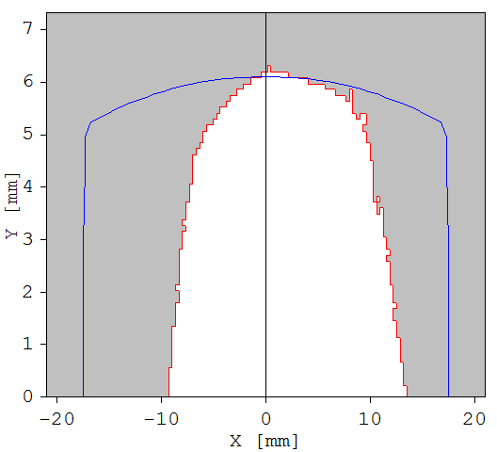
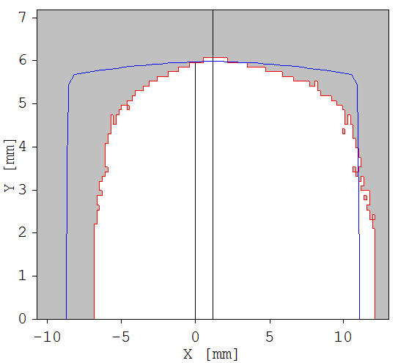
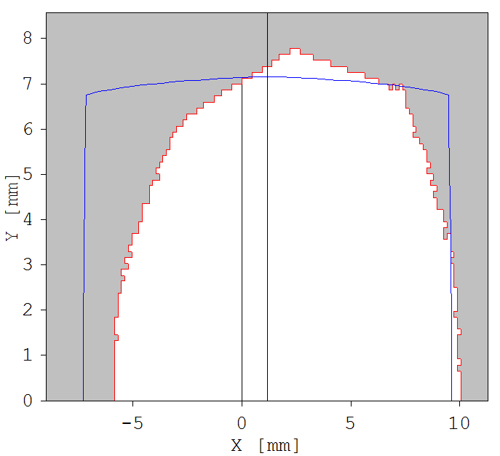
ON- and OFF- momentum dynamic aperture
Lattice “3Q_SPLIT_SHORT_5”. Chromatic + harmonic sextupoles
CHR+HRM SXT
3Q_SPLIT_SHORT_5
CHR+HRM SXT
3Q_SPLIT_SHORT_5
ON-momentum
Off-momentum
δ=+5%
Chamber
60 x 40 mm
Chamber
60 x 40 mm
3Q_SPLIT_SHORT_5
CHR+HRM SXT
Chromatic and
Harmonic sextupoles
tuned to vanish first and
second order chromaticity,
imrpove momentum acceptance
and minimize
Resonance Driving Terms
Off-momentum
δ=−5%
Chamber
60 x 40 mm

Slide 63
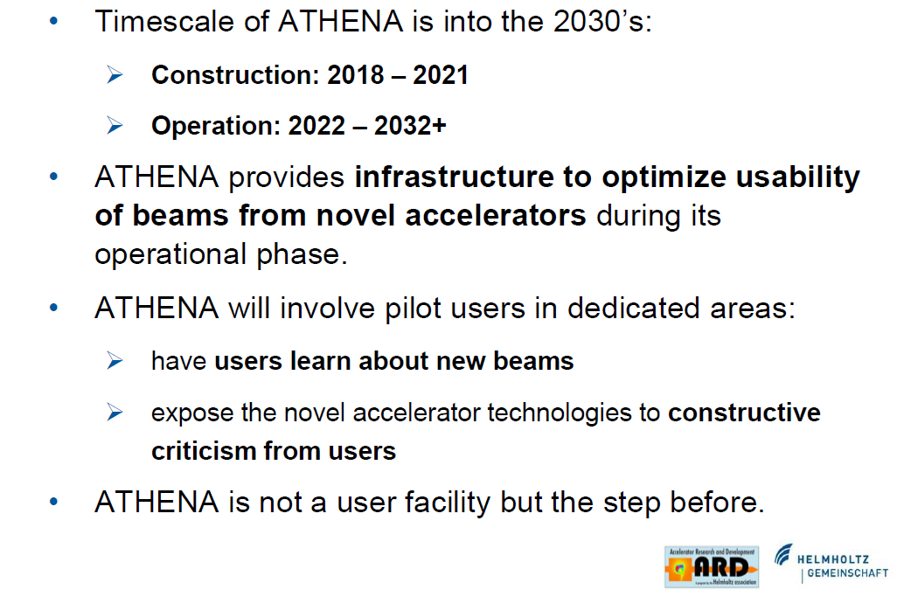

Slide 64
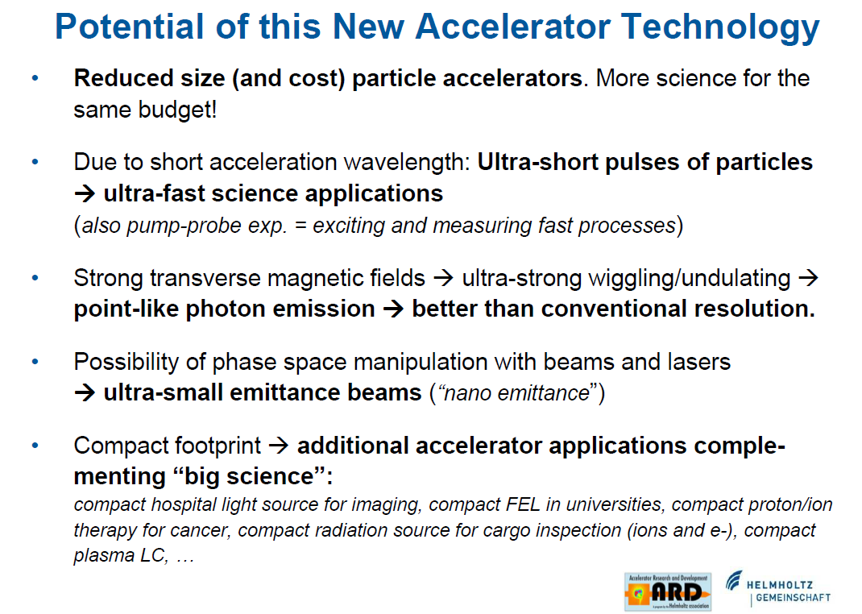

Slide 65
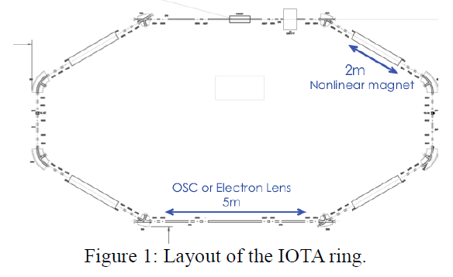
Prototypes
IOTA ring - 2012
The IOTA ring is designed for the proof-of-principle experiment of the nonlinear integrable optics at the ASTA facility.
It is desirable to accommodate more experiments, such as the nonlinear focusing with electron beam lens and optical stochastic cooling. These options demanded incorporation of a 5 m-long straight section.
The stretched ring includes two 5 m long and four 2 m nonlinear magnet insertions sections. The e- beam energy is 150 MeV.
IOTA - 2012

Slide 66
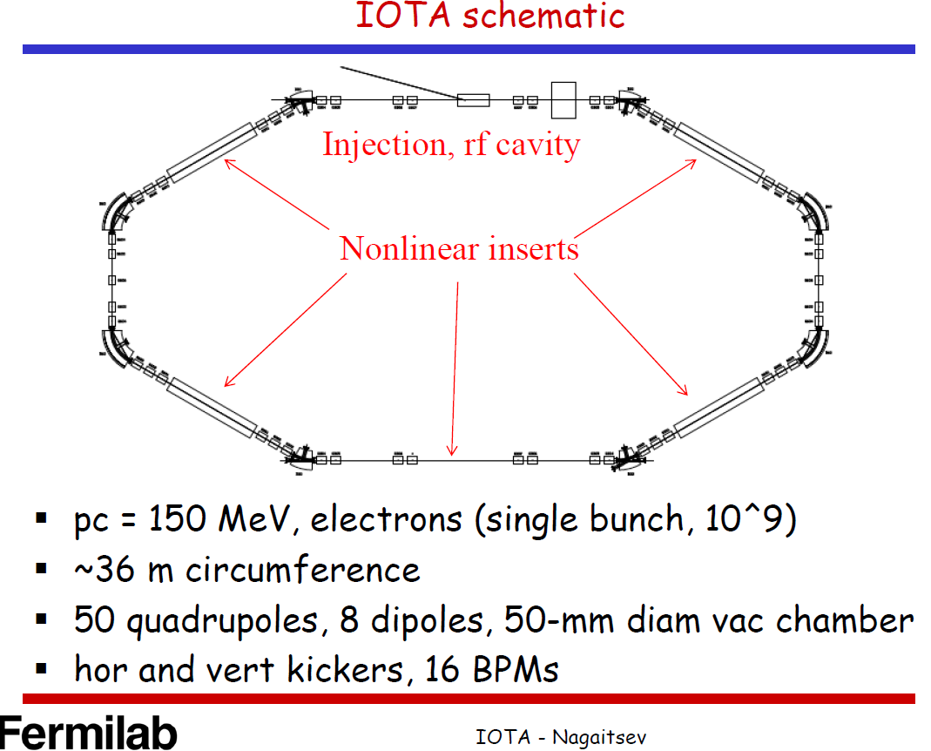
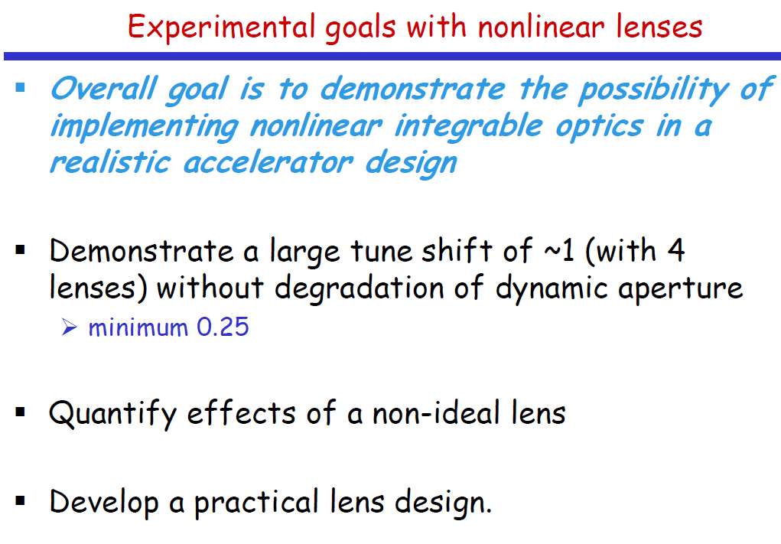
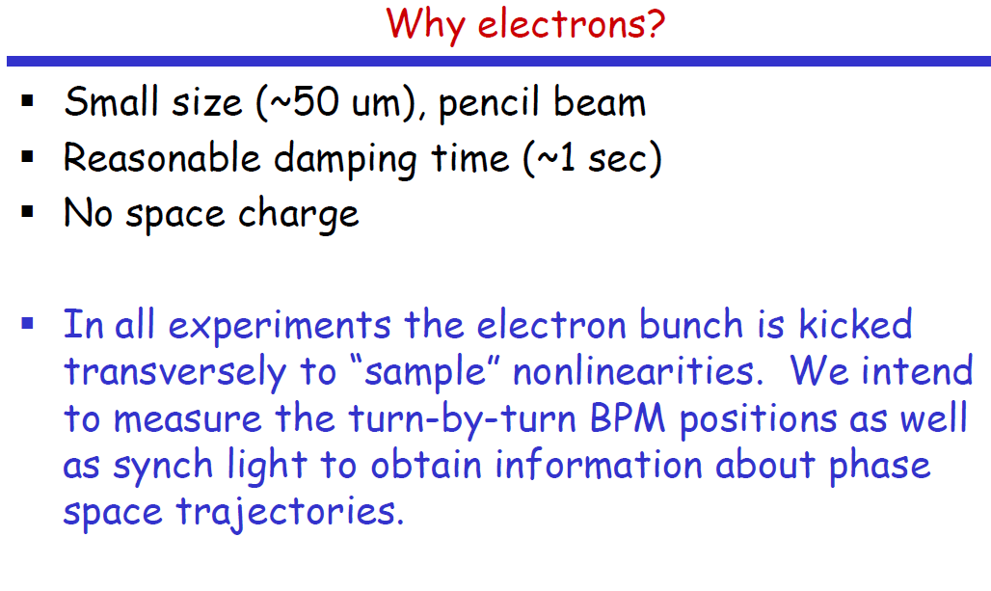
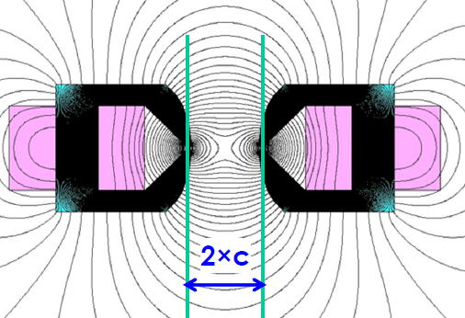
IOTA Ring layout, IPAC2012, New Orlean ( USA)
S. Nagaitsev
Experiments with electron lenses
and with non-linear magnets

Slide 67
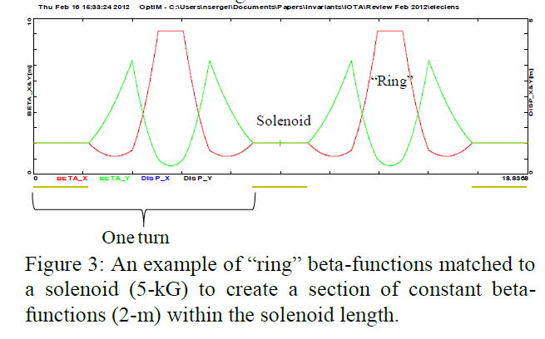
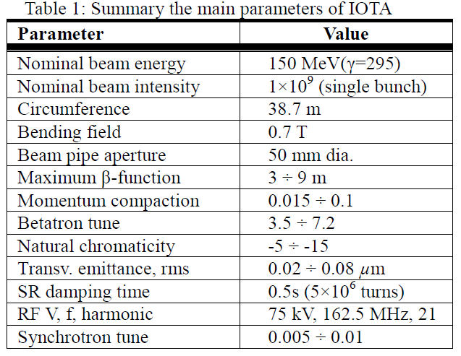
IOTA ring - 2012
IOTA - 2012

Slide 68
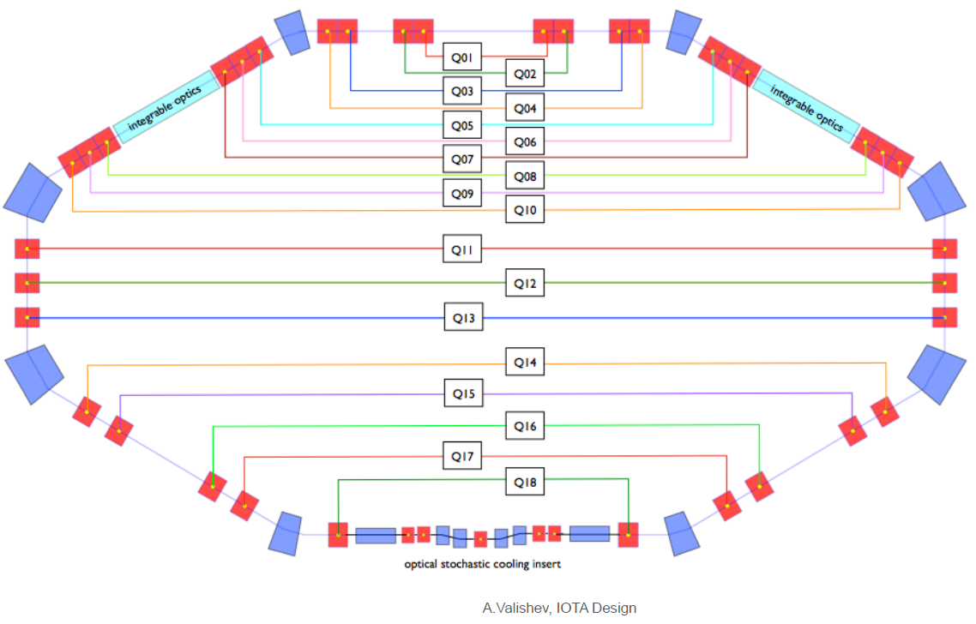

Design of IOTA (Integrable Optics Test Accelerator)
IOTA ring layout – 22 May 2014
2 May 2014

Slide 69




Optical stochastic experiment at IOTA (2014)

