Slide 1
PETRA IV Lattice Studies
Joachim Keil, DESY
on behalf of the PETRA IV study group
2nd Workshop on Low Emittance Ring Lattice Design
Lund, 1 December 2016

Slide 2
Outline
Introduction
Layout of PETRA III/IV
Design Parameters of PETRA IV
Lattices under consideration:
  HMBA-Lattice
  Lattice with phase space exchange and
  arcs with non-interleaved sextupoles
Conclusion & Outlook

Slide 3
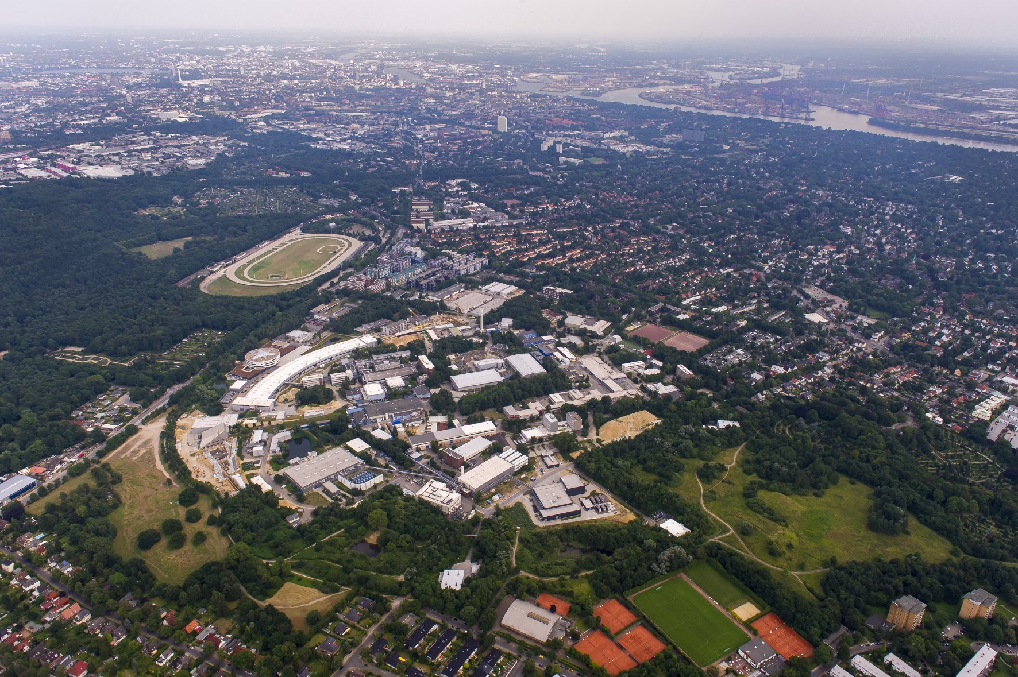
Overview of PETRA III
Parameter | Value
Energy | 6 GeV
Current | 100 mA, Top-Up
Hor. Emittance | 1.2 nm·rad
Ver. Emittance | 12 pm·rad
Bunches | 40, 960
Circumference | 2304 m
Harmonic number | 3840
RF Voltage | 20 MV
Energy loss/Turn | 6.1 MeV
Hall PXE
Von Laue hall
Hall PXN
PETRA III
PETRA I: e± collider (1978-1986), PETRA II: pre-accelerator for HERA (1990-2007)
PETRA III: commissioned 2009; in operation for users since middle of 2010
Von Laue hall: 14 beamlines, PXE, PXN (2014): 7+5 beamlines

Slide 4
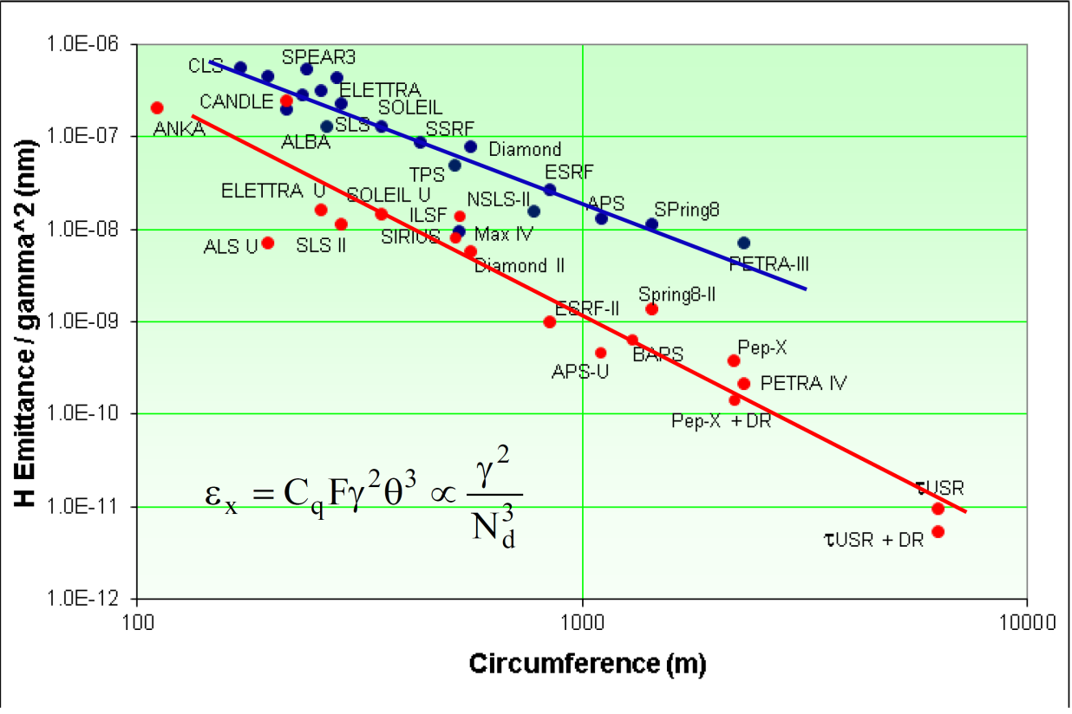
Motivation for PETRA IV
The Multi-Bend Achromat offers new possibilities to reach ultra low emittances
Many facilities world wide have upgrade plans based on MBA designs
With an emittance of 1.2 nm·rad PETRA III will not be competitive in the future
Design goal of PETRA IV: diffraction limited at 1 Å in both planes at 6 GeV
Emittance 10‒30 pm·rad
Round beam to mitigate emittance growth due to IBS
R. Bartolini, IPAC 2016
DBA, TBA
MBA

Slide 5
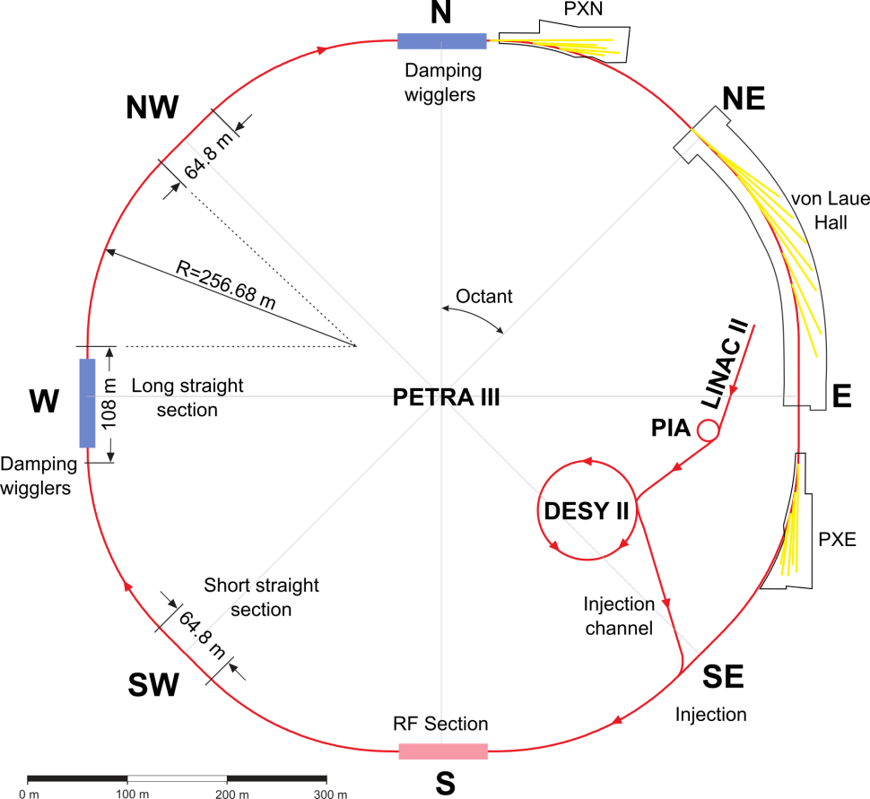
Layout of PETRA III
Octagonal shape, circumference 2304 m, emittance 1.2 nm·rad
Eight Arcs (45°), 201.6 m long
  5 pure FODO-arcs
  2 modified FODO arcs with 2 DBA-like cells at the beginning (PXN, PXE)
  One arc build from 9 DBA cells
  L_{cell} = 23 m, 5 m ID straight sections
Eight straight sections
  4 long straights N,S,E,W (108 m)
  20 damping wigglers in N and W;
  RF cavities in S (20 MV)
  4 short straights NW,NE,SE,SW (64.8 m)
Beamlines
  von-Laue Hall:14; PXN:5; PXE: 7
Pre-Injectors:
LINAC II & PIA: 450 MeV
DESY II: 6 GeV, ε≈340 nm·rad

Slide 6
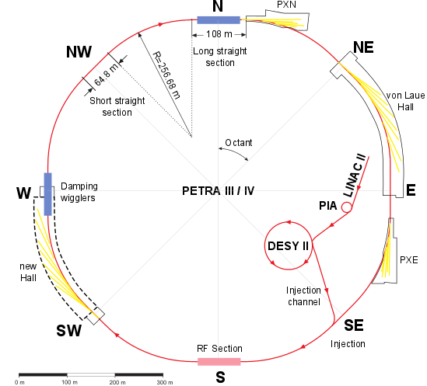
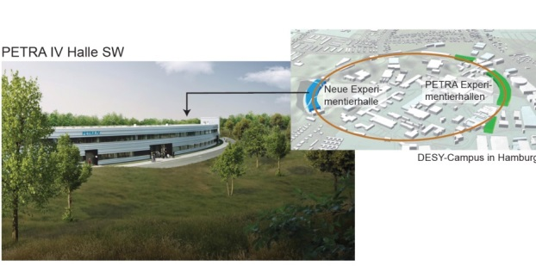
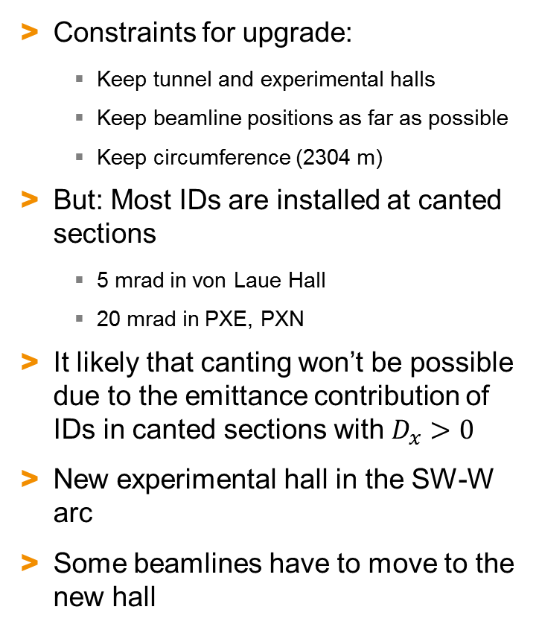
Possible Layout of PETRA IV
Constraints for upgrade:
  Keep tunnel and experimental halls
  Keep beamline positions as far as possible
  Keep circumference (2304 m)
But: Most IDs are installed at canted sections
  5 mrad in von Laue Hall
  20 mrad in PXE, PXN
It likely that canting won’t be possible due to the emittance contribution of IDs in canted sections with $D_{x}>0$
New experimental hall in the SW-W arc
Some beamlines have to move to the new hall

Slide 7
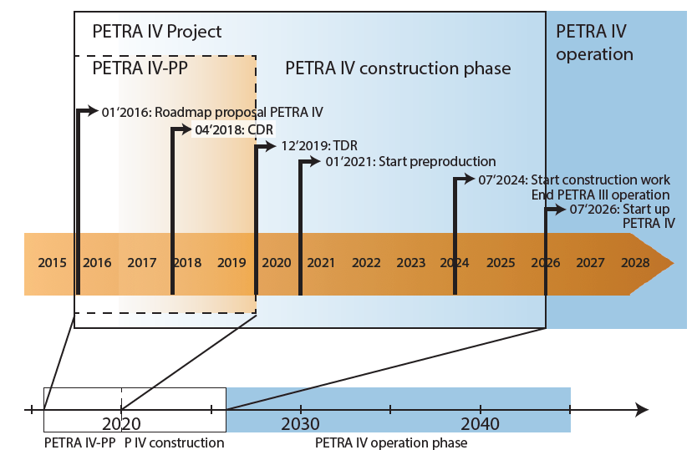
Time Schedule of PETRA IV Project
Tight time schedule:
Project preparation phase 1/16 – 12/19
Conceptual Design Report 4/2018
Technical Design Report 12/2019

Slide 8
Desired Parameters of PETRA IV
Parameter | Value
Energy | 6 GeV (4.5 – 6 GeV)
Current | 200 mA (100 – 200 mA)
Number of bunches | ~ 1000
Emittance horz. | 10 pm·rad (10 – 30 pm·rad)
vert. | 10 pm·rad (10 – 30 pm·rad)
Bunch length | ~ 100 ps
Number of Beamlines | 30
Very challenging design parameters!
Equal beam size at IDs → round beam
Goal: Investigate what are the limits to reach the desired parameters

Slide 9
Lattices Investigated for PETRA Upgrade
An upgrade to convert PETRA III into a diffraction limited light source needs a reduction in emittance of two orders of magnitude
  New lattice is required
  Very strong sextupoles → severe reduction of dynamic aperture
  Exploit unique layout of PETRA with 8 long straight sections and
  6 ID-less arcs for unconventional designs
Started to investigate two different lattice types
  Based on the ESRF-HMBA cell
  Based on 4D-phase space exchange and MBAs with non-interleaved sextupoles

Slide 10
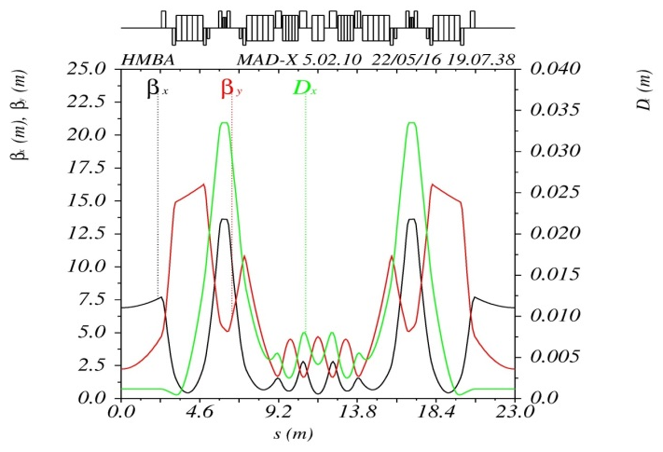
Lattice based on HMBA Cells
Lattice build from HMBA-cells of the ESRF-EBS
  Selected also at other facilities as a starting point for lattice design
  Scaling of the cell is necessary to replace the DBA cells & FODO-arcs of PETRA III
Arcs:
  Use 9 HMBAs cells to build a 45° arc (201.6 m)
  All 8 arcs in all octants are identical
Straight sections:
  FODO cells to connect arcs with matching triplets at both ends
  Altogether 4 long (108 m) and 4 short (64.8 m) straight sections
PETRA III
DBA cell
Scaled
H7BA cell

Slide 11
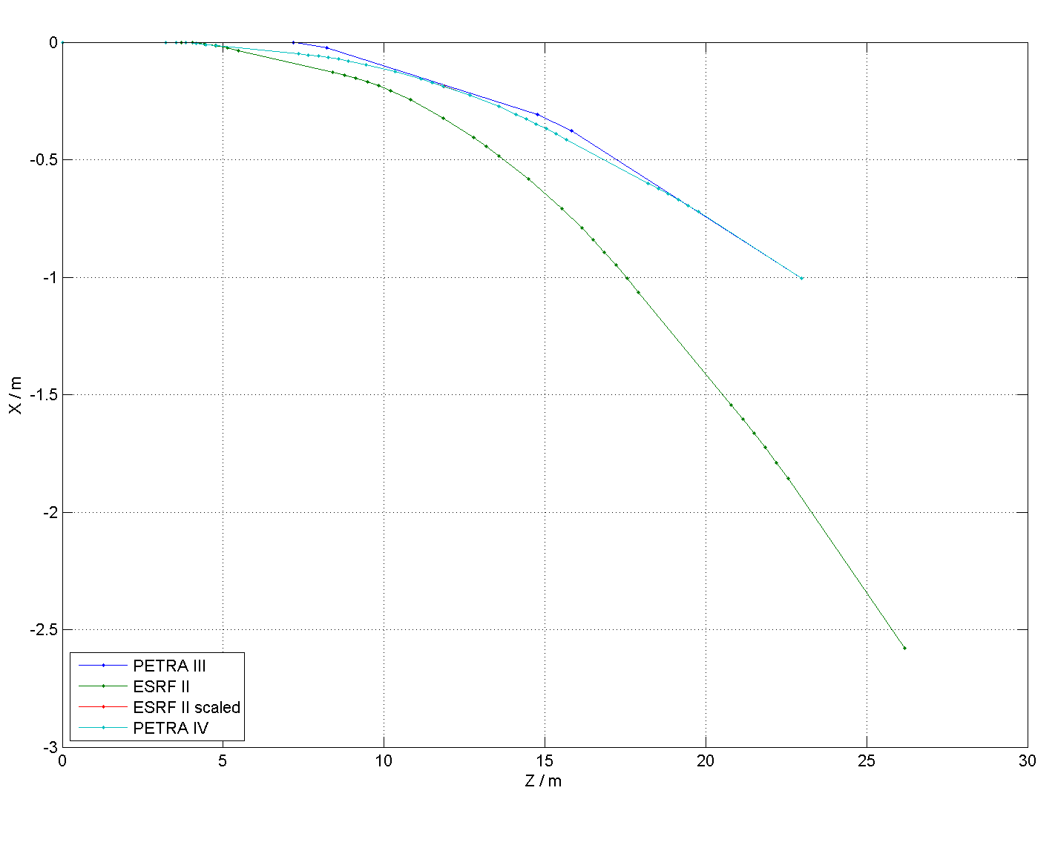
H7BA Cell Scaling
H7BA-cell of ESRF
~9 cm
Scaled H7BA-cell
~3.5 cm
25
0.08
0.06
25
0.03
20
0.04
0.02
0.02
20
0.01
0.00
0.00
15
-0.02
-0.01
Betafunctions [m]
Dispersion [m]
15
-0.04
Betafunctions [m]
Dispersion [m]
-0.06
-0.02
10
-0.08
10
-0.03
-0.10
-0.04
5
-0.12
5
-0.05
-0.14
-0.06
-0.16
0
0
5
10
15
20
25
0
0
5
10
15
20
-0.07
PETRA III
Scaling the H7BA cell to the P3 DBA cell:
  Length: 26.4 m → 23 m
  Bending angle: 11.25° → 5°
Result:
  Emittance: 134 pm rad → 11 pm rad
  Dispersion peak: 9 cm → 3.5 cm
  Quadrupoles & sextupoles stronger → DA, MA smaller
5°
PETRA IV
L(PETRA III) = 23 m
11.25°
ESRF-EBS
L(ESRF-EBS) = 26.4 m

Slide 12
HMBA Lattice : Arcs
~3.5 cm
0.03
35
0.02
30
0.01
~25 m
25
0.00
-0.01
Betafunctions [m]
Dispersion [m]
20
-0.02
15
-0.03
10
-0.04
-0.05
5
-0.06
0
950
1000
1050
1100
1150
-0.07
9 H7BA cells, 207 m, 45°
All 8 arcs have equal optics and phase advance → 72 HMBA cells
Two octants are mirror symmetric; super periodicity of lattice is 4

Slide 13
HMBA-Lattice : Straight Sections
Short straight sections in SW, NW, NE, SE
Long straight sections in N, S, E, W
arc
arc
arc
arc
0.03
Δφ_{x} = Δφ_{y} = 2·2π
0.03
35
Δφ_{x} = Δφ_{y} = 2π
0.02
35
0.02
30
0.01
30
0.01
25
0.00
25
0.00
Betafunctions [m]
-0.01
-0.01
Dispersion [m]
Betafunctions [m]
Dispersion [m]
20
-0.02
20
-0.02
15
-0.03
15
-0.03
10
-0.04
10
-0.04
-0.05
-0.05
5
-0.06
5
-0.06
0
1120
1140
1160
1180
1200
1220
1240
-0.07
0
2000
2050
2100
2150
-0.07
2 x FODO
Triplet
5 x FODO
Triplet
Length 64.8 m
Length 108 m
Layout of straight sections:
  FODO lattice with matching triplets at both ends
  Phase advance of 2·2π (long straight section) and 2π (short straight section)
  in both planes to keep symmetry
  RF cavities (500 MHz, 5 MV) in south

Slide 14
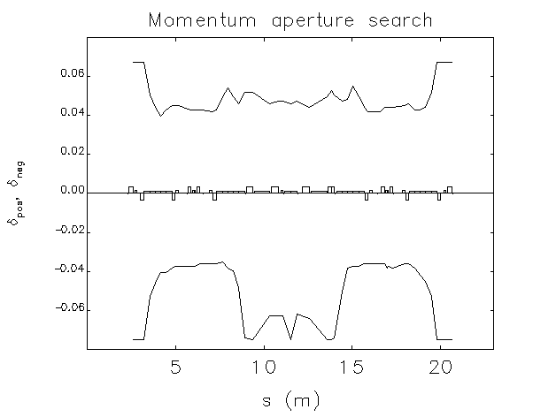
HMBA Lattice : DA and MA
Result for the full ring from HMBA cells:
Emittance of HMBA-based ring is 12 pm·rad at 6 GeV ✓
  No effects of IDs on emittance considered
  In addition a factor of two for round beam
Momentum acceptance is ok: 3-4% ✓
Dynamic acceptance is too small: 0.29 /1.2 mm·mrad ✗
  Cell not yet optimized (tune scans, MOGA, …)
Some quadrupoles too strong, g < 120 T/m ✗
  Stronger focusing & shorter cell length
Next steps:
Try a more relaxed H6BA (or H5BA) cell and include
(vertical) damping wigglers to reduce emittance
Try a relaxed MBA cell design in 6 ID-less arcs
Optimization of the lattice (tune scans, MOGA, …)
Include errors
β_{x}=21.9 m
β_{y}=20.9 m
Not optimized

Slide 15
Touschek Lifetime
2.5%
10 pm
2%
20 pm
1.5%
For very small emittances Touschek lifetime will rise again
A larger momentum acceptance shifts the lifetime minimum to higher emittances
From Piwinski’s formula: For τ > 5 h in the range of 10-30 pm·rad a momentum acceptance of > 2% is needed
  Conditions: E = 6 GeV, round beam, N = 10¹⁰ particles in bunch
  <β_{x}> = 4.8 m, <β_{y}> = 8.9 m, <D_{x}> = 1.3 cm , σ_{s}=1 cm, σ_{p} = 10⁻³ (scaled ESRF-HMBA-cell)

Slide 16
Phase Space Exchange Lattice: Twists
Lattice design to get a round beam:
Two x-y phase space exchange insertions (Twists) in long straight sections
Twist insertions couple (x,x’) ↔ (y,y’) phase space twice per turn
Positions of Twist insertions still allow off axis injection (injection oscillation in x-plane in ver. low gap chambers at undulators)
Horizontal natural emittance ε₀ is equally distributed in both planes:
ε_{y} ≈ ε_{x} ≈ ε₀ /2 (exact if two Twists installed opposite of each other)
3 arc octants:
y = hor., x = vert.
y ↔ x
schematic
3 arc octants,
injection section,
undulator sections :
x = hor., y = vert.
x ↔ y
Idea of Lattice: R. Brinkmann

Slide 17
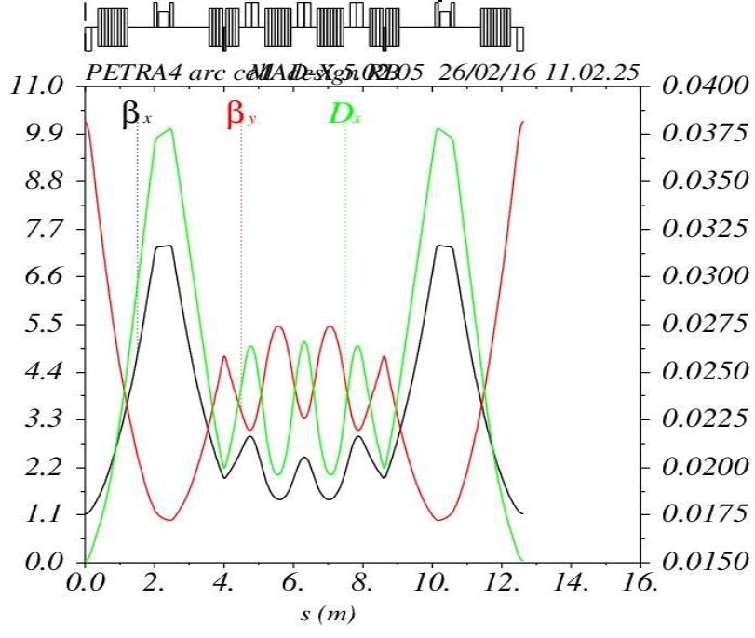

Phase Space Exchange Lattice: Arcs
PETRA has altogether 8 arcs:
  In two arcs a design with achromats is
  needed for the installation of undulators
  6 ID-less arcs can have a different design
Each of the six arcs consists of a ~200 m long MBA with a bending angle of 45°
Use non-interleaved sextupole pairs with 180° phase advance to cancel nonlinear kicks of sextupoles → large DA
Only SF-type cells in all arcs (because of two Twists)
Two SF families correct the sum of the chromaticities of the two half-rings 1 & 2:
SF
SF
Δμ_{x,y} = π
β_{x ,}β_{y} / m
D_{x} / m
(preliminary design)
Unit cell in arcs
without undulators
ε₀ = 44 pm·rad @ 6 GeV
  $$ξ_{A}=ξ_{x1}+ξ_{y2}$$
  $$ξ_{B}=ξ_{y1}+ξ_{x2}$$

Slide 18
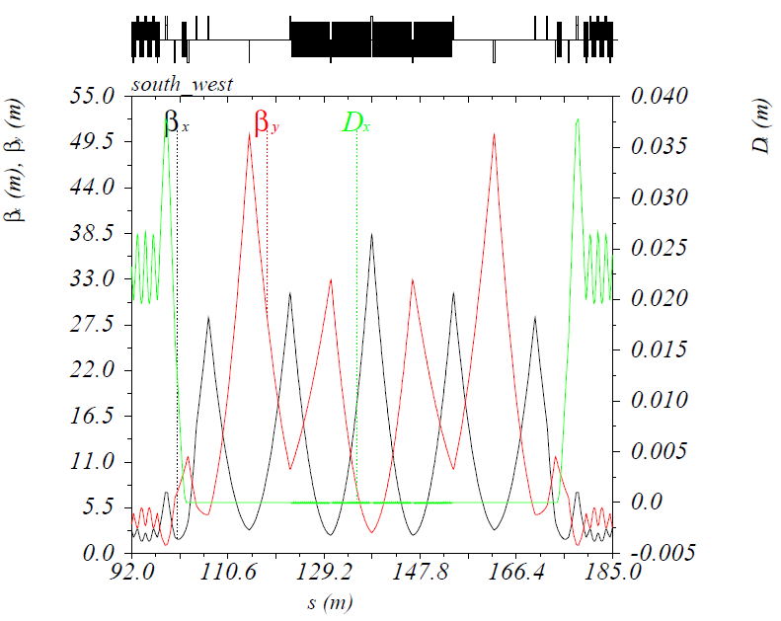
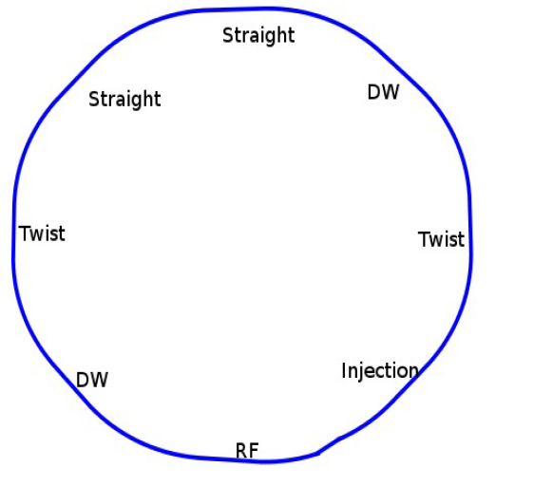
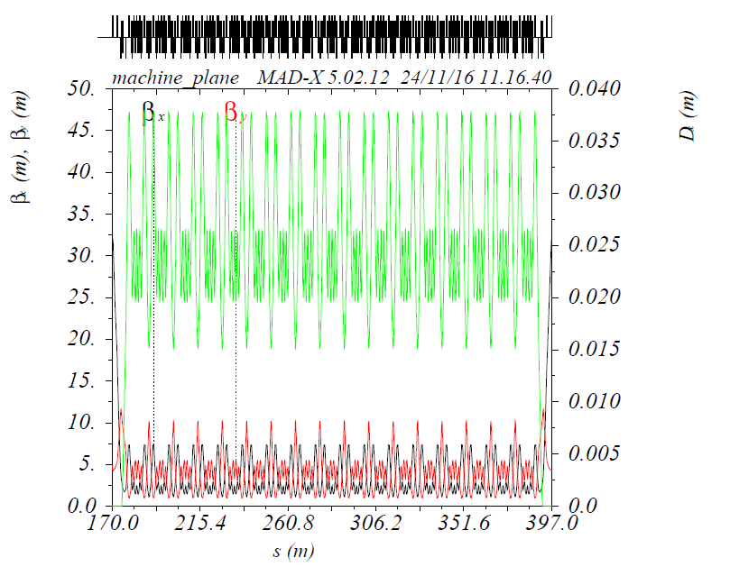
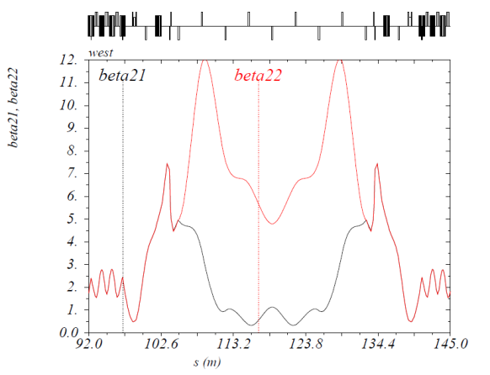
Test of Phase Exchange Lattice
Prove of principle of the phase exchange lattice
Eight straights with equal lengths (two with damping wigglers; one with 100 MHz RF)
Two Twist sections in E and W (9 skew quads)
Eight arcs with non-interleaved sextupoles
Two SF sextupole families (N + S)
No Undulator arcs
Damping wigglers
Arc from unit cells
Twist

Slide 19
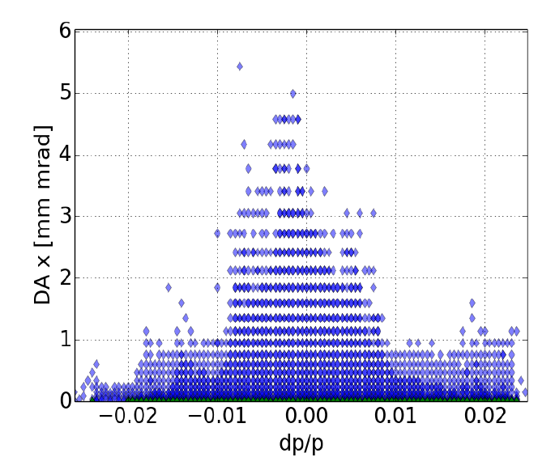
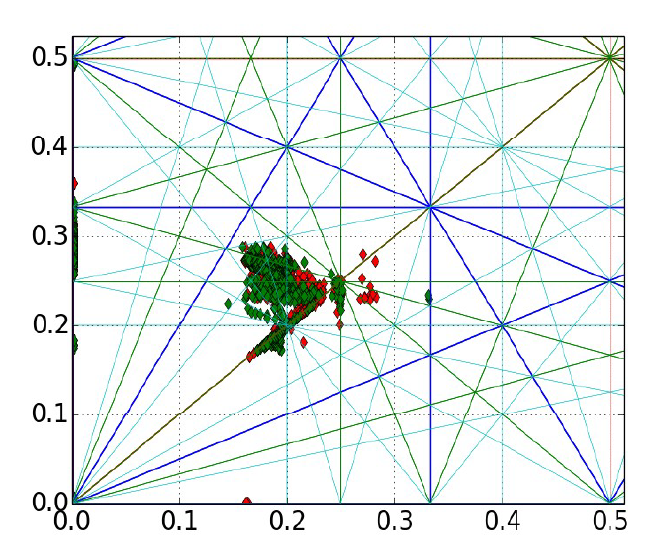
Test-Lattice : DA and MA
Tune footprint for ξ_{x}= ξ_{y} = 0
Mesh: -3 mm < x₀ < 3 mm (at β=1 m) and y₀=0 mm
Red: δ<0, green δ>0
Hor. Dynamic Acceptance ~4.5 mm·mrad for Δp/p=0 (ver. always larger)
Momentum Acceptance ± 2.4% (limited by higher order chromaticity)
Emittance: ε_{x} ≈ ε_{y} = 24 pm·rad @ 6 GeV (without DW)

Slide 20
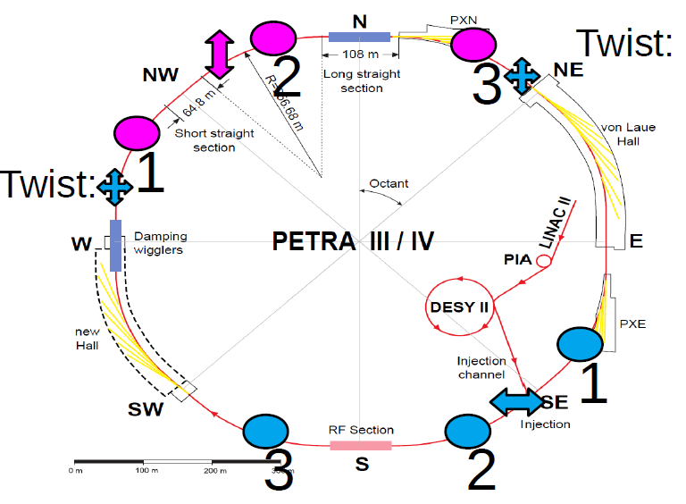
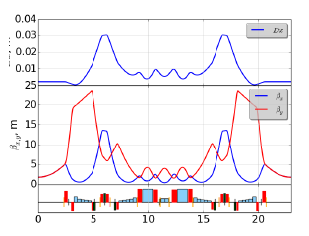
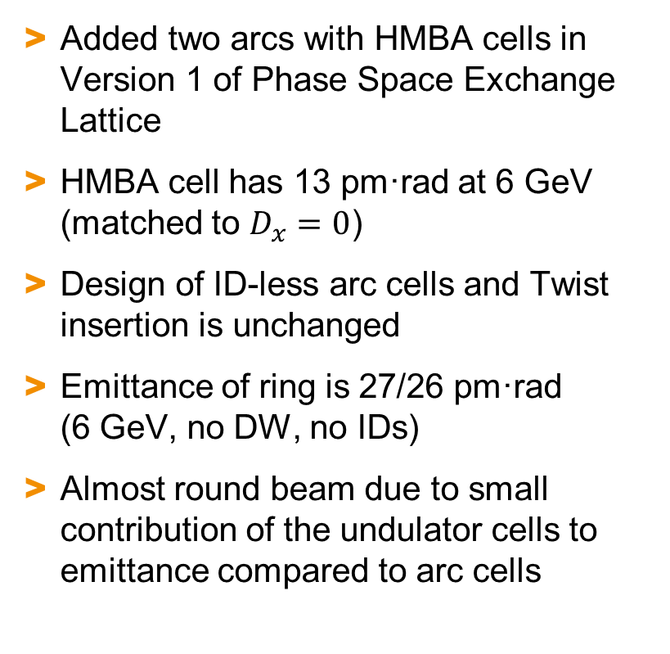
Phase Space Exchange Lattice V1
Added two arcs with HMBA cells in Version 1 of Phase Space Exchange Lattice
HMBA cell has 13 pm·rad at 6 GeV (matched to $D_{x}=0$)
Design of ID-less arc cells and Twist insertion is unchanged
Emittance of ring is 27/26 pm·rad
(6 GeV, no DW, no IDs)
Almost round beam due to small contribution of the undulator cells to emittance compared to arc cells

Slide 21
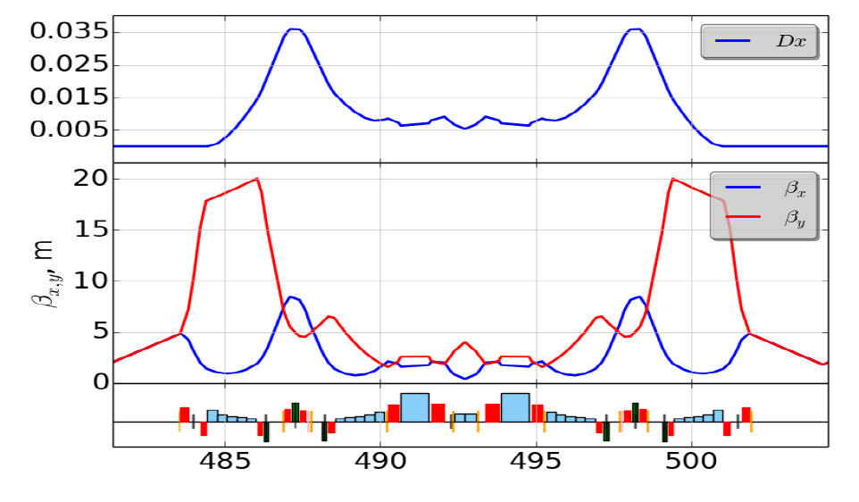
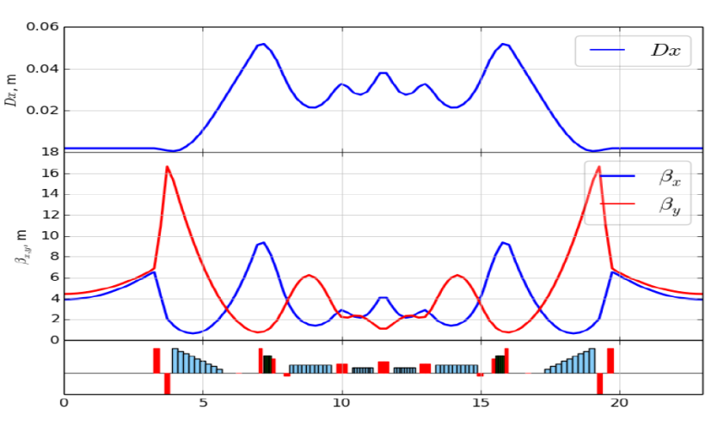
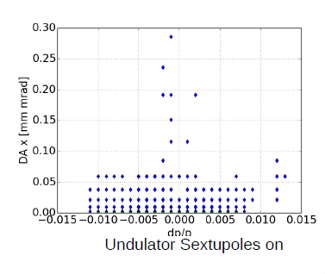
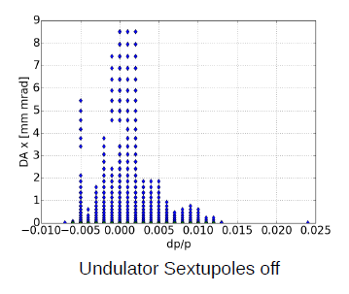
Chromaticity Correction and DA
Tried two chromaticity correction schemes:
With sextupoles in HMBA-arc on:
  Global DA limited by the cell-DA (~0.4 mm·mrad in
  hor. direction) and by the arc-DA in momentum
With sextupoles in HMBA arc off:
  Compensation of Chromaticity in ID-less arcs
  Asymmetry in mode distribution (3 vs. 5)
  → stronger sextupoles required → reduced MA
Mixing of interleaved/non-interleaved cell designs is not optimal
Next step: integrate a H6BA cell with non-interleaved sextupoles in lattice → damping wigglers needed
H7BA: 12 pm·rad
Δμ_{x,y} = 3π/π
NI-H6BA: 33 pm·rad
Δμ_{x,y} = π
SF
SF

Slide 22
Conclusions and Outlook
Lattice studies how to convert PETRA III in a diffraction limited
light source using MBAs have been started
Goal for parameters are very challenging: emittance of 10-30 pm·rad
at 6 GeV for 200 mA in ~1000 bunches
Two different lattice types are currently being evaluated:
  A lattice based on ESRF-style H7BA-cells
  A lattice based on MBAs with non-interleaved sextupole pairs
  and incorporated x-y phase space exchange
Lattice studies are still in a very early stage
Next steps: Optimization of cell designs for both lattice types; include realistic errors in the simulations; collective effects; injection scheme, …

