Slide 1
Update on Accelerator Toolbox Code and Computations for the ESRF EBS
2 December 2016,
LER design workshop
LUND
B. Nash
ESRF

Slide 2
Outline
History of AT, atcollab
Structure of AT
integrators
Application to ESRF EBS
Conclusions

Slide 3
Widely used Codes for electron rings
Elegant
APS-Borland et. al.
MAD-X/PTC
CERN- module structure
with organizers
AT
???
BMAD
Cornell- D. Sagan
http://www.lepp.cornell.edu/~dcs/bmad/
(OPA, Tracy, …?)

Slide 4
History of AT
AT is a Matlab based tool box for accelerator simulation
originally created by Andrei Terebilo during the late 1990’s at SLAC.
He left acc. phys. 2010
Some interaction with Tracy code (Nishimura et al)
at early stage
http://inspirehep.net/record/264780?ln=en
AT is used within MML and LOCO (Portmann, Safranek),
but may also be used as a stand alone modeling code.
No one was coordinating the AT development, after Andrei stopped,
After I joined ESRF in 2009, I decided to try to coordinate AT
development in an open source collaboration.
atcollab

Slide 5
atcollab
How to organize AT development across multiple labs, when it is already
in use by so many?
Can we support an open source collaborative development
for the AT code?
Needed parts of open source project:
*) Repository in version control system: SourceForge chosen with svn
*) communication amongst users and developers: (mailing list, wiki, website…)
*) documentation, bug reporting, etc
*) well defined releases
http://sourceforge.net/projects/atcollab/
considerations:
> copyright issues? (I asked A. Terebillo and he suggested we go ahead)
> branching and forking of code?
> How to find common ground and bring different development together?

Slide 6
atcollab communication
mailing list: atcollab-general@lists.sourceforge.net
27 members from 15 institutes
ESRF (5)
NSRC, Taiwan (3)
LBL (3)
IHEP, China (3)
ALBA (3)
SLAC
Australian Synchrotron
Mayo Clinic
INFN
Diamond
KIT, ANKA
SOLEIL
ELETTRA
Canadian Light Source
LAL
on Twitter:
@atcollab_tweets
Archives and subscription info at
A better website
is needed!
https://lists.sourceforge.net/lists/listinfo/atcollab-general

Slide 7
atcollab svn repository
http://sourceforge.net/projects/atcollab/
trunk
atmat
atintegrators
relocated from AT1.3
atdemos
atgui
atphysics
lattice
pubtools
get copy of repository with:
svn checkout https://svn.code.sf.net/p/atcollab/code-0/trunk atcollab
Having repository online facilitates email discussion. Can refer to code
with URL. e.g. ringpass function is here:
http://sourceforge.net/p/atcollab/code-0/HEAD/tree/trunk/atmat/attrack/ringpass.m
AT is also distributed with MML by Greg Portmann.
MiddleLayer/Release/at
If possible, we should bring these versions together!

Slide 8
principles we follow in our development
Backwards compatibility. Previous lattice construction methods
(using global variables) and integrators written with AT1.3 should
still work.
Some tests with MML integration show no
issues. More tests are needed, and feedback
greatly appreciated!
(Any problems with LOCO?)
Compilation should be simply done by calling atmexall.
We test this on as many different versions of Matlab, and
as many platforms (Linux, Windows, Mac) as we can.
Tools that are working but not fully integrated or adequately
tested go into the pubtools directory. After further testing,
we migrate these tools into the other main AT directories.

Slide 9
Classes
Issue: how to write functions that identify particular elements that will
work for lattices at different labs?
Solution: add a “Class” field to all elements
Sextupole
Drift
Quadrupole
Bend
RingParam
Octupole
Corrector
RFCavity
Aperture
KickMap
QuantDiff
Wiggler
Multipole
ThinMultipole
Matrix66
Solenoid
indsext=findcells(‘ring’,’Class’,’Sextupole’)
gives indices of all sextupoles
Example:

Slide 10
Integrators
AT has the following integrators in the atintegrators directory:
AperturePass.c
BendLinearPass.c
BndMPoleSymplectic4E2Pass.c
BndMPoleSymplectic4E2RadPass.c
BndMPoleSymplectic4Pass.c
BndMPoleSymplectic4RadPass.c
CavityPass.c
CorrectorPass.c
DriftPass.c
QuantDiffPass.c
EAperturePass.c
IdTablePass.c
IdentityPass.c
Matrix66Pass.c
QuadLinearPass.c
SolenoidLinearPass.c
StrMPoleSymplectic4Pass.c
WiggLinearPass.c
GWigSymplecticPass.c
Others have developed different integrators.
We should find the most accurate and fastest integrators.

Slide 11
Moving away from global Variables Element and Ring Creation
global FAMLIST, THERING
Issue: We want to be able to create
many lattices in one Matlab session
element
creation
ring
structure
AT 1.3 uses
For the element creation, output elements directly. For example
^{DR1=atdrift(‘D1’,0.7)}
QF=atquadrupole(’QF1’,0.94,0.39,’QuadMPoleFringePass’)
SH=atsextupole('SH',0,0,'StrMPoleSymplectic4Pass');
B1=atsbend(’B1',0,0,0,'BndMPoleSymplectic4Pass');
QF =
FamName: 'QF1'
PassMethod: 'QuadMPoleFringePass'
Length: 0.9400
Class: 'Quadrupole'
K: 0.3900
PolynomB: [0 0.3900]
PolynomA: [0 0]
MaxOrder: 1
NumIntSteps: 10

Slide 12
Integrators
void StrMPoleSymplectic4Pass(double *r, double le, double *A, double *B,
int max_order, int num_int_steps,
double *T1, double *T2,
double *R1, double *R2,
double *RApertures, double *EApertures, int num_particles)
{ int c,m;
double norm, NormL1, NormL2;
double *r6;
double SL, L1, L2, K1, K2;
SL = le/num_int_steps;
L1 = SL*DRIFT1;
L2 = SL*DRIFT2;
K1 = SL*KICK1;
K2 = SL*KICK2;
for (c = 0;c<num_particles;c++) { /*Loop over particles */
r6 = r+c*6;
if(!atIsNaN(r6[0])) {
/* misalignment at entrance */
if (T1) ATaddvv(r6,T1);
if (R1) ATmultmv(r6,R1);
/* Check physical apertures at the entrance of the magnet */
if (RApertures) checkiflostRectangularAp(r6,RApertures);
if (EApertures) checkiflostEllipticalAp(r6,EApertures);
/* integrator */
for (m=0; m < num_int_steps; m++) { /* Loop over slices */
r6 = r+c*6;
norm = 1/(1+r6[4]);
NormL1 = L1*norm;
NormL2 = L2*norm;
fastdrift(r6, NormL1);
strthinkick(r6, A, B, K1, max_order);
fastdrift(r6, NormL2);
strthinkick(r6, A, B, K2, max_order);
fastdrift(r6, NormL2);
strthinkick(r6, A, B, K1, max_order);
fastdrift(r6, NormL1);
}
/* Check physical apertures at the exit of the magnet */
if (RApertures) checkiflostRectangularAp(r6,RApertures);
if (EApertures) checkiflostEllipticalAp(r6,EApertures);
/* Misalignment at exit */
if (R2) ATmultmv(r6,R2);
if (T2) ATaddvv(r6,T2);
}
}
}
Many models out there.
We have a magnetic field.
Usually, fourth order symplectic integrator
(Ruth, Forest, Yoshida…)
Depends on Hamiltonian, should be
separable into two solvable parts
BndMPoleSymplectic4Pass.c
BndMPoleSymplectic4E2Pass.c
X. Huang (improves drift in dipole)

Slide 13
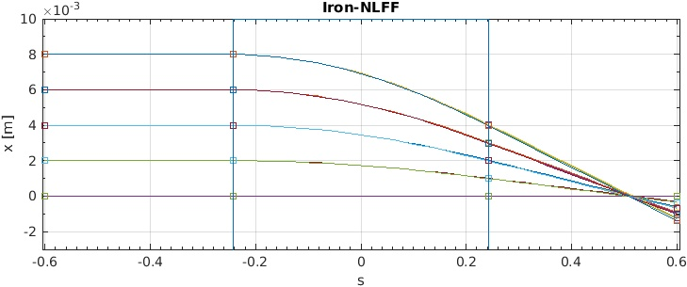
test integrator with RADIA MODEL
Magnet length
Lines : RADIA
Squares : AT
RADIA model script provided by G. Le Bec. Performs tracking of electrons in the complete field generated by the magnet (full line). Squares represent the particles tracking in AT for the equivalent hard edge, iron length, straight multipole model.

Slide 14
new tools
atmatch (S. Liuzzo)
atfastring (L. Farvacque)
linear matrix, chromatic and amplitude tune shift
quantum diffusion element
used for collective effects, spin dynamics studies
atplot (L. Farvacque)
allows arbitrary function
together with synoptic
collective effects- multiparticle tracking
with impedance (S. White)
Apertures in elements for improved loss mapping
(L. Farvacque, R. Versteegen)
quantum diffusion element
QuantDiffPass
(N. Carmignani, B. Nash)
see Nash et. al. IPAC 14 for some details
http://inspirehep.net/record/1417208
recently added by S. Liuzzo:
error setting and correction tools

Slide 15
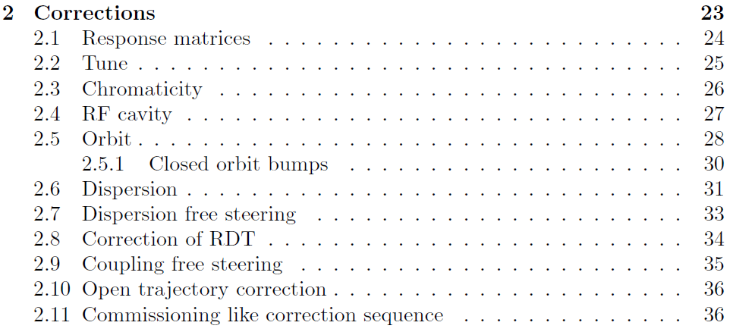
Functions in PubTools, started documentation process
Available functions, documentation in progress, draft available in atmat/pubtools
[...
rcor,... % corrected lattice
ch,... % final H cor values
cv,... % final V cor values
cq,... % final Quad cor values
cs... % final Skew Quad cor values
]=CorrectionChain(...
rerr,... %1 initial lattice with errors
r0,... %2 model lattice
indBPM,... %3 bpm index
indHCor,... %4 h steerers index
indVCor,... %5 v steerers index
indSkewCor,... %6 skew quad index
indQuadCor,... %7 quadrupole correctors index
Neig,... %8 number of eigen vectors
corrorder,... %9 correction order 1: orbit, 2: tune,…
ModelRM,... %10 response matrices
speclab,... %11 label
verbose) %12 verbose (false)
Finally, a single function does the whole commissioning like procedure
(S. Liuzzo)

Slide 16
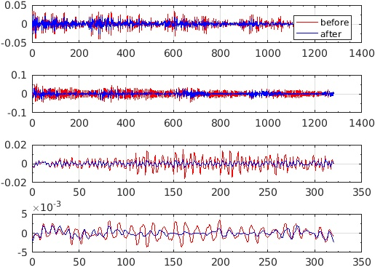
RDT and Dispersion correction
This function can be used on a fitted lattice or on the lattice with errors.
RDT quad
alpha: 0.80 (h disp) 0.10 *(tune) 0.80 (v disp)
RDT Disp. Tune Steering iter 1, n-eig: 150, 50,
RDT Disp. Tune Steering iter 2, n-eig: 250, 100,
before --> after
rq: 9.174 -> 5.711
rs: 15.024 -> 7.079
dX: 5.839 -> 1.810mm
dY: 1.466 -> 0.715mm
tX: 0.008 -> 0.007
tY: -0.000 -> -0.004
min mean max
qs:-0.03 -0.00 0.03 1/m2
ss:-0.01 -0.00 0.01 1/m2
dpp: 0
RDT skew
H disp (measured-reference)
The normal and skew quadrupole components are computed from gradient errors and from alignment errors.
V disp (measured-reference)
(S. Liuzzo)

Slide 17
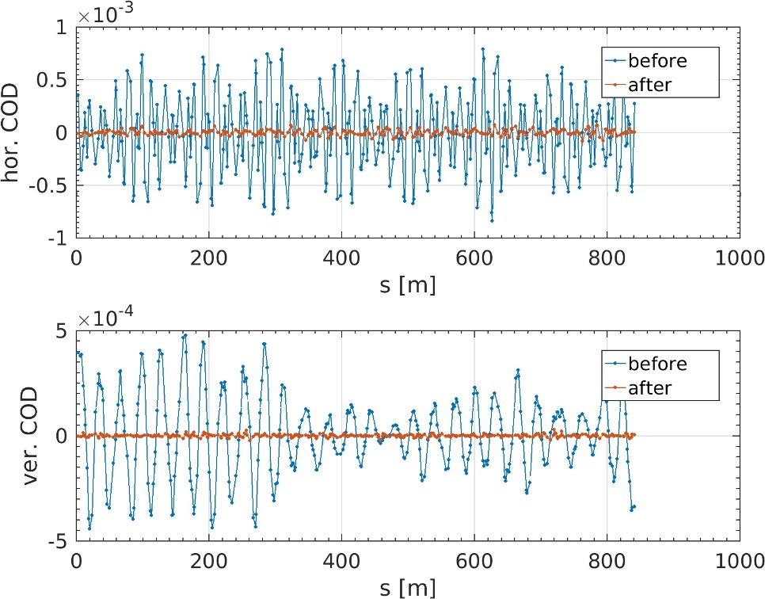
Orbit correction
[rcor,inCOD,hs,vs]=atcorrectorbit(…
rcor,...
indBPM,...
indHCor,...
indVCor,...
inCOD,...
[
[50 50];...
[100 100];...
[150 150];...
[200 200];...
[220 220];...
[240 240];...
[260 260]...
],...
[true true],...
1.0,...
ModelRM,...
zeros(2,length(indBPM)),...
[0.5e-3 0.5e-3],...
true);
Orbit correction iter 1,n-eig: 50, 50,
Orbit correction iter 2,n-eig: 100, 100,
Orbit correction iter 3,n-eig: 150, 150,
Orbit correction iter 4,n-eig: 200, 200,
Orbit correction iter 5,n-eig: 220, 220,
Orbit correction iter 6,n-eig: 240, 240,
Orbit correction iter 7,n-eig: 260, 260,
before --> after
oX: 128.917 -> 26.728um
oY: 65.781 -> 6.688um
min mean max
hs:-0.01 0.00 0.01 mrad
vs:-0.02 -0.00 0.01 mrad
dpp: 3.2212e-25
several correction iterations with different number of eigenvectors
Possible to correct to reference orbit
Usable for bumps
Defaulted RM computation from model
Correctors limits
Average of correctors to zero and DPP correction
Easy iteration varying the number of eigenvectors.
(S. Liuzzo)

Slide 18
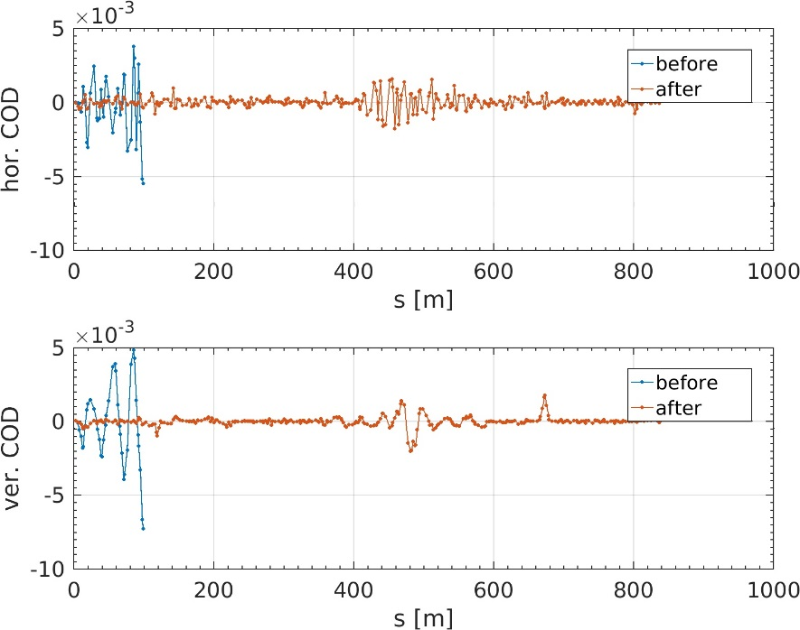
Open Trajectory correction
correcting trajectory with model rm
Search closed orbit
Trajectory correction: nbpms= 19 ncor: 16, 16,
computing ORM for available trajectory
H PLANE
correcting available H trajectory
V PLANE
correcting available V trajectory
X: 1393.790 -> 806.879 um
Y: 1136.597 -> 420.950 um
Search closed orbit
Trajectory correction: nbpms= 34 ncor: 31, 31,
computing ORM for available trajectory
H PLANE
correcting available H trajectory
V PLANE
correcting available V trajectory
X: 1330.159 -> 575.785 um
Y: 779.406 -> 262.396 um
……. …. … …. … … … ….
Search closed orbit
Trajectory correction: nbpms= 319 ncor: 286, 286,
computing ORM for available trajectory
H PLANE
correcting available H trajectory
V PLANE
correcting available V trajectory
X: 184.243 -> 178.645 um
Y: 65.737 -> 52.012 um
Search closed orbit
no improvement from last step. increasing lim to: 0.0025
Trajectory correction: nbpms= 320 ncor: 287, 287,
computing ORM for available trajectory
H PLANE
correcting available H trajectory
V PLANE
correcting available V trajectory
X: 195.664 -> 190.196 um
Y: 95.250 -> 84.276 um
Search closed orbit
Found closed orbit
[rcor,inCOD]=atfirstturntrajectory(...
rerr,...
inCOD,...
indBPM,...
indHCor,...
indVCor,...
2.0e-3,...
60,...
[true true],...
ModelRM,...
zeros(2,length(indBPM)),...
[5e-3 5e-3]);
Possible to correct to reference trajectory
Defaulted RM computation from model
Correctors limits
Average of correctors to zero and DPP correction
(S. Liuzzo)

Slide 19
To Do for at and on the horizon
Improve documentation
continue standardization of lattice format
merge physics tools and integrators into common repository
more tests of compatibility with MML
Python AT- pyAT is in development in collaboration
with Will Rogers from Diamond
https://github.com/willrogers/at

Slide 20
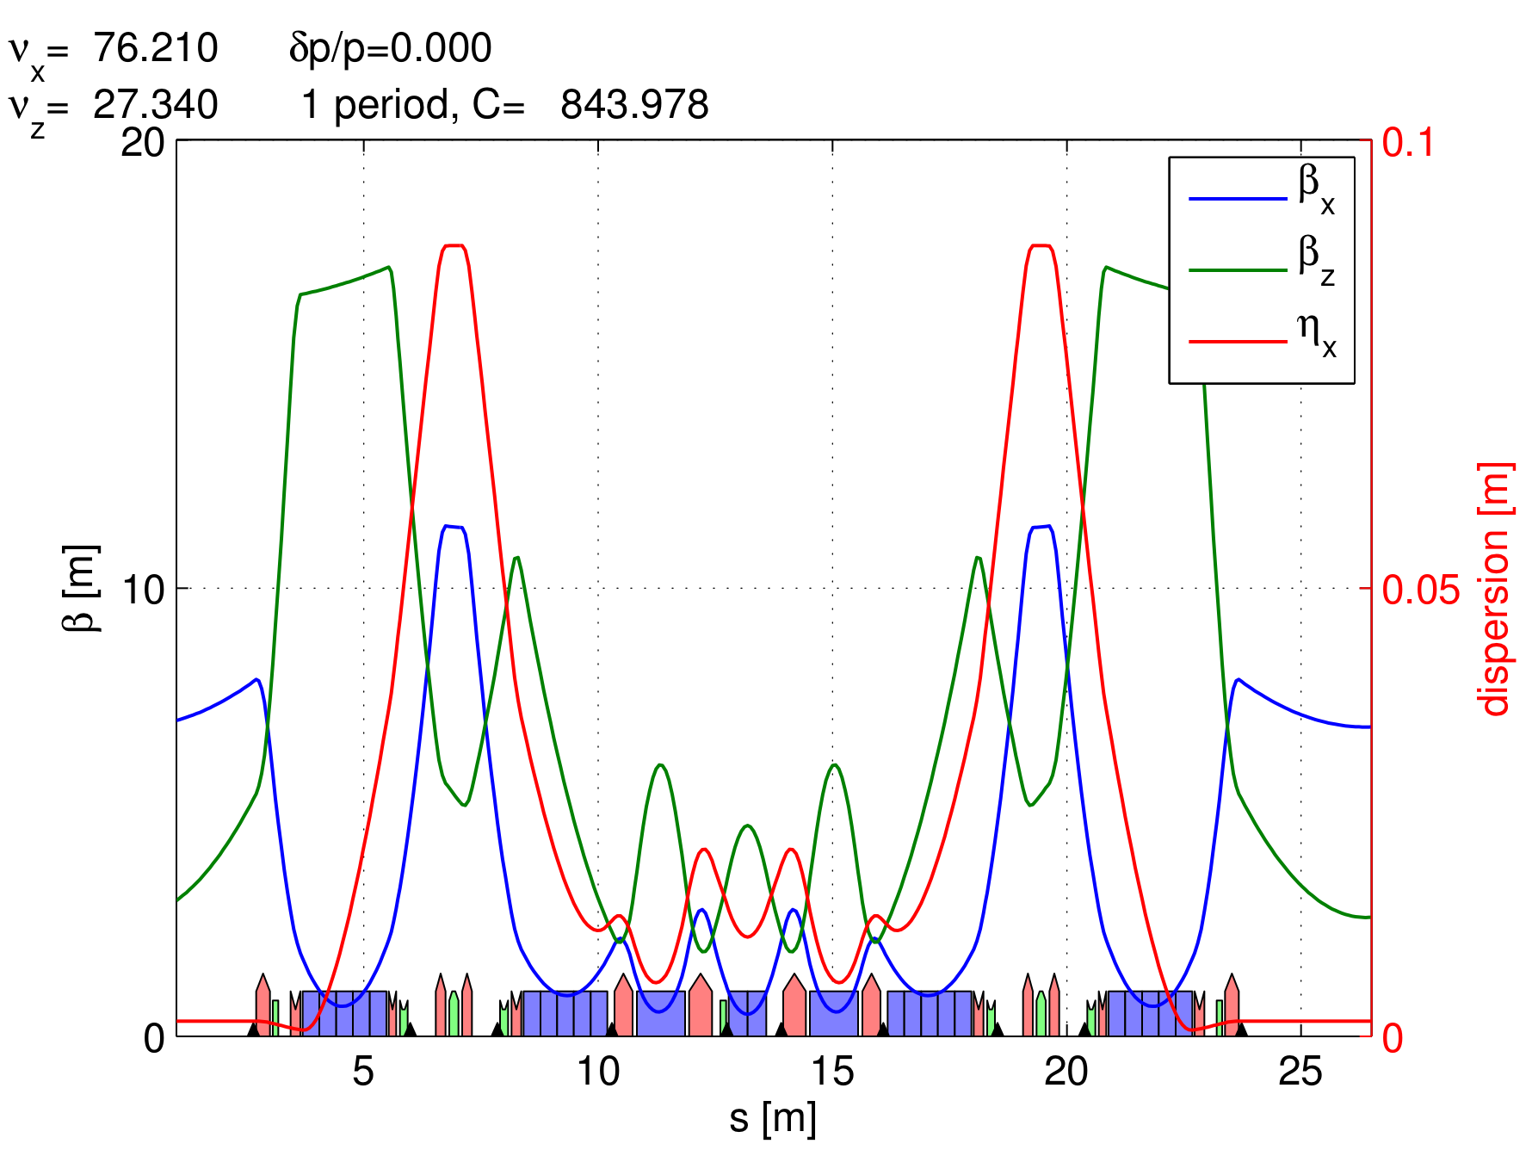
Calculations for ESRF EBS
 | current ESRF | EBS
circumference (m) | 844.39 | 843.979
emittance (pm) | 4000 | 135
beta_x,y | 37/3 | 6.9/2.6
damping times (msec) | 7/7/3.5 | 8.5/13/8.8
momentum compaction | 1.78e-4 | 0.87e-4
tunes | 36.44/13.39 | 75.6/27.6
Energy loss/turn (MeV) | 4.88 | 2.60
Natural chrom | -130/-58 | -100/-84
(atplot)

Slide 21
calculating parameters in AT for ESRF1, EBS
function atx() gives linear optics plus
Ohmi Envelope results
[linopt,p]=atx(esrf)
[linoptS28D,pS28D]=atx(S28D)
p =
ll: 844.3904
alpha: 1.7758e-04
fractunes: [0.4396 0.3901]
fulltunes: [36.4396 13.3901]
nuh: 36.4396
nuv: 13.3901
chromaticity: [5.7983 6.1301]
dampingtime: [0.0070 0.0070 0.0035]
espread: 0.0011
blength: 0.0043
modemittance: [4.0131e-09 1.3081e-36 4.5432e-06]
energy: 6.0400e+09
fs: 2.1040e+03
eloss: 4.8806e+06
synchrophase: 0.5732
momcompact: 1.7758e-04
pS28D =
ll: 843.9773
alpha: 8.5140e-05
fractunes: [0.2100 0.3400]
fulltunes: [76.2100 27.3400]
nuh: 76.2100
nuv: 27.3400
chromaticity: [5.9996 3.9997]
dampingtime: [0.0088 0.0134 0.0091]
espread: 9.3359e-04
blength: 0.0029
modemittance: [1.3211e-10 -5.0066e-38 2.7210e-06]
energy: 6.0000e+09
fs: 1.3017e+03
eloss: 2.5224e+06
synchrophase: 0.3985
momcompact: 8.5140e-05

Slide 22
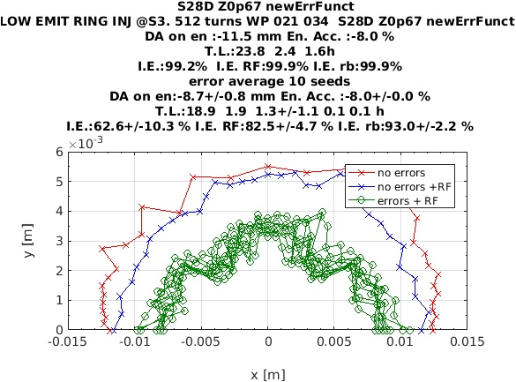
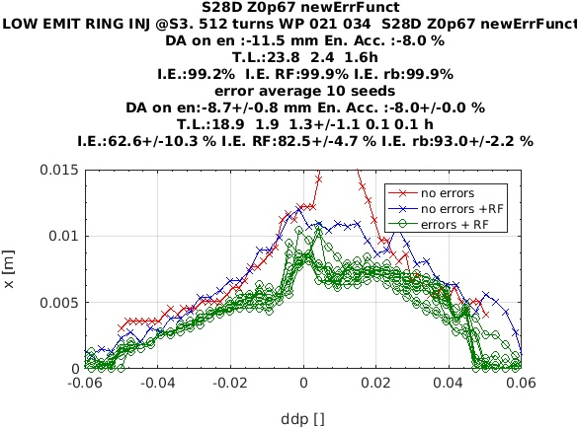
dynamic aperture
Zn = .67 ohms
for bunch lengthening
booster beam params for injection efficiency calcs:
epsx,y=(120,5) (60,5), (30,30)

Slide 23
momentum acceptance and Touschek Lifetime
5 error seeds
tau=16.3+/-2.8 hrs
computed on cluster (paralellized tracking) by
N. Carmignani

Slide 24
mode parameters
multi-bunch
16 bunch
4 bunch
200mA, 868 bunches
90 mA
40 mA
Mode | Intensity | I_b (mA) | Lifetime
Uniform | 200 | .202 | 8.5 hrs
16 bunch | 90 | 5.62 | 2.42 hrs
4 bunch | 40 | 10 | 1.78 hrs

Slide 25
Conclusions
AT is still widely used in light source community
An attempt has been made to coordinate development, called atcollab
AT is used in two ways, as an online modeling tool, usually integrated within MML, and secondly as a design tool for low emittance light sources
We (at ESRF) have added tools to make AT powerful for design purposes, and others can benefit from our work.
We have attempted to maintain backwards compatibility, so we hope that our version of AT can also be used widely with MML and a standard version can be maintained.
AT has been the main tool used in the modeling for the ESRF EBS.
Let’s work together for a release of AT2.0!!

Slide 26
EXTRA SLIDES

Slide 27
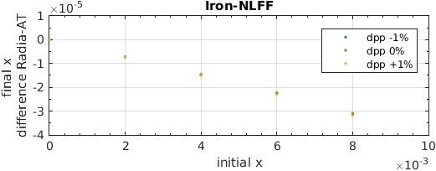
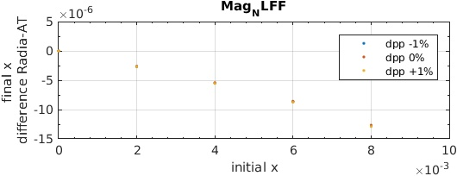
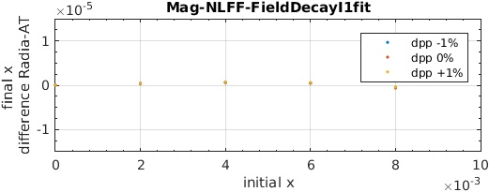
Quadrupole model: AT vs RADIA
K
s
F1
To fit at best the tracking in RADIA for QF8, with a trapezoid,
(field integral unchanged)
F1=0.079 m
(I1+ = I1- = 0.00013)
Also similar or better then a sliced model

Slide 28
RINGPARAM
Issue: if we want to define many different ring structures at the same
time, we need a way to define global parameters for each one.
Idea: create an element in each ring to store global parameters for that
ring.
ATRINGPARAM(FAMNAME,E0,NBPERIODS)
reference energy
periodicity of lattice
Not many functions yet developed to take advantage of this feature.
(IdentityPass needed as PassMethod
for RingPass)

