Slide 1
Envelope tracking as a tool for low emittance ring design
M. Aiba and M. Ehrlichman
2nd LERD workshop
01.12.2016, Lund, Sweden

Slide 2
Introduction
Computations for low emittance ring design (LERD)
Linear optical functions (Beta and Dispersion)
Basis of LERD – Quads and Bends configuration
Radiation integrals
→ Emittance, Damping time, etc.
Particle tracking
→ Nonlinear opt. – Dynamic aperture, life time, etc.
Envelope (or sigma matrix) tracking
→ Emittance, Damping time, IBS, etc. for any coupled lattice
Implemented in SAD code from KEK
Not everybody is using this “tool”

Slide 3
Sigma matrix
$$σ_{beam}=\left[\begin{matrix}\begin{matrix}\left\langle x^{2}\right\rangle & \left\langle xx′\right\rangle & \left\langle xy\right\rangle \\ \left\langle x′x\right\rangle & \left\langle {x′}^{2}\right\rangle & \left\langle x^{′}y\right\rangle \\ \left\langle yx\right\rangle & \left\langle yx′\right\rangle & \left\langle y^{2}\right\rangle \end{matrix} & \begin{matrix}\left\langle xy′\right\rangle & \left\langle xs\right\rangle & \left\langle xδ\right\rangle \\ \left\langle x^{′}y′\right\rangle & \left\langle x^{′}s\right\rangle & \left\langle x′δ\right\rangle \\ \left\langle yy′\right\rangle & \left\langle ys\right\rangle & \left\langle yδ\right\rangle \end{matrix} \\ \begin{matrix}\left\langle y^{′}x\right\rangle & \left\langle y^{′}x′\right\rangle & \left\langle y^{′}y\right\rangle \\ \left\langle sx\right\rangle & \left\langle sx′\right\rangle & \left\langle sy\right\rangle \\ \left\langle δx\right\rangle & \left\langle δx′\right\rangle & \left\langle δy\right\rangle \end{matrix} & \begin{matrix}\left\langle {y′}^{2}\right\rangle & \left\langle y^{′}s\right\rangle & \left\langle y′δ\right\rangle \\ \left\langle sy′\right\rangle & \left\langle s^{2}\right\rangle & \left\langle sδ\right\rangle \\ \left\langle δy′\right\rangle & \left\langle δs\right\rangle & \left\langle δ^{2}\right\rangle \end{matrix}\end{matrix}\right]$$
Sigma matrix represents the beam:
- Beam sizes (squared) = Diagonal elements
- Emittances = Eigen values
- Coupling terms = Off-diagonal elements

Slide 4
Envelope tracking (1)
Transport sigma matrix element by element
Synchrotron radiation is included as Damping and Diffusion matrices
Reference: K. Ohmi, K. Hirata, and K. Oide, “From the beam-envelope to synchrotron-radiation integrals”, Phys. Rev. E 49-1, p.751 (1994)
IBS can be included in the same manner
Reference: K. Kubo, K. Oide, “Intrabeam Scattering in Electron Storage Rings”, PRST-AB 4, 124401 (2001)
Generalization of the method in J.D. Bjorken, S.K. Mtingwa, “Intrabeam Scattering”, Part. Acc. Vol. 13, pp. 115-143 (1983)
$$σ_{beam}→{Mσ}_{beam}M^{T}$$

Slide 5
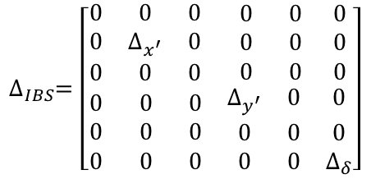
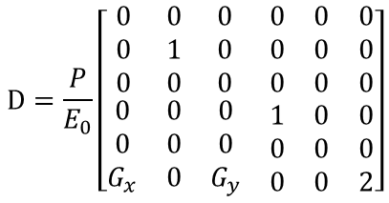
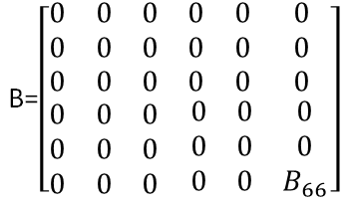
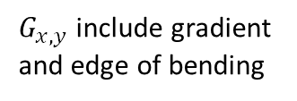
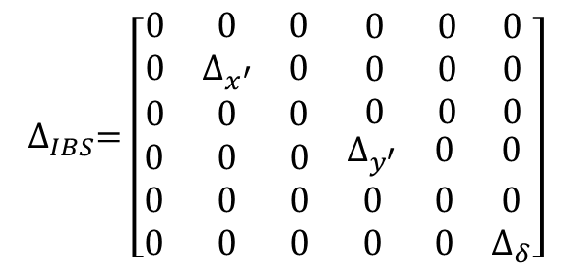
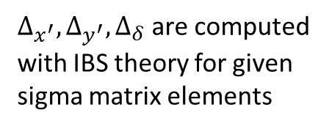
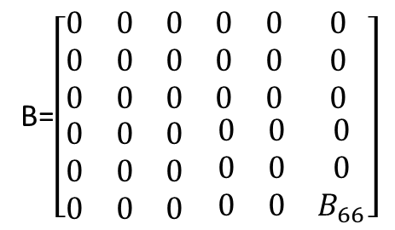
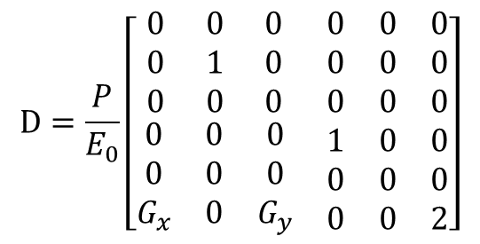
Envelope tracking (2)
SR and IBS effects are computed at each element
$$∆_{IBS}=\left[\begin{matrix}\begin{matrix}0 & 0 & 0 \\ 0 & ∆_{x^{′}} & 0 \\ 0 & 0 & 0\end{matrix} & \begin{matrix} 0 & 0 & 0 \\ 0 & 0 & 0 \\ 0 & 0 & 0\end{matrix} \\ \begin{matrix}0 & 0 & 0 \\ 0 & 0 & 0 \\ 0 & 0 & 0\end{matrix} & \begin{matrix}∆_{y^{′}} & 0 & 0 \\ 0 & 0 & 0 \\ 0 & 0 & ∆_{δ}\end{matrix}\end{matrix}\right]$$
IBS diffusion
$∆_{x^{′}}, ∆_{y^{′}}{,∆}_{δ}$are computed
with IBS theory for given
sigma matrix elements
1) At all elements
$$σ_{beam}→σ_{beam}+∆_{IBS}$$
IBS:
2-a) If the element is dipoles
Damping matrix
(on-energy beam)
Diffusion matrix
$$D=\frac{P}{E_{0}}\left[\begin{matrix}\begin{matrix}0 & 0 & 0 \\ 0 & 1 & 0 \\ 0 & 0 & 0\end{matrix} & \begin{matrix}0 & 0 & 0 \\ 0 & 0 & 0 \\ 0 & 0 & 0\end{matrix} \\ \begin{matrix}0 & 0 & 0 \\ 0 & 0 & 0 \\ G_{x} & 0 & G_{y}\end{matrix} & \begin{matrix}1 & 0 & 0 \\ 0 & 0 & 0 \\ 0 & 0 & 2\end{matrix}\end{matrix}\right]$$
Damping:
$$σ_{beam}→{\left(I−lD\right)σ}_{beam}{(I−lD)}^{T}$$
Transport & Diffusion:
$$σ_{beam}→{Mσ}_{beam}M^{T}+\int{MBM^{T}ds}$$
2-b) If the element is not dipoles
$G_{x,y}$include gradient
and edge of bending
$$B_{66}=\frac{55}{24\sqrt{3}}\frac{r_{e}ℏ}{mc}\frac{γ^{5}}{{\left|ρ\right|}^{3}}$$
B=$\left[\begin{matrix}\begin{matrix}0 & 0 & 0 \\ 0 & 0 & 0 \\ 0 & 0 & 0\end{matrix} & \begin{matrix}0 & 0 & 0 \\ 0 & 0 & 0 \\ 0 & 0 & 0 \end{matrix} \\ \begin{matrix}0 & 0 & 0 \\ 0 & 0 & 0 \\ 0 & 0 & 0\end{matrix} & \begin{matrix}0 & 0 & 0 \\ 0 & 0 & 0 \\ 0 & 0 & B_{66}\end{matrix}\end{matrix}\right]$
$$σ_{beam}→{Mσ}_{beam}M^{T}$$
Transport:
3) Continue tracking until an equilibrium is reached

Slide 6
Rad. Int. vs Envelope tracking
Comparison for SLS2 lattice
 | Radiation integral | Envelope tracking
Natural emittance (pm) | 137 | 139
Energy spread (‰) | 1.03 | 1.03
Hor. Damping time (ms) | 4.54 | 4.48
Ver. Damping time (ms) | 8.07 | 7.96
Long. Damping time (ms) | 6.60 | 6.57
Note:
- Need to slice dipole to 1~2 cm length for good agreement
for Envelope tracking.
- Required slice length depends on optical function.

Slide 7
Emittances with full coupling
Envelope tracking can handle any coupled lattice
Equilibrium emittances of Mobius rings (no IBS) are computed:
$\frac{ε_{0}}{ε_{x}}=\frac{ε_{0}}{ε_{y}}=\frac{1}{J_{x}}+\frac{1}{J_{y}}$ is confirmed *
* M. Borland, Private communication (2015)

Slide 8
IBS simulation (1)
“Standard” simulation procedure
Compute IBS growth rate for one turn
IBS (diffusion) increases the momentum spread (<x’²>, <y’²>, <δ²>)
Add synchrotron radiation damping at the end of turn
For the transverse planes:
ε=ε₀+dε_{IBS}+dε_{SR}
dε_{SR} is computed for the equilibrium emittances and damping
times
Transverse equilibrium emittances are set “artificially”
to mimic a coupled lattice
For the longitudinal plane:
δ=δ₀+dδ_{IBS}+dδ_{SR}
and the bunch is “forcibly” fit to the RF bucket
Continue the tracking until dε_{IBS}+dε_{SR}~0 and dδ_{IBS}+dδ_{SR} ~0
Faster simulation: ε=ε₀+N(dε_{IBS}+dε_{SR}) (N~10-1000)
𝛿
s

Slide 9
IBS simulation (2)
Result for:
Zero current bunch length ~ 3mm
Zero current vertical emittance = 5 pm (Artificially set!)
Standard → Env. tracking:
Horizontal emittances ↑
Vertical emittances →
Longitudinal emittance ↓

Slide 10
IBS simulation (3)
Simulation for full-coupled lattice
Short bunch length and increased bunch current to enhance IBS
 | Without IBS | IBS "Standard" simulation | Env. tracking with SR+IBS
Hor. Emittance (pm) | 88 | 165 | 135
Ver. Emittance (pm) | 88 | 88 | 134
Energy spread (‰) | 1.03 | 1.31 | 1.21
Bunch length (mm) | 1.24 | 1.58 | 1.45
Bunch current (mA) | 5 | 5 | 5
Weak point of Standard simulation
(artificial introduction of coupling)
is more evident for full-coupled lattice

Slide 11
Summary
Envelope tracking
a good complement tool for LEDR
can handle any coupled lattice
including synchrotron radiation and IBS

