Slide 1



Nonlinear dynamics and Low emittance tuning for CLIC damping ring (DR) new design
H. Ghasem^{1,2}
Y. PapaPhilippou²
¹ School of Particles and Accelerators, IPM, Tehran, Iran
² CERN, Geneva, Switzerland
2nd Workshop on Low Emittance Ring Lattice Design, MAXIV
1-2 December 2016
Special thanks to Javi Alabau-Gonzalvo and Eduardo Marin Lacoma

Slide 2
Outline
CLIC overview
CLIC DR new design
  Longitudinal variable bend and superconducting wiggler
  Trapezium field profile dipole
  Optics and parameters
Nonlinear dynamics
  Chromaticity correction and tune sensitivity with energy
  Phase space and dynamic aperture
  Lost particles
  FMA
  Multipole error
  Acceptance
Vertical emittance tuning algorithm - to bring the vertical emittance to design value (ε_{y}<1 pm rad including IBS effect) under the misaligned lattice
  Effects of misalignments – Theory
  Distribution of correctors
  Tuning algorithm
  Tolerances
  Vertical emittance

Slide 3
CLIC overview
The goal: Colliding electrons and positrons head-on collision at energies up to several Tera-electron volts (TeV).

Slide 4
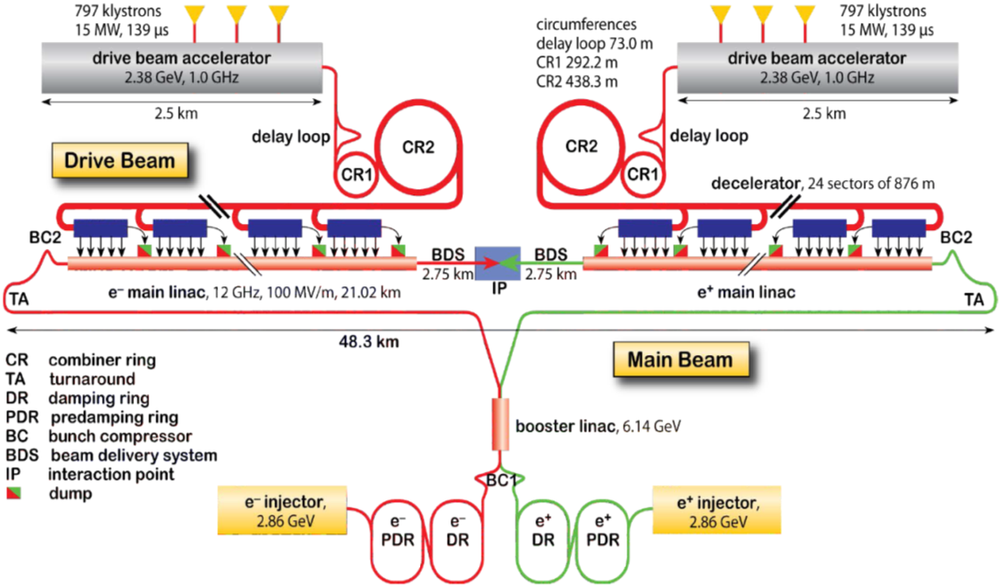
CLIC overview
Technology: Using radiofrequency (RF) structures and a two-beam concept to produce accelerating fields as high as 100 MV per meter to reach a nominal total energy of 3 TeV, keeping the size and cost of the project within reach

Slide 5
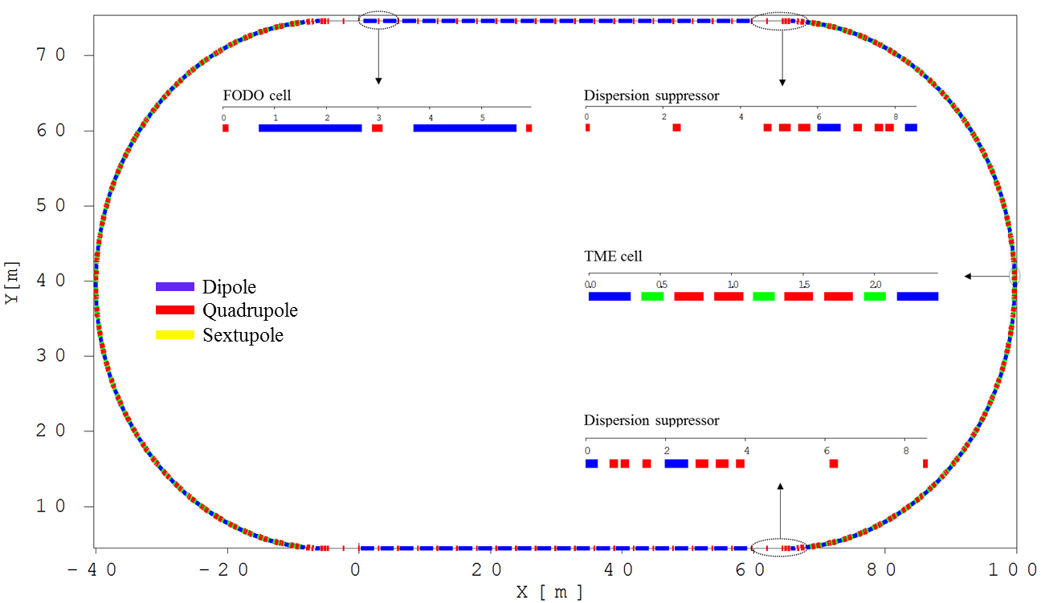
General layout of CLIC damping ring (DR)
The DRs’ layout has a racetrack shape and consists of two arcs and two long straight sections.
The arcs are composed of theoretical minimum emittance (TME) cell with longitudinally variable bends and the straight sections are based on FODO cell filled with high field super conducting damping wigglers.
Each arc/straight section includes of 42 TME/10 FODO cells and there are totally 90 dipoles and 40 superconducting wiggler magnets in the whole DR.
There are four matching sections grouped in two types to match the optics of straight section to the optics of arc section and vice versa.

Slide 6
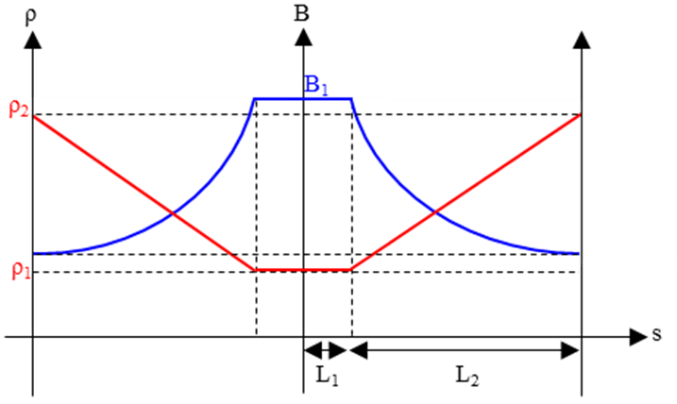
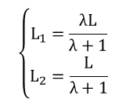
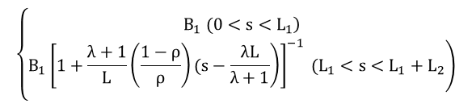
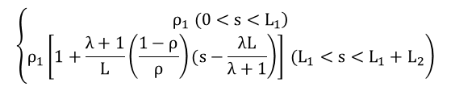
Longitudinal variable bend
The longitudinally variable dipole, whose magnetic field varies along their length, can provide lower horizontal emittances than a uniform dipole of the same bending angle.
For this propose, the maximum magnetic field of a variable bend should be applied at its center and decreases towards the two exit edges of the dipole.
Several longitudinal field profile of dipoles and corresponding DR parameters have been studied.
The results revealed that damping ring based on trapezium field profile dipole provides better conditions in view of beam emittance, number of dipole and ring circumference, etc. and therefore I mainly focus on DR based Trapezium dipole.
Defining λ and ρ as λ = L₁/L₂ and ρ = ρ₁/ρ₂ and assuming L as the half length of dipole ;
$$\left\{\begin{matrix}L_{1}=\frac{λL}{λ+1} \\ L_{2}=\frac{L}{λ+1}\end{matrix}\right.$$
$$\left\{\begin{matrix}\left.ρ_{1} (0<s<L_{1}\right) \\ \left.ρ_{1}\left[\left.1+\frac{λ+1}{L}\left(\frac{1−ρ}{ρ}\right)(s−\frac{λL}{λ+1}\right)\right] (L_{1}<s<L_{1}+L_{2}\right)\end{matrix}\right.$$
$$\left\{\begin{matrix}\left.B_{1} (0<s<L_{1}\right) \\ \left.{B_{1}\left[\left.1+\frac{λ+1}{L}\left(\frac{1−ρ}{ρ}\right)(s−\frac{λL}{λ+1}\right)\right]}^{−1} (L_{1}<s<L_{1}+L_{2}\right)\end{matrix}\right.$$
S. Papadopoulou, F. Antoniou and Y. Papaphilippou,
Emittance reduction with variable bending magnet strengths: Analytical optics considerations, preprint (2016).

Slide 7
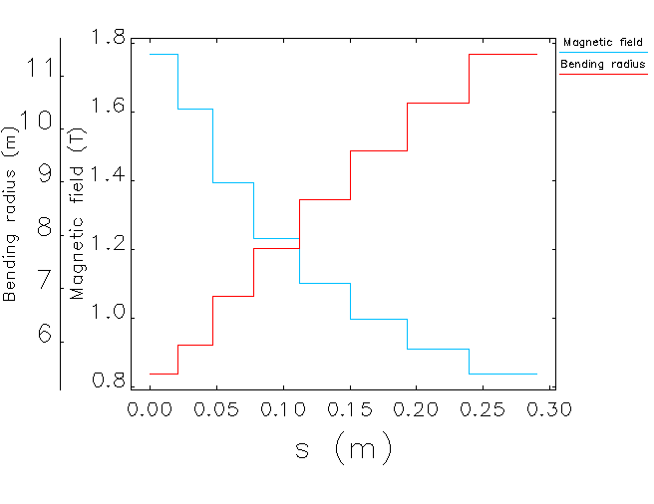
Trapezium field profile dipole
The dipole total length is set to L = 58 cm as the optimized value.
Each trapezium field profile dipole bends the beam 4 Degrees.
Trapezium dipole has small gradient for beam focusing.
The highest field section with length of about 4.2 cm provides magnetic field of 1.76 T.
Parameters | Highest field section | Lowest field section
Length (cm) | 4.1825 | 5.0550
Field (T) | 1.7666 | 0.8366
Radius (m) | 5.4000 | 11.4028
Def. angle (Deg.) | 0.4438 | 0.2540
K (m⁻²) | -1.1000 | -1.1000
Gradient (T/m) | -10.4937 | -10.4937

Slide 8
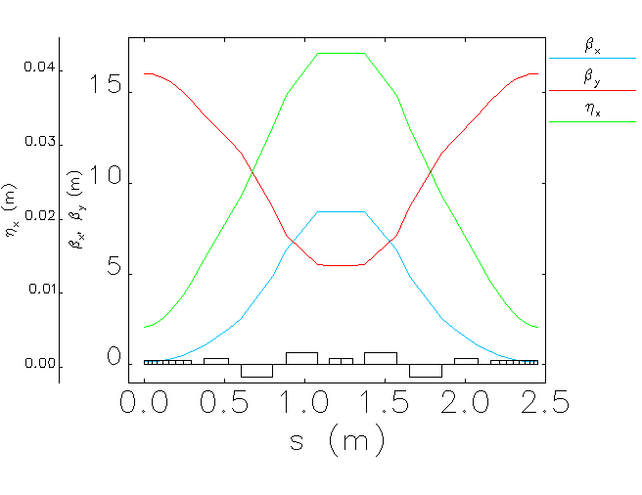
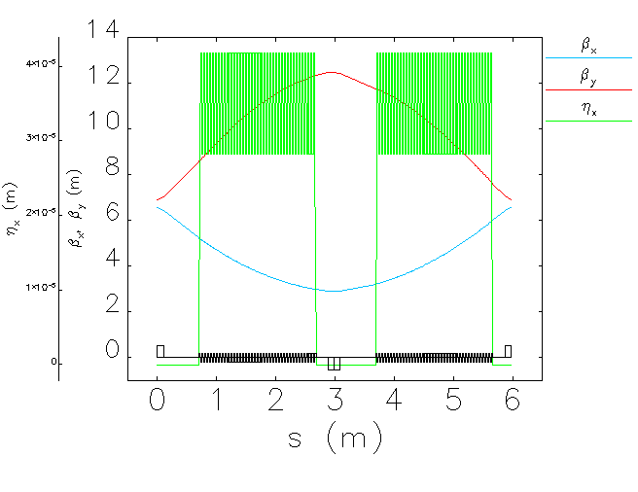
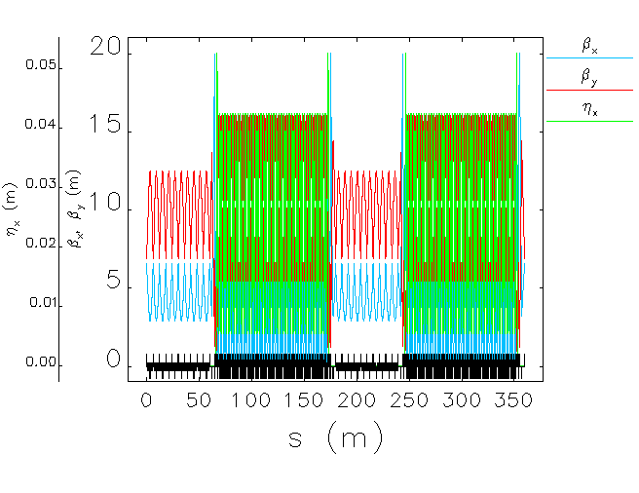
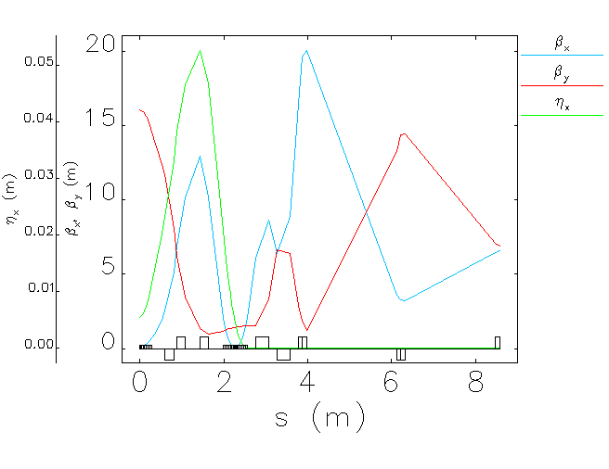
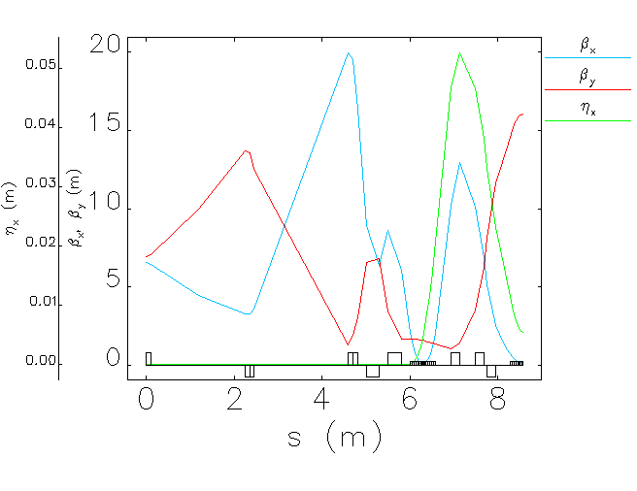
Optical functions and parameters
Parameters | Value
Energy (GeV) | 2.860
Circumference (m) | 359.440
Hor./Ver. tune | 45.2895/8.3133
Natural emittance (pm.rad) | 75.8924
Natural chromaticity | -128.789/-61.832
1st order mom. com. factor | 1.2478E-4
Energy spread | 1.2745E-3
Energy loss per turn (MeV) | 5.721
Damping time (ms/ms/ms) | 1.179/1.199/0.604
TME cell;
Length= 2.45 m
ψ_{x}/2π= 0.442
ψ_{y}/2π= 0.042
FODO cell;
Length= 5.969
ψ_{x}/2π= 0.238
ψ_{y}/2π= 0.096
Wiggler (l=2 m, B=3.5 T, λ=49 mm)
Dispersion suppressor;
Length=8.57
ψ_{x}/2π= 0.851
ψ_{y}/2π=0.726
Dispersion suppressor;
Length= 8.56
ψ_{x}/2π= 0.851
ψ_{y}/2π= 0.709

Slide 9
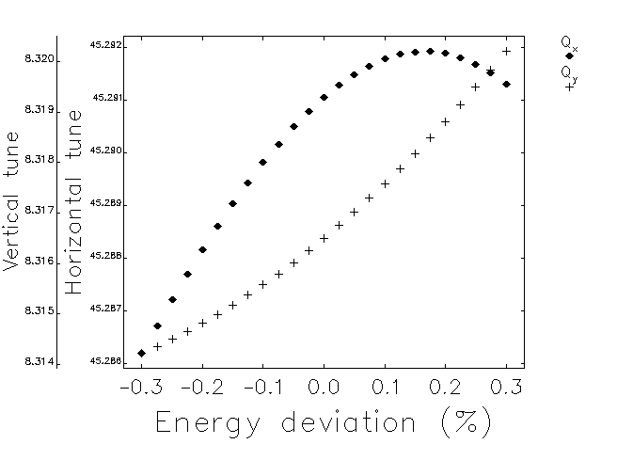
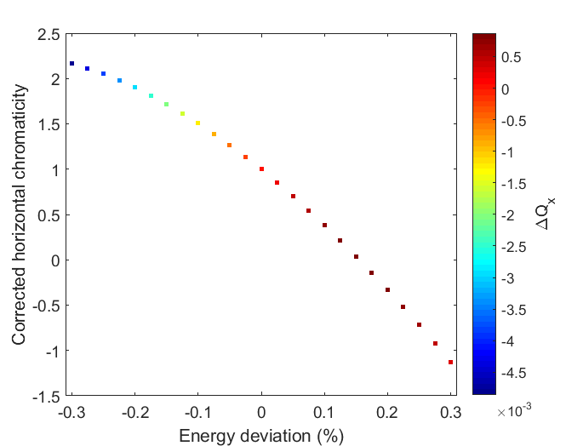
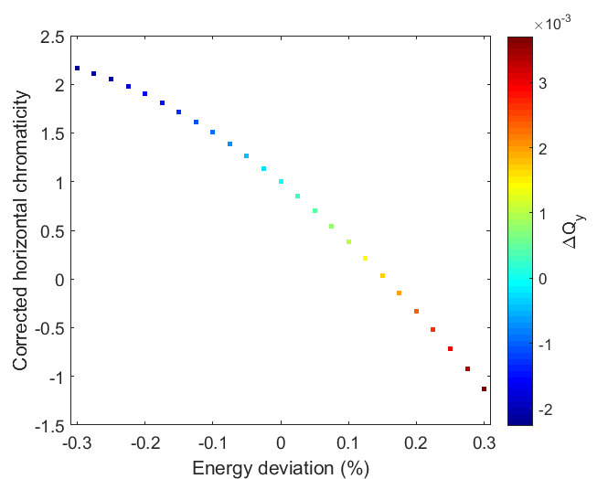
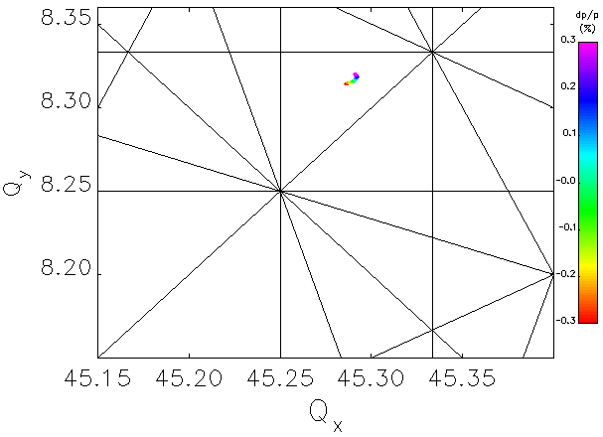
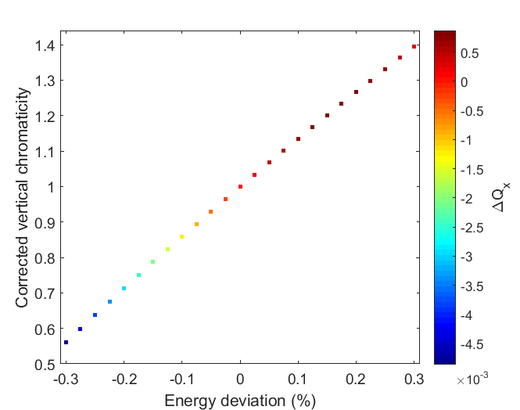
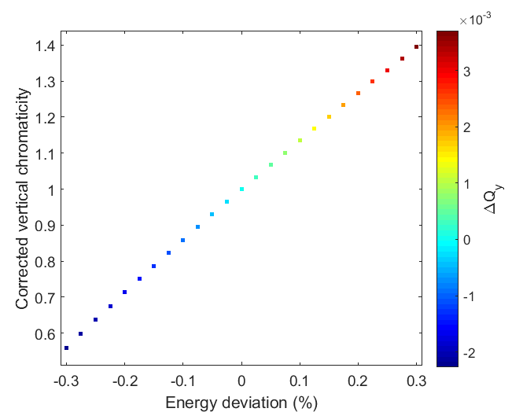
Chromaticity correction-Tune shift with energy
Two families of sextupole magnets both with the same length of 15 cm in the TME cell are considered to correct the natural chromaticity of ring to +1.
Parameters | SD | SF
Length [cm] | 15
Pole radius [mm] | 15
Sextupole strength [m⁻²] | -362.6698 | 416.5494
B” (T/m⁻²) | -3459.7589 | 3973.7531
Pole tip field (T) [R=15 mm] | 0.3892 | 0.44705
Small variation of tune point up to ±0.3 % energy deviation reveals that present sextupole arrangement was good a starting point to perform nonlinear beam dynamics.

Slide 10
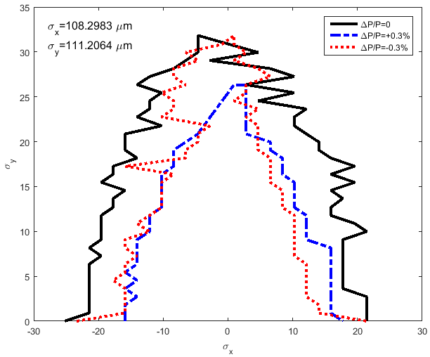
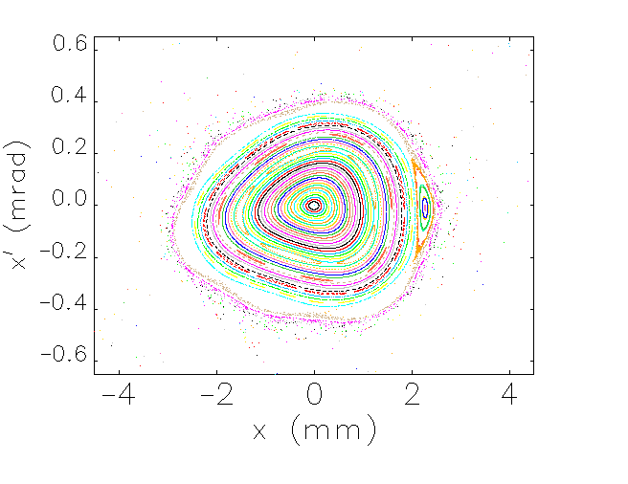
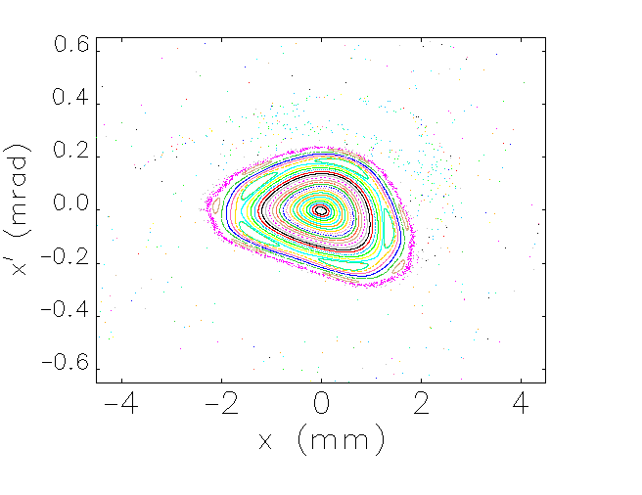
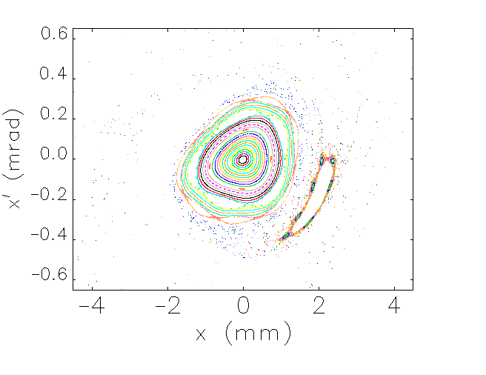
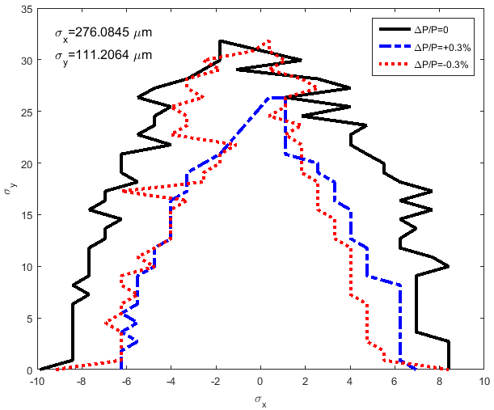
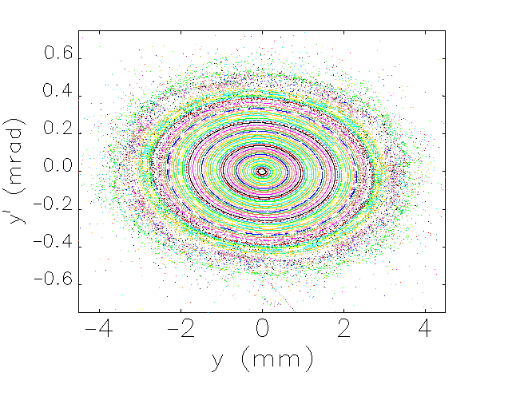
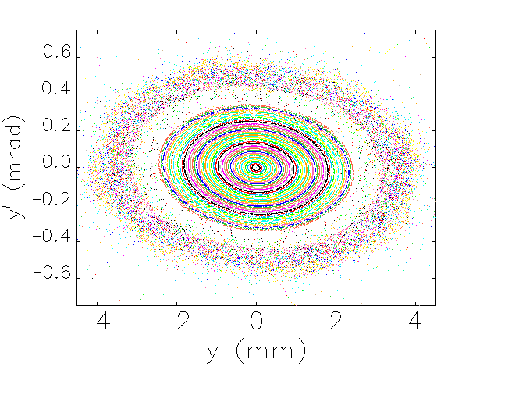
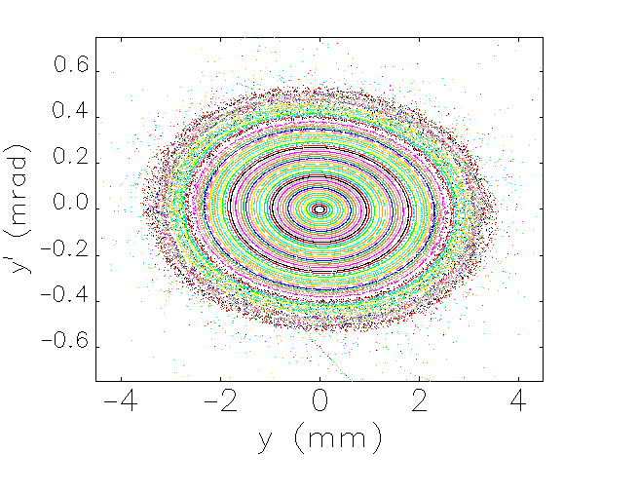
Phase space & DA
DA: Physical transverse stable space for the particles after a given number of turns (2000 here)
The injected beam normalized emittance and energy spread;
For electron DR: ε_{xn}=10 μm and ε_{yn}=10 μm, δ=0.3%
For positron DR: ε_{xn}=65 μm and ε_{yn}=10 μm, δ=0.3%
Electron DR
ΔP/P=0
ΔP/P=0.3%
ΔP/P=-0.3%
Positron DR

Slide 11
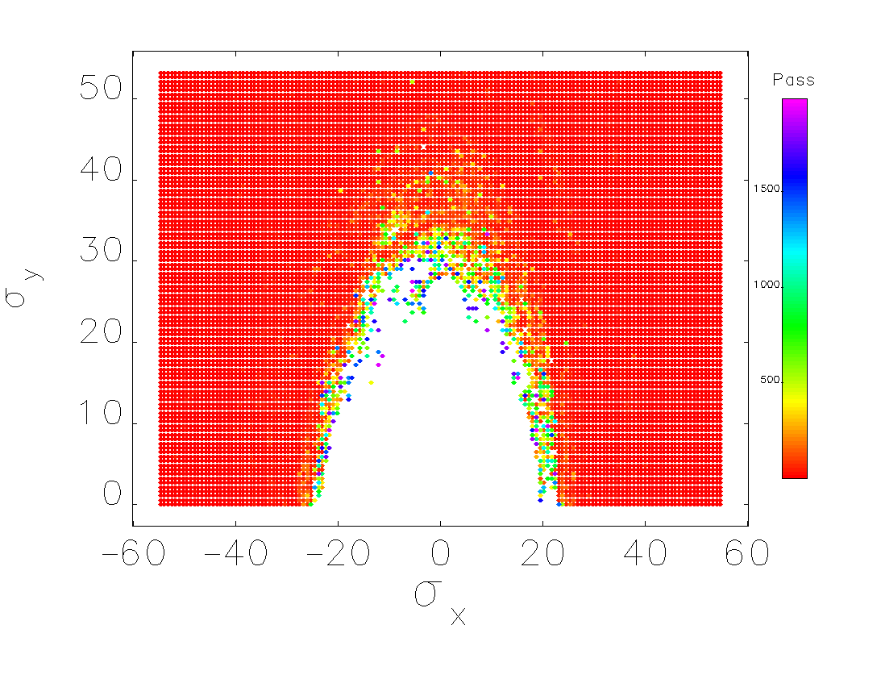
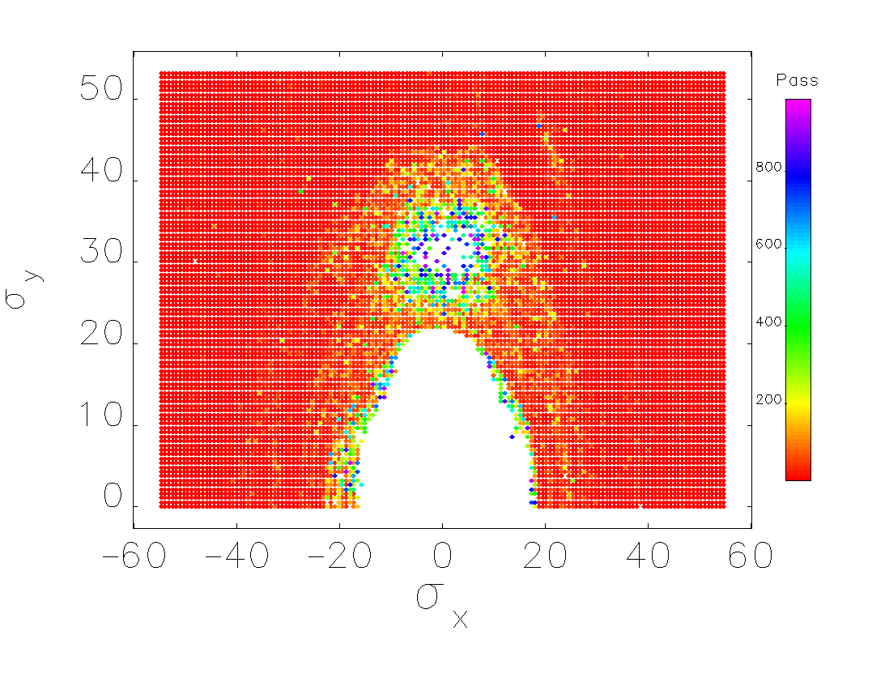




DA & lost particles
ΔP/P=0
ΔP/P=0.3%
ΔP/P=-0.3%
Electron DR
Positron DR

Slide 12
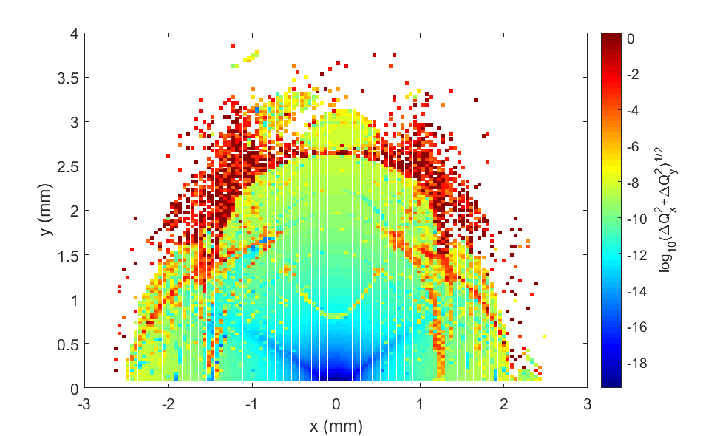
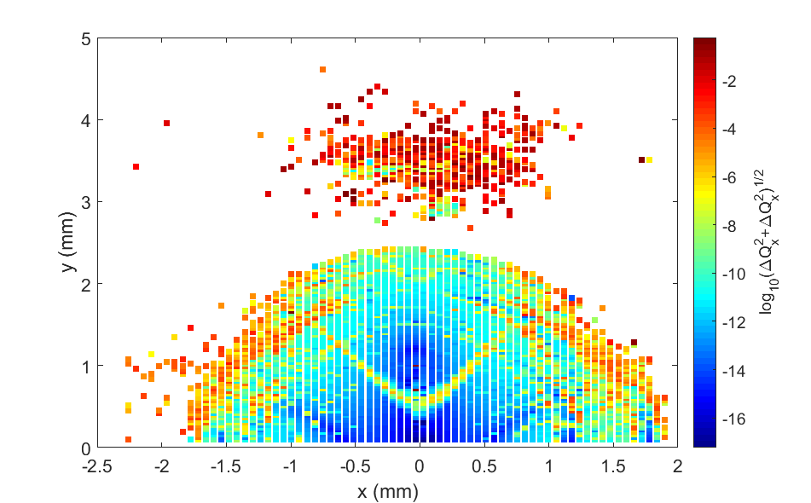
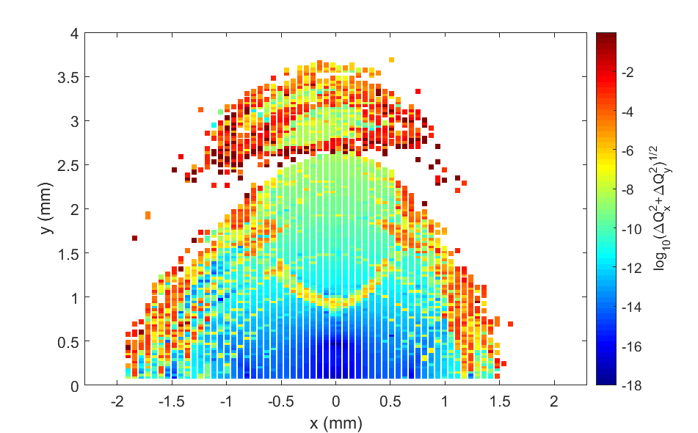
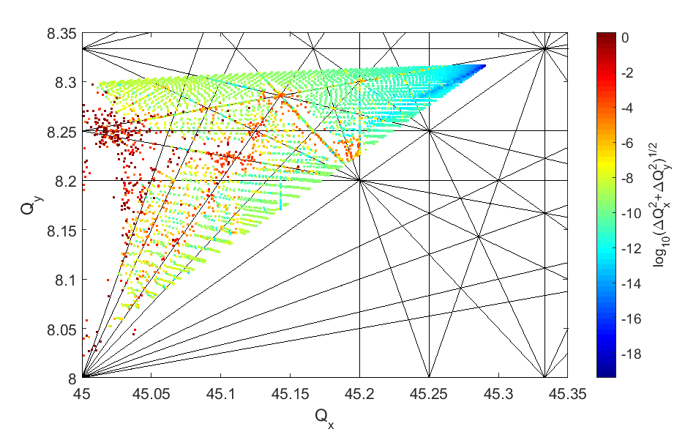
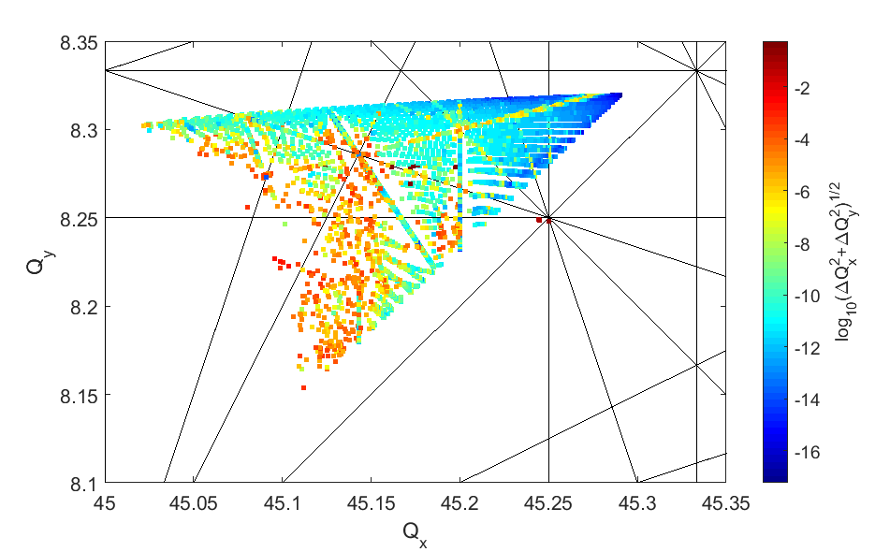
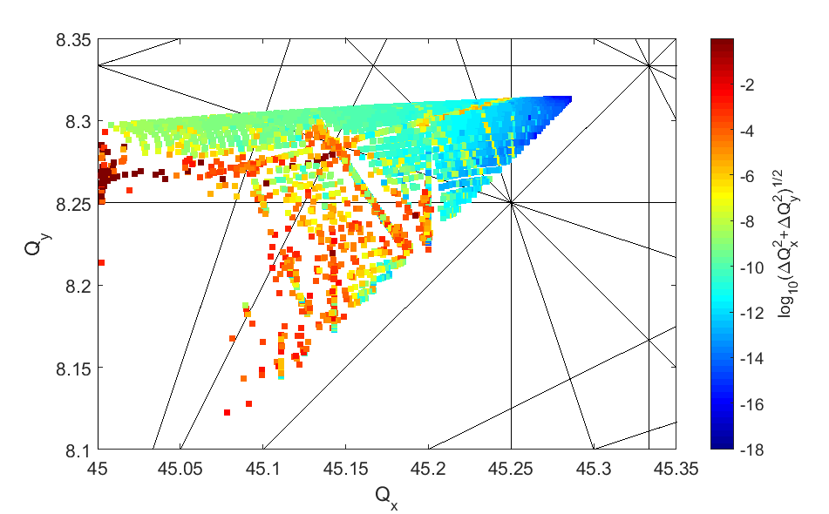
Frequency Map Analysis
ΔP/P=0
ΔP/P=0.3%
ΔP/P=-0.3%

Slide 13
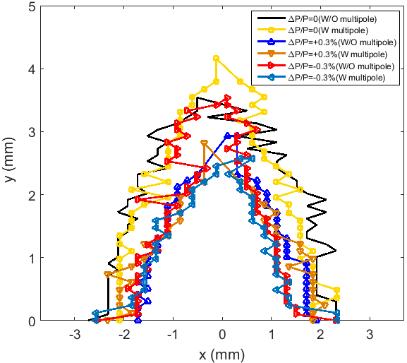
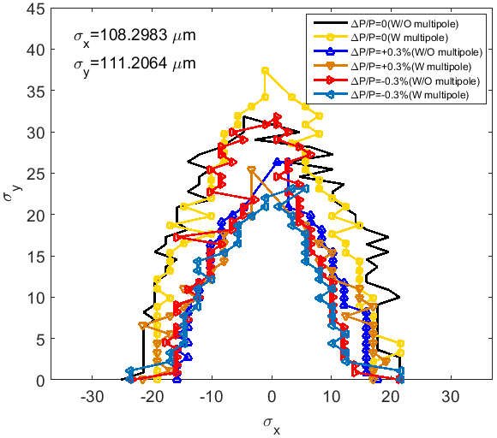
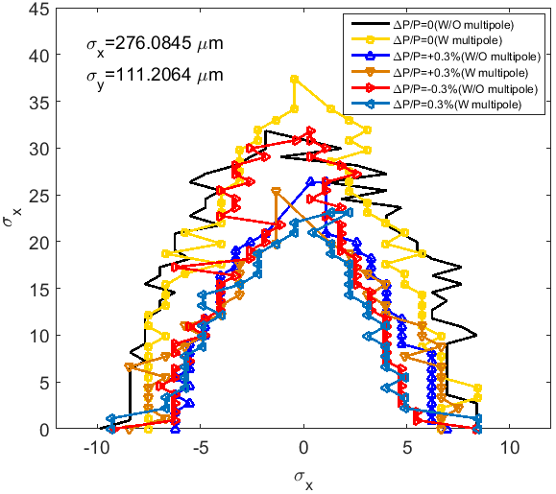
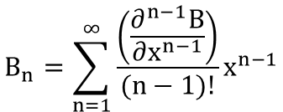
DA & multipoles
 | Order | Multipole | Systematic | Random
Dipole, B_{n}/B₁ @ 10 mm | 2 | Quadrupole | 1.00 *10⁻⁴ | 1.00*10⁻³
 | 3 | Sextupole | 1.50*10⁻⁴ | 1.00*10⁻³
 | 4 | 8-pole | 0.00 | 1.00*10⁻³
 | 5 | 10-pole | 5.00*10⁻⁵ | 1.00*10⁻³
 | 6 | 12-pole | 0.00 | 1.00*10⁻³
 | 7 | 14-pole | 5.00*10⁻⁴ | 1.00*10⁻³
 | 8 | 16-pole | 0.00 | 1.00*10⁻³
Quadrupole, B_{n}/B₂ @ 10 mm | 3 | Sextupole | 0.00 | 1.00*10⁻³
 | 4 | 8-pole | 0.00 | 1.00*10⁻³
 | 5 | 10-pole | 0.00 | 1.00*10⁻³
 | 6 | 12-pole | 1.00*10⁻⁶ | 1.00*10⁻³
 | 7 | 14-pole | 0.00 | 1.00*10⁻³
 | 8 | 16-pole | 0.00 | 1.00*10⁻³
 | 9 | 18-pole | 0.00 | 1.00*10⁻³
 | 10 | 20-pole | 1.00*10⁻⁷ | 1.00*10⁻³
 | 11 | 22-pole | 0.00 | 1.00*10⁻³
 | 12 | 24-pole | 0.00 | 1.00*10⁻³
 | 13 | 26-pole | 0.00 | 1.00*10⁻³
 | 14 | 28-pole | 1.00*10⁻⁸ | 1.00*10⁻³
 | 15 | 30-pole | 0.00 | 1.00*10⁻³
 | 16 | 32-pole | 0.00 | 1.00*10⁻³
 | 17 | 34-pole | 0.00 | 1.00*10⁻³
 | 18 | 36-pole | 1.00*10⁻⁸ | 1.00*10⁻³
Sextupole, B_{n}/B₃ @ 10 mm | 4 | 8-pole | 0.00 | 1.00*10⁻³
 | 5 | 10-pole | 0.00 | 1.00*10⁻³
 | 6 | 12-pole | 0.00 | 1.00*10⁻³
 | 7 | 14-pole | 0.00 | 1.00*10⁻³
 | 8 | 16-pole | 0.00 | 1.00*10⁻³
 | 9 | 18-pole | 1.00*10⁻⁶ | 1.00*10⁻³
 | 15 | 30-pole | 1.00*10⁻⁷ | 1.00*10⁻³
 | 21 | 42-pole | 1.00*10⁻⁶ | 1.00*10⁻³
 | 26 | 54-pole | 5.00*10⁻⁷ | 1.00*10⁻³
 | 33 | 66-pole | 1.00*10⁻⁷ | 1.00*10⁻³
 | 39 | 78-pole | 5.00*10⁻⁸ | 1.00*10⁻³
 | 45 | 90-pole | 1.00*10⁻⁸ | 1.00*10⁻³
$$B_{n}=\sum_{n=1}^{∞}{\frac{\left(\frac{∂^{n−1}B}{∂x^{n−1}}\right)}{(n−1)!}x^{n−1}}$$
Electron DR
Positron DR

Slide 14
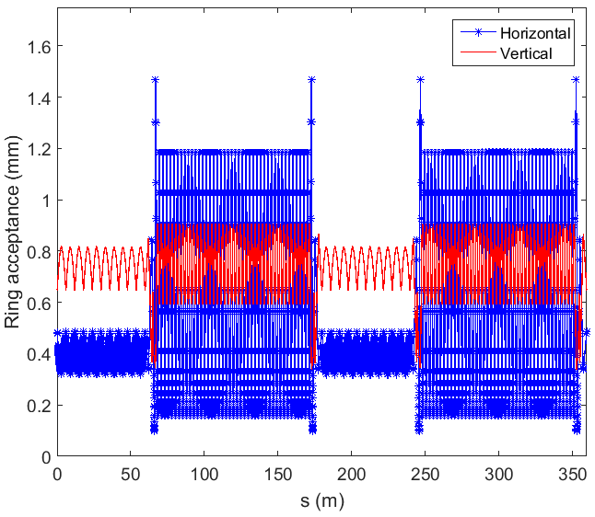
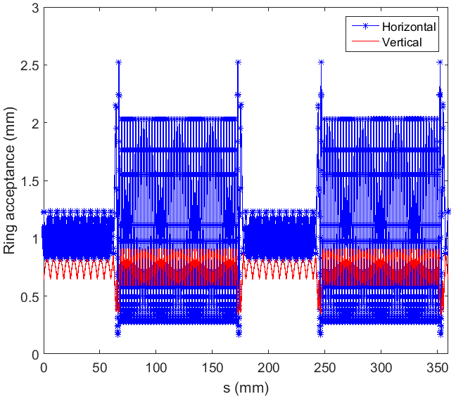
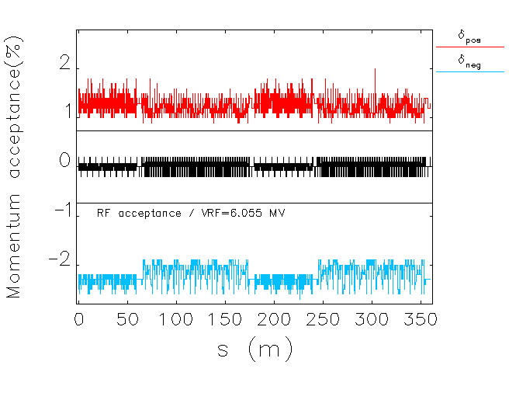
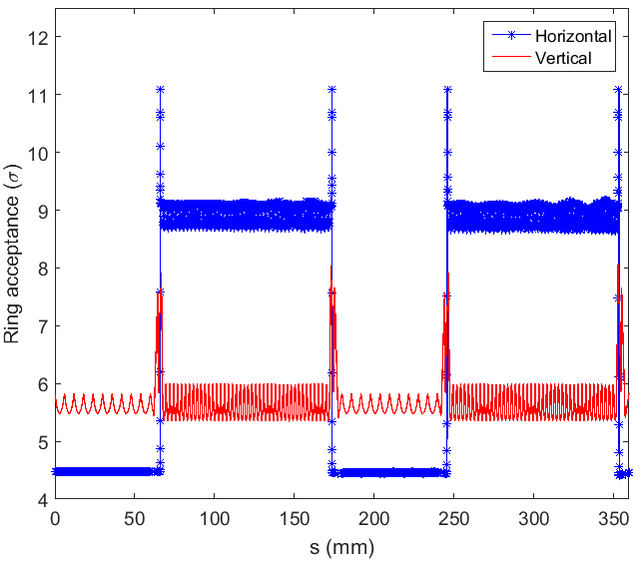
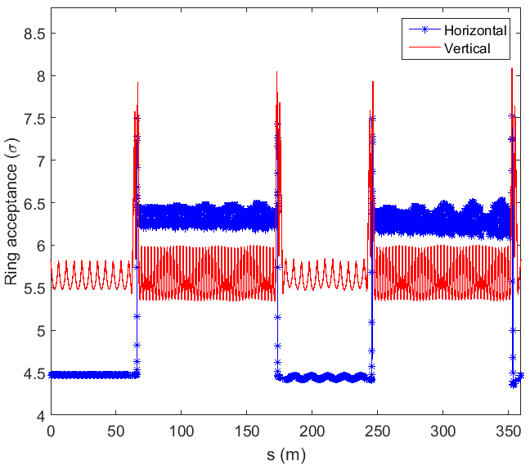


Acceptance
RF frequency, f_{RF}: 2 GHz
Natural radiation loss per turn, U₀: 5.7 MeV
Parasitic energy loss per turn, U_{p}: 50 keV
Harmonic number, h: 2398
Harmonic efficiency coefficient, m: 0.8
RF voltage, V_{RF}: 6.055 MV
Over voltage factor, q: 1.0493
RF acceptance, ε_{RF}: ±0.736 %
Electron DR
Positron DR
$$ε_{RF}=±\sqrt{\frac{2(U_{0}+U_{p})}{παhmE}[\sqrt{q^{2}−1}−\cos^{−1}(1/q)]}$$
$${Ring acceptance}_{i}=\sqrt{2β_{i}ε_{i}}+η_{i}δ$$
ε_{i} is assumed to be 10 times larger than the injected beam and the “i” indicates horizontal and vertical directions.
No essential requirement for the aperture for the DR vacuum system in view of acceptance.
10 mm residual vertical dispersion and 1.5% momentum deviation are assumed.

Slide 15
Vertical emittance
In practice, the vertical emittance for a circular machine is dominated by two factors;
  residual vertical dispersion (This is caused by the coupling between longitudinal and vertical motion)
  betatron coupling (This is caused by the coupling between horizontal and vertical motion)
Magnet alignment errors are the dominant sources of vertical emittance in particular:
  tilts of the dipoles around the beam axis;
  vertical alignment errors of the quadrupoles;
  tilts of the quadrupoles around the beam axis;
  vertical alignment errors of the sextupoles.
In the rest, the impact of these errors on the vertical emittance shall be discuss.
Tuning algorithm to minimize the vertical emittance by correcting for these errors will be presented.

Slide 16
Vertical emittance and tuning algorithm
Nominal lattice
Vertical steady state emittance
Feed expected misalignments
Correctors distribution
Orbit correction
Vertical dispersion and coupling correction
Vertical equilibrium emittance measurement

Slide 17
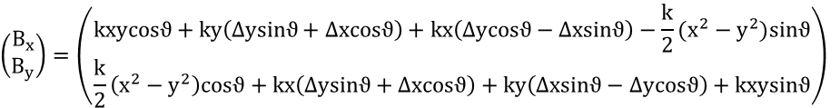


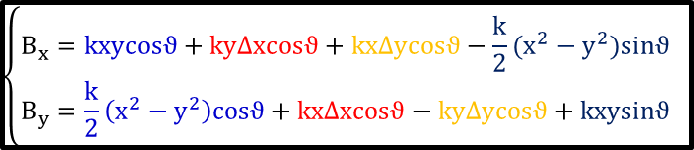
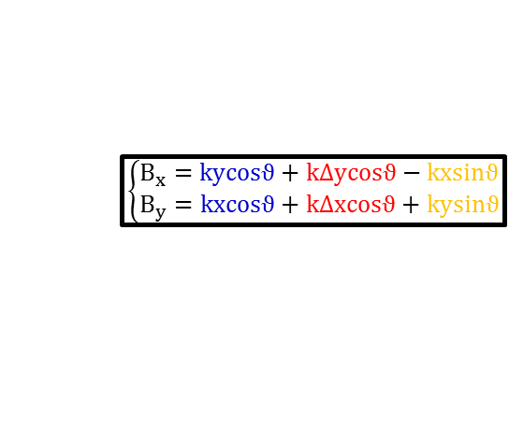
Misalignments of magnets
Combined Dipole
$\left(\begin{matrix}B_{x} \\ B_{y}\end{matrix}\right)=\left(\begin{matrix}ky \\ B+kx\end{matrix}\right)→\left(\begin{matrix}B_{x} \\ B_{y}\end{matrix}\right)=\left(\begin{matrix}cosϑ & −sinϑ \\ sinϑ & cosϑ\end{matrix}\right)\left(\begin{matrix}k\left(y+∆y\right) \\ B+k(x+∆x)\end{matrix}\right)$=$\left(\begin{matrix}kycosϑ+k\left(∆ycosϑ−∆xsinϑ\right)−Bsinϑ−kxsinϑ \\ \left(B+kx\right)cosϑ+k\left(∆ysinϑ+∆xcosϑ\right)+kysinϑ\end{matrix}\right)$
Ignoring Δxsinθ, Δysinθ
$$\left\{\begin{matrix}B_{x}=kycosϑ+k\left(∆ycosϑ\right)−Bsinϑ−kxsinϑ \\ B_{y}=\left(B+kx\right)cosϑ−k\left(∆xcosϑ\right)+kysinϑ\end{matrix}\right.$$
Combined horizontal dipole
generated by Δx, θ
Vertical dipole
generated by Δy, θ
Skew quadrupole
generated by θ
Quadrupole
$\left(\begin{matrix}B_{x} \\ B_{y}\end{matrix}\right)=\left(\begin{matrix}ky \\ kx\end{matrix}\right)→\left(\begin{matrix}B_{x} \\ B_{y}\end{matrix}\right)=\left(\begin{matrix}cosϑ & −sinϑ \\ sinϑ & cosϑ\end{matrix}\right)\left(\begin{matrix}k\left(y+∆y\right) \\ k(x+∆x)\end{matrix}\right)$=$\left(\begin{matrix}kycosϑ+k\left(∆ycosϑ−∆xsinϑ\right)−kxsinϑ \\ kxcosϑ+k\left(∆ysinϑ+∆xcosϑ\right)+kysinϑ\end{matrix}\right)$
Ignoring Δxsinθ, Δysinθ
$$\left\{\begin{matrix}B_{x}=kycosϑ+k∆ycosϑ−kxsinϑ \\ B_{y}=kxcosϑ+k∆xcosϑ+kysinϑ\end{matrix}\right.$$
Orth. quadrupole
generated by θ
Hor/ver dipole
generated by Δx/Δy
Skew quadrupole
generated by θ
Sextupole
$$\left(\begin{matrix}B_{x} \\ B_{y}\end{matrix}\right)=\left(\begin{matrix}kxy \\ \frac{k}{2}(x^{2}−y^{2}) \end{matrix}\right)→\left(\begin{matrix}B_{x} \\ B_{y}\end{matrix}\right)=\left(\begin{matrix}cosϑ & −sinϑ \\ sinϑ & cosϑ\end{matrix}\right)\left(\begin{matrix}k(x+∆x)\left(y+∆y\right) \\ \frac{k}{2}({(x+∆x)}^{2}−{\left(y+∆y\right)}^{2})\end{matrix}\right)$$
$$\left(\begin{matrix}B_{x} \\ B_{y}\end{matrix}\right)=\left(\begin{matrix}kxycosϑ+ky\left(∆ysinϑ+∆xcosϑ\right)+kx\left(∆ycosϑ−∆xsinϑ\right)−\frac{k}{2}(x^{2}−y^{2})sinϑ \\ \frac{k}{2}\left(x^{2}−y^{2}\right)cosϑ+kx\left(∆ysinϑ+∆xcosϑ\right)+ky\left(∆xsinϑ−∆ycosϑ\right)+kxysinϑ\end{matrix}\right)$$
$$\left\{\begin{matrix}B_{x}=kxycosϑ+ky∆xcosϑ+kx∆ycosϑ−\frac{k}{2}(x^{2}−y^{2})sinϑ \\ B_{y}=\frac{k}{2}\left(x^{2}−y^{2}\right)cosϑ+kx∆xcosϑ−ky∆ycosϑ+kxysinϑ\end{matrix}\right.$$
Ignoring Δxsinθ, Δysinθ,
ΔxΔy, Δx², Δy²
Orth. sextupole
generated by θ
Orth. quadrupole
generated by Δx
Skew quadrupole
generated by Δy
Skew sextupole
generated by θ

Slide 18
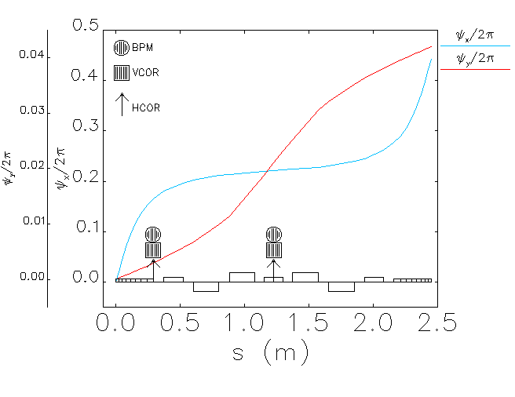
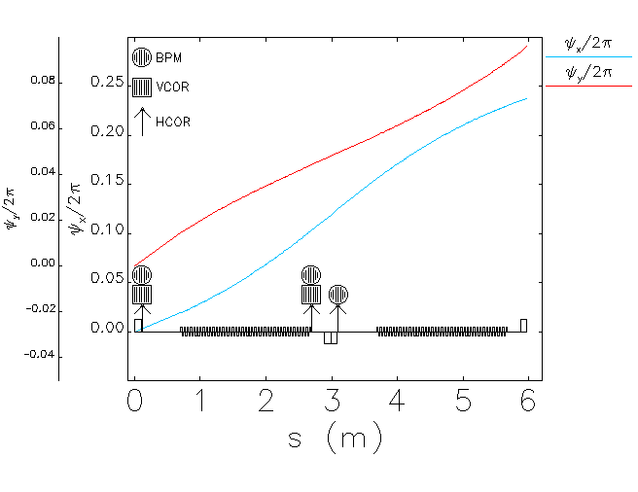
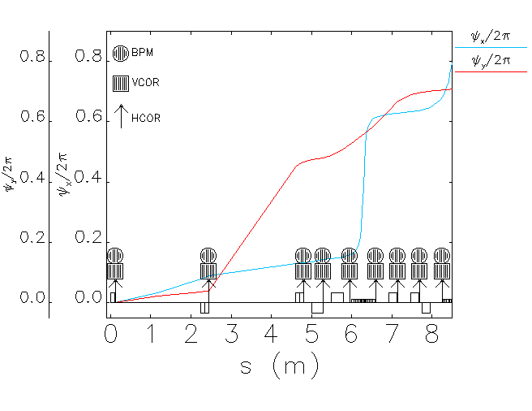
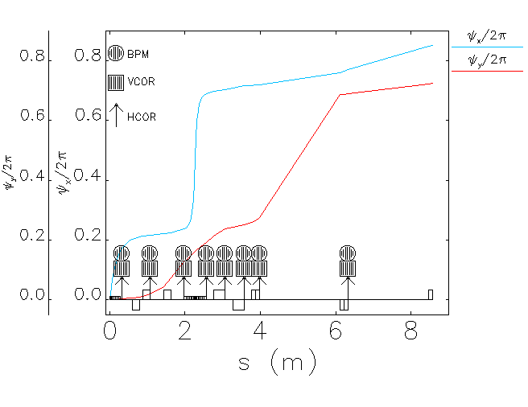
Correctors
Correctors installed
242 vertical; (84 per arc, 8 per DS-I, 9 per DS-II, 20 per LSS)
262 horizontal; (84 per arc, 8 per DS-I, 9 per DS-II, 30 per LSS)
Monitors installed
262 BPM; (84 per arc, 8 per DS-I, 9 per DS-II, 30 per LSS)
Skew quads
2 sextupole families in the arcs
Skew quads installed as windings in the sextupoles.

Slide 19








Correction method – response matrix
The variation of the vertical orbit at the BPM position s_{j} resulting from the corrector kick θ_{i} at s_{i} is expressed by;
The self-consistent solution of vertical dispersion when a skew quad strength changes by Δ(kl) is
$$∆y=\frac{\sqrt{β(s_{j})}}{2sin⁡(πQ_{y})}\sum_{i=1}{θ_{i}}\sqrt{β(s_{i})}cos⁡(πQ_{y}−[ψ\left(s_{j}\right)−ψ\left(s_{i}\right)])$$
$$∆η_{y}=Δ(kl)η_{x}\frac{\sqrt{ββ_{0}}}{2sin⁡(πQ_{y})}cos⁡(πQ_{y}−[ψ−ψ_{0}])$$
This is the response of vertical orbit a unit change in vertical corrector strength.
This is the response of dispersion function to a unit change in skew quad strength.
$$\left[\begin{matrix}{Δy}_{1} \\ {Δy}_{2} \\ \begin{matrix}\begin{aligned}{Δy}_{3} \\ . \\ . \\ .\end{aligned} \\ {Δy}_{nBPM}\end{matrix}\end{matrix}\right]=R_{n.m}\left[\begin{matrix}θ_{1} \\ θ_{2} \\ \begin{matrix}\begin{aligned}θ_{3} \\ . \\ . \\ .\end{aligned} \\ θ_{mCor}\end{matrix}\end{matrix}\right]$$
$$\left[\begin{matrix}{Δη}_{y1} \\ {Δη}_{y2} \\ \begin{matrix}\begin{aligned}{Δη}_{y3} \\ . \\ . \\ .\end{aligned} \\ {Δη}_{ynBPM}\end{matrix}\end{matrix}\right]=R_{n.m}\left[\begin{matrix}k_{1} \\ k_{2} \\ \begin{matrix}\begin{aligned}k_{3} \\ . \\ . \\ .\end{aligned} \\ k_{mCor}\end{matrix}\end{matrix}\right]$$
Feed misalignment error
Feed misalignment error
$$Y_{Meas.}+R.Θ_{Cor}=0$$
$${η_{y}}_{Meas.}+R.k_{Skew}=0$$
$$Θ_{Cor}= R^{−1}(−Y_{Meas.})$$
$$k_{Skew}= R^{−1}(−{η_{y}}_{Meas.})$$

Slide 20





Dipole vertical offset
For the case of Δy = 150 μm;
Accumulated histogram;
For 100 machine samples, the vertical emittance due to the dipole vertical displacement up to 100 μm is below than 0.5 pm rad.
For the case of 150 μm, vertical emittance is above 0.5 pm only for 5 machine samples.

Slide 21





Dipole roll
For the case of Δϕ = 500 μrad;
Accumulated histogram;
Dipole roll up to 0.7 mrad is tolerable.

Slide 22





Quadrupole vertical offset
For the case of Δy = 20 μm;
Accumulated histogram;
Vertical emittance is very sensitive to misalignment of quads.
Vertical emittance due to the quad vertical offset up to 20 μm is below than 1 pm rad for 99 machine samples.
To be in the goal vertical emittance region, vertical offset of the quads must be kept in ±15 μm.

Slide 23





Quadrupole roll
For the case of Δϕ = 150 μrad;
Accumulated histogram;
For 100 machine samples, the vertical emittance up to 200 μrad quadrupole roll is below than 1 pm rad.
±100 μrad corresponding to the vertical emittance below than 0.5 pm for 100 machine samples can be achievable with the present day alignment techniques.

Slide 24





Sextupole vertical offset
For the case of Δy = 25 μm;
Accumulated histogram;
Vertical emittance is very sensitive to misalignment of sextupoles.
For 100 machine samples, vertical emittance due to the sextupole vertical offset up to 20 μm is below than 1 pm rad.
The vertical emittance will be kept in the goal region for 10 μm vertical offset of the sextupoles.

Slide 25





Sextupole roll
For the case of Δϕ = 250 μrad;
Accumulated histogram;
Vertical emittance is not very sensitive to the roll of sextupole.
Up to 300 μrad, the vertical emittance is in the goal region for the 100 machine samples.

Slide 26

Vertical emittance
Error | Unit | Value
Dipole/quadrupole/sextupole/BPM vertical misalignment | μm | 35/20/20/50
Dipole/quadrupole/sextupole roll | μrad | 80/50/50
BPM roll | μrad | 50
BPM noise | nm | 200
For 95% of machine samples,
vertical emittance is below than 0.7 pm rad.

Slide 27









Closed orbit & vertical dispersion

Slide 28


Corrector’s strength

Slide 29








Coupling coefficients

Slide 30




Shift of tune & chromaticity

Slide 31
Thank you!

Slide 32
Back up slides

Slide 33


Intra beam scattering
The IBS algorithm is based on the Bjorken and Mtingwa’s * formula.
Assumed parameters;
No. Particles:4E9
Bunch charge:0.72 nC
Vertical emittance: 0.73 pm
RF voltage=6.055 MV
Harmonic=2398
Bunch length=1.577 mm
Calculated with ELEGANT
Parameters | Without IBS | With IBS | Growth rate (%)
Natural emittance (pm.rad) | 73.752 | 89.847 | 21.823
Energy spread | 1.275E-3 | 1.303E-3 | 2.196
Bunch length (mm) | 1.577 | 1.612 | 2.194
* J.D. Bjorken, S.K. Mtingwa
Intrabeam Scattering, Part. Acc. Vol. 13, 1983, 115-143.

