Slide 1
Long Term Plans at MAX IV
Pedro F. Tavares
Low Emittance Rings Workshop - MAX IV 2016

Slide 2
Outline
The MAX IV Accelerator RoadMap
The quest for higher brightness: The MBA lattice.
How can we go further ? The next generation.
An exercise: preliminary design for a diffraction limited source in the MAX IV 3 GeV ring tunnel.
Conclusions

Slide 3
Max IV Accelerator Roadmap
LINAC
Soft X-Ray FEL (proposal Swedish User Community)
Hard X-Ray FEL
3 GeV Ring
Brightness Improvements: current lattice and Ids (200 pm rad)
Brightness Improvements: additional focussing (150 pm rad)
1.5 GeV Ring
Timing modes
Completely new lattice (diffraction limit at 10 keV)

Slide 4
The Quest for higher brightness

Slide 5
How was it possible ?
High Brightness
Accelerator Physics
New Lattica Design (MBA)
New Tools for Dynamic Analysis
Accelerator Engineering
Compact Magnets
Distributed Pumping – NEG coating
Low Frequency RF
Long Bunches

Slide 6
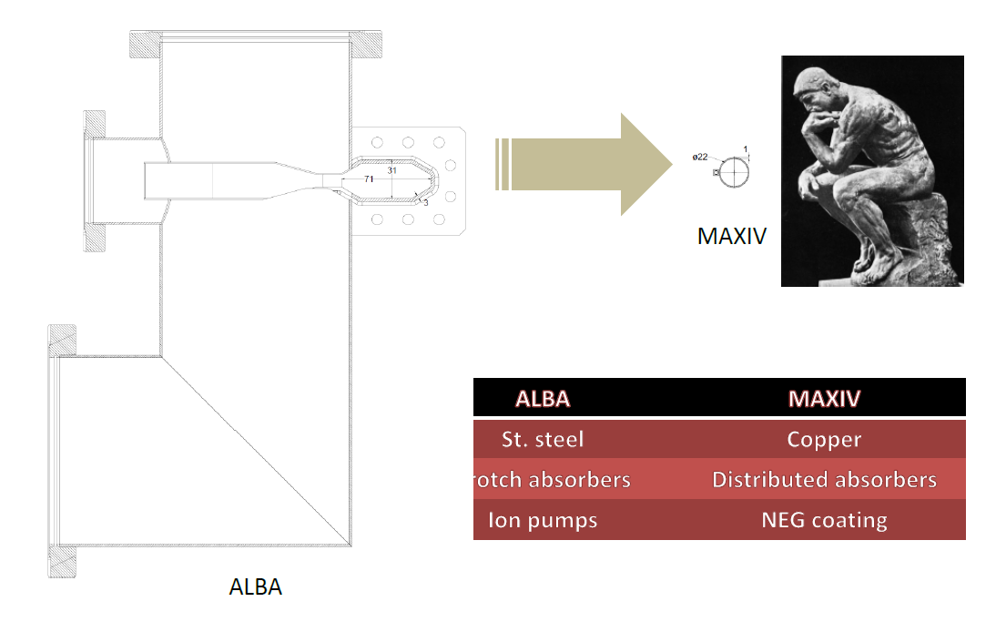
Compactedness is the key !
Picture by E. Aldmour

Slide 7
Beyond MAX IV – exploring future possibilities
Can the MBA concept be used to design a storage ring that provides a bare lattice emittance ̴ 10 pm rad within the MAX IV 3 GeV ring circumference (528 m) ?
If we take the present trend to smaller gaps to a new level, and consider that “…when it is necessary that a magnetically significant dimension of a magnet is very small, a permanent magnet will always produce higher fields than an electromagnet”, K. Halbach J.App.Phys (1985), Vol. 57, N. 1.
Large scale use of permanent magnet technology could play a key role in this development.

Slide 8
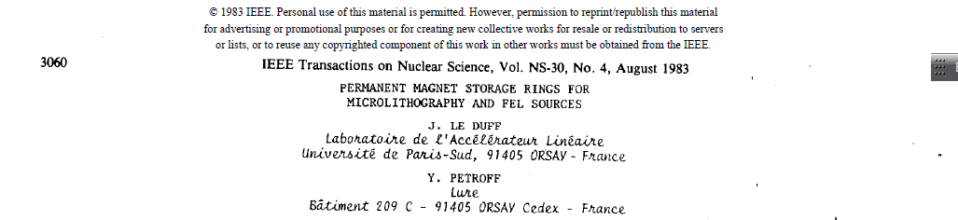


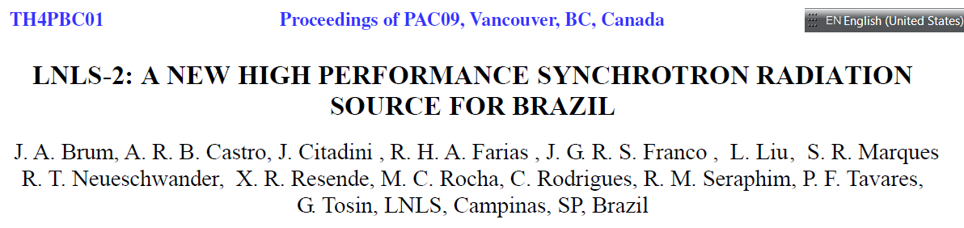

Slide 9
Current SR Projects using PM Technology (for dipole magnets)
Sirius
ESRF-II
Spring 8-II

Slide 10
Diffraction Limited @ 10 keV within ~ 500 m
Compact Design – Small Aperture
Enabling Technologies
Novel Injection Schemes
High Gradient Permanent Magnets
NEG coating very small apertures
Long(er) Bunches

Slide 11
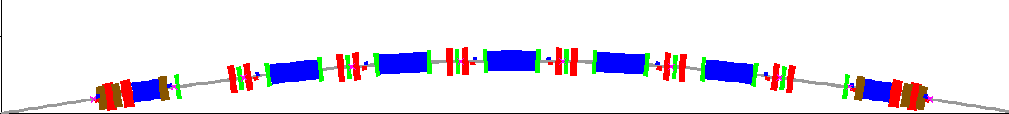
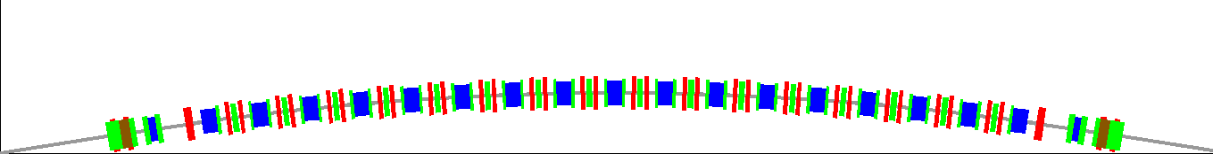
Beyond MAX IV – an exercise
Existing 7 BA
Future Lattice Candidate – 19 BA

Slide 12
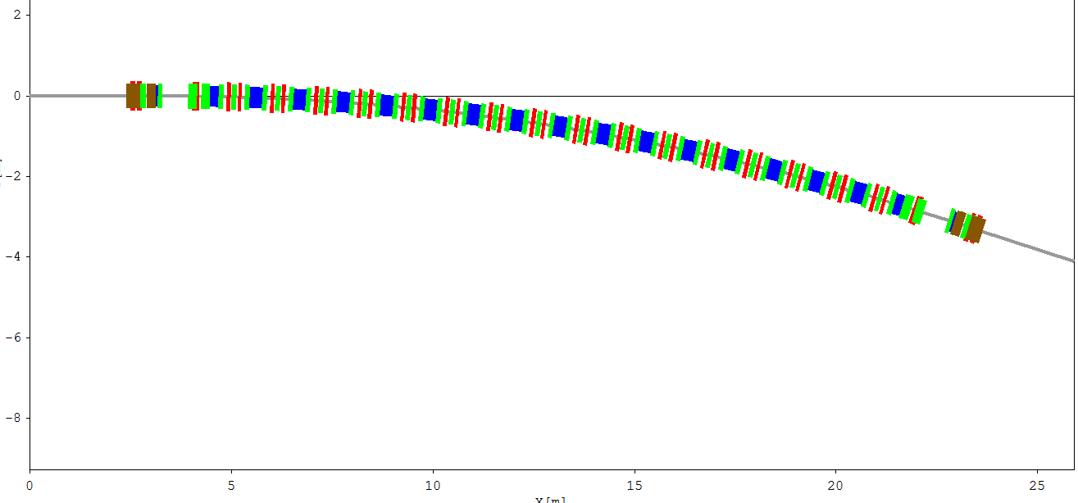
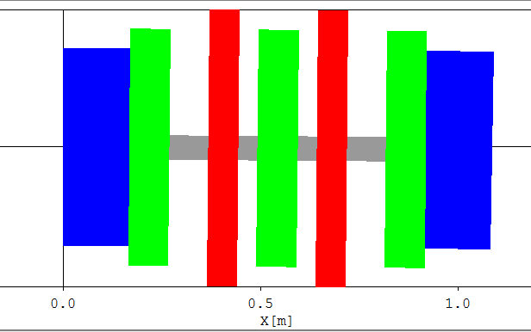
Beyond MAX IV – an exercise
Lattice design: OPA (A.Streun)
Elegant (M.Borland)
19-BA lattice in the MAX IV 3 GeV ring tunnel
QF
QF
SD
SF
SD
BH
BH

Slide 13
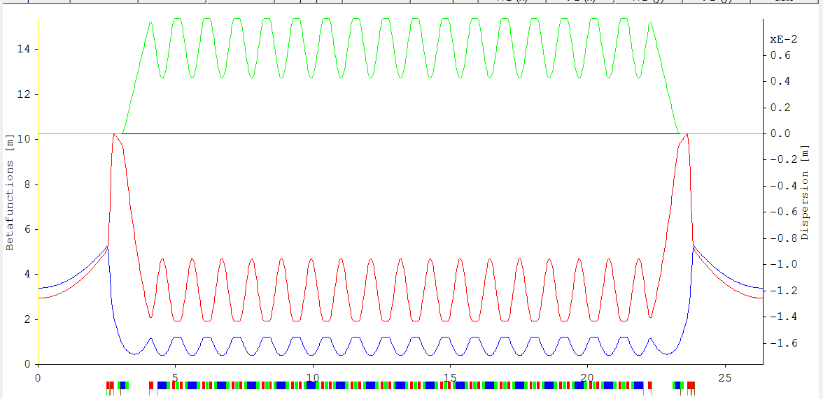
Beyond MAX IV – an exercise
19-BA lattice in the MAX IV 3 GeV ring tunnel

Slide 14
19-BA lattice in the MAX IV 3 GeV ring tunnel – Magnet Parameters
Magnet bore radius = 5.5 mm

Slide 15
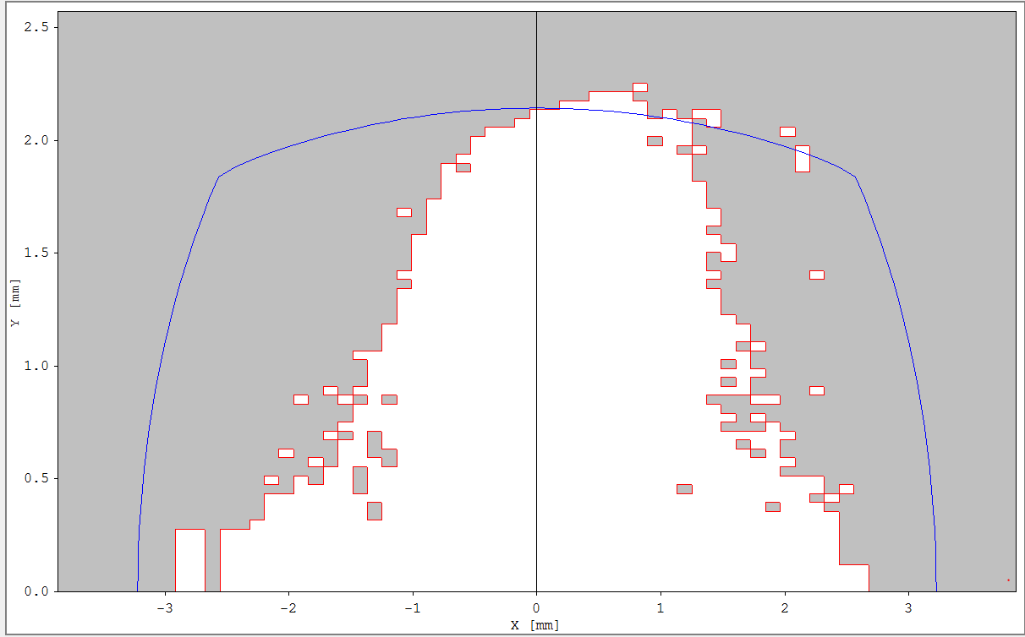
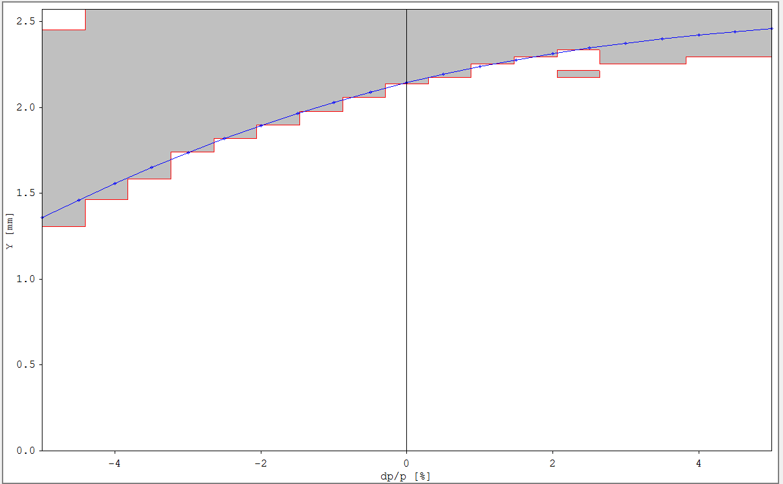
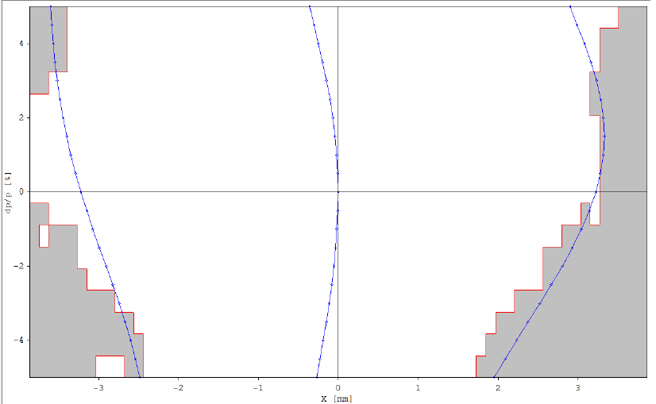
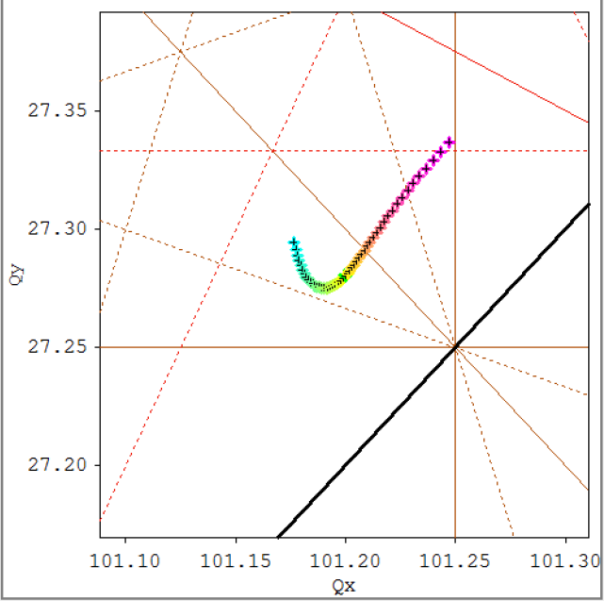
19-BA lattice in the MAX IV 3 GeV ring tunnel - Dynamic and momentum aperture
No errors !
Δp=±4%

Slide 16
Challenges
Magnet Design (field quality, rad. damage, temp. dependence, trim)
Light Extraction
On-axis injection (fast kickers), Swap-out ?
Collective effects (incoherent (IBS) and coherent) – More lengthening ?
Low alpha
Heat load on chambers
NEG coating of very small aperture chambers
Mechanical integration
.......

Slide 17
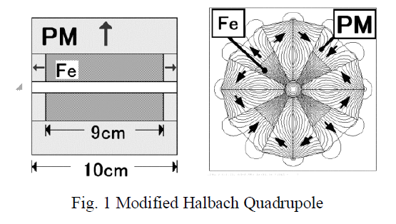
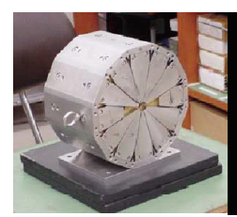
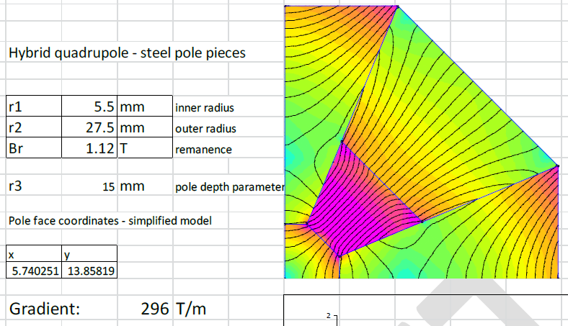
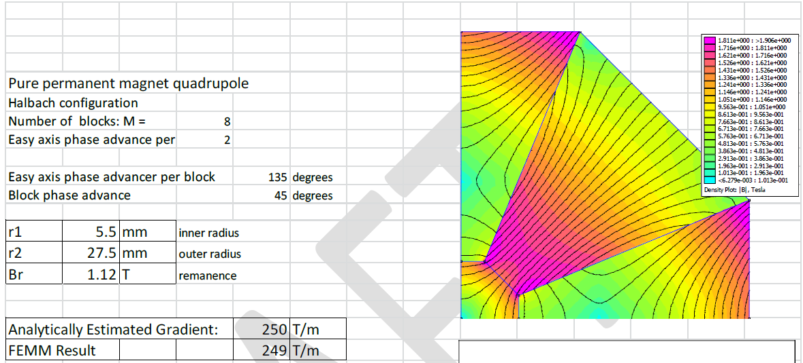
High Gradient PM Quadrupole Examples
7 mm bore radius, 285 T/m – Mihara et al, EPAC2004, Iwashita et al, PAC2003

Slide 18
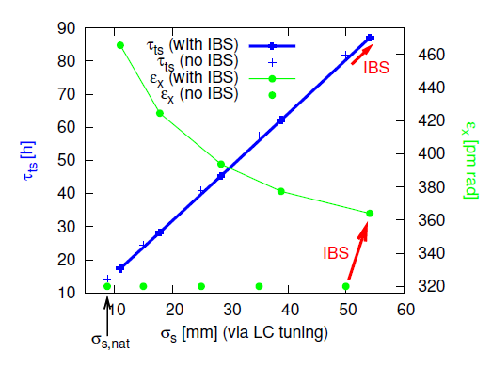
Intra Beam Scattering
IBS in the present MAX IV 3 GeV ring
IBS in the 19-BA
Calculations by Johan Bengtsson
Plot by S.Leemann
MAX-lab Internal Note 201211071

Slide 19
Multiple Harmonic Cavities

Slide 20
Conclusions
As a result of the introduction of the MBA lattice concept, small aperture magnets and vacuum systems are becoming a common choice for storage-ring based light sources.
This naturally leads to reconsider proposals for using permanent magnets in storage ring lattices, which have been around for a long time and in many labs.
A few synchrotron radiation facilities (LNLS, ESRF, Spring 8) labs have recently started going seriously in that direction.
The time may have come when the benefits of large scale use of permanent magnets in storage ring lattices outweigh the risks/costs ? This could lead to yet another order of magnitude jump in source brightness

Slide 21
THANK YOU !

Slide 22
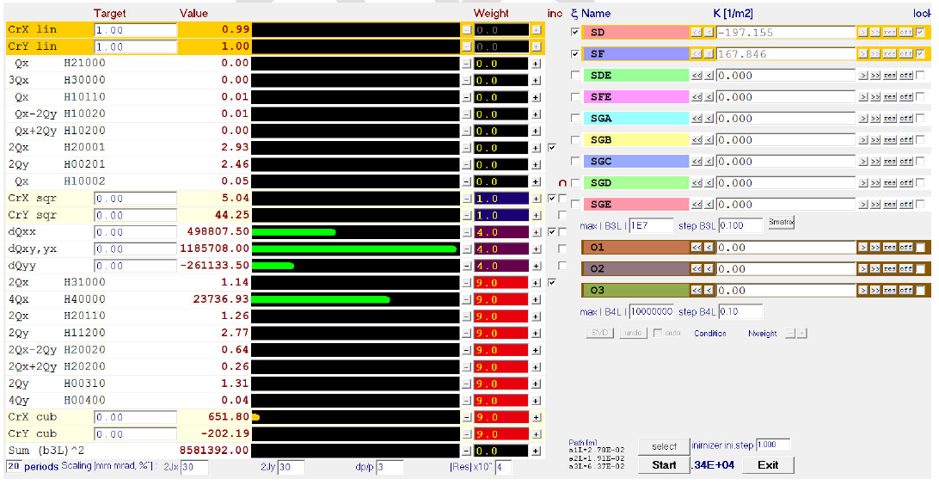
NL Dynamics – Chromaticity Correction

Slide 23
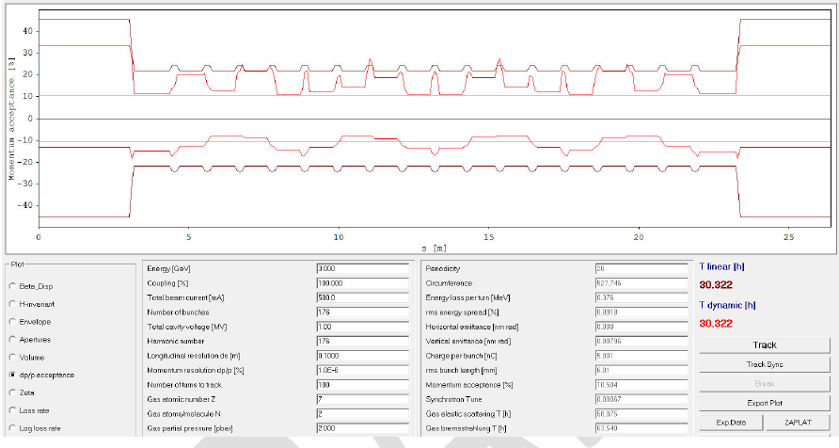
Touschek Lifetime

Slide 24
Long Term Planning – The Accelerator Roadmap

