Slide 1
Summary of design studies for a possible upgrade of Diamond
M. Apollonio – Diamond Light Source Ltd.
Low Emittance Lattice Workshop, Lund, December 1st 2016 thanks and credits to:
A. Alekou, T. Pulampong, R. Bartolini, R. P. Walker (DLS)
S. Liuzzo, P. Raimondi, N. Carmignani (ESRF)
Notes:
OK

Slide 2
Outline
  Low Emittance
    From 2.7nm to <270pm
    Constraints on new machine
  Evolution of Diamond-II low emittance lattice
    Double Double Bend Achromat (DDBA)
    Double Triple Bend Achromat (DTBA)
  Where we stand
    Optimizations
    Open issues
  Summary
Notes:
OK

Slide 3
lattices
Low Emittance DDBA HMBA DTBA optimization conclusions
  Diamond II wish list
  Emittance: from 2.7 nm to <270pm
  Minimal changes to present machine
    Keep tunnel / beamline structure
    Leave straight sections as they are
    Re-use hardware wherever possible (RF, magnets, …)
  Keep I09-I13 optics (mini-beta sections)
  Maintain short pulse operations (low-alpha optics)
  Minimize dead-time
  Minimize technology risks
Notes:
OK

Slide 4

lattices
Low Emittance DDBA HMBA DTBA optimization conclusions
  Broadly speaking, emittance reduction is achievable with usual approach, i.e.
  Increase n. of dipoles
  Increase Jx with combined function dipoles
  MBA solutions with longitudinal gradient dipoles
  However, reducing emittance may not be the only target
  increase ratio of straight_sections / C
  This twofold request led to the Double DBA concept (DDBA)
Notes:
OK

Slide 5
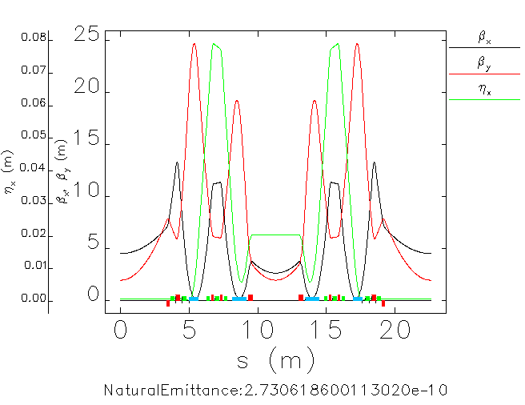
lattices
Low Emittance DDBA HMBA DTBA optimization conclusions
  Double Double-Bend Achromat (DDBA)
  modification of present Diamond DBA cell
  central region “cleared” to host a new insertion device (VMX)
  A modified 4BA with a 10x emittance reduction factor and 2x n. of possible beamlines
  Baseline design for Diamond-II
  until the end of 2015
Notes:
OK

Slide 6
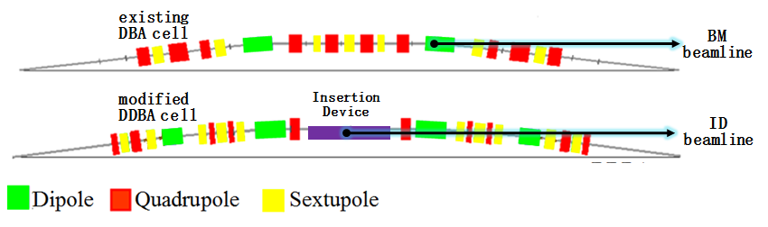
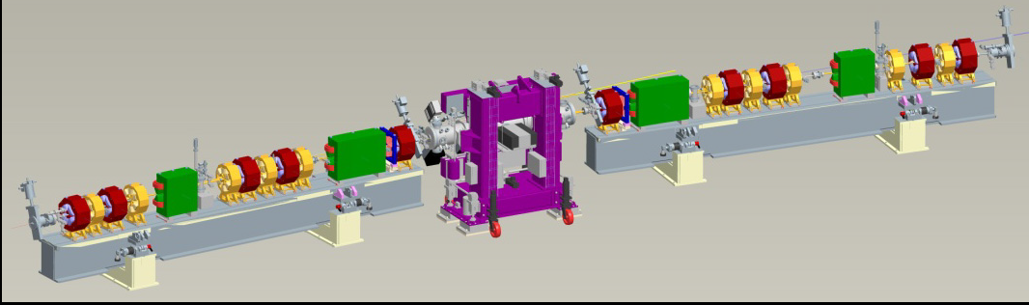
lattices
Low Emittance DDBA HMBA DTBA optimization conclusions
  at present one DDBA cell has been installed in Diamond and is being commissioned
Notes:
OK

Slide 7
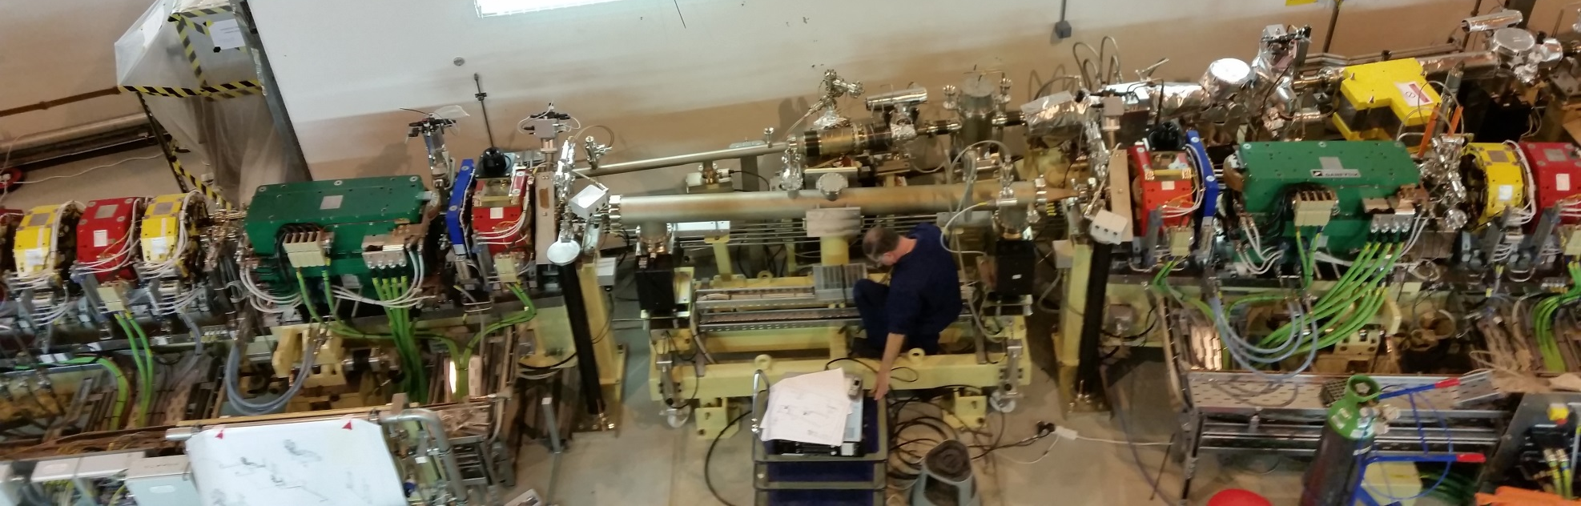
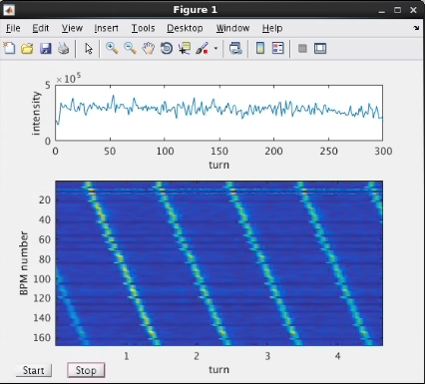
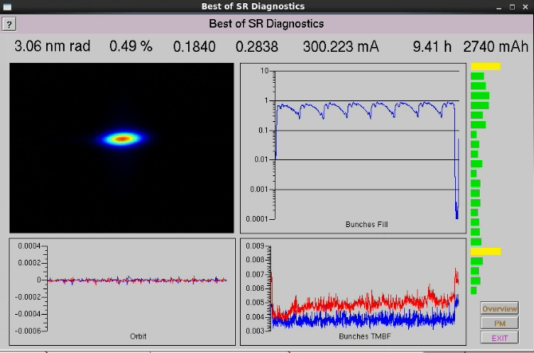
lattices
Low Emittance DDBA HMBA DTBA optimization conclusions
DDBA cell installation (16/11/2016)
Beam current = 300mA
(24/11/2016)
beam accumulation in the SR
(17/11/2016)
Notes:
OK

Slide 8
lattices
Low Emittance DDBA HMBA DTBA optimization conclusions
  There were few reasons to go beyond the DDBA concept:
    a request from beamlines for a more aggressive scheme: 20x reduction in emittance
    Challenges in the optimization of Lifetime, Dynamic Aperture
  Point (1) led to a 6BA-like approach, where the 7BA ESRF cell (HMBA) was modified to create a central ID straight
  Collaboration with ESRF very fruitful in overcoming some design difficulties
  Emittance → 140 pm
Notes:
OK

Slide 9
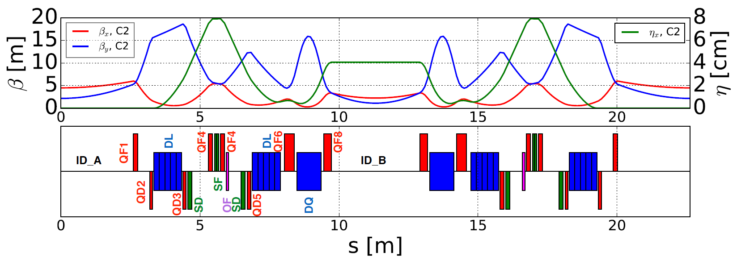
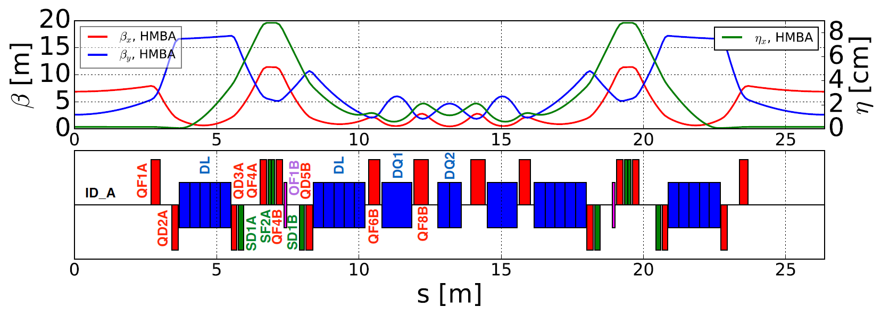
lattices
Low Emittance DDBA HMBA DTBA optimization conclusions
Sextupoles located at large η_{x} dispersion bumps
DII - DTBA
E: 3 GeV
Cell lenghts: 22.6m
C: 561m (24 cells)
Central DQ2 removed
Drift spaces kept equal
Magnet lengths shortened thanks to
reduced gradient (6GeV → 3GeV)
ESRF - HMBA
E: 6 GeV
Cell lenghts: 26.4m
C: 844m (32 cells)
DII-DTBA
ESRF-HMBA
C2
~ (3π,π) phase advance
Parameters | DDBA | DTBA
No. of magnets(D/Q/S) Hor. Emittance Tune (H/V) Nat. chrom (H/V) Bunch length Energy spread α_{c} Straight length (L/M/S) [m] | 4/5/10 270 pm.rad 51.21/17.31 -128/-93 2.17 mm 7.92e-04 9.96e-05 9.1/6.7/3.4 | 6/8/8 130 pm.rad 58.18/21.31 -77/-118 1.88 mm 6.82e-04 1.02e-04 8.0/5.2/3.0
Porting the ESRF-HMBA concept into Diamond SR:
by scaling magnet lengths while keeping the same
inter-distances
by shortening cells to fit Diamond length constraints
Notes:
OK

Slide 10
lattices
Low Emittance DDBA HMBA DTBA optimization conclusions
There are indeed two kinds of cell, C1 and C2, used to reproduce the SP-6 structure of the present lattice (1long / 3 short straights):
-C1 C2 C2 C1
C1 is an asymmetric cell: +1.5m w.r.t. C2
Both C1/C2 cells need re-matching (see later)
long straight
short straight
new straight
ID_C
ID_B
ID_B
ID_B
ID_B
ID_C
2 x ID_A
2 x ID_A
2 x ID_A
DII-SuperPeriod
Notes:
OK

Slide 11
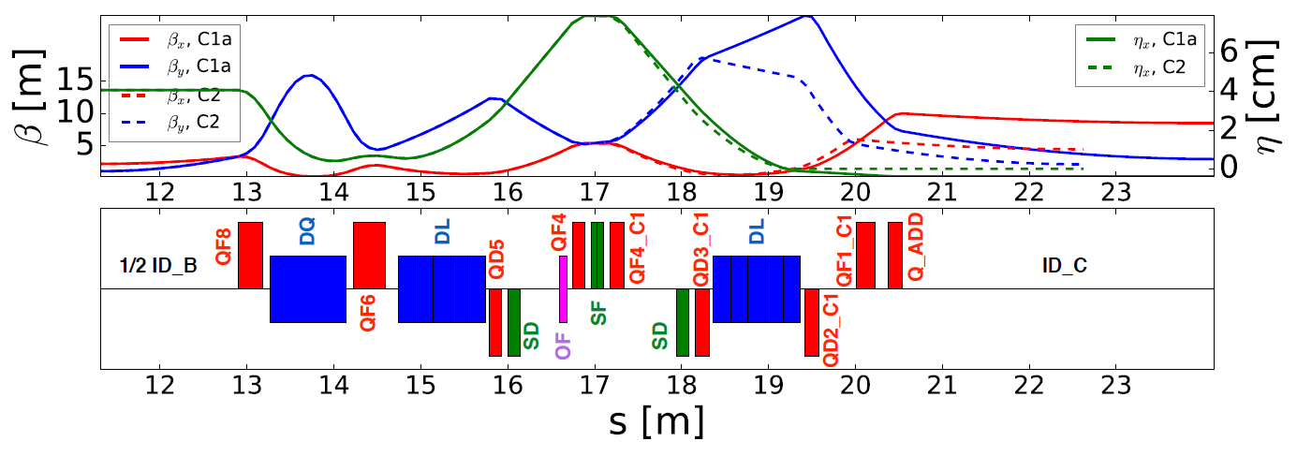
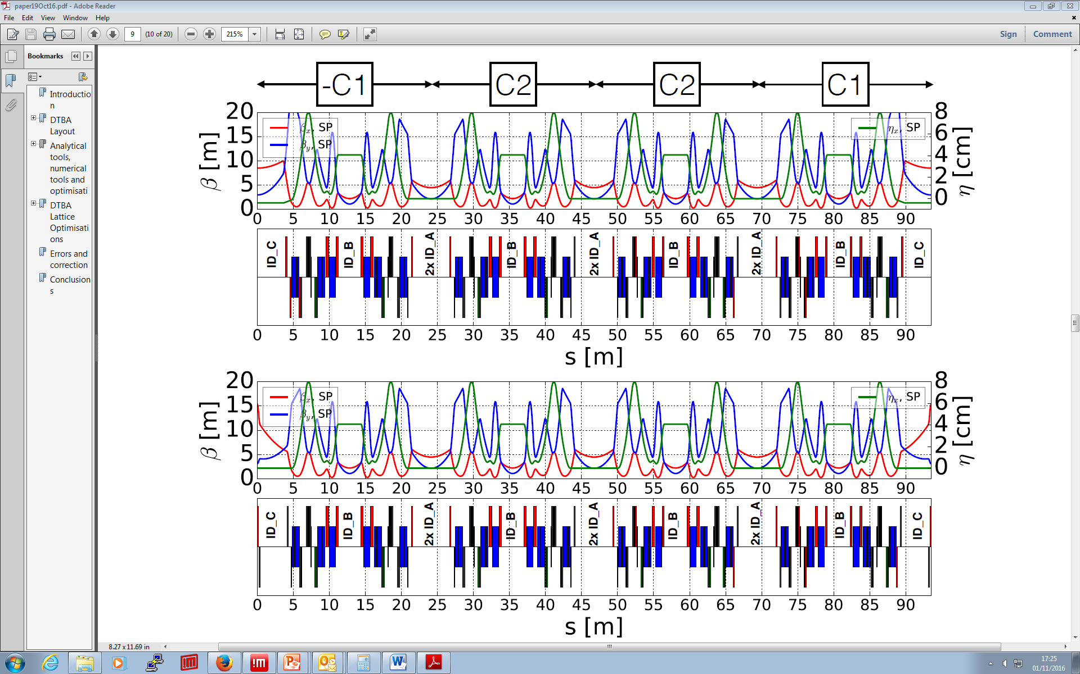
lattices
Low Emittance DDBA HMBA DTBA optimization conclusions
C1a/2
extra quad
D-II SuperPeriod
Notes:
Q1: betax,y appear to be different from the values seen in the present VMX lattice. Is it supposed to be so? No “complaint” from BLs? CHECK WITH TP
Betax,y(I21) @ str5 = 10.0m / 5.3m Betax,y(DII-C1a)@str5 ~ 8.5m / ~2.5m
Betay @ str6 = 4.5m / 1.5m Betay(DII-C2) @str6 ~ 4m / ~2m

Slide 12
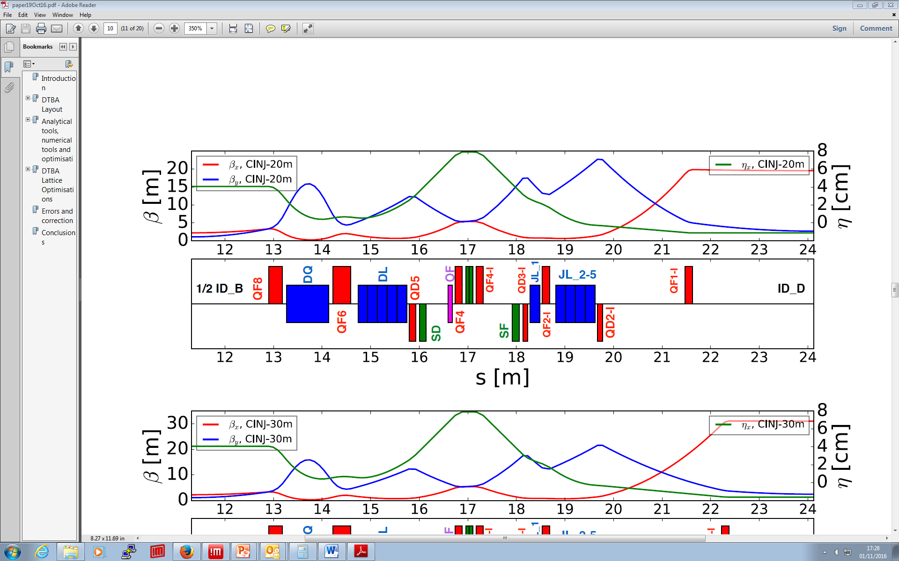
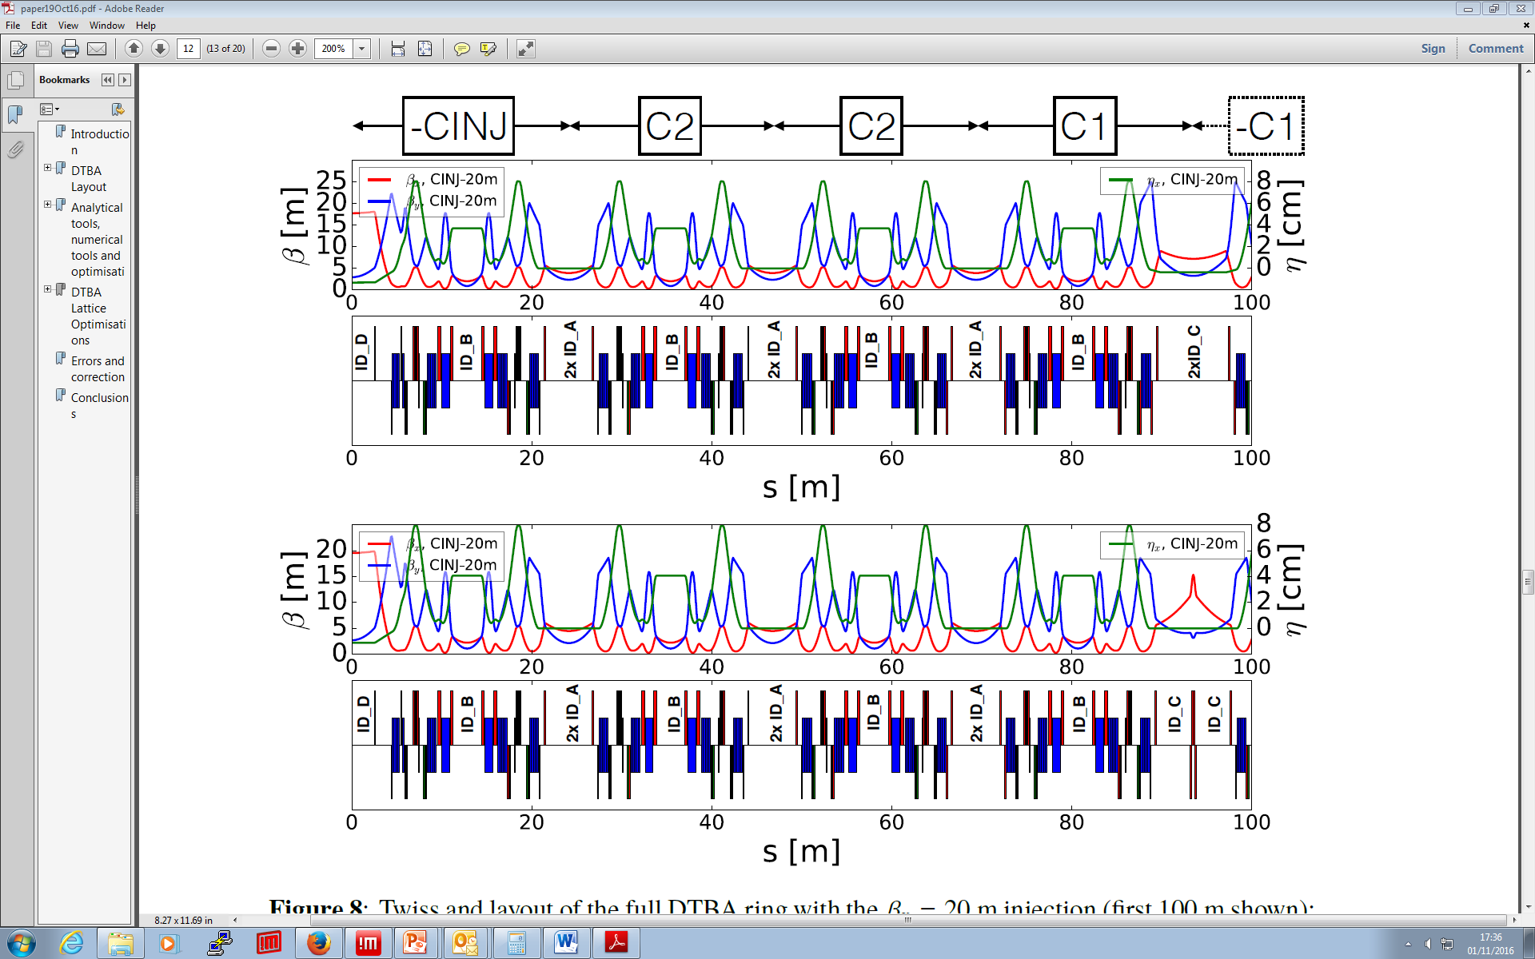
lattices
Low Emittance DDBA HMBA DTBA optimization conclusions
Injection Cell
Adjust QF1-I to increase β_{x}
Combat reduced DA@injection
SP-1 modified with INJ cell
Notes:
OK

Slide 13
lattices
Low Emittance DDBA HMBA DTBA optimization conclusions
DA@C2 independent from beta@injection
DA@Cinj grows with beta@injection
MA larger with no inj cell
no CINJ
no CINJ
no CINJ
courtesy of A. Alekou
Notes:
ON

Slide 14
lattices
Low Emittance DDBA HMBA DTBA optimization conclusions
Optimizing the lattice:
interplay between Linear & Non-linear dynamics
Linear optimization
  Matching technique
  Cancellation of non-linear driving terms
  Cell-length adaptation
Non-linear optimization
  MOGA
Notes:
Quasi OK

Slide 15
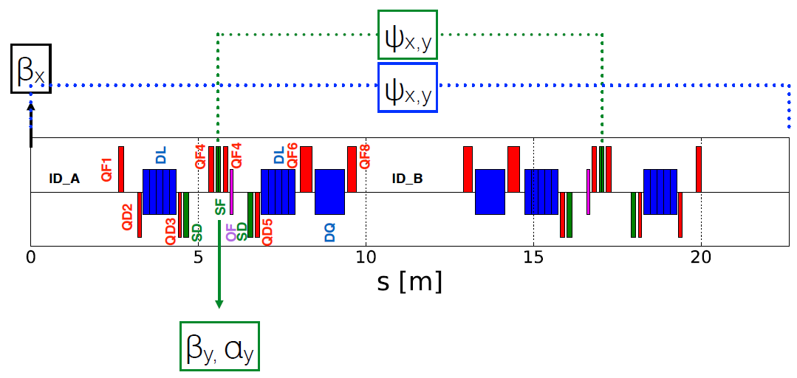
lattices
Low Emittance DDBA HMBA DTBA optimization conclusions
C2 matching technique imported from ESRF experience based on 5 main parameters (controlled by cell quads)
β_{x} @ IDs
β_{y},α_{y} at central SF sextupoles
ϕ_{x,y} advance between sextupoles [3π/π]
ϕ_{x,y} advance in the cell
These parameters have been
kept fixed when changing cell length (HMBA → DTBA)
scanned when tuning quads during DTBA optimization (later)
C1 matching:
ϕ_{x,y} advance in the cell = C2 case (for symmetry)
α_{xy} @ LS = 0
η_{x}’ @ LS = 0
(η_{x} = 0 additional constraint for some C1 cases)
 | C1a | C1c
quads used for matching | 5 | 6
Matching params | φ_{x}=2.3833 φ_{x=}0.8458 α_{x} = 0 / α_{y} = 0 η_{x’}= 0 | φ_{x}=2.3833 φ_{x=}0.8458 α_{x} = 0 / α_{y} = 0 η_{x’}= 0 / η_{x}= 0
η_{x} @ long str. [mm] | -3.96 | 0.00
ID_C [m] | 3.586 | 3.732
Waist at ID_C | yes | no
Notes:
----- Meeting Notes (27/11/16 00:42) -----

Slide 16
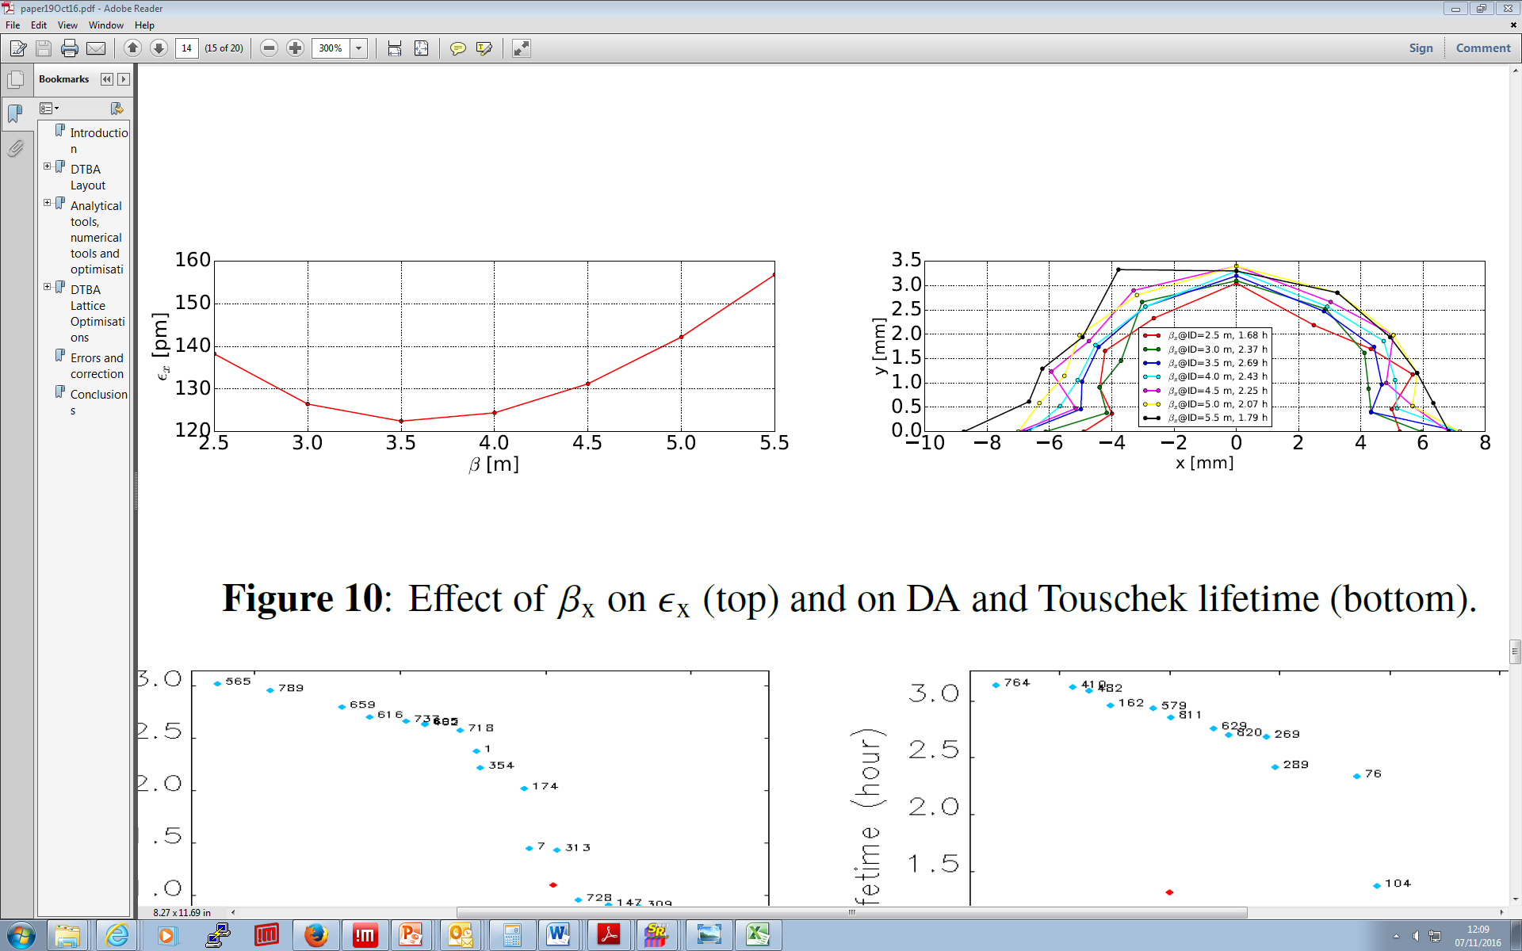
lattices
Low Emittance DDBA HMBA DTBA optimization conclusions
LINEAR KNOBS optimization
Cell optimization scan
Empirical finding (*) that some observed parameters (knobs) have effective impact on physically relevant quantities:
β_{x} @ IDs → ε_{x}
β_{y} @ sext → ε_{x}, ξ_{x}
α_{y} @ sext → dQ_{y}/dAy
Κ4 @ oct → dQ_{x}/dAx
ϕ_{y} advance between sextupoles → dQ_{x}/dAy
Each parameter scanned individually while keeping others fixed
(*) P. Raimondi, ESRF
ε_{x} vs β_{x} @ ID_{A}
DA @ ID_{A}
courtesy of A. Alekou
Notes:
Confirm that each parameter is a function of quads: beta = beta(quads), alfa=alfa(quads), phi=phi(quads) ...

Slide 17
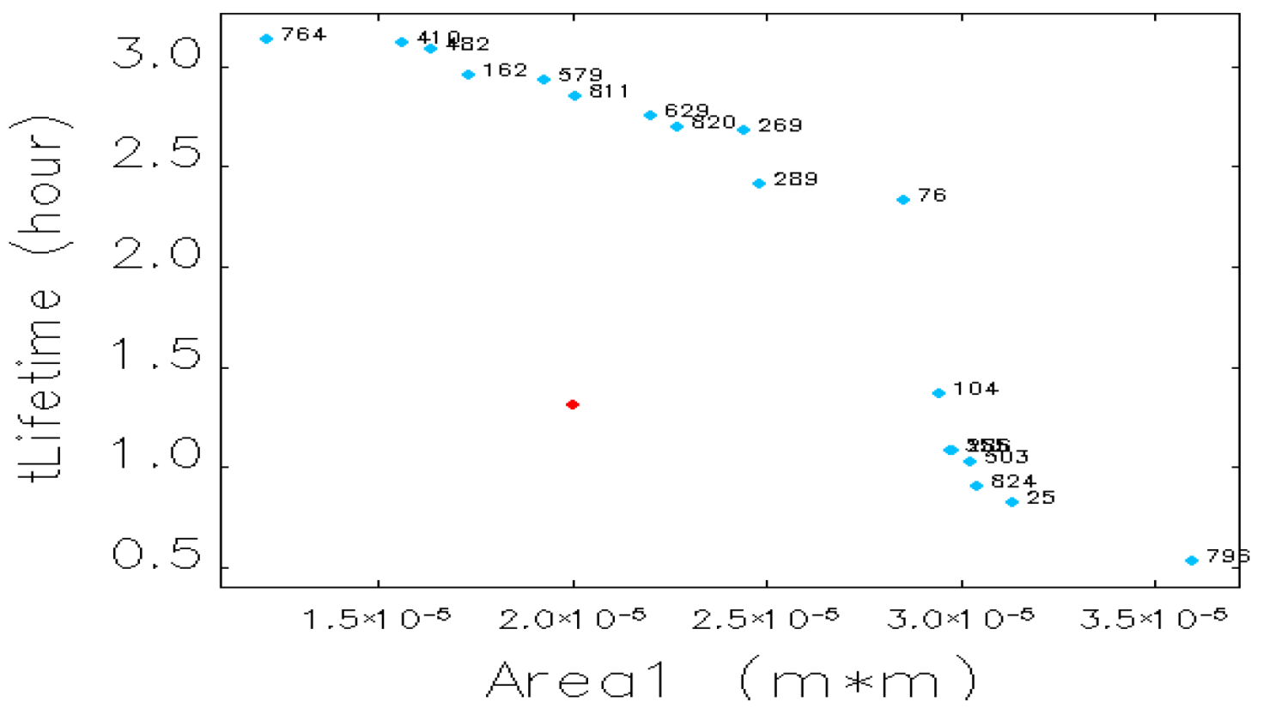
lattices
Low Emittance DDBA HMBA DTBA optimization conclusions
LINEAR KNOBS optimization
Cell-2 MOGA optimization^{(*)} on the whole set of parameters
(β_{x}, β_{y}, α_{y}, Κ4, ϕ_{x,y}) → (τ,DA) [keep ξ=(2,2)]
Promising improvement, BUT still errors to be included
With a DA of 11 mm and a lifetime of 3.2h the DTBA is a promising candidate for Diamond II.
Most of the design effort is concentrating on this lattice
pick up solution for further optimization
(*) 24xC2 ring
Ib = 300mA
Nb = 900
Bl = 1.71 mm
C = 1.0%
courtesy of A. Alekou

Slide 18
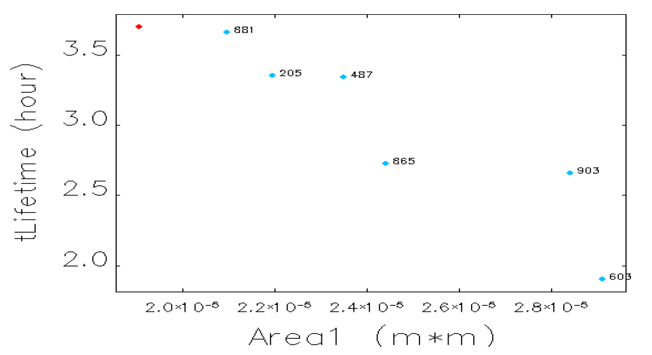
lattices
Low Emittance DDBA HMBA DTBA optimization conclusions
SP – sextupoles / octupoles
chromaticity control (2,2)
C2: SD1, SF1, SD2 / OF1
C1: SD3, SF2, SD4 / OF2
(τ,DA) optimization
NON-LINEAR optimization
MOGA improvement in DA
courtesy of A. Alekou
Notes:
SD2 is not used at all? What is it for?

Slide 19
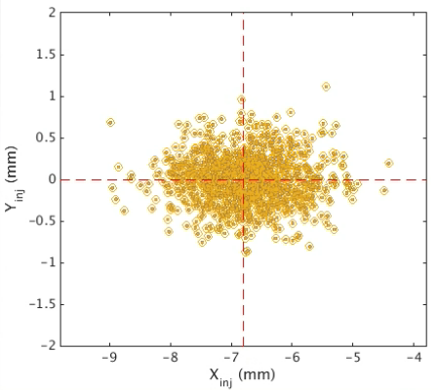
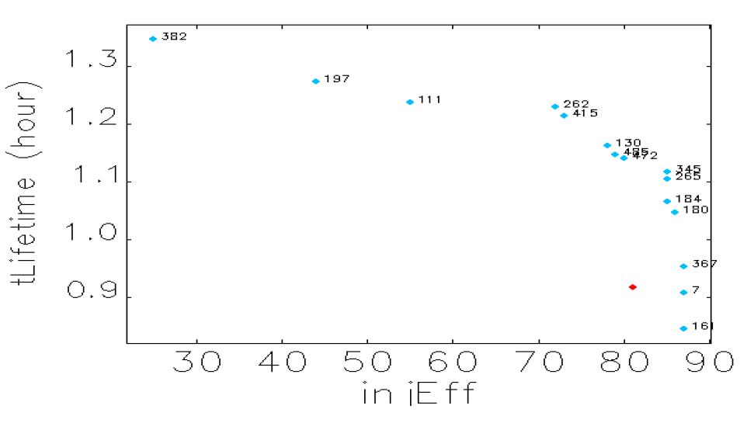
lattices
Low Emittance DDBA HMBA DTBA optimization conclusions
Injection Efficiency optimization → DTBA lattice with InjCELL
chromaticity control (2,2)
C2: SD1, SF1, SD2 / OF1
C1: SD3, SF2, SD4 / OF2
(τ,DA) optimization
Cinj: SF3, SD5, SD6 / OF3
(τ,IE) optimization
➔ IE~85%, τ ~ 1.1hr
NON-LINEAR optimization
IE parameters
N_{part} = 1e3
N_{turns} = 512
ε_{x} = 150nm
InjGap = 6.8mm
C = 1%
Ib = 300mA
HHC cavities for bunch lengthening will be necessary
to increase Touschek lifetime
courtesy of A. Alekou
Notes:
Injection Cell reduces the MA, hence the drop in LT. Higher Harmonic Cavities possible way of compensating for this effect

Slide 20
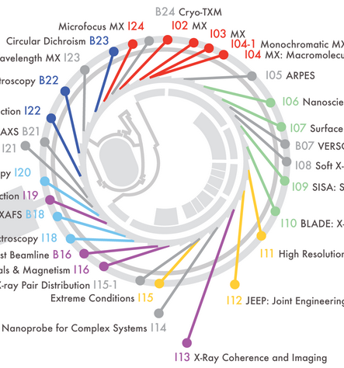
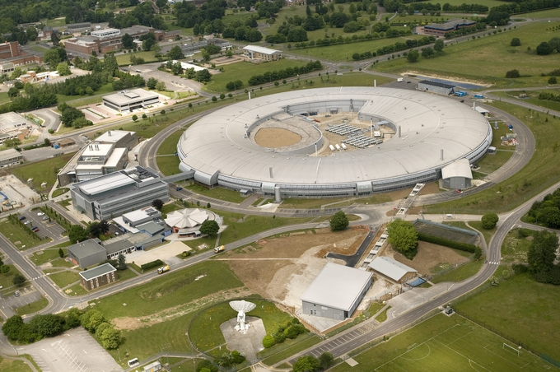
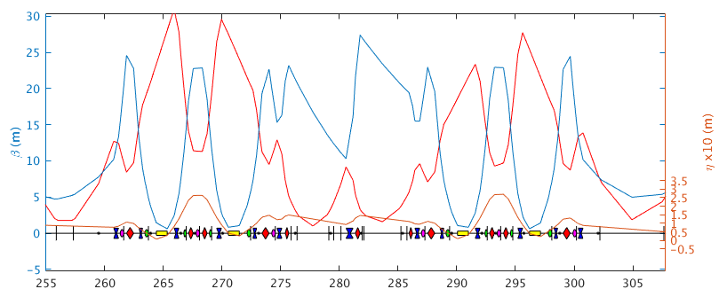
lattices
Low Emittance DDBA HMBA DTBA open issues conclusions
Issues:
integration of present
features into new
lattice
I09 / I13 straight @ mini-β
I21 strong focussing section
Low alpha-optics
improve performance @ BL
mini-β straights critical, with low β_{y} and virtual focussing
present proposed solution under study for mini-β cases
I13: coherence
imaging
250m

Slide 21
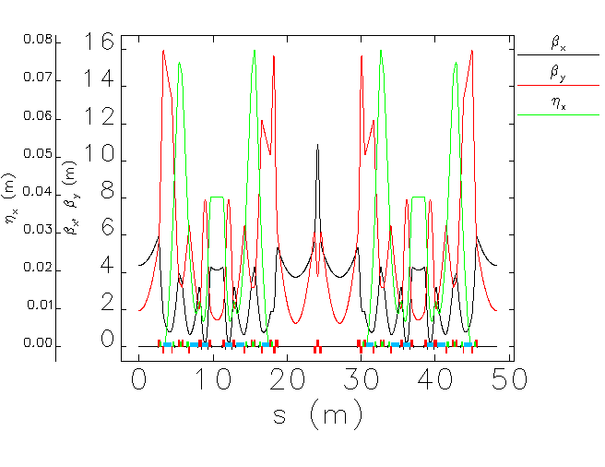
lattices
Low Emittance DDBA HMBA DTBA present situation conclusions
mini-β
STR Q-Q: 4.88m straight section
courtesy of T. Pulampong
Notes:
Check better newer plots

Slide 22
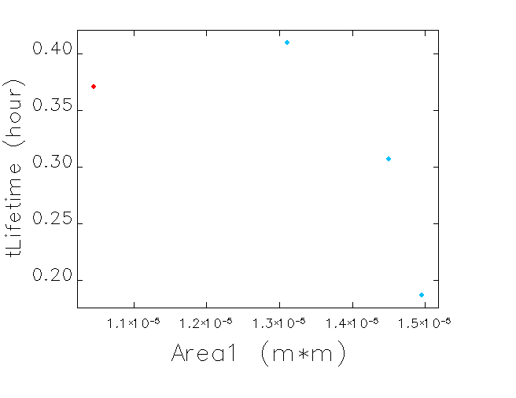
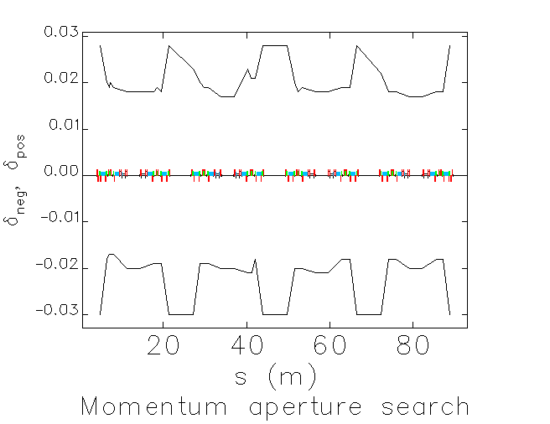
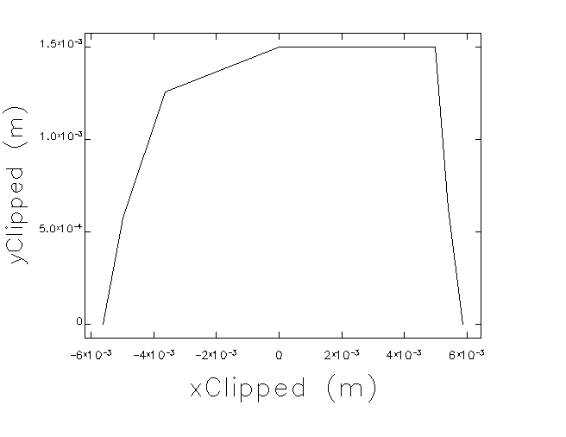
lattices
Low Emittance DDBA HMBA DTBA present situation conclusions
!
mini-β
courtesy of T. Pulampong
courtesy of T. Pulampong
DA
MA
~-5.8 mm
Notes:
Check newest results with TP

Slide 23
lattices
Low Emittance DDBA HMBA DTBA present situation conclusions
Initial consideration on layout, engineering
Integration, girders, beamline layout, etc.
courtesy of R. Bartolini

Slide 24
lattices
Low Emittance DDBA HMBA DTBA present situation conclusions
Diamond is considering a development to reduce emittance by a factor 10x to 20x
Following the DDBA concept, and the expertise developed at ESRF the DTBA concept emerged, which should double the n. of beamlines
Initial studies suggest DTBA cells organized in 6-fold SP could fulfil the 20x emittance reduction
However optimization process is underway to ensure:
  Good LT/DA are achievable
  Non linearities can be controlled
  Present machine requirements are met (mini-β / low-α)

Slide 25
Thanks for your attention

