Slide 1
Elettra 2.0
Emanuel Karantzoulis
www.elettra.eu

Slide 2
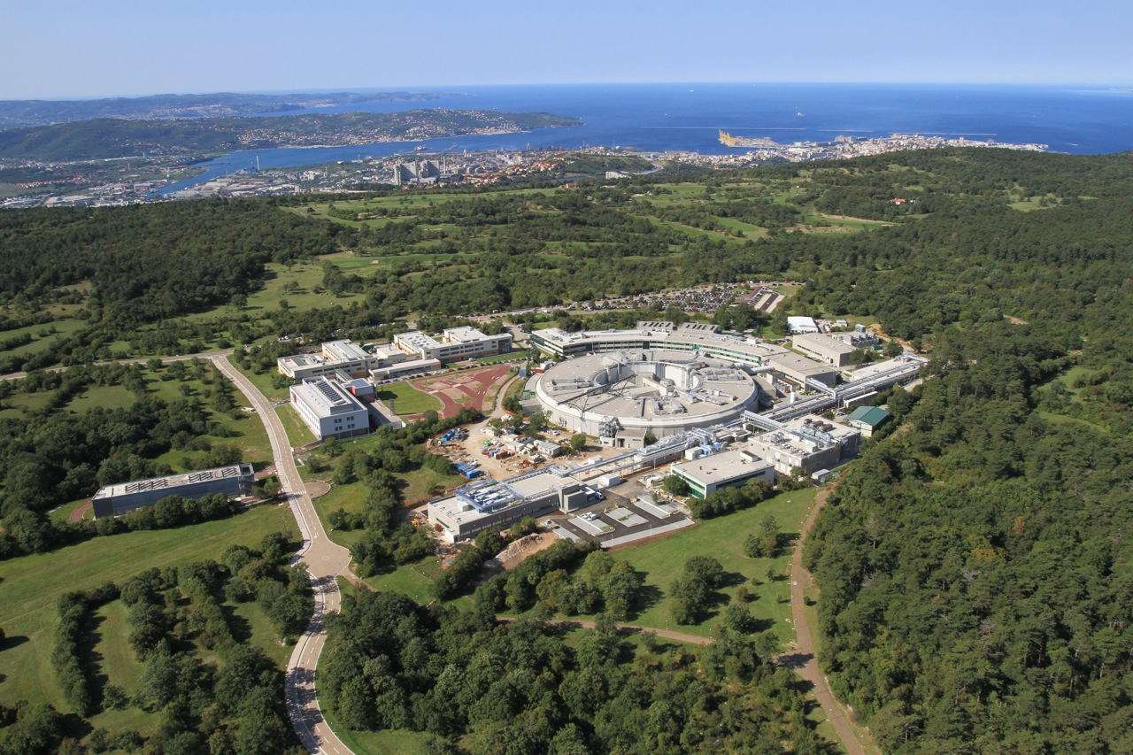
Elettra - Sincrotrone Trieste operates 2 complementary Light Sources
Elettra
FERMI

Slide 3
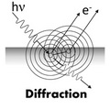
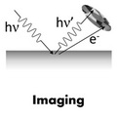
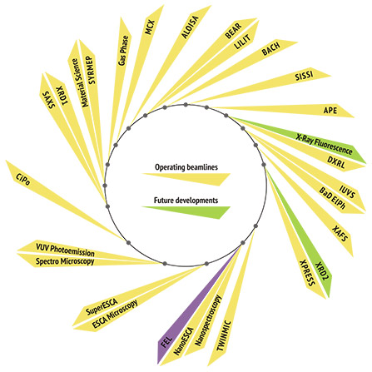
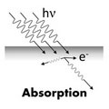
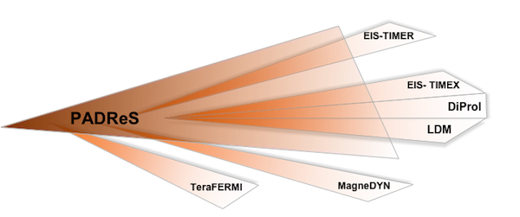
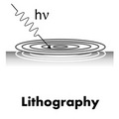
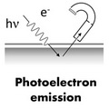
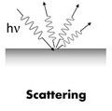
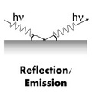
Beam lines 28 + 6

Slide 4
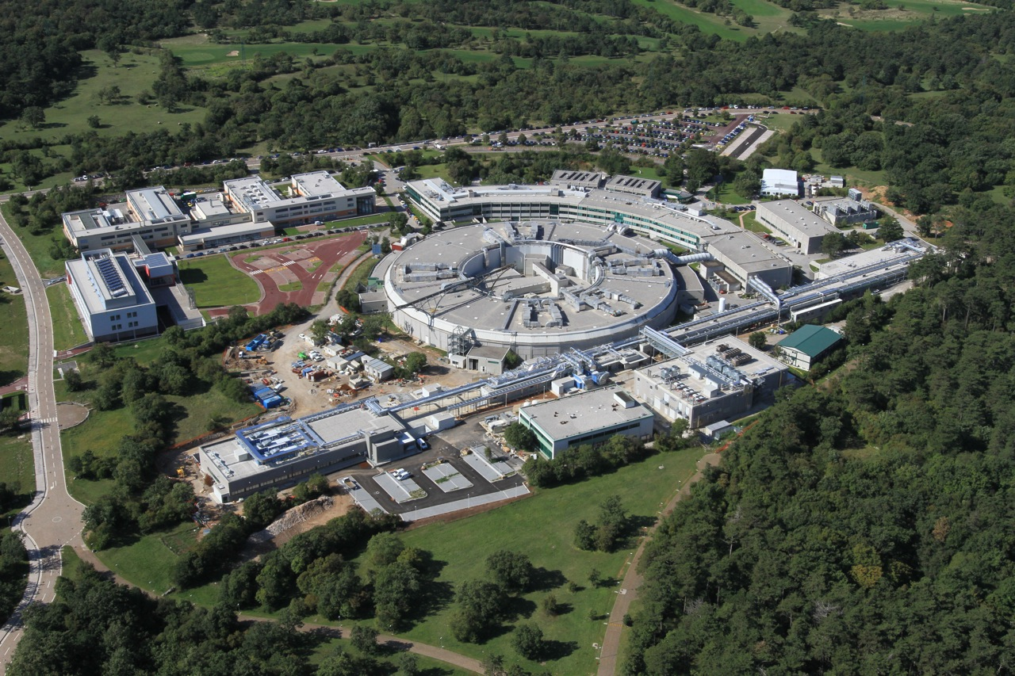
FERMI
Seeded FEL (HGHG), 1.5 (1.8 ) GeV, 10 Hz (50 Hz) – First Lasing Dec.13, 2010
Open to external users since 2012 (FEL-1) (100-20 nm, 12 - 62 eV)
and 2015 (FEL-2) (20- 4 nm, 62 - 320 eV)
∼ 200 m
Linac Tunnel +
Injector Extension
∼ 100 m
Undulator Hall
∼ 50 m
Experim. Hall

Slide 5
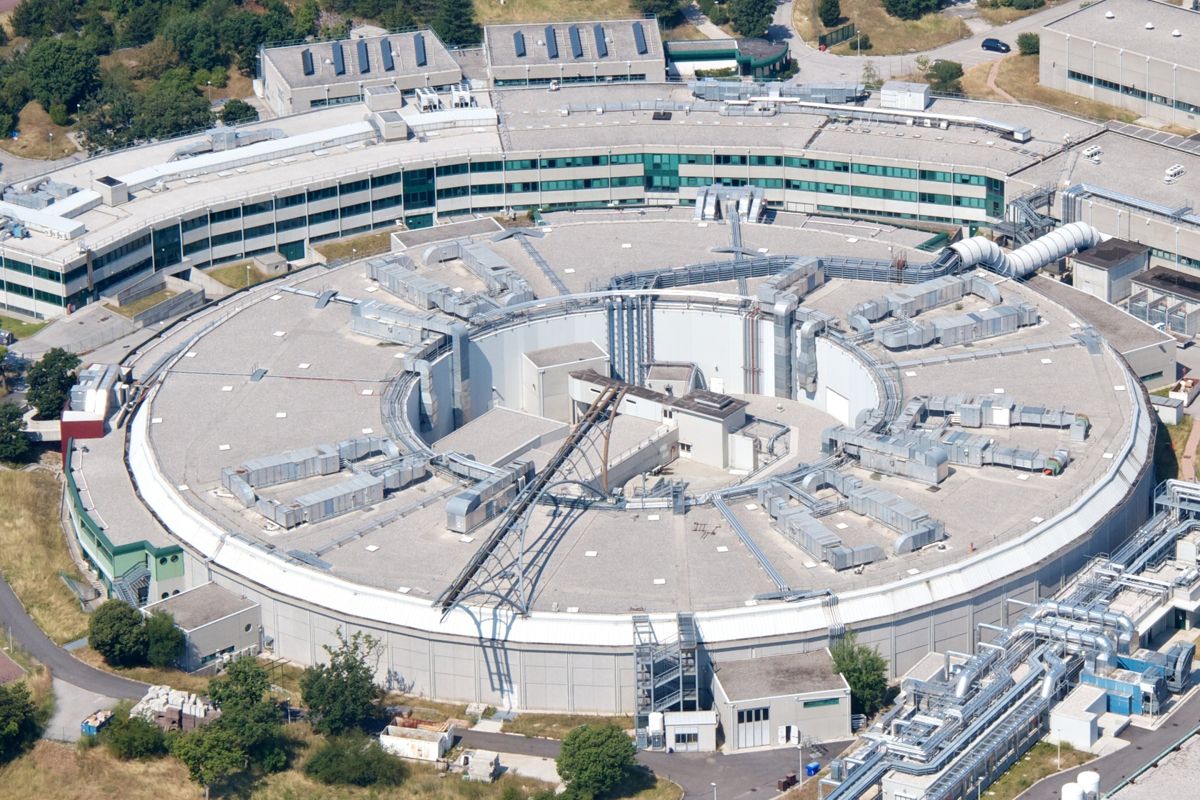
Elettra
Third generation light source (DBA - 259.2 m) , open to external users since 1994
The machine complex initially made of a 1 GeV linac and a storage ring operating at 2.0 (7nm-rad) and since 1998 also at 2.4 GeV, in 2008 built a full energy injector (2.5 GeV booster plus 100 MeV linac) and since 2010 operates in top-up mode.
Linac +
Booster (114 m)
Storage Ring (259 m)
Operate also a storage ring FEL and superconducting systems ( a 3.5 T wiggler and a third harmonic cavity )

Slide 6
SR Parameters

Slide 7
Elettra short and mid term developments
Elettra has been upgraded during the years to keep the performance competitive to the new light sources being built in the recent years. Some current upgrades include:
RF upgrade (booster Solid State Amplifier )
PS-controls upgrade
Build new bpm electronics (detectors)
Upgrade vacuum system electronics
Fixed gap undulators
Studies are going on to exploit the margins for other relatively low impact upgrades to extend the performance to the ultimate limits allowed by the present machine also in terms of operability and stability.
Some possibilities ( and actualities) include :
  Increasing the energy to 2.5 GeV, 140 mA
  Reduce the coupling by installing skew quadrupoles
  Reduction of the emittance, presently closest to the theoretical limit for a DBA, with a new “chromatic” optics (60 % reduction if SCW not include, 20% if included at full field).
  Unifying space in the arcs, to integrate the two separated shorter straight section in a 2.5 m straight to provide possibilities for new insertion devices.
  Low alpha optics for short bunches ( coherent infrared – papers published )
E. Karantzoulis et al, “Elettra Status and Future Prospect”, IPAC 2015, Richmond, May 2015

Slide 8
Elettra 2.0: The Future
Conceptual design study to investigate a successor to the machine, Elettra 2.0
Based on latest trends in this field, i.e. next generation, ultimate light sources (ULS):
  Higher brilliance (more than one order of magnitude at lower photon energies, e.g. 1 keV),
  High level of coherence in both planes (3rd generation sources have only high vertical coherence),
  Smaller spot size and divergence,
  Higher flux and a variety of insertion devices.
E. Karantzoulis, “Evolution of Elettra towards an Ultimate Light Source”, IPAC 2014, Dresden, June 2014, p. 258 (2014); http://www.JACoW.org

Slide 9
Elettra 2.0 requirements
The requirements for the new machine have been developed based on the interaction with the users’ community and considering costs optimization.
A dedicated workshop on the future of Elettra was held in April 2014 to examine the various requirements
E. Karantzoulis , “Elettra2.0-The Next Machine”, IPAC 2015, Richmond, May 2015
Design boundary conditions
Beam energy: 2 GeV
Beam intensity: 400 mA
Emittance: to be reduced by more than 1 order of magnitude
Horizontal electron beam size: less than 60 µm
Conserve filling patterns: multibunch, hybrid, single bunch, few bunches
Keep the same building and the same ring circumference (259-260 m)
Existing ID beam lines and their position should be maintained
Free space available for IDs: not less than that of Elettra
Keep the existing bending magnets beam lines
Use the existing injectors, that means off-axis injection
Easy part
Tough part

Slide 10
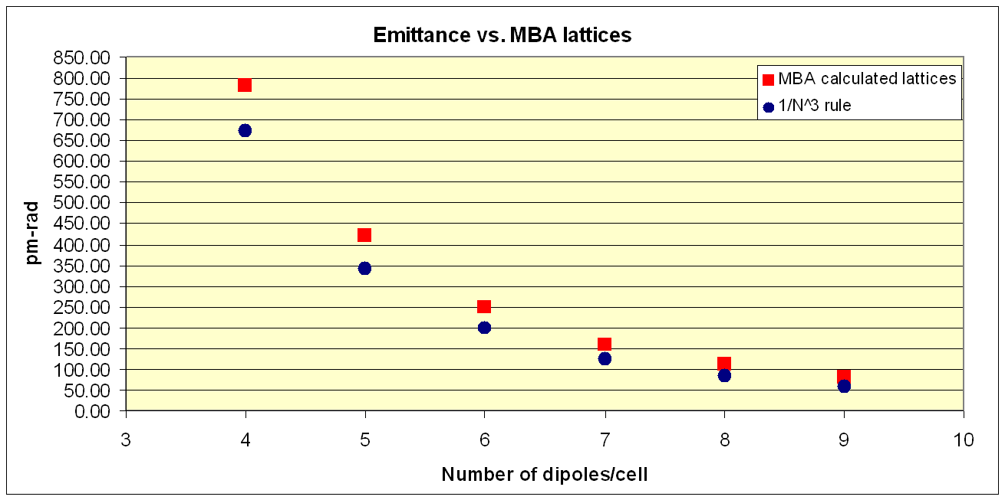
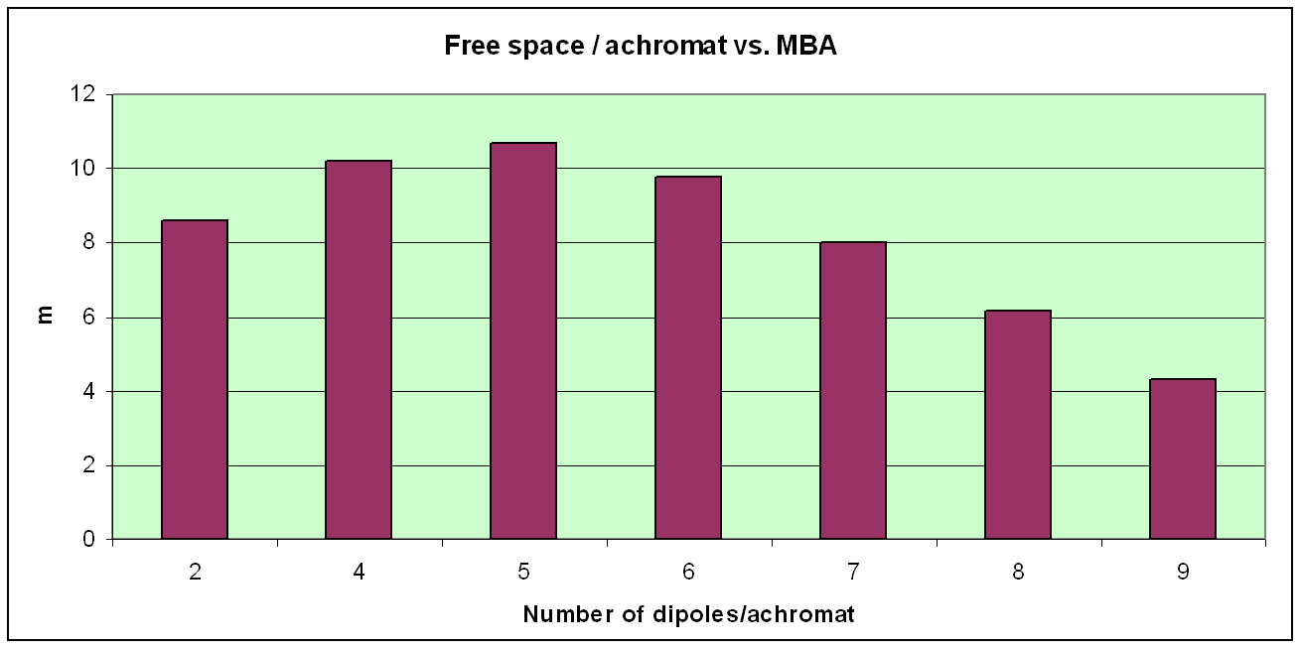
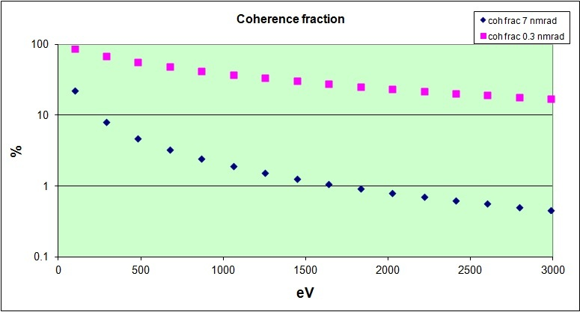
Multi-bend achromat studies
2 GeV 100 mA, period 46mm, Np=98, L=4.5m
0.1 KeV Elettra 22% Elettra2.0 87%
1 keV Elettra 2% Elettra2.0 38%

Slide 11
Elettra 2.0 Lattice
Best configuration satisfying all user requests is based on a six-bend achromat. Versions that minimize interferences and induce minimal position shift of the dipole beam lines were examined. Possible new beam lines from central dipoles
Various dipole magnet versions were also studied
All dipoles at about 0.8T electromagnets
Emit: 0.25 nm-rad, WP 33.2 , 9.3
Nat. chrom -63,-50 , dE/turn: 162 keV
Another solution with the 2 and 4th dipole at 1.4 T PM + 2 quads each.
Emit: 0.28 nm-rad, WP 33.2 ,9.3
Nat.chrom -81,-44 , dE/turn: 202 keV
A third solution with the 2 and 4th dipole at 0.8 +1.4 T with a series of short PMs
Emit: 0.25 nm-rad, WP 33.2 ,9.3, Nat.chrom -77,-55 , dE/turn: 196 keV
E. Karantzoulis , “Elettra2.0-The Next Machine”, IPAC 2015, Richmond, May 2015

Slide 12
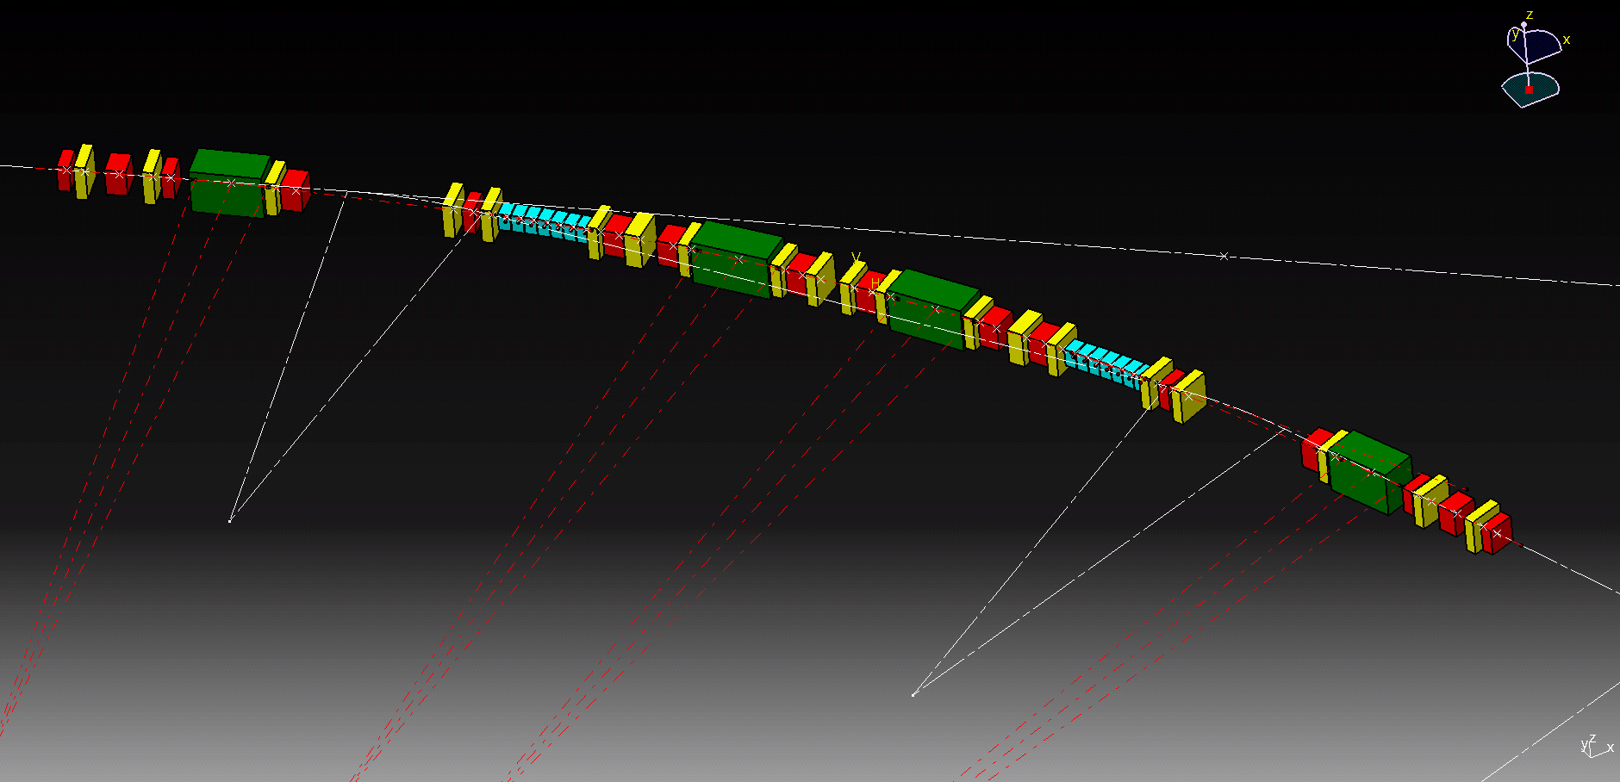
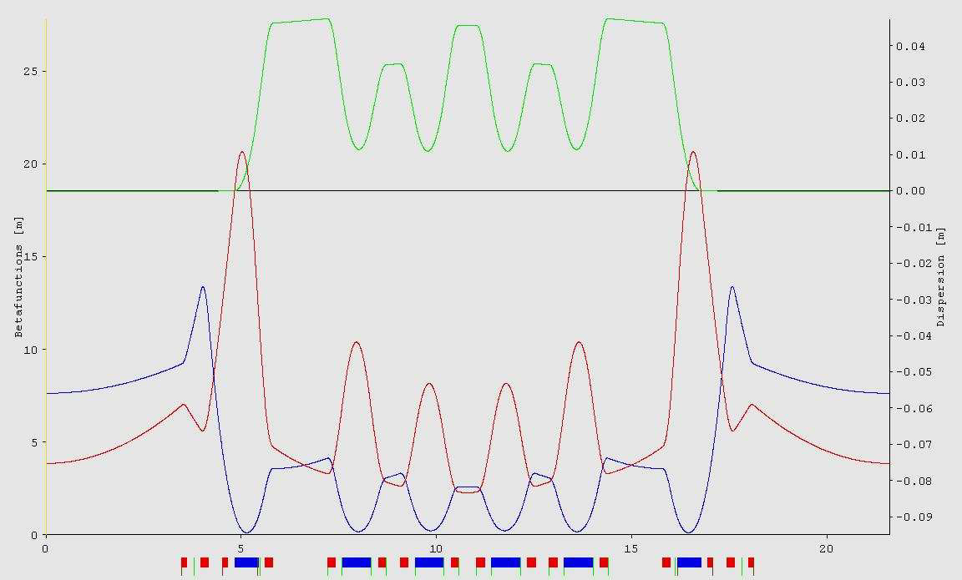
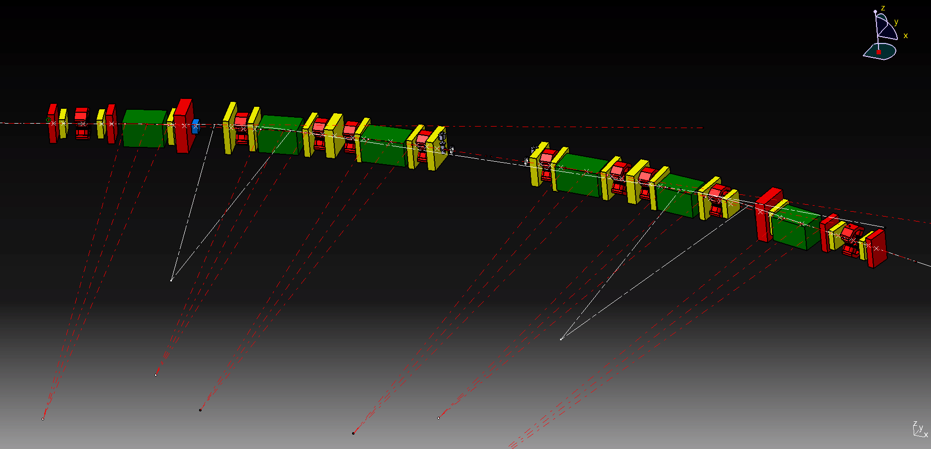
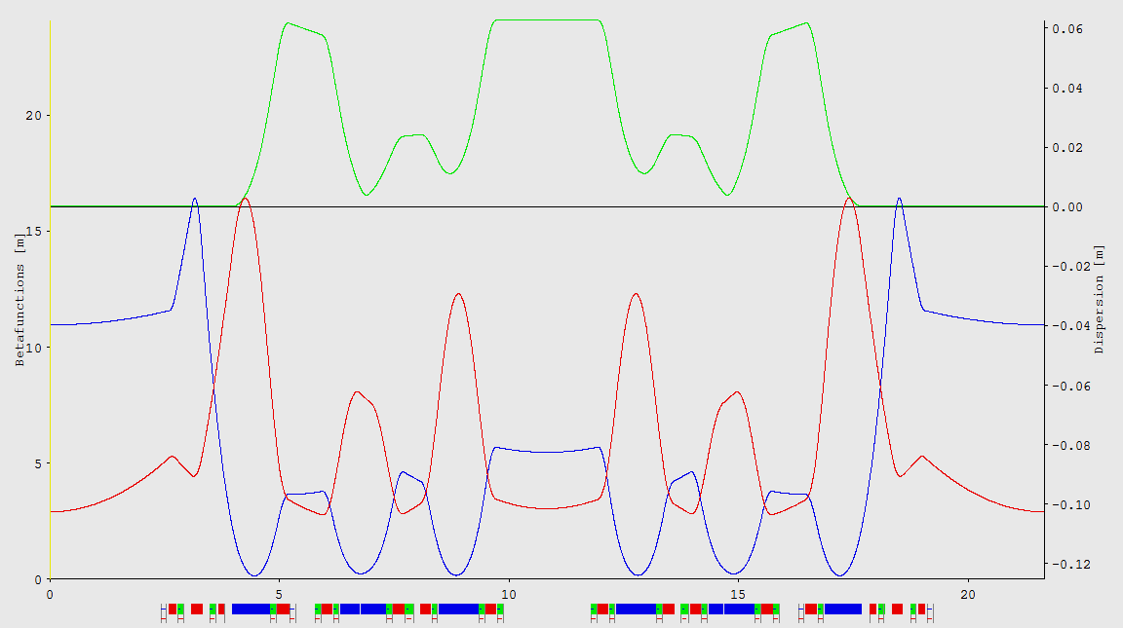
2 principal configurations
A. Streun, “OPA version 3.39”, PSI, 2014

Slide 13
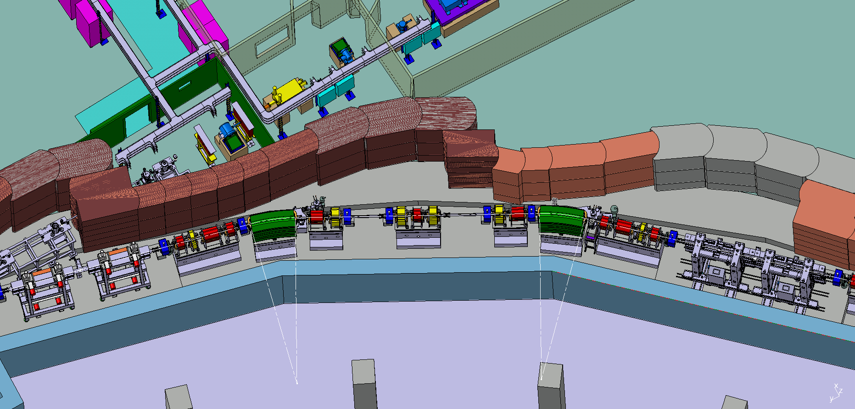
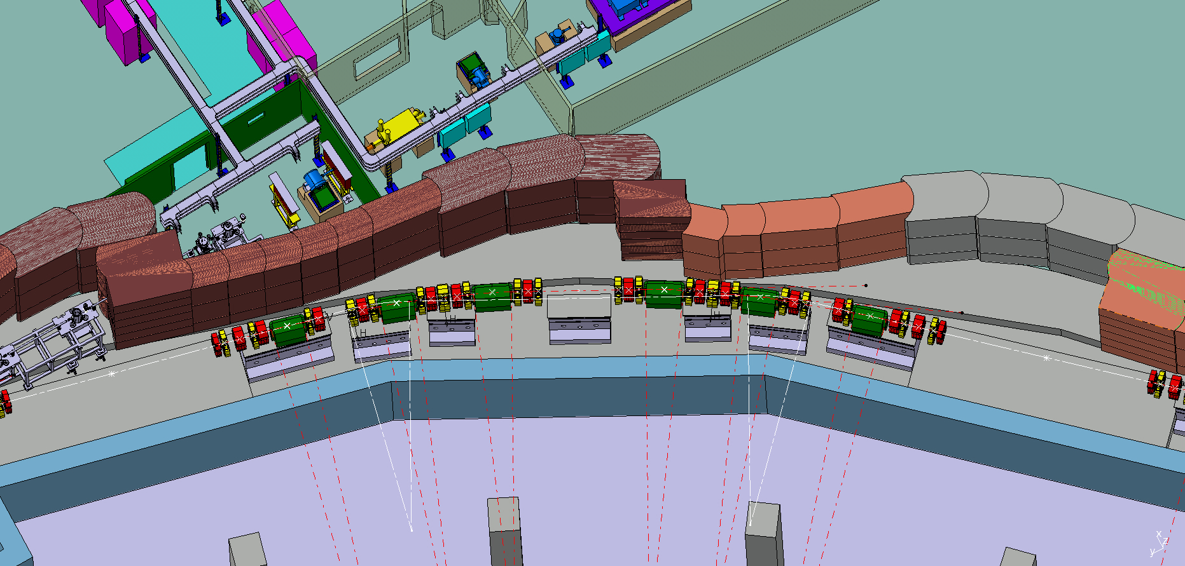

Slide 14
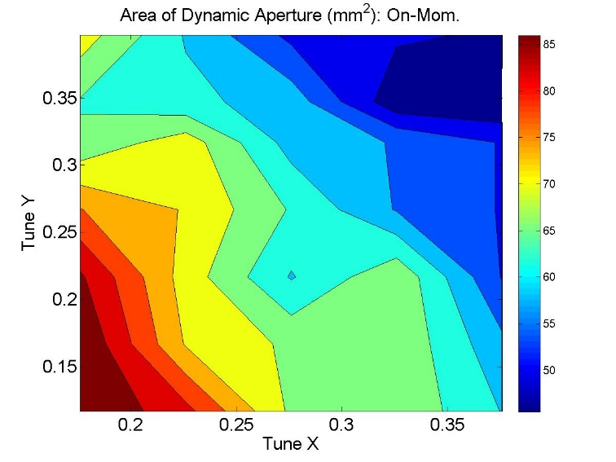
2nd configuration: list of optics and rf functions
Circumference (m) | 259.2
Energy (GeV) | 2
Number of cells | 12
Geometric emittance (nm-rad) | 0.258
Horizontal tune | 33.10
Vertical tune | 9.19
Betatron function in the middle of straights (x, y ) m | (9.5,3.2 )
Horizontal natural chromaticity | -76
Vertical natural chromaticity | -52
Horizontal corrected chromaticity | +1
Vertical corrected chromaticity | +1
Momentum compaction | 3.44e-004
Momentum compaction second order | 3.60e-004
Energy loss per turn (with no IDs) (keV) | 156
Energy spread | 6.67e-004
Jx | 1.52
Jy | 1.00
Jdelta | 1.48
Horizontal damping time (ms) | 14.8
Vertical damping time (ms) | 22.9
Longitudinal damping time (ms) | 15.0
Dipole field (T) | <0.8
Quadrupole gradient in dipole (T/m) | <15
Quadrupole gradient (T/m) | <50
Sextupole gradient (T/m²) | <3500
RF frequency (MHz) | 499.654
Beam revolution frequency (MHz) | 1.1566
Harmonic number | 432
Orbital period (ns) | 864.6
Bucket length (ns) | 2
Natural bunch length ( mm, ps ) | 2.16 , 7.2
Synchrotron frequency (kHz) | 5.23
On-momentum dynamic aperture in mm² for the bare lattice, as a function of the working point.
horizontal and vertical tune shifts with ±3% relative momentum deviation

Slide 15
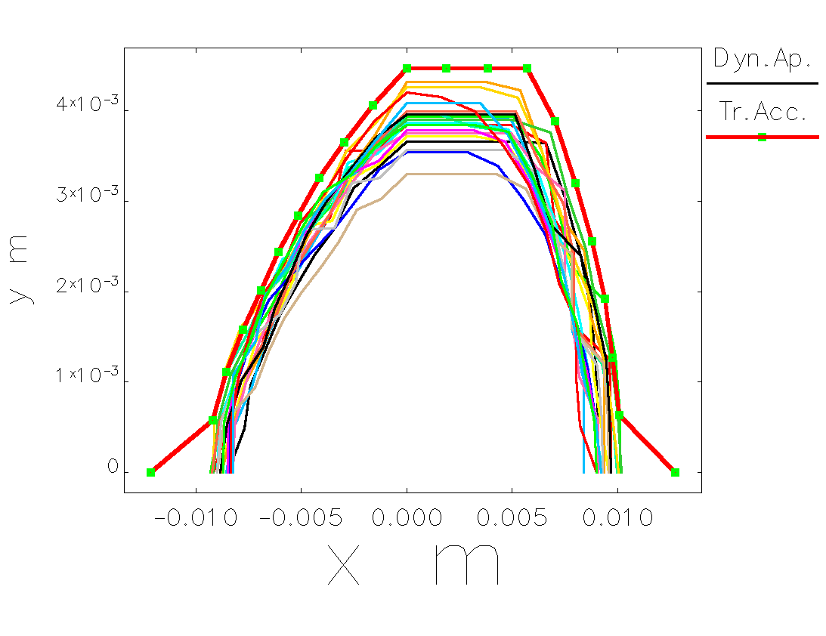
DA with errors
Element Type | Parameter | Value | Unit
Dipole | Δx | 20 | μm
 | Δy | 20 | μm
 | Δz | 300 | μm
 | Roll angle | 100 | μrad
 | ΔBl/Bl | 0.01 | %
Quadrupole | Δx | 20 | μm
 | Δy | 20 | μm
 | Δz | 300 | μm
 | Roll angle | 100 | μrad
 | ΔBl/Bl | 0.01 | %
Sextupole | Δx | 20 | μm
 | Δy | 20 | μm
 | Δz | 300 | μm
 | Roll angle | 100 | μrad
 | ΔBl/Bl | 0.01 | %
Corrector | Δz | 20 | μm
 | Roll angle | 100 | μrad
BPM | Δx | 20 | μm
 | Δy | 20 | μm
 | Δz | 300 | μm
 | Roll angle | 100 | μrad
Dynamic aperture for the bare lattice (named transverse acceptance in the legend), and in the presence of machine errors plus corrections, for 20 independent error seeds
“elegant” runs ref. S. Di Mitri

Slide 16
Some new concepts
Issues and concepts
Important issues
Injection in a relatively small dynamic aperture
Physical (inter-magnet) space
Oriented towards
Air cooled electromagnets (total heat load in the air 80 kW )
independent power supplies
3D girders
Use of permanent magnets
Series of short permanent magnets for bending and focusing (including longitudinal field variation)
Electromagnets with physical length=magnetic length
3D girders

Slide 17
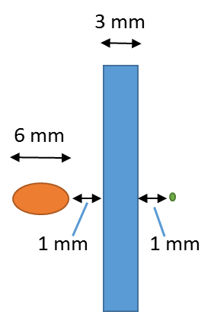
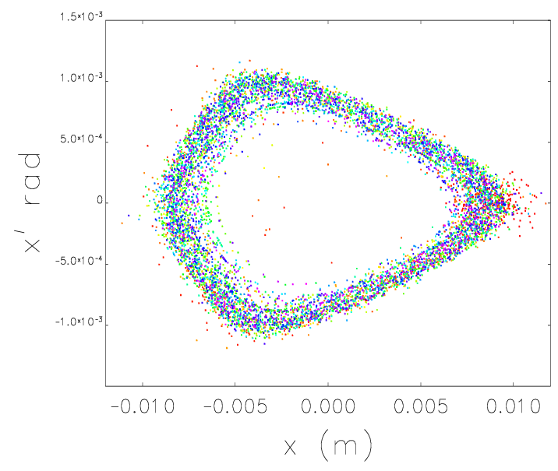
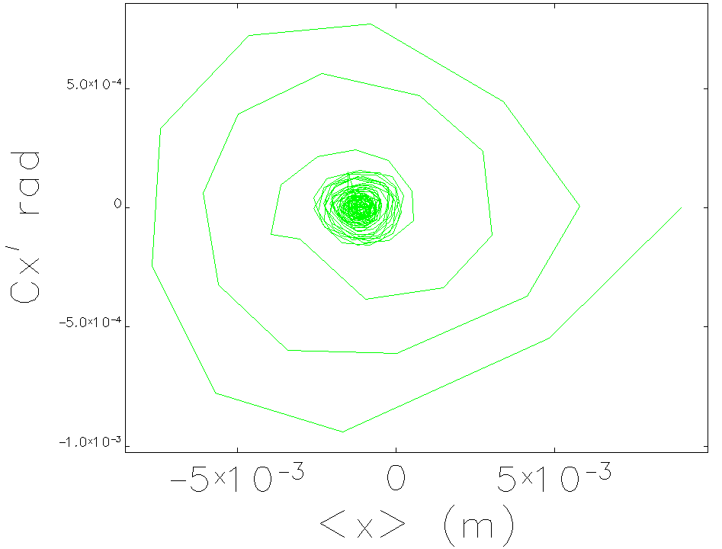
Preliminary injection studies
Filamentation in the horizontal phase space of 200 macroparticles beam tracked over 500 turns, with initial offset of -9 mm at the injection point, in the presence of high order transport, RF focusing and synchrotron radiation (colour legend is arbitrary, one colour per turn in the ring). Right: motion of the beam centroid in the horizontal phase space, sampled every 10 turns, over 500 turns in total.
Promising
using the already existing injection system + injectors.
The actual 18 mm bump should be reduced to 9 mm bump and it appears possible
Bare lattice transmission is 100% after 500 turns
Ref. S. Di Mitri

Slide 18
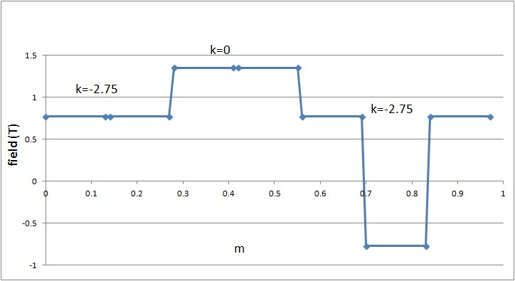
The short-PM dipole-series
Substitute the 2&5 dipole with a series of small PM dipoles:
sum angle 5.6 deg
0.13 m, 0.86 deg,
0.8 T, k=-2.6
0.13 m, -0.86 deg, 0.8 T, k=-2.6
0.13 m, 1.51 deg,
1.4 T, k=0
Longitudinal gradient
Issues:
Temperature dependence
Opening – closing the magnet
PM with gradients

Slide 19
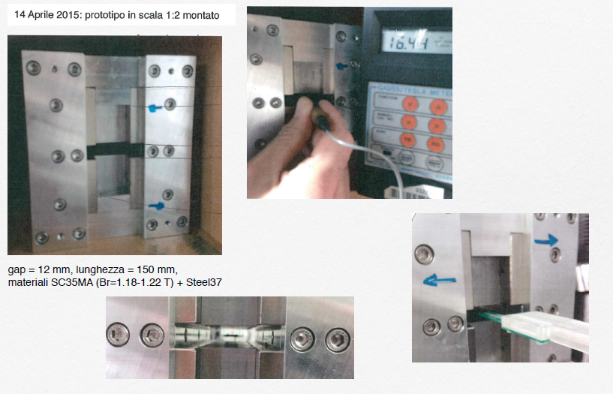
A PM scaled prototype
(Ref. Bruno Diviacco)

Slide 20
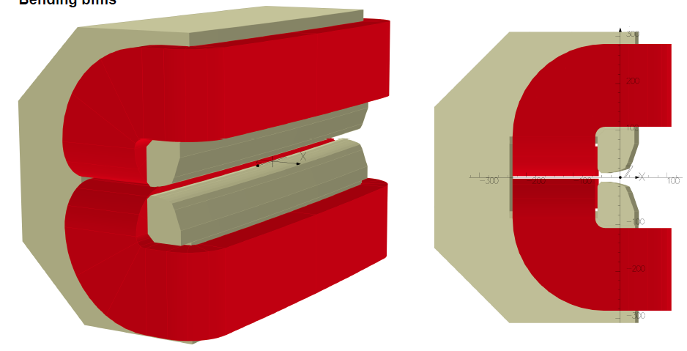
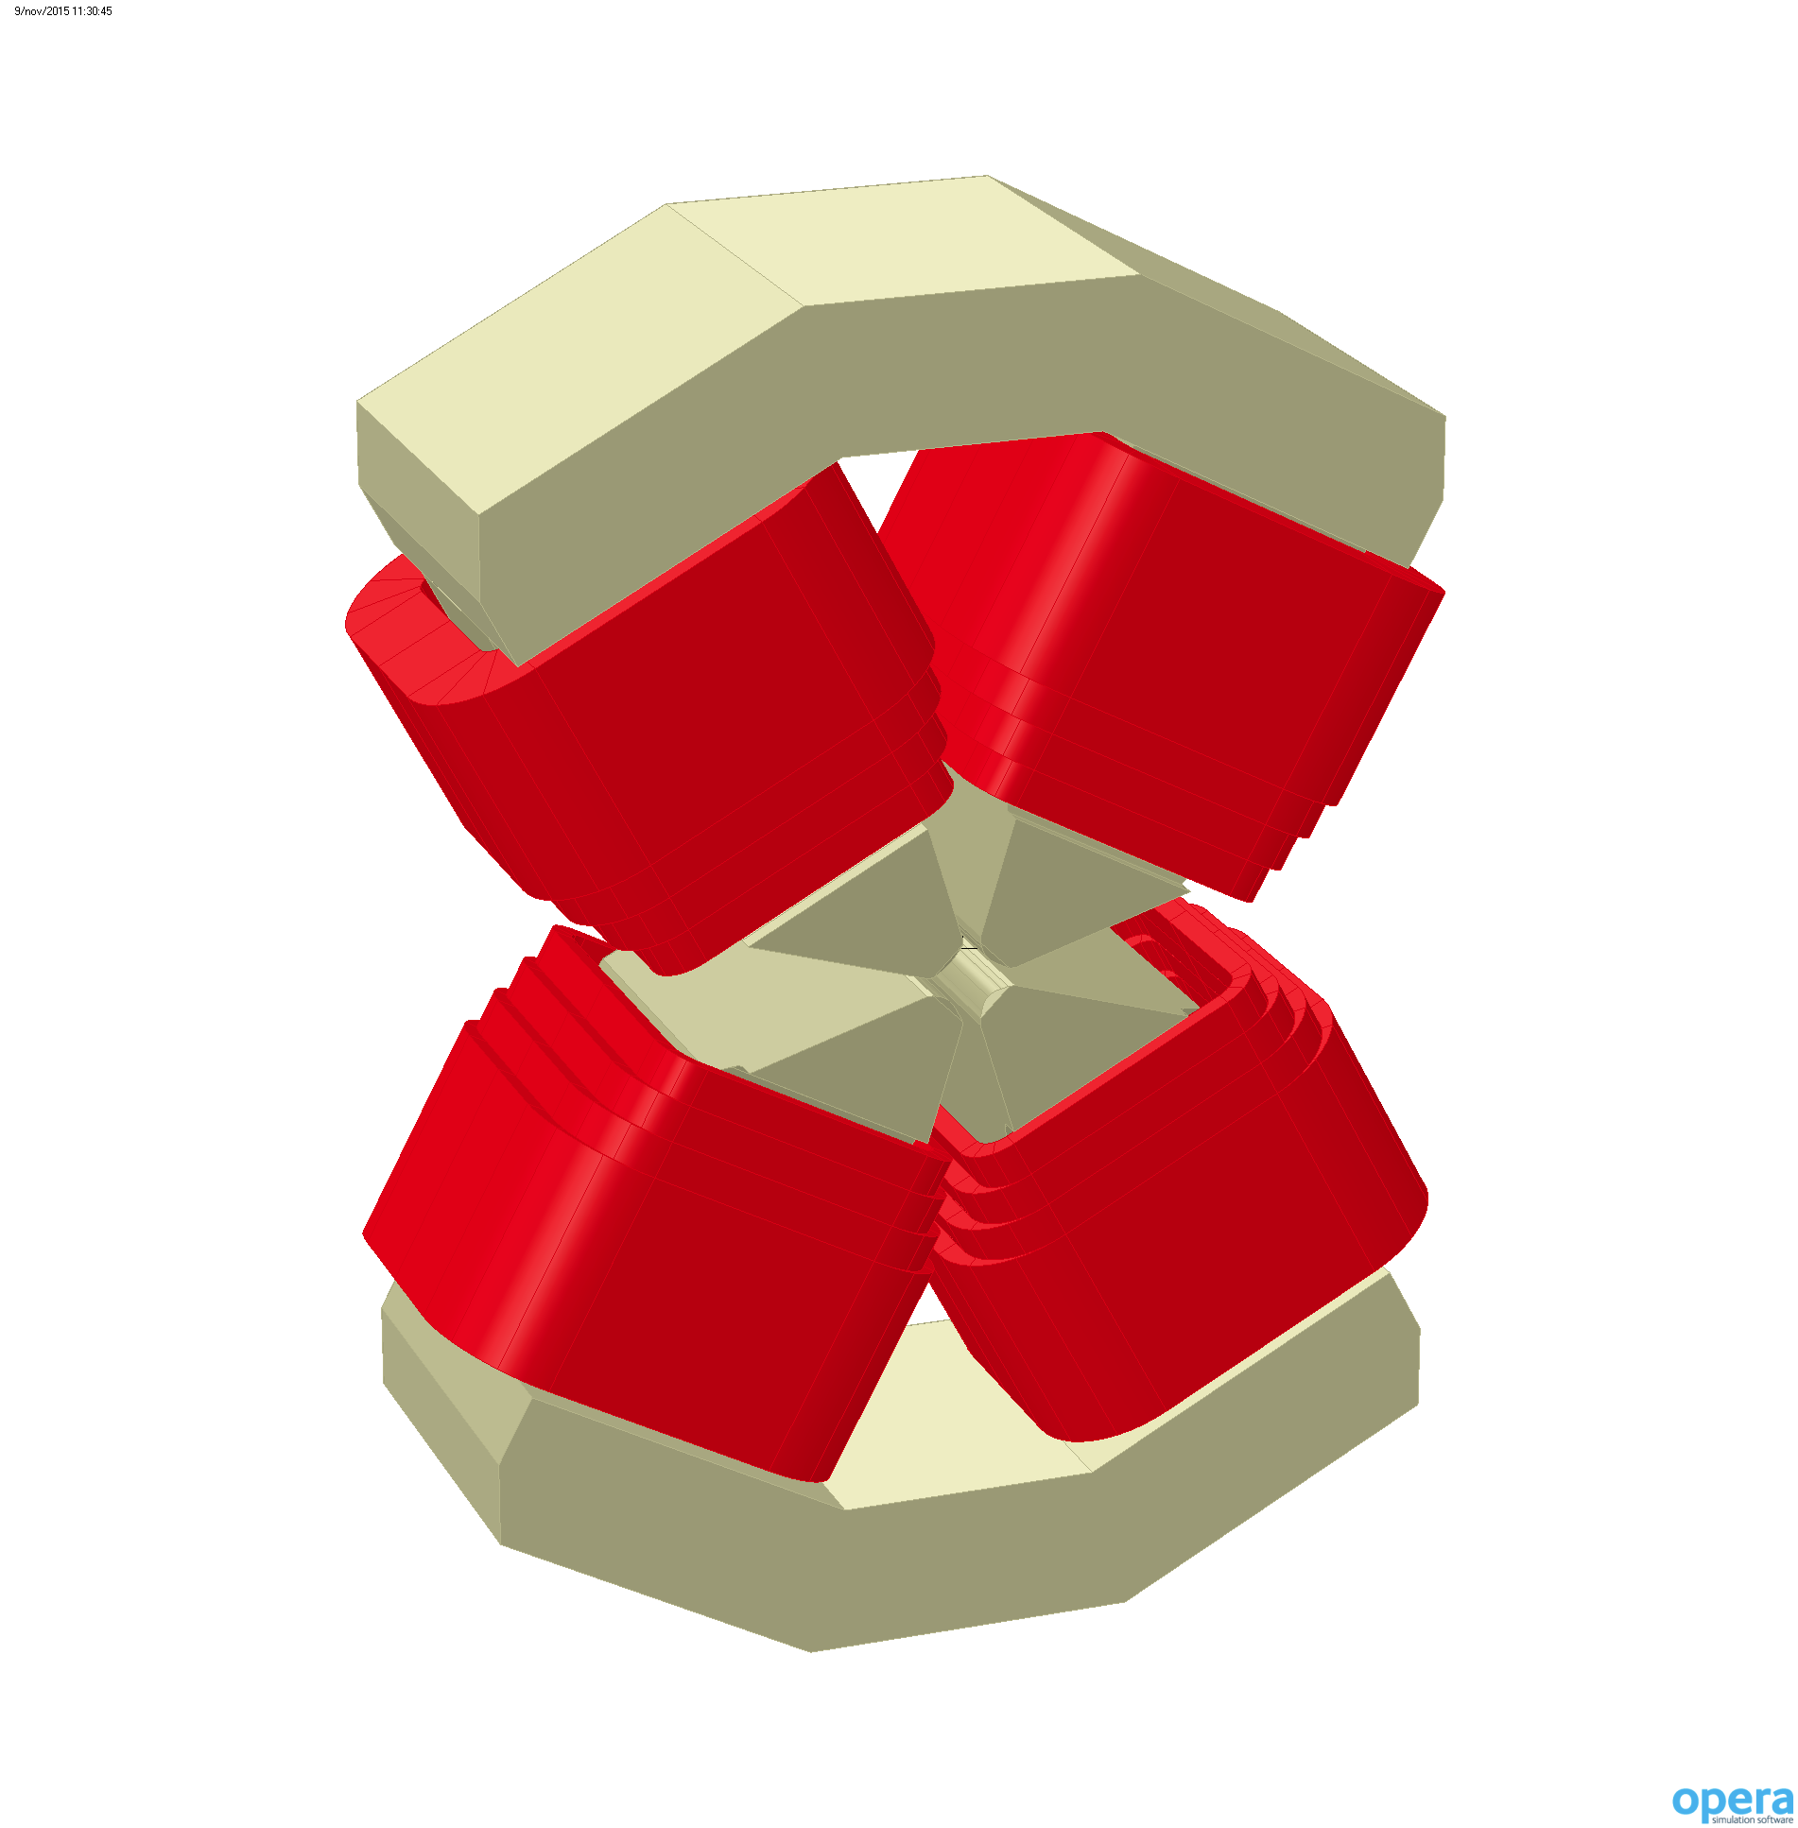
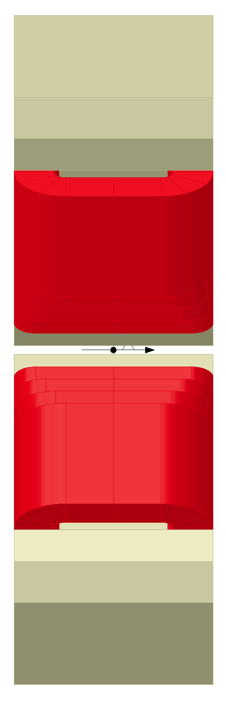
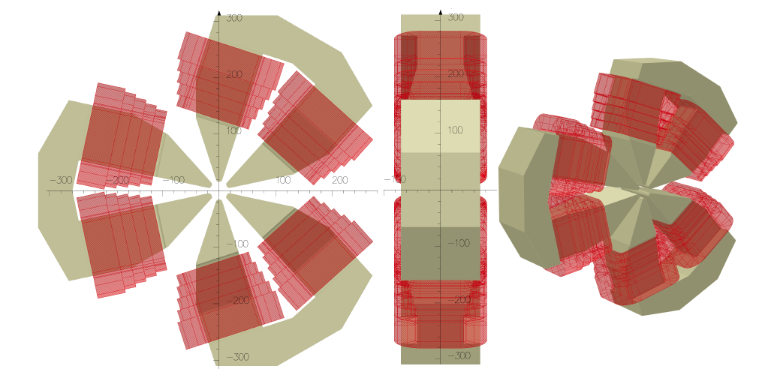
Magnets
Almost final with Lm=Lp. Use of new materials such as Cobalt – Iron alloys will also be considered
The quadrupole designs were developed with the vacuum chamber in order to resolve all the possible transversal interferences (beam lines). Asymmetric poles geometry has been opted.
The bending integrated quadrupole component is done by only the pole profile geometry. In order to optimize space and performances, different coil and frame geometries are evaluated. Space between the pole terminations will be employed in order to obtain the requested frame stiff.
The sextupole magnets have the higher design issue. The transversal interferences between coils and vacuum chamber are resolved.
Ref. D. Castronovo (Opera)

Slide 21
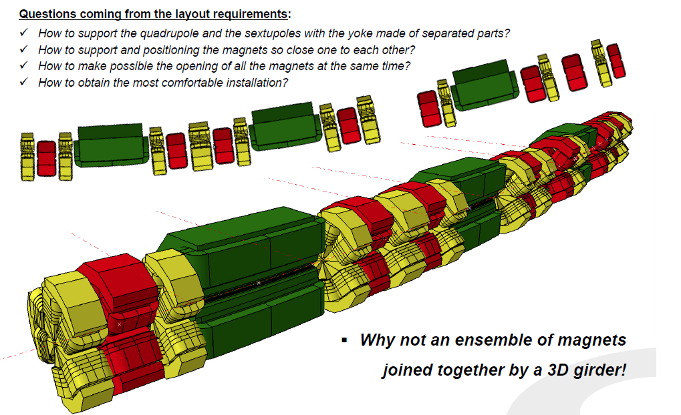
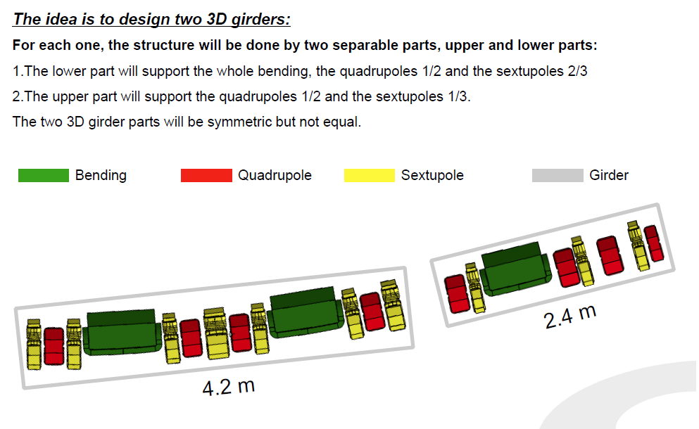
Supports

Slide 22
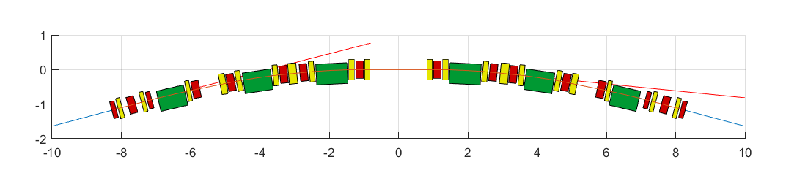
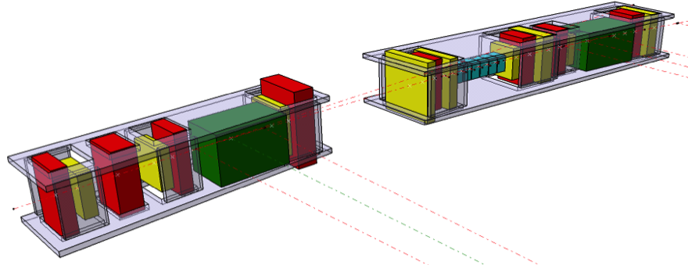
Physical interference control
Total Path Length = 12*21.63 = 259.56 m
Old concrete support bases will not be reused, new girders will be constructed, propose 3D because magnets are thin.

Slide 23
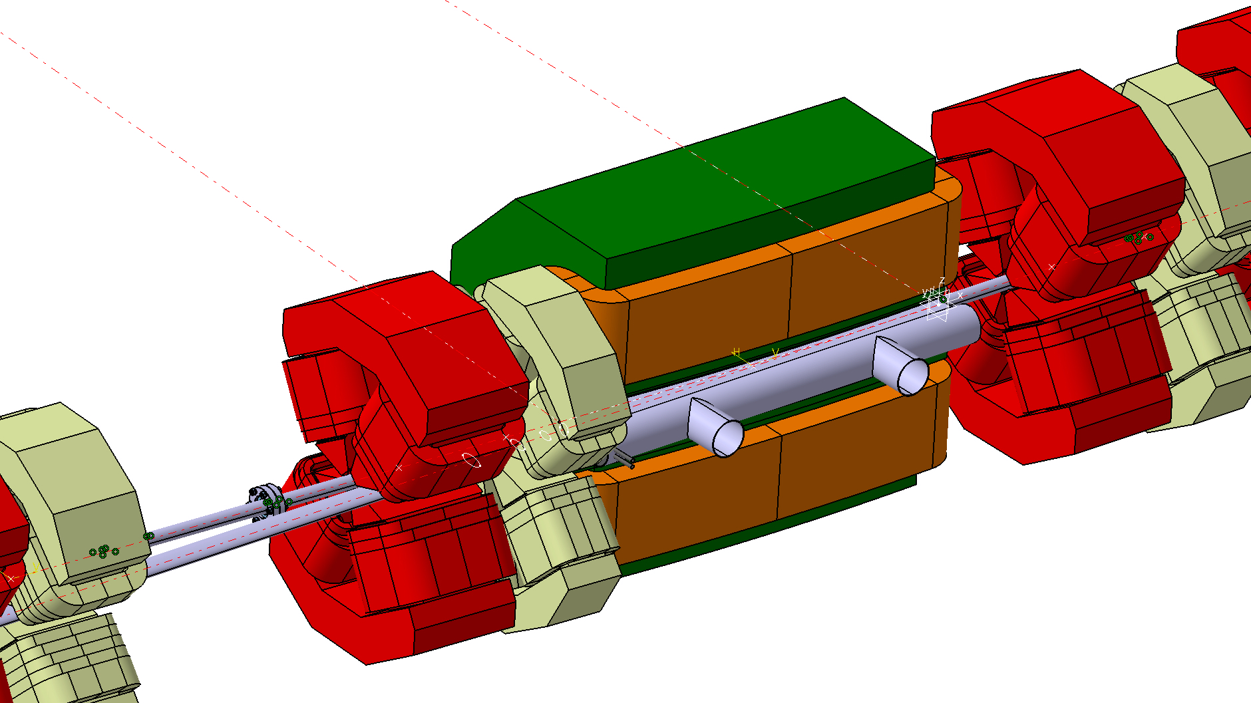
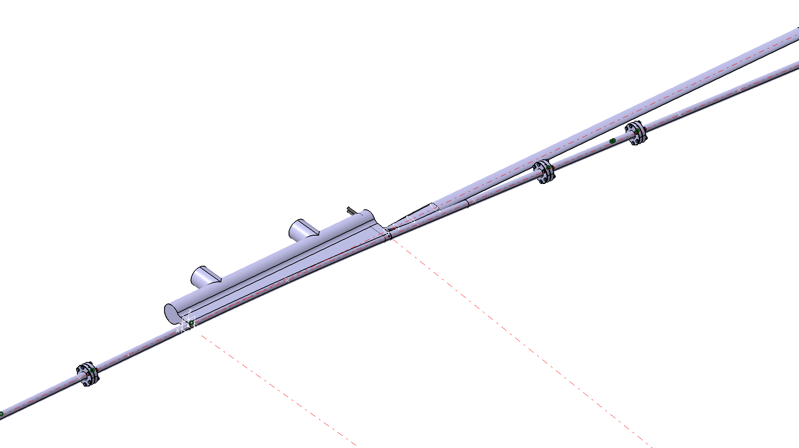
Vacuum chamber geometry
Preliminary studies
Vacuum chamber: Best compromise (considering also the magnet power) seems to be a circular cross section with 26 mm external diameter (with/without antechamber).
For the long straight sections the current vertical dimension of 9 mm is assumed.
The material maybe mixed S. Steel for light exits and straight chambers ; copper for curved pipes
Long straights with NEG and maybe also the straight short ones
(Ref. L. Sturari
and I. Cudin )

Slide 24
Elettra and Elettra2.0
Parameter | Units | Elettra | Elettra2.0
Circumference | m | 259.2 | 259.(2-8)
Energy | GeV | 2 - 2.4 | 2
Horizontal emittance | pmrad | 7000 | 230-280
Vertical emittance | pmrad | 70 (1% coupl) | 2.5
Beam size @ ID (σx,σy) | μm | 245 , 14 (1% coupl) | 43 , 3
Beam size at short ID | μm | 350 , 22 (1% coupl) | 45 , 3
Beam size @ Bend | μm | 150, 28 (1% coupl) | 17 , 7
Bunch length | ps | 18 (100 with 3HC ) | 9 (70-100 with 3HC )
Energy spread | DE/E % | 0.08 | 0.07
Bending angle | degree | 15 | 5, 5.6 and 4.4

Slide 25
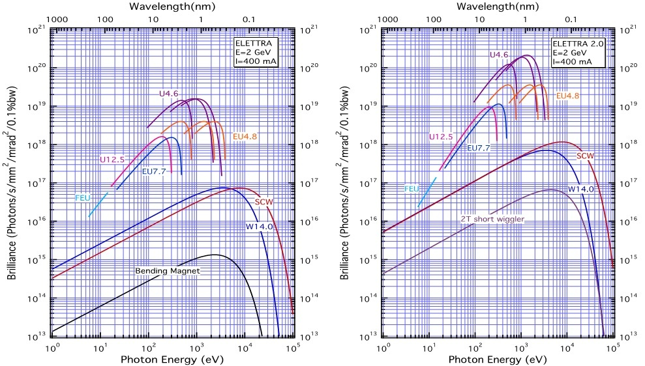
Brilliance

Slide 26
Summary
The Laboratory operates the first European third generation Synchrotron Light Source for soft x-rays at 2 and 2.4 GeV and a HGHG 1.8 GeV Free Electron Laser.
There are plans for improvements for both mid and long term future.
Elettra2.0 lattice is fixed as a 6BA structure. The “white paper” is completed and available. Work continues towards CDR completion by the end of the year.

Slide 27
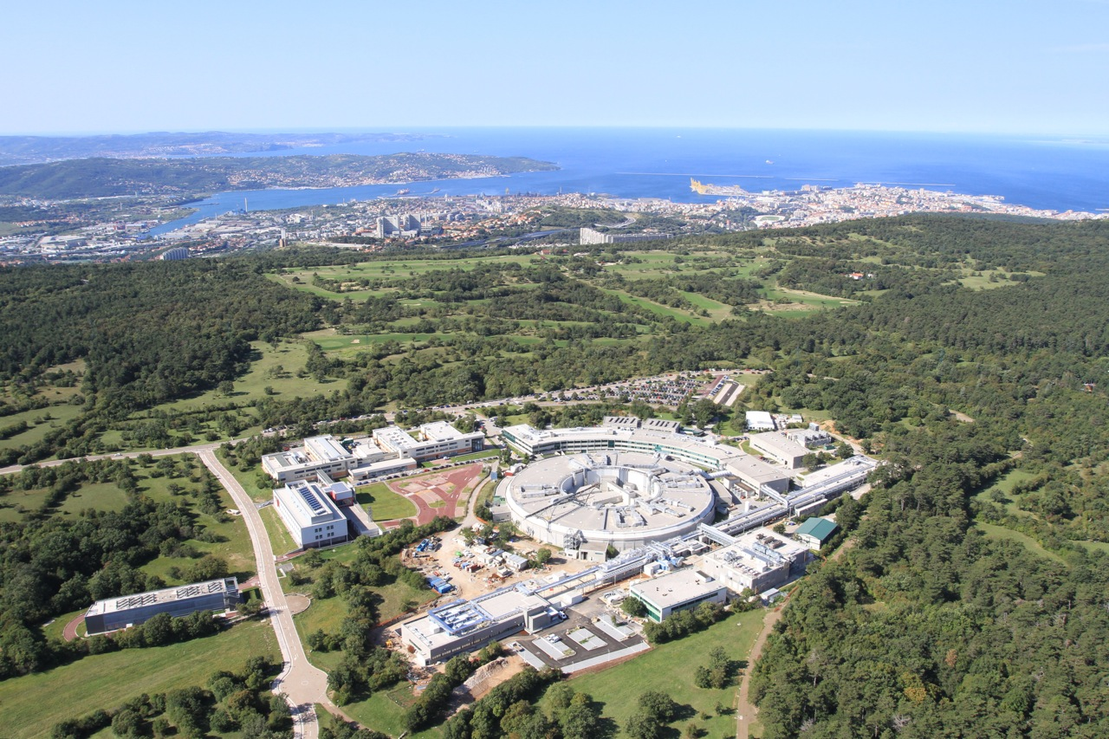
Thank you for your attention

