Slide 1
Off-axis injection lattice design studies of HEPS storage ring
This work done by Physics group of HEPS
Reporter : Y. M. Peng
LERLD 2016 workshop
1-2 December 2016

Slide 2
Outline
Introduction of HEPS present nominal design
Design goals of off-axis lattice
Design considerations
Dynamic analysis
Summary

Slide 3
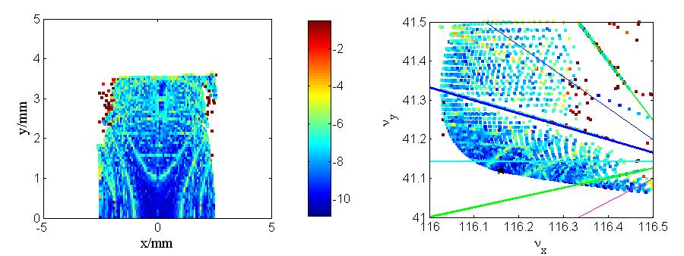
Introduction of HEPS current lattice
HEPS is a 6-GeV light source with emittance less than 0.1nm, proposed to be built in Huairou district , suburbs of Beijing ,China.
The current design is a 48-H7BA cells lattice with emittance 59.4pm.
Efficient dynamic aperture ( the particles is recognized lost when tune run across the integer & half integer resonance lines):~2.5mm in x and ~3.5mm in y.
DA is only sufficient for on-axis injection schemes.

Slide 4
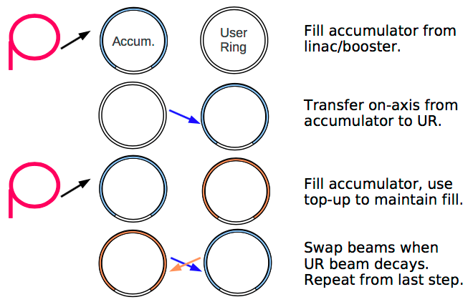
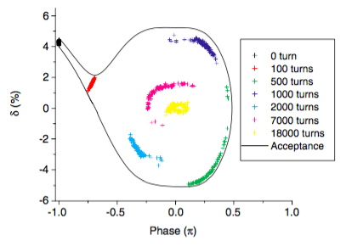
On–axis injection schemes
’ swap-out’ injection
Each injector shot replaces an existing stored bunch
DA only need accommodate the injected beam size
Requires full-charge injector
Old beam dumped or recycled
Complexity in beam dump or recycled ring
Longitudinal injection
  Can be achieved beam accumulation
  Requires large MA.
  Or a very challenging injection kicker (very narrow pulse width).
Swap-out, M. Borland, USR workshop, 2012
Swap-out, M. Borland, USR workshop, 2012
Long. Inj., M. Aiba, et al., PRST-AB,
HEPS
MAX-IV

Slide 5
Off–axis Lattice goals
Emittance less than 100 pm at 6GeV with a circumference about 1.3km
6-m straight section for insertion devices
Vertical beta functions at IDs close to 3m in vertical
Horizontal beta functions at IDs not too large (<10m) to improve brightness
Sufficient injection aperture and a 10-m straight section for off-axis injection
typically ~10 mm for local-bump injection and ~5 mm for pulsed multipole injection
Sufficient MA for Lifetime at 200 mA

Slide 6
Lattice design consider
To enlarge the DA, except optimizing the multipole sets, it seems necessary to increase the beta functions at the straight section.
3 parts of the design
Standard cell : H7BA , as same as the nominal design , designed with low beta functions for optimal matching of the electron and photon beam.
Injection cell: two cells neighboring are re-matched to make a high-beta section for injection.
Opposite cell (survey requirement): opposite to the high-beta straight section in the ring, with beta functions below 15 m for the convenience of installing RF cavities there

Slide 7
Standard cell --Hybrid 7BA*
Dispersion bump
Combined dipole
L=3m
High gradient quadrupole
Longitudinal gradient dipole
Longitudinal gradient dipole
Phase advance of Δφx=3π and Δφy=π between corresponding sextupoles chosen to cancel geometrical sextupole kicks
Two octupoles were also placed in the dispersion bumps and used to reduce the detuning terms;
*: L. Farvacque et al., IPAC13, 79

Slide 8
MOGA/PSO optimization(48-H7BA)
32 element parameters (all tunable magnet positions and strengths)
Constraints:
A reasonable maximum value of beta function along the ring, max(β_{x} , β_{y} ) ≤ 30 m;
Reasonably low beta functions in ID section for high brightness, 1.5 m ≤ β_{y} < 4 m and 1.5 m ≤ β_{x} < 15 m;
Stability of the optics, Tr(Mx,y) < 2, with Mx,y being the transfer matrix of the ring in the x or y plane;
Fractional tunes in (0, 0.5), which is favorable against the resistive wall instability;
Reasonable natural chromaticities, |ξx, ξy| ≤ 5.5 in one 7BA;
All drifts between adjacent magnets longer than 0.1 m;
One of the drifts neighboring the inner three dipoles should be longer than 0.35 m to accommodate a three-pole wiggler which is to be used as a hard X-ray source;
Reasonably low energy loss in each turn due to synchrotron radiation (U₀ ≤ 2.2 MeV)

Slide 9
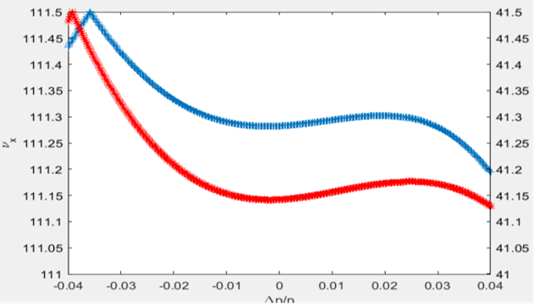
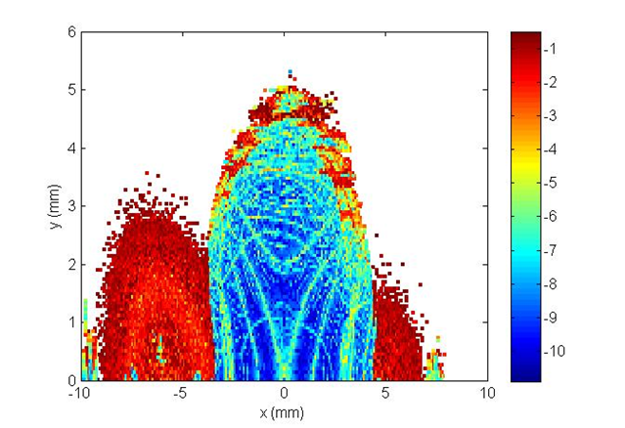
Main parameters of 48 normal cells
Parameters | units | values
Circumference | m | 1295.7
Emittance | pm.rad | 60.2
Tune |  | 111.284/41.143
Natural chromaticity |  | -134.12/-137.15
Beta functions in SS | m | 7.20/3.07
Energy spread |  | 8.5827E-4

Slide 10
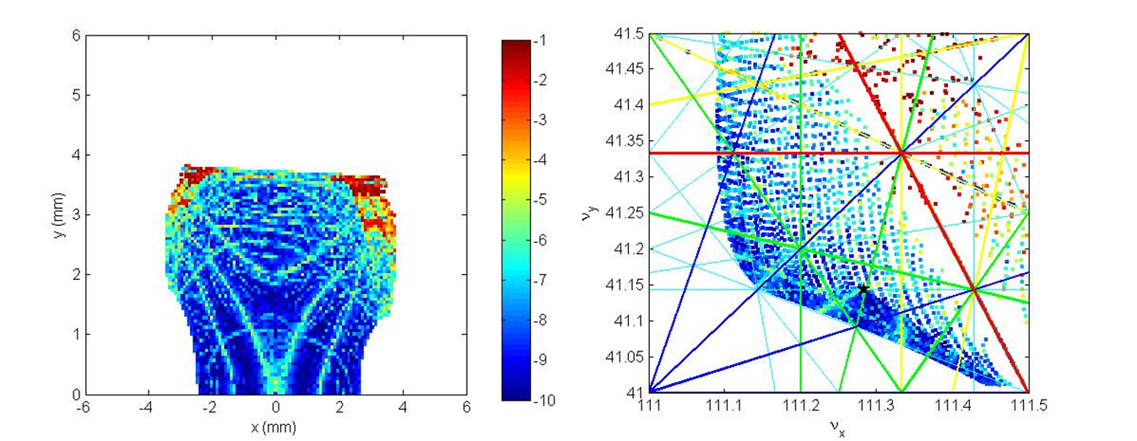
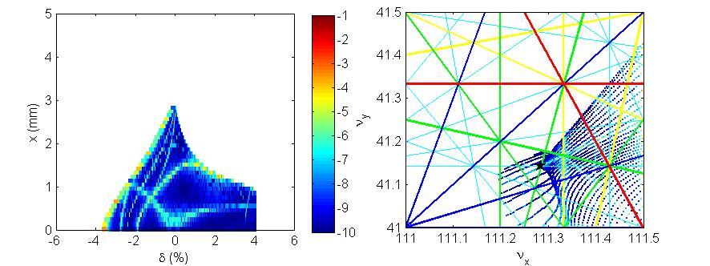
Effective DA(H~2.4mm,V~3.7mm)
Ring acceptance projected in the (x, δ) plane and the corresponding frequency map at the center of the 6-m straight section

Slide 11
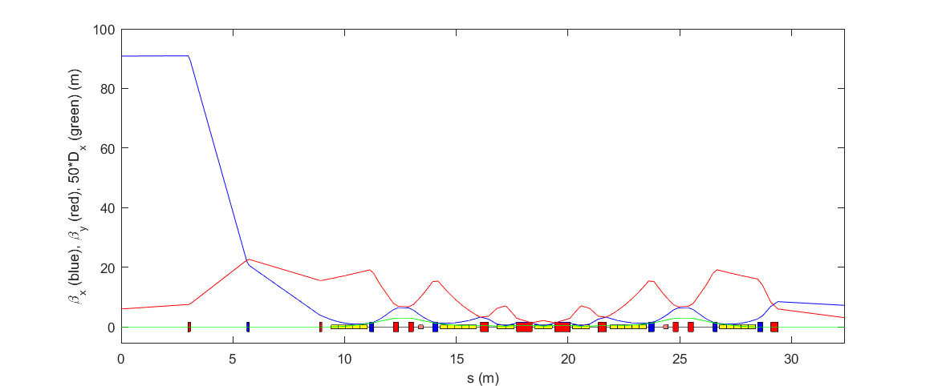
Injection cell
Add one family additional quadrupoles in each straight section.
Increase the length of long straight sections from 6m to 10m.
β_{x} in straight section >90m, estimated value of DA in horizontal is more than 8.5mm
The straight sections have the same phase advance as the standard 6-m ones
Didn’t break the Phase advance of Δφ_{x}=3π and Δφ_{y}=π between corresponding sextupoles
The optical functions in dipole is same as the standard 6-m ones

Slide 12
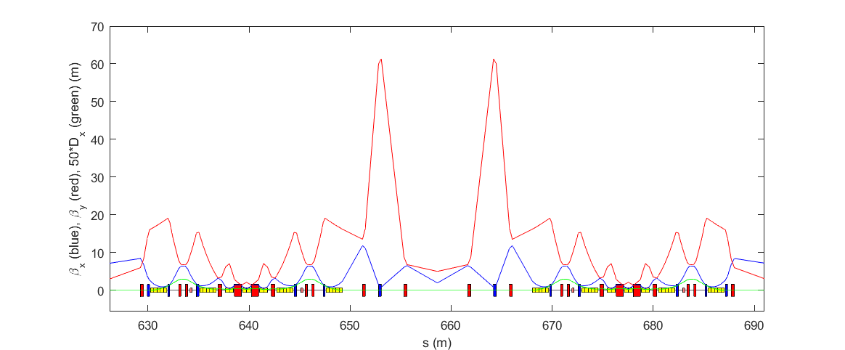
Opposite straight section
The total length is equal to the high-beta straight section
The horizontal phase advance has a 2π difference with the high-beta straight section

Slide 13
Main parameters of off-axis injection lattice
Parameters | units | values
Circumference | m | 1317.3
Emittance | pm.rad | 60.2
Tune |  | 112.284/41.143
Natural chromaticity |  | -137.09/-140.02
Straight section | m | 6*46+10*2
Beta functions in 6 m-SS | m | 7.20/3.07
High beta in 10 m-SS | m | 90.86/5.99
Low beta in 10m-SS | m | 1.96/5.02
Energy spread |  | 8.5827E-4
Momentum compact factor |  | 3.14E-5
RF frequency | MHz | 499.8
Harmonic number |  | 2196
RF voltage | MV | 3.4
Bunch length | mm | 2.56

Slide 14
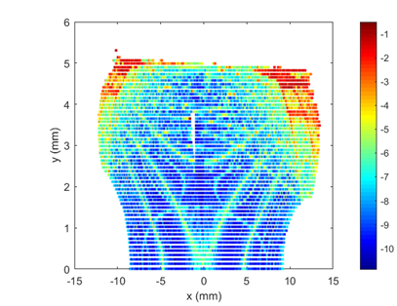
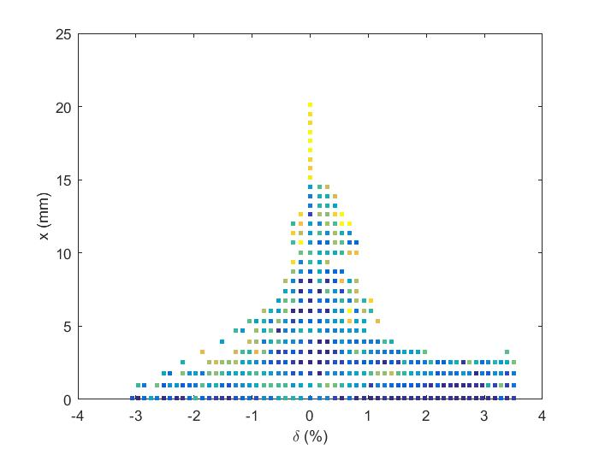
Nonlinear analysis
  Nonlinear optimization is not done, just scaling the sextupole strengths to keep the corrected chromaticity unchanged, (+0.5, +0.5).
Effective dynamic aperture and the ring acceptance projected to (x, δ) at the center of the high-beta straight section

Slide 15
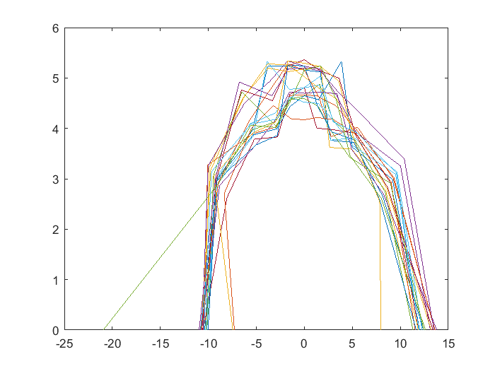
DA with error
20 seeds
1000 turns
Misalignment in girder:30μm
Misalignment between girders:100μm
Tilt :1E-4
Accuracy of BPM:0.1 μm
Integral field errors:
Quad: 2E-4
Dipole:1E-3
Sextupole:1E-3
Only correct the orbit and beta beating, not correct the dispersion and emittance y

Slide 16
LMA and Touschek lifetime
In the calculation, the bare lattice is used, RF cavity and synchrotron radiation are turned on
 | τ_{1/2} [h]
Bare Lattice | 0.65
Bare Lattice with IBS | 0.81
Bare Lattice with LC | 3.14
Bare Lattice with LC and IBS | 3.4
Bunch length with LC is about 12mm

Slide 17
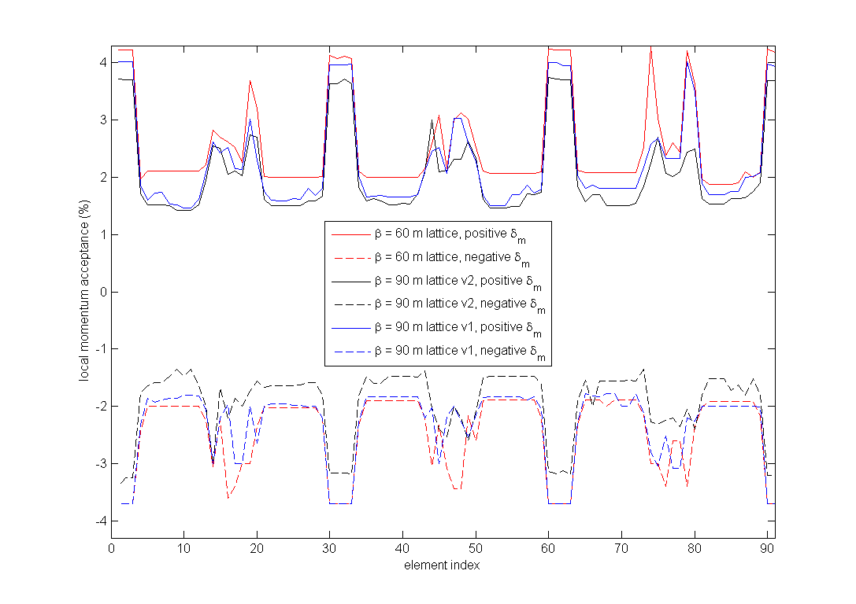
LMA
If the largest horizontal beta function reduced to 60 m. In this case, the DA is slightly smaller (scales as square root of beta function, ~7.4mm), but the effective MA at the dispersive region is increased to ~2%, and the Touschek lifetime for bare lattice with LC and IBS is about 7.5 hours.

Slide 18
Summary
We have had a lattice with enough DA for off-axis injection, but the MA in dispersive region had a obvious decrease.
There is probably an ‘optimal’ value of the highest beta function to simultaneously obtain a large enough DA for off-axis injection and large enough LMA for a long enough Touschek lifetime.
We need more nonlinear optimization, maybe use local chromaticities correction in high-beta cell.

Slide 19
Thank you for your attention!

