Slide 1
Login in Indico
https://indico.maxiv.lu.se/
The username for many of the MAX IV staff is composed by the 3 + 3 first characters of your name and surname.
e.g. analab for ana labrador

Slide 2
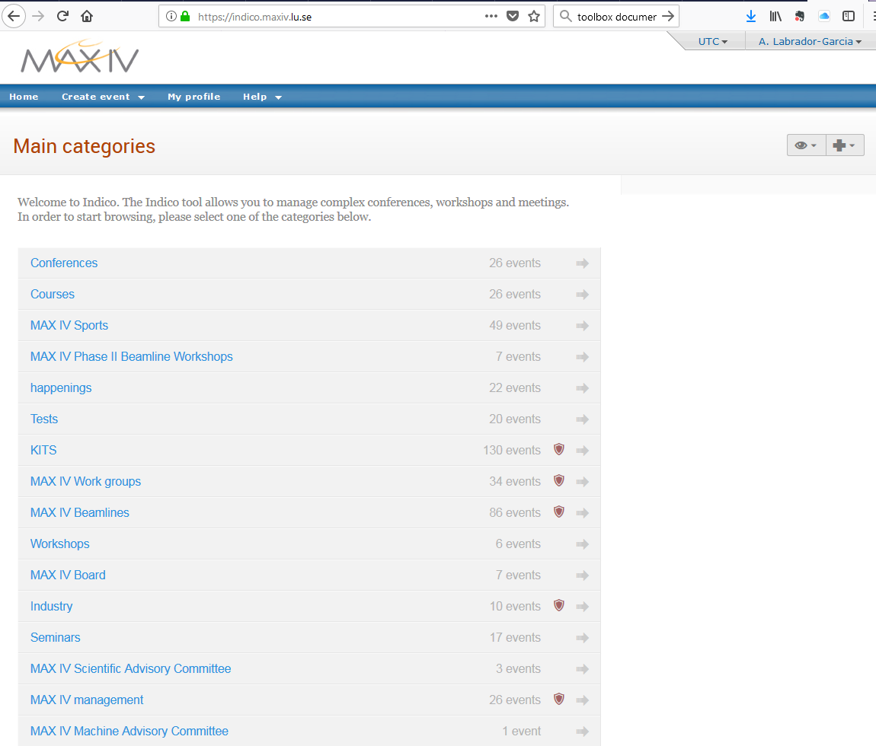

Slide 3
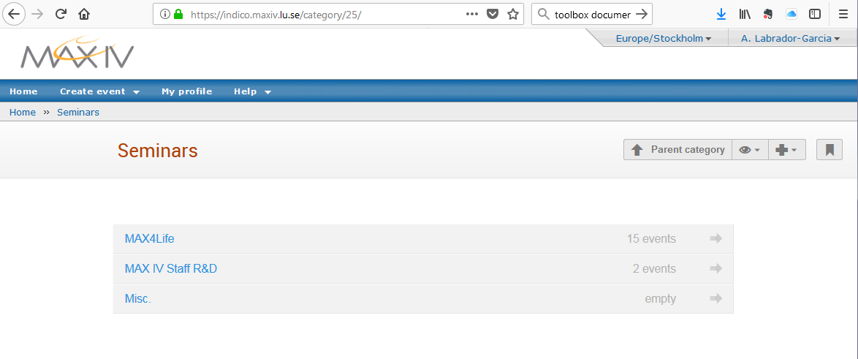

Slide 4
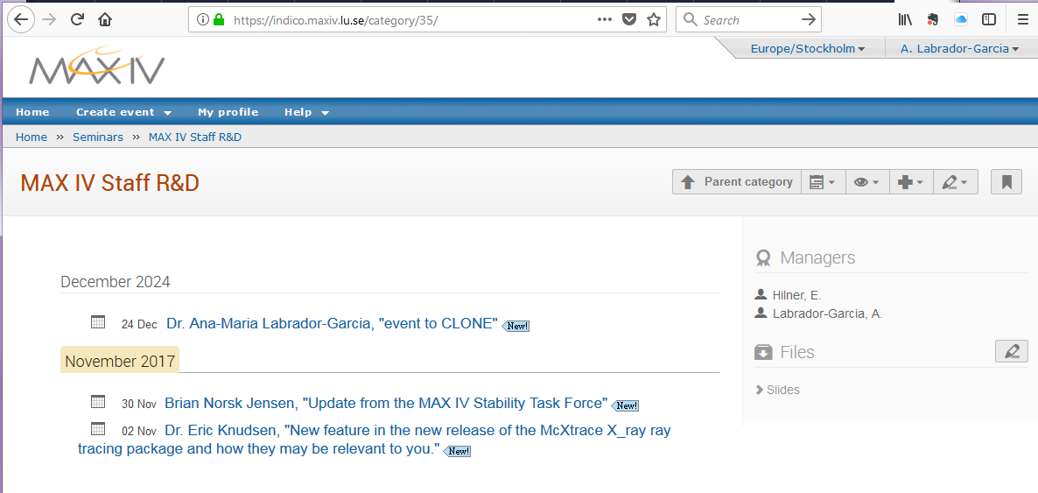
Two possible actions:
Create event
Click in an existing one to
Edit it
Clone it
1
2

Slide 5
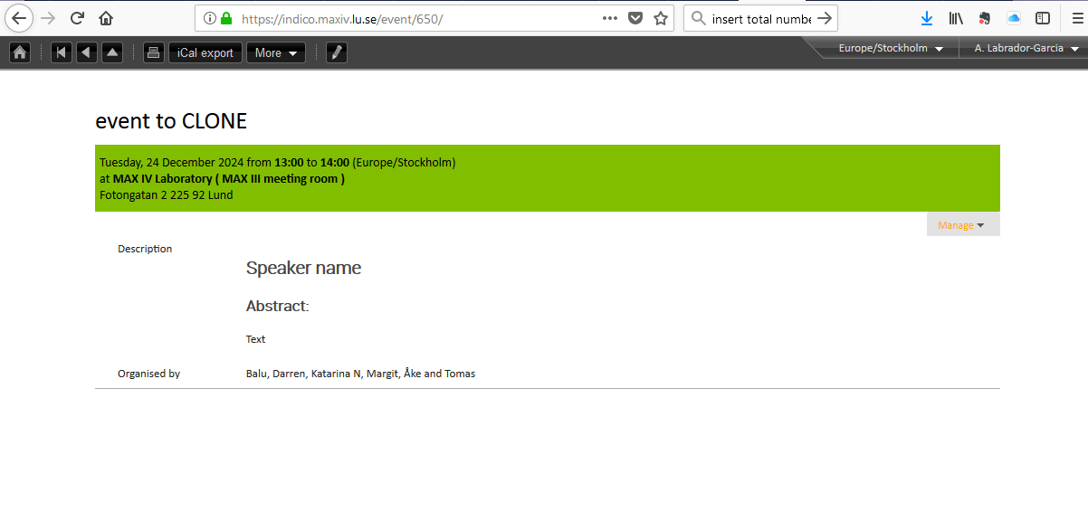
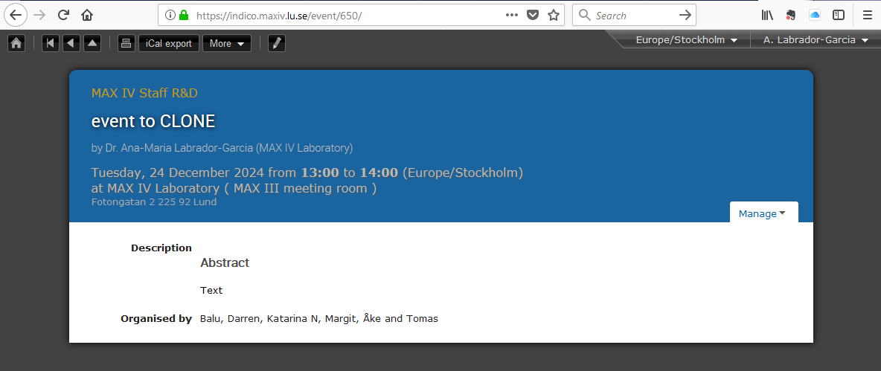
Two possible actions:
Create event
Click in an existing one to
Edit it
Clone it

Slide 6
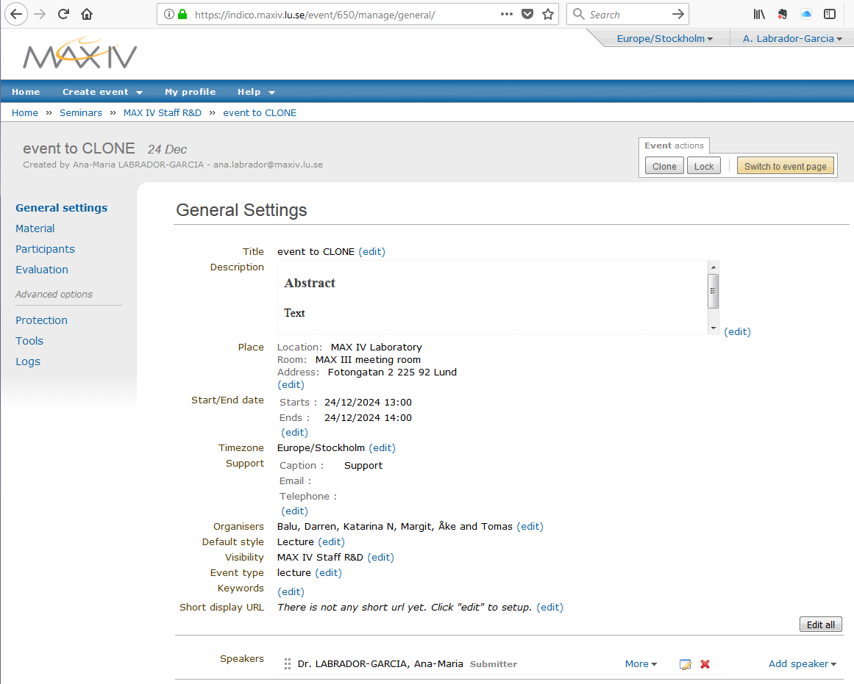
Page after clicking on the pencil
Recommended to use the Clone feature
Because some fields will be already filled in and one only needs to modify a few (see next slide)

Slide 7
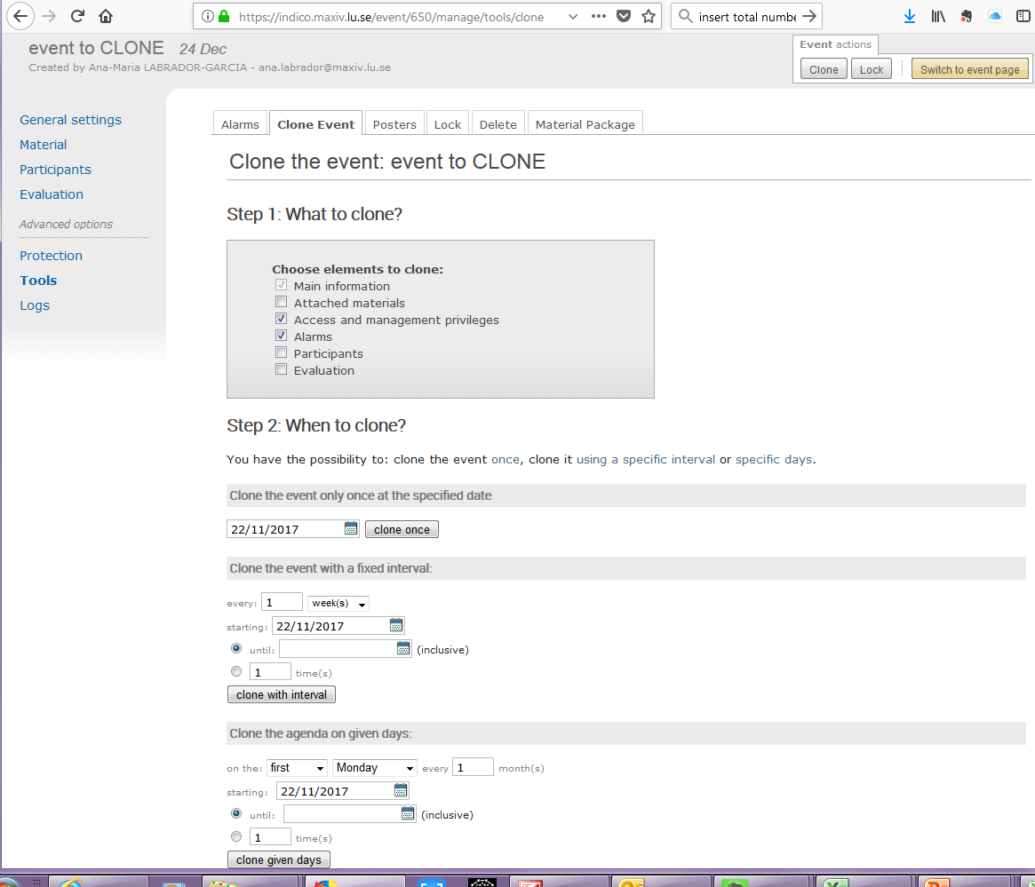
Select the date of the new event/seminar
Click on Clone once

Slide 8
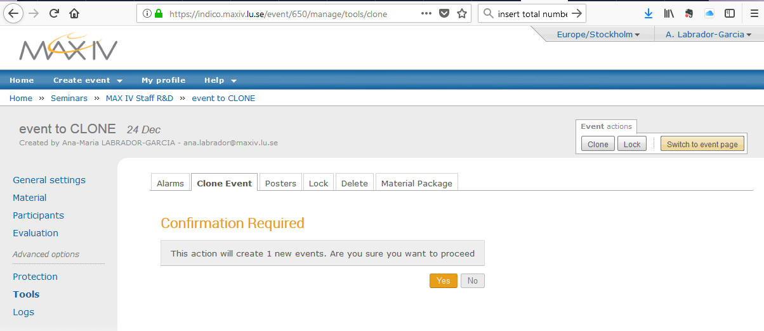
Following previous step,
You need to confirm the action:

Slide 9
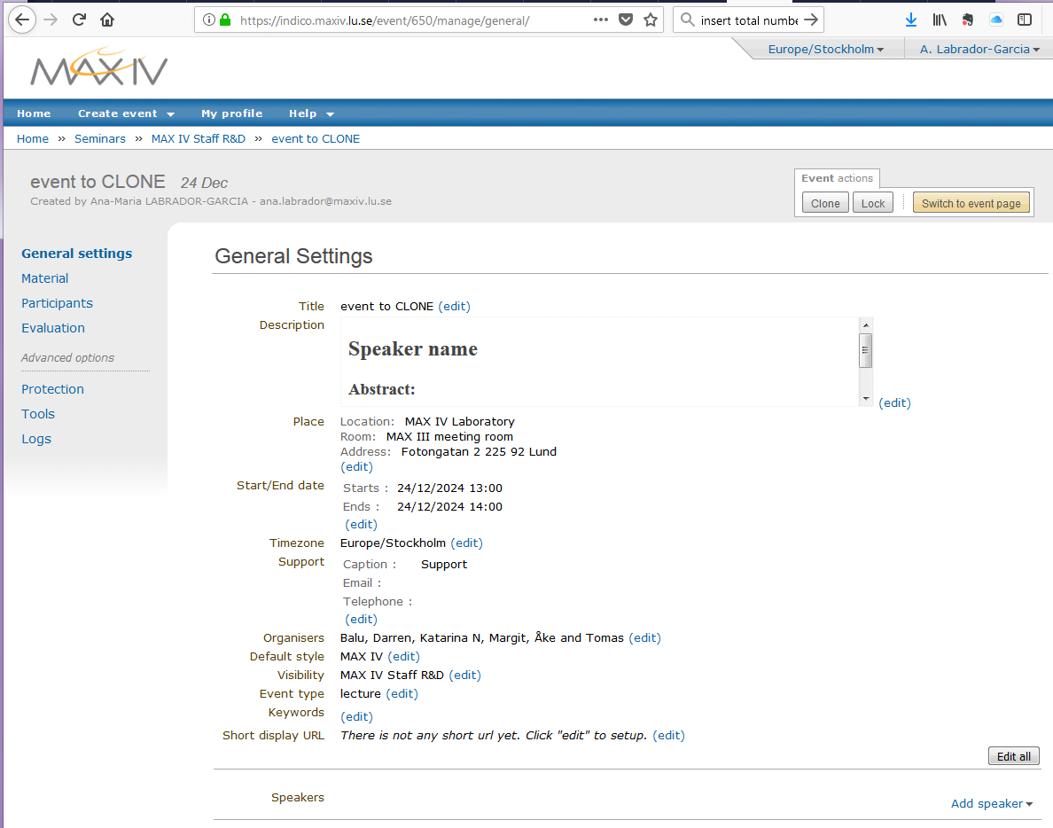
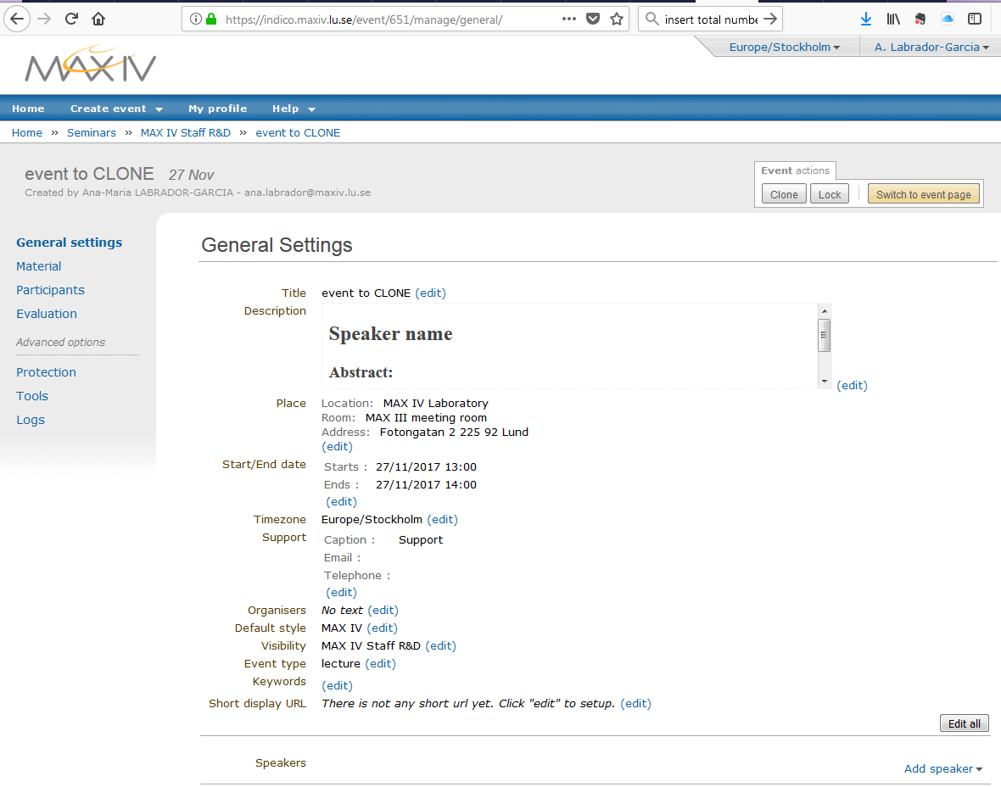
Event from which a clone will be created
Cloned event that now required a minor editing
See next slide

Slide 10
(edit) and save
* insert here the title
* Insert here the abstract
* Edit meeting room
* Date/time was set during the clone action
* Update the organizers when need it
to remove the existing name
* To add the speaker

Slide 11
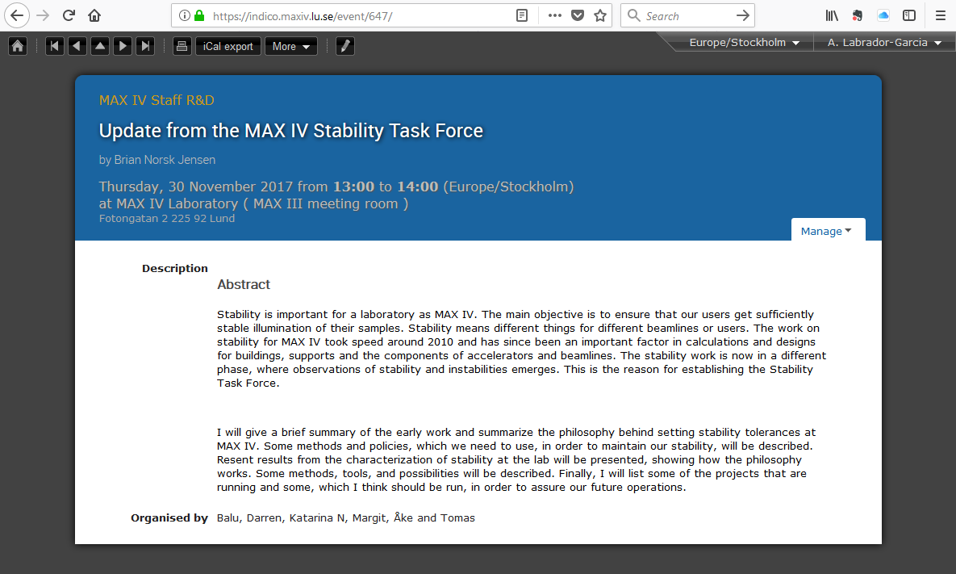
Final aspect of the seminar event

