Slide 1
Automation
Python, PyTango + QT Designer
Operations perspective on automation

Slide 2
Python, PyTango
Controlling / reading tango devices with Python.
Specifying tango devices to be controlled / read in Python scripts: gr00_valve = PyTango.DeviceProxy("i-gr00/vac/vgmb-02")
Get device attribute into Python variable: gr00_state = gr00_valve.State() Print(gr00_state) >> CLOSED

Slide 3
Python, PyTango
Allows for easy access and control of tango devices. Using functions and lists to handle commands to many devices:
Defining a list of valve devices: self.valves = [PyTango.DeviceProxy("i-sp02/vac/vgmb-04"), PyTango.DeviceProxy("i-sp02/vac/vgmb-03"), PyTango.DeviceProxy("i-sp02/vac/vgmb-02")]
Defining a function that closes all valves: def closevalves(self): for dev in self.valves: dev.close()

Slide 4
Building the GUI in Qt Designer
Drawing the user gui in Qt Designer.
Connect signals (=button clicked, checkbox marked etc.) to the python functions.
Allows for a custom made, reliable and user friendly tango device control GUI.

Slide 5
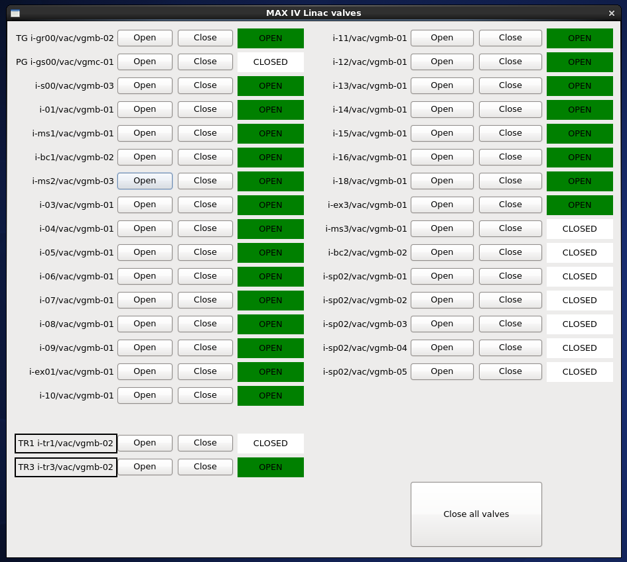
Example: Linac commissioning, linac valves

Slide 6
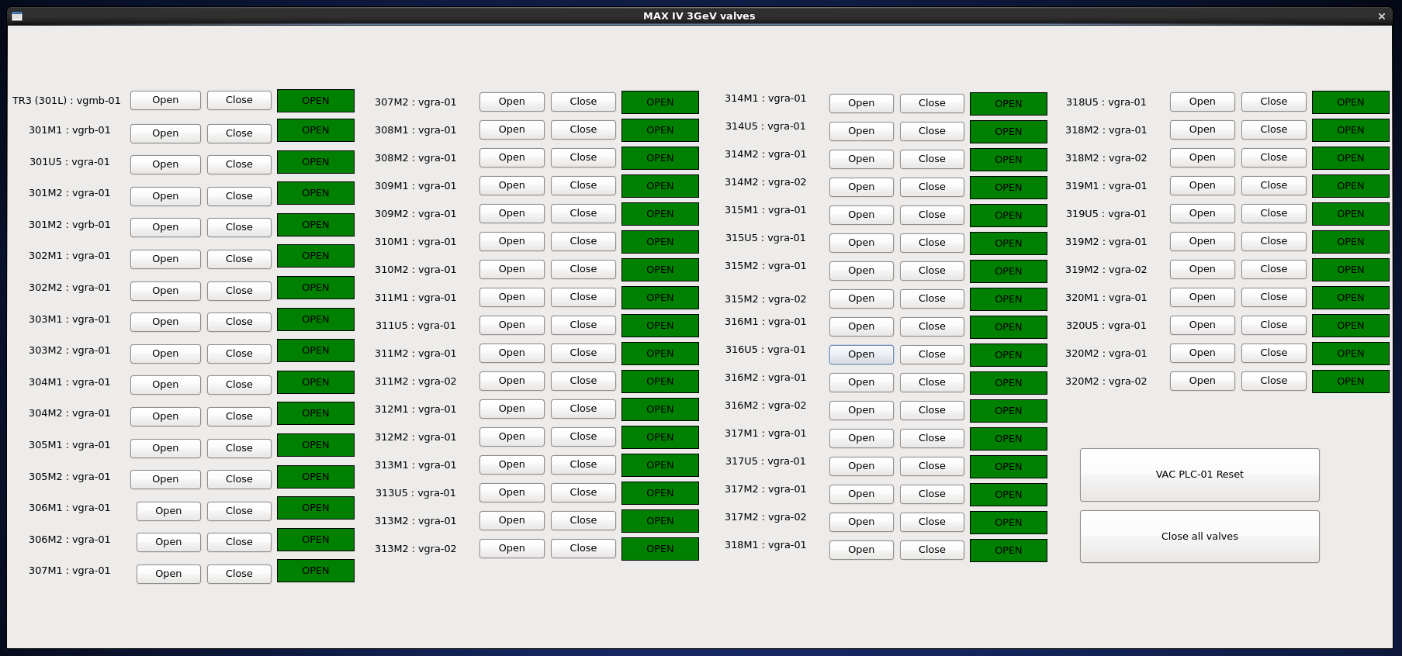
Example: 3GeV ring commissioning, 3GeV valves

Slide 7
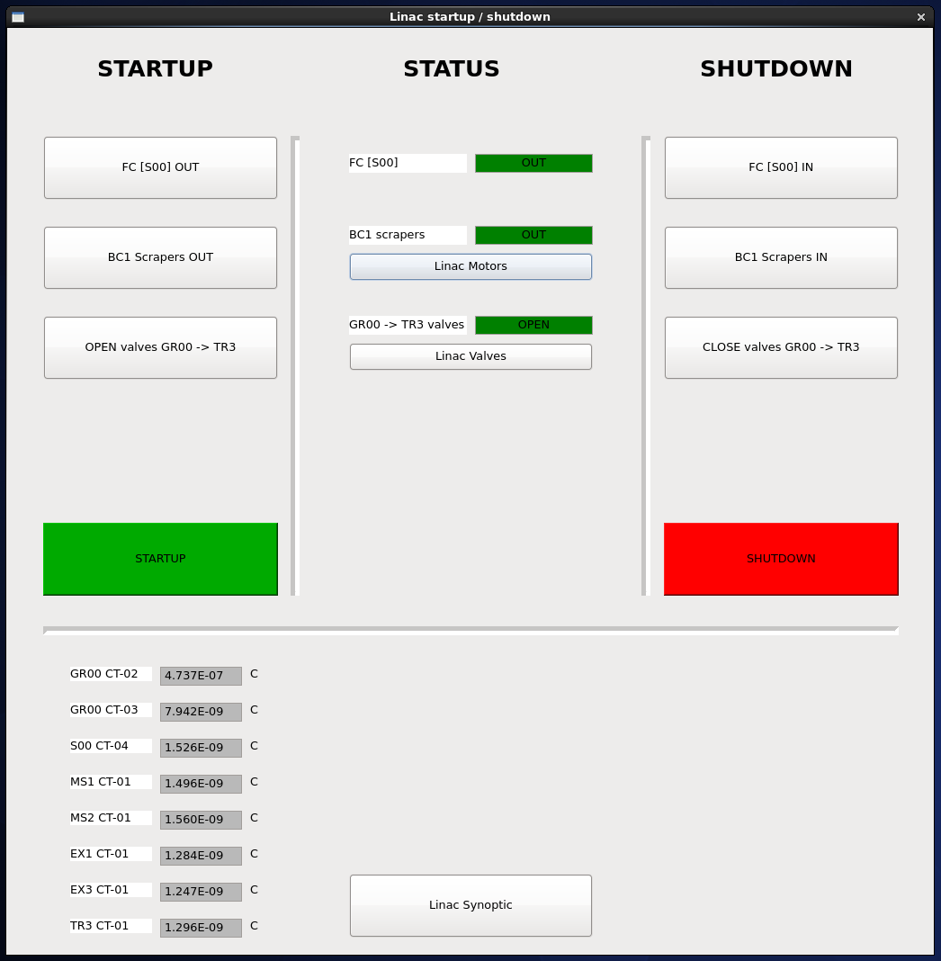
Example: Further development => Linac startup / shutdown

Slide 8
Turning this into ’automation’
Bringing these functions and commands into automated processes by conditions =>
if (’Radiation safety group says OK TO RUN’): then startup() etc.

Slide 9
Operators developing
Natural line that operators develop scripts and GUIs
When ’in operators-group’-developed scripts are finished and standarized, they should be handed over to the IT-group

Slide 10
Operational point of view on automation
Automation and Operation goals
Modes of operation, SPF + 3GeV top up + 1.5GeV top up
Solving errors by automation? Safety aspects?
Control system robust enough? MPS and PSS reliability.
Challenges, difficulties => Feedback systems, finding the operation modes

Slide 11
THE END
Thank you!

