Slide 1
Control Systems for Accelerators and Automation 2015-12-03
David Fernández.
ALBA Computing & Controls

Slide 3
Different views at different levels
SUBSYSTEMS
Power supplies
Vacuum
RF
Insertion Devices
Diagnostics (BPM, BLM, etc. (SRM, FS, FCT, Scrappers…)
Linac / Booster (both can be subdivided in the subsystems)…...
TRANSVERSAL subSYSTEMS
Timing/Synchronization,
Equipment Protection Sys.
Personnel Safety Systems.
TRANSVERSAL-SOFTWARE
Alarm System
Archiving System

Slide 4
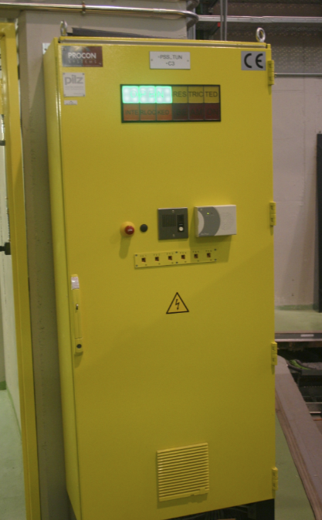
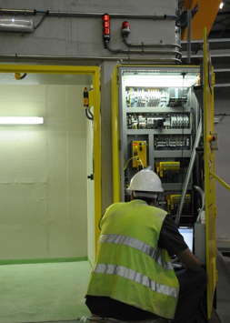
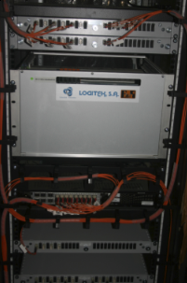
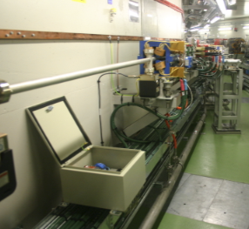
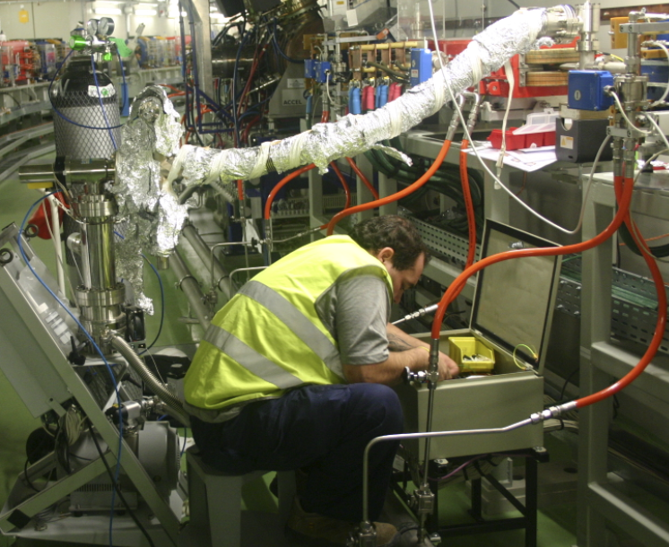
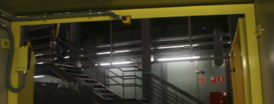
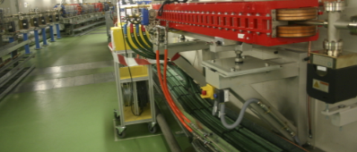
PLC based systems: Equipment protection and Personnel protection
EPS
PSS

Slide 5
Personnel Protection
Intrusion
Search procedures
Access control
Radiation monitors
Equipment protection
Water interlocks
Temperatures
Actuators
Logic of valves and vacuum itlks
RF, Vacuum Eq. IDs, etc.
Logic of shutters
Interfaces with timing
…
Hundreds of signals
Thousands of signals

Slide 6
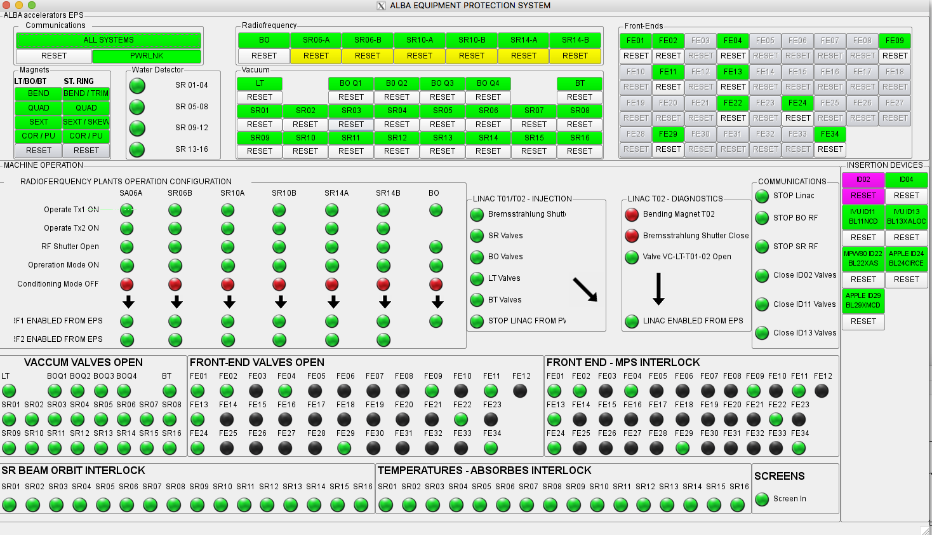
Interlocks and Equipment protection
Notes:
Global interlock view.
Gives the operator the general status of the machine at a glance

Slide 7
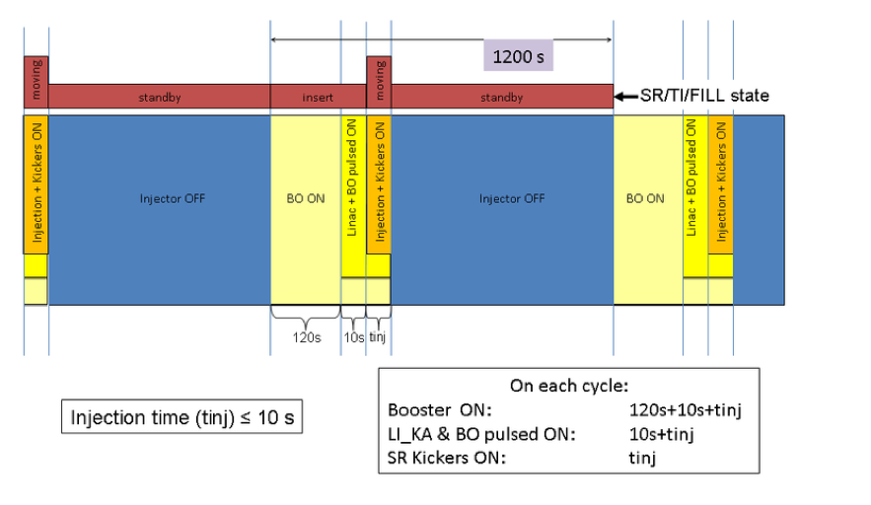
Defining procedures. “Ad hoc”: Injection procedures (Top-Up)
Notes:
There are a certain number of actions candidate to be automated.
The injection (in particular in top-up):
It uses the timing system (events and sequences) for the high precision synchronization.
It defines software sequences for the injection process

Slide 8
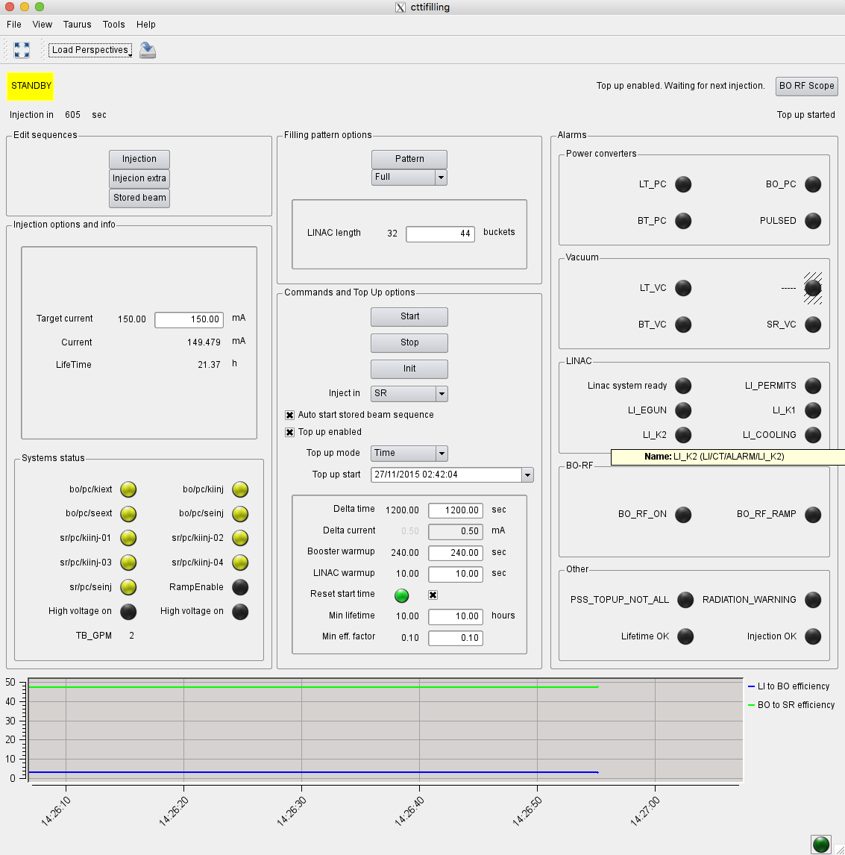
Timing Injection Filling patterns Top-up …
Notes:
Ad hoc application summarizing the automated procedures

Slide 9
Timing
Notes:
Ad hoc application summarizing the automated procedures

Slide 10
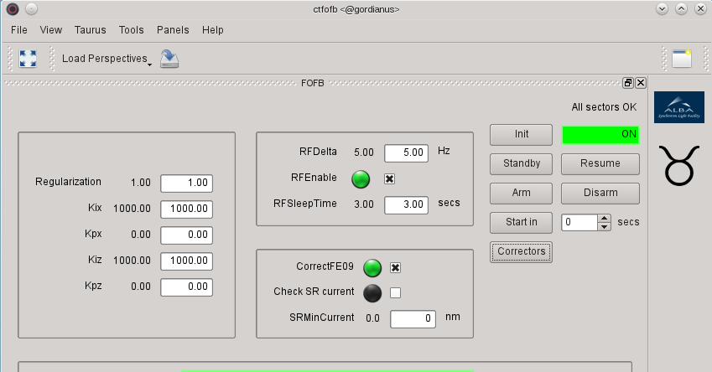
Start / Stop Orbit feedback.
Notes:
Ad hoc application summarizing the automated procedures

Slide 11
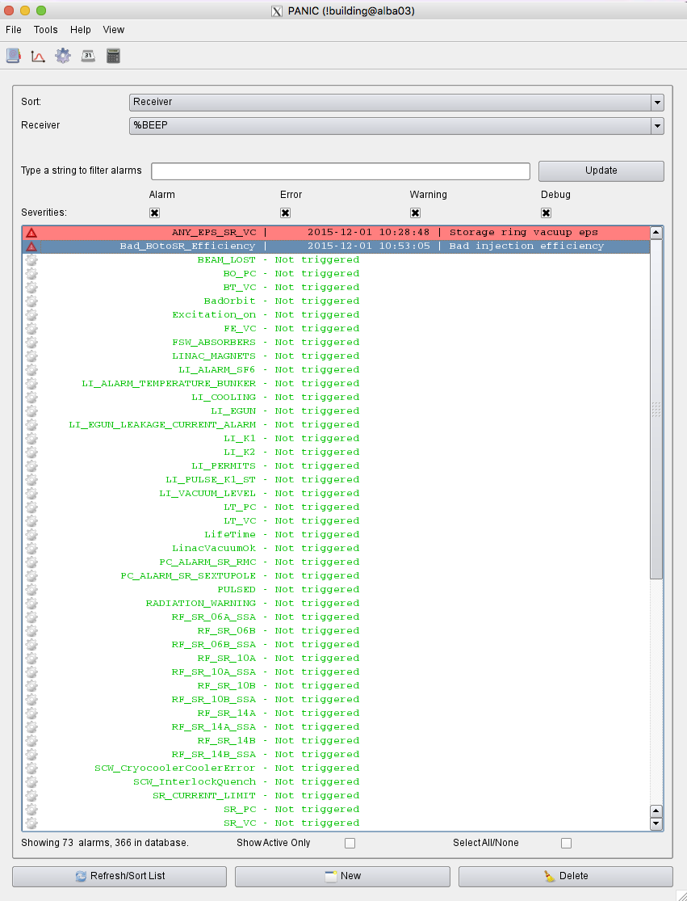
Alarm handling
Defined by the Operators: Historic archive Manage states, Acknowledgment,
actions,
persistence,
receivers,
…
Notes:
Flexible procedures. Defined by the operators

Slide 12
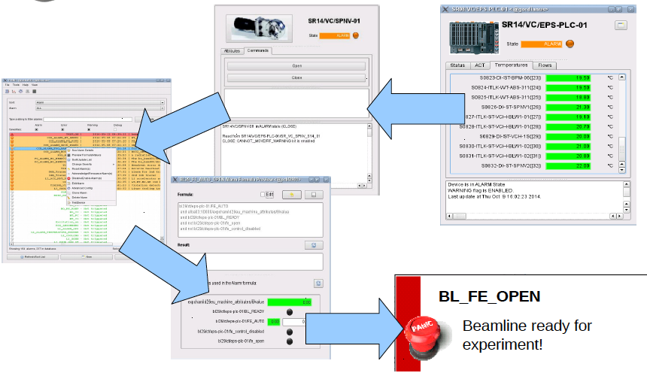
Alarm handling & Automation
Notes:
Many are handled automatically at the PLC level by the Equipment Protection System
However, there are cases, where we need to combine these variables with others to produce an action
Besides, we need that to be flexible (for example, editable by the operators…)
The system (designed for alarm handling) can also handle these procedures

Slide 13
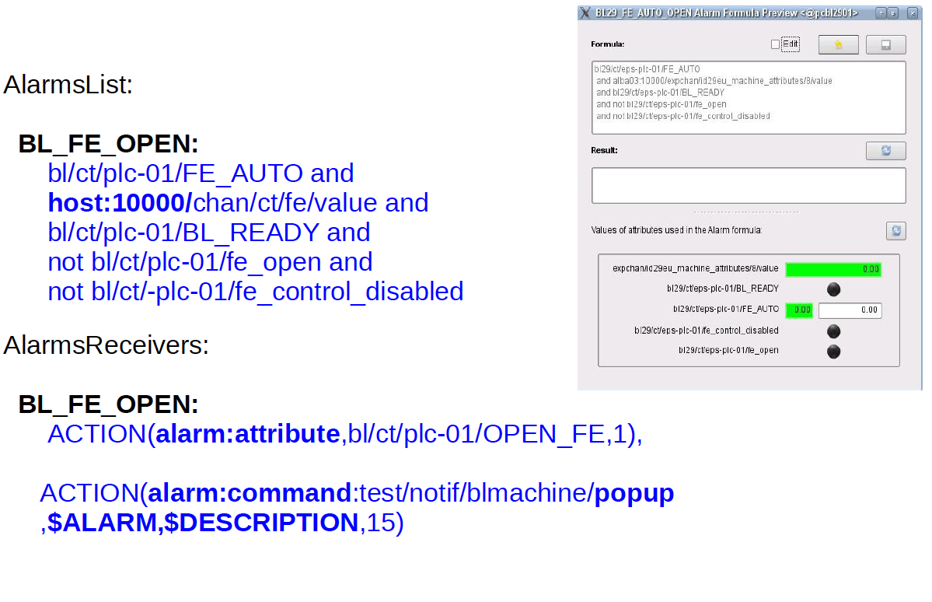
Alarm handling & Automation (Panic app. HowTo)
Notes:
An example…
Define conditions for opening the shutter.... Which actually automatically open the front-end shutter.

Slide 14
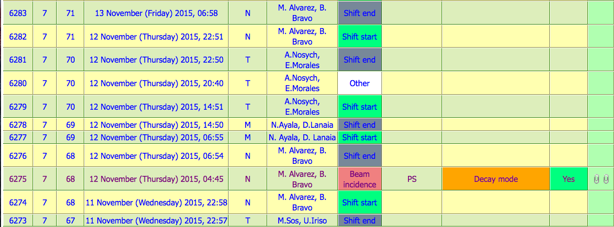
Incidences
Operators face a certain number of incidences (logbook(PSI) and RT)
“From the CR we heard a noise like a little explosion and immediately after there was
the PANIC alarm regarding Bo PS”
Notes:
The logbook is crucial to register incidences and actions
It is also very important to send relevant information to relevant people (and eventually trigger some (manual) actions)
At Alba we use ELOG developed at PSI for the ELOGs, and Request Tracker for the incidences (about 60000 since 2010)

Slide 15
Summary
Protection systems
Transversal systems
Predefined sequences (i.e. filling patterns)
Alarm handling. Recovery methods
Ways to define and automatize procedures (profit from the experience of the operators)
Many thanks!

