Slide 1
Control principles and guidelines@MAXIV
KITS Control and Acquisition mini workshop, KITS

Slide 2
What is Tango?
Provides a unified interface to all equipments, hiding how they are connected to a computer (serial line, USB, sockets….)
Hide the network
Location transparency
Tango is one of the Control System available today but other exist (EPICS…)
04/28/10

Slide 3
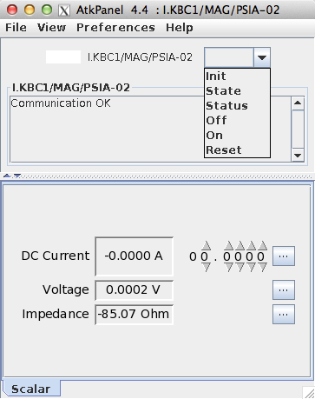
Distributed control system
Standard Interface
Modular
Comes with many tools
Well supported by the synchrotron community
Companion frameworks

Slide 4
TANGO : introduction
Machine A
Machine B
Application 1
Application 3
L_{β}
L∝
?
?
Application 2
Application 4
L_{β}
?
L_{β}
SE₁
SE₂

Slide 5
TANGO : introduction
Machine A
Machine B
Application 1
Application 3
L_{β}
L∝
Application 2
Application 4
L_{β}
L_{β}
SE₁
SE₂

Slide 6
TANGO : introduction
Machine A
Machine B
Application 1
Application 3
L_{β}
L∝
Application 2
Application 4
L_{β}
L_{β}
SE₁
SE₂

Slide 7
TANGO : introduction
Machine A
Machine B
Application 1
Application 3
L_{β}
L∝
Application 2
Application 4
L_{β}
L_{β}
SE₁
SE₂

Slide 8
TANGO : introduction
Machine A
Machine B
Application 1
Application 3
L_{β}
L∝
Application 2
Application 4
L_{β}
L_{β}
SE₁
SE₂

Slide 9
TANGO : introduction
Distributed Application

Slide 10
TANGO : introduction

Slide 11
TANGO : introduction

Slide 12
TANGO : introduction

Slide 13
TANGO : introduction

Slide 14
TANGO : introduction

Slide 15
TANGO : introduction
TANGO
(CORBA based)
A standard tool in charge of the communications between software components making up distributed and heterogeneous applications

Slide 16
TANGO : device : interface
Has a communication interface
interface device <=> class
interface = commands + attributes
commands ≈ actions
attributes ≈ physical units
Interface
Commands
attributes
public
Generics
Specifics
Generics
Specifics
Init
State
Status
PowerOn
PowerOff
-
current
privé
Implementation/Realisation

Slide 17
A Tango Device Class (example)
A ski lift class
3 states
ON, OFF, FAULT (OFF at startup)
3 commands
3 attributes
Name | In | Out | Allowed
Reset | Void | Void | If FAULT
On | Void | Void | If NOT FAULT
Off | Void | Void | Always
Name | type | format | Writable
Speed | double | scalar | Read/Write
Wind_speed | double | scalar | Read
Seats_pos | long | spectrum | Read
04/28/10

Slide 18
TANGO : device : summary
Device
Generic
Behavior
ID Unique
Classe
My Device
ens-[seg]/dom/elem.1
Instantiation
ens-[seg]/dom/elem.2
Commands
attributes
Status
ens-[seg]/dom/elem.3
properties
Where to store the properties and all the configuration data ?

Slide 19
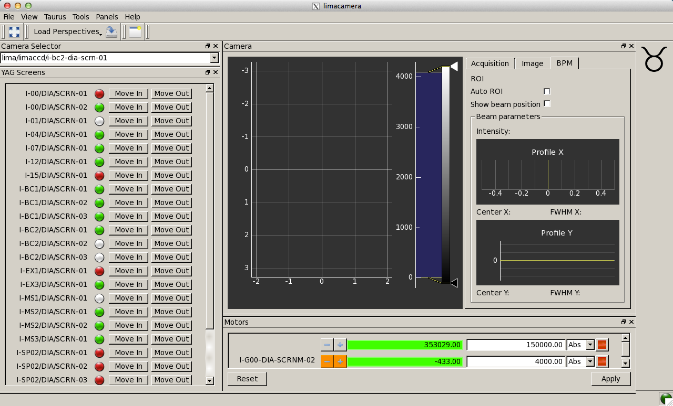
Archiving Performance
polling vs cache/event
Polling Case:
Tango Device
Hardware
Current
Voltage
Resistance
Interlocked
…
Short Term DB
Hardware
performance =
100 requests/s
Long Term DB
Tango device performance =
< 100 requests/s

Slide 20
Archiving Performance:
polling vs cache/event
Cache/Event Case:
Tango Device
Cache polling fit bandwidth
80 Hz (80% of 100)
Hardware
Current | 2.4
Voltage | 4.81
Resistance | 2
Interlocked | FALSE
Output | ON
…
Short Term DB
Hardware
performance =
100 request/s
Long Term DB
events
Tango
Performance =
10000 request/s
+ events
Drawback: Accept delay in answer

Slide 21
Properties
Settings to initialise the device

Slide 22
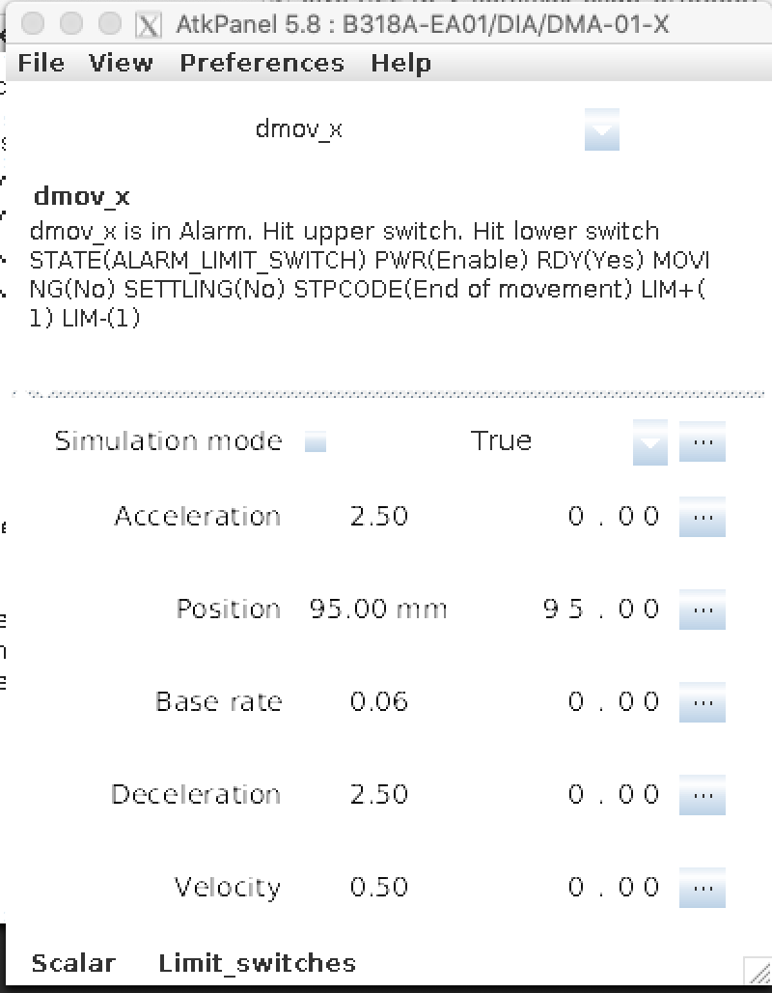
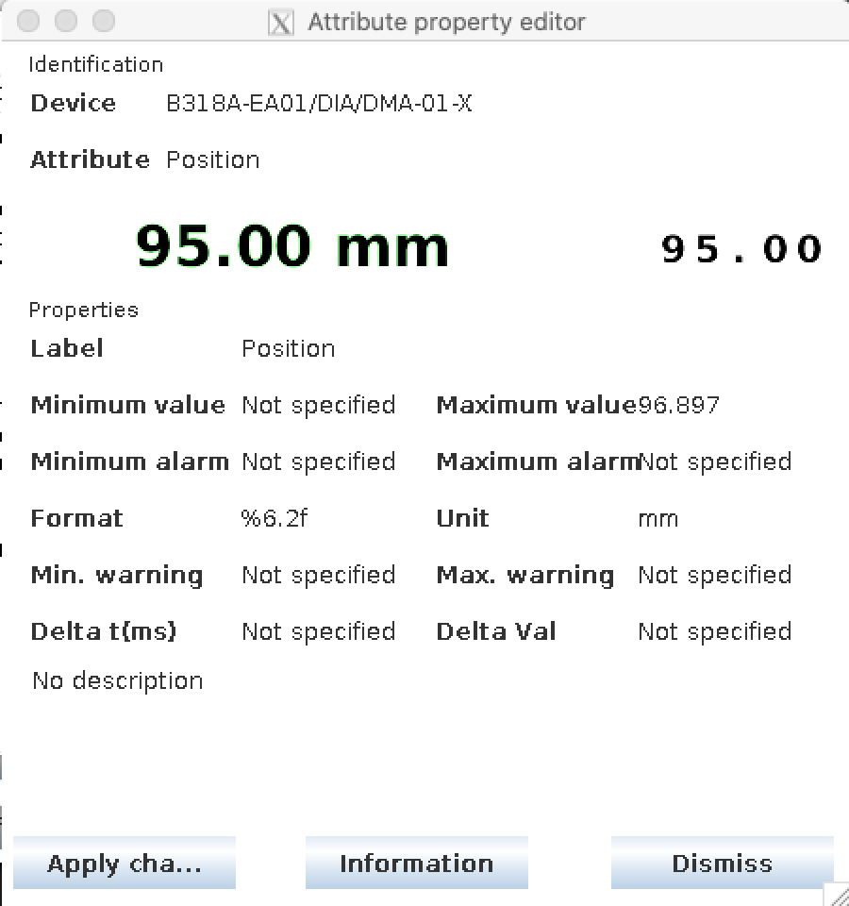
Attributes
Physical parameters of the device

Slide 23
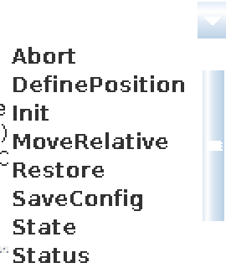
Commands
Physical actions of the device

Slide 24
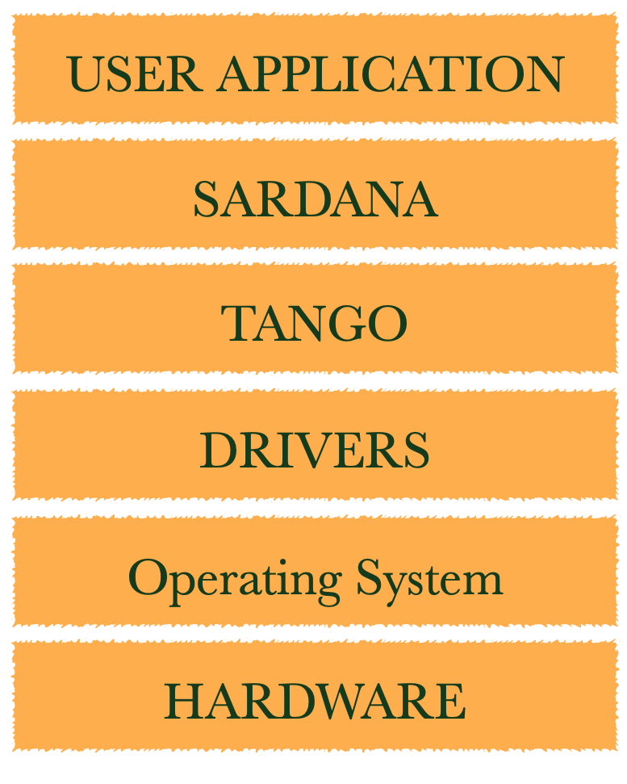
Verticale “Lasagna” layers

Slide 25
Beamline’s Control System

Slide 26
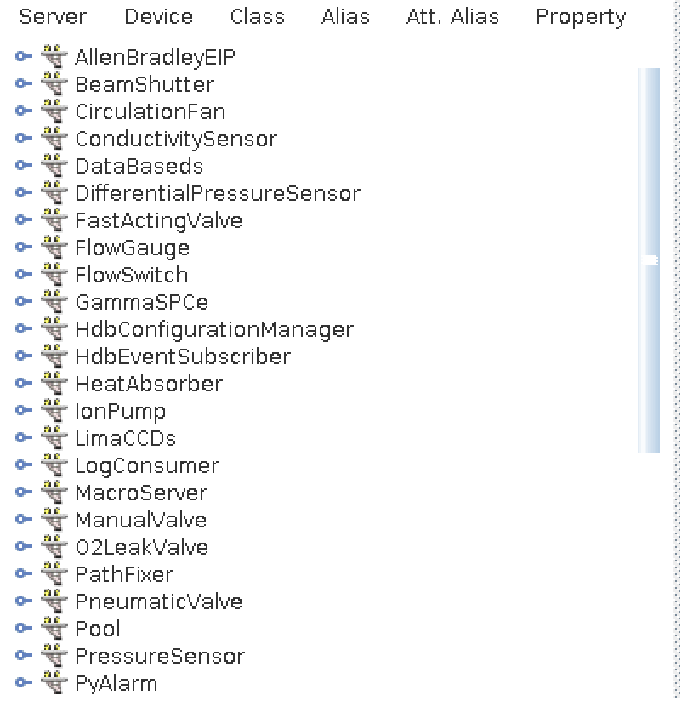
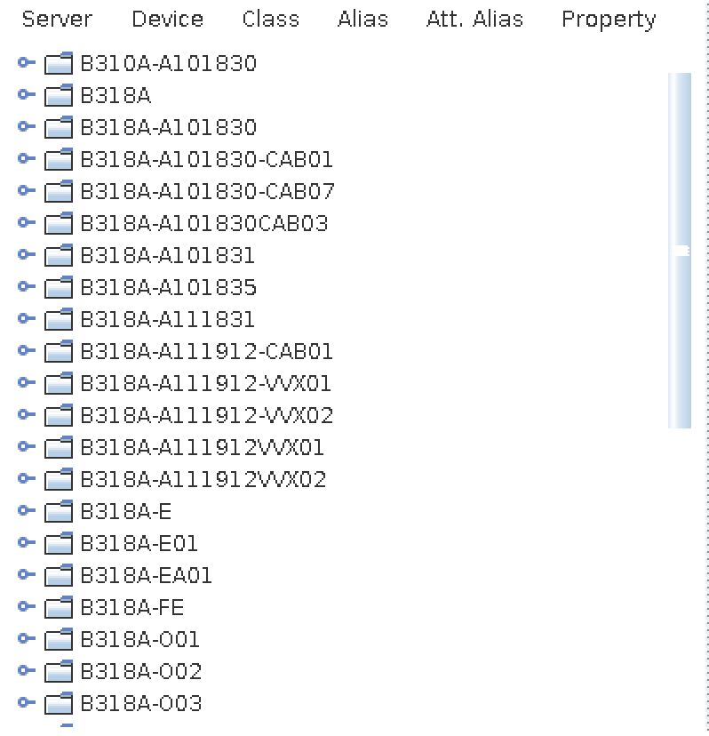
Database - Jive

Slide 27
PLC system example
Valv
Insert
Extract
High Level
Device
TCO
- Temperature
Gauge
- Pressure
Ion Pump
- Pressure
Low level
Device
PLC
GammaSPCe
Hardware
Controller
PLC
TCO
Gauge
Valv
Heat Absorber
…
Ion Pump
Hardware

Slide 28
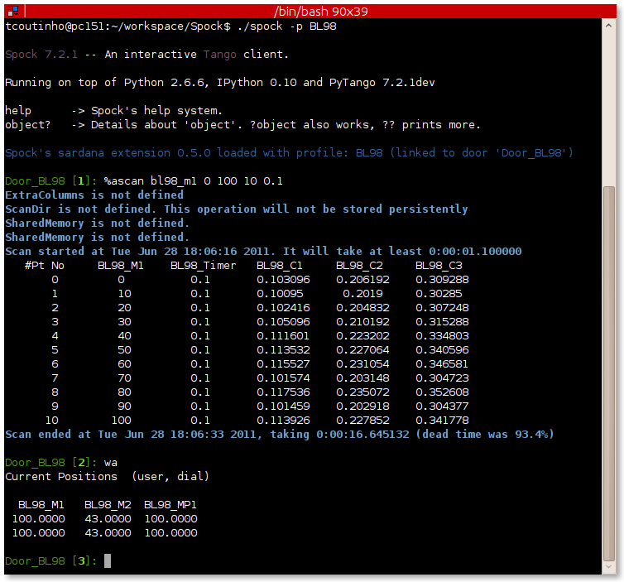
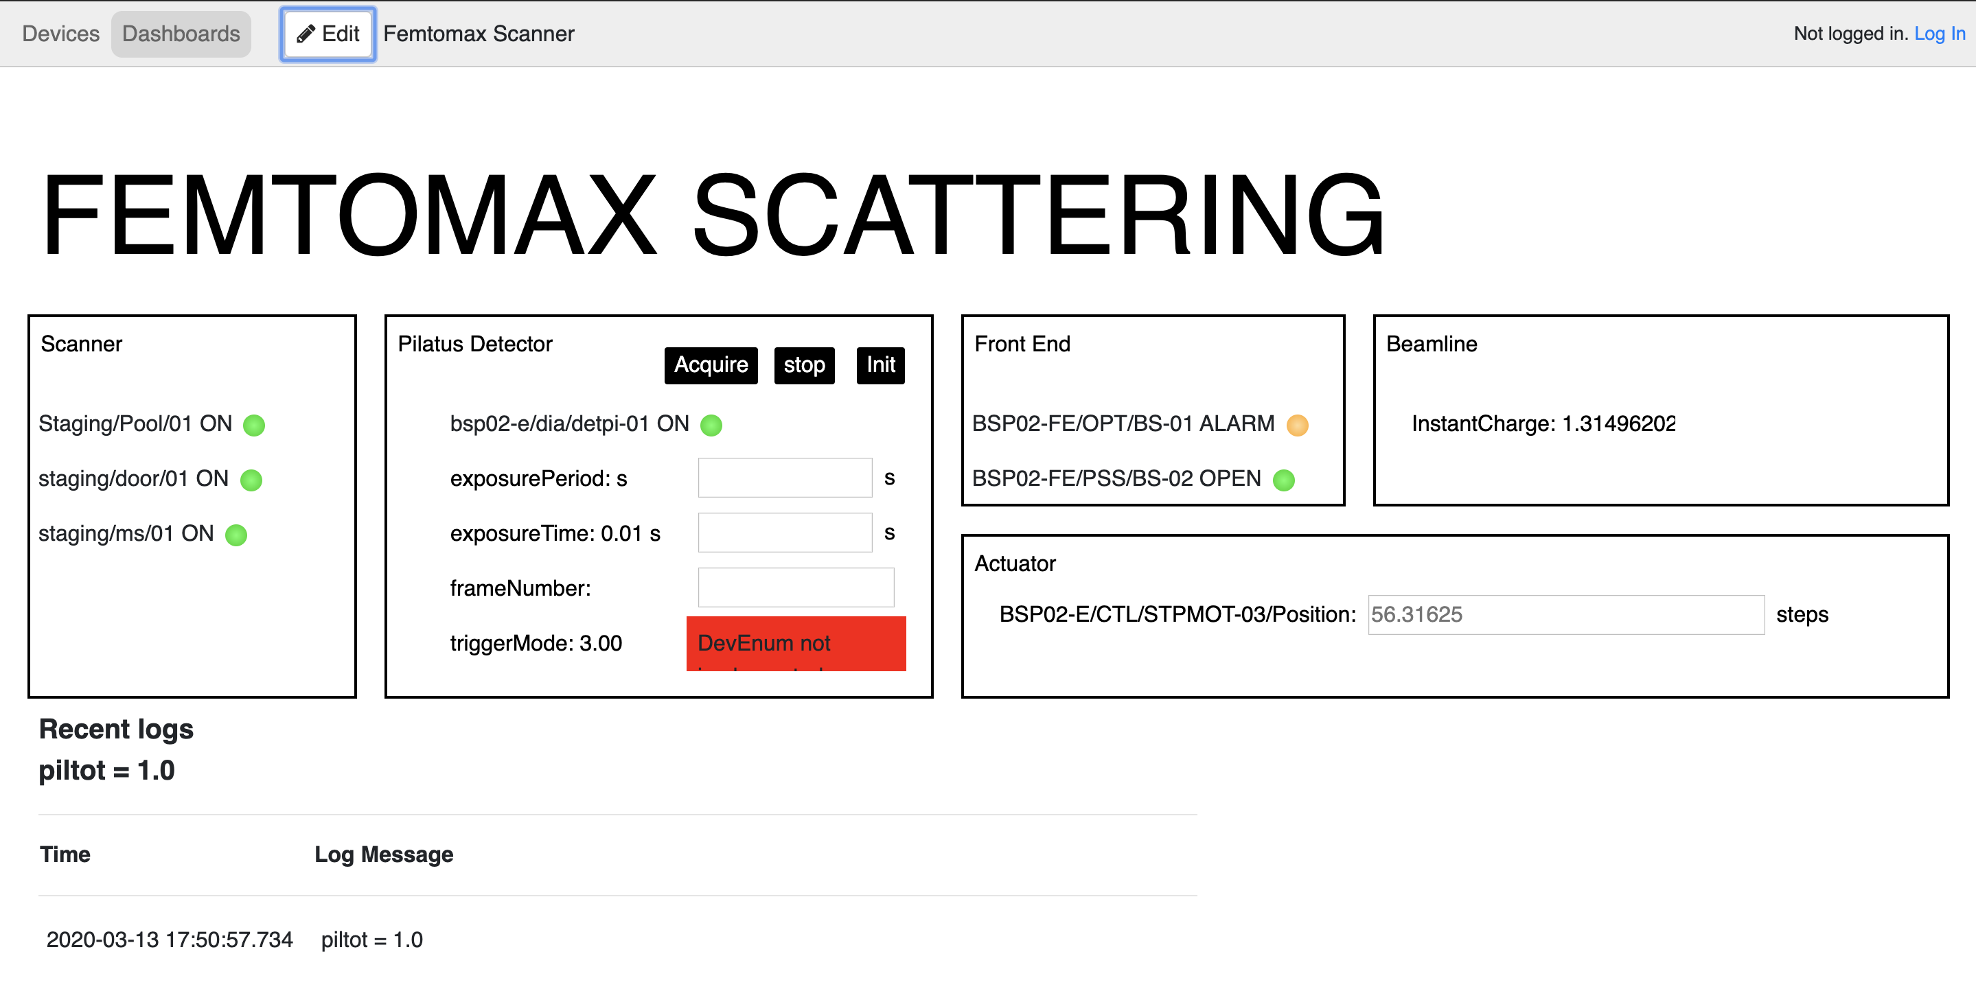
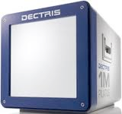
Components
SOFTWARE | User Interface
 | Computation Layer
 | Hardware Layer
HARDWARE
Undulator
Mono
Acquisition
icepap
DAQ
DAQ

Slide 29
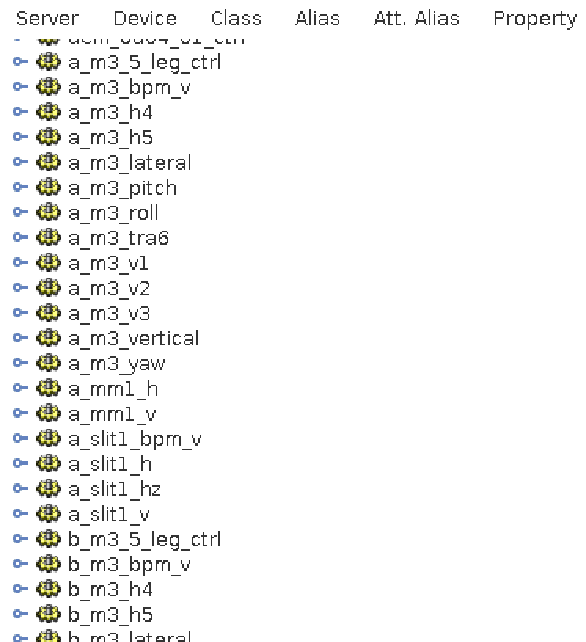
Naming convention
Device name follows the MAX IV standard naming convention
Alias can be define within a custom beamline convention
Some alias are generated from the motor spreadsheet

Slide 30
Python Client interface
# Connection to a remote device
pilatus = DeviceProxy(‘bsp02-e/dia-detpi-01’)
# Set the attribute transparently
pilatus.filename = ‘/data/visitor/beammax/…’
pilatus.framePeriod = 0.1
pilatus.exposureTime = 0.05
pilatus.frameNumber = 200
pilatus.triggerMode = “EXTERNAL_MULTI"

Slide 31
Python Client interface
# Execute action
pilatus.acquire()
# At any time the state should known
# ON, STANDBY, RUNNING, …
pilatus.state()

Slide 32
Intranet Of Things
 | Accelerators | Biomax
Host | 168 | 15
Process | 1945 | 77
Device | 12392 | 705
Control Point | 491079 | 24501
Class of device | 170 | 50
attributes | 234631 | 10500
commands | 130251 | 7717
MAX IV = 700 000 control points

Slide 33
IT Infrastructure
Latency ± 300 us
Core Switch
Access switch
Access switch
Ethernet
VM
VM
VM
VM
VM
VM
redundant 2+2
32*6 core Intel Xeon
16 TB ram
4*40Gbit
Access switch 40Gbit

Slide 34
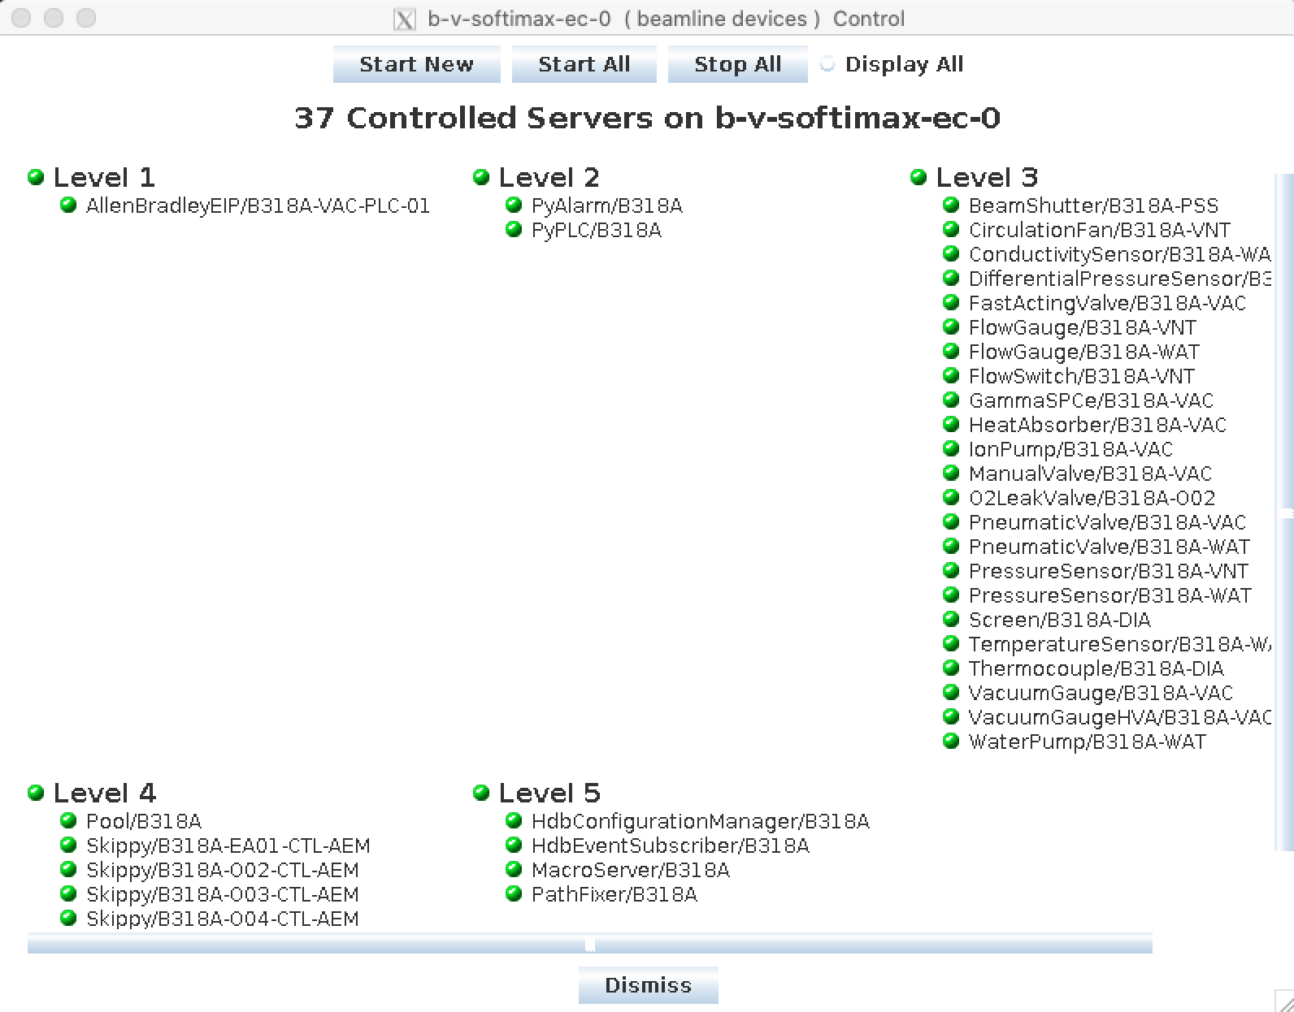
Tango Servers - Astor
Process managing one or more devices
Start, Stop, Restart, Change host
Statistics: uptime, reliability, …

Slide 35
From complex to usable
Accelerator
scan e 200 1000 1
Beamline
Data collection
500K
25K

Slide 36
Guideline
Only report/control the strict minimum
The hardware can run without the Tango device
The Tango device should NOT change the state of the equipment at the initialisation
Exception: memorised attributes
SOC, Separation of Concern ~ Single Responsibility
Stay alive to report hardware failure
Init command to recover a connection (Not restart)
Stay in FAULT in case of problem, Acknowledge via the Init command
Avoid automatic reconnection

Slide 37
Guideline
Complex device should be split into several
Integration instead of reinventing the wheel
Reusable over specific

