Slide 1
Update from LEAPS IT Work Group
Mark Heron, Daniel Salvat, Darren Spruce, Steve Aplin, Gerd Mann and Mirjam Van Dallen

Slide 2
Agenda
Development of LEAPS IT WG Coordination
Technical topic for this meeting
Status of CALIPSO+ JRA2, PaNOSC and ExPaNDS
LEAPS-INNOV Proposal Status
LEAPS WG session in LEAPS plenary

Slide 3
LEAPS WG3
At the LEAPS plenary in PSI in 2019 we created LEAPS IT WG3 Executive
Mark Heron – Diamond
Daniel Salvat – Alba
Darren Spruce – MaxIV
Gerd Mann – PSI
Steve Aplin – EuXFEL
Appoint someone to LEAPS R&D board
Lorenzo Pivetta – Elettra

Slide 4
LEAPS IT Work Group
We are meeting 2 times per year to develop the IT input into the LEAPS roadmap
Input into the LEAPS developments
Pilot projects 2021+?
Co-fund activities 2023+?
Also, to share what we are doing?
Much more here-and-now
Needs to be collective benefit
Should not be looking to duplicate other meetings
Drove the idea for Technical Talks
To share knowledge and experience between facilities

Slide 5
Face-to-Face Meeting : LEAPS IT WG Meeting PSI May 2019

Slide 6
Meeting Incentives : Dinner and Coffee

Slide 7
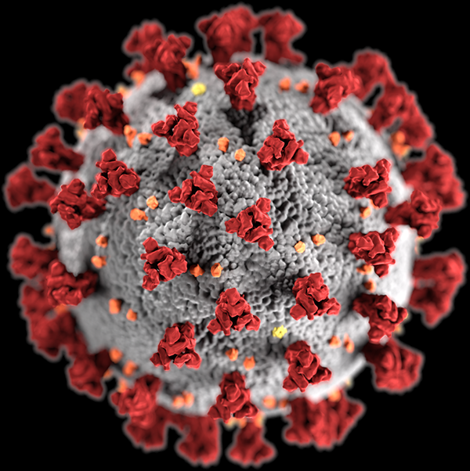
Video Conference Incentives : COVID-19
Courtesy The Francis Crick Institute

Slide 8
Proposed Topics for Work Group Meeting
Doodle poll offered the following topics
High Performance file system such as GPFS and Lustre
Development of modern web based application using tools such as REACT
Systems for synchronisation of sample and detector on Photon beamlines (ie timing and triggering system used)
Cyber security at light sources
Your plans and experience with data analysis workflow engines
Your plans and experience on Machine Learning
What do you see as Future IT Architectures for Synchrotron Lightsources?
Have you managed High Throughput Data Transport (i.e. from Detector to Storage)?
How are you engaging real users to help validate solutions we want to develop?

Slide 9
Voting on Topics for Work Group Meeting
Following facilities voted
DESY
HZDR
MAX IV Laboratory
Elettra - Sincrotrone Trieste
ALBA SYNCHROTRON
PSI
SOLARIS
ESRF
Diamond

Slide 10
Results of Voting

Slide 11
Other Topics Proposed in Doodle Poll
Follow topics were also proposed
Real-time analysis and rapid offline processing for feedback to users during beam times
Activities for User and Staff Training on new IT-technologies @lightsources
Other Software-defined storages, such as BeeGFS or Isilon; There should be a separated forum to discuss future IT architecture challenges and also about the engagement of real users.
Remote Operations Solutions
Remote Access systems for Smart Working (starting form basic Remote Desktops - VNC, NoMachine, etc. till commercial MS Teams and Zoom)
Data compression, software packaging and shared repository
What data compression schemes are using or planning to use
Not ranked for interest

Slide 12
LEAPS Webinar – “Learning to Run Again”

Slide 13
Topic for this meeting
Strong need to share experience of remote access and remote operation in response to COVID-19
LEAPS IT WG Executive overrode the selection process to set the topic of the meeting
“IT Solutions to address Operational Challenges during COVID-19”
Talk and discussion from each of:-
PSI
ESRF
Max IV
Soleil
DESY
Elettra
Diamond
EUXFEL
Alba
Distil key points in a summary

Slide 14
Topic for this meeting
“IT Solutions to address Operational Challenges during COVID-19”
Remote control of experiments
Unattended operation of experiments
Communications between remote users and staff on site performing the experiment
Remote access to IT systems, such as No Machine NX, ThinLinc, SSH, etc
Web based tools and services, such as WebJive, ISPyB, MX CuBE, etc
Cyber Security
Data transfer to home institute, such as Globus
Remote data analysis services
Future plans in response to COVID 19
We’re interested in sharing knowledge on
What works well
Where you see needs for improvements or developments
What is missing

Slide 15
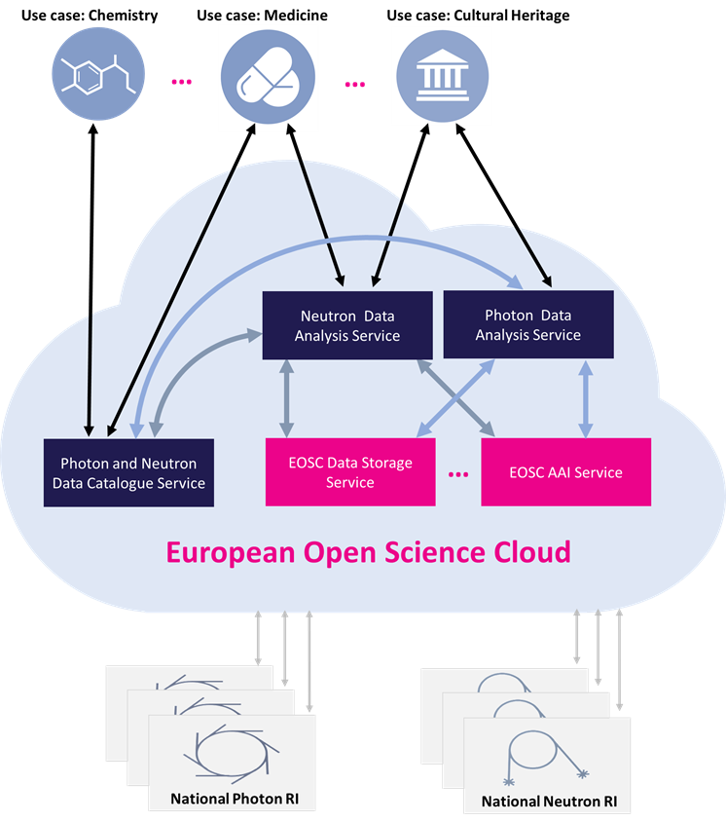
ExPaNDS Status
Started 01/09/2019
Enable EOSC services to the scientific users of Photon and Neutron faculties.
Develop FAIR data
Connect Photon and Neutron facilities through a platform of data catalogues and analysis services through the EOSC
Cooperate with the EOSC governance bodies to improve the EOSC.
Develop standard relationships and interconnections between scientific publications, photon and neutron scientific datasets, experimental reports, instruments and authors.
All WPs progressing
Close working with PaNOSC
Home page: https://expands.eu

Slide 16
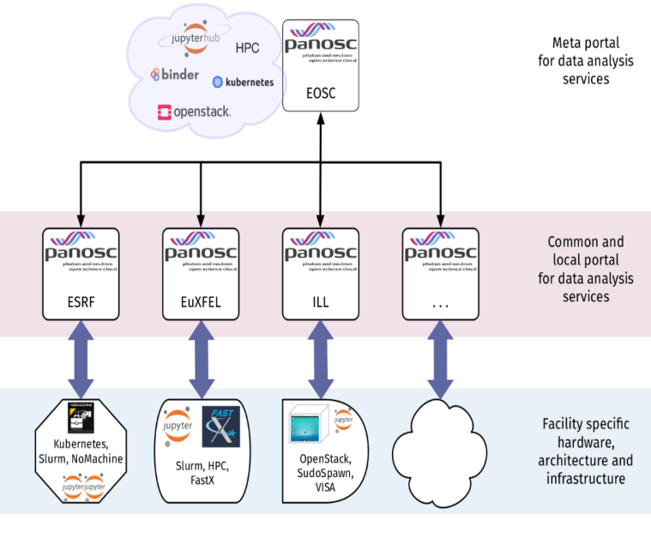
PaNOSC Status - courtesy of Andy Gotz
FAIR Data Policy framework ready https://doi.org/10.5281/zenodo.3826039
Search API prototype available https://github.com/panosc-eu/search-api
Data services portal backend + frontend under development (see https://confluence.panosc.eu/wp4 + https://github.com/panosc-portal)
Data services: Jupyter, Desktop, VyNIL simulation
HDF5 web viewer https://h5web.panosc.eu
Training platform https://pan-learning.org
UmbrellaId connected to eduTeams
Collaborating closely with ExPaNDS

Slide 17
Calipso+ JRA2 - courtesy of Valentina Piffer
GOAL → to develop demonstrators for remote data analysis for a small number of archetypal experiments:
build on the HPC platforms of participating institute;
cloud-based where applicable.
STATUS → June 2020:
Jupyter service is being generalised at most sites
Other services (containers+VM) are being tested
Main difficulty encountered in providing DAAS services in production is the lack of data analysis policy at all the sites (a survey has been sent out – awaiting feedback from sites)
Future developments will be in EOSC with PaNOSC + ExPaNDS
Access to the platform through umbrellaID
The results of JRA2 were presented at the European Synchrotron User Organisation (ESUO) during their remote webinar (April2020). The slides from the ESUO presentation are available online: https://cloud.esrf.fr/s/yjegRgoqRgPrQMY
Deliverables to the projects can be found here: http://www.calipsoplus.eu/jra2-daas/

Slide 18
To Recap
INFRAINNOV-04-2020: Innovation Pilots Call
From Work Group 3 IT we proposed
IT Strategic Blueprint
Data Reduction and Compression
From Work Group 3 IT jointly with Work Group 1 Detectors we proposed
Detector ToolBox
Evident that there was insufficient funding to support all three - at a meaningful level
IT Strategic Blueprint was not well aligned to the innovation call
Not enough funds and interest for Detector ToolBox
Solution was one proposal on Data Reduction and Compression

Slide 19
Objectives : Data Reduction and Compression
The Problem
More and more, science is not limited by photon flux but is instead limited by the detectors, data rates or data volumes the experiments can produce.
On the other hand, technological developments on Storage rings and FELs, as well as detectors are giving orders of magnitudes increase every year → Data explosion.
The Solution
Working on detector readout, data reduction and compression would enable those experiments which are not possible to be performed today, and current ones to be more efficient → Quality of scientific data and increase scientific output.

Slide 20
Benefits : Data Reduction and Compression
Maximize effectiveness of IT infrastructure by minimizing the data footprint of highly demanding experiments generating data volumes.
Maximize effectiveness of data reduction pipeline by integrating high speed detector readout
Minimize data volumes to increase efficiency and reduce costs:
Detector, data storage, data processing, curation, archiving, downloading…
Preserve value of the data.
Enable scientists to discard unnecessary data with confidence.
Help industry to deliver highly capable detector solutions with high data rates

Slide 21
Participiation: Data Reduction and Compression
Participant name | Task 1 | Task 2 | Task 3 | Task 4 | Task 5 | Total person | Total
 |  |  |  |  |  | months | Cost
 |  |  |  |  |  |  | €
DLS |  | 0.5 |  | 8 |  | 8.5 | 70833
PSI |  | 0.5 | 1 | 8 | 2 | 11.5 | 95833
HZB |  | 0.5 |  | 8 |  | 8.5 | 70833
HZDR | 3 | 0.5 |  | 14.5 |  | 18 | 150000
SOLEIL |  | 0.5 |  | 8 |  | 8.5 | 70833
DESY |  | 0.5 | 1 | 8 |  | 9.5 | 79167
ESRF |  | 0.5 | 2 | 8 |  | 10.5 | 87500
ALBA |  | 3.5 |  | 8 |  | 11.5 | 95833
MAXIV | 3 | 0.5 |  | 8 |  | 11.5 | 95833
XFEL |  | 0.5 | 1 | 8 |  | 9.5 | 79167
ELETTRA |  | 0.5 | 1 | 8 |  | 9.5 | 79167
ISA |  |  |  |  |  | 0 | 0
INFN |  |  |  |  |  | 0 | 0
SOLARIS |  | 0.5 |  | 8 |  | 8.5 | 70833
PTB |  |  |  |  |  | 0 | 0
FELIX |  |  |  |  |  | 0 | 0
Total | 6 | 9 | 6 | 102.5 | 2 | 125.5 | 1045833

Slide 22
LEAPS Plenary 2020 : Hosted by Alba in Barcelona in Nov 23-26

Slide 23
Thank You

