Slide 1


LEAPS Status Overview
Workshop LEAPS WG3 “IT solutions to address operational challenges during the COVID-19”– Zoom meeting 18th of June 2020
Mirjam van Daalen (PSI)
Vice Chair LEAPS CB

Slide 2
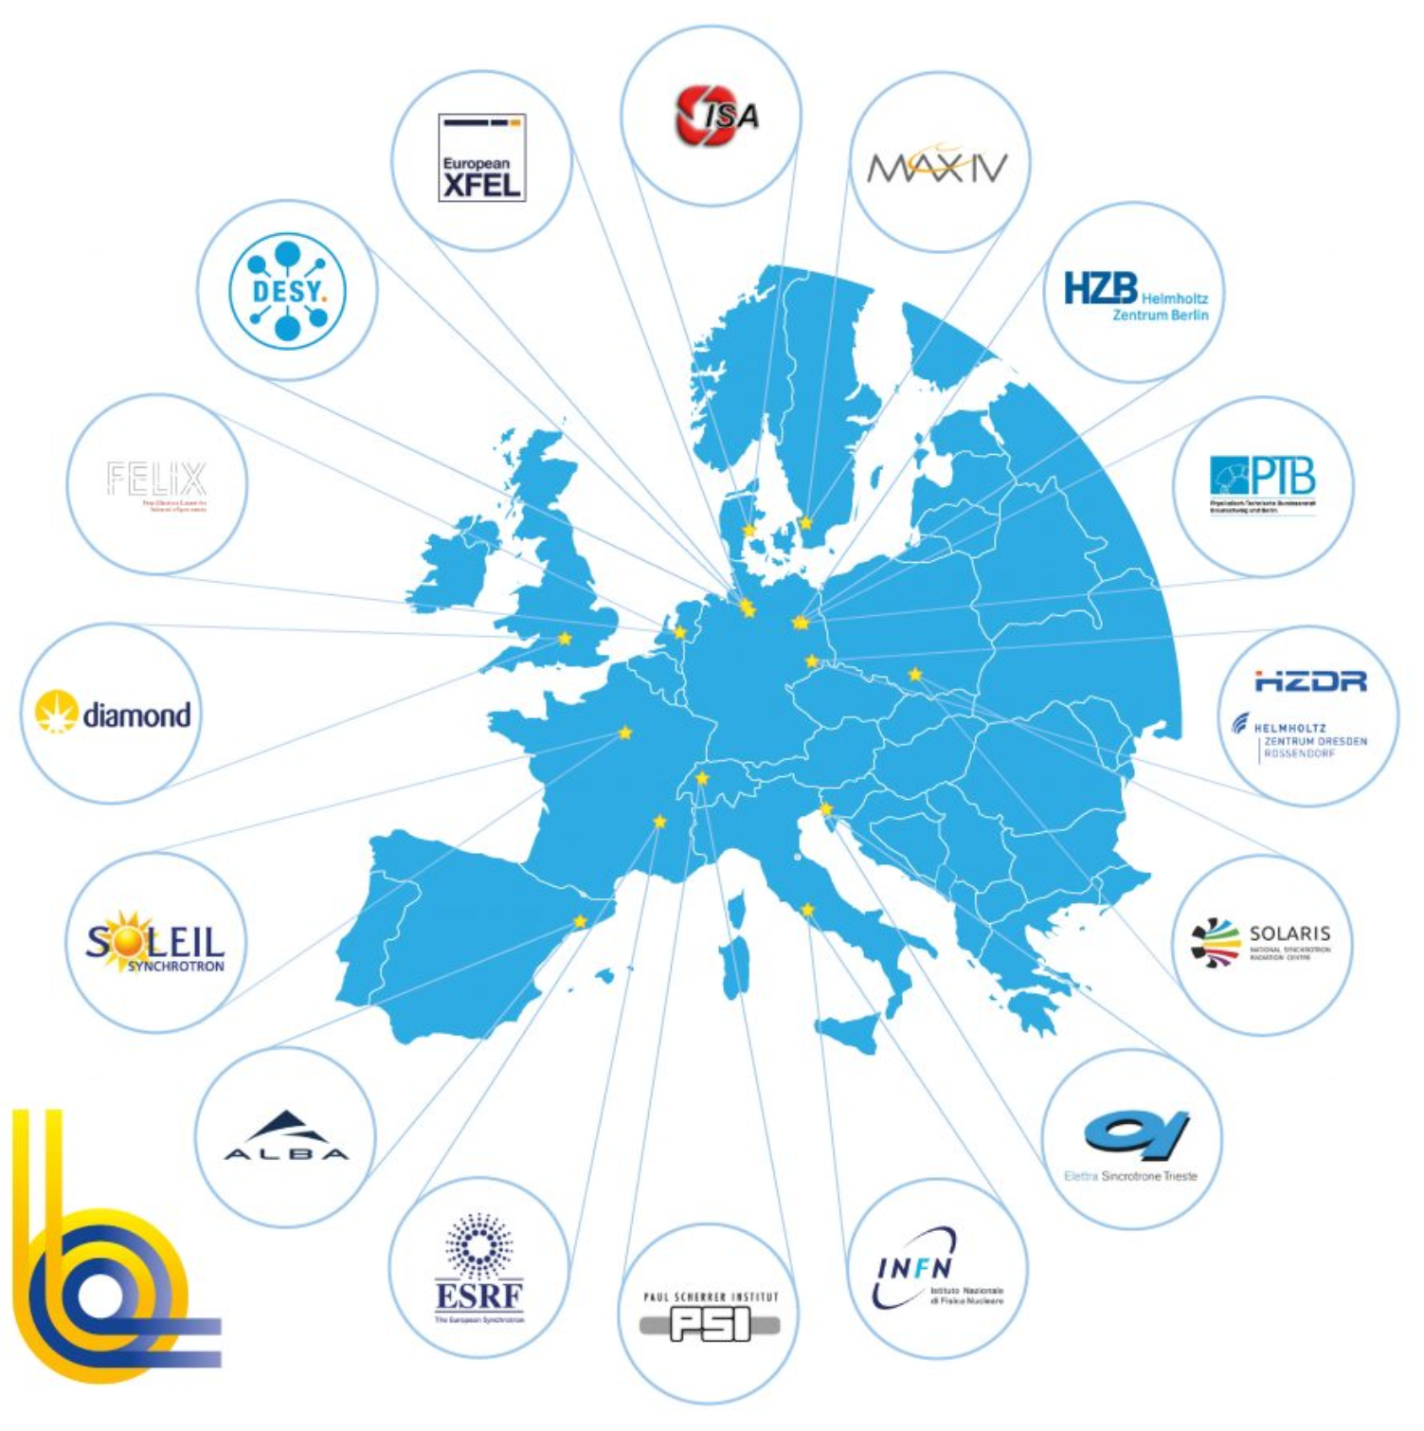
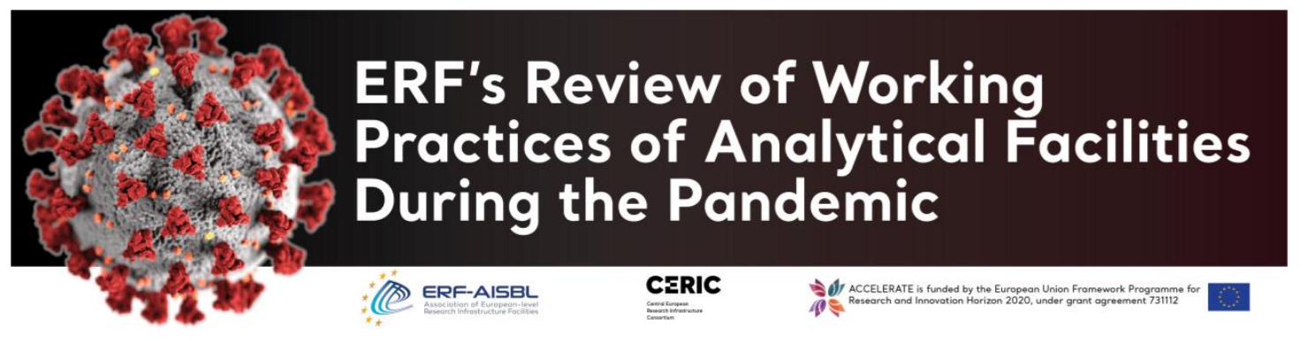
RIs challenges and opportunities in the pandemic era
Challenges in operation
Opportunities
Lock down
Visibility of science in society
Family conciliation, support to staff
Extended smart working
See for example AOBA 2nd Summit: EU, AS, Am RIs
Collaboration strengthening
Reduced DEV activities
New safety measurements
https://www.cells.es/en/media/news/world-x-ray-science-facilities-are-contributing-to-overcoming-covid-19
Light Operation
Support to users
Contribution to COVID-19 related research
Remote control
Modified Operation
Sample mail-in
Activation of rapid access
Quick response all around the world
Experiments being performed also in light op.
Webinar on operation in preparation
most LEAPS members and other RIs in the world; see www.lightsources.org
Webinar on COVID-19 research in preparation
https://www.ceric-eric.eu/wp-content/uploads/2020/05/Working-practices-During-Pandemic.pdf

Slide 3
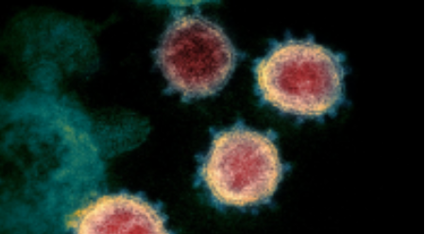
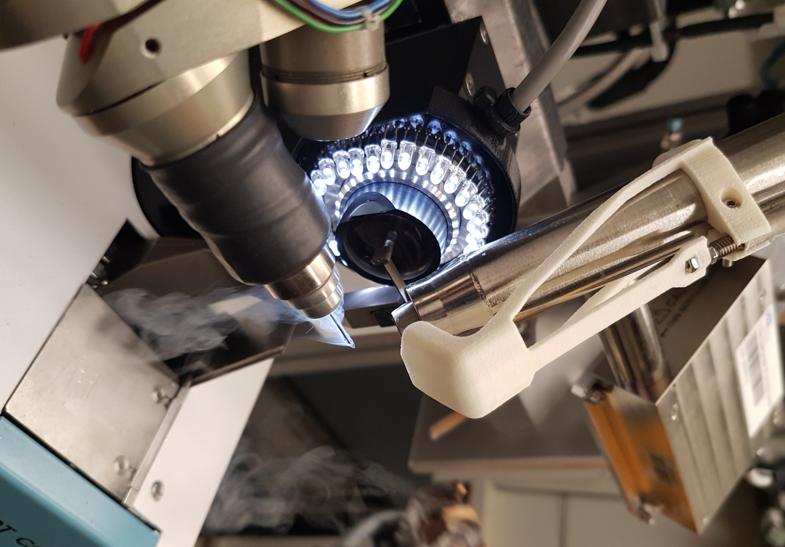
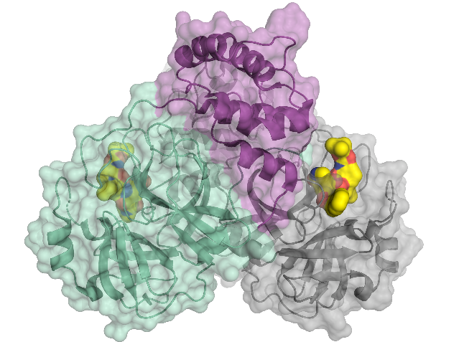
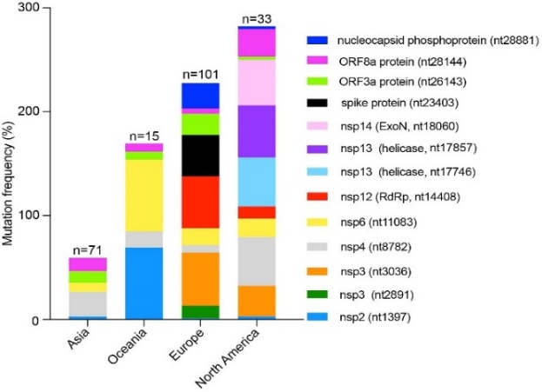
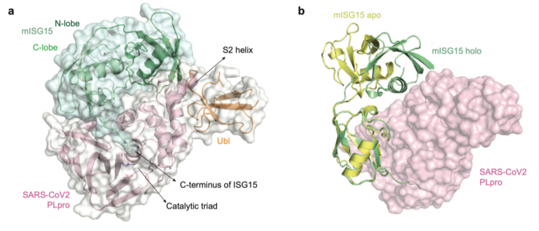
COVID-19 related research at LEAPS
AcceS-Ge CoViD-19
SOLEIL, INRAe and SANOFI to develop potential targets for the conception of new structure-based drugs
The biotech company Molox GmbH and HZB form a consortium of regional research groups and BASF. For identifying a starting point for the development of a potential active substance against coronavirus
Several initiatives of participation in collaborations with research institutions are being developed, some projects funded
Proteins have been resolved and are being deposited in the Protein Data Base (PDB) and first publications on SARS-CoV-2 with the contribution of LEAPS members are appearing
https://www.synchrotron-soleil.fr/
en/beamlines/proxima-1/acces-ge-covid-19
At BESSY II
Decoded the 3D architecture of the main protease of SARS-CoV-2, involved in the reproduction of the virus
At Elettra
Studying how the virus is evolving revealing that EU, North American and Asian strains might coexist, each of them characterized by a different mutation pattern.
At SLS
studying how the inhibition of papain-like protease PLpro blocks SARS-CoV-2 spread and promotion of anti-viral immunity
(DOI:10.21203/rs.3.rs-27134/v1)
Not exhaustive list
https://science.sciencemag.org/content/368/6489/409 (doi: 10.1126/science.abb3405)
https://doi.org/10.1186/s12967-020-02344-6).

Slide 4
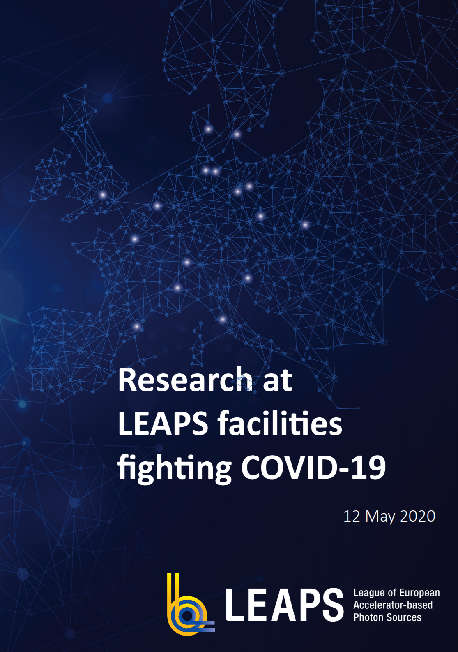

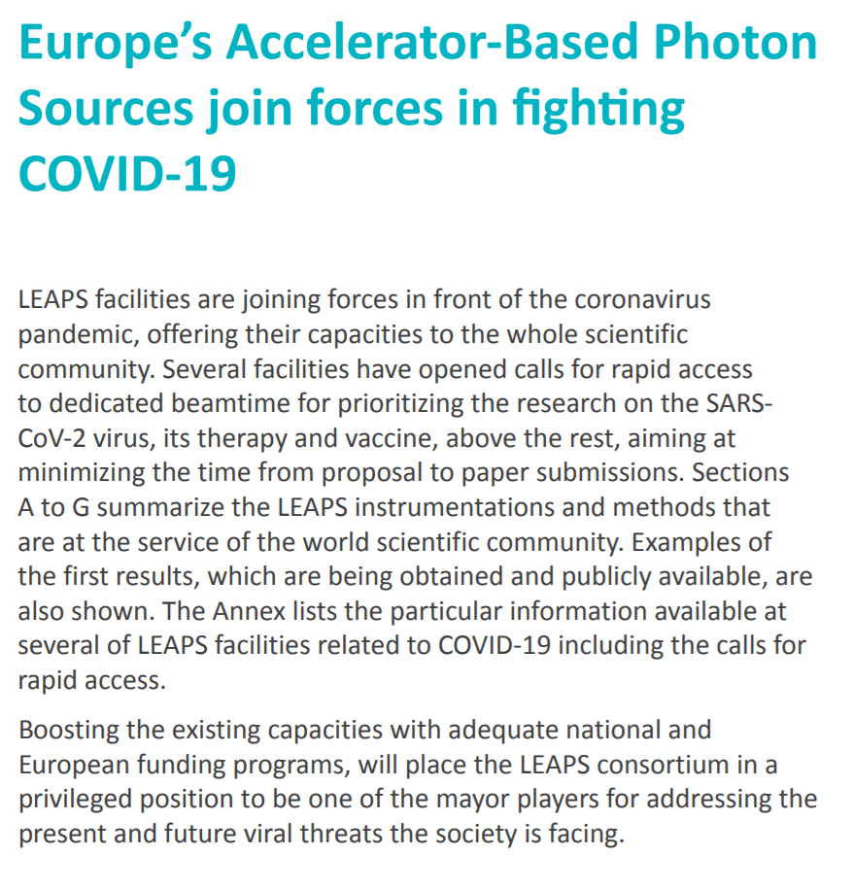
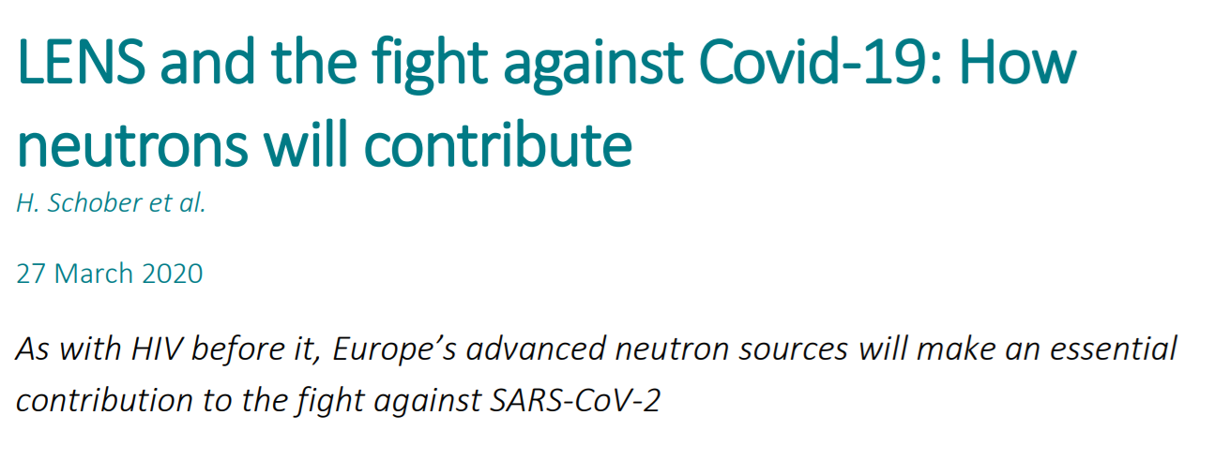
LEAPS and other RIs answering to the most urgent challenge:
Position Paper on COVID-19
https://www.lens-initiative.org/wp-content/uploads/2020/04/LENS-Declaration-Covid-19-1.pdf
Need of new developments for optimizing the capabilities of user facilities during the next period (remote access, more automatization, increase in scientific staff…)
Available experimental techniques at the service of the international community
https://leaps-initiative.eu/wp-content/uploads/2020/05/LEAPS_fighting_COVID19_May2020.pdf

Slide 5
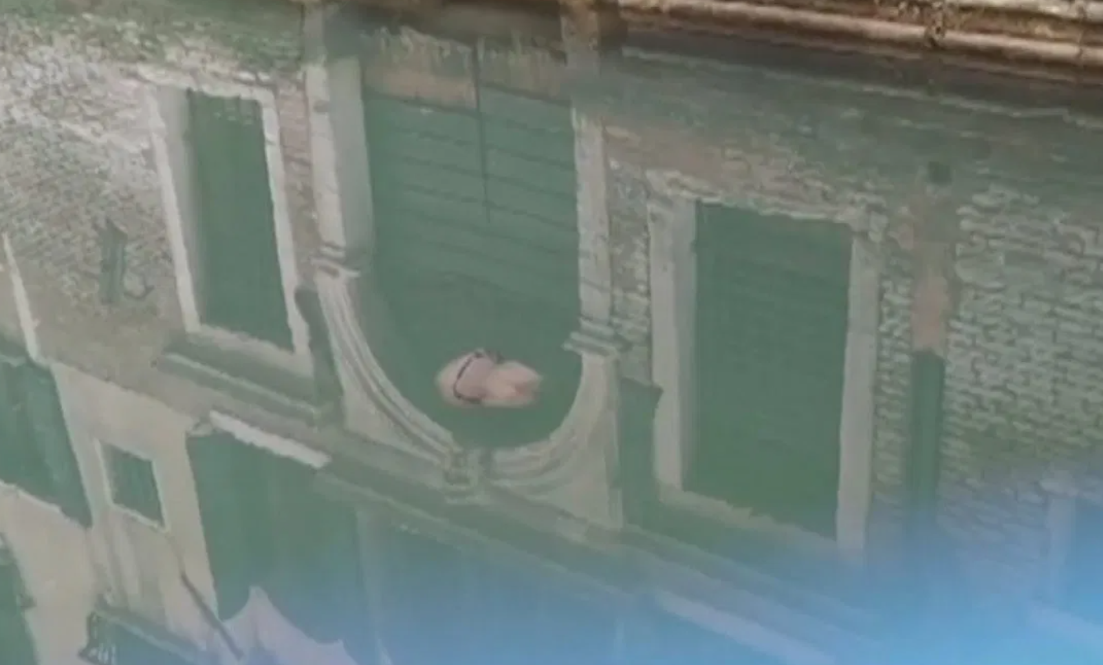
RIs prepared for contributing to the reconstruction thanks to interdisciplinarity
Most Urgent
Vaccine & cures
The world is performing an unwanted but still useful experiment on quantifying which is the effect of human activity and mobility in the environment.
Data collection and analysis must be used for verifying models and prepare strategies, RIs are there to help not only with the Big Data handling but with the analytical instruments
shielding materials, understanding the behavior of the virus in different environments, developing affordable medical equipment, expansion and containemend models
Developing strategies for coexisting with virus
… and then
Contribute to social and economical recovering
Water in Venice canals is more transparent but CO₂ emissions have not significantly decreased
Elaborating transportation models and strategies for responding to threats in other fields (economy, communication, networking, contamination,….)
Challenges as those of the Green Deal are now even more significant
Clean transport, clean energy, control versus privacy, data sharing and connection, existing diseases, viral threats, food and alimentation need scientific answers
RIs play a great role in education and innovation
Rhizostoma pulmo in Venice canals
RIs are an European asset for the reconstruction during and after the crisis
European Commission together with MS can play an invaluable role in boosting RIs capacities with specific programs

Slide 6
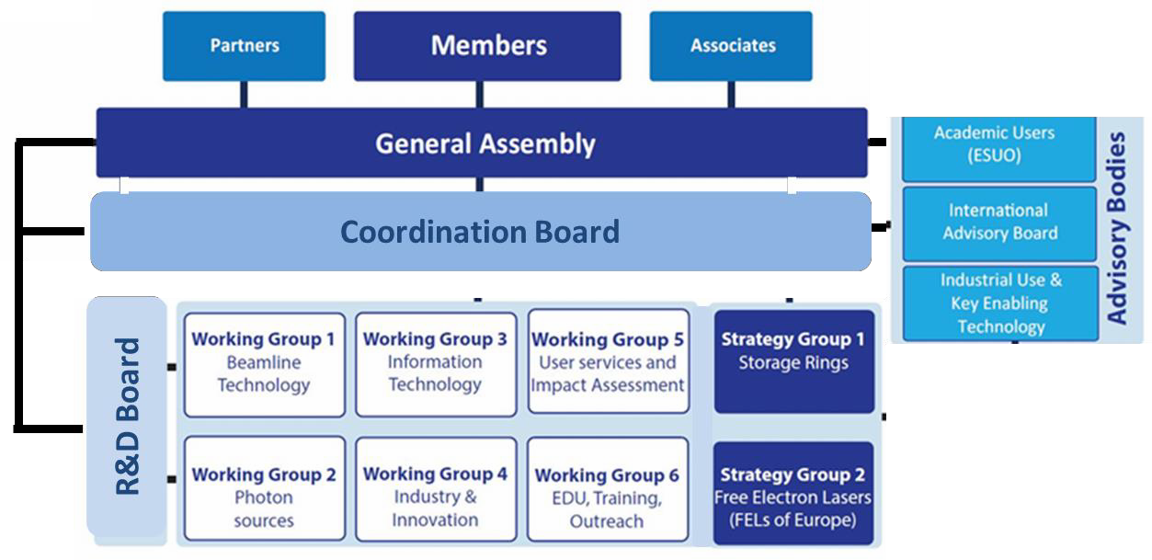

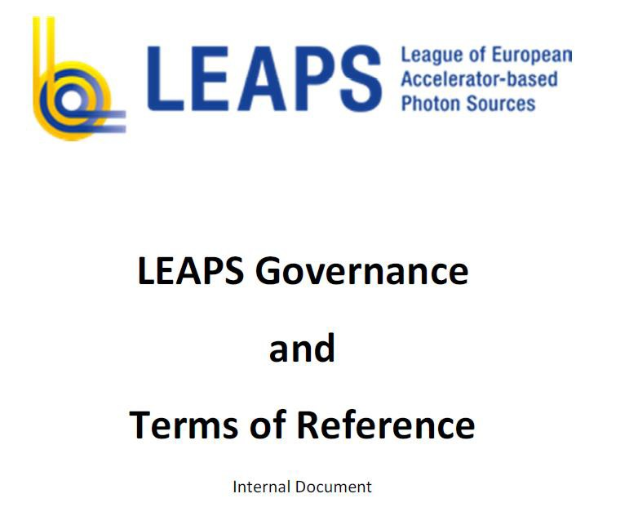
LEAPS achievements
Implementation of LEAPS organization

Slide 7
Key Events
February 2020 - Meeting with other Ris communities for organizing contribution to HE (LENS, CERIC-ERIC, ION Community, Laser Lab Europe, INSTRUCT, EMFL Community, EM Community)
May 2020 – deadline LEAPS-Innov
June 2020 – first contact with EC Johannes Klumpers (Research & Industrial Infrastructures)
June 2020 – webinar “Learning to run again”
July 2020 – presentation of common position papers HE and Viral Threats to the EC.
October 2020 - European parliament event on 6 May to present our initiative to the European Commission at large
November 2020 – Plenary meeting in Barcelona, gathering LEAPS members people, users, industry, national funding agencies, European Commission representatives
7

Slide 8
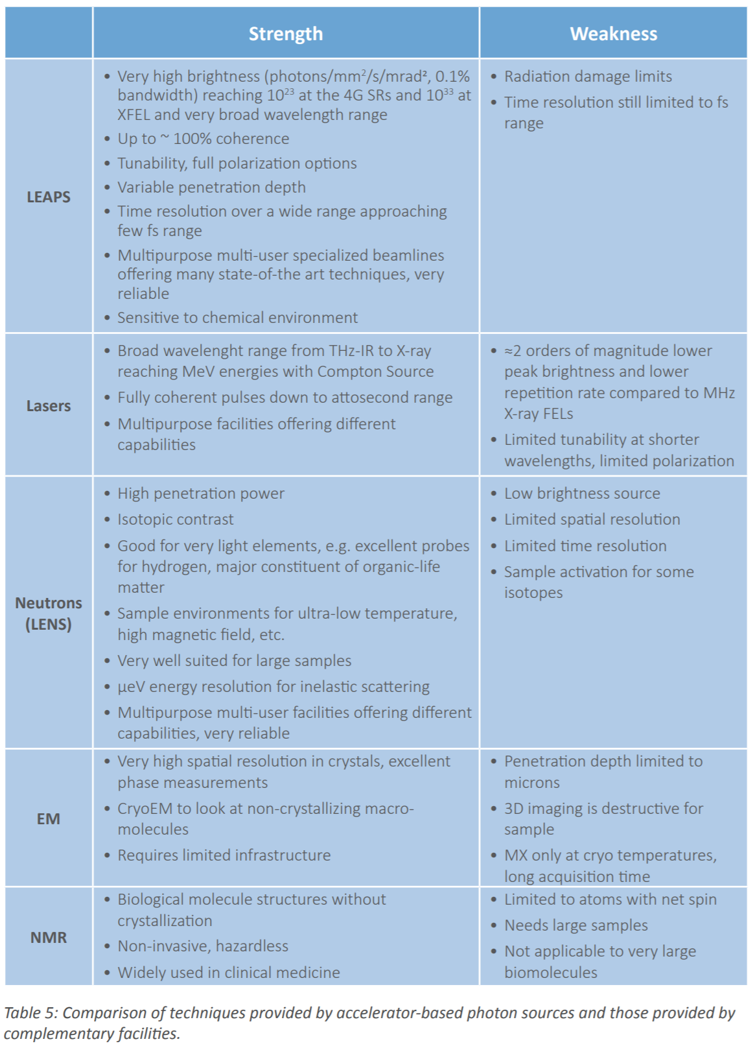
Initiative of gathering other analytical RIs for summing up complementary capacities
Meeting on 21 February in Brussels
Preparation of a common position paper for Missions to be ready around end of June
Plus common approach for Viral Threats
Working group with representation Analytical Research Infratsructures in Europe (ARIE)
LEAPS
Neutrons (LENS, just appointed LEAPS Partner)
Lasers
EM
Ions
High Field Magnets
From our landscape document =>

Slide 9
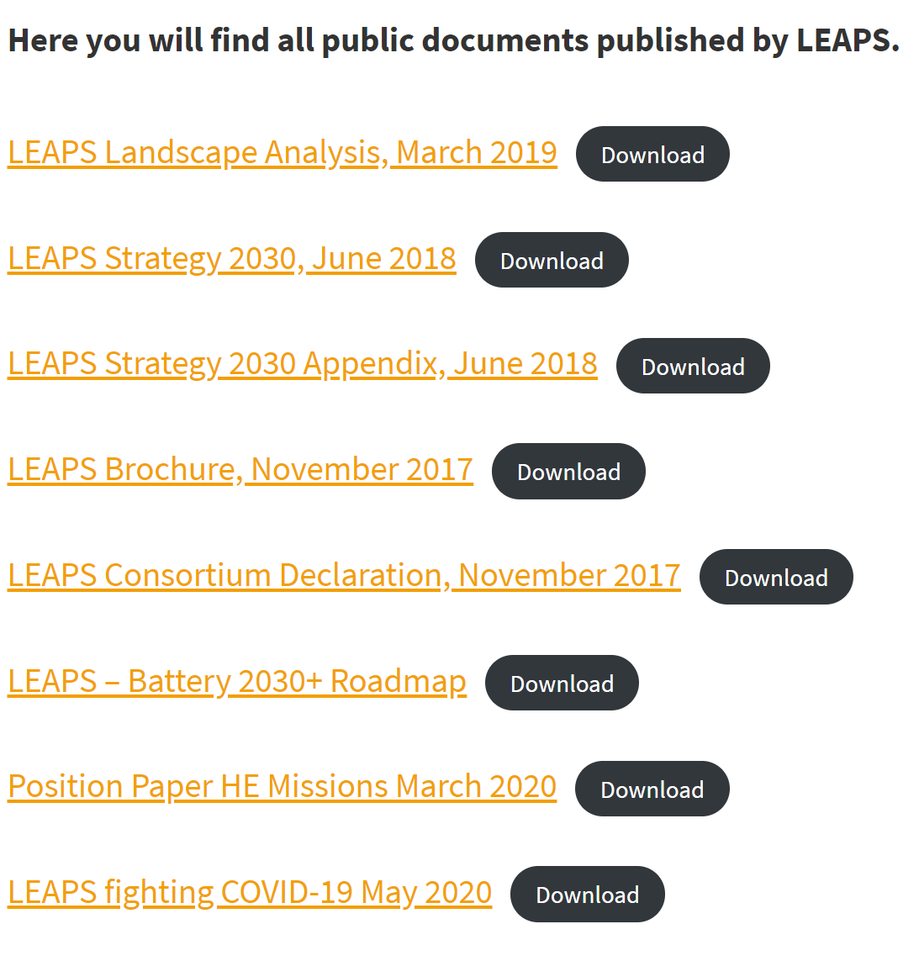
https://leaps-initiative.eu/about/leaps-documents/
In preparation:
Response to GD consultation
Ready to participate in GD and COVID19 calls in H2020
Position Paper on Missions with other Analytical Facilities
Position Paper for Viral Threats with other Analytical Facilities
Preparation of ‘Internal Project’: working together for specific developments, summing up capacities and already approved individual investments
Fast reaction to unexpected crisis

Slide 10
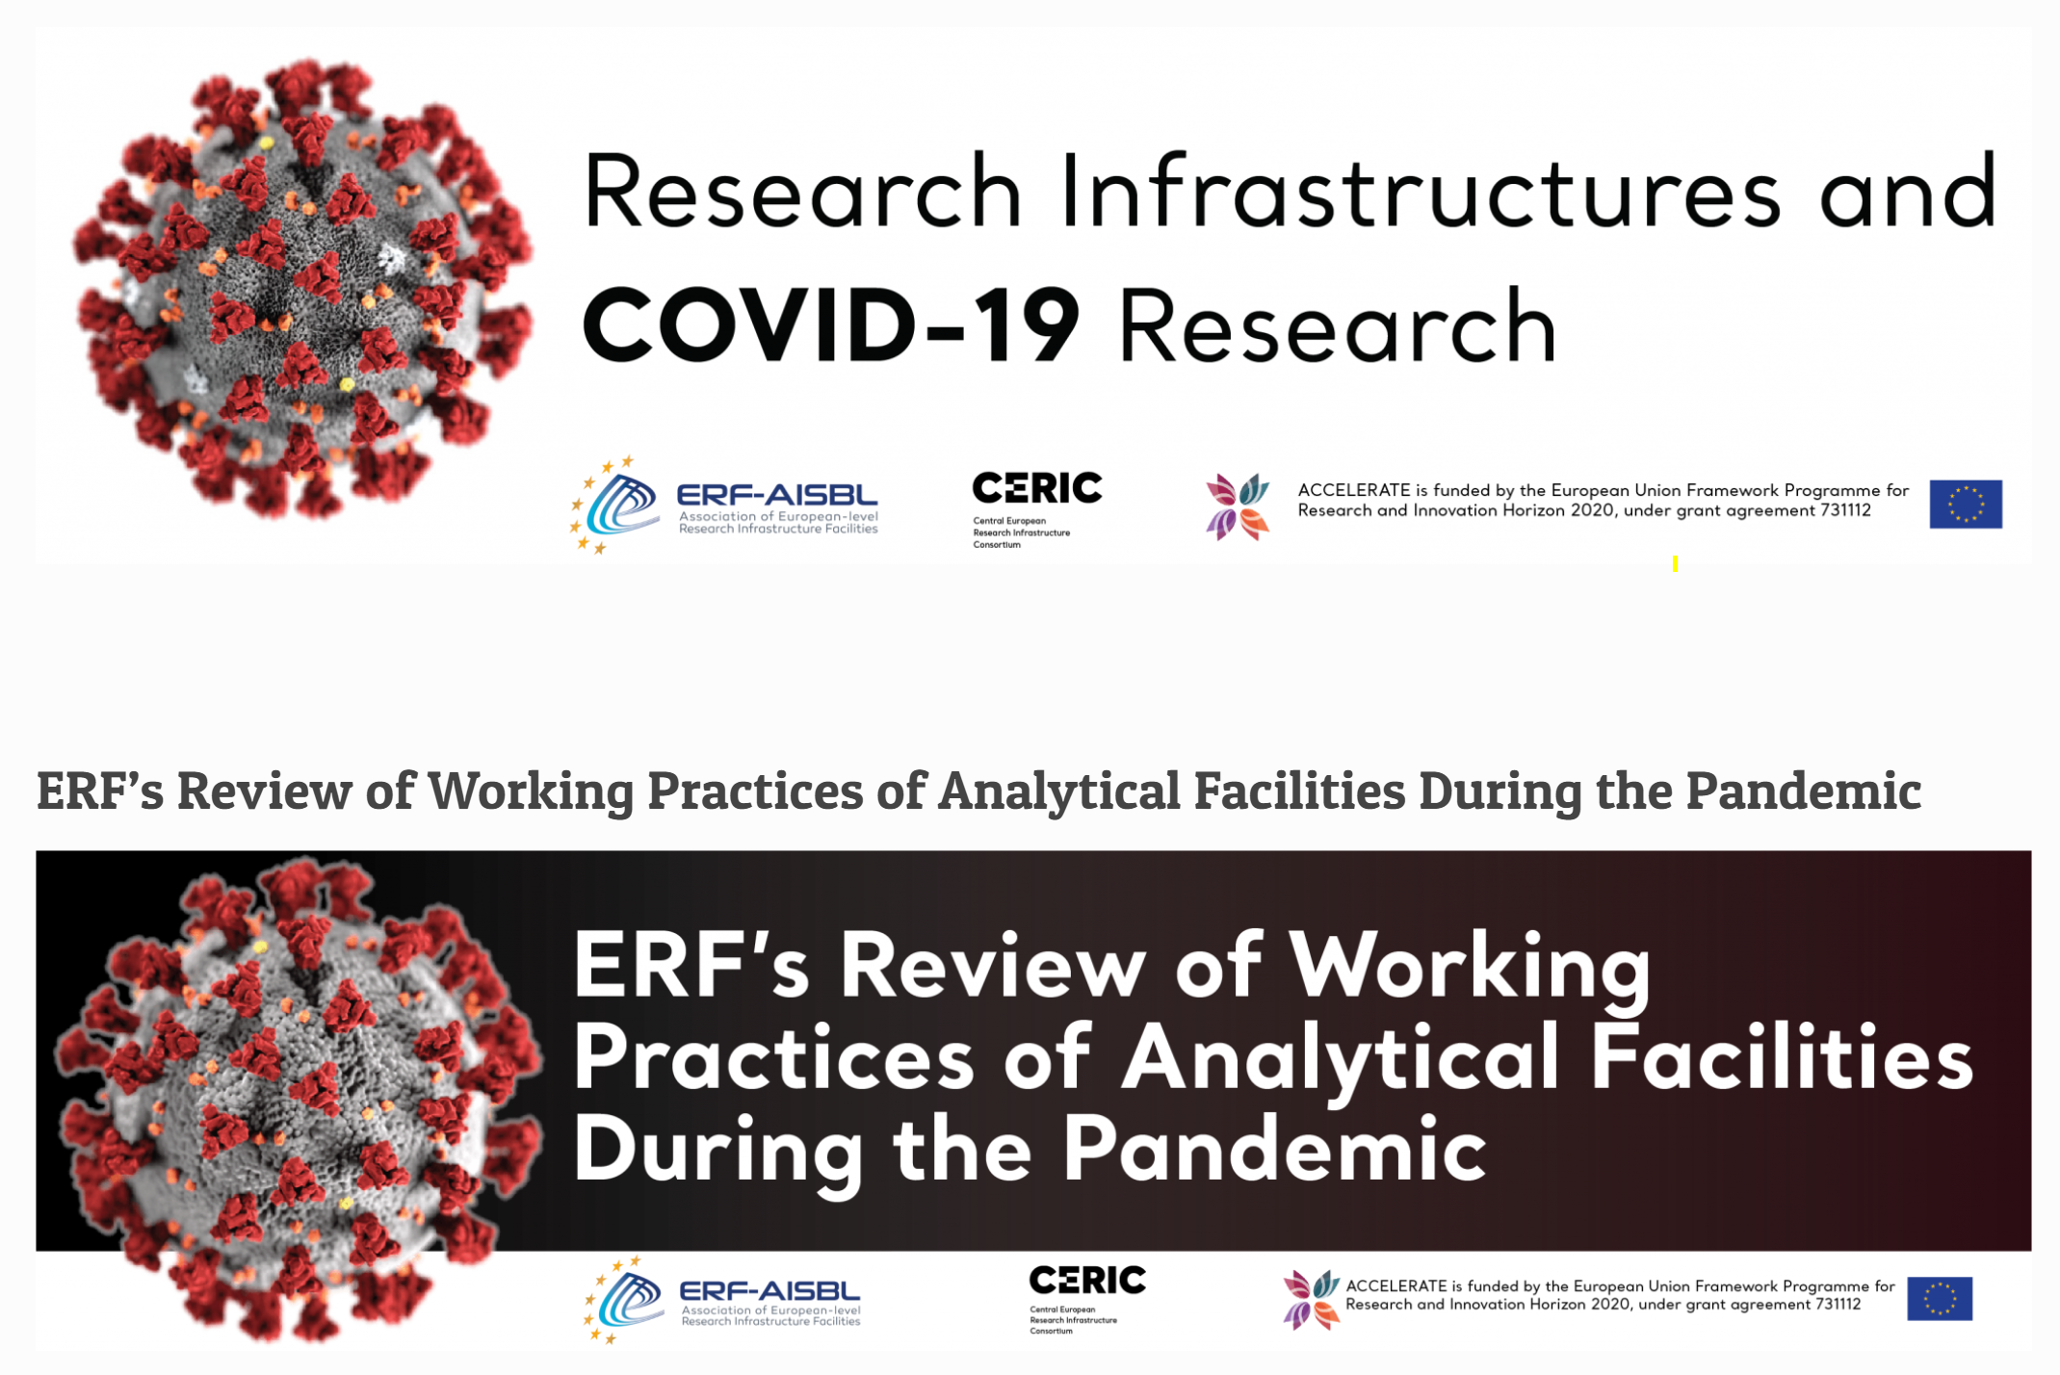
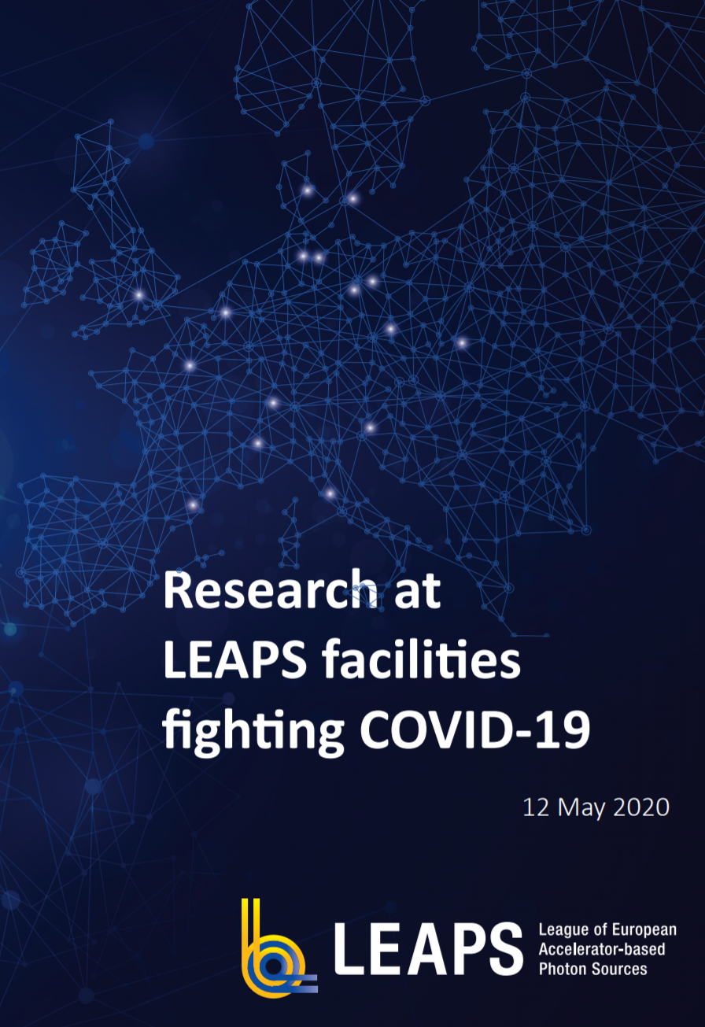
Top 6
Caterina
Answering to COVID-19 Pandemic
LEAPS Position Paper on COVID-19
Published mid-May on our website
https://leaps-initiative.eu/wp-content/uploads/2020/05/LEAPS_fighting_COVID19_May2020.pdf
Participation of singular members in ERF-AISBL/CERIC-ERIC initiatives
Preparing webinars on
Operation during and after the pandemic
Scientific contribution to fight the pandemic

Slide 11
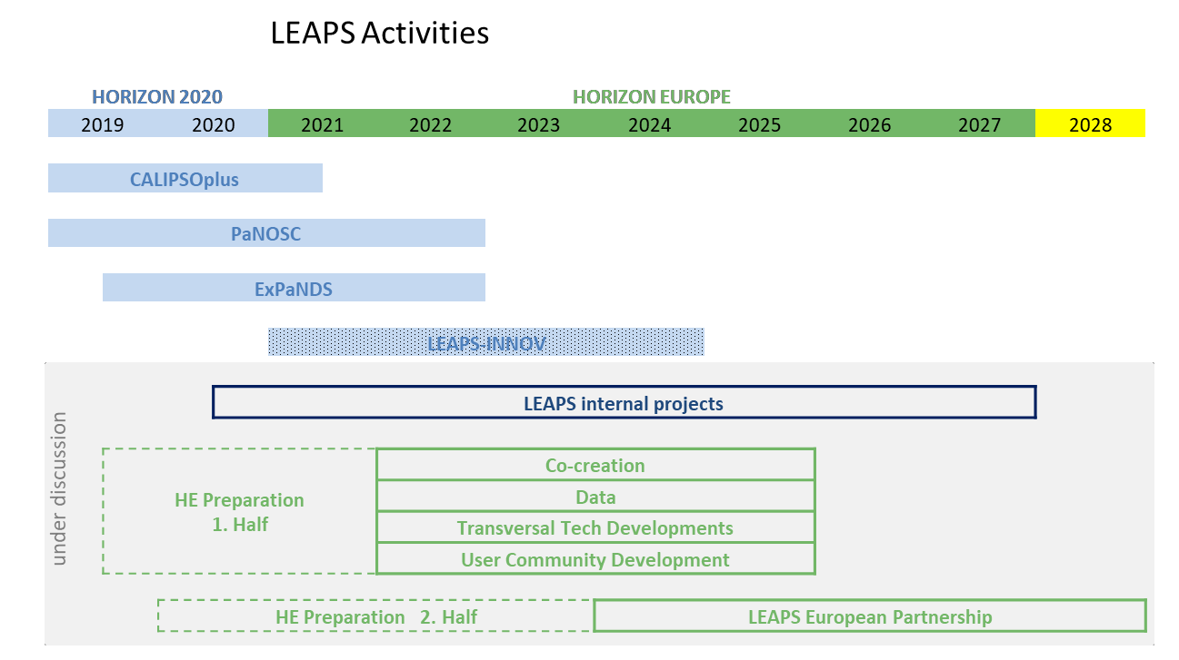
LEAPS plans for 2020(+)
Green Deal HZ2020

Slide 12
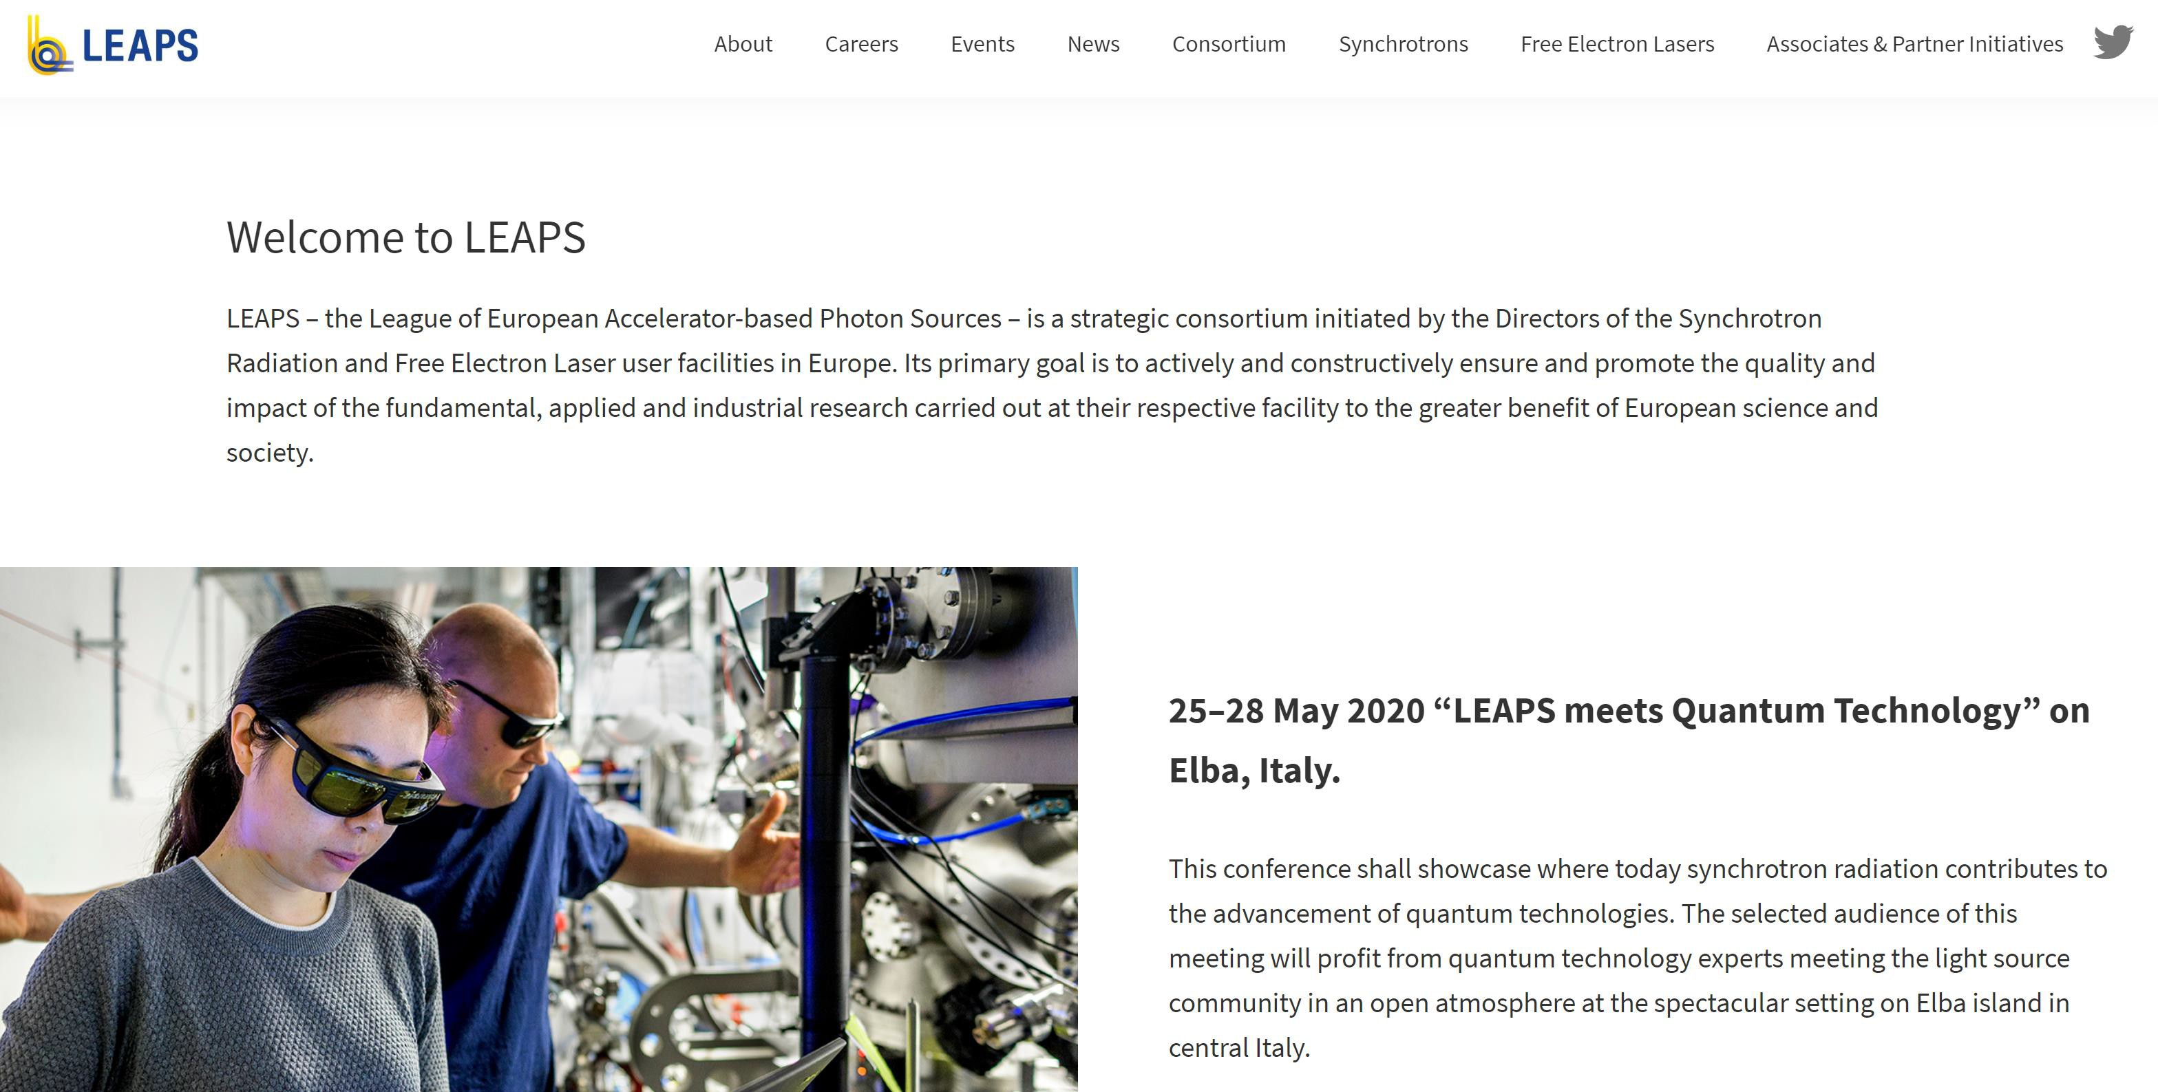
On going LEAPS activities
New webpage on-line (visit https://leaps-initiative.eu/)
8

Slide 13
What long-term positive and negative effects do you expect the crisis will have on the RIs in Europe?
Positive
Develop new tools, more environment friendly, enhance digital transformation
Implementation of new ways of teleworking, with attention to balance between private and working life
Stronger awareness in the society on the need of science and RIs, what should reflect in governmental decisions
Strengthening collaboration in view of a common objective which affects everybody
Develop tools for being prepared in future to different threats, not only viral
Negative
Difficulty of maintaining contacts, multitudinous meetings, face to face exchange, important for advancing in ideas and collaborations
Difficulty of user access and need of developing remote access and sample mail-in with new resources, including human resources
Difficulty for weaker countries from budgetary point of view, both in RIs and in research institutions where users come from (mention Sesame?)

Slide 14


Tak
Tack
“The strength of LEAPS lies in its staff and users, hailing from all European countries, beyond those which host the facilities. Member States and facilities should optimize the funding instruments under Horizon Europe for the benefit of researchers and innovators across all Europe”
Thanks
Bedankt
Dziękuję
Danke
Merci
Grazie
Gracias
شك

