Slide 1
IT solutions to address operational challenges during the COVID-19 @ALBA Synchrotron
Daniel Salvat – Head of MIS Section
Computing Division
June 18th 2020

Slide 2
Overview
What is ALBA.
Moving from on-site to remote work.
Internal and External Communication.
Resuming scientific activities.
Slowly increasing activities until today.
Cyber Security.
Data transfer to home institution.
Remote data analysis services.
Future plans in response to COVID 19.
The challenge of moving to teleworking.

Slide 3
ALBA Synchrotron
3rd Generation Synchrotron Light facility.
Cerdanyola del Vallès (Barcelona).
3 GeV electron beam.
Inaugurated in April 2010.
8 Beamlines in operation:
BL01 – MIRAS (Infrared micro spectroscopy)
BL04 – MSPD (High resolution and high pressure power diffraction)
BL09 – MISTRAL (Cryo nano-tomography and spectroscopy imaging)
BL11 – NCD-SWEET (Small angle X-ray scattering).
BL13 – XALOC (Macromolecular crystallography)
BL22 – CLÆSS (Absorption and emission spectroscopy)
BL24 – CIRCE (Photoemission spectroscopy and microscopy)
BL29 – BOREAS (Resonant absorption and scattering)
5 Beamlines under construction (expected operation 2021-2023):
BL20 – LOREA (Angle resolved photoemission spectroscopy)
BL16 – NOTOS (Absorption and diffraction)
BL25 – MINERVA (ESA Metrology Beamline)
BL06 – XAIRA (Microfocus for macromolecular crystallography)
BL31 – FAXTOR (Fast X-ray tomography and radioscopy)

Slide 4
Moving from on-site to remote work.
First indices of lockdown appeared on March the 9th.
The User Office (and MIS) prepared a COVID19 Rapid Access to contribute on the research.
Crisis Committee had its first meeting on March 11th 2020.
~220 staff members sent home on the 12th of March 2020.
The accelerator was shut down on the 13th of March.
The Spanish Government declared the Alarm State on the 14th of March.
Immediate reaction from the Computing (IT mainly) support:
RDP Proxy bandwidth increased from 25Mbps to 200Mbps (Citrix).
+ VPN prepared for 35 connections.
NoMachineNX licenses upgraded from 10 to 70 hosts.
In total, 193 people from the staff and 12 installed in beamlines were covered to connect to ALBA’s network.
Zoom as the standard Communication Tool , although it was under testing at that time, for instant messaging and video calls.
Confluence as the central point of communication.
E-mail + mailing lists boosting their usage.
Phones redirected by most of the staff.
By the middle of the week after, everyone was able to work from home with no technical issues.

Slide 5
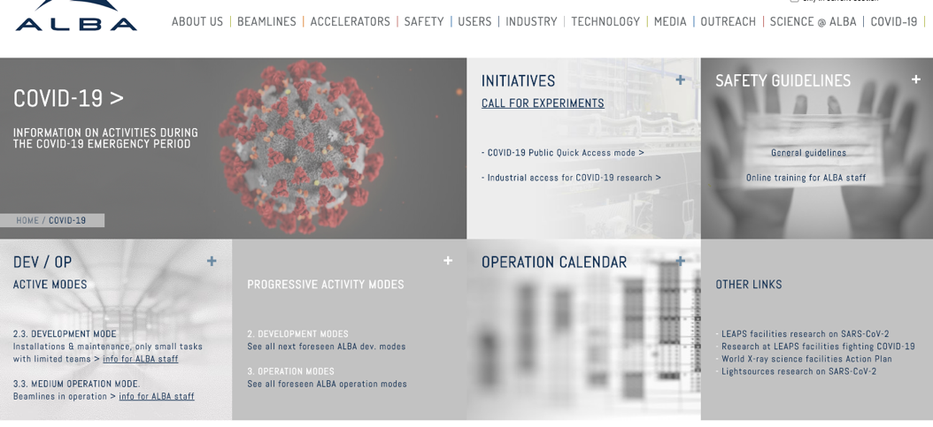
Internal and External Communication

Slide 6
Resuming scientific activities
ALBA was closed from the 13th until 29th of March.
First ”Light Operation” mode was planned for the end of March and beginning of April.
Only the MX Beamline was ready for that, as it is fully automated and remote-operation enabled.
Online Safety training course were recorded, on a weekly basis, in Zoom sessions and uploaded to a streaming service to make them available to the rest of the staff.
Finally, COVID19-Operation mode started on April 16th.
Only COVID19-related research was permitted.
Number of people on-site reduced to the minimum (< 20).
Hosted a proprietary experiment in MX.

Slide 7
Slowly increasing activities until today
Support from the Controls point of view did not change.
Although it was discussed, no new automation implemented in the control system.
Mail-in sample is manually managed by staff on site.
Local Contact, Floor Coordinators or Beamline Technicians
Empowerment of the communication tools for support
Conferences (Zoom).
Service Management and work planning (Jira).
Knowledge management and coordination (Confluence).
Remote operation/access for users and staff:
NoMachineNX setup done to all beamlines.
Different levels of maturity in term of use.
MX is the only beamline today prepared for unattended measurements/experiments.
MxCuBE & ISPyB running together since 2018.

Slide 8
Cyber Security
Reinforcement of communication with the staff.
New specific teleworking guidelines available.
Campaigns of security alerts monitoring communication and awareness with the staff.
Support and review of personal equipment and their security setup.
Beta testing of new thin client setup for teleworking.
VPN device and license upgrade (35 → 50).
Installation in progress.

Slide 9
Data transfer to home institution
Globus is under consideration.
Aspera provided by REDIRIS (National Research and Education Network - NREN) is also being evaluated.
Cloud archiving operational and transfer to be integrated (AWS contracted to Sparkle through the Géant Cloud Framework).

Slide 10
Remote data analysis services
Remote Desktop access to a VDI (Citrix Virtual Desktop) on Windows available for:
Infrared Micro Spectroscopy Beamline, using and instrument proprietary software (Opus and Unscrambler).
Soft X-Ray Microscopy Beamline, using a proprietary software (Amira) and GPUs.
Plans on Data Analysis as a Service to be developed and tested within the CALIPSOplus and ExPaNDS projects.

Slide 11
Future plans in response to COVID 19
Integration of current processes to remote science enabling tools are being investigated.
Zoom channel creation automation integrated with the scheduling system is already in beta testing.

Slide 12
“Out-of-ALBA” Computing Contributions
Temporarily enabled V100 GPU node for COVID → Folding@home processing international initiative.
More info: https://foldingathome.org/2020/03/10/covid19-update/

Slide 13
The challenge of moving to teleworking
From the organizational point of view, Agile teams had a smooth transition to teleworking.
Factors:
Tools were already there (Confluence, Jira, Zoom,…).
Time-boxing sprints (3/4 weeks).
Intermediate (sprint) objectives.
Level of support and its uncertainty.
Progress transparency.
Significant level of automation helped in the efficiency of the delivery process and service support.

Slide 14
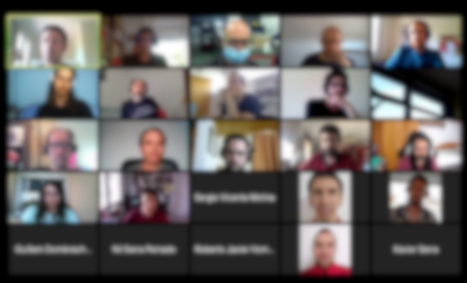
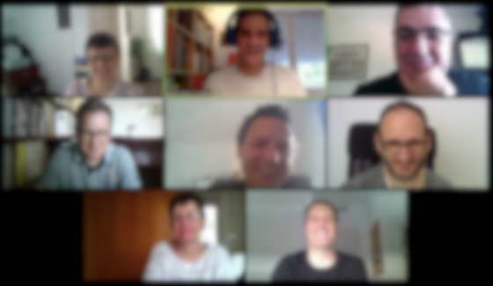
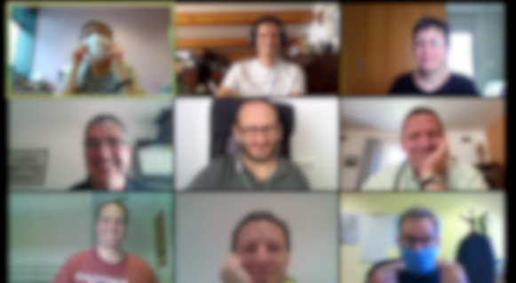
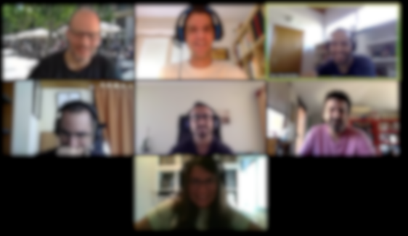
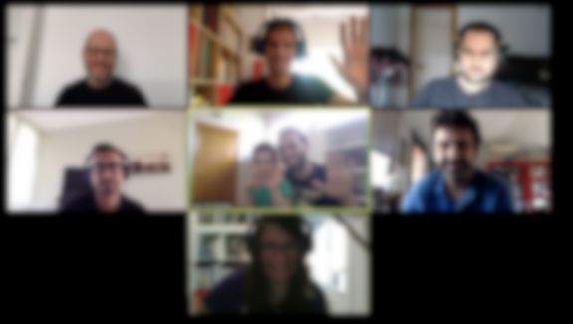
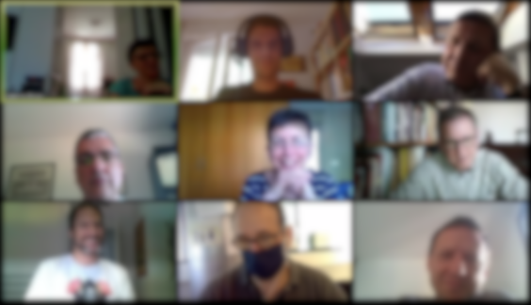
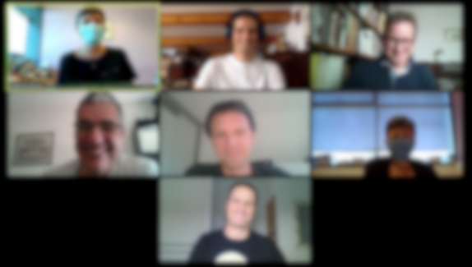
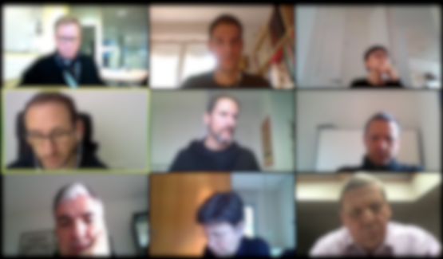
IT solutions to address operational challenges during the COVID-19 @ALBA Synchrotron
Thank you

