Slide 1
LEAPS-IT Covid-19 MAX IV Status

Slide 2
Contents
MAX IV within Lund University & Sweden
IT supporting services
2 Case studies
Summary / Conclusions

Slide 3
Covid times in Sweden
No lockdown
Government follow advice of public health agency
Schools remained open but universities closed classes and moved to remote teaching
Swedish health dept strategy, responsible social distancing to reduce peak and achieve herd immunity
MAX IV
Following Lund university guidelines
Staff advised to do remote working as much as possible
Concern over well being, home office environment
Keep operating, no users from outside local area
Remote experiments using local groups
Covid Task Force responsibilities currently delegated to line

Slide 4
IT @ MAX IV : Remote access perspective
MAX IV provides remote access to staff and users
Remote login through VPN
Data access through data transfer services (globus, sftp)
Differentiate between staff (“known risk”) vs users/contractors/collaborators (with their own devices)
Contractors and collaborators:
Network-wise same as staff
AD managed access to resources and/or data based on needs
Visiting Users:
By default only access from outside to specific resources

Slide 5
IT @ MAX IV : Remote access for remote operation
Important to differentiate between:
Security
Safety
Remote users operating beamline require to be able to
access beamline controls infrastructure without compromising safety of the personnel or equipment
Example: robot movement
Access compute systems and data from “unknown” end systems without compromising IT security (of the lab)
Security: implement controlled access to specific resources -see previous slide
Safety: remote access has to deal with reduced sensorial input (can’t see, can’t hear what’s happening at the beamline)

Slide 6
IT @ MAX IV Managing remote access
VPN realms:
General staff access (office network)
DMZ, access to internal resources controlled by FW rules
Staff - machine network
Access to machine network, only for authorized groups (staff only)
One realm per beamline
for beamline staff only
Gives access into beamline sub-net
Remote users realm
Currently only BioMAX beamline
Gives access into a specific sub-net within the beamline network (DMZ)
Access to central resources controlled by FW rules and VPN filter
General user realm
Any DUO user
Gives access to specific processing resources (offline-HPC, jupyter hub, hdf5viewer) and internal information web pages
General DMZ, access controlled by FW rules and VPN filter
VPN authentication with 2FA (user pwd + OTP token)

Slide 7
Different beamlines, different needs
Case B: same/similar capability of conducting experiment as if on site
Implemented for BioMAX
Remote user VPN realm = “BioMAX DMZ”
For registered remote users only
Video-conf based training for first-time users
Case A: experiment is carried out by beamline staff, guided by remote users via video link
Video conferencing with shared desktop capability (zoom)
Beamline staff initiates zoom session from beamline computer
Remote users do not need VPN access to lab
Users collect data through existing data transfer system (globus, sftp)
Note: In case of MAX IV, beamlines have no direct internet access by default
Case B: VPN includes client device into beamline network
Case A: Enable in FW and whitelist zoom server addresses

Slide 8
IT @ MAX IV : Collaboration tools
Provide solid base set of services, open to user preferences, follow what works best
All the following were already in place before covid struck
Zoom: video conferencing – NORDUnet contract covering all Nordic academic institutions
Capacity was quickly extended
MS Teams: chats, calls, small meetings
Box: document sharing
Jabber: chat (mainly operators)
Main extra effort on IT support - many first-time users, equipment orders etc.

Slide 9
MAX IV Case Studies
BioMAX | MX, MAD, SAD, SSAD, Atomic resolution data collection, Large sample ensemble screening, In situ crystal diffraction | 5-25 keV | 20 μm x 5 μm
BLOCH | high resolution angle-resolved photoelectron spectroscopy (ARPES), optionally spin resolved (Spin-ARPES) and core-level spectroscopy (CLS) | 10 -1000 eV | 10μm x 25μm (VxH)
Considered not feasible in immediate term:
Balder | XAS, XES | 2.4 - 40 keV | defocused V ~0.1-2 mm x H ~ 2-9 mm, focused 100 x 100 µm2
NanoMAX | Scanning transmission microscopy (STXM) with absorption and phase contrast X-ray fluorescence microscopy (XRF) Coherent diffraction imaging techniques (CDI) Ptychography in forward direction and Bragg geometry | 5 - 30 keV | 300nm – 30 nm. Mature goal 10 nm

Slide 11
BioMAX remote access scope
The user has full control of the experiment , regardless of physical location (not the same as “mail in” service)
Multiple connections are supported, and the active control of the experiment is transferable (facilitates collaboration, BAG beam sharing, staff support)
Notes:
Our vision for remote access was to take full advantage of tea automation available at the beamline and provide the user full control of the experiment without having to rely on someone on site to do things for them. We did not want to have a restriction on where the users want to log in from and since we have individual accounts and many BAG porposals, it was important to give everyone in a proposal access to the experiment and also make it easy for staff to help users remotely.

Slide 12
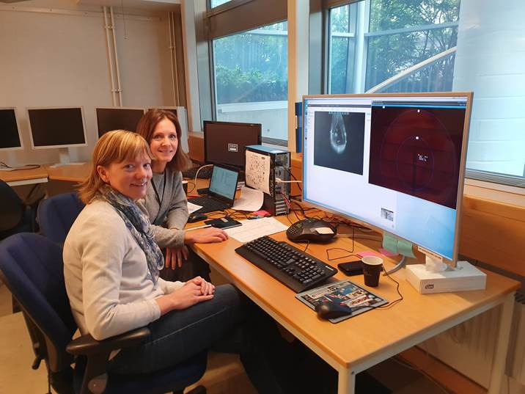
BioMAX Remote Project Status
Kick-off meeting in Spring 2018, with participation of MX, IT, User Office, Safety, Industrial Liaison
Treated as high priority by MAX IV management
First commissioning experiments with LU in June 2019
First fully remote user experiment on 31st October (AstraZeneca)
Notes:
Officially we started working on this in 2018, it has been a large project involving many groups at Max iv , fortunately this project was given high priority by management so we could go from having absolutely no means or provisions for remote users to running tests about one year later during a very busy period with many beamlines coming on line and many other projects, last week we had Astra Zeneca collecting data from Gothenburg on their own scheduled beamtime

Slide 13
BioMAX Remote Access Capabilities
Supported for full remote access:
Mounting and dismounting samples with the robot (only SPINE pins in UniPucks)
Conventional data collection with cryojet
Running automated scripts enabled on MXCuBE
Online and offline data processing
Data transfer via internet
Supported only with on-site backup:
Manual mounting (no room temperature experiments)
Samples shipped in non standard containers
Hazardous samples/experimental conditions
Special experiments (vg HVE SSX)
Notes:
As of now, remote users can do conventional data collection from cryocooled samples in standard containers. This covers maybe 90% of more of the experiments. All the beamline control commands that are necessary to run the experiment are enabled on MXCuBE, and it is also possible to do data processing and data transfer. Experiments that require going into the hutch, sample manipulation on site or a special sample environment require having someone at the beam line to help and may or may not become available remotely depending on resources and demand.

Slide 14
BioMAX User administration
No differences in procedures for proposal submission sample safety declaration, user agreement
Users must explicitly request remote beamtime. Eligible users must have:
Radiation training up to date (requested by radiation safety)
Knowledge of remote access practices (what is allowed and what is not)
Experience in beamline use (yearly training at beamline)
User must ask staff directly for remote access, and the list of remote-eligible users is maintained manually
We want to add some supporting functionality in DUO to help us handle remote users
Notes:
ON the user administration side, there is no difference between remote and local users until it comes to the actual beamtime session; we want to know when users want to do a remote experiment and we want users to fullfill some conditions. This is something that is open to review in the future, but for the time being we want to ensure that the users have radiation traning this was something that radiation safety was keen on, since the users actually have indirect control over the front end and safety shutters and, also who know what is expected and are familiar with BioMAX, I will talk a little bit more about this in the next slide. Right now almost anything pertaining to handling remote experiments is done manually, and hopefully we will start implementing some functionality in DUO to help us with this.

Slide 15
BioMAX User training
Beamline and beamline control software are relatively new and under continuing development. Users should be well aware of non-intuitive features, known-issues and procedures specific to BioMAX
Key training contents: Sample shipping; use of MXCuBE and ISPyB/EXI; Computing environment and data handling; remote connections to MAX IV
BAG training sessions (started in 2019)
Training during the beamtime (perhaps not optimal?)
Remote training
Notes:
We want the users to come to beamline at least one in the last year and we want to train them specifically for remote access : we are still developing the beamline and we are still developing the data collection software. Not all the users have had the chance to become very experienced with either the beamline or MXCube or the computing environment at bioMAX. For remote experiments, it is critical that the users know to ship the sample, have familiarity with the software and how to handle the data and of course that they know how to connect remotely in the first place. All these things are covered in BAG training sessions that we started at the begining of this year, we also make provisions for training during the beamtime, although we have actually not done this yet. What we have also explored is, for users who have already been to MAX IV to do a specific remote training session remotely.

Slide 16
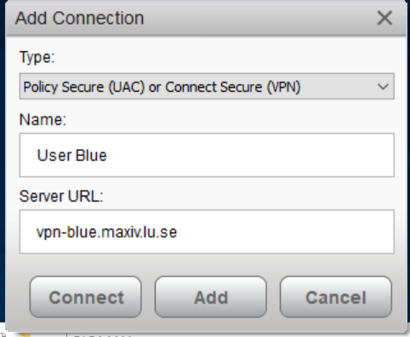
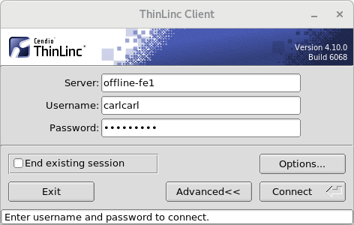
BioMAX Remote connection
Dual authentication VPN connection using Pulse Secure (software downloaded from MAX IV).
Two VPN servers:
Beamline network (vpn-blue) Restricted to beamtime only
Office network (vpn-white) Used primarily for offline data processing. Available 24/7 to users with an active proposal
Access to computer on the MAX IV network with the ThinLinc client (https://www.cendio.com)
ISPyB available to prepare the experiment and monitor automated data processing
Notes:
An important aspect is the software tools. The IT group insisted in the use of a VPN server, mainly because that was the standard way to access MAX IV before we started this project and it would have been too costly to set up and maintain two different systems. The VPN connection that allows an SSH connection to a computer at MAXIV and allows the rest of the user computer to remain open to the internet or its own local network. To log in to that server, users use a remote client, thinlinc, which is perhaps less used than NoMachine for this purpose but has more or less the same features. We actually have a separate server that users can use outside of beamtime, tipically for processing the data.Of course ISPyB which is critical to prepare the experiments and monitor remote experiments is already ready

Slide 17
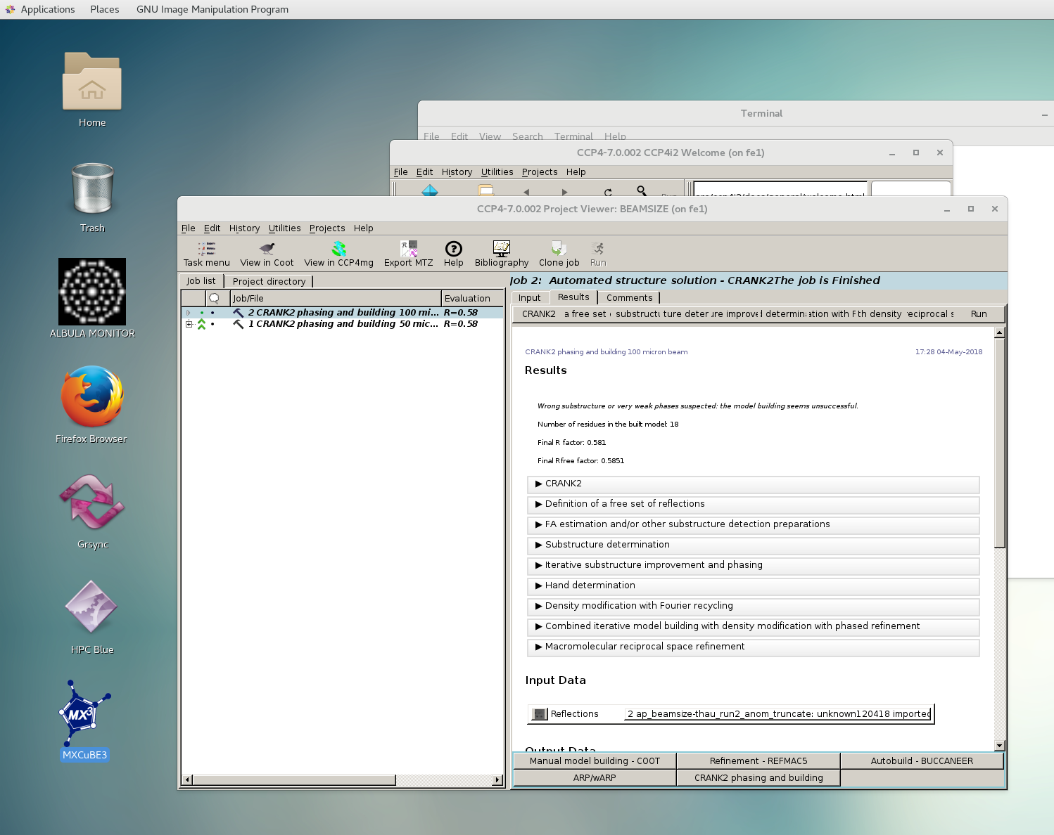
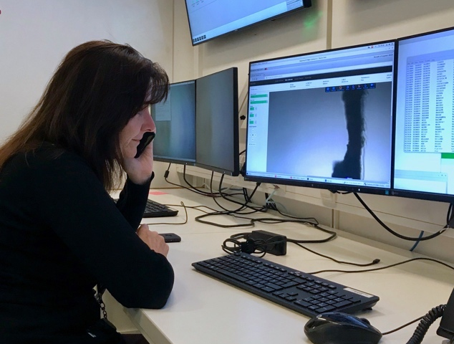
Remote Thinlinc beamline desktop
Controlled computer environment
Configuration mimics that of the beamline control computers
Low level beamline control software is not installed for machine protection sake.
Possibility to reconnect to the same session at different times from different locations
Session shadowing (helps support and training)
Notes:
The advantage of using a desktop for the experiment is that provides an easy way for the users to run all the programs they need for the experiment, not just MXCubE, but ALBULA for image viewing and access to the data processing in a self contained controlled environment that we can maintain. We can configure it to mimic the beamline workstations and also preserves the state of the data collection if the connection is lost

Slide 18
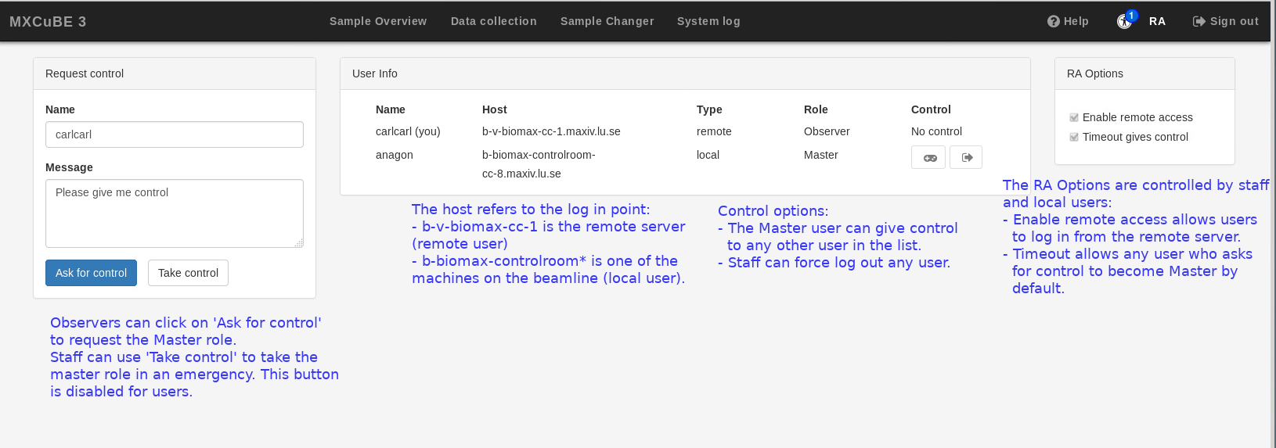
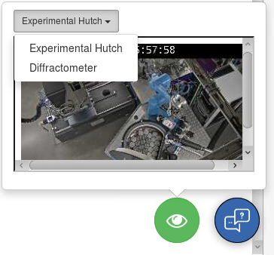
MXCuBE3 remote tools
Remote Tab
Chat tool
Video monitoring
Beamline status information
A web-browser based diffraction image viewer is under development
Working on a better way to preserve information if the connection is lost
Notes:
we are also relying on remote features in MXCuBE. Here it helped us a lot to colaborate with ESRF who were already using MXCuBE3 for remote access beofre we did. We did a little bit of work on the remote tab to improve handling of multiple connections. We are also using extensively the video monitoring of the beamline and the chat and we have some information on the beamline status. We have not given up to dispensing with the thinlinc cleint and using mxcube from the users browser, but I think we will need a well functioning diffraction viewer. Hopefully braggy is coming along.

Slide 19
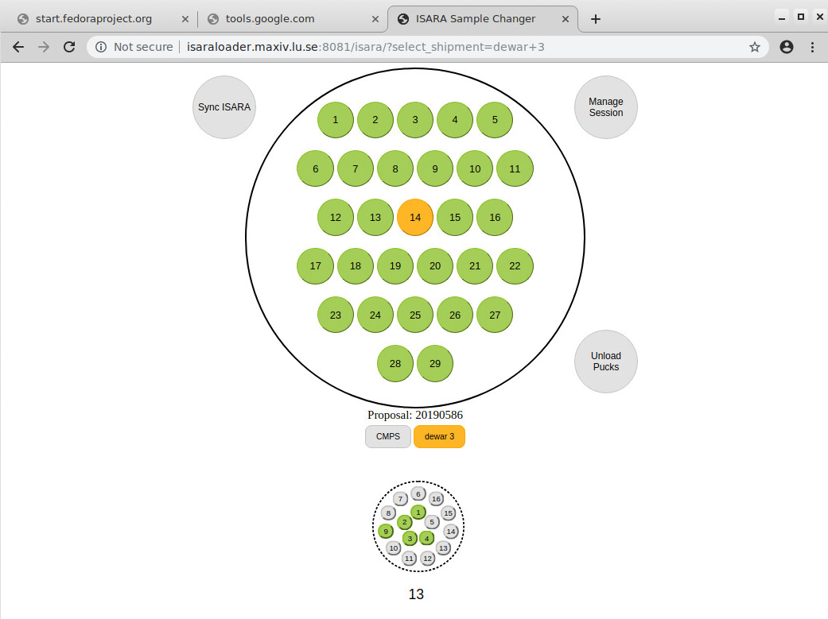
BioMAX Remote experiment support
Communication with the users in advance of the experiment is important.
Staff takes care of dewar handling, sample loading and unloading. Testing interface to transfer UniPuck position in the dewar to ISPyB
Usual level of support (questions about the experiment, troubleshooting). No support overnight
Notes:
For support we are hoping that remote experiment will not make a huge difference or give us a lot more work. I think that we will probably need to emphasize communicating with the user before the experiment to ensure that they are well prepared. Right now we tend to talk mainly to the PI and probably we will have to reach out to more of the people actually doing the experiment. A big difference is that staff will be inchanrge of loading the pucks. We are hoping to use an application dveloped in house to be able to associate automatically each puck with a position in ISPyB, that will be very helpful. Otherwise, we offer users the same lever of support

Slide 20
BioMAX current status
From October 2019
Only Astra Zenica industrial users used the service, connecting from Goteberg (3 hours travel)
Other users not showing interest
Covid- 19
From March, only local Lund users allowed on site
Future/Improvements
Other kinds of experiments.. Serial crystallography
Would like to remove local installations e.g. VPN client

Slide 22
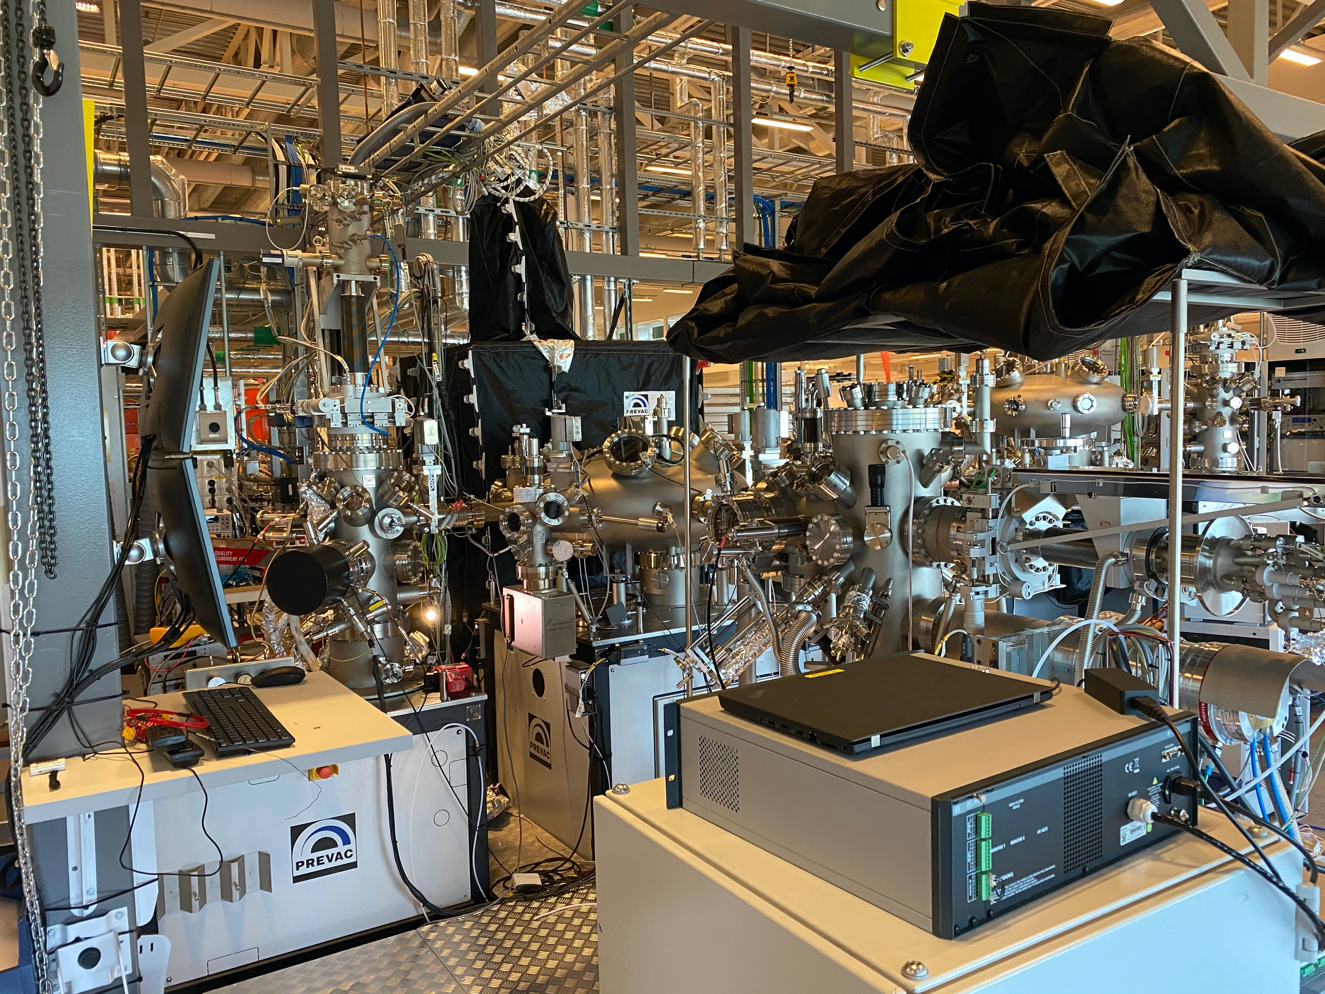
BLOCH

Slide 23
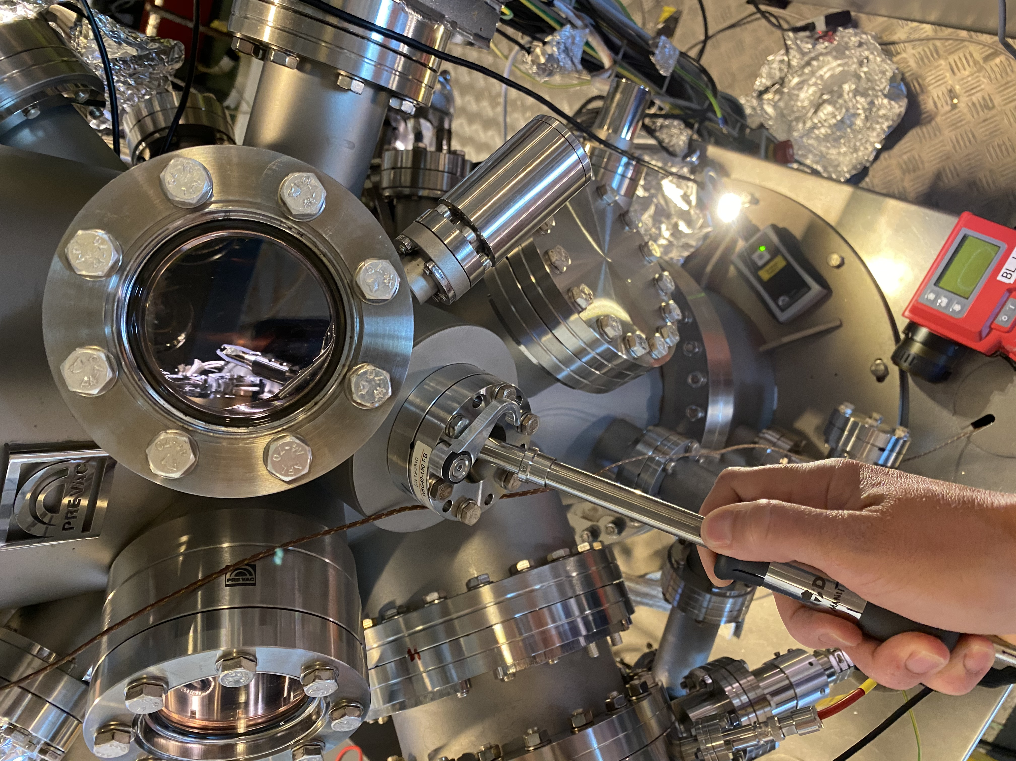
BLOCH Remote Experiments
Sample Preparation
Depending on sample, users can send sample
Preparation (e.g. splicing) can be done locally
Sample is inserted into sample chamber and manipulated locally

Slide 24
BLOCH Remote Beamline Operation
Staff are permitted to operate remotely, users not.
Radiation safety permit needed
There are some risks (e.g. no access to Stop button)
Permits 2 hours – 1 week data collection unattended
Users need to see data to assess it, usually knowledge is unique for a particular experiment
Transfer data done with Dropbox
Data assessment done with Zoom
Timed out after 40 minutes

Slide 25
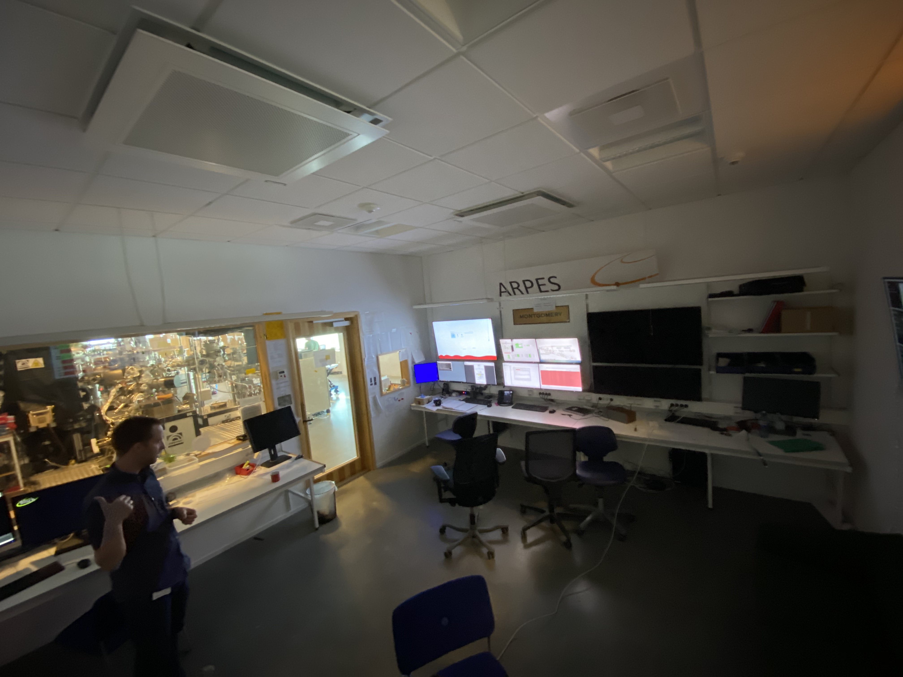
BLOCH Remote Operation
Wide angle camera able to see beam line + zoom in on screens

Slide 26
BLOCH remote Data Management Issues
Scienta detector not built for remote access
Path fixer in Scientific Data Management not working yet
Users + staff new to globus file transfer
Teething troubles because not tried so far
Training may be needed also
Zoom time out after inactivity
Making Data assessment more difficult from remote
Overall 10% success rate so far

Slide 27
MAX IV Remote Access Summary
IT enablers for remote experiments
Secure and easy access (e.g. VPN)
User friendliness
Common accounts to services
Feedback during experiments (easy to understand status)
More automation
Easier to execute instrument procedures
More reliability, less risk to equipment
Data Management
Facilitate access to data and data assessment
Future: Scientists need encouragement to think about instrument design & experiemnt workflow, taking into account remote experiments

Slide 28
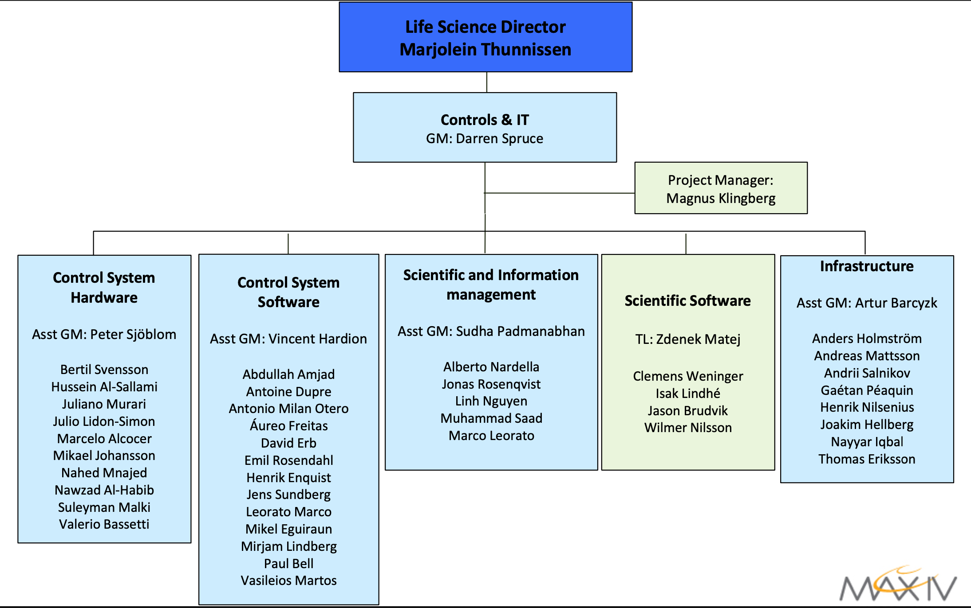
Thanks to all involved

Slide 29
