Slide 1
IT solutions to address operational challenges during COVID-19 Philippe Pierrot (I.T Security Officer and head of HelpDesk Alain Buteau (Head of I.T infrastructure group)

Slide 2
A few reminders on situation on March 15th (before COVID lockdown in France)
SOLEIL has about 500 employees (350 permanent)
Half of them were already equiped with laptops (mostly scientists ans technical staff)
VPN access was available for 50 connections
"Remote access for external " for remote operation of beamlines was available on 4 beamlines (MX ones)
"Remote access for SOLEIL staff" was available through VPN and NX gateways and was routinely used
VPN accounts were accorded only for scientific and technical staff

Slide 3
What were the operational challenges on March 16th
Provide I.T solution to allow all (or nearly all) SOLEIL staff to work from home
For people that did not have laptops
Provide them shared laptops for the COVID period
For people with specific computing requirements (Bank access for accountants, powerful 3D workstations for engineering staff, etc)
Organize physical visit of SOLEIL employees for them to take away their desktops PC
Organize deployment of VPN clients on these desktop machines
VPN
Decide which are the priorities for VPN account creation for SOLEIL permanent staff
Decide what to do regarding account creation for temporary staff (trainees, ..) and subcontractors
Order more VPN licences

Slide 4
Solutions set up in March and early April
Configuration of a virtual PC with minimum SOLEIL applications (Antivirus , windows update , VPN client and CITRIX connection) to be deployed on private computers
VPN
100 additional VPN licences (for a total of 150 licences) ordered to FORTINET were received only after 3 weeks
Communication with users
Regular (weekly) communication with users through SOLEIL COVID newsletter
Organisation of documentation and help procedures in our Confluence Knowledge Base
Global activation of RENATER Drive cloud storage solution for all SOLEIL employees (was previouly under test)

Slide 5
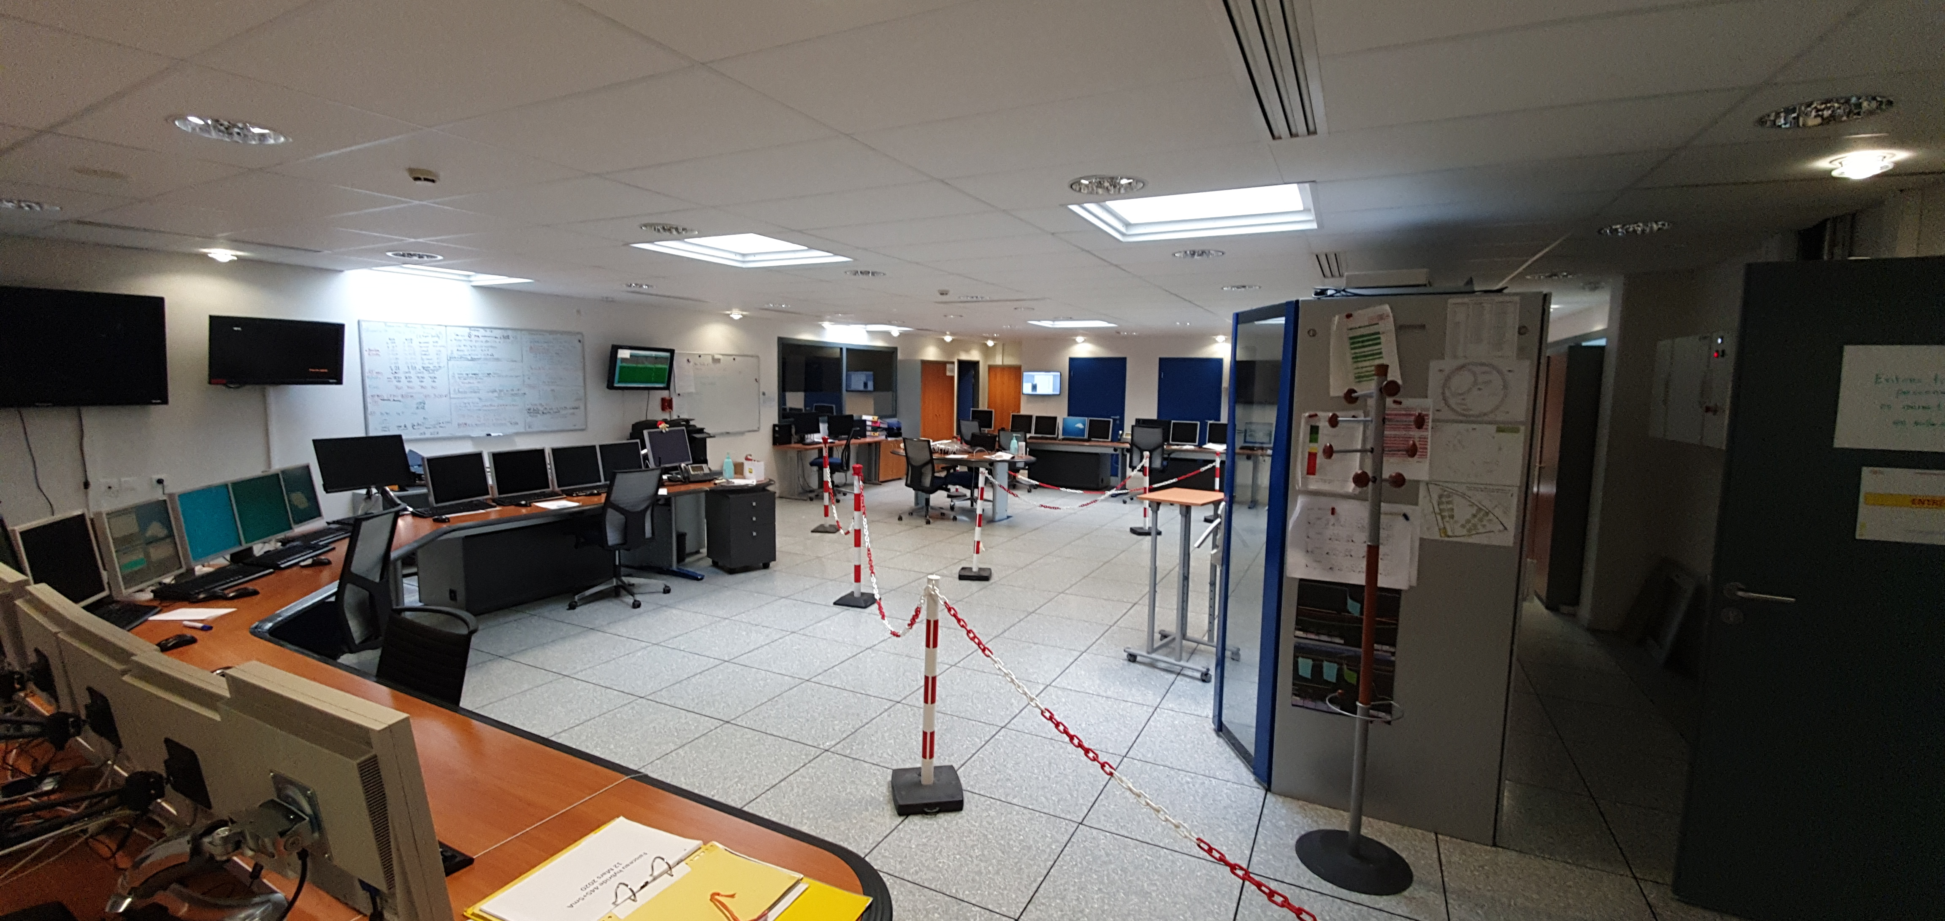
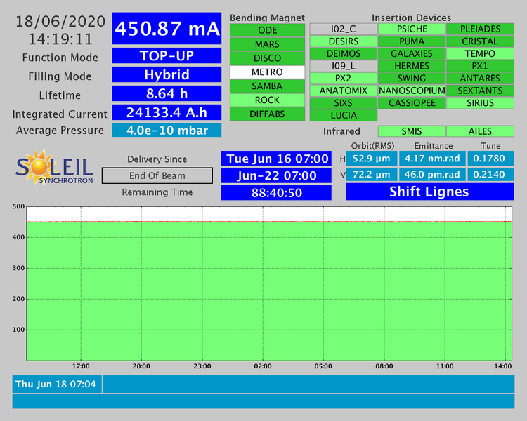
In May
Operation of Accelerators restarted on May 20th as planned to our yearly
Control Room had to be adapted to safety rules
Safety training for external users has been adapted to COVID risk and behavior
Coronavirus crisis meeting are held every week to manage safety protections.
SOLEIL staff is on majority at home but week after more people are fully or partly on site
Beamlines restarted (more than 20 are now running from May 26th)
Mostly "in house" experiments
But external users are also now working
Today 28 beamlines are opened

Slide 6
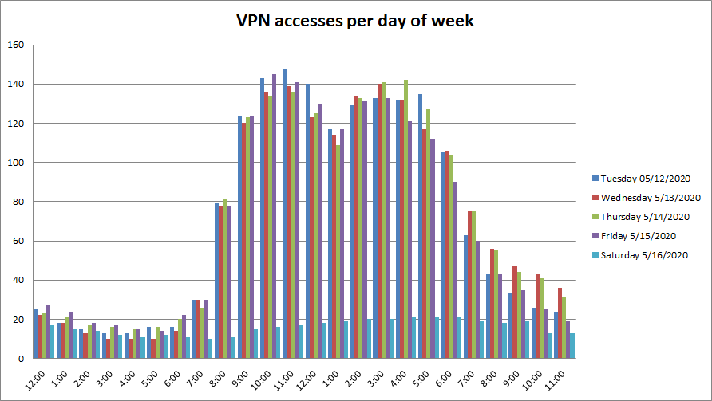
What worked well
Support staff (beamlines and techncal teams) were already used to remote access, so SOLEIL supervision was flawless during containment
VPN infrastructure handled the exceptional load without problem
Most "enterprise" software applications were already available through the VPN
Usage of videoconferencing solutions (RENAvisio and RENdez-vous) provided by French Research Operator (RENATER) spread rapidly
JIRA and Confluence tools helped in managing high flux of users requests and providing them documentations

Slide 7
What did not worked well
Administrative staff lack of computing skills/training, so changing their work environment generated a heavy workload for IT support.
Videoconferencing solutions provided by RENATER suffered from regular overloads and subsequently led to bad experience for users. --> high pressure from users to provide access to unsecure/forbidden apps (zoom, discord, slack...)
No access to corporate phone systems from home
Could not find a suitable chat/voice/video collaborative tool that would suit our needs and security requirements. Currently testing MS Teams...

Slide 8
Next steps
Industrialize TEAMS access for all SOLEIL employees and to communicate with external scientific users
Deploy NoMachine solution for all beamlines
Complete GLOBUS tests (currently ongoing)
Deploy sftp server for DataTransfert (in parallel with our existing "Data Portal" which suffers performances limitations)
Reinforce parternship with RENATER for hosting more services such as Cloud Drive , mails, ...

Slide 9
Conclusion
COVID-19 crisis highlighted our lack of collaborative tools and remote access possibilities for non-technical staff. Now that management is aware of this, projects are getting a boost !
Beamlines are now claiming for remote access possibilities, but few are prepared for it (automation, procedures, etc).
We have to train SOLEIL staff to increase global computing skills
Communication on cybersecurity recommandations and rules must be enhanced
I.T people (and especially HelpDesk) had to be very creative to help people doing their work despite of the diversity of I.T skills in our staff Solving the "ease of use vs security" equation is not an easy task!

