Slide 1
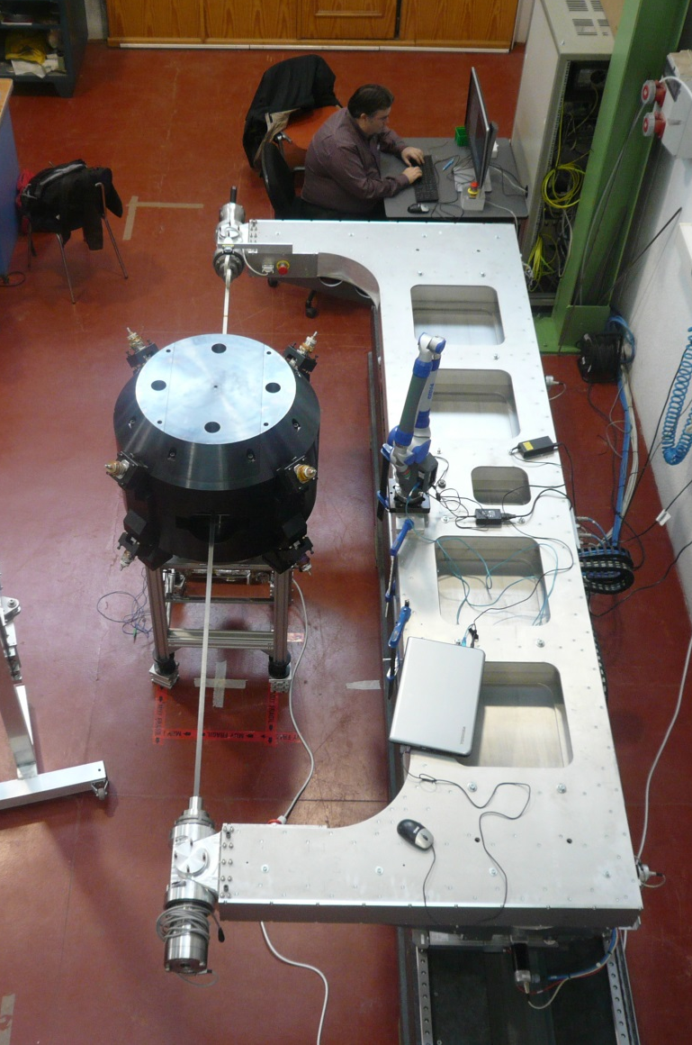
ALBA Magnetic measurements laboratory.
Latest developments.
J.Marcos on behalf of ID Section

Slide 2
Outline
1
Introduction
2
Activities
3
Latest developments
4
Conclusions

Slide 3
Outline
1
Introduction
2
Activities
3
Latest developments
4
Conclusions

Slide 4
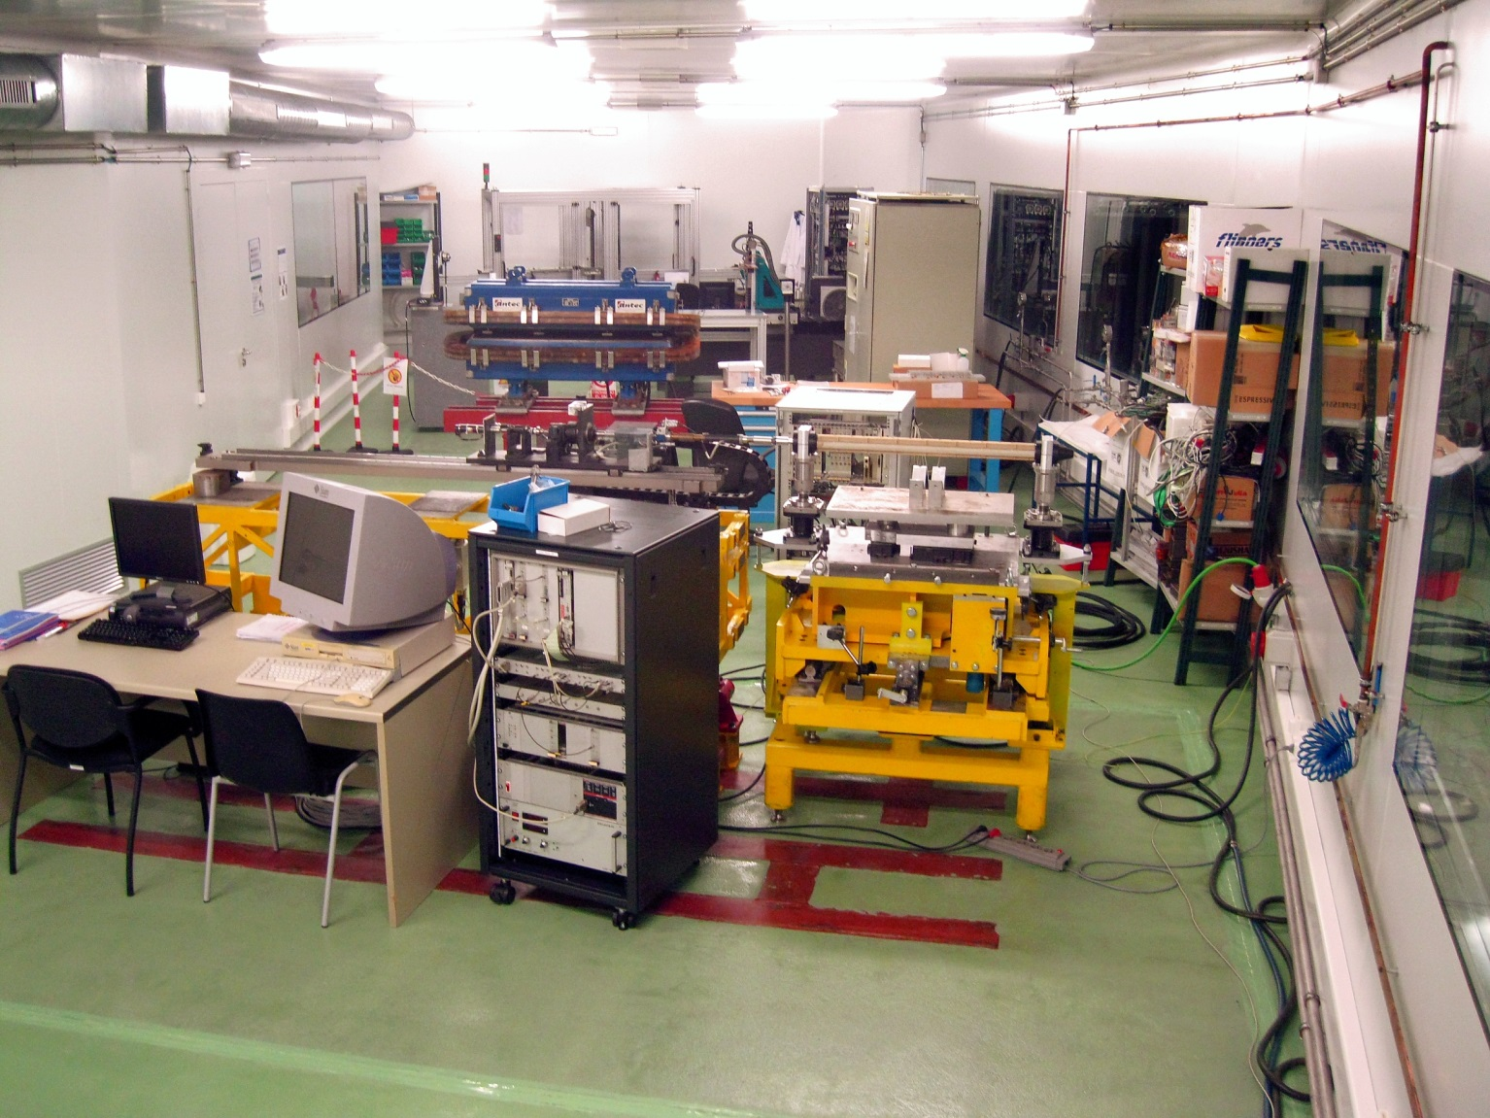
Introduction
Fixed Stretched Wire
Hall probe bench
High current PSs
150 m² laboratory
Temp. controlled ±0.1ºC
Flipping coil
Rotating coil
Helmholtz coils
(not shown)

Slide 5
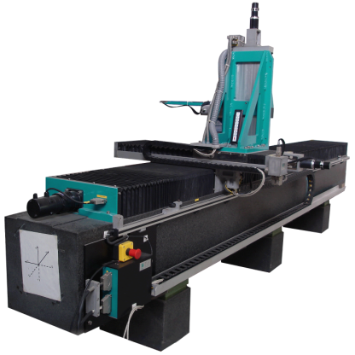
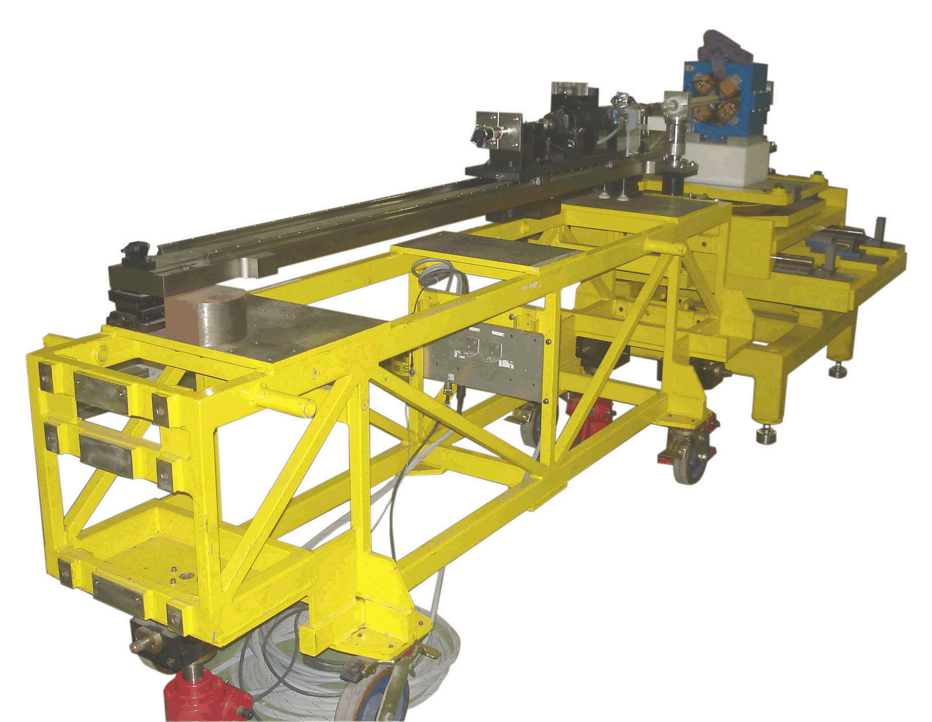
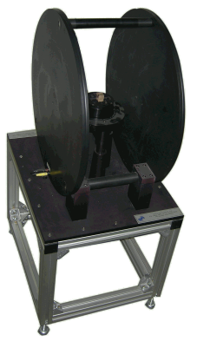
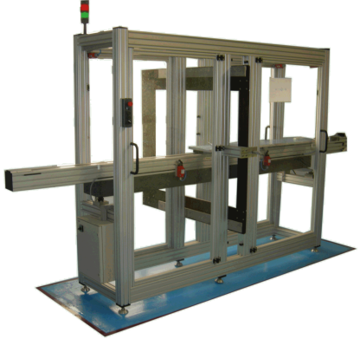
Introduction
Available systems
Hall probe bench
  3D field mapping
Rotating coil bench
  Accelerator Magnets harmonics
Flipping coil bench
  ID field integrals
Helmholtz coils
  Magnetic blocks magnetization
Fixed stretched wire
  Magnetic blocks field integrals

Slide 6
Outline
1
Introduction
2
Activities
3
Latest developments
4
Conclusions

Slide 7
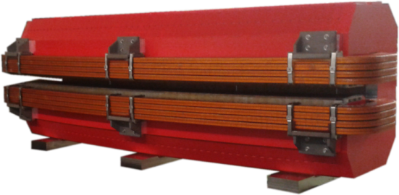


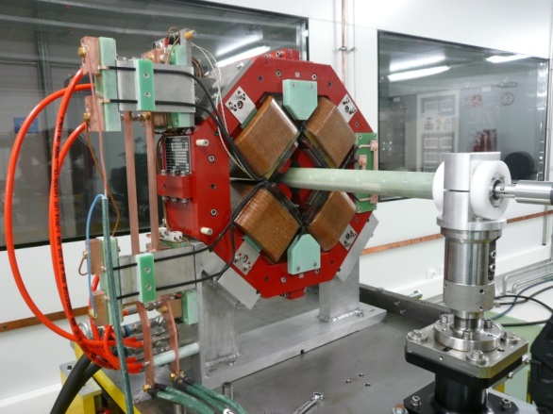
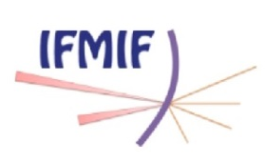


Activities
Since 2014 a significant portion of the lab. resources has been devoted to the measurement of magnets for other facilities and manufacturing companies.
Measurement of SR Bending Magnets for SESAME (Jordan)
  Designed by CERN, manufactured by TESLA Eng. Ltd.
  16+1 magnets, measured during Nov 2014 – Oct 2015
Measurement of quadrupoles for MEBT of IFMIF (Japan)
  Designed by CIEMAT, manufactured by ANTEC S.A.
  5 quadrupoles, measured during Apr 2015 – Nov 2015

Slide 8
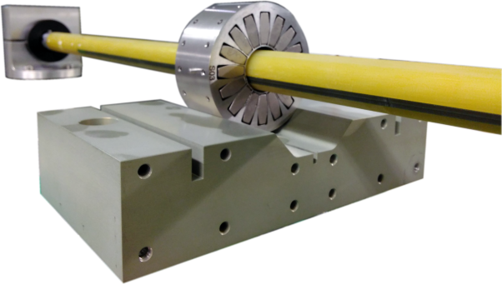

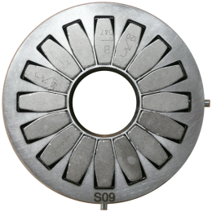

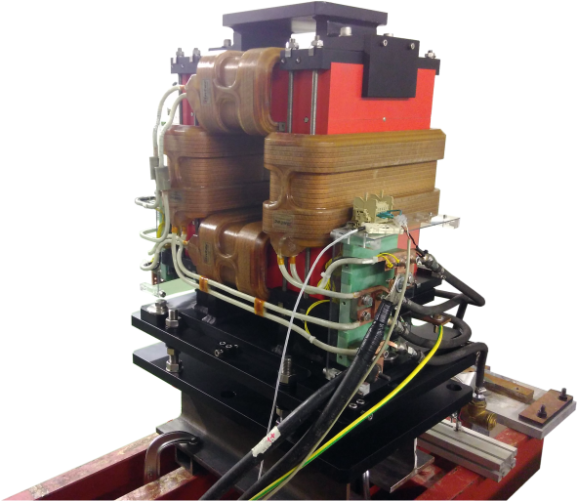

Activities
Measurement of permanent magnet quadrupoles for DTL of LEHIPA proton accelerator in BARC (India)
  Manufactured by Elytt Energy S.L.
  19 quadrupoles measured during Jul 2015 – Mar 2016
Measurement of corrector magnets for CNAO (Italy)
  Manufactured by ANTEC S.A.
  2 correctors measured on Apr 2016

Slide 9
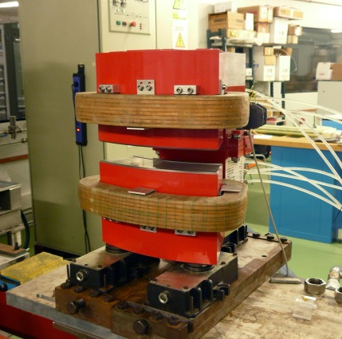
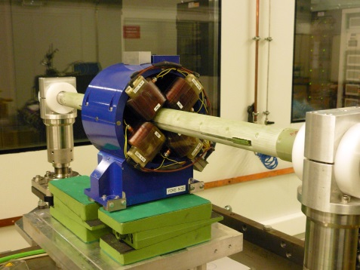


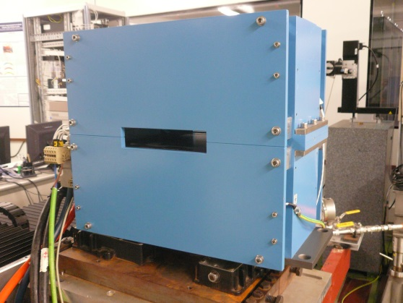

Activities
Measurement of SR magnets for ThomX (France)
  Manufactured by SigmaPhi
  15 bending magnets measured during Feb 2016 – Jul 2016
  34 quadrupoles measured during Feb 2016 – Jul 2016
  2 sextupoles measured on Jul 2016
Measurement of dipoles for CLARA (UK)
  Manufactured by ANTEC S.A.
  4 dipoles measured during Sep 2016 – Oct 2016

Slide 10
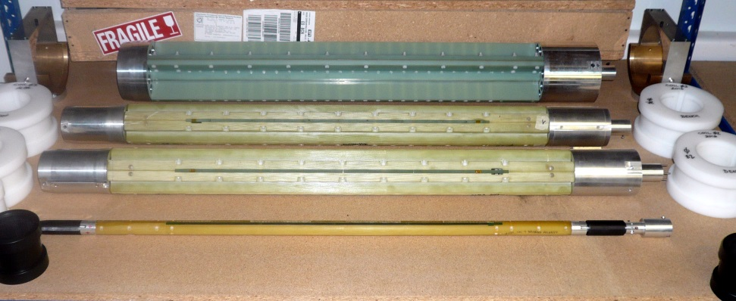
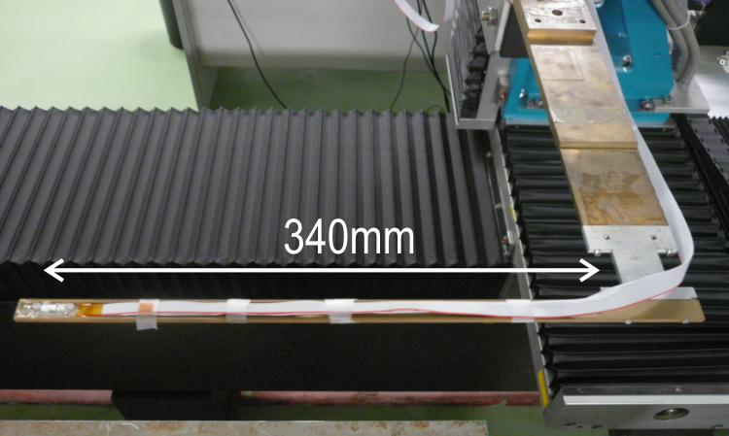
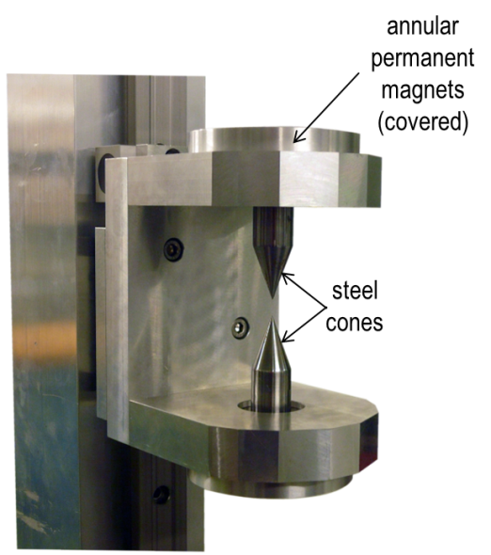
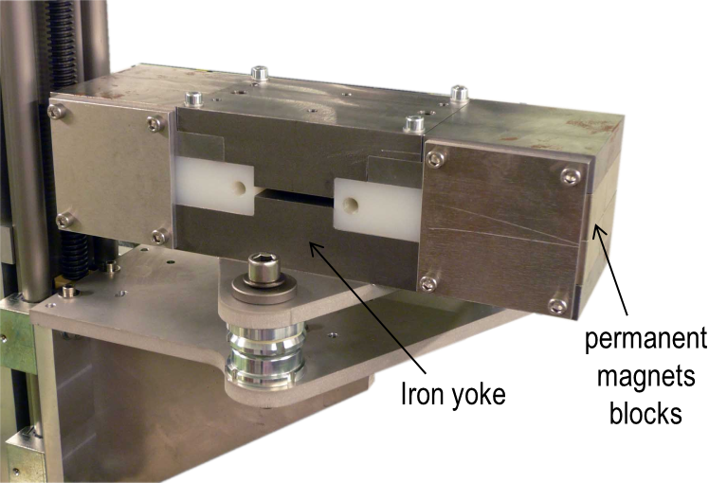
Activities
At ALBA magnetic measurements lab. we make a continuous effort in order to improve the performance of the existing systems and to extend its capabilities.
different diameter rotating coils
Hall probe with increased length for closed magnets
magnetic needles system with enhanced gradient for fiducialization
reference dipole for alignment of Hall probes

Slide 11
Outline
1
Introduction
2
Activities
3
Latest developments
4
Conclusions

Slide 12
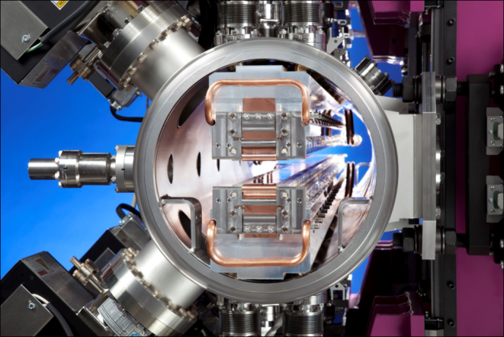
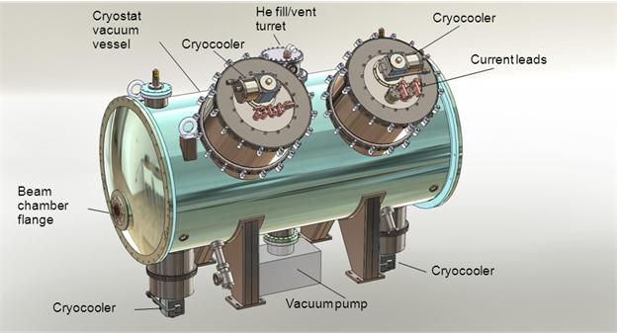
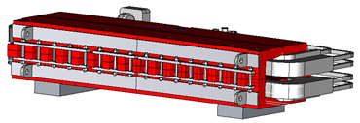
Latest developments
During the last years an interest has emerged in developing systems to measure magnetic field inside “closed” structures
→ superconducting devices (either wigglers or undulators), in-vacuum devices (either cryogenic or RT), H-type long dipolar magnets…
in-vacuum ID
Superconducting device
H-type dipole

Slide 13
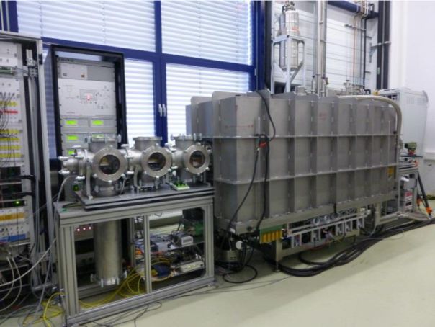
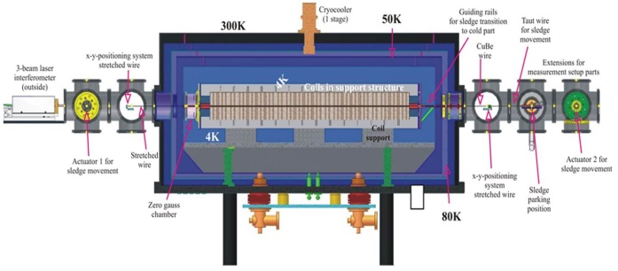
Latest developments
Most of the implemented solutions involve introducing the mechanics inside the vacuum chamber, and are very specific for each case.
SAFALI system
Spring8 (2007)
ESRF (2008)
CASPER II system
ANKA (2011)
IN-SITU UNDULATOR FIELD MEASUREMENT WITH THE SAFALI SYSTEM
T. Tanaka et al.
Proceedings of FEL07, Novosibirsk, WEPPH052
CONSTRUCTION OF A CRYOGENIC PERMANENT MAGNET UNDULATOR AT THE ESRF
J.Chavanne et al.
Proceedings of EPAC08, Genoa, WEPC105
FIRST CHARACTERIZATION OF A SUPERCONDUCTING UNDULATOR MOCKUP WITH THE CASPER II MAGNETIC MEASUREMENT SYSTEM
S.Gerstl et al.
Proceedings of IPAC15, Richmond, WEPMA027

Slide 14
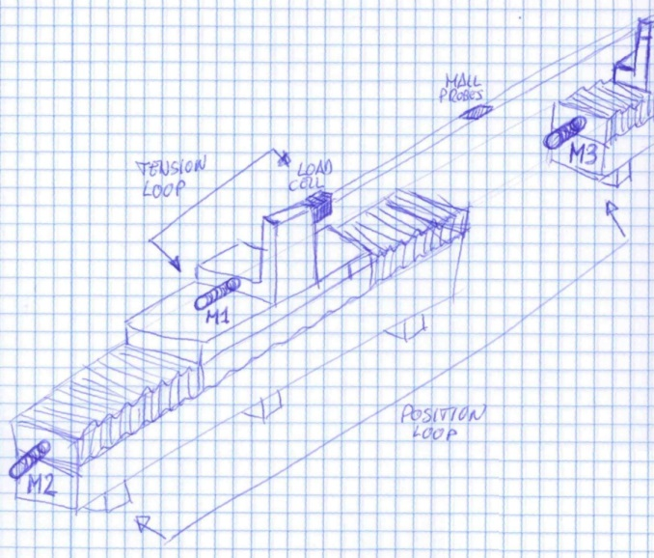
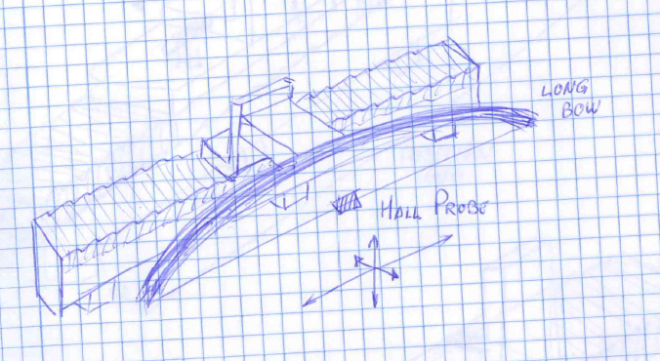
Latest developments
At ALBA we have been looking for a more general approach, providing more flexibility.
Two conceptual alternatives based on placing a light Hall probe on top of a stretched flexible tape were presented at IMMW18 Workshop (2013).
Main concern: vibrations. But they depend on tension and f₀ can be shifted to high values (>100 Hz).
Option 2: double-bench
Option 1: «longbow»
Using current existing bench with an attached «longbow» arch.
Main drawback: a bench ~3 times longer than the structure to be measured is required.
M2 and M3 motors defining position.
M1 motor controlled by a load cell at higher frequency.
More complicated solution from a mechanical and control system point of view.

Slide 15
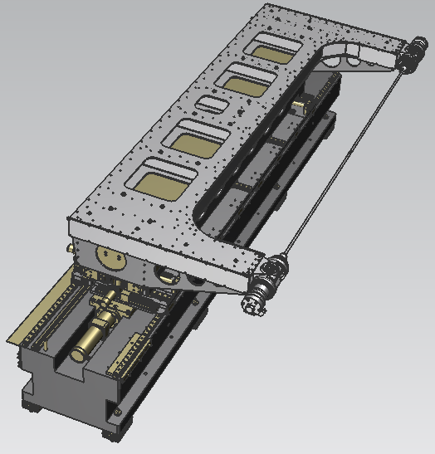
Latest developments
It was decided to implement the «longbow» option, given that it was mechanically simpler.
A prototype well suited to carry out an on-going collaboration with CIEMAT has been developed in-house.
Design specifications
Ranges
X → 230 mm
Y → 90 mm
Z → 1280 mm
Maximum speed v_{z} = 13mm/sec
Repeatability
X, Y, Z ≤ 0.03mm
Positioning errors
σ_{X}, σ_{Y,} σ_{Z} ≤ 0.05mm
Angular errors
Roll, Pitch < 0.05mrad
Yaw <0.1mrad
Y
X
Z

Slide 16
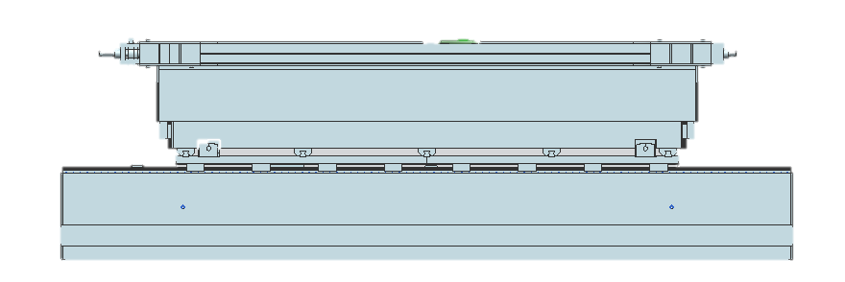
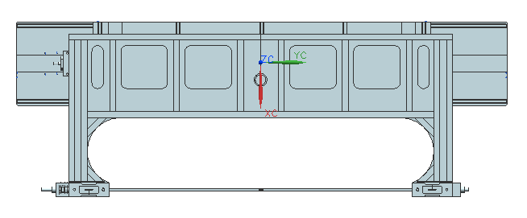
Latest developments
Dimensions
Side View
2600
650
650
1400
4300
Top View
1445(+125)
600

Slide 17
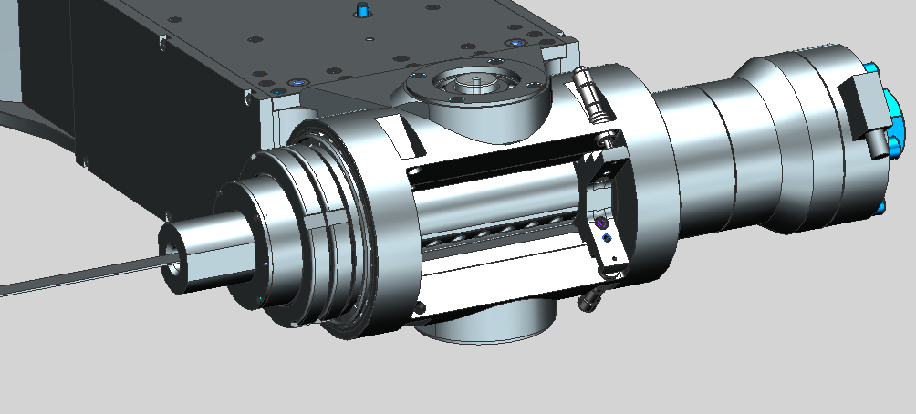
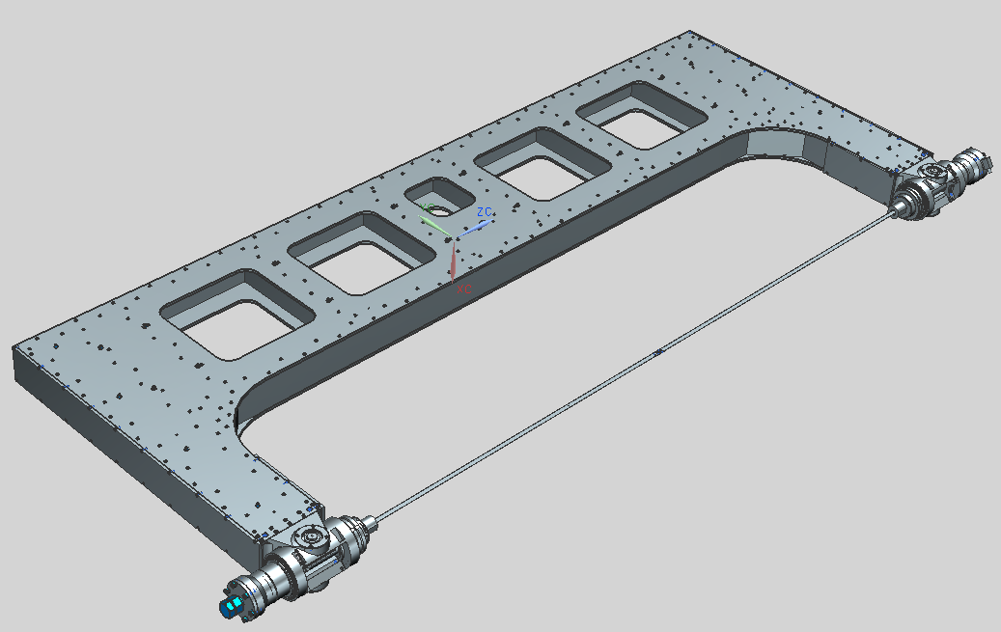
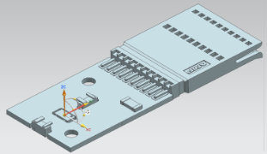
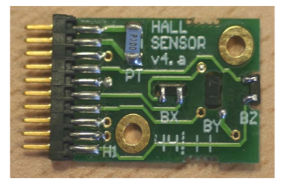
Latest developments
«Longbow» structure
Aluminum profile structure
Two tensioning blocks, one with stretch gauge
Mass ~400Kg
Carbon fiber strip
Cross section: 16×1.4 mm²
Vibrating length: 2600 mm
Density: 1600 Kg/m³ (36 g/m)
Nominal tension: 5 kN (max. 20 kN)
Stress: 223 MPa
Security factor: 13
f₀ = 71Hz
Elongation ~4mm
Hall probe
2mm-thick in-house 3D probe using F.W.Bell sensors.
Standard calibration against NMR probes.
Pt-100 sensor for thermal correction.

Slide 18
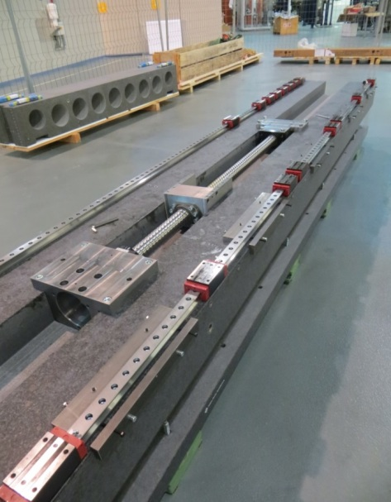
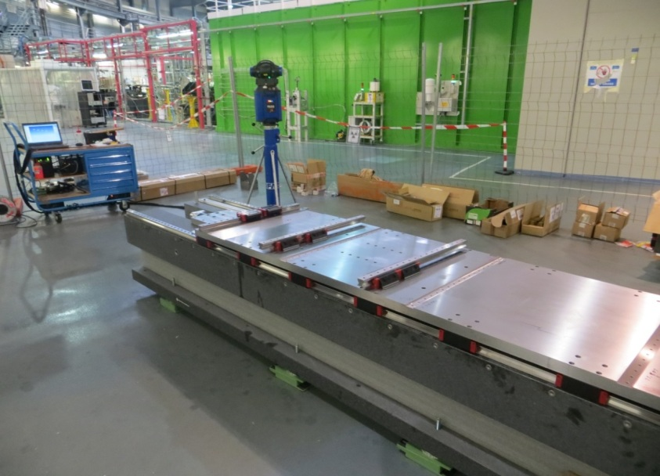
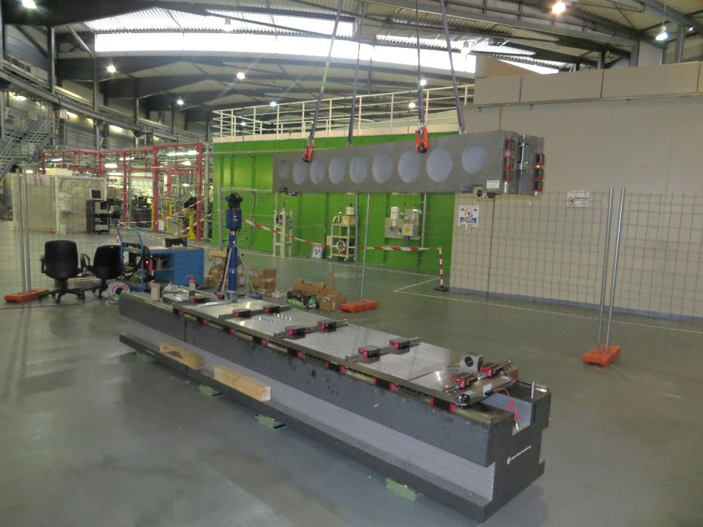
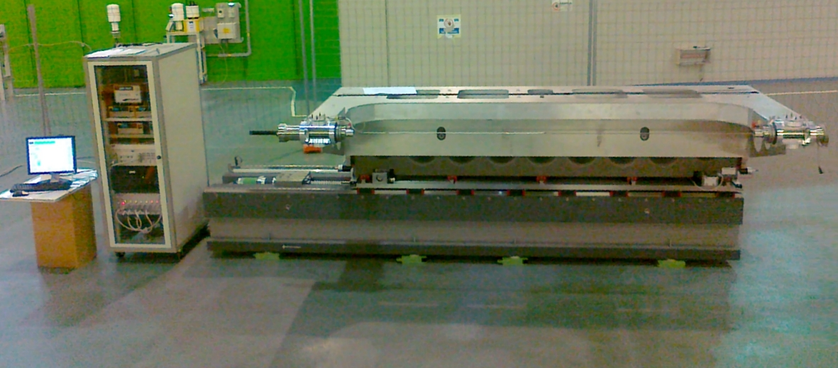
Latest developments
Assembled bench in ALBA Experimental Hall

Slide 19
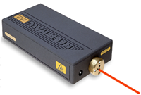

Latest developments
Mechanical system thoroughly characterized using laser interferometer
Resolution (linear) | 1 nm
Resolution (angular) | 41 nrad
Maximum sampling rate | 5 kHz
Noise level | ~0.1 nm RMS
Accuracy (linear) | ±0.7p.p.m
Linearity (angular) | ±0.5 μrad
Interferometer Renishaw ML10
Parameter | Specification | Measured
X positioning error (wrt encoder) | 50 μm | 7 μm
Y positioning error (wrt encoder) | 50 μm | 5 μm
Z positioning error (wrt encoder) | 50 μm | 10 μm
Roll angle error | 50 μrad | 3.5 μrad
Pitch angle error | 50 μrad | 25 μrad
Yaw angle error | 100 μrad | 20 μrad

Slide 20
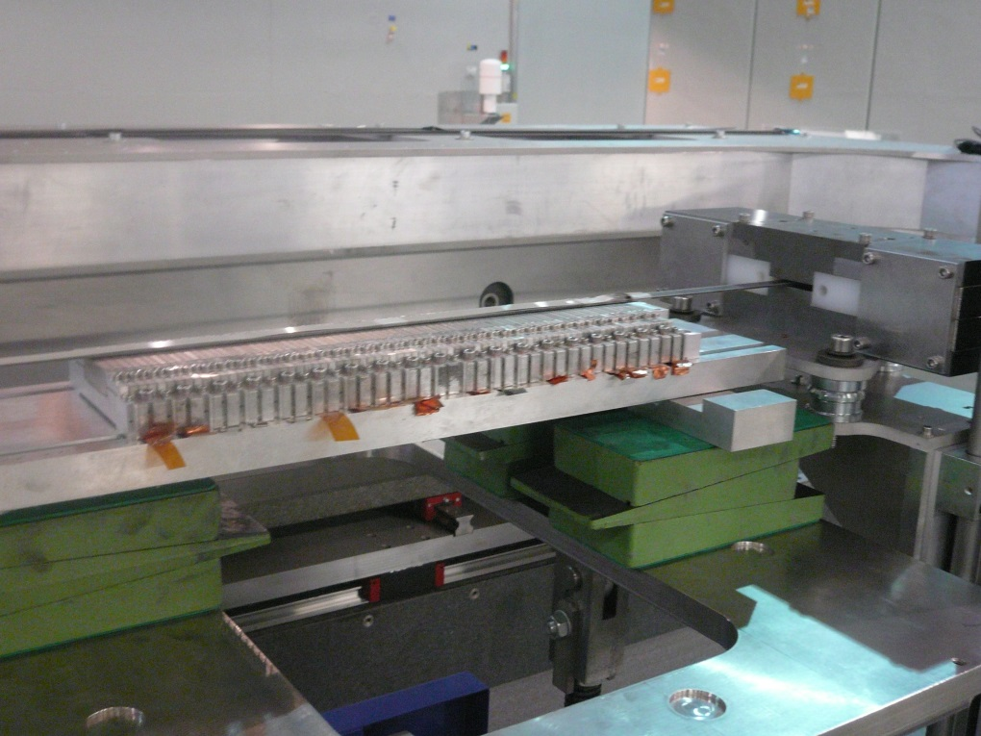
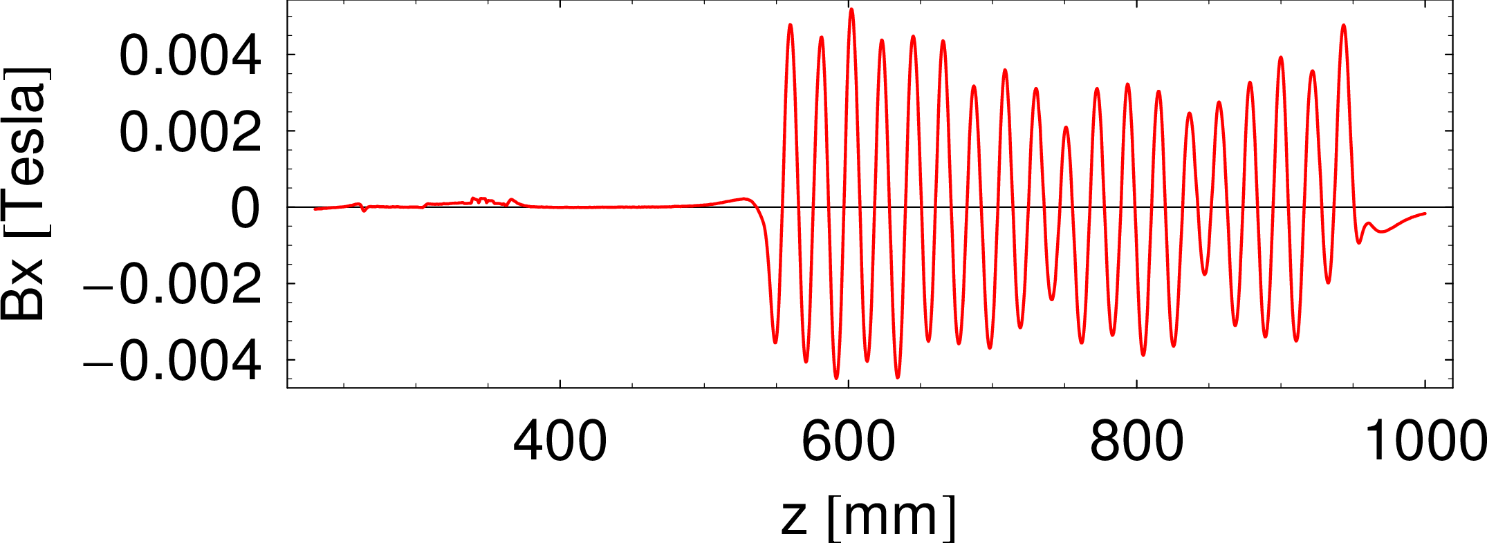
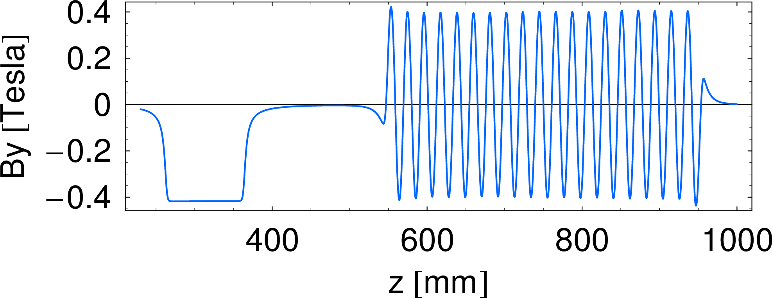
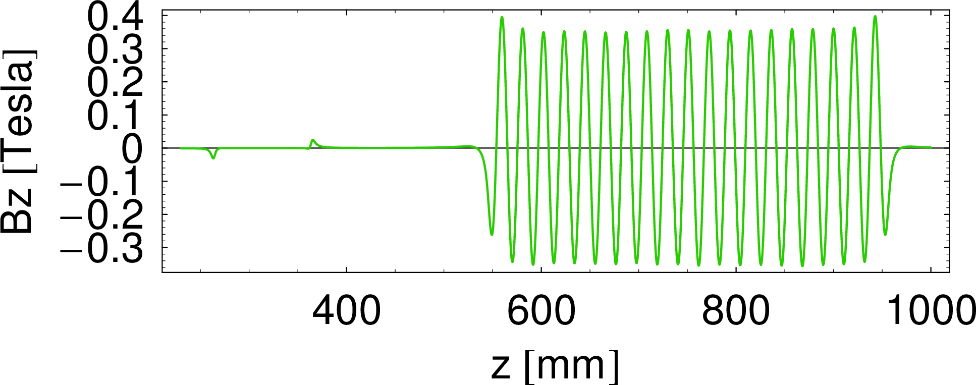

Latest developments
Magnetic tests at ALBA
on-the-fly measurements
Alignment dipole
undulator array
Y
Alignment dipole
Z
X
test undulator array
19 periods
$$λ_{0}=21.3mm$$

Slide 21
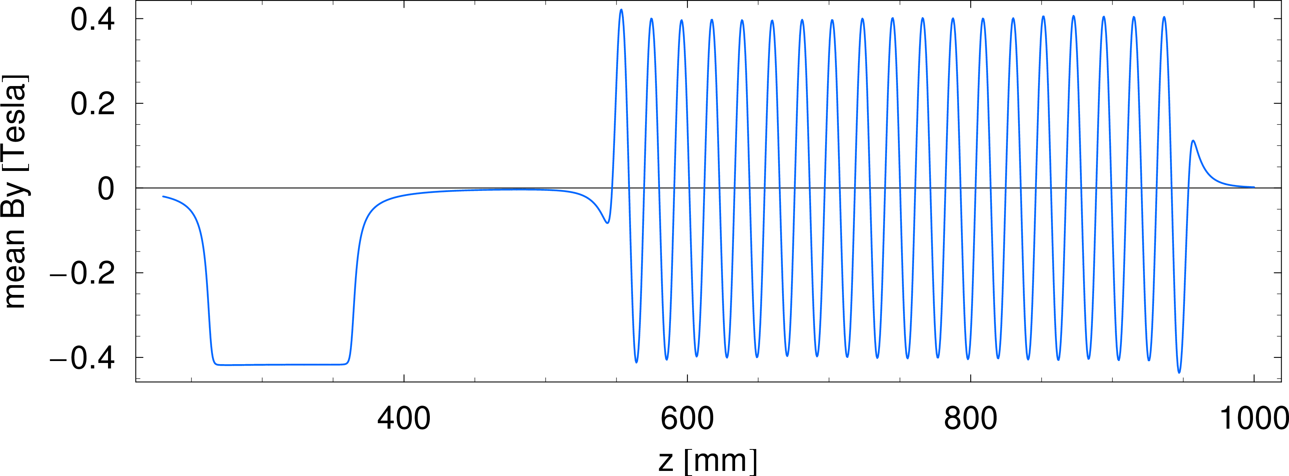
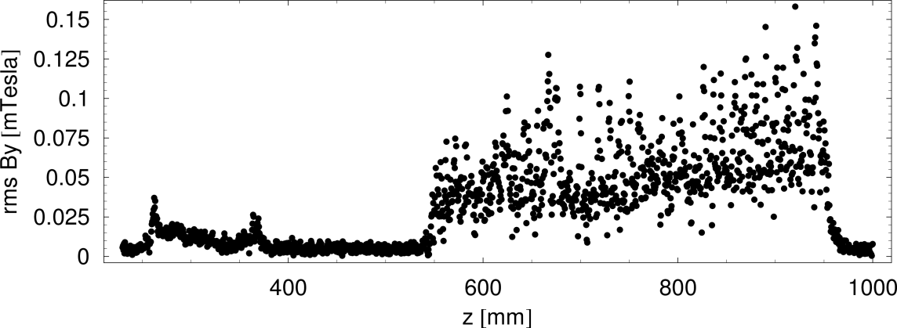

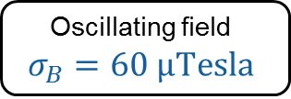
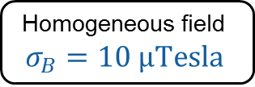
Latest developments
Magnetic tests: Comparison of 10 successive measurements.
By identifying the pole positions of the undulator using the condition $\frac{∂B_{y}}{∂z}=0$:
rms error of the pole locations is $σ_{z}∼1\text{μm}$
rms error of field strength at the poles is $σ_{B}∼40 \text{μTesla}$
Calculated optical phase error is reproducible within 0.01º
Homogeneous field
$$σ_{B}=10 \text{μTesla}$$
Oscillating field
$$σ_{B}=60 \text{μTesla}$$

Slide 22

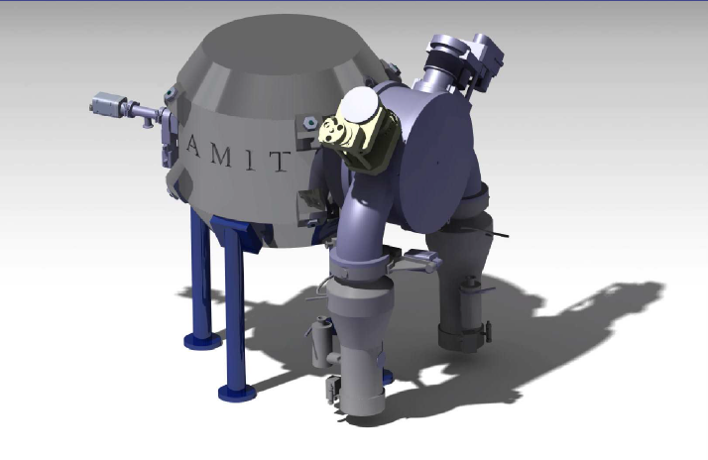
Latest developments
Compact Superconducting Cyclotron for ¹¹C and ¹⁸F production being developed by CIEMAT within AMIT project (Advanced Molecular Image Technologies).
GENERAL
Energy | >8.5 MeV
Current | >10 μA
Cyclotron type | Classical
MAGNET
Type | Low Tc SC
Configuration | Warm Iron
Superconductor | NbTi
Central Field | 4 Tesla
Nominal current | 110 Amp
RF SYSTEM
Configuration | One 180º Dee
Acc. Voltage | >60 kV
ION SOURCE
Type | Internal
Ions | H⁻
OPTIMIZING THE RADIOISOTOPE PRODUCTION WITH A WEAK FOCUSING COMPACT CYCLOTRON
C. Oliver et al.
Proceedings of Cyclotrons2013, Vancouver, WE4PB03

Slide 23
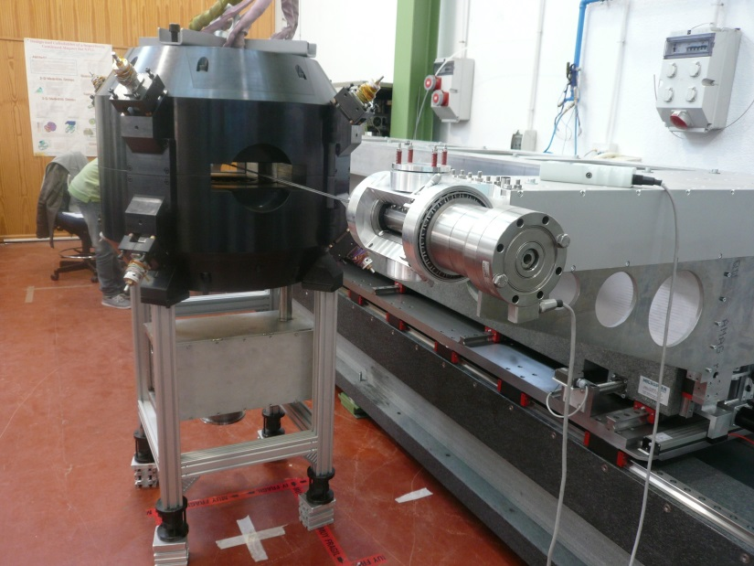




Latest developments
«Longbow» bench moved to CIEMAT premises on 24th October 2016
Check of magnetic field distribution in good field region
First test with warm coils on 27th Oct
(@100mA current)

Slide 24
Outline
1
Introduction
2
Activities
3
Latest developments
4
Conclusions

Slide 25
Conclusions
ALBA magnetic measurement laboratory receives many requests from other institutions and manufacturing companies.
Improvements and new developments are implemented in order to keep the laboratory up to date and to provide new services.
Our last development has been a Hall probe bench for measuring closed and small aperture magnetic structures.
A proof of concept prototype has been built and successfully tested at ALBA.
The prototype is currently in CIEMAT premises (Madrid), and during the following months it will be used to check a superconducting cyclotron magnet.

Slide 26

Thanks on behalf of all involved!
(Logistics, Alignment, Mechanical & Controls Engineers…)

