Slide 1
Status of the ASTRID2 facility
Jørgen S. Nielsen
Center for Storage Ring Facilities (ISA)
Aarhus University
Denmark

Slide 2
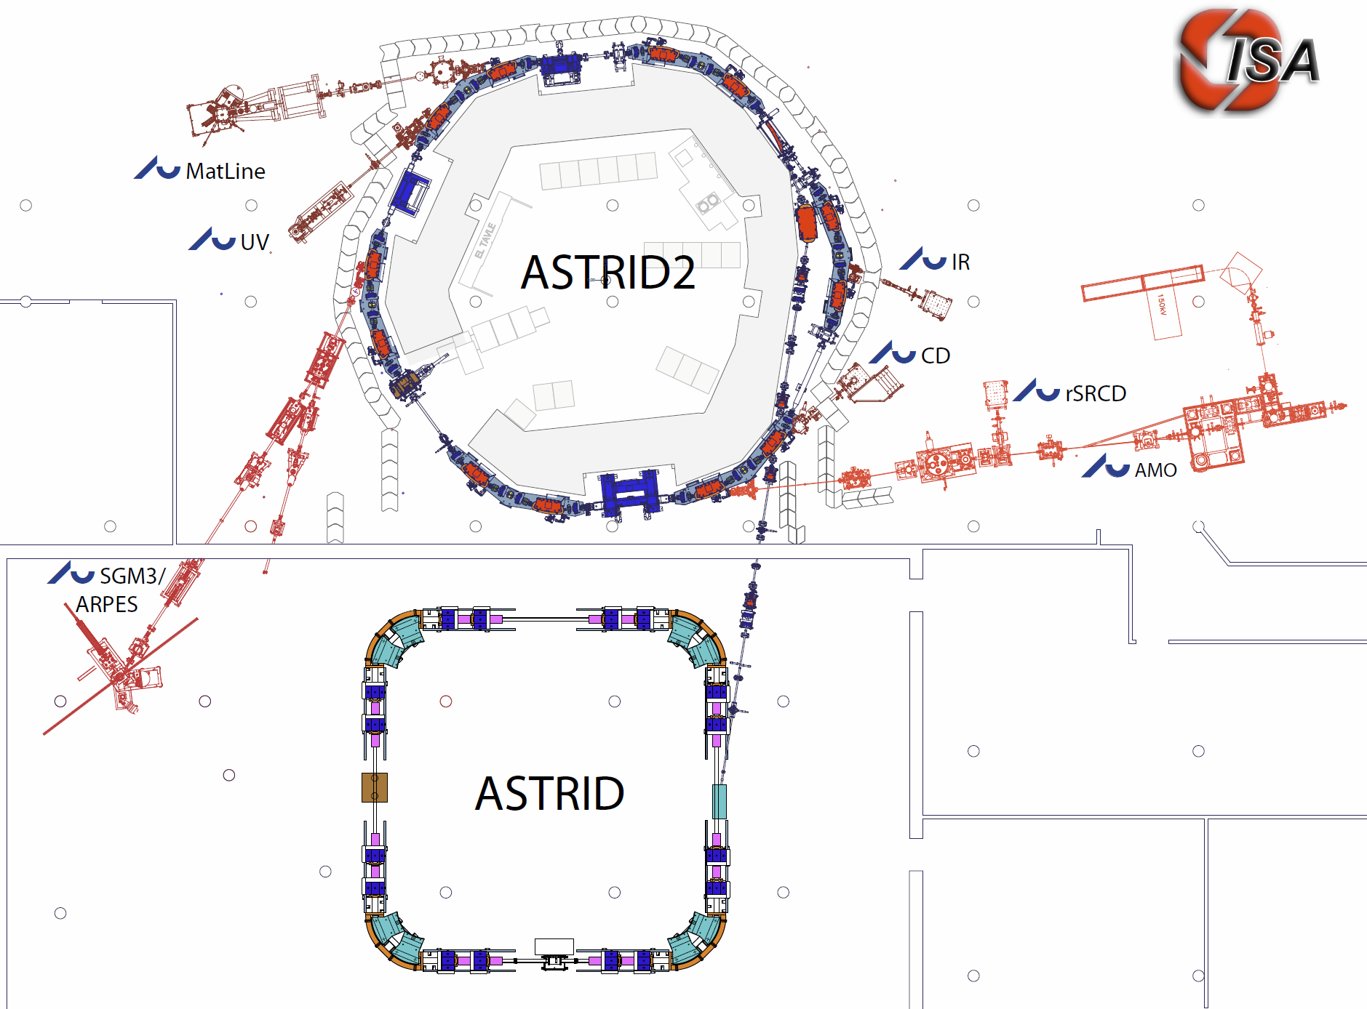
The ASTRID 2 facility
ASTRID2 main parameters
Circumference 45.71m
Energy 580MeV
Current 200mA
Characteristic energy 257eV
RF frequency 105MHz
Harmonic 16
Horiz. emittance 12nmrad
Straight sections 6
Length straight sections 2.82m
ID’s 3
Microtron (100MeV)
Notes:
Microtron, Booster, Inj. Bl., A2 ring, 6 beamlines, 7 experiments

Slide 3
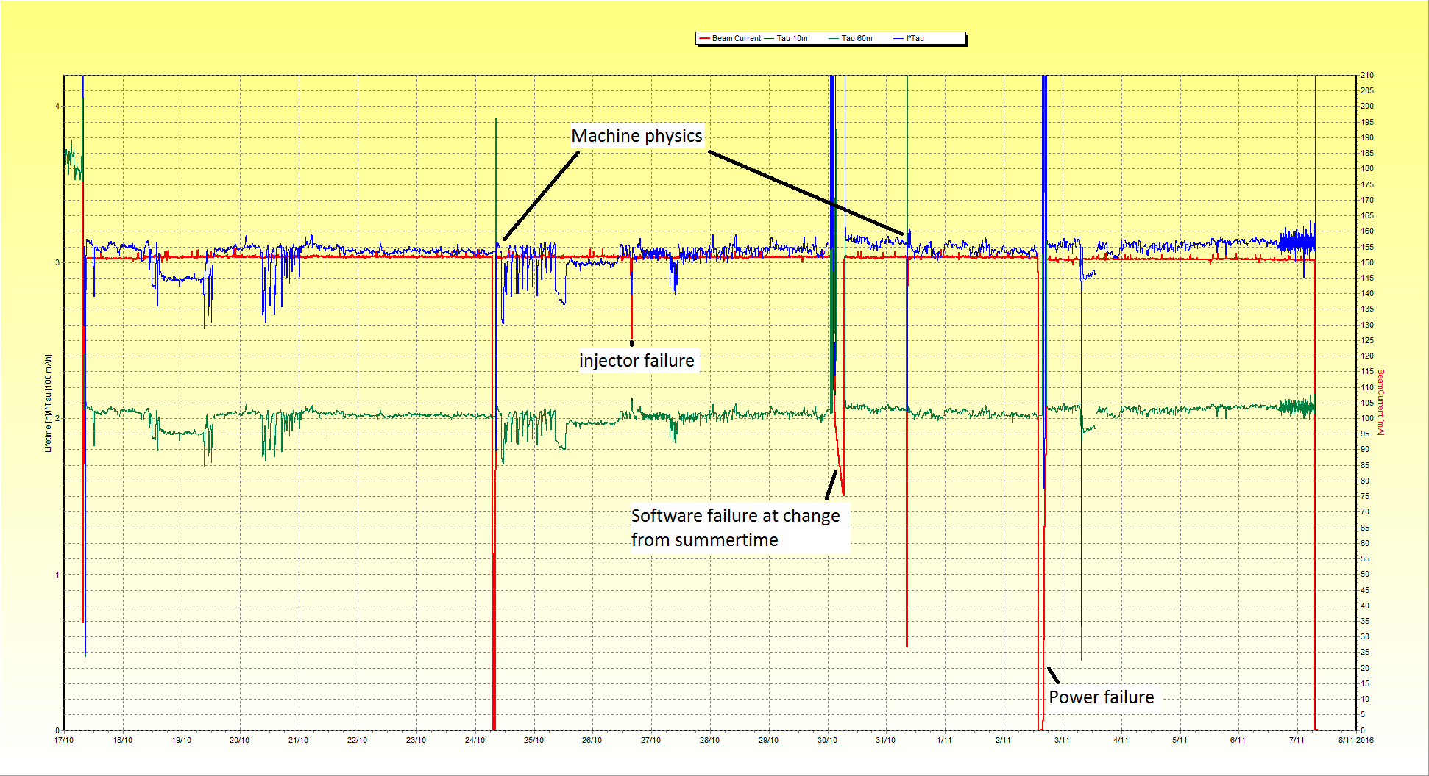
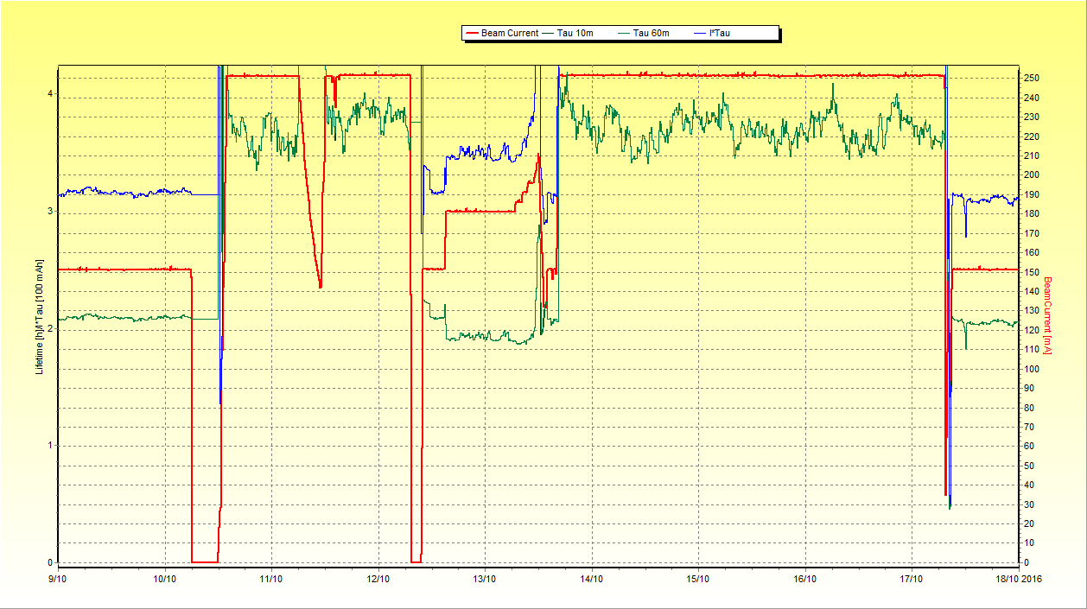
ASTRID2 Status
3 weeks of user beam
Normal operation
150 mA continuous TopUp
Vertical beam is not completely stable at higher beam currents
6 beam lines in operation
With 7 experiments
250 mA TopUp during machine physics for conditioning
MTBF (estimates)
ASTRID2: ~1 month
ASTRID: ~1 week
250 mA during 1 week
of machine studies
Notes:
User mode plot from Y:\AccPhys\Plots\CurrentLifetime\161109-NicePlotsForESLS

Slide 4
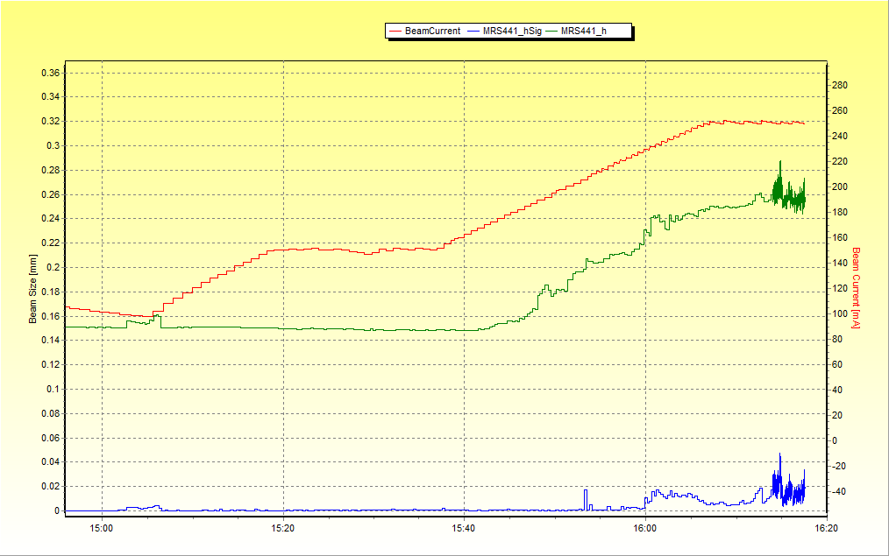
Vertical beam size
At high beam current the vertical beam size grows
Above ~170 mA we see that the vertical beam size grows
The limit has steadily been increasing since startup
Believe it is due to ions captured by the beam
250 mA
150 mA
Vertical
Beam size
Variation in
Vertical Beam size
Notes:
Data from Y:\AccPhys\Instabilities\Vertical\160805-Testing250mA\160805_161646-MRS441_h_hSig_AccumTo250mA

Slide 5
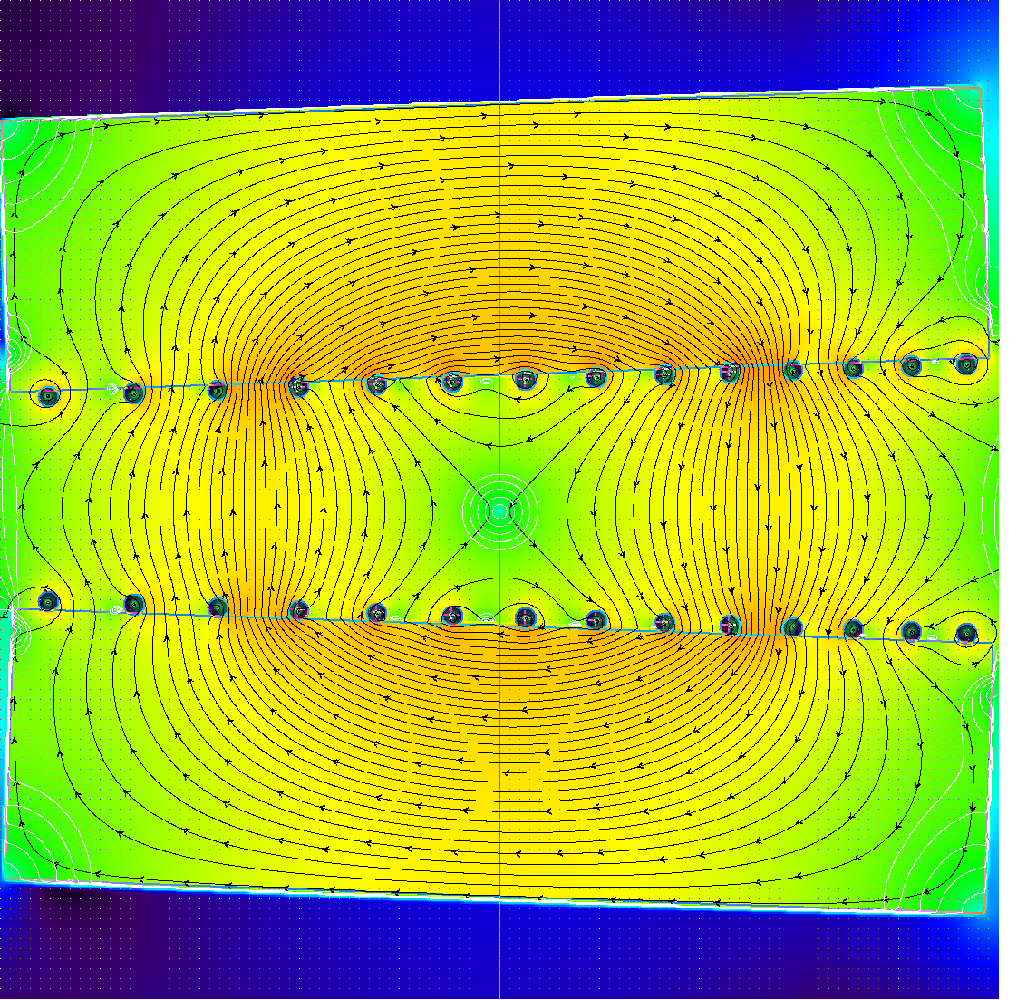
New developments
Spring 2017: LOCO studies using MatLab Middle Layer
2017: Will add more power supplies to our Pole Face Strips
4 power supplies per unit (12 units)
Quadrupole corrector
Tune correction and ID compensation
Vertical and horizontal corrector
Correct errors in position of combined function dipoles
Skew quadrupole
Idea: Vary coupling around the ring
Implementing a Fast Orbit FeedBack system
Hope to have ready during spring of 2017
1
2
4
3
Notes:
Picture is taken from PFW_as_V_corrector_160202_nh.docx (\\isa\data\Ast2Doc\machine\design\PFW)
Upper current is 11 A, and lower current is 9 A, (i.e. 10 A ± 1.0 A)

Slide 6
Orbit disturbances
Disturbance from ASTRID during injections
Up to ~20 µm (even after feedforward)
Cars on parking lot above ASTRID2
Up to ~5 µm
Fairly strong 50 Hz noise peaks
50 Hz: ~3 µm
150 Hz: ~0.4 µm
250 Hz: ~0.2 µm
350 Hz: ~0.3 µm
550 Hz: ~0.2 µm

Slide 7
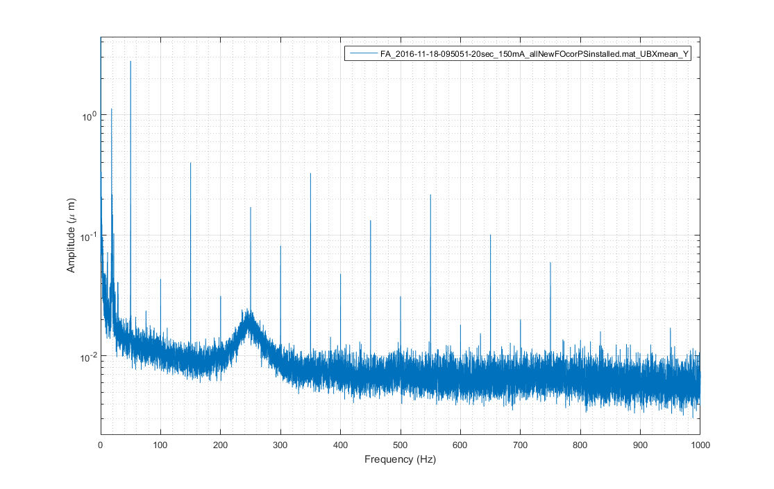
Orbit disturbances
Average of FFT of beam positions from all 24 vertical pickups
Notes:
Beam position FF plot from \\isa\data\Astrid2\AccPhys\Orbit\FAdata\FOFB\161118-AllNewFOcorrectorsInstalled (FA_2016-11-18-095051-20sec_150mA_allNewFOcorPSinstalled_UBXmean_Y.png),

Slide 8
Fast Orbit FeedBack
Beam positions from the 10 kHz Libera Electron FA output
Can use our original window frame correctors
Upgraded the existing power supplies with a fast (1 kHz) analog input
Will use a standard PC running LabVIEW real-time to do the calculations (5-10 kCalc/s)
DACs: 4 pcs TI DAC8568 (8 ch, 16 bit) controlled via SPI from a FPGA enabled DAQ-card at a rate of 5-10 kHz

Slide 9
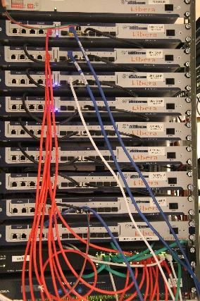
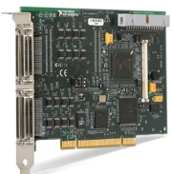
FOFB overview
24 Libera Electron with Grouping
One 10 kHz FA output
Ethernet
Standard PC
with NI PCI-7811R
LabVIEW real-time
SPI-like connections
4 wire each
DAC
8568
DAC
8568
DAC
8568
DAC
8568
6 Power
supplies
6 Power
supplies
6 Power
supplies
6 Power
supplies

Slide 10
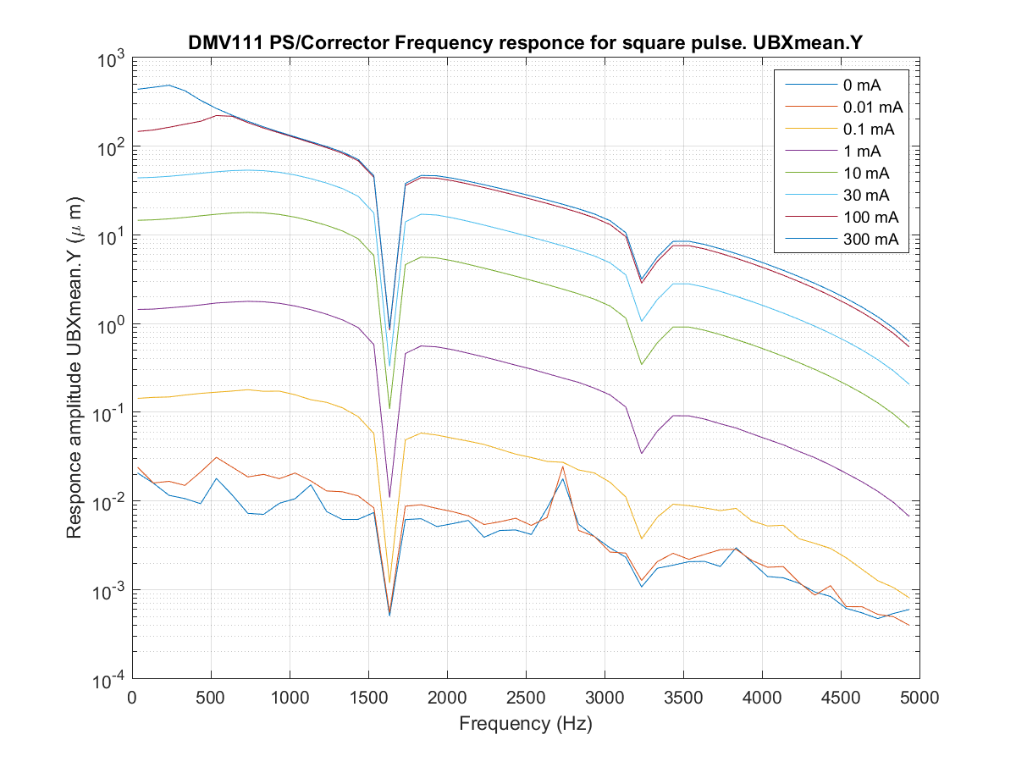
FOFB status
Power supplies are upgraded and tested
Tested successfully that LabVIEW real-time PC can receive Libera FA data at 10 kHz
DAC modules are in production
Actual LabVIEW feedback program needs to be written
Measured
frequency
response
Notes:
Corrector responce plot from \\isa\data\Astrid2\AccPhys\PowerSupplies\CorrectorSupplies\160329-TestingFastCorrectorUpgrade\analyse (FastCorrector_Overall_1f.png),
See ELOG http://isaelog:5717/Ast2Facility/801

Slide 11
Thank you for your attention

