Slide 1
Elettra (and FERMI ) Status and upgrades
Emanuel Karantzoulis
Notes:
Slide 2: Title of the Presentation
Before you start editing the slides of your talk change to the Master Slide view:
Microsoft Office :Menu: View > Slide Master;
Macintosh – View > Master > Slide Master
Edit the following items:
On the Slide Master (first master slide) – lower area
a) On the left Delete the text and write the title of the event/Conference, Location
b) On the right delete the text and write the name and surname of the speaker and the date (day, month , year)
Close Master View
To start adding slides insert a new slide and select a Layout:
For Title & Subtitle
For text with bullet points
For Text
For Picture, graphs, visuals
Two columns
Blank

Slide 2
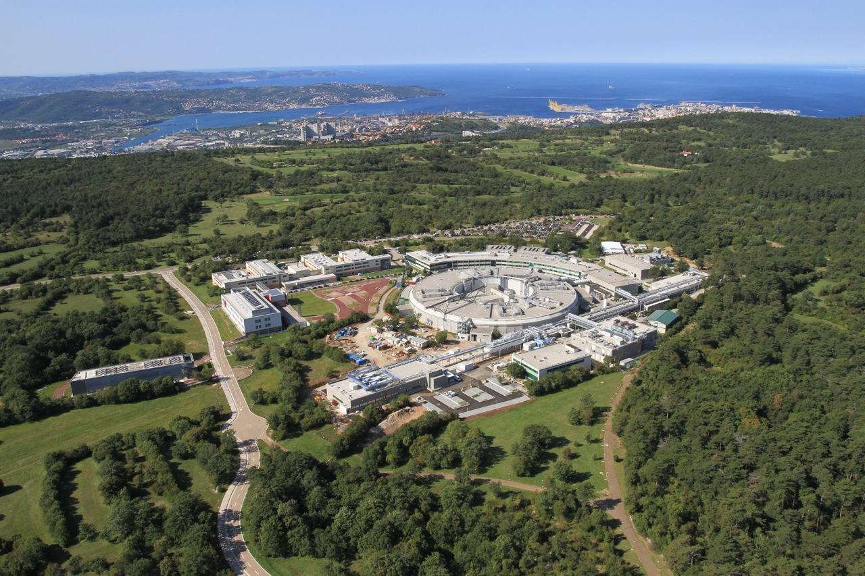
Elettra Sincrotrone Trieste in brief: 2 complementary Light Sources
Elettra
FERMI
Notes:
Slide 3 – (..) : Content of the presentation
Insert a new slide: Home > “New Slide” and choose a slide Layout:
For Title & Subtitle
For text with bullet points
For Text
For Picture, graphs, visuals
Two columns
Blank
If you want Copy & paste an element from the Clip Board to the particular slide:
1. Click on a box to mark it.
2. Position the mouse pointer on the box frame: Copy!
3. Click on the particular slide: Paste!
How you intend to use the elements is your choice.
You can combine the text block style with the background colour in different manner.

Slide 3
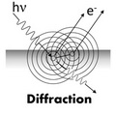
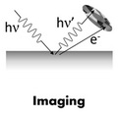
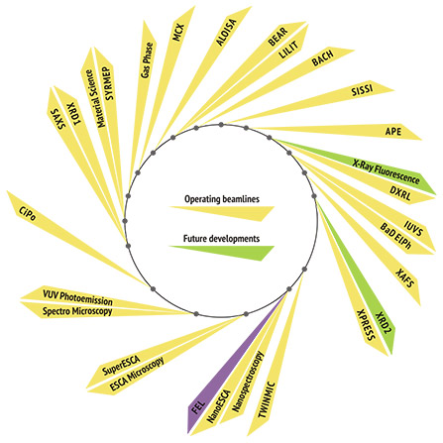
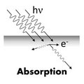
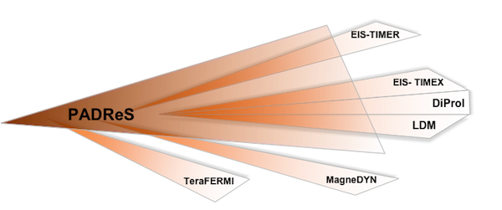
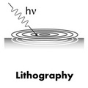
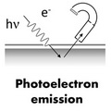
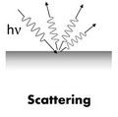
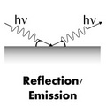
Beam lines 28 + 6

Slide 4
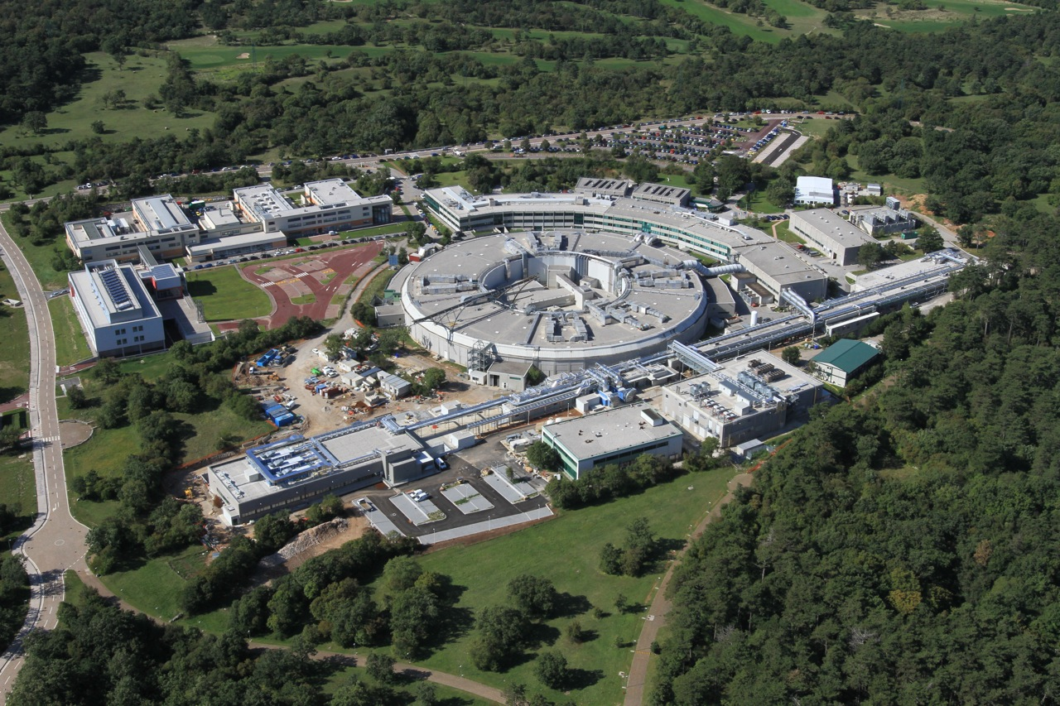
FERMI
Seeded FEL (HGHG), 1.5 (1.8 ) GeV, 10 Hz (50 Hz) – First Lasing Dec.13, 2010
Open to external users since 2012 (FEL-1) (100-20 nm, 12 - 62 eV)
and 2015 (FEL-2) (20- 4 nm, 62 - 320 eV)
∼ 200 m
Linac Tunnel +
Injector Extension
∼ 100 m
Undulator Hall
∼ 50 m
Experim. Hall

Slide 5
FERMI Layout
X-band
Electron linear accelerator tunnel
Laser Heater
BC1
BC2
PI
L1
L2
L3
L4
undulator hall
FEL1
Transfer Line
FEL2
PADReS
experimental hall
Photon Beam Lines
EIS (TIMER /TIMEX)
FEL1
slits
DIPROI
FEL2
Pump&Probe
Autocorrelator
LDM
I/O mirrors & gas cells
MAGNEDYN
TeraFERMI

Slide 6
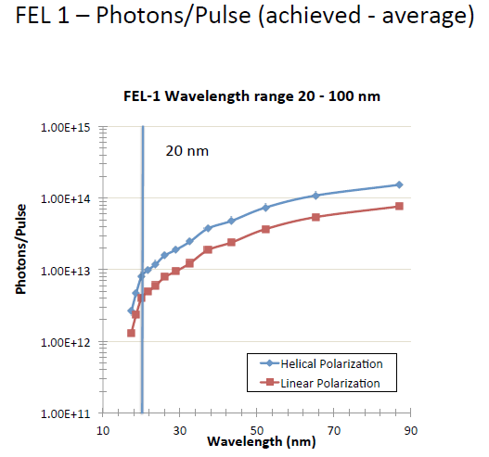
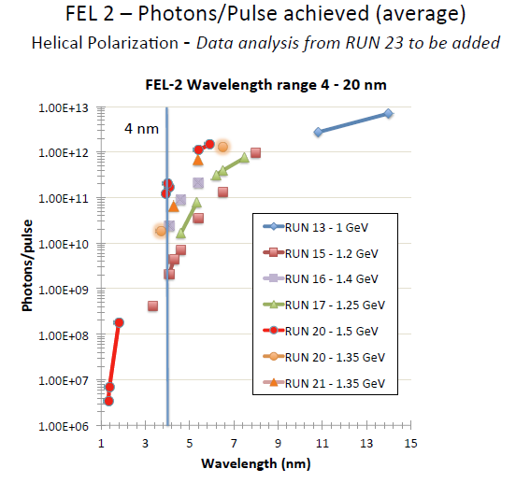
FERMI Overview
FERMI is the first in the world single-pass FEL user facility, based on the high gain harmonic generation scheme HGHG
Two FEL lines are available (externally seeded – single and double stage HGHG -> XUV spectral range characterized by a very high degree of coherence both in the longitudinal and transverse )
Four beam lines presently in operation: DiProi, EIS-TIMEX, LDM, TerraFERMI
62 - 12 eV
320 - 62 eV

Slide 7
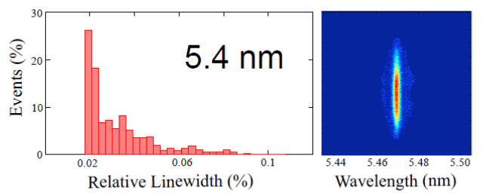
FERMI – electron/photon beam parameters
uJ
Notes:
Slide 3 – (..) : Content of the presentation
Insert a new slide: Home > “New Slide” and choose a slide Layout:
For Title & Subtitle
For text with bullet points
For Text
For Picture, graphs, visuals
Two columns
Blank
If you want Copy & paste an element from the Clip Board to the particular slide:
1. Click on a box to mark it.
2. Position the mouse pointer on the box frame: Copy!
3. Click on the particular slide: Paste!
How you intend to use the elements is your choice.
You can combine the text block style with the background colour in different manner.

Slide 8
FERMI – Status
FEL-1: open to external users since December 2012.
Nominal performance of FEL -2 reached in September 2014
FEL-2 open to external from the first users period of 2015.
Upgrade plans
Shorter Pulses -> < 5 ps
• Coherent harmonic generation uses two time-coincident laser seed pulses at offset frequencies to generate a modulated seed field to generate <5 fs pulses.
• Single-pulse operation relies on a short electron bunch (or limited region of the bunch that can support lasing).
• Superradiance starts from laser seeding but relies on longitudinal self-focusing (a sort of solitary wave that develops in the e-beam phase-space) to generate high peak-power < 5 fs pulses).
• Chirped-pulse amplification (CPA) relies on a chirped seed pulse combined with compressor optics to generate few fs (and potentially as) pulses.
Notes:
Slide 3 – (..) : Content of the presentation
Insert a new slide: Home > “New Slide” and choose a slide Layout:
For Title & Subtitle
For text with bullet points
For Text
For Picture, graphs, visuals
Two columns
Blank
If you want Copy & paste an element from the Clip Board to the particular slide:
1. Click on a box to mark it.
2. Position the mouse pointer on the box frame: Copy!
3. Click on the particular slide: Paste!
How you intend to use the elements is your choice.
You can combine the text block style with the background colour in different manner.

Slide 9
Two-pulse, two-colour operation-> already established for line 1 but more can be done: to independently tune the two colours over a wide range of photon energies to cover different combinations of resonances. Even more important is the possibility to use very short pulses since core resonances are short lived, as well as to be able to tune the time delay between the two pulses anywhere from zero to a few picoseconds. (promising EEHG)
Shorter Wavelengths -> 1.8 GeV
Simultaneous use of FEL-1 and FEL-2 (multi-wave spectroscopy)

Slide 10
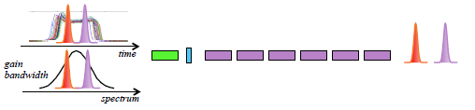
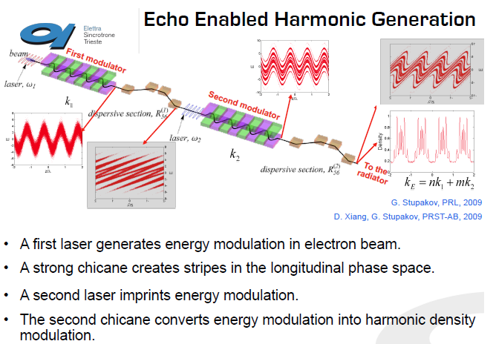
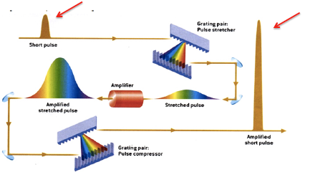
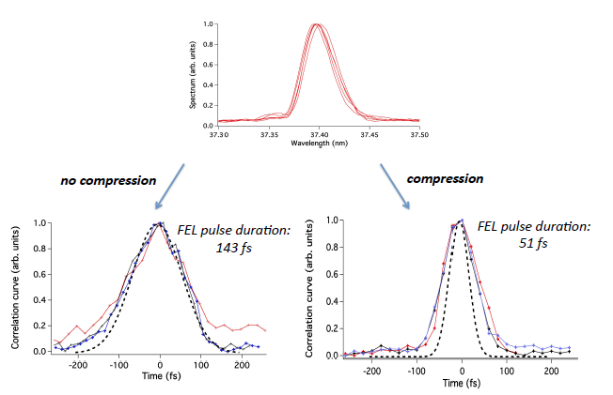
Present and future experiments
Multiple pulses are generated by double pulse seeding in different ways, depending on the requirements on the output radiation. Typical temporal separation between 250-300 and 700-800 fs. (L. Gianessi et al.)
Pulse compression in Chirped
Pulse Amplification experiment
(G. De Ninno et al.)
Echo-Enabled Harmonic Generation (EEHG) at FERMI
FEL-2 Feasibility study (E. Alaria et al.)

Slide 11
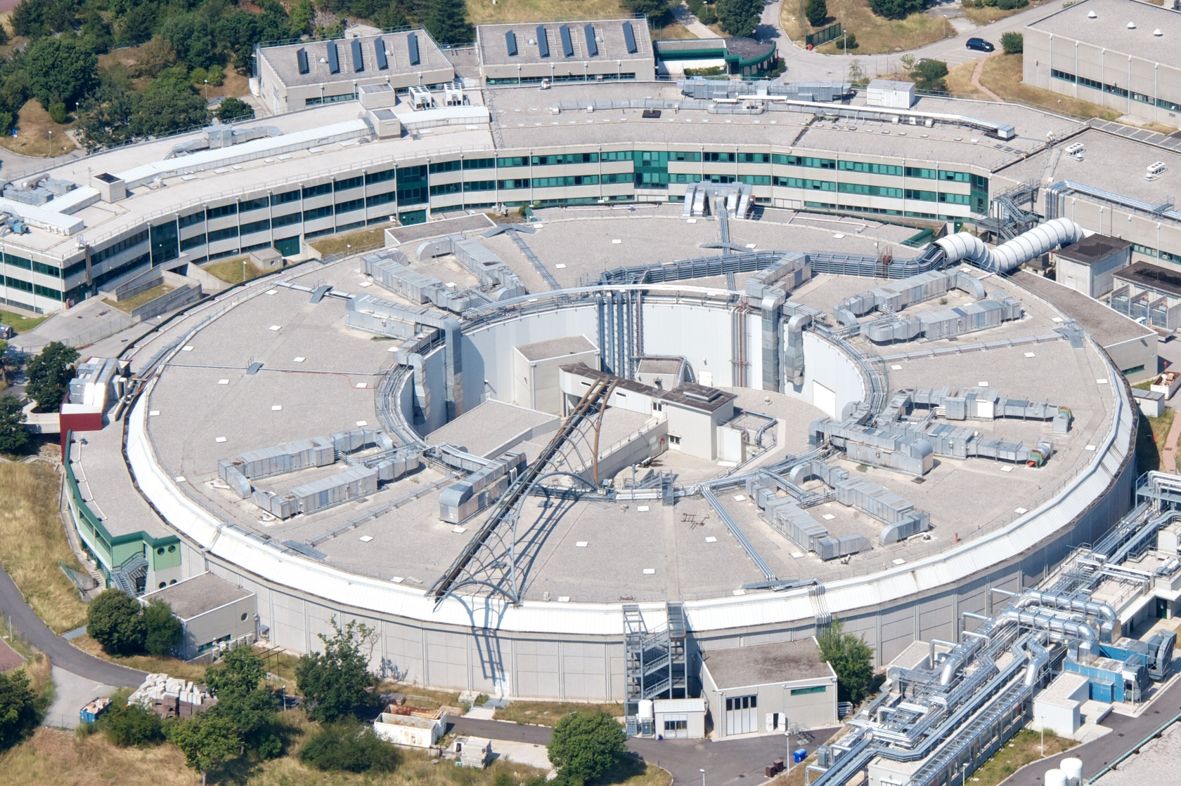
Elettra
Third generation light source (DBA - 259.2 m) , open to external users since 1994
The machine complex initially made of a 1 GeV linac and a storage ring operating at 2.0 (7nm-rad) and since 1998 also at 2.4 GeV, in 2008 built a full energy injector (2.5 GeV booster plus 100 MeV linac) and since 2010 operates in top-up mode.
Linac +
Booster (114 m)
Storage Ring (259 m)
Operate also a storage ring FEL and superconducting systems ( a 3.5 T wiggler and a third harmonic cavity )

Slide 12
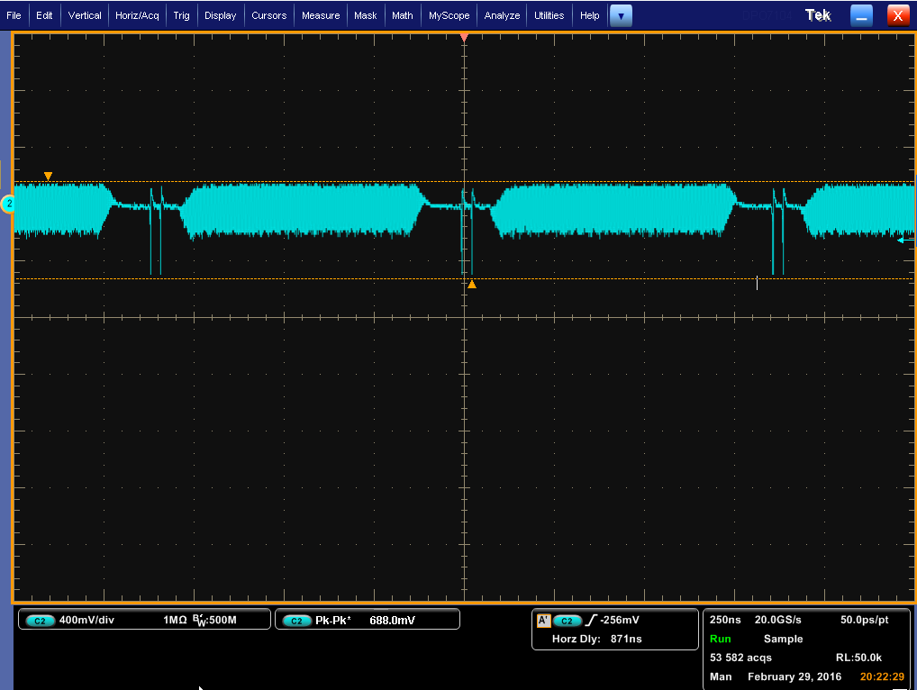
Elettra in brief
Operating modes for users:
Operates for 6400 hours per year (24h, 7/7 ), 5016 hours for users
Top-up 2.0 GeV, 310 mA for 75 % of users time
Top-up 2.4 GeV, 160 mA for 25 % of users time
Filling patterns: multi-bunch 95 % filling or hybrid. Other filling patterns, as single bunch, few bunches or other multi-bunch fillings can be provided.
28 beam lines
More than 900 proposals per year
Oversubscription rate from 1.5 to 3 depending on the beamline.
Notes:
Slide 3 – (..) : Content of the presentation
Insert a new slide: Home > “New Slide” and choose a slide Layout:
For Title & Subtitle
For text with bullet points
For Text
For Picture, graphs, visuals
Two columns
Blank
If you want Copy & paste an element from the Clip Board to the particular slide:
1. Click on a box to mark it.
2. Position the mouse pointer on the box frame: Copy!
3. Click on the particular slide: Paste!
How you intend to use the elements is your choice.
You can combine the text block style with the background colour in different manner.

Slide 13
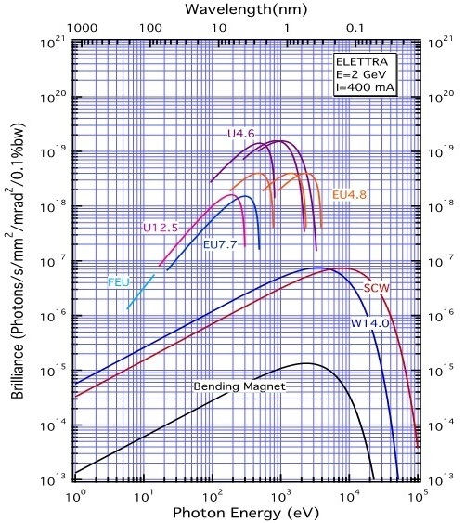
IDs and brilliance
22 ID segments + 1 SCW installed -> 18 beam lines ( planar, elliptical, canted, electromagnetic)
6 bending magnet source points serving 9 beam lines + 1 IR = 10 beam lines

Slide 14
Uptime Statistics
Maximum running without a beam dump: 603 hours , the average of maxima is about 300 hours
2016 data at 88.8% of total user run time
Mean fault duration ~ 1.0 hour
No downtime from the injectors

Slide 16
Top-up statistics
During top-up systems run well and the top-up % of user beam-time is high ~ 98%. The remaining 2% is due to failures that, however, do not impact on the availability.

Slide 17
Top-up downtime
considered when the intensity is less than 99.5% of the nominal
Note: the failures here are not considered as downtime, BUT they can be considered (and therefore not shown here) if the intensity goes below 50% of the nominal.

Slide 18
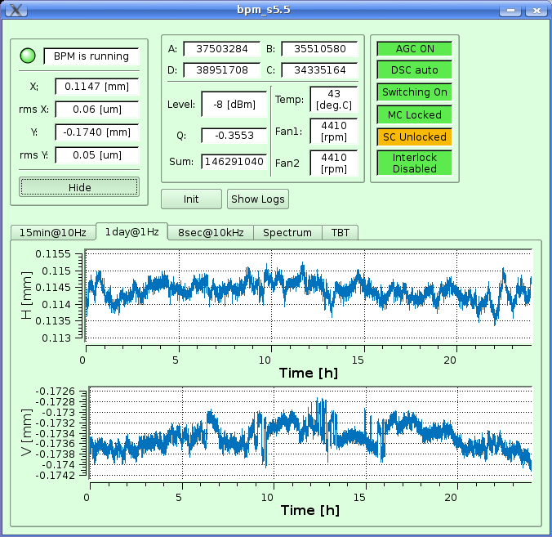
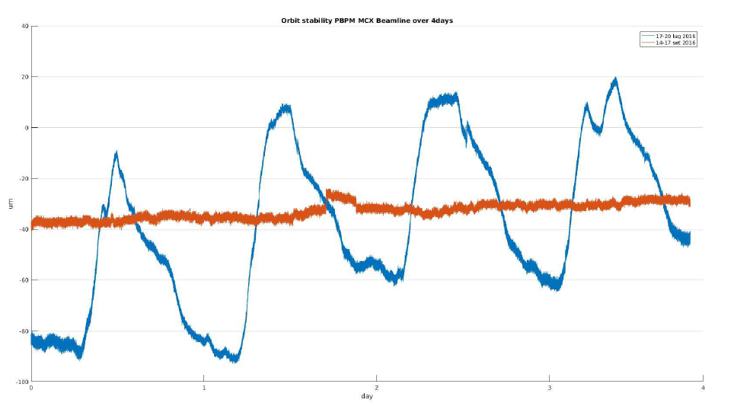
Beam orbit stability
Electron orbit stability requirements met most of the time provided that ambient temperature is within the defined limits, i.e., ± 0.5⁰C
Short term stability (< 24 hours) is < 10% of the electron beam size
Long term (>24 h) is ≤ ± 5 μm ptp (max value for >120 h).
Photon beam stability: 10 um in 4 days
(no photon beam feed-back)
H:1.6 um
V: 1 um
when temperature control does not function properly

Slide 19
Elettra short and mid term developments
Elettra has been upgraded during the years to keep the performance competitive to the new light sources being built in the recent years. Some current upgrades include:
RF upgrade (booster Solid State Amplifier )
PS-controls upgrade
Build new bpm electronics (detectors)
Upgrade vacuum system electronics
Fixed gap undulators
Studies are going on to exploit the margins for other relatively low impact upgrades to extend the performance to the ultimate limits allowed by the present machine also in terms of operability and stability.
Some possibilities ( and actualities) include :
  Increasing the energy to 2.5 GeV, 140 mA
  Reduce the coupling by installing skew quadrupoles
  Reduction of the emittance, presently closest to the theoretical limit for a DBA, with a new optics (60 % reduction if SCW not include, 20 if included at full field).
  Unifying space in the arcs, to integrate the two separated shorter straight section in a 2.5 m straight to provide possibilities for new insertion devices.
  Low alpha optics for short bunches ( coherent infrared – papers published )
E. Karantzoulis et al, “Elettra Status and upgrades”, IPAC 2016, Busan, Korea
Notes:
Slide 3 – (..) : Content of the presentation
Insert a new slide: Home > “New Slide” and choose a slide Layout:
For Title & Subtitle
For text with bullet points
For Text
For Picture, graphs, visuals
Two columns
Blank
If you want Copy & paste an element from the Clip Board to the particular slide:
1. Click on a box to mark it.
2. Position the mouse pointer on the box frame: Copy!
3. Click on the particular slide: Paste!
How you intend to use the elements is your choice.
You can combine the text block style with the background colour in different manner.

Slide 20
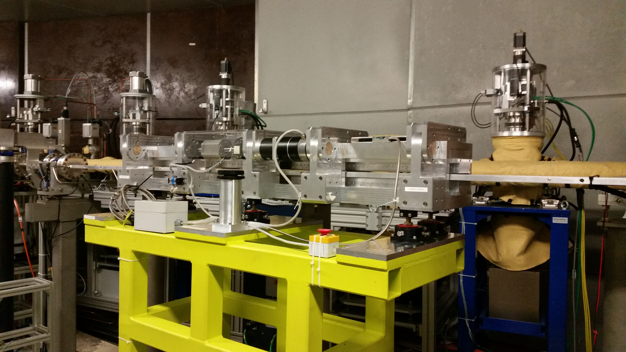
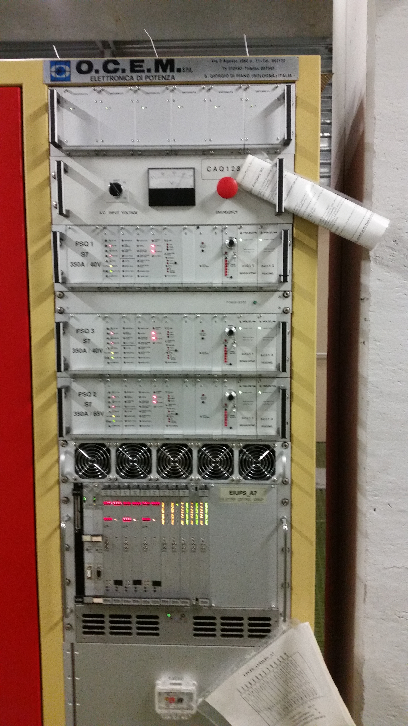
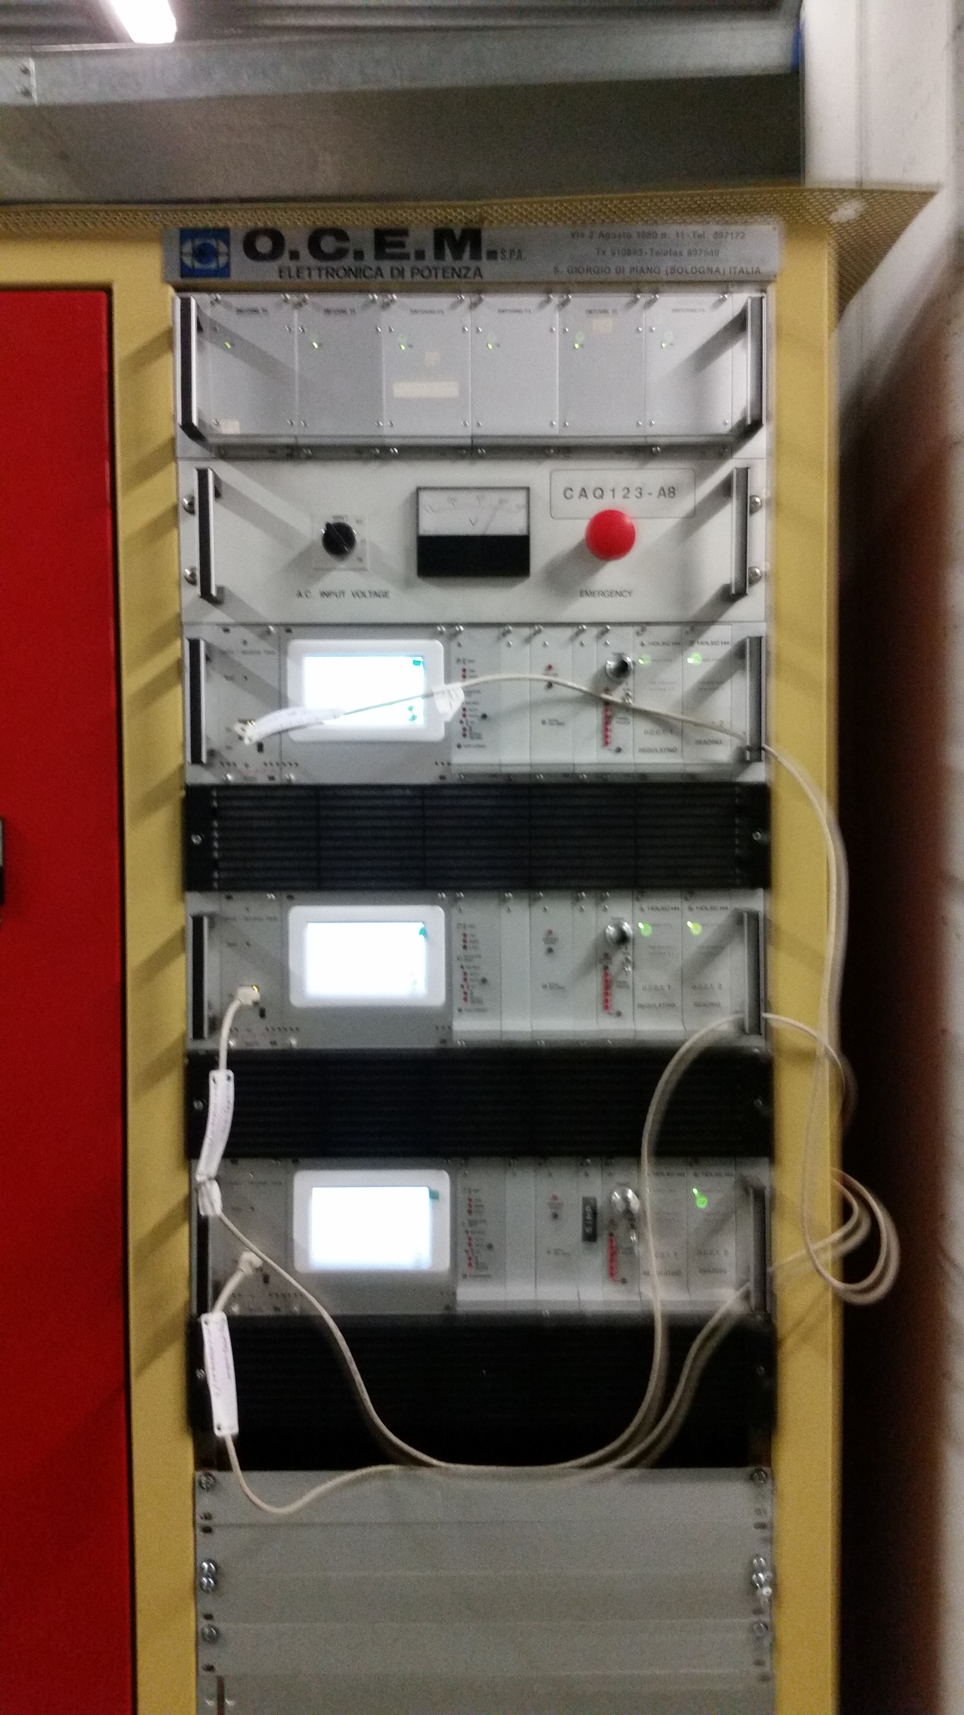
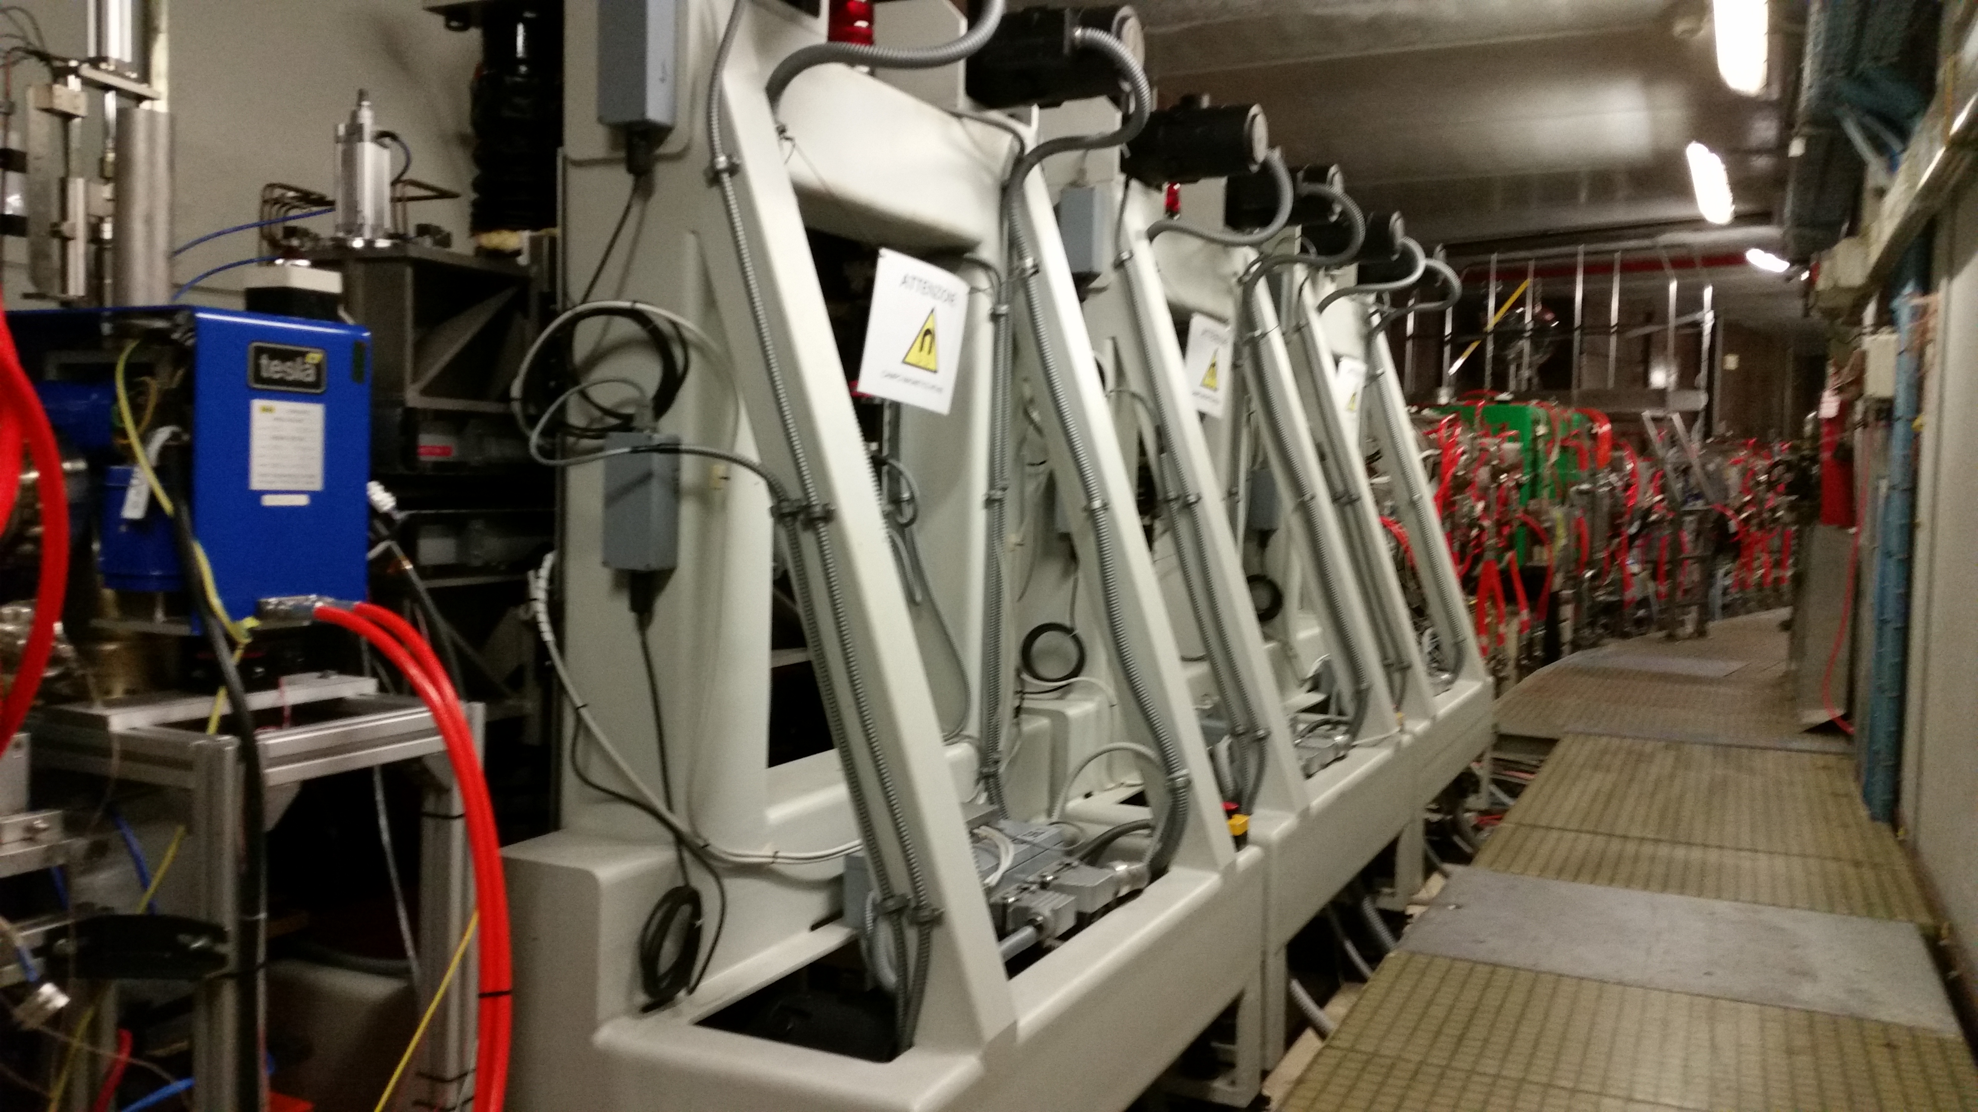
old
new
Fixed gap undulator
a moving gap undulator

Slide 21
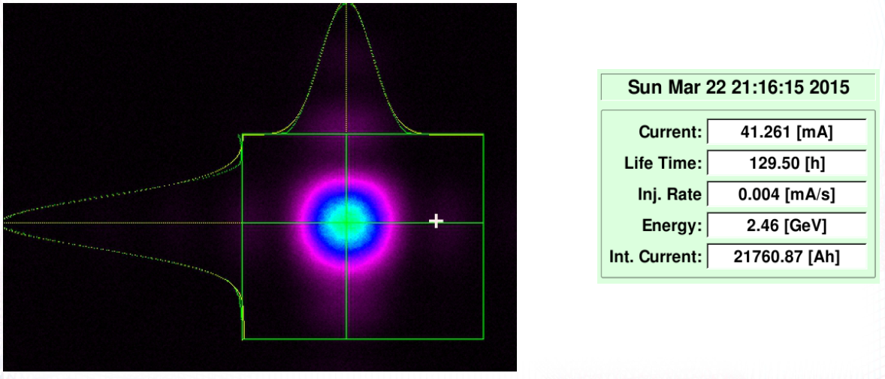
Energy upgrade
At 1950 A out of a max of 2000 A of the dipole power supply. To reach 2.5 GeV a small additional power supply is needed.

Slide 22
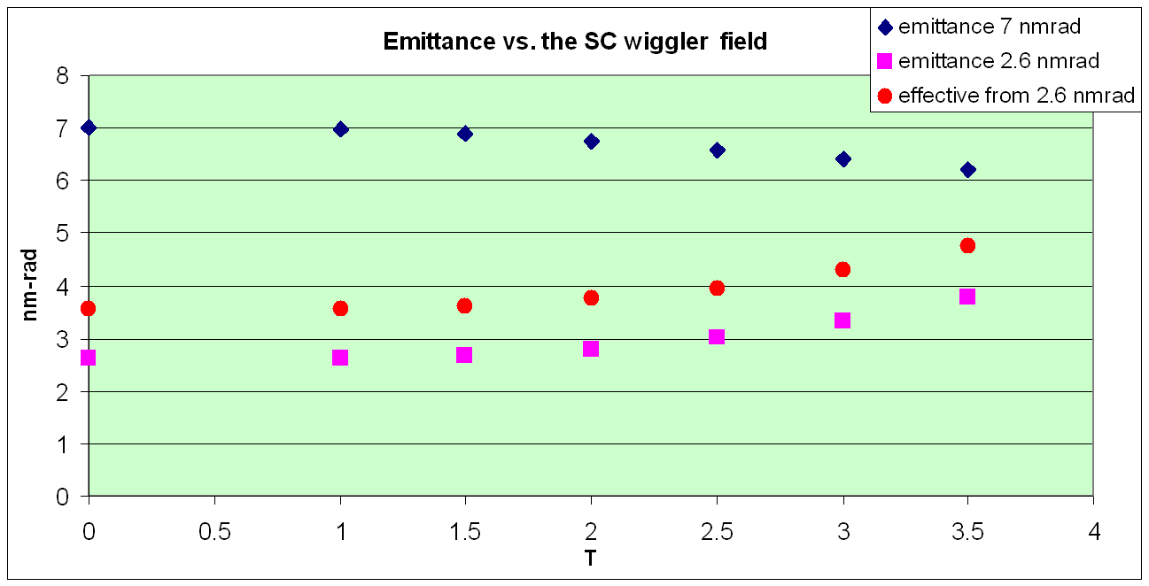
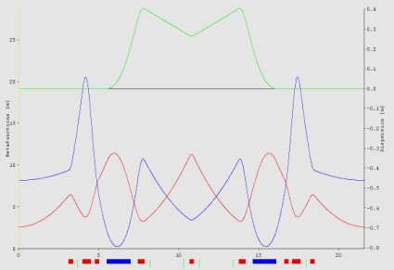
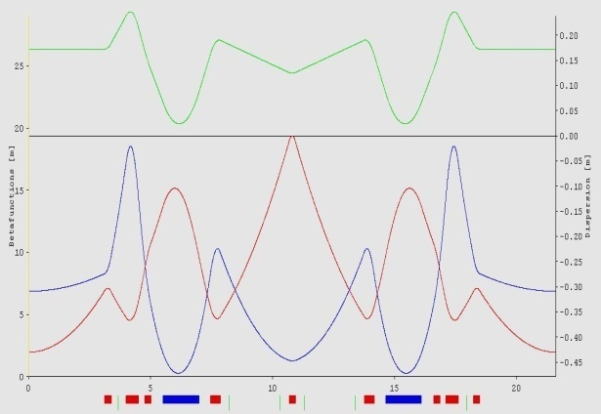
Low emittance optics (LEO) and SCW
WP (16.3,7.2)
E=2.6 nm rad at 2 GeV
WP (14.3,8.2)
E=7 nm rad at 2 GeV
With the SCW the gain is small BUT:
If dispersion locally goes to zero the emittance at 3.5 T becomes 3.5 nm-rad

Slide 23
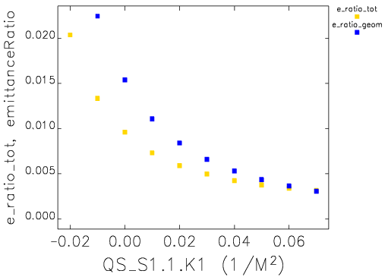
Coupling control
Elettra lacks SQs, operates at 1% coupling using the spurious vertical dispersion. Two SQ families with modest strength are needed along the ring to reduce the coupling
⇒ Coupling correction to < 0.5% requires < 0.7 T/m local, < 0.2 T integrated SQ gradient.

Slide 24
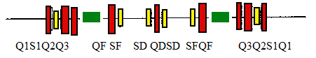
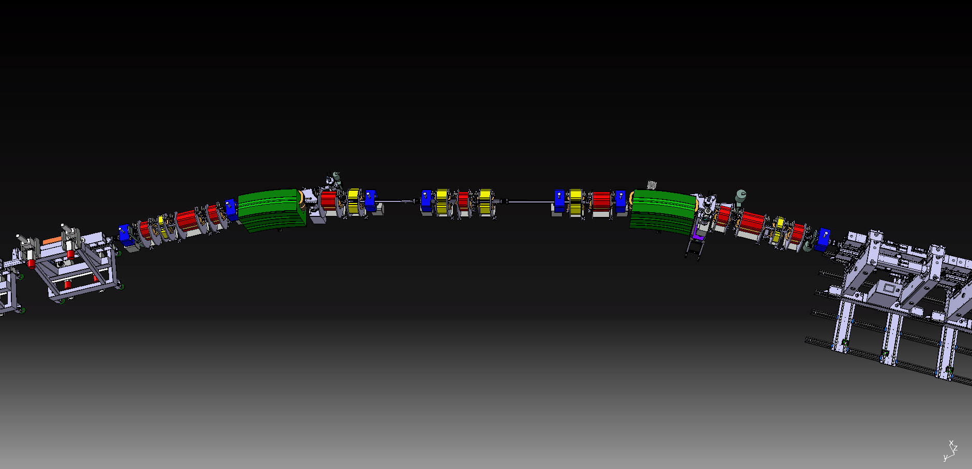
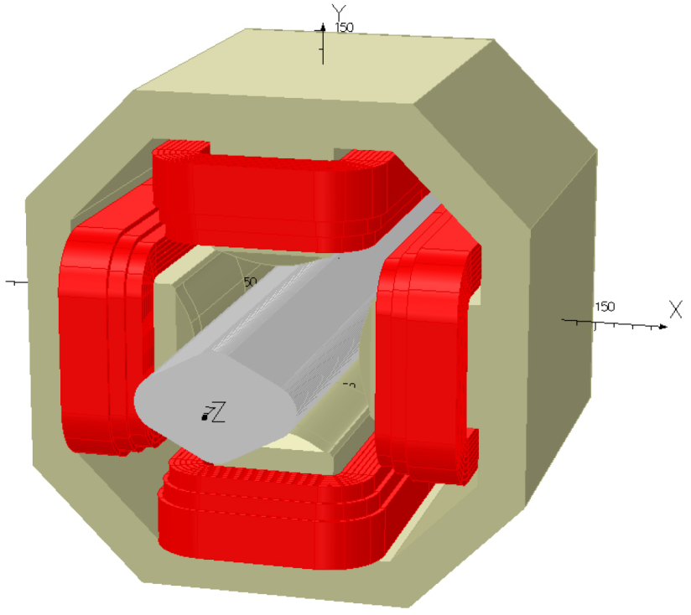
Magnetic & Mechanical Design
Room for skew quad, <0.3m
Magnetic design according to specification:
  physical length < 0.3 m
  integrated norm. strength k₁l < 0.015 m⁻¹
  bore diameter ≥ 85 m
  power supply at ≤ 20 A (30W)
Total cost 12 x (magnets, supports, ps ) ~220 k€

Slide 25
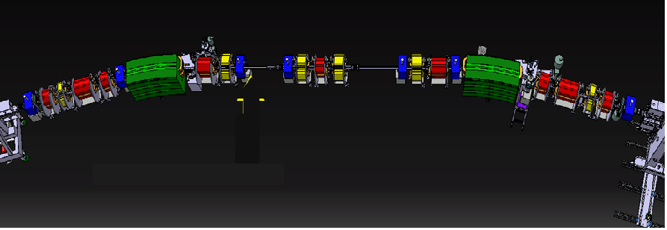
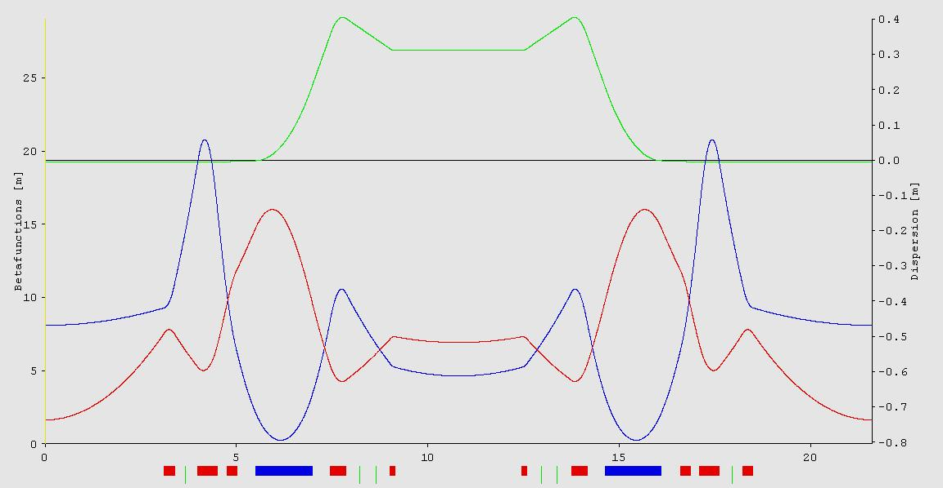
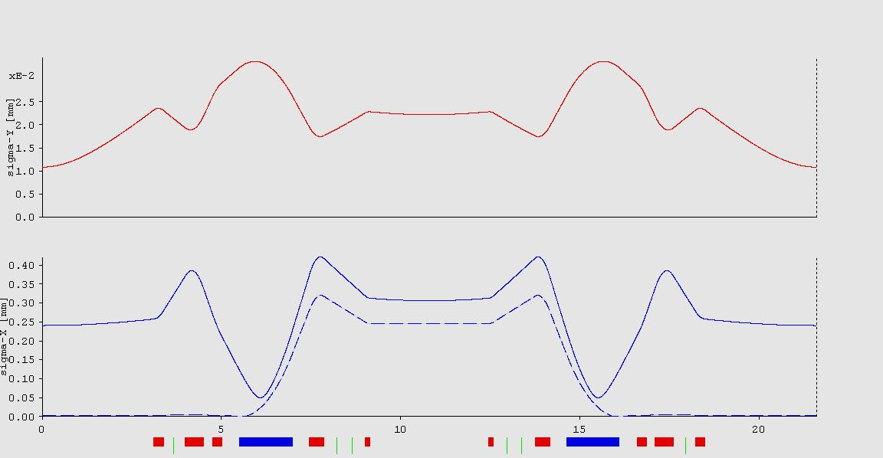
Unifying space in the arcs
About 2.5 m unified free space can be gained (now are two separated 1 and 1.5 )
Emit: 7 nmrad
Tunes 14.3 8.2
Chroms -42 ,- 16
Need to build 2 quadrupoles/achromat
25

Slide 26
Elettra 2.0
Conceptual design study to investigate a successor to the machine, Elettra 2.0
Based on latest trends in this field, i.e. next generation, ultimate light sources (ULS):
  Much higher brilliance (more than one order of magnitude at lower photon energies, e.g. 1 keV),
  High level of coherence in both planes (3rd generation sources have only high vertical coherence),
  Smaller spot size and divergence,
  Higher flux and a variety of insertion devices.
E. Karantzoulis, “Evolution of Elettra towards an Ultimate Light Source”, IPAC 2014, Dresden, June 2014, p. 258 (2014); http://www.JACoW.org
Notes:
Slide 3 – (..) : Content of the presentation
Insert a new slide: Home > “New Slide” and choose a slide Layout:
For Title & Subtitle
For text with bullet points
For Text
For Picture, graphs, visuals
Two columns
Blank
If you want Copy & paste an element from the Clip Board to the particular slide:
1. Click on a box to mark it.
2. Position the mouse pointer on the box frame: Copy!
3. Click on the particular slide: Paste!
How you intend to use the elements is your choice.
You can combine the text block style with the background colour in different manner.

Slide 27
Elettra 2.0 requirements
The requirements for the new machine have been developed based on the interaction with the users’ community and considering costs optimization.
A dedicated workshop on the future of Elettra was held in April 2014 to examine the various requirements
E. Karantzoulis , “Elettra2.0-The Next Machine”, IPAC 2015, Richmond, May 2015
Design boundary conditions
Beam energy: 2 GeV
Beam intensity: 400 mA
Emittance: to be reduced by more than 1 order of magnitude
Horizontal electron beam size: less than 60 µm
Conserve filling patterns: multibunch, hybrid, single bunch, few bunches
Keep the same building and the same ring circumference (259-260 m)
Existing ID beam lines and their position should be maintained
Free space available for IDs: not less than that of Elettra
Keep the existing bending magnets beam lines
Use the existing injectors, that means off-axis injection
Easy part
Tough part

Slide 28
Elettra 2.0 Lattice
Best configuration satisfying all user requests is based on a six-bend achromat. Versions that minimize interferences and induce minimal position shift of the dipole beam lines were examined. Possible new beam lines from central dipoles
Various dipole magnet versions were also studied
All dipoles at about 0.8T electromagnets
Emit: 0.25 nm-rad, WP 33.2 , 9.3
Nat. chrom -63,-50 , dE/turn: 162 keV
Another solution with the 2 and 4th dipole at 1.4 T PM + 2 quads each.
Emit: 0.28 nm-rad, WP 33.2 ,9.3
Nat.chrom -81,-44 , dE/turn: 202 keV
A third solution with the 2 and 4th dipole at 0.8 +1.4 T with a series of short PMs
Emit: 0.25 nm-rad, WP 33.2 ,9.3, Nat.chrom -77,-55 , dE/turn: 196 keV
E. Karantzoulis , “Elettra2.0-The Next Machine”, IPAC 2015, Richmond, May 2015

Slide 29
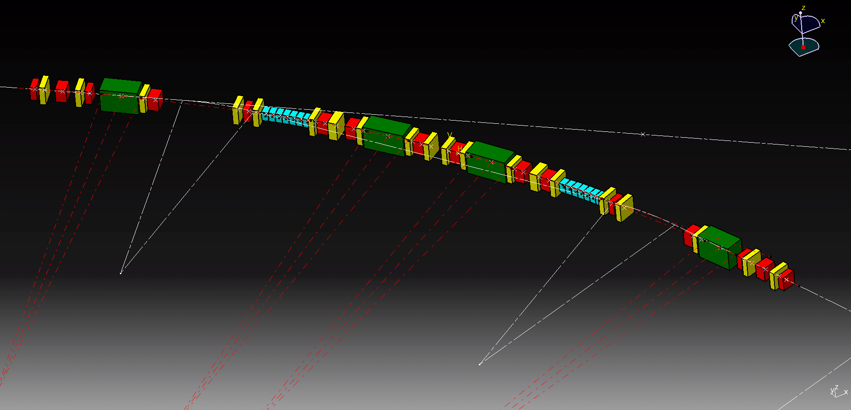
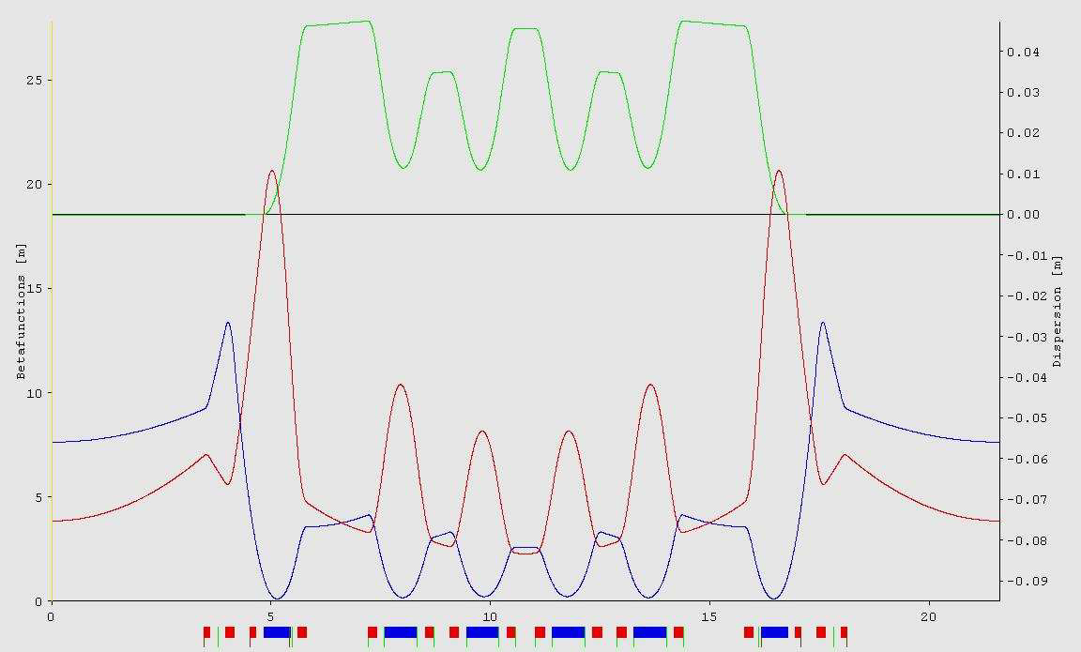
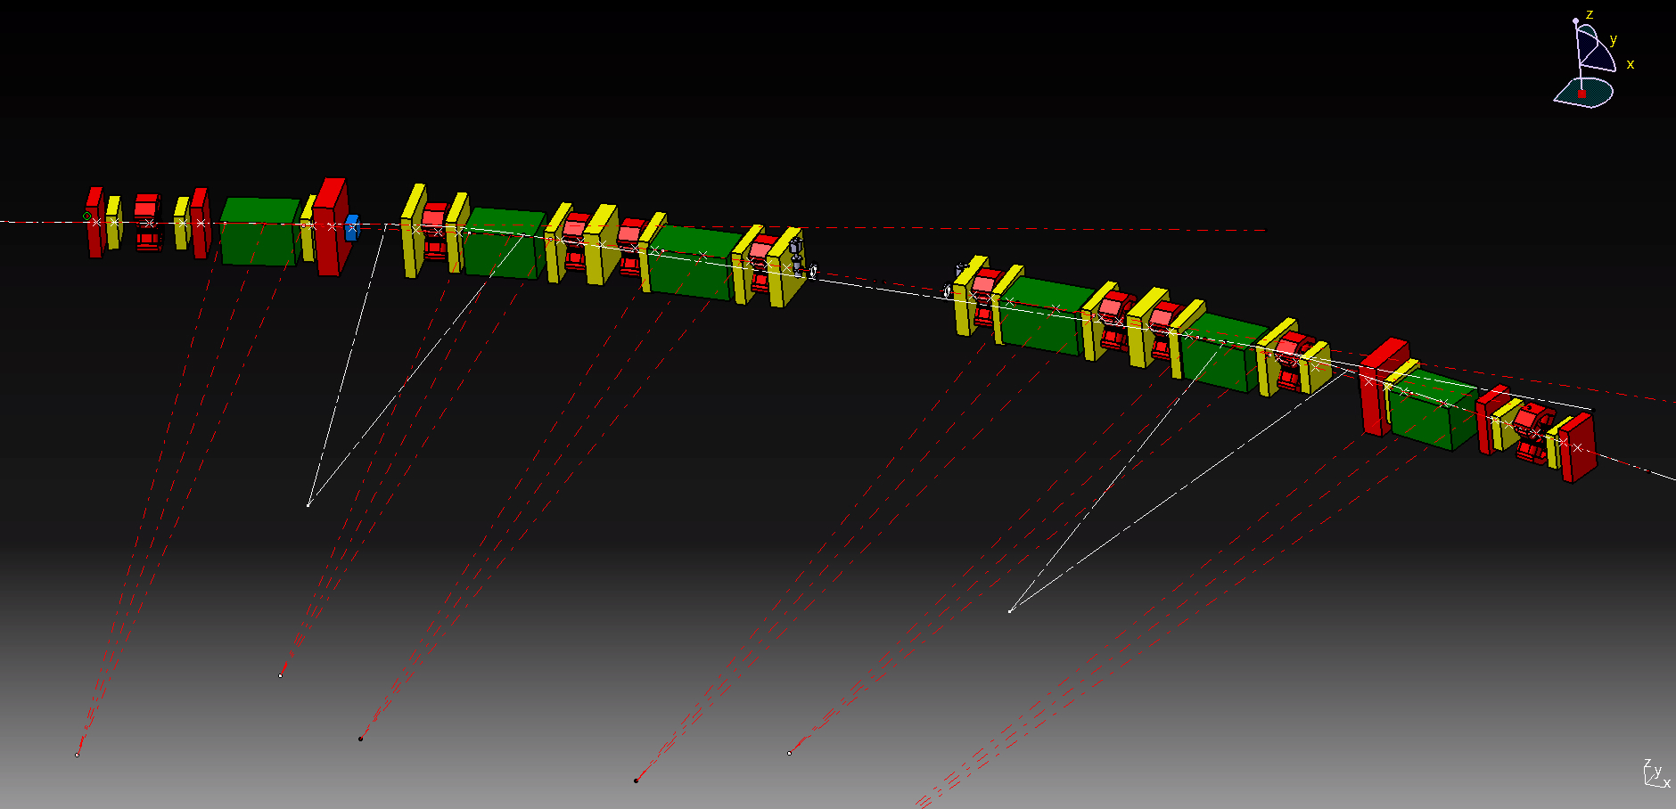
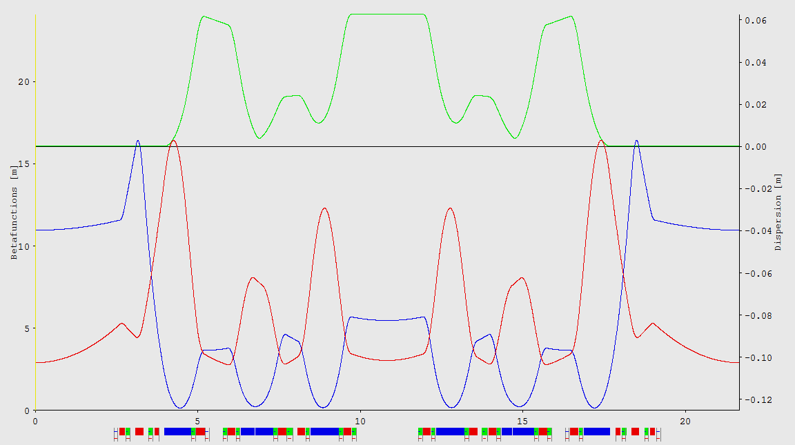
2 principal configurations
A. Streun, “OPA version 3.39”, PSI, 2014

Slide 30
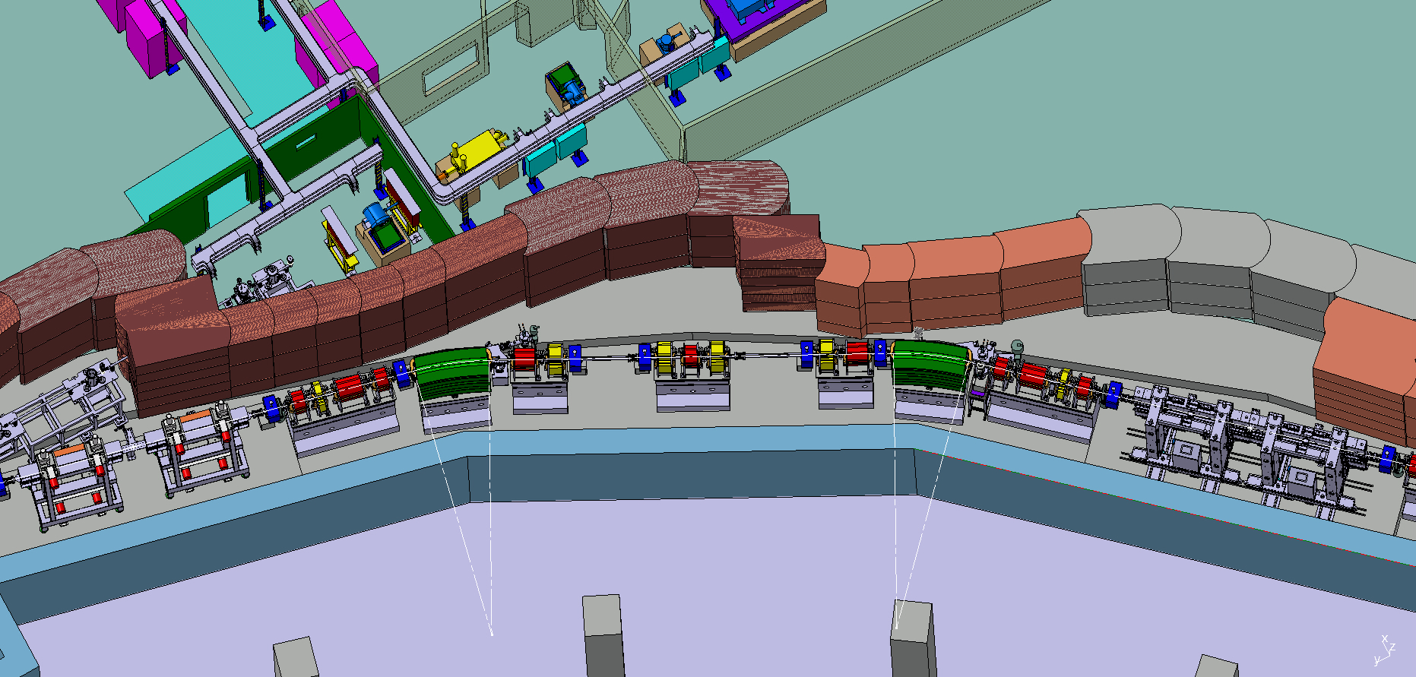
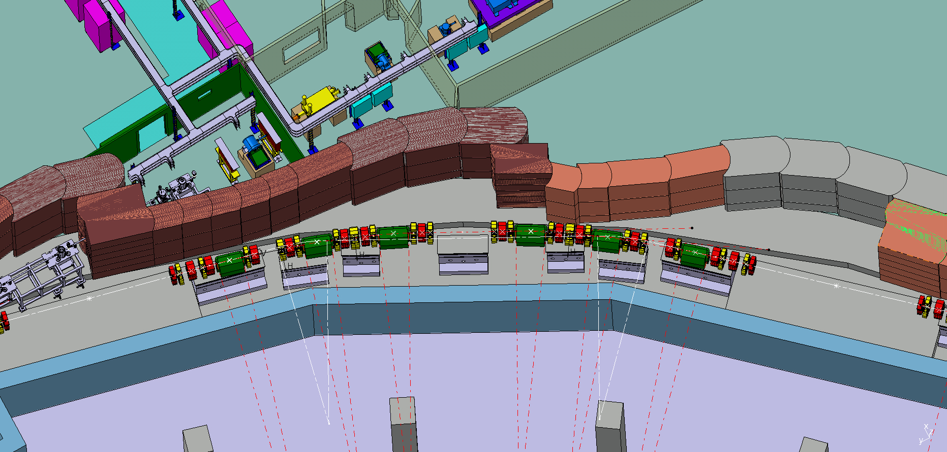

Slide 31
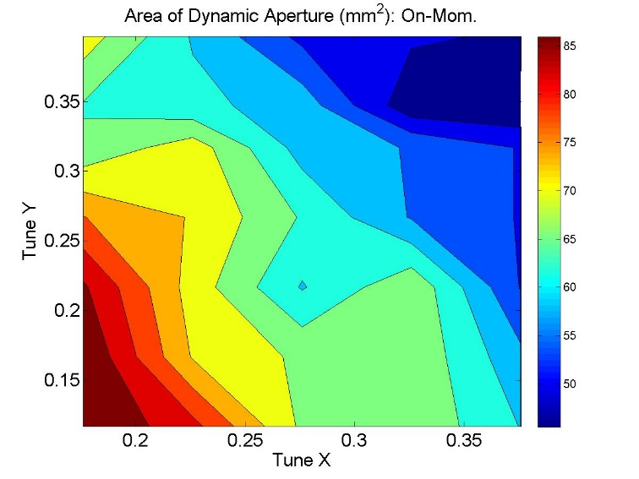
2nd configuration: list of optics and rf functions
Circumference (m) | 259.2
Energy (GeV) | 2
Number of cells | 12
Geometric emittance (nm-rad) | 0.258
Horizontal tune | 33.10
Vertical tune | 9.19
Betatron function in the middle of straights (x, y ) m | (9.5,3.2 )
Horizontal natural chromaticity | -76
Vertical natural chromaticity | -52
Horizontal corrected chromaticity | +1
Vertical corrected chromaticity | +1
Momentum compaction | 3.44e-004
Momentum compaction second order | 3.60e-004
Energy loss per turn (with no IDs) (keV) | 156
Energy spread | 6.67e-004
Jx | 1.52
Jy | 1.00
Jdelta | 1.48
Horizontal damping time (ms) | 14.8
Vertical damping time (ms) | 22.9
Longitudinal damping time (ms) | 15.0
Dipole field (T) | <0.8
Quadrupole gradient in dipole (T/m) | <15
Quadrupole gradient (T/m) | <50
Sextupole gradient (T/m²) | <3500
RF frequency (MHz) | 499.654
Beam revolution frequency (MHz) | 1.1566
Harmonic number | 432
Orbital period (ns) | 864.6
Bucket length (ns) | 2
Natural bunch length ( mm, ps ) | 2.16 , 7.2
Synchrotron frequency (kHz) | 5.23
On-momentum dynamic aperture in mm² for the bare lattice, as a function of the working point.
horizontal and vertical tune shifts with ±3% relative momentum deviation

Slide 32
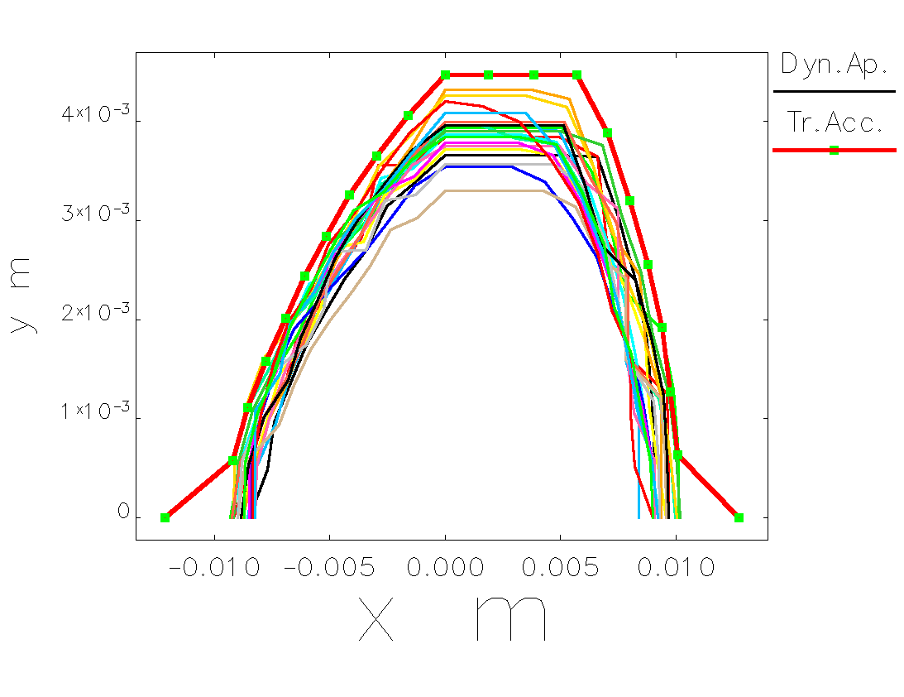
DA with errors
Element Type | Parameter | Value | Unit
Dipole | Δx | 20 | μm
 | Δy | 20 | μm
 | Δz | 300 | μm
 | Roll angle | 100 | μrad
 | ΔBl/Bl | 0.01 | %
Quadrupole | Δx | 20 | μm
 | Δy | 20 | μm
 | Δz | 300 | μm
 | Roll angle | 100 | μrad
 | ΔBl/Bl | 0.01 | %
Sextupole | Δx | 20 | μm
 | Δy | 20 | μm
 | Δz | 300 | μm
 | Roll angle | 100 | μrad
 | ΔBl/Bl | 0.01 | %
Corrector | Δz | 20 | μm
 | Roll angle | 100 | μrad
BPM | Δx | 20 | μm
 | Δy | 20 | μm
 | Δz | 300 | μm
 | Roll angle | 100 | μrad
Dynamic aperture for the bare lattice (named transverse acceptance in the legend), and in the presence of machine errors plus corrections, for 20 independent error seeds
“elegant” runs ref. S. Di Mitri

Slide 33
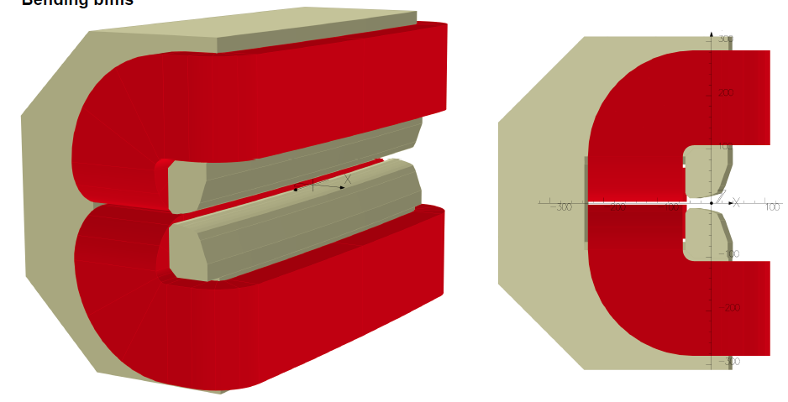
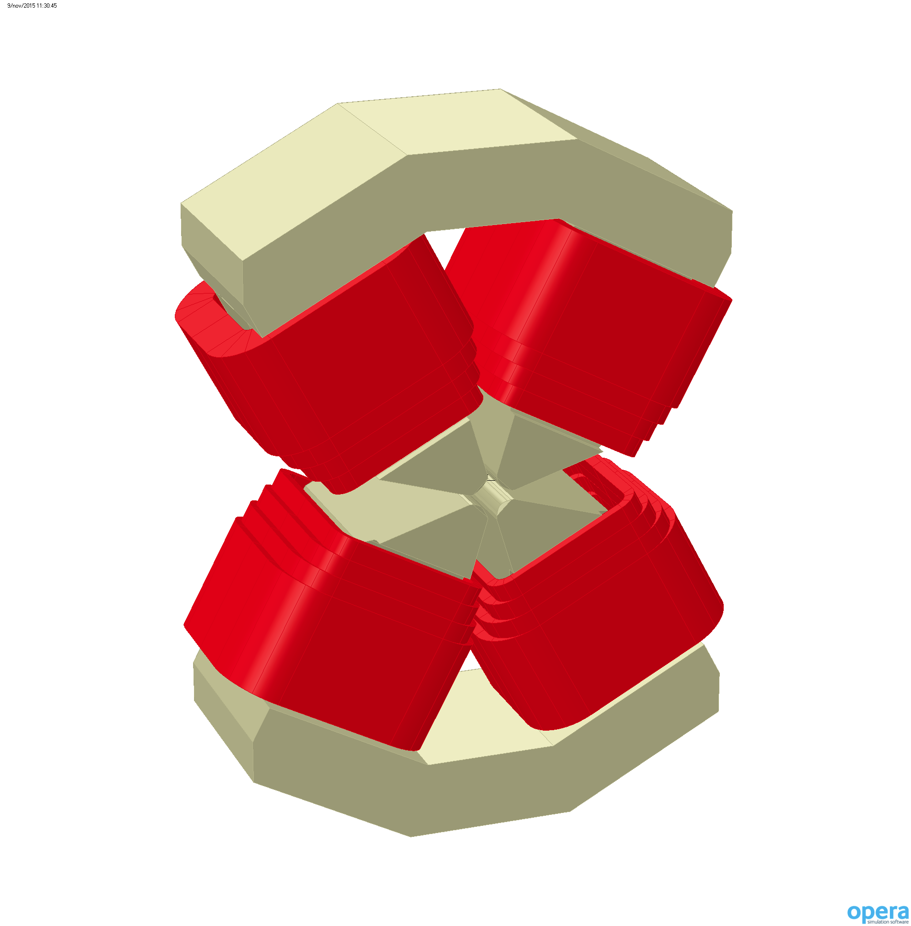
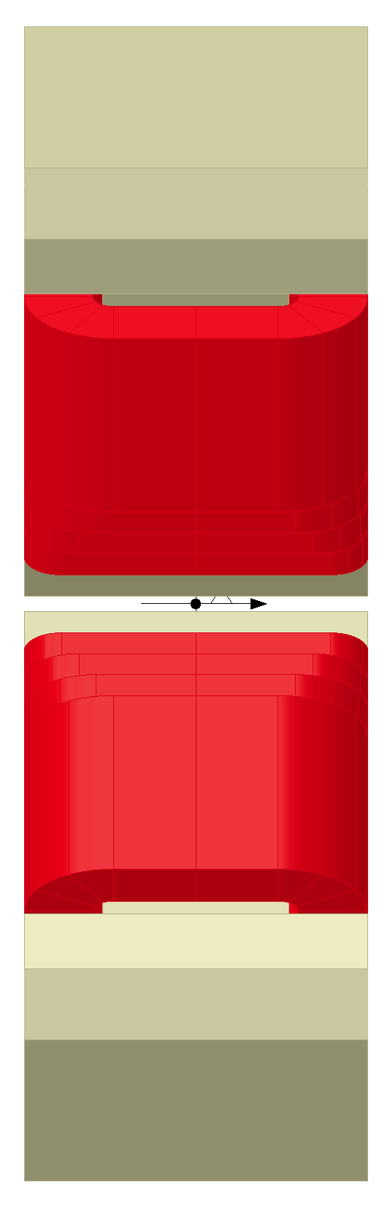
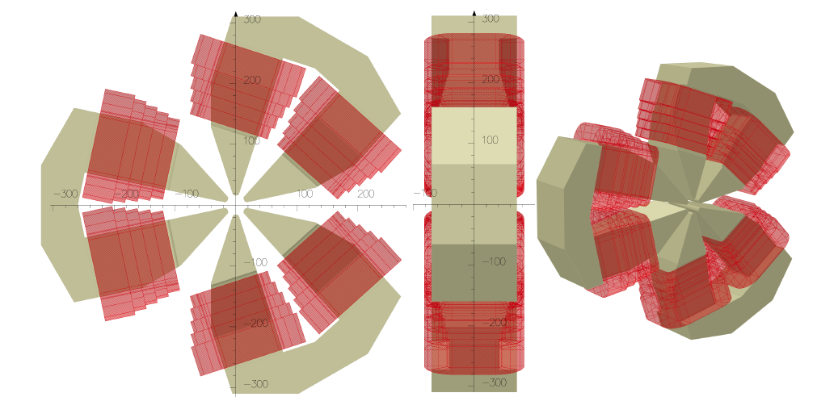
Magnets
Almost final with Lm=Lp. Use of new materials such as Cobalt – Iron alloys will also be considered
The quadrupole designs were developed with the vacuum chamber in order to resolve all the possible transversal interferences (beam lines). Asymmetric poles geometry has been opted.
The bending integrated quadrupole component is done by only the pole profile geometry. In order to optimize space and performances, different coil and frame geometries are evaluated. Space between the pole terminations will be employed in order to obtain the requested frame stiff.
The sextupole magnets have the higher design issue. The transversal interferences between coils and vacuum chamber are resolved.
Ref. D. Castronovo (Opera)

Slide 34

Elettra 2.0 brilliance
Notes:
Slide 3 – (..) : Content of the presentation
Insert a new slide: Home > “New Slide” and choose a slide Layout:
For Title & Subtitle
For text with bullet points
For Text
For Picture, graphs, visuals
Two columns
Blank
If you want Copy & paste an element from the Clip Board to the particular slide:
1. Click on a box to mark it.
2. Position the mouse pointer on the box frame: Copy!
3. Click on the particular slide: Paste!
How you intend to use the elements is your choice.
You can combine the text block style with the background colour in different manner.

Slide 35
Elettra and Elettra2.0
Parameter | Units | Elettra | Elettra2.0
Circumference | m | 259.2 | 259.(2-8)
Energy | GeV | 2 - 2.4 | 2
Horizontal emittance | pmrad | 7000 | 230-280
Vertical emittance | pmrad | 70 (1% coupl) | 2.5
Beam size @ ID (σx,σy) | μm | 245 , 14 (1% coupl) | 43 , 3
Beam size at short ID | μm | 350 , 22 (1% coupl) | 45 , 3
Beam size @ Bend | μm | 150, 28 (1% coupl) | 17 , 7
Bunch length | ps | 18 (100 with 3HC ) | 9 (70-100 with 3HC )
Energy spread | DE/E % | 0.08 | 0.07
Bending angle Lattice | degree | 15 DBA | 5, 5.6 and 4.4 6BA

Slide 36
Conclusions
Elettra is running well although is 23 year old, many small projects contribute to this including replacement of old / obsolete hardware
Many mid term possibilities in discussion
A conceptual design project for Elettra 2.0 is ongoing.
FERMI@Elettra runs successfully giving unique opportunities to experimentalists.
Many new ideas are used / will be tested.

Slide 37

Thank you for your attention

