Slide 1
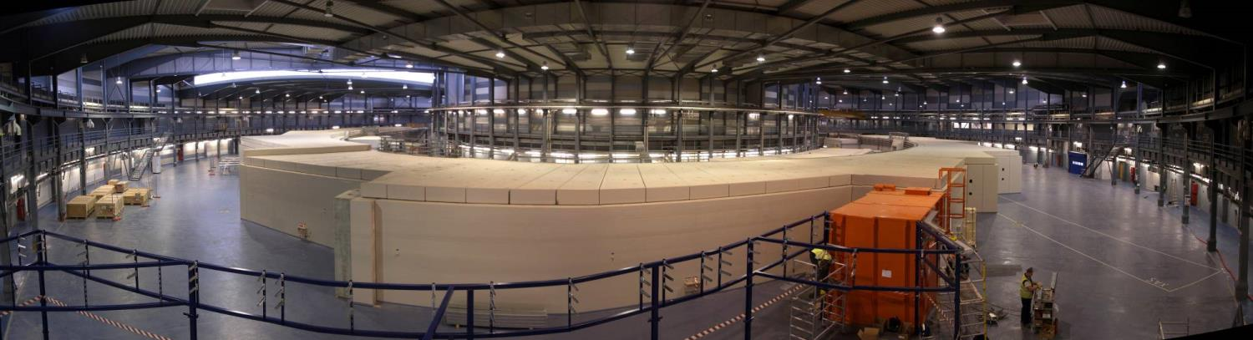
ALBA Status
Ferran Fernandez
On behalf of the Accelerator Division

Slide 2
Outline
Introduction
Operation
Accelerator Developments
Other activities

Slide 3
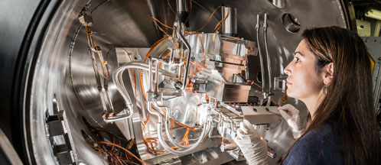
Introduction

Slide 4
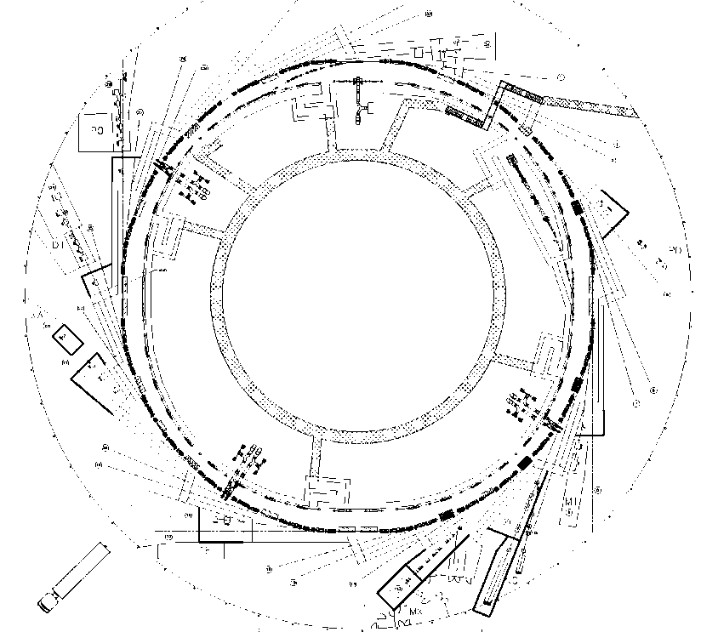
Layout
Parameter | Value
Energy | 3 GeV
Circumference | 268.8 m
Emittance | 4.5 nm·rad
Current | 250 mA
Rf frequency | 500 MHz
# cavities | 6
Long straights | 4 (8 m)
Medium straights | 12 (4 m)
LINAC
100 MeV
BOOSTER
100 MeV ->
3 GeV
STORAGE RING
3 GeV

Slide 5
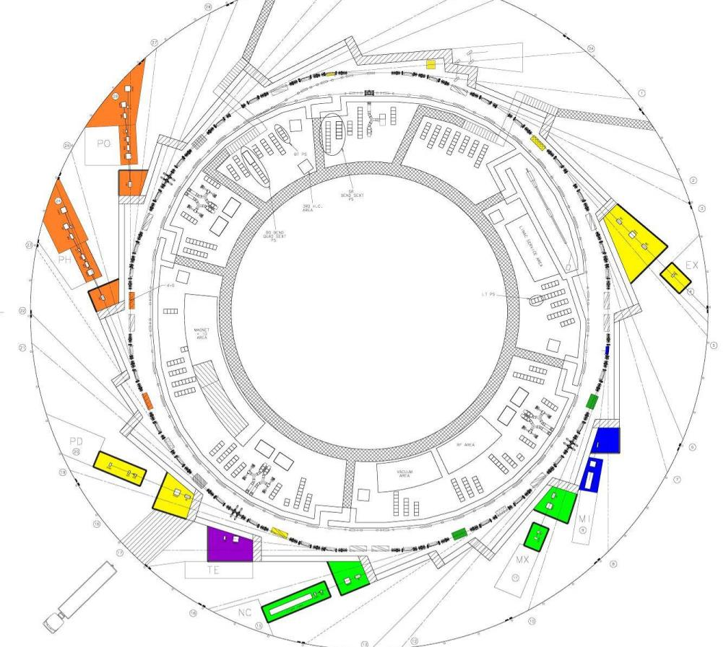
BL29: BOREAS
EU71– (0.08-3 keV)
REsonant Absorption
and Scattering
In operation (8)
In construction (2)
Bending: e⁻ Diagnostics
BL01: MIRAS
Bending – (0.4-100 µm)
IR Spectroscopy
BL24: CIRCE
EU62– (0.1-2 keV)
Photoemission
spectroscopies
BL04: MSPD
SCW31 – (8-50 keV)
HP/HR
Powder Diffraction
BL22: CLÆSS
MPW80– (2-63 keV)
Absorption &
Emission Spectroscopies
BL09: MISTRAL
Bending– (0.27-2.6 keV)
X ray Microscopy
BL20: LOREA
EUXX– (10-450 eV)
ARPES
BL11: NCD
IVU21– (6-13 keV)
Non Cristalline Diffraction
SAXS/WAXS
BLXX: XAIRA
IVUXX (~5-25 keV)
Macromolecular Cristallography
BL13: XALOC
IVU21 – (5-22 keV)
Macromolecular Cristallography

Slide 6
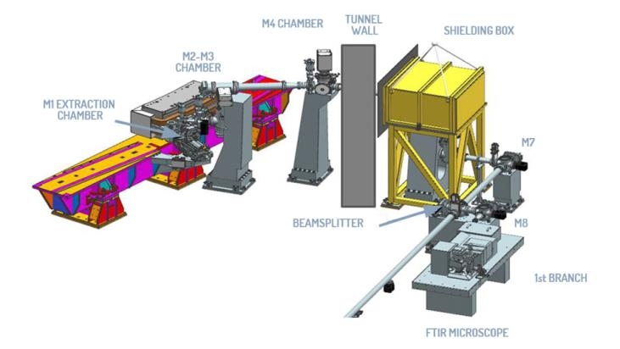
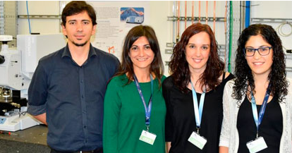
New Beamlines - Miras
1st official user on 12 October
1st industrial signed on 17 October

Slide 7
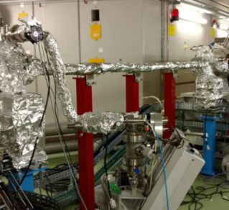
New Beamlines – Lorea & Xaira
Lorea: Angle-resolved Photoemission Spectroscopy
  The 9th BL -> procurement stage
  Schedule:
    Summer 2017 -ID, FE and vacuum chambers
    Fall 2017 -Lead hutch + infrastructure
    Beginning 2018 -Optics, end station, cabling,…
    Beginning 2019 -First user
Xaira: PX beamline with a beam spot in the micron range
  The 10th BL -> design stage
  Target: First user end 2020
ID vacuum chamber - Aug16

Slide 8
Beamtime proposals

Slide 9
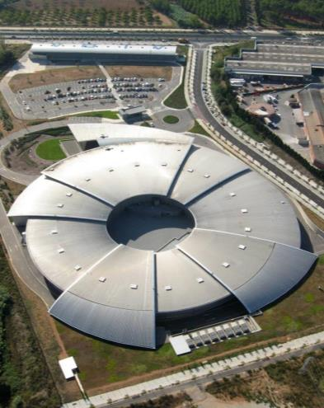
Operation
Top-up
Statistics
News
Improvements

Slide 10
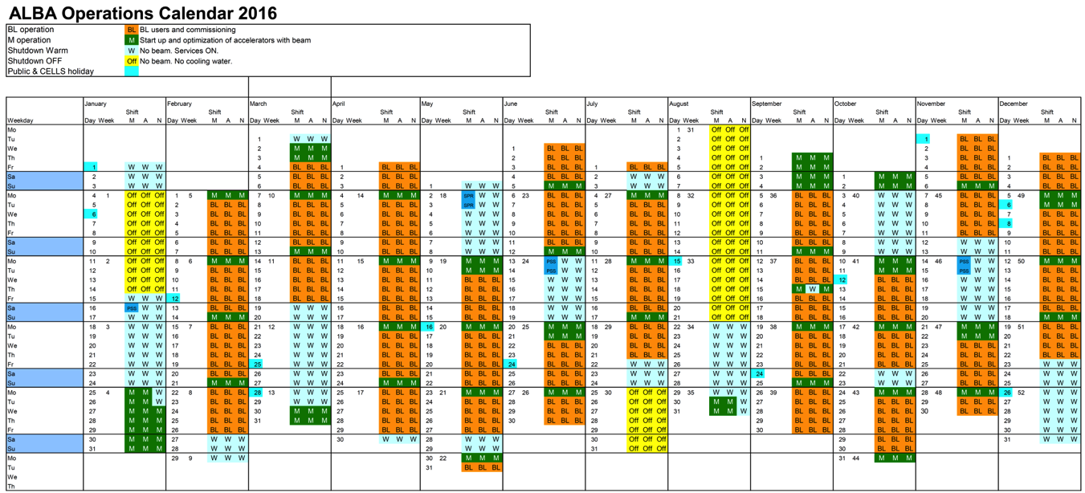
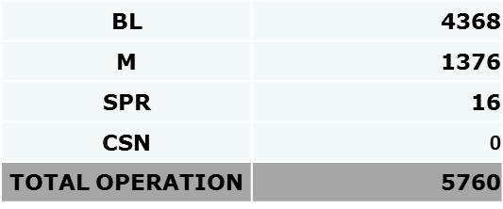
Operation – Top-up
24/7
8 Runs (4-5 weeks)
Top-up every 20min

Slide 11
Operation - Statistics
 | 2012 | 2013 | 2014 | 2015 | 2016 | 2017
Accelerator operation [h] | 3280 | 4464 | 5250 | 5730 | 5744 | 5888
Scheduled user beam [h] | 2387 | 3540 | 3888 | 4320 | 4368 | 4632
Availability [%] | 76.7 | 83.8 | 96.8 | 97.3 | 97.7*
MTBF [h] | 21.0 | 25.0 | 33.7 | 51.4 | 59.8*
MTTR [h] | 1.0 | 0.8 | 1.1 | 1.4 | 1.4*
* Until 15 Nov

Slide 12
Operation - Statistics

Slide 13
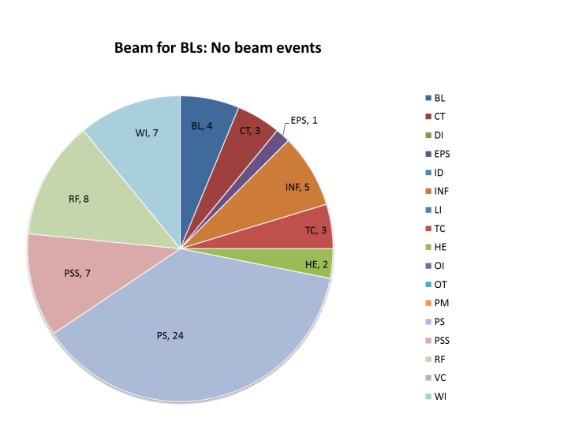
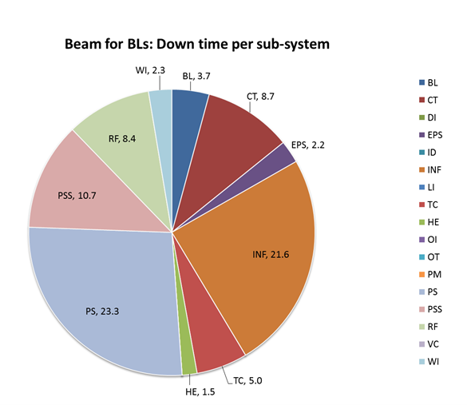
Operation – Statistics
BL Beamlines PSS
CT Controls
DI Diagnostics
EPS EPS interlock
ID Insertion Devices
INF Infrastructure
LI Linac
MML High Level Software (MML)
OE Human error
OI Orbit Interlock
OT Others
PM Pulsed magnets
PS Power Supplies
PSS PSS (except BLs)
RF Radio Frequency
VC Vacuum
WI Water interlocks
# events Down time [h]
During 2015, 63 events (87.4 h) with no beam for BLs
35 x Beam lost due to hardware failure
25 x FE closed (mainly for reinjection)
3 x beam killed to prevent failures (2xMIRAS + 1xPSS)

Slide 14
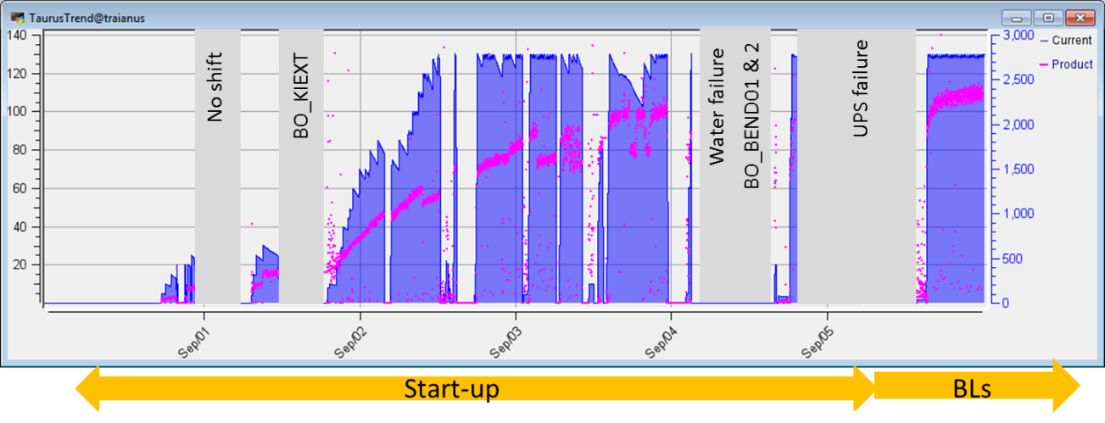
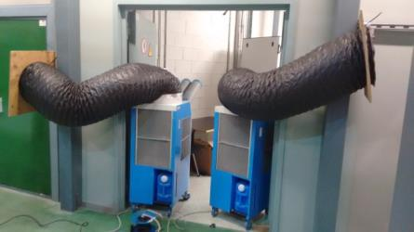
Accelerators - WEEK 35
Operation - Startup
            Installation of LOREA Al vacuum chamber and opening of RF cavities –> conditioning needed
            Problems with: RF, M1 re-centering, BO_KIEXT, BO_BEND01/02, water failure.
            Almost no accelerator tests were done
            Poor conditioning, therefore, low lifetime
            And then, UPS failure … Beam for users started 8h late

Slide 15
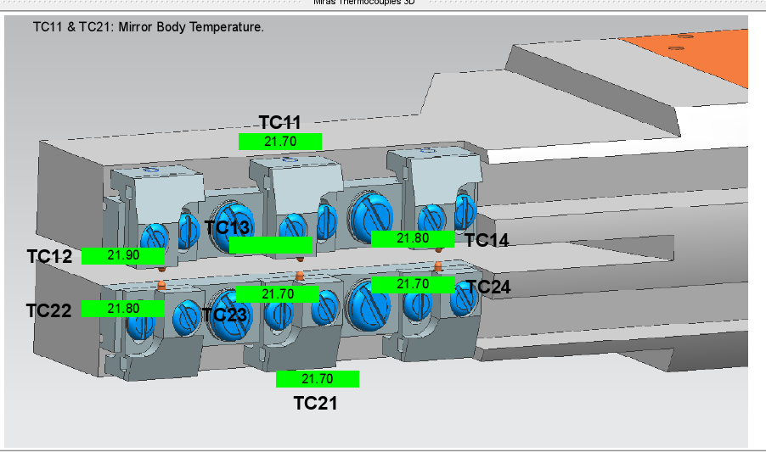
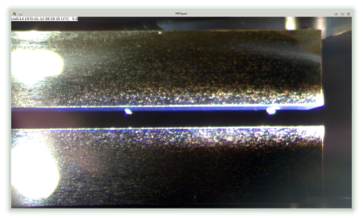
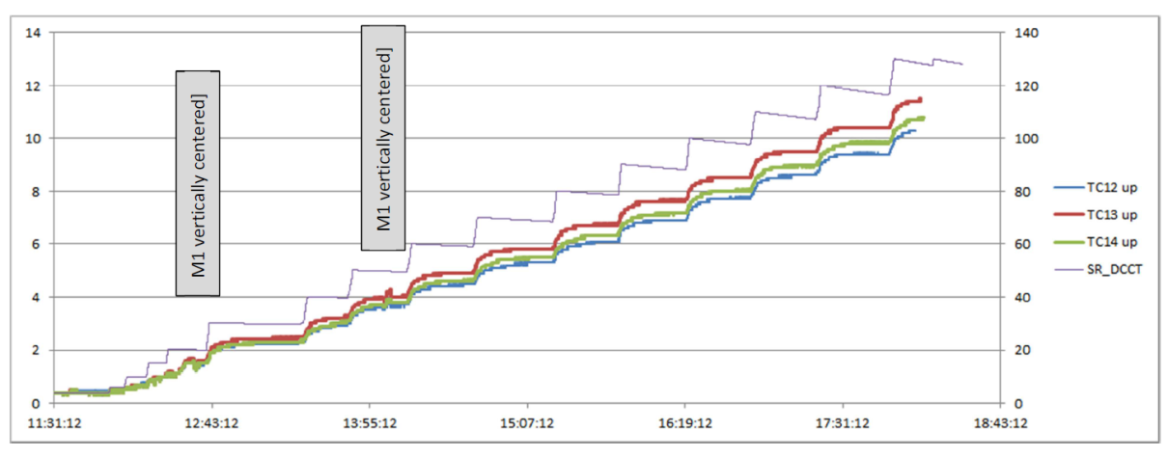
Operation News – Miras Mirror
120mA

Slide 16
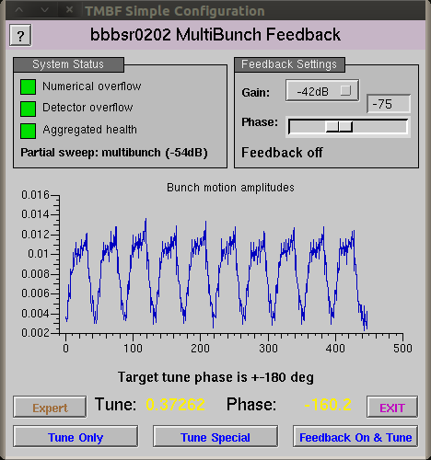
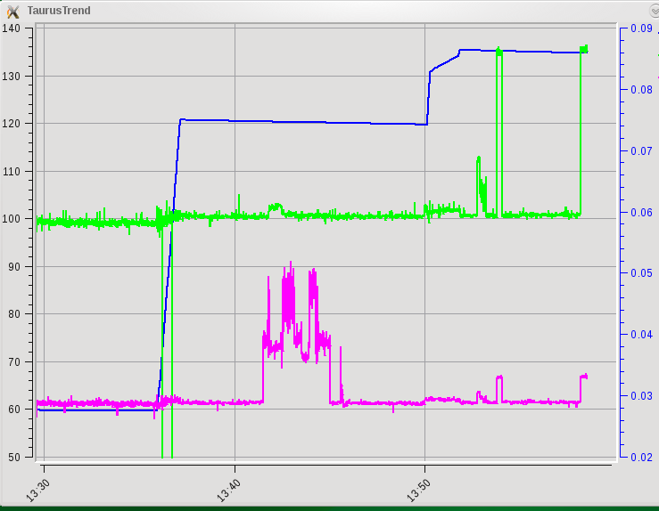
Operation News – Bunch-by-bunch
The Horizontal BbB feedback is in operation since 11th October 2016
Tests with low chromaticity
σx
σy
Diamond BbB software
BbB: ON OFF ON OFF ON OFF

Slide 17
Operation News – RF amplifiers
1 BO RF plant → 1 IOT
6 SR RF plants → 12 IOTs
5x L3 – IOTs
6x TH794 – IOTs
2x TH795 - IOTs
Spares:
2x TH794 - IOTs
1x TH795 – IOTs
BO
S14B
S14A
ALBA SR is operating now with 12 IOTs
increasing slowly the current,
always ensuring reliability
S06A
S06B
S10B
S10A

Slide 18
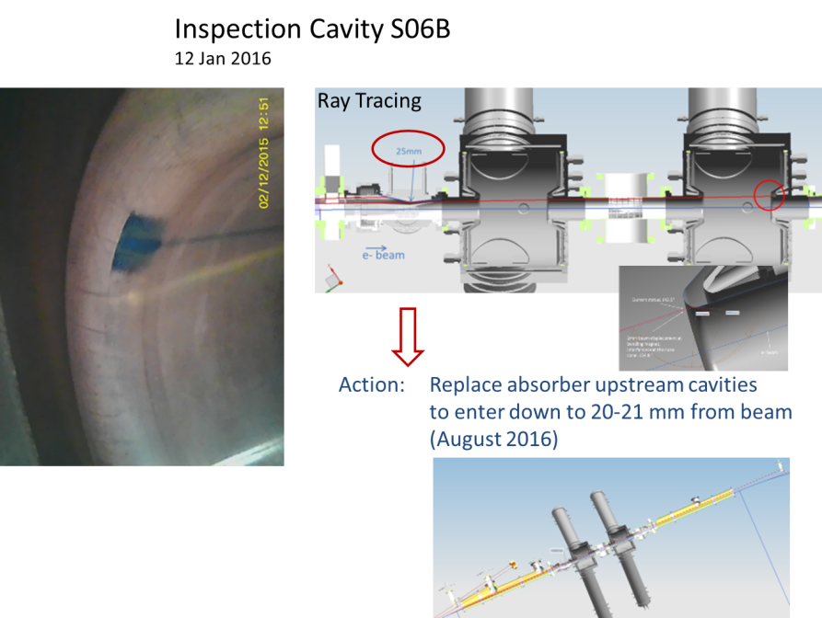
Operation News – RF cavity absorber
Voltage in cavity S06 was limited due to arcs
Absorber has been replaced on 16th Nov
So far no arcs at “nominal” voltage

Slide 19
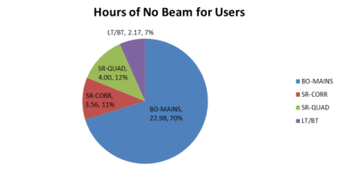
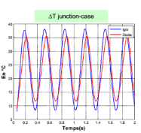
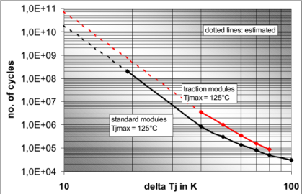
Operation improvement – BO PC
Motivation: | The failure of Main Booster power supplies is responsible for the 70% of Beam time loss due to power supplies.
Identification of the failure cause: | The transition from decay mode to top-up mode increased the stress on the power semiconductors(IGBT). This stress is mainly due to the Thermal and Power cycling of power semiconductors. Another area to improve is to acquire the capacity to modify the control/regulation parts and to add more diagnostic to the power supplies.
Top up mode/ 1yr
Decay mode / 1 yr
R. Petrocelli, Electronics Group

Slide 20
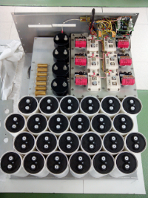
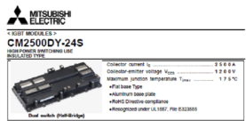
Operation improvement – BO PC
Current actions: | Increase the maintenance of power modules, replacement of power semiconductors once a year. Balancing the stress in different modules. Reducing the number of cycles by reducing the warming up of power supplies during each injection. (working on it)
Next step Actions: | Increase the number of spare modules. To use this additional modules as a test bench for a solution. Call for Tender in March 2017.
Further actions: | Refurbishment of all power supplies modules with a proven solution ( starting 2018). Improvements in control/regulation and diagnostics (starting June 2018)
R. Petrocelli, Electronics Group

Slide 21
Accelerator Developments
Single Bunch Bucket Selection
Beamsize using interferometry
Bunch-by-Bunch Transverse Size
“Speckle” tests
… and others with no time to cover

Slide 22

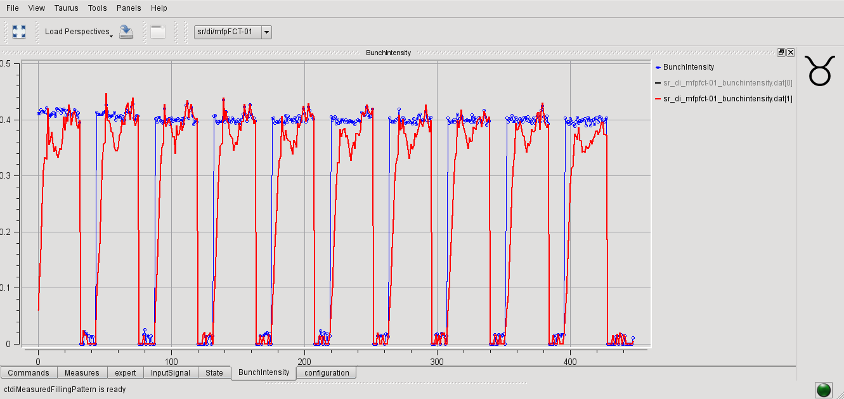
Single Bunch Bucket Selection
  Precise measurement filling pattern
  Top Up SBBS algorithm → Precise filling patterns
  (Single Bunch Bucket Selection)

Slide 23
Beam size reconstriction using visible interferometry
Rotaring the interferometry slits
to obtain the full beam size
Coupling scan tests
L. Torino et al.
PRST-AB paper

Slide 24
Bunch by bunch interferometry transverse beam size measurement using Fast Gated Camera
SB
Observation of induced “bunch train” instability
MB
Beam size acquisition synchronised wih the bunch position
SB
MB

Slide 25
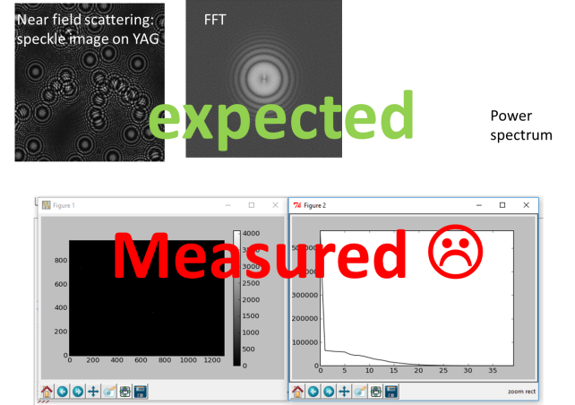
“Speckle” Collaboration

Slide 26
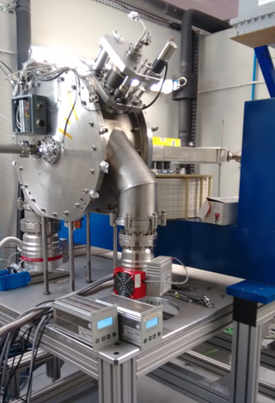
Other Activities
International Collaborations
Magnetic Lab
RF Lab

Slide 27








International Collaborations
H2020 - FCC - EuroCirCol
    → WP4: Cryogenic Beam Vacuum System
CLIC-CERN
    → WP1: Damping Ring Stripline Kicker test
    → WP2: Collective Effects
    → WP3: Beam Instrumentation & Diagnostics
    → WP4: 1.5 GHz RF System
INFN - ELI-NP project
    → WP1: Magnetic simulations
    → WP2: BPM measurements
ILSF
  → Associate partner: 1% Budget & Beamtime
  → PhD Collective Effects
CERN – HTS-BS-FCC
→ Agreement to be signed soon
H2020 - ARIES – ADA
→ Start date May 2017

Slide 28
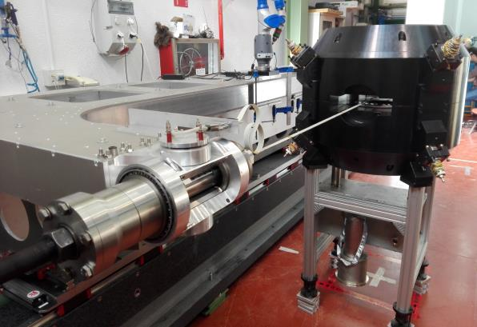

Collaborations/Contracts
Magnetic Lab
  Elytt/LEHIPA permanent magnets quads
  CIEMAT cyclotron magnet (new magnetic bench)
  ThomX magnets
  Elytt/CLARA (STFC) dipoles
  CIEMAT – LIPAC magnets
  …
RF lab
  Test and Conditioning cyclotron cavity for CIEMAT
  Digital LLRF for DIAMOND
  …
ALBA magnetic bench at CIEMAT
Measureing the Cyclotron magnet
CIEMAT Cyclotron cavity
at ALBA RF lab

Slide 29
Division Head
F. PEREZ
Operations
M. PONT
Operators
F.FERNANDEZ
M. ALVAREZ
O. SERRES
D. YEPEZ
E. MORALES
RF & Linac
RF
A. SALOM
B. BRAVO
J. OCAMPO
Linac
R. MUÑOZ
D. LANAIA
IDs
J. CAMPMANY
Magn Lab
J. MARCOS
V. MASSANA
Beam Physics
U. IRISO
Beam Dynamics
G. BENEDETTI
T. GÜNZEL
Z. MARTÍ
M. CARLÀ
CLIC
Diagnostics
A. OLMOS
A. NOSYCH
L. TORINO
ELI – NP
J.C GIRALDO
M. SOS
N. AYALA
R. FOS
MINECO
Z. HAZAMI
PhD
P. SOLANS
L. GARCIA MINECO
J.M. ALVAREZ
CLIC
WP4
CLIC
X. RODRIGUEZ CLIC
Accelerator Division
Thanks, to all Alba staff

