Slide 1

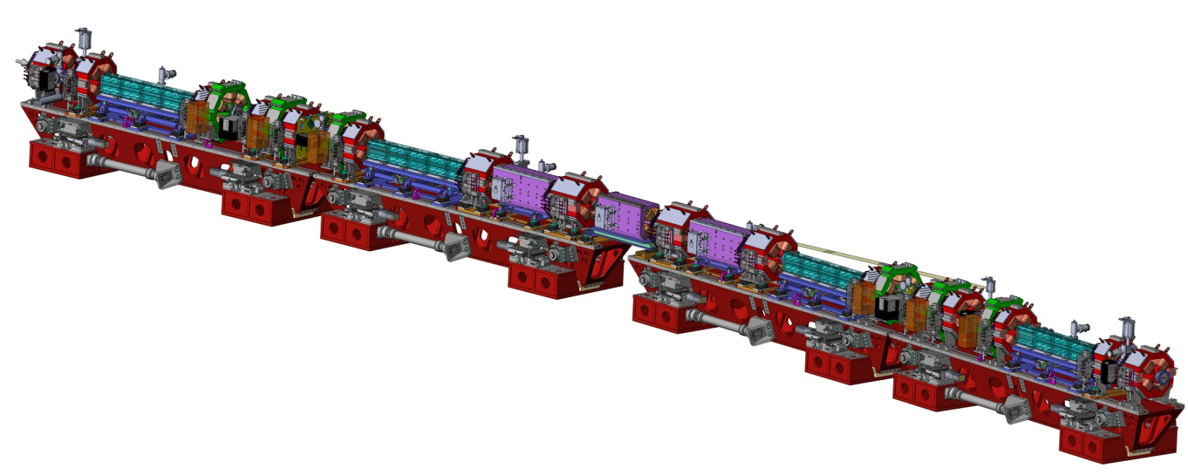


The XXIV European Synchrotron Light Source Workshop
28-30 November 2016, Elite Hotel Ideon Lund
ESRF Status and upgrade
Jean-Luc Revol
On behalf of the ESRF operation team
and the
EBS Accelerator Project Team

Slide 2
acknowledgements
This presentation gathers the works of many ESRF contributors.
A specific acknowledgement must be mentioned to:
JC Biasci, P Raimondi, D Einfeld, K Scheidt, J Chavanne, L Farvacque, S White,
C Benabderrahmane, G LeBec, J Jacob
ISDD engineering group.
I Leconte, L Hardy
who prepared a lot of slides .

Slide 3
outline
Introduction
Schedule 2015-2020
Operation performance
Project design status
Procurement status
Assembly & Installation Phase

Slide 4
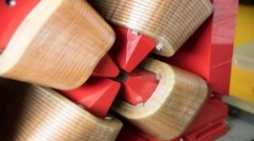
ESRF EBS: An ambitious new standard for synchrotron storage rings
10²⁴
10²³
10²²
10²¹
10²⁰
10¹⁹
10¹⁸
10¹⁷
10¹⁶
10¹⁵
10¹⁴
10¹³
10¹²
10¹¹
10¹⁰
10⁹
10⁸
10⁷
10⁶
ESRF-EBS (2020)
ESRF Extremely Brilliant Source
ESRF-EBS – 150 M€ (2015-2022)
ESRF (2014)
Third
generation
ESRF (1994)
Synchrotron Radiation
Brilliance (photons/s/mm²/mrad²/0.1%BW)
Second generation
~100 times more brilliant and coherent X-rays
Programme to exploit the qualities of this new and unique extremely brilliant X-ray source:
- Creation of new beamlines
- Innovative detector programme
- « Data as a Service » strategy
First generation
X-ray tubes
1900 1920 1940 1960 1980 2000 2020

Slide 5
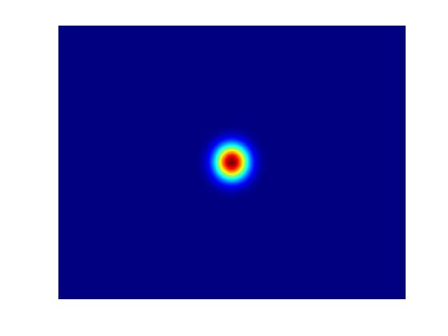
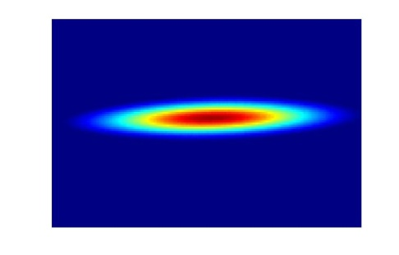
ESRF EBS: An ambitious new standard for synchrotron storage rings
Reduce the horizontal emittance from 4nm to 0.14nm
Beam-line experiments can benefit from : an increase in brilliance
an increase of coherence
(the coherent fraction, in hor. plane)

Slide 6
brilliance and coherence increase
Improved Coherence
Brilliance
Hor. Emittance [nm] | 4 | 0.135
Vert. Emittance [pm] | 4 | 5
Energy spread [%] | 0.1 | 0.09
β_{x}[m]/β_{z} [m] | 37/3 | 6.9/2.6
Source performances will
improve by a factor 50 to100
Undulator: CPMU18,
K=1.68
L=2m
Coherence
18mm Undulator spectrum

Slide 7
Extremely Brilliant Source: Accelerator Upgrade
The Extremely Brilliant Source Project aims to:
Substantially decrease the Store Ring Equilibrium Horizontal Emittance
Increase the source brilliance
Increase its coherent fraction
Must fit in the same tunnel : same circumference as much as possible
Keep the electron energy (6 GeV)
IDs at same locations: keep Beamlines where they are
Maintain the existing bending magnets beamlines
Preserve the time structure operation and a multibunch current of 200 mA
Re-use injector complex
Limit the downtime for installation and commissioning to less than 18 months
Maintain standard User-Mode Operations until
the day of shut-down for installation

Slide 8
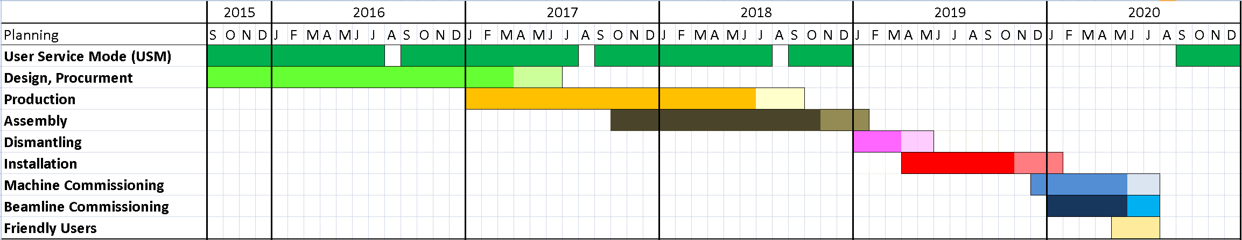
Operation and EBS EBS project plan (2015-2020)
01/10/2017 – Start of assembly phase
17/12/2018 – Start of shutdown
– Start of dismantling phase
January 2017-June 2018 – Delivery of components
18/03/2019 – End of dismantling phase
– Start of installation phase
04/11/2019 – End of installation phase
02/12/2019 – Start of storage ring commissioning phase_
09/01/2020 – Start of beamline commissioning phase
May-July 2020 – Friendly Users_
25/08/2020 – Start of USM
1.5 year of User Service Mode interruption
Notes:
Mark periods/phases: Design/procurement, Pre-assembly, dismantling, installation

Slide 9
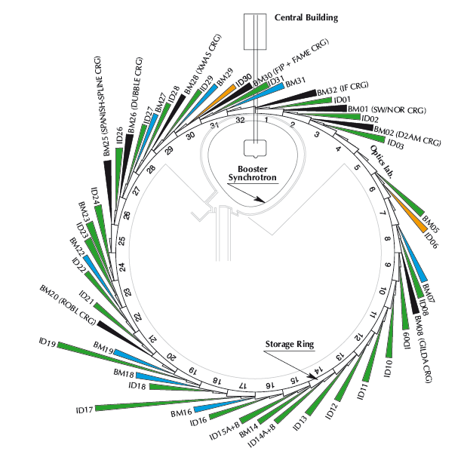
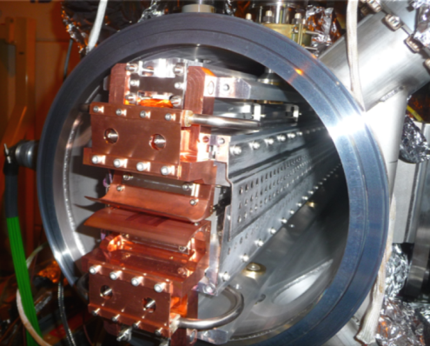
ESRF today
Accelerator and source division (ASD) mission
Storage ring
6GeV, 844 m
Energy | GeV | 6.04
Multibunch Current | mA | 200
Horizontal emittance | nm | 4
Vertical emittance | pm | 4
Booster synchrotron
200 MeV ➔ 6 GeV
300m, 10 Hz
32 straight sections
DBA lattice
42 Beamlines
12 on dipoles
30 on insertion devices
72 insertion devices:
55 in-air undulators, 6 wigglers,
10 in-vacuum undulators, including 3 cryogenic
E- Linac
200 MeV

Slide 10
Operation : Machine statistics for 2013-2016
 | 2013 | 2014 | 2015 | 2016
Availability (%) | 98.93 | 99.11 | 98.53 | 99.10
Mean Time Between Failures (hrs) | 79.70 | 105.5 | 93.6 | 95.1
Mean duration of a failure (hrs) | 0.86 | 0.94 | 1.37 | 0.86
(Until 22 November 2016)
2014: 52 Failures ➔ 1 every 4.4 days
2015: 59 Failures ➔ 1 every 3.9 days
USM : 5544 hours (63.3%)
SD : 1944 hours (22.2%)
MDT : 1272 hours (14.5%)
For 2016 (four over five runs ): 42 failures

Slide 11
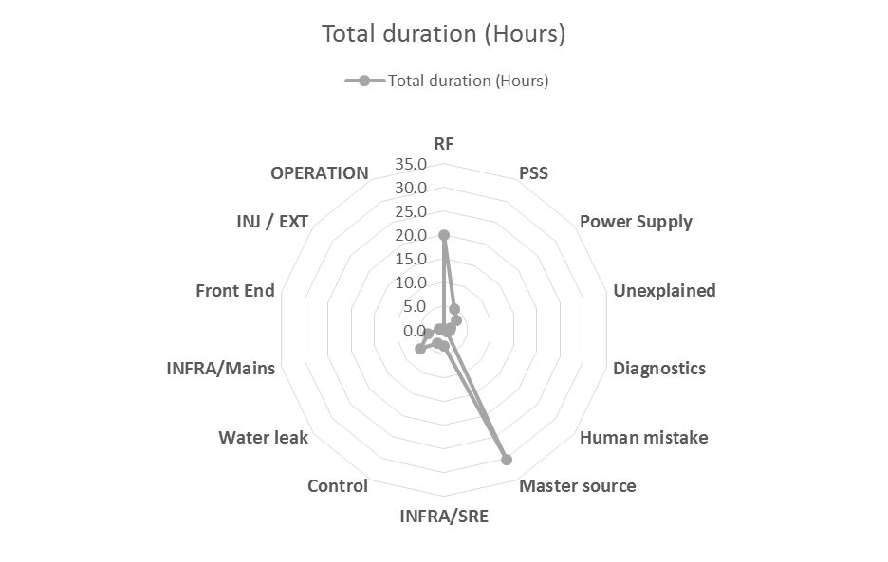
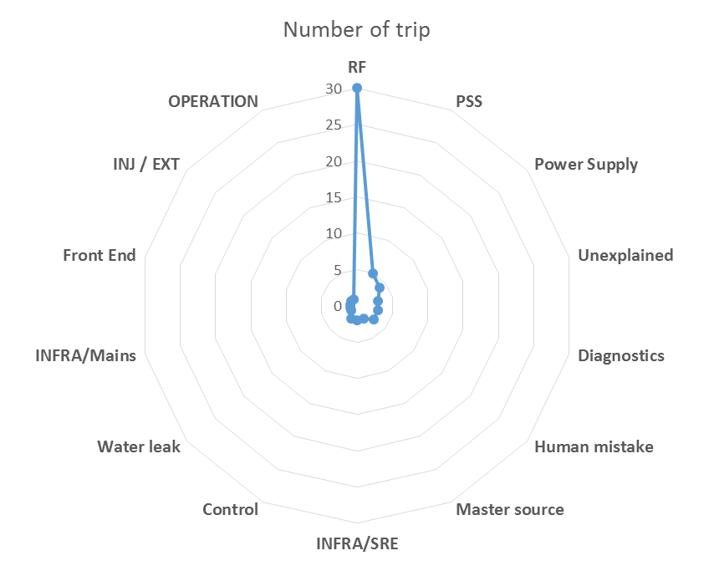
Operation 2015: Failure distribution per equipment
 | Number of trip | Total duration (Hours) | Average duration
RF | 30 | 20.0 | 0.7
PSS (Beamlines) | 5 | 5.0 | 1.0
Power Supply | 4 | 3.3 | 0.8
Unexplained | 3 | 1.4 | 0.5
Diagnostics | 3 | 1.2 | 0.4
Human mistake | 3 | 0.8 | 0.3
Master source | 2 | 30.3 | 15.2
INFRA/SRE | 2 | 3.3 | 1.7
Control | 2 | 3.1 | 1.5
Water leak | 1 | 6.4 | 6.4
INFRA/Mains | 1 | 3.5 | 3.5
Front End | 1 | 1.1 | 1.1
INJ / EXT | 1 | 0.3 | 0.3
OPERATION | 1 | 0.2 | 0.2
Grand Total | 59 | 79.9
Preliminary statistics for 2016: 50% of failures due to RF

Slide 12
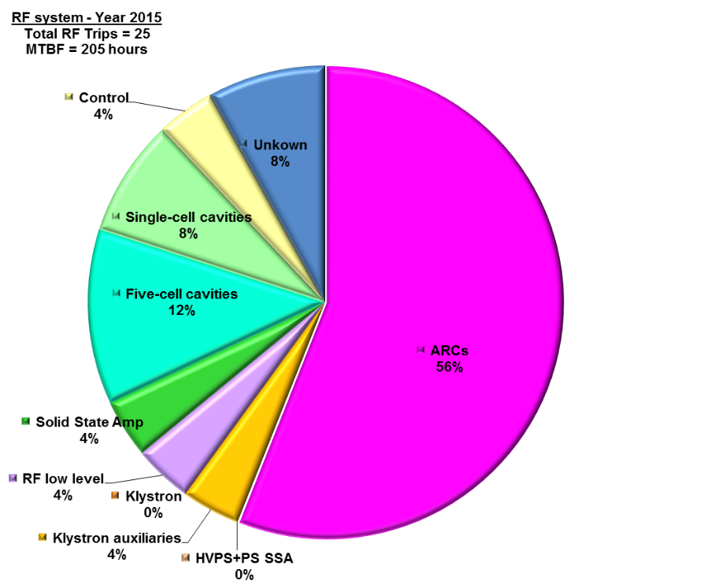
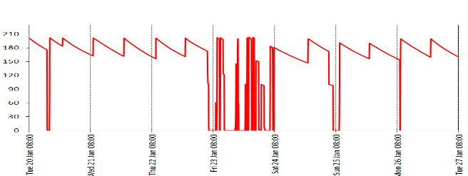
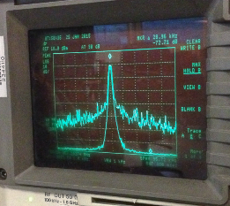
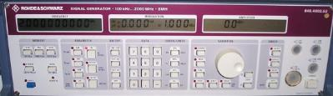
Operation 2015: RF failures
Numerous RF trips are due to Arc Detections (14/25) more or less distributed among the RF system, nevertheless a majority on TRA3 (8/14).
Single Cell Cavity: Two trips due to Cavity #1 field breakdown. None from April 2015
SR SSA: Only one trip (bad connection at the On/Off bus)
+ 30 hours due to the RF master source
Noisy signal
Clean signal

Slide 13
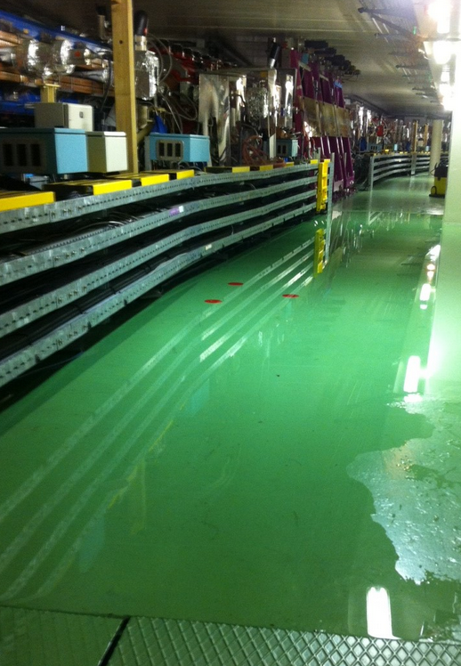
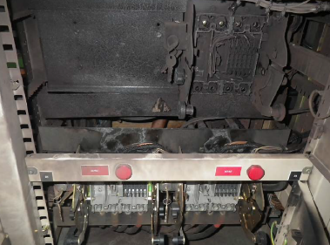
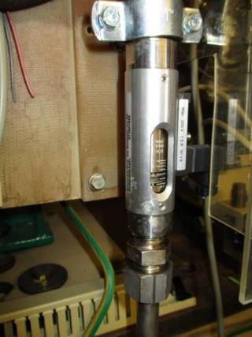
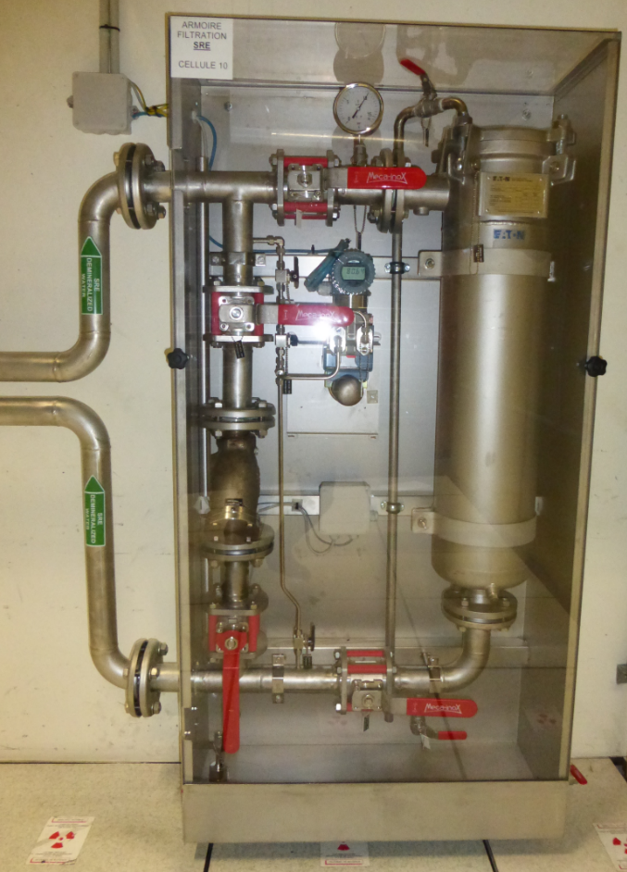
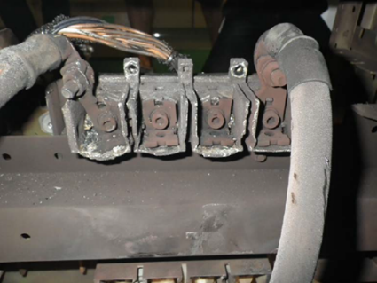
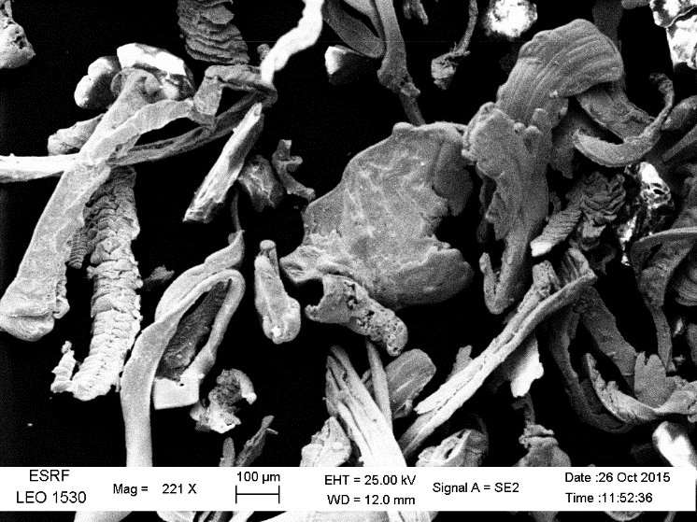
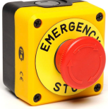
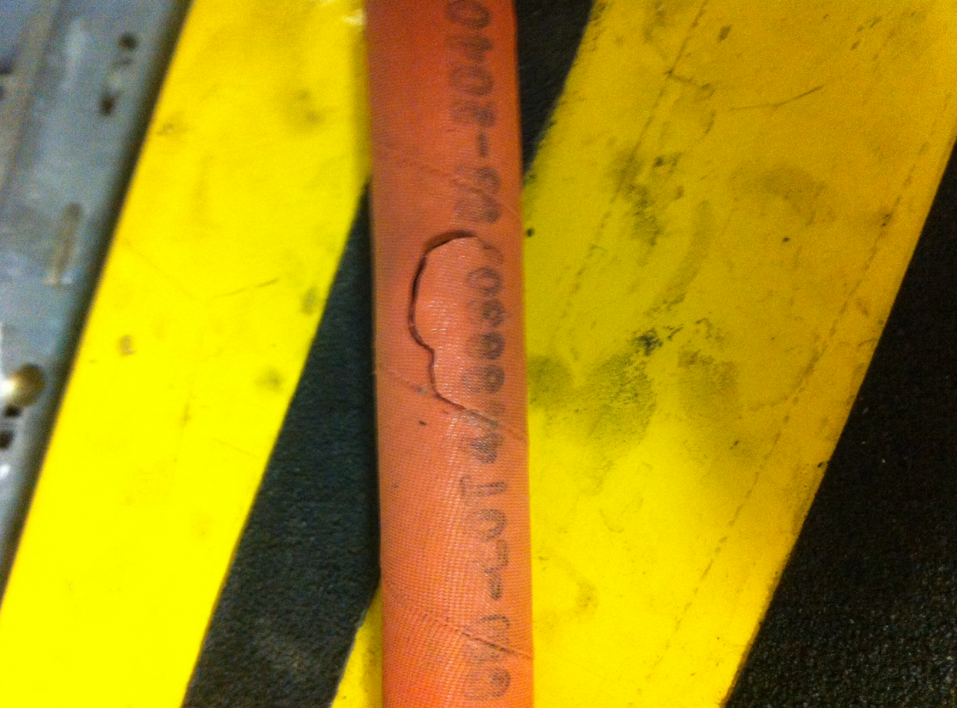
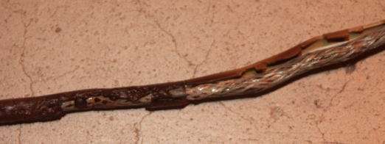
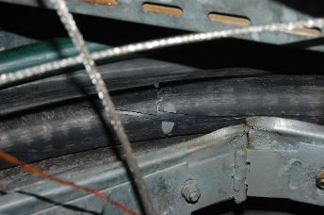
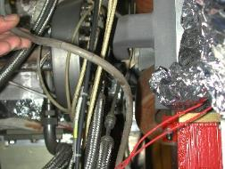
Disaster gallery….
Metallic dust in the water circuit
Magnet PS circuit breaker short circuit
Radiation damage on cables
October 2015
Magnet water cooling hoses

Slide 14
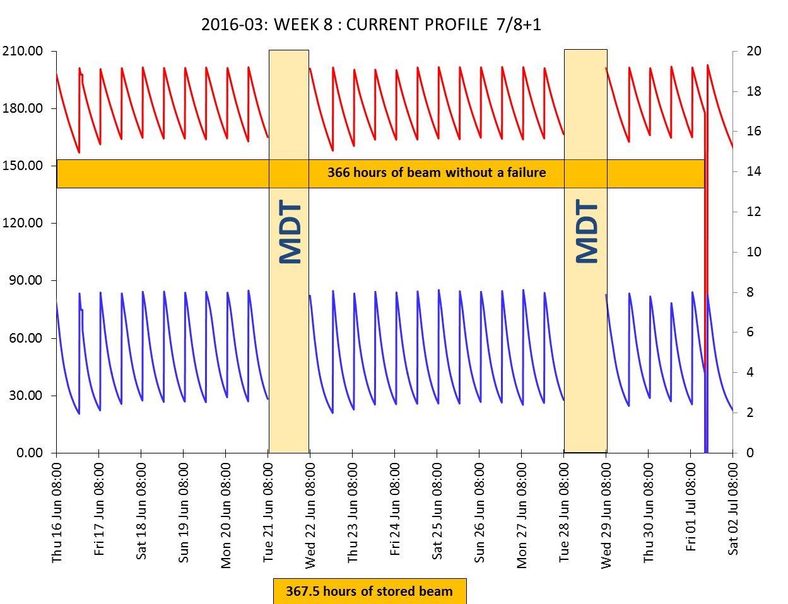
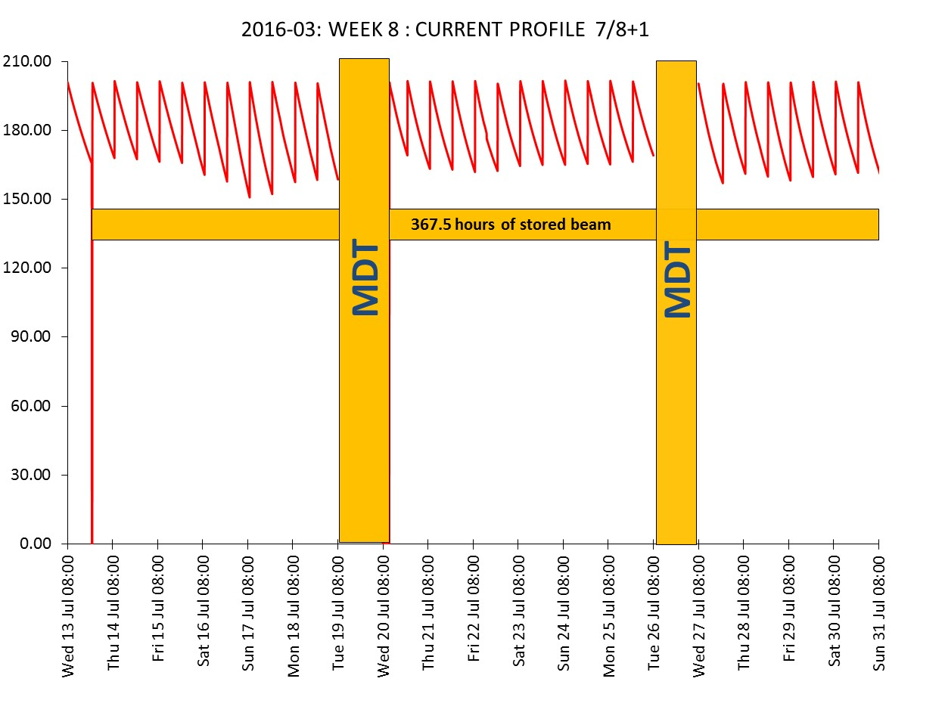
Operation : Machine
JUNE – JULY 2016 with long periods of deliveries without a failure!

Slide 15
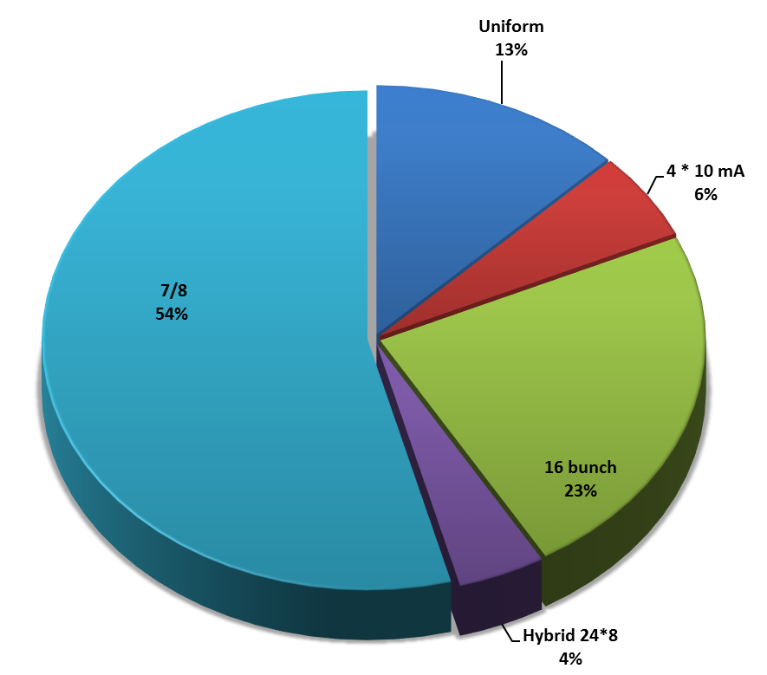
Operation: filling modes in 2016
7/8 + 1
54%
8 mA in the single bunch
16 Bunch in top-up since 26 April 2016
I max = 90 mA,
Refill every 20 mn, delta I = 5 mA, Vertical emittance < 10 pm
skipped refills <2%

Slide 16
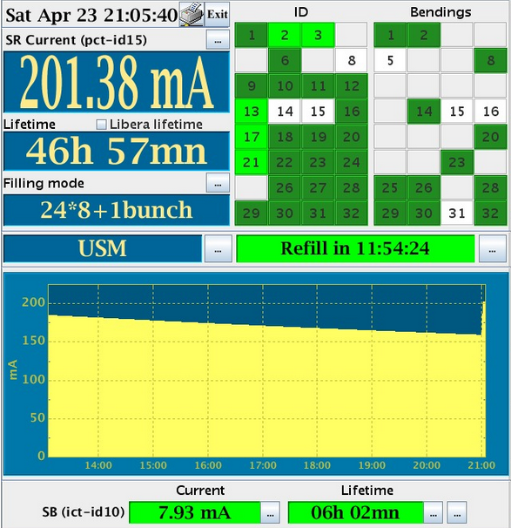
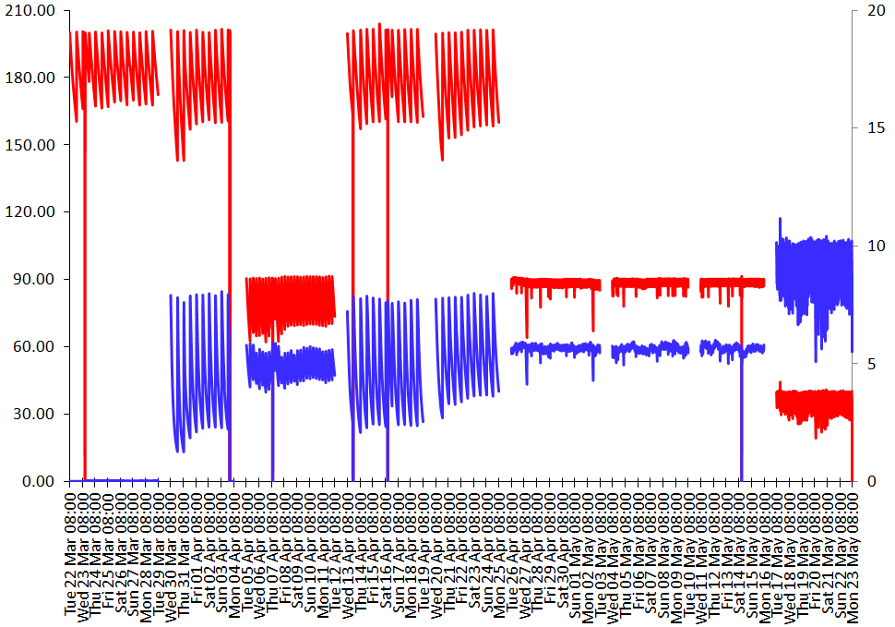
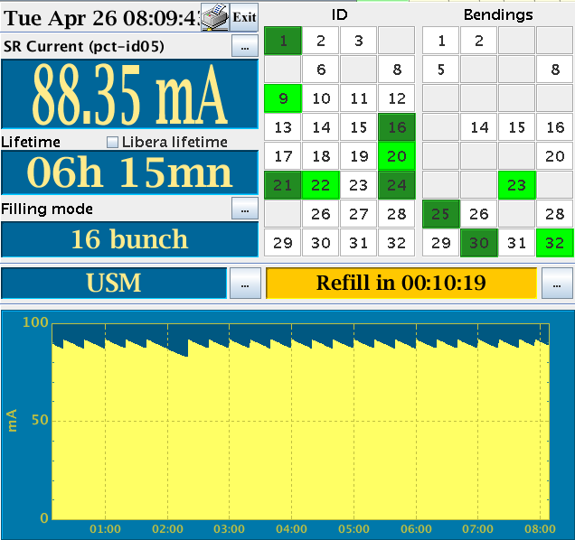
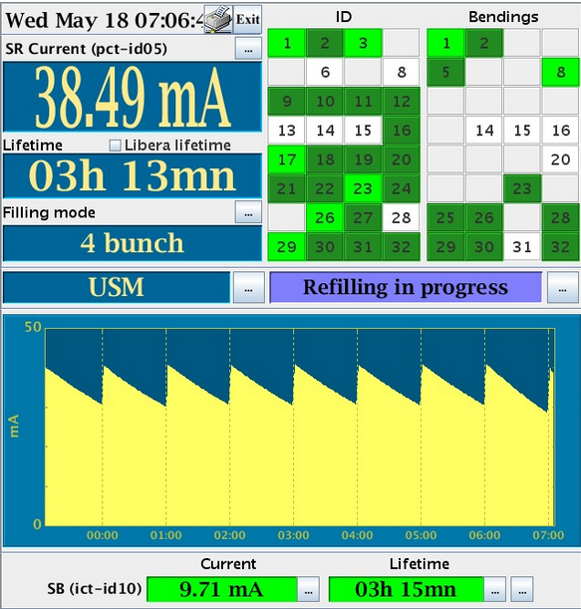
Operation : Machine
UNIFORM 7/8 + 1 16 bunch 7/8 + 1 Hybrid 16 bunch top-up 4*10mA top-up
MDT
MDT
MDT
MDT
MDT
MDT
MDT
MDT

Slide 17
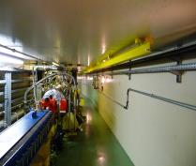
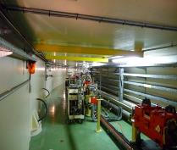
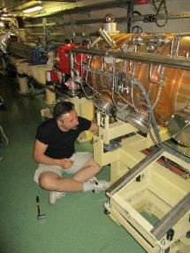
Operation: top-up
After a long period with minimum intervention, the injection underwent major upgrades in view of the top-up
New Libera Beam Position Monitor electronics
Quadrupole movers
Two additional RF cavities
Linac: New➔ gun, pre-buncher, buncher
Third modulator (for redundancy)
A new booster Ramped Injection Power Supply (RIPS)
is under commissioning
New power supplies for the septum magnets
Bunch cleaning system
… etc
Injector reliability will increase compared to the past but remains a critical item in top-up

Slide 18
Operation: full top-up sequence
The whole injection sequence, including preparation, lasts for 2½ mn
Check:
Beam in the booster
I < I_{ref}
Otherwise skip injection
Inject
Cleaning in the SR
Prepare SR injection
Check Booster
Many changes are anticipated with RIPS
SY injection on
Linac on
BPSS on
Warm-up time
SYRF on
Countdown [s]

Slide 19
Operation top-up injection sequence
Refill
Cleaning
t [s]
Cleaning in the Storage ring (~40 s):
Vertical emittance blow-up up to 10 pm
Will be suppressed when applying the cleaning in the booster (ready for operation)
Filling up (~12 s, depends on mode and periodicity):
Perturbations due to the kicker bump, at 10 Hz
Will be reduced by a kicker modification (in progress)
Almost inexistent in the future EBS machine
The present duration of the injection sequence is ~55 s, for a periodicity of 20 mn in 16-bunches
The cleaning in the booster will have 2 benefits:
  the suppression of the perturbations of the stored beam,
  a strong reduction of the top-up duration, down to ~15 s
Validation should occur during this run.

Slide 20
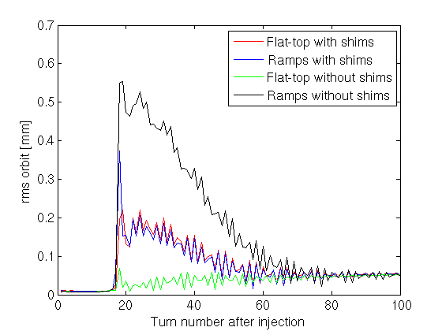
Operation top-up: stored beam orbit perturbation
The injection in the SR is performed with a 4 kickers orbit bump: in theory no perturbations on the stored beam when it is closed
Sources of perturbations to the stored beam:
      The bump is passing through sextupole magnets: amplitude dependent quadrupole field -> bump non-closure and optics functions distortion (beam envelop) In principle the perturbations last a few milliseconds (at 10Hz), but the fast orbit feedback might lengthen the damping)
      The 4 kicker pulse shapes and timing are not strictly identical: bump non closure
      The 4 kickers are slightly misaligned: vertical perturbations
Presently the dominant source of perturbations comes from the sextupole field
Significant effort ongoing to implement a passive compensation using copper shims inside the kicker ferrite gap to generate a non linear field in order to cancel the sextupole field.

Slide 21
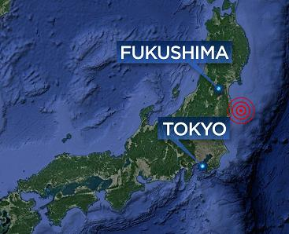
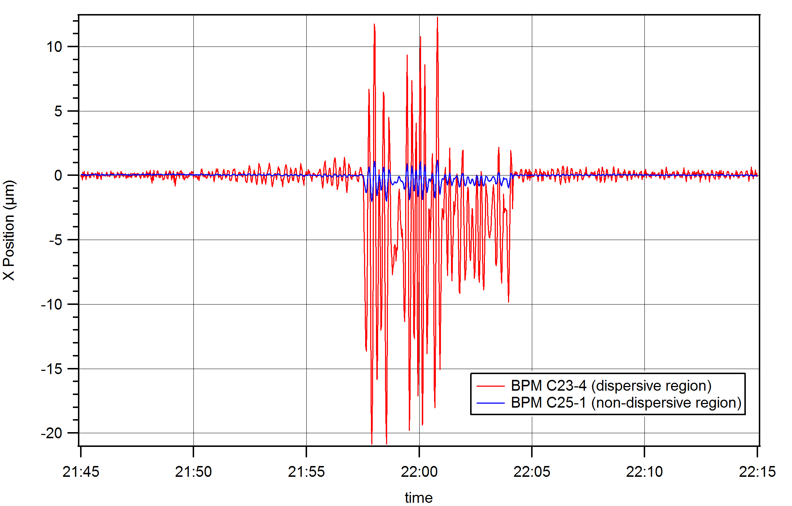
Japanese earthquake – perturbation reduction with RF control
Sunday 21 November 2016
typical 20 s period
23:04:08
the RF-control
is switched back ON
22:57:30
the RF-control
is switched-OFF

Slide 22
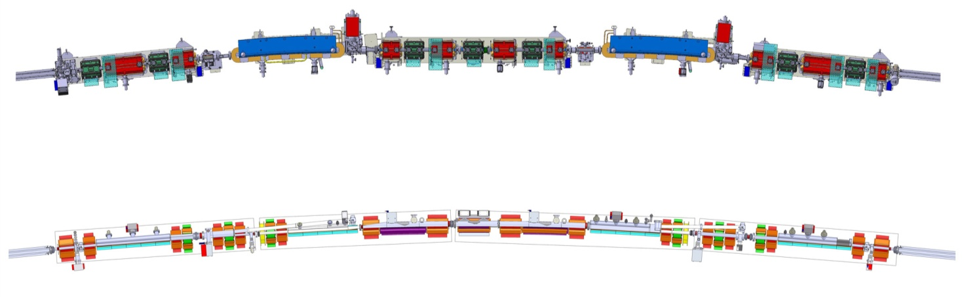
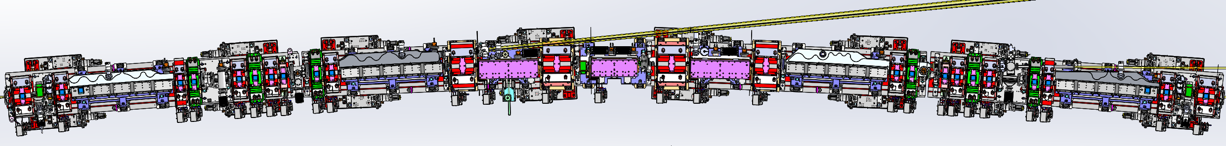
New lattice vs present esrf lattice
Present ESRF lattice
32 cells, Double Bend Achromat = (2 dipoles + 15 quad. sext.) per cell
ID length = 5 m (standard) / 6m / 7m
Dipole
Dipole
5m
6m
ESRF EBS lattice
Hybrid 7 Bend Achromat = (4 dipoles + 3 dipoles-quad + 24 quad., sext., oct.) per cell
ID length = 5 m
Dipole
Dipole
Dipoles-quadrupoles
Dipole
Dipole
31 magnets per cell instead of 17 currently
Free space between magnets (total for one cell): 3.4m instead of 8m today !!

Slide 23
Progress status: Design
Design of all the components nearly completed:
- Magnets ~95% (including Kickers and PM-septa)
- Vacuum System ~95% (One-of-a-kind chambers in injection section in progress)
- Absorbers ~100%
- Girders ~100%
- Supports ~100%
- Diagnostics ~80% (Collimators, Special chambers in progress)
- Power Supplies ~90% (Sizing optimization and hot-swap implementation in progress)
All elements have been fully integrated and are consistent with the overall specifications and requirements

Slide 24
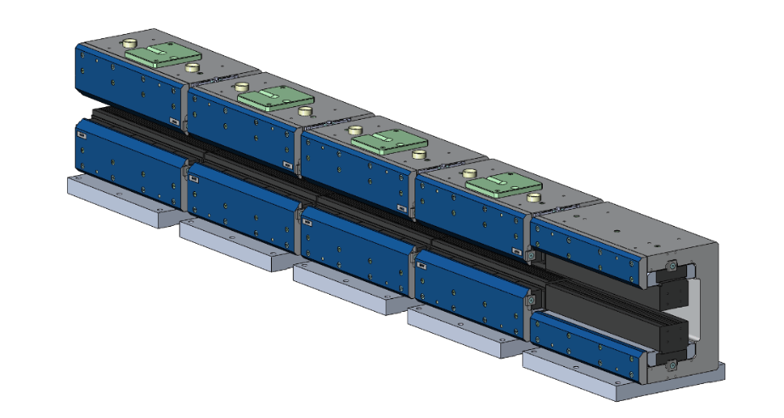
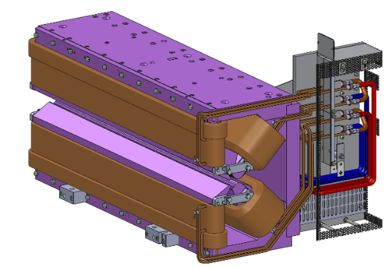
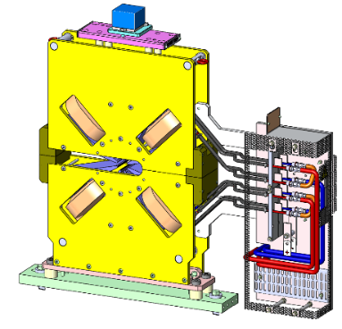
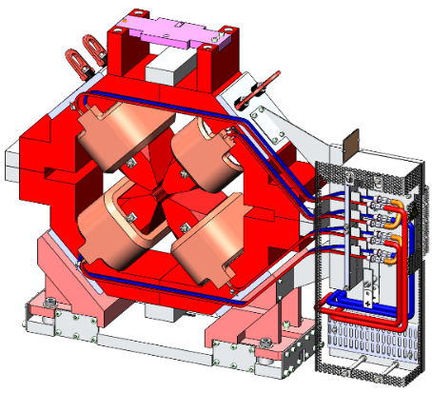
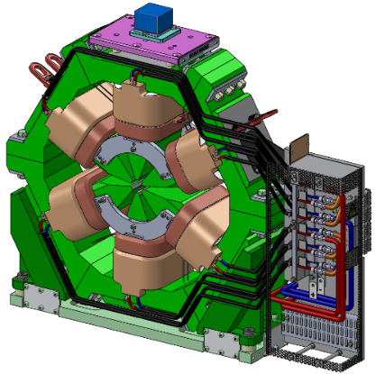
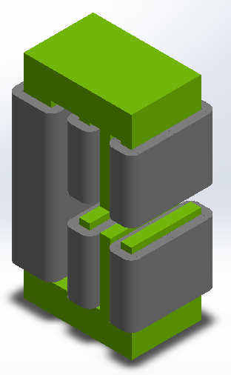
magnets
Assembled in house
TESLA
BINP
132 Dipoles
100 Dipole-quadrupoles
66 Octupoles
More than 1000 Magnets to procure in less than 3 years
DANFYSIK
SEF
TESLA
(MG)
524 Quadrupoles
(132 HG, 392 MG)
DANFYSIK
(HG)
196 Sextupoles
98 Correctors

Slide 25
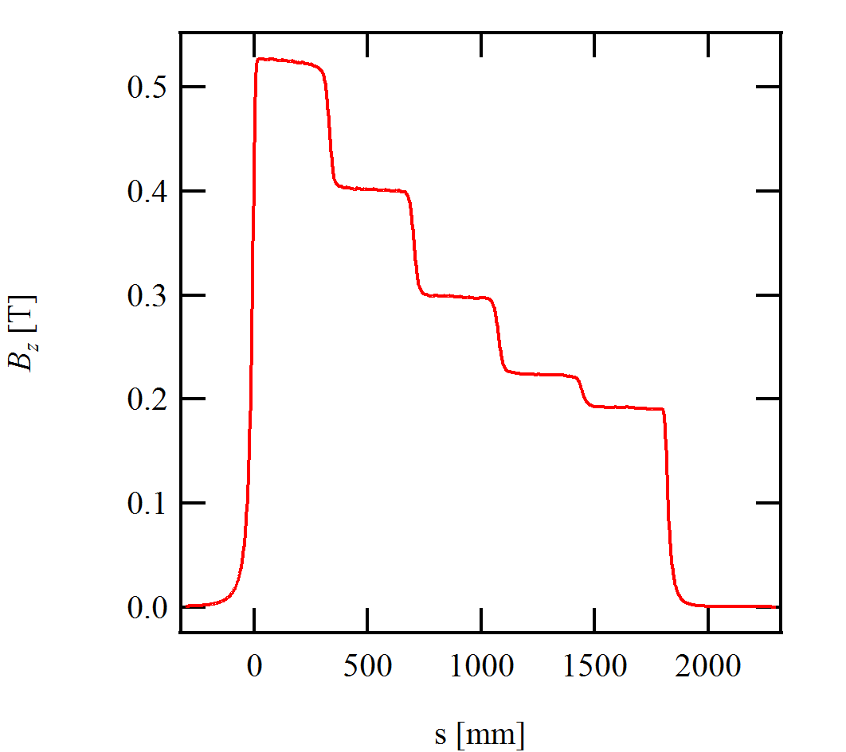
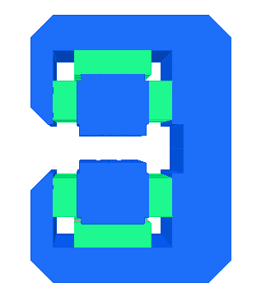
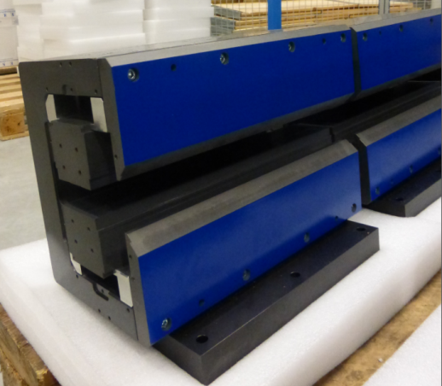
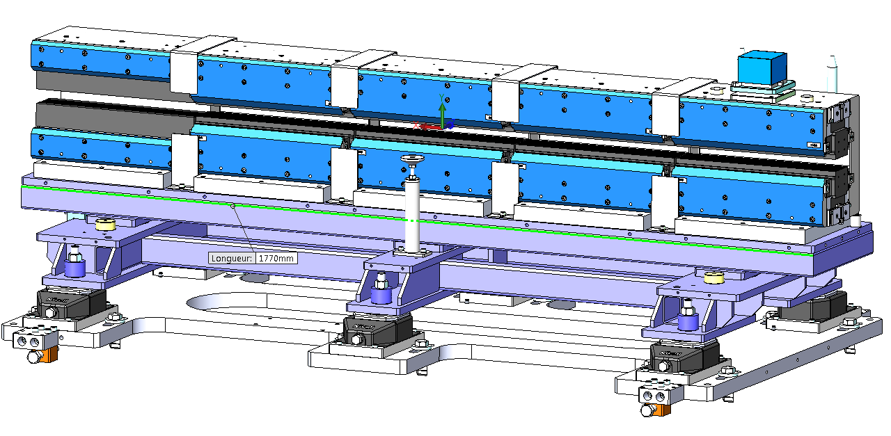
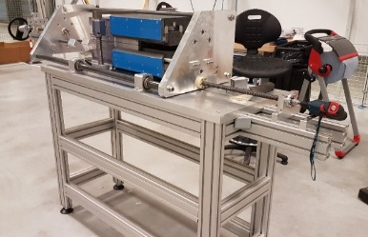


dipoles
Each dipole based on 5 PM modules
Strength 0.67-0.17 T &
Iron length 1788 mm
25.5 – 30.5 mm GAP
Iron: Pure Iron
Permanent magnet Sm₂Co₁₇
PM assembly tool
Around 6000kg of PM, 660 Iron modules,
Partially delivered
Dipole assembly area

Slide 26



sextupoles
2 types
1700 T/m² gradient, 166 − 200 mm length
19.2 mm bore radius
0.5 kW power consumption
Including additional correction coils
Pre-series magnet delivered

Slide 27



quadrupoles
High Gradient
2 types
89 & 87 T/m gradient
388 − 484 mm length
12.7 mm bore radius
1.9 & 1.7 kW power consumption
Pre-series magnet delivered
Moderate Gradient
4 types
Up to 54 T/m gradient, 162− 295 mm length
16.4 mm bore radius
0.7 − 1.1 kW power consumption

Slide 28






Dipole quadrupoles
2 types
Nominal dipole 0.55 – 0.39 T
Nominal gradient 36-39 T/m
1028-800 mm
18.6 mm bore radius
1.6- 1.2 kW power consumption
Poles longitudinally curved
Pre-series magnet in production

Slide 29



octupoles
36900 T/m3 gradient, 90 mm length
18.6 mm bore radius
0.1 kW power consumption
Allows the required stay clear for Synchrotron radiation fan
Pre-series magnet in production

Slide 30

correctors
Horizontal: 10 T.mm
Vertical 10 T.mm
Skew quadrupole: 0.12 T
25.5 mm gap mm bore radius
Pre-series magnet delivered

Slide 31

Girders
Four identical girders per cell
Mass of:
Magnetic elements
Supports 6-7T/girder
Vacuum equipements
5100mm

Slide 32

girders
Girder supported by 4 adjustable Z feet made of motorised wedges
Y adjustment by 2 manual jacks pushing the girder
 | HORIZONTAL (Y) | VERTICAL (Z)
Girder to girder | 50 μm | 50 μm
Motorized Z adjustment resolution 5μm
Manual Y adjustment resolution 5μm
1st natural frequency :
- 50Hz (design criteria)
- 49 Hz measured
Z
Y
Z feet optimised for maximum stiffness
X

Slide 33



girders
Vertical movement
Horizontal movement
Motorized Wedge Airloc
Wedge Nivell DK2
Horizontal Jacks functions:
horizontal adjustment
guiding the vertical movement
improoving the stiffness
Z movement:
Accuracy: 10.8µm
Repeatability: 3.3µm
Increment: 0.3µm
Preload springs (2x0.7T)
«Pushing back»
spring (3.5T)
Pre-series girder delivered by NORTEMECA and AVS
flatness 40μm

Slide 34




Vacuum chambers
Three main families of chambers:
In situ bake-out
Low profile stainless steel chambers (inside combined dipole-quadrupoles & HG quadrupoles)
High profile aluminium chambers (dipole magnets + other)
High profile stainless steel chambers (quadrupoles, sextupoles, octupoles)
High profile cross section
20mm
Low profile cross section
13mm
High profile cross section
20mm

Slide 35





Family 1: Aluminium dipole CHAMBERS
4 dipole chambers per cell made of Aluminum
CH2
CH5
CH9
CH13
Design completed
Prototype done
Manufacturing in progress

Slide 36






Family 2: high profile stainless steel CHAMBERS
Straight Chambers
CH1
CH3
CH4
CH11
CH12
Thick ante-chamber acting as stiffener
1.5 mm sheet EB welding
High profile cross section
Design completed
Manufacturing in progress
20

Slide 37





Family 3: low profile stainless steel CHAMBERS
Curved chambers
CH6
CH7
CH8
Low profile cross section (inside dipole-quadrupoles and HF quadrupoles)
Design complete
Manufacturing in progress
13

Slide 38




RF fingers
8 different bellows = 8 different RF Fingers.
Close collaboration with the vacuum
chamber designer.
FEA model
Prototype tested, additional tests in progress
Design completed
Manufacturing in progress
Blade contact
Patented

Slide 39






Vacuum chambers – CH12 Diagnostics
H stripline
V stripline
Shaker
Current transformer
Beam losses collimator
Procurement in progress
1
4
2
4
3
5

Slide 40

Photon Absorbers

Slide 41


photon absorbers
~391 absorbers (including crotch absorbers, without injection cell specials)
Total power to be absorbed: 504.5 kW (30 x 15.795 kW + 2x 15.314) kW
Power density: 10 to 110 W/mm2 (normal to beam)
=> moderate power parameters compared to current ESRF
Scattered radiation blocked in the absorber to avoid chamber cooling
Photon Absorbers
Synchrotron radiation
E Beam
Absorber flange mounted on the ante-chamber
CuCr1Zr as an alternative to Glidcop
Integrate the CF flange in the CuCr1Zr absorber body
(Sharma Sushil idea)
Tight space constraints
All contracts placed,
absorbers in production

Slide 42











Absorbers design : two families
Family Toothed (up to 110 W/mm²)
Family Frontal (up to 50 W/mm²)
Toothed geometry optimized to reduce thermal stresses over large area
ABS CH5-1-1
Temperature photon
Toothed absorber
ABS CH13-1-13
Crotch 1
ABS CH4-1-1
No weld, no braze
ABS CH9-1-29

Slide 43



Absorbers optimized to block scattered radiation
No water cooling on chambers
60degC local
Teeth Absorbers intercept the Radiation at grazing angle
Scattered fraction is high (5-10%)
Long End Tooth blocking the Scattered Radiation from reaching the Chamber
Frontal Absorbers intercept Radiation close to Normal Incidence
=> Scattered Fraction is low (<3%)
Screen blocking most of the scattered radiation
An average 10W≤ P_{scatt} ≤30W irradiated on vessels
Efficiency ∼ 85% (Screen + Long Tooth)

Slide 44
1000 large Power supplies and 1000 small Power Supplies
Type | Name |  | NOMINAL FIELD VALUES |  |  | Electrical design |  |  | PS |  |  |  | nom | maxWatt
 |  | quantity | Length | dB/dx | lattice | Power | Voltage | Current | OVdesign |  | Watts | Watts | Watts | P total
 |  | per cell | [m] | [T/m] |  | [kW] | [V] | [A] | factor | Imax | Pnom | Pmax | cell | cell
Quadrupole, mod. gradient | QF1 | 2 | 0.349 | 53.7 |  | 1.06 | 12.1 | 87.5 | 1.2 | 102 | 1167 | 1576 | 2334 | 3152
Quadrupole, mod. gradient | QD2 | 2 | 0.266 | 51.5 |  | 0.86 | 9.8 | 87.5 | 1.2 | 106 | 966 | 1418 | 1932 | 2836
Quadrupole, mod. gradient | QD3 | 2 | 0.216 | 46.5 |  | 0.74 | 8.4 | 87.5 | 1.2 | 117 | 843 | 1519 | 1687 | 3037
Quadrupole, mod. gradient | QF4 | 4 | 0.216 | 51.5 |  | 0.74 | 8.4 | 87.5 | 1.2 | 106 | 843 | 1238 | 3373 | 4952
Quadrupole, mod. gradient | QD5 | 2 | 0.212 | 52.5 |  | 0.86 | 9.8 | 87.5 | 1.2 | 104 | 966 | 1364 | 1932 | 2729
Total |  | 12 |  |  |  |  |  |  |  |  |  |  | 11257 | 16705
Quadrupole, high gradient | QF6 | 2 | 0.36 | 95.2 |  | 1.42 | 15.7 | 90.4 | 1.1 | 99 | 1535 | 1857 | 3070 | 3714
Quadrupole, high gradient | QF8 | 2 | 0.48 | 96.2 |  | 1.66 | 18.6 | 89 | 1.1 | 98 | 1767 | 2139 | 3535 | 4277
Total |  | 4 |  |  |  |  |  |  |  |  |  |  | 6605 | 7992
Dipole-Quadrupole, high field | DQ1 | 2 | 1.11 | 37.54 | 33.9 | 1.59 | 15.75 | 100.7 | 1.2 | 121 | 1729 | 2490 | 3458 | 4980
Dipole-Quadrupole, mod field | DQ2 | 1 | 0.77 | 37.04 | 33.7 | 1.38 | 17.0 | 81.0 | 1.2 | 97 | 1469 | 2116 | 1469 | 2116
Total |  | 3 |  |  |  |  |  |  |  |  |  |  | 4928 | 7096
Sextupole, long | SD | 4 |  | 4500 | 4300 | 1.01 | 11.7 | 86 | 1.1 | 95 | 1111 | 1344 | 4444 | 5377
Sextupole, long | SF | 2 |  |  |  | 1.01 | 11.7 | 86 | 1.1 | 95 | 1111 | 1344 | 2222 | 2689
Total |  | 6 |  |  |  |  |  |  |  |  |  |  | 6666 | 8066
Octupole | OF1-2 | 2 | 0.1 |  |  | 0.30 | 3.2 | 94 | 1.2 | 113 | 426 | 613 | 852 | 1226
Total |  | 2 |  |  |  |  |  |  |  |  |  |  | 852 | 1226
 |  | 27 | Total PS power for one cell for main electromagnets |  |  |  |  |  |  |  |  |  | 30.3 | 41.1
 |  |  |  |  |  |  |  |  |  |  |  |  | KW | KVA
 |  | magnet | coils |  | type
corrector AC+DC (5 independent coils) |  | 3 | 5 |  | AC+DC
Sextupole, short correctors |  | 6 | 6 |  | DC
Total number of coils/cell |  |  | 51
Contracts in place by December 2016
About 1000 DC-DC low voltage converters: the average channel power is around 1kW and a maximum of 2.3kW.
The stability requested will be 15ppm with a MTBF of more than 400 000 hours.
The integration in 32 cabinets will be designed with the Computer Services for redundancy and HOT-Swappability

Slide 45

RF Layout
Cell 5
Cell 7
-7 dB
-7 dB
5 cell cavities replaced by 14 HOM damped single cavities
Storage Ring
KLYS
1
KLYS 2
Keep the existing transmitters
Teststand
75 kW
tower
75 kW
tower
75 kW
tower
75 kW
tower
75 kW
tower
In
house
SSA
75 kW
tower
3x existing 150 kW SSAs
3rd harmonic cavities
  under study
Cell 25

Slide 46


RF cavities
Fabrication of 12 HOM damped cavities by RI
4 cavity delivered
2 cavities conditioned o 750 kV within 2 weeks
Cavity assembly area

Slide 47

Front-ends
BM Front-End
42 Front-Ends
28 ID FE’s
14 BM FE’s
Front-Ends new design (completed) for :
SR junction chambers
BM FE photon shutter unit
Procurement in progress
ID Front-End

Slide 48

Bending magnets source: 2-pole, 3-Pole or short wigglers
All new projects of diffraction limited storage rings have to deal with:
Increased number of bending magnets / cell => BM field reduction
Conflict with hard X-ray demand from BM beamlines
ESRF will go from 0.85 T BM to 0.54 T BM
The BM Sources will be replaced by dedicated 2-Pole or 3-Pole Wigglers
Half assembly
Field Customized
Large fan with flat top field
2 mrad feasible for 1.1 T 3PW
Mechanical length ≤ 150 mm
Source shifts longitudinally by ~3m
Source shifts horizontally by ~1-2cm
Flux from 3PW

Slide 49

mockup
Many tests have been made with the prototype mockup:
Girder performances
Girder handling
Survey
Thermal issues
Compatibility checks
Services and cabling optimization
A full cell mockup will be built from January 2017:
4 fully assembled girders will
be used to test and optimize the
assembly and installation sequences

Slide 50





Buildings for the assembly and installation phase
Chartreuse hall for dipole assembly assembled girder storage
ESRF 10-11-12-13 Temporary building for storage and dismantling
All critical contracts for logistic in place
ESRF 1 Girder assembly hall & ESRF2 Storage buildings

Slide 51
Girders assembly in ESRF01

Slide 52




Assembly phase
All the girders will be assembled in ESRF1 (Sep 2017 - Oct 2018)
and stored mainly in the Chartreuse hall before the Long Shutdown
Assembling
of vacuum chambers
on dedicated tables
Assembling
of magnets on the girders
Then opening of magnets and add the whole vacuum section,… alignment,…..

Slide 53
Dismantling and infrastructure preparation
The tunnel must be cleaned up prior the installation of the new machine.
Some work/upgrade will be anticipated prior the long shutdown
The existing machine will be dismounted using the cranes
Each component of the present storage ring must be fully dismounted, radiation measured, traced and stored following French safety regulation.
Some civil work needed prior rolling the new girders.

Slide 54

Installation
Normally access for ordinary maintenance is via the roof, using over-head cranes,
but ….
Assembled girders are
too heavy for the cranes
➔Specific handling tools.

Slide 55
Dismantling & installation planning
Dismantling and installation sequence has be evaluated and a preliminary schedule prepared

Slide 56
Conclusion
EBS officially started on January 1st 2015
No impact on user operation
Continuation of the development (injector, top-up, cryo undulators,…)
Project execution progression:
Engineering Design virtually completed
Procurement in full swing
Delivery of all pre-series components expected by end 2016/ start 2017
➔ Schedule now heavily linked to external manufacturers!
Assembly to be started in less than 1 year (mock spring 2017)
Dismantling/installation/commissioning in preparation
At this stage, no major show stopper identified.

Slide 57

Many thanks for your attention

Slide 58


Lifetime of S28B
S28A
DA -8.1mm@S3
TLT ~ 13h.
S28B
DA -10mm@S3
TLT ~ 21h
e_{y}=5pm | ESRF | Upgrade
Multibunch | 64 h | 21 h
16 bunch | 6 h | 2.1 h
4 bunch | 4 h | 1.4 h

Slide 59

Collimation optimization to decrease losses in the IDs

Slide 60



Collimator shielding 50 cm LEAD local shielding
μSv/h
total
0.5
neutrons
ambient dose equivalent rate (μSv/h)
0.5
cm

