Slide 1
Progress of HEPS Lattice Design
Gang Xu, Yi Jiao
HEPS Accelerator physics
2016/12/01
2nd Workshop on Low Emittance Ring lattice Design, MAXIV-lab, Lund, Sweden

Slide 2
Topics
Introduction to HEPS and its R&D
Works on nominal design
  Nonlinear dynamics
  Lattice correction for errors and misalignments
  1st turn issue: find out the closed orbit
  ID effects
  Fringe field effects
  Lattice for off-axis injection
Optimization nonlinear behavior on the nominal design by PSO/MOGA
Injection simulation: tolerance and efficiency
Anti-bend scheme
Summary
Notes:
Introduction to HEPS

Slide 3
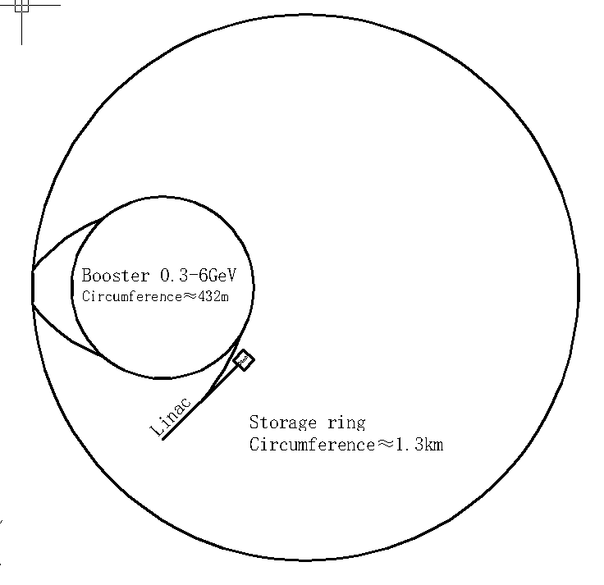
Introduction to HEPS
Design Goals
Parameters | Value | Unit
Energy | 6 | GeV
Circumf. | ~1.3 | km
emittance | < 100 | pm⋅rad
current | ≥ 200 | mA
Schematic of HEPS Complex

Slide 4
Accelerator R&D of HEPS
Based on the nominal lattice design
R&D
  Magnet: Q>80T/m
  combined function B, G~50T/m
  longitudinal gradient B
  (both for electrical and permanent)
  RF superconducting RF(166MHz)
  KICKER and its pulse power supply
  Vibration wire for alignment
  on-line control-able girder
  NEG coating and absorbor
  10ppm power supply
  CPMU

Slide 5
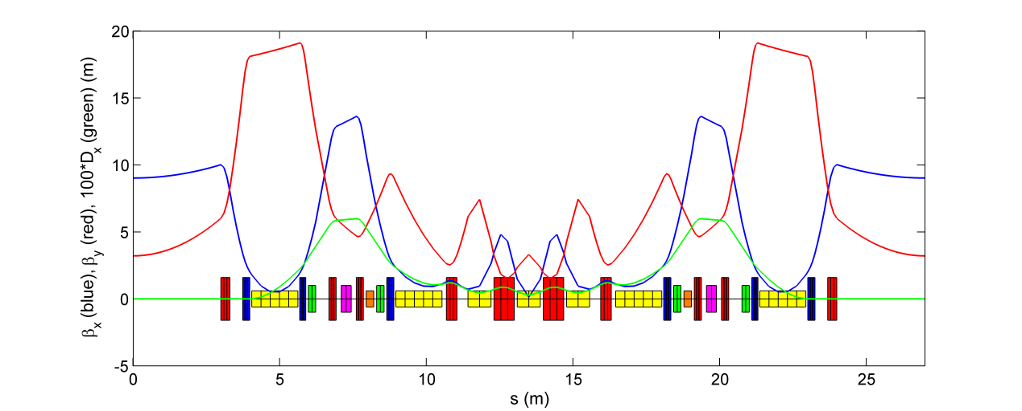
Nominal Design – Hybrid 7BA (1/2)
Four outer dipoles with long. gradients are used to create two dispersion bumps with all the sextupoles therein for an efficient chromatic correction; both permenant dipoles and electromagnets are considered and are under R&D.
Inner three dipoles are combined with defocusing gradients (J_{x} > 1), and neighbouring them are high-gradient quadrupoles, for a compact layout and an ultralow emittance.
Now max. quadrupole gradient of 80 T/m is used in the lattice design. After the quadrupole R&D, we will determine the available max. quadrupole gradient.
Notes:
Several FEL facilites has been constructed or being design or constructed. They are in Beijing, etc.
放图,跟其他光源比较，找一张合适的图

Slide 6
Nominal Design – Hybrid 7BA (2/2)
Reserve enough space between adjacent magnets (min. 7.5 cm, max. 81 cm) for diagnostics, 3-pole wiggler (35 cm) and other equipment.
Between each pair of sextupoles, a -I transportation is designed to cancel most of the nonlinearities induced by sextupoles.
Two octupoles are used to correct the detuning terms.
The 7BA is about 27 m. Forty-eight such 7BAs form the ring, with a circumference of 1295.6 m, providing forty-eight 6-m straight sections with low beta functions, especially in y plane, for insertion device (ID).
Notes:
Several FEL facilites has been constructed or being design or constructed. They are in Beijing, etc.
放图,跟其他光源比较，找一张合适的图

Slide 7
Nominal Design – Main parameters
Parameters | Values | Units
Beam energy E₀ | 6 | GeV
Beam current I₀ | 200 | mA
Bunch number n_{B} (high brightness/timing mode) | 648/60
Circumference | 1295.6 | m
Horizontal damping partition number J_{x} /J_{y}/J_{z} | 1.37/1.0/1.63
Natural emittance | 59.4 | pm⋅rad
Working point (x/y/z) | 116.16/41.12/0.0029
Natural chromaticity (x/y) | 214/−133
Number of 7BA achromats | 48
Number of low-beta 6-m ID sections | 48
Beta functions in low-beta straight section (x/y) | 9/3.2 | m
Damping times (x/y/z) | 18.9/25.9/15.9 | ms
Energy loss per turn, U₀ （without IDs） | 1.995 | MeV
Energy loss per turn, U₀（estimated for 10 IDs） | 2.5 | MeV
Max. beam Power | 500 | kW
Energy spread σ_{δ} (without ID) | 7.97×10⁻⁴
Momentum compaction | 3.74×10⁻⁵
RF voltage (fundament-frequency) V_{rf} (Injection/operation)* | 0.88/2.65 | MV
RF frequency (fundament-frequency), f_{rf} | 166.6 | MHz
RF voltage (third harmonic) V_{rf} (Injection/operation)* | 2.64/-0.53 | MV
RF frequency (third harmonic), f_{rf} | 499.8 | MHz
Harmonic number n_{h} | 720
Natural bunch length σ_{z} (injection/operation) | 2.8/32 | mm
* The RF voltage is calculated with U₀ = 1.995 MV.

Slide 8
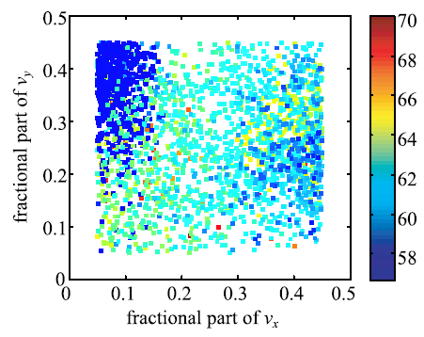
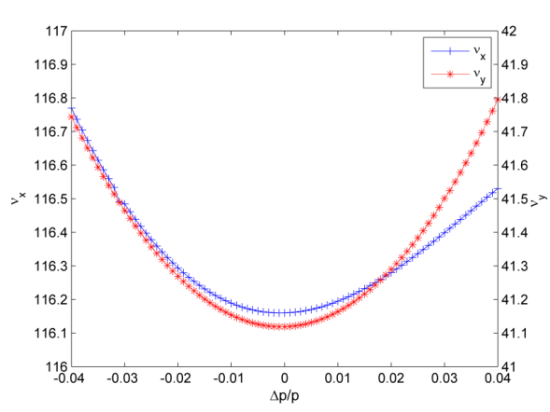
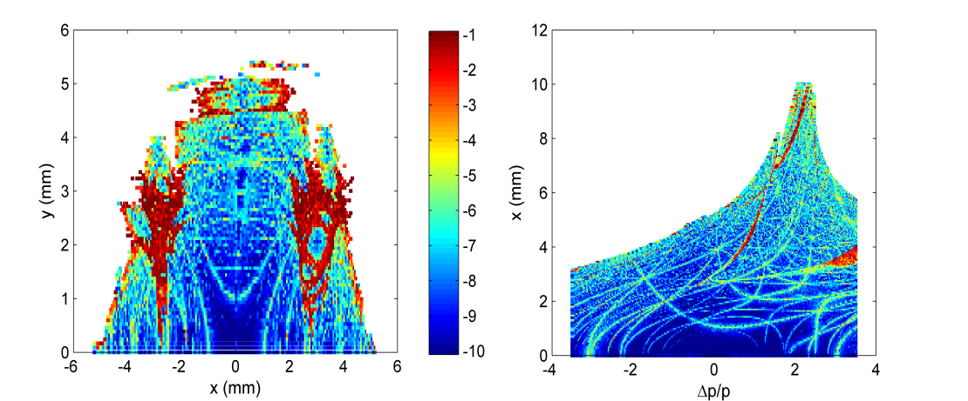
Nominal Design - Nonlinear dynamics (1/4)
Scan the quadrupole strengths, vary the integer and fractional tunes, while keeping the -I transportation between sextupoles.
Grid scan of the multipole strengths for each tune (3 sextupole families and 1 octupole family for the nominal design, only two free knobs) to optimize the nonlinear dynamics.
υ_{x}
υ_{y}
y (mm)
x (mm)
δ
x (mm)
δ
Tune vs. δ, ring acceptances projected in the (x, y) and (x, δ) planes, obtained with only the bare lattice

Slide 9
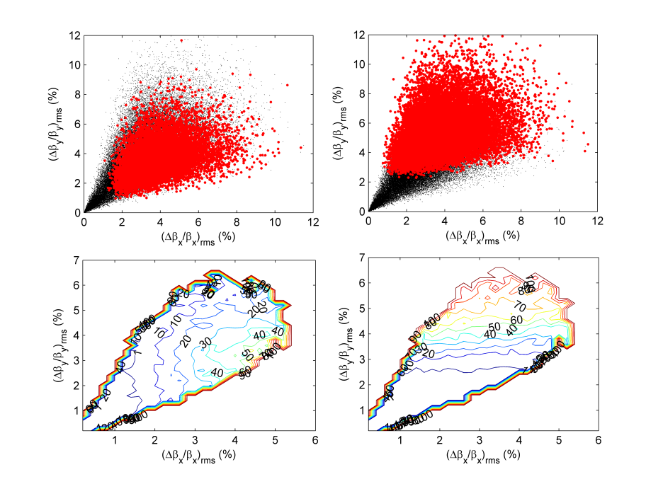
Nominal Design - Nonlinear dynamics (2/4)
Tracking with the bare lattice (include RF, radiation) shows the local MA size is about 4%. But Half integer resonances are crossed by particles with δ of 3%.
Statistically analyze the effect of half integer resonances on MA, including quad. field errors and orbit in sextupoles.
Horizontal half integer resonances have stronger effect than the vertical one.
Half integer resonances can be safely crossed but needs well control of the optics distortion.
To keep the probability of MA reduction due to crossing of half integer resonances below 1%, the rms beta betas should be smaller than 1.5% in x and 2.5% in y plane.
MA size
S (m)
MA reduction probability vs. rms beta beat
Y. Jiao, Z. Duan, NIM-A, 841, 2017

Slide 10
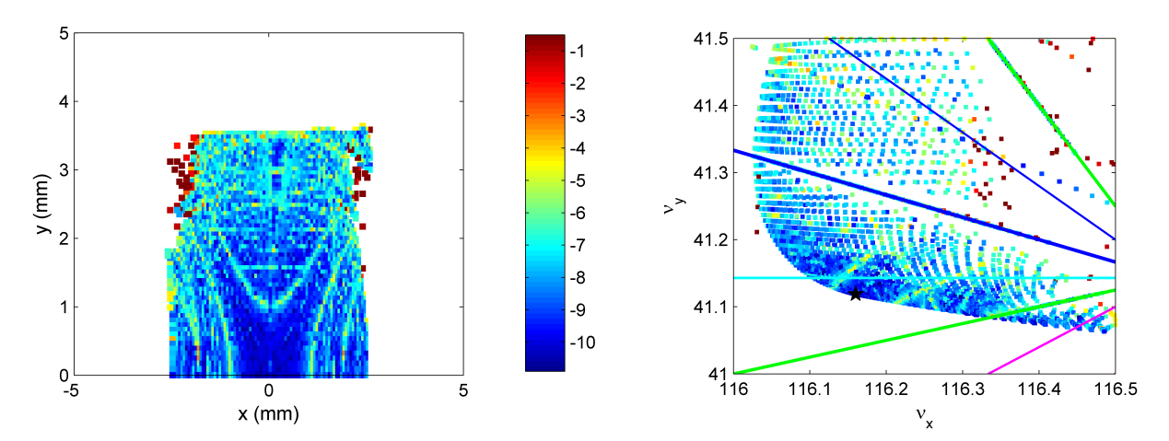
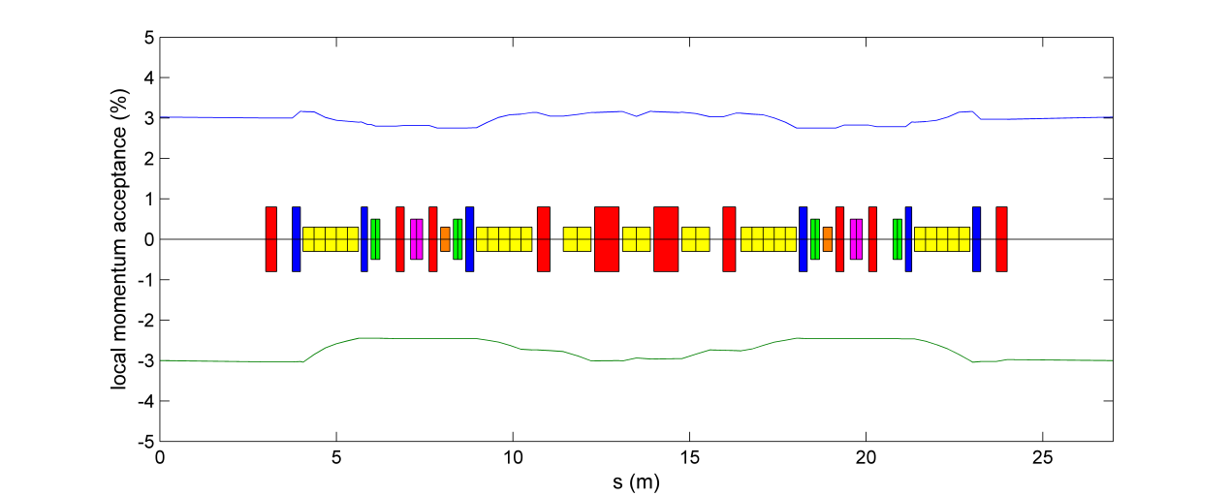
Nominal Design - Nonlinear dynamics (3/4)
In the HEPS design, we use the ‘effective’ DA and MA of the bare lattice to measure the actual ring acceptance with practical errors.
  Consider both integer and half integer resonances are fatal to dynamics and cannot be crossed without loss,
  Within the effective DA/MA, not only the motions remain stable after tracking over a few thousand turns, but also the tune footprint is bounded by the integer and half integer resonances nearest to the nominal tunes,
  In this way, one can avoid too optimistic estimation of the nonlinear performance of the ring, especially when having only the bare lattice in hand.
For the nominal design, the effective DA is about 2.5 mm (vs. 5 mm), and effective MA is about 3% in the 6-m straight section and 2.5% at dispersive region (vs. 4%).
υ_{y}
Effective MA (%)
y (mm)
x (mm)
υ_{x}
S (m)

Slide 11
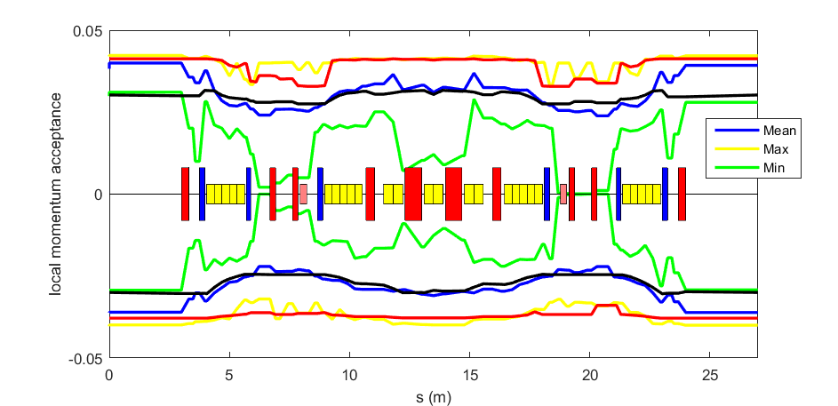
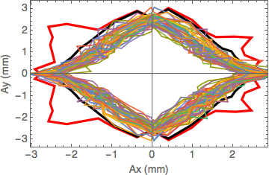
Nominal Design - Nonlinear dynamics (4/4)
Just recently the simulation study of error effects and lattice calibration process is almost finished. We calculate the DA and LMA with different error seeds.
Results show reasonable agreement between the effect DA and LMA and the DA and LMA with errors.
It indicates that effective DA and MA can give a reasonable estimation of the actual ring acceptance.
Red curve: DA or MA of bare lattice considering limitation of integer resonances
Black curve: DA or MA of bare lattice considering limitation of both integer and half integer resonances

Slide 12
Error sources and modeling
Error Setting for now
 | Quad/Sext/Octu | Bend | Girder
X/Y Shift (μm) | 30 | 200 | 50
Z Shift (μm) | 150 | 150 | 200
X/Y TILT (mrad) | 0.2 | 0.2 | 0.1
Z TILT (mrad) | 0.2 | 0.1 | 0.1
 | Quad | Bend/Sext | Octu
Field Error Include multipole | 2e-4 | 3e-4 | 5e-4

Slide 13
Simulation on orbit correction
Beam diagnostics and correction element
  8 correctors (6 used in optics correction )
  14 TBT BPMs
  4 skew quadrupoles (2 dispersion free)
 | Noise (m) | Tilt (mrad) | Gain | Shift (mm)
BPM(10Hz) | 1e-7 | 10 | 5% | 0.1/1e-3

Slide 14
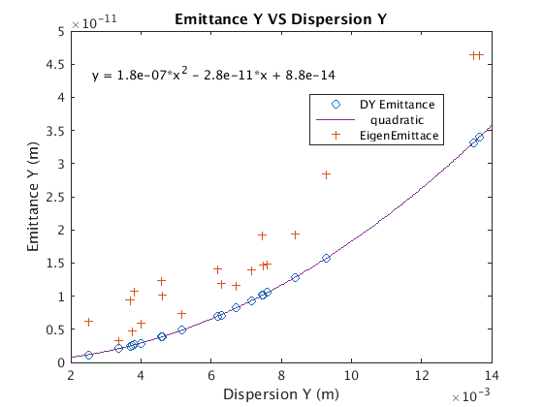
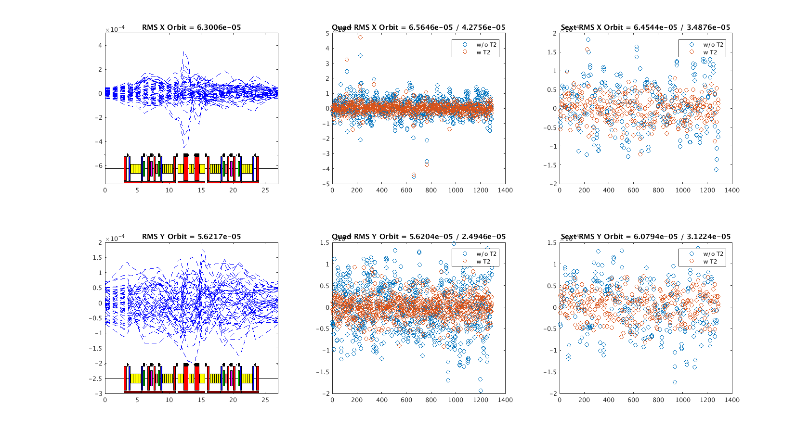
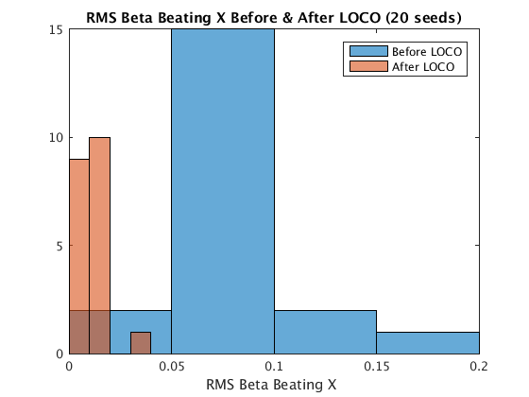
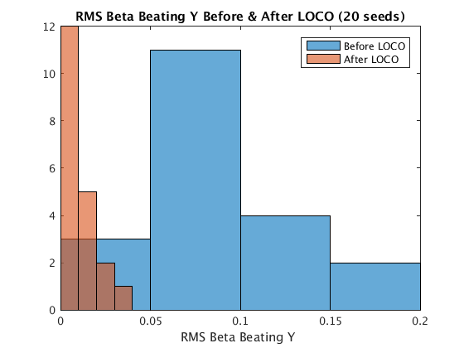
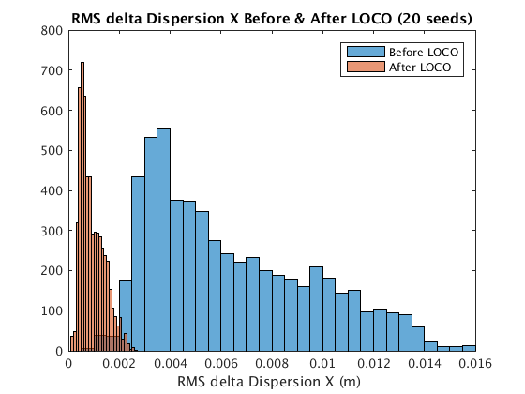
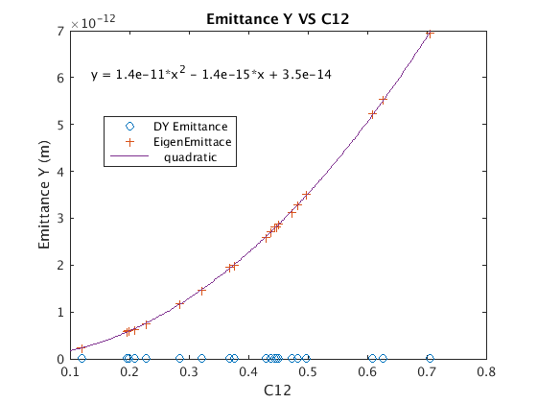
Simulated Commissioning
Orbit Correction
  w/o BBA: 70/50μm;
  w/ BBA : 40/25μm (Quad), 30/30μm(Sext);
Optics Correction
  Beta beating: 6%/8%➔2%/1% (H/V);
  Delta Horizontal Dispersion<1mm;
Vertical Dispersion Correction
  Skew quadrupole (Dy>0)*2 /Cells
  Vertical emittance < 10pm
Coupling Adjustment
  Skew quadrupole (Dy=0)*2 /Cells
  Vertical emittance < 6pm

Slide 15
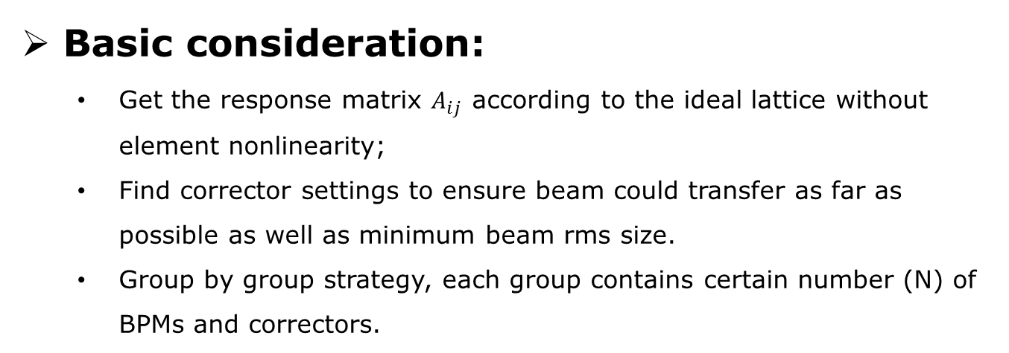
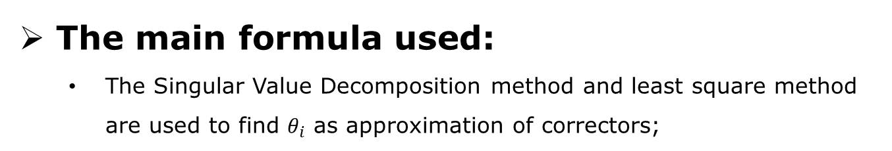
First Turn Optimizing Strategy
The main formula used:
  The Singular Value Decomposition method and least square method are used to find $θ_{i}$ as approximation of correctors;
Basic consideration:
  Get the response matrix $A_{ij}$ according to the ideal lattice without element nonlinearity;
  Find corrector settings to ensure beam could transfer as far as possible as well as minimum beam rms size.
  Group by group strategy, each group contains certain number (N) of BPMs and correctors.
Notes:
Where $θ_{i}$ is the expected corrector strength, R_{j} is BPM signal and $A_{ij}$ is the lower triangular response matrix of the nominal lattice

Slide 16
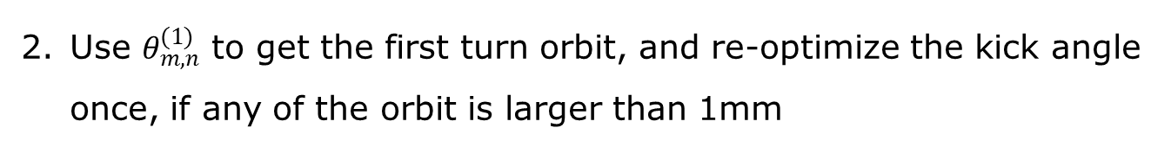
First Turn Optimizing Strategy
The main steps:
1. Get $θ_{m,n}^{}$ and optimize $κ_{n}$ group by group:
Group 1
Group 2
Group n
One turn
BPMm
BPM
m+1
BPM
m+2
BPM
m+m
BPM
(n-1)*m+1
BPM
(n-1)*m+2
BPM
(n-1)*m+m
BPM1
BPM2
Use $θ_{m,n}^{(1)}$ to get the first turn orbit, and re-optimize the kick angle once, if any of the orbit is larger than 1mm
With steps 1 and 2, the beam can survive for more than 1000 turns
Notes:
Where $θ_{i}$ is the expected corrector strength, R_{j} is BPM signal and $A_{ij}$ is the lower triangular response matrix of the nominal lattice

Slide 17
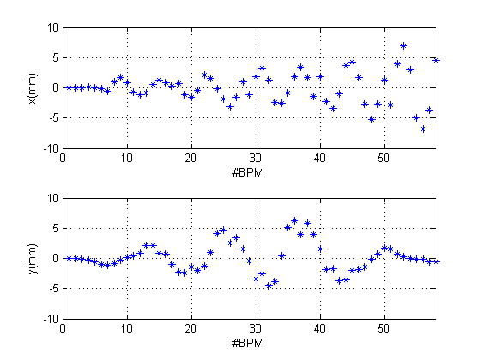
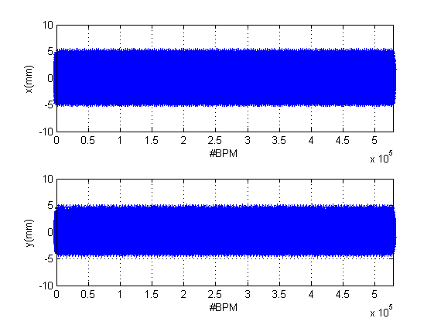
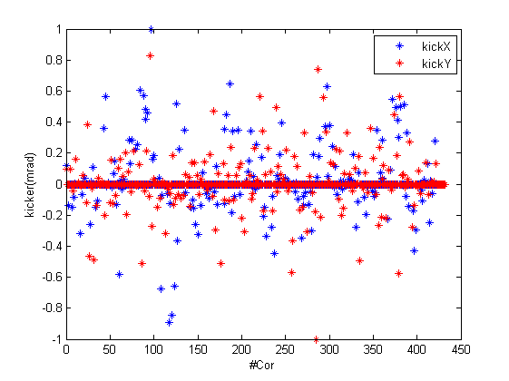
First Turn Commissioning Strategy
One Example
Lattice Settings
  The total number of BPM and corrector are 528 and 432
  With rand errors in range of 3σ(σ=0.1mm) misalignment of all the quadruples
  The limit of the corrector strength is 1mrad
  Beam lost when BPM signal exceed 8mm
Left(a) BPM signal before correction; middle(b) 1000 Turn simulation after correction; right (c) corrector setting

Slide 18
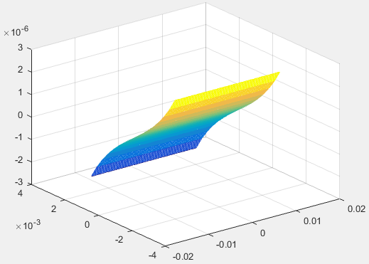
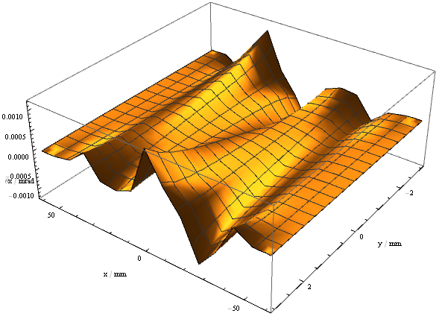
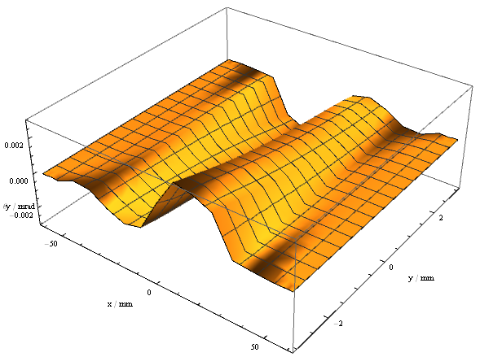
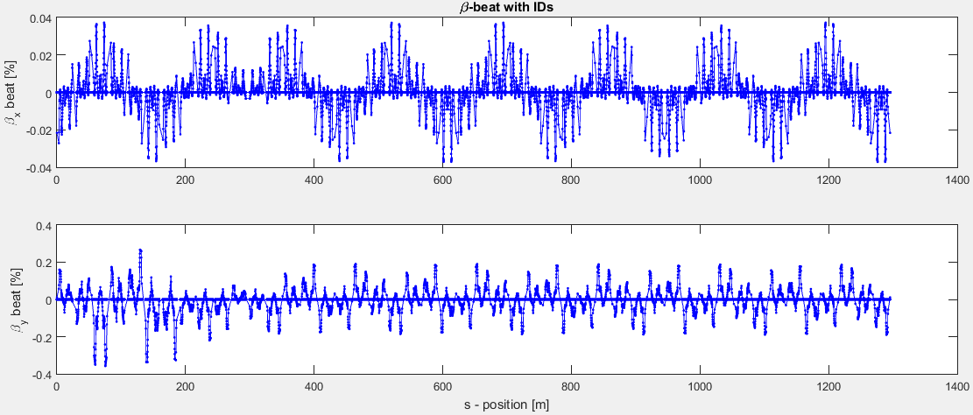
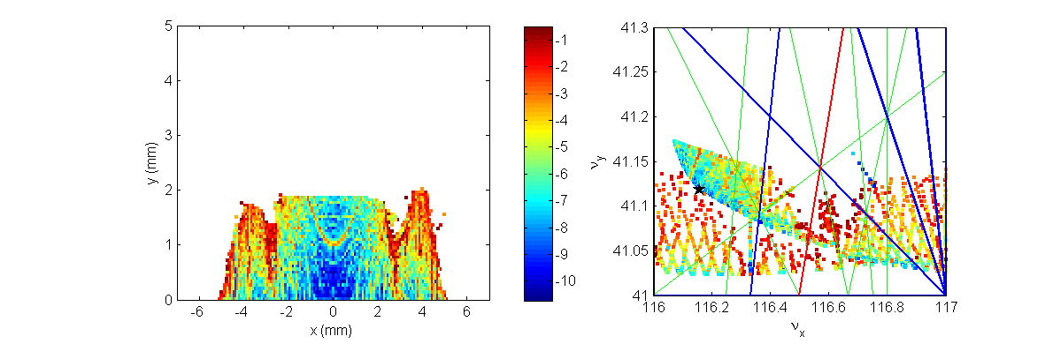
Nominal Design - ID effects
Symplectic integration method has been applied to study the linear and nonlinear effects of various types of IDs:
The maximum vertical tune shift is 0.01 and the vertical dynamic aperture reduce to 2 mm due to the nonlinear effect with totally 21 IDs.
canonical momentum kick map of planar U20
Horizontal and vertical kick map of inclined mode of EPU52
Beta-beat effects related to the 21 IDs
Dynamic aperture related to the 21 IDs (δ=0)
By Dr. Li Xiaoyu

Slide 19
Nominal Design - Fringe field & ID effect
Now consider the actual field of high gradient quadrupole Q8 and longitudinal graident dipoles (outer 4 dipoles) in the lattice.
Including fringe field of Q8 causes evident beta beats and variation in tune.
In the future, we will build the actual field model for all magnets in the lattice.
 | ν_{x} | ν_{y} | emittance(pm)
hard-edge | 116.1597 | 41.1188 | 59.387
Q8 fringe field | 115.7789 | 40.8228 | 58.576
△ | -0.3808 | -0.296 | -0.811
Q8
Outer 4 dipoles with long. gradient
 | ν_{x} | ν_{y} | emittance(pm)
hard-edge | 116.1597 | 41.1188 | 59.387
Outer dipole fringe field | 116.1597 | 41.1168 | 60.2160
△ | 0.0000 | -0.0020 | 0.8290
By Dr. Guo Yuanyuan

Slide 20
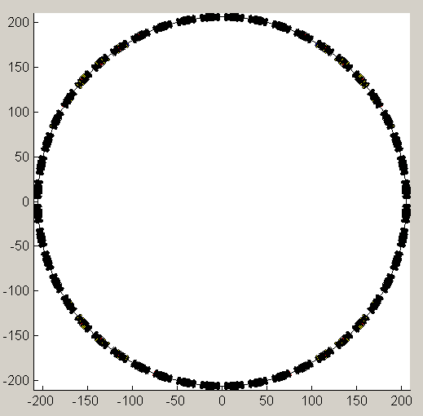
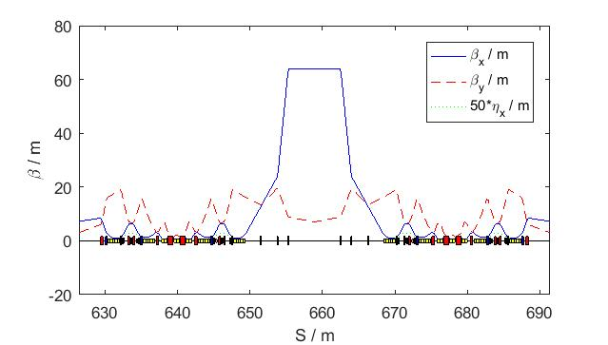
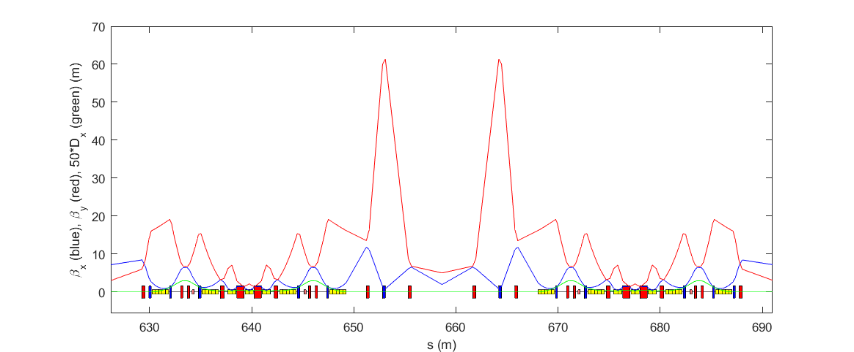
Alternative design for off-axis injection(Details in Yuemei Peng’s talk)
For accelerator construction it is better to use mature technology if possible, to reduce potential risk in the commissioning and operation of the machine.
Off-axis injection schemes, e.g., w/ local-bump pulsed kickers or pulsed multipoles, are proven and commonly used in existing machines. Off-axis injection design is explored.
Replace two opposite straight sections with longer, high-beta or moderate-beta section
  Circumference increased by ~ 1.5% (20 m) to ~1317 m,
  Emittance remains the same, since beta and dispersion functions in the dipoles are not changed.

Slide 21
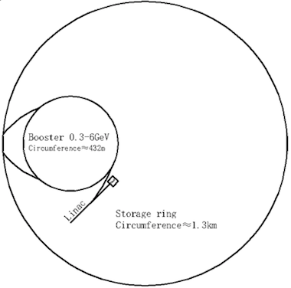
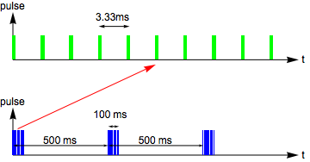
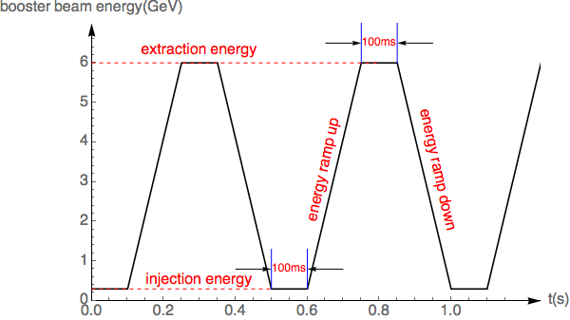
The swap-out scheme for HEPS (preliminary)
x’
Courtesy of Y. M. Peng
x
s
Mirror-symmetric layout of injection/extraction region in the storage ring.
Accumulation of extracted bunch in the booster at top energy and re-inject into the storage ring.
The same kicker time structure allows ~ 30 bunches swap-out at 2 Hz.
Swap-out injection allows twice the pulse length of injection/extract kicker system.
Beam current will have a bigger jitter(~1/60) for high charge mode.

Slide 22
Different injection schemes for HEPS storage ring
Nominal lattice design
  On-axis accumulation with an active double-RF system^{[1]}
  On-axis swap-out injection^{[2]}
Alternative lattice design with high-beta insertions
  Off-axis pulsed multipole injection^{[3]}
[1] B. C. Jiang et al., NIM A 814 (2016) 1-5; G. Xu, et al., IPAC 2016; Z. Duan, et al, eeFACT 2016.
[2] L. Emery and M. Borland, In Proc. PAC’03, pp.256–258.
[3] Y. Jiao and G. Xu, Chin.Phys. C37 (2013) 117005, for an old lattice design.

Slide 23
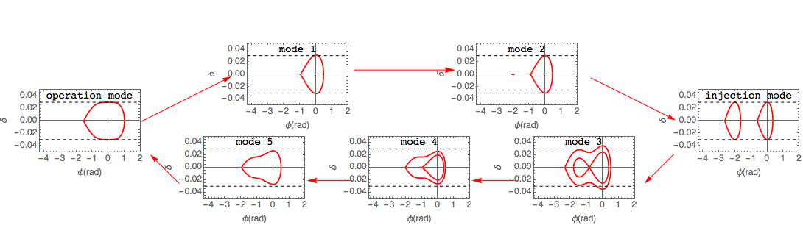
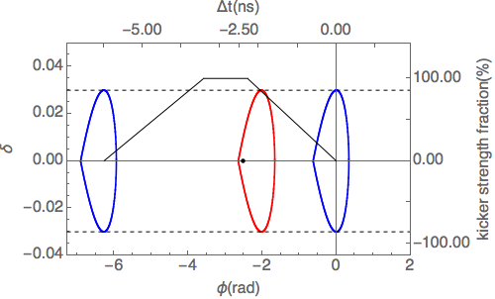
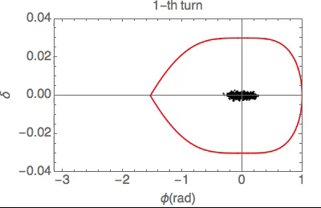
On-axis accumulation in longitudinal phase space

Slide 24
Preliminary injection layout design
Injection element | parameter | value
stripline kicker | Length | 3 m
 | total kick angle | 3 mrad
 | fall time ( 90% - 10%) | 2.2 ns
 | full width ( 10% - 10%) | < 6 ns
 | total kick angle jitter | < 2%
Lambertson magnet | Length | 2 m
 | horizontal bend angle | 100 mrad
 | vertical bend angle | 10 mrad
 | bend angle jitter | < 2e-5

Slide 25
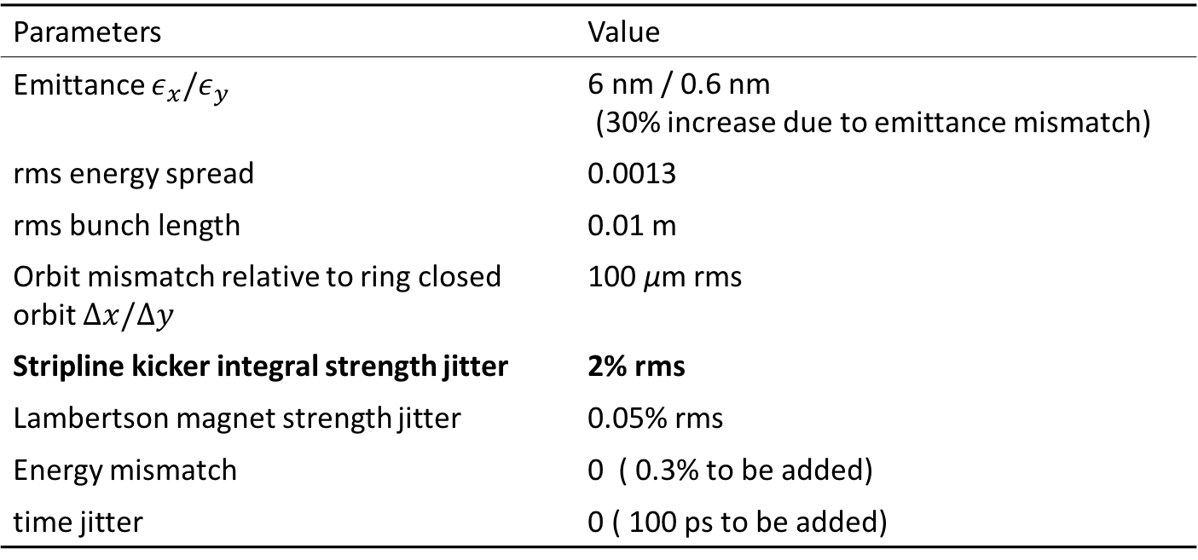
Parameters used in injection tracking
Parameters | Value
Emittance $ε_{x}/ε_{y}$ | 6 nm / 0.6 nm (30% increase due to emittance mismatch)
rms energy spread | 0.0013
rms bunch length | 0.01 m
Orbit mismatch relative to ring closed orbit $Δx/Δy$ | 100 μm rms
Stripline kicker integral strength jitter | 2% rms
Lambertson magnet strength jitter | 0.05% rms
Energy mismatch | 0 ( 0.3% to be added)
time jitter | 0 ( 100 ps to be added)

Slide 26


Time lag between injected bunch and circulating bunch is 2.4 ns
Jitter of Kick angle from injection kicker is the dominant effect in injection system error:
for

Slide 27
Injection simulation
For the machine with the worst DA,
  50 seeds of injection errors
  500 particles tracked for 2000 turns
  Injection loss rate is statistically analyzed.
Time lag between injected bunch and circulating bunch is 2.4 ns
For higher injection efficiency, we still need to seek the balance between kicker fall time and tolerable kick angle jitter.

Slide 28
Injected bunch 2.3ns far from the circulation bunch
Some cases particle will lose

Slide 29
Time lag between injected bunch and circulating
Injected bunch 2.2ns far from the circulation bunch
No particle lost even for kicker jitter 2%.

Slide 30
PSO/MOGA optimal: balance between DA and MA with emittance(1/2)
Keep the circumference basically unchanged (+/- 1 m) and adopt the same lattice structure
Use PSO (particle swarm optimization) and MOGA (multi-objective genetic algorithm) to globally scan and optimize all tunable element parameters
  We have shown [1] that applying them in a successive and iterative way will be more effective than using either of them alone in approaching the true global optima for an explorative multi-objective problem.
  32 variables (magnetic positions, strengths, bending angles, etc.)
  2 objectives (emittance and scaled ring acceptance as a function of effective DA and MA)
  Practical constraints (-I transportation, reasonable beta functions, stability of optics, enough drift space for 3-pole wiggler, enough separation between the fractional tunes, etc.)
Variables | Scanning range
Lengths of the drifts | [0.1, 1.6] m
Gradients of (Q1 to Q6) | [-2.6, 2.6] m⁻²
Gradients of (Q7 and Q8) | [-4, 4] m⁻²
Gradients of dipoles (BC1 and BC2) | [-2.4, 2.4] m⁻²
Length of inner dipoles | [0.6, 1.0] m
Length of outer dipoles | [1.2, 1.8] m
Dipole angles | [0.1, 2] deg.
Sextupole strengths | [-280, 280] m⁻³
Octupole strengths | [-2×10⁴, 2×10⁴] m⁻⁴
[1] Y. Jiao, G. Xu, arXiv: 1605.05021.

Slide 31
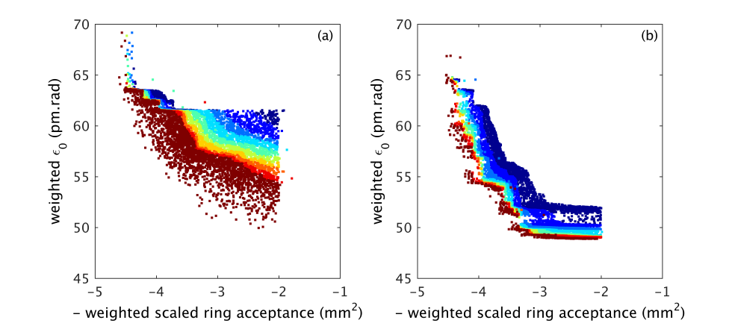
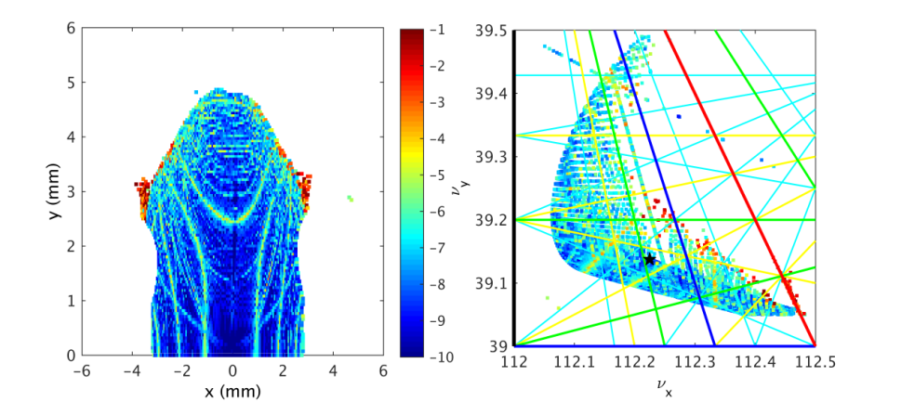
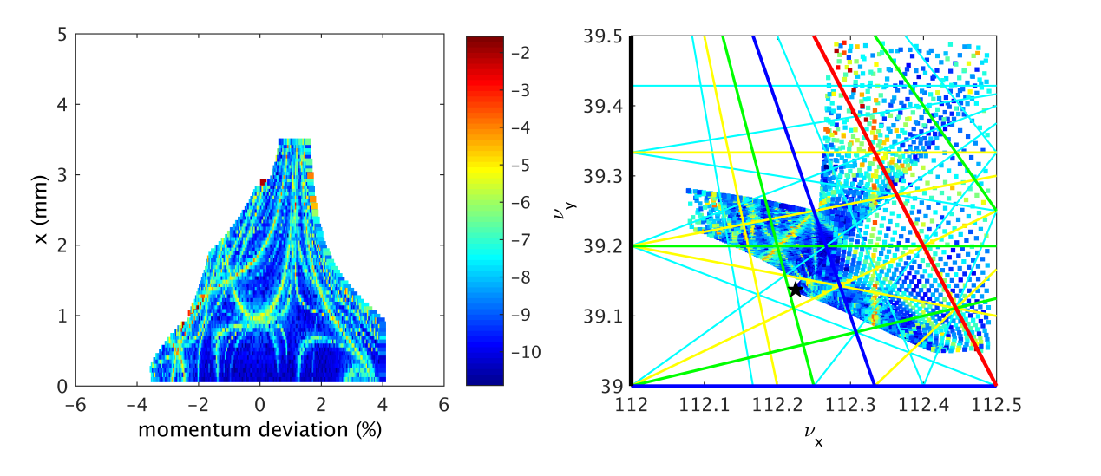
PSO/MOGA optimal: balance between DA and MA with emittance(2/2)
A turning point around 50 pm.rad.
  It seems best to choose a solution with emittance slightly above 50 pm.rad, to ensure that the lattice has a robust nonlinear performance, i.e., not very sensitive to the variation of linear optical parameters which will may lead to a change in emittance.
One typical solution, w/ lower emittance and larger effective DA & MA than nominal design.
  Tunes (112.23, 39.14), emittance: 52.1 pm.rad, effective MA: 3.5%, U₀: 1.96 MeV, effective DA x/y: 3.0/4.8 mm, beta function at ID section center : (7.9, 4.2) m
Weighted emittance
Solutions of the last iteration of
PSO (left) and MOGA (right)
-1* Scaled ring acceptance
y (mm)
x (mm)
x (mm)
δ

Slide 32
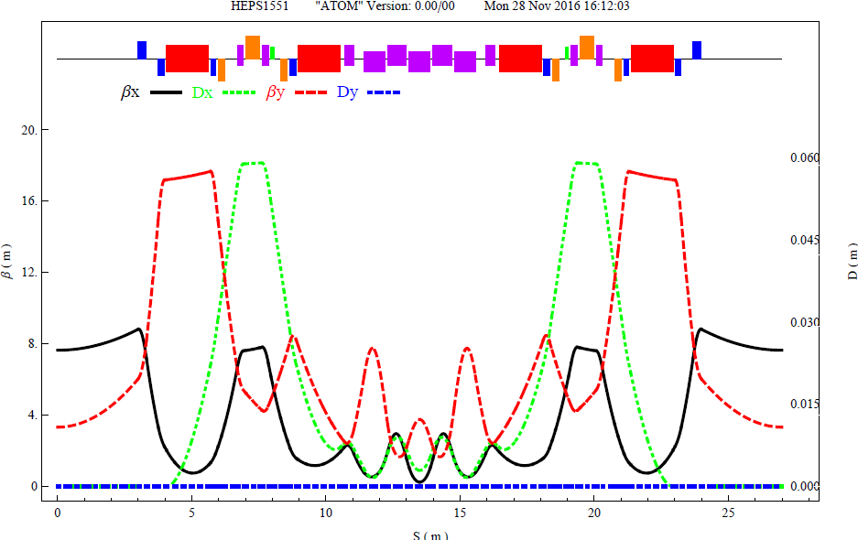
Alter. Design – Same circ., anti-bends
Using anti-bends can effectively reduce the dispersion function especially at combined function bends.
Preliminary study based on the nominal design: the natural emittance can be decreased from 60 to 36 pm.rad.
  High gradient Q(80T/m) need increase the pole radius 2mm
  U0 increase from 2MeV to 2.6MeV, radiation power in crease by 30%
  Momentum compact factor decrease from 4.5E-5 to 2.1E-5
  The radiation to inside need deal with especially for the bellows
detailed optimization for DA and MA
4 anti-bends in half cell

Slide 33
Summary
Many works to the nominal design
Anti-bend also in consideration
Modification will be made based on the R&D of hardware

Slide 34
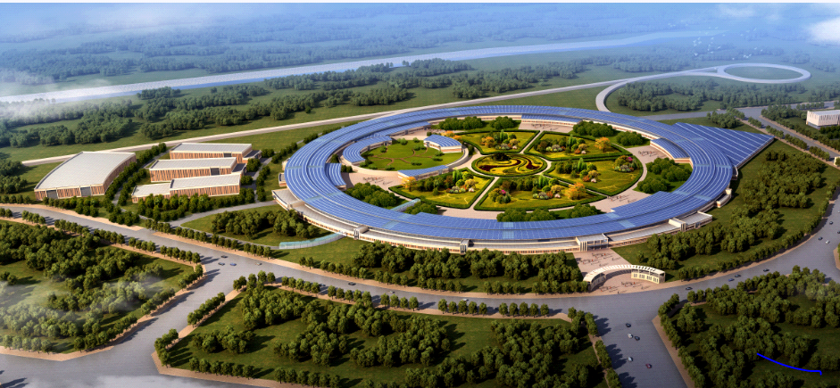
Thank you for your attention!

