Slide 1

SLS-2
Upgrade of the Swiss Light Source
Andreas Streun on behalf of SLS-2 project team
PSI Villigen, Switzerland
The SLS
  ♦ layout ♦ achievements ♦ upgrade summary
Low emittance lattice concept
  ♦ TME cell dilemma ♦ longitudinal gradient bends and anti-bends
Period-12 7-BA lattice
  ♦ parameters ♦ non-linear optimization ♦ period 12 vs. period 3
  ♦ source point shifts ♦ straight sections ♦ brightness
Design Progress
  ♦ instabilities ♦ orbit & optics ♦ vacuum ♦ injection ♦ superbend
Outlook
2nd workshop on low emittance ring design
Dec. 1-2, 2016, Lund, Sweden

Slide 2
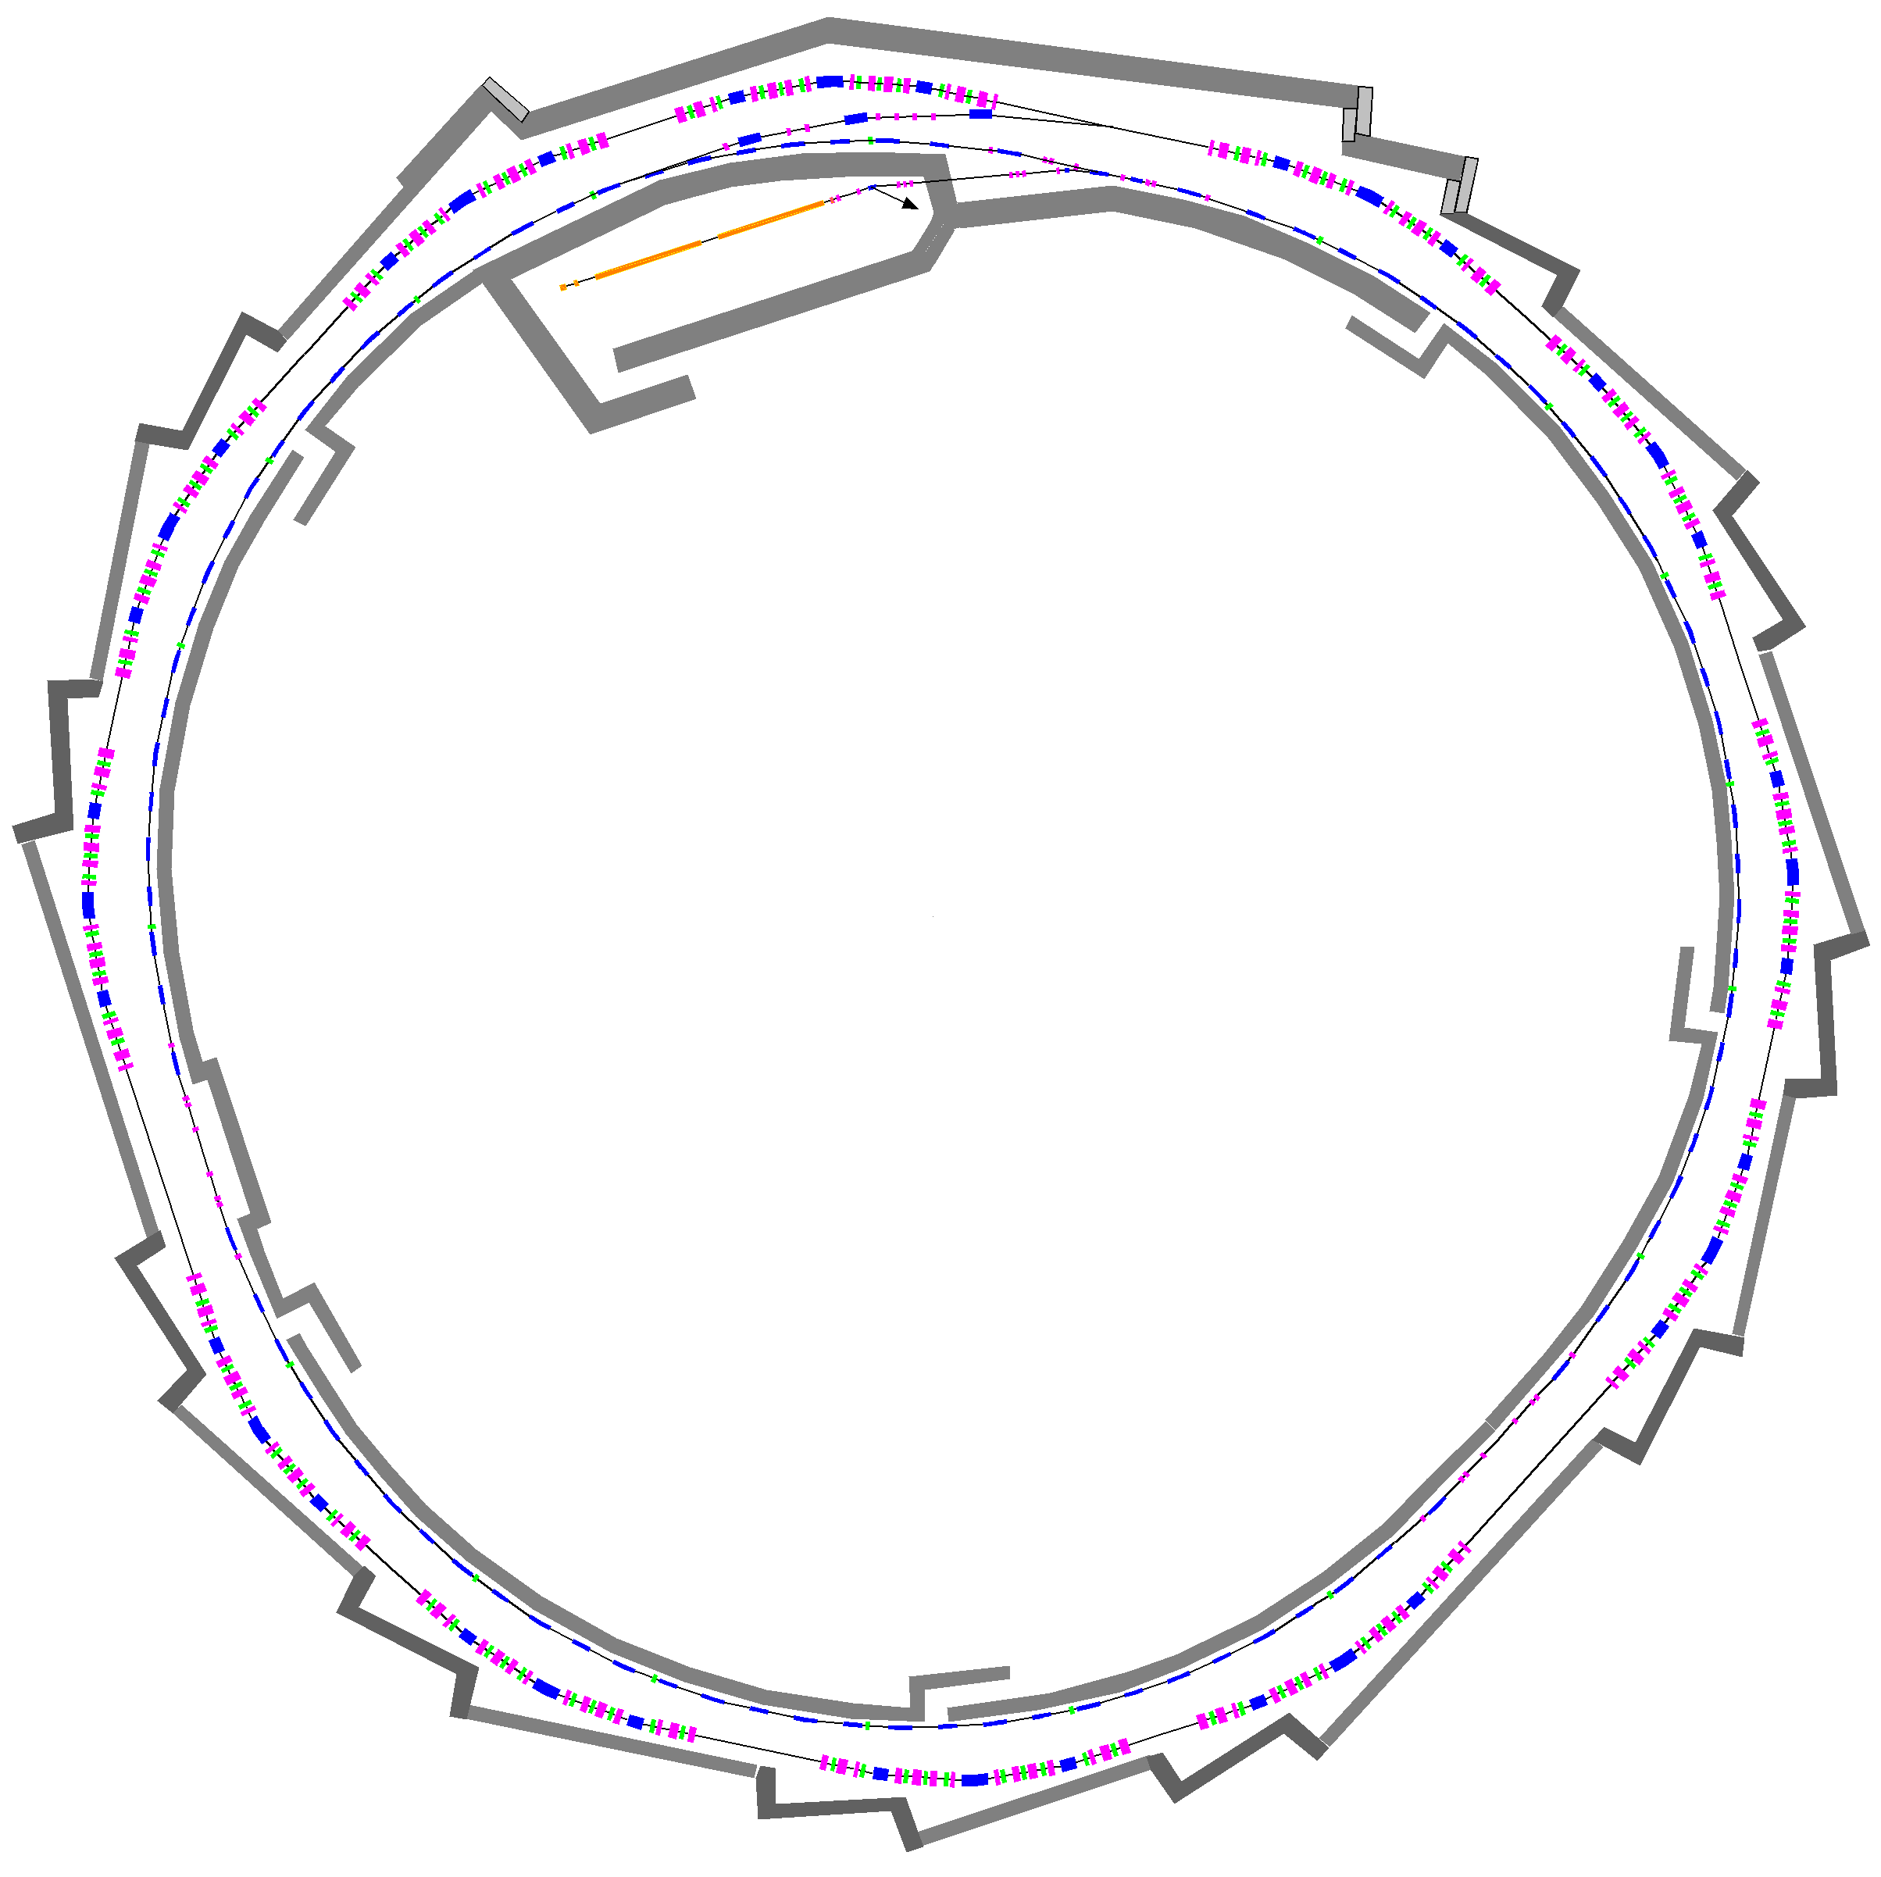
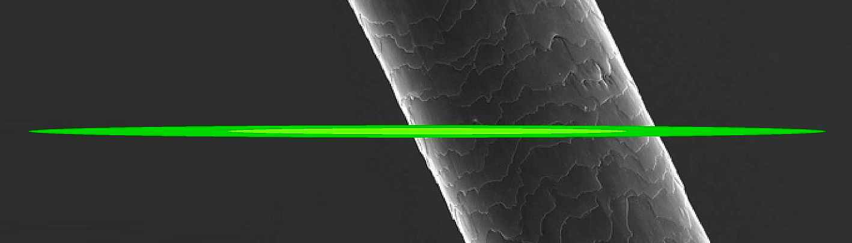
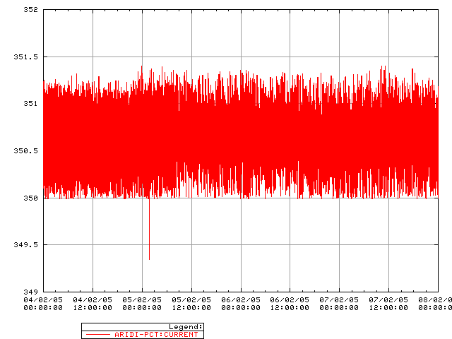
1. The SLS
Electron beam cross section in comparison to human hair
transfer lines
90 keV
pulsed (3 Hz)
thermionic
electron gun
100 MeV
pulsed linac
Synchrotron (“booster”)
100 MeV → 2.4 [2.7] GeV
within 146 ms (~160’000 turns)
Current vs. time
2.4 GeV storage ring
ε_{x} = 5.0..6.8 nm, ε_{y} = 1..10 pm
400±1 mA beam current
top-up operation
1 mA
4 days
shielding
walls

Slide 3
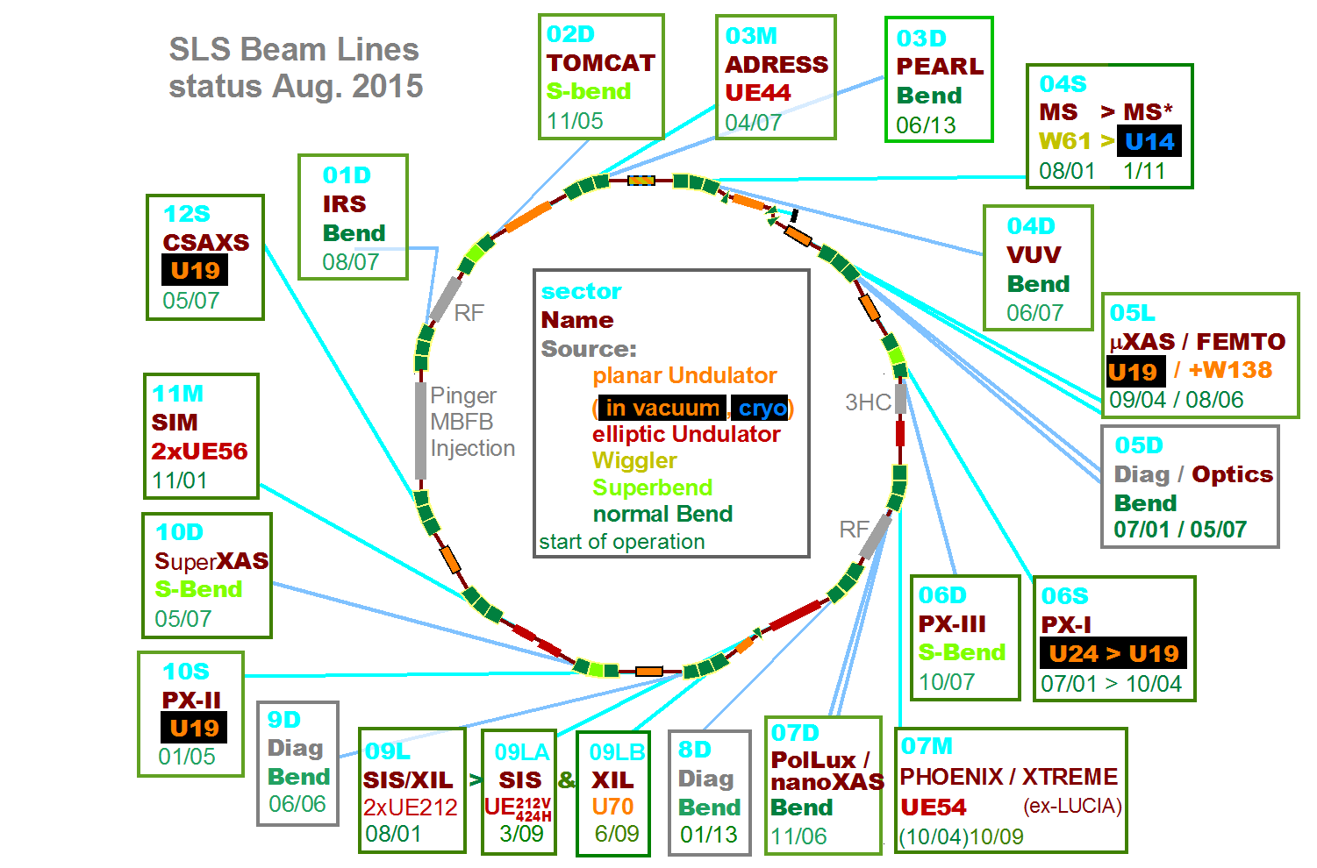
SLS beam lines

Slide 4
SLS major achievements
Reliability
  >5000 hrs user beam time per year
  97.5% availability (2005-2015 average)
    2016 (< Nov. 15): availability 99.2%, mean time between failures: 11 days
Top-up operation since 2001
  constant beam current 400-402 mA over many days
Photon beam stability < 1 μm rms (at frontends)
  ‏fast orbit feedback system ( < 100 Hz )‏
  undulator feed forward tables, beam based alignment,
  dynamic girder realignment , photon BPM integration etc...
Ultra-low vertical emittance: 0.9 ± 0.4 pm
  model based and model independent optics correction
  high resolution beam size monitor developments
150 fs FWHM hard X-ray source FEMTO
  laser-modulator-radiator insertion and beam line
Emittance 5 nm at 2.4 GeV → no longer state of the art
  SLS flagship applications (CXDI, Ptycho, RIXS etc.) not competitive in future?

Slide 5
Need for a new lattice concept
Upgrade task: factor >30 lower emittance
SLS challenge: small circumference
Scaling of new ring designs to SLS upgrade:
Approximate emittance scaling ε_{x} ∝ (Energy)² / (Circumference)³
SLS E = 2.4 GeV C = 288 m
MAX IV E = 3 GeV C = 528 m ε_{x} = 328 pm → 1290 pm
SIRIUS E = 3 GeV C = 518 m ε_{x} = 240 pm → 950 pm
ESRF-EBS E = 6 GeV C = 844 m ε_{x} = 147 pm → 590 pm
ALS-U E = 2 GeV C = 200 m ε_{x} = 106 pm → 50 pm
different concept: on-axis swap-out with additional accumulator ring
SLS-2: New lattice cell concept ε_{x} → 150 pm

Slide 6
Upgrade summary: storage ring old → new
Lattice type: 12×TBA → 12×7-BA
  longitudinal gradient bend / anti-bend cell
Emittance: 5 nm → ≈150 pm^{(incl. IBS)}
Circumference: 288 m → 290.4 m
Periodicity: 3 → 12
Straight sections:
3×11 m, 3×7 m, 6×4 m → 12×5½ m
3 Superbends: 2.9 T → 6.0 T
maintained:
  2.4 GeV beam energy, 400 mA current
  off-axis top-up injection

Slide 7
Upgrade summary: impact
+ new
Building: 400 m circumference
  ring tunnel: modification on 3×25 m length
18 Beam lines
  1 shutdown (laser beam slicing)
  3 major, 7 medium, 4 minor, 3 no modifications
  6 spaces for new beam lines
Booster synchrotron: 270 m circumference
  emittances 10/2 nm at 2.4 GeV → “SLS-2 ready” ✓
  booster-to-ring transferline adaptation
Storage ring RF-system:
  500 MHz, 4 × ELETTRA cavity ✓
  3rd harmonic passive s.c. twin cavity → keep/active/new?

Slide 8
2. SLS-2 low emittance lattice concept
New LGB/AB cell based on
  longitudinal gradient bend (LGB) to minimize emittance
  anti-bends (AB) to provide optics matching for LGB
get low emittance with moderate optics.
  not possible with traditional TME cell !
Further emittance reduction:
increase of damping (radiation loss)
increase of horizontal damping partition (J_{x})
A. Streun & A. Wrulich, Compact low emittance light sources based on longitudinal gradient bending magnets, NIM A770 (2015) 98–112
A. Streun, The anti-bend cell for ultralow emittance storage ring lattices,
NIM A737 (2014) 148–154

Slide 9
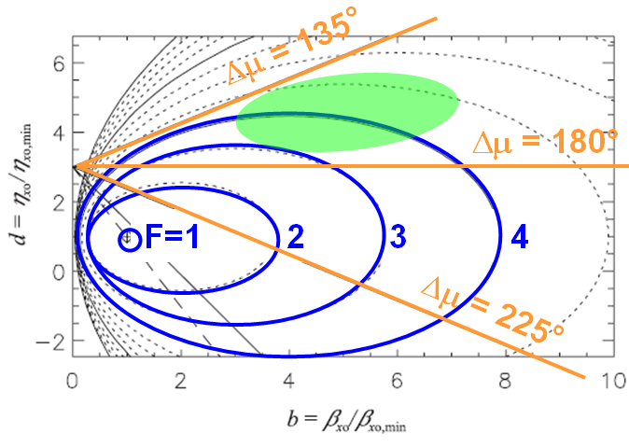
The dilemma of the TME-cell
Traditional “theoretical minimum emittance” (TME)
  base cell for multi-bend achromat lattices
  minimum emittance (TME) conditions
Deviations from TME conditions
Ellipse equations for emittance
Cell phase advance
⇨ Real cells: μ < 180° ⇨ F ~ 3...6
β_{x} η
homogeneous bend,
length L , curvature h = 1/ρ
quad
quad
d
b
✗
S. C. Leeman & A. Streun,
PR ST AB 14, 030701 (2011)

Slide 10
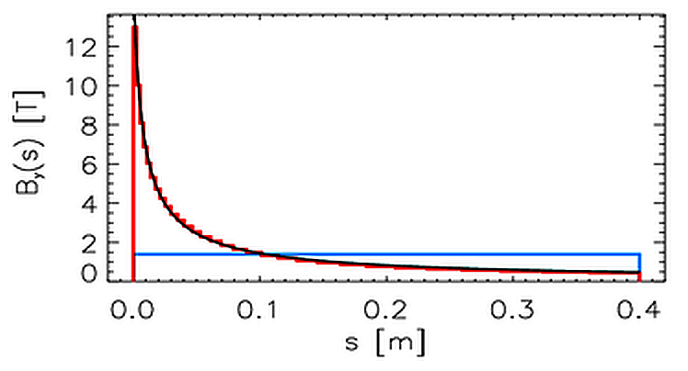
1st step The longitudinal gradient bend (LGB)
Dispersion’s betatron amplitude
Orbit curvature
Longitudinal field variation h(s) to compensate H (s) variation
Curvature is source of dispersion:
Optimization of curvature h(s) :
  approx. hyperbolic field variation
  (for symmetric bend, dispersion
  suppressor is different)
  Result for ½ symmetric bend ⇨
  ( L = 0.8 m, Φ = 8°, 2.4 GeV )
Trend: h₀ → ∞ , β₀ → 0 , η₀ → 0
h(s) = B(s)/(p/e)
optimized profile
hyperbola fit
homogeneous bend
✗

Slide 11
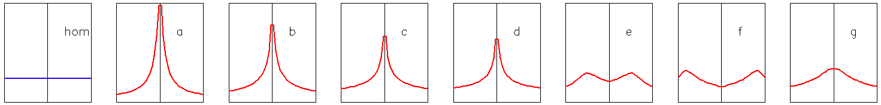
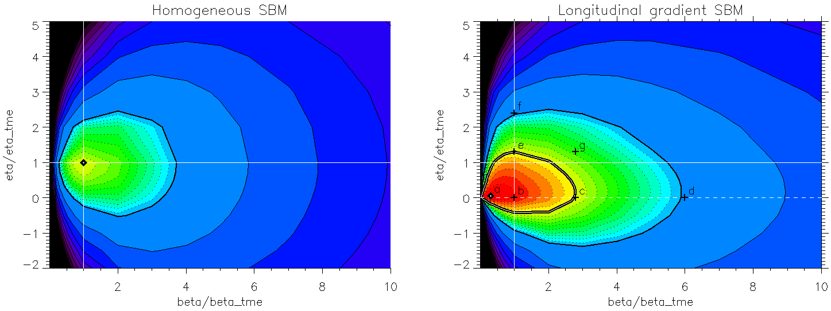
LGB optimization with optics constraints
Optimization of field profile B_{y}(s) for fixed β₀, η₀
  Emittance (F) vs. β₀, η₀ normalized to parameters for
  the “theoretical minimum emittance” of a homogenous bend.
Homogeneous Bending Magnet
Longitudinal Gradient Bend
d
phase advance
in TME cell
d
135°
F = 3
F = 3
operating region for LGB cells
180°
F = 2
F = 2
usual operating region for TME cells
F = 1
how to suppress dispersion?
F ≈ 0.3
F = 1
225°
b
b
LGB requires small (~0) dispersion at centre, but tolerates large beta function !

Slide 12
2nd step The anti-bend (AB) [or reverse/inverse bend]
General problem of dispersion matching:
  dispersion production in dipoles → “defocusing”: η’’ > 0
Quadrupoles in conventional (TME) cell:
  over-focusing of beta function β_{x}
  → high phase advance & chromaticity ✗
  insufficient focusing of dispersion η
  → compromise on emittance ✗
LGB needs η₀ ≈ 0 − but tolerates moderate β_{x}
⇨ to do: disentangle η and β_{x}
use anti-bend (AB) angle θ < 0 → kick Δη’ = θ < 0
AB out of phase (60-80°) with LGB:
⇨ Δη’ < 0 at AB → Δη < 0 at LGB ✓

Slide 13
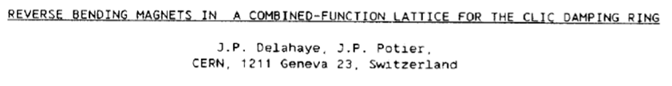
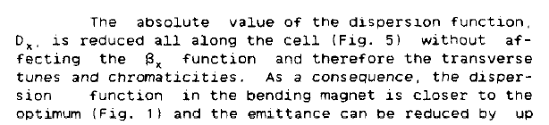
Momentum compaction
Anti-bend ⇨ negative momentum compaction factor
small
large
< 0
negative
AB history
PAC 1989
1980’s/90’s: proposed for isochronous rings and to increase damping - but ⇨

Slide 14
in a nutshell − the way to minimum emittance
x’
Quantum excitation
ηδ
LGB
Minimization of I₅
η → ≈0 where h → max.
x
η’δ
AB dispersion matching:
η → ≈0 at LGB center.
Radiation integrals
Damping partitioning
Damping
Increase of horizontal damping
partition number J_{x} = 1 − I₄/I₂
traditional (combined function):
k < 0 where h > 0, η > 0
AB
k > 0 where h < 0, η > 0
Increase of radiation loss ∼ I₂
LGB I₂ increase for h =h(s)
AB Σ|bend angles| > 2π

Slide 15
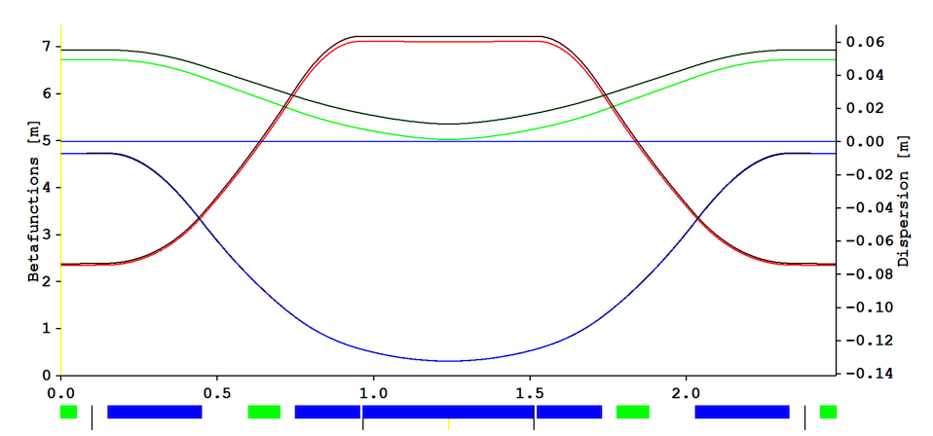
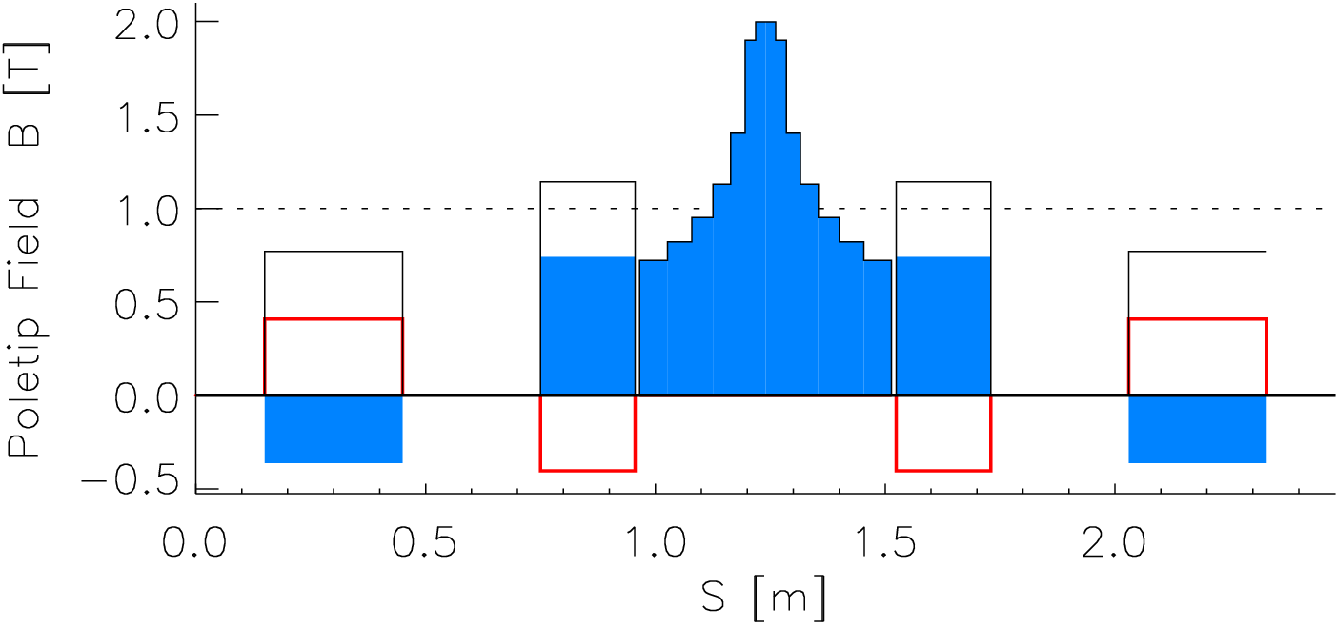
SLS-2 LGB/AB-cell
5° angle, 2.48 m length
Tunes ν_{x/y} = 0.40 / 0.08
LGB angle = 4.38° longitudinal gradient bend
TGB angle = 0.31°+θ transverse gradient bend
(i.e combined function bend)
AB angle = −θ anti-bend (half quadrupole geometry)
AB-angle θ 0.78° 0°
Emitt. [pm] 135 535
Damp. J_{x} 1.80 1.15
E- loss [keV] 7.9 5.8
MCF α [10⁻⁴] −2.1 +4.8
Dispersion η
for θ = 0.78°
for θ = 0°
β_{x} β_{y}
AB TGB LGB TGB AB
dipole field
quad field
total |field|
sextupoles
}R = 13 mm

Slide 16
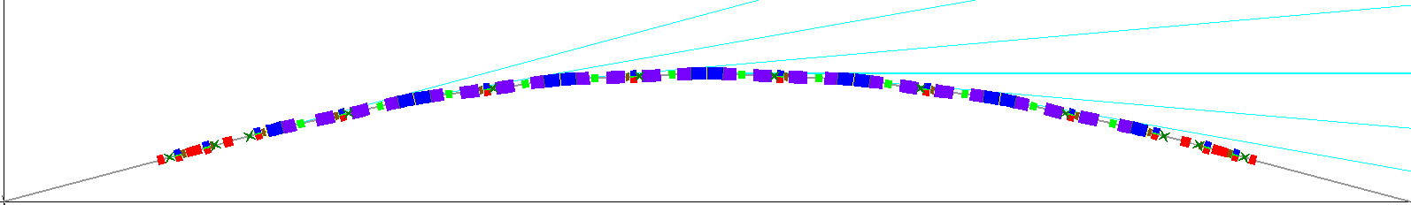
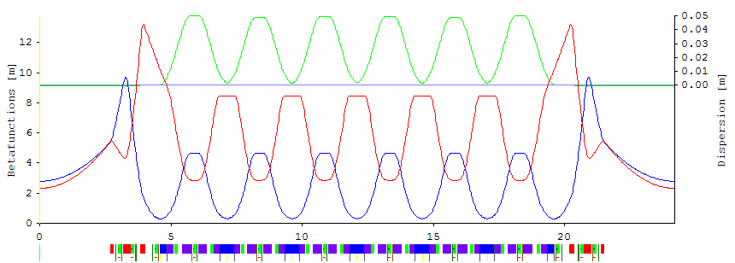
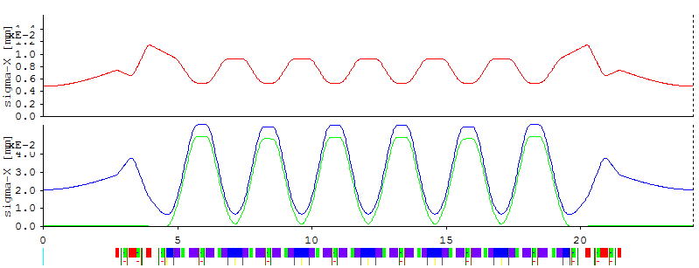
3. SLS-2 period-12 7-BA lattice
Arc layout (30°)
Optical functions
rms beam size
≈ 20 μm × 5 μm
in straight centers
β_{x} β_{y} η
σ_{x} σ_{y} ησ_{e}

Slide 17
Lattice parameters
Name | SLS*⁾ | SLS-2^{#)}
Emittance at 2.4 GeV [pm] | 5022 | 138 → 150^{♦)}
Lattice type | TBA | 7BA
Circumference [m] | 288.0 | 290.4
Total absolute bending angle | 360° | 585°
Working point Q_{x/y} | 20.42 / 8.74 | 37.17 / 10.31
Natural chromaticities C_{x/y} | −67.0 / −19.8 | −66.4 / −40.3
Optics strain¹⁾ | 7.9 | 7.0
Momentum compaction factor [10⁻⁴ ] | 6.56 | −1.37
Radiated Power [kW] ²⁾ | 205 | 232
rms energy spread [10⁻³ ] | 0.86 | 1.05 → 1.08^{♦)}
rms bunch length [mm] | 3.73 | 2.60 → 8.5^{♦)}
damping times x/y/E [ms] | 9.0 / 9.0 / 4.5 | 4.6 / 8.0 / 6.5
product of horiz. and vert. normalized chromaticities C/Q
assuming 400 mA stored current, bare lattice without IDs
*) SLS lattice before FEMTO installation (<2005)
#) SLS-2 with 3 superbends
^{♦)} including intra-beam scattering for 1 mA bunch current (400 mA in 400 of 484 buckets; 500 MHz),
10 pm vertical emittance, 1.4 MV RF voltage,
3rd harmonic cavity for 3× bunch length.

Slide 18
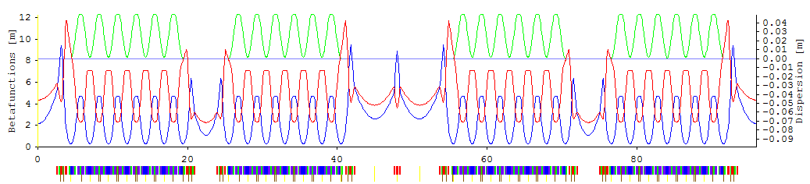
Problems with previous period-3 lattice
maintain undulator source points
  straight sections: 6 × short, 3 × medium, 3 × split long
  no modification of (undulator) beam lines and building
  287.25 m circumference → harmonic “478¾” → 479 → −260 kHz
non-linear dynamics
  good beam lifetime and injection efficiency for zero chromaticity
  bad for large non-zero chromaticity
    may be required for suppression of beam instabilities
switch to period-12 geometry
  superior non-linear performance
  simpler structure, standardization
  managable modifications for beam lines and building

Slide 19
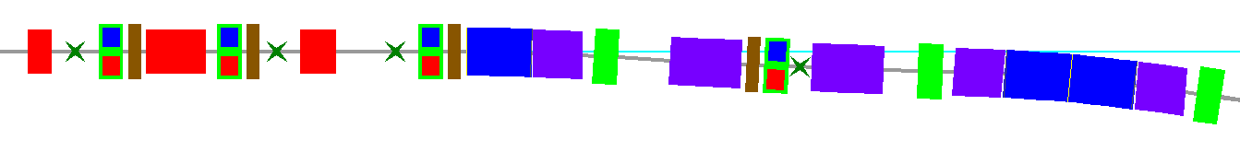
Non-linear optimization
Sextupole
Octupole
Longitudinal
Gradient Bend
Quadrupole
BPM
Horizontal
corrector
Vertical
corrector
Anti-Bend
Combined
Function Bend
Method: MOGA
Objectives:
dynamic acceptances
at Δp/p = 0, +3, −3 %
Constraints:
orbit, matrix trace,
chromatic footprint,
magnet strengths
 M. Ehrlichman, Genetic algorithm for chromaticity correction in diffraction limited storage rings, PR AB 19, 044001 (2016)
Variables
4 chromatic sextupole families
3 harmonic sextupole families
4 octupole families
constraint on chromaticity: −2 variables
8 variables
quadrupoles via matching knobs
Computing
64 XEON cores, typically 45 hrs

Slide 20
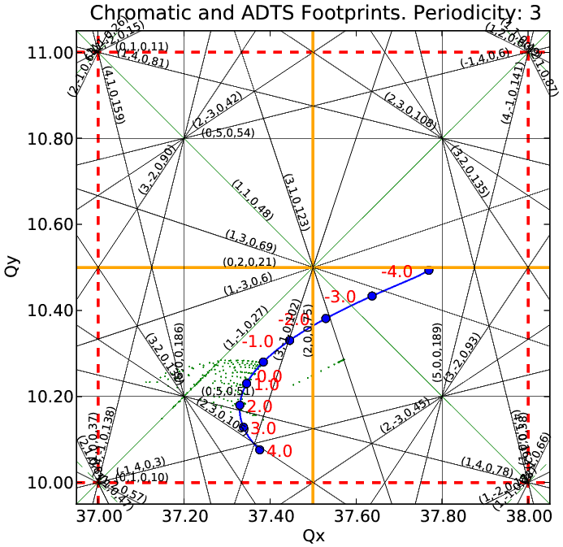
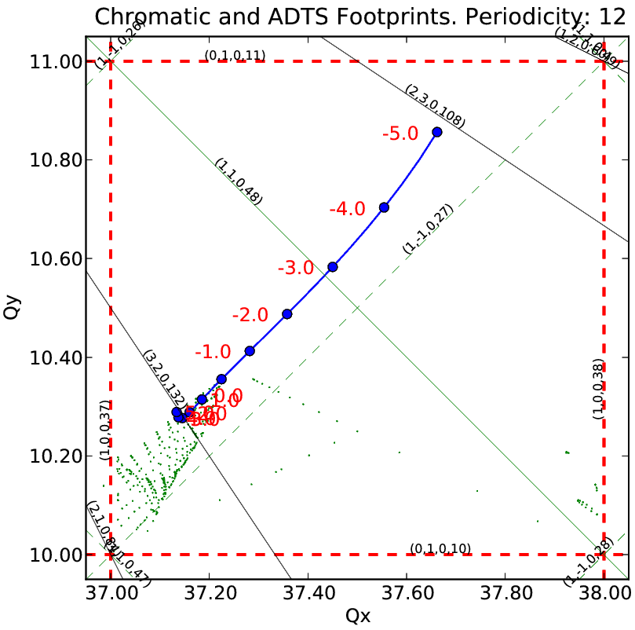
Tune footprints period 3 and 12
chromaticities −5 for CBI-suppression ( < 0 because α < 0 ! )
chromatic and amplitude dependent tunes after MOGA
previous period-3 lattice and new period-12 lattice
Michael Ehrlichman

Slide 21
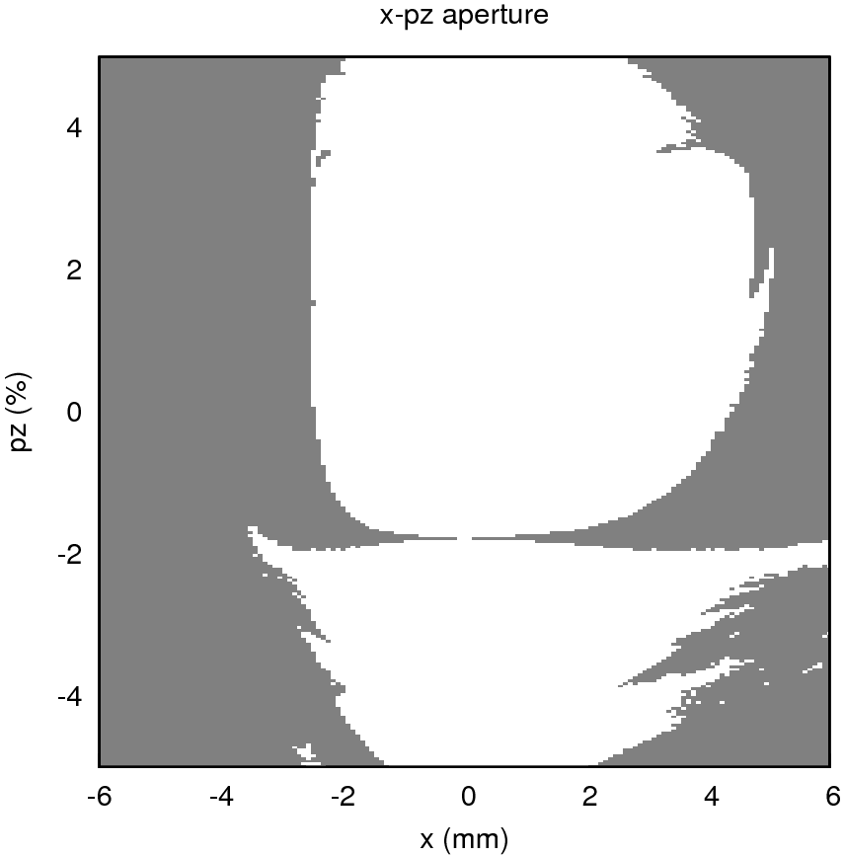
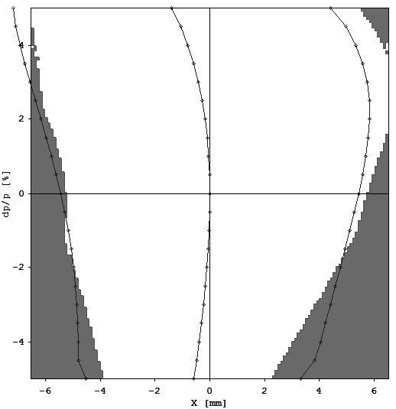
Dynamic apertures period 3 and 12
chromaticities −5: horizontal dynamic aperture vs. momentum
period-3: lifetime 0.5 h period-12: lifetime 3.9 h
( chroma 0 → 4.4 h ) ( chroma 0 → 5.3 h )
lifetime calculation parameters: 1.4 MV RF voltage for 5% RF energy acceptance,
no 3rd harmonic cavity, 10 pm vertical emittance, 6D-tracking (Bmad)
2 MV → 7% acceptance → lifetime 14.6 h (?)
Michael Ehrlichman

Slide 22
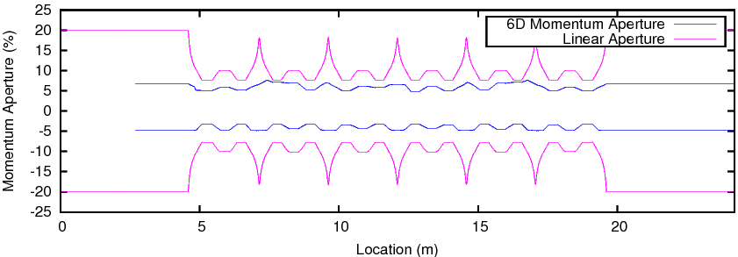
Momentum acceptance and ½-integer crossing
SLS-2 period-12
chroma −5
6D momentum
acceptance
Touschek particle may survive crossing non-systematic ½-integer
if resonance is narrow
  optics correction: beta beat 1-2 % rms
if crossing is fast
  high local chromaticity at resonance
  high synchrotron tune
G.-M. Wang et al., IPAC-2016, THOBA01 → measurements
Y. Jiao & Z. Duan, NIM A 841 (2017) 97-103 → simulations

Slide 23
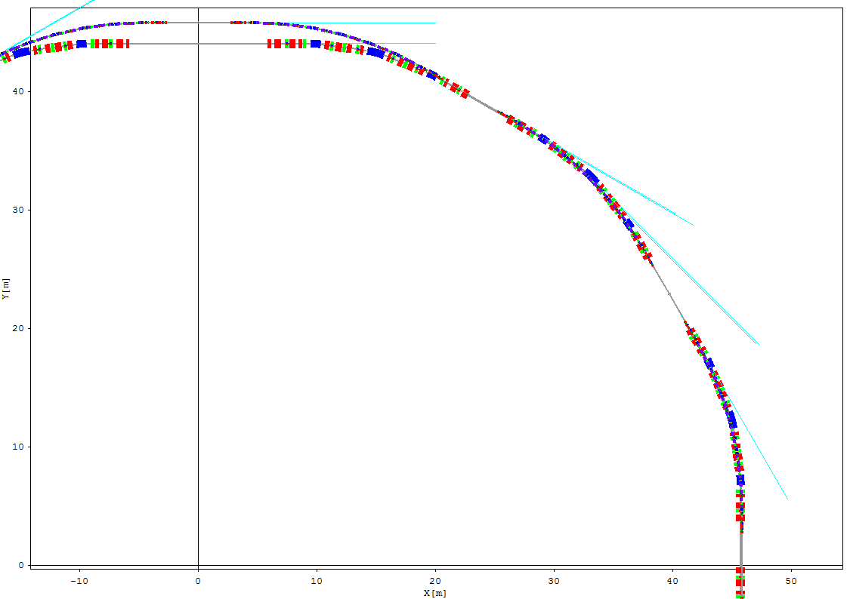
Source point shifts
L-straight
radial and longitudinal shifts [mm]
relative to SLS-now (without Femto)
S-straight
Superbend
Lattice Circumference | SLS now f6cwo 288.00 m | SLS2-period 3 dc01a 287.25 m | SLS2-period 12 db12c 290.40 m
Harmonic number | 480 = 2⋅2⋅2⋅2⋅2⋅3⋅5 | 479 = 479 (-260 kHz) | 484 = 2⋅2⋅11⋅11
3 × L-straight L ΔR ΔS | 11760 | 2 x 5161 0 0 [ ±3030* ] | 5384 1771 0
3 × M-straight L ΔR ΔS | 7000 | 5028 0 0 | 5384 -8 0
6 × S-straight L ΔR ΔS | 4000 | 2897 0 0 | 5384 65 ±1782
3 × Superbend ΔR arc 2,6,10 ΔS |  | -225 -1 | -178 -205
M-straight
2/6/10S → longer
4/8/12S → shorter
* due to splitting the L-straights

Slide 24
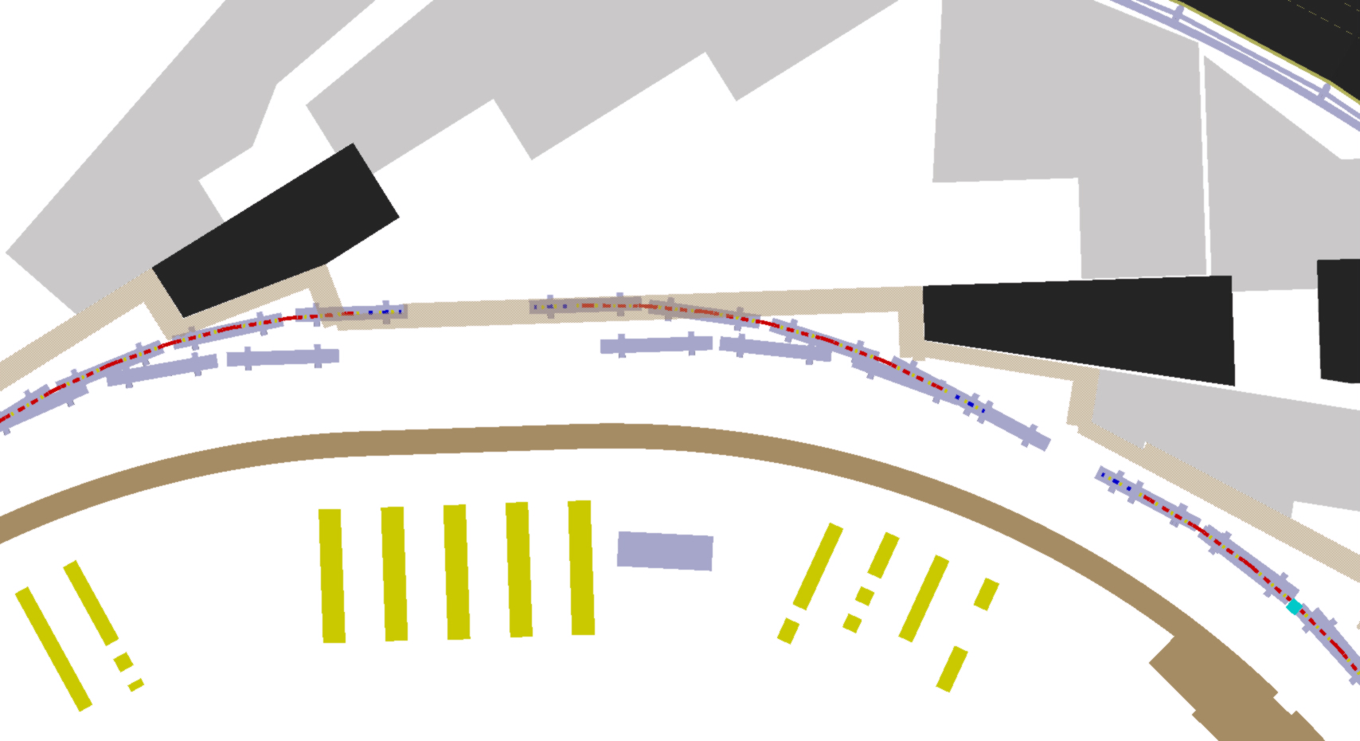
5L straight: period-12 lattice and existing SLS girders
Lothar Schulz
Tunnel & ceiling modification at 3 long straights.
Beam lines affected have to be refurbished anyway.

Slide 25
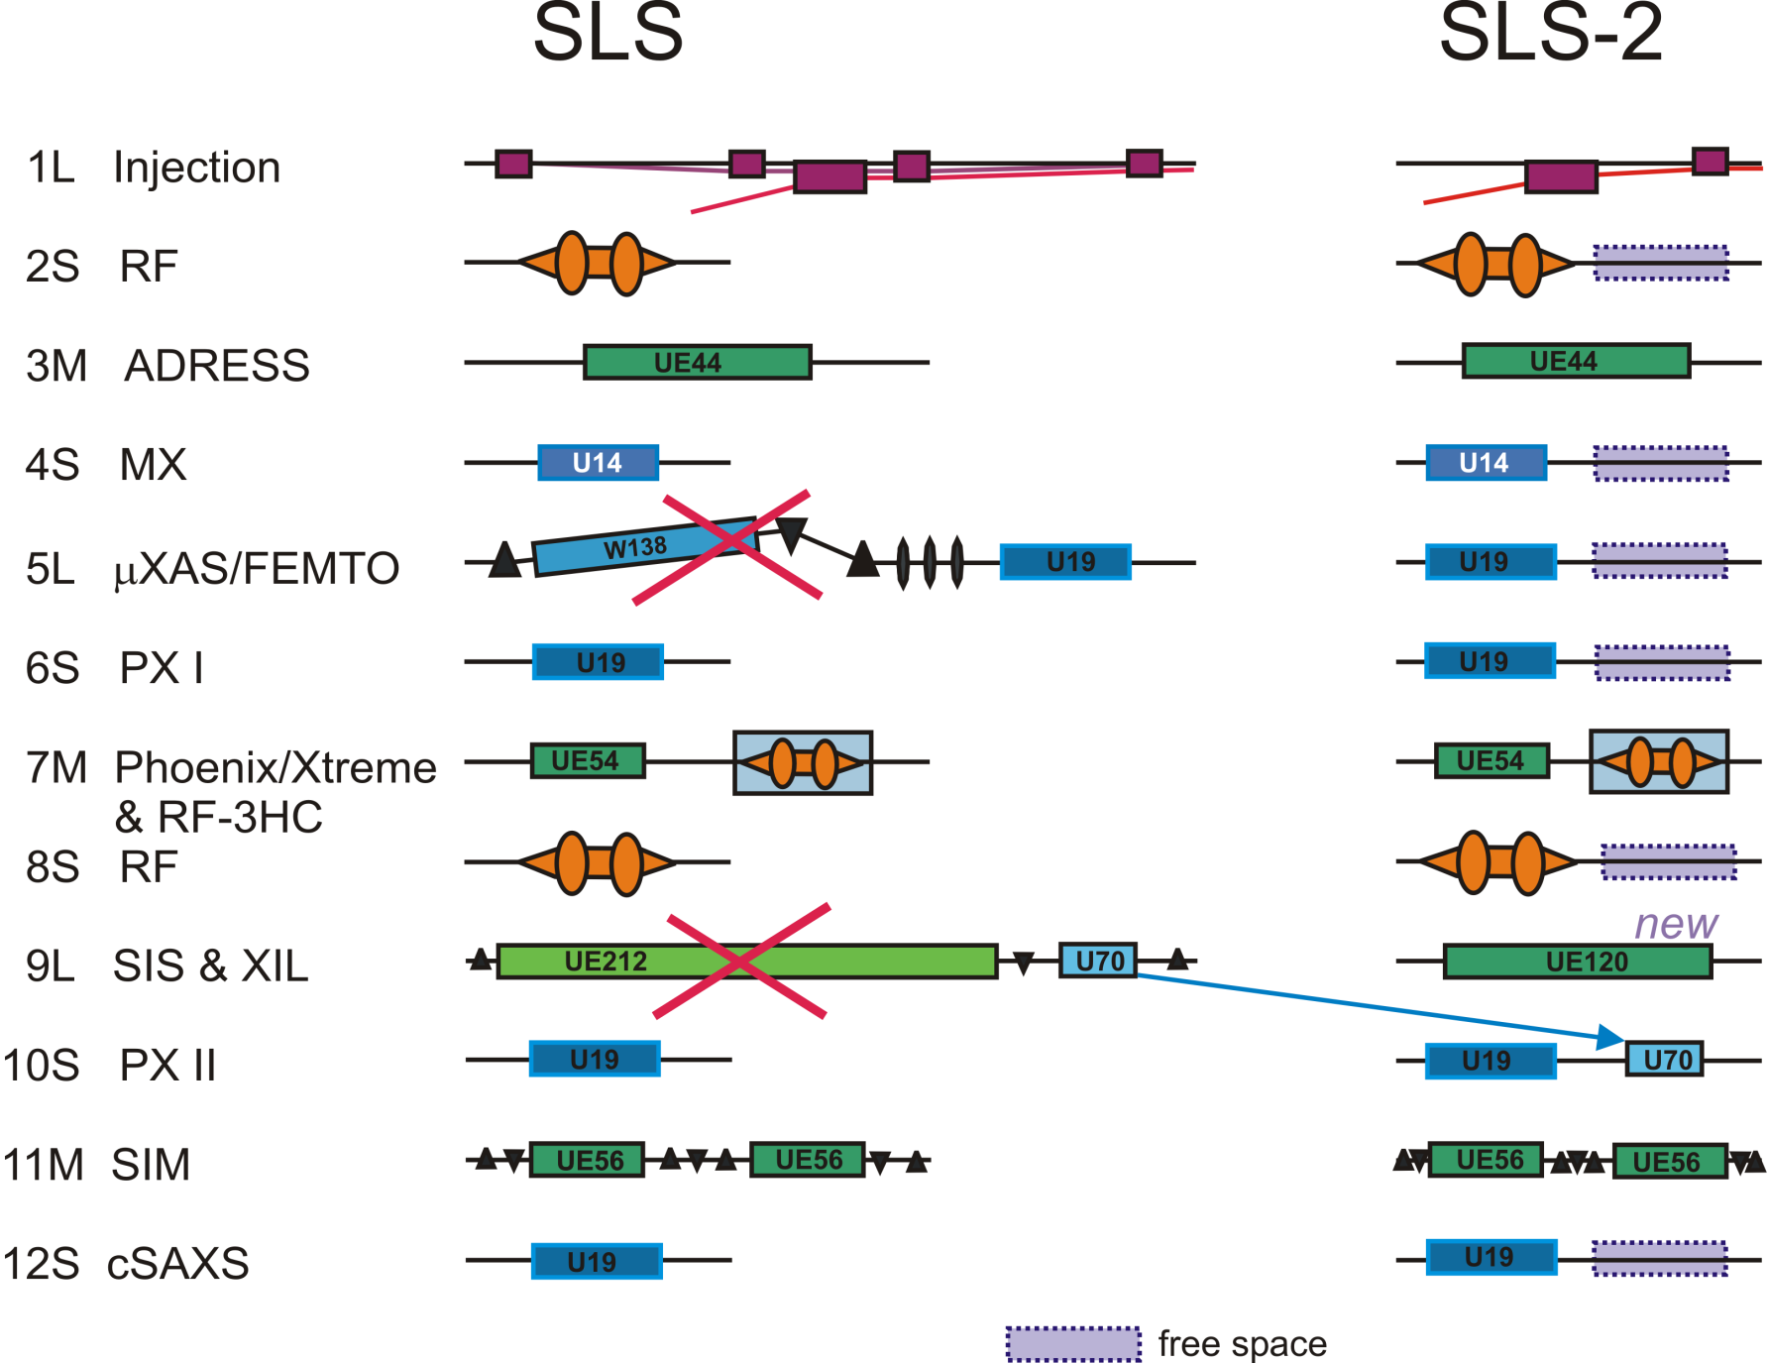
Straight sections

Slide 26
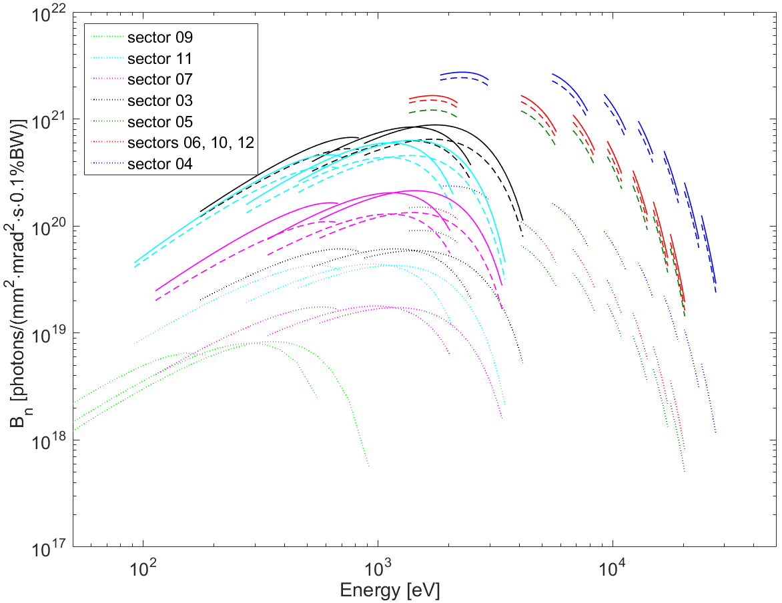
Brightness
Up to factor 40 higher brightness compared to SLS now.
Brightness comparison per sector for the
existing undulators
(SRW calculation)
⋅ ⋅ ⋅ ⋅ SLS now
−−− SLS-2 period-12
- - - SLS-2 period-3
 A. Saa Hernandez, Synchrotron radiation from insertion devices at SLS-2,
Internal report SLS2-Note-03-2016-10-18
Angela Saa Hernandez

Slide 27
4. Design Progress
Work well in progress, and delayed or postponed
Beam instabilities: confidence in 400 mA beam current?
  Longitudinal single and multi-bunch instabilities
  Transverse single and multi-bunch instabilities
Lattice refinement
  Girder layout, orbit and optics correction
Vacuum system
  Concept design: copper [plated] chamber
Injection schemes
  single multipole / longitudinal on-axis / anti-septum bump
Magnets
  Superbend design
  Design of normal conducting magnets and undulators
RF systems, feedback systems, diagnostics, engineering integration

Slide 28
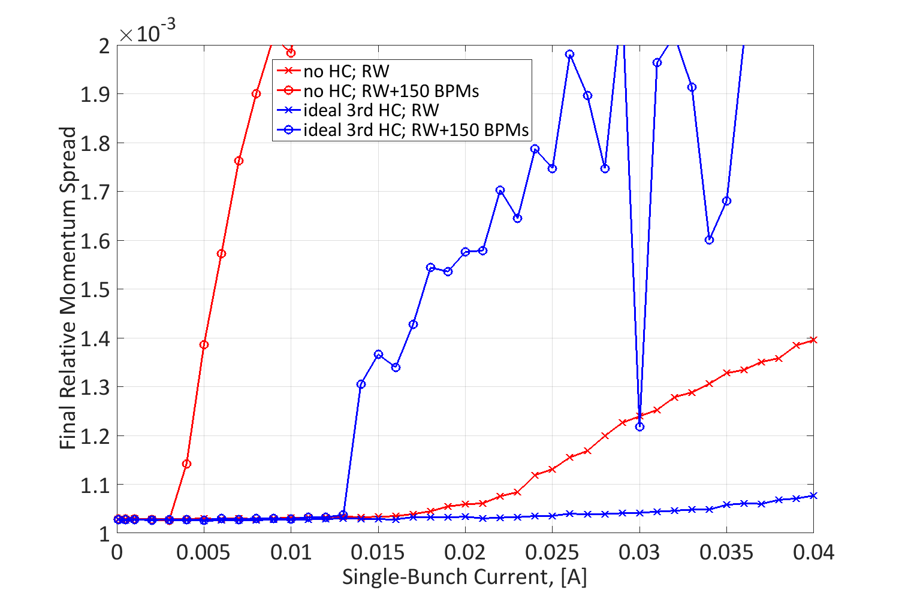
Single bunch longitudinal: microwave instability
Haisheng Xu
Design current 1 mA in train,
up to 5 mA in single bunch (“cam shaft”)
~3 mA
~13 mA

Slide 29
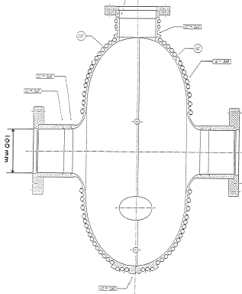
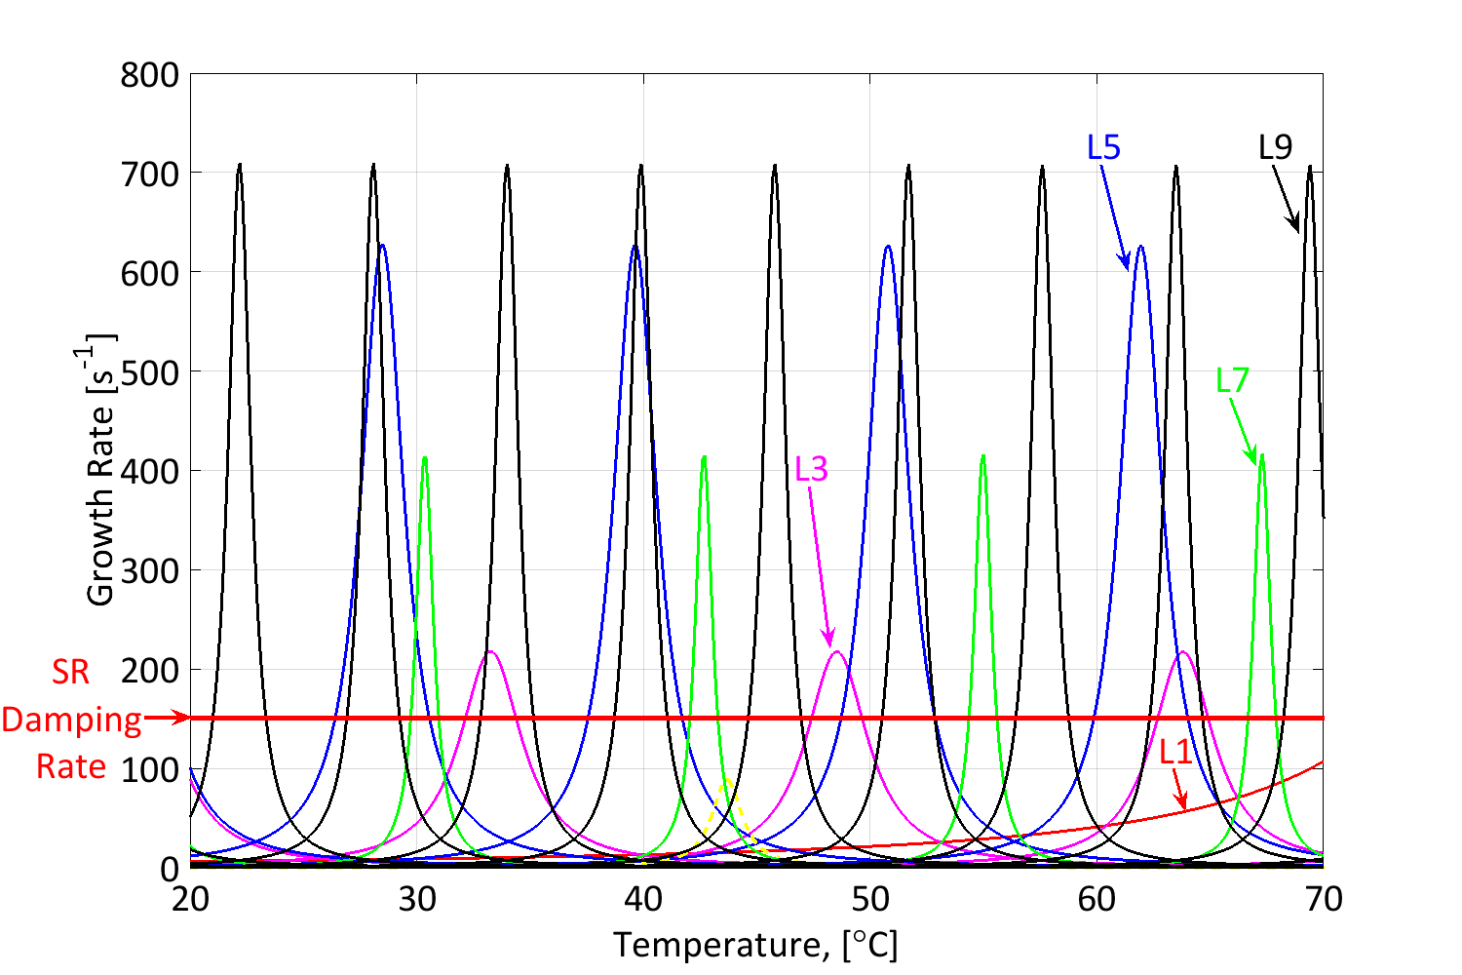
Multi-bunch longitudinal: cavity HOMs
Haisheng Xu
HOMs of ELETTRA-type 500 MHz cavity used in SLS
Stable Windows
→ HOM free windows can be found with SLS-2 conditions too
(negative momentum compaction, weaker longitudinal radiation damping)

Slide 30
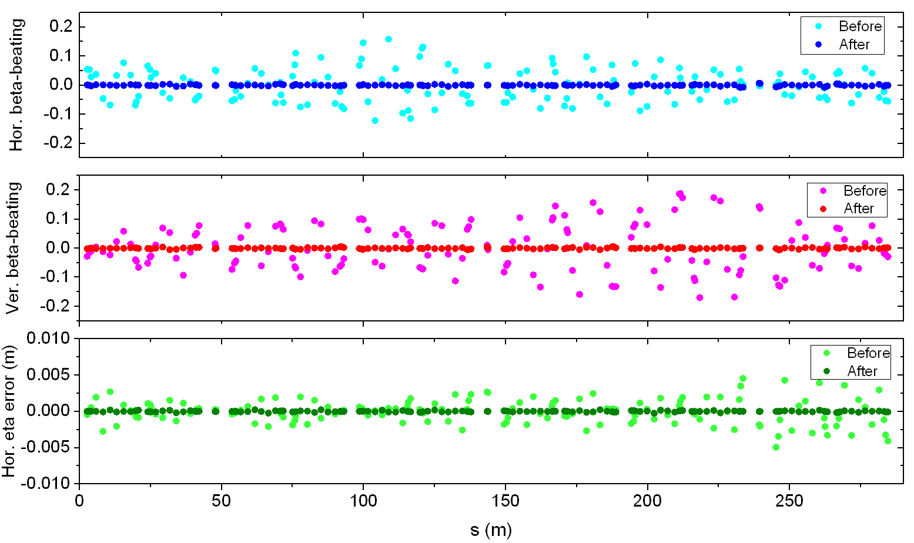
Orbit and optics correction
Masamitsu Aiba & Michael Böge
Orbit correction: 150 × BPM / CH / CV
  Orbit distortion acceptable after simulated beam based alignment.
  Error settings: 50 μm girders absolute, 20 μm girder joints, 20 μm elements,
  10 μm BBA resolution, 20 bit/2 mrad corrector resolution.
  residual orbit: 40 nm rms
  corrector kicks: 200 (40) μrad max (rms)
Optics distortion suppressed through
LOCO-style optics corrections
Horizontal and vertical emittances at SLS-2 are
not smaller than vertical emittance at SLS today
(1..10 pm).
“SLS-2 ready” BPM electronics for SLS:
2..3 × better resolution and feedback frequency.
upgrade scheduled for 2015/16 → delayed.

Slide 31
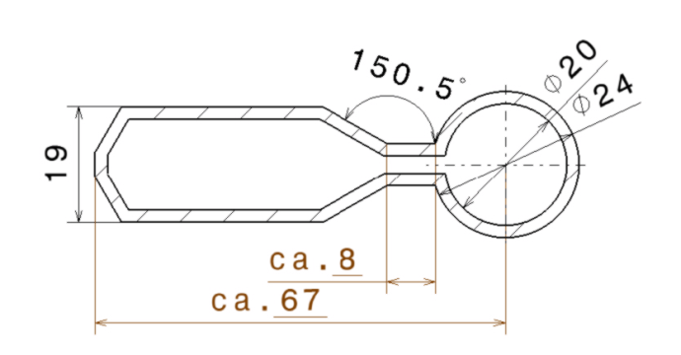
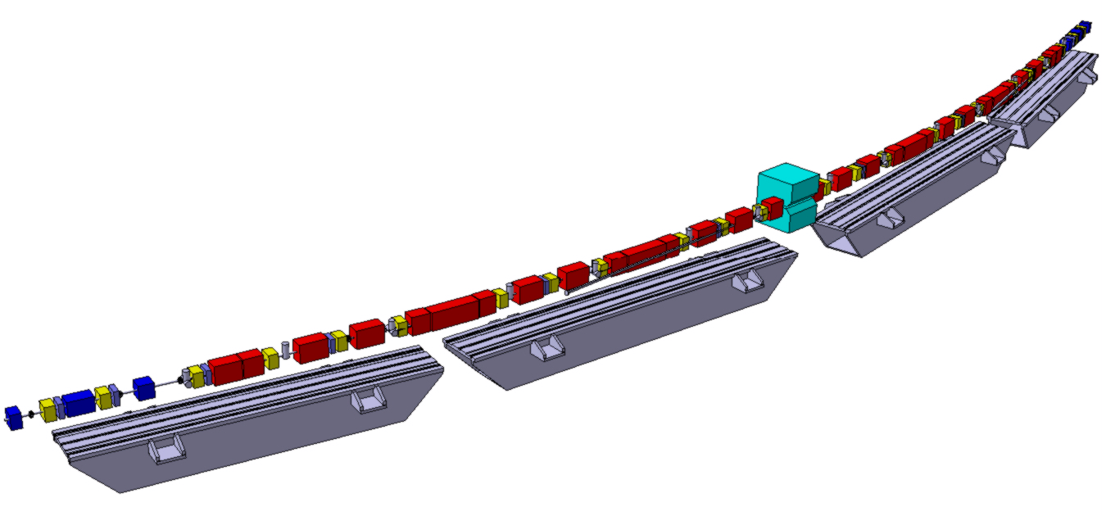
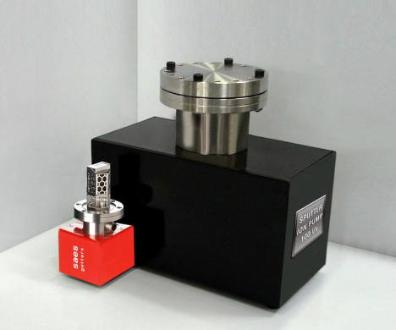
Vacuum system
High field bends (≈2 T n.c., ≈6 T s.c.)
⇨ antechambers.
No NEG coating.
Full copper or copper-coated stainless steel (at correctors).
Discrete pumps, e.g. NEXTorr® on CF63 flanges.
Maximum local pressure < 3 pbar after 1000 Ah of beam.
Discrete crotch absorbers, e.g. GlitCop®.
Distributed absorbers on the inner
side of the anti-bend chambers.
Lothar Schulz
Absorbers and pumping ports
Super-LGB cryostat
100 l/s NEXTorr®
and sputter ion
pumps.
Existing SLS-girders

Slide 32

Anti-septum injection scheme
DLSR : miniaturization of components. → injection elements too!
→ electrostatic razor blade, pulsed anti-septum, etc.
Kicker-1
0.15 m
3.8 mrad
Kicker-2
(Anti-septum)
0.5 m, -13.8 mrad
Kicker-3
0.4m
10 mrad
Christopher Gough
Masamitsu Aiba
Bump height = −12 mm
Anti-septum wall = 1 mm
Injection point −15...−16 mm
(separation = 3...4 mm)
Dynamic aperture ≈ 5 mm
Septum
(from SLS)
0.8 m, 5°,
70 μs full sine
Kicker
Septum
Anti-septum
Anti-septum wall thickness can be as thin as 1 mm:
- Short pulse (6 μs, half sine)
- Stray field comes after the injection bunch passes!

Slide 33
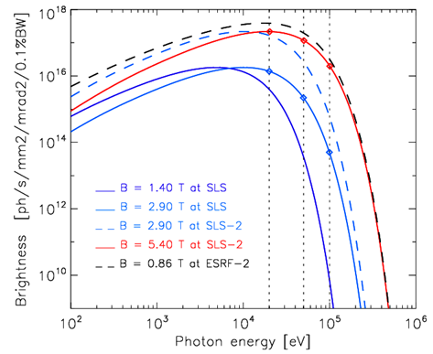
Longitudinal gradient super-bend
Hard X-rays & low emittance
Requirements
  hyperbolic field shape
  warm bore
  removable from beam pipe
Challenges:
  restricted space
  thin superinsulation
Concept design done
  CDR chapter written ✓
→ Prototype fabrication
  technical design 2017
  cost estimate 400 kCHF
  company selection
Super-LGB brightness
for ±0.5 mrad fan opening angle
and full vertical acceptance
⬥ 2.9 T at SLS(1) →  5.4 T at SLS-2
- - ESRF-2 0.86 T 2-pole wiggler

Slide 34
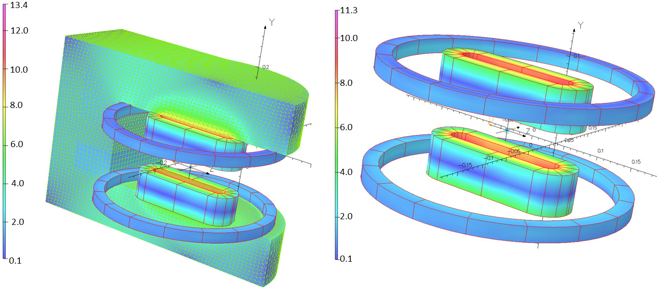
Superbend magnetic design
Requirements:
Necessity to evacuate the synchrotron radiation: split racetracks + solenoids.
Maximum longitudinal magnet length about 400 mm.
B-field profile full width half maximum (FWHM): 40-70 mm.
B-field peak: ≥6 T.
B-field integral (along the beam path): 0.61 T m.
Ciro Calzolaio
Stephane Sanfilippo
Alexander Anghel
Sergei Sidorov
Outer coils
to guarantee
the required
field integral
Inner coils
to produce the
B-field peak
ARMCO^{R} (better V-permendur) to enhance the field and reduce the stray field

Slide 35
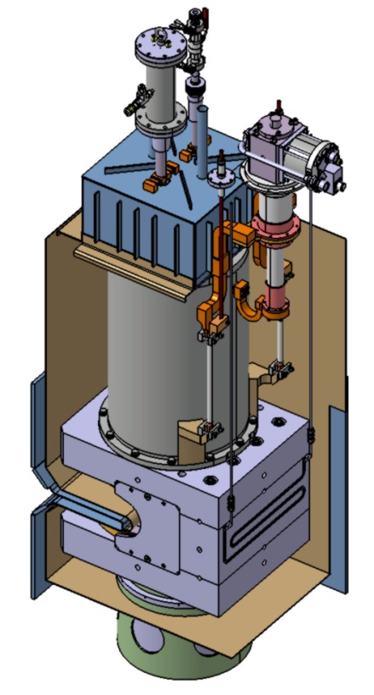
Superbend components and parameters
Ciro Calzolaio
Stephane Sanfilippo
Alexander Anghel
Sergei Sidorov
Gifford-McMahon
(or pulse tube) cryocooler
To guarantee 8-10 hours autonomy in case of cryocooler failure.
LN₂ vessel
 | Outer coils | Inner coils
Conductor type: | Nb-Ti | Nb₃Sn (RRP)
Insulation: | Formvar | S-glass
I_{c} @ 4.2 K (A) | 752 @ 5T | 810 @ 12T
Magnetic energy (kJ) (1 coil) | 3.8 | 16.6
Inductance (mH) (1 coil) | 50 | 210
Current per turn (A) | 400 | 400
N. turns (1 coil) | 200 | 1485
Extraction Voltage (V) (τ_{damp}=0.4s) | 340 | 140
Horizontal aperture (mm) |  | 53
Peak field at conductor (T) | 2.8 | 11.3
Peak temperature (K) | 4.2 | 4.3
50 K
thermal connection
LHe vessel
4 K
thermal connection
ARMCO^{R}
(or V-permendur)yoke
HTS current leads
316 L yoke reinforcement
Pre-cooling pipe
G10/Steel Support
Cryostat
inner wall

Slide 36
5. Outlook: SLS-2 roadmap
CDR originally planned for end 2016, delayed...
rest of 2016: project plan
  define project group: responsible staff persons.
  establish (i.e. update/extend) plan: tasks & milestones.
winter 2017: set priorities to address pending critical tasks
  n.c. magnet designs.
  mechanical integration.
  complete beam instabilities study.
  tolerance studies (magnets, alignment).
  cost estimate for building modifications.
spring 2017
  review meeting ?
  proposals for 2MCHF project budget (2017-2020)
    prototypes: super bend ? injection kicker ?
summer/fall 2017: CDR editing
}→
may affect lattice layout!
}→
confidence in design

Slide 37

SLS-2 accelerator project “cloud”
Beam Dynamics:
Masamitsu Aiba, Michael Böge, Michael Ehrlichman, Ángela Saá Hernández, Andreas Streun
Instabilities & impedances, and RF-systems:
Haisheng Xu, Lukas Stingelin, Micha Dehler, Paolo Craievich
Magnets:
Ciro Calzolaio, Stephane Sanphilippo, Alexander Anghel, Sergei Sidorov, Philippe Lerch,
Marco Negrazus, Vjeran Vrankovic
Pulsed magnets:
Christopher Gough
Vacuum system:
Lothar Schulz, Andreas Müller, Adriano Zandonella
General concept and project organisation:
Albin Wrulich, Lenny Rivkin, Terry Garvey, Uwe Barth
Open position: post-doctoral fellow
SLS-2 design issues based on R&D at the existing SLS storage ring
Start between May 1 and Aug.1, 2017; limited to 2 years.
Application deadline Dec. 20, 2016
Info: https://www.psi.ch/pa/stellenangebote/1391
Contact: andreas.streun@psi.ch
THE
END

