Slide 1
Eiger at the Australian Synchrotron
Tom Caradoc-Davies, Jun Aishima, David Aragao
Australian Synchrotron / Monash University
Melbourne, Australia

Slide 2
Eiger - First beam, Friday, 3rd February
General user operations from 18/2/17

Slide 3
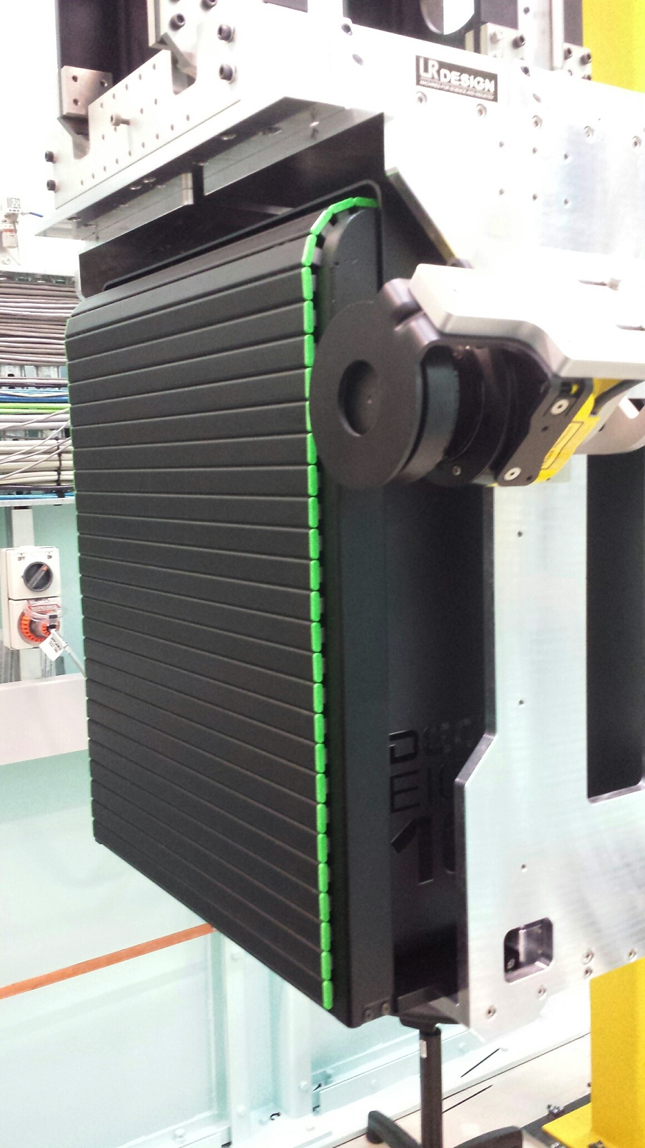
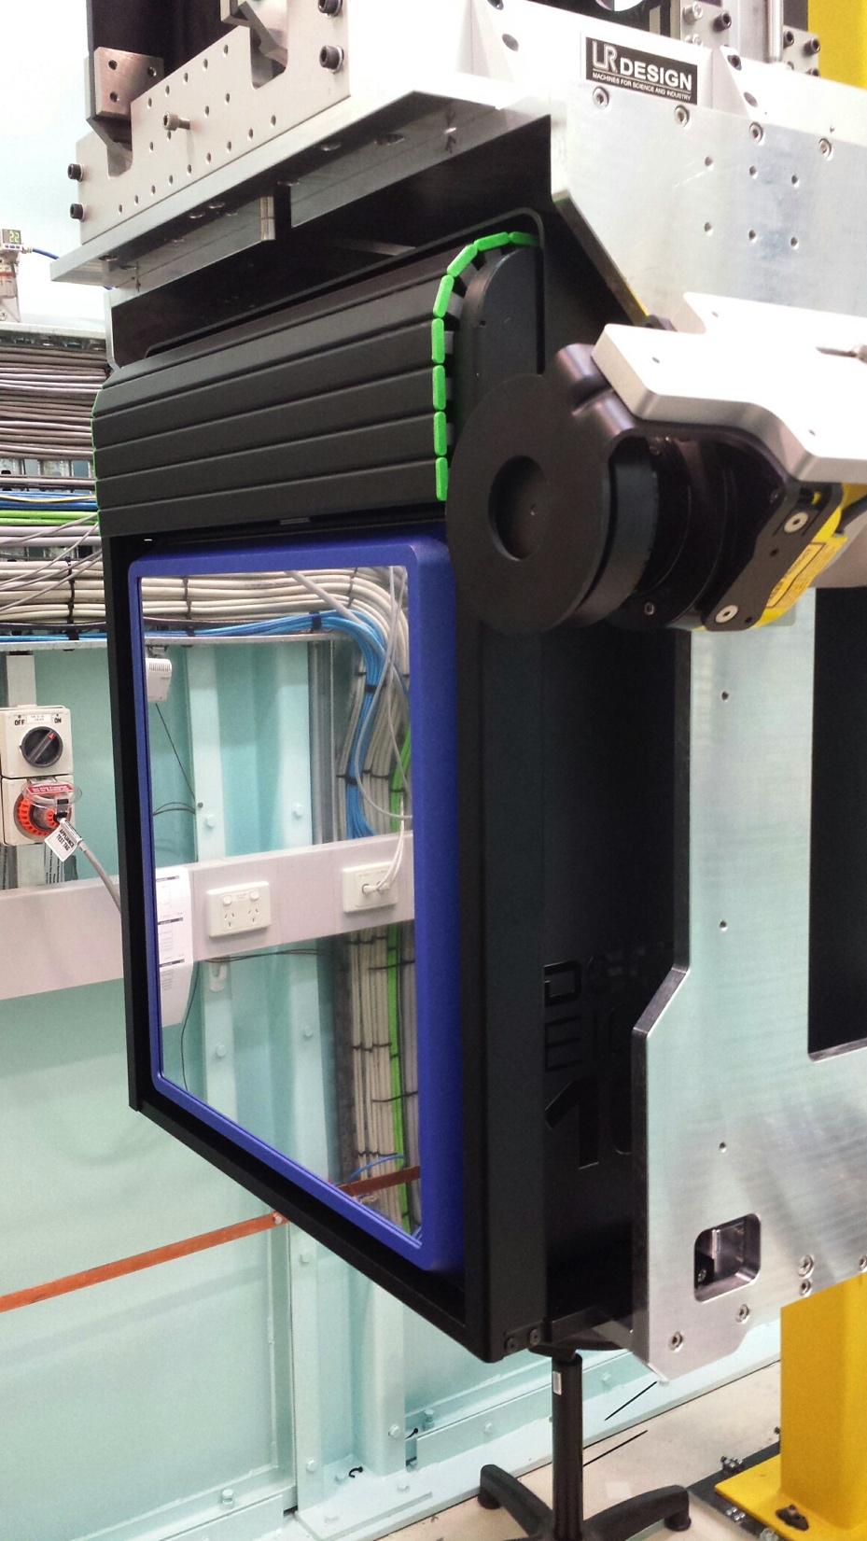
Eiger Cover – ADS Engineering
Roller cover
Interlocked to hutch search state
Working very well

Slide 4
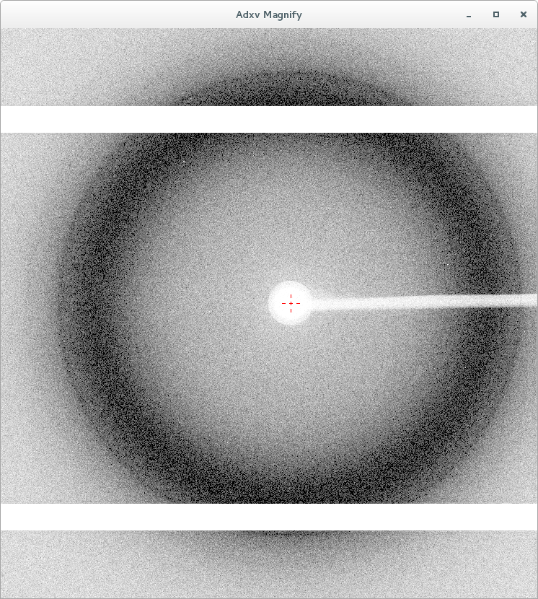
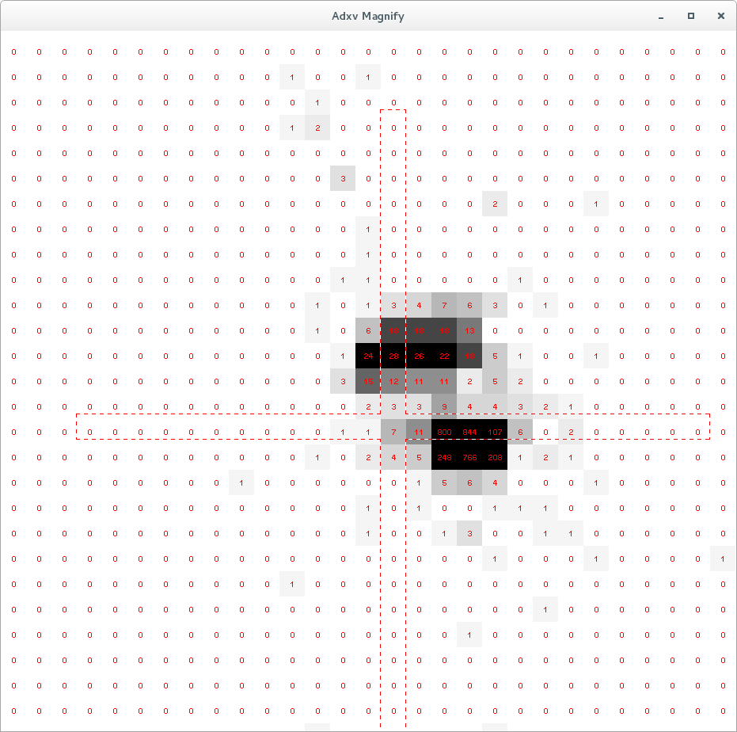
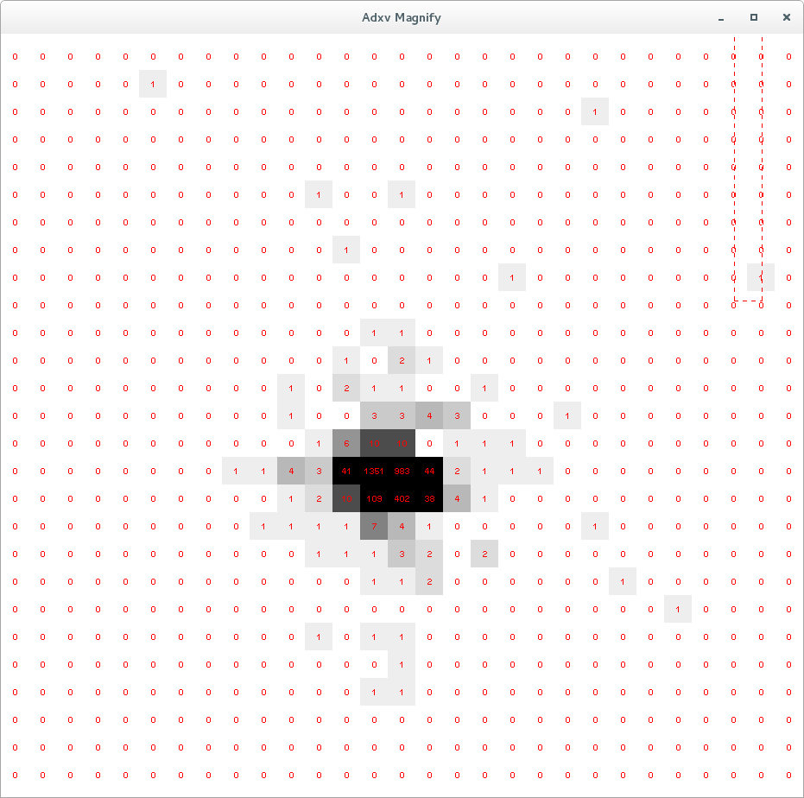
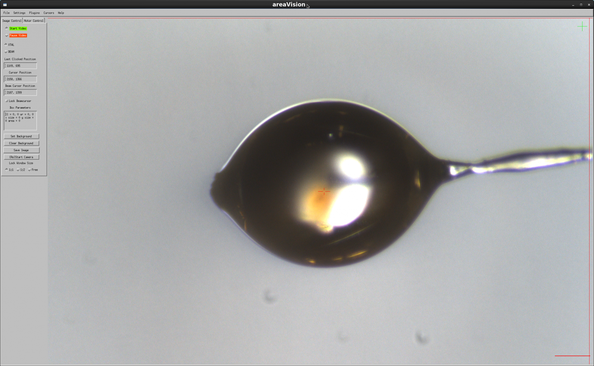
Eiger for direct beam measurement.
Used Eiger in 4M ROI at 750Hz for direct beam tests. Adjusting cryocooler settings fixed split beam issue.
Also used to measure incident flux but
issues with count rate correction gave 1.9% stdev in Io. Counts from 1500-2500 per pixel (333e⁶ cts/sec/mm²).
Used oil in loop and scatter instead of direct beam to get more accurate data. Counts per pixel 25-45 (6e⁶ cts/sec/mm²).
Now stdev 0.243% on Io for channel-cut crystal and 0.305% for double-crystal set. Matches other diagnostics.
Eiger a very powerful tool for measuring beam at sample (shape, position and intensity).

Slide 5
MX2 collection and processing system outline
Collect Server
Python Wrapper
Oscillation
AD eiger
QEGui
Epics
PyEPICS
ZMQ, via python BL library
PyEPICS
PyEPICS
Running on a galil 4080
DCU & Eiger
SIMPLON API
HW triggering on omega encoder

Slide 6
Screening
A new screening method is being tested
Small wedges of data are collected with wider delta (angle per image)
Processed on same nodes as regular datasets with same code, with higher priority
Aim for processing stats in less than a minute to help user make judgements about full data collection
Aim to provide angle/image (ideally 0.1 * mosaicity/image), dose, resolution
Pros:
Reliable indexing
In general matches stats in dataset (I/sigI, Rmerge etc)
Cons:
Slow. Between 30-60 seconds for results
Dose.

Slide 7
Software used to process data at the MX beamlines
Custom pipeline software – Nathan Mudie - https://github.com/AustralianSynchrotron/mx-auto-dataset
Custom web application software – Nathan Mudie - https://github.com/AustralianSynchrotron/mx-sample-manager
xdsme – my upgrades to add handling inverted rotation axis, improve integration speed, etc.- (BSD license following from original) https://github.com/JunAishima/xdsme
Pierre Legrand (Soleil) (BSD license) https://github.com/legrandp/xdsme
XDS http://xds.mpimf-heidelberg.mpg.de/
Pointless, Aimless (CCP4)
Sadabs and Xprep for CX data

Slide 8
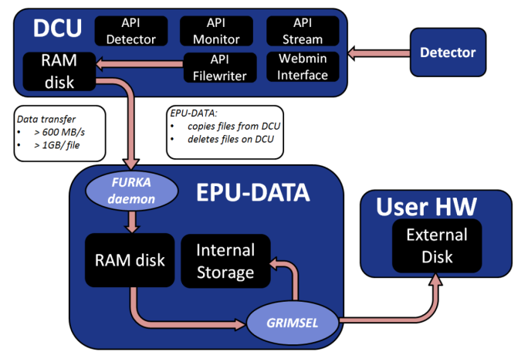
Dectris’s solution - Eiger Processing Unit
A computer able to retrieve data from the detector via DCU, write it to disk (/data), able to write onto other external disk drives, and ability to do some processing
4x E7-8870 v4 – 2.1 GHz, 20 cores each (40 hyperthreaded)
755 GB RAM – 512 GB can be used for a Ramdisk to store data pulled from DCU.
16 TB RAID spinning disk storage – meant to hold 1-5 days’ worth of data
We have # 002!

Slide 9
Benchmarking the EPU
9k image lysozyme dataset collected at the SLS – kindly provided for us by Andreas Forster (Dectris)
More representative of fine sliced experiments than the publicly available 16M 900 image insulin dataset or 9M 1800 image transthryretin dataset
Goal was to be able to process a dataset (collected at the maximum rate) in less than 4x the data collection time when using 3 of the 4 CPUs
This was verified by Dectris and us using the 9k image dataset and 120 threads.
Dectris have recommended that 16-40 threads be reserved for Furka/Grimsel
Comparison with two Dell 730 servers (node1 and node2)
2x E5-2650 v3 at 2.3 GHz, total 20 cores (40 hyperthreaded)
64 GB RAM

Slide 10
EPU alone is not sufficient to replace a cluster
Dataset/computer | Eiger 16M 9k images (Dectris, using xdsme) | Screening (MX2, typical)
EPU (1 CPU) | 13 mins | 30 s – 1 min
EPU (3 CPUs) | 5:30 mins | (not tested)
Node1/2 (2x E5-2650 v3 40threads) 64 GB RAM | 12 mins | 30 s – 1 min
EPU (3 CPUs) approaches Dectris design target of processing < 4x collection time
Phase 1: Many jobs with multiple slow jobs
Phase 2: Fewer jobs on EPU, multiple slow jobs
Phase 3: One fast EPU and some screening jobs
Slow sample changer (~4.5 minutes per change) prevents multiple datasets from queueing – saves us for now
Notes:
Create a processing system where they are equivalent
Easily expandable by adding more computing nodes – simply subscribe the new node to the processing Redis queue

Slide 11
Processing results - setup
Initial
EPU:
6 jobs
(3x datasets+3x screening)
Node 1:
1 jobs
(dataset)
Current
EPU:
2 jobs
(dataset+screening)
Node1:
2 jobs
(dataset+screening)
Future
EPU:
1 job (140 threads)
(dataset)
Node2:
1-2 jobs
(1-2x screening)
Node 2:
1 jobs
(dataset)
Node2:
2 jobs
(dataset+screening)
Node1:
1-2 jobs
(1-2x screening)
Node...
Initial Issues:
Ram limited
Full swap, unstable machines
User changer needs to kill zombies
Current -Investigating :
XDS fork integrate
Cluster design
Ramdisk use on EPU
Spotfinder hardware needs

Slide 12
Impact of no cluster
Processing is far slower than collection.
Users have 2 choices:
Wait for processing. Slows data collection down drastically.
Collect without processing information. Can collect a lot of poor data especially when learning how to use Eiger e.g. incorrect attenuation (too low = no signal, too high = fast radiation damage).
No option for rastering (no spare computing power).
Cluster being scoped.

Slide 13
MX2 processing system outline
newdataset.py
IP:*.2.44
http://processing/retrigger/submit
redis queues
Screening
autodataset
Screening-cpu 2
host:EPU
Screening-host:Node1
Screening-
host:Node2
autodataset-cpu1
host:EPU
autodataset
host:EPU02
autodataset
host:EPU03
EPU
Node1/2

Slide 14
Network/Filesystem
DCU->EPU link on 10Gbps network.
EPU has bonded dual 40Gbps (Mellanox card) to switch.
EPU->730 link on dual 10Gbps.
Filesystem is vanilla linux EXT4.
Processing from EPU file system (not RAM-disk).

Slide 15
EPU Summary
Works well as a data storage device
Integrates well with DCU – makes master, then data files available seamlessly via NFS
The CPUs are very capable processing nodes
Dectris designed the EPU for all three CPUs to be used for rapid processing of 1 job. The 3 CPUs combined processed the data in about 4x the collection time
We tested using the three CPUs independently allowing us to have more processing jobs instead of a single fast job.
Running 6 jobs however, drastically slowed the system as it became memory limited and 100% swapped out.
Some issues with Furka/Grimsel (a bug with large files, now fixed by Dectris). Ramdisk would fill and needed cleaning.
Using custom Python with lsyncd to synchronise EPU storage to SAN.
We have EPU serial #002 so problems aren’t unexpected…

Slide 16
Data Storage
Long term data storage (6 months to 3 years: TBD retention period)
Facility SAN is a commercial IBM product (EOL: Jun 2017)
~80 Tb free for 9 beamlines (3 high demading)
Temporary storage as part of new custom build Facility Cluster
~100 Tb available
New facility new storage in build process (~Sep 2017) → CEPH
0.5 Pb but might increase if we can make our case
Current user data rate generation
Commercial companies: ~3 Tb/20h
Academic users: 0.5 to 2 Tb/20h → Still learning
After experiment we compress all data in a single file using Squashfs (~70% of original size: Master file compresses a lot)
How would this look like with a cluster, rastering, spotfinder, etc?

Slide 17
MX team – Tom Caradoc-Davies, David Aragao, Daniel Ericsson, Stephen Harrop*, Sofia Macedo, Santosh Panjikar, Jason Price, Alan Riboldi-Tunnicliffe, Rachel Williamson
Nathan Mudie
IT Group – Uli Felzmann*, Robbie Clarken, Andreas Moll
Dectris – Andreas Forster, Diego Gaemperle
SLS – Simon Ebner, Zac Panepucci, Meitian Wang
HDRMX – http://hdrmx.medsbio.org
NSLS2 – Bruno Martins for AD Eiger
Centre for Advanced Molecular Imaging – for jointly funding my position!

