Slide 1
HDR Handling at EMBL-HH Status Report
Marina Nikolova

Slide 2
Overview
Introduction
Software Set-up
Data Acquisition
Data Transfer Management
Data Visualization
Infrastructure Organization
Outlook

Slide 3
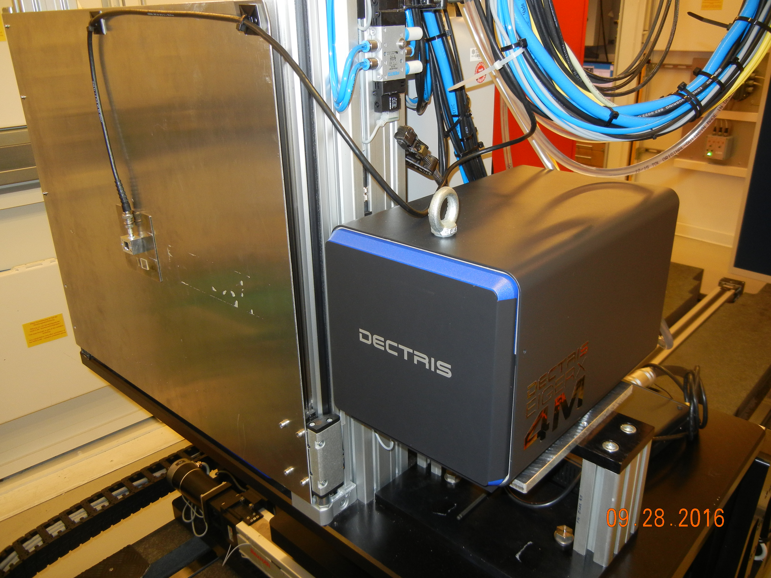
Introduction
EMBL: 3 beamlines at Petra III on the DESY campus
A pool of detectors:
2 Pilatus 6Ms, Pilatus 2M, Pilatus1M, Eiger 4M
Eiger 16M delivery expected end of April
TINE control system for device communication
Shutdown: January – April

Slide 4
System Overview: Control and Data Flow
Adxv
GUI
MxCuBE
Image Tracker
Collection
Server
PPU
Server
Pilatus
Eiger
Grimsel

Slide 5
Collection Server
TINE server
Communicates with and schedules devices involved in collection sequence:
Detector
Diffractometer
Detector shield
Energy
Transmission
Resolution
Pilatus or Eiger based on configuration

Slide 6
Data Transfer Management Software
PPU TINE Server – an engine for remote script execution
Allows execution of queued command sequences on PPUs
Pilatus
Per user restart of DECTRIS’ furka/grimsel on (GUI) client request
Verification of process status and data transfer DCU => PPU
Eiger
Data download DCU => PPU on collection server request
Parallel command-line CURL downloads via 10Gb/s connection
Built-in download verification and multiple retries on failure
CURL file DELETE request during collection on successful download
Maximum download rate: 370 Eiger 4M frames/sec

Slide 7
System for Real-Time Data Visualization
Image Tracker
TINE Server
Learns of files transferred (DCU => PPU) via communication with data transfer software – grimsel (Pilatus) / ppu-server (Eiger)
Decision which frame to display next made based on a set of rules
Command to display frame sent to adxv viewer via socket
ADXV
New socket commands for hdf5 slab control
-o_direct flag for fast I/O over nfs
Fix for data type issue – yellow lines along space between modules
Fix for crashes on opening big hdf5s

Slide 8
Infrastructure Organization
P13
DCU
P13
PPU
Infiniband Storage 40 Gb/s
P14
PPU
P14
DCU
P13
MW
P13
UI
P14
UI
P14
MW
Processing
Processing
Processing

Slide 9
Eiger Streaming Client
Tioga: “where it forks”/”swift current”, zmq
Tested without beam only
No dropped messages
2 10 Gb/s connections DCU ⬄ PPU
Consistent rate of ~510 frame writes/sec at 750Hz
Writes to /ramdisk of PPU
Subsequent collection blocked in arm until stream is finished
Pull Message
Bitshuffle lz4 Decompress
Write cbf
Parse out configuration (once)
all PPU CPU threads

Slide 10
Outlook
Tioga tests with beam
Writes to storage – BGFS 7.5 GB/s
Connection to Dozor?
Connection to Image Tracker
Add pixel mask
Flatfield Correction?

Slide 11
Acknowledgements
Gleb Bourenkov
Andrew Arvai
Stefan Fiedler
Thank you

