Slide 2
Conda Introduction
Benjamin Bertrand

Slide 3
Outline
Conda
Live Demo
Conda build
Conda and Ansible

Slide 4
Package, dependency and environment management for any language – Python, R, Ruby, Lua, Scala, Java, Javascript, C/C++, FORTRAN
https://conda.io

Slide 5
Conda / Anaconda
Conda: An open-source (BSD-3-Clause) package manager
Anaconda:
A software distribution: both open-source (personal) and Commercial editions
Company supporting Anaconda / conda (previously named Continuum Analytics)
Miniconda: minimal installer for conda (https://docs.conda.io/en/latest/miniconda.html)
Notes:
I’d like to clarify something. There is often confusion between conda and anconda.

Slide 6
Anaconda Terms of Service (ToS)
Anaconda changed their ToS in April 2020: https://www.anaconda.com/terms-of-service
The TOS change does not apply to conda-forge, nor to other channels hosted on anaconda.org; the TOS change in question applies only to the “defaults” channel and other software hosted on repo.anaconda.com
https://conda-forge.org/blog/posts/2020-11-20-anaconda-tos/
Notes:
The TOS were changed to limit anaconda use for commercial activities

Slide 7
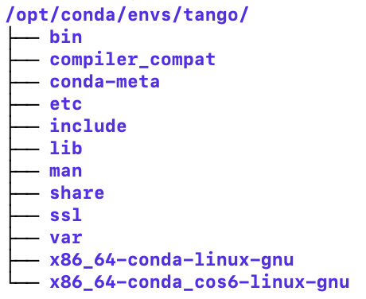
Conda concepts
A conda package is a compressed tarball file (.tar.bz2 or .conda) that contains a collection of files to be installed and some metadata. It can include system libraries, binaries, text files…
A conda channel is a repository of conda packages (remote or local)
A conda environment is a directory that contains a specific collection of conda packages. It is self-contained and isolated from the system.
A conda server is a web server serving conda packages
Notes:
No need to be root to install packages.
Standard UNIX Filesystem hierarchy.

Slide 8
Conda Server
The official conda channels are hosted by Anaconda at https://conda.anaconda.org
MAX IV has its own conda server, based on Quetz, at https://conda.maxiv.lu.se. It’s used to mirror (proxy) external channels (conda-forge, anaconda main) so they can be used internally without internet access. It can also host local channels.

Slide 9
Conda channels (1/2)
Anaconda default channels:
pkgs/main
pkgs/r
pkgs/free (built without the new compiler stack – removed in conda 4.7)
conda config --show default_channels
Extra channels
conda-forge: https://anaconda.org/conda-forge: community-led collection of recipes (https://conda-forge.org)
https://anaconda.org/tango-controls (deprecated - packages moved to conda-forge)
Anyone can create a channel

Slide 10
Conda channels (2/2)
conda config --show channels
Add the “-c” flag to conda commands
conda create –n foo –c conda-forge pytango
Update the config
conda config --add channels <mychannel>
conda config --set channel_alias https://conda.maxiv.lu.se/get conda config --add channels conda-forge conda config --add channels maxiv-kits conda config --remove channels defaults
Notes:
It’s important to know from where packages are downloaded.
Avoid using too many channels.

Slide 11
Conda installation
curl -LO https://repo.anaconda.com/miniconda/Miniconda3-latest-Linux-x86_64.sh bash Miniconda3-latest-Linux-x86_64.sh -bp $HOME/miniconda
rm -f Miniconda3-latest-Linux-x86_64.sh
# Let conda update your ~/.bashrc or ~/.zshrc source $HOME/miniconda/bin/activate conda init
Alternatives to Miniconda:
Miniforge: https://github.com/conda-forge/miniforge
Mambaforge: https://github.com/conda-forge/miniforge#mambaforge
Notes:
Conda-forge is providing alternate installers.
Miniforge: minimal installer for Conda specific to conda-forge

Slide 12
Environment creation
Don’t install extra packages in the “base” environment. Keep it for conda, mamba, conda-build. Can interfere with conda and make updates difficult.
conda create –n <name> <list of packages>: create the env <name> under the default location:
<conda install path>/envs/<name> if writeable
~/.conda/envs/<name> otherwise
conda create –p <env path> <list of packages>: you can specify an explicit path instead of a name

Slide 13
Conda activate / deactivate
conda activate <env>
updates PATH -> set the path of the environment first
Run activation script (if any defined) from <conda env>/etc/conda/activate.d/<script> to setup additional env variables
conda deactivate
Run deactivation scripts (if any defined) from <conda env>/etc/conda/deactivate.d/<script> to remove additional env variables
Remove the environment path from PATH

Slide 14
Mamba
Mamba is a reimplementation of the conda package manager in C++ for maximum efficiency
libsolv for much faster dependency solving
Conceived as a drop-in replacement for conda
Same commands as conda
Use conda for activation / deactivation (not mamba)
Quite robust and fast but not 100% drop-in replacement yet (especially for conda-env commands)
https://mamba.readthedocs.io/en/latest/
Notes:
Mamba is still a Python cli. Only certain parts are in C++.
libsolv: the same library used in RedHat dnf

Slide 15
Live Demo https://gitlab.maxiv.lu.se/benber/conda-tutorial

Slide 16
conda build https://docs.conda.io/projects/conda-build/en/latest/index.html

Slide 17
Conda build
To create a conda package, you need a conda recipe: recipe/meta.yaml (https://docs.conda.io/projects/conda-build/en/latest/resources/define-metadata.html)
conda build <recipe dir> (need to install conda-build)

Slide 18
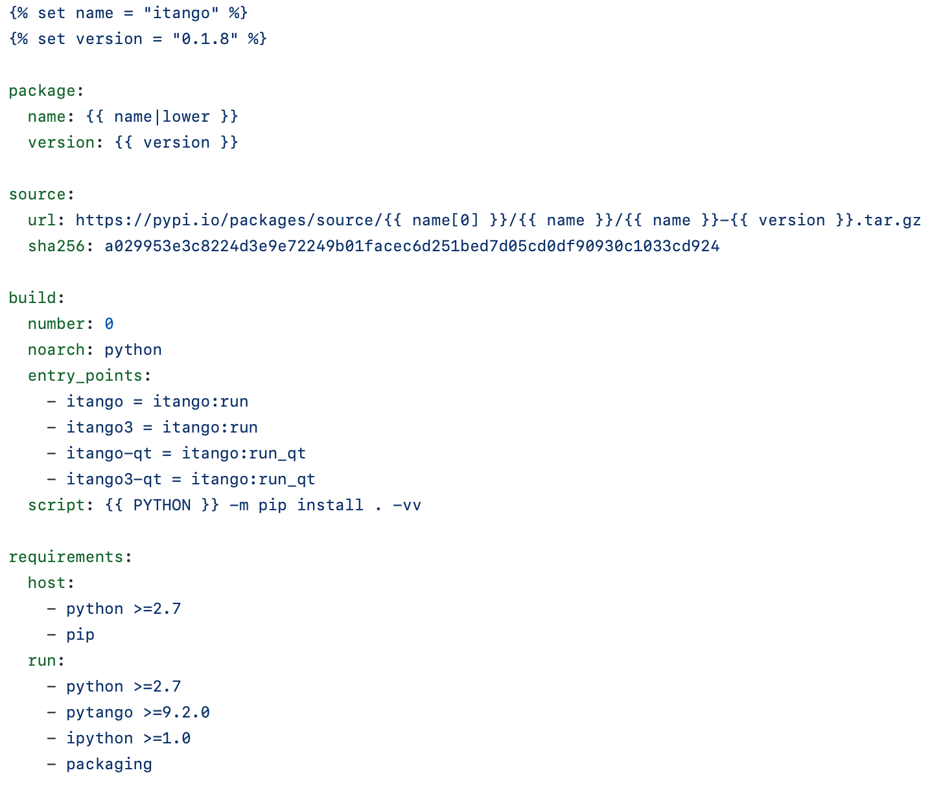
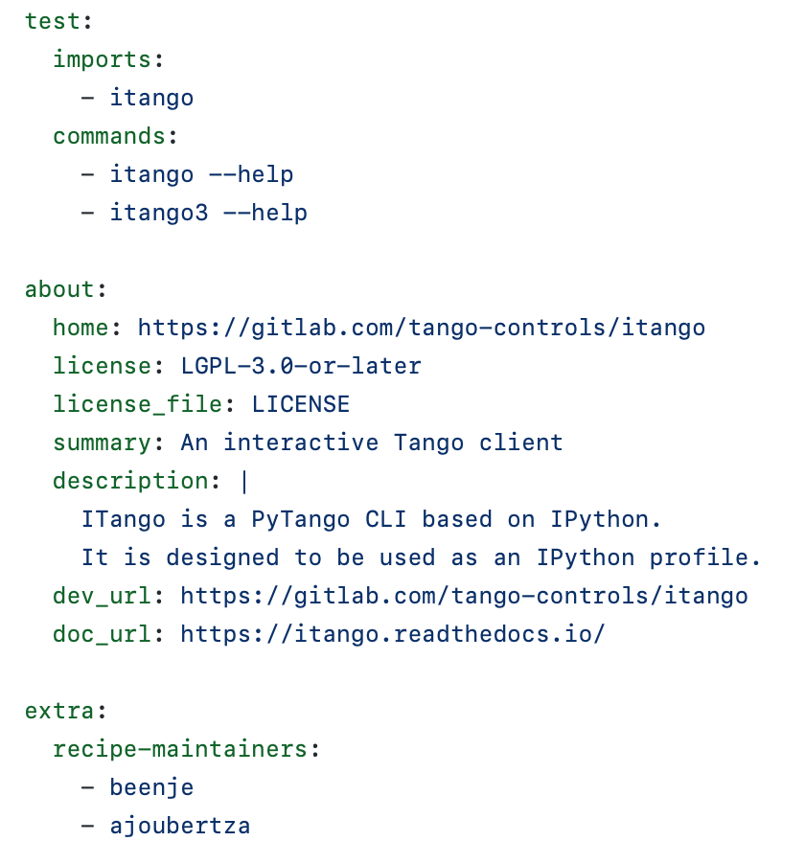
conda recipe (conda-forge)

Slide 19
conda recipe (local)

Slide 20
Conda build process
Download and extract the source into the source directory.
Applies any patches.
Creates a build environment and then installs the build dependencies there.
Runs the build script.
Performs some necessary post-processing steps, such as shebang and rpath.
Creates a conda package containing all the files in the build environment that are new, along with the necessary conda package metadata.
Tests the new conda package if the recipe includes tests:
Creates a test environment with the package and its dependencies.
Runs the test scripts.
https://docs.conda.io/projects/conda-build/en/latest/concepts/recipe.html#conda-build-process

Slide 21
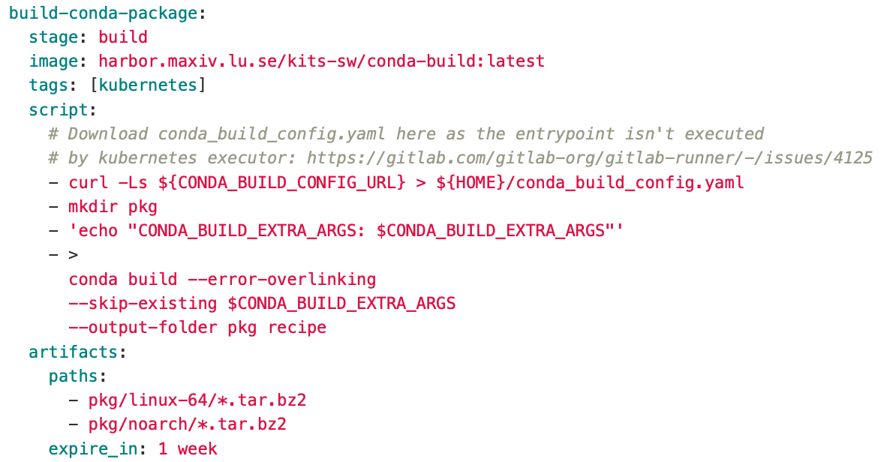
Conda build CI pipeline
Included in the .python-ci.yml and .pythonds-ci.yml templates. Triggered only if recipe/meta.yaml exists:
Build the package
Upload it to conda.maxiv.lu.se (kits-maxiv or kits-maxiv-dev channel depending on the branch)

Slide 22
Testing conda build locally
docker run --rm -it -v $(pwd):/build harbor.maxiv.lu.se/kits-sw/conda-build bash conda build recipe
Ensure the proper conda_build_config.yaml is used.
Not critical for pure Python packages (noarch: python), but important when compilation is involved. It includes the baseline versions of software for conda-forge (compiler…). Ensure ABI compatibility between packages.

Slide 23
Conda and Ansible

Slide 24
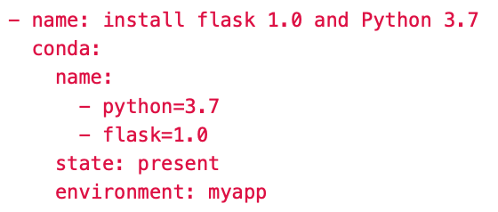
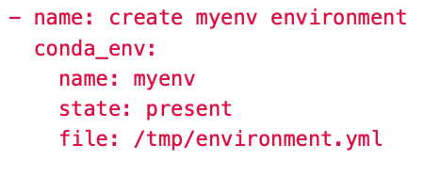
Conda and Ansible
Two MAX IV specific Ansible modules to use conda (part of the Ansible role ans_maxiv_role_conda):
conda
conda_env
Notes:
To use Ansible modules, you have to write some tasks in a role or playbook.

Slide 25
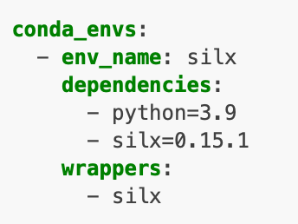
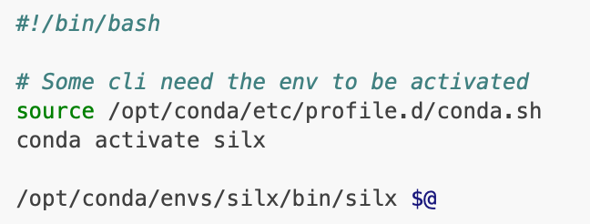
ans_maxiv_role_conda
Install and configure conda + mamba
Can create conda environments based on a list of yaml environment files via the conda_env_files variable
Can create conda environments with some wrappers (using a list of conda packages) via the conda_envs variable
Notes:
Part of the cs playbook

Slide 26
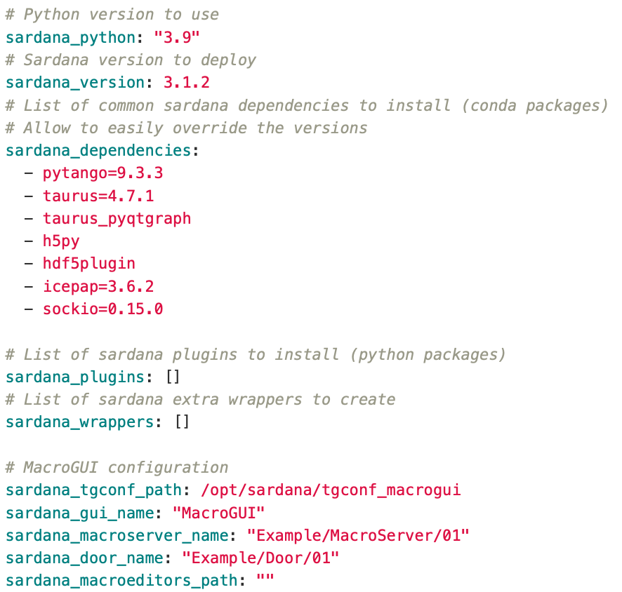
Sardana role/playbook
ans_maxiv_role_sardana
Notes:
More complex environment. Specific role. You also need to install pypi packages.

Slide 27
Tips
Use conda info to check the current configuration (channels used, condarc files…)
Do not install packages in the “base” environment. Keep it for conda, mamba, conda-build. Can interfere with conda and make updates difficult.
Do not use too many channels
Try to only use maxiv-kits and mini-conda-forge
Add packages to mini-conda-forge if needed!

Slide 28
Links
https://conda.io
https://docs.conda.io/projects/conda/en/latest/glossary.html
https://jakevdp.github.io/blog/2016/08/25/conda-myths-and-misconceptions/
http://kits-maxiv.gitlab-pages.maxiv.lu.se/packaging/conda.html
http://kits-maxiv.gitlab-pages.maxiv.lu.se/workflows.html#conda-environments
https://gitlab.maxiv.lu.se/kits-maxiv/ansible-galaxy/ans_maxiv_role_conda
https://gitlab.maxiv.lu.se/kits-maxiv/ansible-galaxy/ans_maxiv_role_sardana
https://gitlab.maxiv.lu.se/kits-maxiv/cfg-maxiv-mini-conda-forge
http://kits-maxiv.gitlab-pages.maxiv.lu.se/packaging/conda.html#mini-conda-forge-channel

