Slide 2
Installation of Tango ICALEPCS 2021
Benjamin Bertrand

Slide 3
Agenda
Introduction
Tango Source Distribution
CentOS
Debian & Ubuntu
Conda
Windows
Docker
TangoBox

Slide 4
Introduction: what is needed?
Tango host
MariaDB or MySQL database
DataBaseds (tango database)
Tango device server
TangoTest device server for testing
TangoStarter to run device servers
Tango libraries (C++, python, java)
Tango applications
java applications (jive, astor)
Tango libraries (C++, python, java)

Slide 5
Introduction: TANGO_HOST
On Linux, check is done in this order:
TANGO_HOST environment variable
$HOME/.tangorc
/etc/tangorc
On Windows:
TANGO_HOST environment variable
%TANGO_HOME%/tangorc
Notes:
Any Tango application relies on TANGO_HOST to know where the DataBaseds is running

Slide 6
Installation from source
TangoSourceDistribution: https://gitlab.com/tango-controls/TangoSourceDistribution
https://github.com/tango-controls/TangoSourceDistribution/releases/download/9.3.4/tango-9.3.4.tar.gz
Good instructions in the README
- Come with all jar files for Java libraries and applications
- Need to install dependencies yourself before compiling (omniORB, zmq, mysql, gcc, java)
Notes:
Obviously not the most straightforward way. Good to know. Project moved to GitLab but archive still on Github.

Slide 7
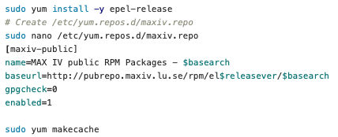
CentOS: repositories
RPM built on Copr

Slide 8
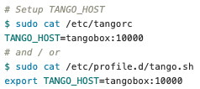
CentOS: install tango-db

Slide 9
CentOS: start tango-db

Slide 10
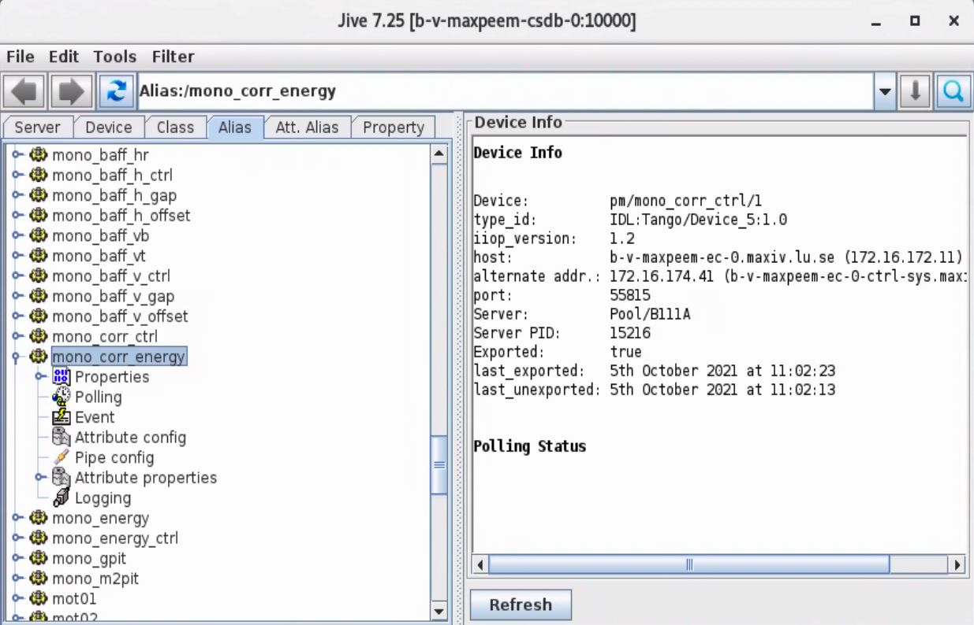
CentOS: pytango & java

Slide 11
Debian & Ubuntu
Notes:
Install in interactive mode, will create the database and the /etc/tangorc file

Slide 12
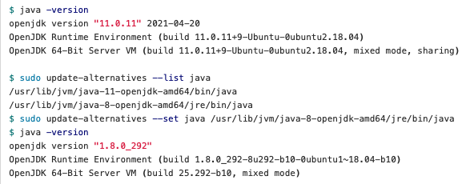
Debian & Ubuntu: pytango & java
WARNING! Do not use java 11!
Notes:
Java applications not in the official repo due to liensing issue. Available from Frederic Picca. Note it’s not the latest version.

Slide 13
Conda 1/2
Packages on conda-forge (Linux only):
tango-idl
cpptango
tango-database
tango-test
tango-admin
pytango
itango
pytango available for Windows on tango-controls channel
Notes:
You can run DataBaseds from conda. You have to create a systemd file (or supervisor) yourself. Good to use in docker.

Slide 14
Conda 2/2
Miniforge provides conda installer already configured to use conda-forge. Can even include mamba. Alternative to Miniconda.
Notes:
Don’t recommend using pip to install pytango on Linux (no wheel yet)

Slide 15
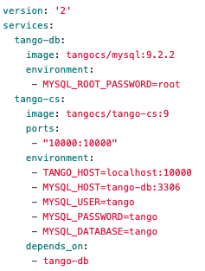
Docker
Works on Linux, macOS and Windows
Using docker-compose:
tango-cs running DataBaseds, TangoAccessControl, TangoTest
Other images from SKA: https://gitlab.com/ska-telescope/ska-tango-images
Notes:
Hand-on session Kubernetes@SKA

Slide 16
Windows
TangoSetup
Get TangoSetup-9.2.2_win64.exe from https://www.tango-controls.org/downloads/
https://tango-controls.readthedocs.io/en/latest/installation/tango-on-windows.html
PyTango:
pip (wheel for windows)
conda (from tango-controls channel): conda create -y -n tango -c tango-controls pytango

Slide 17
TangoBox
TangoBox is a Virtual Machine image running Tango Controls system and its various tools. It is intended to be used for demonstration and training.
https://tango-controls.readthedocs.io/en/latest/installation/vm/tangobox.html
Notes:
Hands-on: Install Party

Slide 18
Conclusion
Many ways to install Tango
On Linux: RPM, deb, conda, docker
On Windows: binaries, pip, conda, docker, VM
On macOS: docker, VM

Slide 19
Links
https://tango-controls.readthedocs.io/en/latest/installation/index.html
https://gitlab.com/tango-controls/TangoSourceDistribution
https://gitlab.com/tango-controls/tango-spec
https://github.com/conda-forge/miniforge

