Slide 1
CoSAXS beamline time-resolved experiment control using TANGO, Sardana and PandABox
KITS Software Control

Slide 2
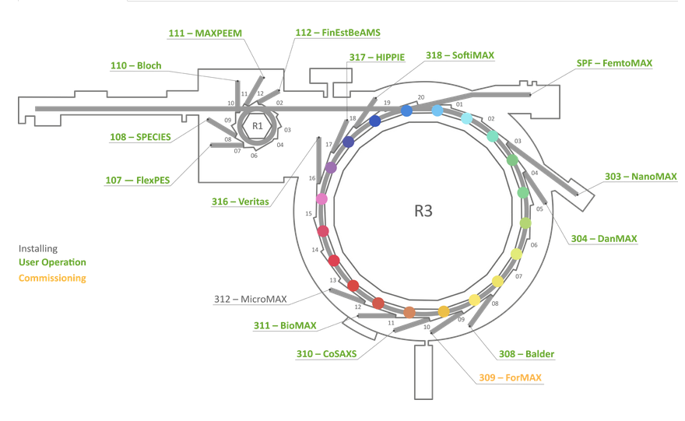
Introduction – MAX IV beamlines overview
14 beamlines in operation
KITS SW beamline contact

Slide 3
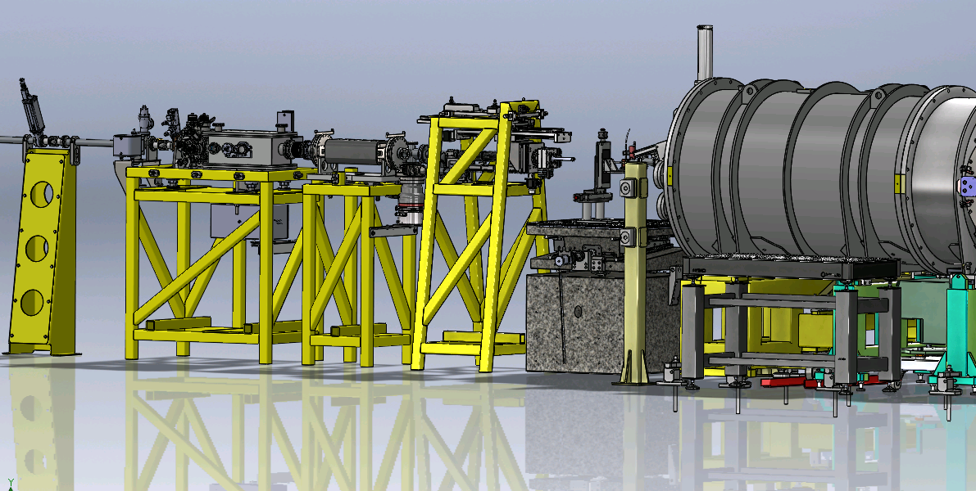
CoSAXS – Coherent and Small Angle X-ray Scattering beamline
X-ray beam
EH general optics
Detectors for DAQ
Sample Environment
Experimental Hutch

Slide 4
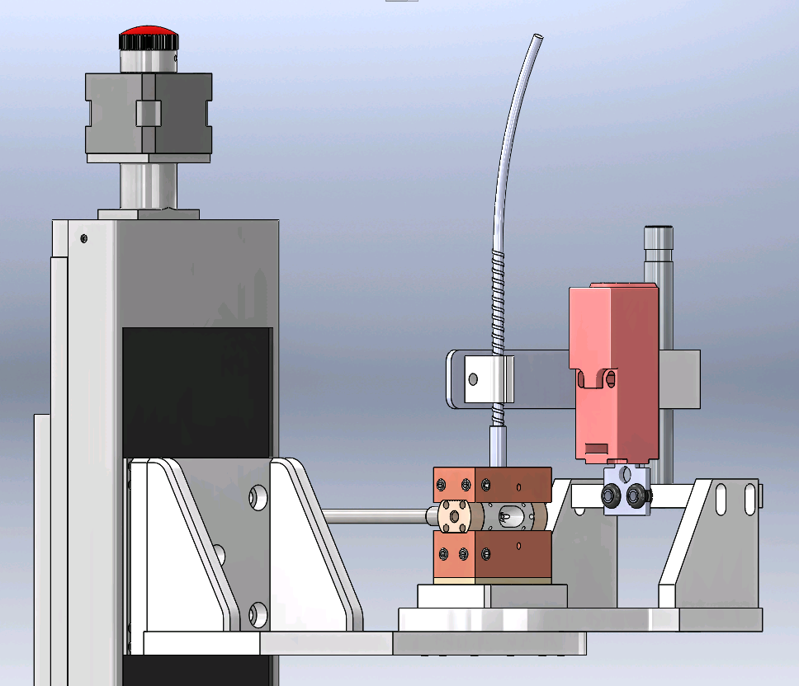
CoSAXS Time-Resolved Experiment

Slide 5
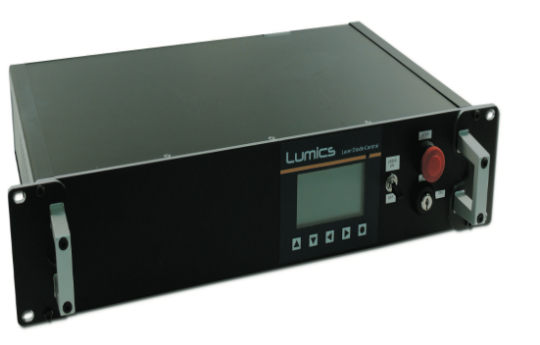
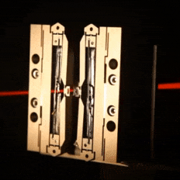
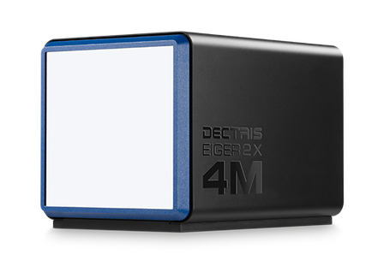
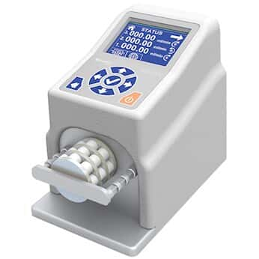
CoSAXS Time-Resolved Experiment
laser
X-ray beam
shutter
sample
detector
peristaltic pump

Slide 6
Hardware Integration in the Control System
TANGO
Device
Attributes: represents a process value in the system
Commands: associated with an action
Device Class is an abstraction of a device’s interface.
State: State of a device may reflect the equipment state. State machine defines available operations in different states of the device.
TANGO Device Class
Hardware Interface
Hardware library according to the communication protocol
Hardware

Slide 7
Hardware Integration in the Control System
Eiger 4M Detector
Attributes List
CountTime
TriggerMode
NbTriggers
nFramesAcquired
FilenamePattern
State
Status
…
TANGO
Device
Eiger
Hardware Interface
Commands List
Arm
Trigger
Abort
Disarm
State
Status
…

Slide 8
Hardware Integration in the Control System
Eiger 4M Detector
TANGO
Device
Eiger
Hardware Interface

Slide 9
Experiment Orchestration with SARDANA
Pool
Motors
1D Channels
2D Channels
Counters
Controllers
MacroServer
Macros
Recorders

Slide 10
Experiment Orchestration with SARDANA
Pool
MacroServer
SPOCK
🖖

Slide 11
CoSAXS Time-Resolved Experiment
laser
shutter
sample
detector
peristaltic pump

Slide 12
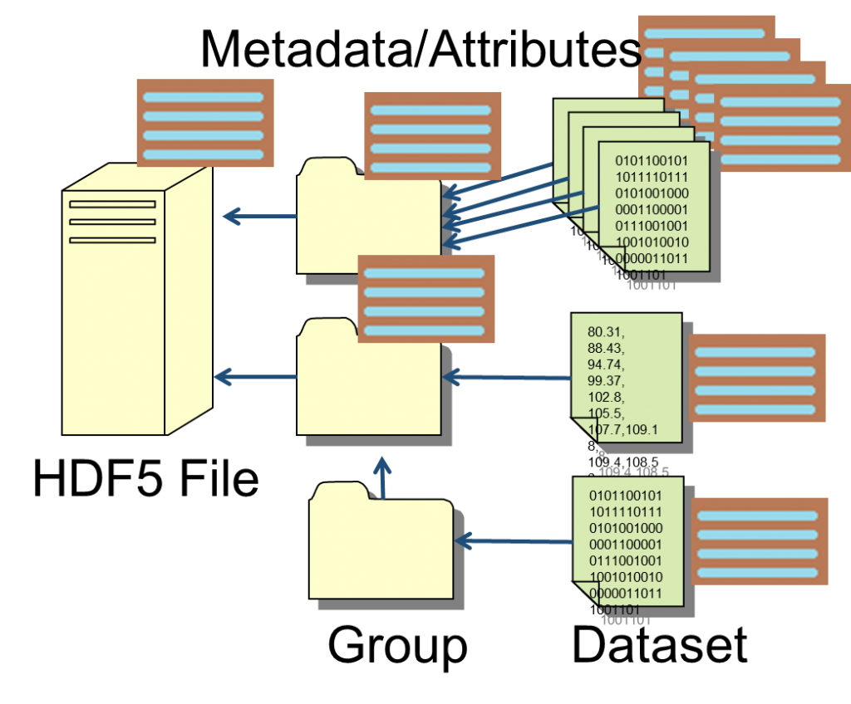
Experiment Orchestration with SARDANA
SCAN ORCHESTRATION
START DATA RECORD
END DATA RECORD
RUN PRE-SCAN HOOKS
RUN POST-SCAN HOOKS
peristaltic pump
PREPARE EQUIPMENTS
DATA ACQUISITION
SYNCHRONIZATION
detector

Slide 13
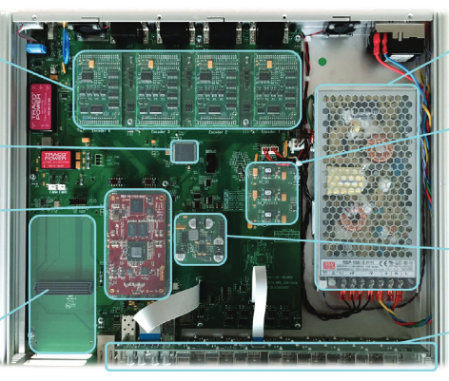
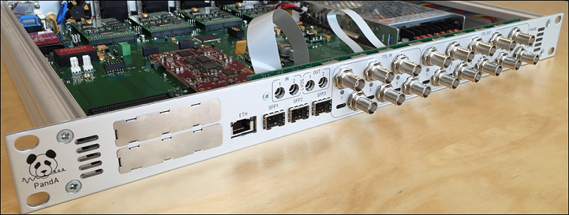
Experiment Synchronization with PandABox
10x TTL OUT
6x TTL IN
FMC-ADC integration 8 channels

Slide 14
CoSAXS Time-Resolved Experiment
laser
shutter
sample
detector
peristaltic pump

Slide 15
Experiment Synchronization with PandABox
1 cycle
Shutter
TTLOUT
Shutter
Analog Feedback
Detector
TTLOUT
Laser
TTLOUT
0
8
18
23
61
Time [ms]

Slide 16
Experiment Orchestration with SARDANA
SCAN ORCHESTRATION
START DATA RECORD
END DATA RECORD
RUN PRE-SCAN HOOKS
RUN POST-SCAN HOOKS
peristaltic pump
PREPARE EQUIPMENTS
DATA ACQUISITION
SYNCHRONIZATION
detector

Slide 17
Thank you!
Vanessa Silva, Research Engineer – KITS SW Control
vanessa.silva@maxiv.lu.se

