Slide 2
MAXIV Metadata ecosystem
Daphne van Dijken

Slide 3
Introduction
“The experimental data & metadata work package targets at supporting a unified way of harvesting metadata and experimental data from a variety of detectors and instruments, and building the capability to handle data volumes and high-speed data rates of the new generation of detectors.”

Slide 4
FAIR data policy
Findable
Accessible
Interoperable
Reusable

Slide 5
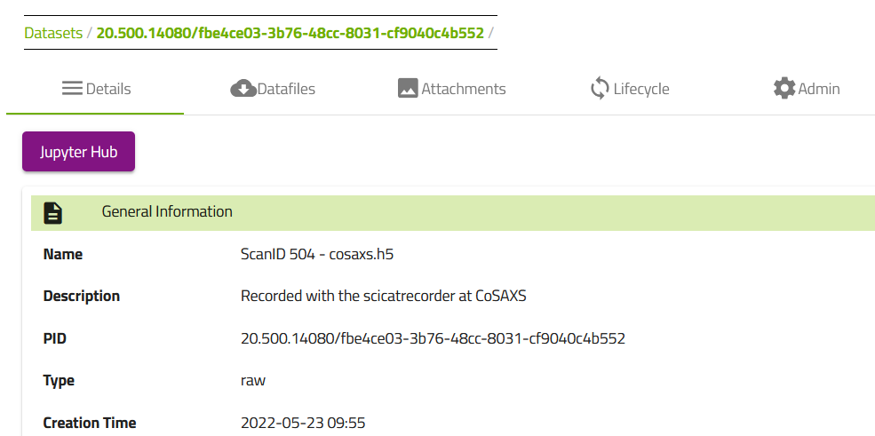
SciCat
Designed to support the lifecycle of (meta)data

Slide 6
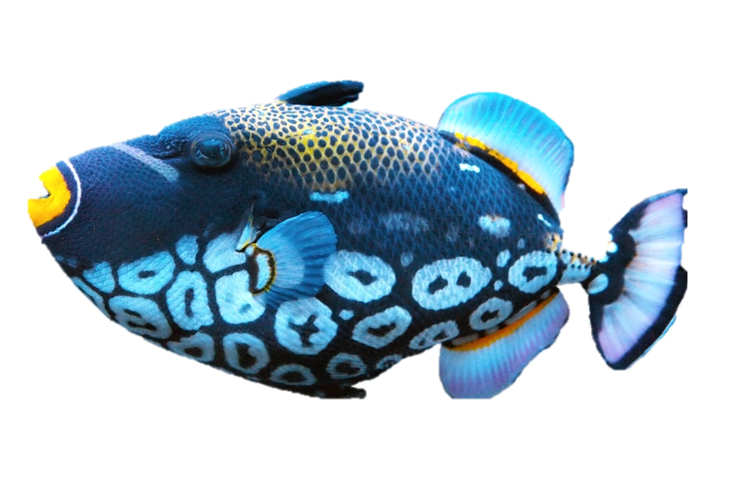
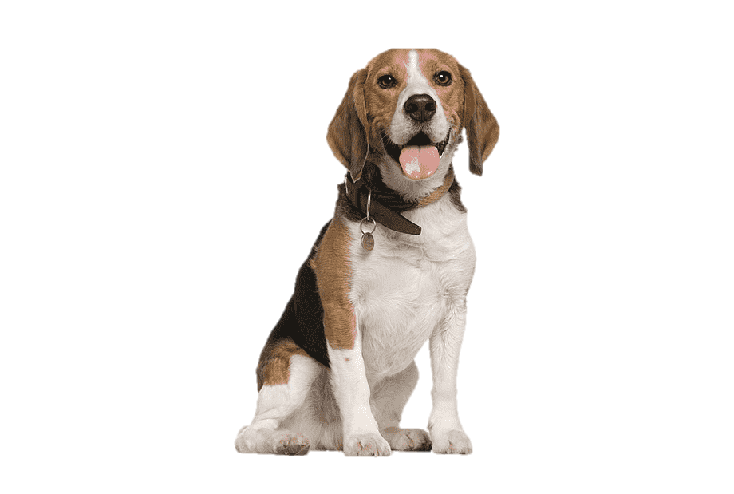
SciZoo
SciDog – Scientific (meta)Data Organizer GUI
SciCat – Scientific Catalog
SciFish – Scientific Form Implementation Service Helper
SciToad (Scanlog) – Scientific Tool Of Analyzing (meta)Data
SciFly – Scientific File Lystener

Slide 7
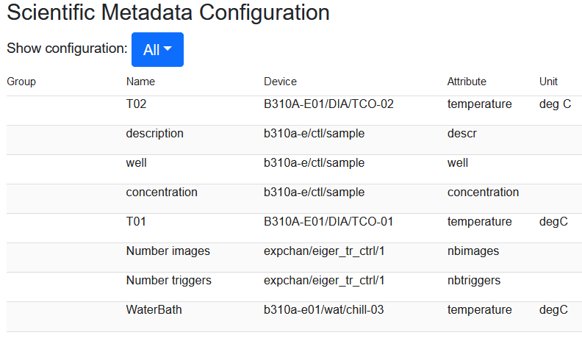
From creation…
Use SciDog to configure which metadata should be recorded

Slide 8
…to during a scan…
Metadata is automatically harvested from various places
From DUO (Digital User Office) for proposal information
From Tango Devices for information about specific parameters
From Sardana, the control system, for information about a scan

Slide 9
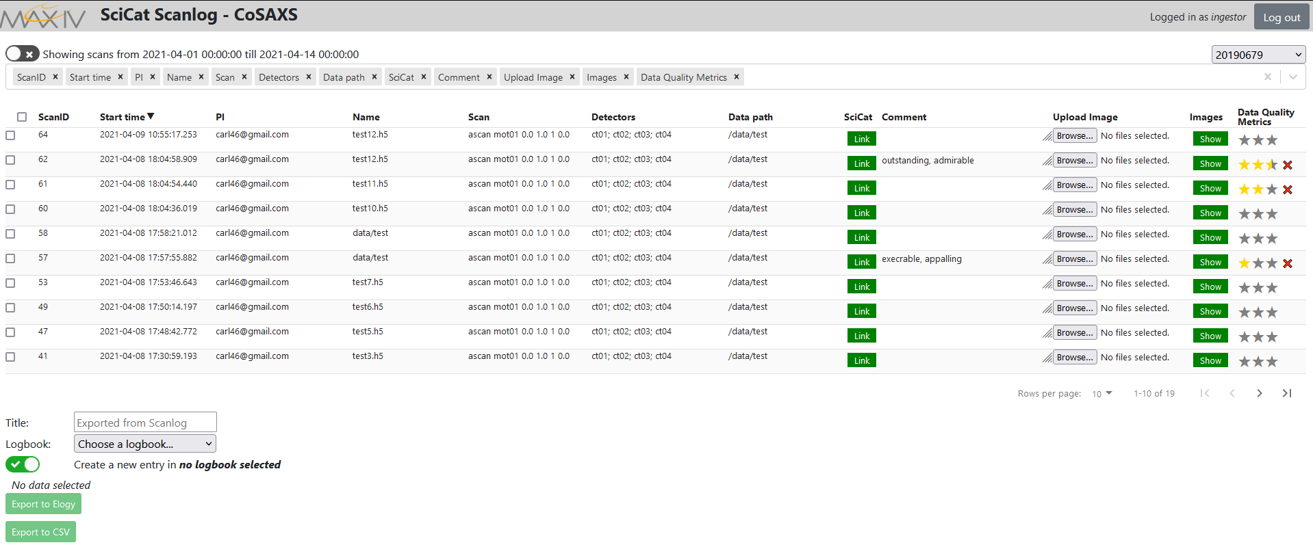
…to during a scan…
This data is automatically gathered by a recorder (SciFish) and stored in the SciCat database

Slide 10
…to data analysis…
Services such as Jupyter Notebook can be connected to analyze the existing raw data
Still work in progress at MAXIV, but implemented in facilities such as ALS (Berkeley, USA)

Slide 11
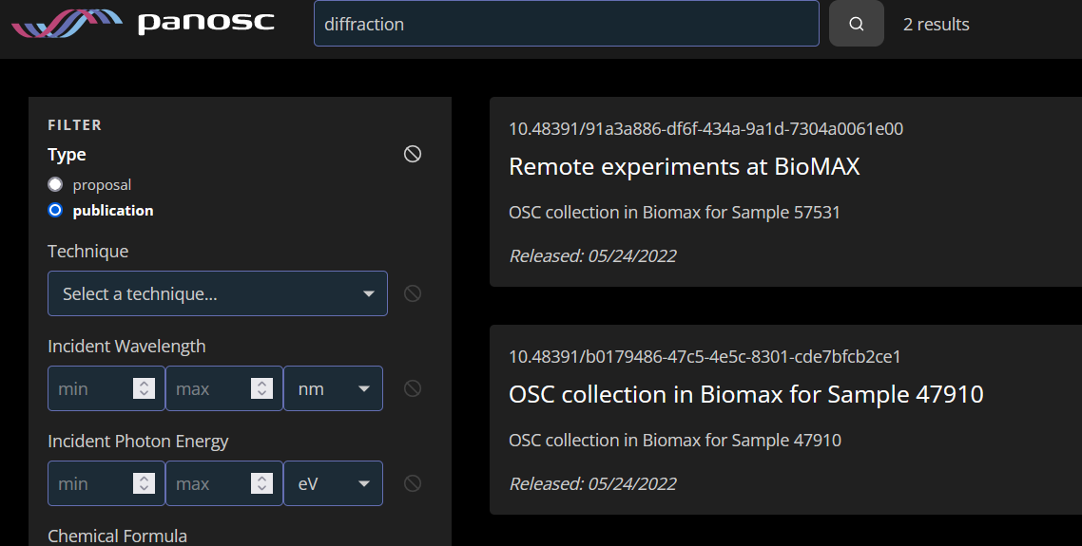
…to publishing a dataset
Datasets are given a unique identifier, a DOI, to be traceable

Slide 12
Process Overview
User
SciDog metadata configuration
Control system (Sardana)
SciFish collects metadata
Control system
(Scienta SES)
SciFly
SciCat database
SciToad/Scanlog
web interface
Publish with DOI to data.panosc.eu
Export to internal systems (Elogy)

Slide 13
KITS MAXIV Strategy
Agile
Two weeks turnover
Feature requests by scientists
Currently known and implemented at 10 out of 16 beamlines

Slide 14
Future
Provide a solution for more control systems
Implement data processing and analysis pipelines
Publishing of datasets with DOI (currently in testing phase)

