Slide 1
Radiofrequency for ALBA-II
P. Solans on behalf of ALBA-RF team
(presented by F. Perez)
11/10/2022

Slide 2
Outline
ALBA-II General Overview
ALBA-II Radiofrequency system
  Main system
  3rd harmonic system
    SSPA transmitter
    DLLRF
    Cavity

Slide 3
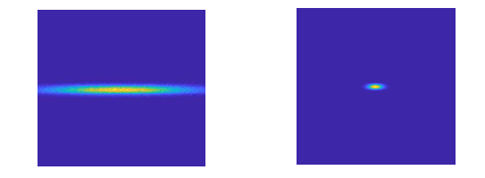
ALBA-II Objective
Upgrade the 3rd Generation ALBA Storage Ring
to a 4th Generation Ultra Low Emmittance Ring: ALBA II
with the aim of doing the it as efficiently as posible,
in terms of cost and time.

Slide 4
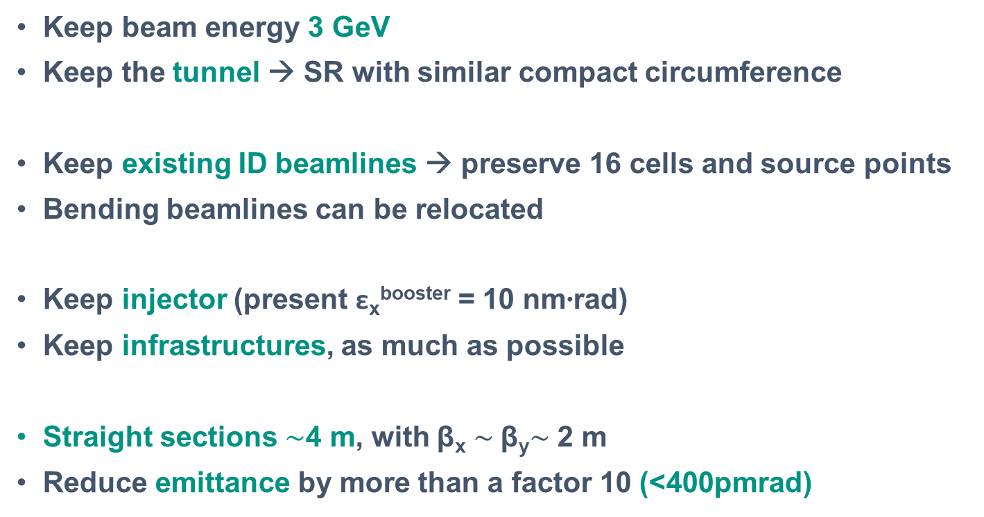
Optimization parameters
Keep beam energy 3 GeV
Keep the tunnel → SR with similar compact circumference
Keep existing ID beamlines → preserve 16 cells and source points
Bending beamlines can be relocated
Keep injector (present ε_{x}^{booster} = 10 nm∙rad)
Keep infrastructures, as much as possible
Straight sections $\sim$4 m, with β_{x} $\sim$β_{y}$\sim$ 2 m
Reduce emittance by more than a factor 10 (<400pmrad)

Slide 5
ALBA-II lattice
From 2x8 double-bend lattice
to 16 multi-bend lattice (6BA)

Slide 6
ALBA-II straight sections for IDs
308 mm
308 mm
But 3 will be used for
the Accelerator:
1 for Injection
2 for RF
308 mm

Slide 7
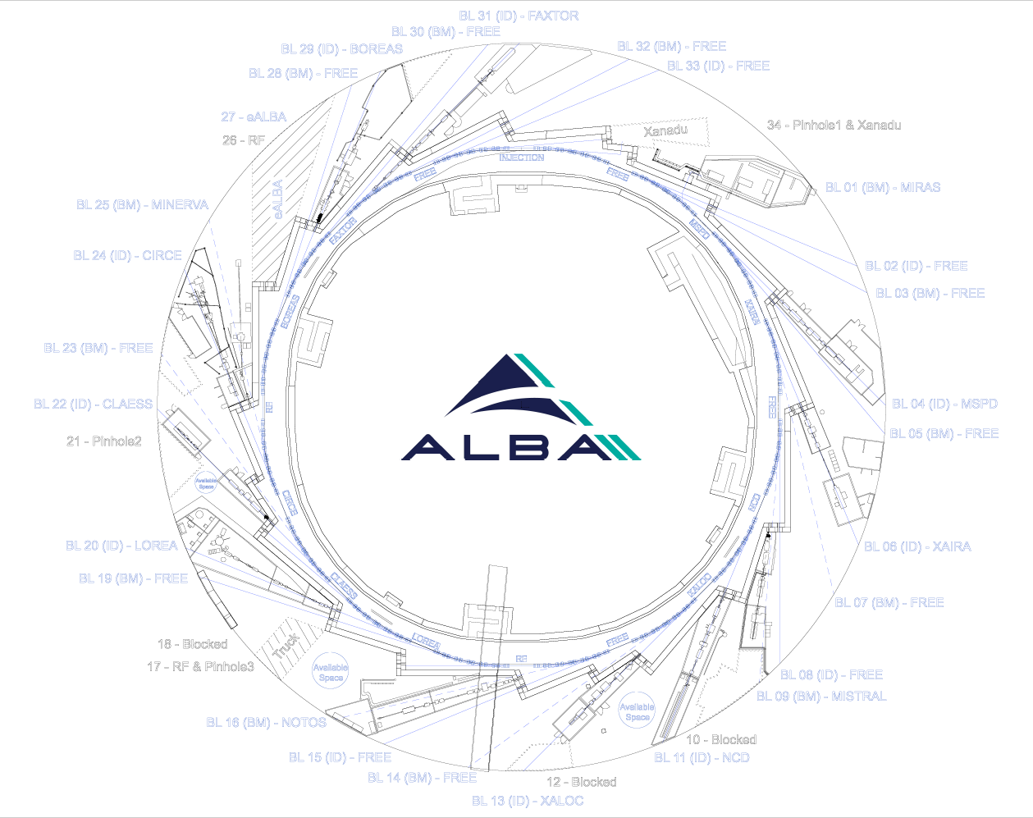
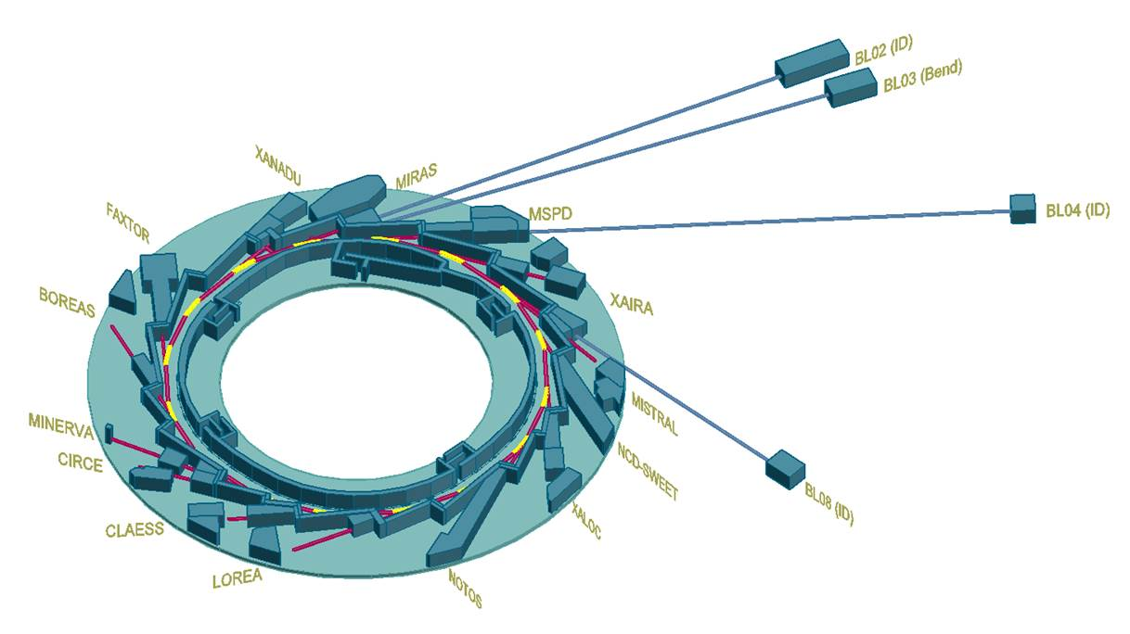
ALBA-II implementation
Possible long beamlines at
BL02-ID , BL03-Bend, BL04-ID, BL08-ID

Slide 8
ALBA-II Implementation
Magnets
  ∼ 600 magnets
  With power supplies
  Some, permanent magnets?
Vacuum chambers
  ∼ 270 m vacuum chambers
  SS, Cu, NEG coated
Girders
  High vibration modes
  High precision remote movement
Many others:
  Upgrade RF system with SSPA and 3rd Harmonic Cavity
  New Diagnostics equipment
  New Insertion Devices
  …

Slide 9
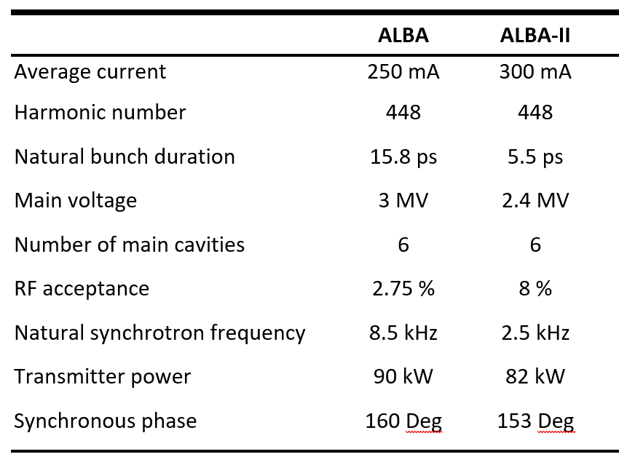
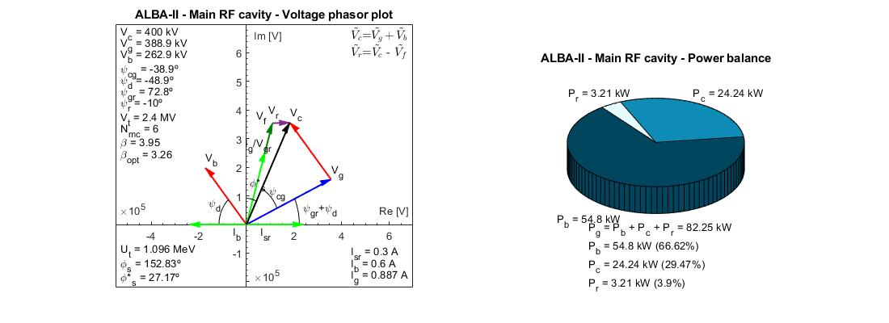
ALBA-II Main System
500 MHz EU HOM cavities.
IOT based transmitter replaced by SSPA.
Main RF parameters:

Slide 10
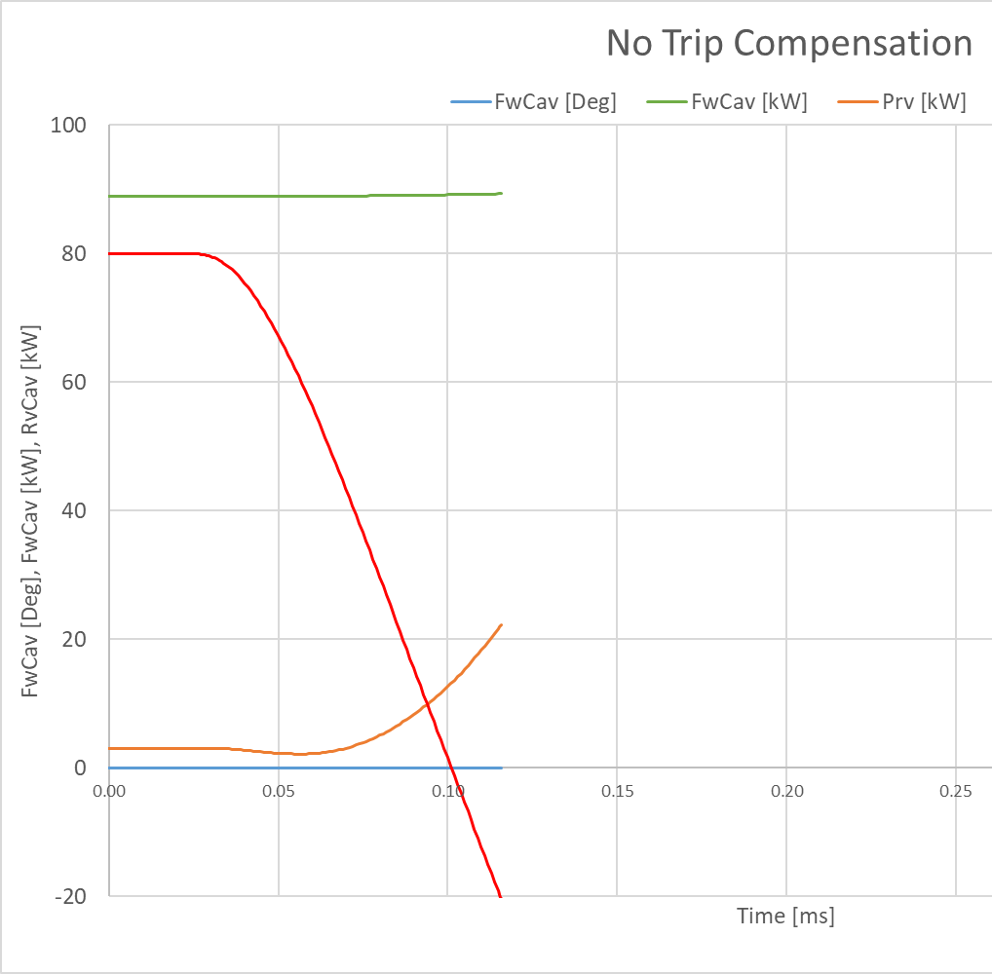
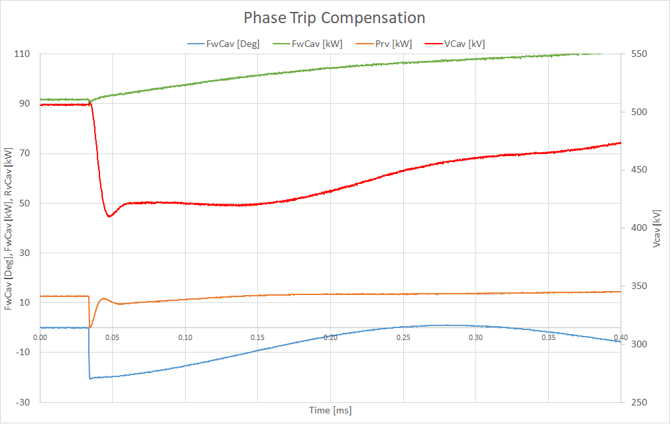
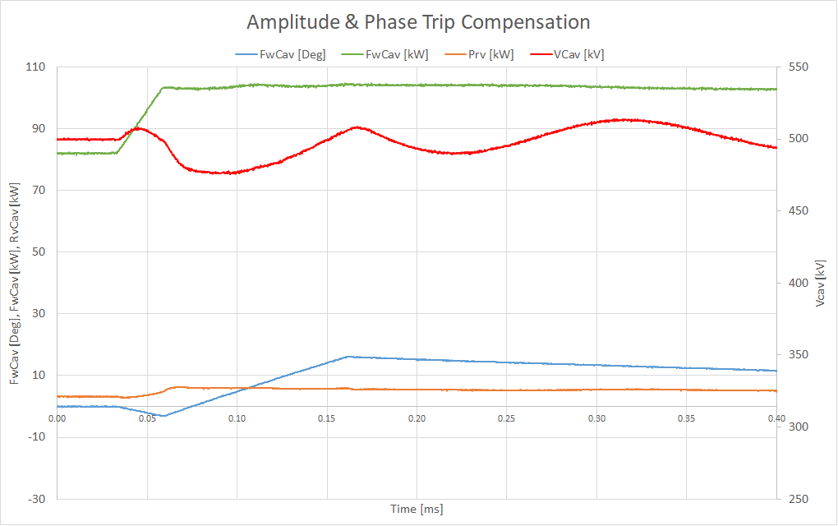
ALBA-II Main System
Novel Trip Compensation (TC)
  Amplitude and phase response allows to decrease main RF voltage and still survive a cavity trip.
  Secondary phase rotation to avoid oscillations.
No TC → Beam lost Phase TC → large voltage oscillations Phase & Amplitude TC → more stable voltage

Slide 11
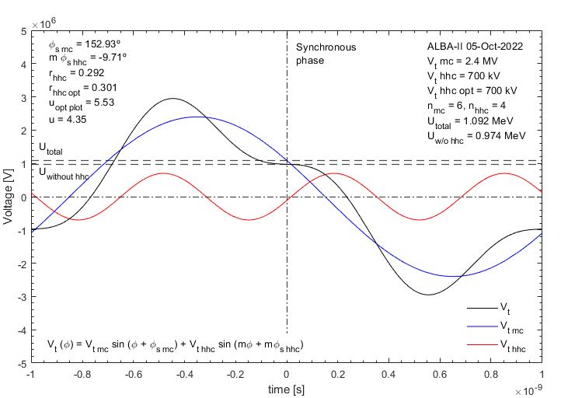
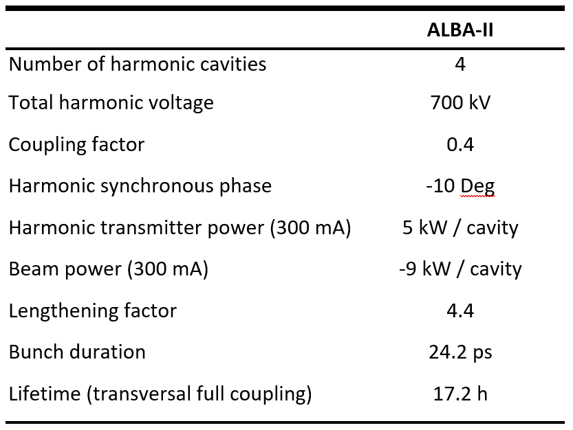
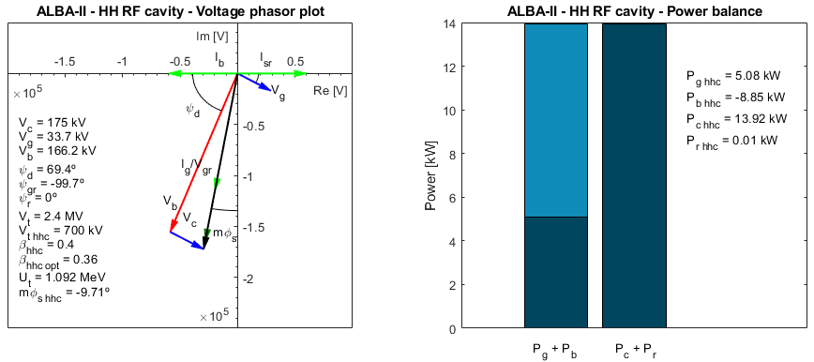
ALBA-II Harmonic System
A 3rd harmonic system is needed for lifetime improvement by means of bunch lengthening.

Slide 12
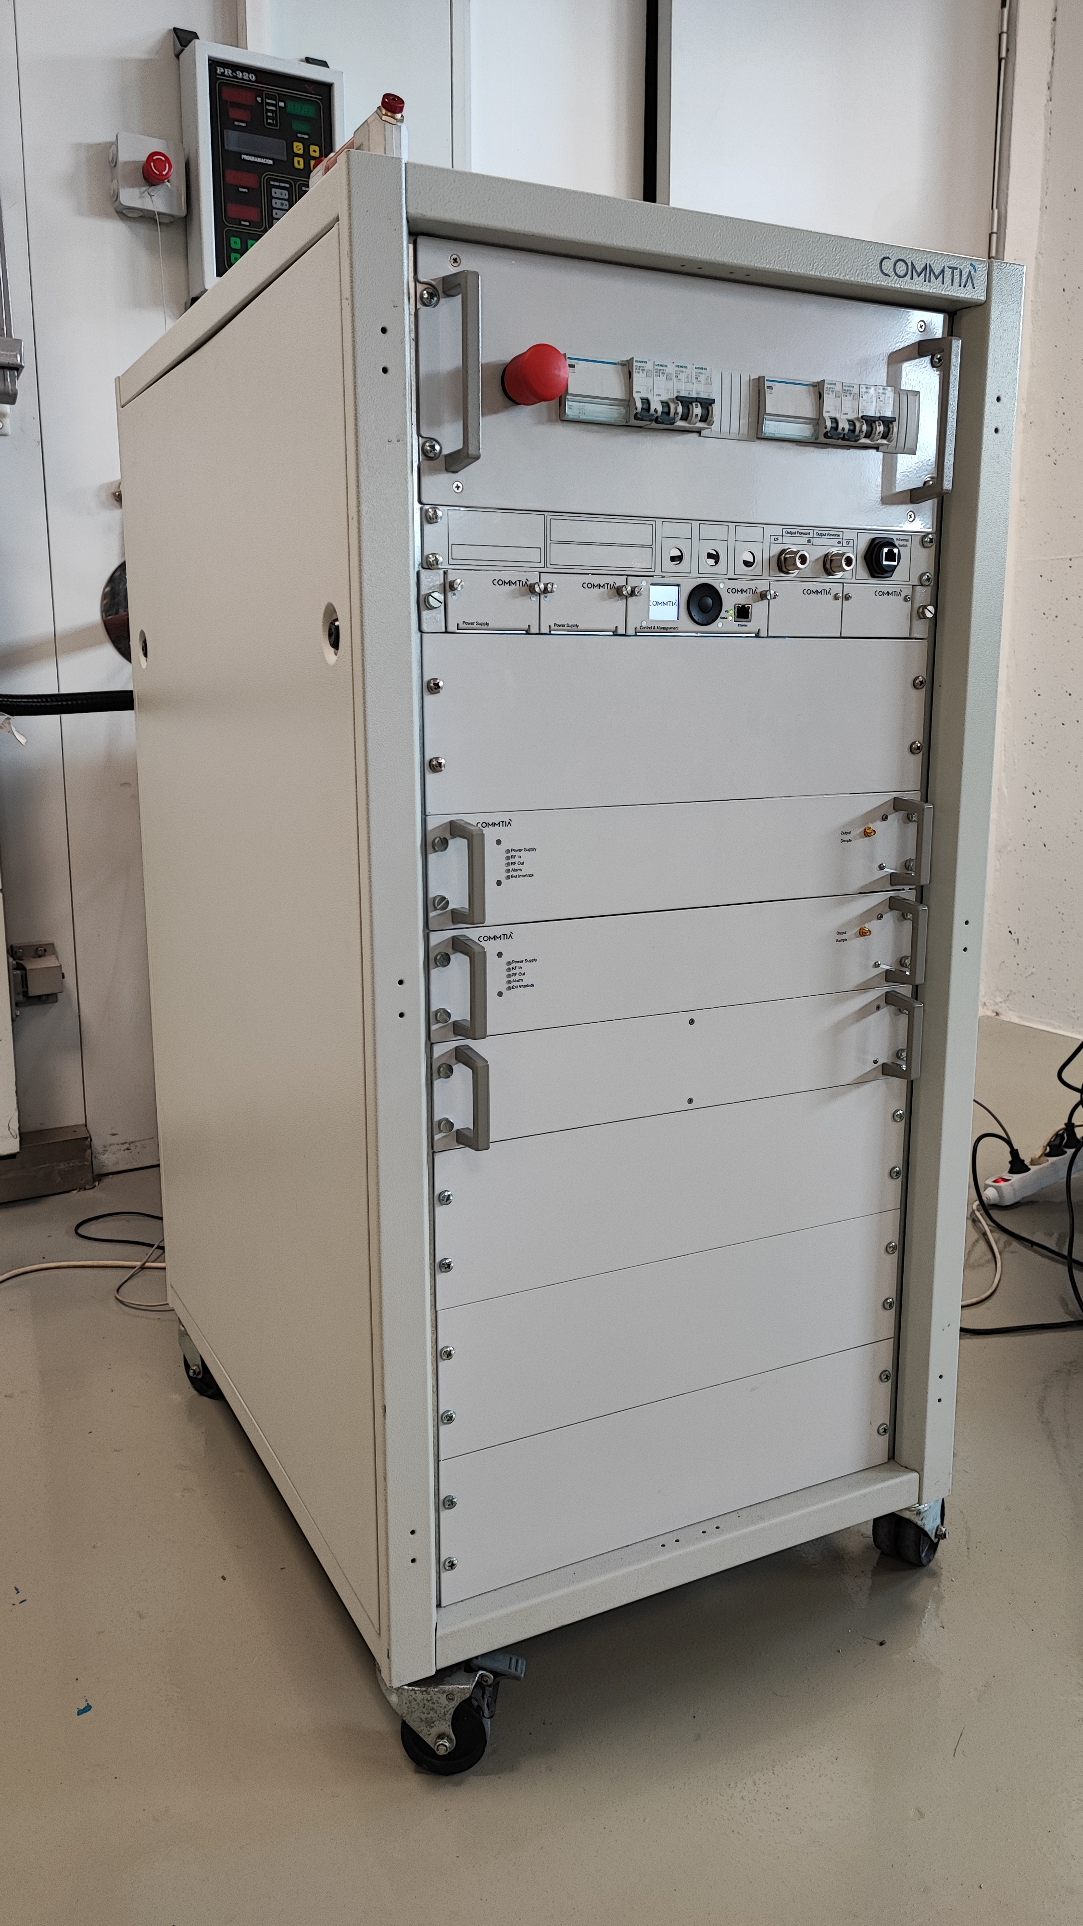
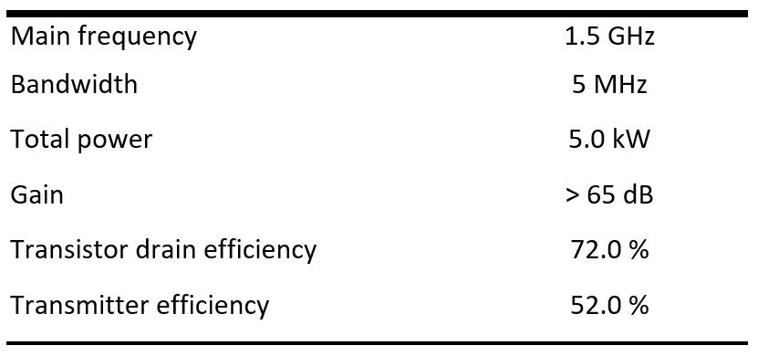
ALBA-II Harmonic System
1.5 GHz SSPA transmitter prototype.
  Manufactured by COMMTIA Systems S.A., Spain.
  Gallium Nitride transistor.
  Individual circulator for every transistor.
  FAT performed on 06/10 successfully.

Slide 13
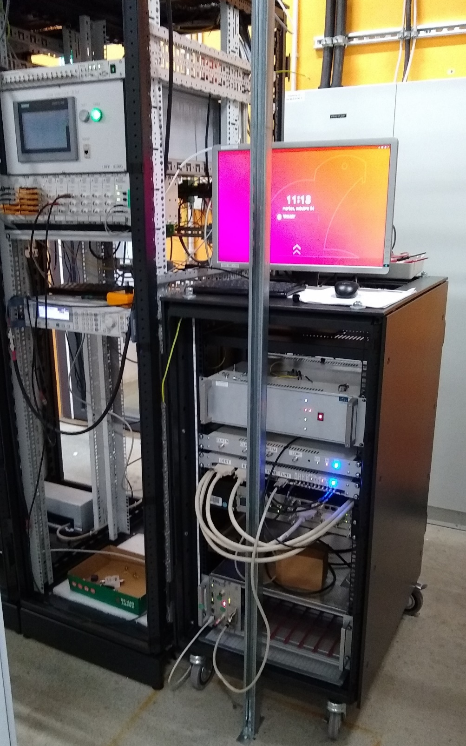
ALBA-II Harmonic System
1.5 GHz DLLRF prototype developed.
  Struck Innovative Systeme (SIS):
    uTCA.4
    SIS8300KU
    SIS8864
    DWC8VM1
  10 ADC, 2 DAC + direct output modulator, 64 GPIO, 125 MHz clock rate, …
  Complete rack with LO generation crate, Plunger motor controller, GPIO patch panel, PSU, …
  Call for Tender published on 09/22 for main and harmonic DLLRF.

Slide 14







ALBA-II Harmonic System
Harmonic EU Cavity according to ALBA Active Design.
  2015: ALBA team started the design of an active 1.5 GHz normal conducting cavity for CLIC Damping Ring and ALBA 3rd Harmonic.
  2018: ALBA, with EU funds, started the construction of a prototype.
  2020: Agreement between ALBA, HZB and DESY for testing the cavity.
The prototype design was co-funded by ALBA and the CERN through the collaboration agreement KE2715/BE/CLIC for the Development of CLIC Damping Ring Technologies (2015-2018).
The prototype construction was co-funded by ALBA and the European Regional Development Fund (ERDF) within the Framework of the Smart Growth Operative Programme 2014-2020.
The prototype tests were co-funded by ALBA, HZB and DESY through the collaboration agreement RCN-CIN202100124 (2020-2023).

Slide 15
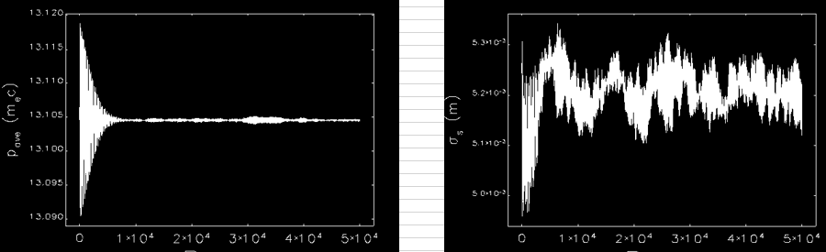
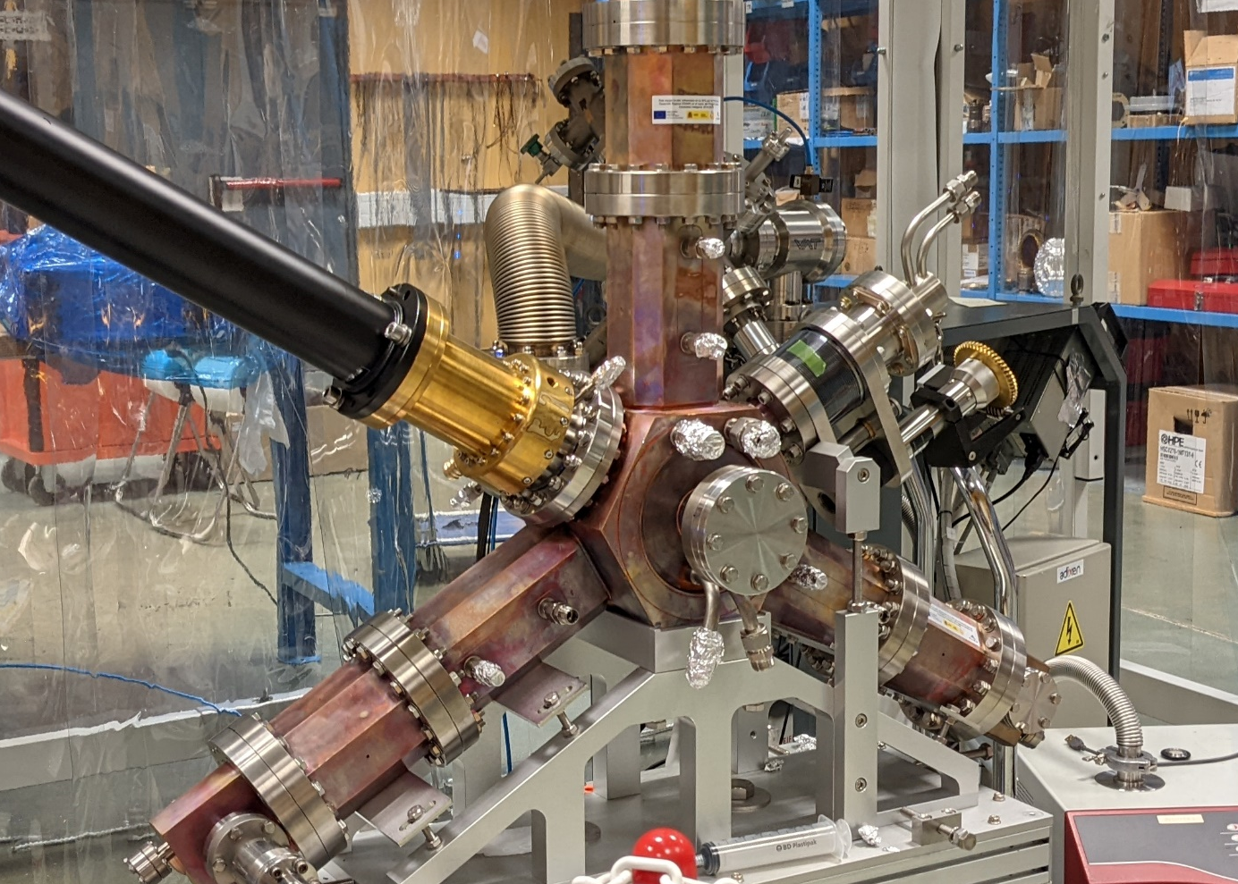
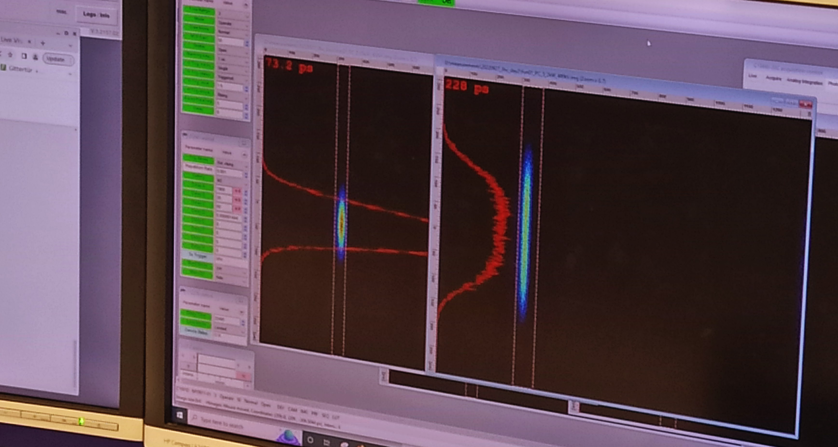
ALBA-II Harmonic System
Harmonic EU Cavity according to ALBA Active design.
  Jul 2021: Elegant simulation started for ALBA-II
    See I. Bellafont talk 11/10 3rd session.
  Dec 2021: SAT at ALBA facility.
    See J. Ocampo talk 12/10 1st session.
  Sep 2022: Tested at Bessy II with beam.
    See A. Matveenko talk 11/10 4th session.
HC Simulations for ALBA-II
ALBA 3HC design and construction
ALBA 3HC comissioning results

Slide 16
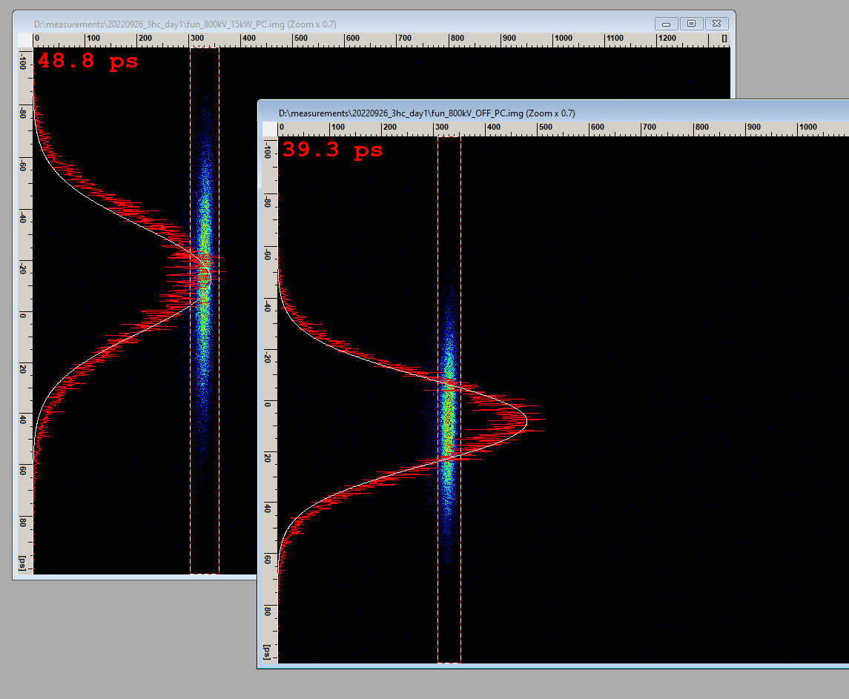
Thanks!
1st bunch lentghening
single bunch – 0.3mA
Harmonic EU Cavity
(ALBA active design)
Sept 26th, 2022

Slide 17
ALBA-II IDs ports
BM | BL |  | SuperBend | Comments
SR02_QD_3 ? | 1 | MIRAS
SR02_QD_1 | 3 | FREE | Ok
SR03_QD_1 | 5 | FREE |  | Limited space due to MSPD
SR04_QD_2 | 7 | FREE
SR05_QD_1 | 9 | MISTRAL
 | 10 | Blocked |  | NCD
 | 12 | Blocked |  | Xaloc
SR07_QD_2 | 14 | FREE
SR08_QD_2 | 16 | NOTOS | Ok (-2.5º) | Superbend requires to move BL 480mm
 | 18 | Blocked |  | Truck entrance
SR09_QD_4 | 19 | FREE | Ok
 | 21 | Blocked |  | CLAESS – Used for Pinhole2
SR11_QD_2 | 23 | FREE
SR12_QD_2 | 25 | MINERVA
 | 27 | Blocked |  | eALBA
SR13_QD_3 | 28 | FREE | Ok
SR14_QD_4 | 30 | FREE | Ok
SR15_QD_4 | 32 | FREE | Ok
 | 34 | Blocked |  | Pinhole1 + Xanadu
Straight | BL |  | Comments
SR01 | 2 | FREE
SR02 | 4 | MSPD | 68mm displacement
SR03 | 6 | XAIRA
SR04 | 8 | FREE | 308mm displacement / Large Beta
SR05 | 11 | NCD
SR06 | 13 | XALOC | 68mm displacement
SR07 | 15 | 3SBar
SR08 | 17 | RF | & Pinhole3
SR09 | 20 | LOREA
SR10 | 22 | CLAESS | 68mm displacement
SR11 | 24 | CIRCE
SR12 | 26 | RF
SR13 | 29 | BOREAS
SR14 | 31 | FAXTOR | 68mm displacement
SR15 | 33 | FREE
SR16 | 0 | INJECTION
Bending Ports
ID Ports
3x FREE
10x IN USE
3x ACCELERATOR
9x FREE
4x IN USE
6x BLOCKED

Slide 18
2022 - 2029

