Slide 1
PETRA-IV
Overview from the perspective of rf HarmonLip 2022
Rüdiger Onken – DESY - MHF
Lund, October 11th, 2022

Slide 2
Agenda
PETRA IV (overview)
The rf system
Optional 3rd harmonic-cavity design ideas

Slide 3
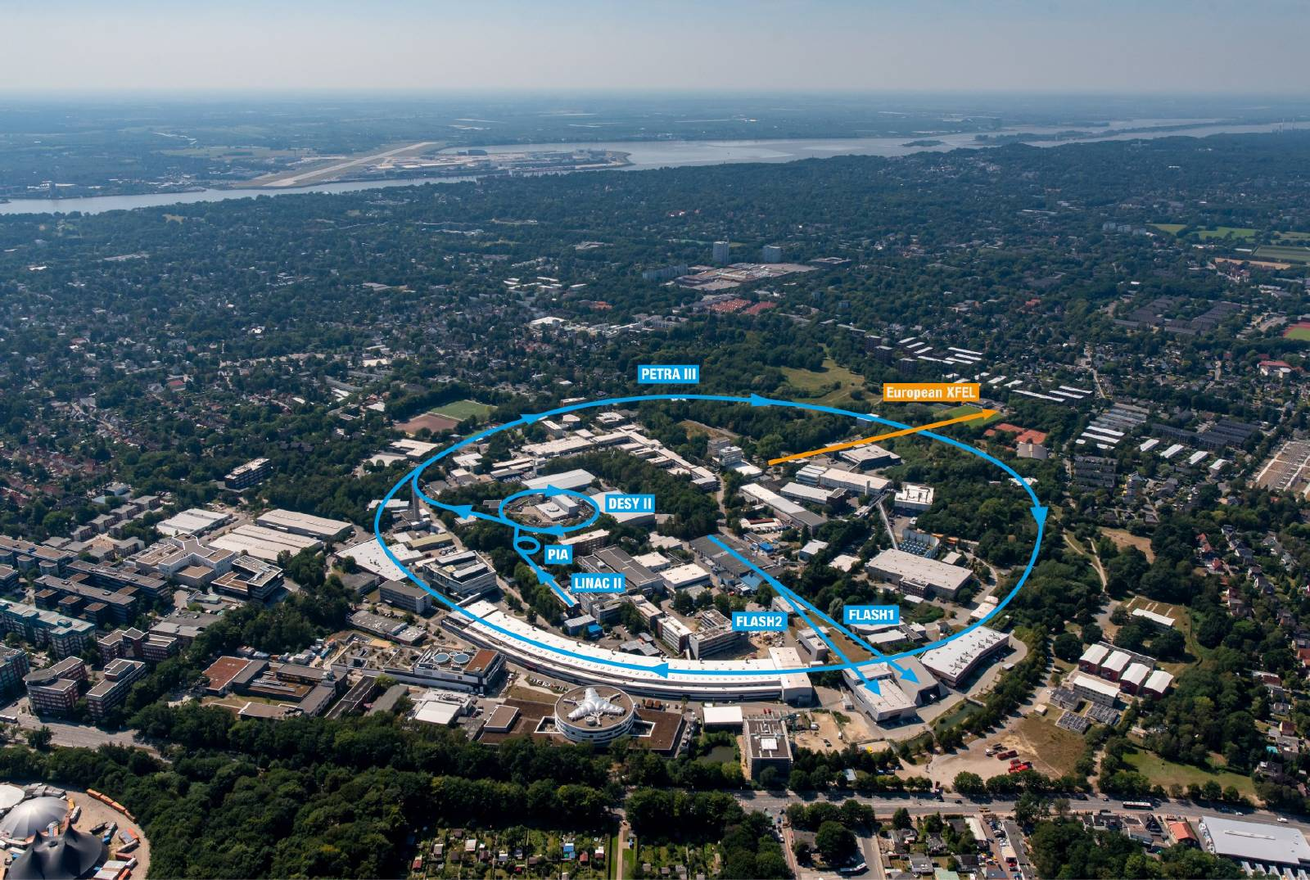
DESY site in Hamburg
History of PETRA (Positronen-Elektronen-Tandem Ring Anlage)
Ring accelerator for electrons and positrons, later also for protons
Length: 2304 meters
Commissioning: 1978
1978-1986: particle physics
1987-2007: pre-accelerator for HERA and source for X-rays
Since 2010: one of the brightest storage ring X-ray sources in the world
23 beamlines with almost 60 measuring stations

Slide 4
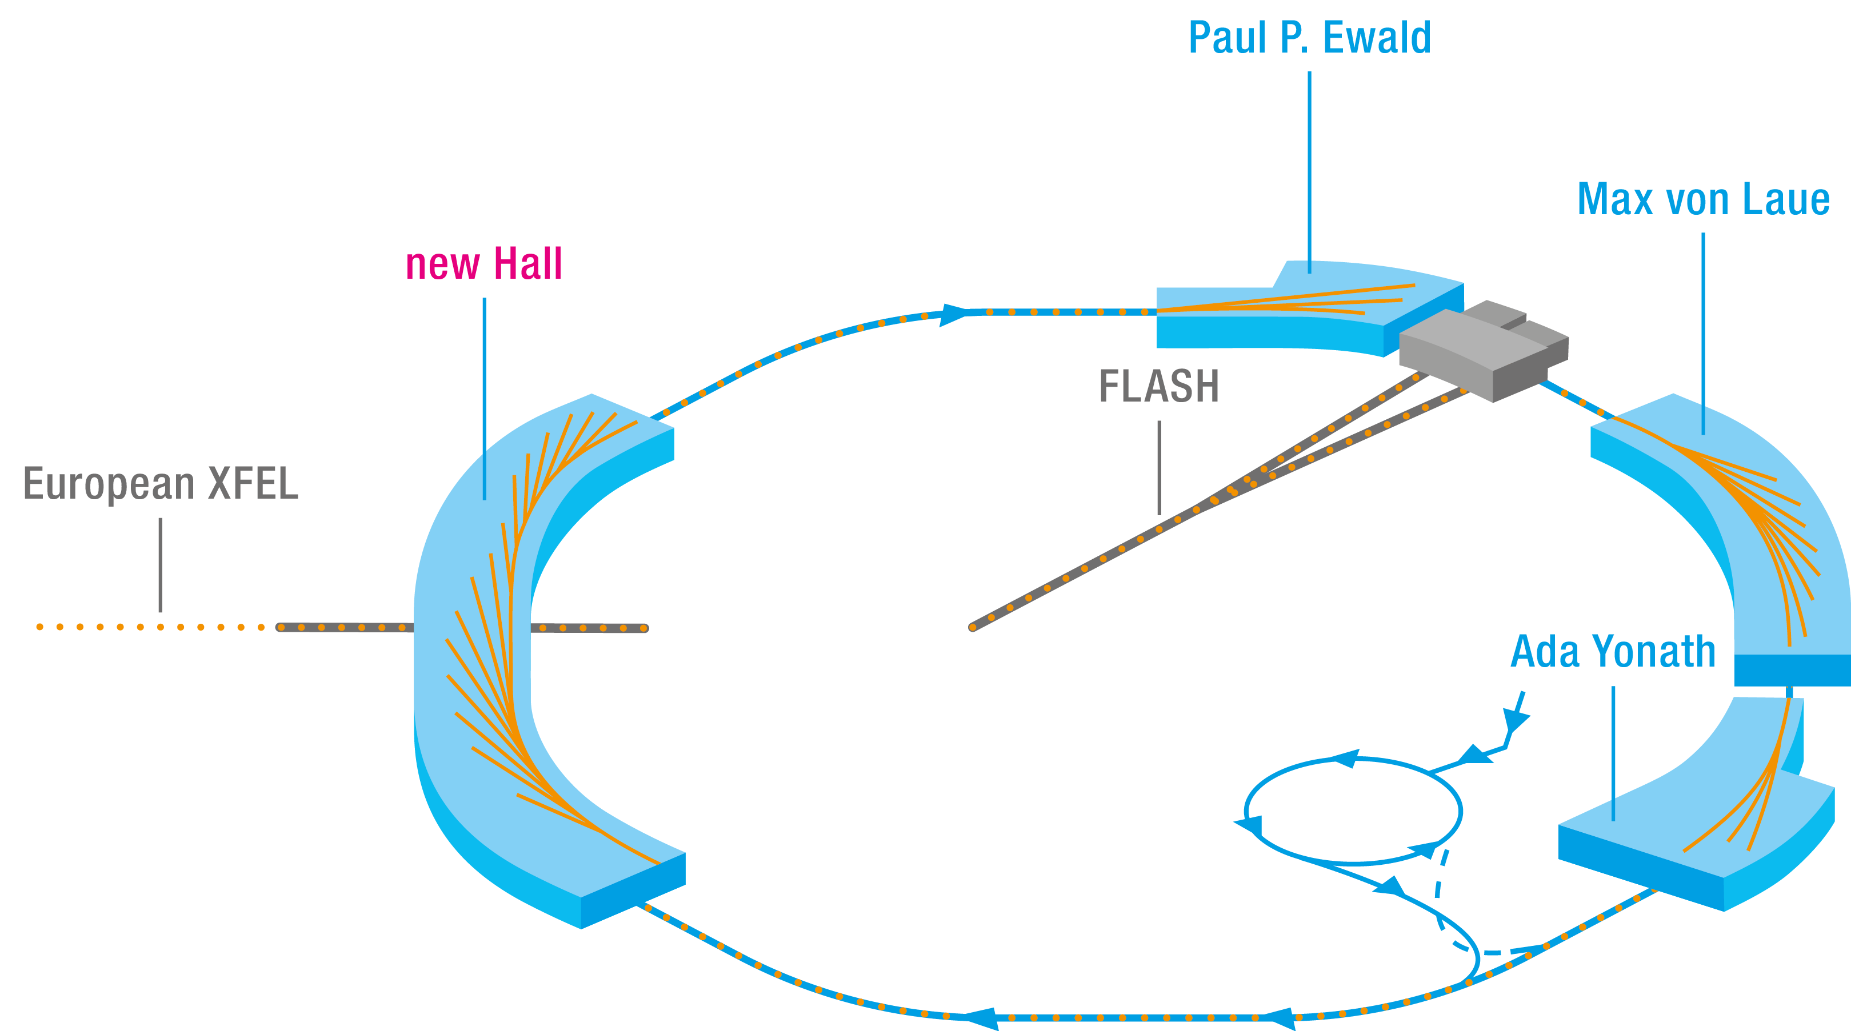
PETRA-IV overview
Parameter | Brightness mode | Timing mode
Beam energy | 6 GeV | 6 GeV
Bunch current | 0.125 mA | 1 mA
Beam current | 200 mA | 80 mA
No. bunches | 1600 | 80
H Emittance | < 20 pm | < 40 pm
V Emittance | 2-10 pm | 5-20 pm
Bunch length (rms) | < 40 ps | < 70 ps
Rel. energy spread | < 1.e-3 | < 1.4e-3
Lifetime (Touschek + Vacuum) | > 10 h | > 5 h
Energy loss: 4 MeV/turn
Revolution frequency: 130.121 kHz
1 mA bunch current ≙ 7.7 nC
Bunch length w/o 3rd harmonic system = 23 ps

Slide 5
PETRA-IV overview, beamlines
PXW Beamlines (new hall – Phase-II)
Phase-I Beamlines (existing Halls)
12 x BLs
+ 2 DBLs
16 x BLs
+ HIKA
Day 1
All fully new

Slide 6
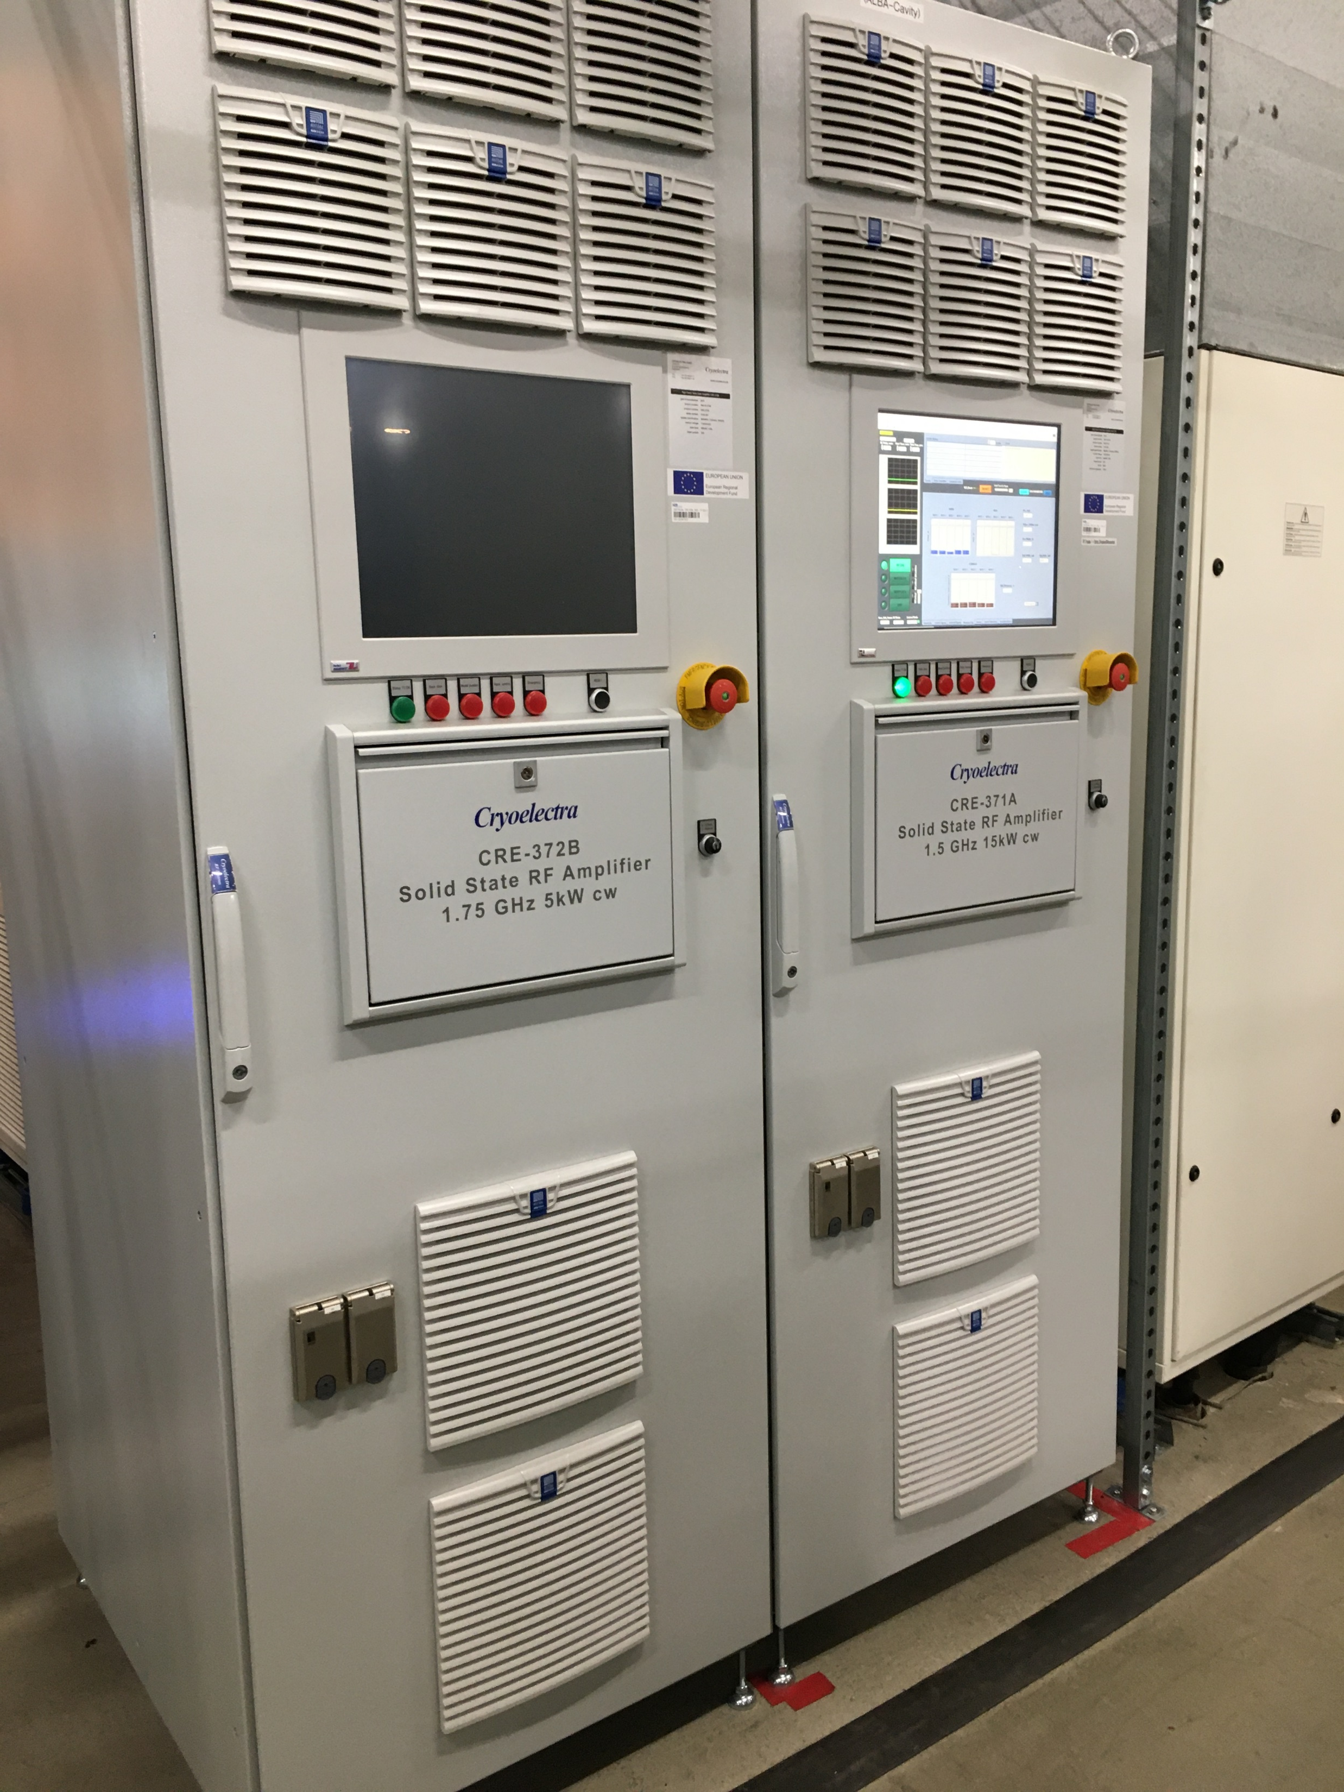
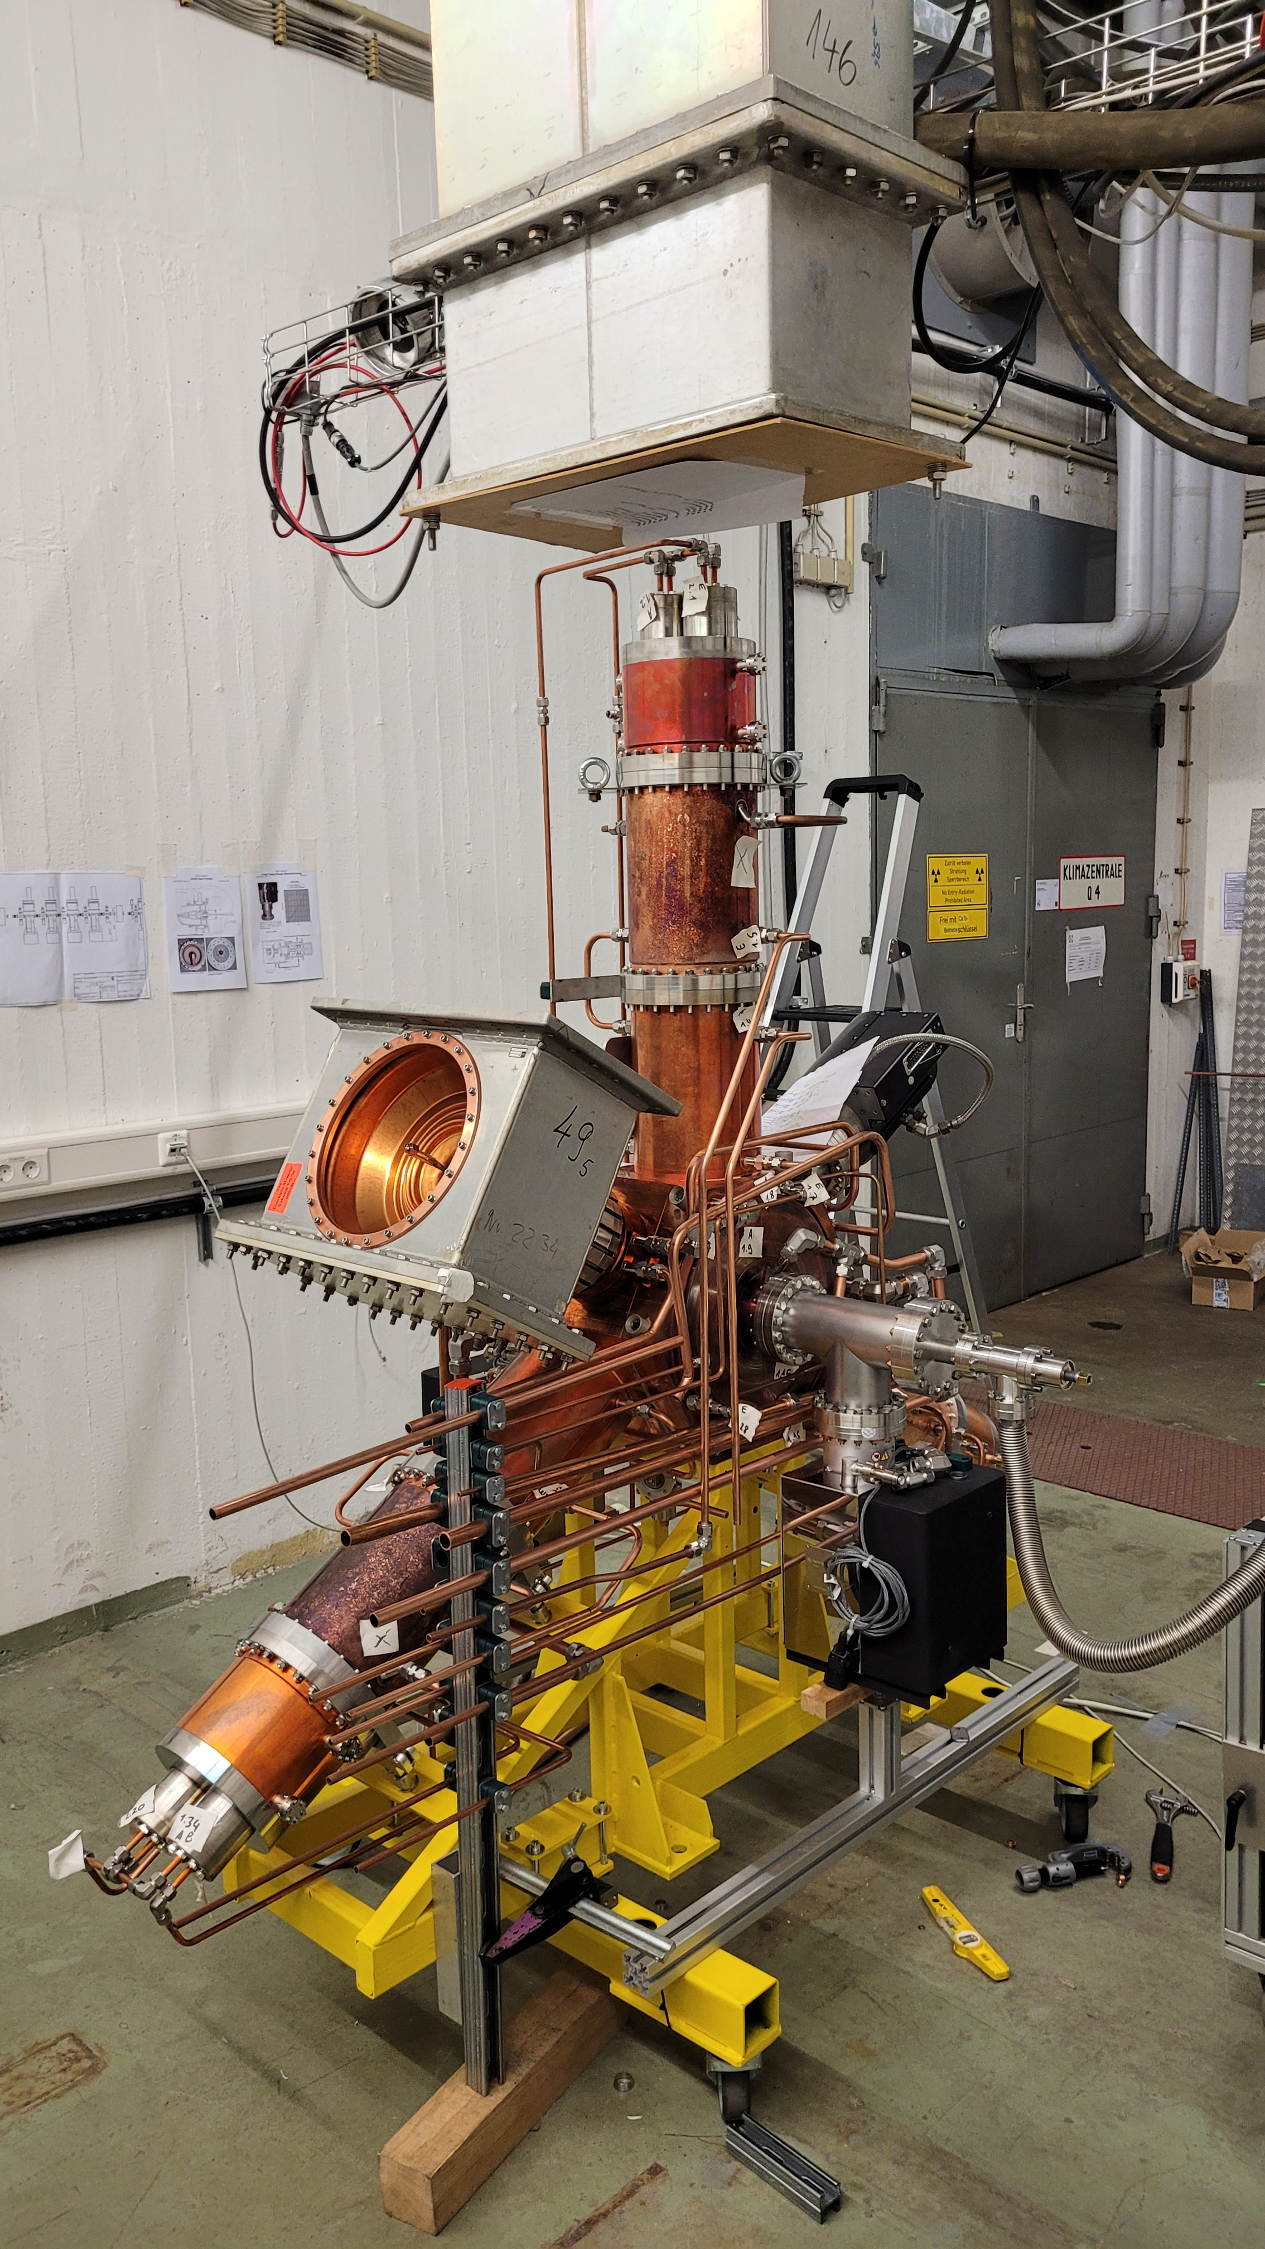
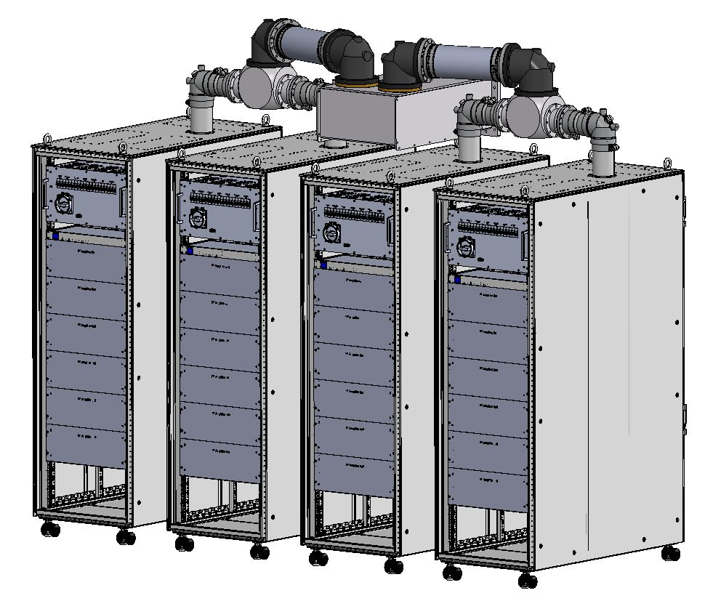
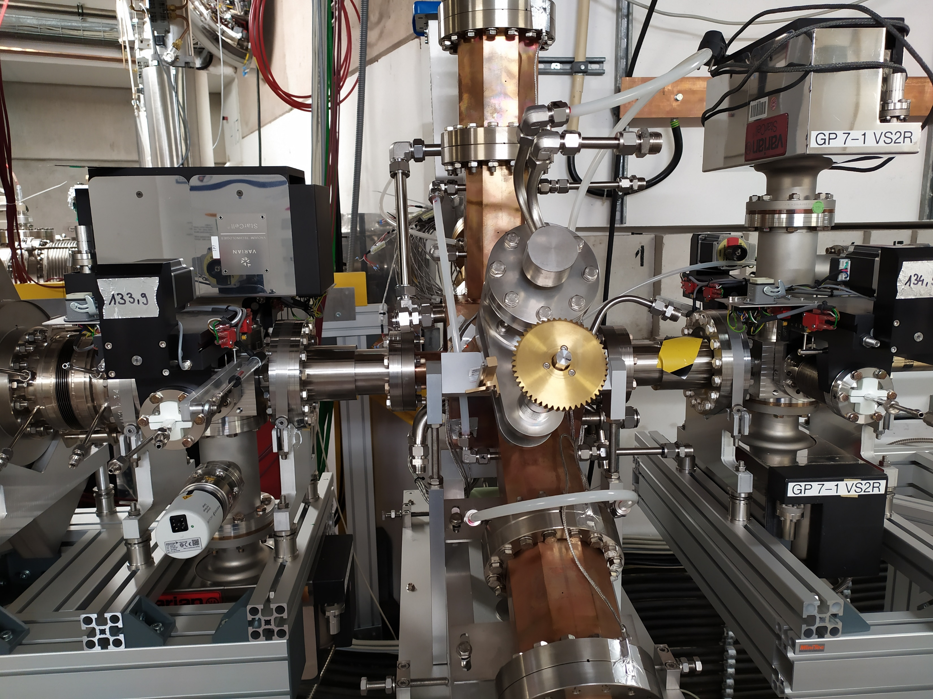
Components of the rf systems
Fundamental system, 500 MHz:
SSA: 120 kW
HOM-damped cavities: BESSY-type (Modified to re-use refurbished DESY IPC & Plunger)
3rd harmonic system, 1.5 GHz:
Active
SSA: 15 kW
Scaled (BESSY-type) HOM-damped Cavity

Slide 7
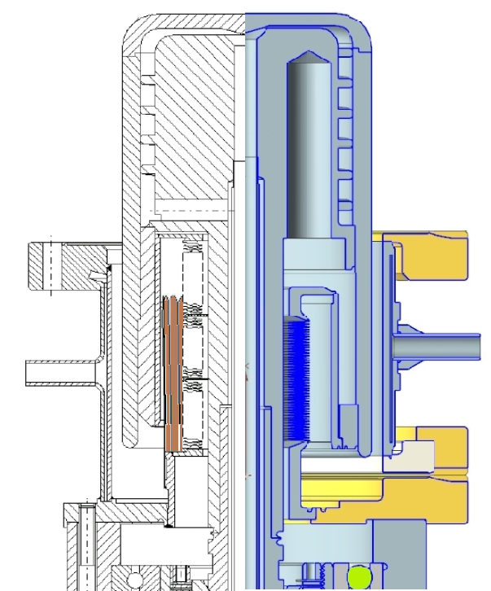
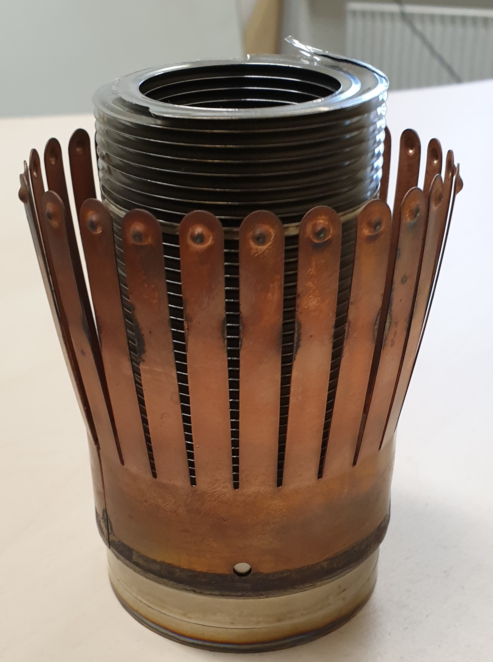
Components of the rf systems
Reusing some components
Refurbishing of plunger (without contact springs):
In house (DESY)
• Reusing main parts of existing plungers
• Design without the problem zone -"contact springs”
• Another flange for better inspection of the plunger bottom
➔ Will be tested in Prototype HOM-damped cavity @ PETRA-III
Reprocessing of the input-couplers:
Already in progress
Treatment of vacuum inner surfaces (copper surfaces and ceramics)
Conditioning @ Coupler test stand up to > 200 kW_{cw}

Slide 8
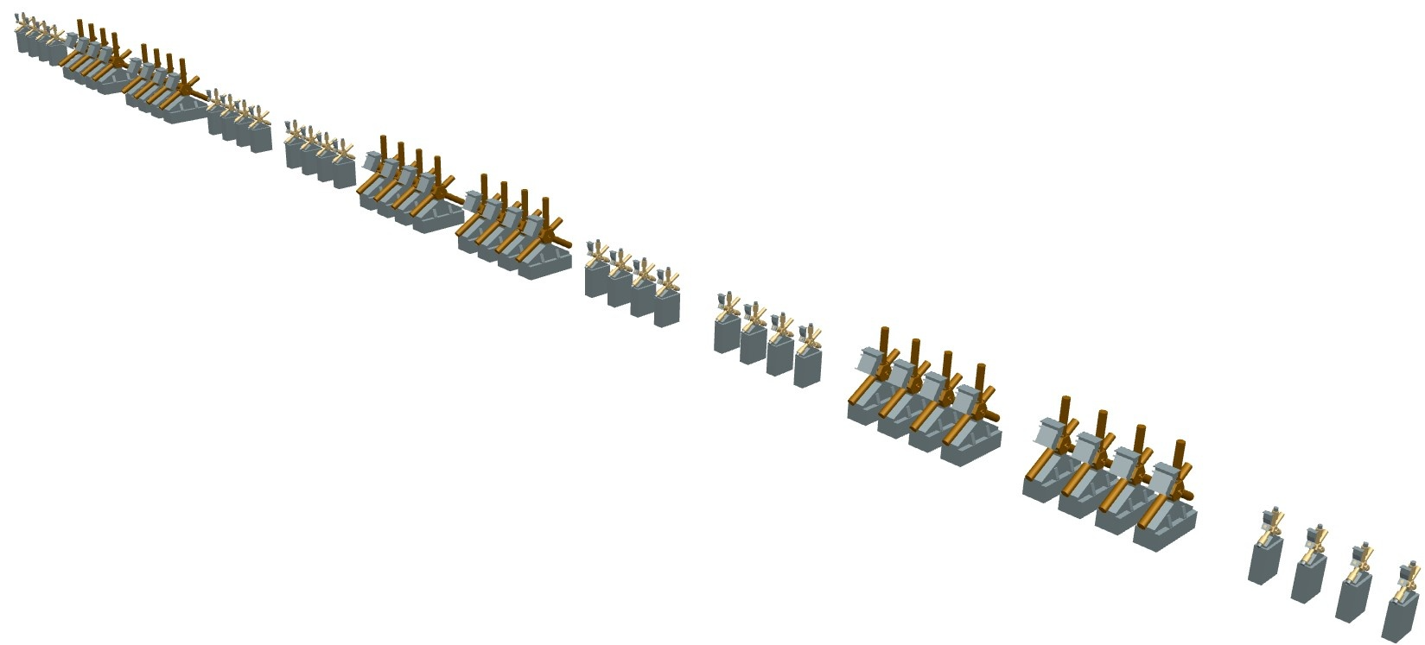
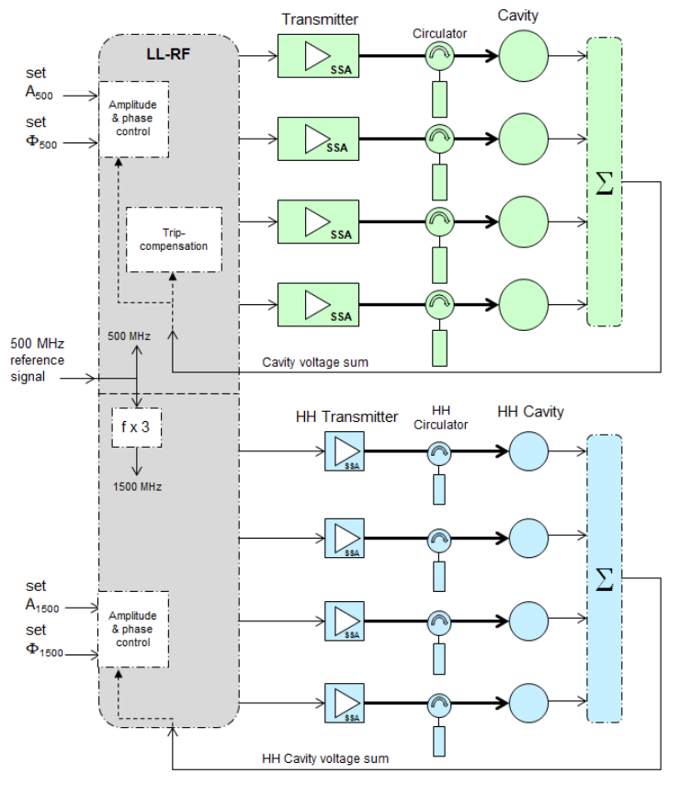
RF-System design
One of six RF-systems
Fundamental (500 MHz): Sum-voltage 8 MV
24 single-cell-cavity, HOM-damped (BESSY-type)
24 SSA, output power 120 kW cw
Harmonic (1.5 GHz): Sum-voltage 2.3 MV
24 single-cell-cavity, HOM-damped (scaled BESSY-type)
24 SSA, output power 10 kW
4 fundamental-subsystems and 4 harmonic-sub-systems grouped together as one rf-system. The PETRA IV rf has 6 rf-systems (4*500 MHz + 4*1.5 GHz)
Each of this systems has its own power- and water-supply. The timing and the controls are also separate (avoidance of single point of failure).
LLRF is realized in µTCA-technique, control of water and temperatures is done by PLC

Slide 9
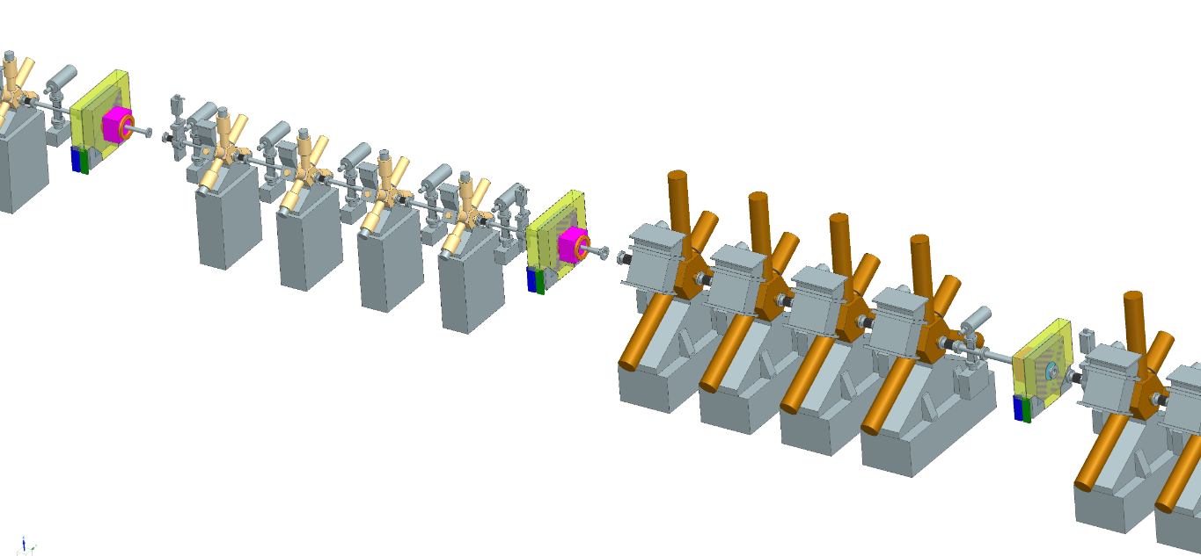
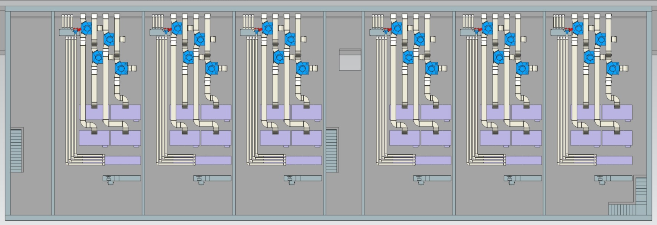
RF-System design
Preliminary construction/layout drawings
Rf-Building, located next to the tunnel

Slide 10
RF-System design
Grouping / clustering – 6 RF-systems
6 rf-systems in total
Detail, one rf-System = two Quartets of SSA & cavities
Best compromise:
Trip compensation with not too many components involved
Trip of one sub-system should not cause a beam loss
If one sub-system fails, the other components are not excessively stressed
Control and regulation for a quartet are manageable
Shutdown of one system (=4 sub-systems) should be possible

Slide 11
Redundancy & Trip-compensation
The rf should not have the “ERROR pole position”
Normal operating
∑ U_{c}: 8 MV ➔ 1.33 MV/system
One system is off
∑ U_{c}: 8 MV ➔ 1.6 MV/system
☒
Concept:
Smooth shut-down of one system should be possible
Slow response to slow failures (shutdown of the subsystem in case e.g. of overtemperature in the cavity)
Arcs or vacuum events
blank out rf
3 remaining sub-systems take over
need of phase and amplitude jump
Not foreseen to compensate a trip of one system
☒
☒
Sub-system : power: 56.4 kW
U_{c}: 333 kV
≙ 1.1 MV/m
Sub-system : power: 82.8 kW
U_{c}: 444 kV
≙ 1.5 MV/m
Sub-system : power: 71.9 kW
U_{c}: 400 kV
≙ 1.3 MV/m
Sub-system : power: 101.7 kW
U_{c}: 533 kV
≙ 1.8 MV/m
Critical:
Tuning of either fundamental and 3rd harmonic systems – to the beam and to each other
in normal operation
in error case
in transition between both cases

Slide 12
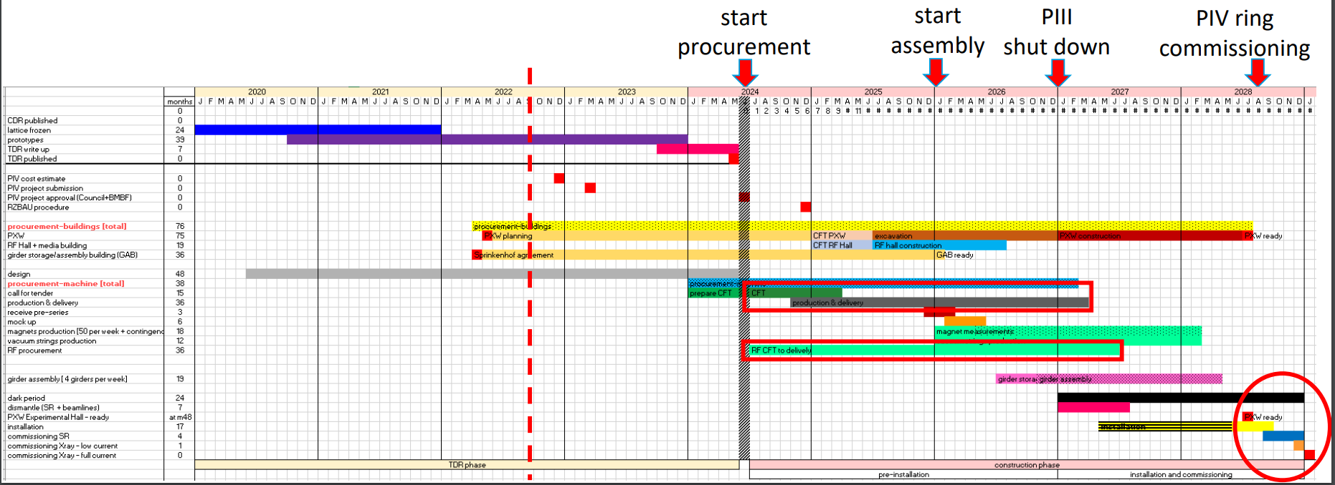
Time-line
Start procurement Jun. 2024
All rf-parts should be delivered within 3 Years
Planning & construction of rf-building Jan. 2025 – Jul. 2026
P-III Shutdown Jan. 2027
P-IV Commissioning Aug. 2028
Preliminary status, as of September 2022

Slide 13
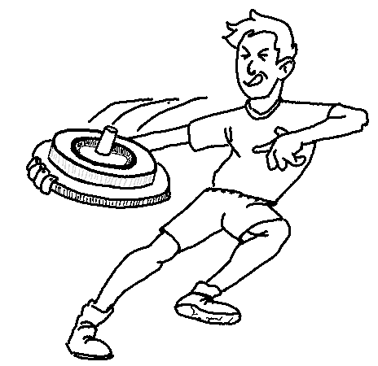
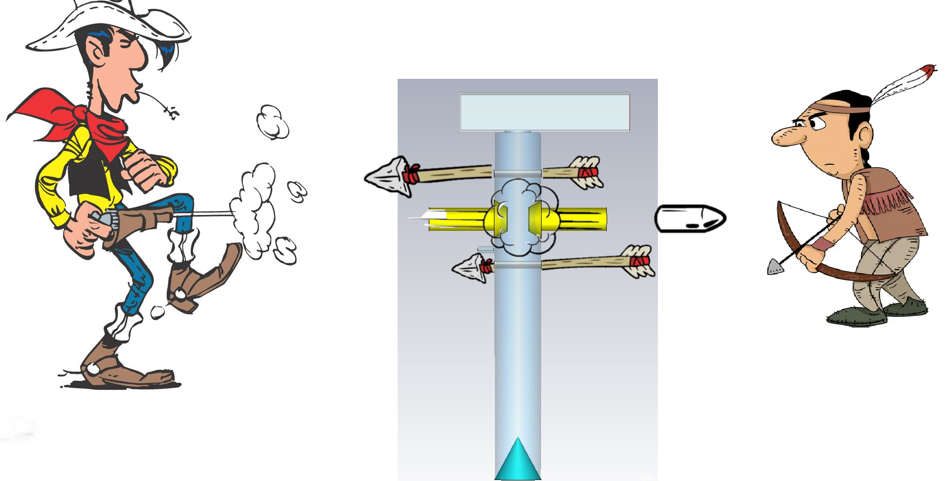
Optional 3rd harmonic-cavity design ideas
Motivation:
downscaled HOM-damped cavity is expensive
cooling circuits, input-coupler and plunger can not be scaled without problems
increased HOM damping properties would be welcome
Are there any alternatives out there, that are:
more simple?
less expensive?
more effective in HOM-damping than the downscaled HOM-damped cavity?
We found two promising candidates:
The „Choke Mode Cavity“ of T. Shintake *
The „Single Mode Structure“ of Herminghaus *
*see Peters talk

Slide 14
Thank you
Rüdiger Onken / Peter Hülsmann
WP 2.12 – RF-systems
ruediger.onken@desy.de / peter.huelsmann@desy.de
+49 40 8998 3453 / +49 40 8998 2782

