Slide 1
Diamond-II Project Review
C. Christou
HarmonLIP 2022
10-12 October 2022
MAX IV

Slide 2
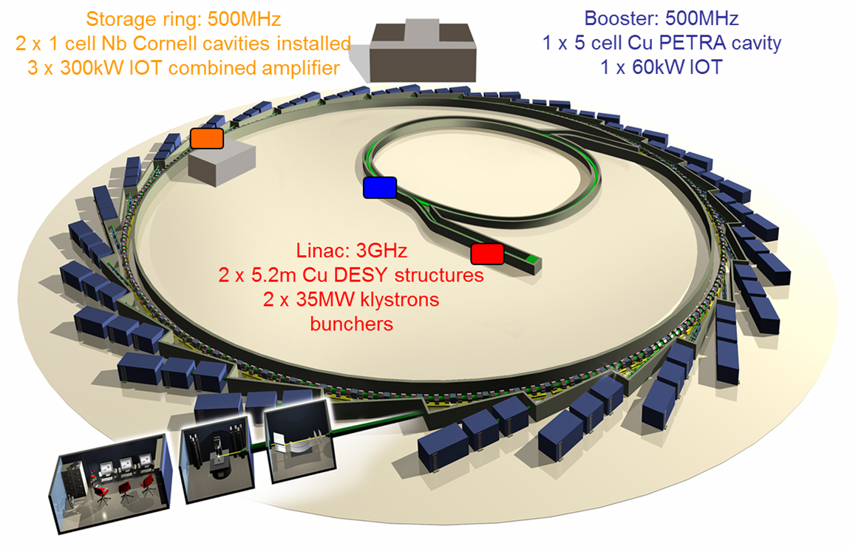
Diamond Light Source
  Diamond is a 3rd generation synchrotron light source
  User operation since 2007
  Top-up since late 2008
Superconducting storage ring RF
  Two CESR-B cavities
  IOT amplifiers, 300 kW per cavity
Major upgrade to Diamond-II
  Will be built in Diamond tunnels
  18 month dark period
    through 2027 and into 2028
Parameter | Value
Circumference | 561.6 m
Energy | 3 GeV
Storage ring current | 300 mA
Lattice | 24 cell DBA
Straights | 6 x 8.3m, 18 x 5.3 m
RF frequency | 500 MHz

Slide 3
Diamond-II upgrade
  Diamond-II improves quality of photon beams delivered to users
  Increase spectral brightness and transverse coherence
  Reduced source size, line-width
  Optimise spectral range
Achieved via reduction in natural emittance, increase in beam energy, new IDs
6 bend achromat design generates 24 mid straights
  6 x 7.5 m long straights
  18 x 5.2 m standard straights
  24 x 2.9 m mid straights

Slide 4
Energy increase to 3.5 GeV
  Significant gain in spectral brightness
  Gain over Diamond at 3 GeV (green) and 3.5 GeV (red)
  Beamline photon energy is indicated

Slide 5

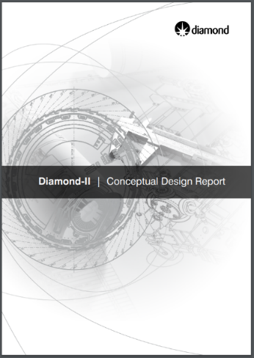
Machine parameters
  Parameters of significance to RF
  Small change in RF frequency
  Very little change to total voltage
  Increase in energy loss per turn
  Harmonic cavity needed for bunch lengthening
  Conceptual Design Report (May 2019)
  https://www.diamond.ac.uk/dam/jcr:ec67b7e1-fb91-4a65-b1ce-f646490b564d/Diamond-II%20Conceptual%20Design%20Report.pdf
Technical Design Report coming shortly

Slide 6
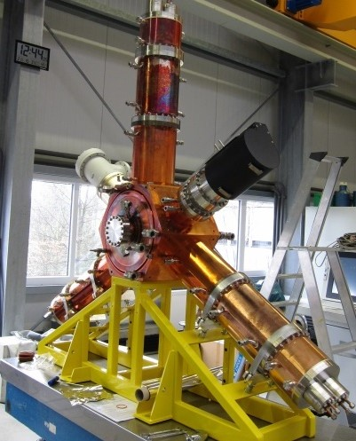
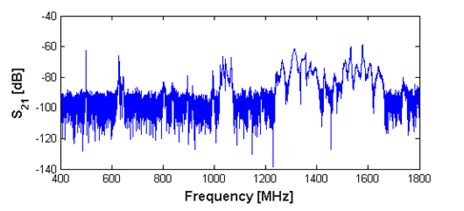
Cavity type
 | Superconducting | Normal conducting
Wall power losses | Minimal | Significant
Infrastructure | Complex | Simple
Field gradient | Higher | Lower
Fault tolerance | Vulnerable | Robust
Footprint | Large | Small
Maintenance | Complex | Simple
Higher order modes | Weak | Managed
Taper | Long | Short
EU HOM-damped cavity
  Latest iteration of cavity installed at BESSY, Alba and ESRF (scaled)
    Flanged joint at base of HOM damper removed to address trapped mode
    Pickup coated at ESRF
  Three cavities have recently been installed in Diamond
    Two fully operational and one to be powered from November 2022
Cavity | Coupling | Q₀ | R_{s}
N16 | 5.17 | 33,000 | 3.75 MΩ
N18 | 5.25 | 33,000 | 3.75 MΩ
N15 | 5.0 | 32,000 | Expected 3.75 MΩ

Slide 7
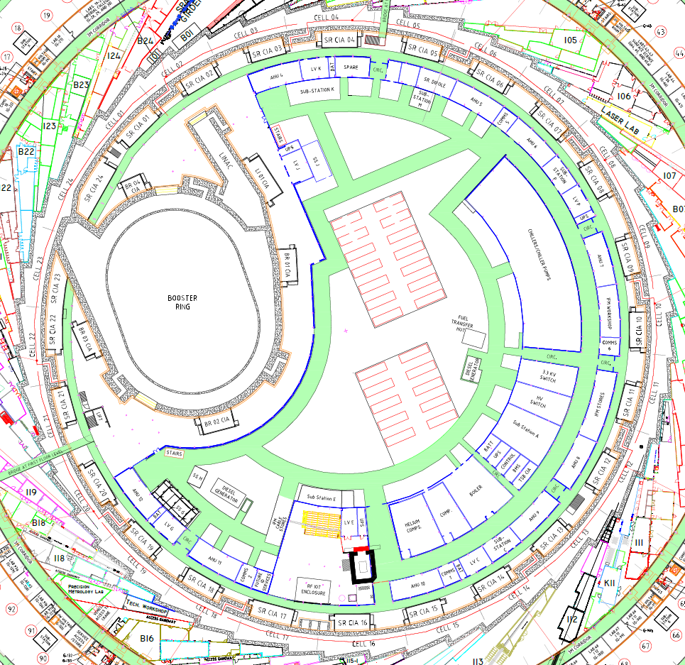
Cavity layout
A new beamline will be installed in what is now the Diamond RF straight
Cavities must move to mid-section straights
  Fundamental cavity cryostat cannot fit in shorter straight and provide clearance for front ends
  Cavity dampers must be rotated to clear front end
  Space must be provided for amplifiers
  Easier to fit multiple smaller amplifiers than smaller number of large amplifiers
  Harmonic cavity is subject to the same constraints

Slide 8
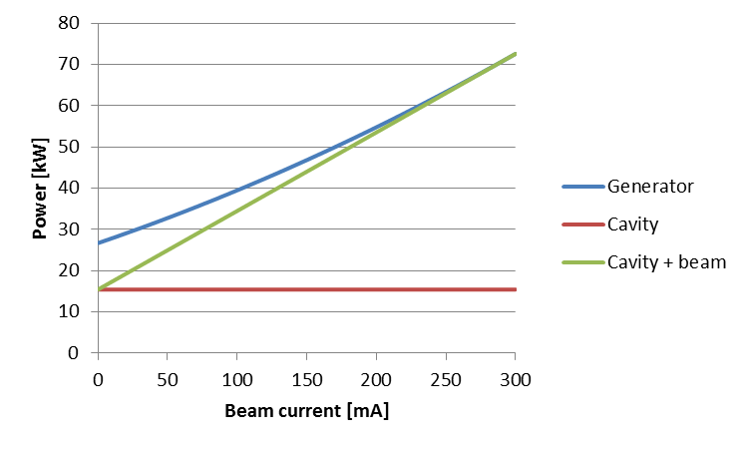
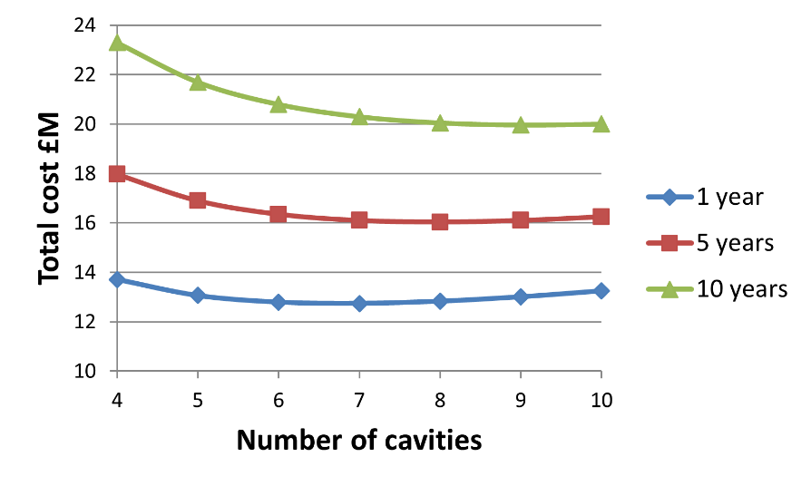
Cavity operating parameters
Number of cavities | 6 | 7 | 8 | 9
Optimal cavity coupling | 3.8 | 4.3 | 4.7 | 5.2
Individual cavity voltage | 450 kV | 386 kV | 338 kV | 300 kV
Generator power per cavity | 104 kW | 85 kW | 73 kW | 63 kW
Power dissipated per cavity | 27 kW | 20 kW | 15 kW | 12 kW
Power dissipated in all cavities | 164 kW | 140 kW | 123 kW | 109 kW
460kW required for 300mA beam with all IDs
Operation with 8 normal conducting cavities
  Reduces voltage per cavity to conservative level
  Minimises running costs
  Gives acceptable total wall power losses
  Allows redundant operation should one cavity fail
  Enables cavities to fit in storage ring

Slide 9
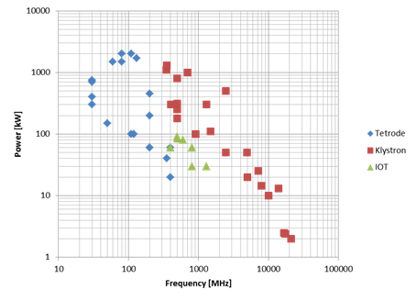
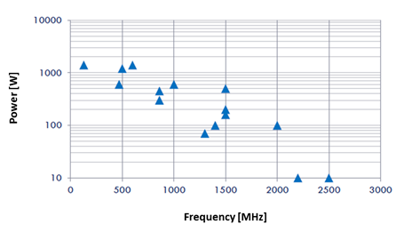
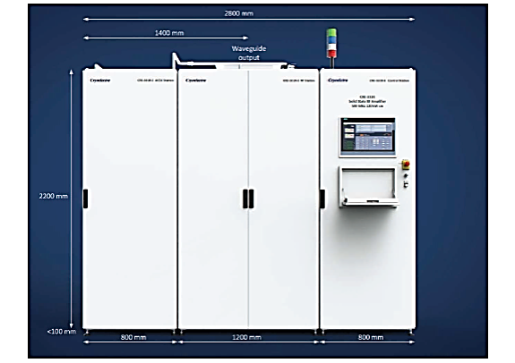
Amplifier design
Vacuum tubes
  Proven IOTs or klystrons at 500 MHz
  Tens of kV in HVPS
  Limited redundancy
  Obsolescence may become an issue
Solid state amplifiers
  LDMOS power transistors up to 1kW
  Typically use 50V supplies
  Easier to work with and less noise on beam
  Extreme redundancy for fault tolerance
Well over half of all Diamond faults are IOT related
  There is no redundancy in Diamond IOT amplifiers
  Amplifier must shut down to protect any IOT
  Separate power supplies would be beneficial
  Solid state amplifiers would provide necessary redundancy
All light sources using solid state amplifiers report superior amplifier MTBF
Several possible industrial suppliers exist
E. Montesinos, LLRF2017

Slide 10
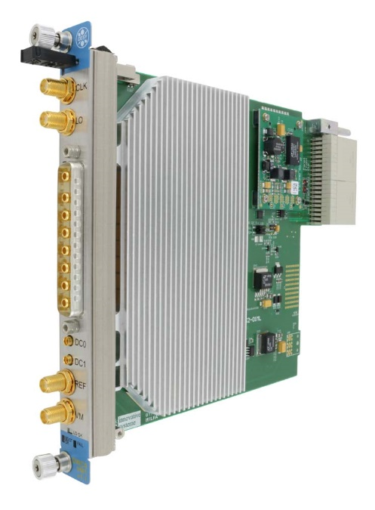
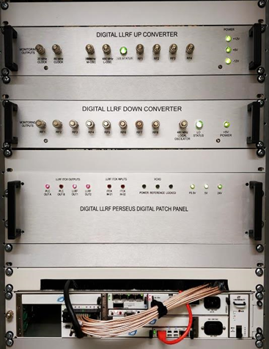
Low level RF
Digital LLRF offers flexibility and adaptability
Using Alba DLLRF in Diamond
IQ or polar PI loops of the cavity field for amplitude and phase.
Cavity tuning
Fast interlock handling.
Automatic start-up and conditioning
Monitoring of RF signals
Recording of main digital processing signals for post-mortem analysis
Features
Based on the MicroTCA standard
Perseus 601X advanced mezzanine card with Virtex6 FPGA
16 Channel 14-bit ADCs and 8 channel 16-bit DACs
Developing upgrade for Diamond-II
MicroTCA 4 downconverter/vector modulator RTM
  Manufactured by Struck under licence from DESY
  8 channel downconverter
  1 channel vector modulator
  350 MHz - 500 MHz (DWC8VM1LF)
  500 MHz - 3500 MHz (DWC8VM1)

Slide 11
Higher Harmonic Cavity
 | Passive NC | Active NC | Passive SC
Advantages | Simple Proven design Simple LLRF to detune cavity | Allows operation at optimal voltage and phase for any beam current LLRF feedback/feedforward possible | Operates to low current Less sensitive to filling pattern Less sensitive to Robinson instability Proven design available High shunt impedance for single cavity operation Large bore for effective HOM damping Simple LLRF to detune cavity
Disadvantages | Gap in fill pattern induces strong modulation Operation well into the Robinson unstable slope Low shunt impedance results in multiple cavity requirement Complex HOM damping required | RF amplifier required Gap in fill pattern induces strong modulation Operation well into the Robinson unstable slope Still in development Low shunt impedance, multiple cavities Complex HOM damping Complex LLRF | Cryogenic system required
Higher harmonic cavity is needed to
  Minimise heating
  Alleviate collective instabilities
  Maximise beam lifetime
Proven elsewhere
Passive superconducting third harmonic cavity
  CEA/SLS/Elettra design available from industry
  Using cryogenic plant for Diamond
  Detune is almost constant for all conditions allowing wide range of operating currents
  Robinson destabilisation is small and can be damped by fundamental cavity detune

Slide 12
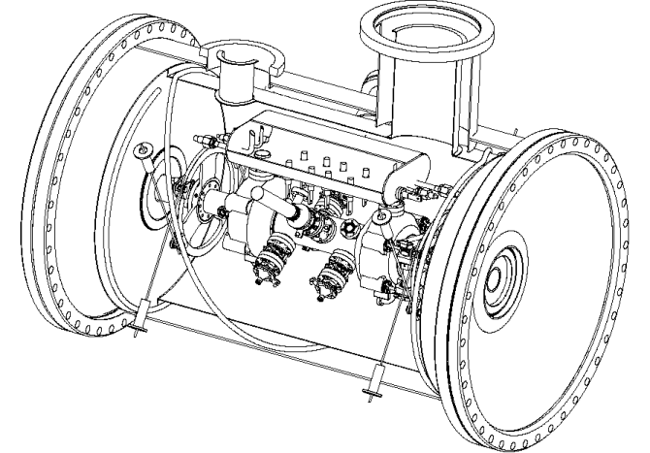
Higher Harmonic Cavity manufacturing
Diamond-II will use a proven design of passive superconducting third harmonic cavity
  Two designs identified: CEA/SLS/ELETTRA “Super3HC” and SSRF third harmonic cavity
  Super3HC module can be manufactured under licence
    Two European manufacturers identified
  SSRF module has been more recently constructed
    Lower start-up cost and preparation effort
Transverse clearance is a problem
  Is a smaller cryostat possible?
CEA/SLS/ELETTRA “Super3HC” cryomodule
SSRF cavity

Slide 13
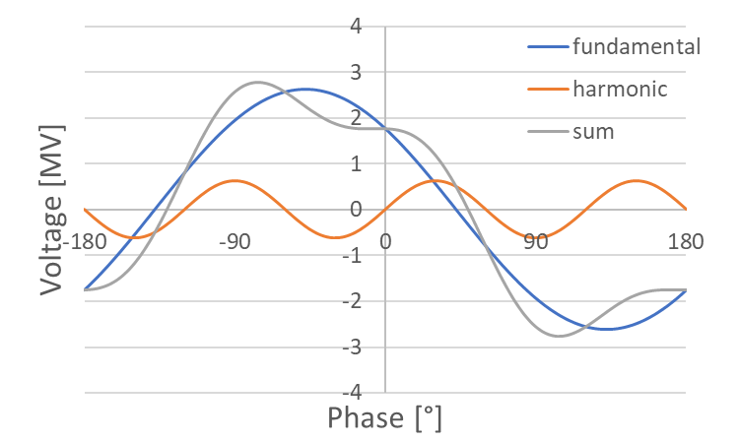
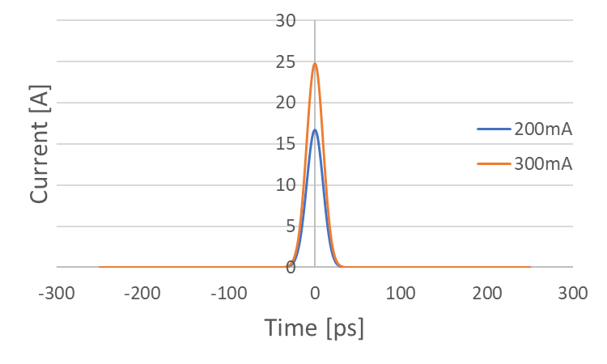
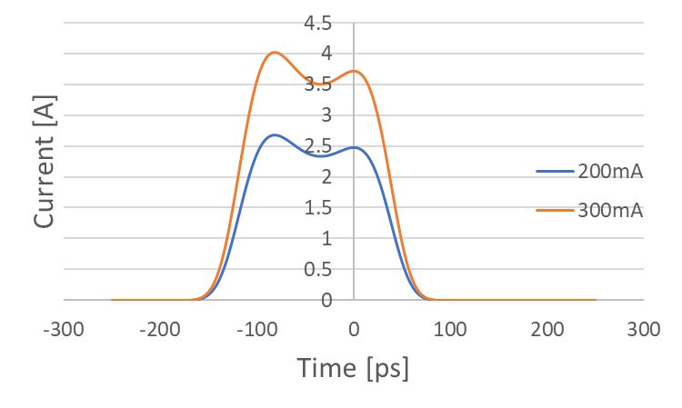
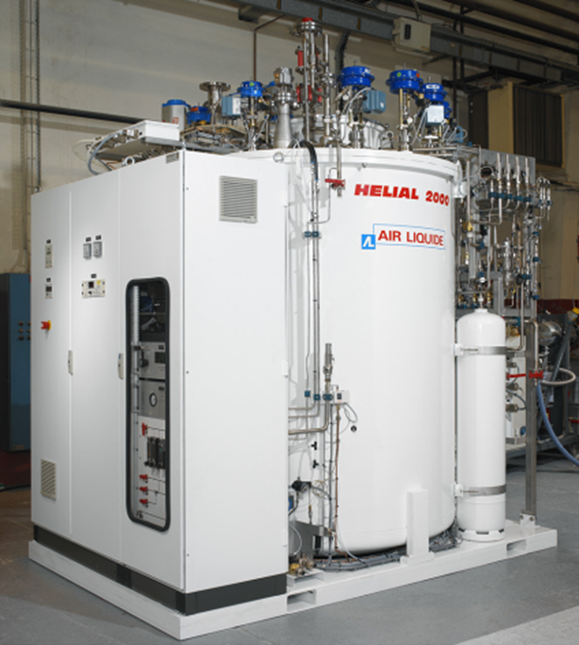
Higher Harmonic Cavity operation
HHC fully detuned
HHC: 57kHz@300mA 38kHz@200mA
Cavity must generate approximately 600 kV
1.1 m CEA third harmonic cavity can fit longitudinally in mid straight
  Locate near present liquid helium plant in RF hall
Diamond cryogenic plant
  Air Liquide Helial 2000
  Closed loop refrigerator
  Design performance of 488W
  Measured performance of 500W plus 20 litres/hr
    PSI 3HC requires 50W and 5 litres/hr
    Manufacturer confirms low power operation
    Can use excess capacity for He recovery

Slide 14
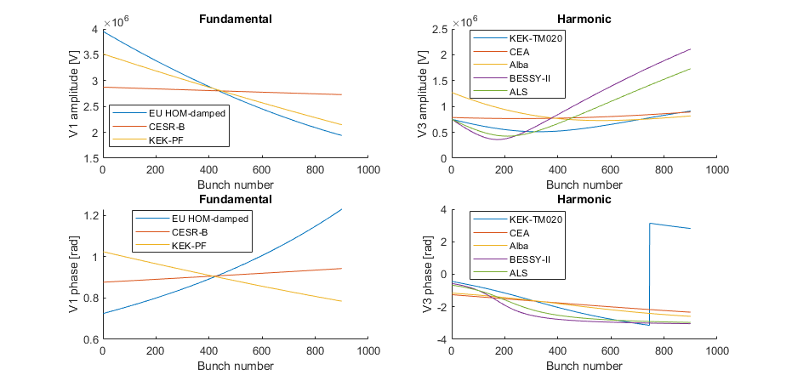
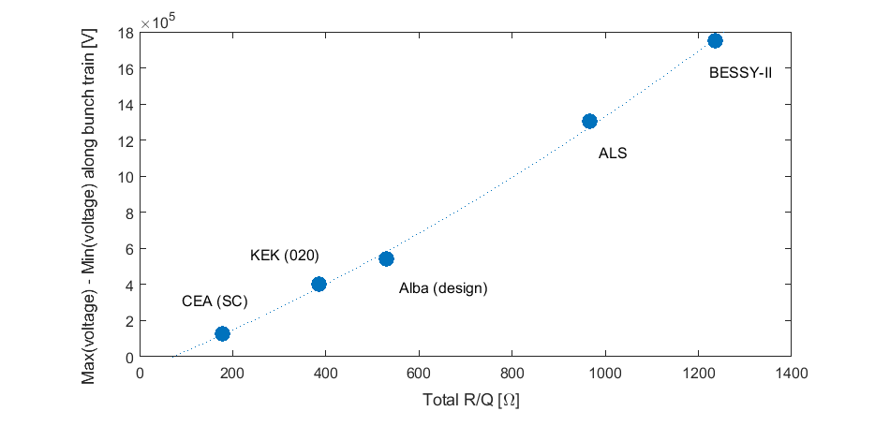
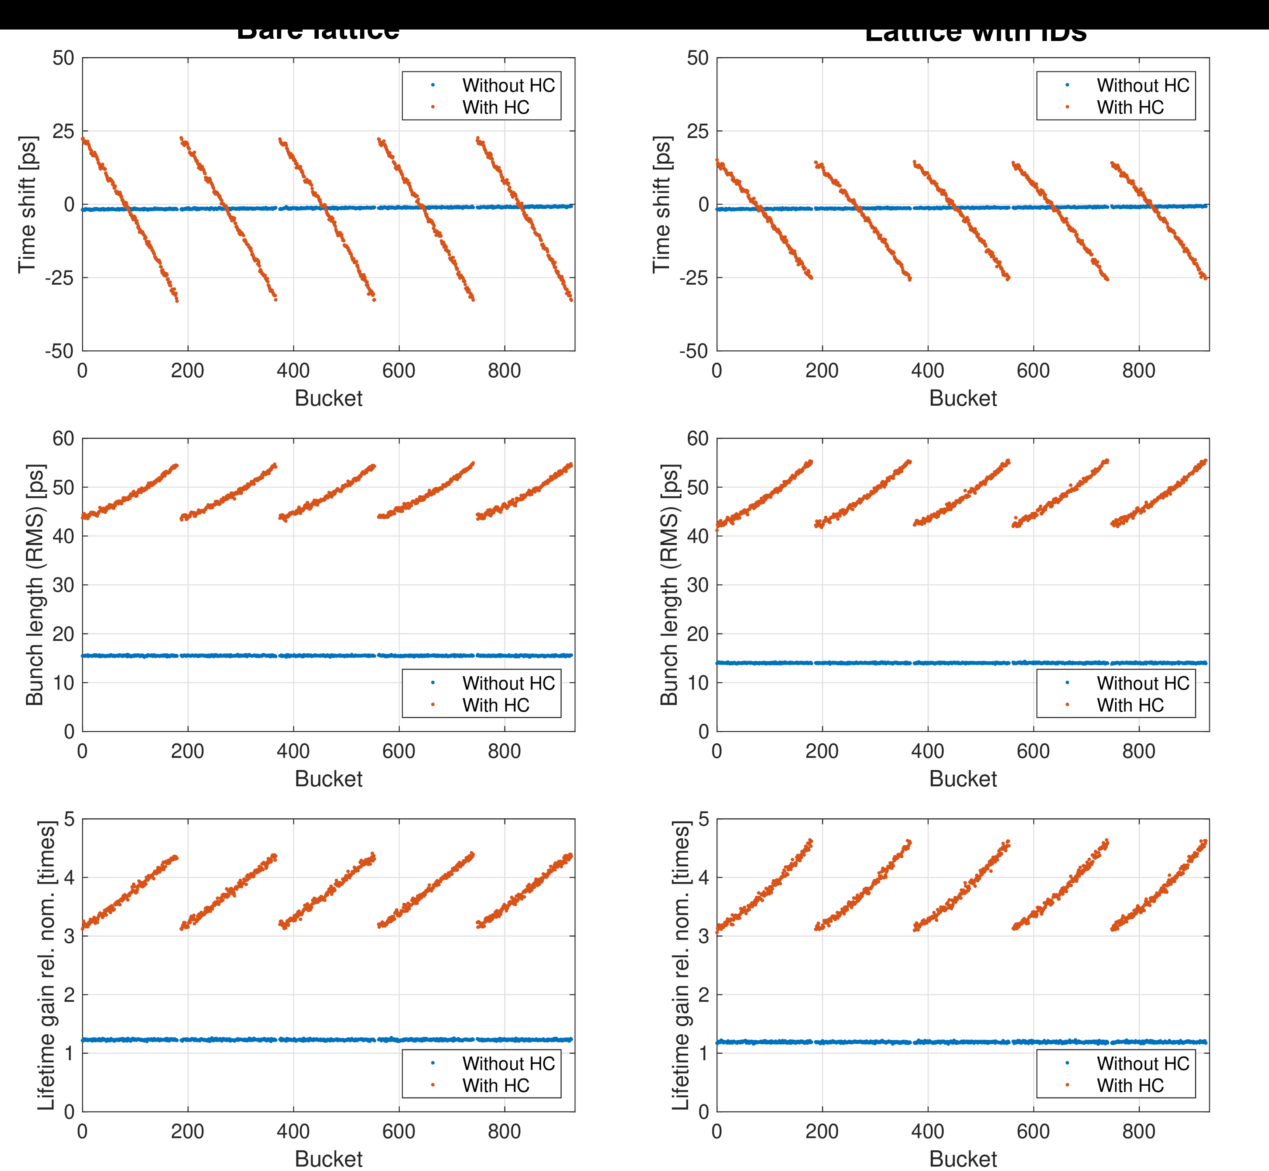
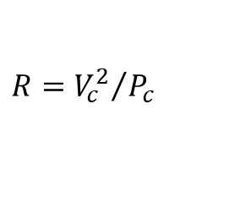
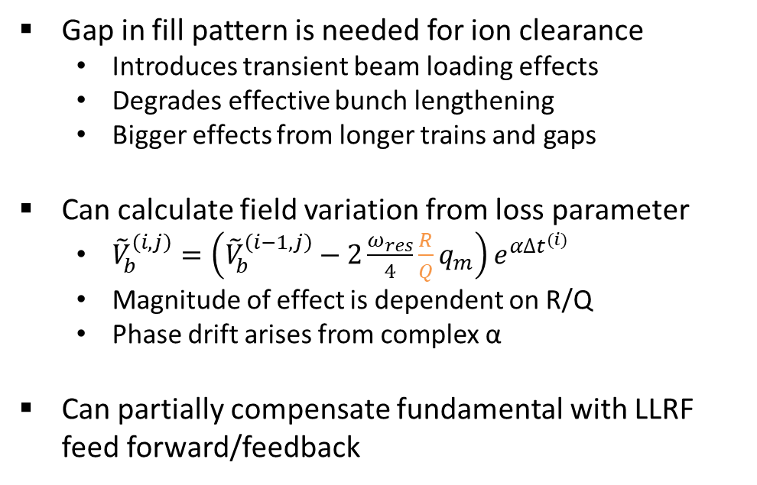
Transient beam loading effects
Gap in fill pattern is needed for ion clearance
  Introduces transient beam loading effects
  Degrades effective bunch lengthening
  Bigger effects from longer trains and gaps
Can calculate field variation from loss parameter
  ${\tilde{V}}_{b}^{\left(i,j\right)}=\left({\tilde{V}}_{b}^{\left(i−1,j\right)}−2\frac{ω_{res}}{4}\frac{R}{Q}q_{m}\right)e^{α∆t^{(i)}}$
  Magnitude of effect is dependent on R/Q
  Phase drift arises from complex α
Can partially compensate fundamental with LLRF feed forward/feedback
$$R={V_{c}^{2}}/{P_{c}}$$

Slide 15

Installation plan
Reduce effort in dark period by carrying out as much work as possible in advance
  Install amplifiers and test into dummy loads during Diamond-I operation
  Remove redundant cavities in Diamond-I shutdowns
  Perform as much of linac upgrade as possible before dark period
Superconducting 3HC is longest lead-time item
  Begin procurement as soon as possible

Slide 16
Summary
Diamond-II is a 24-cell 6-bend achromat design
  24 short mid straights will become available for beamlines, diagnostics, injection and RF
Diamond-II RF will stay at 500 MHz and will use:
  HOM-damped normal conducting cavities
  High power solid state amplifiers
  Digital low level RF
Harmonic cavity is required
  Preferred solution is single superconducting passive third harmonic “Super3HC” design
  SSRF can provide an alternative device
  Superconducting harmonic cavity will use Diamond’s existing cryogenic plant
Diamond operation is scheduled to cease at the end of 2026
  18 month “dark period” and Diamond-II operation from early 2028
Thank you for your attention – Any questions?

