Slide 1
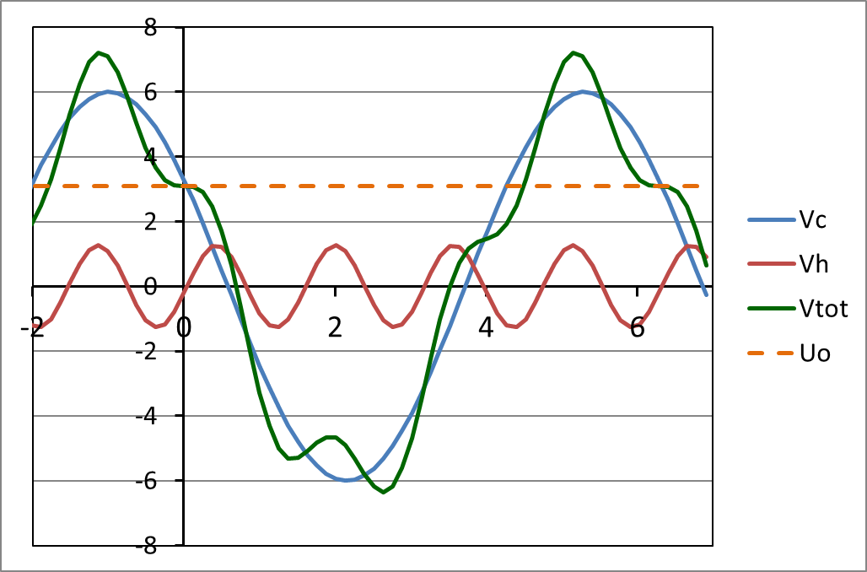
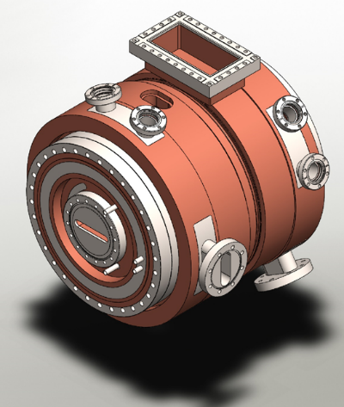
HarmonLIP Workshop
MAX IV / Lund, 10-12 October 2022
Harmonic RF project for ESRF-EBS
Lee Carver, Alessandro D’Elia, Jörn Jacob, Vincent Serrière, Simon White
Part of this work has been performed within the frame of the WP2 collaboration among ESRF, HZB, KEK, PSI & SOLEIL

Slide 2
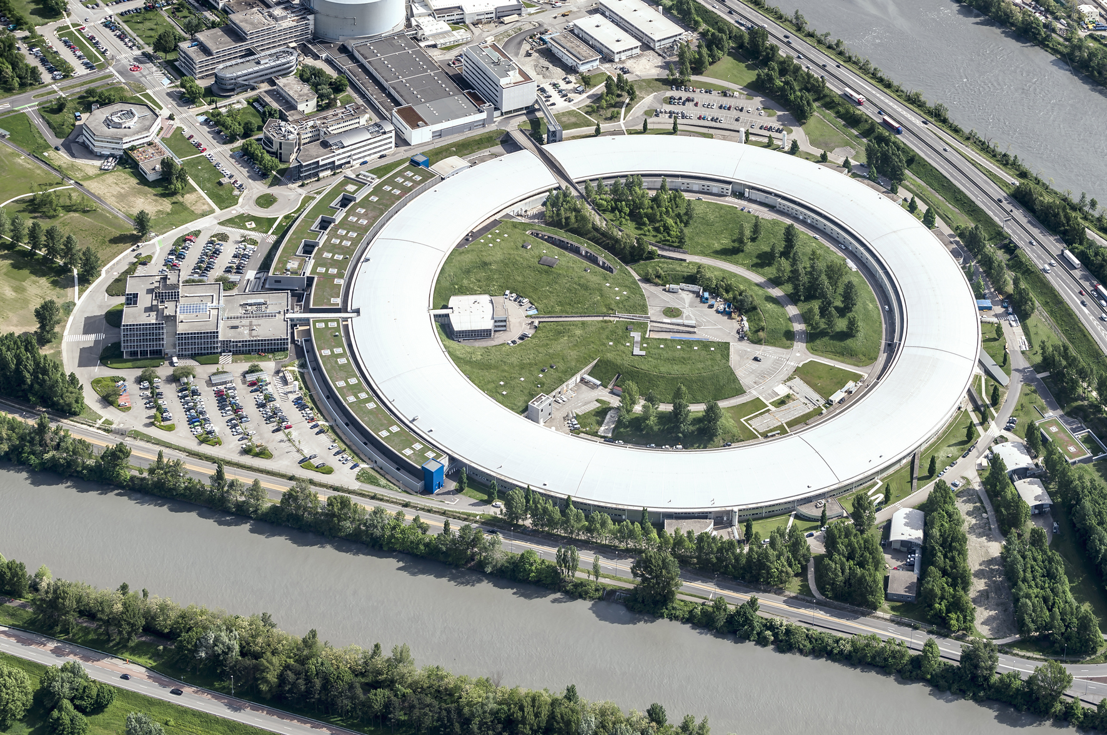
ESRF 1992: First 3rd generation synchrotron light source
Up to 100 keV X-rays
Circ = 844 m
6 GeV Booster
200 MeV Linac
6 GeV Storage Ring
200 mA
Existing Storage Ring
1992: commissioning
1994: external users
since then:
many upgrades
brilliance increase by about a factor 1000
2020 New Extremely Brilliant Source: EBS
First 4th generation high energy light source
further brilliance increase by a factor 40
Substantial gain in coherence

Slide 3
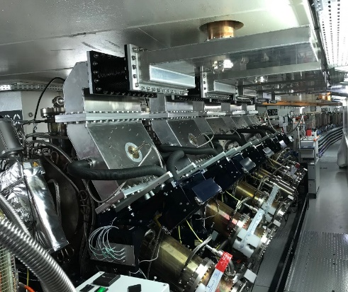
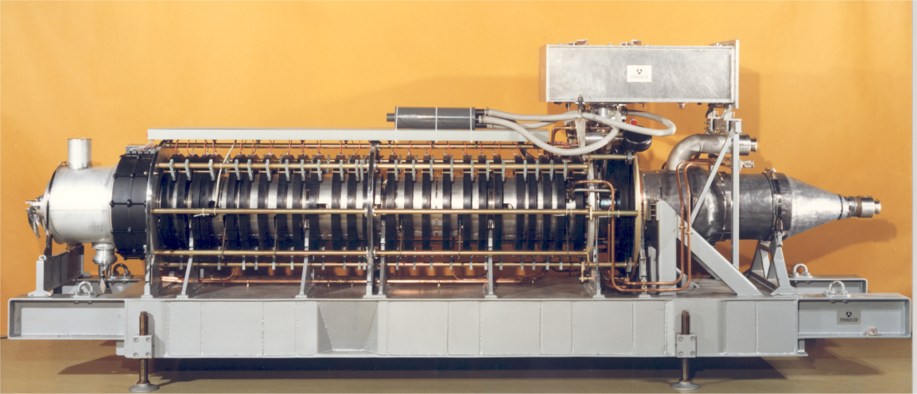
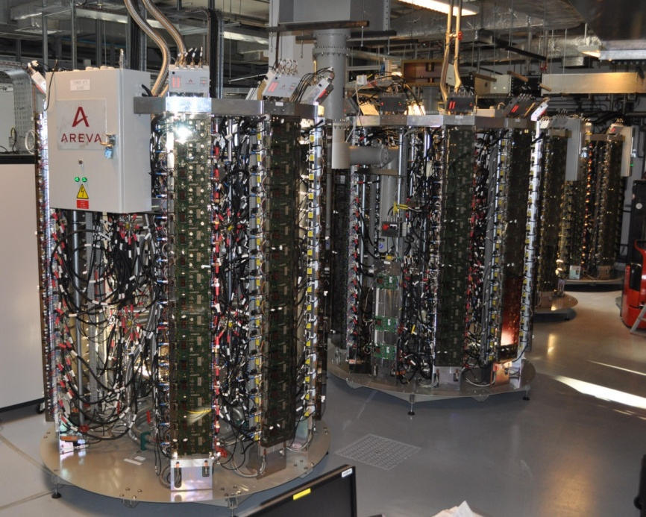
EBS RF system Layout
EBS Storage Ring
Cell 5
Cell 7
Symmetric 3dB splitting using existing magic T’s
352 MHz 1.1 MW klystron
-7 dB
-7 dB
KLYS 1
KLYS 2
NEW Teststand: in new adjacent building
75 kW
tower
75 kW
tower
75 kW
tower
75 kW
tower
75 kW
tower
75 kW
tower
Space for 4th harmonic RF system
Cell 25
ELTA/AREVA
based on SOLEIL design

Slide 4
Gradual implementation of 10 SSA (each 110 kW RF, max 250 kW AC)
Cell 5
Cell 7
SAT for each SSA connected to RF power teststand, switching between:
cavity in teststand and
load with variable mismatch (EH tuner)
03
04
05
06
07
02
08
09
01
10
10 new 110 kW SSAs
by JEMA France
2023
2026
2026
2026
Dec.
2026
Dec.
2023
2024
2024
2025
2025
Klystron 1 dismounted in Autumn 2026 to free space for last 2 SSAs for cavities 04 and 05
Keep Klystron 2 if still spare klystrons left as a unique high power RF source for the teststand
KLYS 1
KLYS 2
← RF Teststand
3 existing 150 kW SSAs / ELTA
Space for 4th harmonic RF system
13
12
11
Cell 25

Slide 5
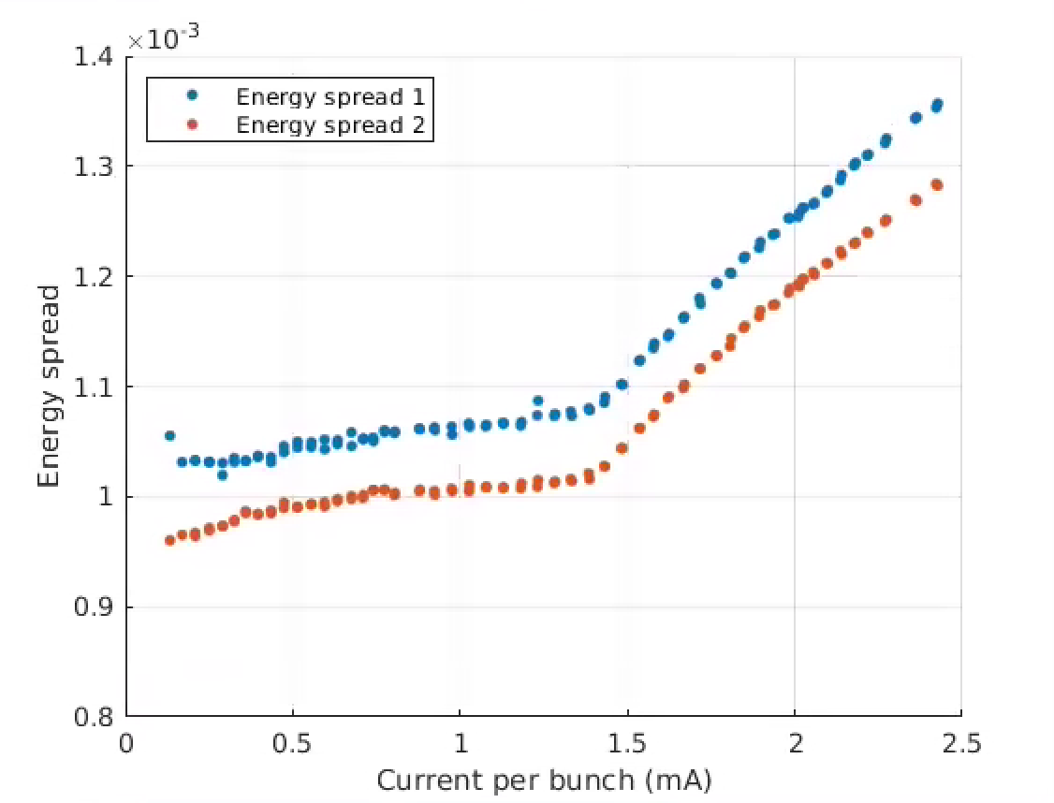
Lifetime in EBS
For all modes: Hor. Emit. ε_{z} = 135 pm | Multibunch 7/8 filling | 16-bunches | 4-bunches
Total current | 200 mA | 92 mA | 40 mA
Current per bunch | 0.23 mA | 5.75 mA | 10 mA
Bunch length (calc.) | 13 ps | 31 ps | 37 ps
Vert. Emit. ε_{z} set at | 10 pm | 20 pm | 20 pm
Touschek Lifetime | 33 h | 3.5 h | 2.5 h
computed, not measured
Threshold ~1.4mA
Measured MWI factor 2 lower than GdfidL computation
[S. White, N. Carmignani et al.]

Slide 6
4th harmonic RF system for bunch lengthening
Harmonic RF system at 1.41 GHz
Bunch lengthening by a factor 2.5 to 3
1st Priority for high I / bunch (16b and 4 x 10 mA)
Reduced Touschek scattering, IBS and microwave instability:
Increased lifetime → less frequent injections, reduced loss rate and radiation load
Improved overall stability
Room for smaller In-Vacuum ID gaps
alleviate possible impact from future lattice developments like mini-beta straights
Reduced emittance and energy blow up
Reduced heat-load and stress of critical chambers, like ceramic chambers or In-Vacuum IDs
Today maximum 35 mA in 16 bunch and 20 mA in 4 bunch operation until installation of new ceramic Kicker chambers
2nd step: for multibunch operation
Intrinsically less Touschek scattering, very low IBS, no MWI
7/8 filling → strong transient beam loading (TBL) almost impossible to avoid
Phase transients partly spoil bunch lengthening
Minimize R/Q of harmonic cavities ⇒ E020 mode cavity
V [MV]
Vtot
Vc = 6.0 MV
Uo = 3.1 MV
Vh,opt = 1.27 MV
ω_{RF} t
Principle: 4th harmonic RF system for bunch lengthening
E020 mode cavity initially proposed by Naoto Yamamoto / KEK

Slide 7
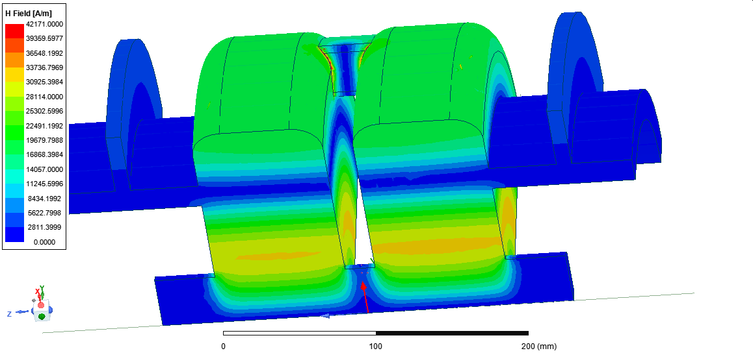
4th harmonic 2-cell E020 mode cavity – in house development
Ferrite LOM (E010 mode) & HOM absorber
454 mm
Active NC cavity design well advanced:
2 coupled and 2 uncoupled cells considered
Freq = 1.409 GHz
R/Q = 44.5 ohm/cell
Q0 = 30500
Smart HOM & LOM dampers almost not affecting Q0 of E020 mode
Elaborate water cooling
Aperture coupler: coupling β = 1
Vacuum ports on HOM dampers also preserving Q0
H-Field
[Alex D’Elia, Vincent Serrière]

Slide 8
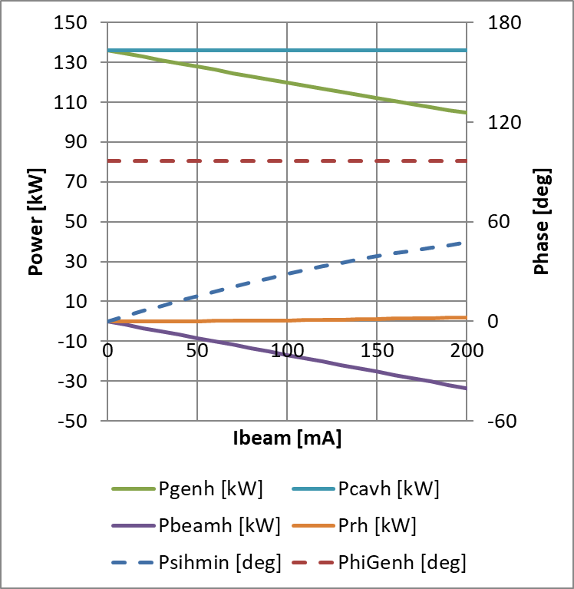
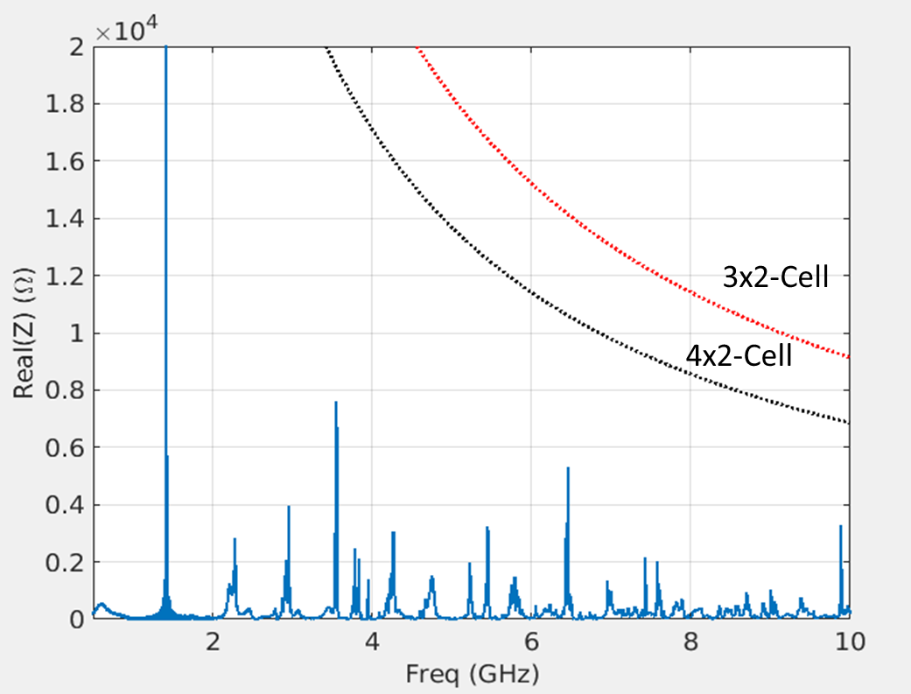
ACTIVE harmonic system - Power requirements
Main RF Voltage | Harmonic RF Voltage | 3 x 2 Harm Cav cells | 4 x 2 Harm Cav cells
6.5 MV | 1.49 MV | 46 kW | 26 kW
6.0 MV (nominal) | 1.35 MV | 38 kW | 22 kW
Optimum harmonic cavity tuning: Load angle = 0
(exactly as for main RF)
Thresholds for LCBI
HOM impedances

Slide 9
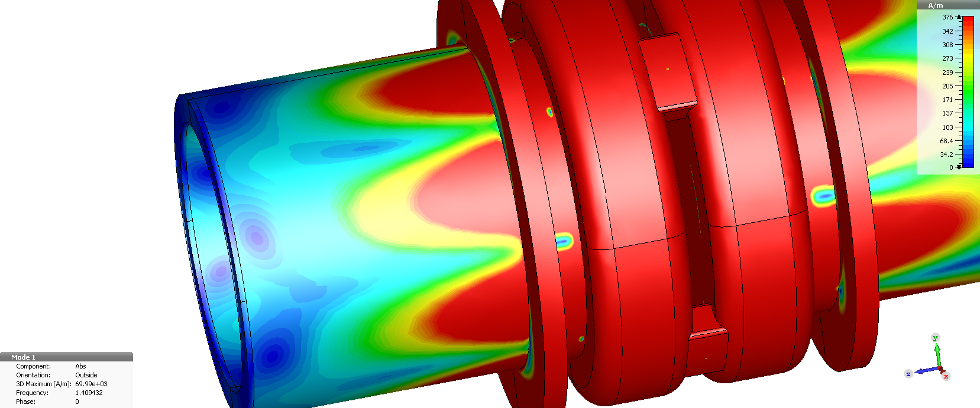
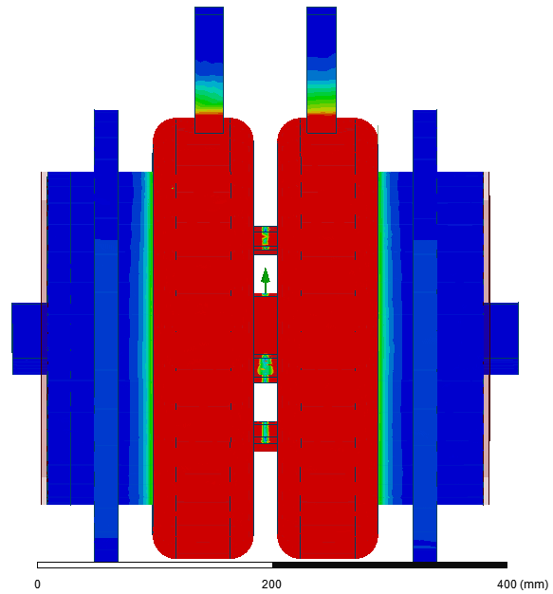
Simulation with Ferrite instead of PML revealed new challenge
Replacing PML with real ferrites in the 3D model:
revealed small azimuthal modulation of fields of TM020 / π-mode of coupled cells
coupling to higher order waveguide TE mode in coaxial HOM/LOM damper reaching ferrite ring
Reduction of Q by a factor 2 !
2 investigated possibilities to mitigate this problem:
H-Field penetration in the original structure
Additional choke
Remarks:
Additional choke to stop TE propagation
Initial RF performances recovered
Power density at the ferrite after optimization ~10W/cm² (15W/cm² is the limit given by the manufacturer: being checked on teststand);
Cavity slightly longer (by ~80mm in total).
Coupling lots moved towards cav’ axis
Remarks:
1 additional HOM damper per cell to stay within LCBI threshold
Q factor ~5% lower because of the HOM dampers
Power density at the ferrite ~15W/cm² (no optimizations done yet);
Review of mechanical integration of the disk needed
Cavity length does not change
Ferrite Loads
Possibility 1
Possibility 2
Ferrite Loads

Slide 10
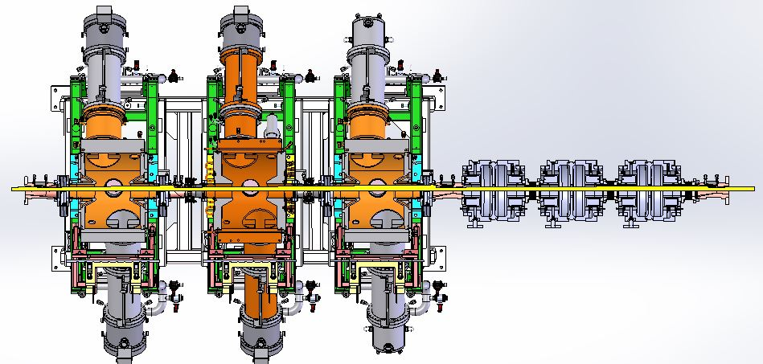
Cell 25 with 3 main RF and 3 harmonic RF cavities
3 harmonic cavities designed to fit in remaining space of cell 25

Slide 11
Status
Status and objectives:
Challenging design of 4th harmonic cavity goes on: → Vincent Serrière’s presentation of latest findings
Launch procurement of cavity and 1.4 GHz SSA hopfully early 2023, including prototype phases
Why not 3rd harmonic at 1.057 GHz ?
Existing 1.3…1.4 GHz SSAs was the main reason to go to 1.4 GHz fro an active system, now also high power transistors around 1 GHz
As suggested by Patrick Marchand: we could now also envisage a 3HC system
We would need 1.6 to 1.8 MV at 1057.11 MHz for 5.5 to 6.0 MV at 352.37 MHz,
Cavities expected to have R/Q = 44 Ohm, Qo ≈ 40000
Collaborations :
Particle tracking simulations under way in a collaboration of ESRF RF and Beam Dynamics groups: → Lee Carvers’s presentation
International exchange and bench marking → WP2 collaboration ESRF, HZB, KEK, PSI & SOLEIL, HarmonLIP
Planned collaboration with ESRF Detector & Electronics group for the development of a fast digital RF feedback system built with ESRF FPGA controllers
Remarks on Active vs Passive and Robinson DC → J. Jacob’s dedicated presentation
Implementation on EBS possibly in about 3 years

Slide 12
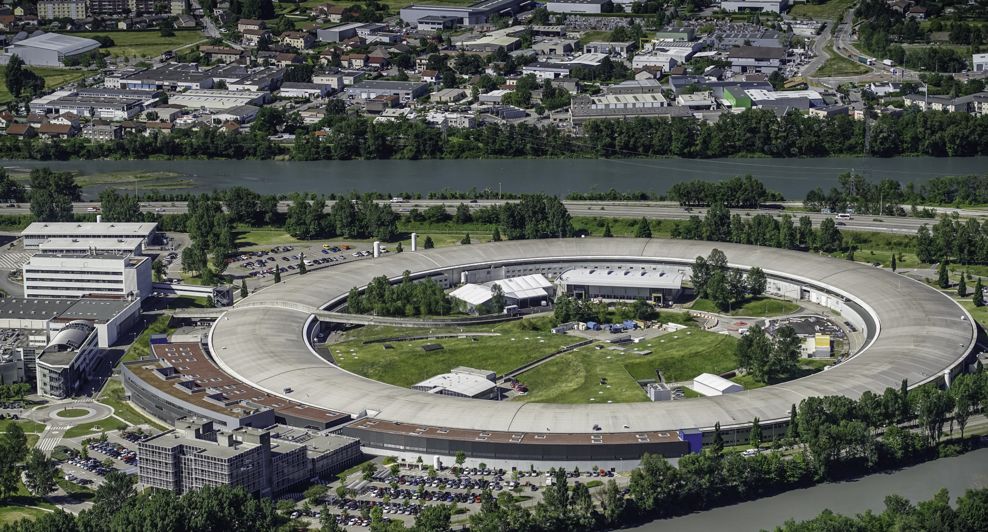
Many thanks for your attention

