Slide 1
Harmonic cavities @ HZB
BESSY II and MLS
11.10.2022, Markus Ries on behalf of the HZB machine group
https://indico.maxiv.lu.se/event/5098/contributions/6747/
!harmagic!

Slide 2
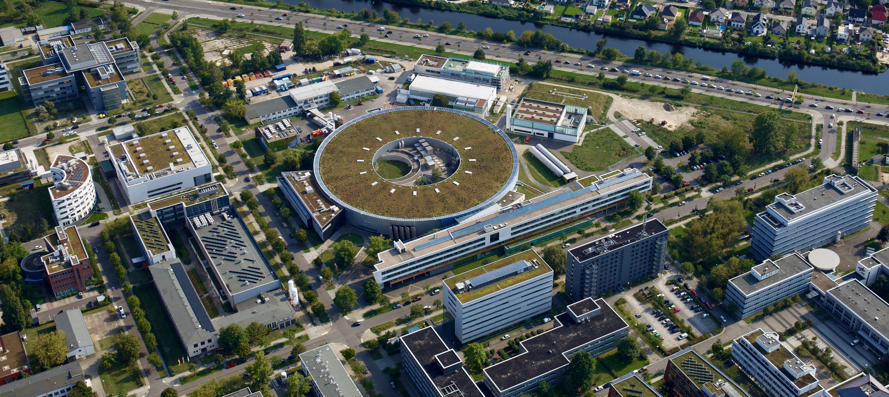
Adlershof campus
HZB / Dirk Laubner

Slide 3
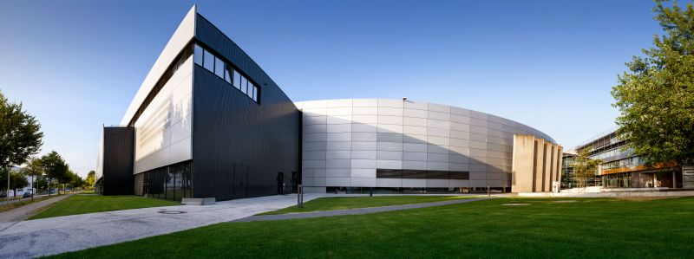
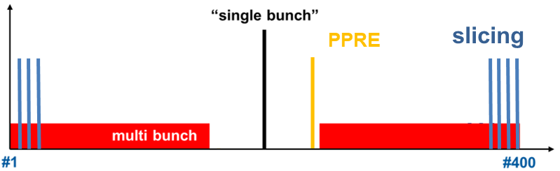
BESSY II
BESSY II – user facility
1988 design, 1994 ground breaking,
1998 user operation
1.7 GeV, 300 mA
decay machine with TopUp upgrade
slicing facility upgrade
superconducting wave length shifter (x2)
in-vacuum undulator
4 x 500 MHz EU cavity → 1.4MV with ~75 kW beam loading
hybrid filling pattern operation
→ flux, brightness, timing
single bunch, few bunch → timing 100ps
low-Alpha → timing 2ps, coherent THz radiation

Slide 4
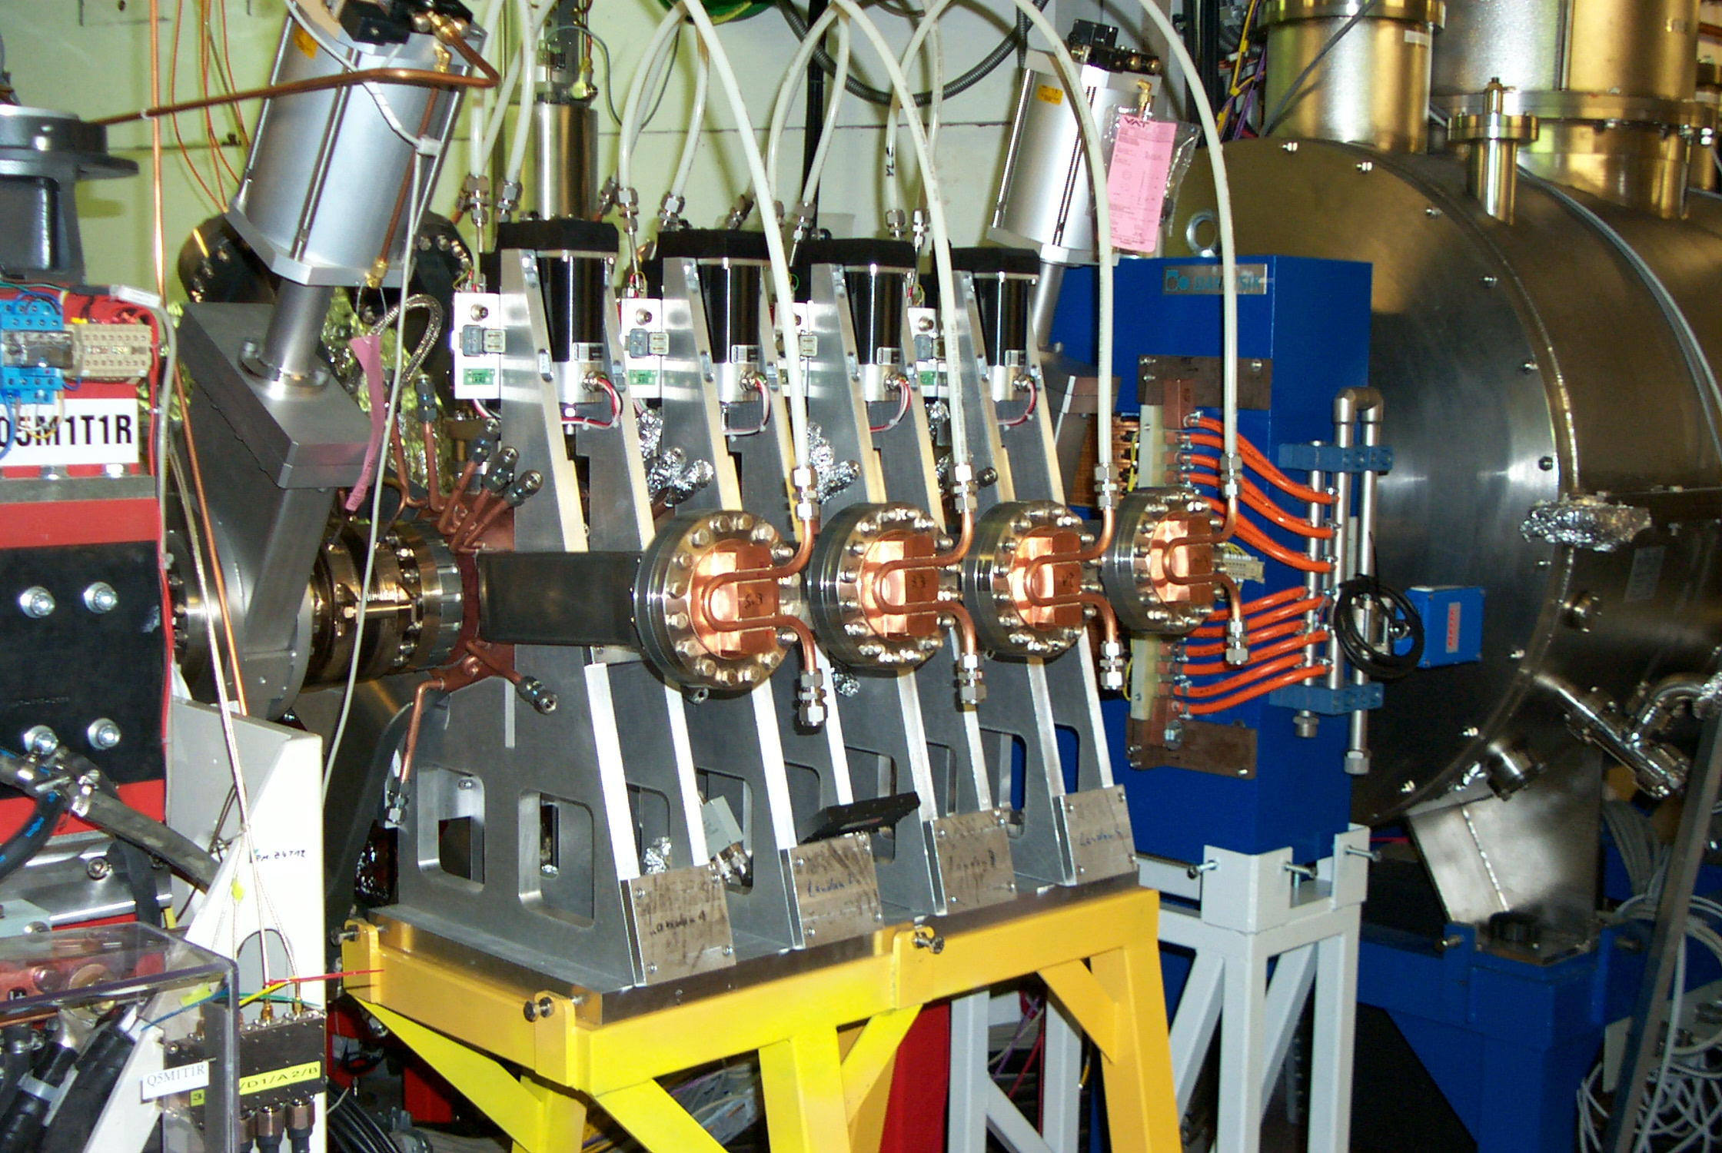
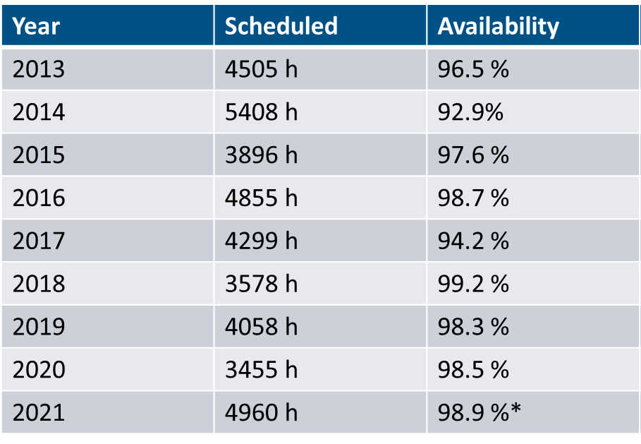
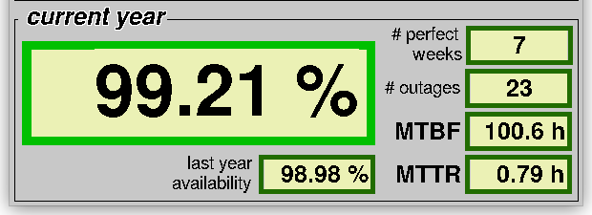
Harmonic cavities for BESSY II
Why harmonic cavities @ BESSY II?
designed as
  decay machine
  without in-vacuum IDs
harmonic cavities for bunch length control nice-to-have-technology
high power incident
→ hardware kept alive beyond its lifecycle, no spares
bunch length sensitive experiments:
STXM, slicing, low-alpha (CSR)…
there probably will be another CPMU
30% bunch lengthening, 25% lifetime increase
required for user operation of BESSY II with state of the art in-vacuum insertion devices

Slide 5
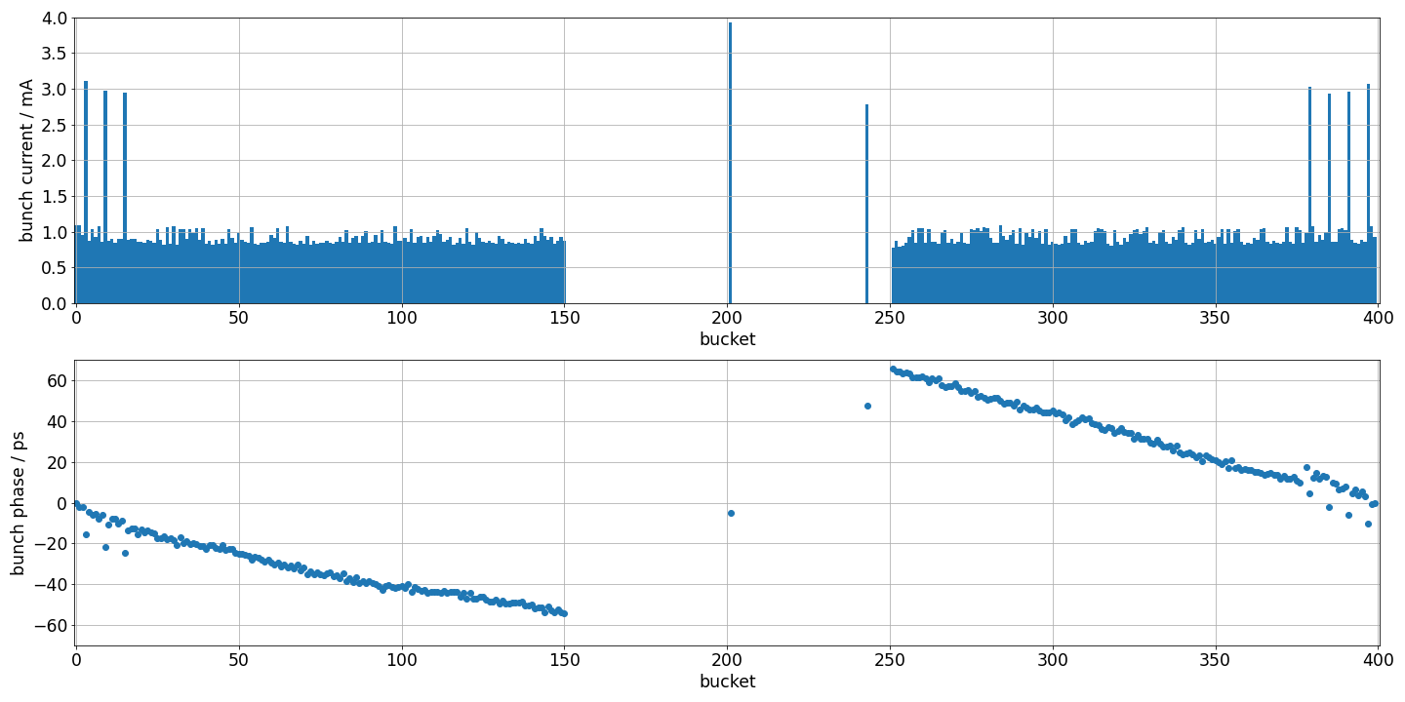
Stability & beam loading
coupled bunch instability thresholds
  transverse ~100mA
  longitudinal ~ 250mA
  (dominated by passive cavities)
large transient of ~120ps for standard fill pattern
we try to convince our users to go towards shorter gap (200 ns → 60 ns)
  hard with diverse user community
  BESSY III perspective
no temperature detuning for main or harmonic cavities
“harmonic plunger” for 3rd harmonic

Slide 6
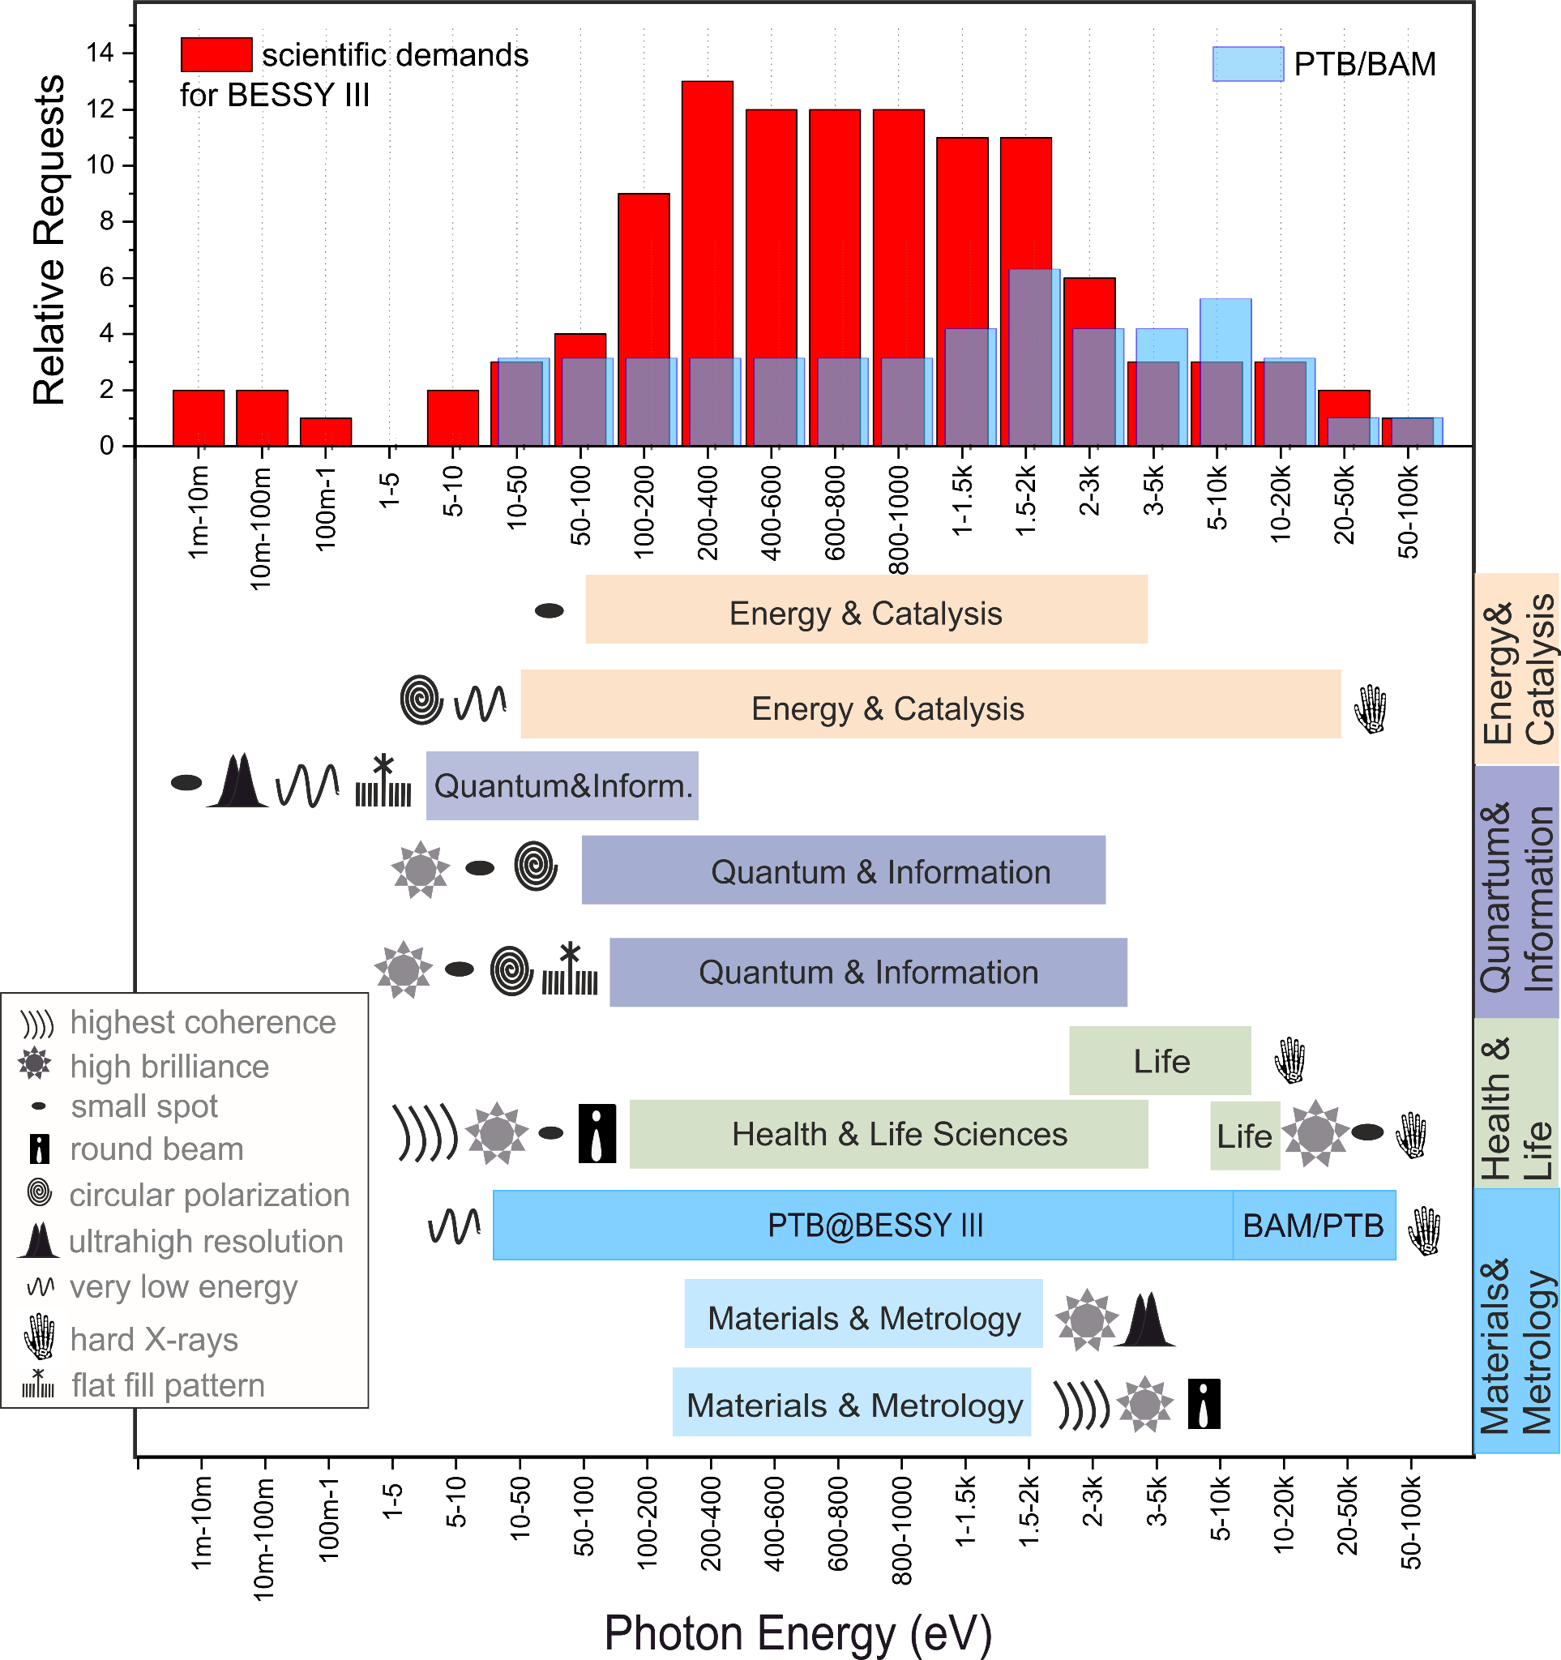
BESSY III
1st ID harmonics polarized up to 1 keV from conventional APPLE-II undulator
Diffraction limited to 1 keV
Stay in Berlin-Adlershof
with same capacity
Nanometer spatial res. & phase space matching
PTB/BAM metrology applications
Ring Energy 2.5 GeV
(1.7 GeV)
Emittance 100 pm rad
(5 nm rad)
Circ. 350 m
16 straights @ 5.6 m
( 240 m, 16 straights @ 4 m)
Low beta straights &
Round beams
Metrology – hom. bends
Momentum > 1.0e-4
compaction factor
Bunch length ~ 10 ps
6 x 500 MHz EU cavity
6 x 1.5 GHz Harmonic EU cavity

Slide 7
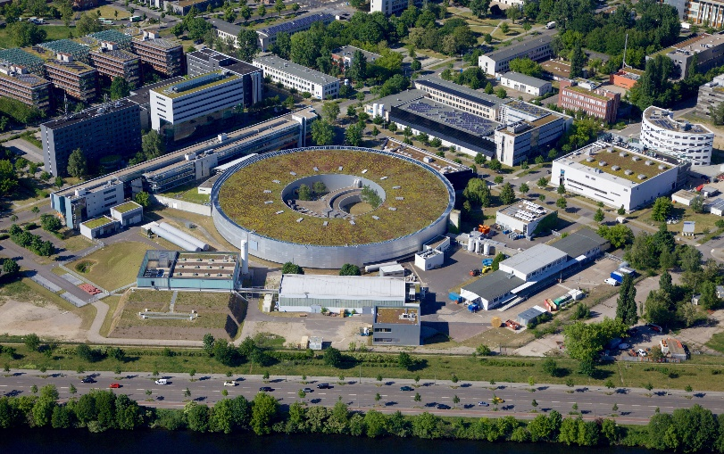
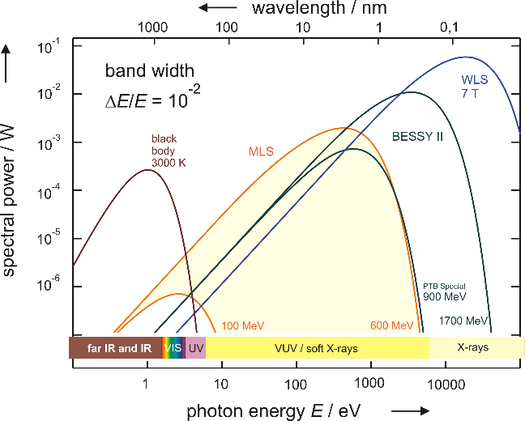
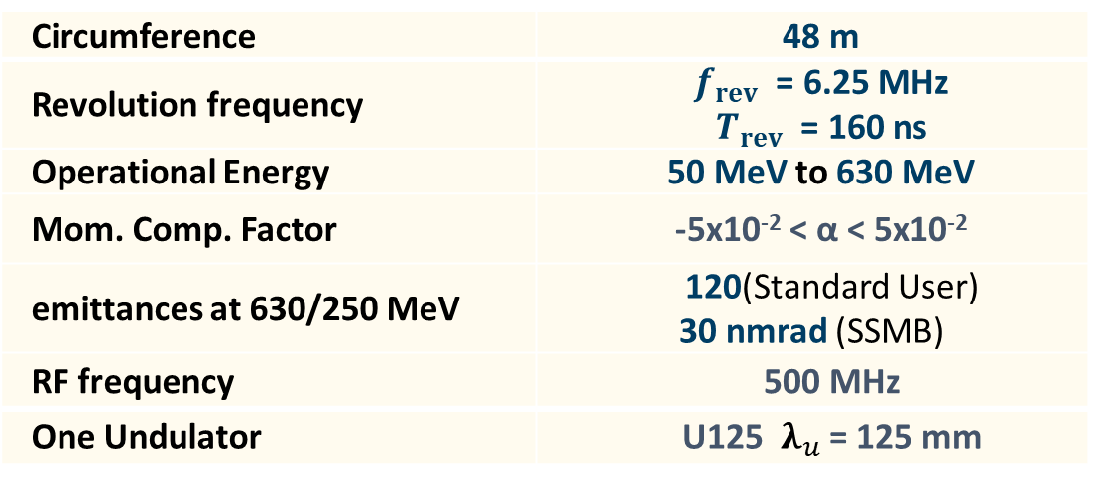
Metrology Light Source
Metrology Light Source (MLS)
BESSYII
user operation since 2008
owned by PTB, designed & operated by HZB
38w/a standard operation, 8 weeks special operation
Circumference | 48 m
Revolution frequency | $f_{rev}$ = 6.25 MHz $T_{rev}$ = 160 ns
Operational Energy | 50 MeV to 630 MeV
Mom. Comp. Factor | -5x10⁻² < α < 5x10⁻²
emittances at 630/250 MeV | 120(Standard User) 30 nmrad (SSMB)
RF frequency | 500 MHz
One Undulator | U125 ${ λ}_{u}$ = 125 mm

Slide 8
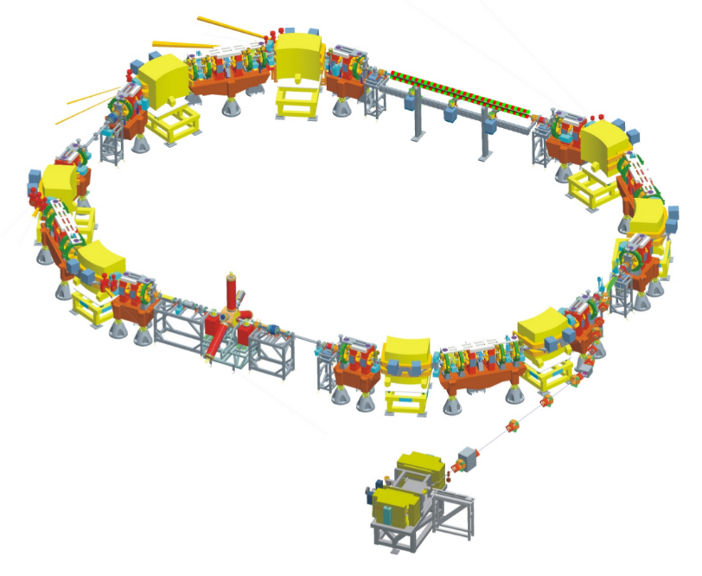
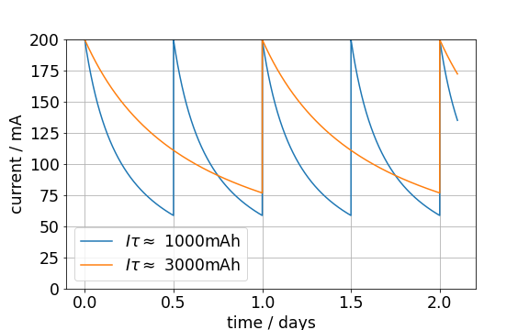
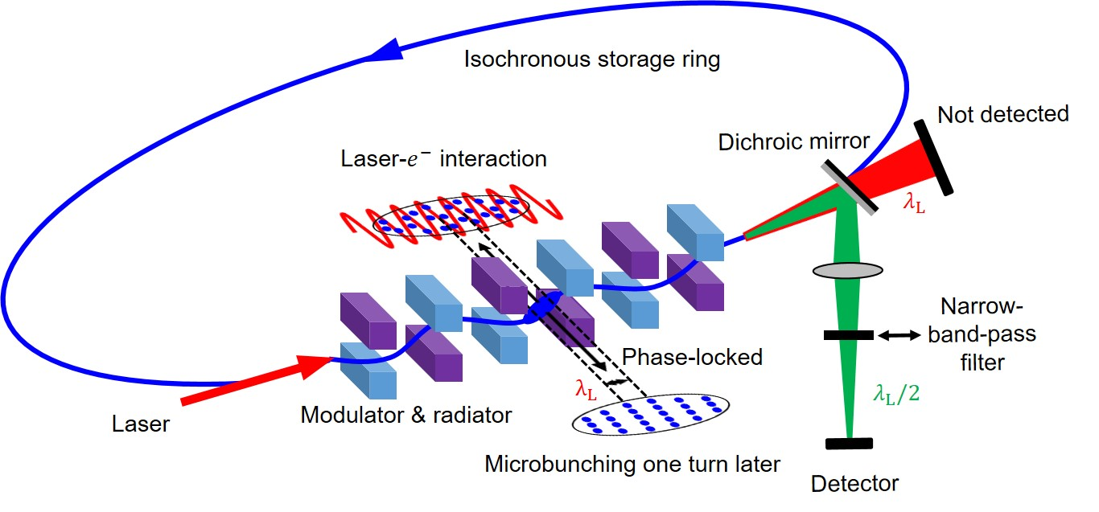
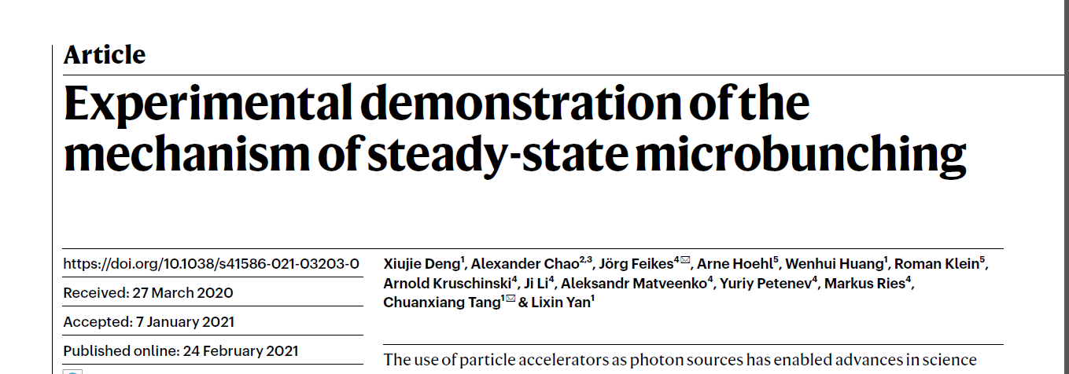
Harmonic cavities for MLS
Why harmonic cavities @ MLS?
first storage ring optimized for low alpha operation by using a dedicated sextupole and octupole correction scheme
unique conditions for experimental ARD towards steady state microbunching -> necessary condition for SSMB: |α| ≤ 2x10⁻⁵
regular and frequent user operation in low-alpha (CSR)
operation conditions
standard
  homogeneous fill pattern,
  no gap
  decaying beam
low alpha
  homogeneous fill pattern,
  no gap
  decaying beam, 160 mA
SSMB
  short train, 10 µA
Deng, X., Chao, A., Feikes, J. et al. Experimental demonstration of the mechanism of steady-state microbunching. Nature 590, 576–579 (2021)

Slide 9
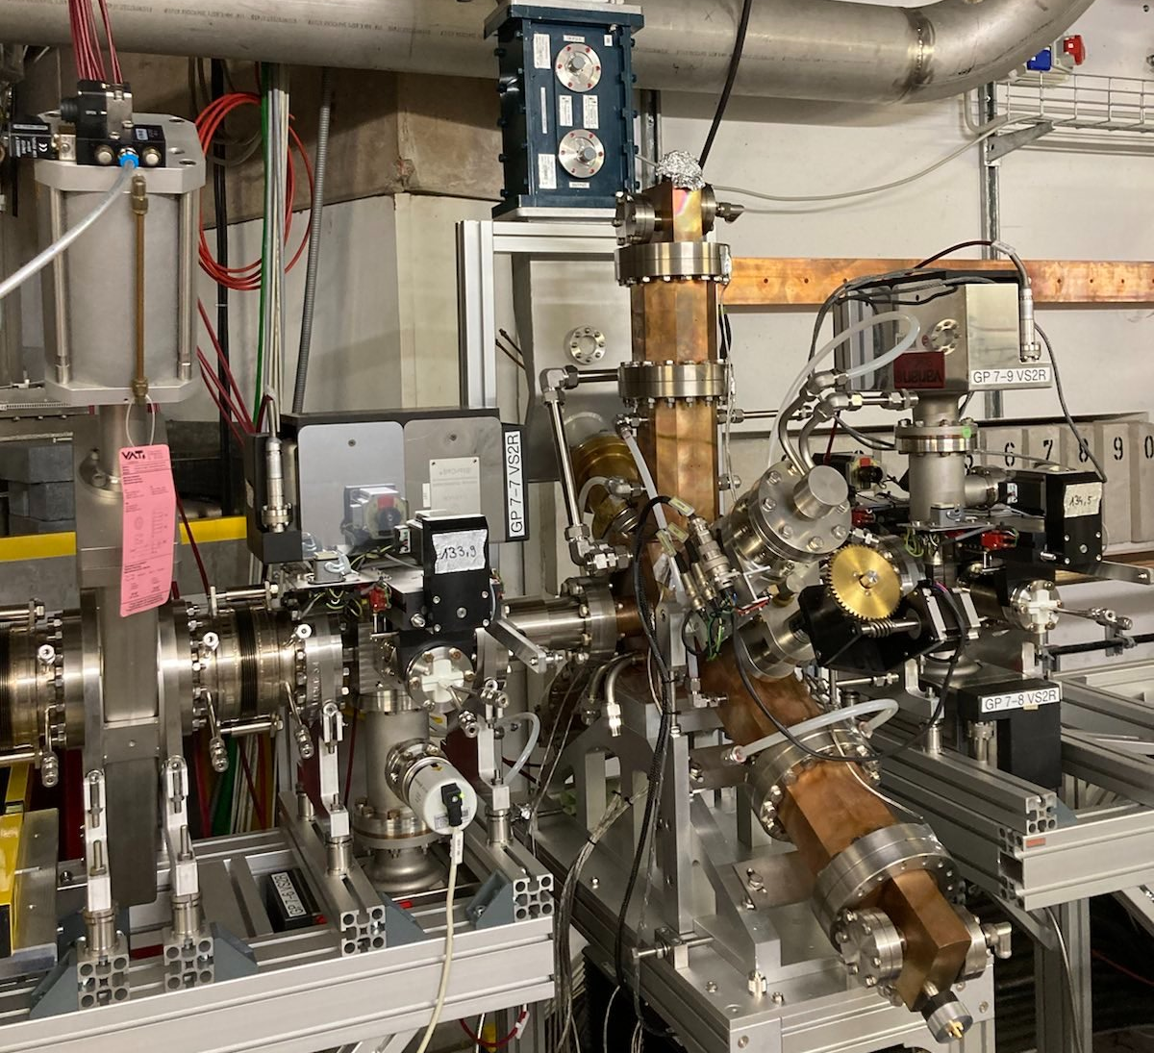

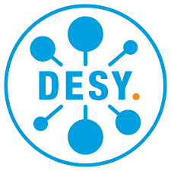
Harmonic EU cavity
Prototype working at BESSY II
ALBA Active Design
collaboration ALBA/HZB/DESY
under commissioning
in operation at BESSY II at this very moment
(parked at -4.5 rev. harmonic, transmitter off)
→ talk of Alexander Matveenko
today 15:55

Slide 10
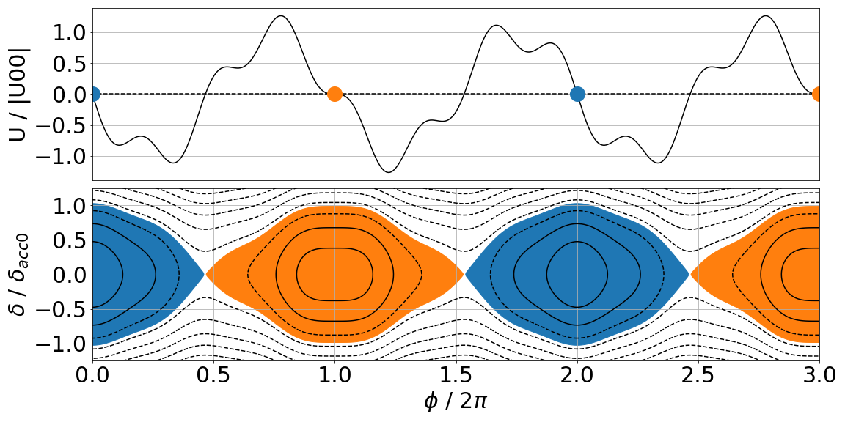
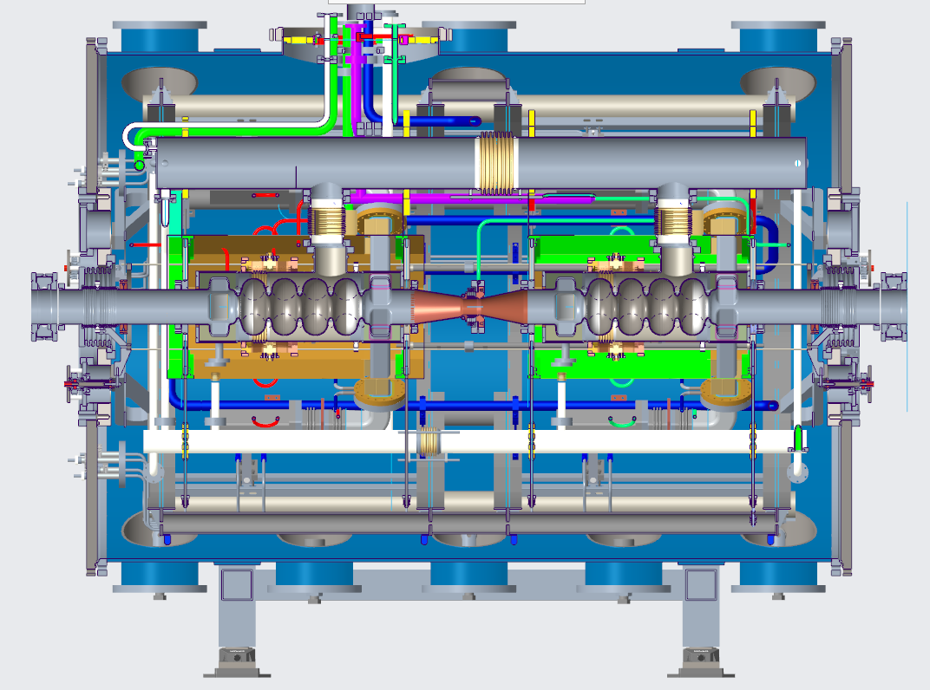
3.5th harmonic cavity @ 1.75 GHz
R&D
VSR “light”
instead of shorten every 2nd bunch → lengthen every 2nd bunch
voltages of 3rd and 3.5th harmonic defined by main RF gradient, momentum acceptance, bunch length
see the talk of Adolfo Velez
Wed. 12, 10:10
R&D with potential
relevance for BESSY III

Slide 11
Where do we go now with Harmonic cavities?
summary
Item | Machine | Frequency | Requested
Cavity | BESSY II | 1.5 GHz | 4
 | BESSY II | 1.75 GHz | 4
 | MLS | 1.5 GHz | 2
Transmitter | BESSY II | 1.5 GHz | 3x15kW (1 existing)
 | BESSY II | 1.75 GHz | 3x15kW (3 existing)
 | MLS | 1.5 GHz | 1x15kW
dLLRF | BESSY II | 1.5 GHz | 3+1
 | BESSY II | 1.75 GHz | 3+1
 | MLS | 1.5 GHz | 1+1
BESSY II
  ensure reliability
  explore beating
MLS
  improve user operation
  high potential for SSMB research
upgrade to dLLRF (20 units including fund. RF)
design ingredient for BESSY III and MLS2
contribute to a common / standardized design
timescale
  6 x 1.5 GHz cavities @ 2025
  4 x 1.75 GHz cavities @ 2026
quite some work to do…
see talk of Andranik Tsakanian tomorrow

Slide 12
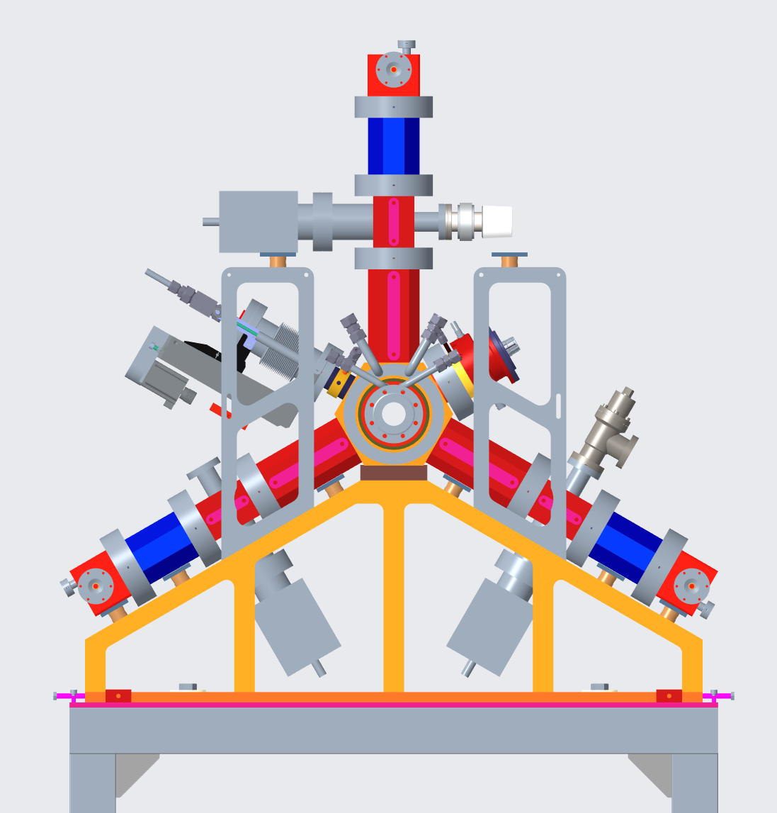
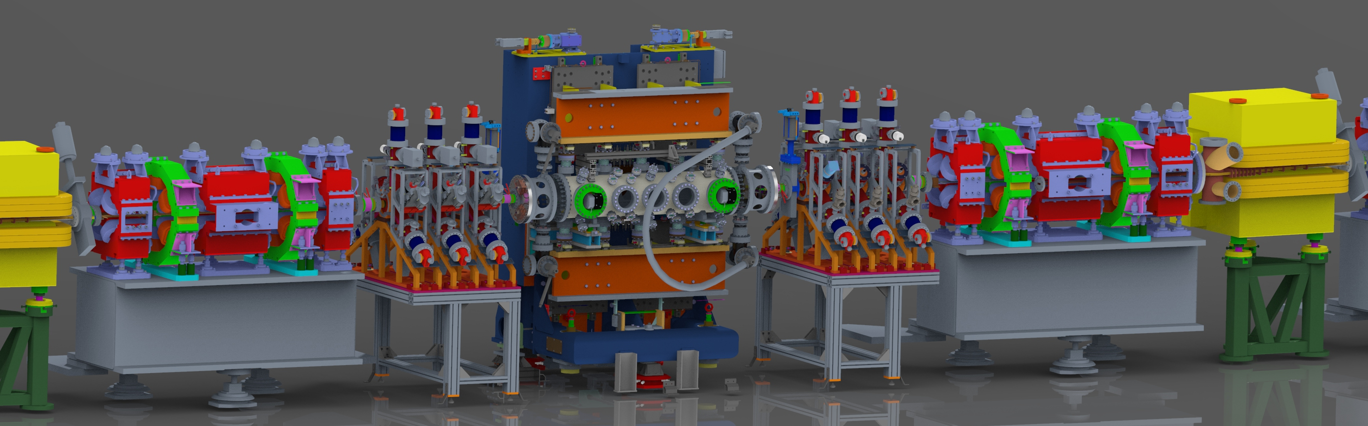
Mid term future at BESSY II
Outlook

Slide 13
Acknowledgement
many thanks
to all HZB and PTB staff contributing to operation and development activities,
to the colleagues from ALBA and DESY for their collaboration,
and all contributors to this workshop
and
for your attention

