Slide 1
The ASTRID2 3rd Harmonic Cavity
Jørgen S. Nielsen
Center for Storage Ring Facilities (ISA)
Aarhus University
Denmark

Slide 2
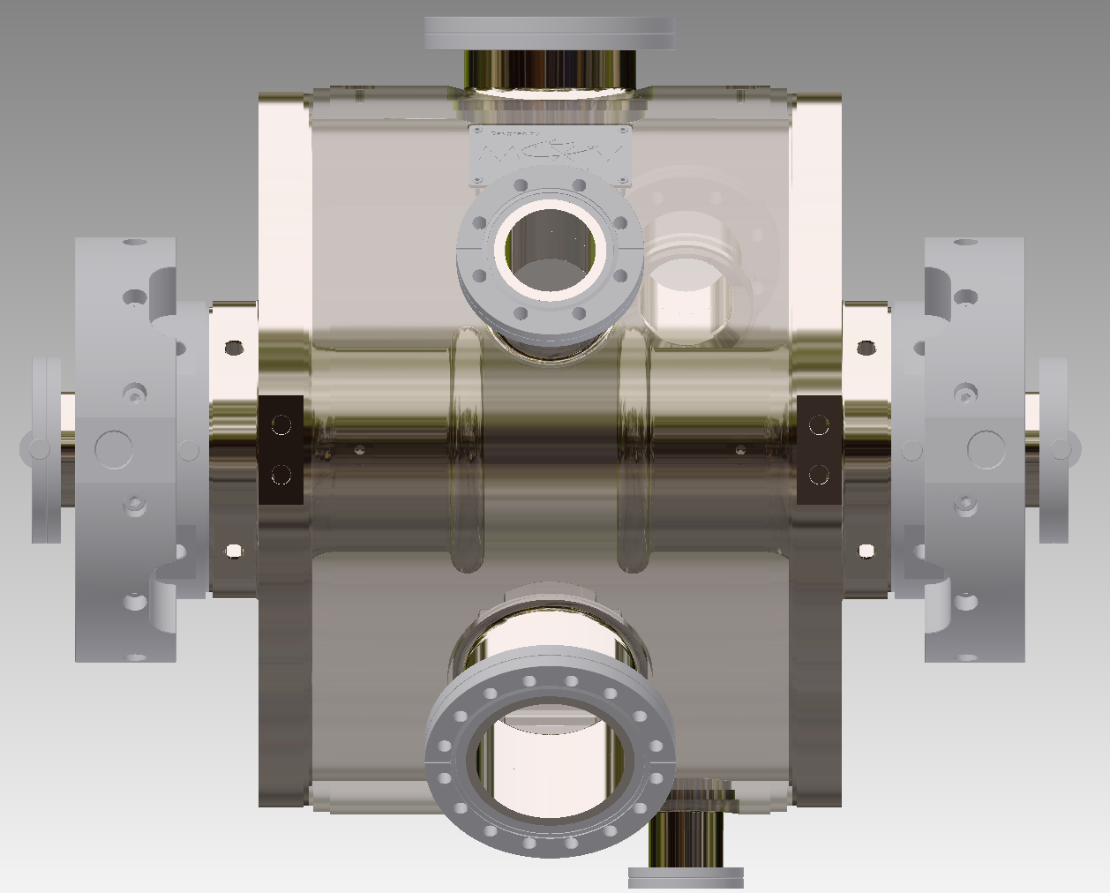
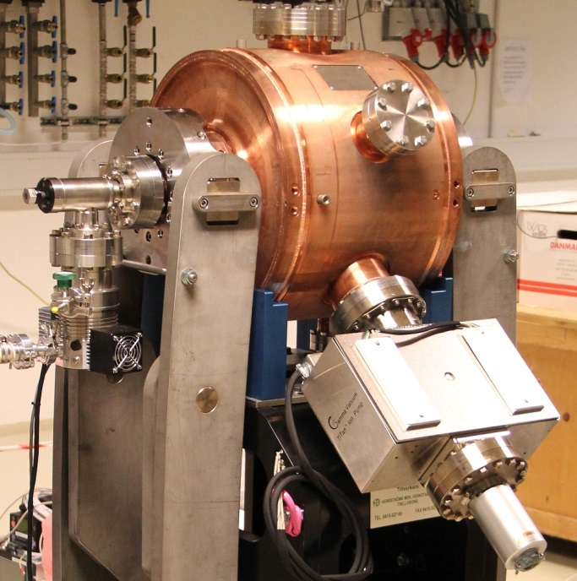
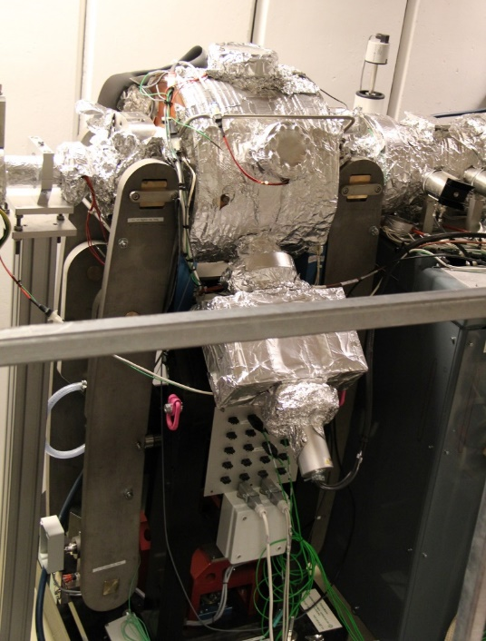
ASTRID2 3rd harm. cavity
Copy of MAX IV cavity, except 315 MHz
Cavity stub end diameter changed
Thanks to Åke and MaxLab
Installed March 2015
Fixed cooling water temperature of ~20°C (at the time)
Before installation
Installed in the ring

Slide 3
Benefits (at installation time)
Better lifetime
Before: 1.4 h @ 80 mA and 1.0 h @ 120 mA
After: 2.0 h @ 80 mA and 1.85 h @ 120 mA
More stable beam
Moved instabilities to higher frequencies
SR diagnostic camera (in control room) showed a more stable beam (and happy users)
Good tuning range is limited
Was for long using a detuning of around +400 kHz (possible tuning range is ±500 kHz).
“Theoretical optimum” (flat potential) should be +160 kHz
Drop in cavity voltage and outgassing 250-300 kHz

Slide 4
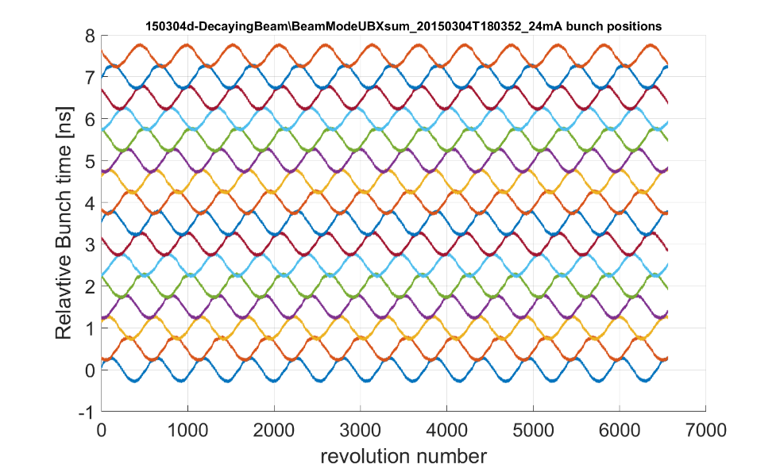
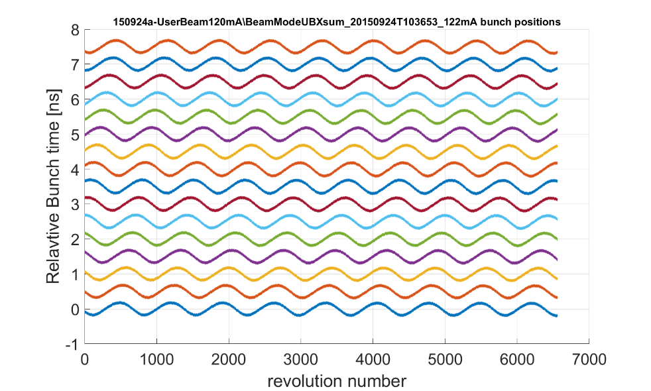
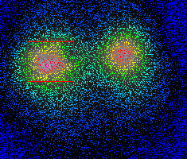
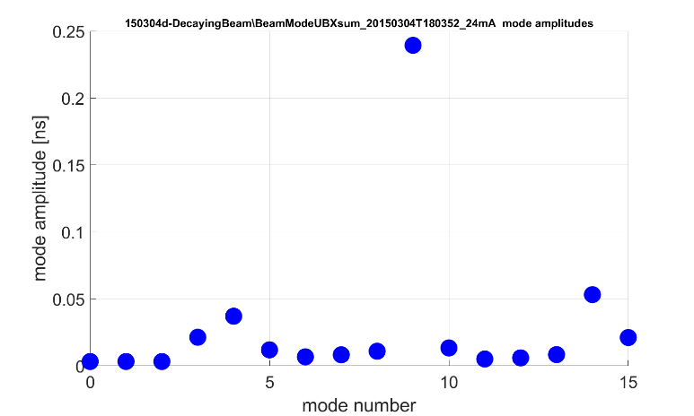
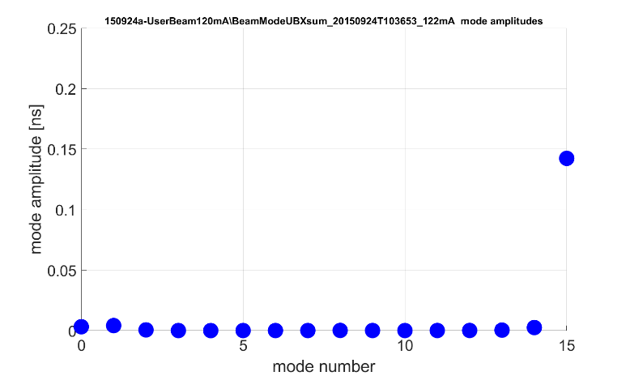
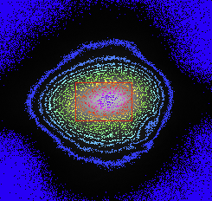
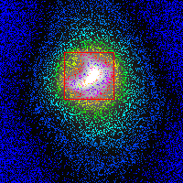
LCBI
After installation of 3rd cavity Longitudinal Coupled Bunch Instability (LCBI) mode spectra changed
Before Landau cavity (24 mA)
Dominant mode: 9
With Landau cavity (120 mA)
Dominant mode: 15
Relative bunch time [ns]
measured with fast oscilloscope
Notes:
Data from before Landau cavity is from \\isasvr14\isadfs\Nat_ISA-Astrid2\AccPhys\Instabilities\BeamModeMeas\150304-OneChannelMeasurements\RePlot_221005_forHarmonLIP\150304d-DecayingBeam
Data from after Landau cavity is from \\\isasvr14\isadfs\Nat_ISA-Astrid2\AccPhys\Instabilities\BeamModeMeas\150911-SingleChMeasWithLandauCavity\RePlot_221005_forHarmonLIP\150924a-UserBeam120mA (BeamModeUBXsum_20150924T103653_122mA)
MRS441 camera picture for Before Landau cavity is from
MRS441 camera picture for With Landau cavity is 160120_085846-ScrDumpOfMRS441videoProgram.png from \\isasvr14\isadfs\Nat_ISA-Astrid2\AccPhys\Diagnostics\MRS\160119-NewFitsChangesBeamsizes

Slide 5
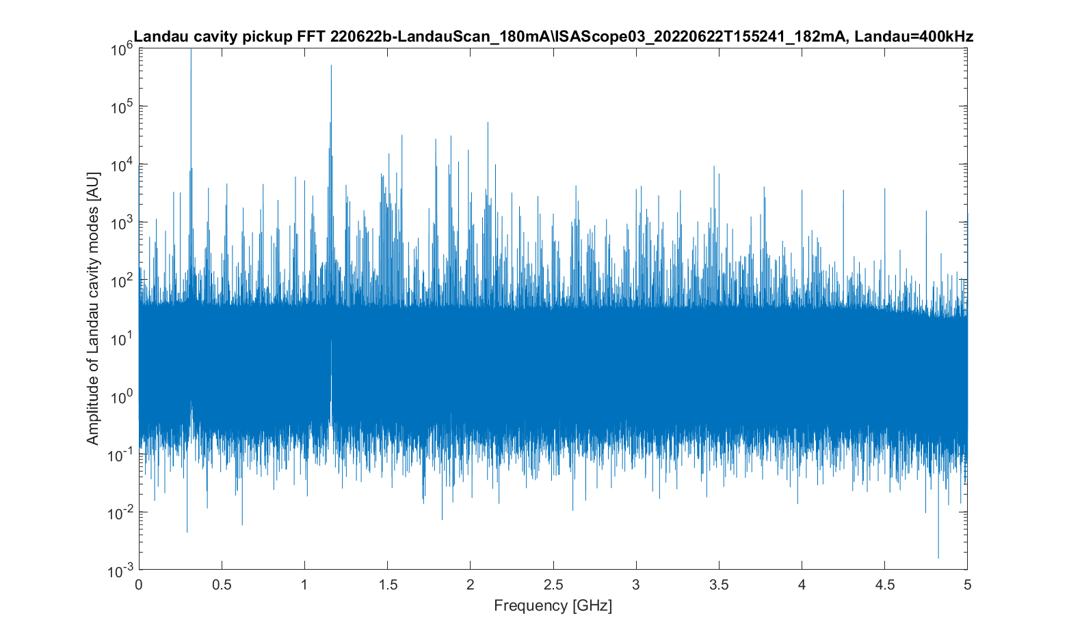
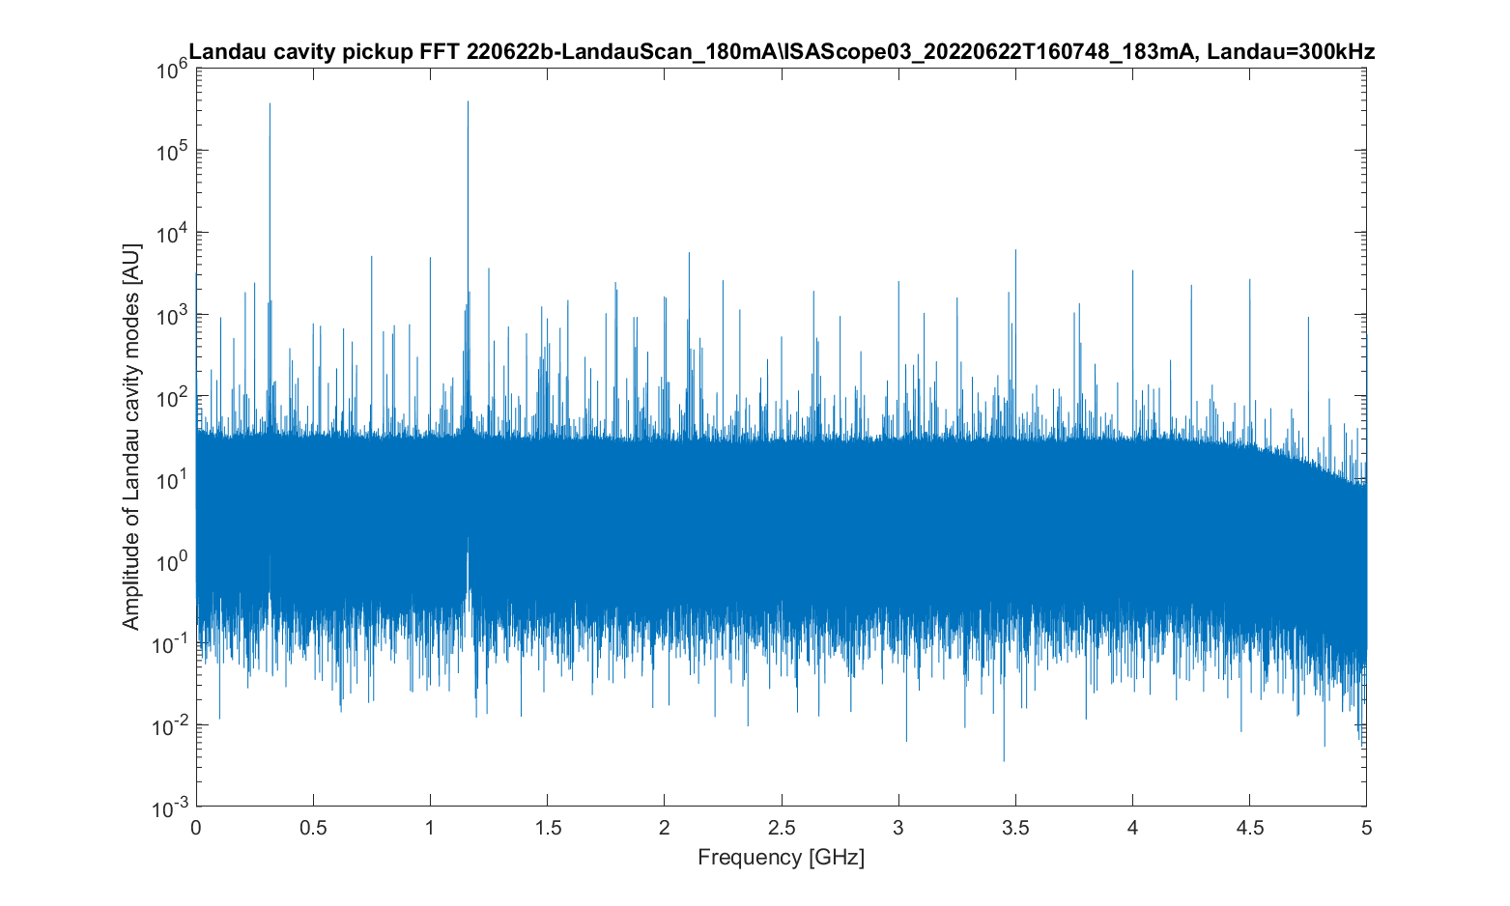
Strong HOM at rev. harm. 177
Direct sampling of Landau cavity pickup signal with (fast) scope and then FFT
Detuning = +400 kHz
Detuning = +300 kHz
Fundamental (315 MHz)
Rev. harm. 177 (1.16 GHz)
Beam has been accumulated at a cavity detuning of +400 kHz
and a cavity temperature of ~20°C

Slide 6
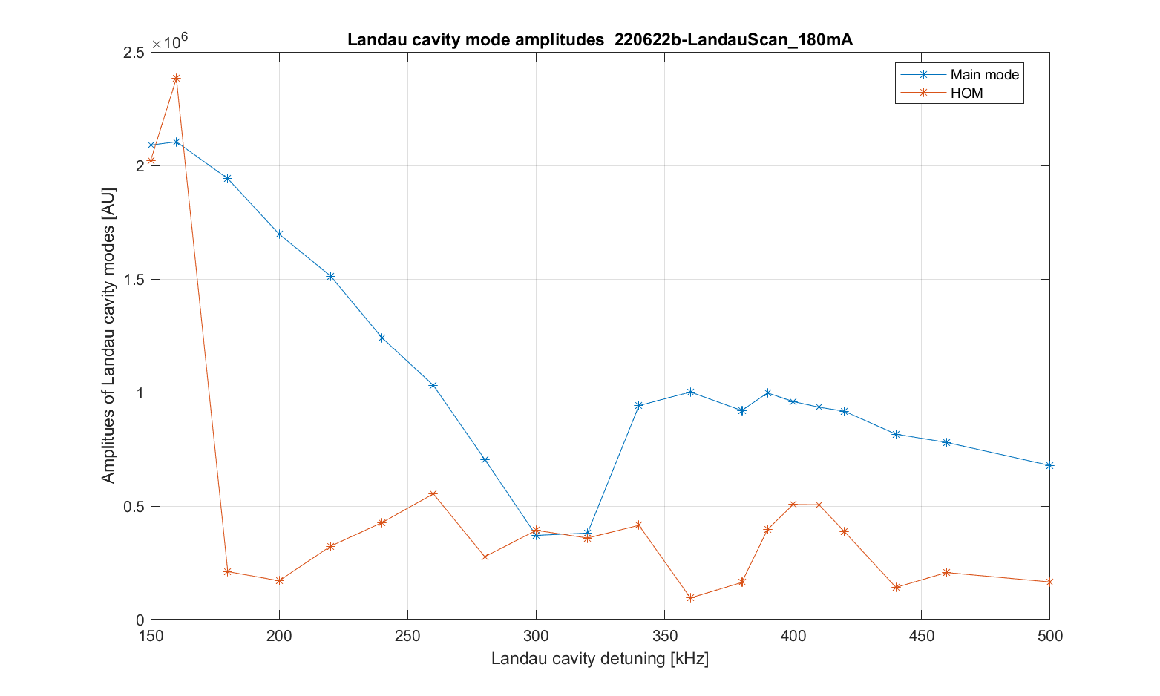
Reduction in fundamental
Scanning the cavity detuning yields a dip in amplitude of the fundamental
Beam
very
unstable
Beam has been accumulated at a cavity detuning of +400 kHz
Notes:
Figure is 220622b-LandauScan_180mA_LandauAmplitudes.png from \\isasvr14\isadfs\Nat_ISA-Astrid2\AccPhys\Instabilities\BeamModeMeas\220621-Scope03with3moreSignals\220622b-LandauScan_180mA\analyse\FFTplots

Slide 7
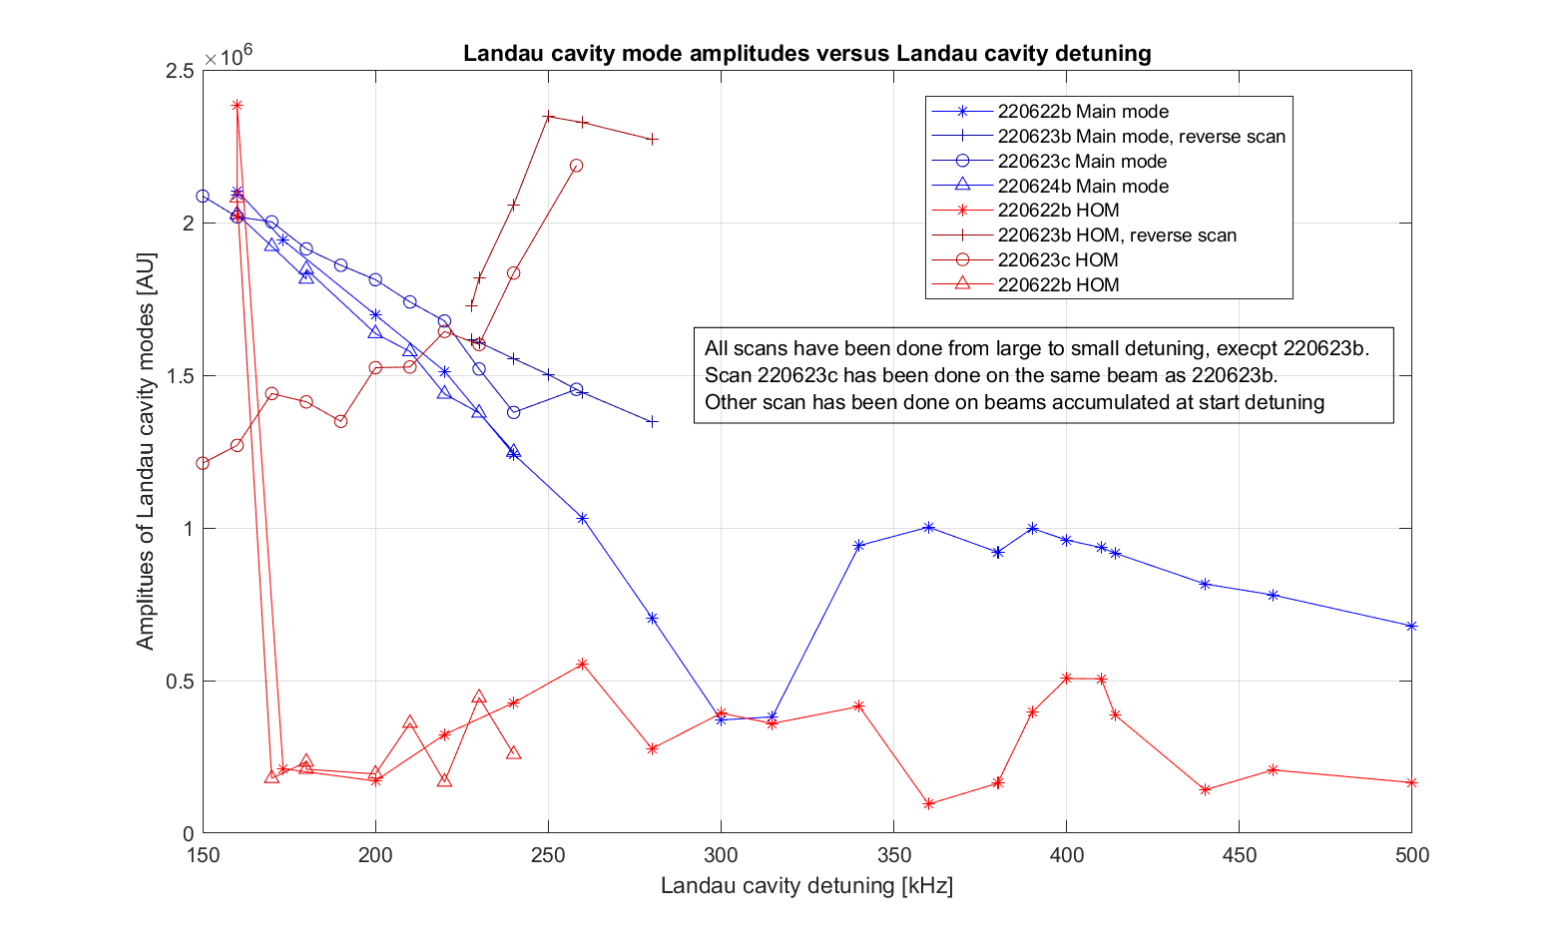
Accumulate at various detuning's
Cavity behavior depends on “history”
Notes:
Figure is LandauScan_LandauCavModeAmplitudes.png from \\isasvr14\isadfs\Nat_ISA-Astrid2\AccPhys\Instabilities\BeamModeMeas\220621-Scope03with3moreSignals\analyse\LandauFFTplots

Slide 8
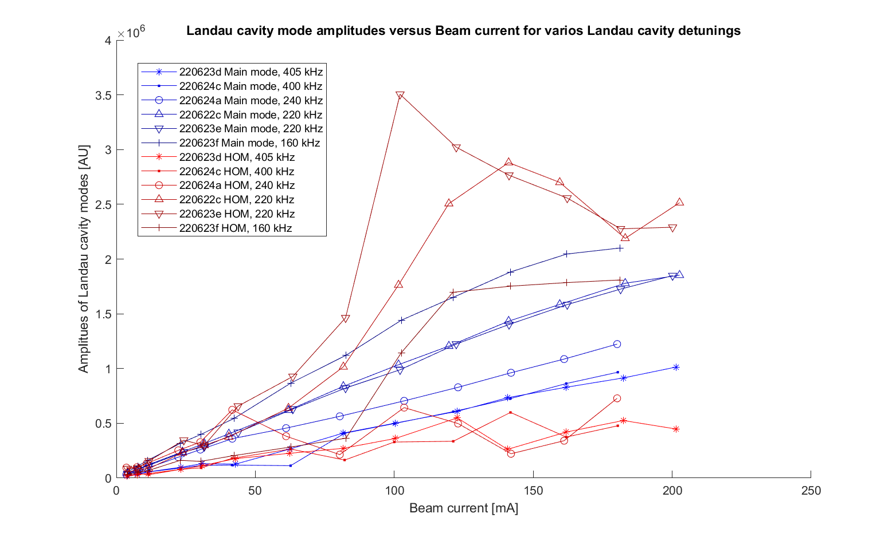
Beam accumulation
Cavity amplitudes as function of beam current
Amplitude of fundamental (blue) increases as detuning is lowered
But amplitude of RevHarm177 (red) are more irregular, but with a tendency that smaller detuning give much more amplitude of harmonic
Notes:
Plot is BeamCurrentAccum_LandauCavModeAmplitudes.png from \\isasvr14\isadfs\Nat_ISA-Astrid2\AccPhys\Instabilities\BeamModeMeas\220621-Scope03with3moreSignals\analyse\LandauFFTplots

Slide 9
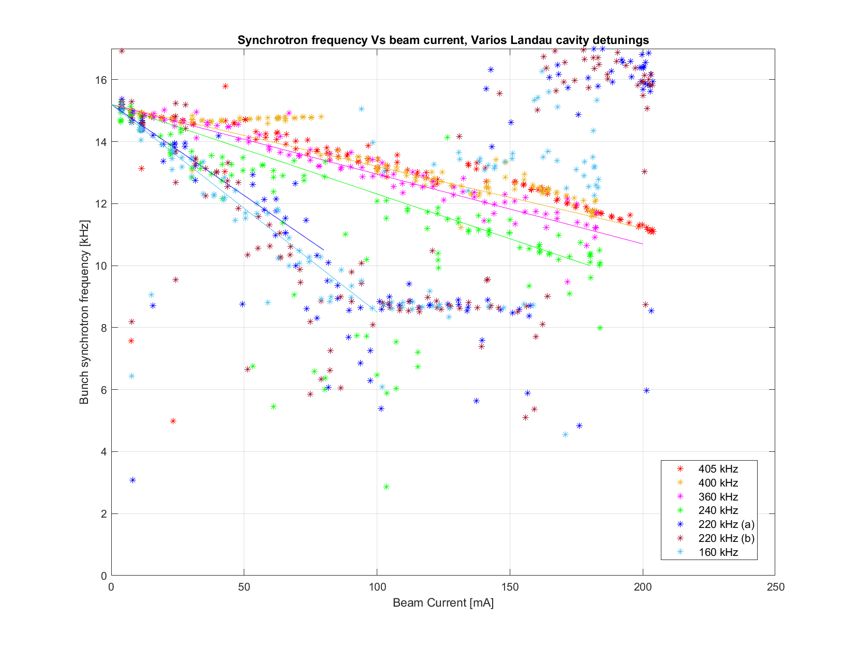
Synchrotron frequency
Synchrotron frequency gives a measure of total voltage seen by the beam (or rather slope around synchronous point)
Notes:
Plot is EvenFill_VsBeamcurrent_fSync.png from \\isasvr14\isadfs\Nat_ISA-Astrid2\AccPhys\Instabilities\BeamModeMeas\220621-Scope03with3moreSignals\analyse\CSdata

Slide 10
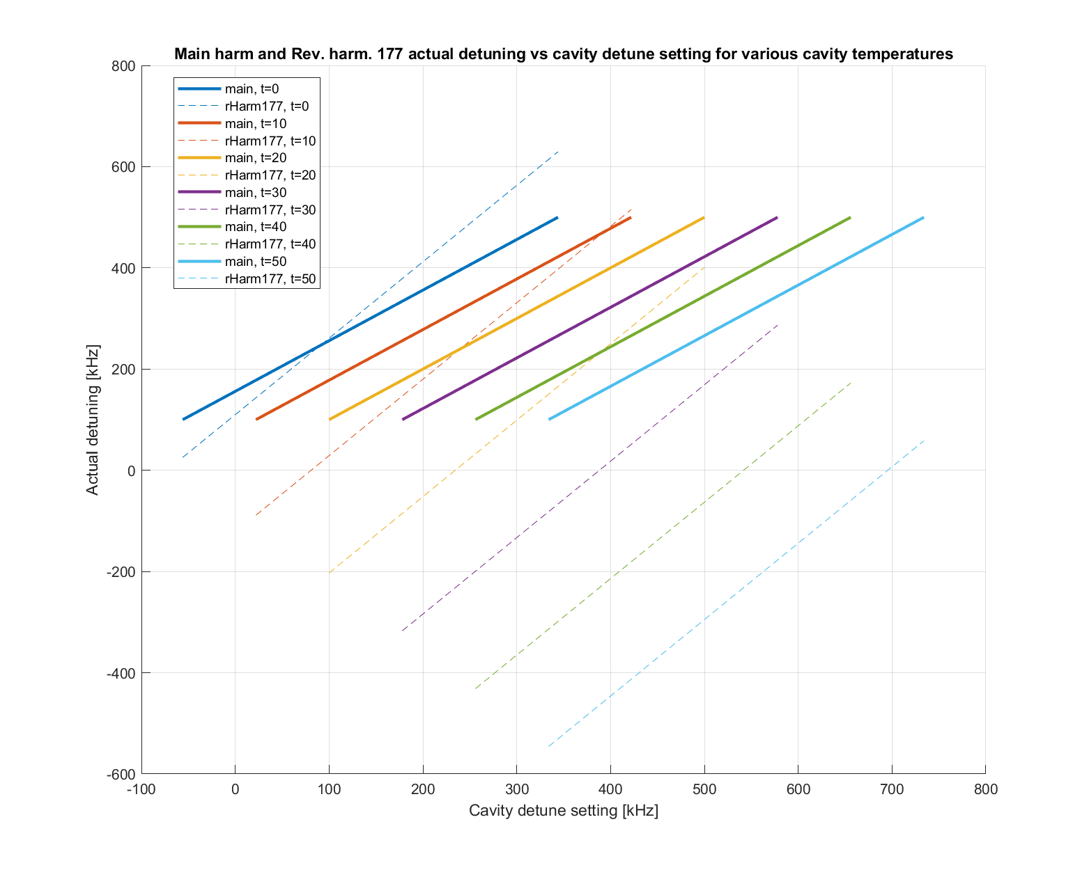
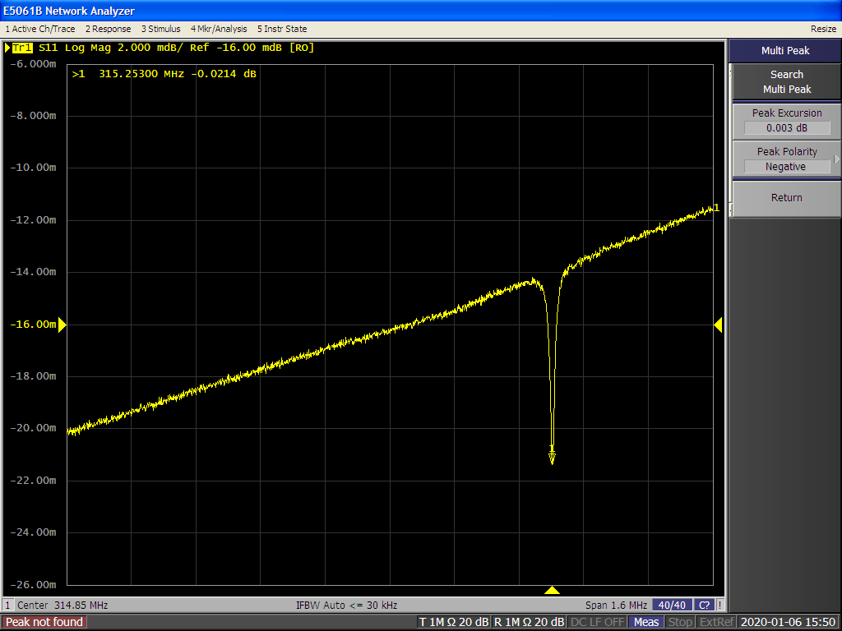
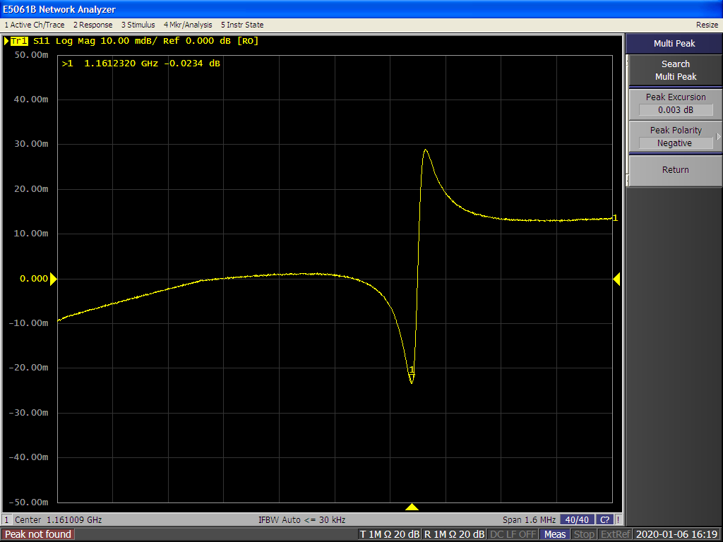
Temperature dependance
Have recorded all resonances with a network analyzer for various cavity temperatures (baking the cavity)
Main resonance
20°C, detune setpoint = 400 kHz
Cooling
Calculation based on fits
Nominal
Heating
Cavity actual detune [kHz]
Rev. Harm. 177
20°C, detune setpoint = 400 kHz
Cavity detune set [kHz]
Notes:
(Raw) Cavity scans are from \\isasvr14\isadfs\Nat_ISA-Astrid2\AccPhys\RF\LandauCavity\191217-HOMinvestigations\191231a-RevHarmTuningScan\RawAnalyzerScreens, rHarmTscan_43_h48 and _h177 (20°C, detuning setpoint is 400 kHz), see ELOG 1438 Rev. harm. 177 resonance is taken as the middle of the sharp flank.
Calculated plot of main and revHarm177 resonances are from \\isasvr14\isadfs\Nat_ISA-Astrid2\AccPhys\RF\LandauCavity\191217-HOMinvestigations\191231a-RevHarmTuningScan\calculations

Slide 11
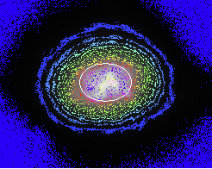
Increased cavity temperature
In August 2022, a small (borrowed) cooler/heater (10-40°C) was installed for our 3rd harm. cavity
By raising the 3rd harm. cavity temperature (30-35°C) we can operate stable at smaller main resonance detuning (“jumping” below the RevHarm177 resonance)
Beam lifetime is better (~2.3 h @180 mA versus ~2.0 h earlier)
with a smaller and more stable horizontal beam size
The range with stable beam is (still) rather narrow
Unless careful with temperature, we see an increase in vertical beam size
It seems that LCBI modes are damped even more, but measurements are uncertain
Bunches are not always nice gaussians, so (automatically) finding the bunch crossing time is not always easy
Notes:
MRS441 camera picture is MRS441CAM_220925_191316_180mA_scr.png from \\isasvr14\isadfs\Nat_ISA-Astrid2\AccPhys\Instabilities\BeamModeMeas\220921-OptimizeWithSmallCooler_Scope06\220925g-Accum180mA_noScopeData

Slide 12
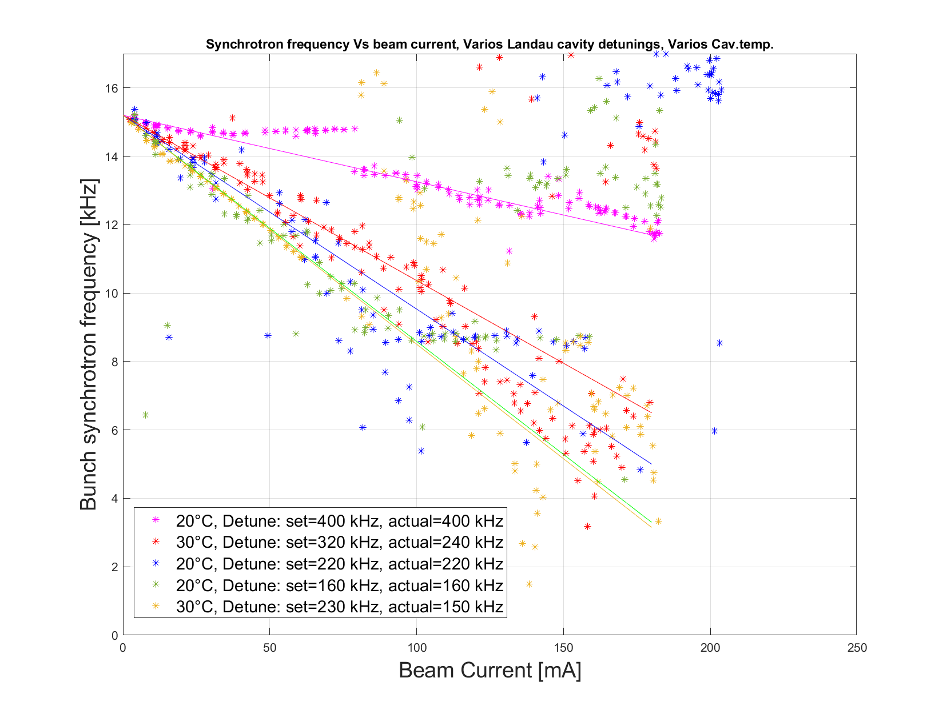
Sync. freq. vary cav. temperature
Synchrotron frequency measurements are consistent for various cavity temperatures
Notes:
Plot is EvenFill_VsBeamcurrent_fSync.png from \\isasvr14\isadfs\Nat_ISA-Astrid2\AccPhys\Instabilities\BeamModeMeas\220921-OptimizeWithSmallCooler_Scope06\analyse\HarmonLIPworkshop\Comparison20and30degC

Slide 13
Summary
At a Landau cavity temperature of 20°C beam parameters (lifetime, beam sizes, …) are only stable in a rather narrow range around a cavity detuning of 400 kHz
With a beam lifetime of ~2.0 h, and some jitter in horizontal beam size
At elevated temperatures (30-35°C) parameters can be found which give better beam lifetime and more stable beam
Presently beam lifetime is ~2.3 h, with a smaller and more stable horizontal beam
Vertically beam size is as earlier (at the right settings)
We will have to build a dedicated cooler/heater system, which can go higher up in temperature (20-70°C)
We should expect some need for conditioning

Slide 14
Thank you for your attention

Slide 15
Extra/spare slides

Slide 16
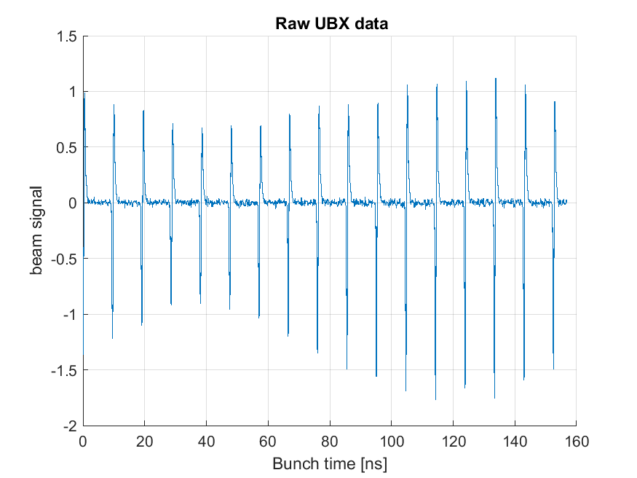
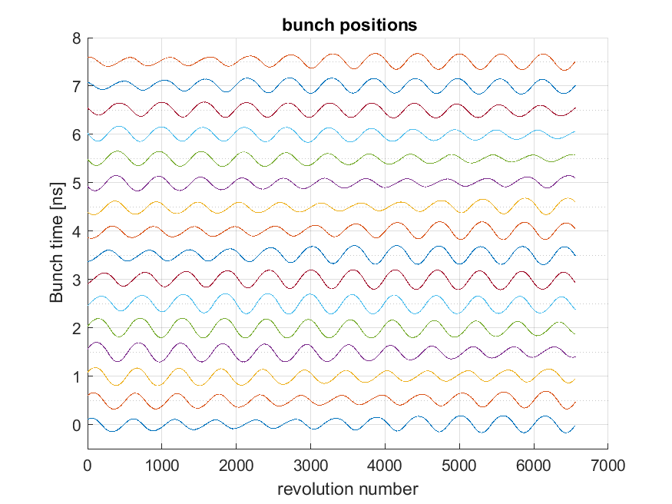
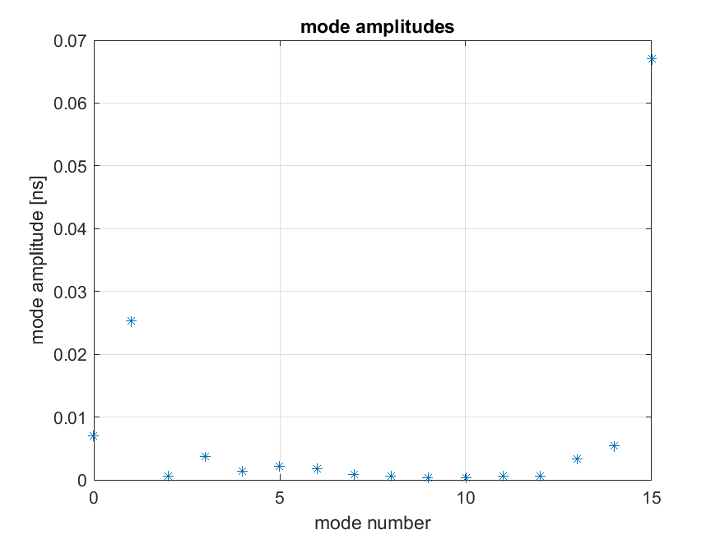
LCBI, 180 mA, Landau cav. at 20°C, detune 400 kHz
220624c-BeamAccumAtLandau400kHz
Notes:
plots from \\isasvr14\isadfs\Nat_ISA-Astrid2\AccPhys\Instabilities\BeamModeMeas\220621-Scope03with3moreSignals\220624c-BeamAccumAtLandau400kHz\BeamModeData

Slide 17
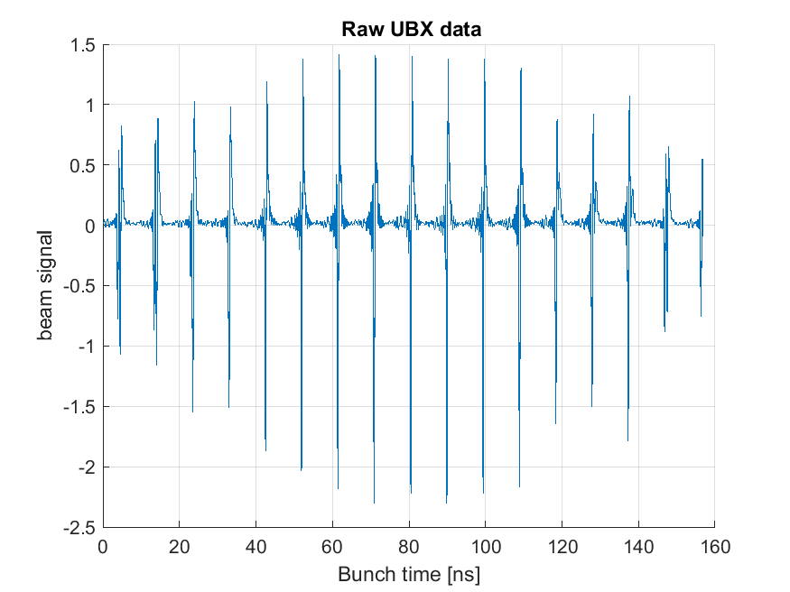
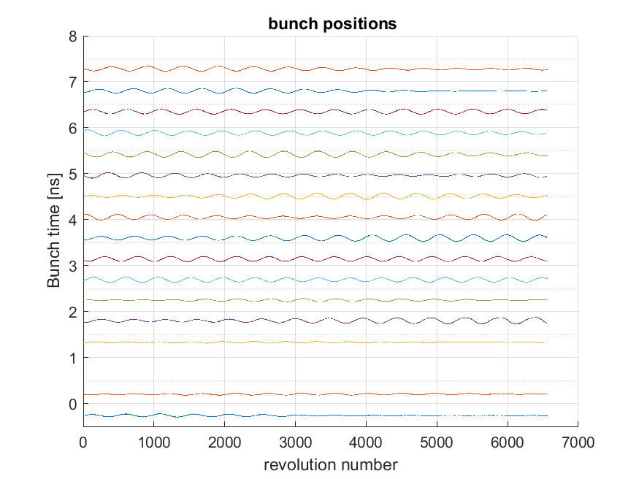
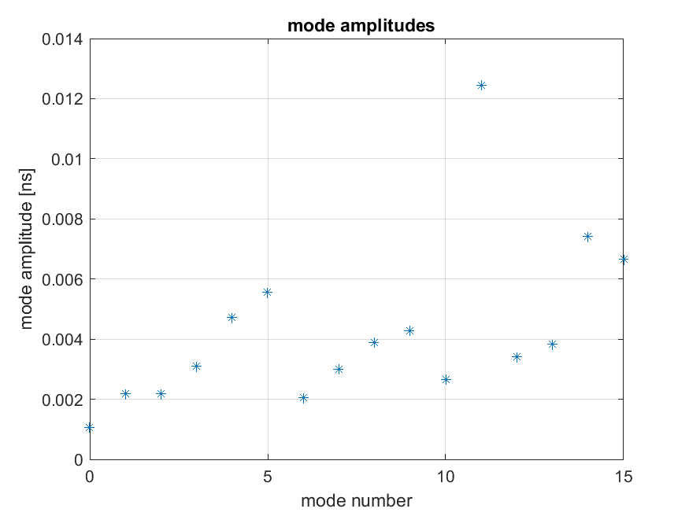
LCBI, 180 mA, Landau cav. at 30°C, detune set 320 kHz (actual 240 kHz)
220925d-BeamAccumAtLandau320kHz30degC
Notes:
plots from \\isasvr14\isadfs\Nat_ISA-Astrid2\AccPhys\Instabilities\BeamModeMeas\220921-OptimizeWithSmallCooler_Scope06\220925d-BeamAccumAtLandau320kHz30degC\BeamModeData

Slide 18
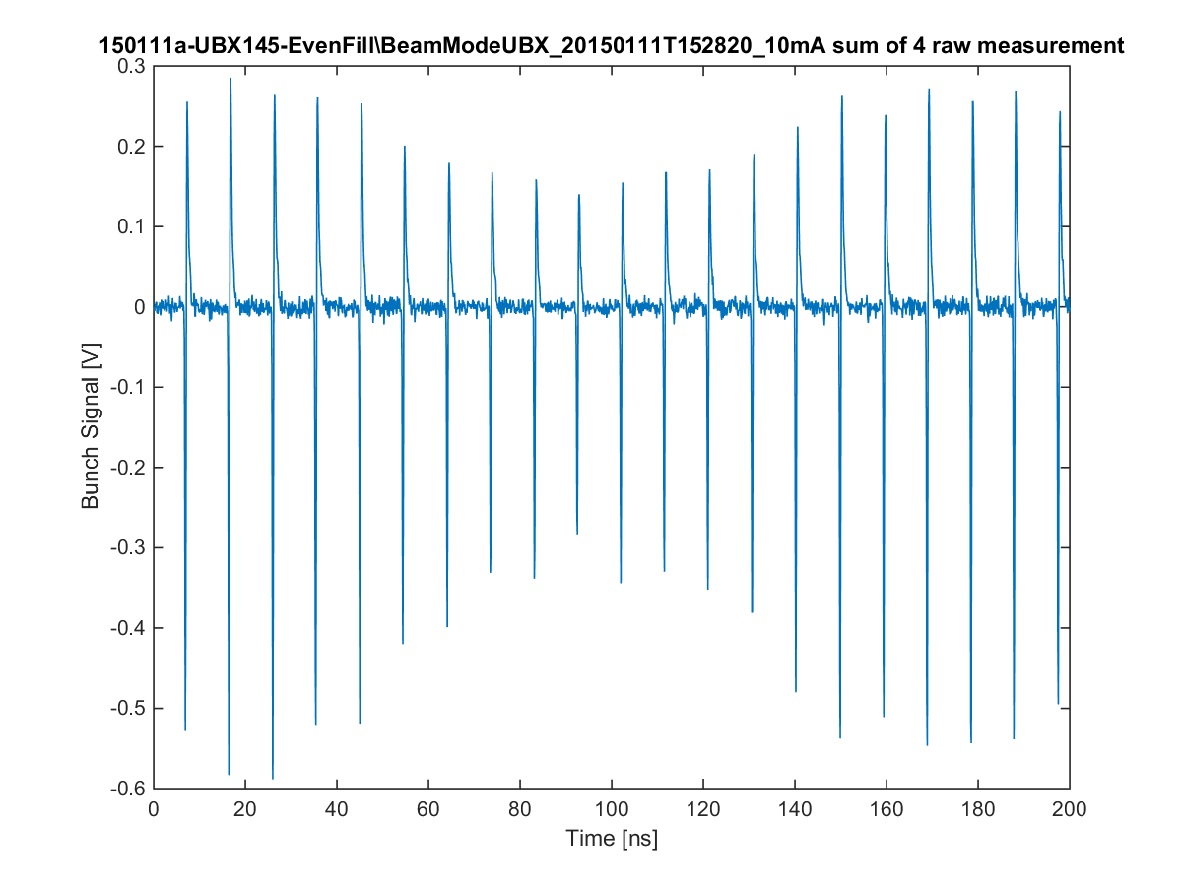
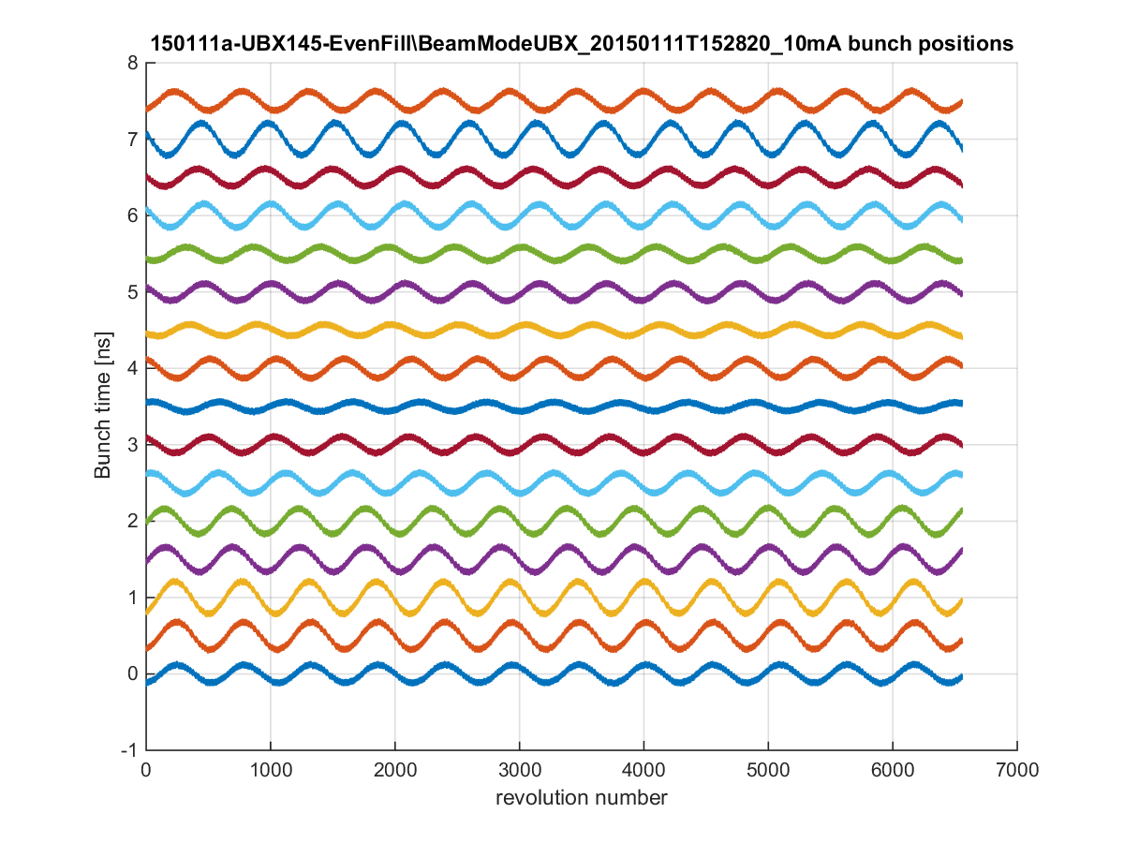
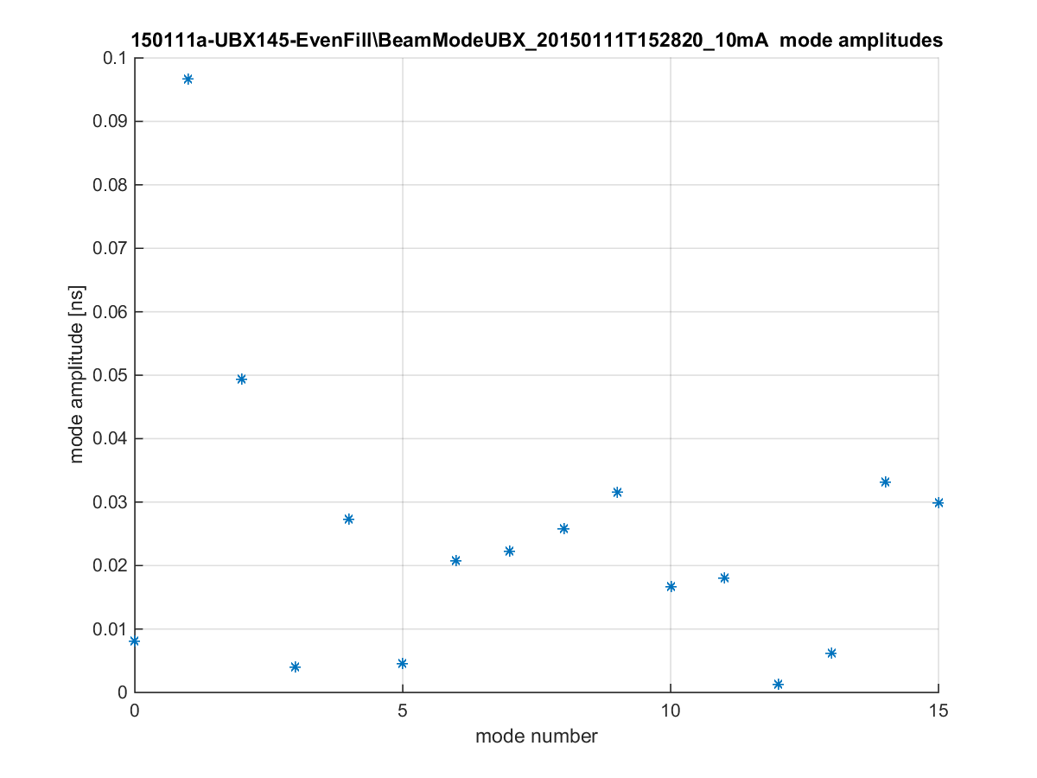
Longitudinal coupled bunch instability
All bunch positions can be found by finding all zero crossings
We can follow the oscillation of each bunch
Before Landau cavity
10 mA

Slide 19
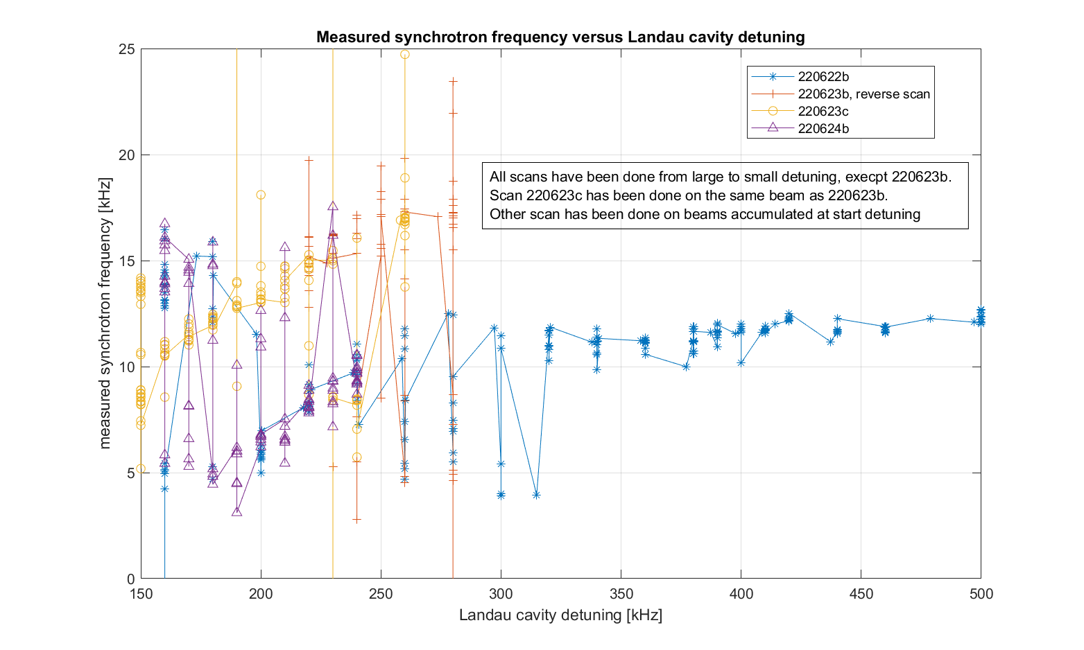
Synch. Freq. Vs cavity detuning
General trend is lower sync. freq. for lower detuning, but with other effects also taking place
Notes:
Plot is EvenFill_VsLandauDetune_fSync.png from \\isasvr14\isadfs\Nat_ISA-Astrid2\AccPhys\Instabilities\BeamModeMeas\220621-Scope03with3moreSignals\analyse\CSdata

Slide 20
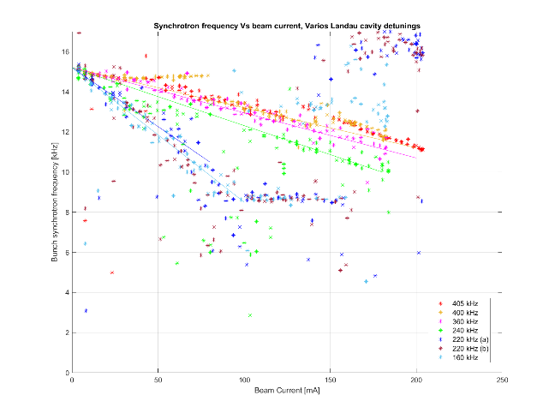
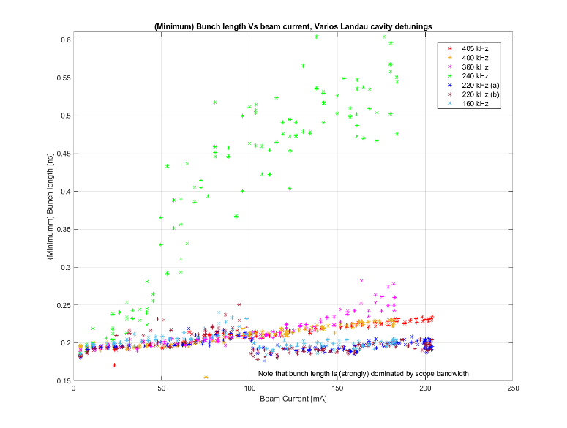
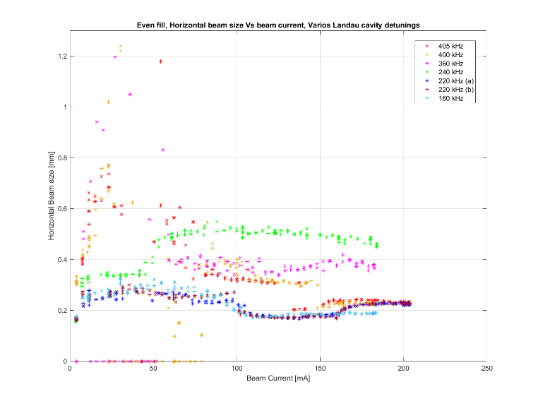
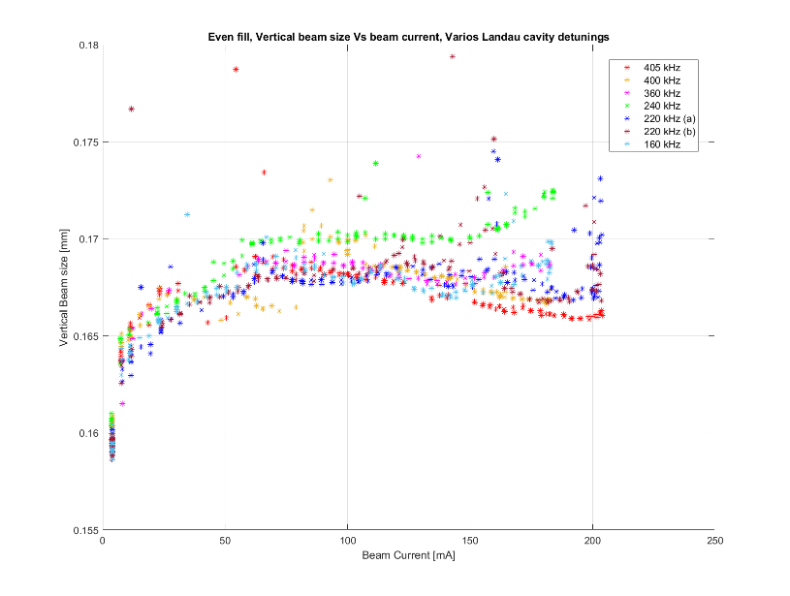
Other parameters (cav. at 20°C)
Beam lifetime
(minimum) Bunch length
Horizontal beam size
Vertical beam size
Notes:
Plots from \\isasvr14\isadfs\Nat_ISA-Astrid2\AccPhys\Instabilities\BeamModeMeas\220621-Scope03with3moreSignals\analyse\CSdata

Slide 21
ASTRID2
ASTRID2 is since 2013 the new synchrotron light source in Aarhus, Denmark
ASTRID2 main parameters
Electron energy: 580 MeV
Emittance: 12 nm
Beam Current: 200 mA
Circumference: 45.7 m
6-fold symmetry
lattice: DBA with 12 combined function dipole magnets
Integrated quadrupole gradient
4 straight sections for insertion devices
Using ASTRID as booster (full energy injection)
Allows top-up operation

Slide 22
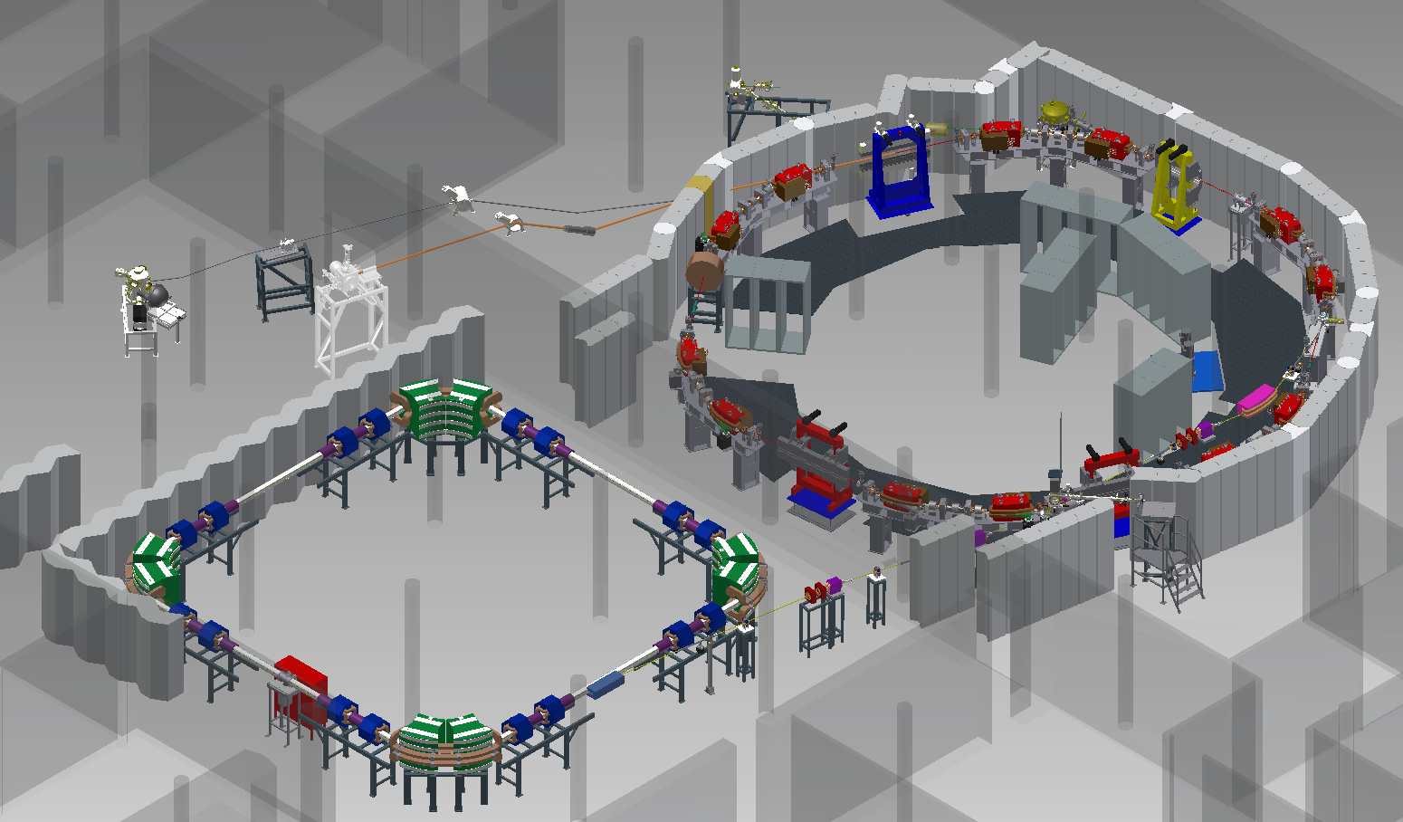
ASTRID2 Layout

Slide 23
Landau cavity
Installed March 2015
Prebaked (130°C)
Preconditioned with 100 W (~20 kV)
Multipactoring around 10 W (200 V)
Installed in the ring

Slide 24
Longitudinal coupled bunch instability
We have strong longitudinal coupled instability
Mode amplitudes are up to ~0.1 ns
10 ns bunch separation
Threshold (beam current) is low (a few mA)
Through dispersion it gives strong horizontal oscillations
Clearly visible on our SR diagnostic camera (with short exposure time)
Dispersion = 0.18 m

Slide 25
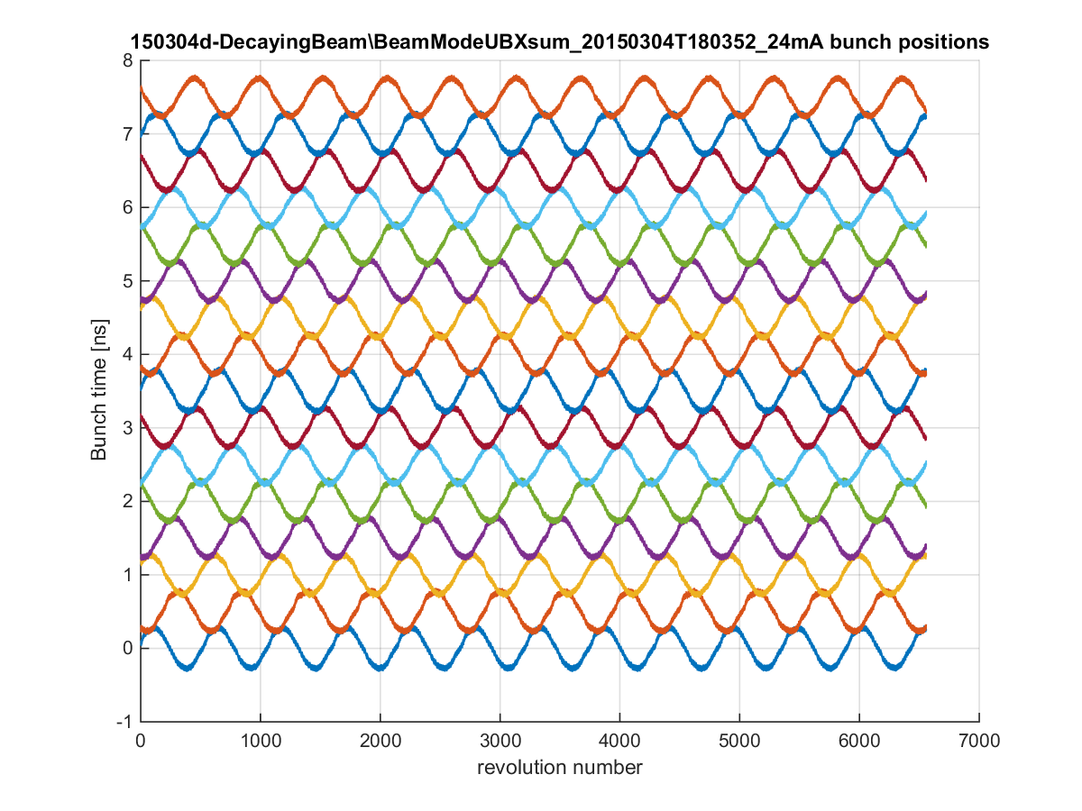
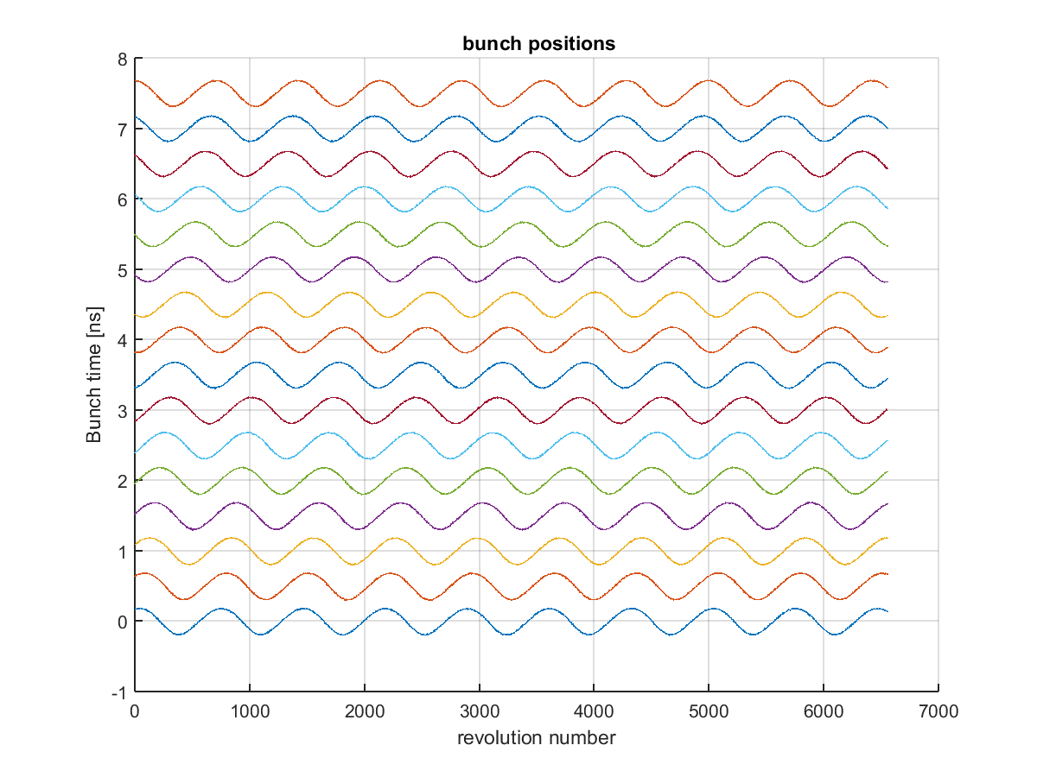
Longitudinal coupled bunch instability
Landau cavity is damping the instability a little, and it changes which modes are the strongest
We can find a Landau detuning where the beam appears stable on our diagnostic camera
We are moving the oscillations higher up in frequency (where they are less apparent)
Before Landau cavity (24 mA)
Dominant mode: 9
With Landau cavity (120 mA)
Dominant mode: 15
Notes:
Before Landau cavity: data is from 150304
With Landau cavity: data is from 150924 (stored in \\isa\data\Astrid2\AccPhys\Instabilities\BeamModeMeas\150911-SingleChMeasWithLandauCavity\150924a-UserBeam120mA\BeamModeData)

