Slide 1
Harmonic Cavities at MAX IV
Åke Andersson on behalf of the MAX IV team
HarmonLIP, MAX IV, Lund, Sweden, October 2022

Slide 2
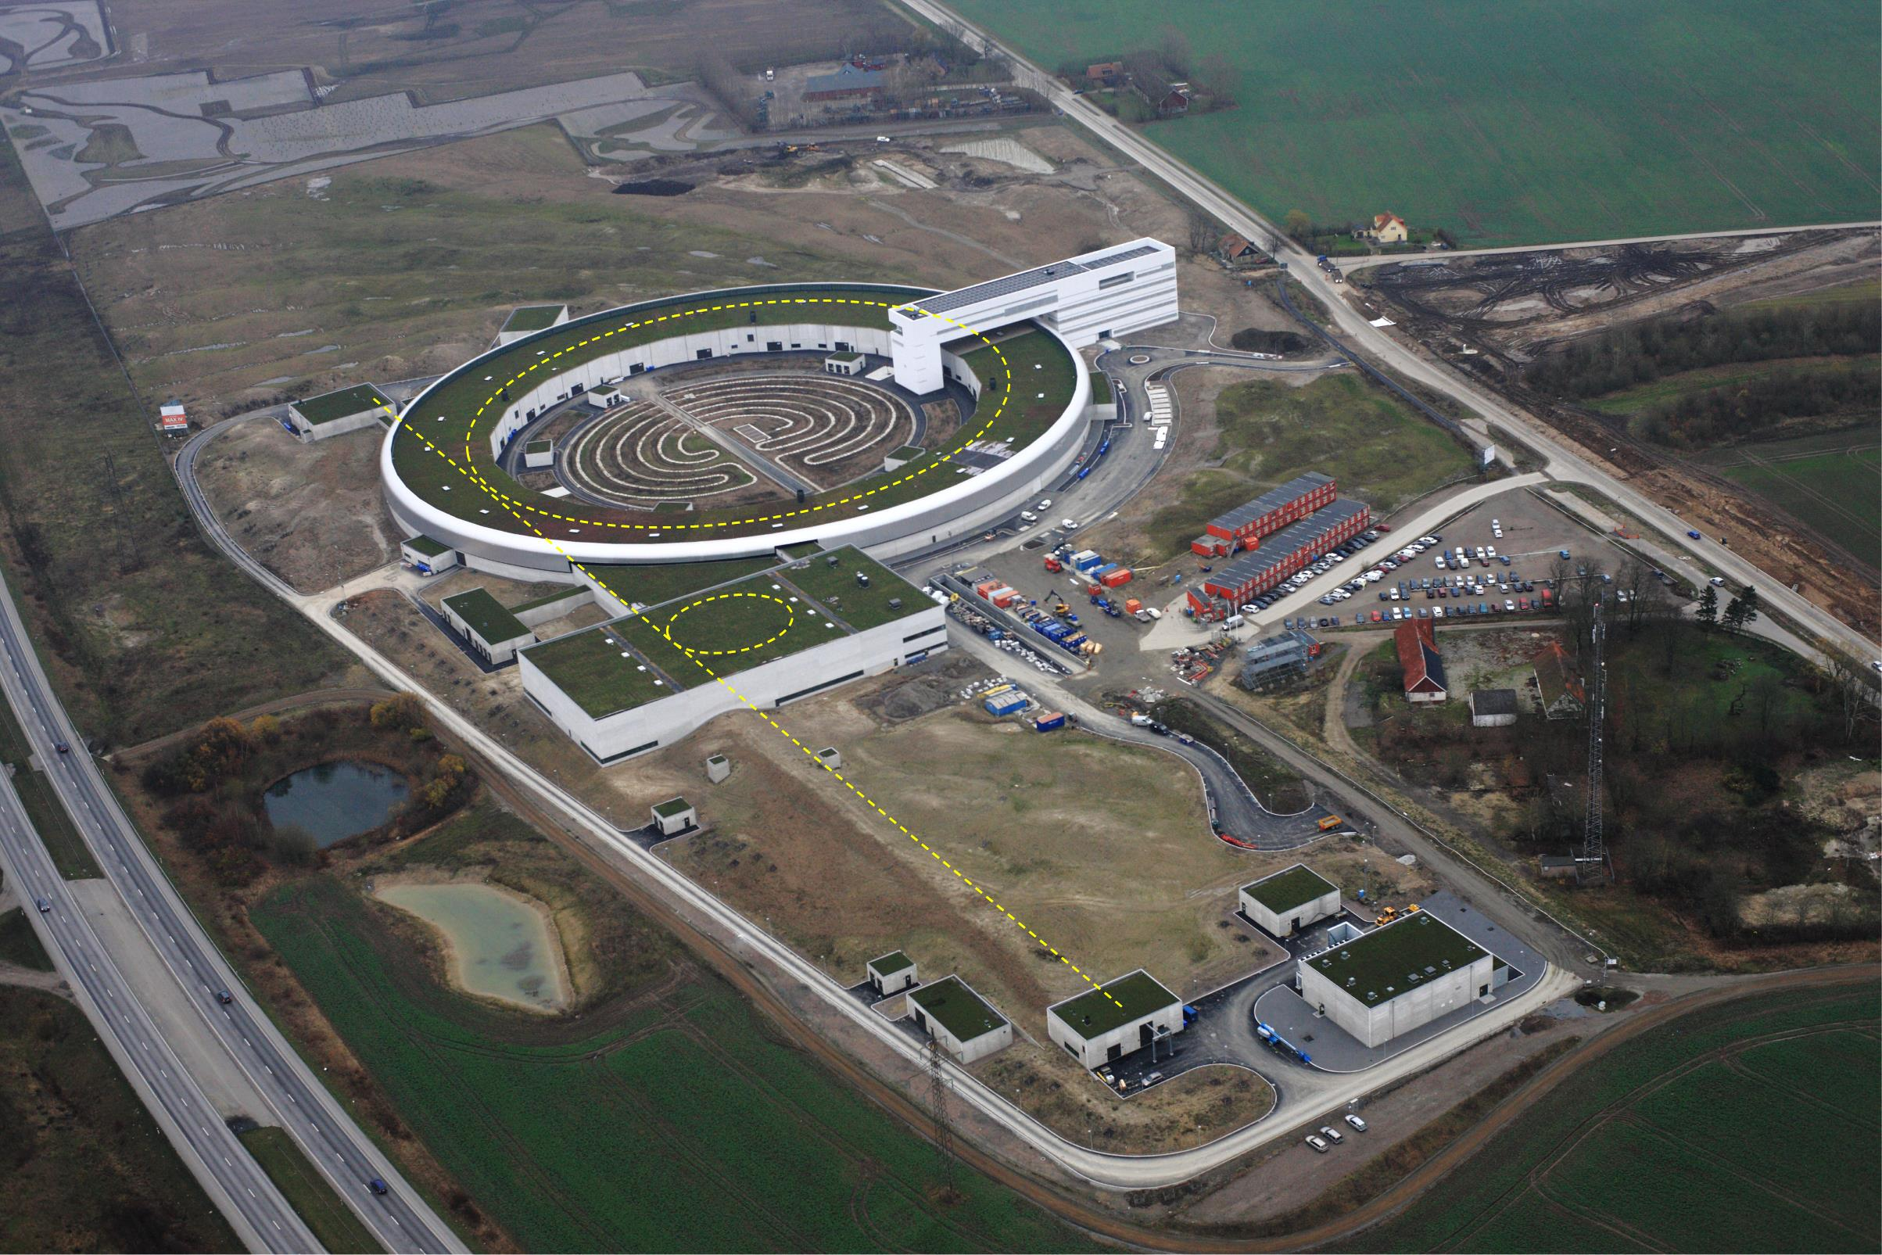
The MAX IV Accelerators
3 GeV ring
528 m circ, MBA, 330 pmrad
Short Pulse Facility
1.5 GeV Ring
96 m circ., DBA, 6 nmrad
Linear accelerator (ca 250 m)
Electron sources
Slide by S.Werin

Slide 3
Harmonic Cavities @ MAX IV
The two MAX IV rings use the same type of main (100 MHz) and harmonic (300 MHz) cavities
Harmonic Cavities were part of the baseline design and installed from day one.
In particular the 3 GeV ring, the first fourth-generation light source, depends critically on the use of Harmonic Cavities for
  Bunch lengthening to mitigate intra-beam scattering and improve lifetime.
  Increased synchrotron frequency spread to mitigate coupled-bunch modes.
The availability of two rings using the same RF systems allows insight into scaling laws of the relevant physical phenomena.

Slide 4
MAX IV Rings Nominal Parameters
 | 3 GeV Ring | 1.5 GeV Ring
Energy [GeV] | 3.0 | 1.5
Current [mA] | 500 | 500
Circumference [m] | 528 | 96
RF frequency [MHz] | 99.931 | 99.931
Harmonic number | 176 | 32
Revolution Frequency [kHz] | 568 | 3123
Energy Loss per turn (dipoles) [keV] | 360 | 117
Energy Loss per turn (dip+IDs) [keV] | <1000 | ̴130
Momentum compaction | 3.07E-4 | 3.04E-3
Horizontal emittance (bare ring) [pmrad] | 330 | 6000

Slide 5
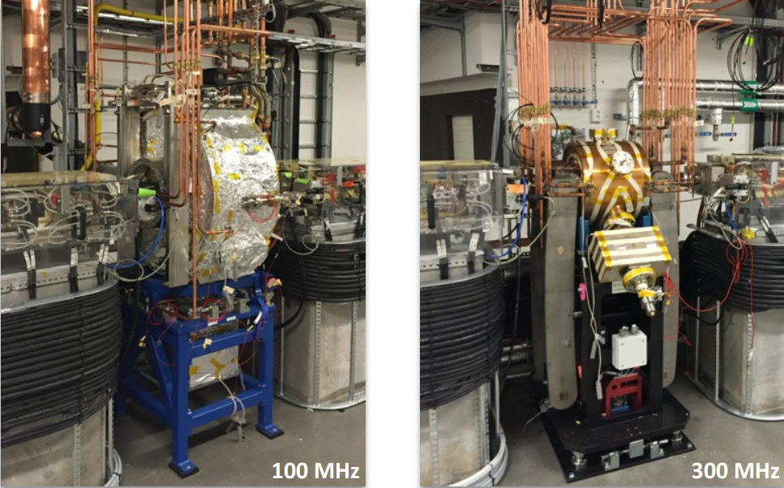
Main cavity parameters
 | Main cavities
Type | Capacity Loaded, Normal Conducting
Frequency tuning | Elastic one-side deformation
HOM dampers | Ports available, not used
For 3 GeV ring:
Max voltage/cavity | 300 kV
Max wall loss/cavity | 27 kW
Max power to beam/cav | 500 kW/6 = 83 kW
Optimum coupling | 4.1
*6

Slide 6
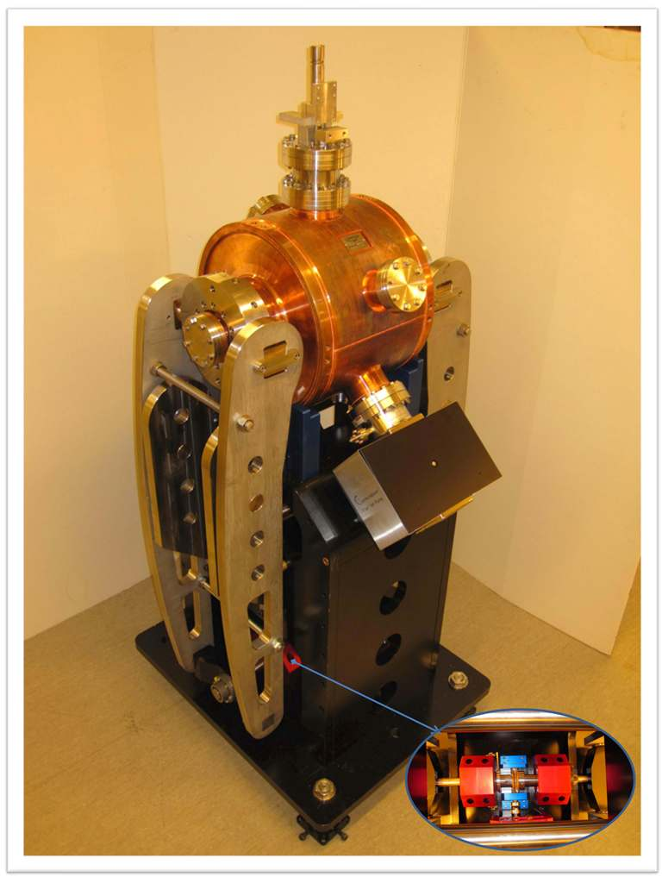
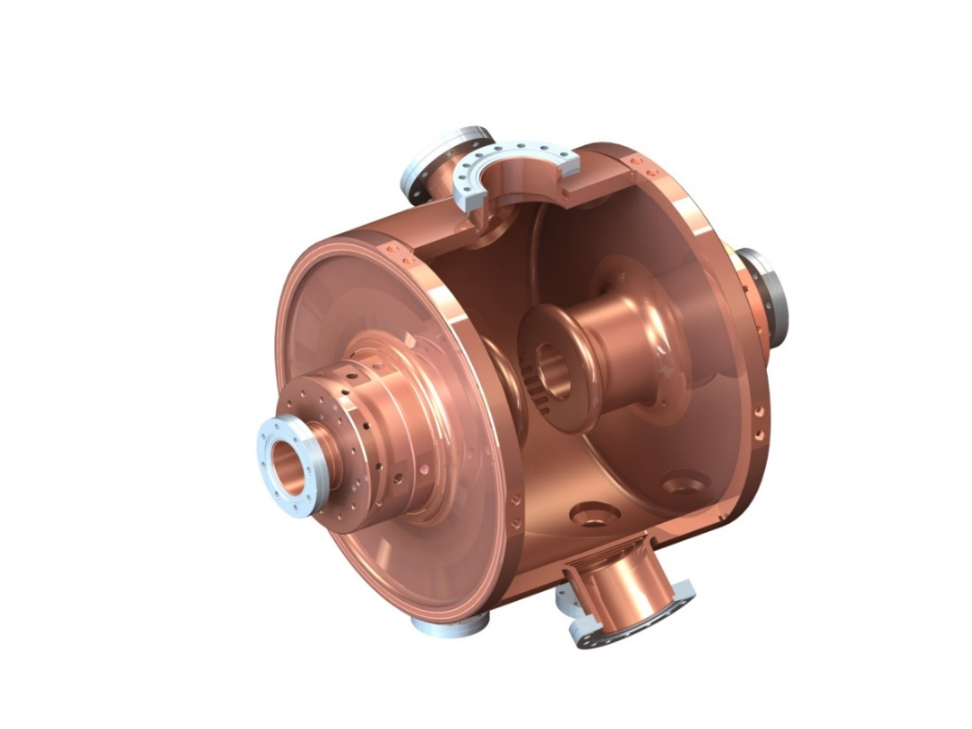
Harmonic cavity parameters
300 MHz
Capacity loaded; NC
Tuning by two-sided elastic deformation
Two (unused) ports for HOM damping
Inner length/diameter: 312mm/400mm
Theory R_{sh}/Q: 2.85MΩ/21600
(Definiton: R_{sh} = V²/2P)
Measured Q: 20900 ➔
R_{sh} = 2.75 MΩ
Mechanical design, Elsayed Elafifi, MAX-lab

Slide 7
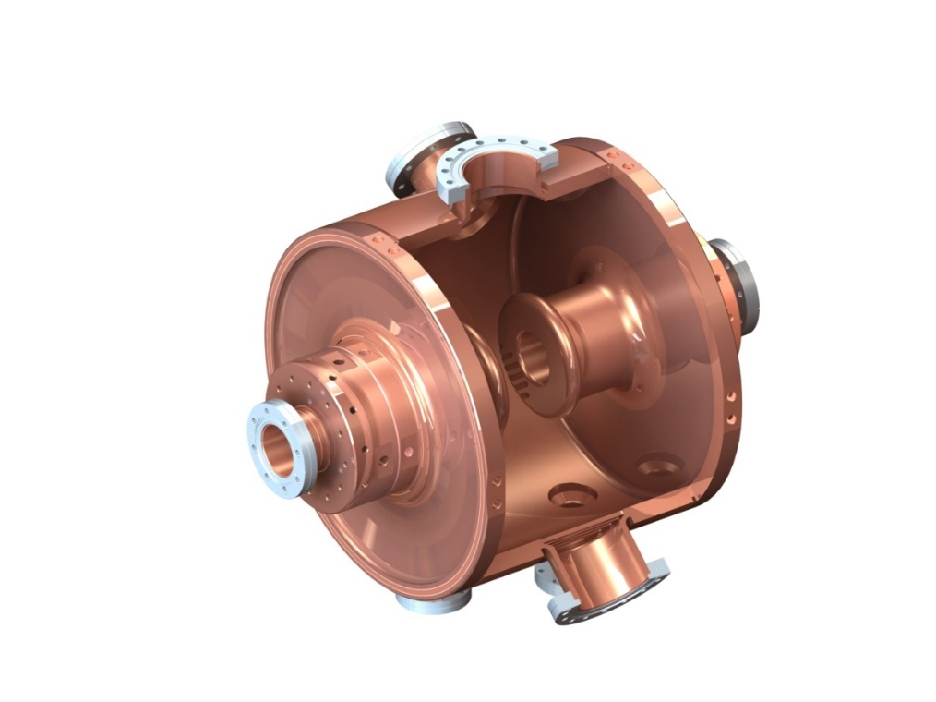
Harmonic cavity parameters
300 MHz
 | Harmonic cavities
Harmonic frequency | 299.793 MHz
Active/passive | Passive (Landau)
Total max voltage for near-FP | 500 kV
Number of cavities | 3
Total shunt impedance | 8.25 MΩ
Max power/cav | 5 kW
Number of cavities | 2
Total shunt impedance | 5.5 MΩ
Max power/cav | 11.4 kW
Two examples for the 3 GeV ring
Theory R_{sh}/Q: 2.85MΩ/21600
(Definiton: R_{sh} = V²/2P)
Measured Q: 20900 ➔
R_{sh} = 2.75 MΩ

Slide 8
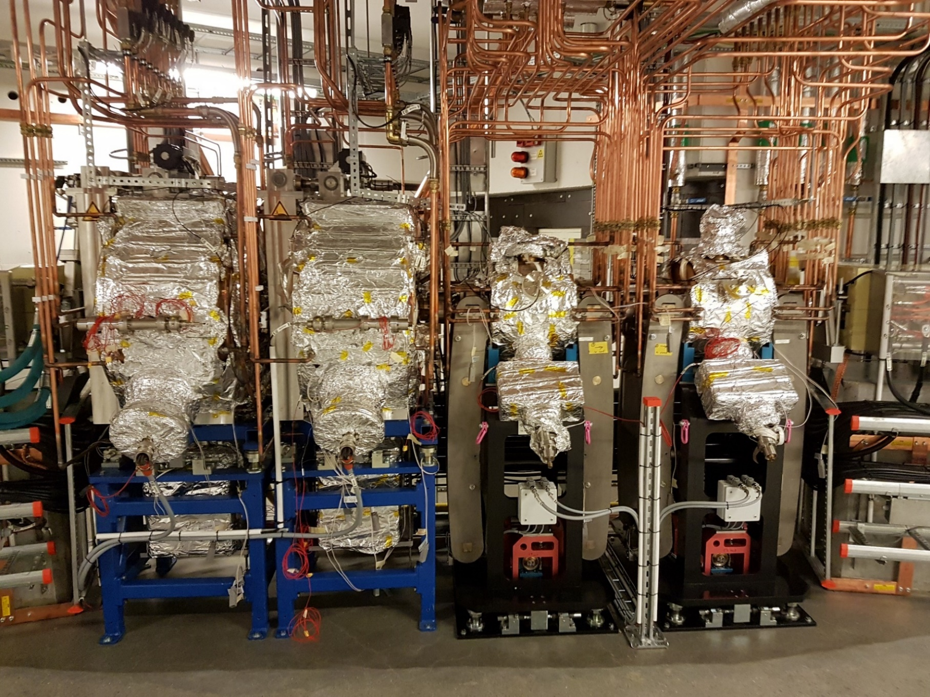
1.5 GeV: RF Straight Section
270 kV
270 kV
~90 kV
~90 kV
A_{ε} = 4.0 %
f_{s} = 7.3 kHz
w/o Landaus

Slide 9
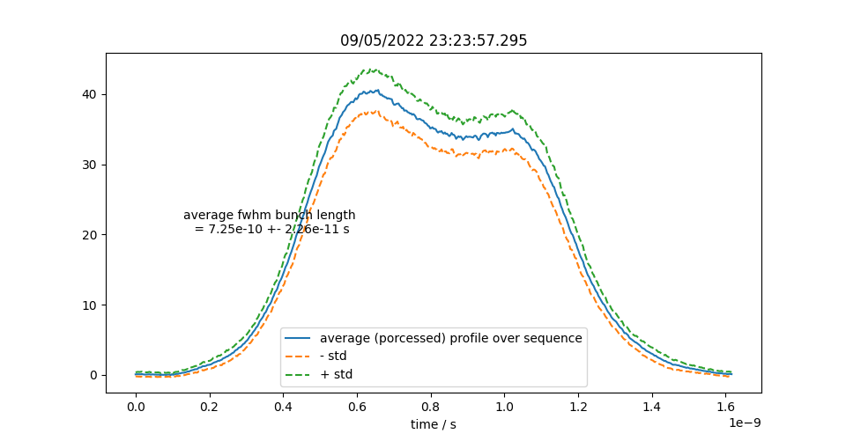
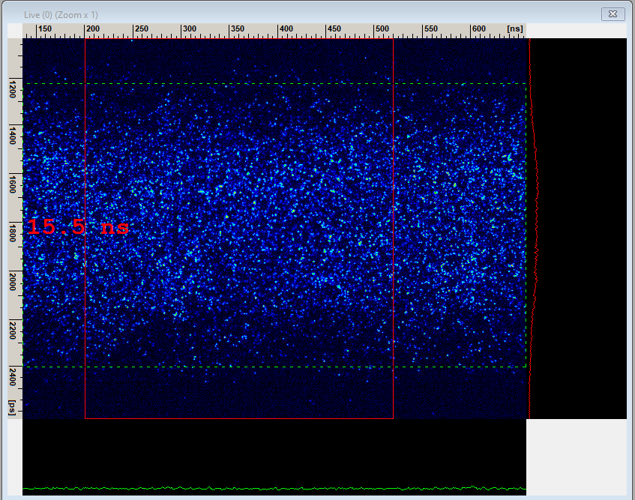
Lengthening at 500 mA in the 1.5 GeV Ring
In the early days (~2018) at 500 mA we observed ion trapping, which we cured by introducing a gap in the bunch train with a resulting transient.
We can now run at 500 mA in uniform fill (vacuum improved along the years).
Measurements: Miriam Brosi
Landaus tuned to 65 kV & 115 kV
FWHM = 725 ps
FWHM_{nat} = 116.4 ps
BL = 6.2

Slide 10
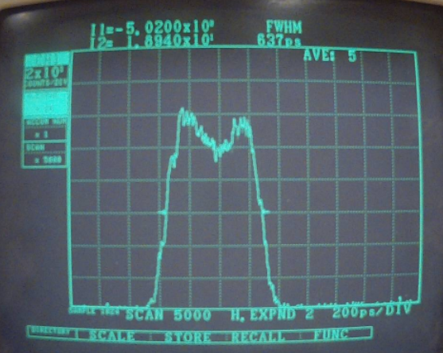
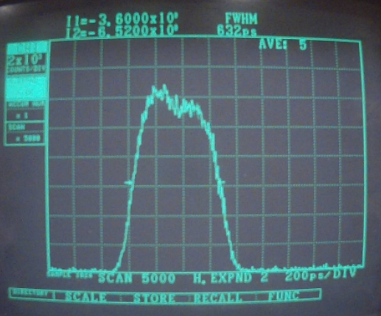
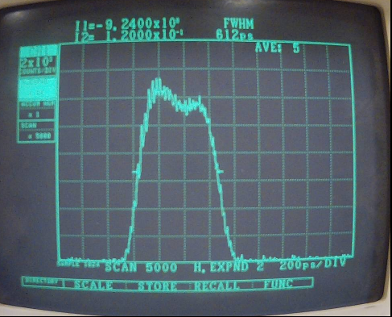
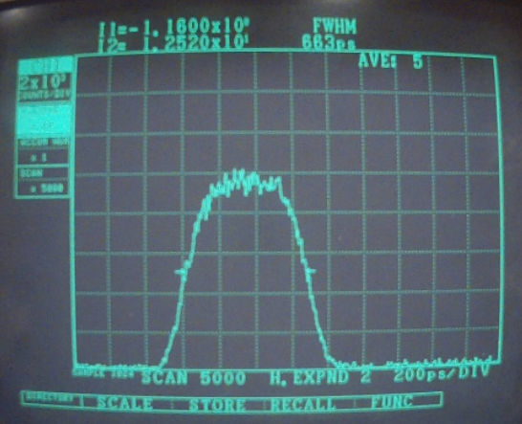
HCs in 3 GeV ring: Suppression of Coupled Bunch Instabilities and Bunch Lengthening
Needed much more effort than in the 1.5 GeV ring!

Slide 11
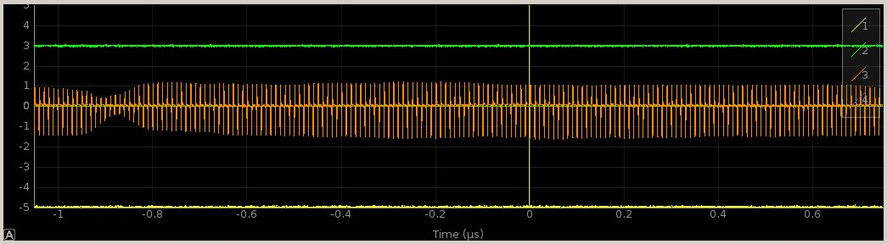
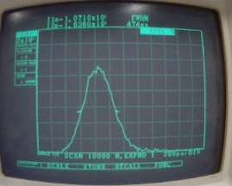
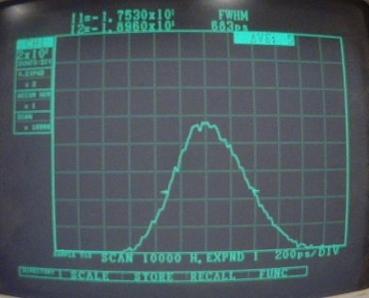
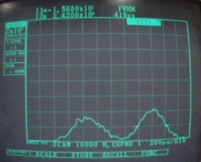
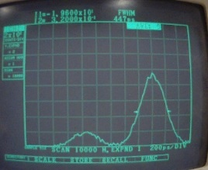
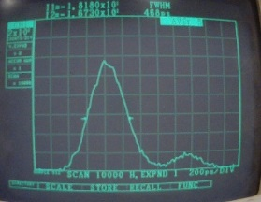
Transient beam loading when running with a gap
Bunch fill-pattern seen on BPM sum signal
3 mA
50 mA
200 mA
170 mA
Why need for gap? See talk by Francis
Longest bunches ~ 680 ps (FWHM)
Natural bunch length = 95 ps (FWHM)
Effective BL < 5, more like 3

Slide 12
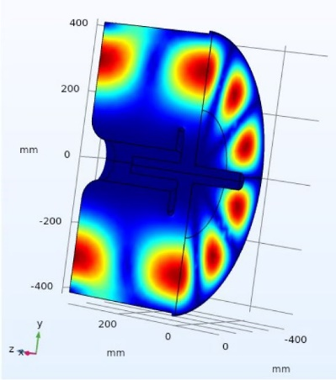
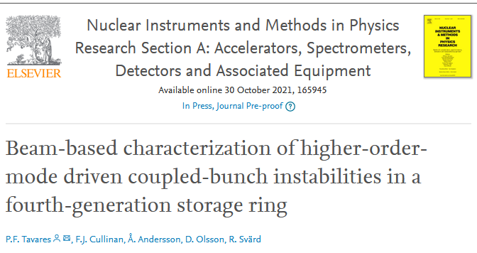
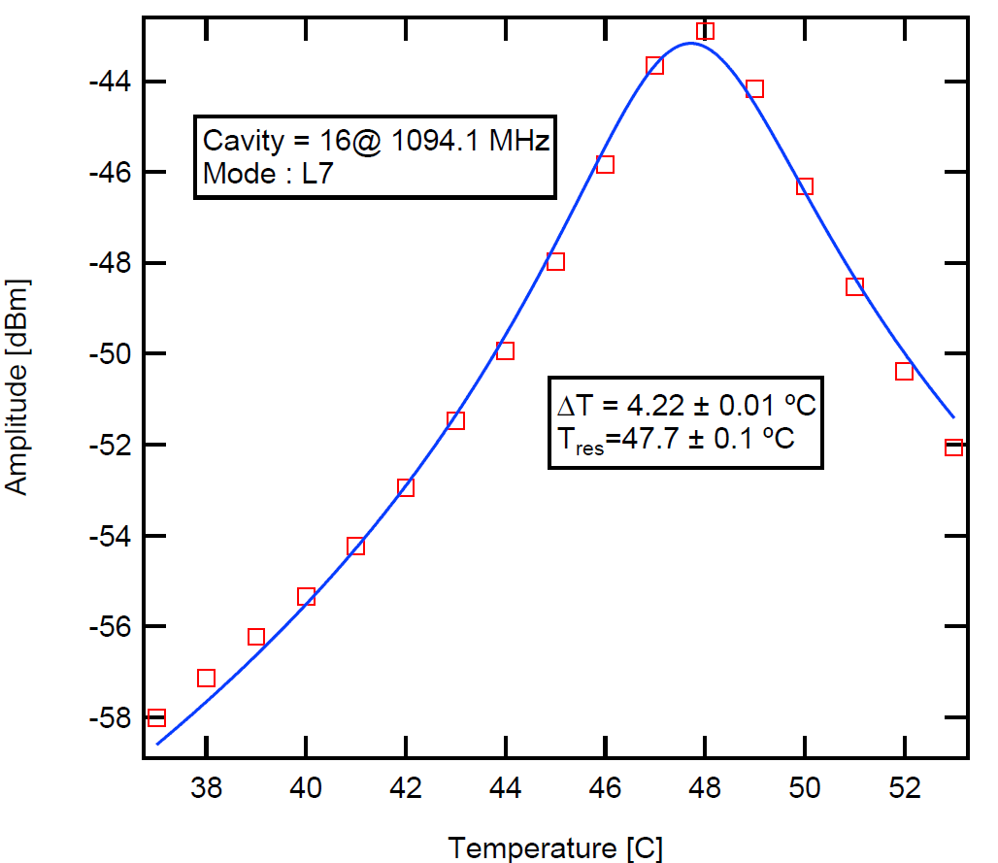
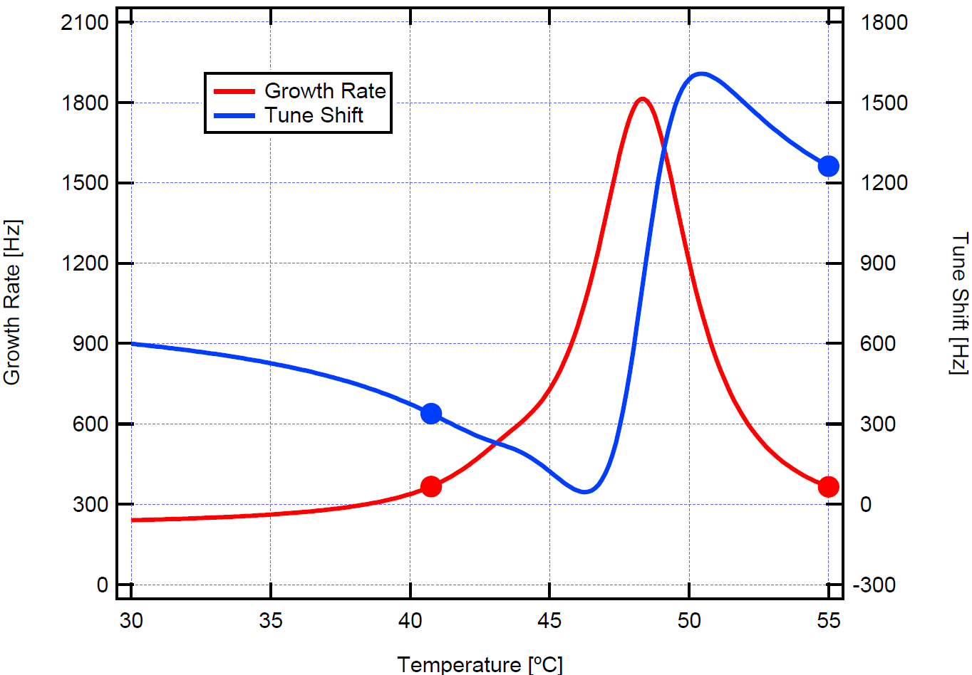
Modelling of Cavity HOMs
Multiple techniques to characterize HOM parameters under real operational conditions.
Optimization takes into account not only the growth rates but also the coherent tune shifts.
Tune shifts from the same mode in different cavities can be made to partially cancel one another
Final optimization done at delivery current (300 mA)

Slide 13
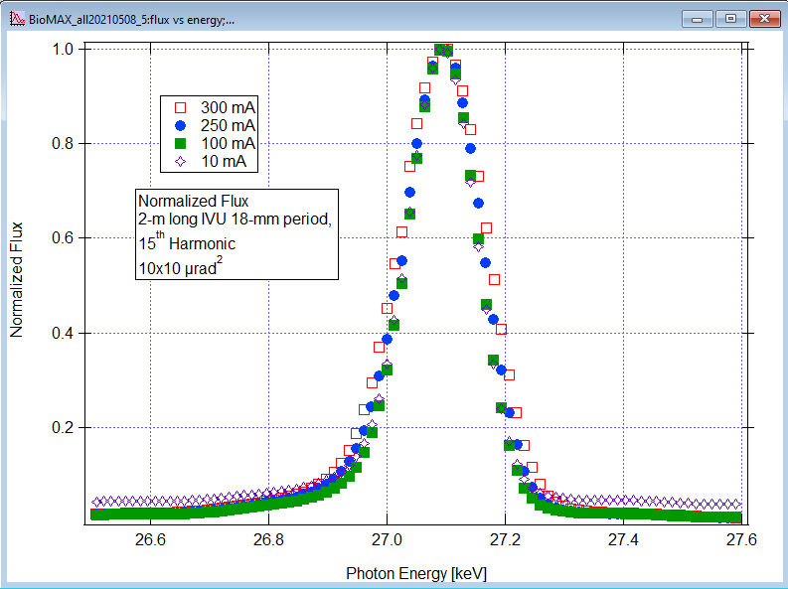
Cavity Temperature/Voltage Optimization
RCDS (Robust Conjugate Direction Search) for optimum main and harmonic cavity voltage amplitudes and temperatures in order to allow increasing the beam current, keeping the beam energy spread at natural level.
Spectral Flux at 15th Harmonic
in pin-hole geometry at BioMAX
Data by Ishkhan Gorgisyan

Slide 14
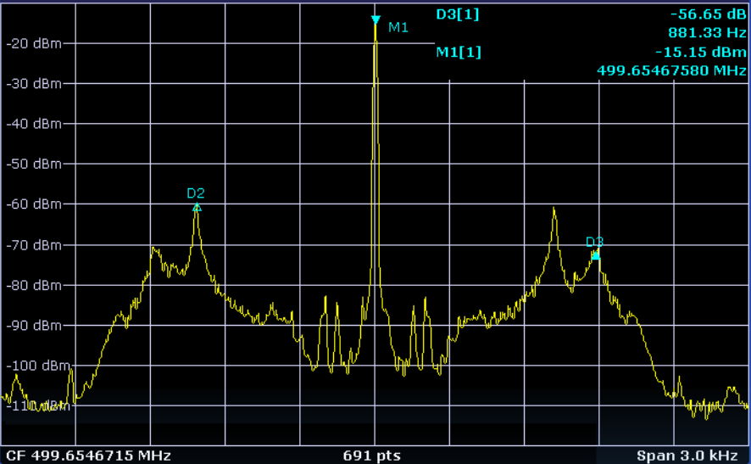
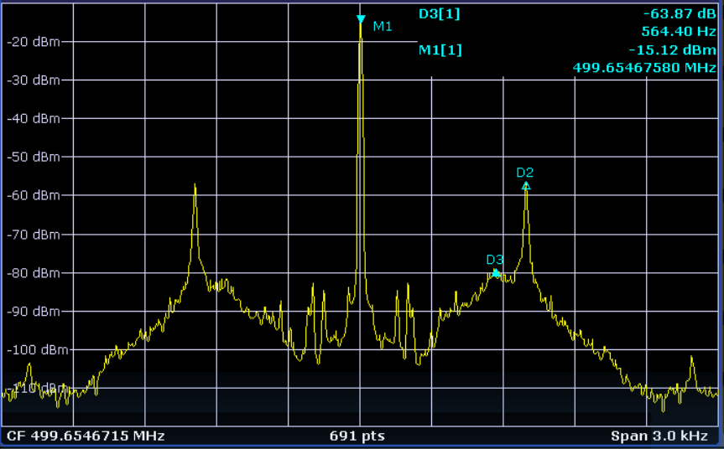
HCs and Coupled Robinson Instabilities
Theoretical curves: R.A.Bosch et al, PRSTAB Vol. 4 074401 , 2001
Beam response observed on spectrum analyser, excitation by BbB feedback system
This instability is suppressed by a Mode-0 feedback system on one main cavity.
Built by David McGinnis, see LLRF2019/218, LLRF 2019, Chicago.
Data by F.Cullinan, Å.Andersson, R.A.Bosch & P.F.Tavares

Slide 15
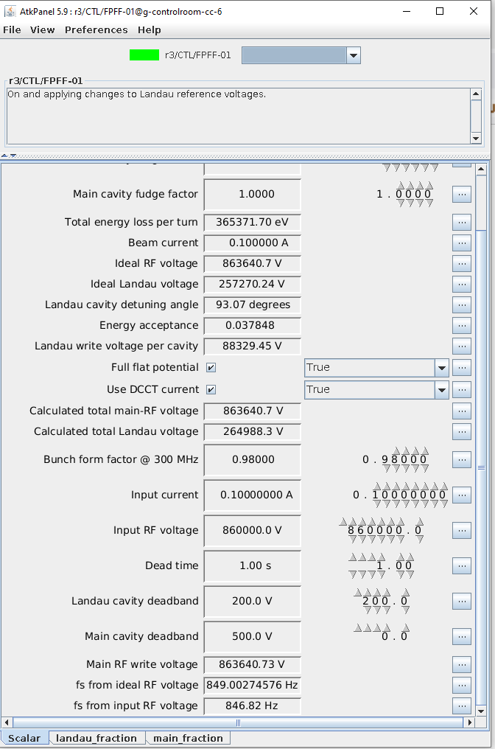
The Flat-potential feedforward device
Maintaining Flat-Potential at different Currents/ID settings is possible also with a Passive Cavity.
A tango device calculates the settings of main and harmonic cavities that created flat (or near-flat) potential conditions for a given beam current and energy loss per turn (defined by dipoles and ID gaps)

Slide 16
Summary
Harmonic Cavities are critical for the performance of the MAX IV rings.
The availability of two rings with widely different parameters and the same RF system components allows for a variety of parametric studies.
  Transient beam loading
  Robinson Coupling
  Mode 1 Instability
  HOM Modelling

Slide 17
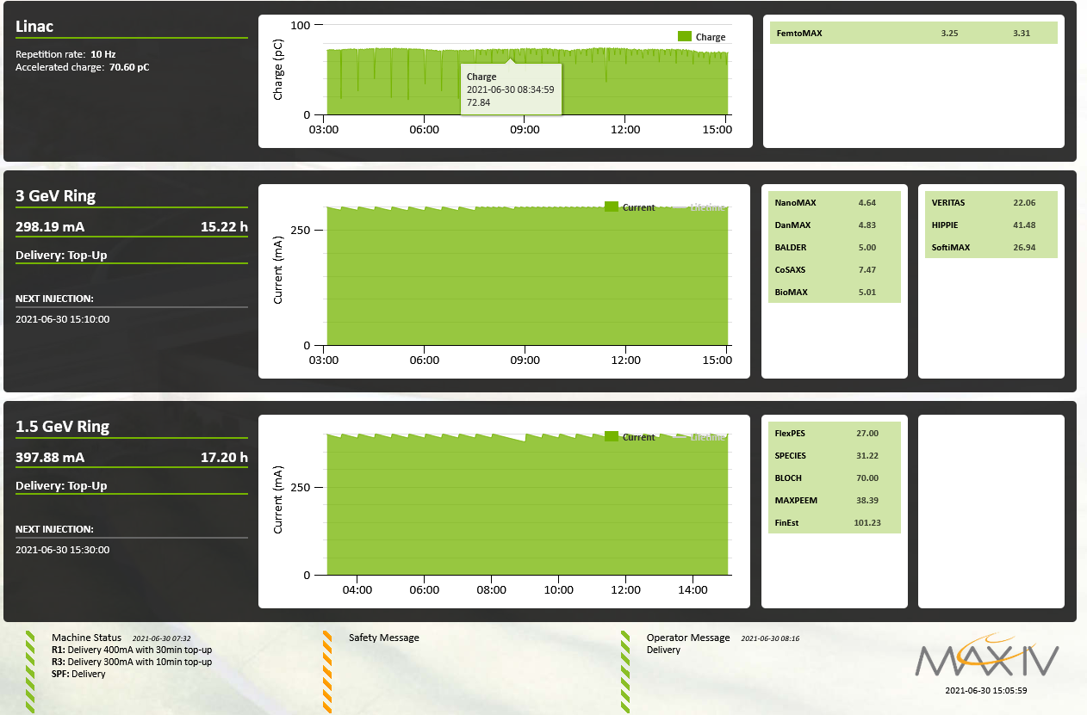

Summary
Harmonic Cavities are critical for the performance of the MAX IV rings.
The availability of two rings with widely different parameters and the same RF system components allows for a variety of parametric studies.
  Transient beam loading
  Robinson Coupling
  Mode 1 Instability
  HOM Modelling

