Slide 1



Slide 2
HarmonLIP Meeteing
Review of Synchrotron Solaris Project
Lund, Max IV Laboratory 10.10.2022
Krzysztof Guła
SOLARIS National Synchrotron Research Centre

Slide 3
Outline
Quick review of NRSC Solaris
RF project review
Operation
Failures

Slide 4
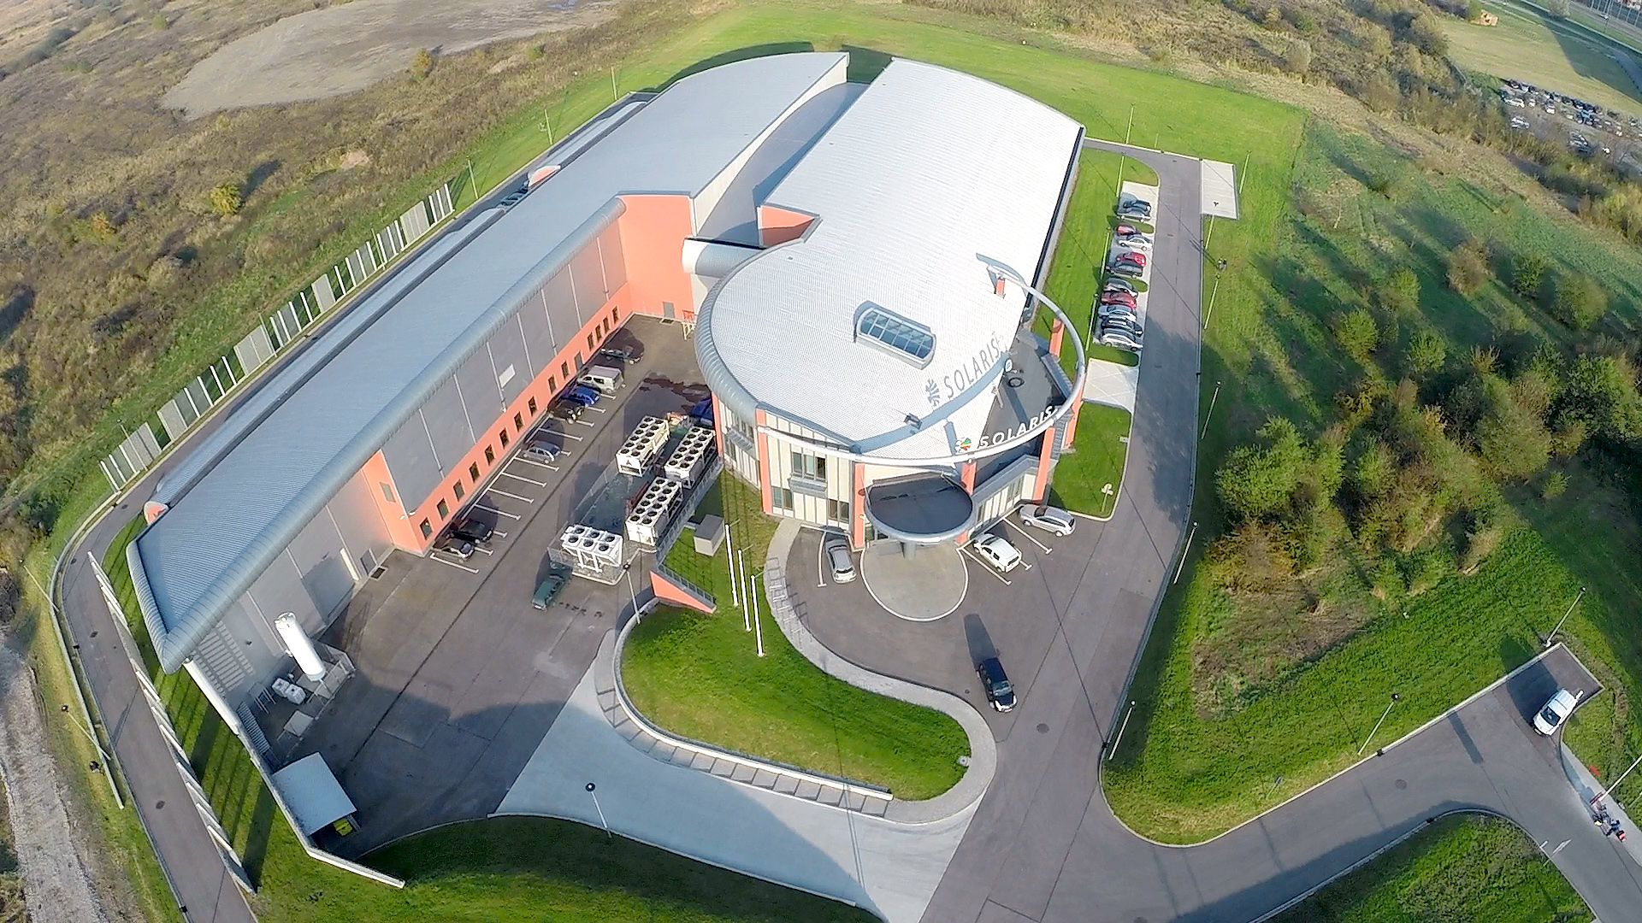
SOLARIS National Synchrotron Research Centre
First light source infrastructure in Poland.
Build with unique collaboration between MAXIV Laboratory and Jagiellonian University, located at Jagiellonian University Campus in Krakow.
Operating parametrs:
- Beam Current: ~430mA (possible 500mA)
Lifetime product: ~4.5
2 injections per day 8:00AM and 8:00PM
X emitance ~10nm rad
Design&installation: 2010-2015
In operation since May 2015.
First Users: October 2018
Staff in 2021: >100 Employees
Accelerator Department: 17 Employees
RF Section: 5 Members

Slide 5
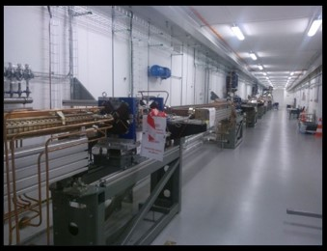
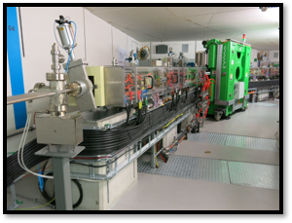
Accelerators
Injector Parameters | Value
Energy max | 600 MeV
Bunch charge | 0.1 nC
Emitance (geom, rms) x/y | 3.1 / 2.0 nm rad
Energy spread (rms) | 0.23%
Bunch length (rms) | 3.68 ps
Injection repetition rate | Up to 10 Hz (linac up to 100Hz)
600 MeV Linac
RF Thermionic Gun
6 S-band 2998.5 MHz accelerating structures
Accelerating gradient 20 MeV/m
3 RF Units & SLED cavities
Dog-leg vertical transfer line
In operation since Dec. 2014
Storage Ring Parameters | Value
Energy | 1.5 GeV
Current | 500 mA
Circumference | 96 m
Horizontal emittance (bare lattice) | 5.982 nm rad
Coupling | 1%
Tunes Q_{x}, Q_{y} | 11.22, 3.15
Natural chromaticities ξ_{x}, ξ_{y} | -22.96, -17.14
Momentum compaction | 3.055 x 10⁻³
Momentum acceptance | 4%
Overall Lifetime | 13 hrs
1.5GeV Storage ring
12 DBA Cells – 96 m circumference
Space for ID’s (10 sections) ~ 3.5 m
10 straight sections for IDs
100 MHz RF system
300 MHz Landau Cavities
Injection dipole kicker
Ramping
In operation since May 2015

Slide 6
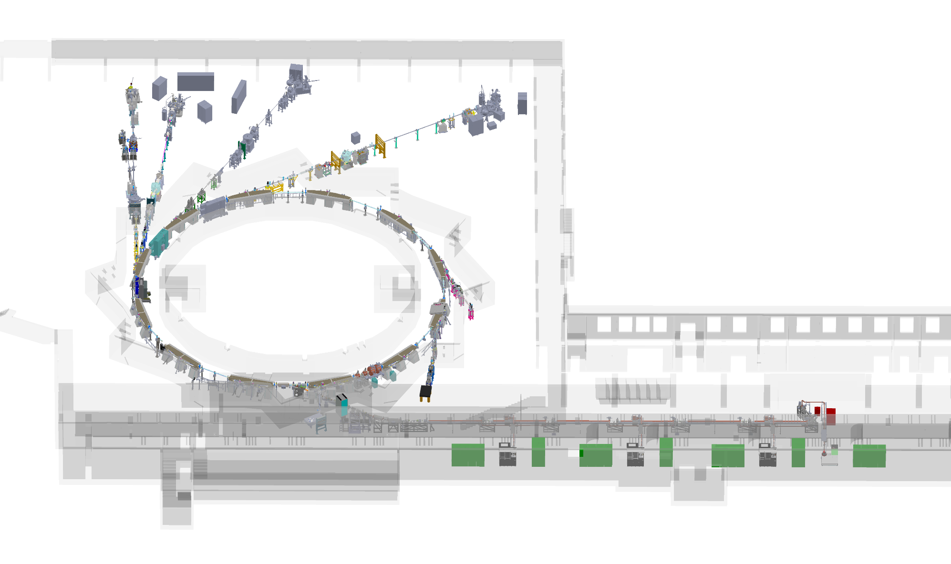
5 fully operational beamline
2 fully operational diagnostic line
2 beamline under construction
1 beamline under commissioning
DEMETER
PIRX
(Peem XAS)
URANOS
(Uarpes)
PHELIX
Experimental hall extension – in progress
CIRI
(FTIR)
SOLCRYS
POLYX
PINHOLE
ASTRA
(Solabs)
LUMOS
6

Slide 7
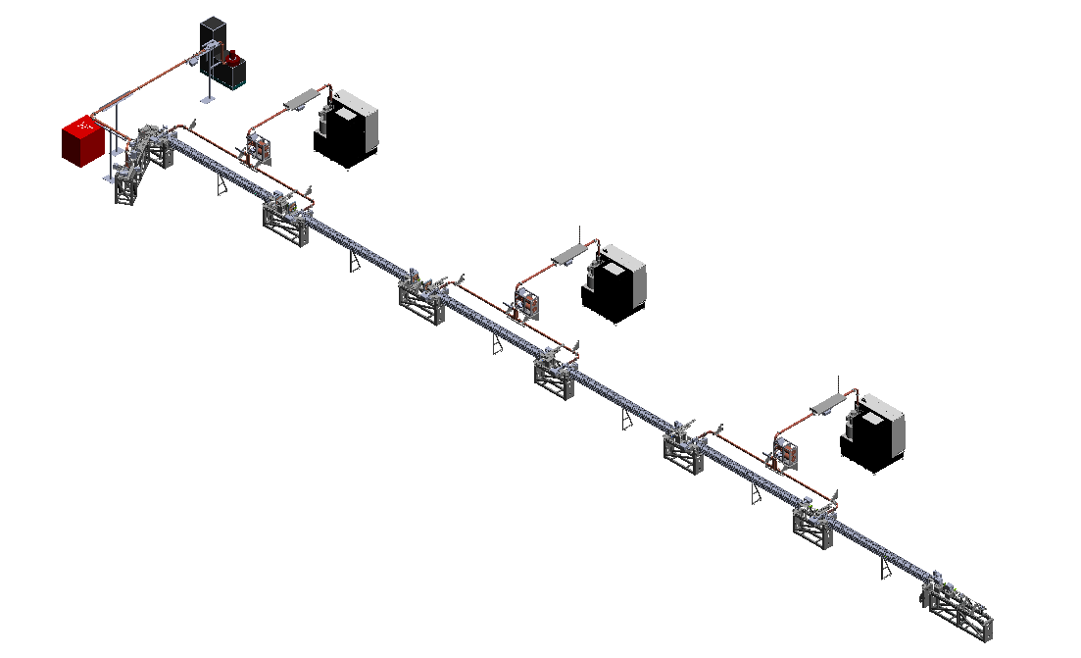
SOLARIS RF System
Klystron with modulator for gun.
3 klystrons with mdulators for accelaration
3 accelerating units with SLED
Thermionic gun
6 accelerate structures
Injector

Slide 8
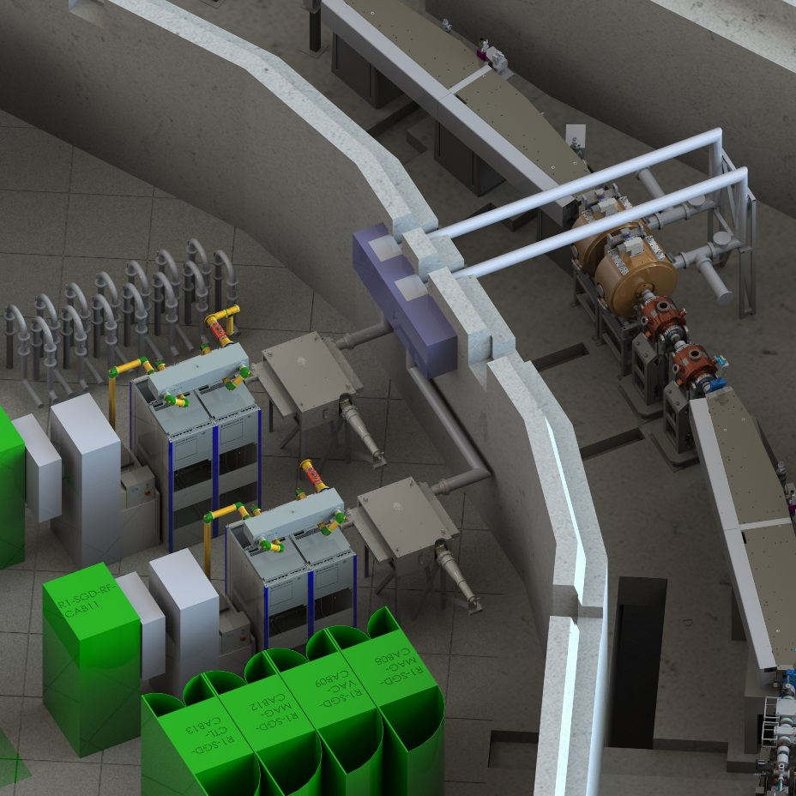
SOLARIS RF System
6 1/8” EIA rigid coax line
with directional coupler
Munufacturer: Exir Broadcasting AB
100 MHz Main Cavity
MunufacturerResearch Instruments
Resonant freq.: 99.93 MHz
Tuning range: ± 540kHz
Gap voltage: 300kV
Circulator (isolator)
Munufacturer: AFT.
FWD peak power: 120kW CW
REV power: 100%
300 MHz Landau Cavity
MunufacturerResearch Instruments
Resonant freq.: 99.93 MHz
Tuning range: ± 550kHz
Gap voltage: 450 kV
100Mhz RF transmitter THR9
Munufacturer: R&S
Technology: Solid State
RF freq.: 99.93MHz
RF peak power: 61.2 kW
Digital LLRF for SR
Munufacturer: Alba
Comercial µTCA board (Nutaq picodigitizer)
Control of amplitude and phase covidy voltage
Control of resonance frequency (covidy tuning)
Safety interlock
I/Q demodulation technique
Tango device server for setting-up
Plunger
Munufacturer: Measline
Tuning range: ± 500kHz
RF power system for Storage Ring

Slide 9
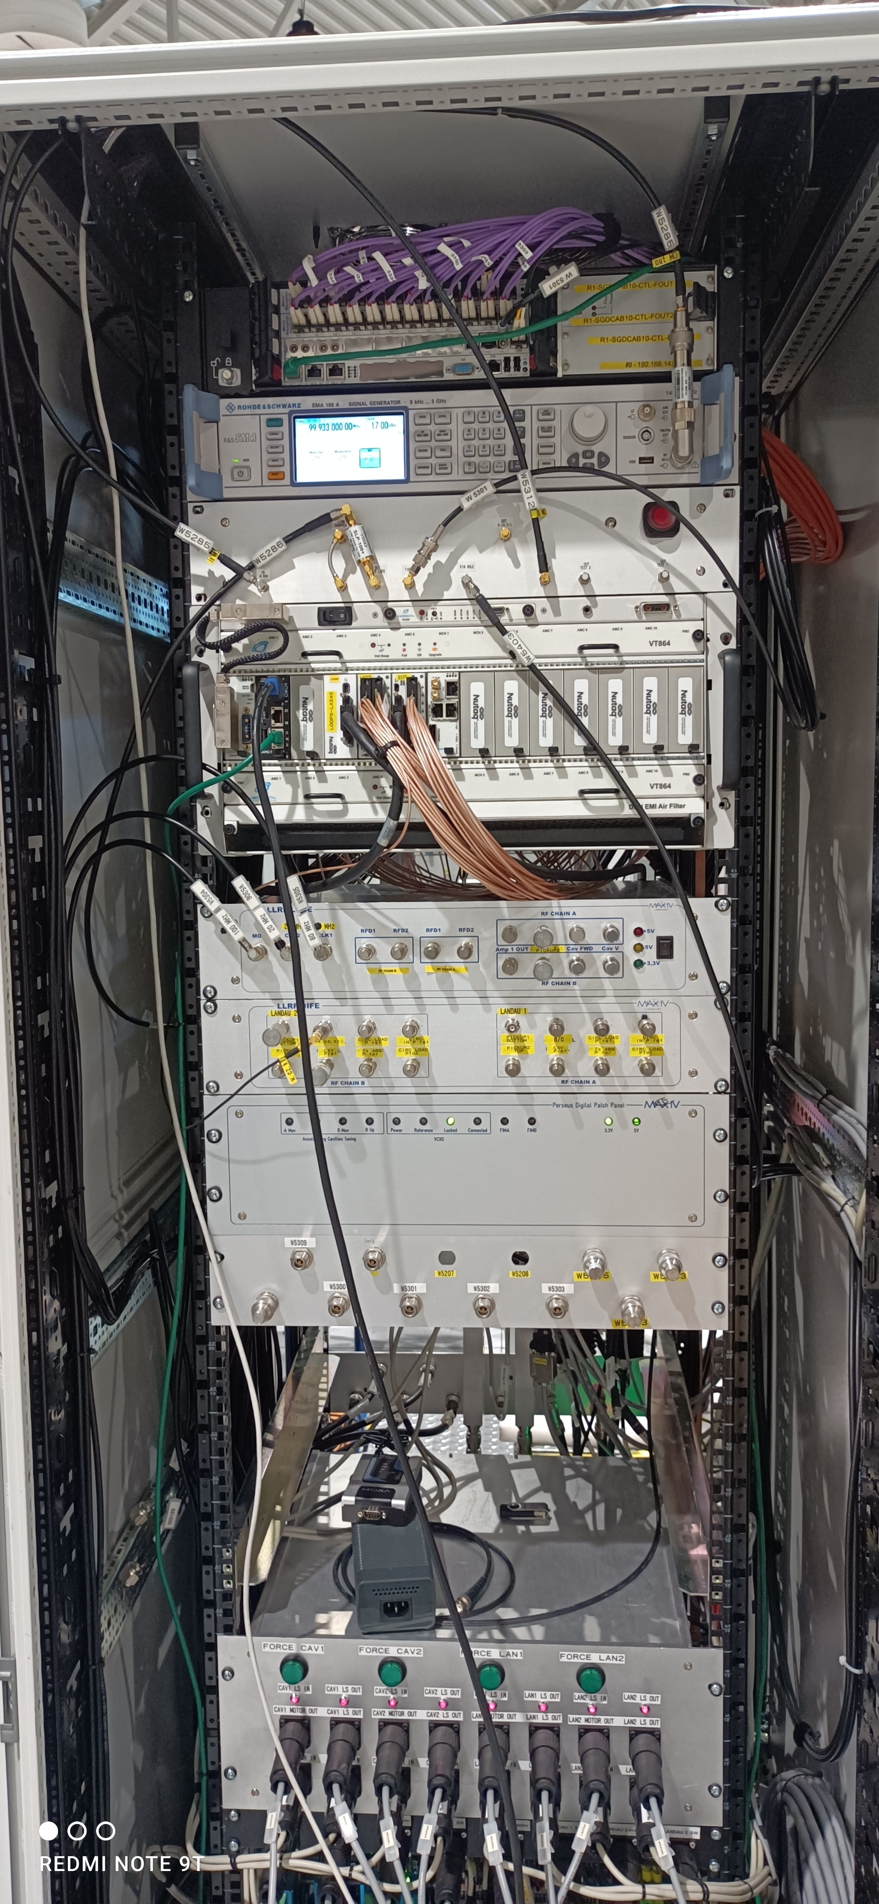
RF Project Review
Master Oscilator (R&S SMA 100A)
LOFE and DIFE Units
LLRF system on Nutaq picodigitizer
Signals didtribution unit
Cavity endplate motor control unit

Slide 10
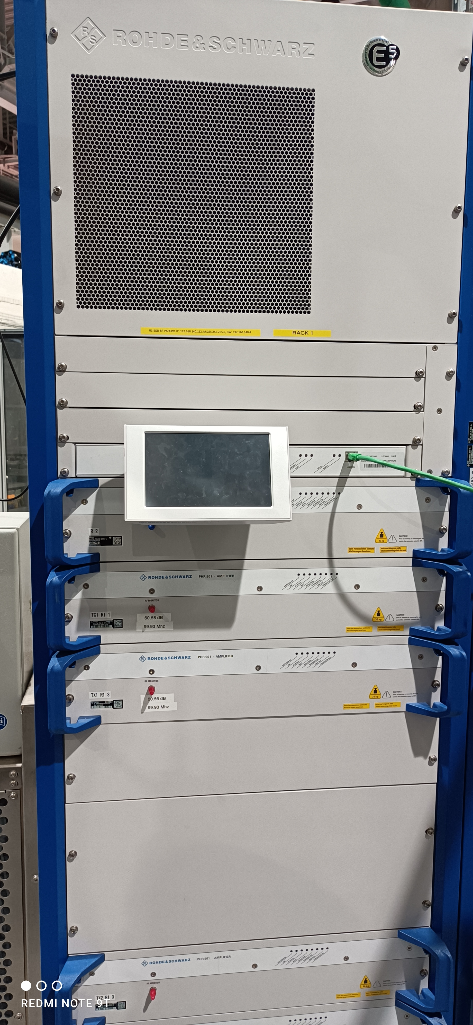
RF Project Review
Master Oscilator (
LOFE and DIFE Units
LLRF system on Nutaq picodigitizer
Signals didtribution unit
Cavity endplate motor control unit
2 R&STransmitters Solidstate 60kW CW

Slide 11
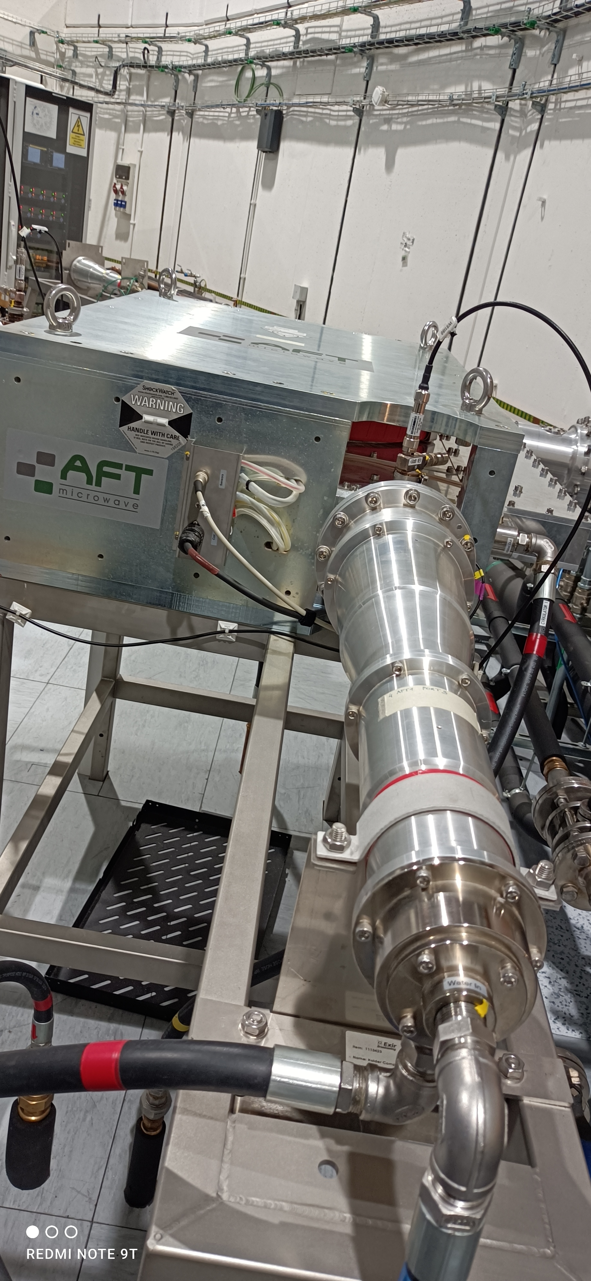
RF Project Review
Master Oscilator (
LOFE and DIFE Units
LLRF system on Nutaq picodigitizer
Signals didtribution unit
Cavity endplate motor control unit
2 R&STransmitters Solidstate 60kW CW
Circulator with Load (AFT Microwaves)

Slide 12
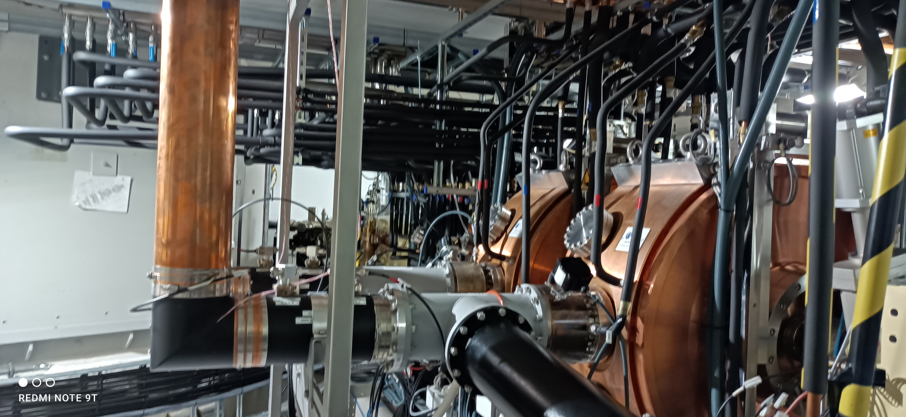
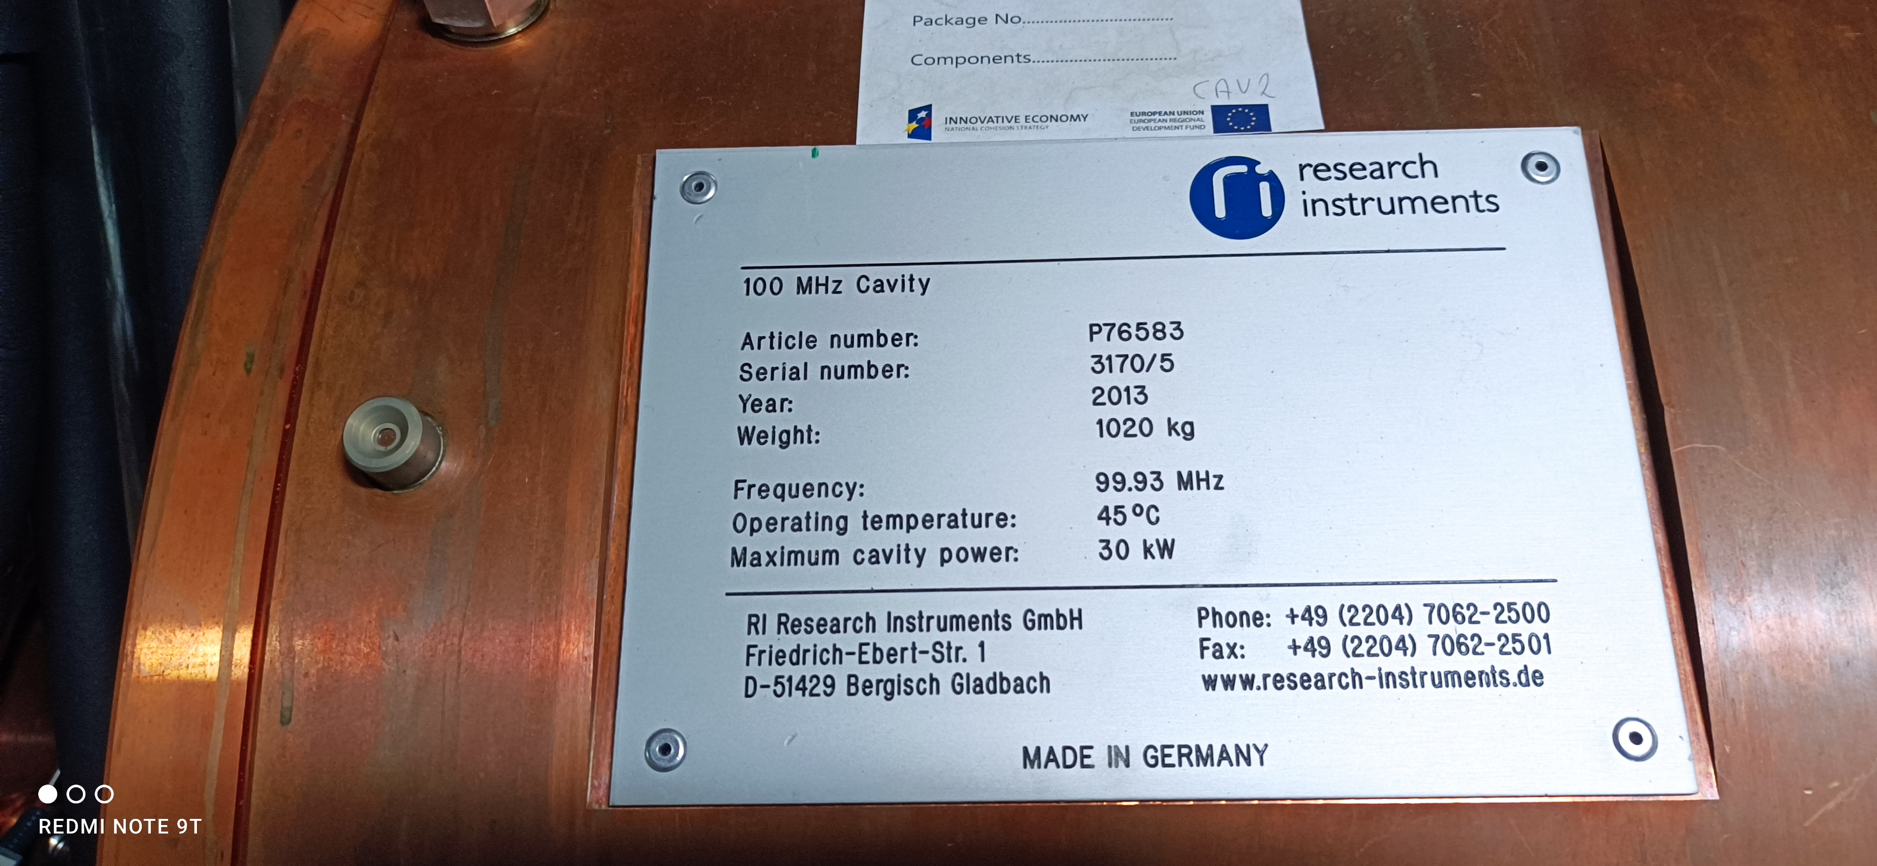
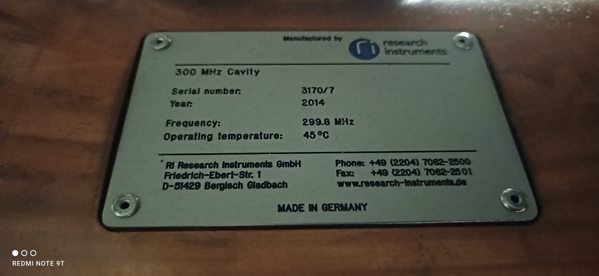
RF Project Review
Master Oscilator (
LOFE and DIFE Units
LLRF system on Nutaq picodigitizer
Signals didtribution unit
Cavity endplate motor control unit
2 R&STransmitters Solidstate 60kW CW
Circulator with Load (AFT Microwaves)
6 1/8 Coaxial Line
Power Couplers
2 Main resonance covidy for 100 MHz and 30kW
Landau Cavities for 3rd harmonic – 300Mhz
Pickups

Slide 13
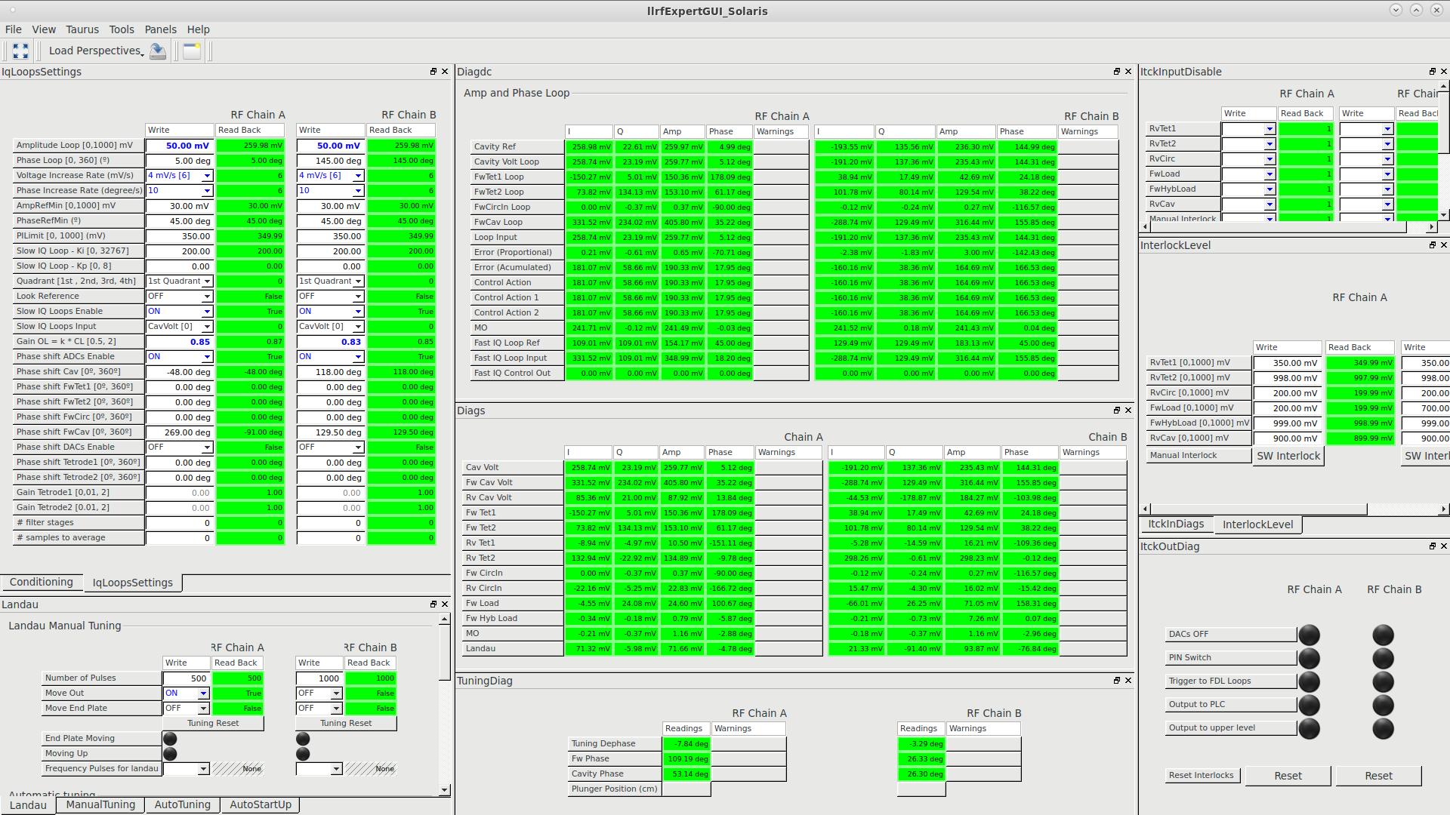
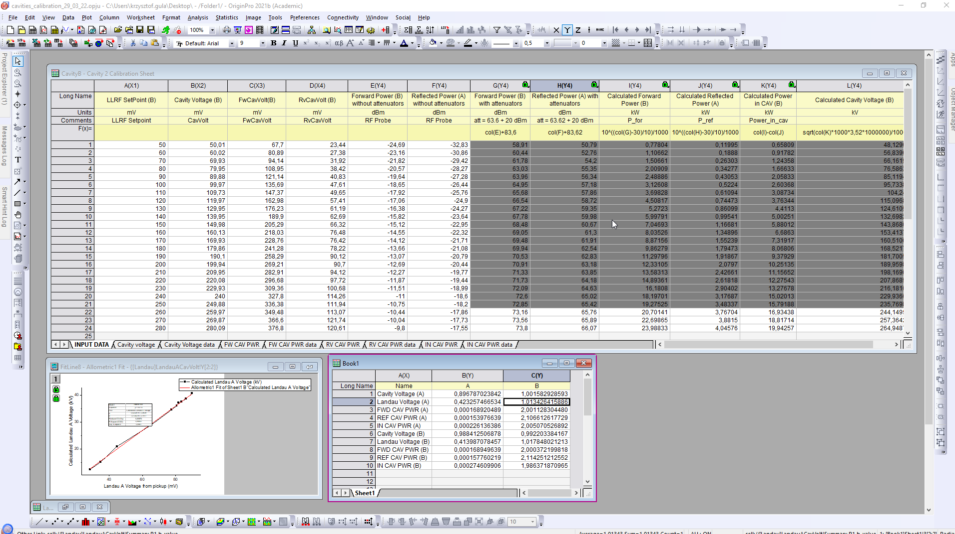
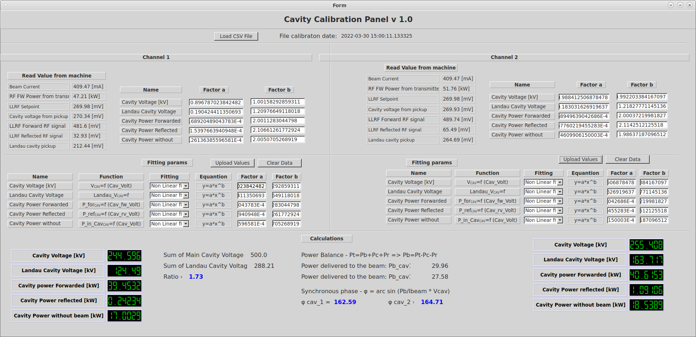
RF Project Review
Master Oscilator (
LOFE and DIFE Units
LLRF system on Nutaq picodigitizer
Signals didtribution unit
Cavity endplate motor control unit
2 R&STransmitters Solidstate 60kW CW
Circulator with Load (AFT Microwaves)
6 1/8 Coaxial Line
Power Couplers
2 Main resonance covidy for 100 MHz and 30kW
Landau Cavities for 3rd harmonic – 300Mhz
Pickups
Software

Slide 14
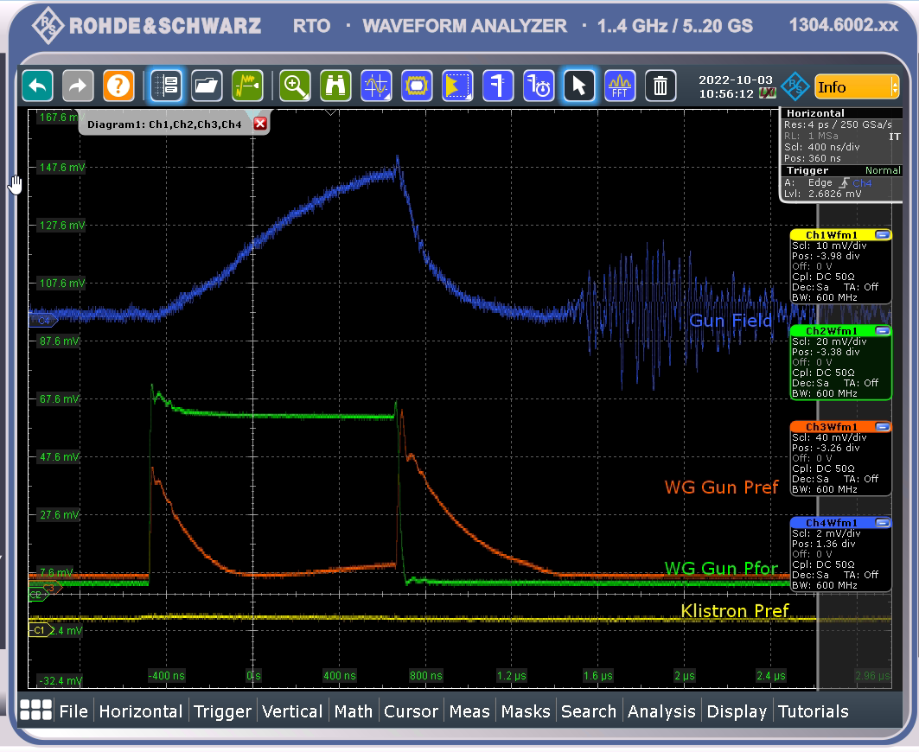
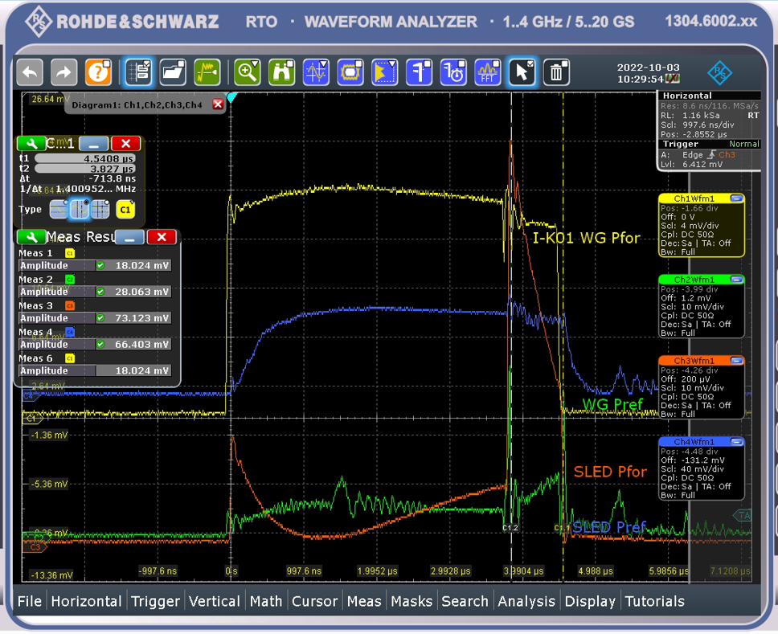
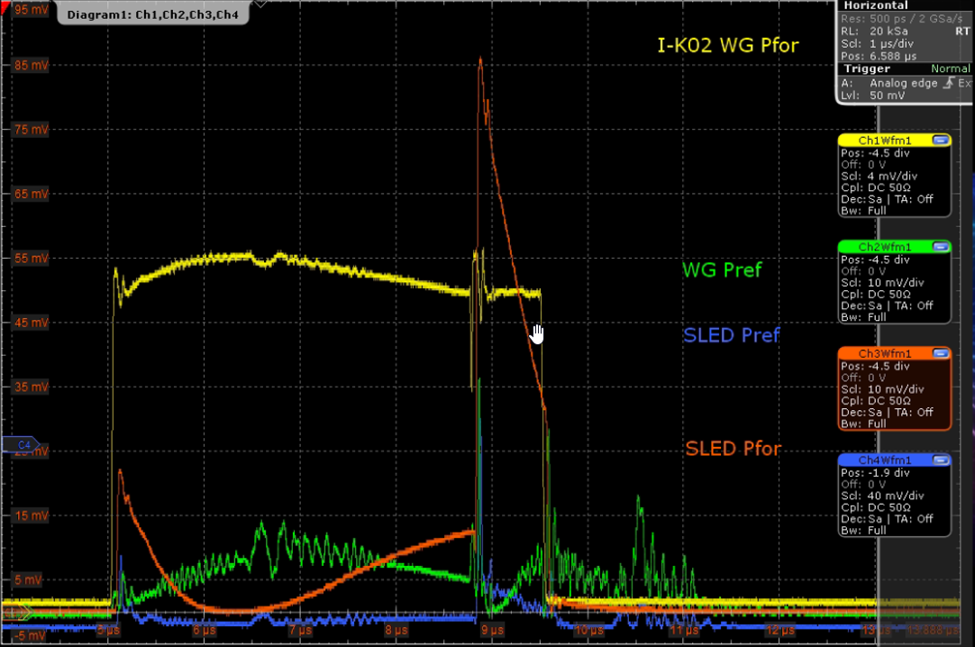
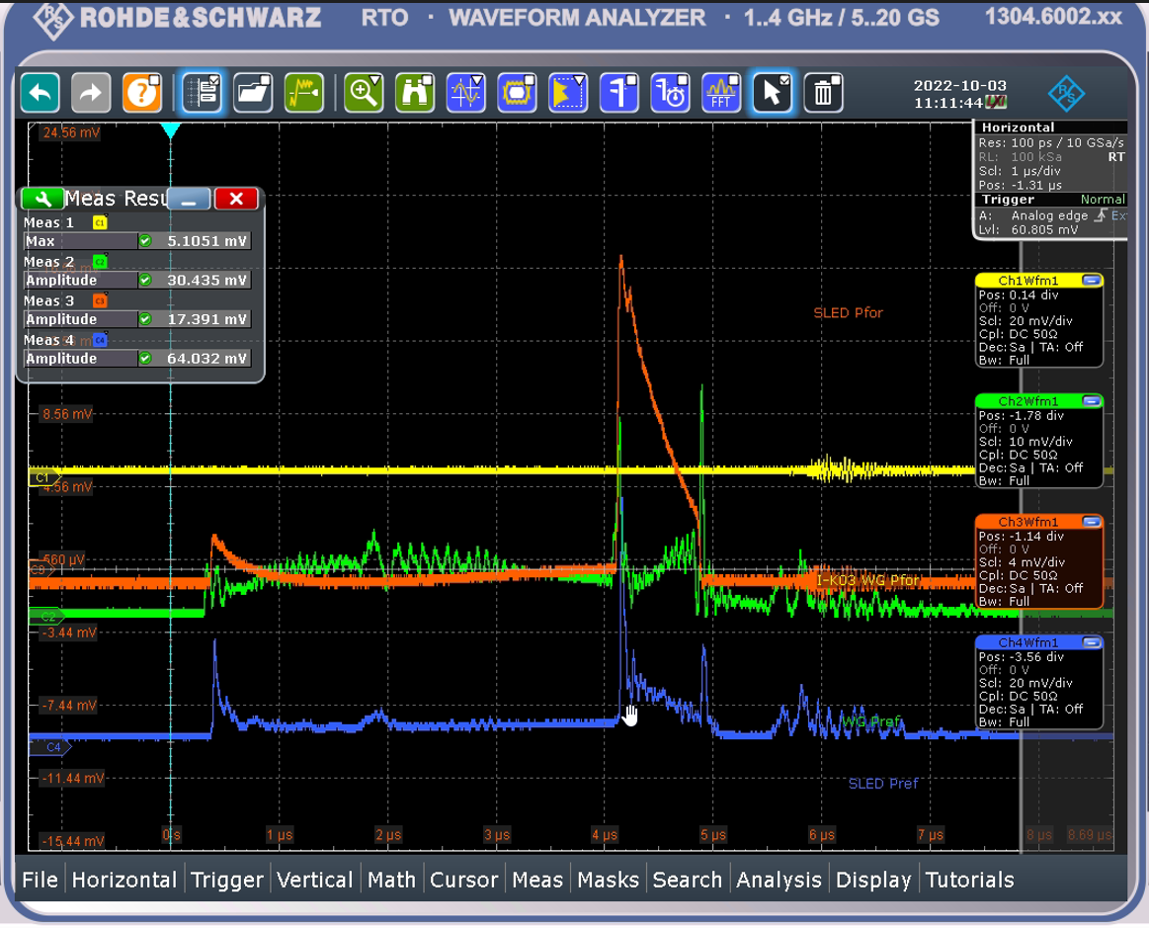
Operation
Injection:
Modulators set value: 1180V (now)
Kicker set voltage: 1600V
Plungers possition: 30mm (Inserted)

Slide 15
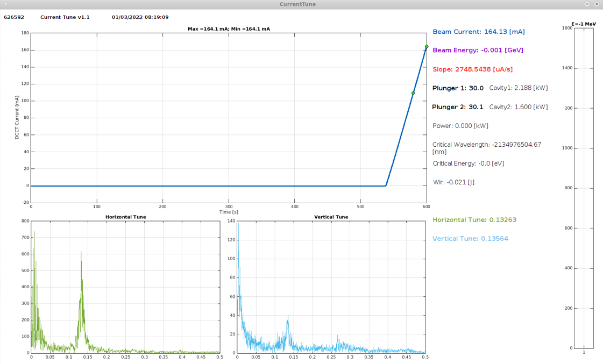
Operation
Injection:
Modulators set value: 1180V
Kicker set voltage: 1600V
Plungers possition: 30mm (Insterted)
Injected current ~430mA
Average slope (inj. Efficjency) >2000uA/s
RF power incresing 50 – 160 mV (1 – 15kW)
Ramping
Increase RF power to 260mV (~55 kW)
Start ramping app,
At ~1.1geV move plunger to 43mm possition
After ramping start python correction
Setting las ID possition
Delivery the beam
Start decreasing RF power app
- If needed – fine plungers tuning

Slide 16
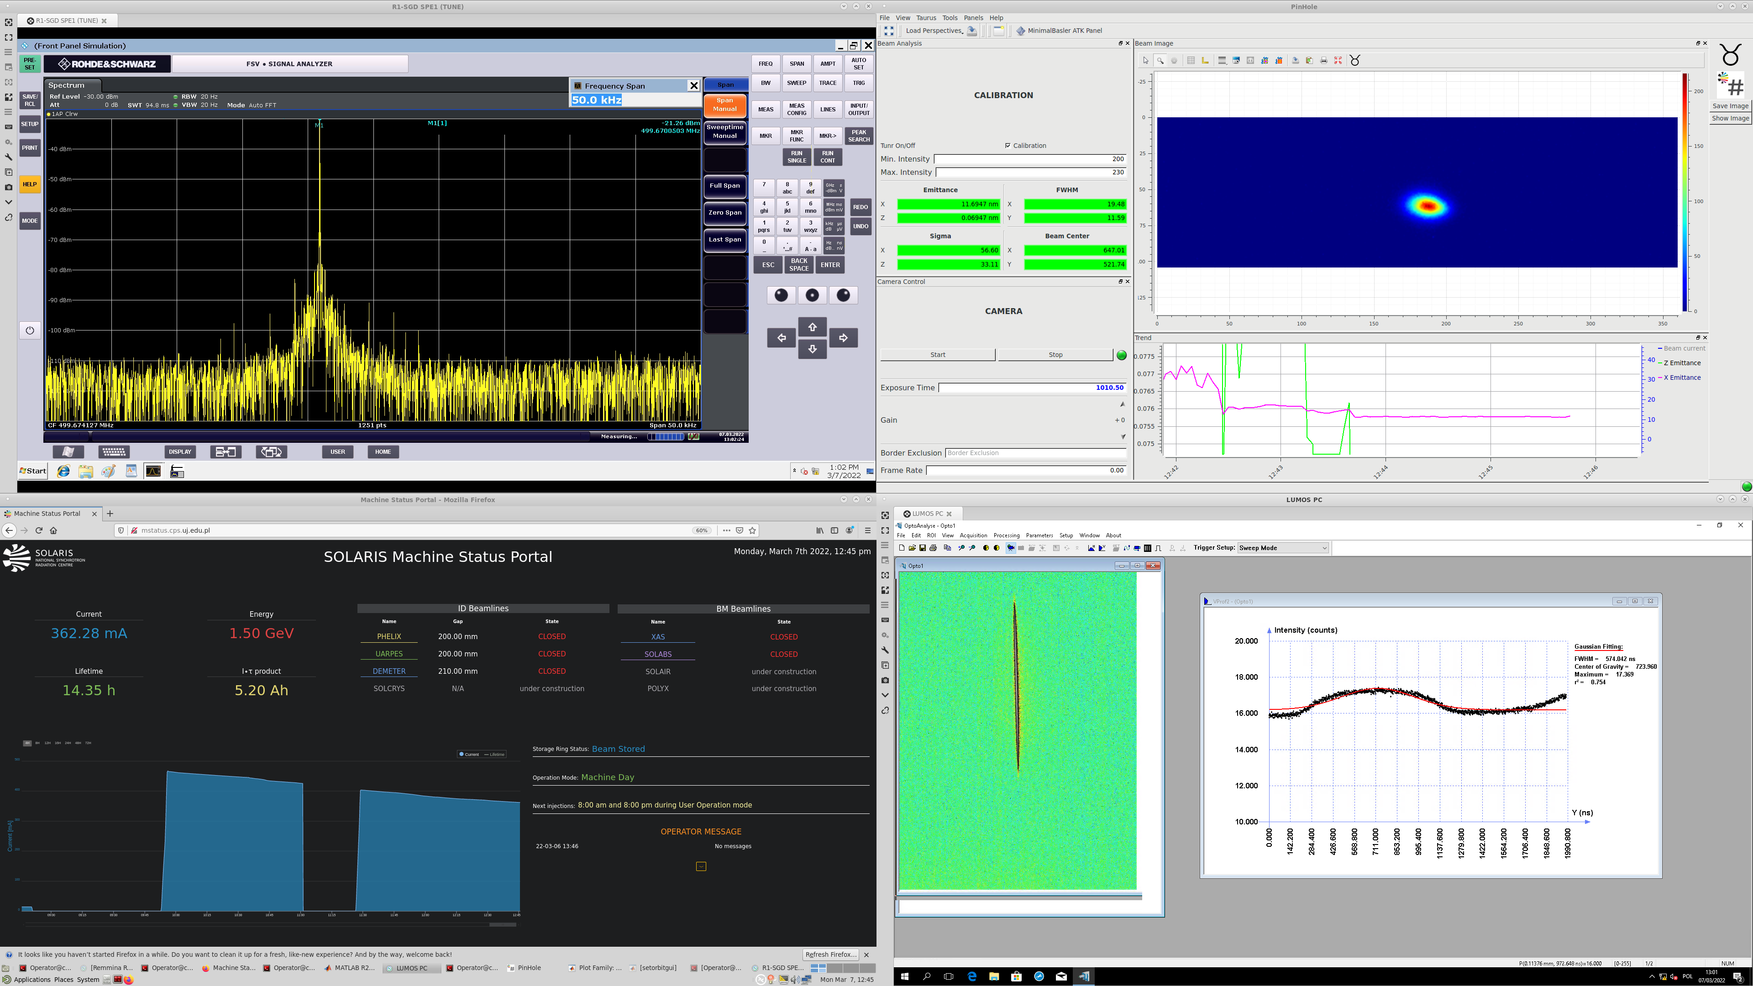
Operation
During a operation, some fine plunger tuning or RF power is needed.

Slide 17
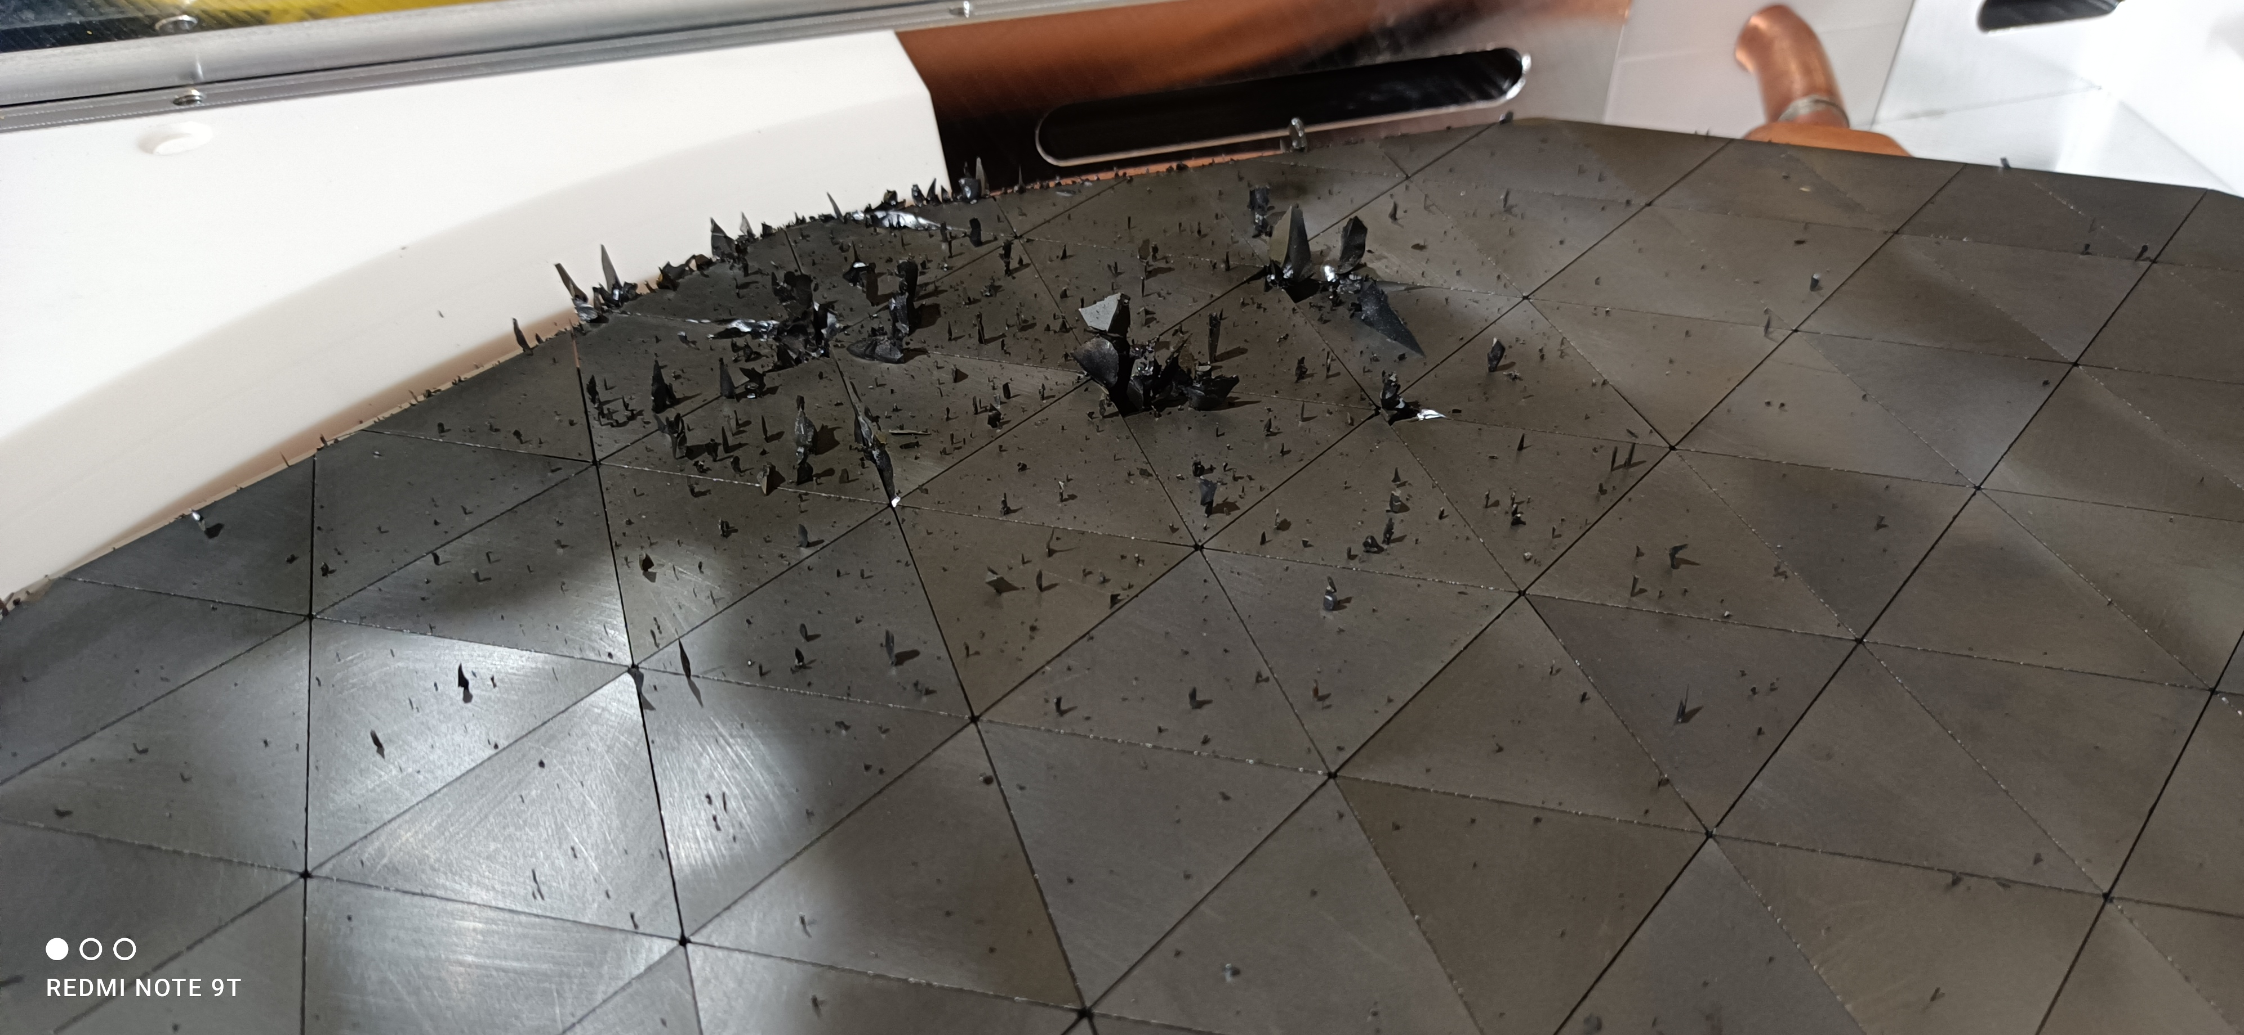
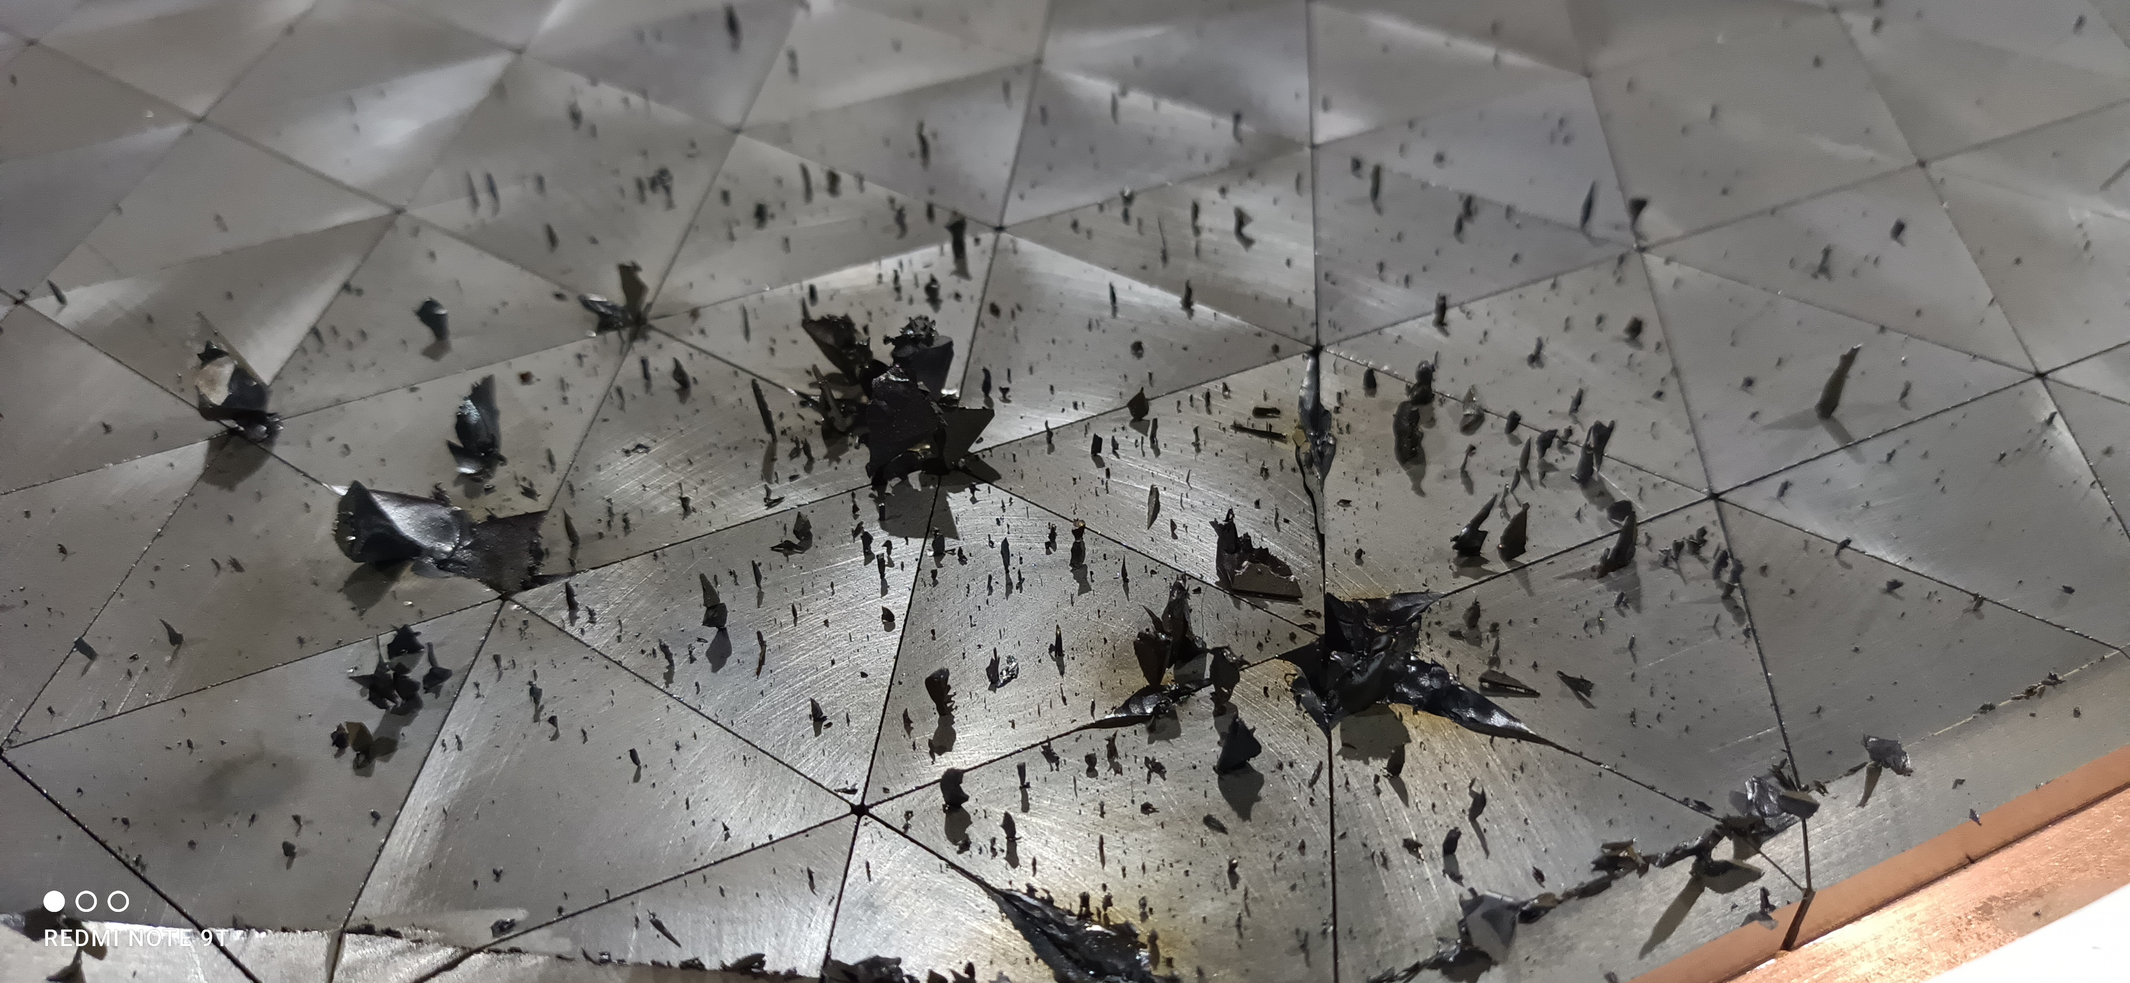
Main failures in 2022
Damaged ferrites on the second circulator – after clean-up working well
Ordered a new one from Microwave Techniques. Delivery: Feb 2023

Slide 18
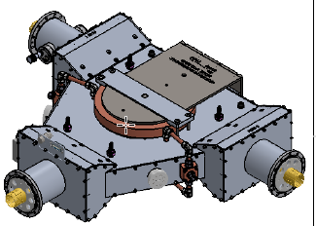
Main failures in 2022
Damaged ferrites on the second ciculator – after clean-up working well
Ordered a new one from Microwave Techniques. Delivery:
Feb 2023

Slide 19
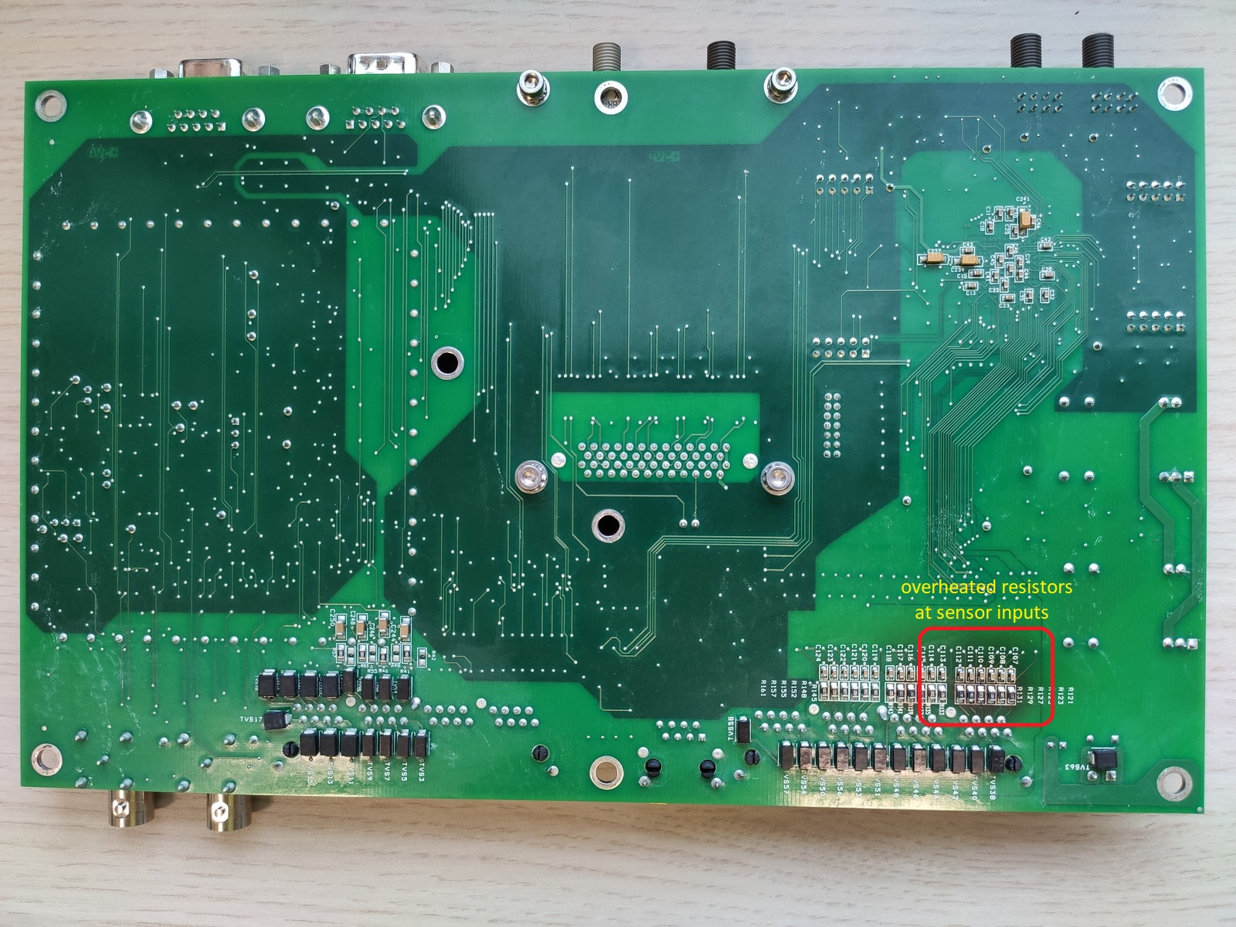
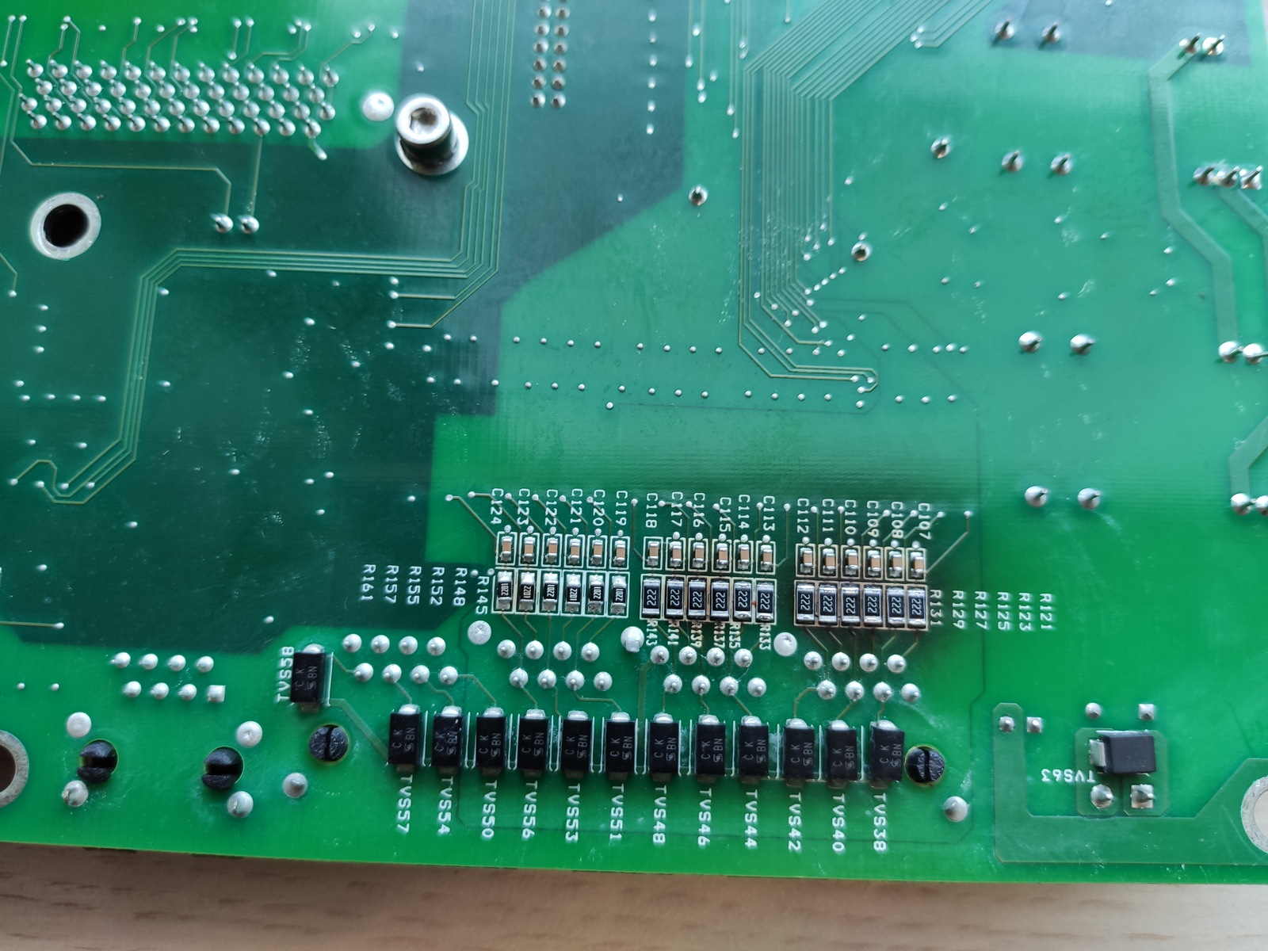
Main failures in 2022
Fault in K00 Modulator „Tank Temp Interlock”
(burned resistors)
- Emergency replacing and plan to do it on the other modulators

Slide 20
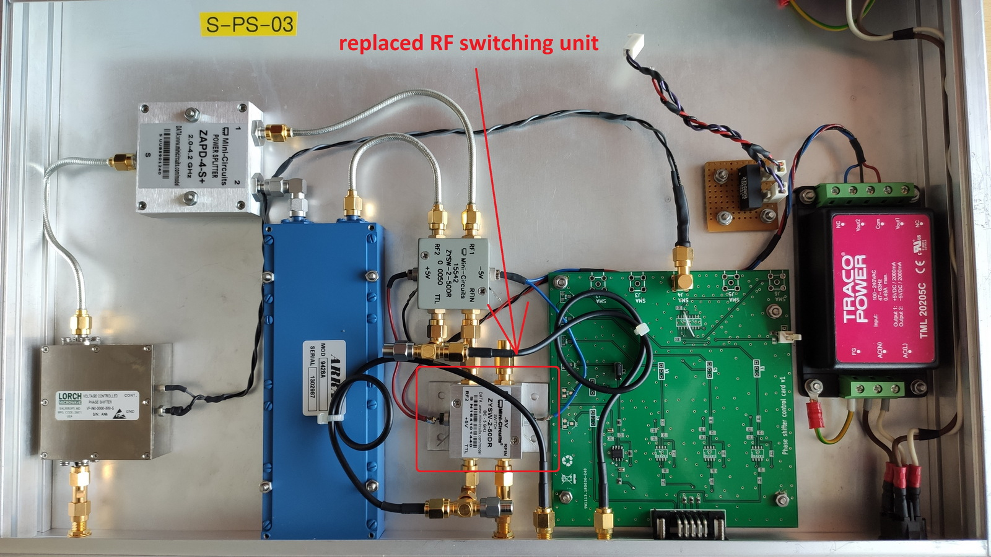
Main failures in 2022
K03 modulator fault (power supply, HVPS, Phase shifter)
- Fail modules replaced

Slide 21
Future, Problems, Questions
Application for automatic cavity tuning
Using Field Stabilisation function on Landau Cavities
Find best point to operate. Emmitance, beam lenght and shape,
Studies to better understand RF knowlage.
Thank you for your attention

