Slide 1
SOLEIL II project review
HarmonLIP
Lund, 11-12 October 2022
Alexis Gamelin on behalf of SOLEIL II Project Team
Part of this work has been performed within the frame of the WP2 collaboration among ESRF, HZB, KEK, PSI and SOLEIL

Slide 2
Overview
SOLEIL II Project
Overview
RF System
Beam dynamics & tracking
Uniform filling at 500 mA and $l=1$ instability
Single bunch collective effects (no HC)
Impact of SB collective effects on HC performance

Slide 3
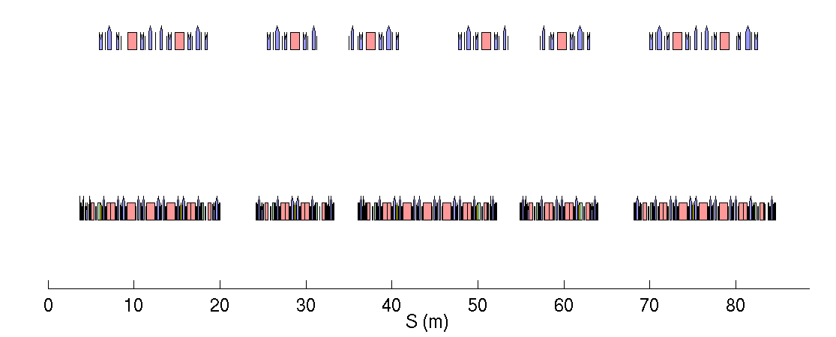
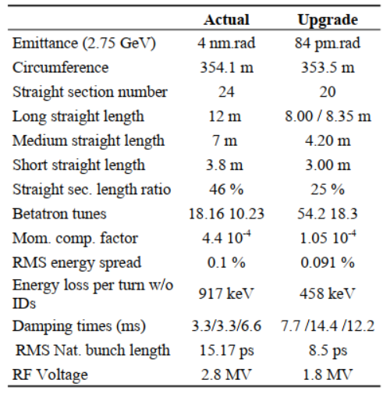
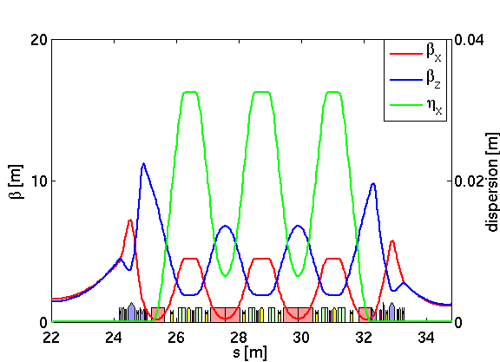
SOLEIL II TDR lattice
12 m
22.5°
7 m
11.25°
3.8 m
Present lattice at 4 nm.rad [32 dipoles]
40 % of straigth length
2BA type
Section replaced
by a 3T superbend
7.35 m
22.5°
4.15 m
11.25°
2.73 m
Upgrade at 84 pm.rad [126 dipoles]
+reverse-bend to lower the emittance
24 % of straight length
7BA HOA type
4BA HOA type
$$β_{x}∼1 m$$
Major features of the TDR lattice:
Fit “at best” the beamlines positioning
Permanent magnets for dipoles, quadrupoles and reverse bends
Standard beam pipe inner diameter of 12 mm
95 % NEG coated ring
Off axis injection (using MIK)
Beam lifetime of ~ 4 hrs w/o HC
$$β_{z}∼1.5 m$$

Slide 4
RF System
Options considered for the HC:
Objectives for the double RF system:
To provide suitable lifetime and IBS reduction, the RF system should be able to lengthen the bunches up to 100 ps FWHM ($≈$ 40 ps RMS) in all operation modes:
Uniform filling @ 500 mA
8 bunches @ 100 mA
1 bunch @ 20 mA
16/32 bunches @ TBD
Passive SC : Super3HC (scaled at m = 3 or m = 4)
Rs (per cavity) = $4,5 GΩ$
$Q_{0}$ =${10}^{8}$
$R/Q$ = $45 Ω$
$N_{cav}$ = 2
Passive NC : ESRF harmonic 2-cell cavity (m = 4)
Rs (per cavity) = 2,4 $MΩ$
$Q_{0}$ = 27 000
$R/Q$ = $88,8 Ω$
$N_{cav}$= 2 or 3
Active NC : ESRF harmonic 2-cell cavity (m = 4)
Rs (per cavity) = 2,4 $MΩ$
$Q_{0}$ = 27 000
$Q_{L}$ = 13 500 ($β=1$)
$N_{cav}$= 1 to 3
Fixed parameters:
Main RF : ESRF - EBS fundamental cavity
Rs (per cavity) = 5$MΩ$
$Q_{0}$ = 35 000
$N_{cav}$ = 3 or 4
$β=5$ ($Q_{L}$ = 5 833)
$V_{c}$ = 1,8 MV
$f_{RF}=352 MHz$

Slide 5
RF System
Options considered for the HC:
Objectives for the double RF system:
To provide suitable lifetime and IBS reduction, the RF system should be able to lengthen the bunches up to 100 ps FWHM ($≈$ 40 ps RMS) in all operation modes:
Uniform filling @ 500 mA
8 bunches @ 100 mA
1 bunch @ 20 mA
16/32 bunches @ TBD
Passive SC : Super3HC (scaled at m = 3 or m = 4)
Rs (per cavity) = $4,5 GΩ$
$Q_{0}$ =${10}^{8}$
$R/Q$ = $45 Ω$
$N_{cav}$ = 2
Passive NC : ESRF harmonic 2-cell cavity (m = 4)
Rs (per cavity) = 2,4 $MΩ$
$Q_{0}$ = 27 000
$R/Q$ = $88,8 Ω$
$N_{cav}$= 2 or 3
Active NC : ESRF harmonic 2-cell cavity (m = 4)
Rs (per cavity) = 2,4 $MΩ$
$Q_{0}$ = 27 000
$Q_{L}$ = 13 500 ($β=1$)
$N_{cav}$= 1 to 3
This talk = baseline solution
Paper: A. Gamelin et al. - Beam Dynamics with a Superconducting Harmonic Cavity for the SOLEIL Upgrade – IPAC’22
Fixed parameters:
Main RF : ESRF - EBS fundamental cavity
Rs (per cavity) = 5$MΩ$
$Q_{0}$ = 35 000
$N_{cav}$ = 3 or 4
$β=5$ ($Q_{L}$ = 5 833)
$V_{c}$ = 1,8 MV
$f_{RF}=352 MHz$
M. Diop talk on NC vs SC HCs
Paper: N. Yamamoto et al. - Feasibility study of an active harmonic cavity for bunch lengthening in an electron storage ring – PASJ’22

Slide 6
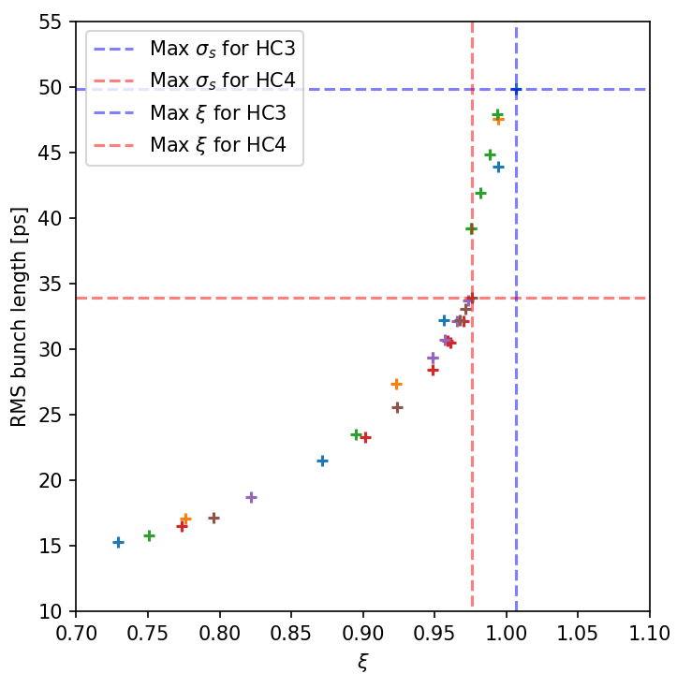
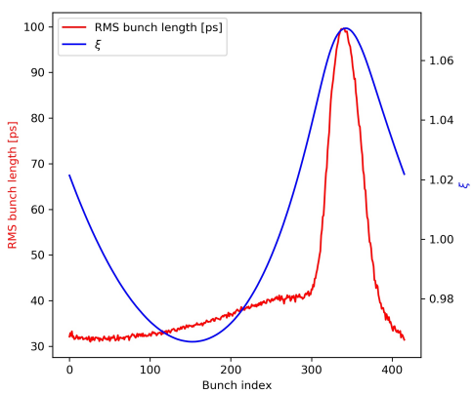
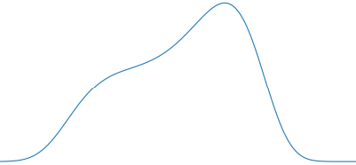
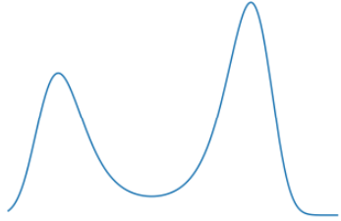
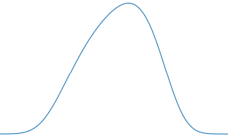
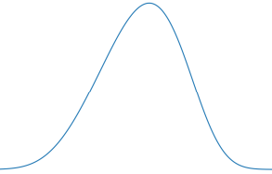
Uniform filling at 500 mA
Here are the stable settings found for a 3rd HC and a 4th HC for the SOLEIL Upgrade using multi-bunch tracking taking into account the beam loading in the main and harmonic cavity (mbtrack2^{[1]}):
At a given turn during the instability
At high current, 500 mA in uniform filling, the 3rd HC allows to get a bit past the (near) flat potential conditions while the 4th HC is limited before $ξ=1$.
The limitation, in both cases, is the $l=1$ instability ^{[2]} / PTBL^{[3]} but it is happening at different distance from $ξ=1$.
The PTBL threshold increases with the bunch length. It then explains why the 3rd HC threshold is higher than the 4th HC as it naturally produce longer bunches.
Double bump
$$σ_{τ0}=9 ps$$
$ξ=−\frac{mV_{2}\sin\left(φ_{2}\right)}{V_{1}\sin\left(φ_{1}\right)}$ is the ratio of the harmonic “force” to the main cavity one
[1] Gamelin, A., Foosang, W., & Nagaoka, R. mbtrack2, a Collective Effect Library in Python. IPAC’21
[2] Venturini, M. (2018). Passive higher-harmonic rf cavities with general settings and multibunch instabilities in electron storage rings. PRAB, 21(11), 114404.
[3] He, T., Li, W., Bai, Z., & Wang, L. (2022). Periodic transient beam loading effect with passive harmonic cavities in electron storage rings. PRAB, 25(2), 024401.

Slide 7
Uniform filling at 500 mA
Here are the stable settings found for a 3rd HC and a 4th HC for the SOLEIL Upgrade using multi-bunch tracking taking into account the beam loading in the main and harmonic cavity (mbtrack2^{[1]}):
At a given turn during the instability
At high current, 500 mA in uniform filling, the 3rd HC allows to get a bit past the (near) flat potential conditions while the 4th HC is limited before $ξ=1$.
The limitation, in both cases, is the $l=1$ instability ^{[2]} / PTBL^{[3]} but it is happening at different distance from $ξ=1$.
The PTBL threshold increases with the bunch length. It then explains why the 3rd HC threshold is higher than the 4th HC as it naturally produce longer bunches.
Double bump
$$σ_{τ0}=9 ps$$
How bunch lengthening from additional impedances impacts these results ?
$ξ=−\frac{mV_{2}\sin\left(φ_{2}\right)}{V_{1}\sin\left(φ_{1}\right)}$ is the ratio of the harmonic “force” to the main cavity one
[1] Gamelin, A., Foosang, W., & Nagaoka, R. mbtrack2, a Collective Effect Library in Python. IPAC’21
[2] Venturini, M. (2018). Passive higher-harmonic rf cavities with general settings and multibunch instabilities in electron storage rings. PRAB, 21(11), 114404.
[3] He, T., Li, W., Bai, Z., & Wang, L. (2022). Periodic transient beam loading effect with passive harmonic cavities in electron storage rings. PRAB, 25(2), 024401.

Slide 8
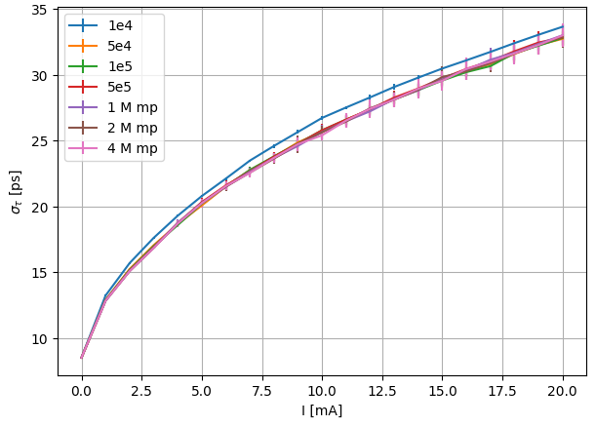
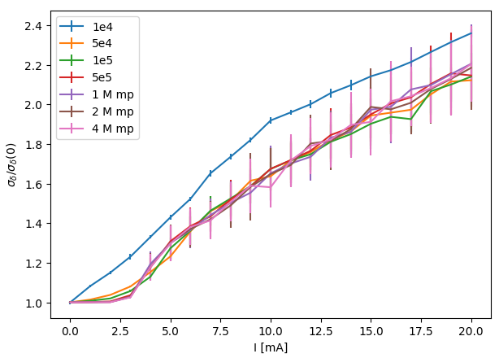
Tracking vs single bunch current
Single bunch collective effects:
Considering a preliminary TDR impedance model (RW + geom. impedance, +20 components including NEG, tapers, IDs, …).
Treated as wake function in the tracking (so no broad band fit).
RMS Bunch length
Energy spread ratio
$σ≈33 ps$ for the single bunch mode
$σ≈27 ps$ for 8 bunch mode
Convergence from 5e5 macro particle in tracking
$σ≈14 ps$ for the uniform filling mode
Microwave Instability (MWI) threshold in between 2 mA and 3 mA

Slide 9
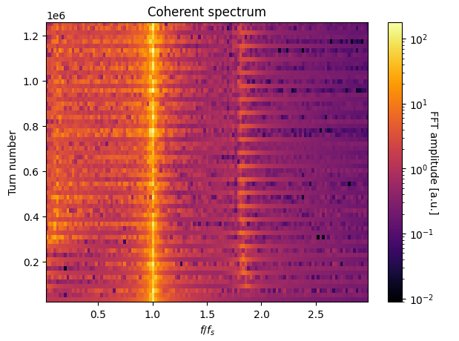
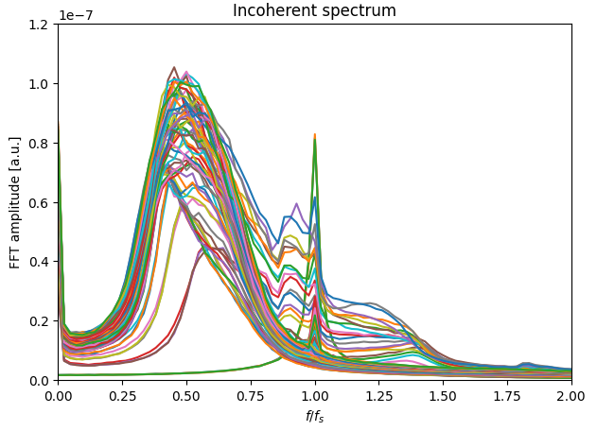
Tracking vs single bunch current
20 mA
20 mA
0 mA
0 mA
The mode m=1 is constant because the (negative) incoherent tune shift is compensated by the dynamic coherent frequency shift for mode m=1 (Ng book p.68 & p.206)
The mode m=2 (slightly shifted downward) is visible in the MWI regime.
Go from a sharp peak at zero current to a spread out bump at higher current (MWI regime) at lower frequency (incoherent tune shift).

Slide 10
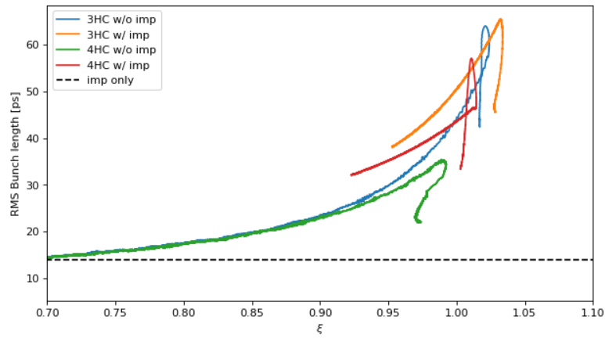
Uniform filling at 500 mA (with SB collective effects)
The turning points corresponds to the threshold of the $l=1$ instability / PTBL.
The instability leads to a decrease of the average harmonic voltage and thus a decrease of the average $ξ$ for lower HC detuning.
As expected from [3], added bunch lengthening from the impedance push the threshold toward higher values.
With the effect of the impedance added, the m = 4 HC provide sufficient margin compared to the requirement for the main operation mode.
1,2 mA/bunch
0 mA/bunch
Harmonic cavity detuning decreases
[3] He, T., Li, W., Bai, Z., & Wang, L. (2022). Periodic transient beam loading effect with passive harmonic cavities in electron storage rings. PRAB, 25(2), 024401.

Slide 11
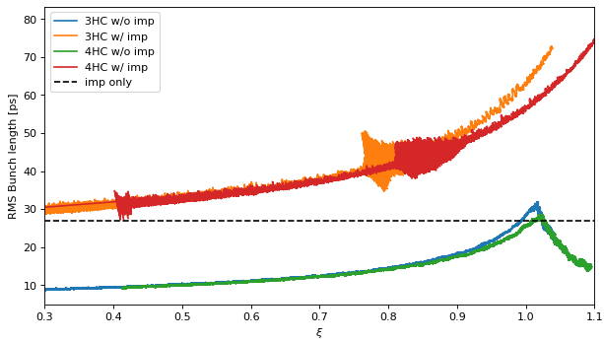
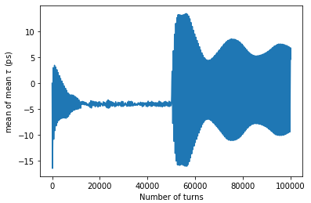
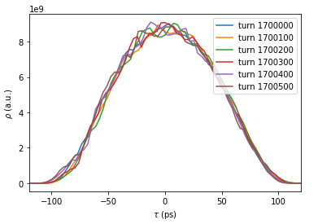
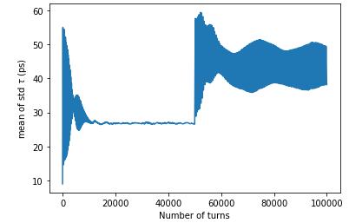
8 bunch mode at 100 mA (with SB collective effects)
Mean center of mass
HC on
HC off
Mean RMS bunch length
12,5 mA/bunch
HC off
0 mA/bunch
HC on
A dipole-quadrupole instability is observed in a given tuning range when the single bunch collective effects are considered (MWI regime).
This instability is observed at lower $ξ$ (and lower bunch length) for the 3HC.
It seems like a “weak” instability: excited beam but not beam loss ?

Slide 12
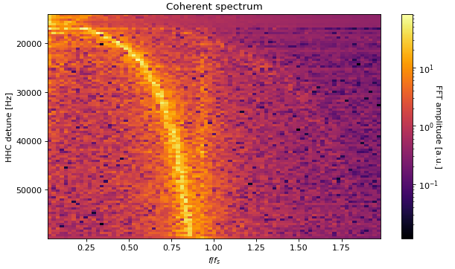
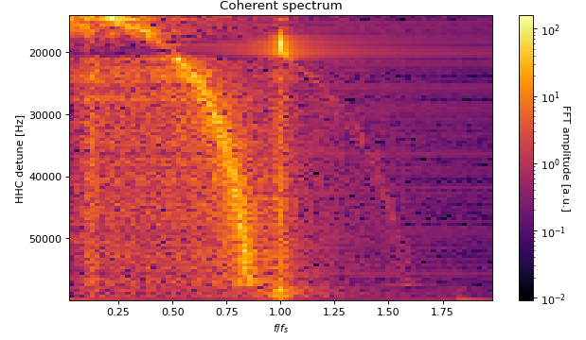
8 bunch mode at 100 mA (with SB collective effects)
Dipole-Quadrupole instability
Dipole mode
Quadrupole mode (?)
3HC only
3HC + impedance model

Slide 13
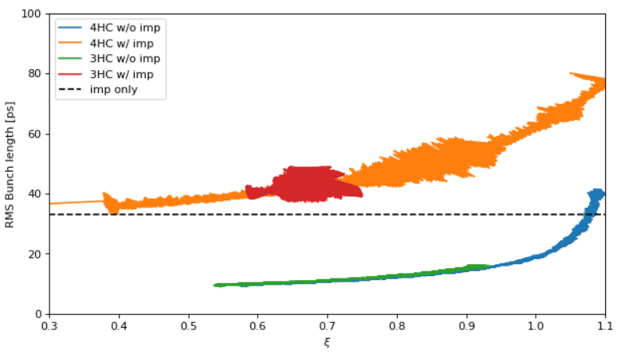
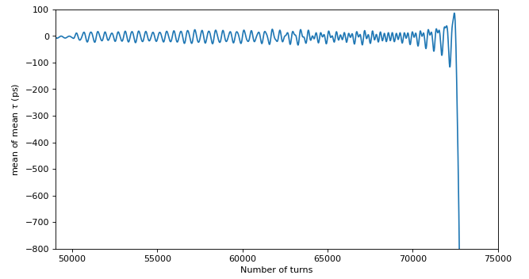
1 bunch mode at 20 mA (with SB collective effects)
The same kind of dipole-quadrupole oscillations as in 8 bunch mode is observed when impedance is added.
In addition, fast beam loss is observed (w/ and w/o impedance) due to the “fast mode coupling instability” (?).
The fast beam loss happens sooner (in $ξ$ and in detuning) when the impedance is taken into account.
20 mA/bunch
0 mA/bunch
Harmonic cavity detuning decreases

Slide 14
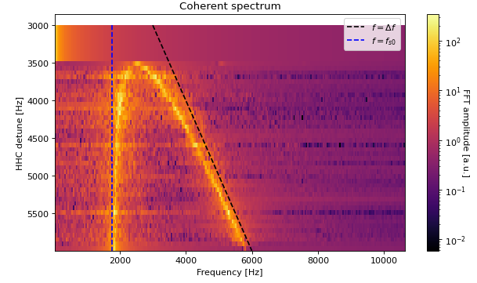
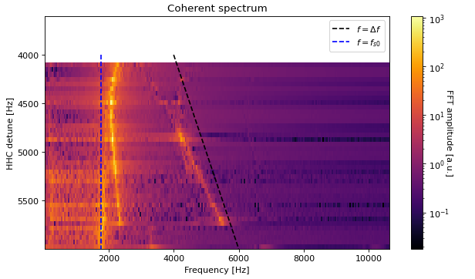
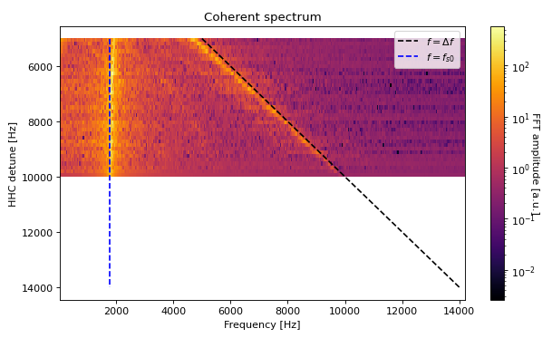
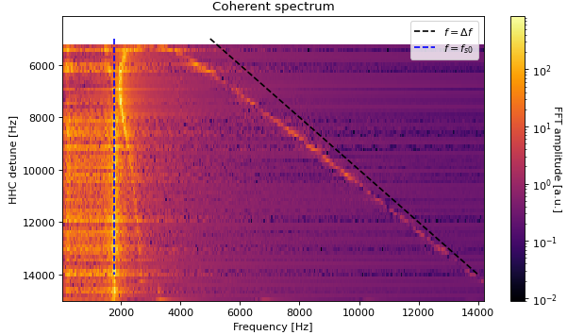
1 bunch mode at 20 mA (with SB collective effects)
3HC only
3HC + impedance model
Without SB collective effects, the 4th HC allows to lengthen the bunch all the way to double bump bunch in a stable way.
For the 3rd harmonic, the bunch lengthening is very rapidly limited by the merging of these two modes.
Adding the SB collective effects lower the threshold of this instability.
4HC only
4HC + impedance model

Slide 15
Conclusions
For the SOLEIL II project:
Self-consistent tracking simulations including impedance model have shown that SC passive HC allows to reach a large enough bunch lengthening factor in all the planned operation modes for the SOLEIL Upgrade.
The 4th harmonic provide more margin in the modes with a lower total current compared to the 3rd harmonic.
Lessons learned:
The $l=1$ / PTBL instability threshold is increased for higher harmonic and more generally when the bunch length is increased.
Adding an impedance model to the HC tracking can considerably change the results (in particular for the high current per bunch regime).
The high current per bunch regime (and interaction with the MWI) needs to be better understood:
Dipole-quadrupole instability in the MWI regime
Single bunch instability leading to fast beam loss

Slide 16
Thank you for your attention!

Slide 17
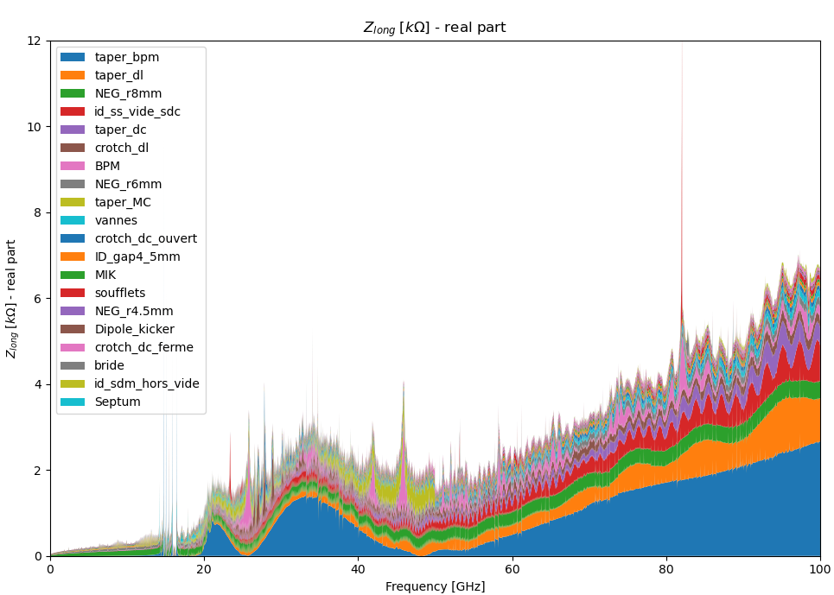
TDR_1 Model
Sorted by strength of contribution (area on the plot)

Slide 18
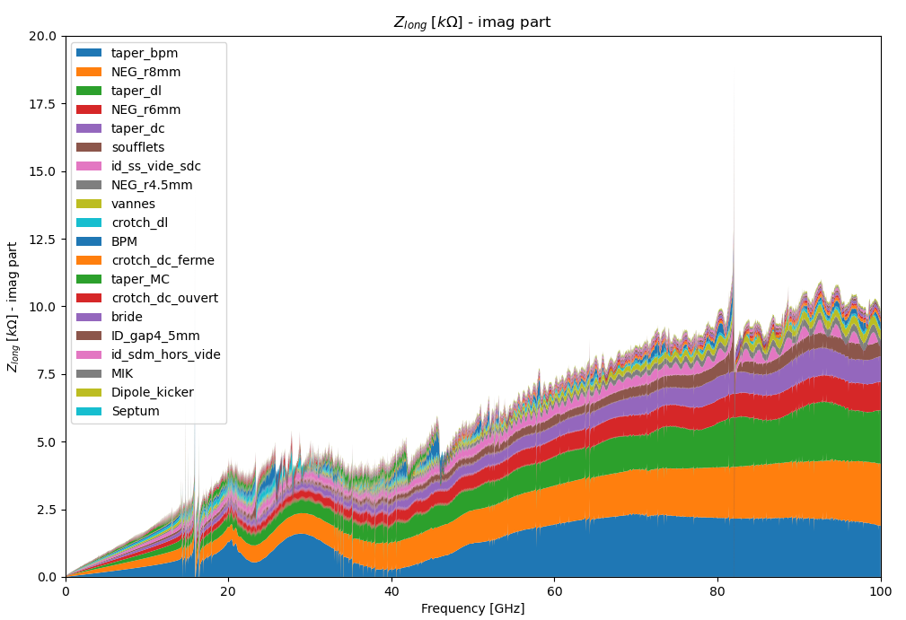
TDR_1 Model

