Slide 1
Review of Simulation Tools for Harmonic Cavity Systems
HarmonLIP
Lund, 11-12 October 2022
Alexis Gamelin
Part of this work has been performed within the frame of the WP2 collaboration among ESRF, HZB, KEK, PSI and SOLEIL

Slide 2
Warning …
This talk is rather partial as:
the examples come from my personal (i.e. limited) experience.
I am the (main) developer of mbtrack2 so many examples are from/about mbtrack or mbtrack2.
If your favorite code/theory/method is not mentioned, sorry about it but it is difficult to be exhaustive ...
Please tell me about it after the talk!

Slide 3
Overview
Analytical methods
  Bunch profile
  Beam stability
Tracking codes
  Codes
  Physics principles
  Benchmark

Slide 4
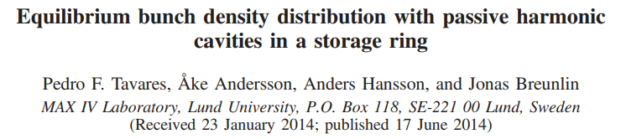
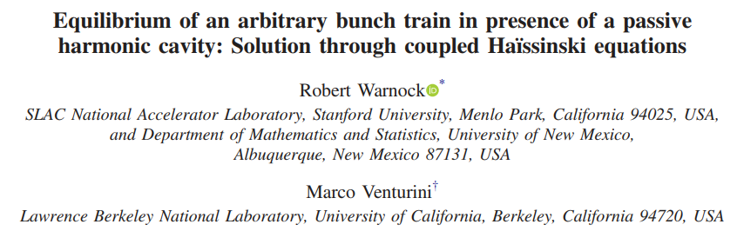
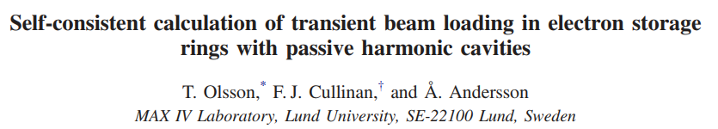
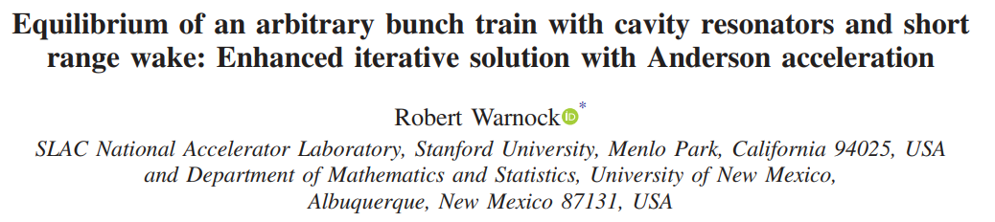
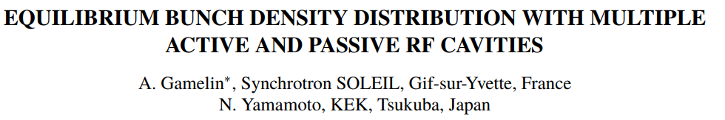

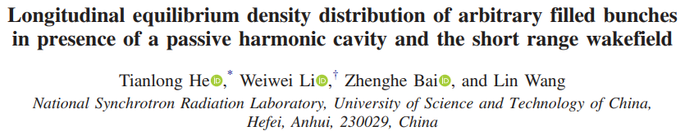
Bunch profile calculation
Aim: compute the equilibrium bunch profile for a given set of parameters.
There are now many analytic and semi-analytic methods to do this for active/passive harmonic cavities for an arbitrary beam filling pattern with/without additional impedance:

Slide 5
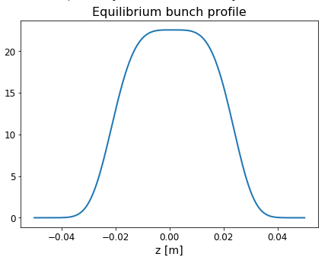

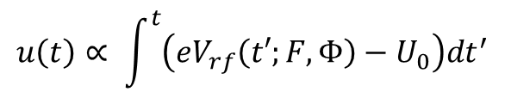
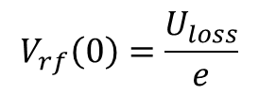
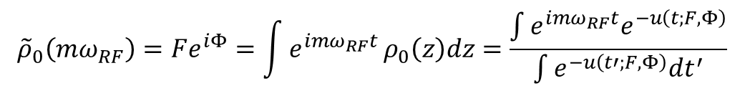
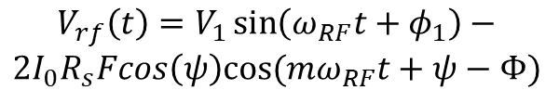
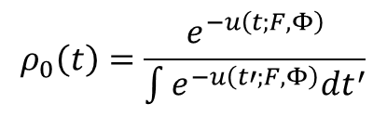
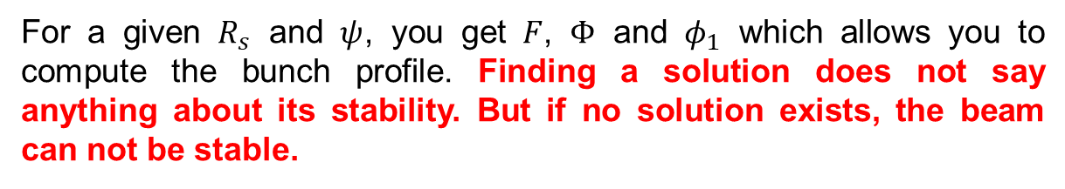
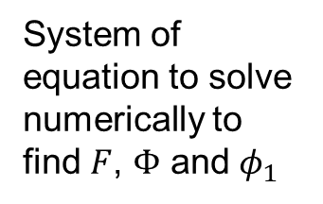
Bunch profile calculation
Example: simple method for passive cavities and uniform beam filling (M. Venturini).
It is possible to compute the bunch profile from the total voltage of the RF system by solving a system similar to the Haïssinski equation^{[1]}:
$$u\left(t\right)∝ \int^{t}{\left(eV_{rf}\left(t′;F,Φ\right)−U_{0}\right)dt^{′}}$$
Define a scaled potential which depends on the bunch profile via $F$ and $Φ$:
$$ρ_{0}\left(t\right)=\frac{e^{−u\left(t;F,Φ\right)}}{\int{e^{−u\left(t′;F,Φ\right)}dt^{′}}}$$
The bunch profile is then given by
$$V_{rf}\left(t\right)=V_{1}\sin\left(ω_{RF}t+φ_{1}\right)−$$
$$2I_{0}R_{s}Fcos\left(ψ\right)cos⁡(mω_{RF}t+ψ−Φ)$$
FT of the bunch profile taken at $mω_{RF}$
$${\tilde{ρ}}_{0}\left(mω_{RF}\right)=Fe^{iΦ}=\int{e^{imω_{RF}t}}ρ_{0}\left(z\right)dz=\frac{\int{{e^{imω_{RF}t}e}^{−u\left(t;F,Φ\right)}}}{\int{e^{−u\left(t′;F,Φ\right)}dt^{′}}}$$
System of equation to solve numerically to find $F$, $Φ$ and $φ_{1}$
$$V_{rf}\left(0\right)=\frac{U_{loss}}{e}$$
For a given $R_{s}$ and $ψ$, you get $F$, $Φ$ and $φ_{1}$ which allows you to compute the bunch profile. Finding a solution does not say anything about its stability. But if no solution exists, the beam can not be stable.

Slide 6
Bunch profile calculation
Comments regarding more complete methods:
To consider non-uniform filling, the computation is mostly similar but it needs to take into consideration a form factor amplitude and phase for each bunch (so also additional equations for each bunch).
To consider active cavities, the total cavity voltage needs to be set a sum of the beam loading voltage and generator voltage.
Unfortunately, there are too few open-source implementation of these algorithms available on the web (that I know of …):
Elegant “haissinski” sub-program which includes passive harmonic cavities with additional impedance in uniform filling (L. Emery, M. Borland): https://ops.aps.anl.gov/manuals/elegant_latest/elegant.html
Mbtrack2 “BeamLoadingEquilibrium” class which includes any number of combination of active or passive cavities in uniform filling (A. Gamelin): https://gitlab.synchrotron-soleil.fr/PA/collective-effects/mbtrack2/-/blob/stable/mbtrack2/utilities/beamloading.py
“BunchLengthening” which includes passive harmonic cavities, BBR wake and arbitrary filling pattern (T. He): https://github.com/hetianlong-afk/BunchLengthening

Slide 7
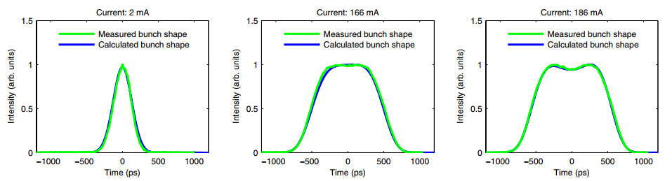
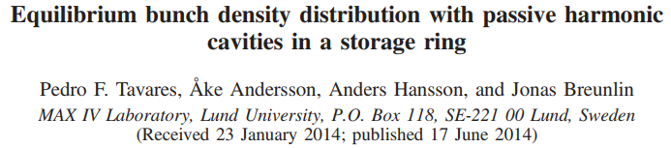
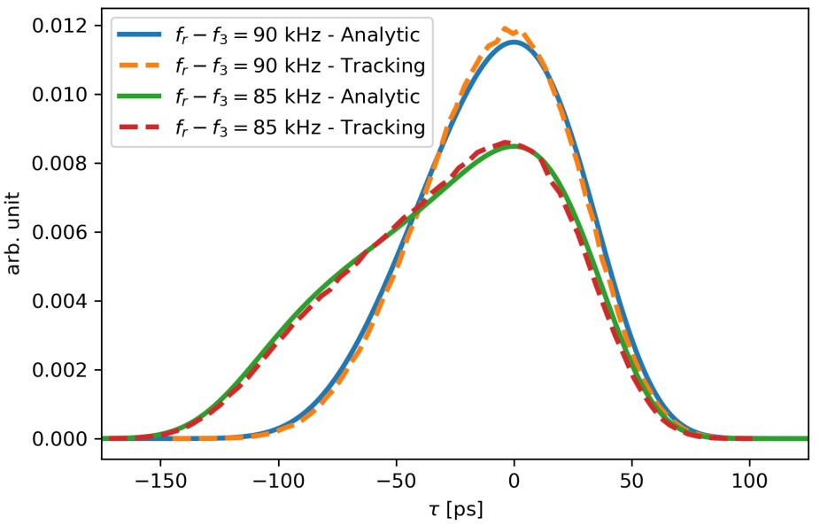
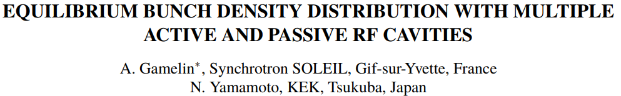
Bunch profile calculation
Example: benchmark against measurements and tracking code.

Slide 8

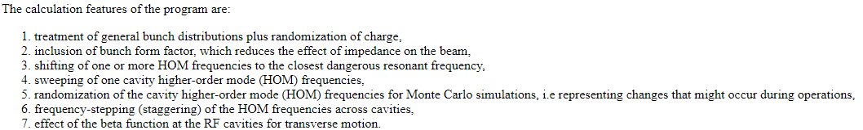


Beam stability
Aim: estimate beam stability for a given instability type
Coupled-bunch mode instability (HOM, AC Robinson, …)
Usual formula
Coupled bunch mode number
$$τ^{−1}=\frac{eαI}{4πE_{0}ν_{s}}\left\{\sum_{n=0 }^{∞}{ω_{μ,n}^{+}}Re\left[Z\left(ω_{μ,n}^{+}\right)\right]−\sum_{n=0 }^{∞}{ω_{μ,n}^{−}}Re\left[Z\left(ω_{μ,n}^{−}\right)\right]\right\}$$
$$ω_{μ,n}^{±}=\left\{nM±\left(μ+ν_{s}\right)\right\}ω_{0}$$
Number of bunches
Clinchor (L. Emery): https://ops.aps.anl.gov/manuals/clinchor_V2.0/clinchor.html
Semi-analytic method based on normal mode analysis to estimate the growth rate of coupled bunch instabilities of an arbitrary filling pattern (gaps, charge variation, …)

Slide 9
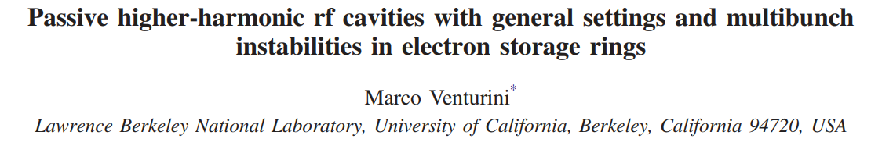
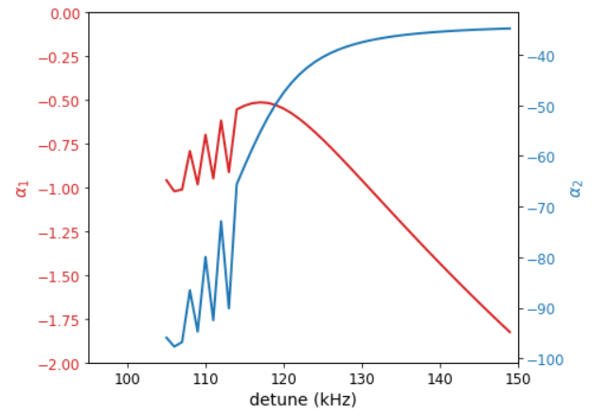





Beam stability
Aim: estimate beam stability for a given instability type
$l=1$ / Periodic Transient Beam Loading (PTBL) instability
Numerical solution of the linearized Vlasov equation
Quite complex and limited to uniform filling.
An open implementation is available on a sub-branch of mbtrack2 but the convergence can be quite difficult …
Semi-analytic methods involving bunch profile calculations
PTBL
$$\frac{{dV}_{tot}}{dt}\left(0\right)∝α_{1}$$
Using bunch profile calculations, it is often possible to estimate the PTBL instability threshold when the Haïssinski solver no longer gives continuous solution (several different solutions are found) or no convergence at all.
stable
$$\frac{{d^{2}V}_{tot}}{dt^{2}}\left(0\right)∝α_{2}$$
Simplified expressions
(A. Gamelin LER’2020)
M. Venturini
T. He

Slide 10
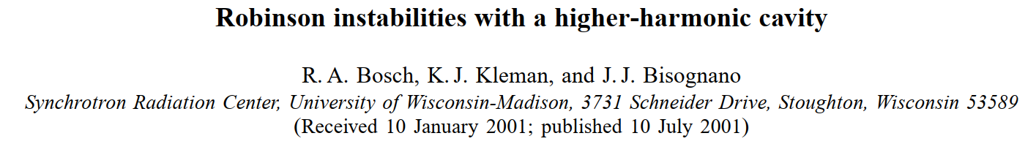
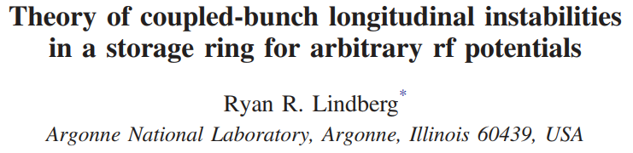
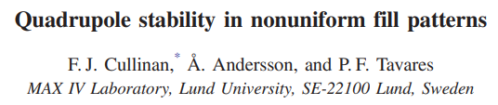
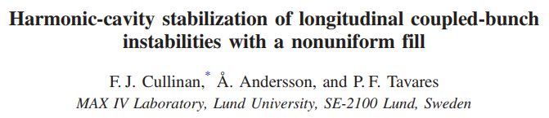
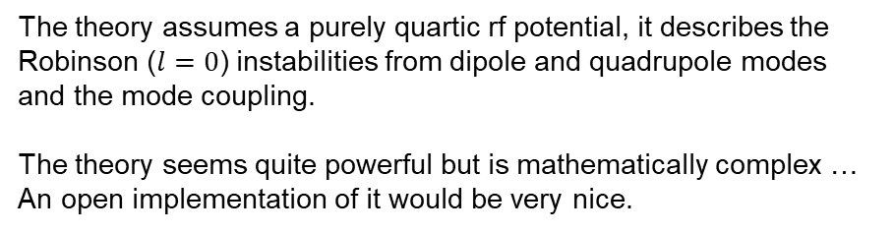
Beam stability
Aim: estimate beam stability for a given instability type
$l=0$ with higher order (synchrotron/azimuthal) modes and fast mode coupling instability
The theory assumes a purely quartic rf potential, it describes the Robinson ($l=0$) instabilities from dipole and quadrupole modes and the mode coupling.
The theory seems quite powerful but is mathematically complex … An open implementation of it would be very nice.
And a few others …

Slide 11
Overview
Analytical methods
  Bunch profile
  Beam stability
Tracking codes
  Codes
  Physics principles
  Benchmark

Slide 12
Multi-bunch tracking codes including beam loading
Code | Language | // | Source & Distribution | RF FB | BxB FB | Single bunch effects | Beam loading implementation
mbtrack - SOLEIL/KEK - Max IV | C | CPU | Semi-open (closed git accessible on demand) https://gitlab.com/soleil_ap/mbtrack https://bitbucket.org/fcullinan/mbtrack/src/master/ | Advance / ? | No / Yes | TD (broad band resonator) | Phasor
mbtrack2 | Python | CPU | Open https://gitlab.synchrotron-soleil.fr/PA/collective-effects/mbtrack2 | Basic | Yes | TD (wake function) | Phasor
elegant | C | CPU | Open https://ops.aps.anl.gov/manuals/elegant_latest/elegant.html | Advance | Yes | FD & TD | Phasor
BlonD | Python | CPU | Open https://blond.web.cern.ch/ | Advance | No | FD & TD | Multi-turn wake
STABLE | Matlab | GPU | Close | Basic | No | TD | Phasor
SPACE | C (?) | CPU | Close
Not mentioned in this table but also worth mentioning:
PyHeadTail (multi-bunch existing but not in the stable distribution version)
CETASIM (beam loading module in progress)
PyAT (beam loading module in progress)
Others I forgot …

Slide 13
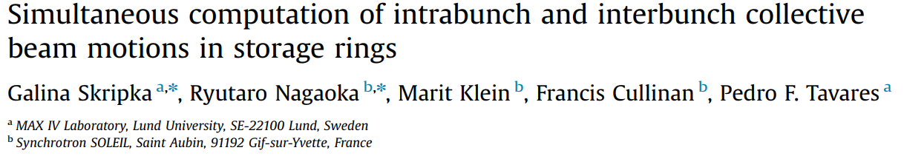
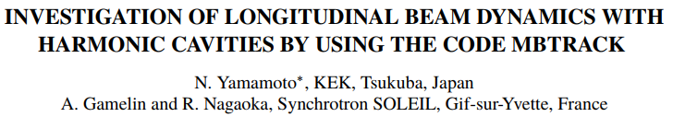
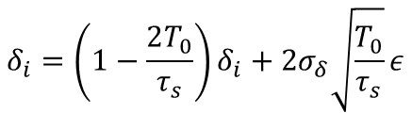
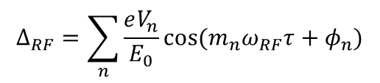


Beam loading using the phasor method in mbtrack
Introduction to the beam loading calculations in tracking codes using the phasor method.
Basic longitudinal equation of motion to go from turn (i-1) to turn i (one turn map) :
$$δ_{i}=δ_{i−1}+Δ_{RF}−U_{0}/E_{0}$$
Initial paper considering passive cavities for mbtrack:
$$τ_{i}=τ_{i−1}−α_{c}T_{0}δ_{i}$$
Synchrotron radiation damping and quantum excitation:
$$δ_{i}=\left(1−\frac{2T_{0}}{τ_{s}}\right)δ_{i}+2σ_{δ}\sqrt{\frac{T_{0}}{τ_{s}}}ε$$
Extension for active cavities for mbtrack/mbtrack2:
Usual way to include RF systems in macro-particle tracking code, what I call “ideal cavity” (no beam loading), is just a sum of n cosine (or sine) like:
$$Δ_{RF}=\sum_{n}{\frac{eV_{n}}{E_{0}}}cos⁡(m_{n}ω_{RF}τ+φ_{n})$$
But this approach can not simulate instabilities generated by the RF system or the transient beam loading …

Slide 14
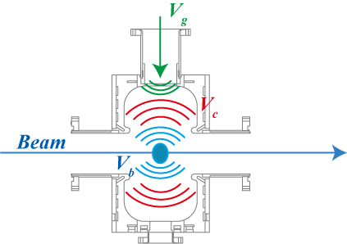

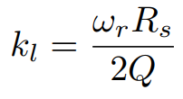







Beam loading using the phasor method in mbtrack
Introduction to the beam loading calculations in tracking codes using the phasor method.
To simulate beam loading, the field in the cavity, expressed through the cavity phasor $\tilde{V_{c}}$ should be decomposed in two components, the generator phasor $\tilde{V_{g}}$ and the beam induced phasor $\tilde{V_{b}}$:
$$\tilde{V_{c}}=\tilde{V_{g}}+\tilde{V_{b}}$$
The generator phasor is expressed in term of the generator voltage $V_{g}$ and phase $φ_{g}$:
$$\tilde{V_{g}}=V_{g}e^{j\left[mω_{RF}τ+φ_{g}\right]}$$
The beam induced voltage $\tilde{V_{b}}$ is built up by the successive passages of the different particles inside the cavity. When a charged particle goes through the RF cavity, it induces a voltage $\tilde{V_{0}}$:
with $k_{l}$ the cavity loss factor
The field induced by the different particles crossing the cavity between time t and time t+∆t is added to the beam voltage phasor $\tilde{V_{b}}(t)$ already present in the cavity at time t:
with $τ$ the cavity filling time and $δ$ the phase slippage factor:
So by sorting the bunch macro-particles into bins, one can compute the beam loading phasor $\tilde{V_{b}}$ evolution during the passage of a bunch.
$$τ=\frac{2Q_{L}}{ω_{r}}$$
$$δ=ω_{r}$$
As a particle see only half of its wake, the energy change felt by the particle due to the RF system is given by:
$$Δ_{RF}=e/E_{0}(Re\left[\tilde{V_{g}}+\tilde{V_{b}}\right]−q_{M}k_{l})$$

Slide 15


Beam loading using the phasor method in mbtrack
Comment about the multi-turn wake vs phasor implementation
The phasor formalism has the advantage that you do not need to keep the history of beam (previous beam distributions) to compute the voltage at the present turn.
This is especially important for superconducting cavities for which the filling time order of magnitude is seconds (so potentially ~100 000 turns).
The multi-turn wake implementation is not limited to resonators (and might be a bit more robust in some cases).
Phasor initialization
To speed-up calculation, it is often needed to initialize the beam phasor to its equilibrium value. It can be done either by tracking a “frozen” beam distribution or more efficiently by using approximate or exact formulas.
The formula for the exact phasor evolution of a “frozen” beam distribution over a turn of duration $T_{0}$ is given by (mbtrack2):
Bin number
Bunch number
with
Distance between two bins in bunch j
MP charge in bin k of bunch j
Distance between bunch j and and (j+1)

Slide 16
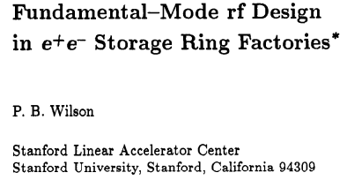
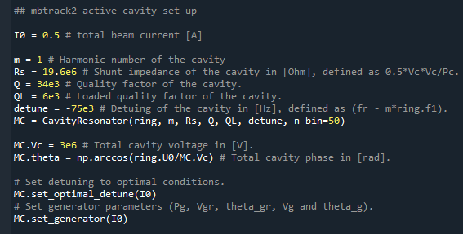

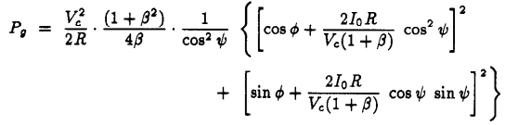





Beam loading using the phasor method in mbtrack
Simulation set-up
How to set-up the different parameters (detuning, generator voltage and phase) to get the total “cavity” voltage and phase that you want in your active cavity ?
Assuming uniform filling at beam current $I_{0}$, but gives good enough results in most cases:
Set the tuning angle/detuning, can be set to optimal detuning (minimum generator power) or arbitrary:
Compute the generator power:
Compute the generator voltage and phase at resonance:
Set the generator voltage and phase:
$$V_{br}=\frac{\left(2 I_{0} R_{s}\right)}{1+β}$$
$$φ_{gr}=arctran\left(V_{c}\sin\left(φ\right)+\frac{V_{br}\cos\left(ψ\right)\sin\left(ψ\right)}{V_{c}\cos\left(φ\right)+V_{br}\cos^{2}{ψ}}\right)−ψ$$
$$V_{g}=V_{gr}\cos{ψ}$$
$$φ_{g}=φ_{gr}+ψ$$

Slide 17
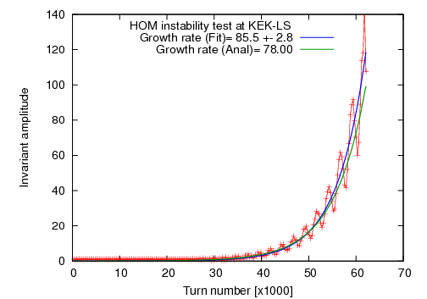
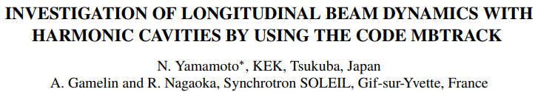
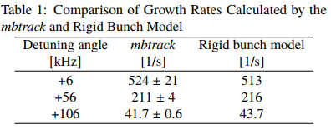
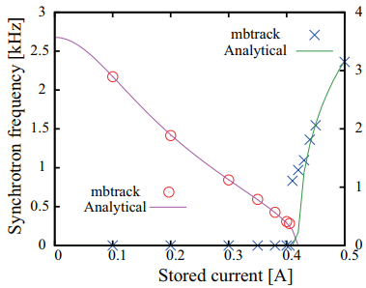
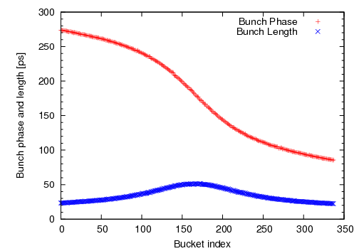
Benchmark: mbtrack (N. Yamamoto)
mbtrack has been widely benchmarked against theory and (a bit) against experiment
AC Robinson & HOM
DC Robinson
Transient beam loading
Experimental result
“mbtrack” result
189 ps
Phase
Length
*M. Pedrozzi, et al., SRF03 (2003) p. 91

Slide 18
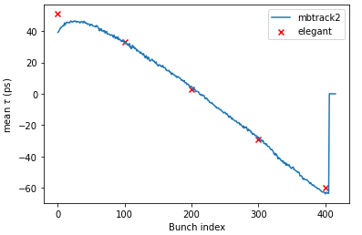
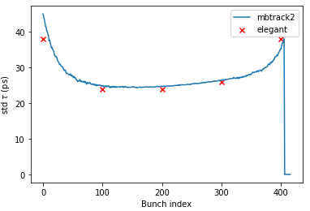
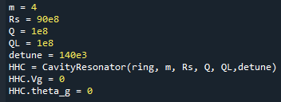
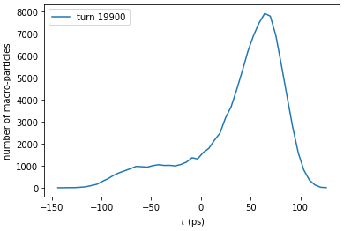
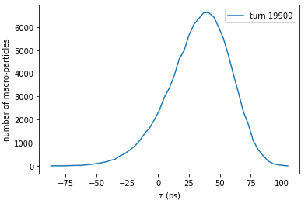
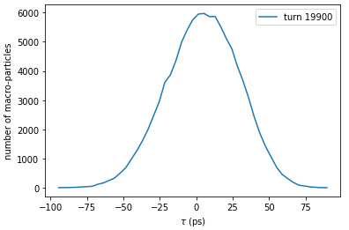
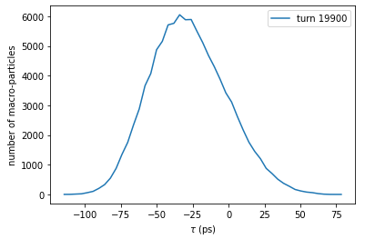
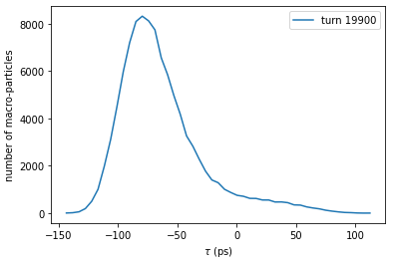
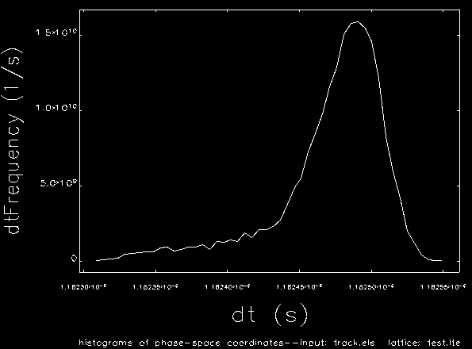
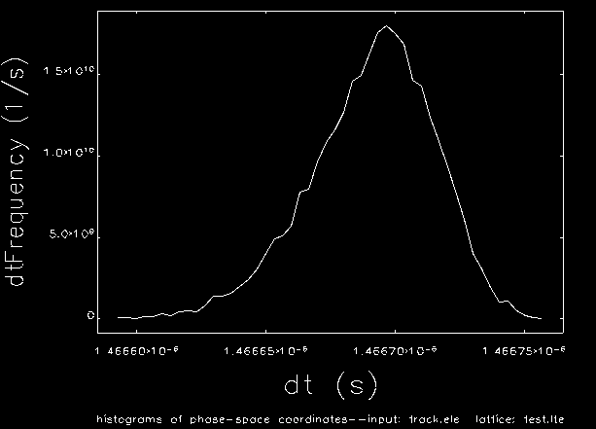



Benchmark: mbtrack2 vs elegant
Benchmark of mbtrack2 vs elegant with SOLEIL II parameters
SOLEIL II parameters
500 mA beam with 10 empty buckets
Using “ideal” main cavity (because I am elegant beginner …)
SC passive 4th harmonic cavity
Center of mass
RMS bunch length
Bunch n°0
Bunch n°100
Bunch n°200
Bunch n°300
Bunch n°400
mbtrack2
elegant

Slide 19



Benchmark: ALS-U with l=1 instability
mbtrack2:
Benchmark the l=1 instability / PTBL using the parameters from M. Venturini paper
Tuning angle for tracking
Only harmonic cavity w/ beam loading as no parameters for main cavity (ideal cavity)

Slide 20


Benchmark: ALS-U with l=1 instability
mbtrack2:
Benchmark the l=1 instability / PTBL using the parameters from M. Venturini paper
Turn = 4e4
HC voltage & phase
Turn = 4e4
Tuning angle for tracking
Only harmonic cavity w/ beam loading as no parameters for main cavity (ideal cavity)

Slide 21



Benchmark: ALS-U with l=1 instability
Comment: about noise on the filling pattern …
Using SOLEIL-II parameters (SC passive HC, $R/Q$ $≈90Ω$), adding some noise on the filling pattern can suppress this instability (but also reduce the achievable bunch lengthening).
I wanted to show this for the ALS-U case ($R/Q$ $≈160Ω$) but I found out that the instability was still there … So be careful about this.
Add a lot of noise …

Slide 22
Conclusions
Analytical methods & theory:
Many recent improvement on theory, analytic or semi-analytic methods, the field is very active!
Lack of good open-source implementation of these, in my view it is a big loss for the community …
Tracking codes:
State of the art tracking codes are now able to simulate multi and single bunch effects at the same time together with RF and bunch by bunch feedback.
Many successful benchmark against theory and other codes.
Probably need more benchmark against experimental data.
In many cases, you need both to solve a problem!
Please, next time you write a nice piece of code, think of your colleagues and make it open-source!

Slide 23
Thank you for your attention!

Slide 24

mbtrack2 examples & tutorials
Jupyter notebook available on google colab (on a web browser, nothing to install):
mbtrack2 base features:
https://colab.research.google.com/github/GamelinAl/mbtrack2_examples/blob/main/mbtrack2_demo.ipynb
dealing with RF cavities and longitudinal beam dynamics:
    https://colab.research.google.com/github/GamelinAl/mbtrack2_examples/blob/main/mbtrack2_cavity_resonator.ipynb

