Slide 1
Tracking simulations and tests results in SLS with Super-3HC
This work (or part of this work) has been performed within the frame of the WP2 collaboration among ESRF, HZB, KEK, PSI and SOLEIL
Lukas Stingelin :: RF coordination SLS 2.0 :: Paul Scherrer Institute
HarmonLIP 2022, 10-12 October 2022, MAX IV

Slide 2
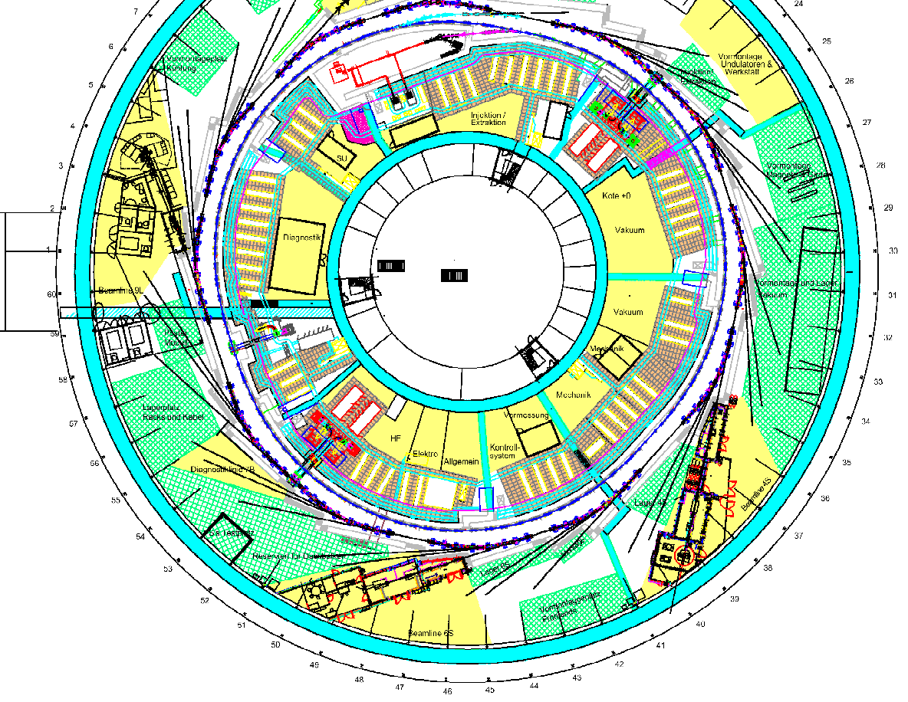
SLS Overview
Booster and SR in same tunnel
Full Linac (100MeV):
2 pulsed klystron TH2100 (35 MW)
Op. since April 2000
Booster + Teststand RF:
1 power plant 180 kW
Op. since July 2000
+ SSA op. since 2016
Storage ring RF:
4 independent power plants 180 kW.
Op. since December 2000
1 two cell Super Conducting 3rd harmonic idle cavity Super-3HC
Op. since October 2002
Linac
1
2
B+TS
4
3
SC

Slide 3
SLS Synchrotron Parameters Compared with SLS 2.0 TDR
 | SLS 2.0 (TDR) | SLS
Circumference [m] | 288 | 288
Energy [GeV] | 2.7 | 2.411
Lattice and ID Energy loss/turn [keV] | 687.6 → 943 | 549→600
Energy loss/turn in wake fields [keV] w. (w.o) 3HC | 7 (22)
Energy spread | 1.16·10⁻³ | 9·10⁻⁴
Momentum compaction α_{c} | 1.05·10⁻⁴ | 7·10⁻⁴
Energy acceptance (without harmonic cavity) | 6.2% → 5.1% | 3%
Main RF frequency [MHz] | 499.6537 | 499.6
Total main RF voltage nominal [kV] | 1780 | 2080
Total main RF voltage maximum [kV] | 2200 | 2600
Harmonic number | 480 | 480
Gap in the filling pattern, empty buckets | 20…30 | 50…90
Damping times x/y/E [ms] | 4.14/7.54/6.41 | 8.4/8.4/4.5
Longitudinal stability threshold per cavity [GHz kΩ] | 6.2
Horizontal stability threshold per cavity [MΩ/m] | 3.3 | 40
Vertical stability threshold per cavity [MΩ/m] | 4.4
Beta functions at main cavity location β_{x} [m] / β_{y} [m] | 9.6/7.0 | 1.5/1.1
Beta functions at harmonic cavity β_{x} [m] / β_{y} [m] | 6.8/4.1 | 3.5/3.5
Synchrotron frequency without harmonic cavity [kHz] | 2.172 | 6.93
Energy fluctuations relative to energy spread | <10%

Slide 4
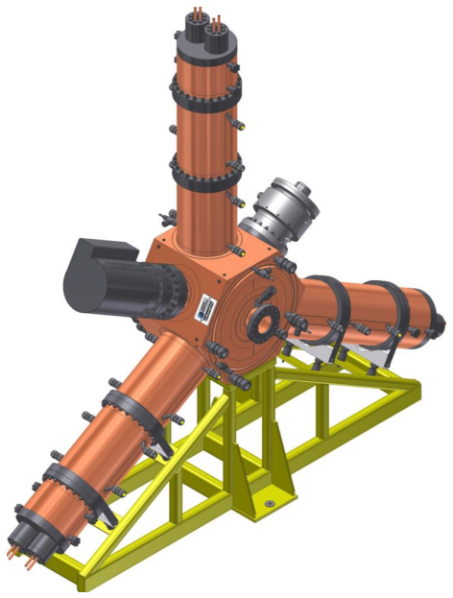
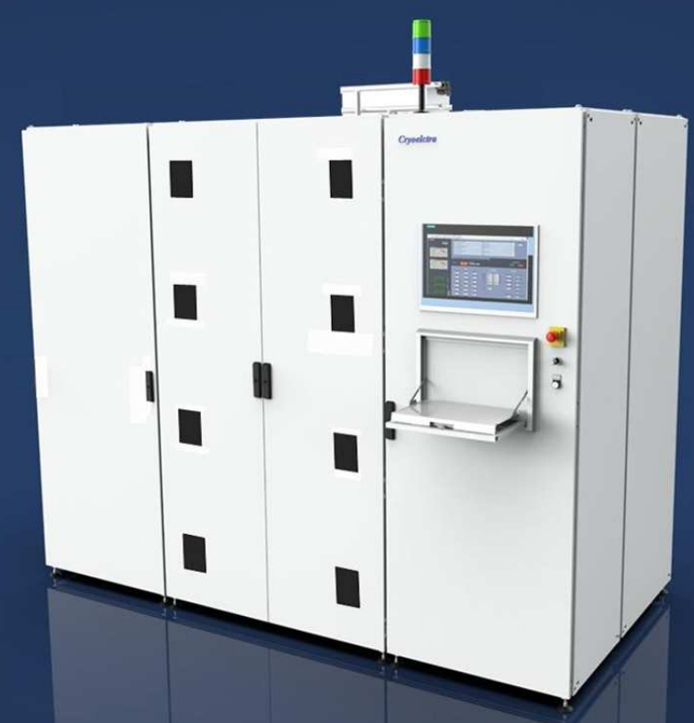
SLS RF Parameters Compared to SLS 2.0
Main RF-System | SLS 2.0 | SLS
Total voltage [kV] | 1780 | 2080
Energy acceptance (without harmonic cavity) | 6.3% → 5.2% | 3%
Number of cavities | 4 | 4
Voltage per cavity [kV] | 445 | 520
Wall loss per cavity [kW] | 30 | 40
Required RF-power with beam and minimum ID Power [kW] | 98.1 | 95
Required RF-power with beam and maximum ID Power [kW] | 124 | 100
Optimal coupling | 3.4…4.3 | 2.5
Detuning for matching [kHz] | -32.4…-44.6 | -33
HOM control | By strong HOM damping | Temp. detuning
Max. voltage for ≤150kW reflected pulse power [kV] (restriction from amplifier specification) | 540
New HOM damped cavities in procurement from Research Instruments
New 150kW Solid State Amplifiers in procurement from Cryoelectra

Slide 5
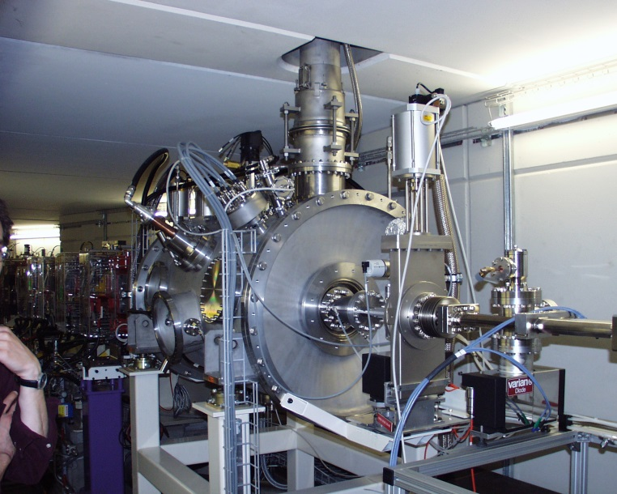
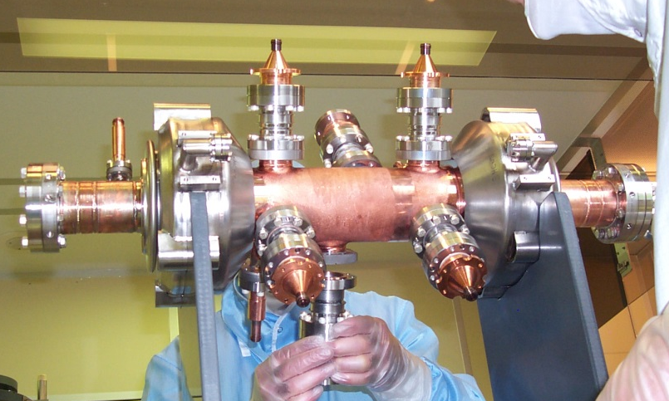
SLS 3rd harmonic Super Conducting system
SUPER-3HC collaboration:CEA-Saclay, PSI, Sincrotrone Trieste and CERN
Use of an idle (only beam-powered) super-conducting cavity
“Scaling” of the 350 MHz sc cavity developed at Saclay for SOLEIL
2 Nb/Cu cells (4.5 K)
6 coaxial HOM couplers (2 longitudinal and 4 transverse)
Nominal voltage <800 kV (4MV/m)
Tested up to 11 MV/m
R/Q=88.4 Ohms (Q= 2 10⁸)
Kryo power needed at 4.5 K and 4MV/m: 45.3 W (~33W Ohmic!)
Total GHe flow:
1.171 g/s = 5.2 l/h of liquefaction
HOM couplers

Slide 6
SLS Operation with Super-3HC
WARM OPERATION (cavity cooling with air or GHe).
With parked cavity, stable operation up to 200 mA.
At higher current: overheating of the cavity and excitation of the long. Coupled Bunch Modes (CBM)
COLD OPERATION (4.5K)
With parked cavity: At higher current excitation of the longitudinal CBMs from main RF.
With tuned cavity, user operation at 400 mA.
  The additional Landau damping from the harmonic system suppress the longitudinal CBM.
  Amplitude loop disabled, tune adjusted for max Lifetime at 400 mA.
1.5 GHz
Warm parking
Cold parking
-1 MHz
+1 MHz

Slide 7
Problems of Super-3HC
Cavity isolation vacuum shows some very fast spikes that seem related to a leak versus the air
One leak on the coaxial line of HOM coupler repaired with fluid silicon
Vacuum leak in the vacuum flange repaired with glue
Turbine failure
  Maintenance of turbines at “Vorbuchner”.
  Improved He cleaning procedure
SLS emergency-stop button was pushed several times accidentally and switched off the cryogenic system.
  Now independent of SLS emergency stop button.
Upgraded Voltage measurement system (“fail safe”, stabilized and linearized)
Now testing new CERNOX temperature measurement-System
At ELETTRA: Problems with tuning system
  Refurbish during SLS-2.0 dark-time.

Slide 8
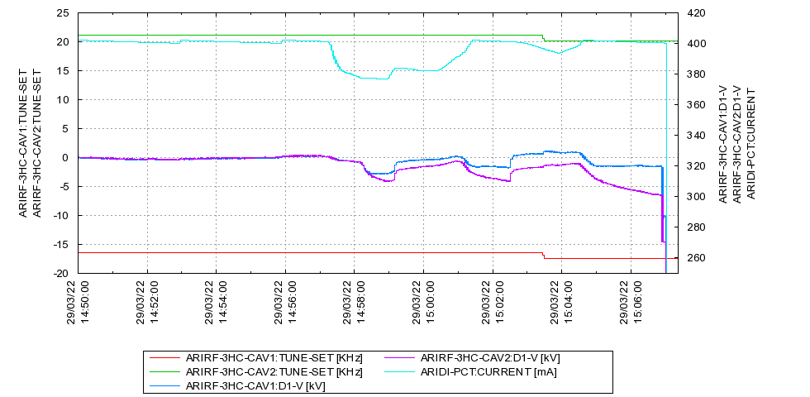
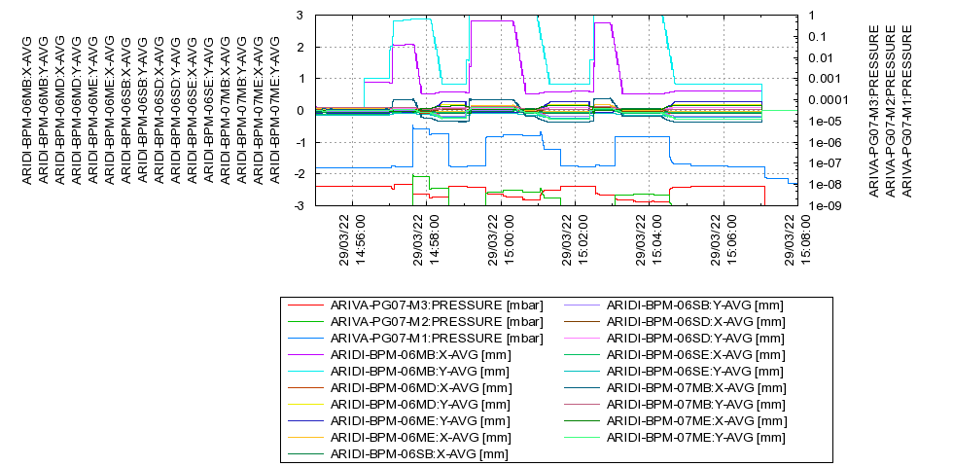
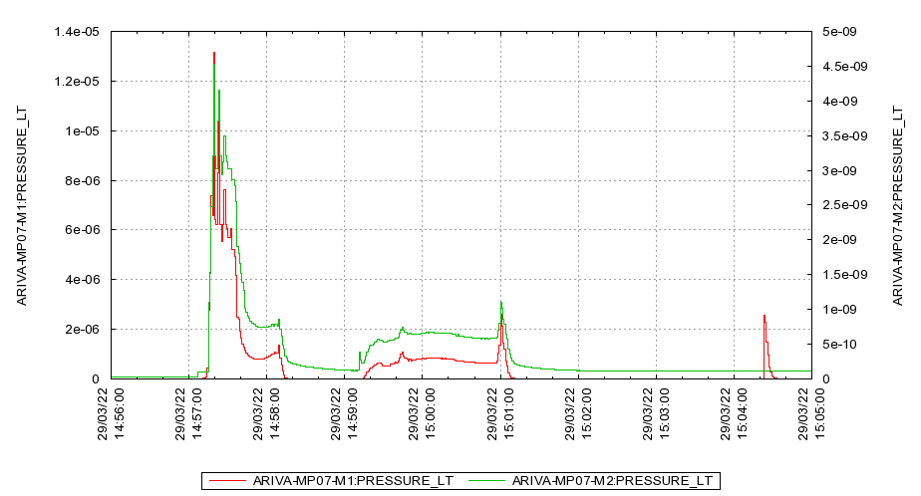
Problems with Super-3HC after March Incident
Orbit off by several mm!
Orbit problems, current drops
Beam-loss (CBI)
Vacuum pressure increase, voltage asymmetry starts
Operator tries to increase voltages
During machine development shift, experiments with orbit bumps.
Faillure of BPM system caused large orbit excursion
Vacuum pressures at absorber before Super-3HC and after 3HC reached 1E-5mbar!
Asymmetry stays during accumulation and drifts over 10s of minutes to new equilibrium.
Vacuum-controller did not interlock the beam!

Slide 9
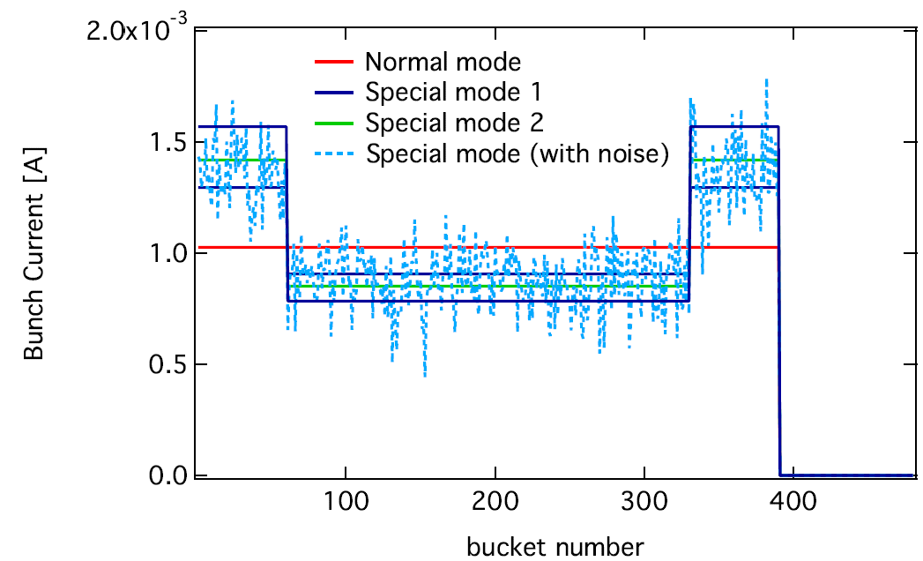
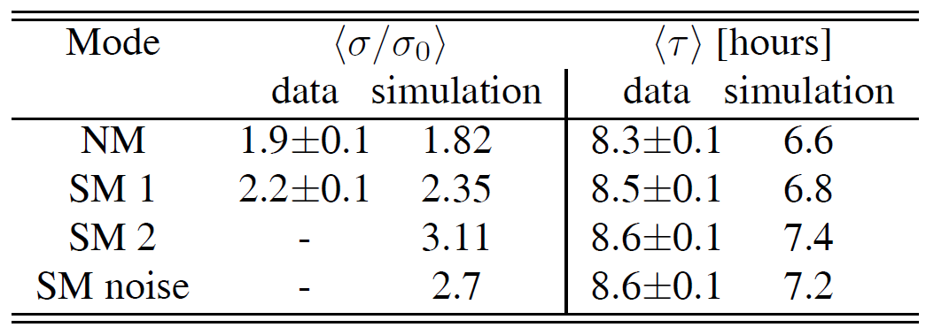
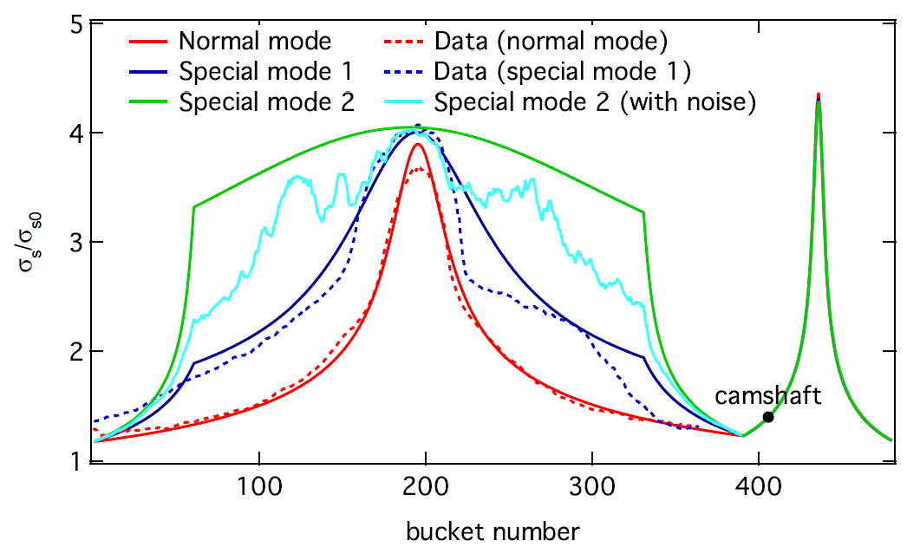
Experiments with Different Filling Pattern
“Impact of Filling Patterns on Bunch Length and Lifetime at the SLS” (N. Milas et al. Proceedings of IPAC’10, Kyoto, Japan)
From 2019: gap in filling pattern was shortened from 90 to 50.
→The beam lifetime increased >30% (lower bunch population +less transient beam loading)
“Exploring The Potential of the Swiss Light Source” (M. Aiba et al. Proceedings of IPAC2019, Melbourne, Australia)

Slide 10
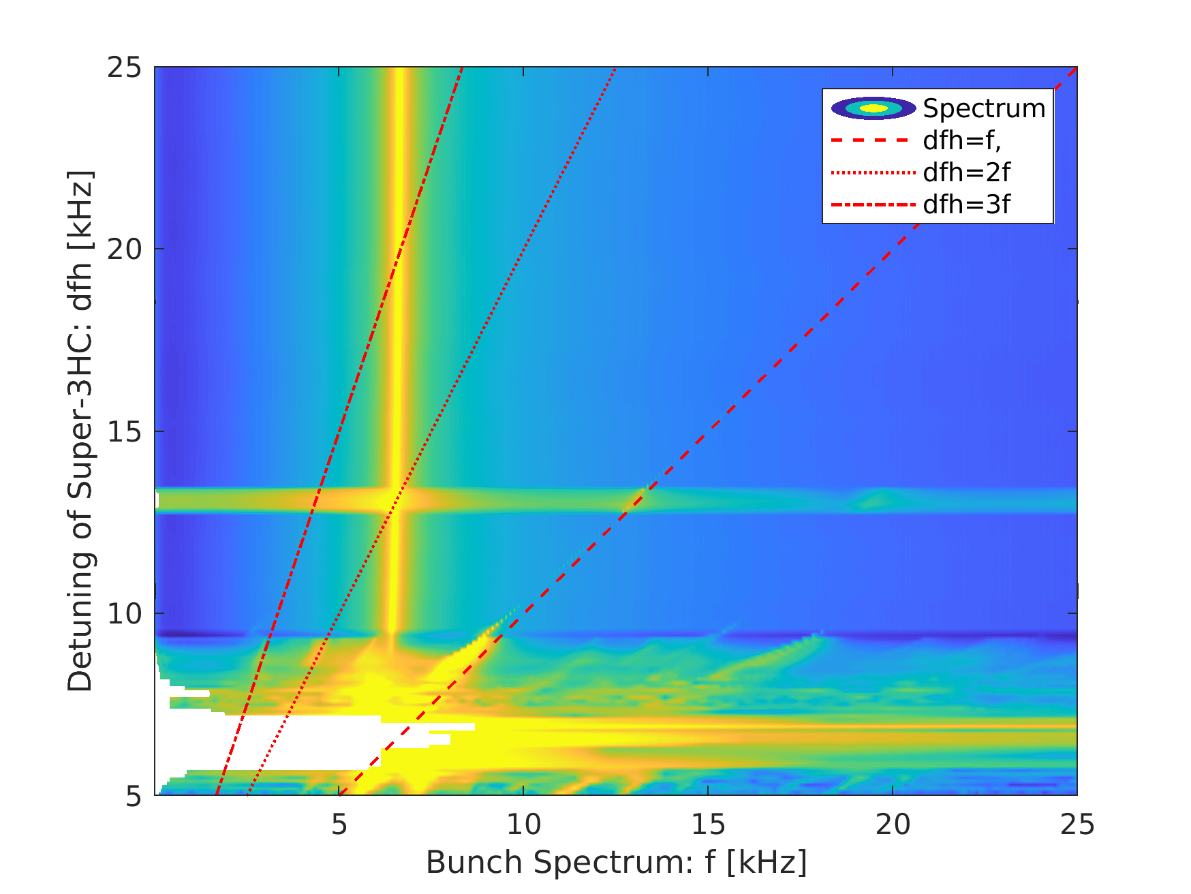
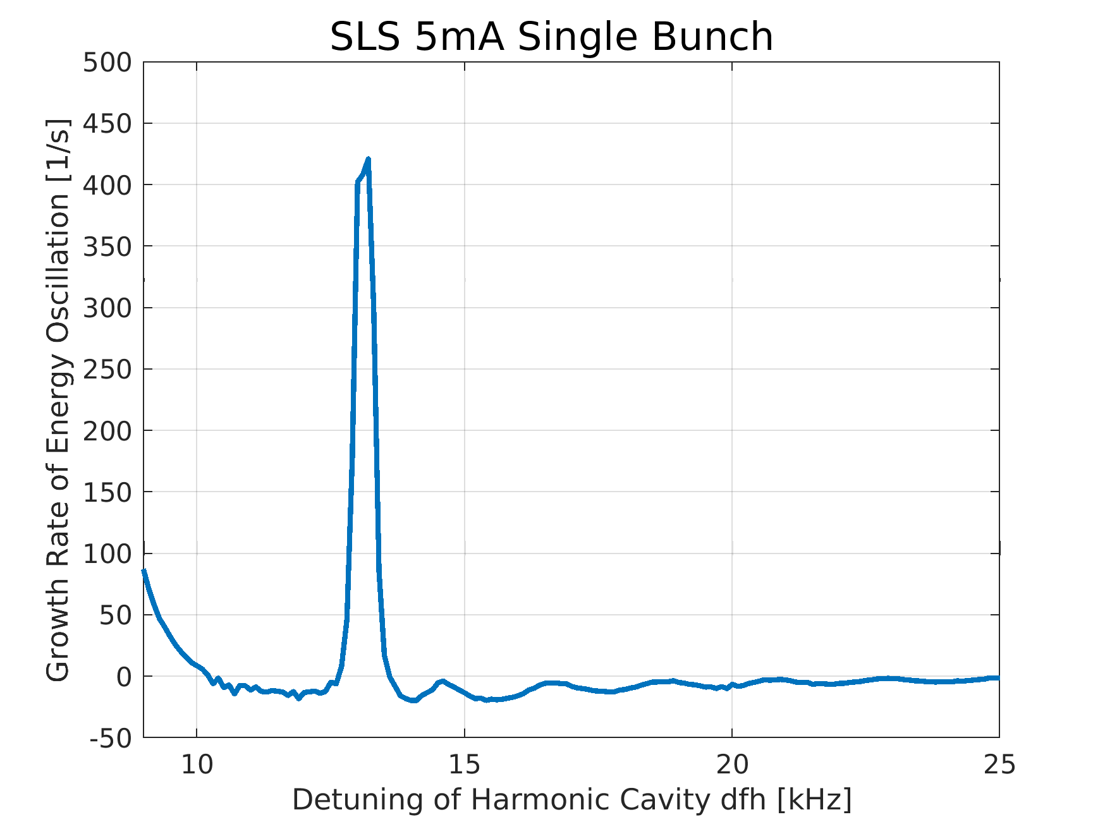
Simulations with ELEGANT:
Bunch Lenghtening at 5mA?
Instability at
dfh=2f_{s}
Only impedances of main- and harmonic cavity are considered in these simulations!

Slide 11
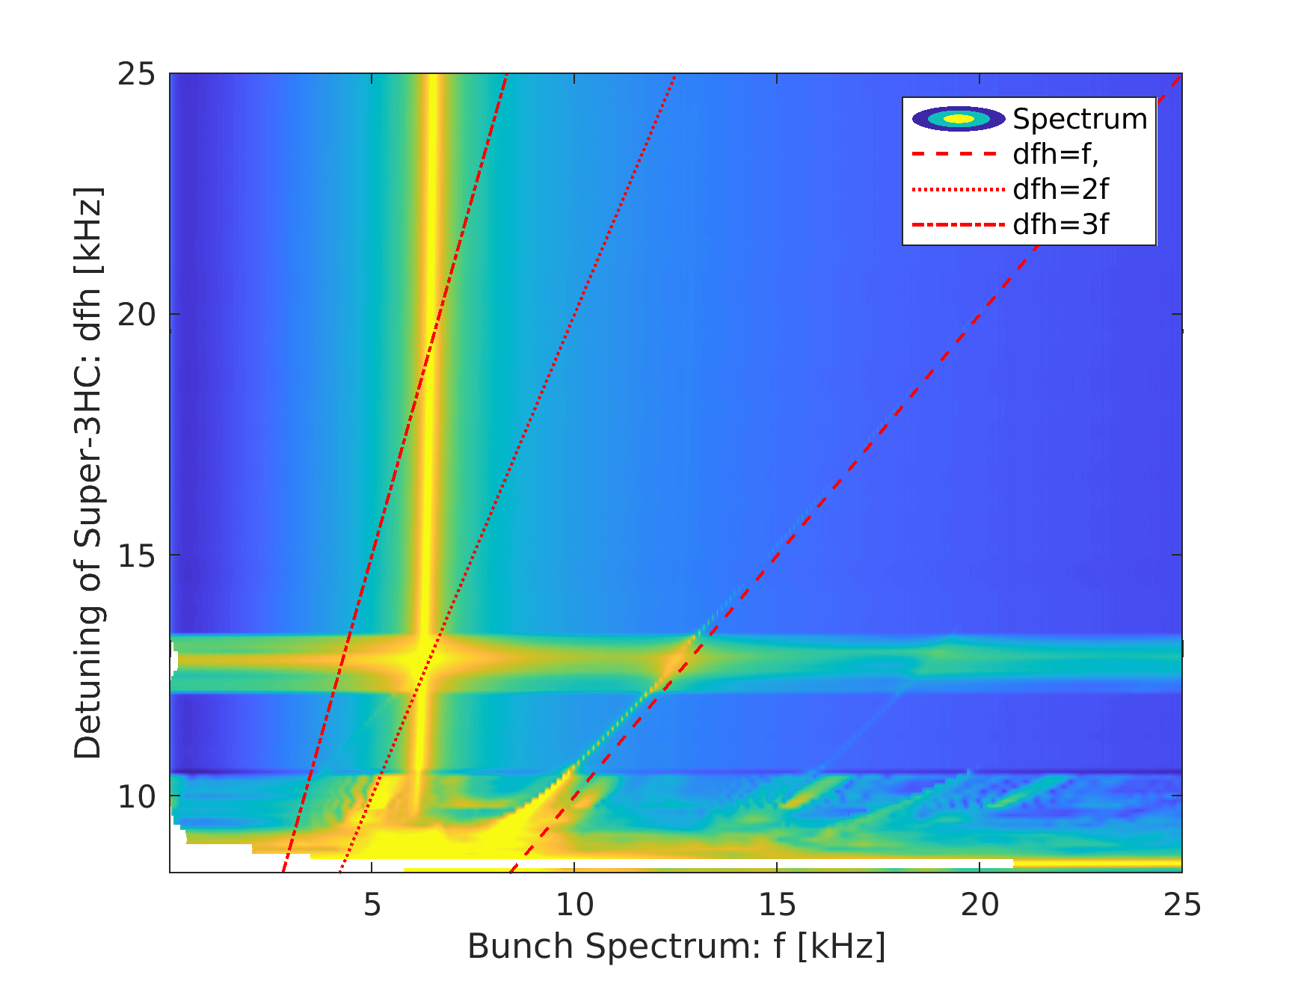
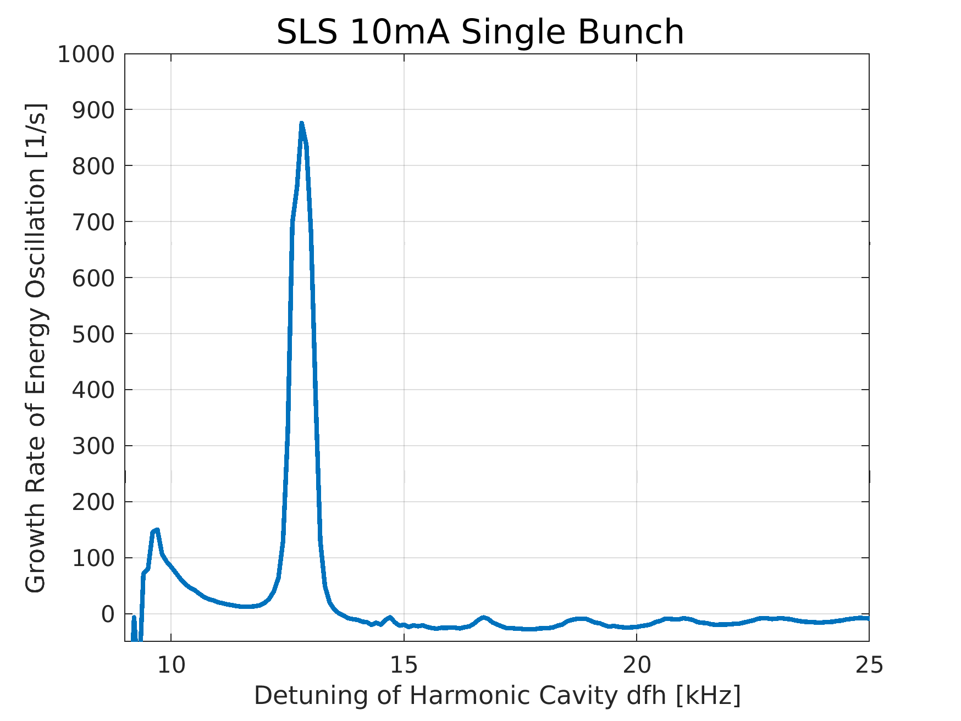
Simulations with ELEGANT:
Bunch Lenghtening at 2x5mA=10mA (2 Bunches)?
Instability at
dfh=2f_{s}

Slide 12
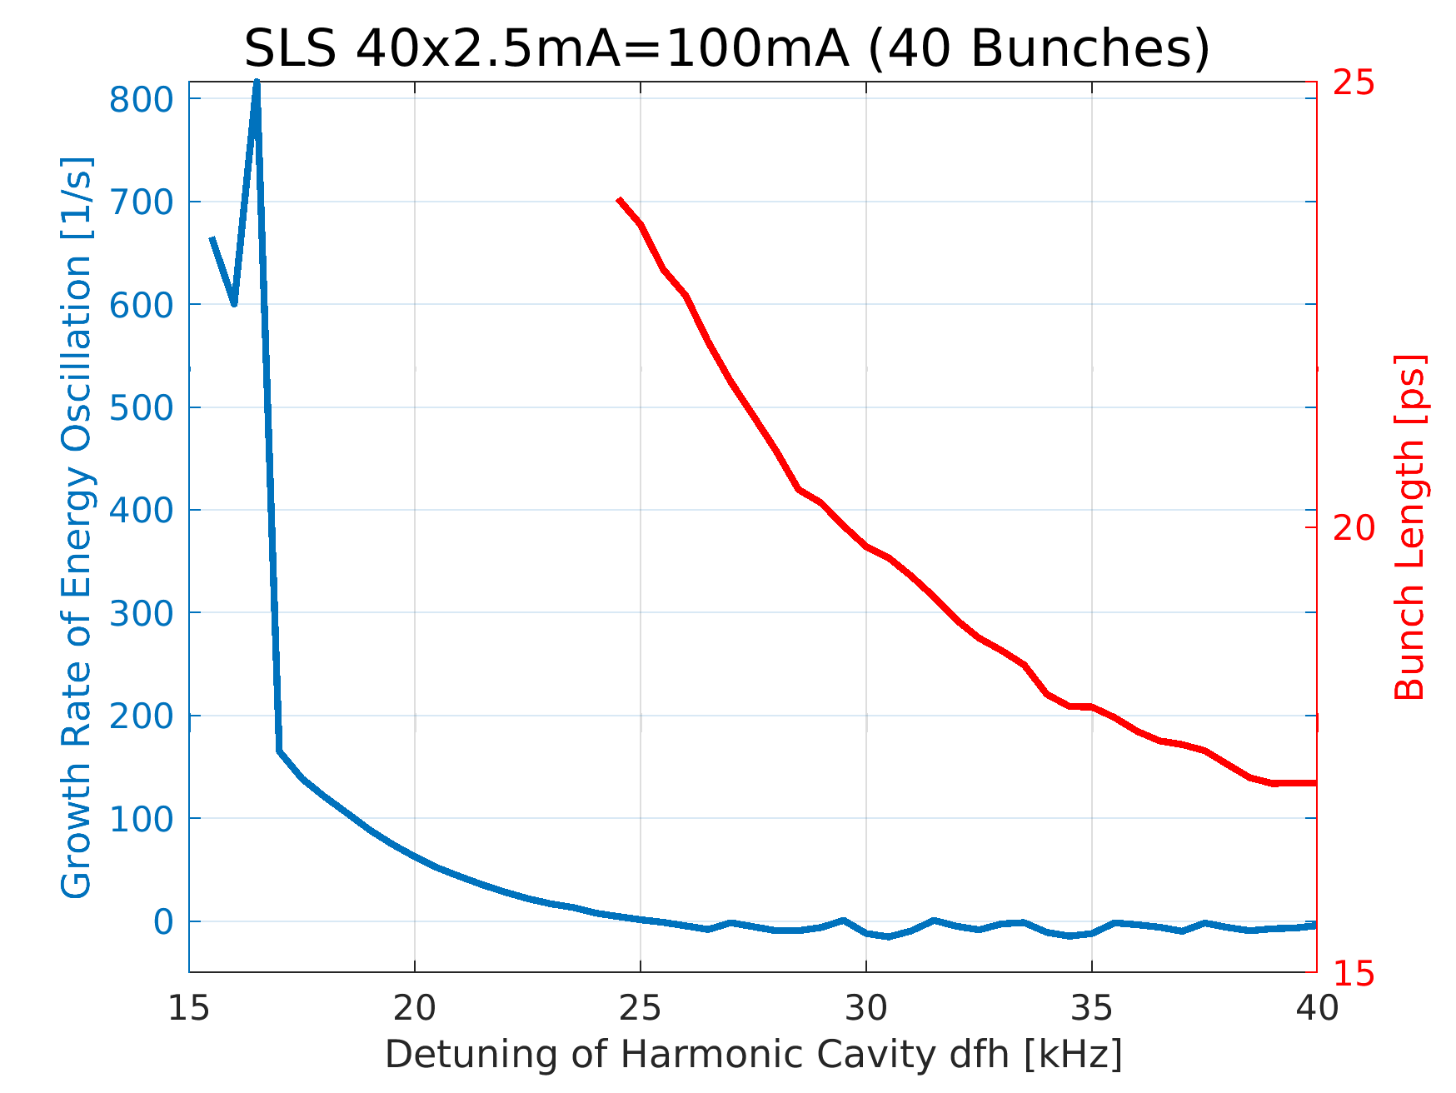
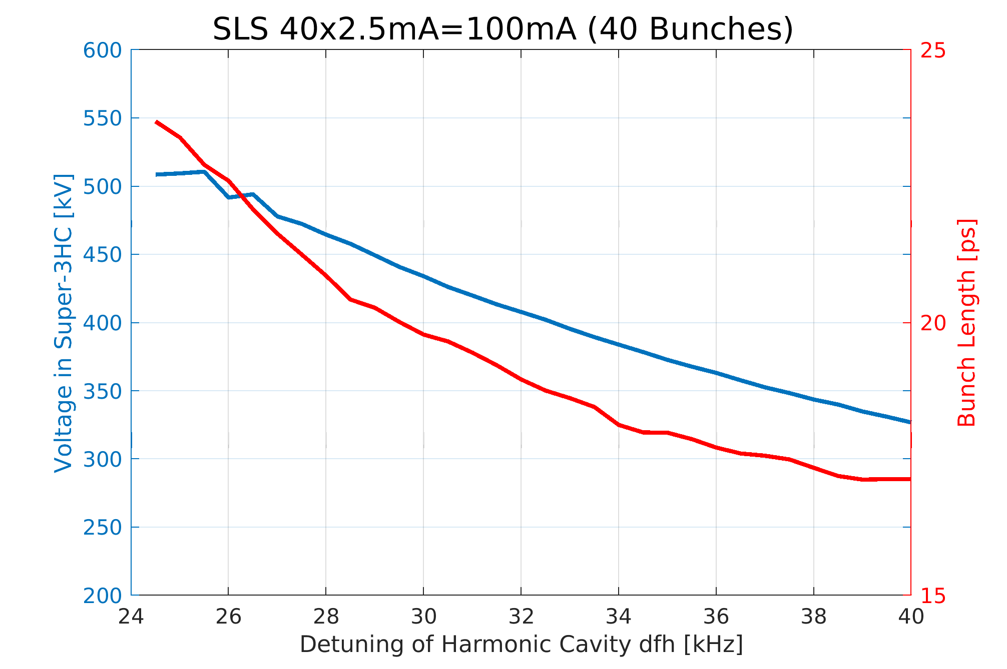
Simulations with ELEGANT:
Bunch Lenghtening at 40x2.5mA=100mA (40 Bunches)
→ From 100mA, efficient bunch lenghtening is possible

Slide 13
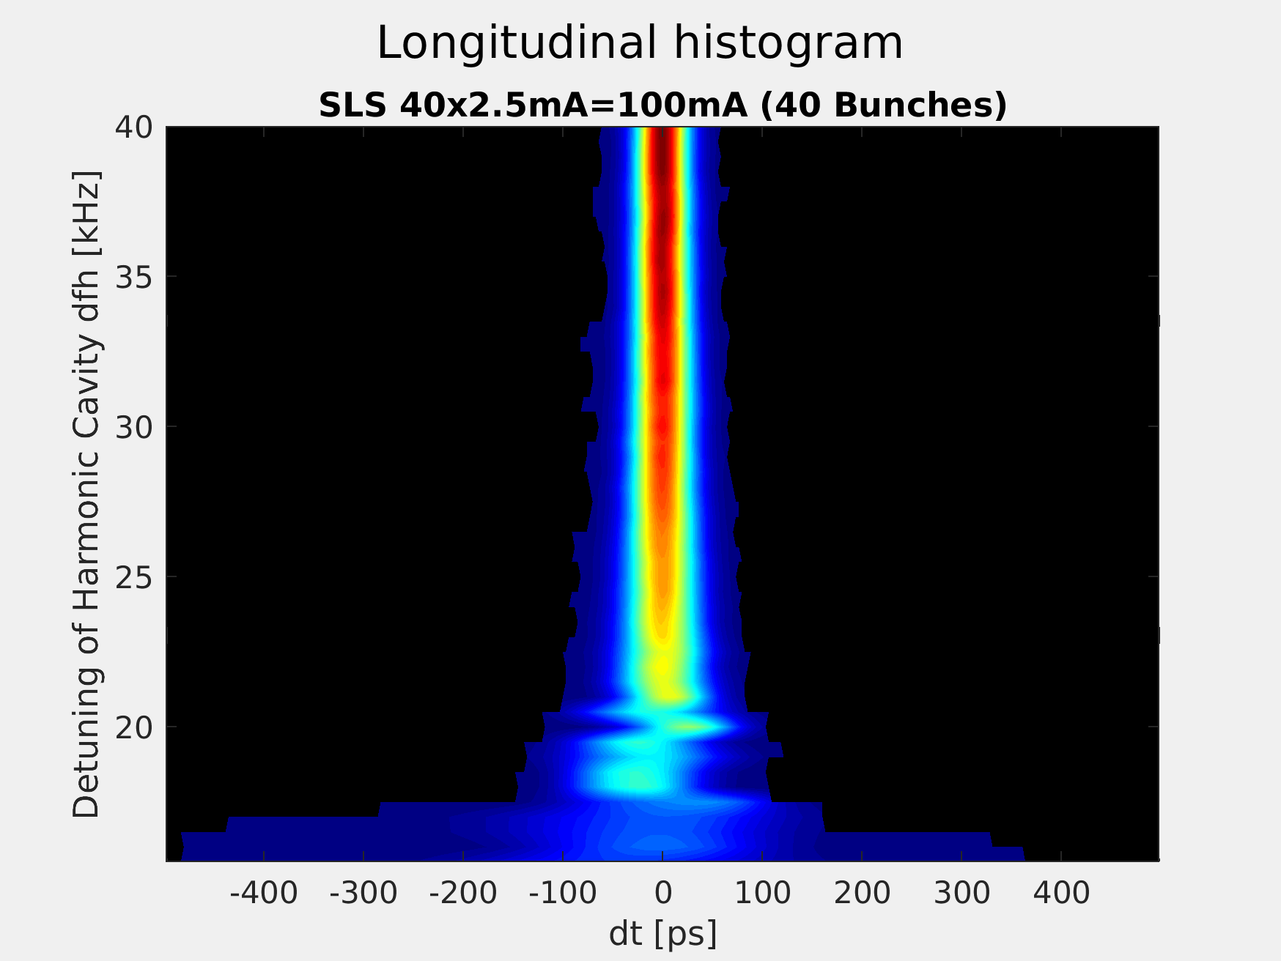
Simulations with ELEGANT:
Bunch Lenghtening at 40x2.5mA=100mA (40 Bunches)
For detuning dfh < 24kHz
Bunches start to oscillate
Voltage in 3HC starts to oscillate
Beam becomes instable

Slide 14
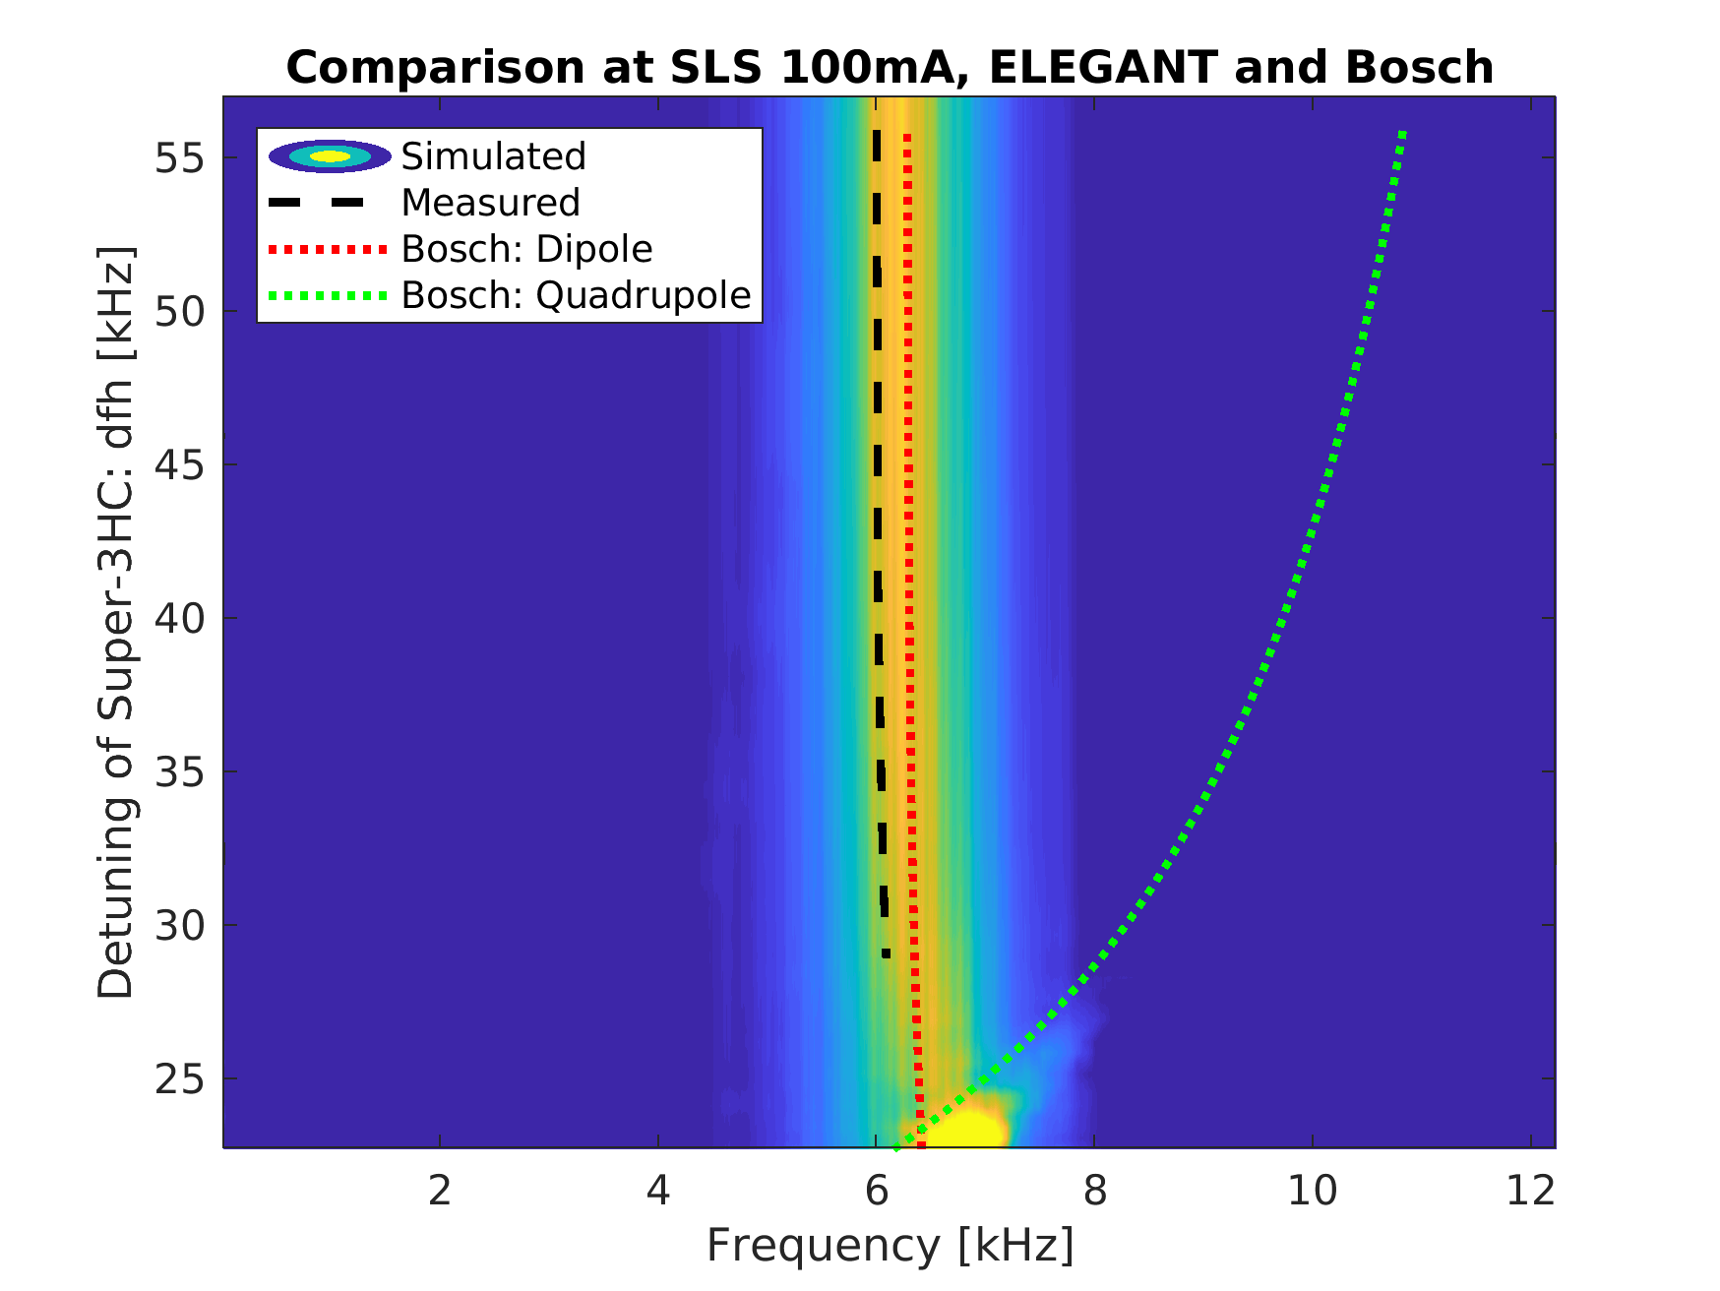
Measurement at SLS: Setup and Results
Complete fill
Measurement of oscillation frequency with main RF-frequency-modulation and spectrum analysis of BPM signal
Without modulation, decrease dfh and measure bunch-lenght with streak-camera
Beam loss at dfh=23.6kHz
with overvoltage of Super-3HC

Slide 15
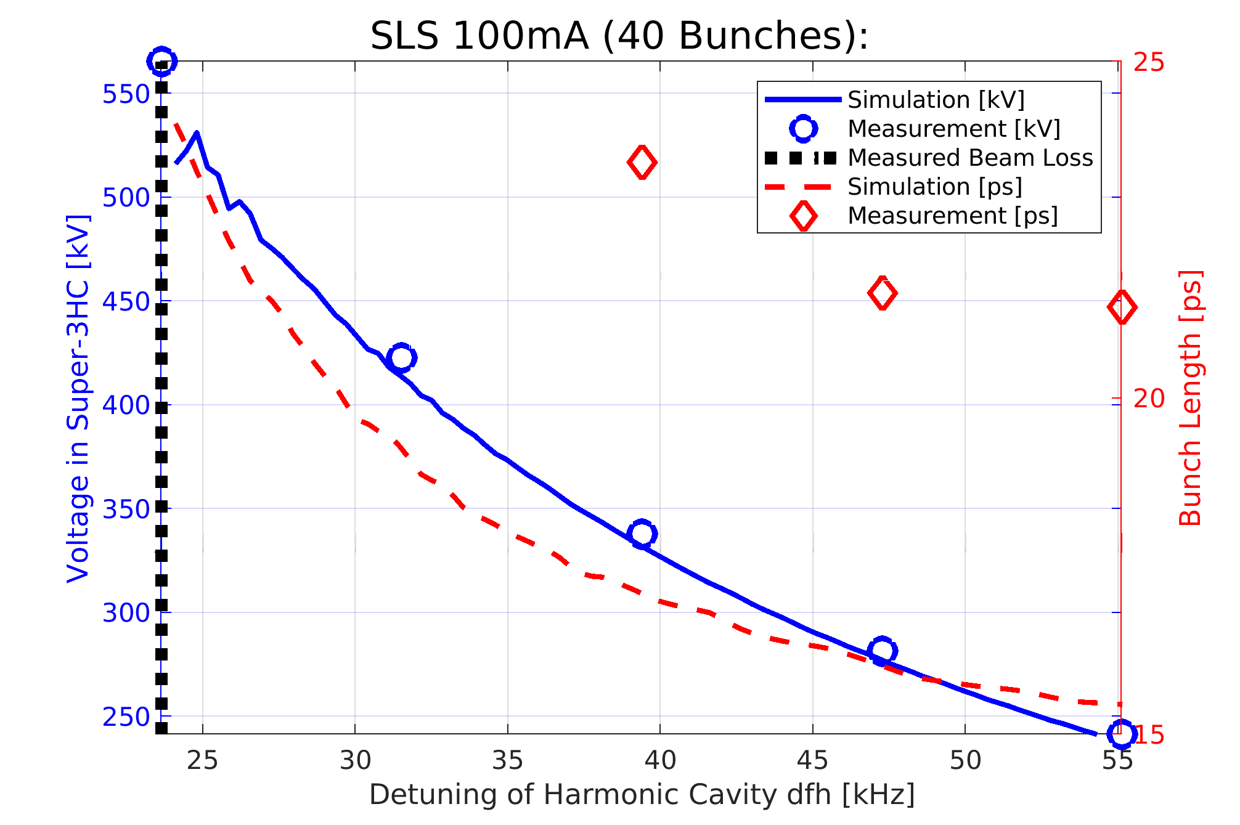
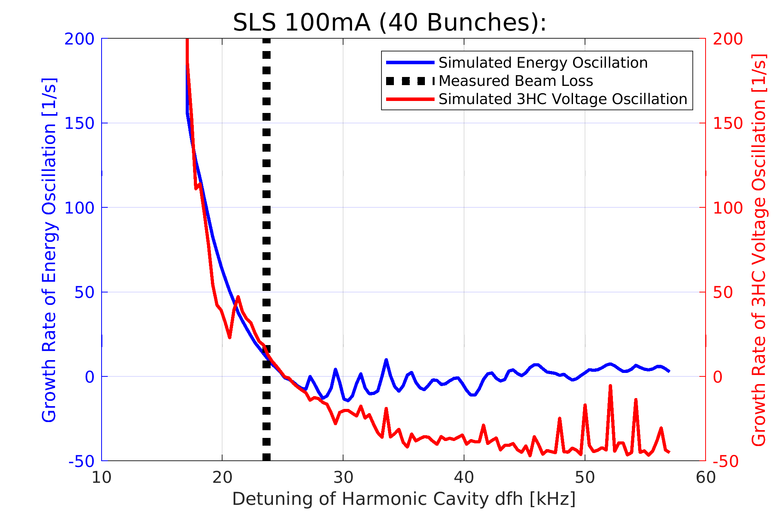
Comparison of Measurement with Simulation
Measured bunch length is about 30% larger than expected!
Beam-loss is at expected detuning of Super-3HC, with 3HC overvoltage
(however, experiment performed only once)
Measured oscillation frequency fits dipole-oscillation
Measured voltage of 3HC fits simulation

Slide 16
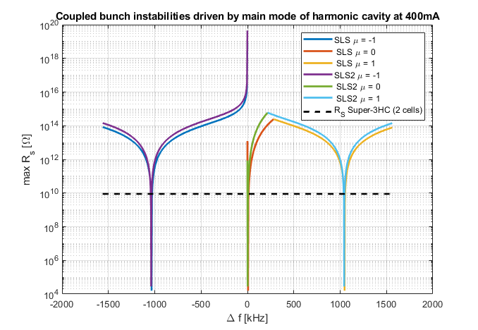
Situation of at 400mA:
Calculation of Threshold Shunt Impedance for Super-3HC
Tried to follow approach of Alexis Gamelin (SOLEIL)
Change of synchrotron frequency not considered
Landau-Damping not considered
Due to lower momentum compaction factor, situation of SLS2 looks slightly more relaxed.
Stable? for opt. Bunch lenghtening

Slide 17
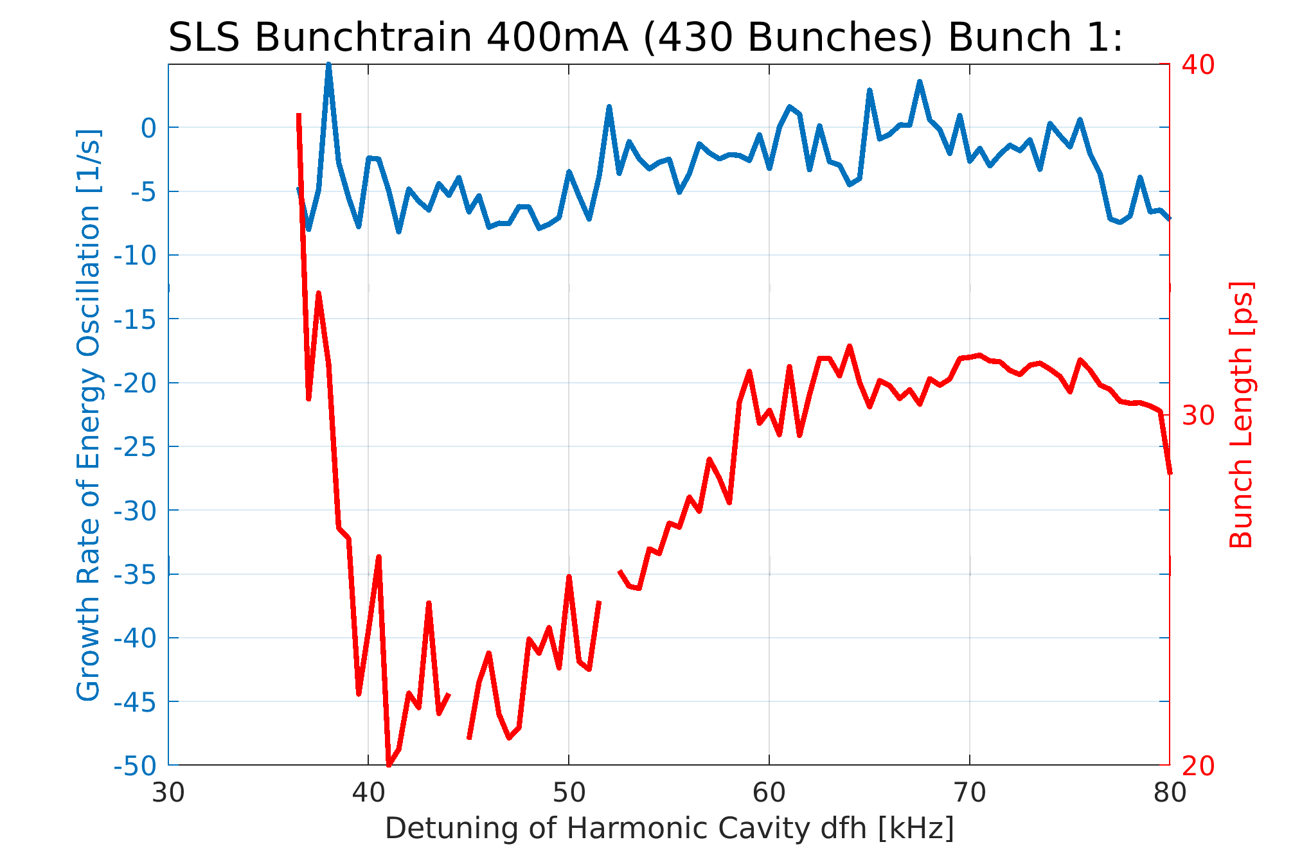
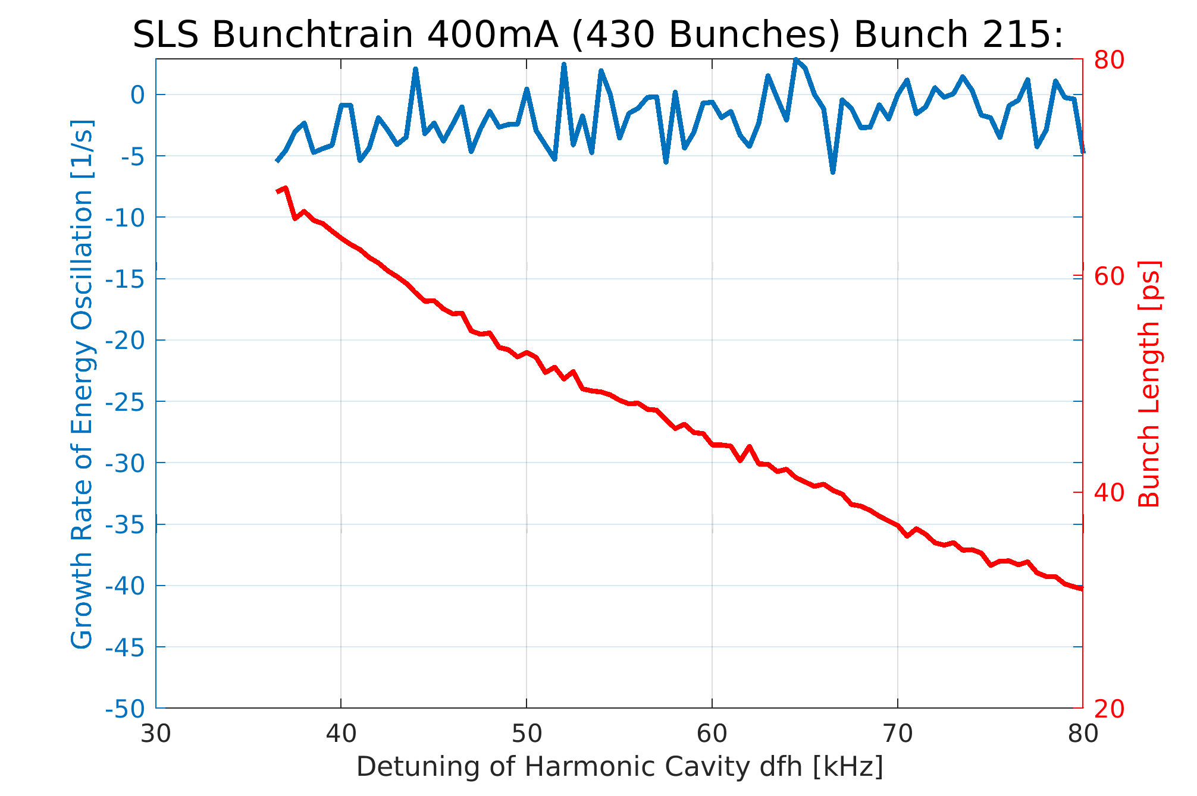
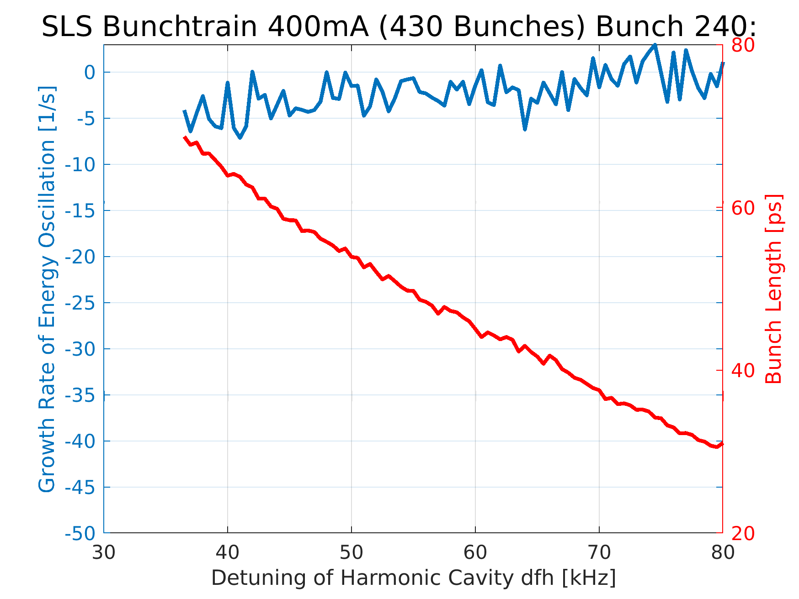
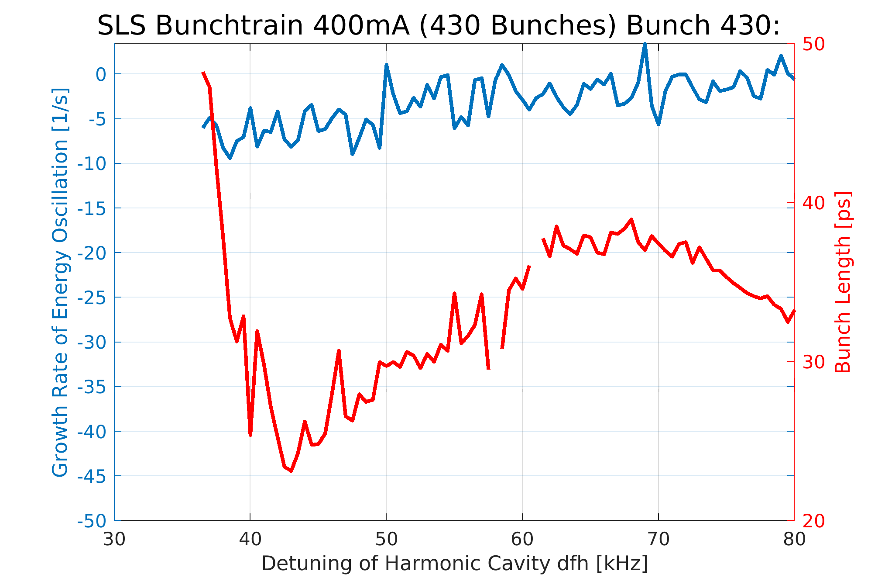
Simulations with ELEGANT:
View on Different Bunches

Slide 18
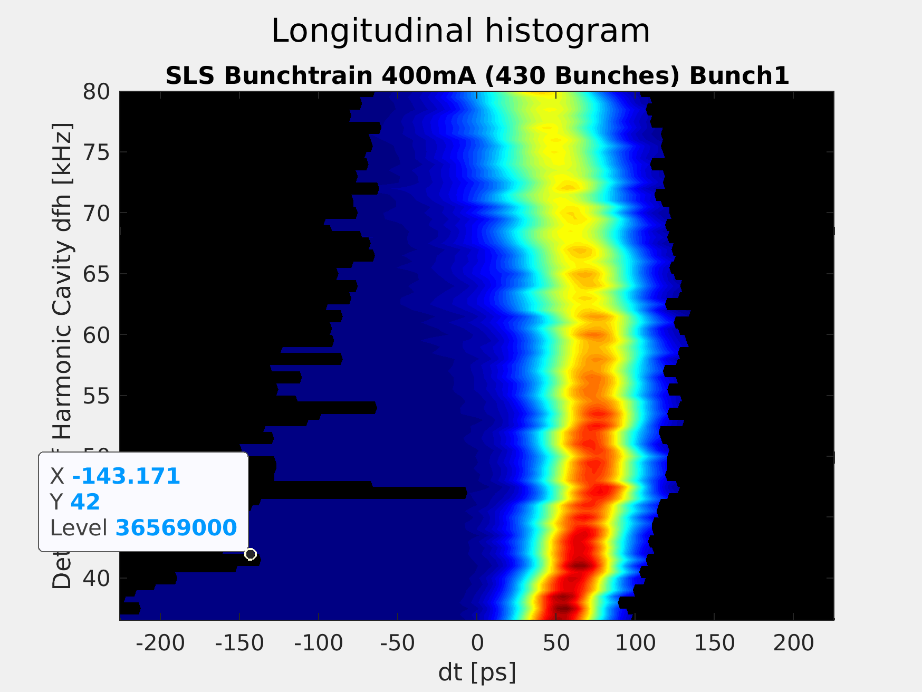
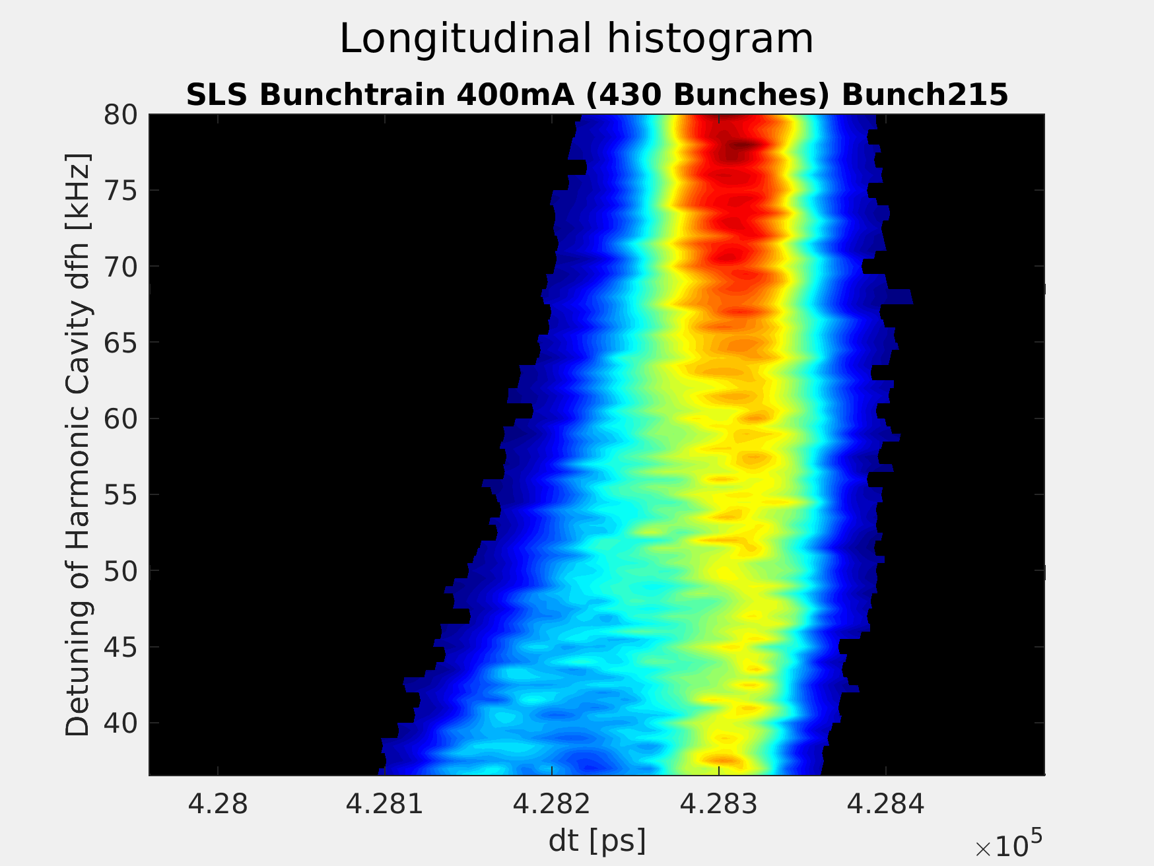
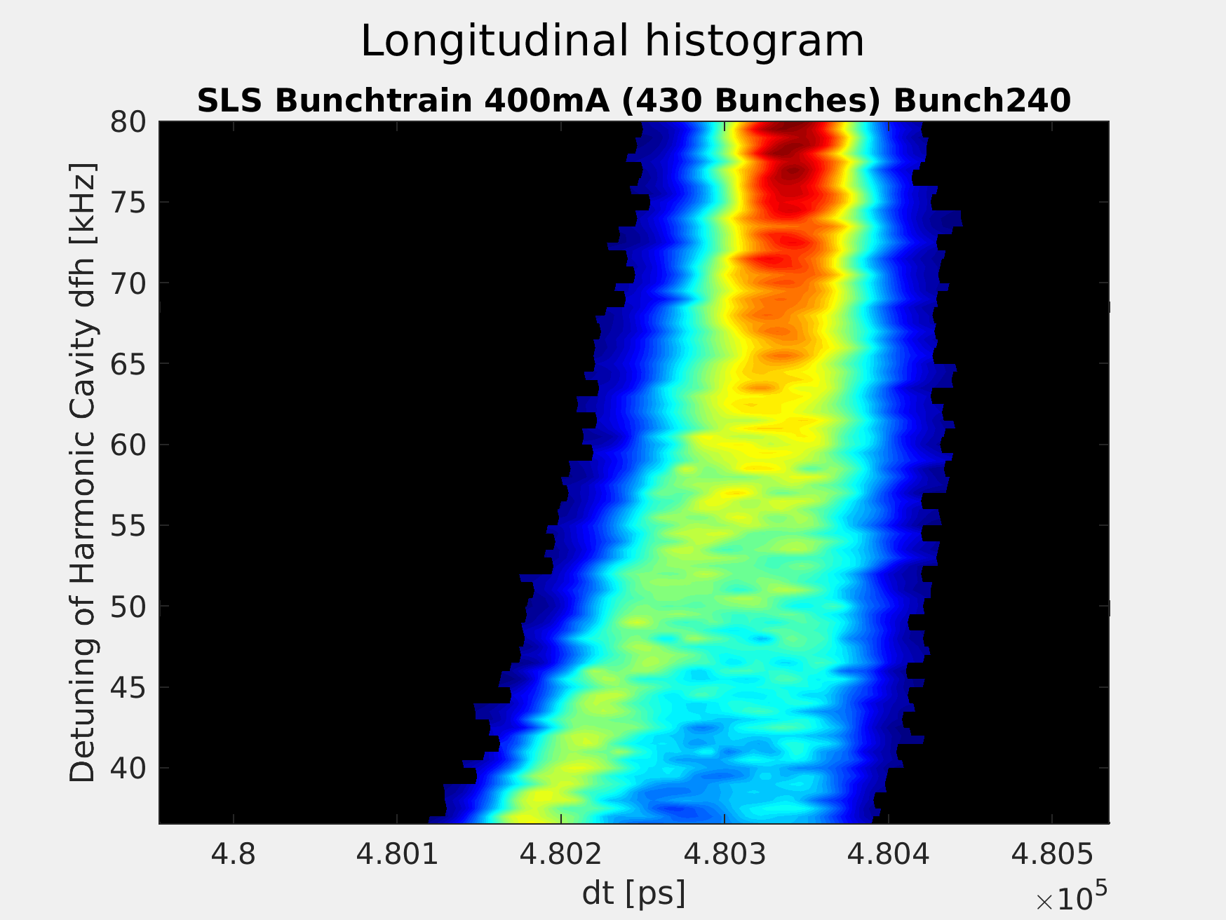
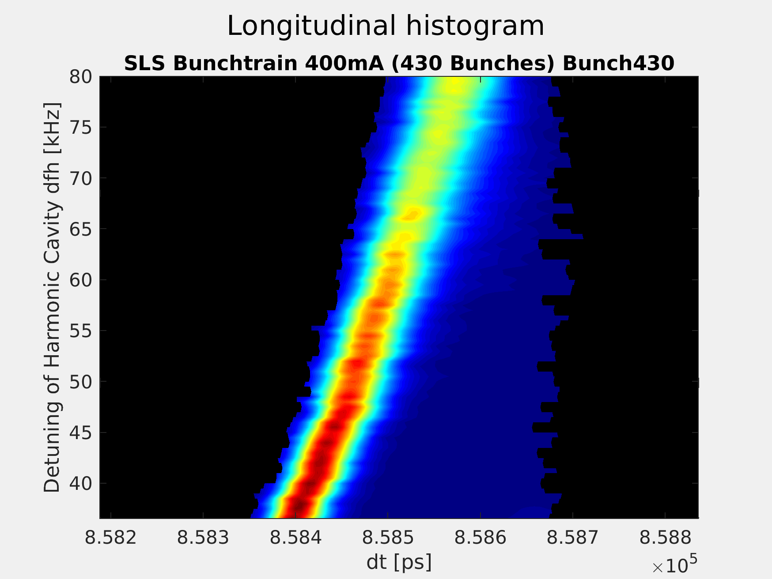
Simulations with ELEGANT:
Bunch profile vs. Detuning of Super-3HC:

Slide 19
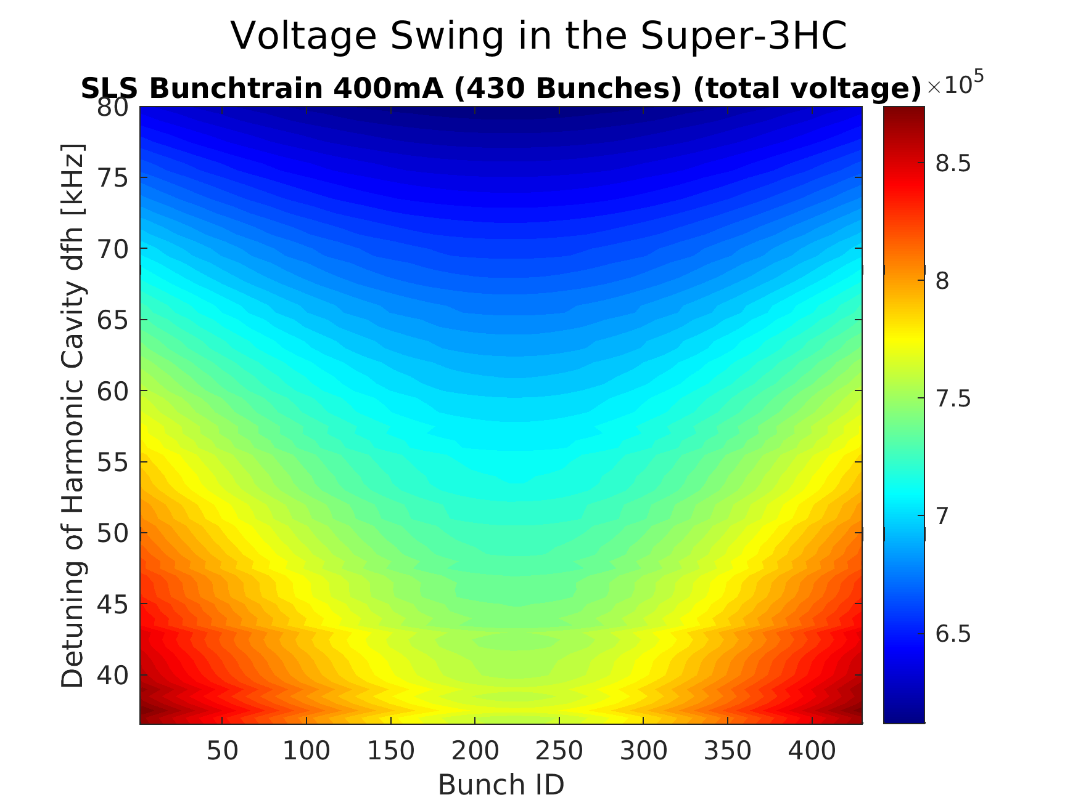
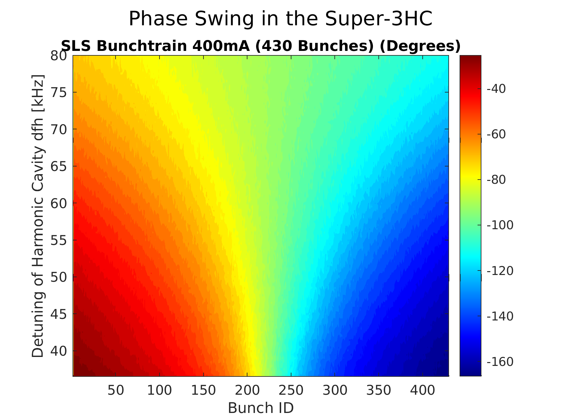
Simulations with ELEGANT:
Voltage- and Phase-Swing of Super-3HC along the Bunch Train

Slide 20
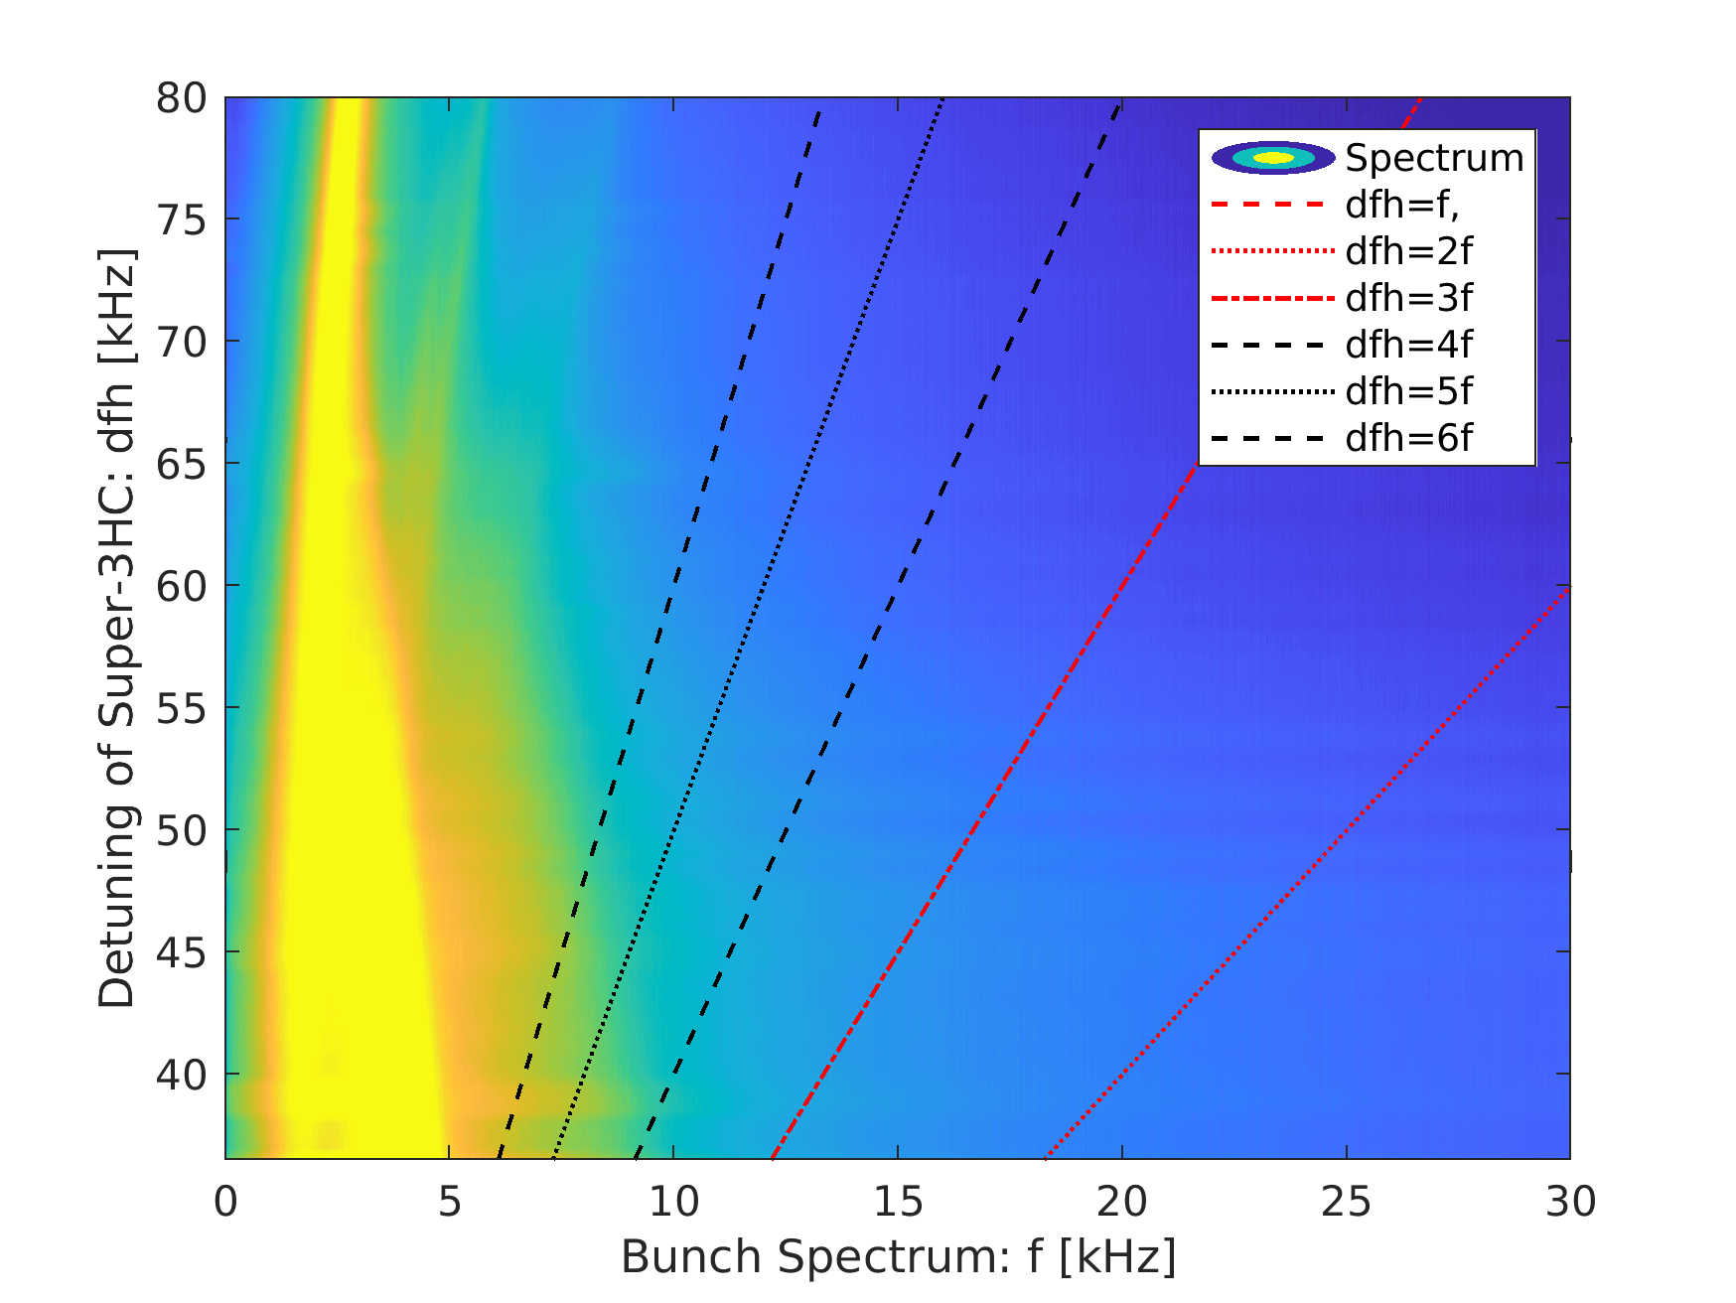
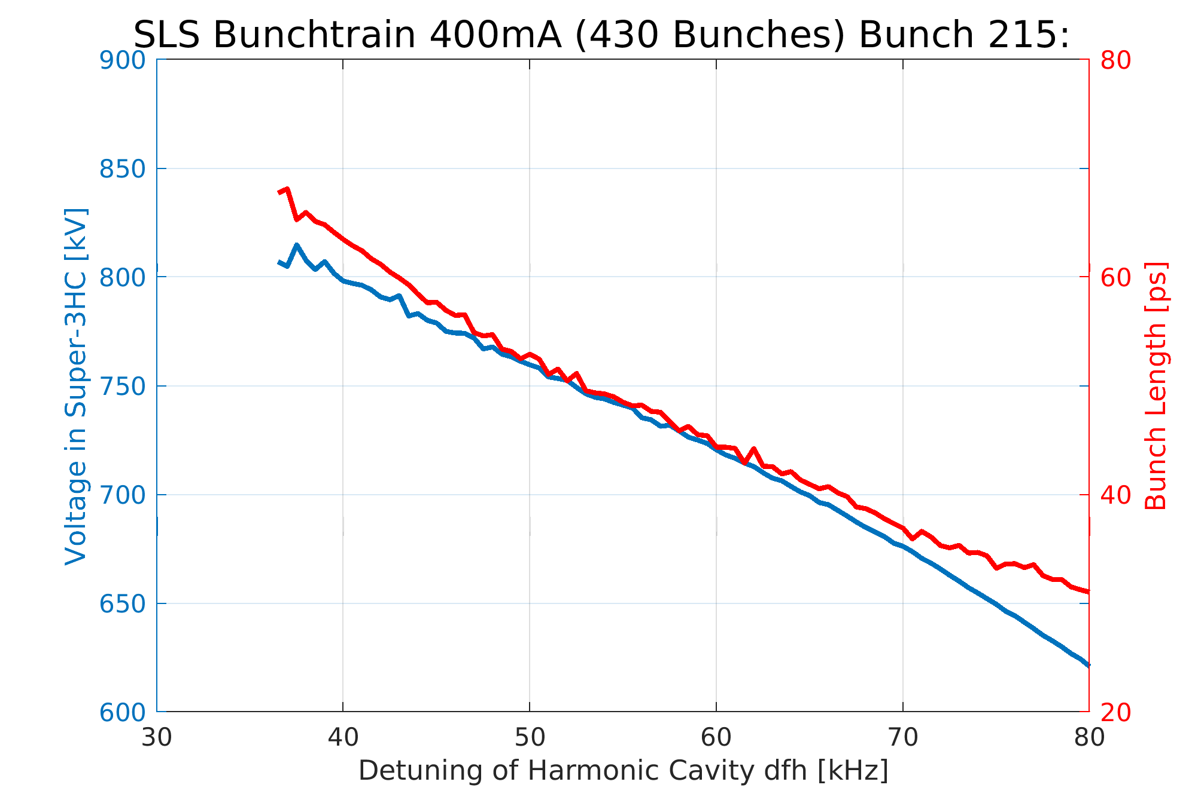
Simulations with ELEGANT:
View on Voltage and Bunchtrain Spectrum

Slide 21
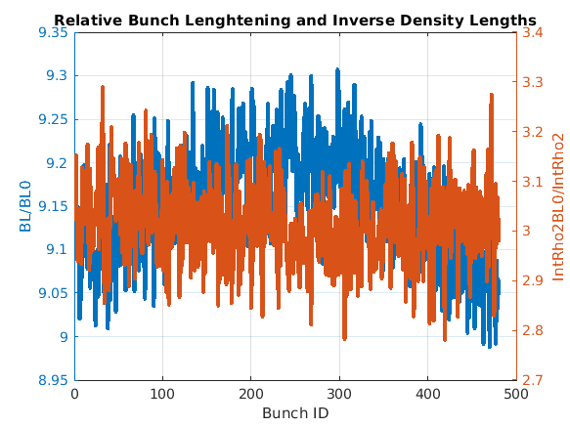
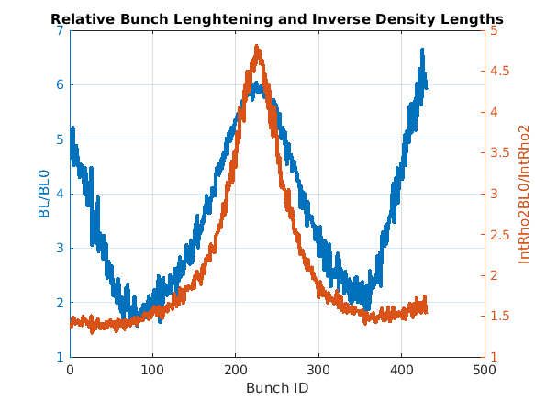
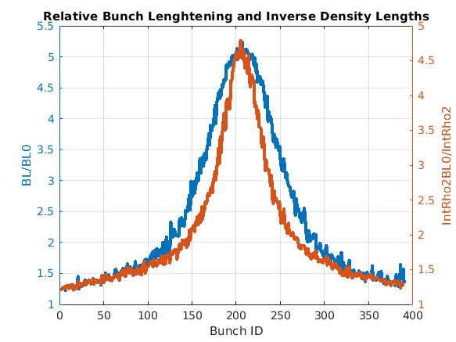
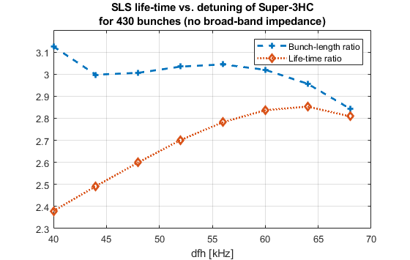
Simulated Detuning-Limit at 400mA and Lifetime for Different filling pattern
Complete fill: limit at dfh=26kHz: V3HC=430kV
430 bunches: limit at dfh=32kHz: V3HC=392..448kV
390 bunches: limit at dfh=34kHz V3HC=383..442kV:
←Assuming Touschek scattering rate proportional to integral of ρ²
(ρ is line density)

Slide 22
Wir schaffen Wissen – heute für morgen
Thanks for your comments!
Simulations were performed with “elegant”:
M. Borland, "elegant: A Flexible SDDS-Compliant Code for Accelerator Simulation,"
Advanced Photon Source LS-287, September 2000
Many thanks to C. Gough, C. Ozkan, M. Aiba for help with the measurements

Slide 23
Operation aspects: Technology for lengthening systems
SUPERCONDUCTING | NORMAL CONDUCTING
Negligible power dissipation | High power dissipation to be compensated by the main RF system.
Transient beam loading effect reduced (SLS R/Q=88.4 Ohms). Complication for feed back systems? | Transient beam loading effect more important (Bessy R/Q=248 Ohms). Problem for feed back system?
Less number of cells for the same voltage and acceptable power losses | Would require 10 cells at the SLS
Less contribution to Robinson anti-damping. At low current the small bandwidth allows fine tuning close to sync. freq. side bands. | Larger bandwidth and higher losses reduce the Robinson stability margin
Efficient HOM free structure | To be demonstrated at higher currents >300 mA
Efficient parking position (high Q) | Parking a little more difficult
High fabrication costs | Relatively cheap construction
Expensive and sensitive cryogenic systems (expert personnel required) | Relatively easy operation (don’t need other personnel than RF people)
Down time critical in case of cryo-failure
Cold tuning system showed some weakness (ELETTRA). OK with top-up mode (SLS) | Robust tuning system (plunger)

Slide 24
CRYOGENIC SYSTEM DESCRIPTION
LHe from Dewar enters the cryomodule through phase separator PS1
The 2 cavity tanks are filled with LHe at 4.5 K from the bottom
On top, common vessel (PS2) recuperates the cold GHe
→ part returned to cold-box
→ part used to cool the copper thermal shield (60K)
→ part used to cool the 2 extremity tubes (4.5-300K)
Inner tube and HOM couplers cooled by conduction
Layers of super-insulation on the shield
Line “T” (inlet) and “S” (outlet) for “warm” GHe circulation in case
of “warm operation” of the cryomodule (cryo-source failure, for instance)
Line “T” also used to mix GHe with LHe (temperature control of the incoming fluid during cooldown)
Scheme of the complete cryogenic system
Compressor and oil removal system located in a dedicated hutch outside.
6 m³ GHe buffer outdoor
Gas recovery  existing PSI system
Layout in the SLS building

Slide 25
SLS Cryogenic Requirements
Component | Load | Comments
2 RF cells | 22 W | Directly in LHe bath
2 L – couplers | 3 W | Cooled by conduction
4 T – couplers | 8.5 W | Cooled by conduction
2 Extremity tubes | 0.2 W | With 2 x 0.05 g/s cold GHe
Cryomodule static losses | 5.1 W | With 0.071 g/s cold GHe in thermal shield (60 K)
Transfer-lines | 6.5 W | Assuming 0.5 W/m load
Total refrigeration power at 4.5 K: 45.3 W
Total GHe flow: 1.171 g/s → 5.2 l/h of liquefaction duty
Estimated cryogenic load @ 4 MV/m, 400 mA and Q=2∙ 10⁸
Cryogenic source
Helial 1000 refrigerator/liquefier from Air Liquide, designed for 7.5 l/h liquefaction and 65 W of refrigeration at 4.5 K (mixed mode). that is about 50 % more than the anticipated requirement. Measured max power 160W
Air Liquide supply:
Screw compressor with oil removal system
Turbine-based-cold-box
Control command system
500 Liter dewar
Cryogenic transfer lines (including valve-box)

Slide 26
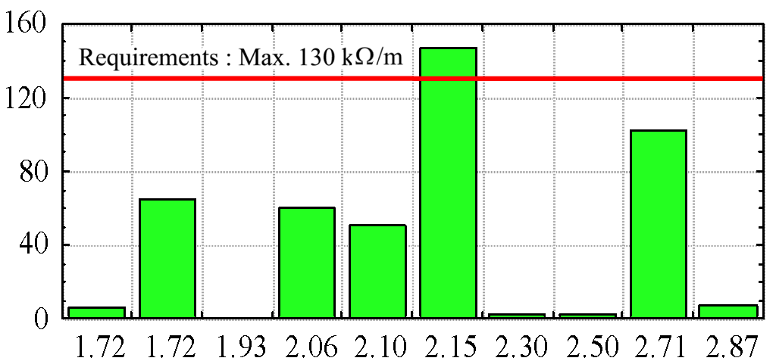
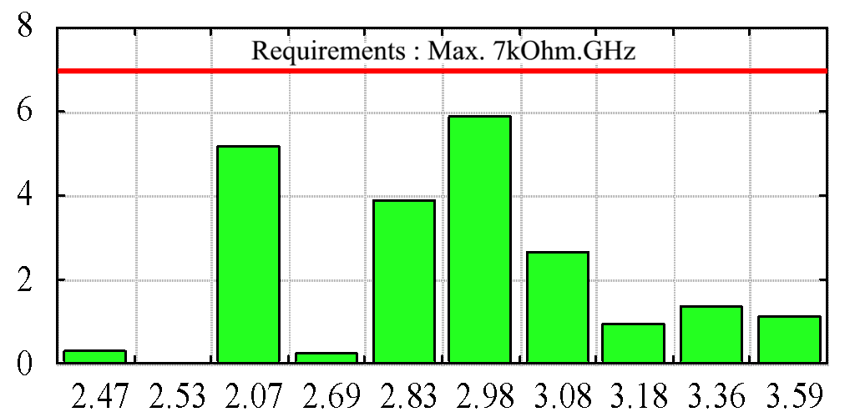
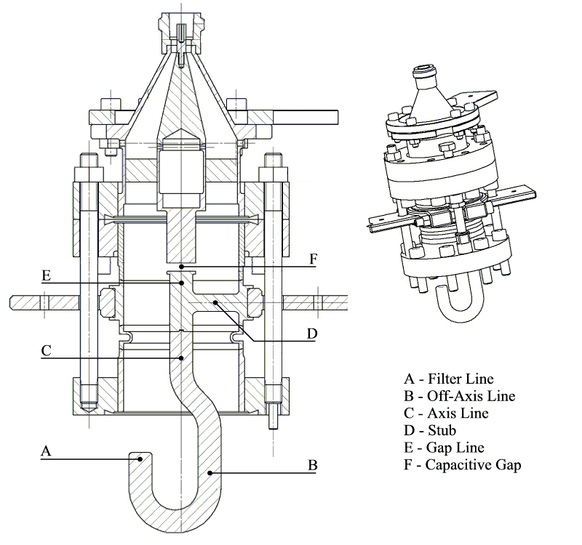
SLS 3rd harmonic Super Conducting system
SUPER-3HC collaboration:CEA-Saclay, PSI, Sincrotrone Trieste and CERN
Transv. modes [kΩ/m]
Measured Q_{o} (at 4.5 K) vs. field for the 2 cells.
Long. modes [kΩ.GHz]
E
F
C
D
A – Filter Line
B – Off-Axis Line
C – Axis Line
D – Stub
E – Gap Line
F – Capacitive Gap
A
B
HOM coupler
Measured HOM Impedance vs. frequency

Slide 27
SLS operation
300mA
I>200 mA without S3HC cavity strong
excitation of longitudinal CBI (operation not possible).
I=400 mA top-up operation reached with S3HC cavity.
CBI completely damped between 0 and 400 mA.
Tuning can be kept constant while injecting up to 400 mA (max elongation at 400 mA).
Transient beam loading effect and 20% less charge per bunch
Streak camera measurements
300mA
s=18ps at 200 mA without S3HC cavity
Life time without S3HC:
~ 4.6 - 5 hours @ 300 mA
CBI
No tuning loop needed because of Top Up
No HOM observed from S3HC!
CBI
Over-voltage
observed

Slide 28
Sync freq. Spectrum broadening  Landau damping
Sync. freq. spectrum broadening , and transient beam loading effect
CBI
20% gap filling pattern
Over-voltage
observed
CBI
Uniform filling pattern
With 20% gap, broadening increases at low voltages
due to transient beam loading (more efficient Landau
Damping), but:
 average lengthening reduced
 average lifetime gain reduced

Slide 29
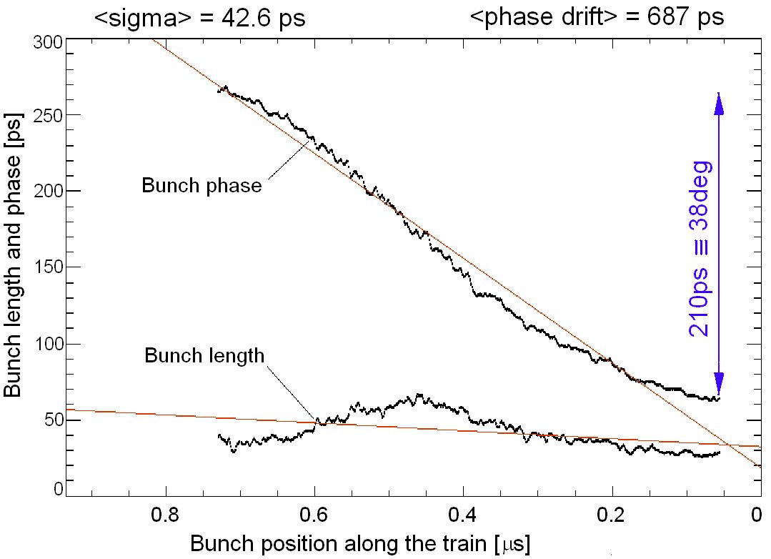
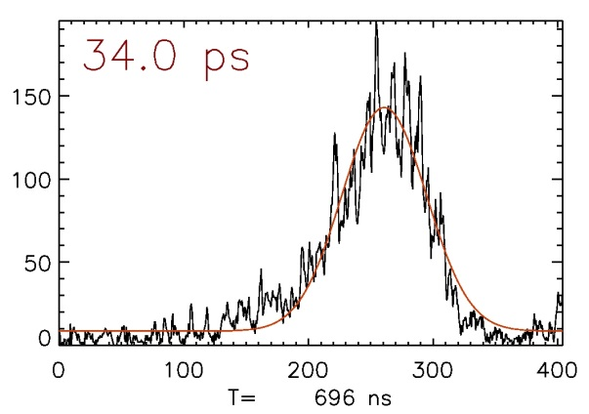
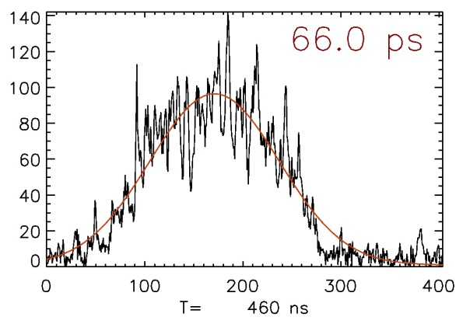
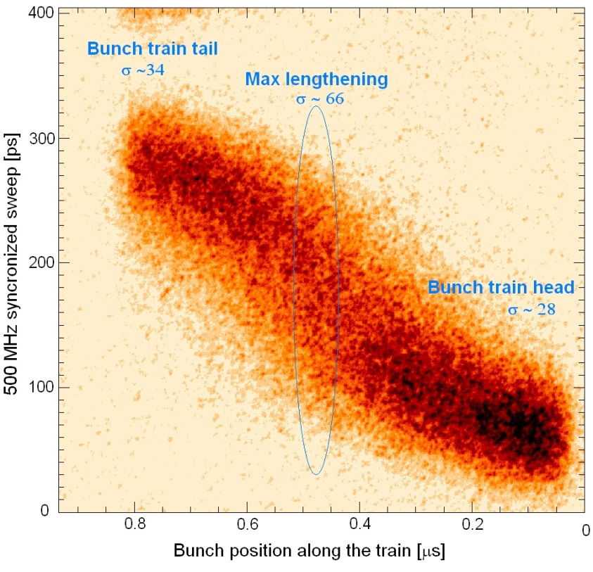
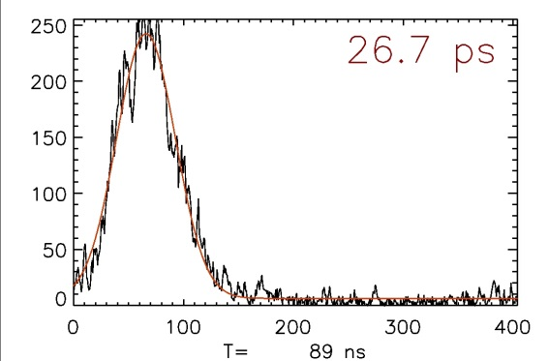
Transient beam loading effect
Streak camera snap shot example
Ib=330 mA
V_{harmonic}~660 KV
Close to maximum elongation
Train tail
~Train
center
Train head

Slide 30
320 mA operation
36
32.4
average phase drift [deg]
28.8
25.2
21.6
18

Slide 31
Suppression of CBM #430 by increased Landau damping 320 mA operation

