Slide 1
COMMENT TALK - HC SIMULATIONS FOR ALBA-II
Ignasi Bellafont
HarmonLIP 2022 - 11/10/2022

Slide 2
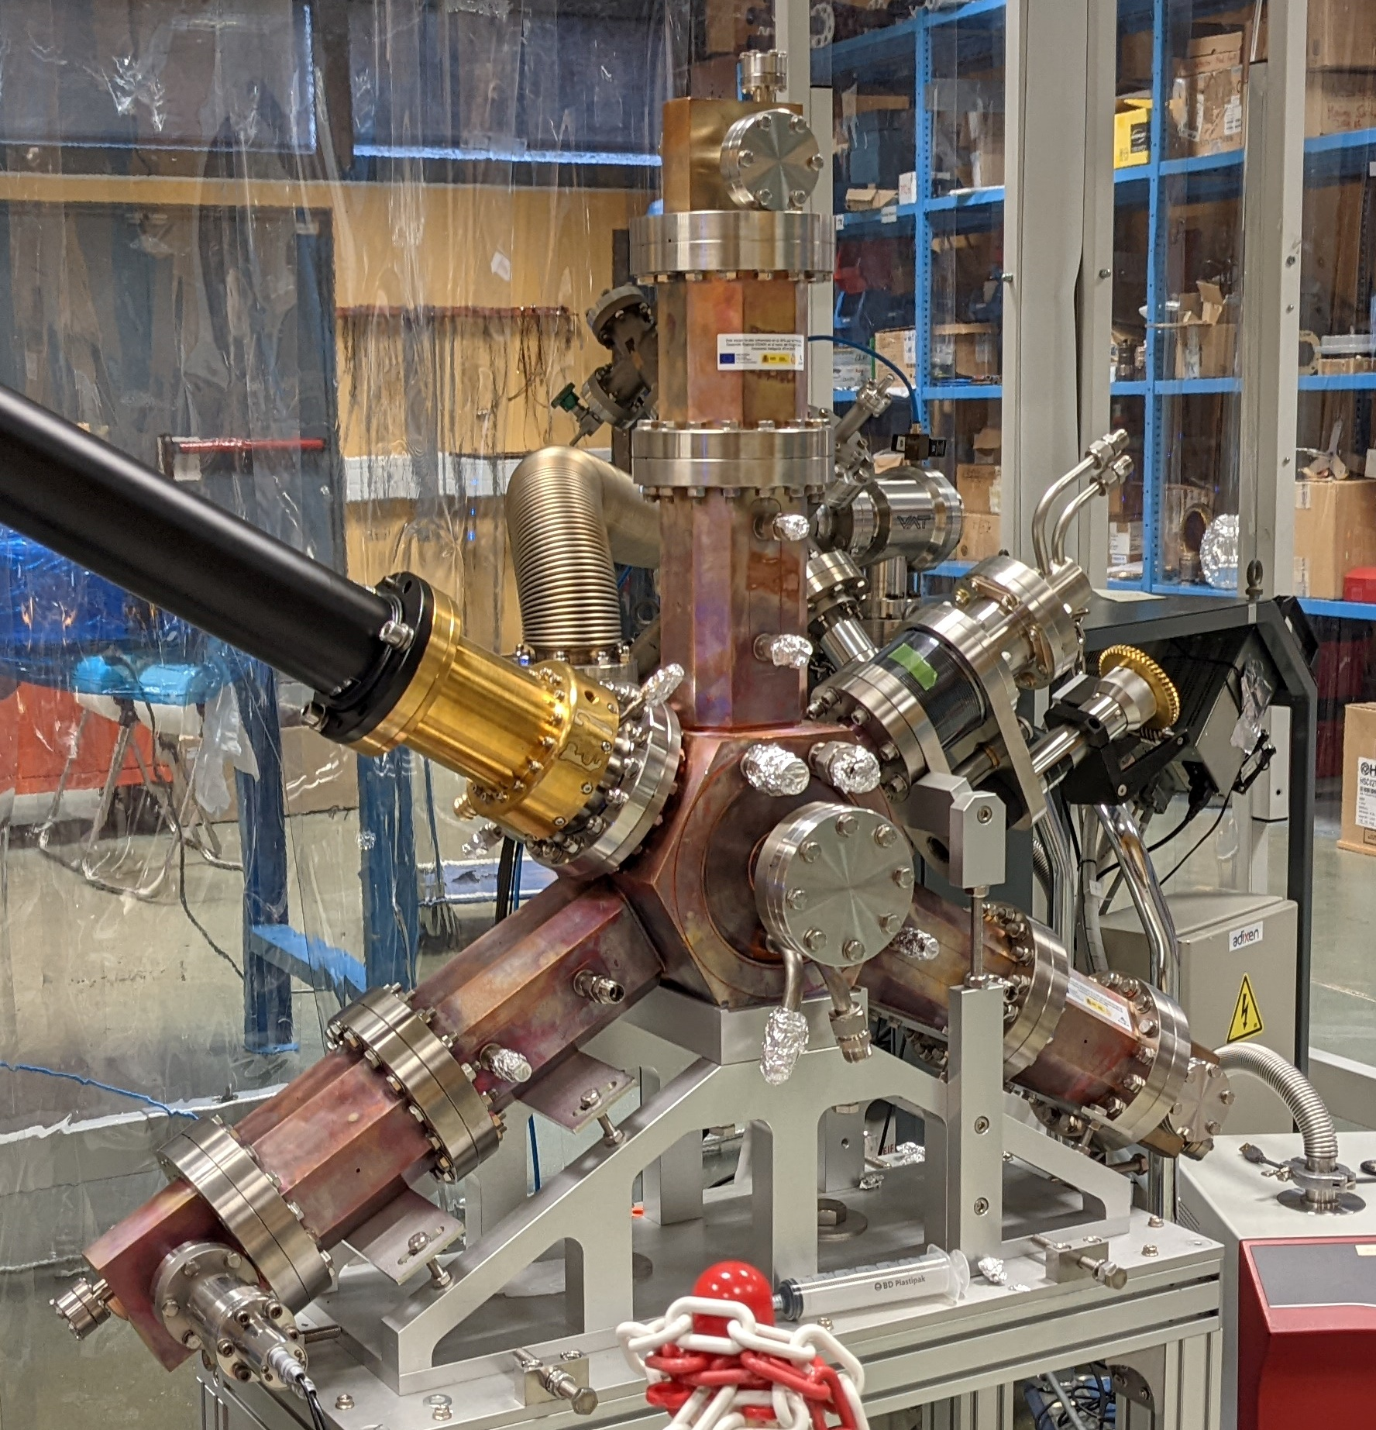
OUTLINE
ALBA-II storage ring & HC motivation
Current RF baseline parameters
General considerations
Baseline - NC active HC simulations
Compared alternatives - NC/SC passive
Summary and conclusions
ALBA Active Harmonic EU Cavity

Slide 3
ALBA-II STORAGE RING
ALBA-II storage ring v 2022.9
As all the other 4th generation light source upgrades, the lower equilibrium emittance comes with much lower momentum compaction factor and thus a lower bunch length and Touschek lifetime
A higher harmonic RF system is thus needed to enhance the bunch length and place the lifetime within reasonable values
Energy [GeV]
3
Circumference [m]
268.80
Harmonic number
448
Current [mA]
300
Momentum compaction factor
0.8·10⁻⁵
Equilibrium emittance [pm·rad]
136
Energy loss with IDs [MeV]
0.97
Natural RMS bunch duration [ps]
6.17
$$τ_{T}∝\frac{\sqrt{ε_{y} }σ_{s}}{I_{b}} δ_{acc}^{a}$$
Natural Touschek lifetime FC [h]
3.4 h

Slide 4
RF PARAMETERS
ALBA has designed a 3rd harmonic normal conducting active cavity based on the main HOM 500 MHz ones (see J. Ocampo talk tomorrow)
In order to check the stability of the proposed system and cross check the analytical calculations, we have run 6D tracking simulations (see next slides)
Complementarily, a 3HC prototype is being tested at BESSY-II (see A. Matveenko talk). Dedicated simulations of the cavity performance will be validated with the experimental results
ALBA-II RF system v 2022.9
Main RF voltage [MV]
2.4
Harmonic RF voltage [kV]
700
Number of cavities (main / hh)
6 / 4
Main RF frequency [MHz]
500
Harmonic RF frequency [MHz]
1500
HC type
NC-HOM
HC shunt impedance [MΩ]
1.1
HC quality factor
13000
Optimal bunch lengthening UFP
5.5

Slide 5
SIMULATION CONSIDERATIONS
The tracking simulations have been performed with the parallel version of Elegant. The main objective, for the time being, is the lifetime evaluation
All simulations have been performed for the nominal fundamental voltage and current (2.4 MV and 300 mA). The harmonic voltage has been varied to find the highest stable operation point (up to an optimal value of around 180 kV per cavity)
To study the stability of the system, the stability over the beam passes of the beam energy, bunch duration, RF voltage and the control loop output has been watched, among other parameters
Each bunch has been generated with 10000 particles, with Gaussian distribution and a bunch length belonging to 0 kV of harmonic voltage. The bunches are then naturally lengthened up to their new stable value owing to the third harmonic system
The simulation starts at nominal beam current and RF voltage, with the cavities already pre-loaded

Slide 6
NC ACTIVE HC - BASELINE

Slide 7
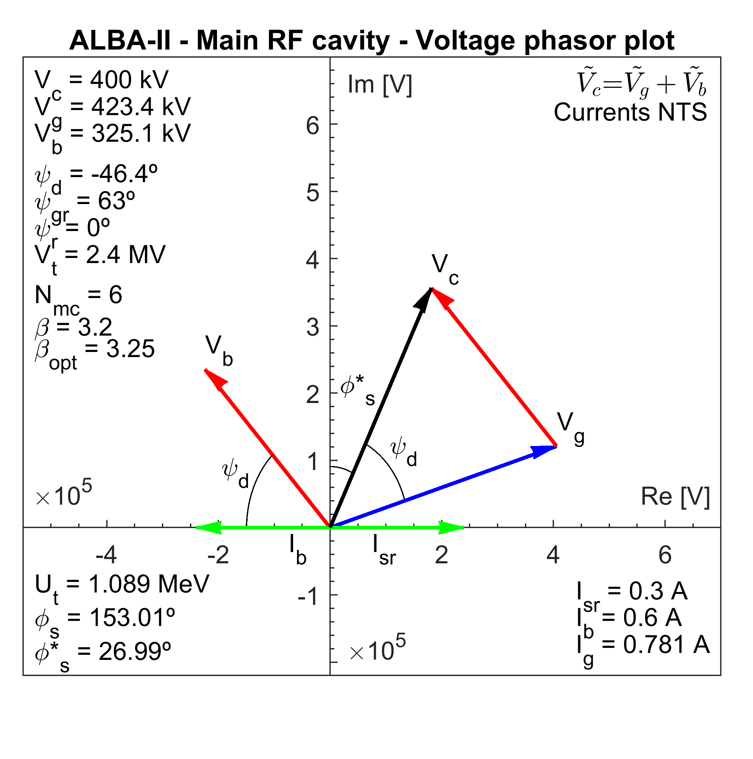
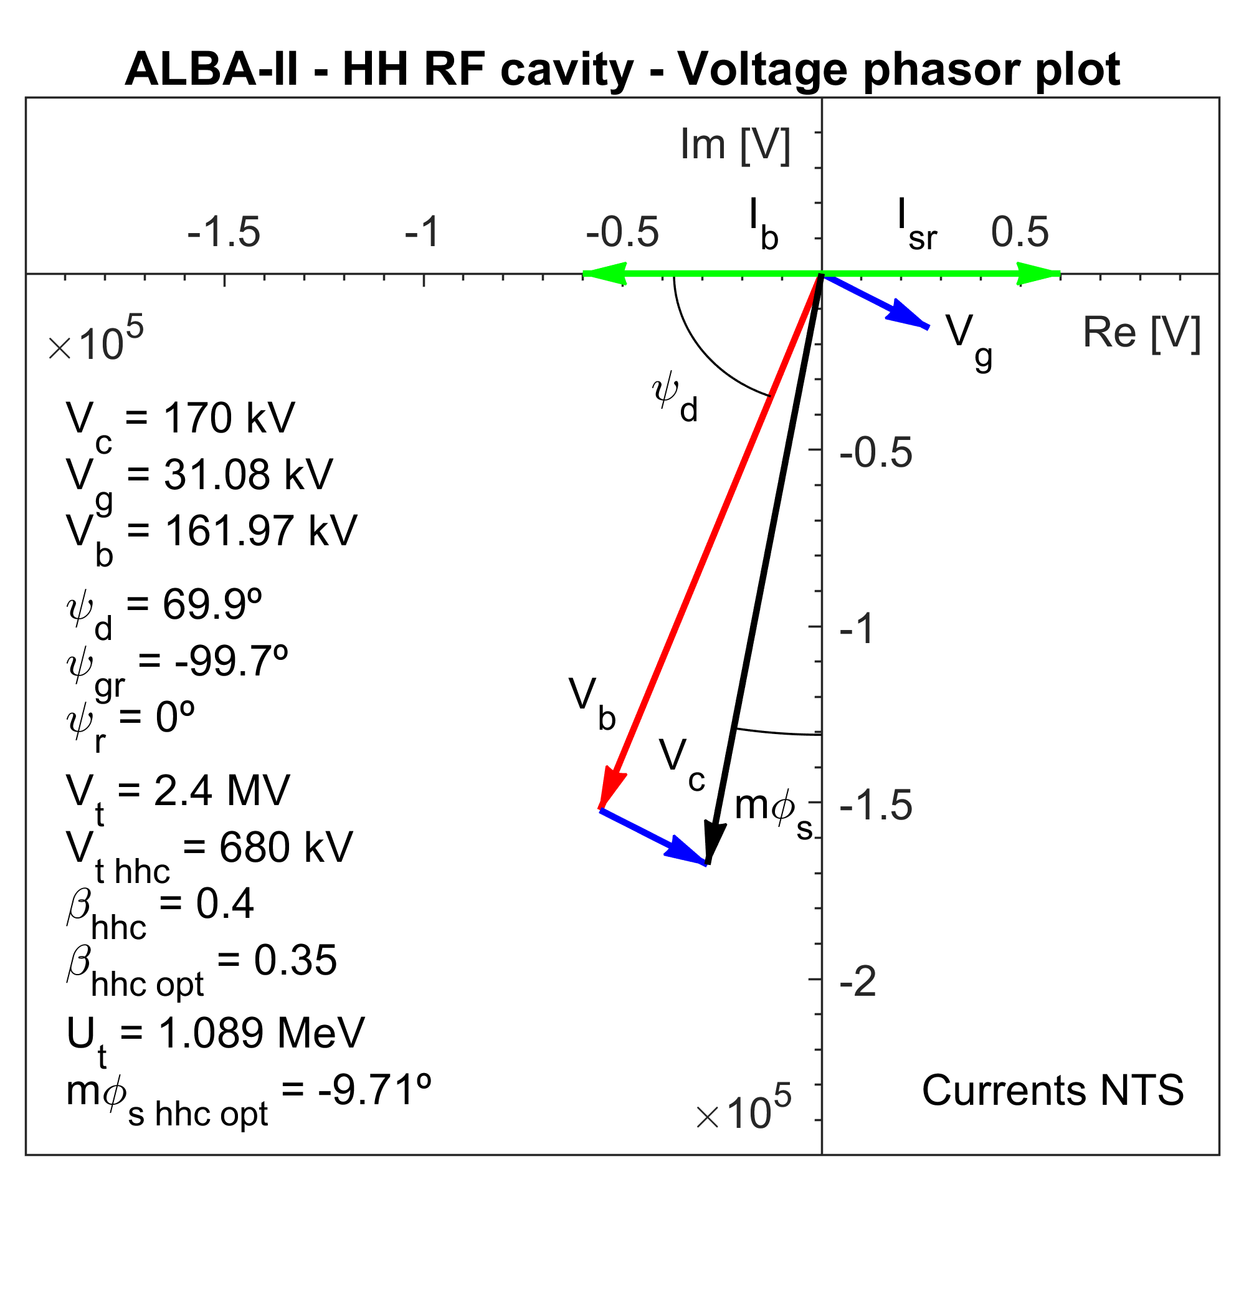
NC ACTIVE HC - BASELINE
To reach 170 kV in each HC, 4.56 kW are supplied by the transmitters and 8.6 kW by the beam
For each main cavity, around 79 kW are supplied, resulting in a 69% of efficiency

Slide 8
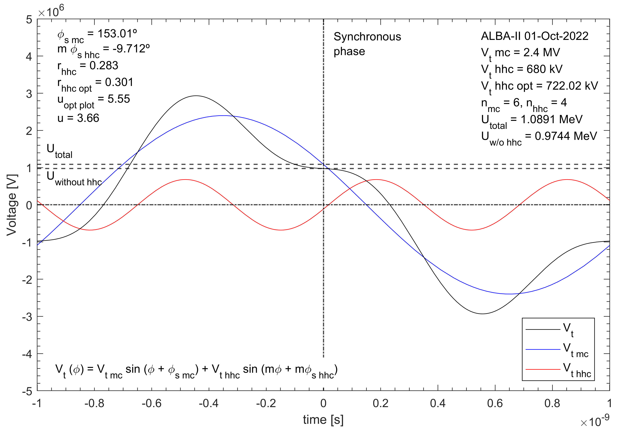
NC ACTIVE HC - BASELINE

Slide 9
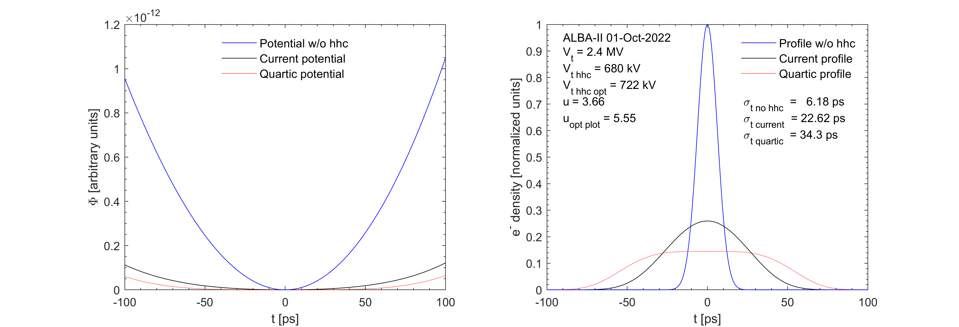
NC ACTIVE HC - BASELINE

Slide 10
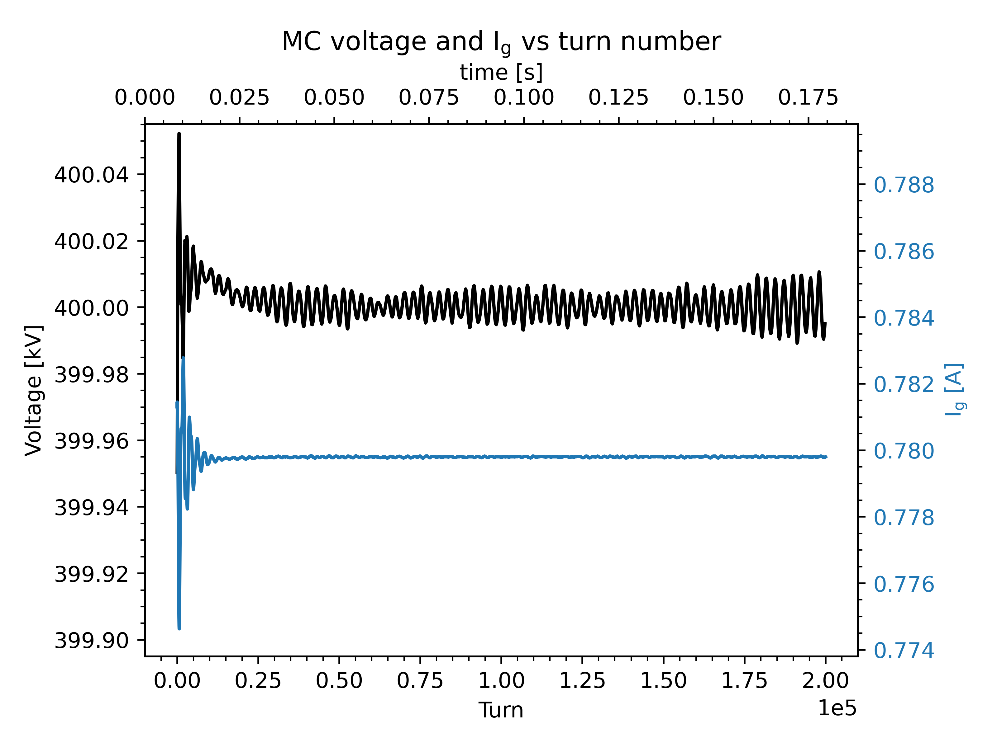
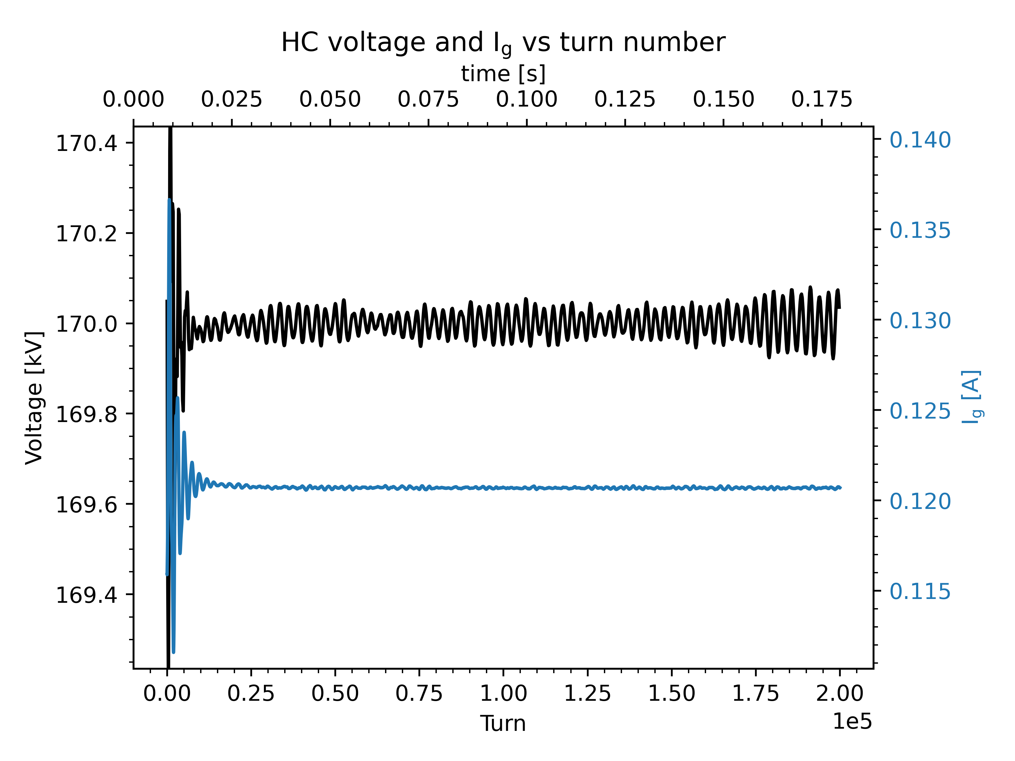
NC ACTIVE HC - BASELINE
Full filling pattern - MC vs HC
The PI feedback loop is stable. The control action converges rapidly and the voltage values remain stable around their setting

Slide 11
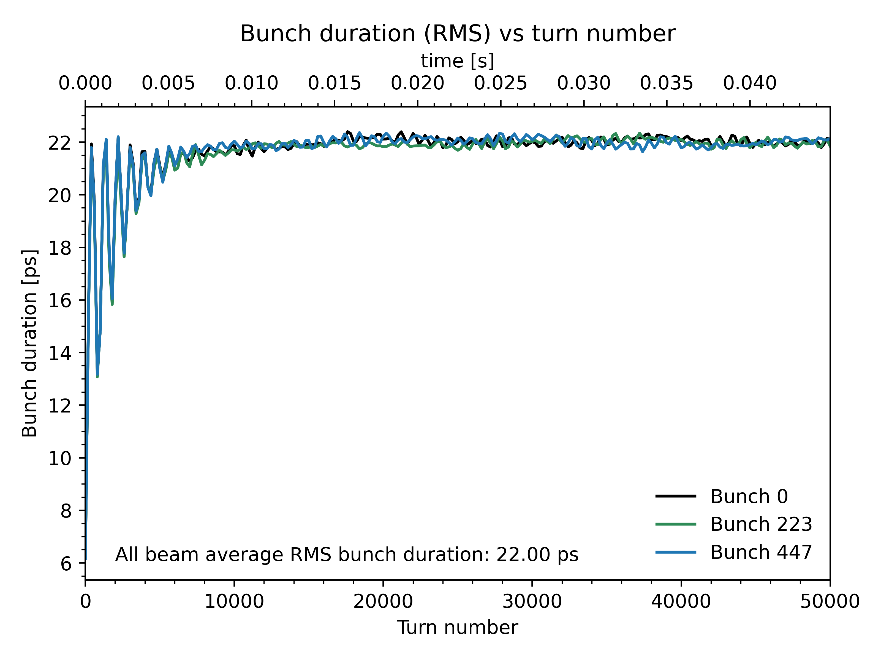
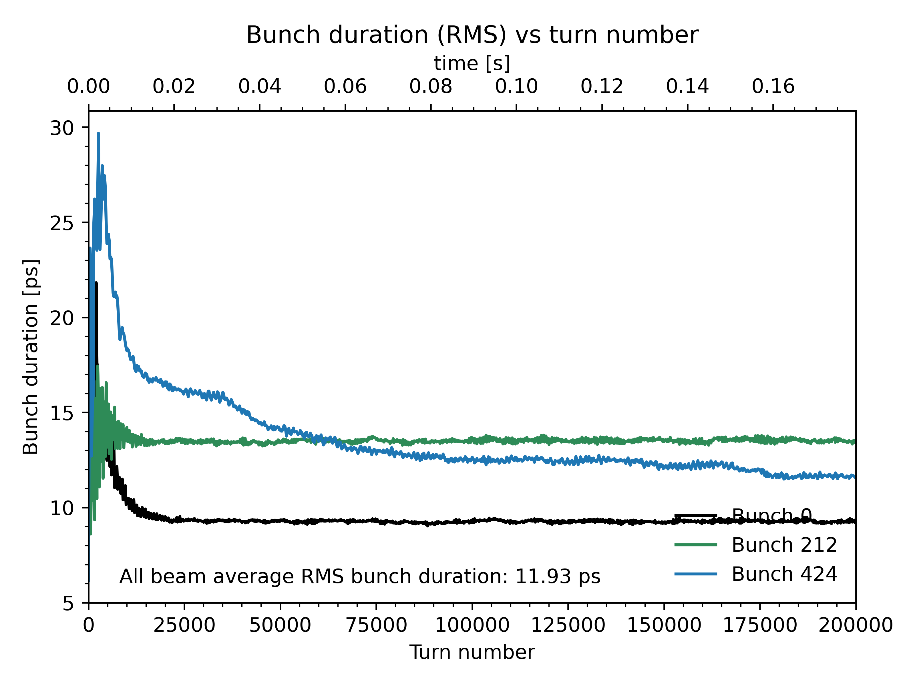
NC ACTIVE HC - BASELINE
Full filling pattern vs 5% gap
FFP
u = 3.6
5% gap
u = 1.9
The transient beam loading originated from a gap in the beam is also calculated. Around a 46% of bunch lengthening would be lost with a 5% gap
For the time being, only a simple PI loop has been studied

Slide 12
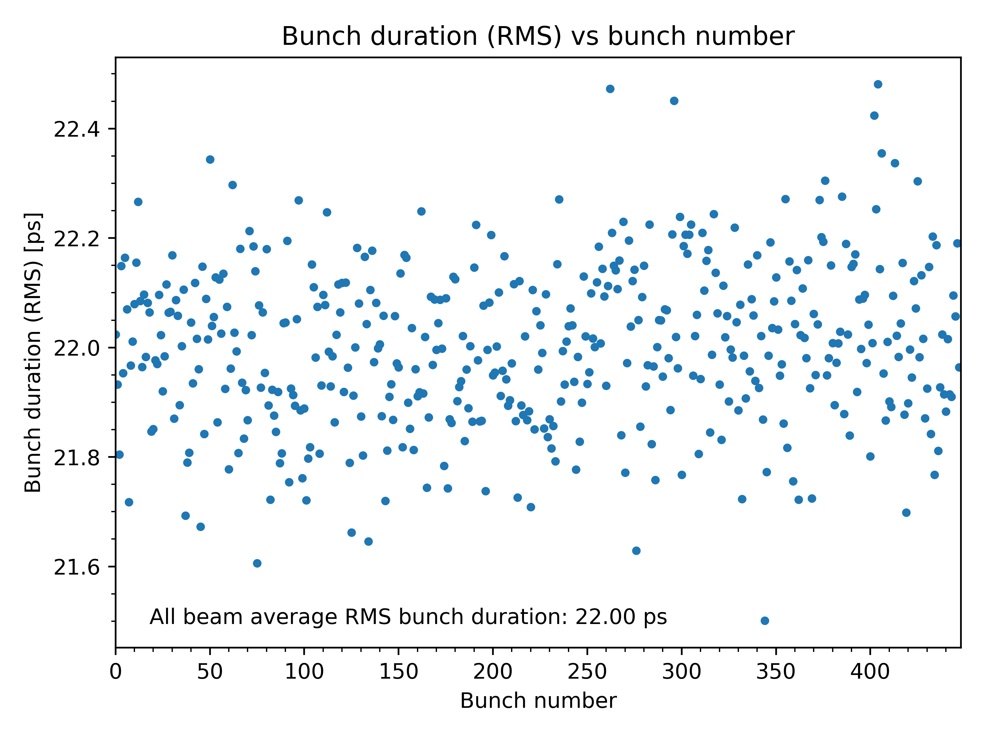
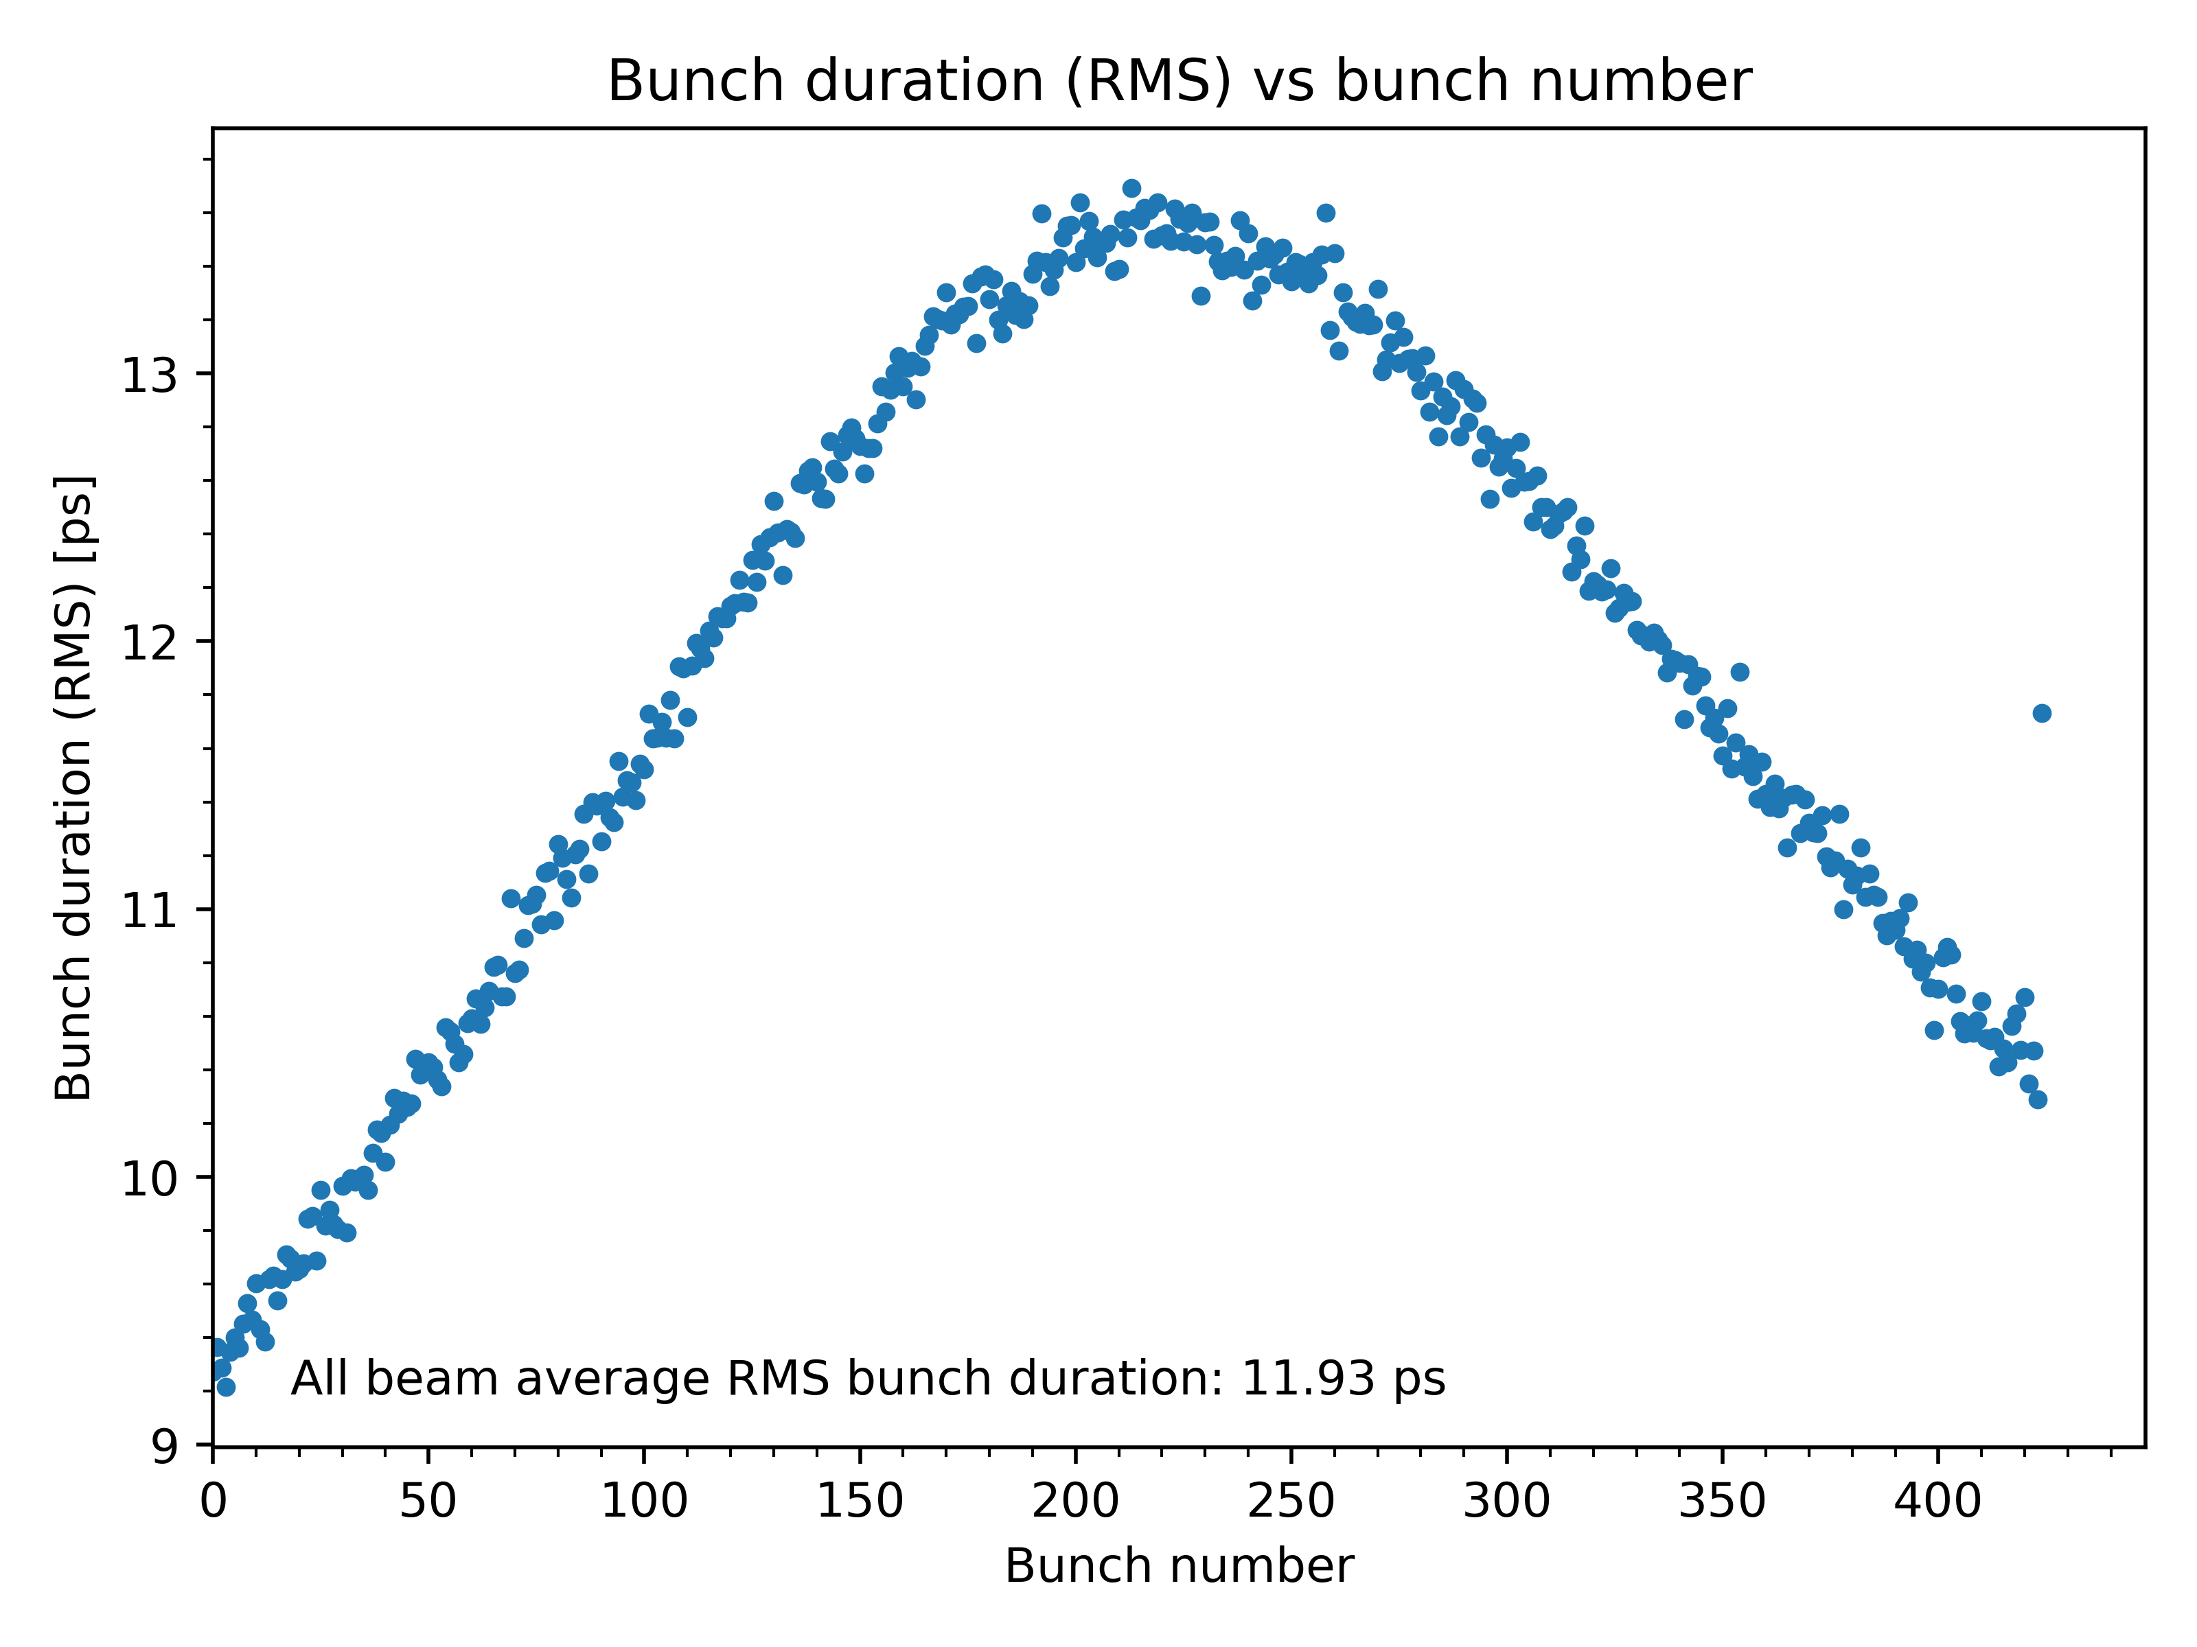
NC ACTIVE HC - BASELINE
Full filling pattern vs 5% gap
FFP
5% gap
The transient beam loading makes a non-uniform bunch duration along the bunch train, so each bunch would end having a different lifetime

Slide 13
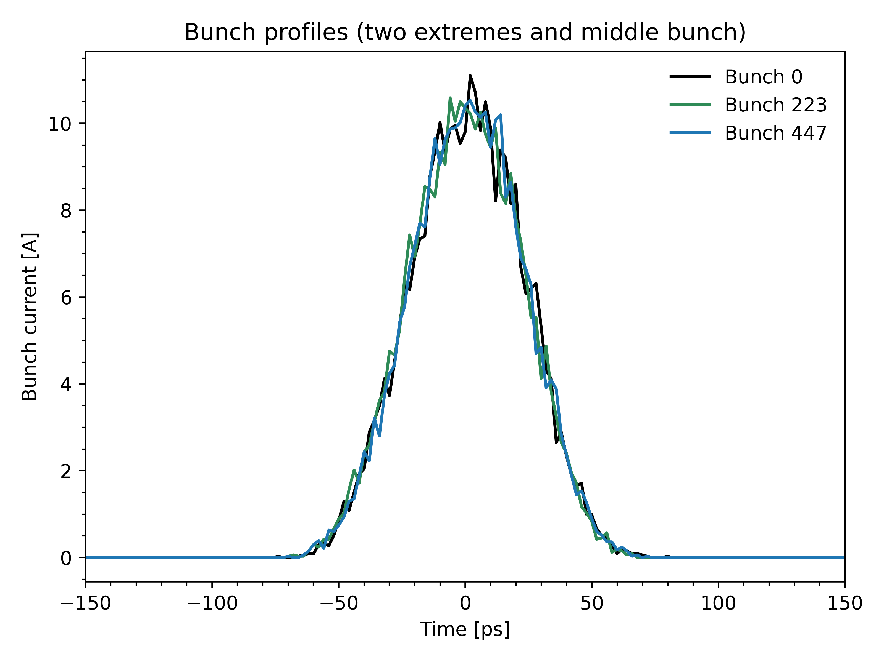
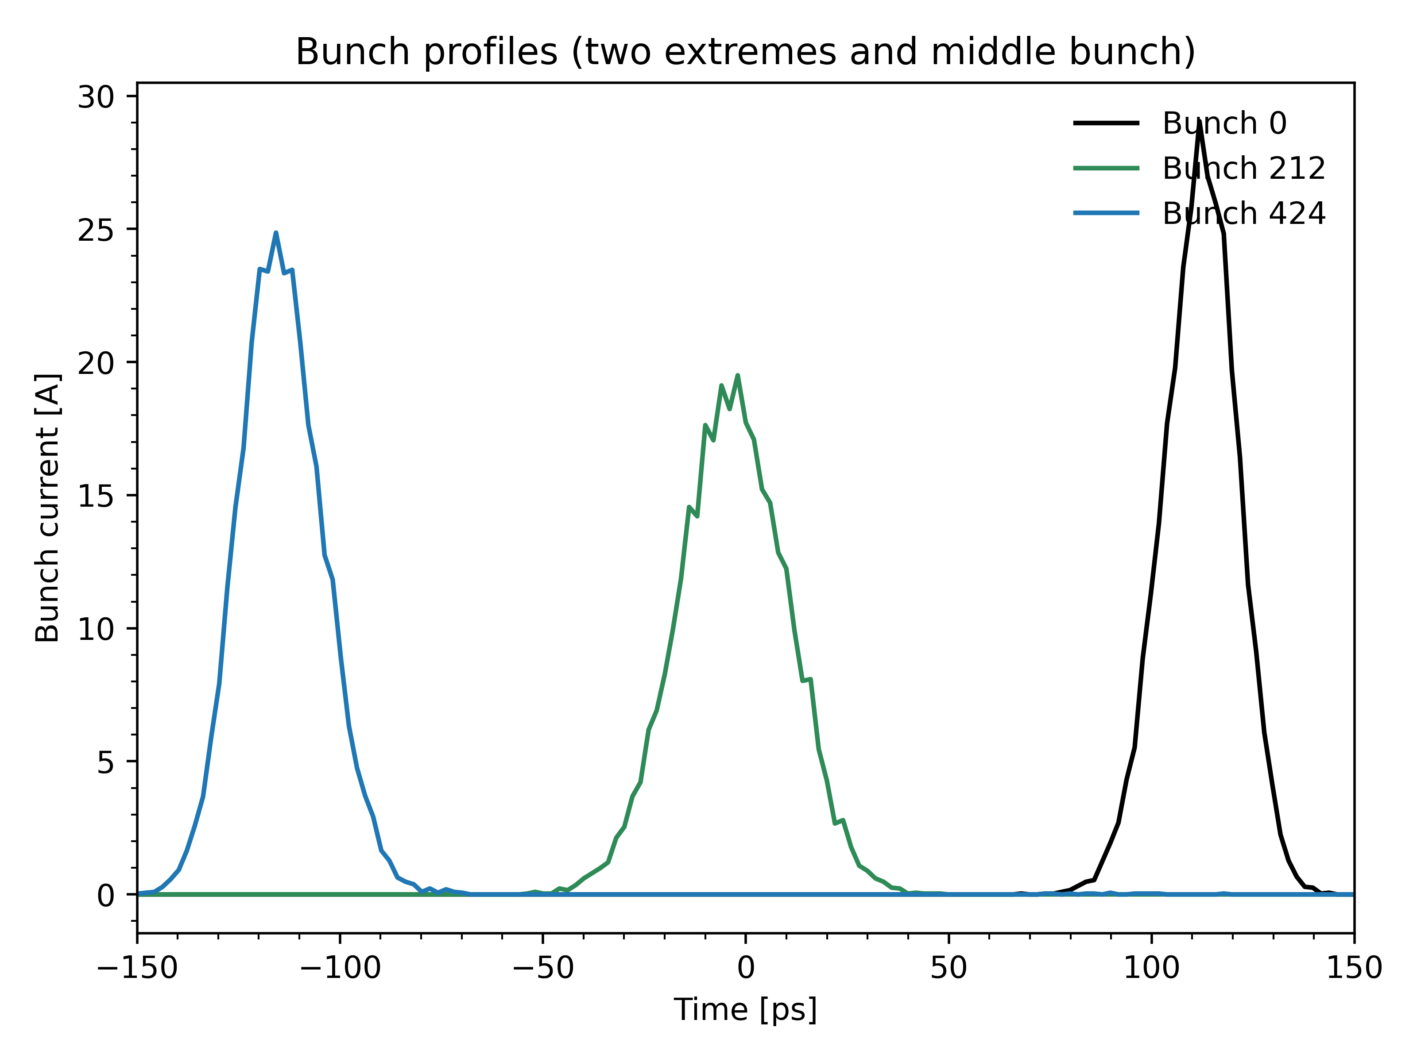
NC ACTIVE HC - BASELINE
Full filling pattern vs 5% gap
FFP
5% gap
Not being around the optimal harmonic voltage, the bunch shape still looks Gaussian

Slide 14
OPTIONS (FOR COMPARISON) NC/SC PASSIVE

Slide 15
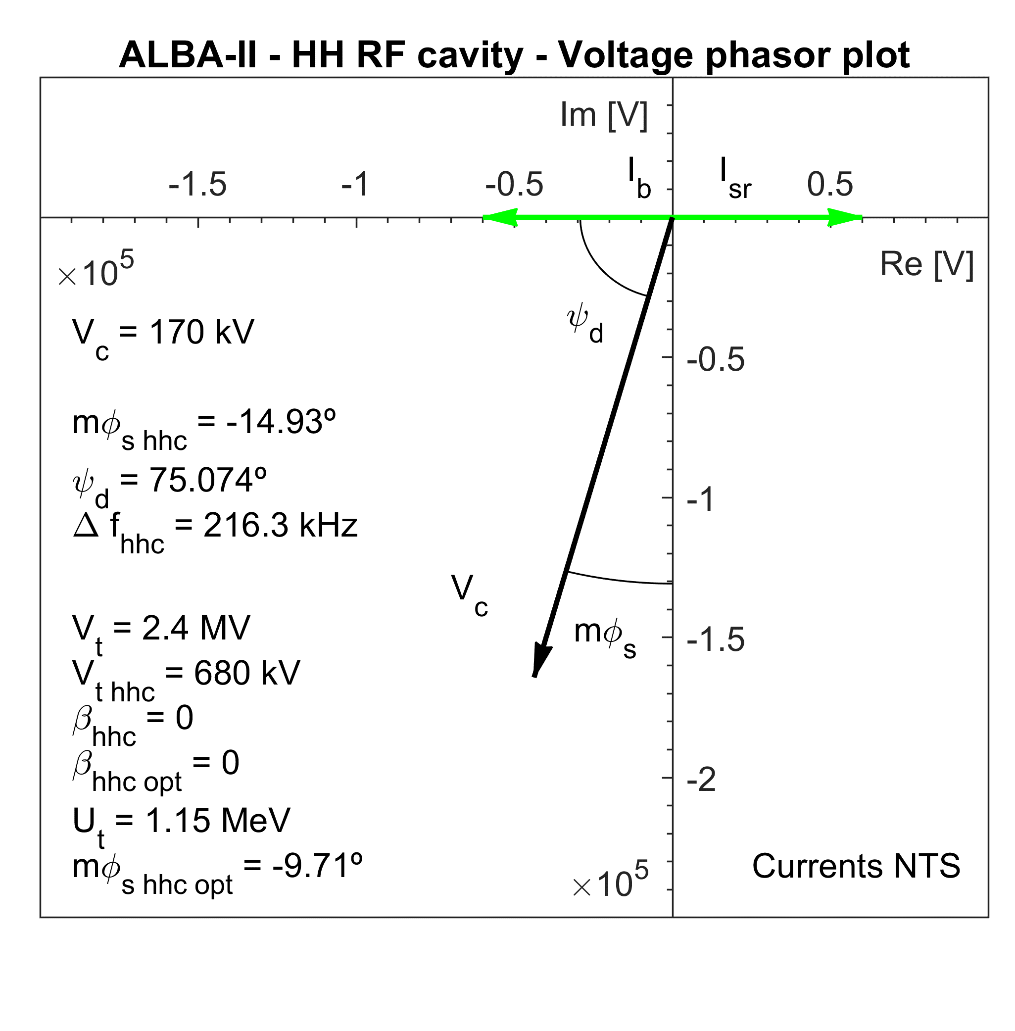
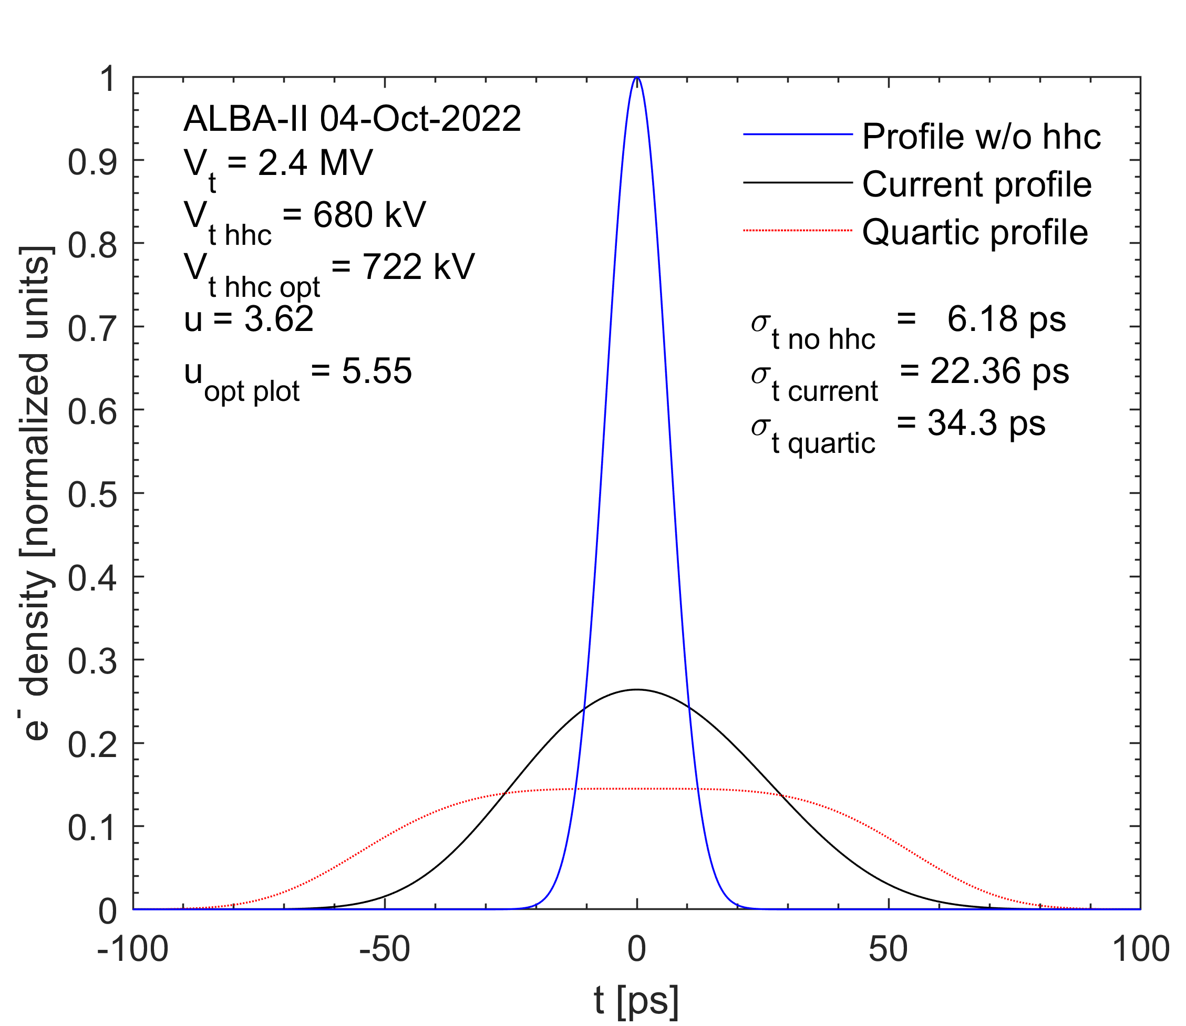
NC PASSIVE HC
For full filling pattern, operating the cavities in passive mode allows up to 700 kV of harmonic voltage. For comparison, 680 kV are shown here

Slide 16
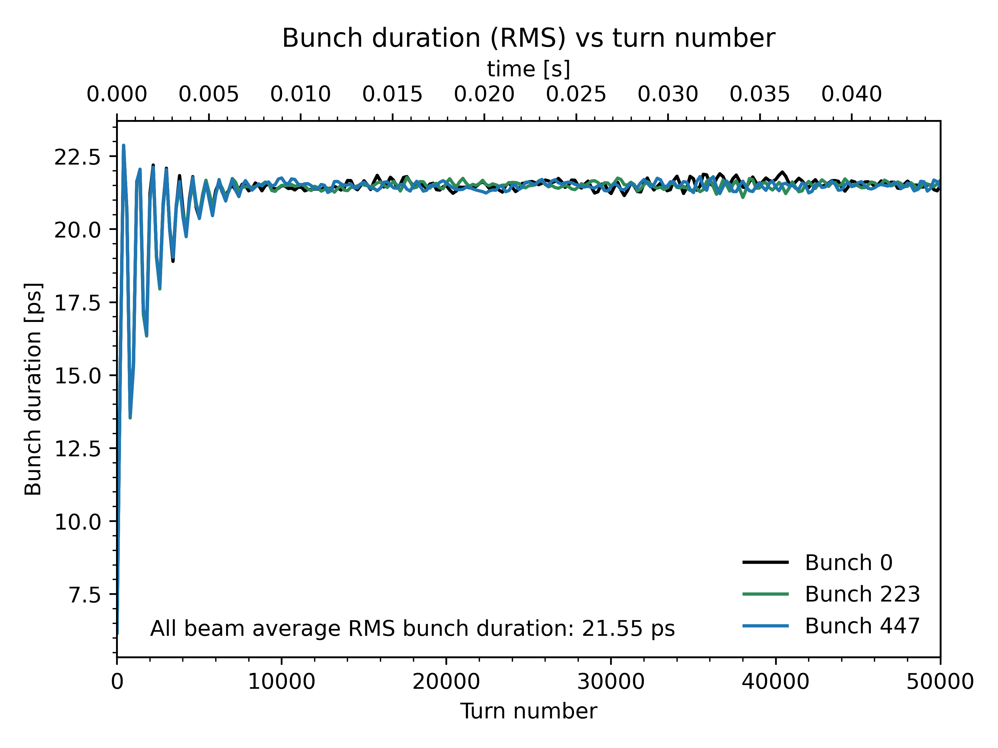
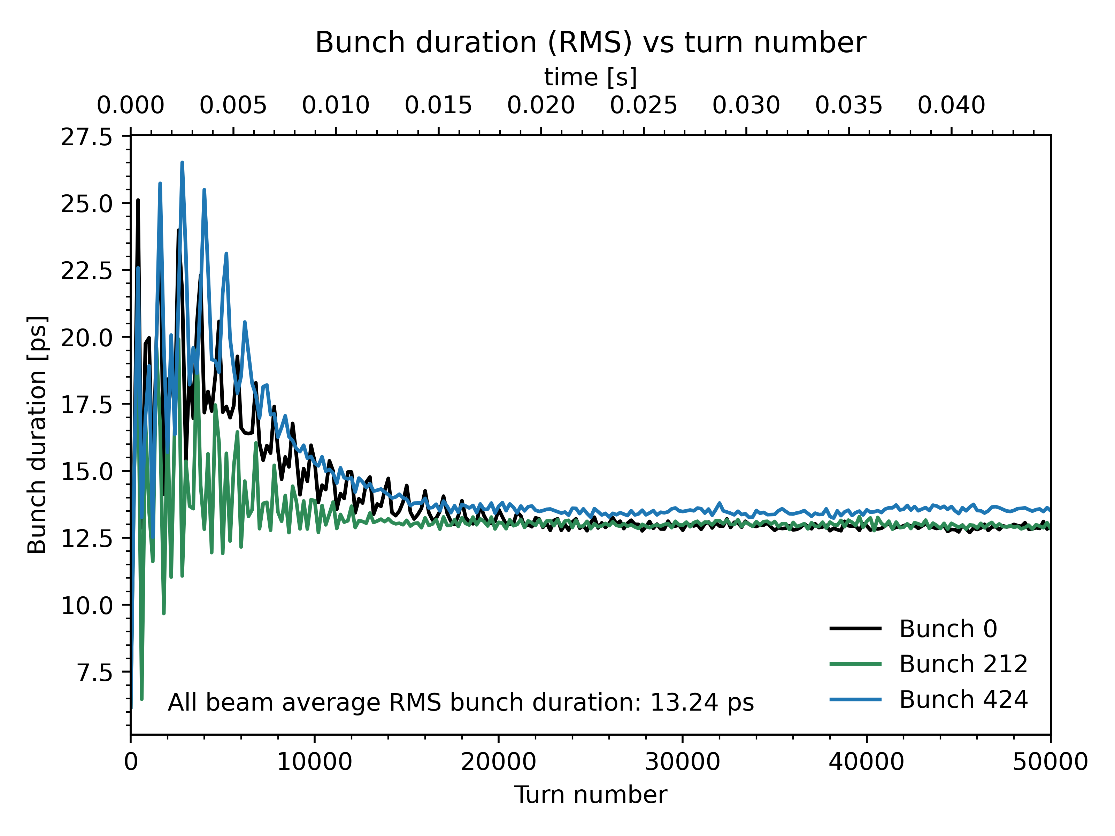
NC PASSIVE HC
Full filling pattern vs 5% gap
FFP
u = 3.5
5% gap
u = 2.2
Around a 39% of bunch lengthening would be lost with a 5% gap, in passive mode. The phase offset would be around 27º from head to tail of the bunch train

Slide 17
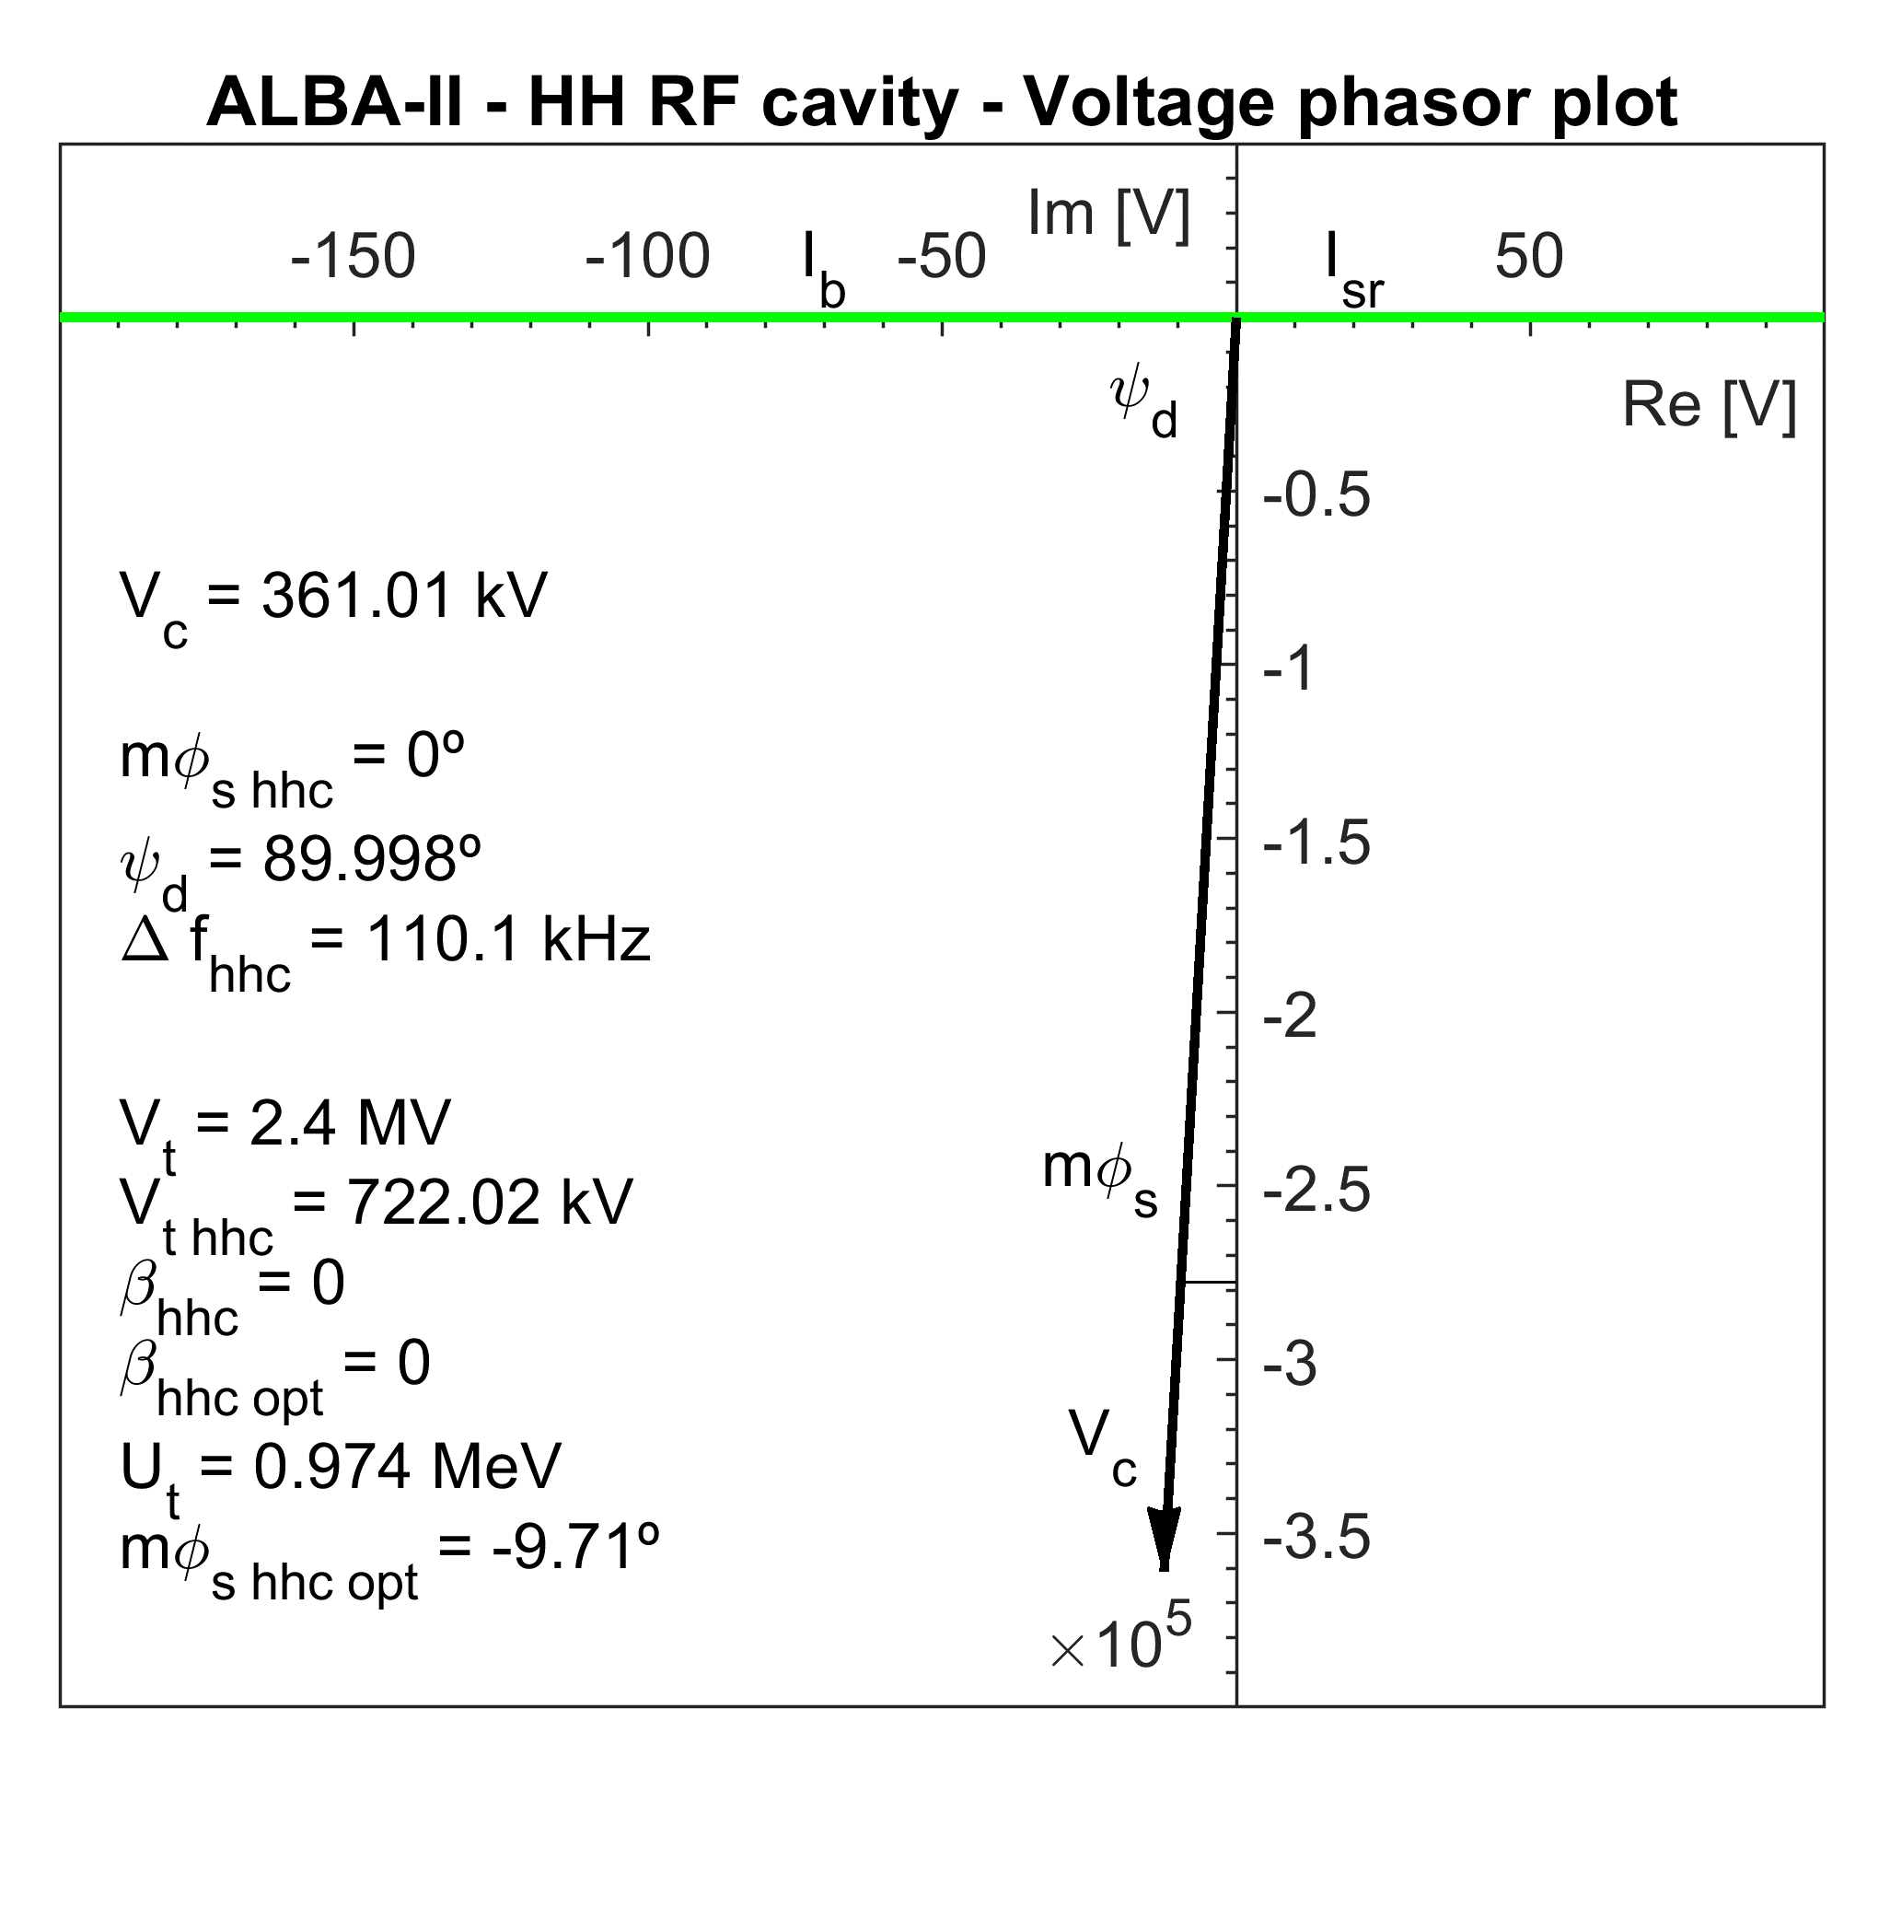
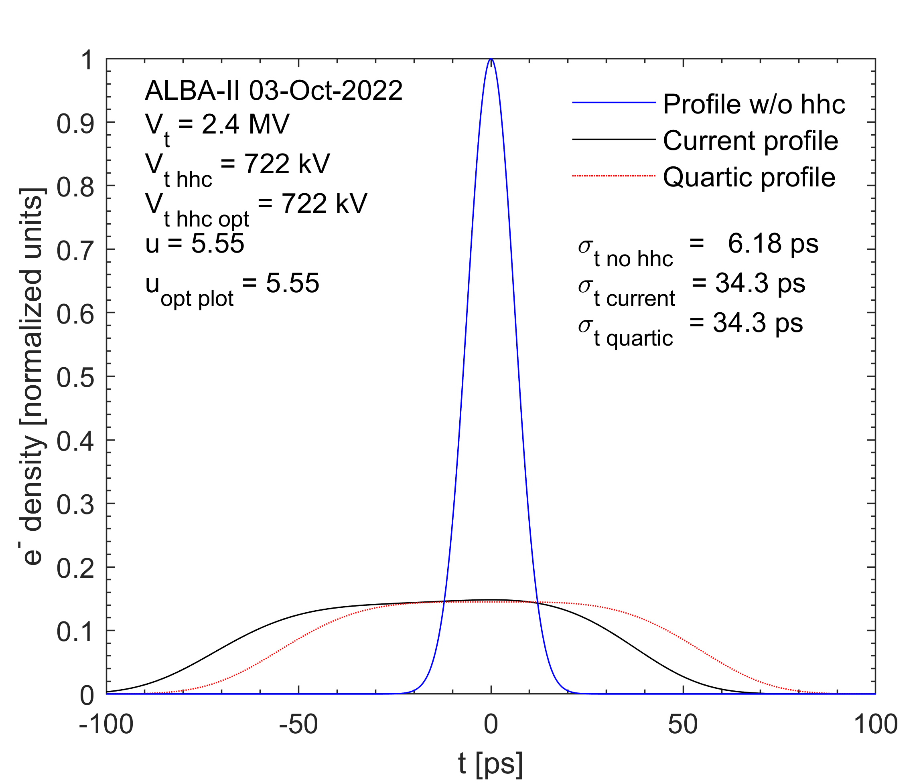
SC PASSIVE HC
The CEA SC 3HC parameters have been used as a reference

Slide 18
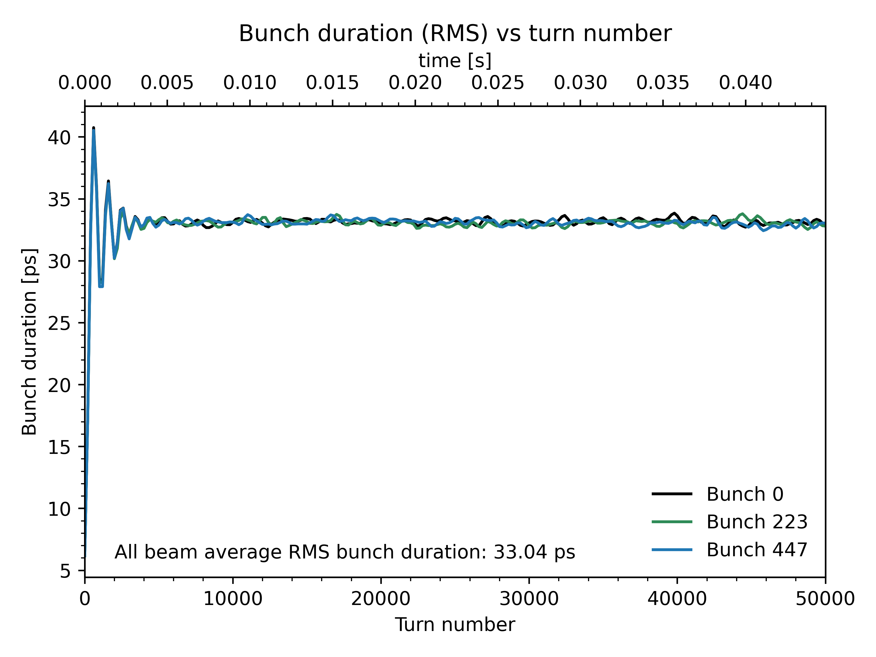
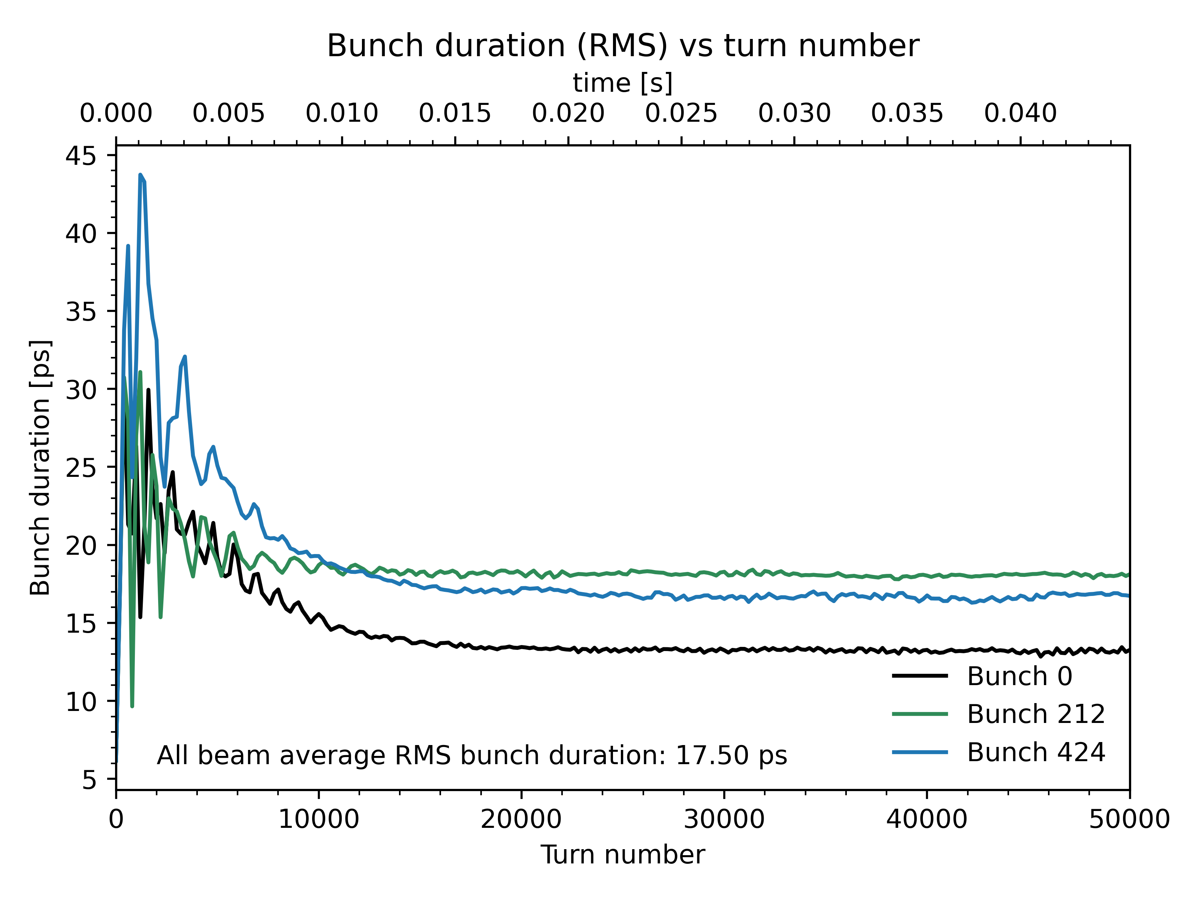
SC PASSIVE HC
Full filling pattern vs 5% gap
FFP
u = 5.4
5% gap
u = 2.8
The superconducting option yields the expected results. It is able to reach the optimal harmonic voltage without entailing beam instabilities

Slide 19
OPTIONS COMPARISON
At least 10 h of Touschek lifetime ($τ_{T}$) are desired for a reasonable reliability and life expectancy of the injection system ( around u = 3)
Option
$τ_{T}$UFP (0% gap)
Main 2.4 MV C = 0.5%
0.36 h
Main 2.4 MV C = 100 %
3.4 h
Option
u 0% gap
u 2% gap
u 5% gap
Main 2.4 MV + HH 680 kV active NC
3.6
2.3
1.9
Main 2.4 MV + HH 680 kV passive NC
3.5
2.8
2.2
Main 2.4 MV + HH 722 kV passive SC
5.4
3.8
2.8

Slide 20
SUMMARY AND CONCLUSIONS
For the time being, the designed active cavity would reach around a 94% of the optimal voltage, yielding around a 3.6 bunch lengthening factor in full filling pattern
The transient beam loading effect is specially dramatic in the case of active harmonic cavities, reducing its lengthening performance in almost around a 46% with a 5% gap
It is mandatory to further study the potential capability of the harmonic cavity (altogether with the main one) of mitigating the transient beam loading effect and the beam instabilities by means of the LLRF
Using the designed cavity in passive mode is also viable from the beam dynamics point of view

Slide 21
THANK YOU FOR YOUR ATTENTION
And many thanks to T. Olsson and S. Wang from Diamond for their support on Elegant simulations

Slide 22
COMMENT TALK - HC SIMULATIONS FOR ALBA-II
Ignasi Bellafont
HarmonLIP 2022 - 11/10/2022

