Slide 1
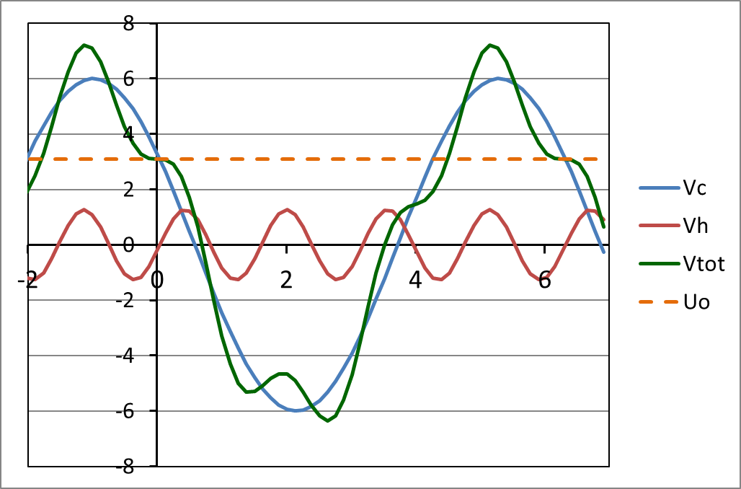
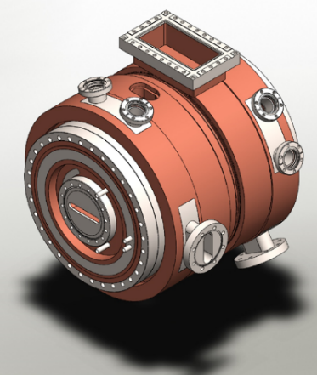
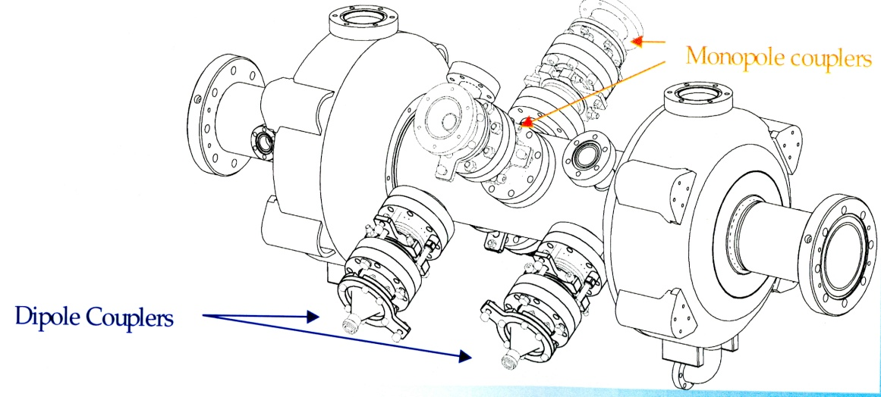
HarmonLIP Workshop
MAX IV / Lund, 10-12 October 2022
Passive vs Active Systems, DC Robinson, DLLRF
Jörn Jacob
Part of this work has been performed within the frame of the WP2 collaboration among ESRF, HZB, KEK, PSI & SOLEIL

Slide 2
Harmonic RF for bunch lengthening
V_{acc}(φ) = V_{c} sin(φ_{s} + φ) + V_{h} sin(nφ_{h} + nφ)
Optimum Working point (1st & 2nd derivatives = 0):
φ_{s} = π - arcsin[ n²/(n²-1) U₀/V_{c} ]
V_{h,opt} = sqrt[ V_{c}²/n² - U₀²/(n²-1) ]
φ _{h,opt} = (1/n) arcsin[- U₀ / (V_{h,opt} (n²-1) ]
For instance 4th harmonic RF for the ESRF:
U₀ = 2.52 MeV / turn (without ID = worst case)
V_{c} = 6.0 MV
φ_{s} = 153.38 deg
V_{h,opt} = 1.35 MV
nφ _{h,opt} = -7.14 deg
V [MV]
φ [rad]
Principle: 4th harmonic RF system for bunch lengthening

Slide 3
Passive NC / SC harmonic caviTY
Passive NC harmonic cavity :
MAXIV, Solaris: 3 x 100 MHz
ALS: 3 x 500 MHz
BESSY: 3 x 500 MHz
Pros:
Simple, most economic solution
V_{h} driven by the beam
Only f_{res} tuning to obtain desired V_{h} = f(Ibeam)
V_{h} phase follows beam phase
no phase tuning required
no DC Robinson problem
Cons:
Low total impedance → only for high current operation
Low Q → V_{h,opt} achievable if enough total current, but not φ_{h,opt} :
i.e.: cancelation of 1st derivative possible, but not 2nd derivative
nevertheless, significant bunch lengthening achievable
High total R/Q → Strong phase transients ∼ R/Q
Passive SC harmonic cavity :
SLS, Elettra: 3 x 500 MHz
APS: 4 x 352.2 MHz, under development
SOLEIL II: possibly
Pros:
Almost purely inductive,
φ_{h} = 0 close to φ_{h,opt} !
No beam power loading
V_{h,opt} easily achievable down to low beam current
Only f_{res} tuning to obtain desired V_{h} = f(Ibeam)
V_{h} phase follows beam phase
no DC Robinson problem
Note: APS project foresees power coupler to slightly load the SC cavity and achieve also φ_{h} = φ_{h,opt}
Low R/Q , → minimize phase transients
Cons:
Operation of SC-RF technology, Cryoplant
Operation requires more financial and manpower resources than NC cavities
Larger risk of down time

Slide 4
ACTIVE NC Harmonic cavity
Active NC harmonic cavity :
ALBA, BESSY, DESY project: 3 x 500 MHz scaling of E010 EU cavity in test at BESSY
KEK: development of 3 x 500 MHz E020 cavity
ESRF: development of 4 x 352.37 MHz E020 cavity
Pros:
Any Vh and φ_{h} can easily be set for any current
Allows bunch lengthening for high and low current / few bunch filling
Still reasonable number of cavities
E020 cavities: similar R/Q as SC cavities
Real alternative to SC cavities
Cons:
Lacking operational experience
DC Robinson stability needs to be addressed
Requires high power RF amplifiers

Slide 5
General stability
Different configurations are being evaluated by the HarmonLIP community w.r.t. stability:
By beam tracking simulations
When possible: by experiments on existing systems
See other presentations
Coming slides → some considerations on:
Robinson DC for active harmonic RF systems
Possible active control

Slide 6
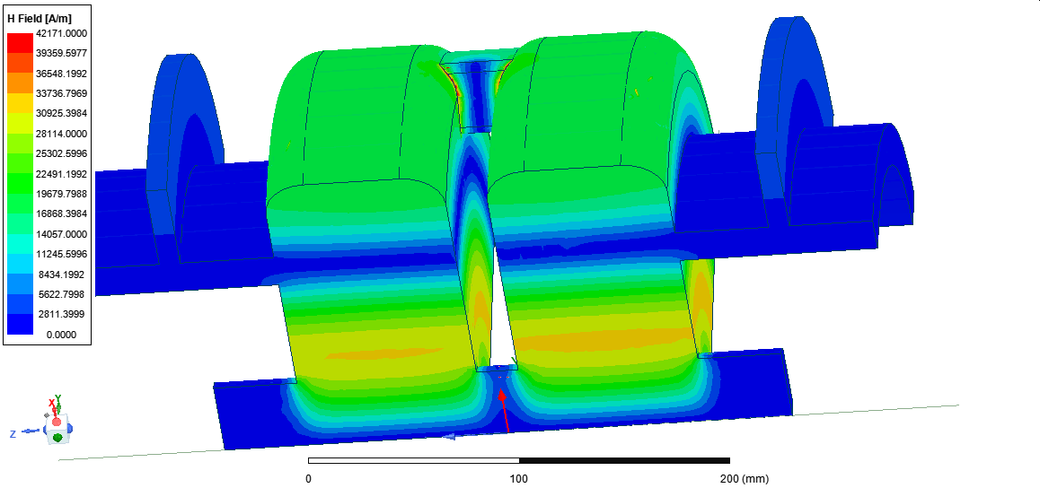
4th harmonic 2-cell E020 mode cavity – ESRF in house development
Ferrite LOM (E010 mode) & HOM absorber
454 mm
Active NC cavity design well advanced:
2 coupled and 2 uncoupled cells considered
Freq = 1.409 GHz
R/Q = 44.5 ohm/cell
Q0 = 30500
Smart HOM & LOM dampers almost not affecting Q0 of E020 mode
Elaborate water cooling
Aperture coupler: coupling β = 1
Vacuum ports on HOM dampers also preserving Q0
H-Field
[E020 proposed by Naoto Yamamoto, KEK
ESRF design by Alex D’Elia, Vincent Serrière]

Slide 7
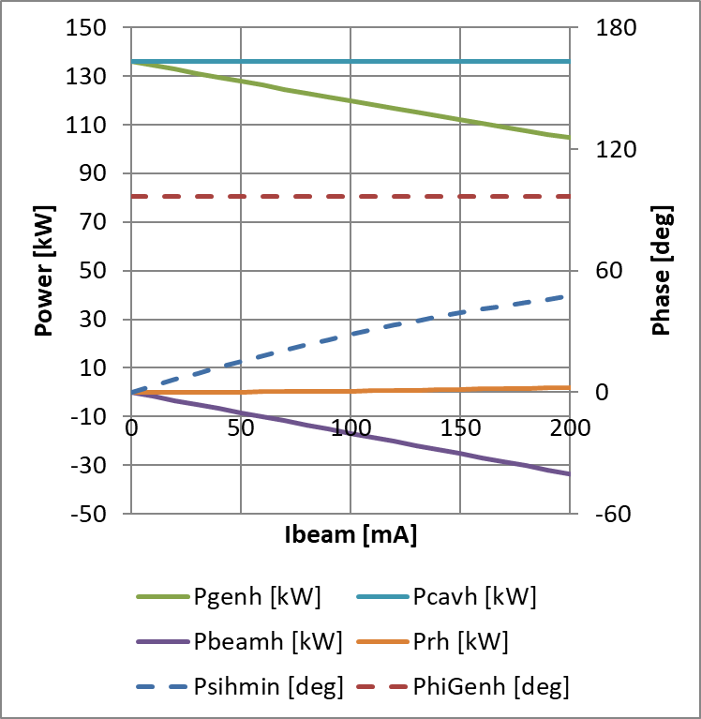
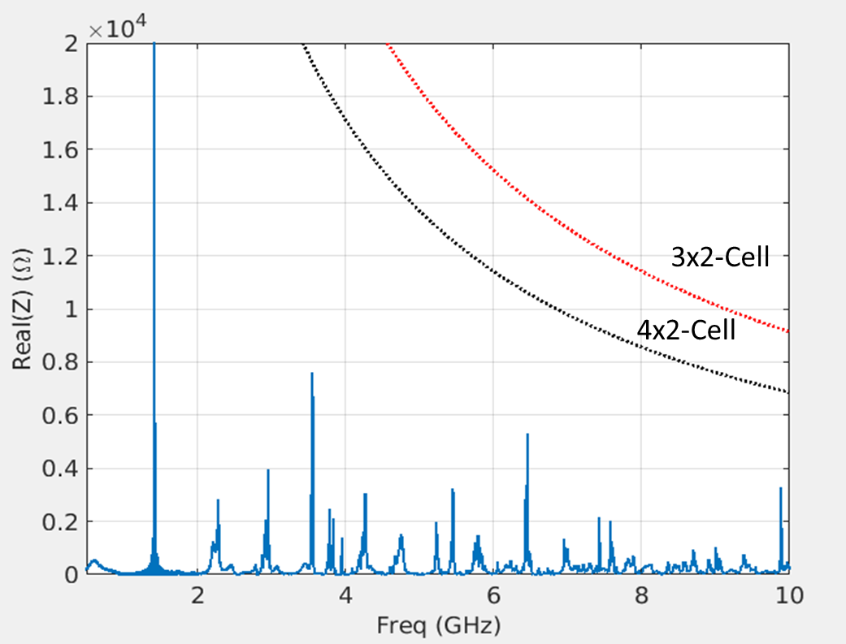
ACTIVE harmonic system - Power requirements
Main RF Voltage | Harmonic RF Voltage | 3 x 2 Harm Cav cells | 4 x 2 Harm Cav cells
6.5 MV | 1.49 MV | 46 kW | 26 kW
6.0 MV (nominal) | 1.35 MV | 38 kW | 22 kW
Optimum harmonic cavity tuning: Load angle = 0
(exactly as for main RF)
Thresholds for LCBI
HOM impedances

Slide 8
Beam loading diagram with harmonic cavity for bunch lengthening
V_{gr}
V_{acc}(φ) = V_{c} sin(φ_{s} + φ) + V_{h} sin(nφ_{h} + nφ)
Optimum Working point (1st & 2nd derivatives = 0):
φ_{s} = π - arcsin[ n²/(n²-1) U₀/V_{c} ]
V_{h,opt} = sqrt[ V_{c}²/n² - U₀²/(n²-1) ]
φ _{h,opt} = (1/n) arcsin[- U₀ / (V_{h,opt} (n²-1) ]
Optimum tuning (min power) ⇔ load angle = 0:
ψ such that V_{gr} // V_{c}
ψ_{h} such that V_{ghr} // V_{h}
Beware, in the vector diagram:
Main RF turns at φ = ωt
Harmonic RF at nφ = nωt
θ
V_{g}
-ψ
φ
V_{C}
V_{b}
-ψ
φ_{s}
I_{beam}
V_{br}
V_{bhr}
ψ_{h}
V_{bh}
φ_{gh} = π/2 – n φ_{h}
V_{gh}
-nφ_{h}
V_{ghr}
ψ_{h}
V_{h}
nφ
☞ φ_{harm} = n φ_{gh}
θ_{h}

Slide 9
Robinson DC (2nd type) – Integration of synchrotron equation
Assumptions:
RF loops (Amp, Phi, tuning | slower than | Synchrotron motion | slower than | Cavity Bandwidths (main & HC)
B ≈ 1 Hz | << | fs ≈ 1 kHz … | << | Above ≈ 40 kHz
⇓
Tuning angles, generator amplitudes and phases are constant at the scale of the synchrotron motion
The beam induced voltages in the cavities follow the beam phase
f_{s} = f_{rf} x sqrt [ α K’ / (2π h E₀/e) ], (K’<0 ⇔ DC Robinson instability)
K’ = -V_{c} cos φ_{s} - nV_{h} cos(nφ_{h}) + V_{b} sin ψ + nV_{bh} sin ψ_{h} (Eq. 1)
> 0
Main RF, giving f_{s0}
< 0
Harm. RF, for cancelling f_{s}
< 0
Main RF
beam loading
(Robinson term)
> 0
Harm. RF,
beam loading
(Stabilizing effect)

Slide 10
Coming examples already shown
at
ESLS RF meeting at SOLEIL in November 2018
Computed for 3rd harmonic RF system
(and not for actual 4th harmonic project)

Slide 11
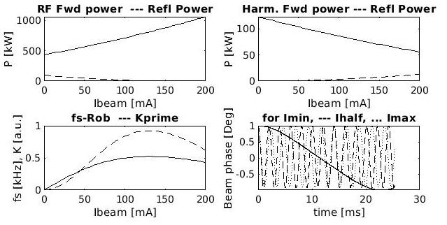
Robinson DC (2nd type) – Integration of synchrotron equation
Numerical integration of synchrotron equation:
Uniform filling (no transients)
Starting with beam phase offset by +1 or -1 deg
Tracking V_{b}, V_{bh} and φ_{beam} turn by turn
Checking convergence (neglecting synchrotron oscillation damping)
No linearization !
V_{h} = V_{h,opt} = 1.89 MV
nφ_{h} = nφ_{h,opt} = -12.2 deg
5 cavities, β_{h} = 1
→ stable
Eq. 1
← Numerical integration

Slide 12
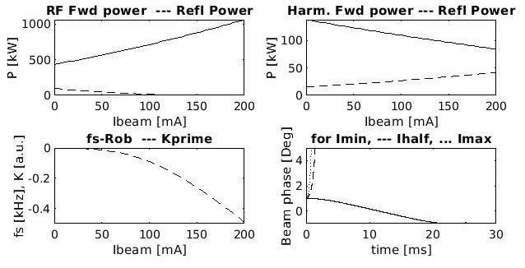
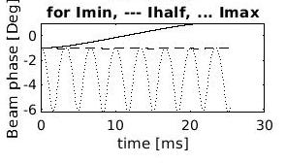
Robinson DC (2nd type) – Integration of synchrotron equation
V_{h} = V_{h,opt} = 1.89 MV
nφ_{h} = nφ_{h,opt} = -12.2 deg
5 cavities, β_{h} = 2
→ Unstable for I_{beam} > 0
Eq. 1
Start with
φ_{beam} = +1 deg
Start with
φ_{beam} = -1 deg
Only for negative beam phases: stabilization through non-linearity of voltage waveform
Equilibrium for ≈ 100 mA

Slide 13
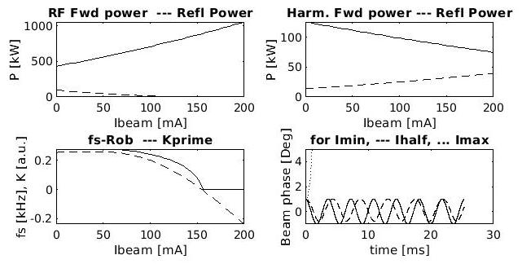
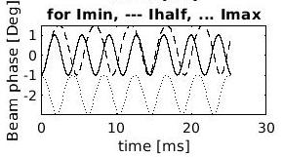
Robinson DC (2nd type) – Integration of synchrotron equation
V_{h} = 1.80 MV ( ≠ V_{h,opt} )
nφ_{h} = nφ_{h,opt} = -12.2 deg
5 cavities, β_{h} = 2
→ Unstable for I_{beam} > 150 mA
Eq. 1
Start with
φ_{beam} = +1 deg
Start with
φ_{beam} = -1 deg
Threshold at ≈ 150 mA confirmed by numerical integration

Slide 14
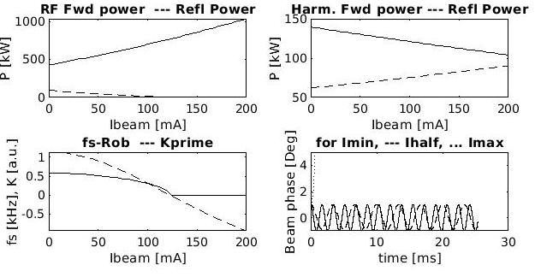
Robinson DC (2nd type) – Integration of synchrotron equation
V_{h} = 1.50 MV ( ≠ V_{h,opt} )
nφ_{h} = nφ_{h,opt} = -12.2 deg
5 cavities, β_{h} = 5
→ Unstable for I_{beam} > 130 mA
Eq. 1
Start with
φ_{beam} = +1 deg
Threshold at ≈ 130 mA confirmed by numerical integration
For active system, Integration of synchrotron equation indicates:
Robinson stable if Harmonic RF beam loading > Main RF beam loading
Sufficient harmonic cavity impedance,
Sufficient number of harmonic cavities
Upper limit for coupling β_{h}

Slide 15
Direct RF Feedback
Analog RF feedback on MAIN RF system:
Gain G
Impedance for coherent in phase longitudinal beam motion reduced by factor 1/G
Reduction of Robinson term in Eq. 1 by a factor 1/G
f_{s} = f_{rf} x sqrt [ α K’ / (2π h E₀/e) ], (K’<0 ⇔ DC Robinson instability)
K’ = -V_{c} cos φ_{s} - nV_{h} cos(nφ_{h}) + V_{b} sin ψ / G + nV_{bh} sin ψ_{h} (Eq. 1)
> 0
Main RF, giving f_{s0}
< 0
Harm. RF, for cancelling f_{s}
< 0
Main RF
beam loading
(Robinson term)
> 0
Harm. RF,
beam loading
(Stabilizing effect)

Slide 16
DLLRF system for FAST Digital RF Feedback
To stabilize main RF, one can compute the optimum correction for a fast RF feedback:
$\left(\begin{aligned}{∆I}_{gr} \\ {∆Q}_{gr}\end{aligned}\right)$ = $\frac{1}{\cos{ψ}}$ $\left[\begin{matrix}cos(ψ −φ_{tune}) & sin(ψ −φ_{tune}) \\ −sin(ψ −φ_{tune}) & cos(ψ −φ_{tune})\end{matrix}\right]$ $\left(\begin{aligned}{∆I}_{c} \\ {∆Q}_{c}\end{aligned}\right)$
where $ψ=f(V_{c}{,I}_{beam}{,N}_{cav}{,R}_{s},β$, $φ_{tune}$), (→ $φ_{tune}$ = Load angle, mostly zero)
Alternative: simulate behaviour of a passive cavity
→ Feedback harmonic voltage phase to lock on beam phase
Results of synchrotron equation integration need to be cross-checked with particle tracking simulations
The two RF feedback approaches need to be included in the simulations and checked

Slide 17
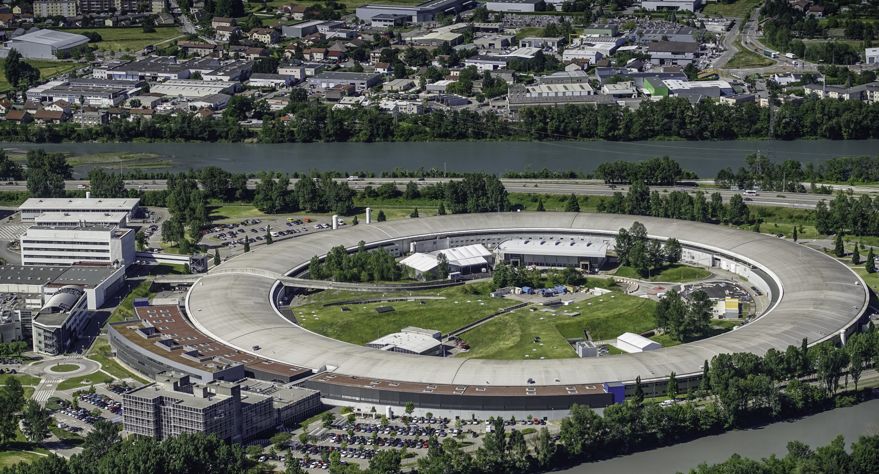
Many thanks for your attention

