Slide 1


PETRA-IV
Single Mode Structures, optional 3rd harmonic-cavity
HarmonLip 2022
Peter Hülsmann – DESY - MHF
Lund, October 12th, 2022

Slide 2

Content
Motivation
What is a single mode structure?
Two promising types of single-mode structures
The TM₀₁₀ choke mode cavity from T. Shintake (1992)
The single mode structure from H. Herminghaus (1978)
Conclusion and outlook

Slide 3
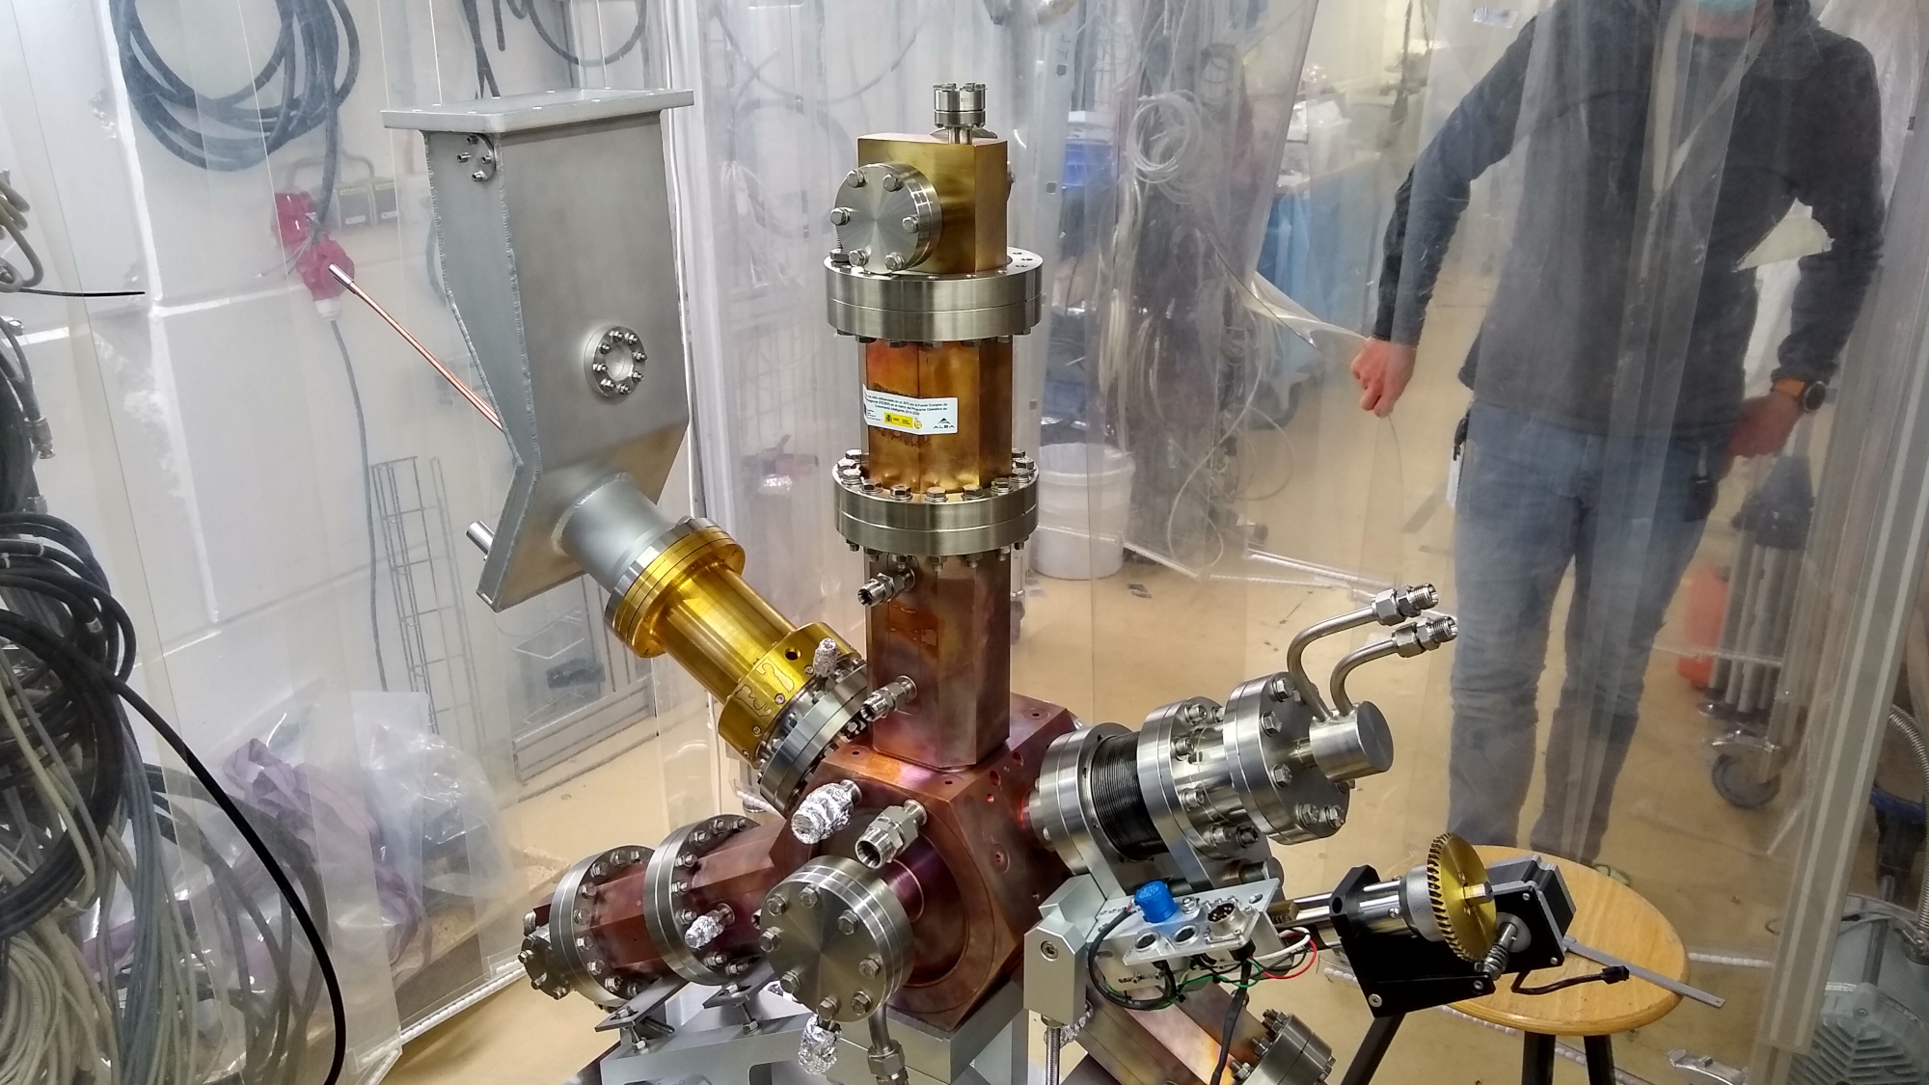
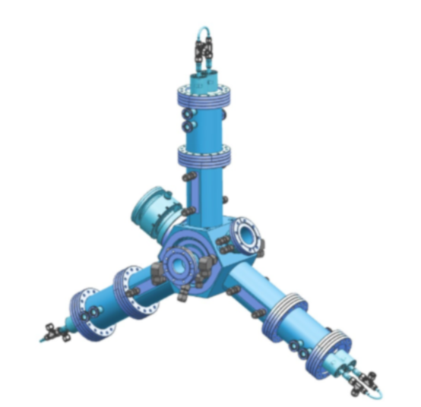
1.1 The 1/3 small sister of the 500 MHz HOM damped cavity
Fig. 4: The 1,5GHz cavity in preparation for high power tests in the HoBiCaT-bunker at HZB (courtesy of A. Matveenko, BESSY II)
Fig 5: The CAD model of the cavity (Courtesy of Beatrice Bravo, ALBA)

Slide 4
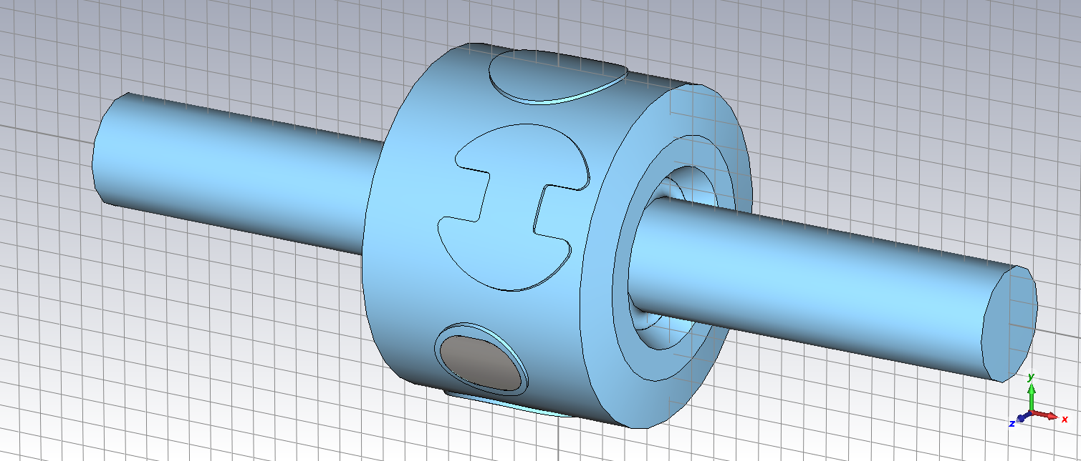
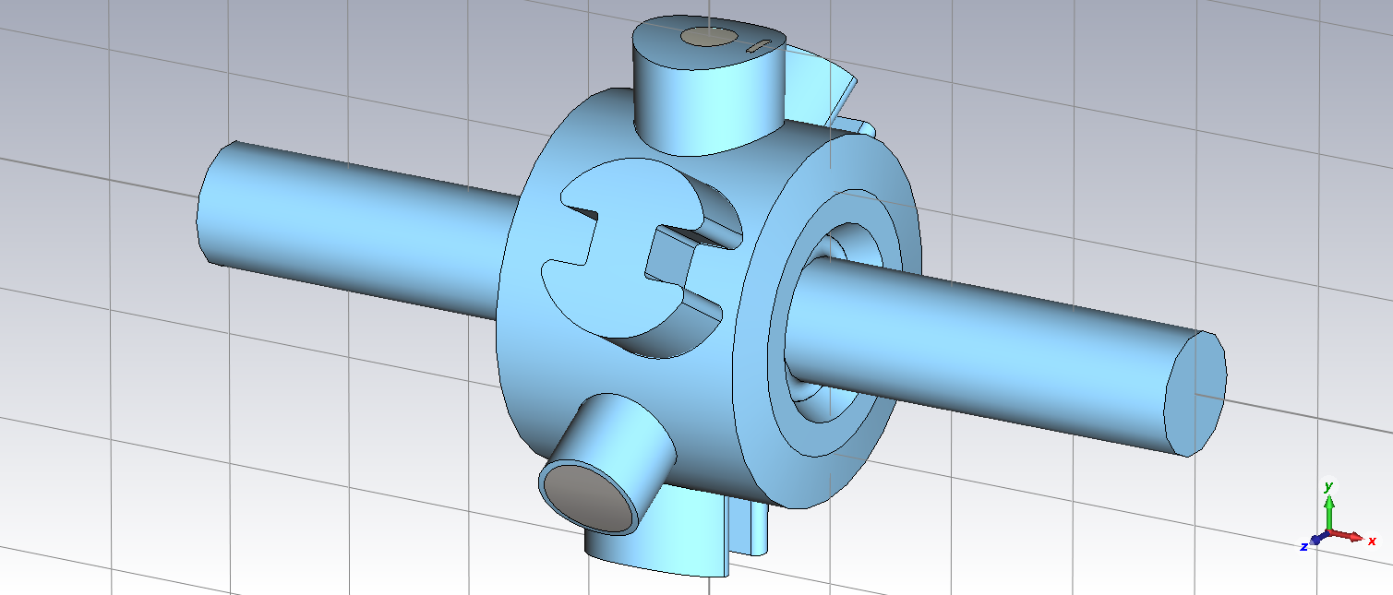
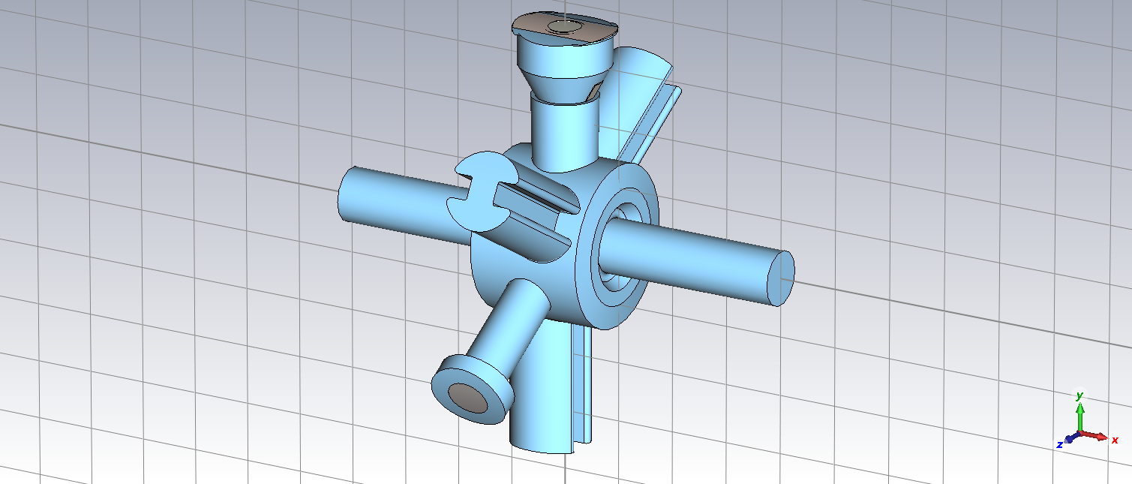
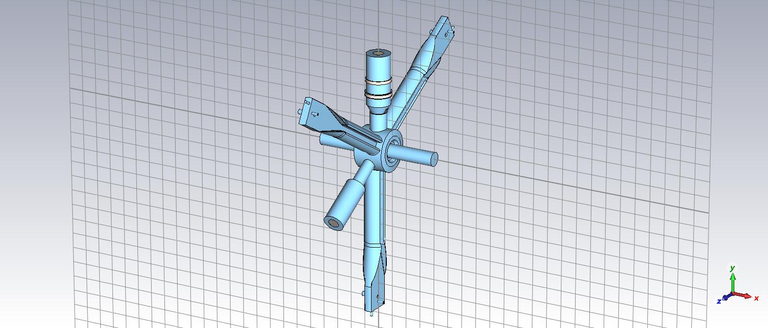
1.2 The basic problem of this kind of cavities
Fig. 6: Eigenmode simulations on the 1.5GHz cavity with CST-MWS performed by TEMF. The HOM waveguides were simulated from zero increasing in length to full length. They were terminated with their characteristic impedance
(Courtesy of W. F. O. Müller from TEMF).

Slide 5
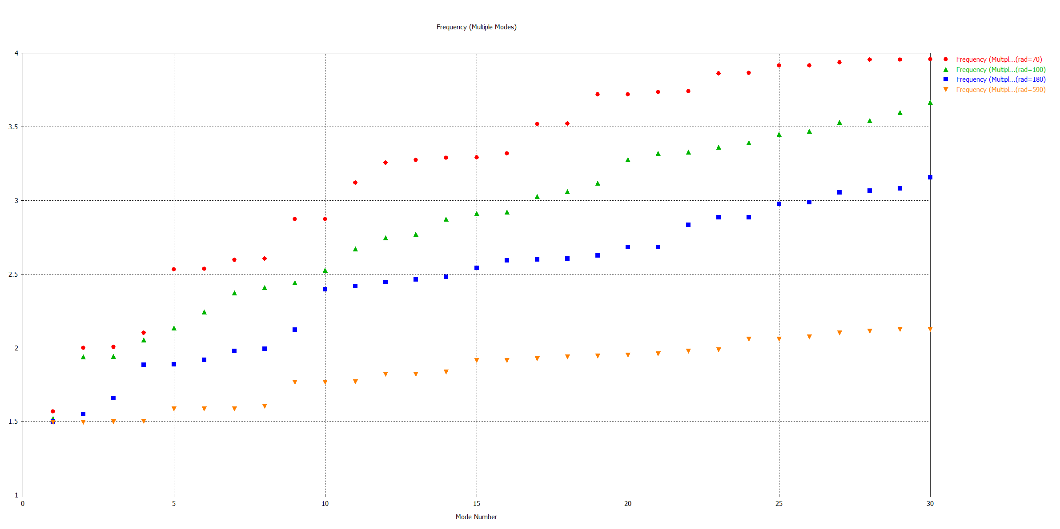
1.3 The basic problem of this kind of cavities
Frequency (Multiple Modes)
3 modes without waveguides
27 modes with full waveguide length
Mode number
Fig. 7: The red dots represent the eigenfrequencies for a waveguide length of zero, orange dots the eigenfrequencies for the full waveguide length. It can be seen that the presence of waveguides causes a multiplication of the eigenmodes. This is because an ideal matching for the HOM modes is not possible

Slide 6
1.4 Motivation for searching an alternative structure
High-harmonic-rf-system needs a frequency of 1.5 GHz, the 500 MHz BESSY-HOM-damped cavity was scaled down by a factor of 3.
Simply downscaling is extremely expensive and mechanically not an easy task. Cavity cooling is very complex (follow-up costs for the water pipes, diagnostics, installation, etc.).
Scaling of Longitudinal loss factor: k_{l} ~ f
Scaling of Transversal loss factor: k_{ꓕ} ~ f²
Increased HOM damping capabilities for the High-harmonic-rf-system would be desirable!
That is why we have started to look for other cavity concepts, which have to fulfil the following requirements:
The concept has to be mechanically very simple
The HOM-damping capabilities must be more effective compared to the BESSY-cavity

Slide 7
2.1 What is a single mode structure
General characteristics of ordinary accelerator structures
Accelerator structures are usually designed so that it is possible to use an rf source to excite a field formation suitable for accelerating charged particles.
But also other field formations with higher frequencies could be excited
These field formations are capable of disrupting the acceleration process, decreasing beam quality and, in the worst case, leading to beam blow-up
The basic idea of a “single mode structure”
The single-mode accelerating structure is designed so that all modes except the wanted mode leave the cavity in the direction of an rf absorber
If this is successful, you have a "single mode structure“ (the name was created, as far as I know, by M. Tigner [1])

Slide 8
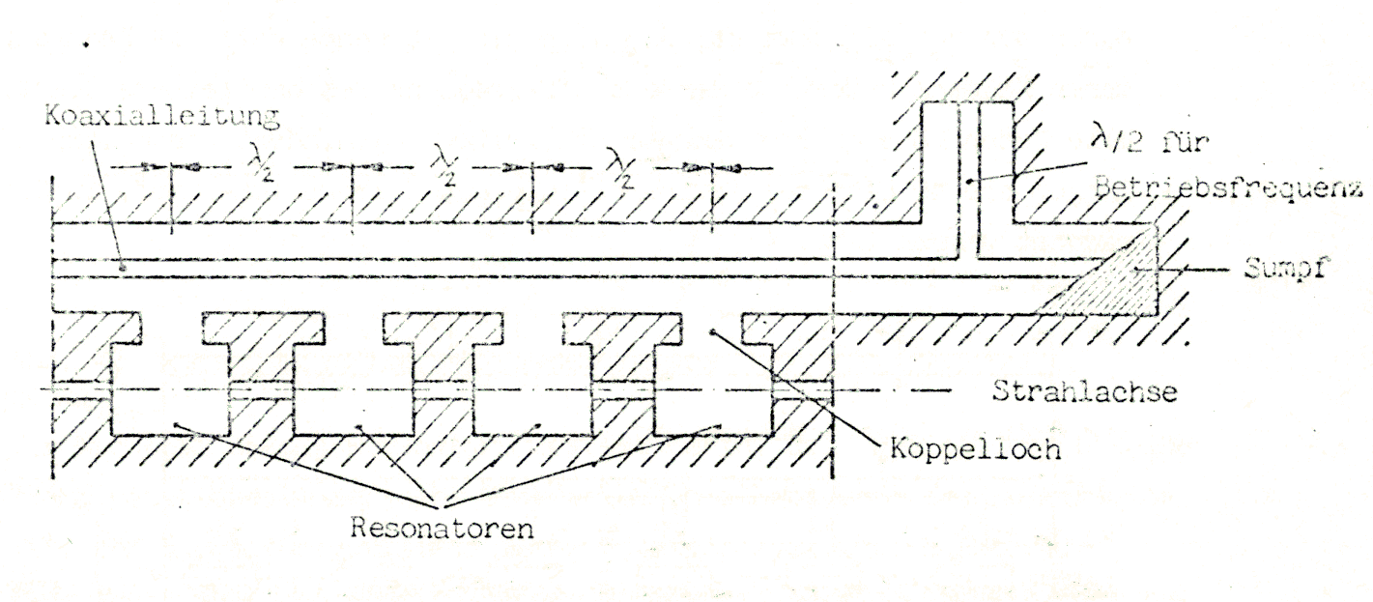
2.2 First Proposal of a “single mode structure”
Coaxial feeder line
λ/2 for the
Operating frequency
RF-load
Beam axis
Coupling holes
Accelerator cavities
Fig. 8: One of the first proposals of a so called “single mode structure” [1]
Picture: R. Klein: “Messung der Shuntimpedanz und Feldassymmetrie von Beschleunigerresonatoren, Diploma Thesis, Institut für Kernphysik der Johannes Gutenberg Universität Mainz, 1981, KPH 21/81

Slide 9
3.1 The choke mode cavity created by Tsumoru Shintake
Fig. 9: A cut view through the “choke mode cavity”. The cavity is azimuthally symmetric. (Picture: T. Shintake [2])
Fig. 10: The TM₀₁₀ mode is rejected by the choke. Due to the distance of λ/2 between the short circuit of the choke and the annular output of the cavity, the TM₀₁₀ mode "sees" a short circuit.(Picture: T. Shintake [2])

Slide 10
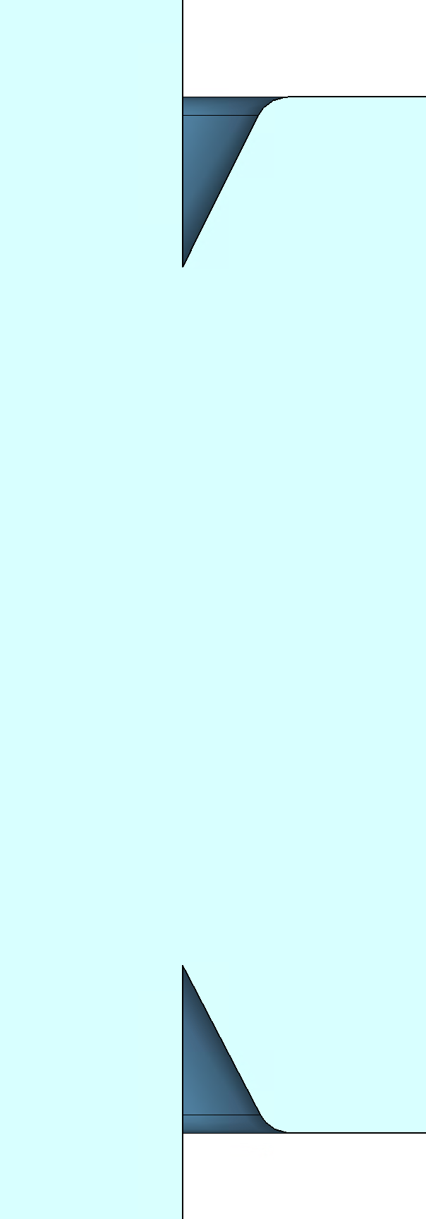
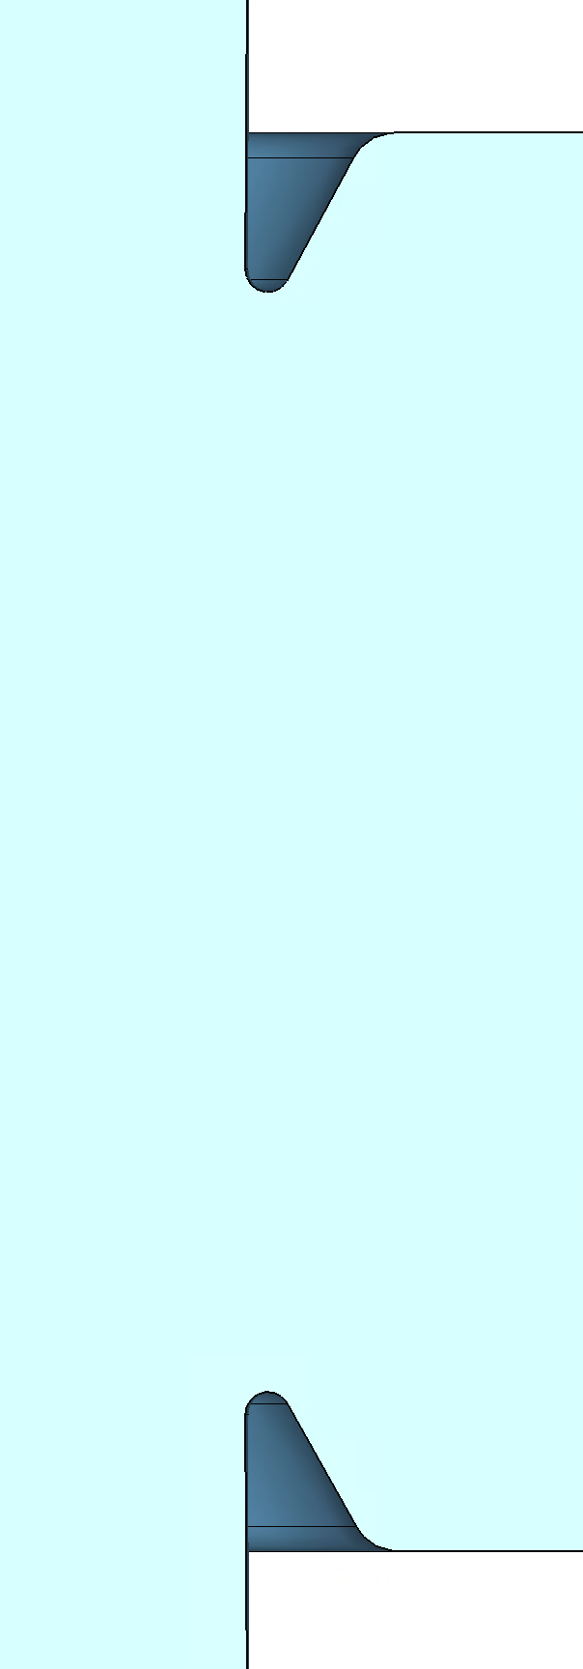
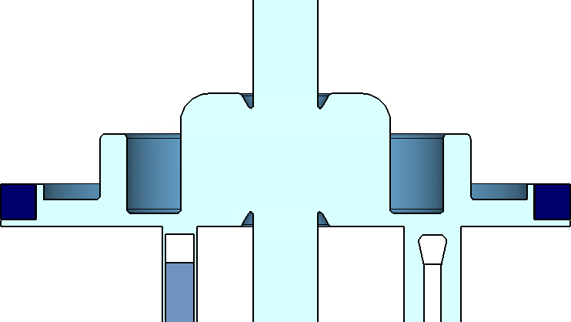
3.2 Final cavity design and parameters
14.60
10.5
R1.5
frequency | f₀ | 1,5GHz
shunt impedance (CST) | R_{S} | 1,7 MΩ
unloaded quality factor | Q₀ | 19.000
 | R_{S}/Q₀ | 88Ω
64.25
72.45
R1.5
14.60
147.3
R20.0
Tab. 1: Key-parameters of our optimized choke mode cavity
30⁰
R1.5
14.60
R3.0
37.45
13.75
5.0
19.0
R3.0
R3.0
25.0
frequency | f₀ | 1,5GHz
shunt impedance (CST) | R_{S} | 1,5 MΩ
unloaded quality factor | Q₀ | 17.000
 | R_{S}/Q₀ | 88Ω
93.45
64.25
SiC
5.0
25.0
R3.0
19.0
R3.0
9.5
10.0
14.60
R3.0
17.0
3.5
Alumina
30⁰
103.16
1.0
46.0
6.2
5.0
20.0
400.0
Fig. 12: The choke mode cavity with all its dimensions, including the high power coupler, tuner plunger and SiC-damper ring, after the optimization procedure with MWS-CST(Picture: S. Karau (DESY MHF))
Tab. 2: Key-parameters of the ALBA-HH-cavity

Slide 11
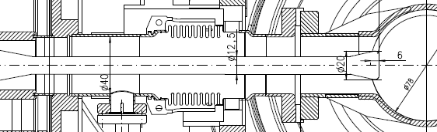
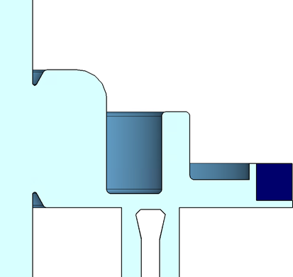
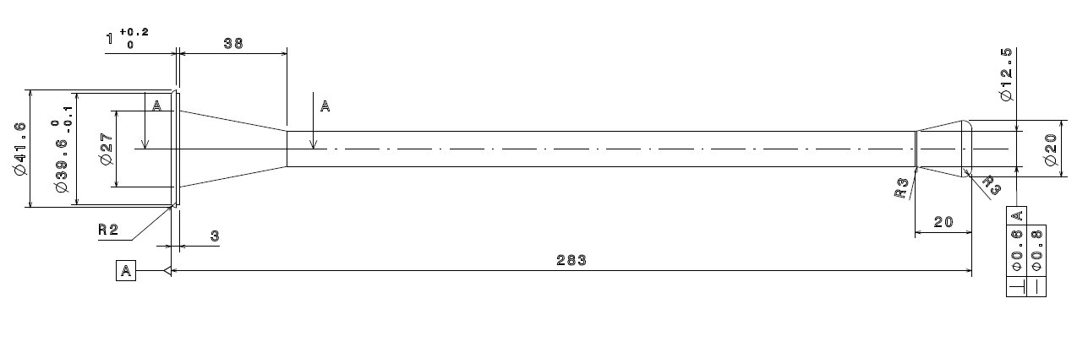
3.3 High power coupler for the choke mode cavity
 | XFEL coupler | Model 5.3.1
outer Ø | 40 | 40
inner Ø | 12.5 | 12.4
head Ø | 20 | 20
head length | 20 | 20.5
head roundings | R3 | 3.5 mm Schräge
Fig. 13: Using the XFEL-coupler allows to adjust the coupling factor b from 0 to 5.
Tab. 3: Dimensions of the XFEL coupler
Fig. 14: Geometry of the XFEL-dipole-coupler
Fig. 15: Location of the coupler.

Slide 12
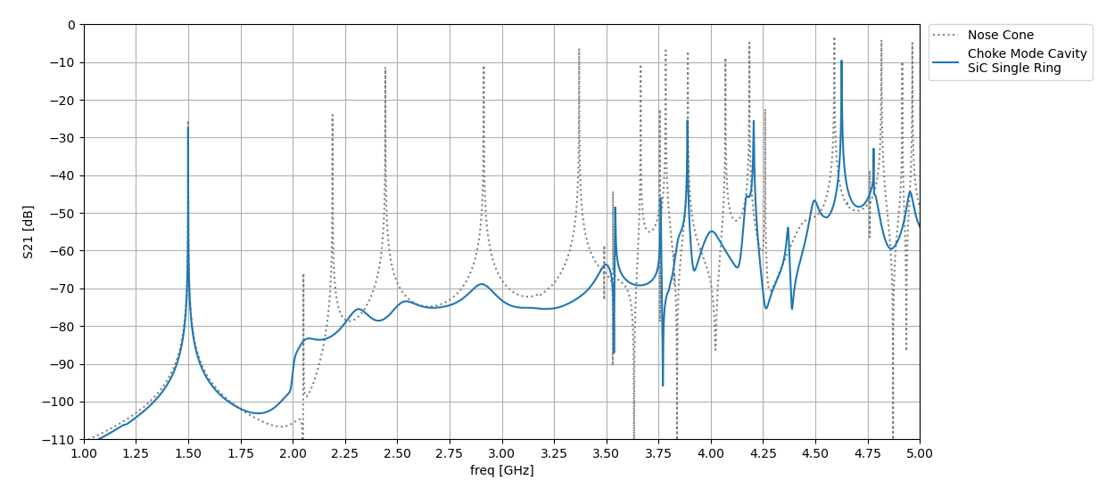
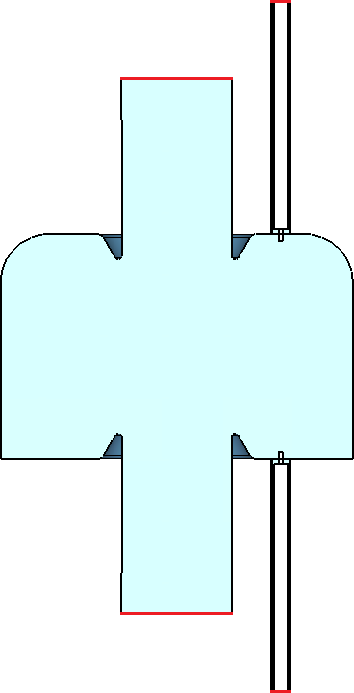
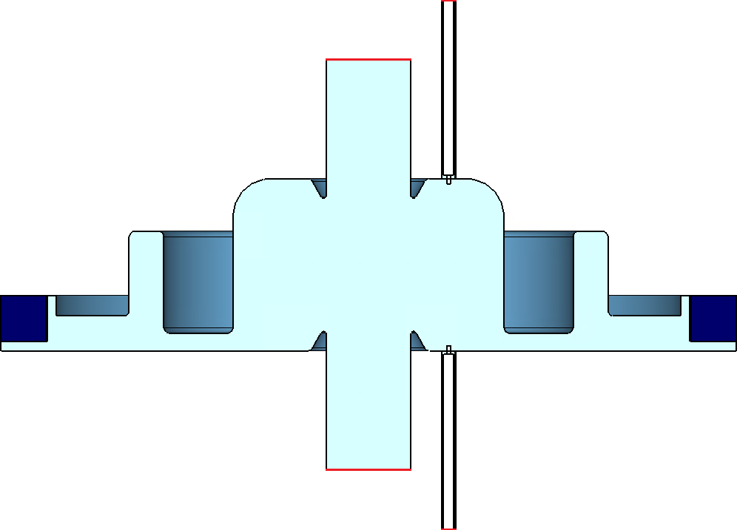
3.4 HOM-Damping Capabilities with one SiC-Ring
TM-310
TM-311
TM-212
TM-210
TM-212*
TM-410
TM-212*
TM-022*
TM-110
TM-111
TM-020*
TM-021
TM-311
TM-010
TM-011
TE-121**
TE-312
TM-310
Port2
Port4
TM-020*
TE-111
Port3
Port2
Undamped cavity
Port4
Port1
Port3
Port1
HOM damped cavity
The pictures are provided with kind permission of Simon Karau (DESY MHF)

Slide 13
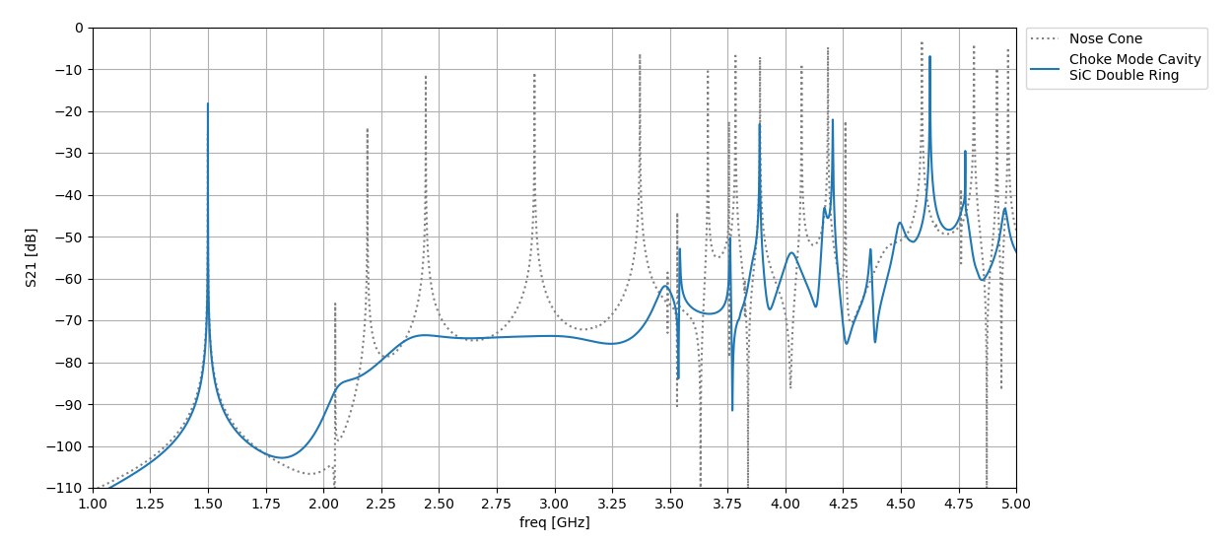
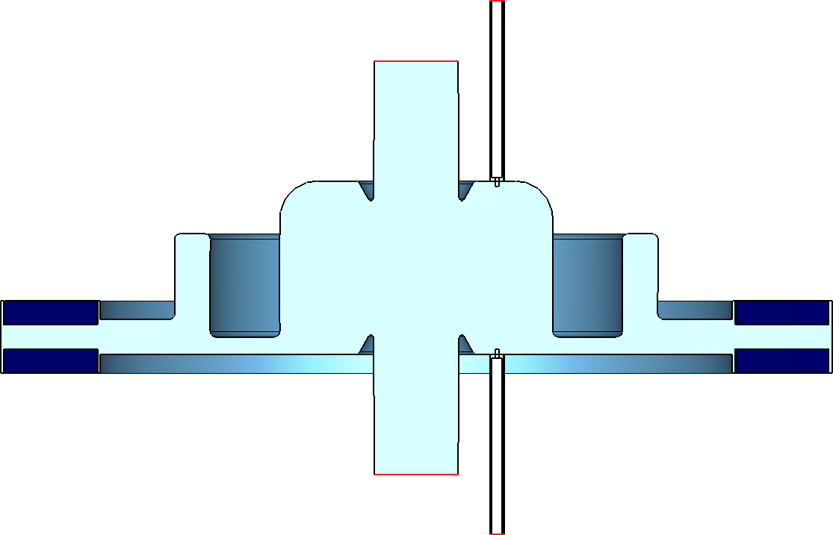
3.4 HOM-Damping Capabilities with double SiC-Ring
TM-310
TM-311
TM-212
TM-210
TM-212*
TM-410
TM-212*
TM-311
TM-022*
TM-110
TM-111
TM-020*
TM-021
TM-010
TE-121**
TM-310
TM-011
TE-312
TE-412
Port2
TM-020*
Port4
TE-111
Port3
Port1
The pictures are provided with kind permission of Simon Karau (DESY MHF)

Slide 14
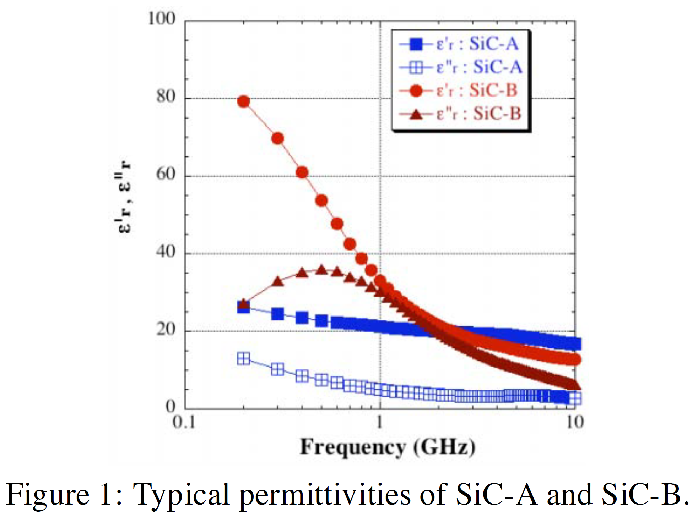
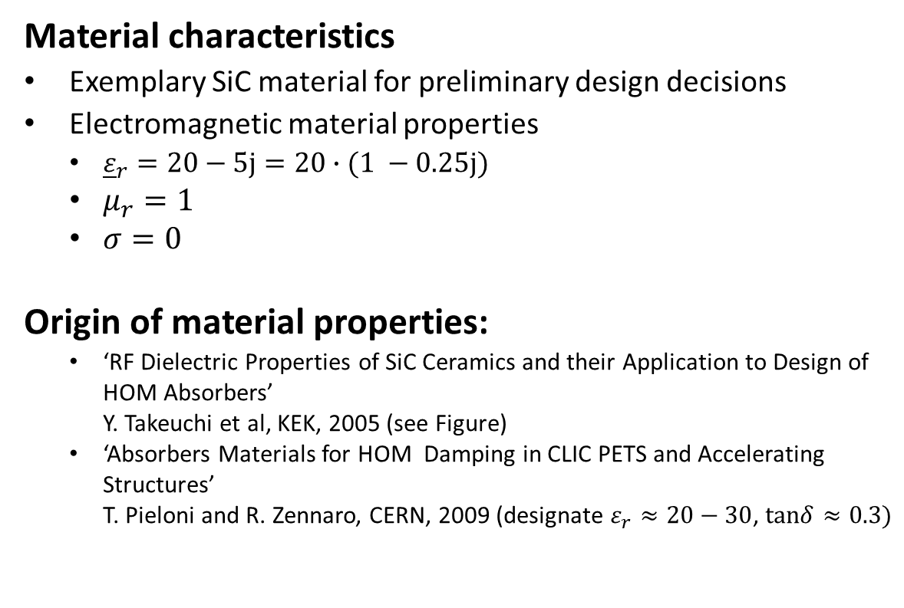
3.5 Simulation with SiC Material, properties
Material characteristics
Exemplary SiC material for preliminary design decisions
Electromagnetic material properties
  ${\underline{ε}}_{r}=20−5j=20∙(1 −0.25j)$
  $μ_{r}=1$
  $σ=0$
Origin of material properties:
  ‘RF Dielectric Properties of SiC Ceramics and their Application to Design of HOM Absorbers’
    Y. Takeuchi et al, KEK, 2005 (see Figure)
  ‘Absorbers Materials for HOM Damping in CLIC PETS and Accelerating Structures’
    T. Pieloni and R. Zennaro, CERN, 2009 (designate $ε_{r}≈20−30$, $tanδ≈0.3)$
Fig. 16: Typical permittivities of SiC-A and SiC-B

Slide 15
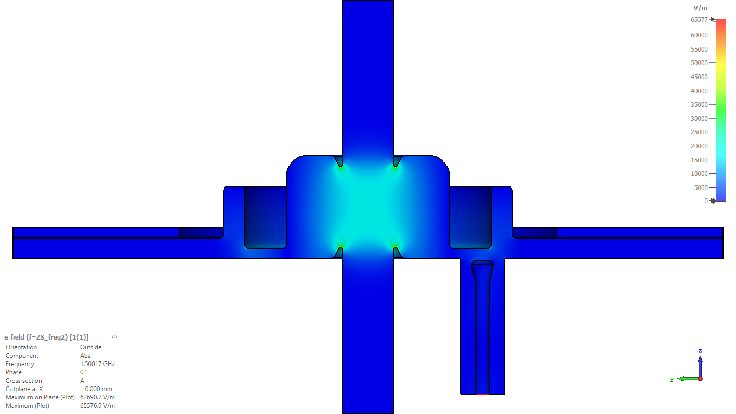
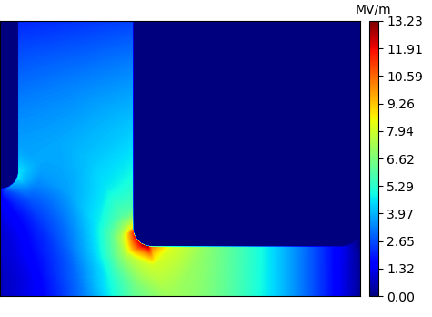
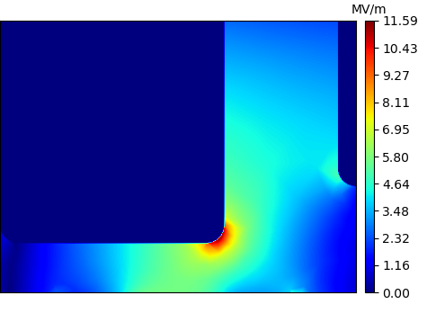
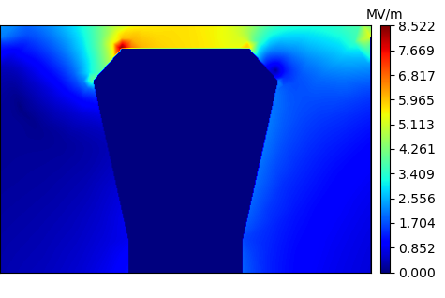


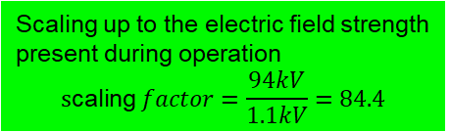



3.6 Max. electric field strength during cavity operation
1,1 kV during simulation and 94 kV during operation.
Local Max E-Field:
$$\max\left\{\left|\vec{E}\right|\right\}=13.2 kV/m$$
Local Max E-Field:
$$\max\left\{\left|\vec{E}\right|\right\}=11.6 kV/m$$
⟹ 1.1 MV/m
⟹ 1 MV/m
Global Max E-Field:
$$max⁡\{|\vec{E}|\}=\text{65.}\text{6 }kV/m$$
Scaling up to the electric field strength present during operation
$$\text{s}\text{caling} factor=\frac{94kV}{1.1kV}=84.4$$
⟹ maximum at the nose cones = 5.5 MV/m.
$$P_{in,avg}=0.5W$$
Local Max E-Field:
$$\max\left\{\left|\vec{E}\right|\right\}=8.5 kV/m$$
⟹ 0.72 MV/m
| Choke Mode Cavity for Petra IV: Optimized Structure for maximal Q-Factor | Simon Karau, 2022-09-07

Slide 16
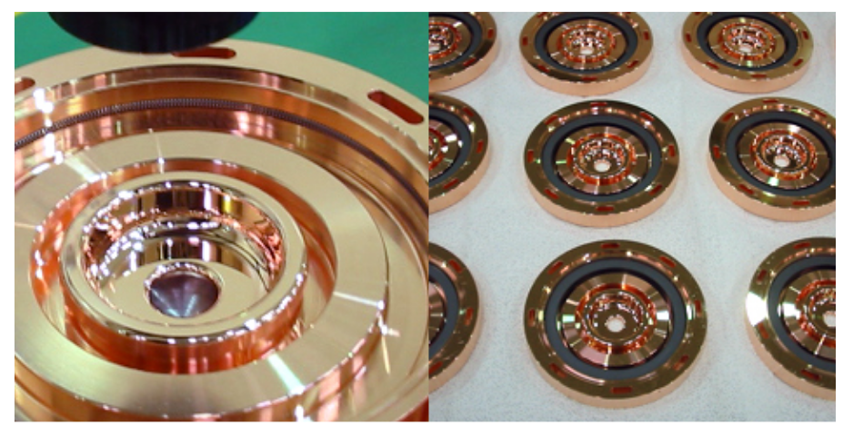
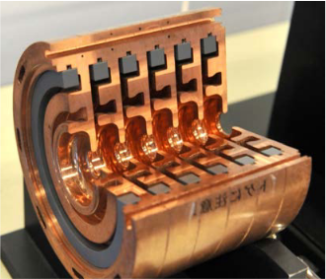
3.7 Fixing the SiC rings in the cavity
Due to the different thermal expansion of copper and SiC, the ring cannot be soldered in place, because it may become very hot. Therefore, the ring is fixed by a tungsten or stainless steel spring.
RF-power to the SiC-ring: 190 W HOM + the leakage power from the fundamental mode
Fig. 23: Example how to fix the siliconcarbide rings in the cavity. A tungsten spring in a groove fixes the rings in their position.
Picture: T. Iganaki, C. Kondo, H. Maesaka, T. Ohshima, Y. Otake, T. Sakurai, K. Shirasawa and T. Shintake: “High-gradient C-band linac for a compact x-ray free-electron laser facility”, Physical Review special topics-Accelerators and Beams, 17, 080702 (2014)

Slide 17
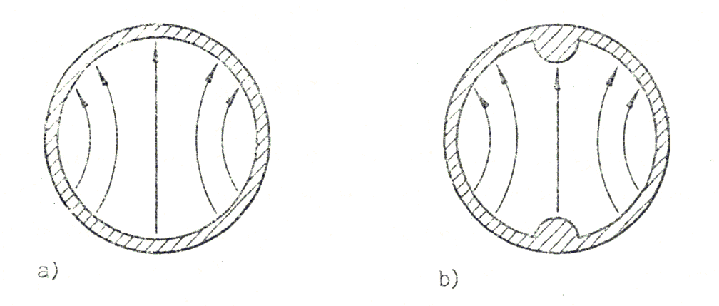
4.1 Cavity, designed by H. Herminghaus (University of Mainz)
The basic idea of H. Herminghaus
Assumption, circular waveguide which a TE₁₁-wave propagates
One can establish a resonator by locally "indenting" the waveguide
The dents form a capacitive load and the cut-off frequency is locally decreased.
By a suitable transformation one can achieve that all modes, except the one with the lowest frequency, are above the cutoff frequency of the tube. They therefore run into a load at one end of the tube
Fig. 17: TE₁₁-mode in a circular waveguide without and with dents [3]

Slide 18
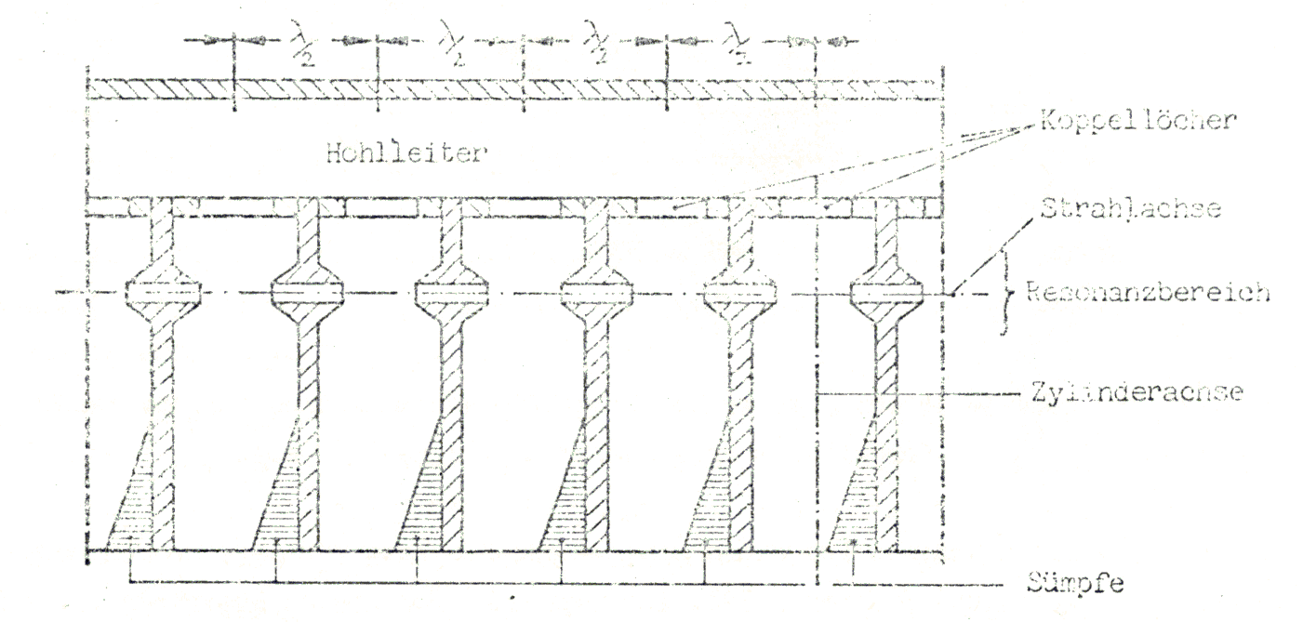
4.2 Cavity created by H. Herminghaus
λ/2
λ/2
λ/2
λ/2
Coupling holes for the HOM‘s
Hollow waveguide (RF feeder line)
Beam axis
Region of the resonance
Cylinder axis of round waveguides
RF-loads
Fig. 18: TE₁₁-single mode cavities connected to a rf feeder line. The dents are formed by the nose cones [3]

Slide 19
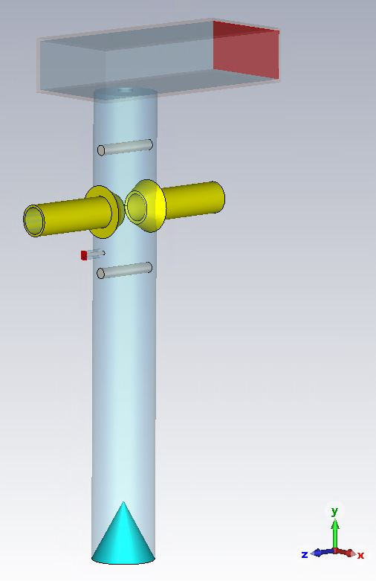
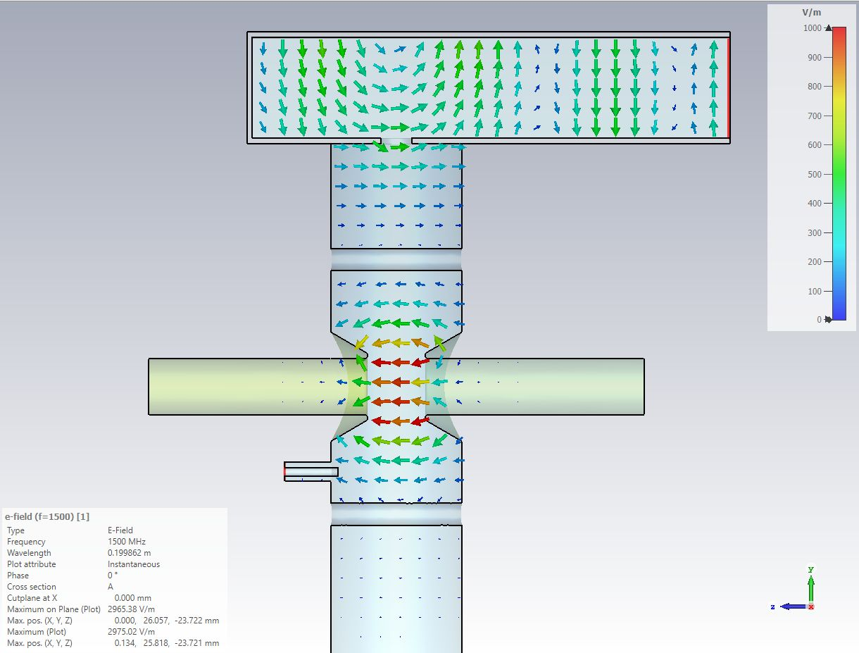
4.3 Alternative: The „Herminghaus" Single Mode Structure
frequency | f₀ | 1,5GHz
shunt impedance (CST) | R_{S} | 1,4 MΩ
unloaded quality factor | Q₀ | 16.100
 | R_{S}/Q₀ | 87Ω
Courtesy of Kathrin Cottel (DESY MHF)

Slide 20
5.1 Choke-mode cavity, conclusions and outlook
Design process is finished.
Adjustable high power coupler (b from 0 to 5) was found (XFEL-dipole-coupler).
Tuning from -300 kHz up to 300 kHz is possible without tuning the choke.
Maximum field strength in the cavity during operation is 5,5 MV/m ( > 30 MV/m would be possible, safety factor is 5,5)
Next steps
A cavity model will be build.
The most suitable SiC is sought, probes will be ordered.
5.2 The TE₁₁₁-like cavity, conclusions and outlook
Design process is not finished
We have not yet been able to achieve the expected high quality factors and shunt impedances
The reason for this is the large beam tube diameter required compared to the old Herminghaus design
Next steps
We have to look for other configurations (elliptical cavity tube, rectangular cavity tube, …)

Slide 21
Thank you
Literature
[1] R. M. Sundelin, J. L. Kirchgessner, and M. Tigner, “Parallel Coupled Structure,” IEEE Trans. on Nuc. Science, Vol. NS- 24, No.3, June 1977, pp.1686-1688
[2] Tsumoru Shintake: „ The Choke Mode Cavity“, 1992 Jpn. J. Appl. Phys. 31 L1567
[3] R. Klein: “Messung der Shuntimpedanz und Feldassymmetrie von Beschleunigerresonatoren, Diploma Thesis, Institut für Kernphysik der Johannes Gutenberg Universität Mainz, 1981, KPH 21/81

Slide 22
Hülsmann, Peter
MHF
Peter.huelsmann@desy.de
++49 (0)40 8998 2782

Slide 23
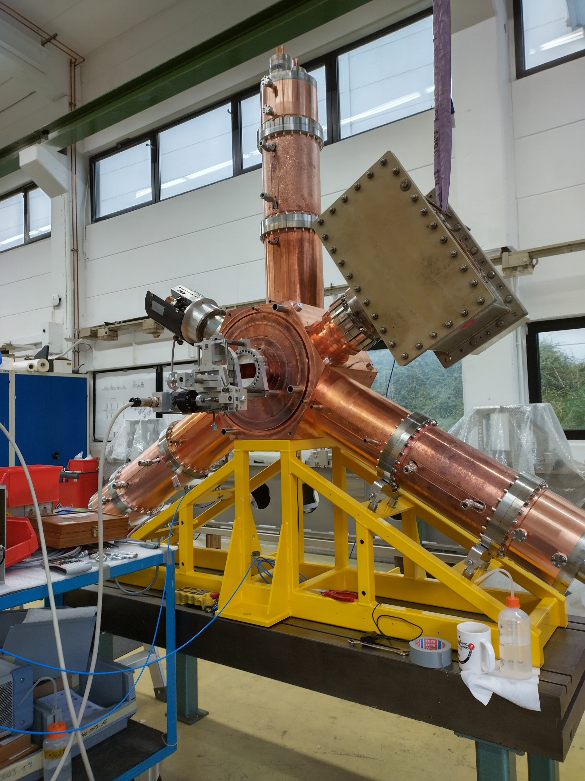
1. The 500 MHz PETRA IV cavity
Fig. 2: Cut through the cavity body
Fig. 1: The 500MHz-HOM-Damped-Cavity prototype at Research Instruments. On the beam pipe flanges a beat pull measurement device is mounted to measure the course of the electric field strength, on- and off axis.
Fig. 3: Ferrite dampers as HOM loads at the waveguide ends

Slide 24
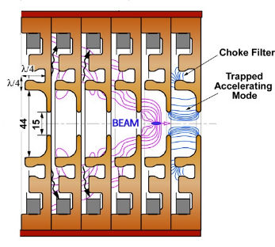
3. An application of the choke mode cavity
Fig.11: The choke mode cavity in a LINAC application. The individual choke mode disks are stacked to form a LINAC. This is a C-band LINAC for a compact X-ray free electron laser facility. The HOM-damper-material is a simple ring made of Siliconcarbide
Picture: T. Iganaki, C. Kondo, H. Maesaka, T. Ohshima, Y. Otake, T. Sakurai, K. Shirasawa and T. Shintake: “High-gradient C-band linac for a compact x-ray free-electron laser facility”, Physical Review special topics-Accelerators and Beams, 17, 080702 (2014)

Slide 25
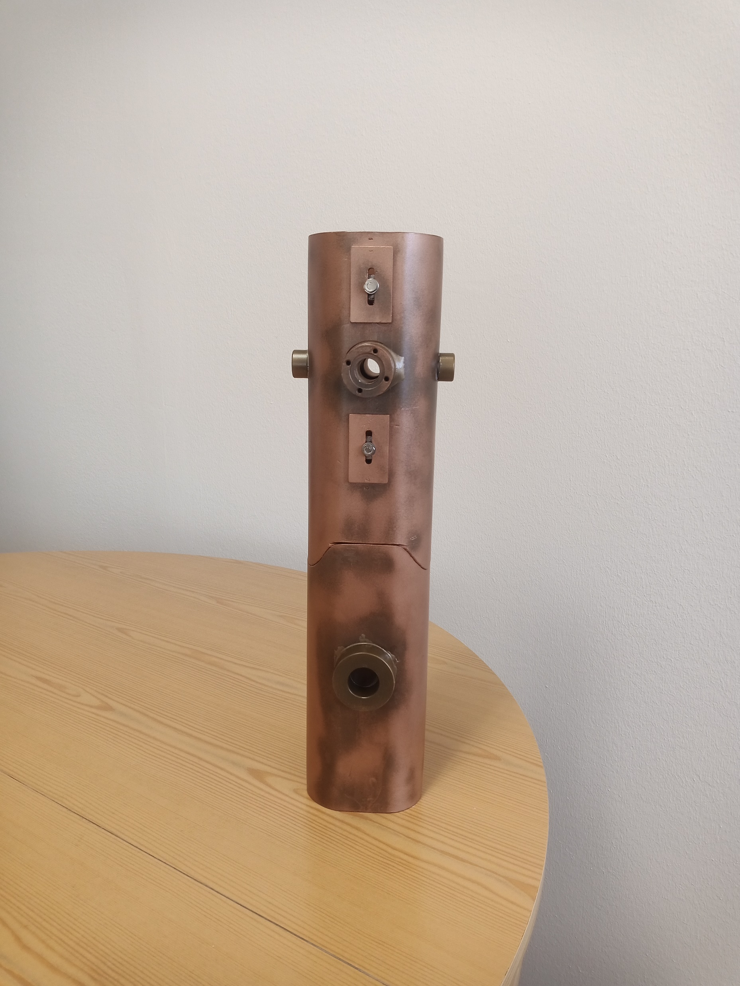
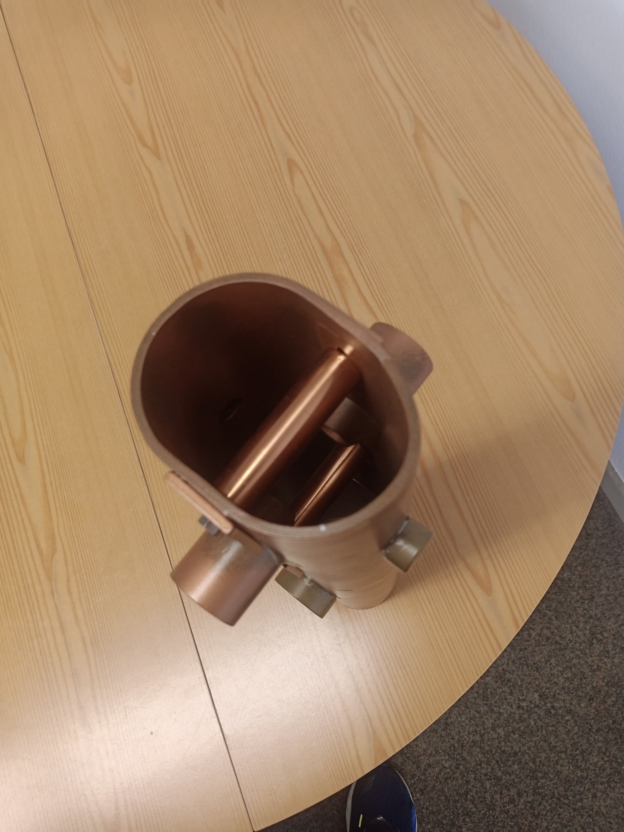
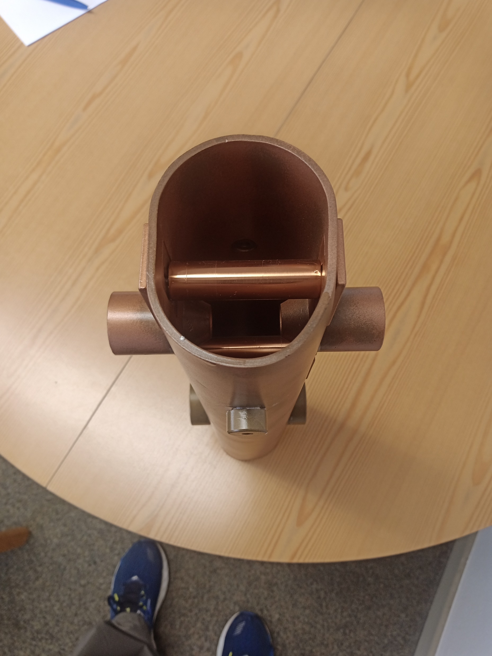
4. Cavity designed by H. Herminghaus, a copper model
beam hole
inductive stubs
nose cones
adjustment for the stubs
compartment for the rf absorber
Fig. 19, 20 and 21: A model of the TE₁₁-cavity for a frequency of 2451,8MHz. The upper part is the cavity itself, the lower part is for the . The picture in the middle or the right shows adjustable inductive stubs and the nose cones of the acceleration gap.
A copper model of the TE₁₁-cavity created by Helmut Herminghaus at University of Mainz in 1978 for LLrf-measurements. The model was provided by the courtesy of Prof. Dr. K. Aulenbacher and Dr. R. Heine (Institut für Kernphysik der Johannes Gutenberg Universität Mainz)

Slide 26
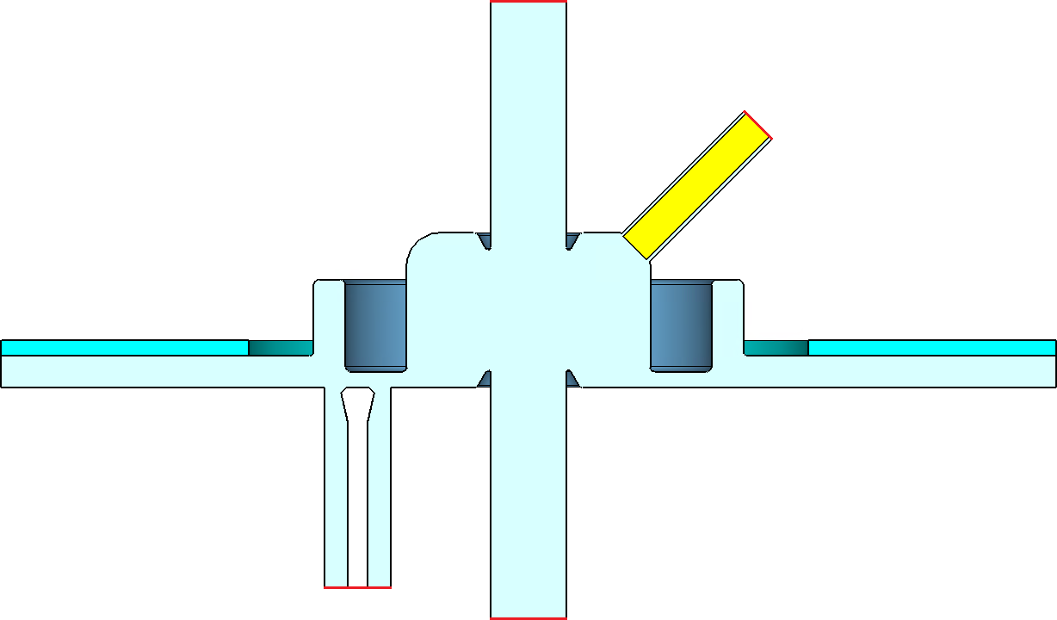
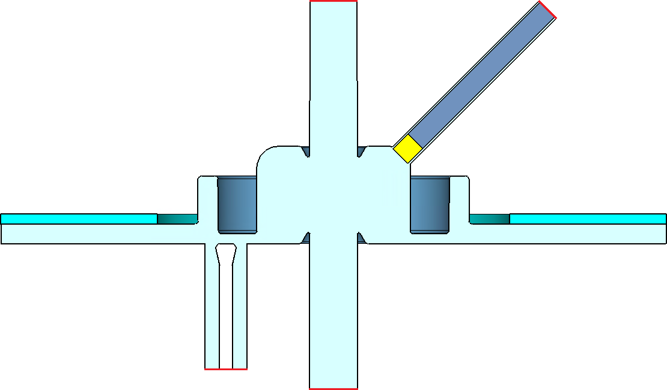
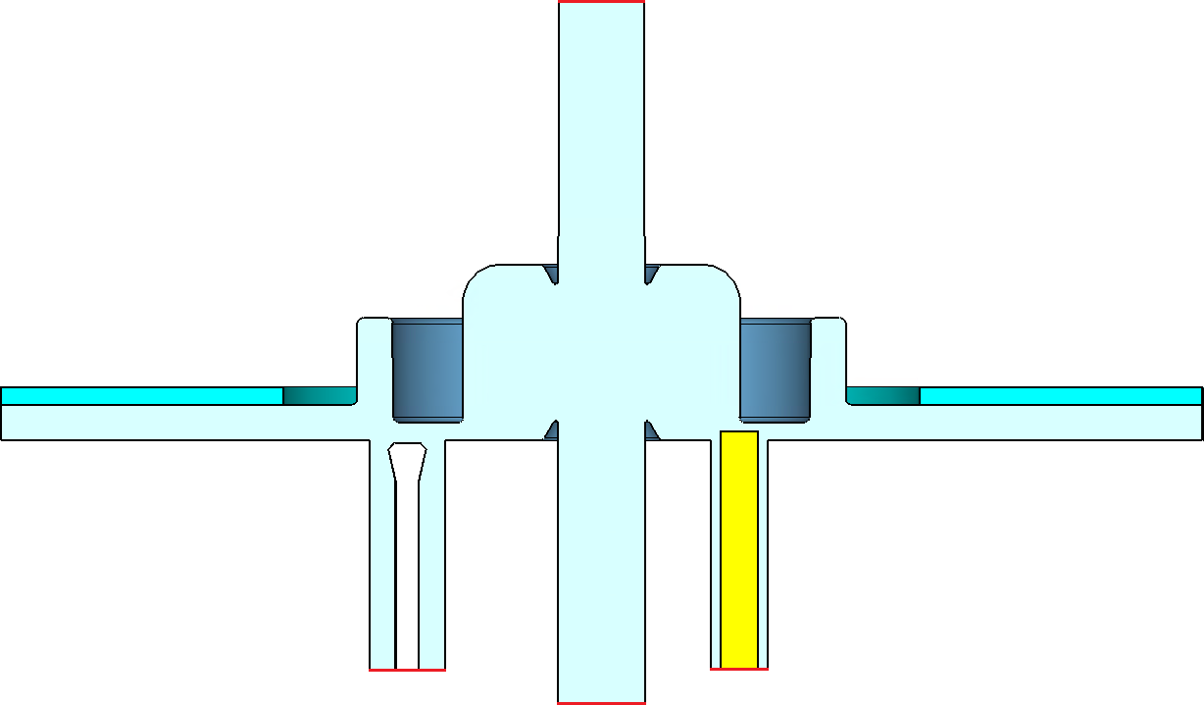
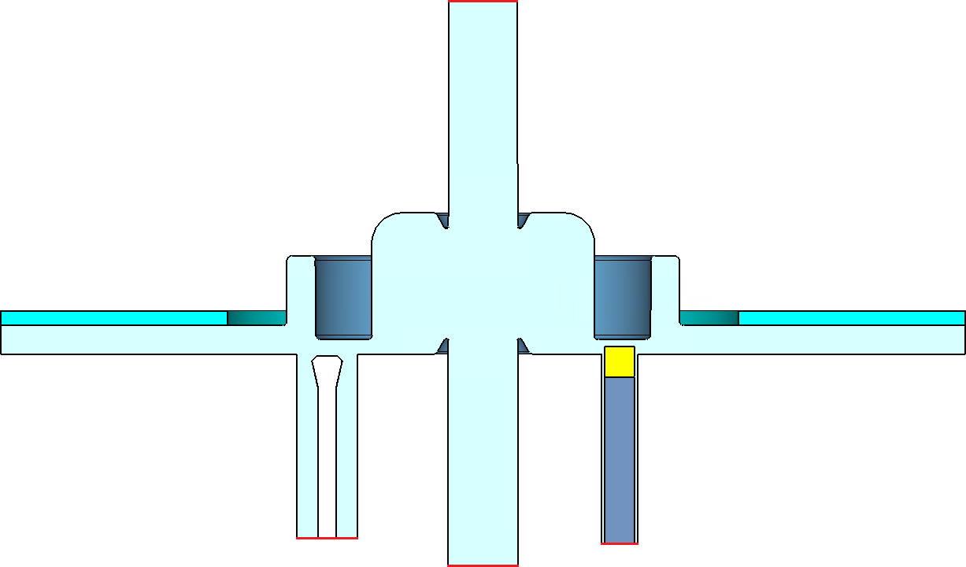
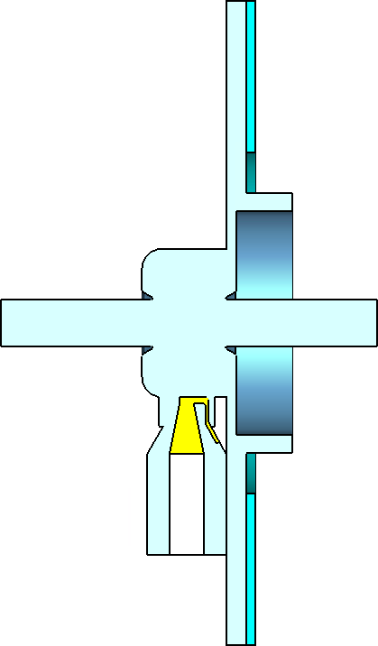
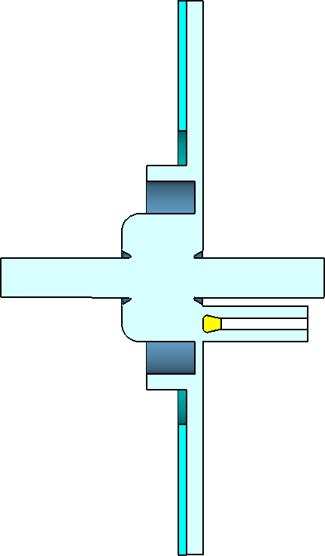
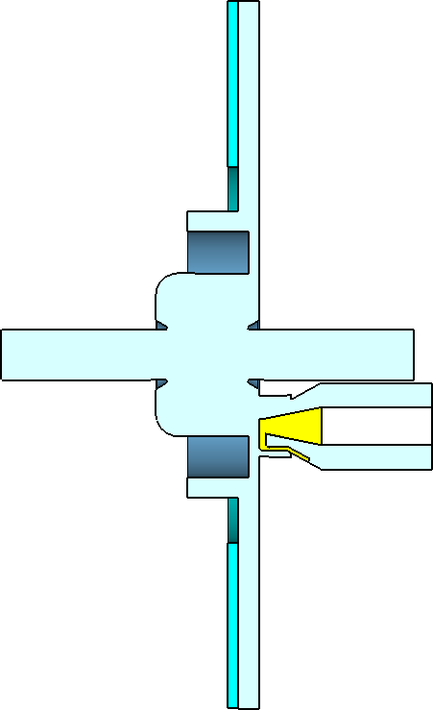
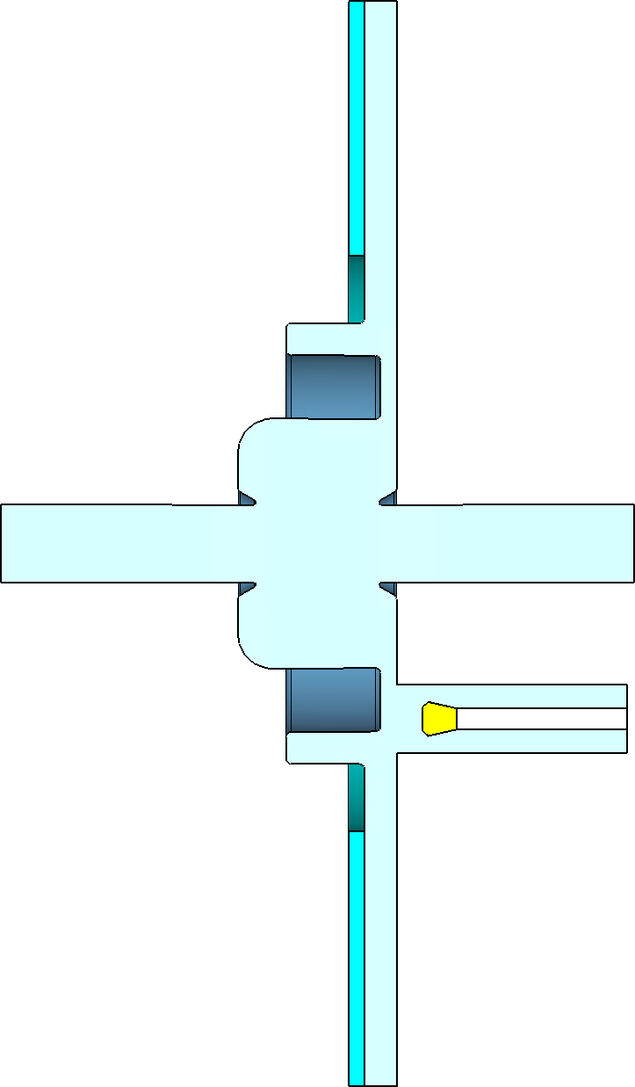
4. Optimizing tuning and coupling
 | Metallic Plunger (Coax-Line) | Metal-dielectric Plunger (Dielectric Filled Circular Waveguide)
Plunger mit 45⁰ an der Nose-Cone | 1 2 3 4 5
Plunger in der Choke Ebene
Plunger
Radius In | 10 mm
Radius Out | 12 mm
Length | 100 mm
Plunger
Radius In | 10 mm
Radius Out | 12 mm
Length | 200 mm
Copper Length | 20 mm
Best position for plunger and tuner
Plunger
Radius In | 10 mm
Radius Out | 12 mm
Length | 100 mm
Pos Radius | 27 mm
Plunger
Radius In | 10 mm
Radius Out | 12 mm
Length | 200 mm
Copper Length | 20 mm
Pos Radius | 29 mm
Different locations for the tuning plunger were tried
and different methods for coupling were tried as well.

Slide 27
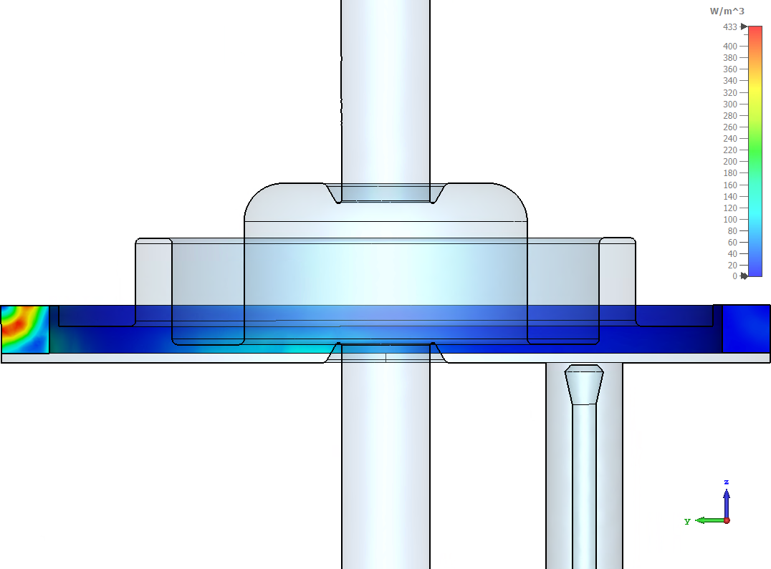
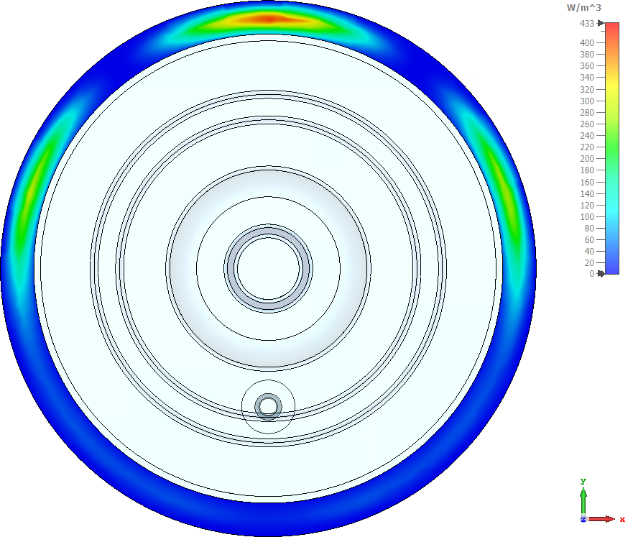
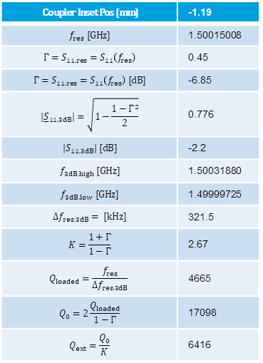
6.2 Damper: SiC-ring-analysis
$$\text{Coupler} \text{Inset} \text{Pos}\text{ [}\text{mm}\text{]}$$ | -1.19
$$f_{res} [GHz]$$ | 1.50015008
$${Γ=S}_{11,res}=S_{11}\left(f_{res}\right)$$ | 0.45
$${Γ=S}_{11,res}=S_{11}\left(f_{res}\right) [dB]$$ | -6.85
$${|\underline{S}}_{11,3dB}|=\sqrt{1−\frac{1−Γ^{2}}{2}}$$ | 0.776
$${|S}_{11,3dB}| [dB]$$ | -2.2
$$f_{3dB,high} \text{[}\text{GHz}\text{]}$$ | 1.50031880
$$f_{3dB,low} \text{[}\text{GHz}\text{]}$$ | 1.49999725
$$Δf_{res,3dB}= [kHz]$$ | 321.5
$$K=\frac{1+Γ}{1−Γ}$$ | 2.67
$$Q_{loaded}=\frac{f_{res}}{Δf_{res,3dB}}$$ | 4665
$$Q_{0}=2\frac{Q_{loaded}}{1−Γ}$$ | 17098
$$Q_{ext}=\frac{Q_{0}}{K}$$ | 6416

